Slide 1
Vertical anti-cryostat and magnetic measurement systems
MSC-TM - 23 September 2021
C. Petrone

Slide 2
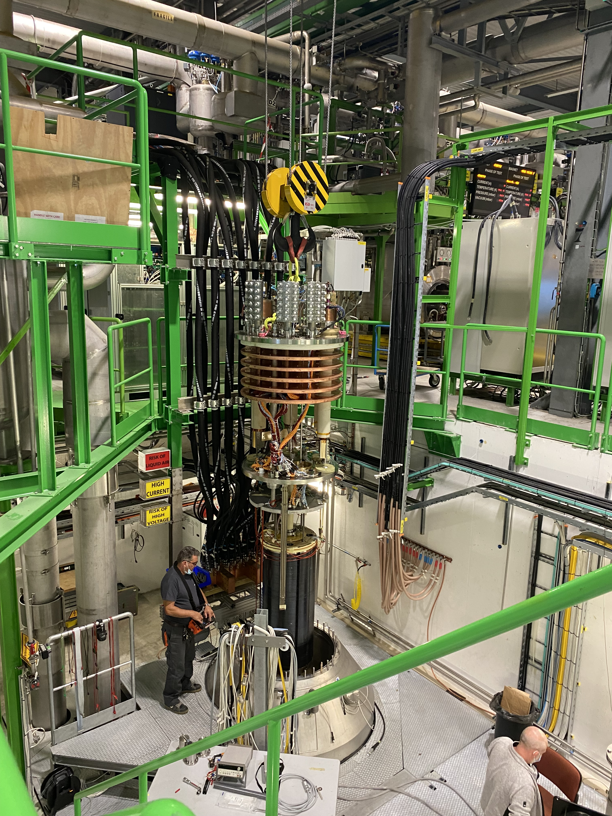
Context
Magnetic measurement: room temperature rotating coils
ADVANTAGES:
Reduced complication for the measurement shaft
No moving mechanical parts at cryogenic temperature
Easy adjustable measurement head
  both measurement and quench revealing
Easy access for debugging
No dimensions shrinkage -> consistent calibration factors
Anti-cryostat

Slide 3
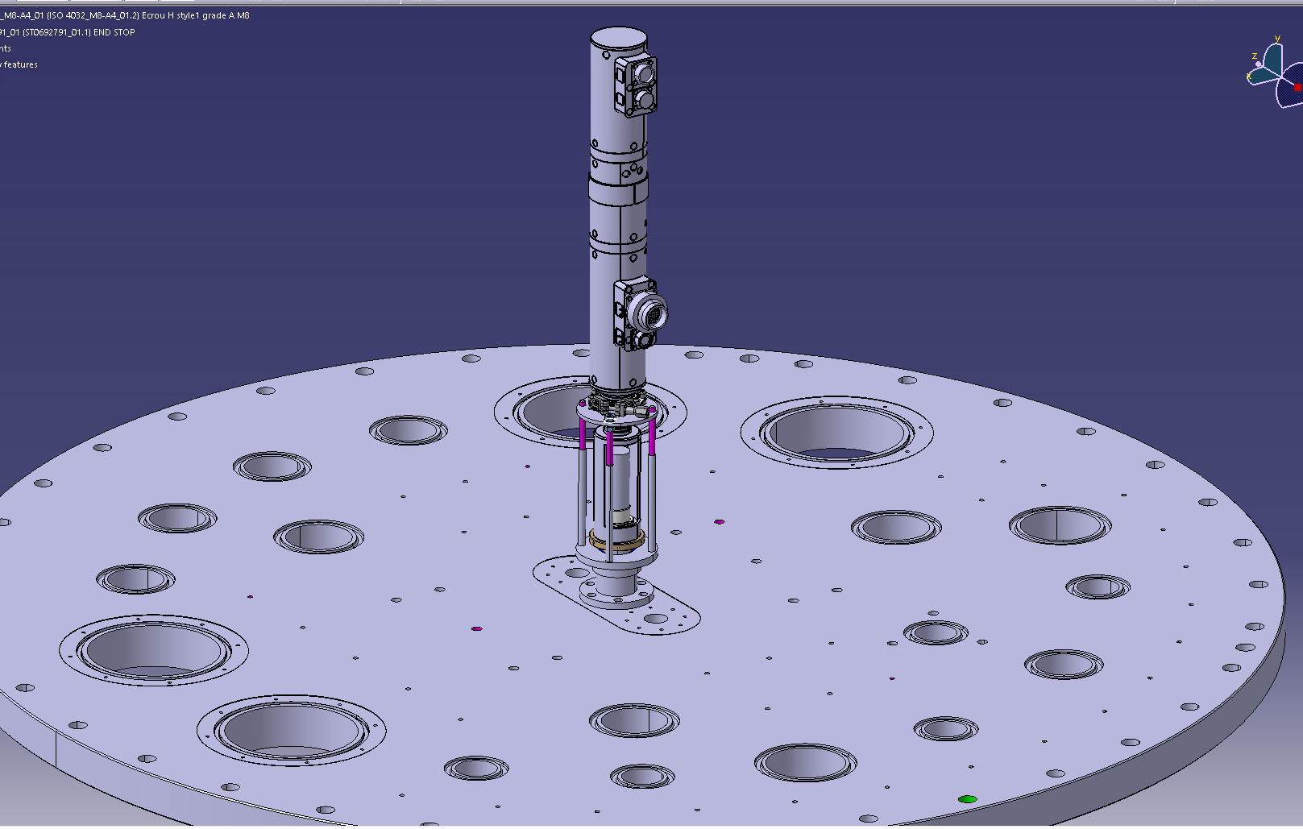
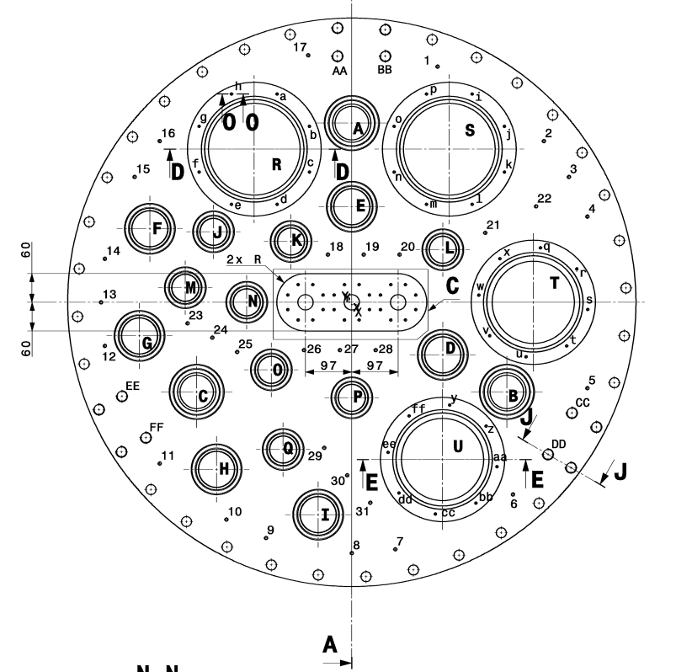
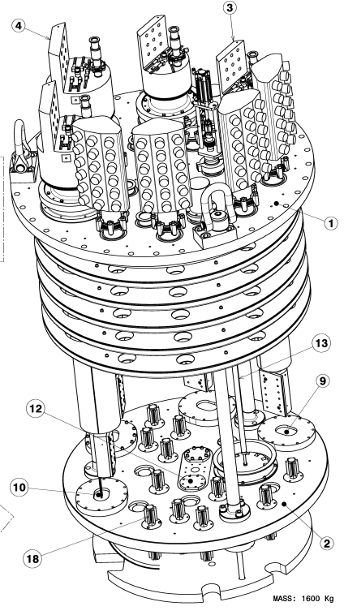
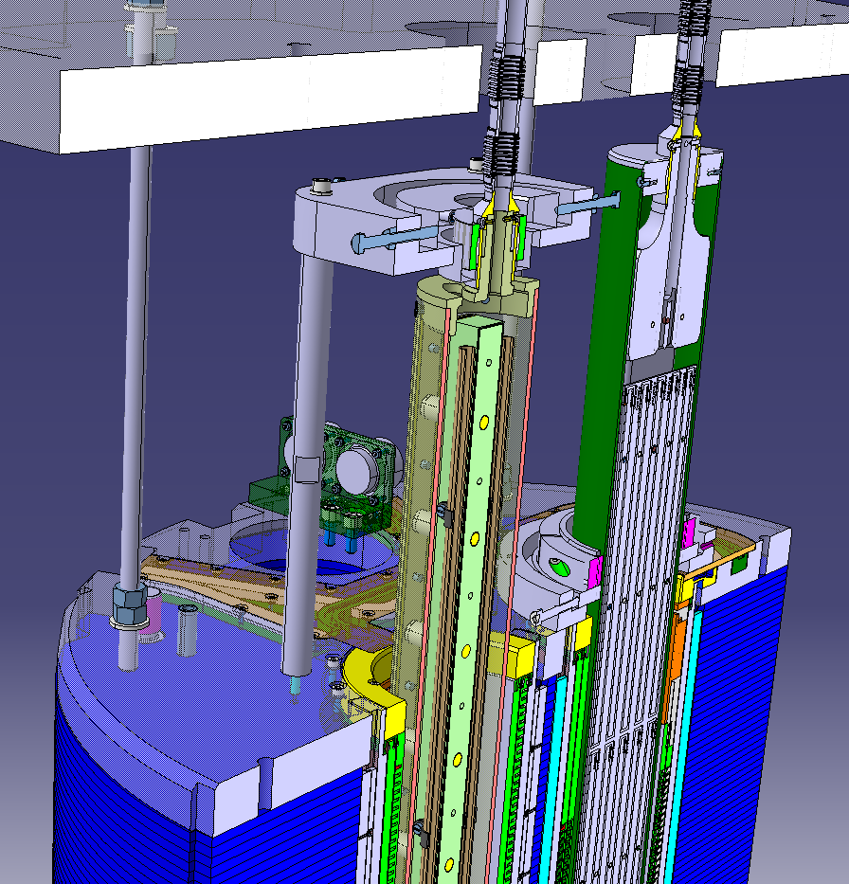
Anti-cryostat
@SM18 Top plate: not presenting the anti-cryostat access yet
4.5 K above the Lambda plate and superfluid helium at 1.9 K below the Lambda plate.
Measurement method used today

Slide 4
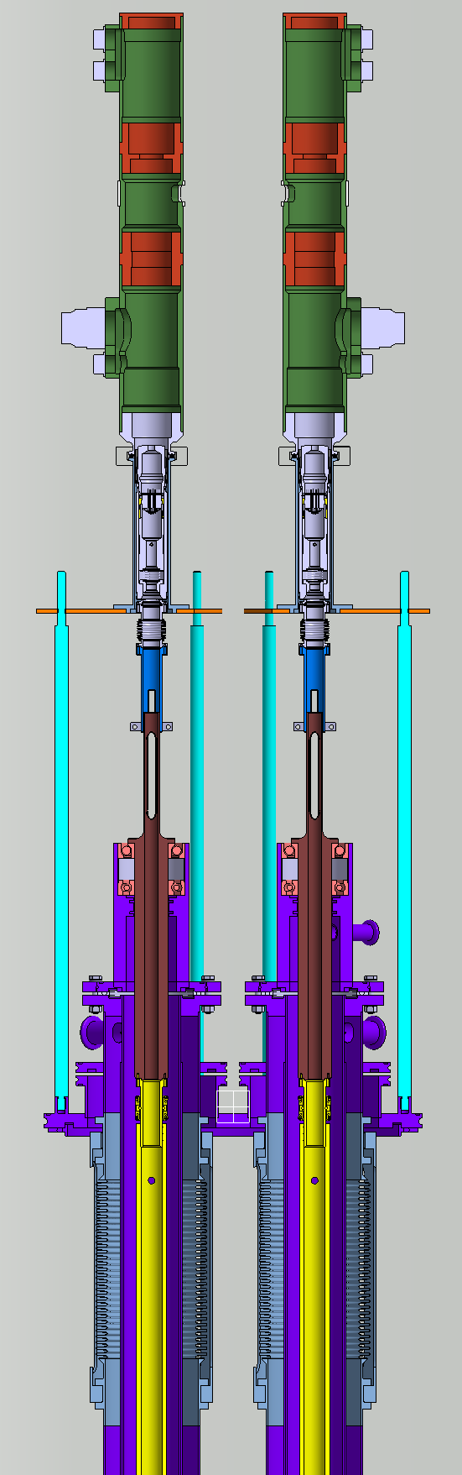
Anti-cryostat
Example: anti-cryostat characteristics:
Bellows to give flexibility, compensate thermal contraction, and compensate tube concentricity
Between the two inner and outer tubes (vacuum) spacers are required
Gap in vacuum between the 2 concentric cylinders used for passing the wires for the heaters and the temperature sensors plus the pipe for blowing hilum to the bottom of the measurement system to distribute potential temperature differences.
Heaters and temperature sensors are required between the 2 tubes and distributed along the length of the anti-cryostat.
For example: according to power consumption analysis, heaters can be glued to the exterior of the internal tube and temperature sensors can be installed on the exterior surface of the internal tube to measure its temperature. Once heaters and the temperature sensors are installed, MLI (multi-layer insulation) can be wrapped around the exterior of the internal tube to thermally insulate the internal tube at room temperature.
Tubes with no longitudinal welds (to avoid magnetic field inhomogeneities)
For example: material 316 LN with suitable inner tolerances (rectitude) to insert the measurement system

Slide 5
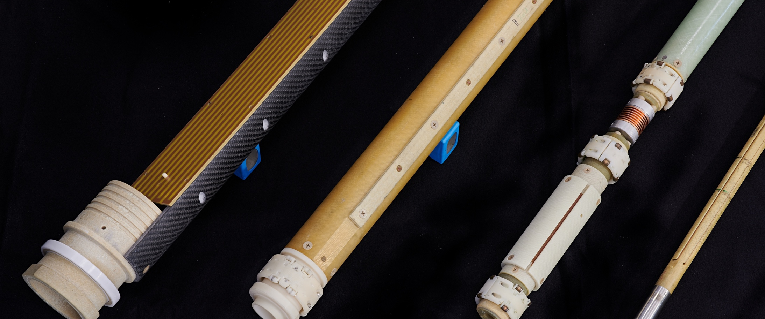
Measurement method: rotating induction coils

Slide 6
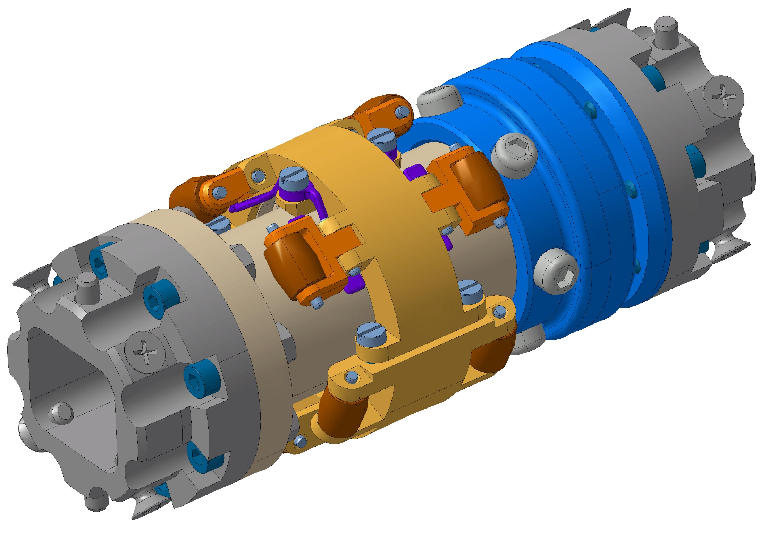
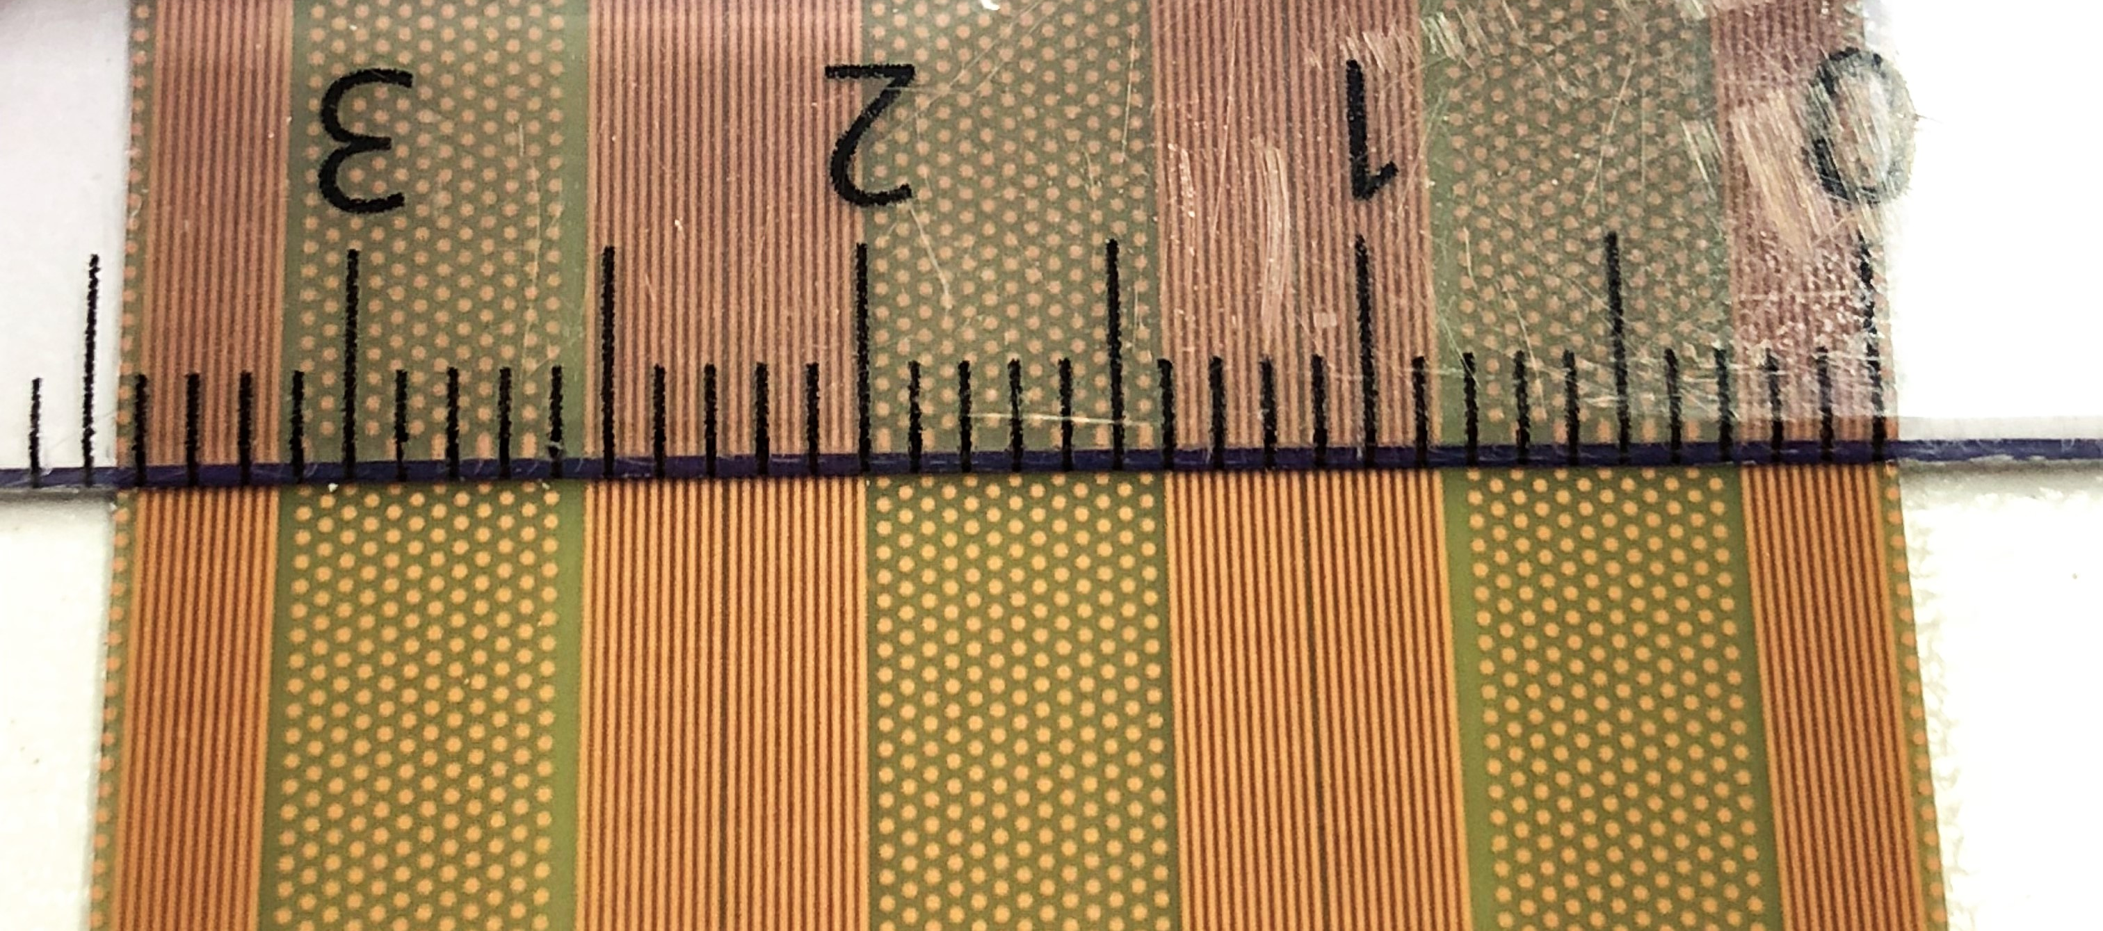
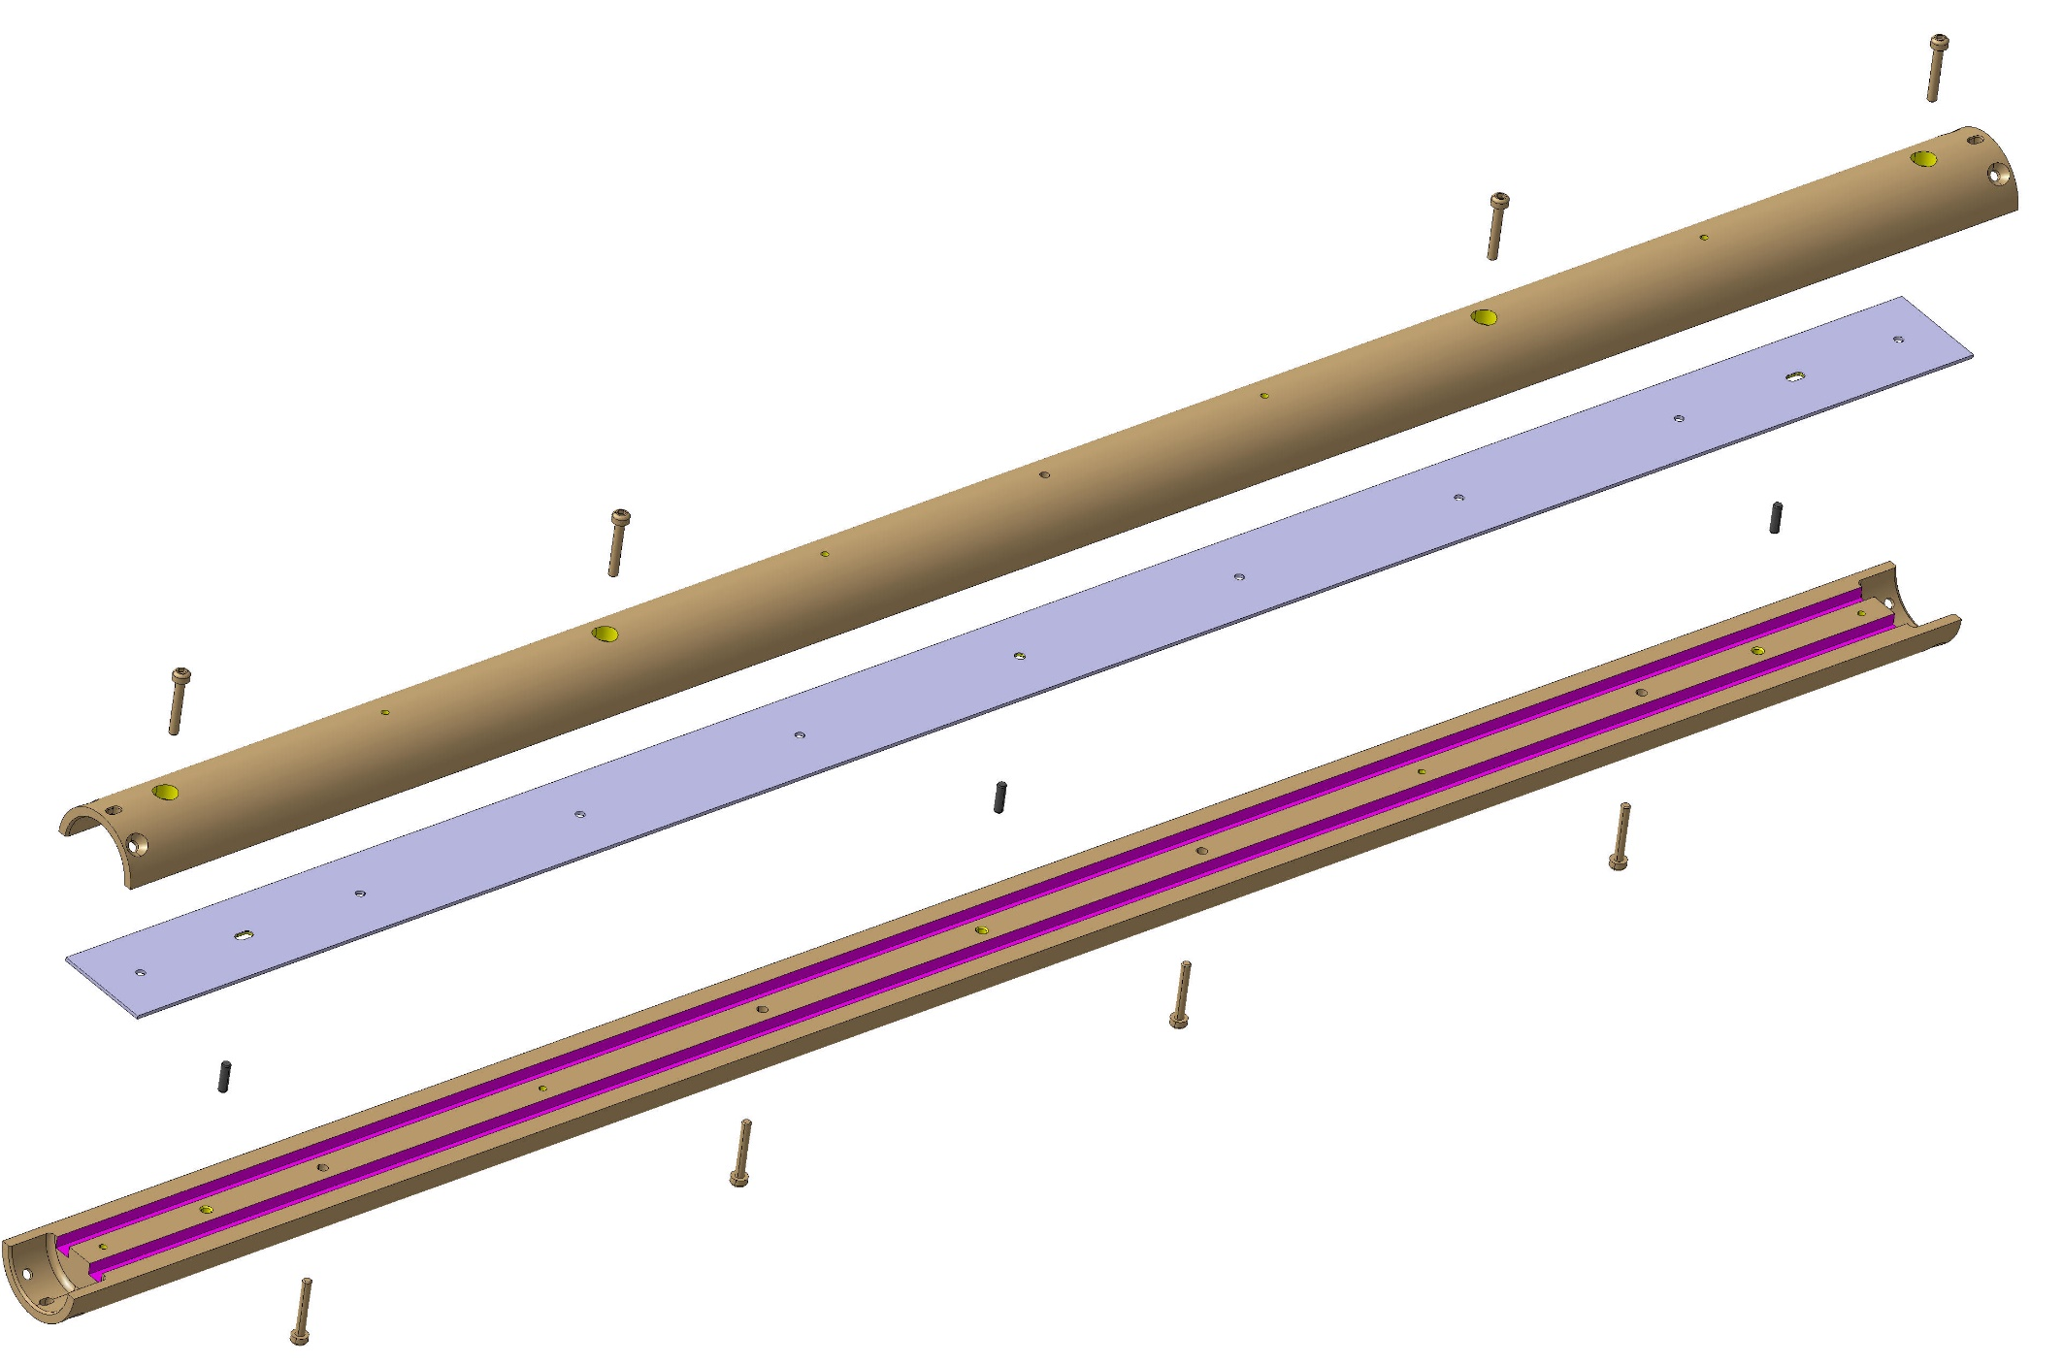
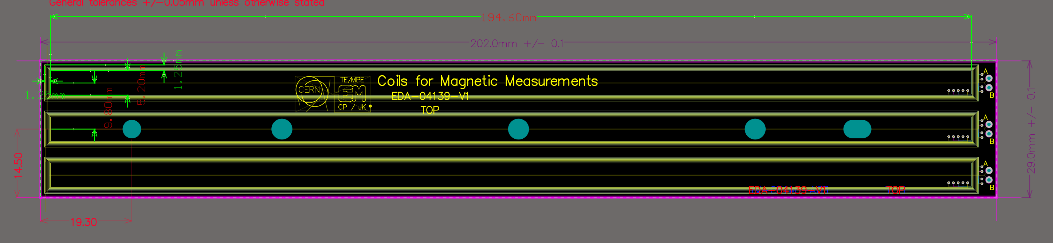
Measurement system: rotating coil
Short rotating-coil magnetometers that can be moved along the magnet axis
Proposal: PCB technology

Slide 7
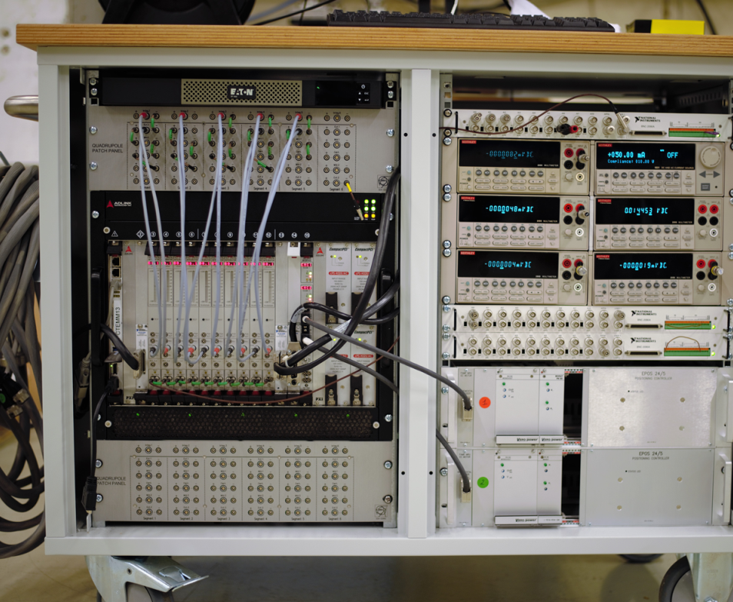
Measurement system: electronic
FAME for cryogenic temperature in SM18
  Flexible Framework Magnetic Measurements (FFMM) software
  Fast Digital Integrators (FDI)
  Motor controller
  Patch panel for compensation scheme
  GPS time synchronization
  Encoder cards for triggering acquisition cards
  PXI computer with windows OS (License?)

Slide 8
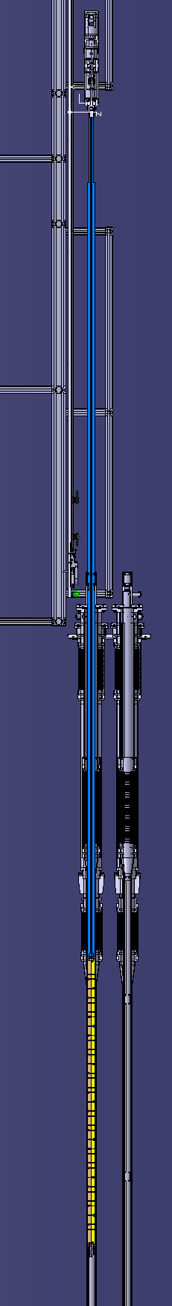
Rotating coil
Motor Unit
Coil displacement system
Preferable automatized system:
Additional motor controller
Software development
Manual movement -> evaluate safety
Manual translation intervention time
Test Facility integration
Data post processing
MRU connection
Supporting structure
Can be mobile
Intermediate connection
Shaft holder
Top flange
Extension with coils
Anti-cryostat

Slide 9
Open points
Anti-cryostat diameter
Anti-cryostat length
Scanning mechanical design
Test Facility integration
Software and related rule
Deadlines and time scale
Spare parts
Safety design requirements
The supply shall comply with CERN safety rules (available at the link: http://cern.ch/safety-rules) and the Swiss and/or French and European legislation.
All documents produced shall be submit in electronic format:
Drawings in CATIA®, AUTOCAD® and/or HP-GL® format

