Slide 1
HL-LHC WP3
MQXFA Longitudinal TIG welding tests
Mickaël Crouvizier EDMS 2xxxxxx
EN/MME/MM 31.08.2022

Slide 2
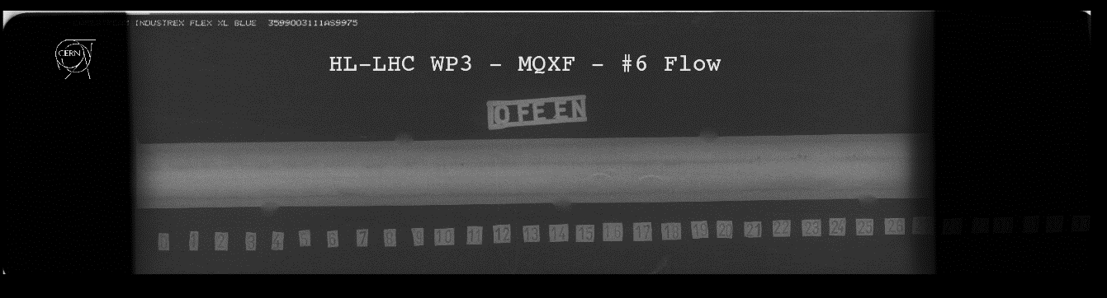
Sampling
  An indication was found on plate #6 at 60 mm by radiographic testing (white arrow).
  Frame in red illustrates the sample extracted for subsequent metallographic inspection.
  Courtesy of Alexandre Porret EN/MME - EDMS 2724411
  2724411

Slide 3
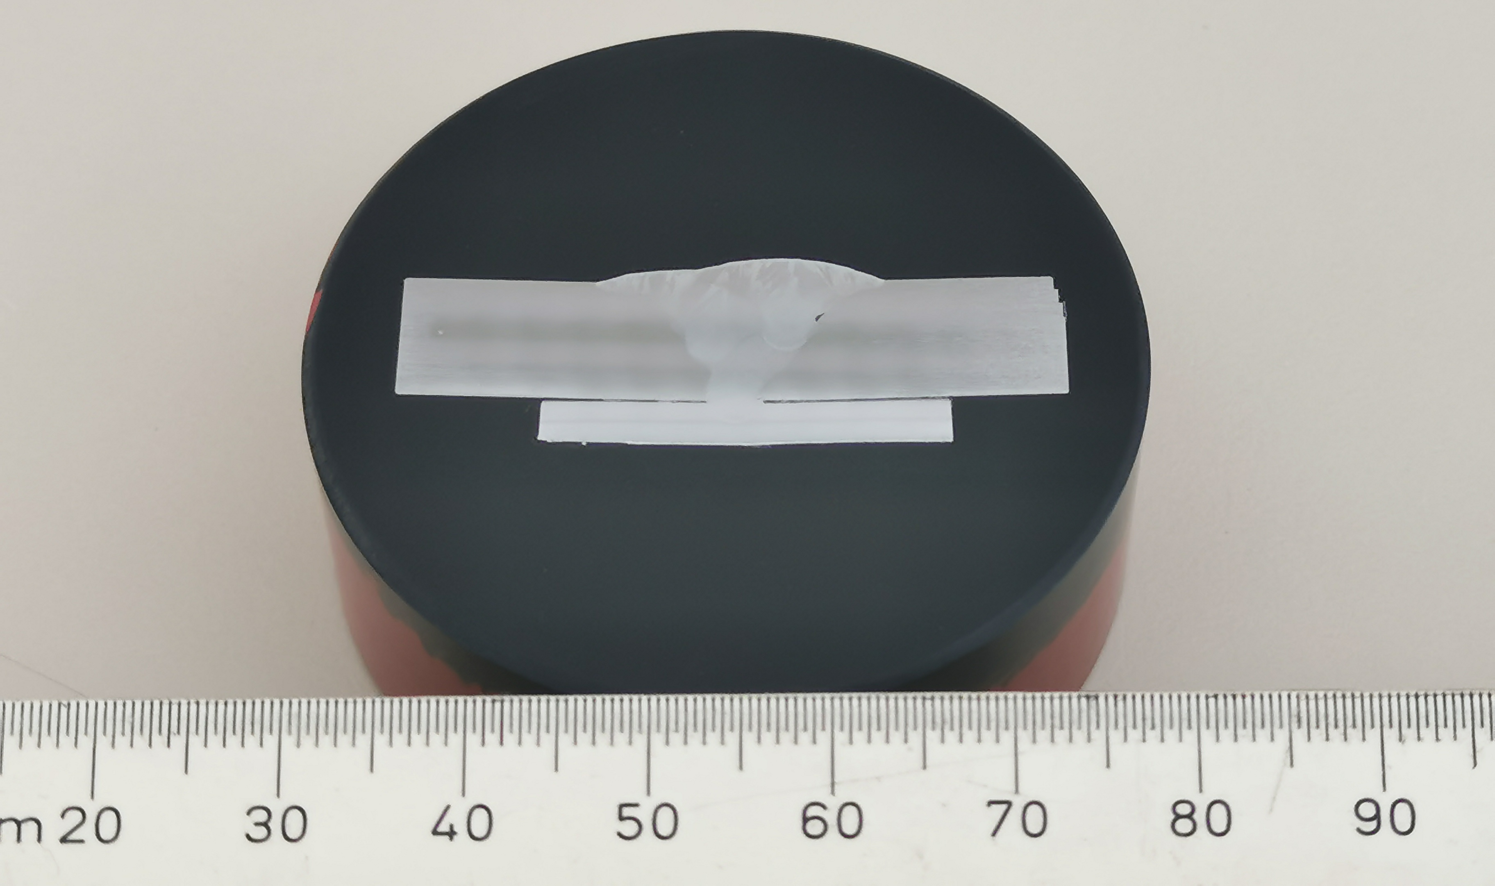
Metallographic inspection
  A transverse cross section has been prepared following a dedicated procedure, Etchant #13b of ASTM E407 has been used to reveal the microstructure.
  Examination has been done with a Zeiss AXIO imager optical microscope under bright field illumination. High-definition pictures are set out in annexes.

Slide 4
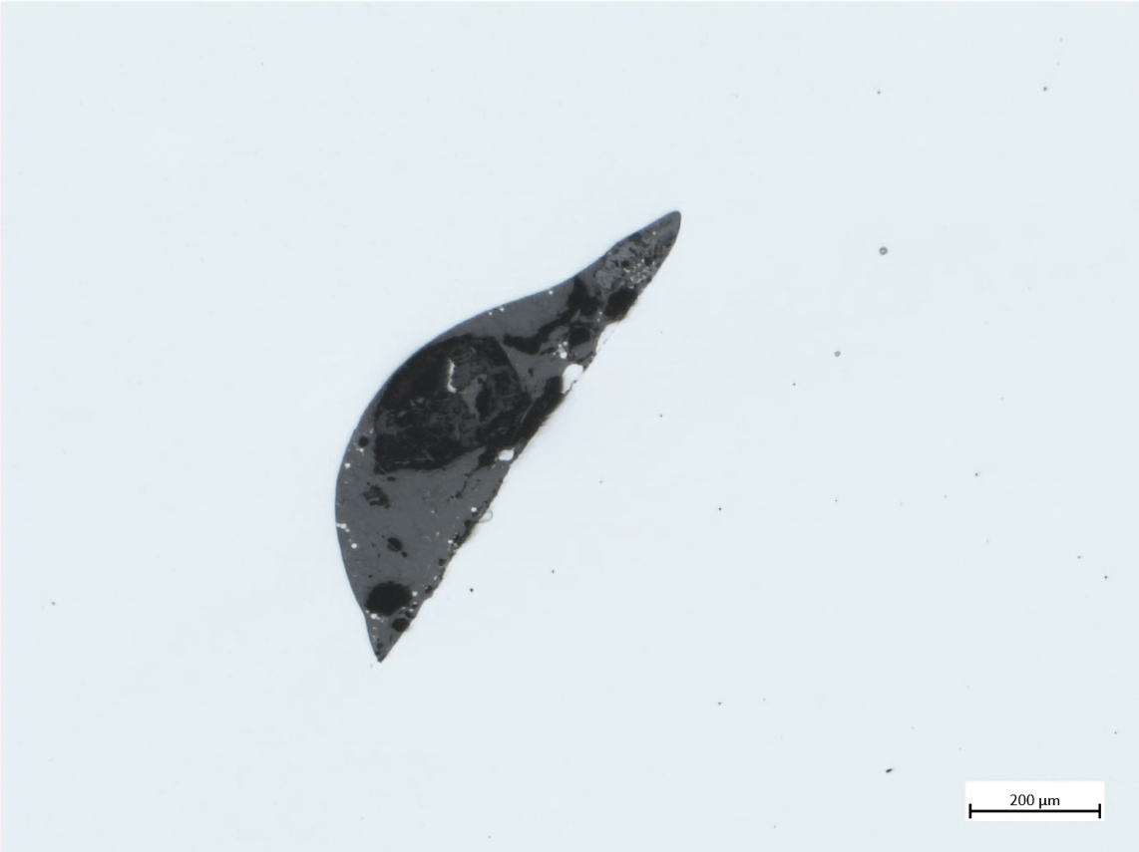

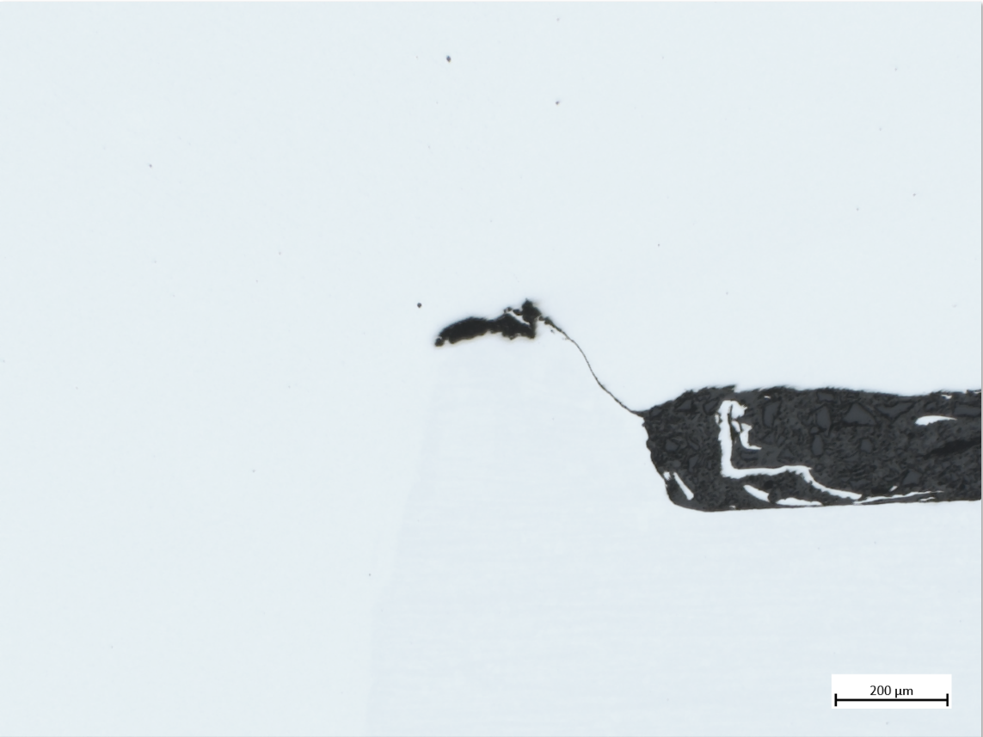
Metallographic inspection as polished
  Lack of side wall fusion (ref 401 of ISO 6520-1) and microcrack (ref 1001 of ISO 6520-1) at the junction between backing plate and butt weld joint are observed.

Slide 5
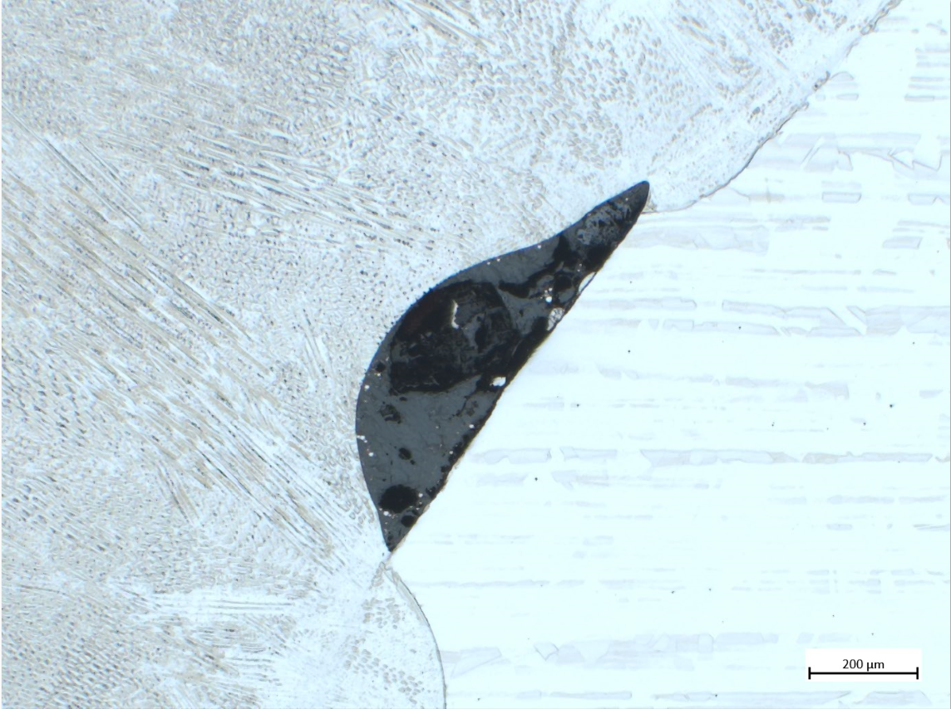
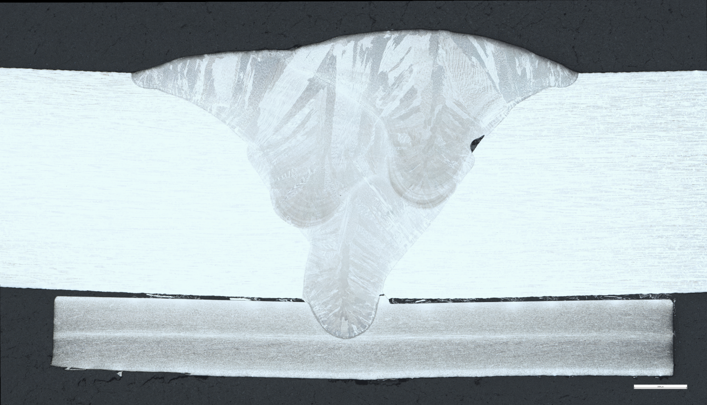
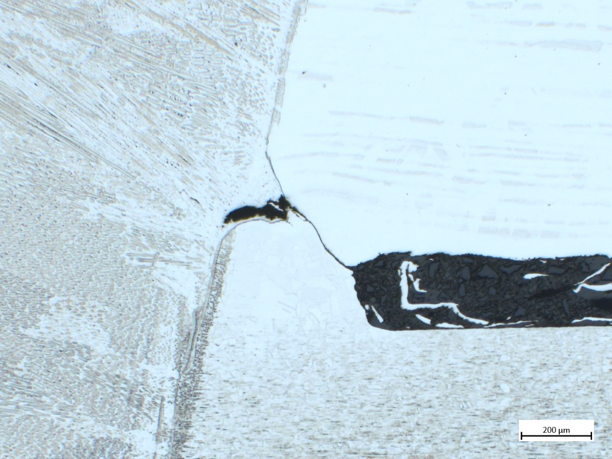
Metallographic inspection etched
  Lack of side wall fusion (ref 401 of ISO 6520-1) and microcrack (ref 1001 of ISO 6520-1) at the junction between backing plate and butt weld joint are observed. Oxides are noticed in the cavity formed by the lack of fusion.

Slide 6
Conclusion and discussion
  Metallographic examination revealed:
  Lack of side wall fusion (ref 401 of ISO 6520-1): not authorized according to the level B of ISO 5817,
  Microcrack (ref 1001 of ISO 6520-1) at the junction between backing plate and butt weld joint are observed: authorized according to the level D of ISO 5817; for level C and B the acceptance is related to stress crack propagation susceptibility of the base material.

