Slide 1
Radiographic Testing Comparison
MQXFA Longitudinal TIG Welds
PORRET Alexandre RT2 ISO 9712
2022/09/07

Slide 2
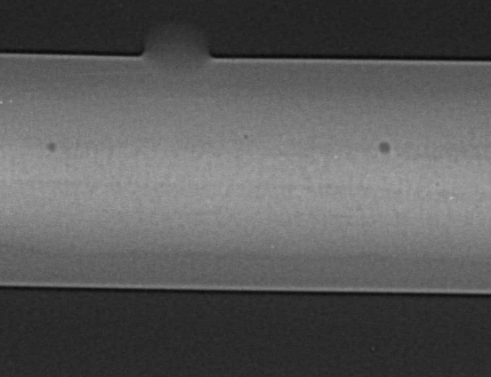
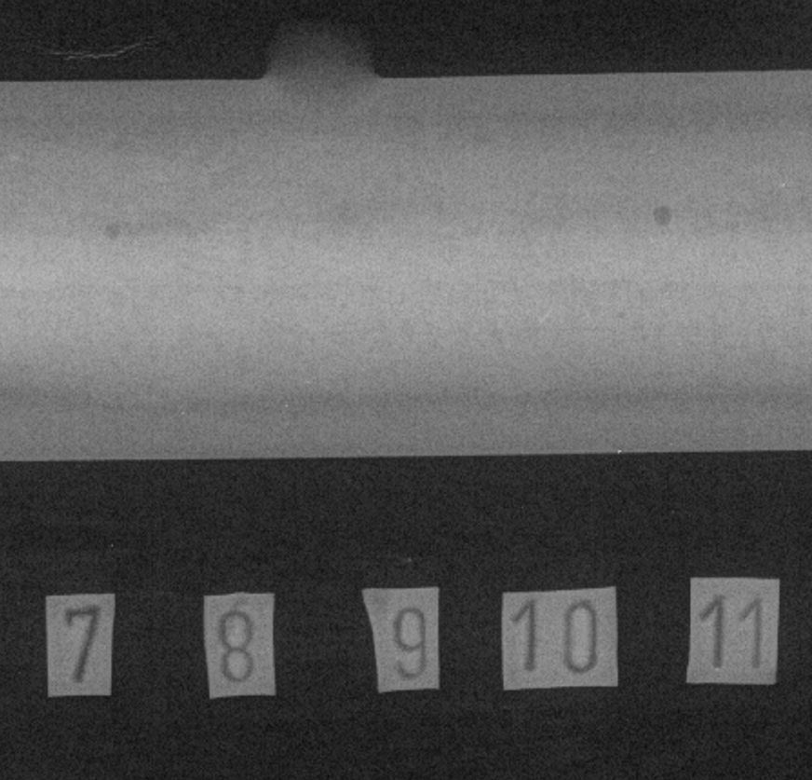
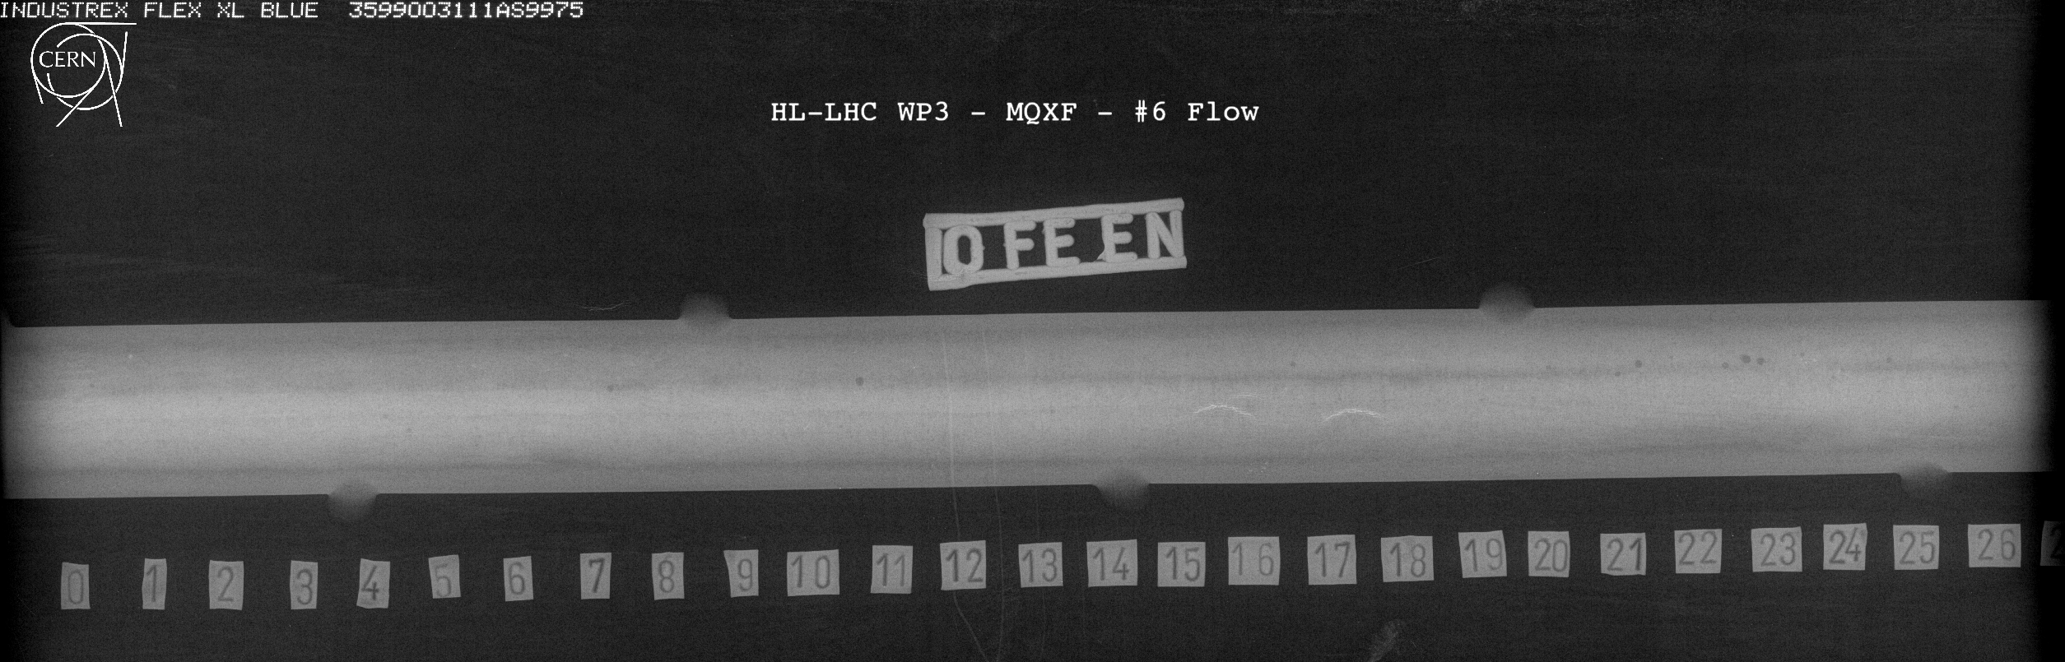
FERMILAB Plate #6
Lacks of fusion
Lacks of fusion (Ref 401 of ISO 6520-1)

Slide 3
Conclusion
Lacks of fusion (ref 401 of ISO 6520-1) were detected on the FERMILAB Plate #6 by radiographic testing => These indications are not acceptable according to ISO 10675-1 level 1
Some lacks of fusion could also be seen on the films received at CERN: for a better interpretation, the original film need to be provided.
No comparison was done on FERMILAB Plate #4 due to no correspondence with the film received

Slide 5
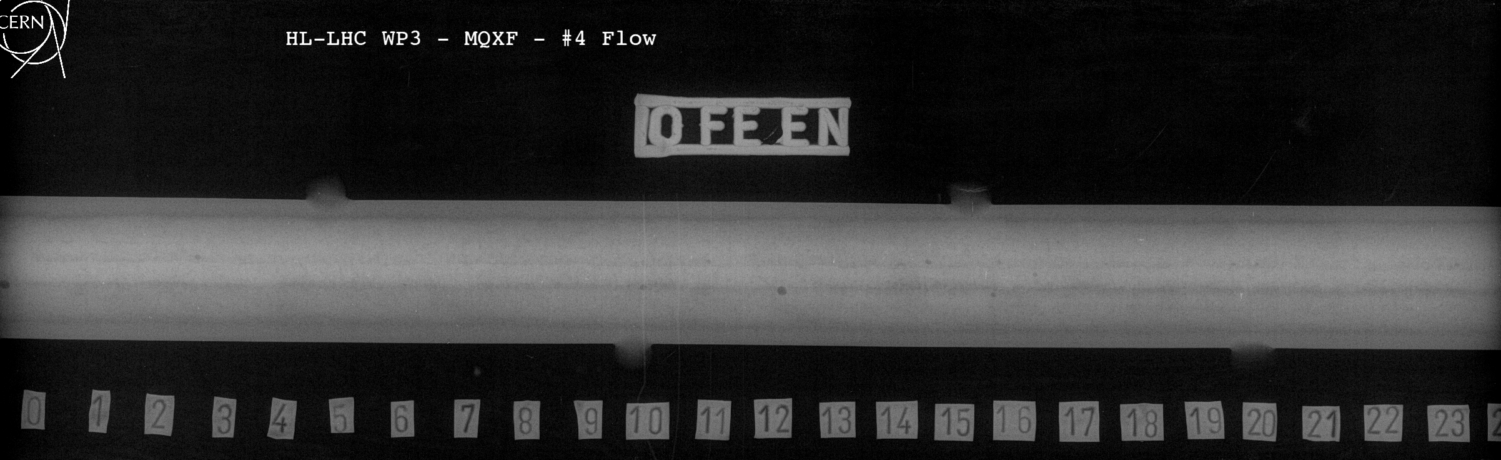
FERMILAB Plate #4
Lacks of fusion (Ref 401 of ISO 6520-1)

