Slide 1
Inter-Beam Distance in FCC-ee Arcs
J. Bauche, FCC-ee optics meeting, 1st December 2022.
Based on contributions from the Arc Half-Cell WG:
L. Baudin, F. Carra, C. Eriksson, C. Garion, R. Kersevan, S. Rorison, C. Tetrault, M. Timmins, L. Von Freeden

Slide 2
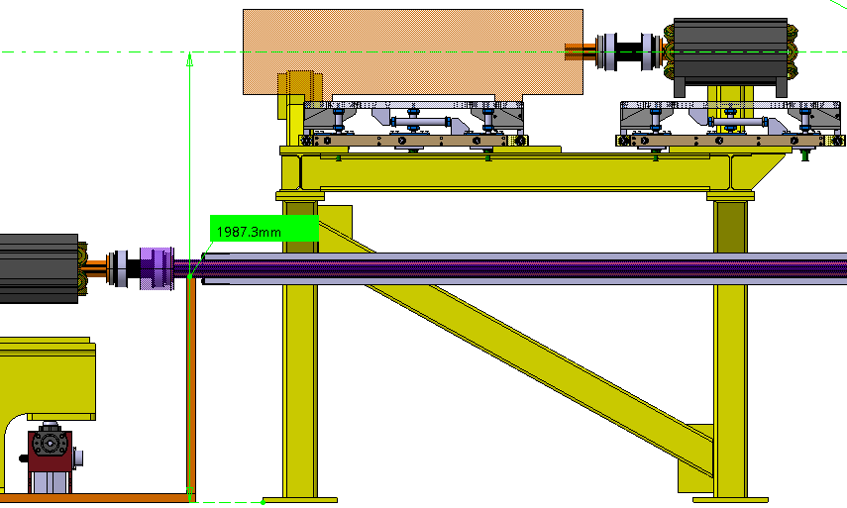
Let’s start with a confirmation…
CATIA model courtesy: C. Tetrault (EN-MME)
  An option presently considered for vertical placement of the booster (arc half-cell design studies):
  The booster SSS can be azimuthally offset from the collider SSS
    Decrease vertical distance between booster and collider beam axis
    Better stability of booster supports
    Eases integration in Ф5.5m tunnel
  → OK from the optics point of view?
Booster SSS on top of collider dipoles

Slide 3
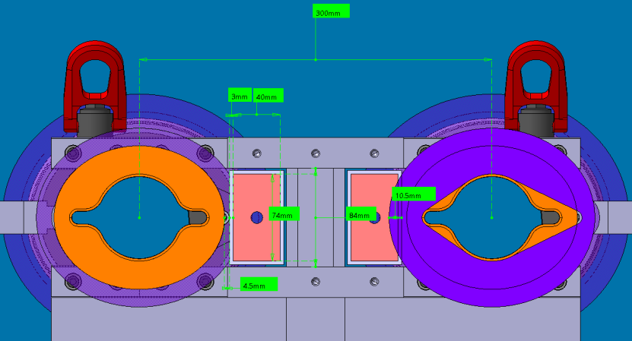
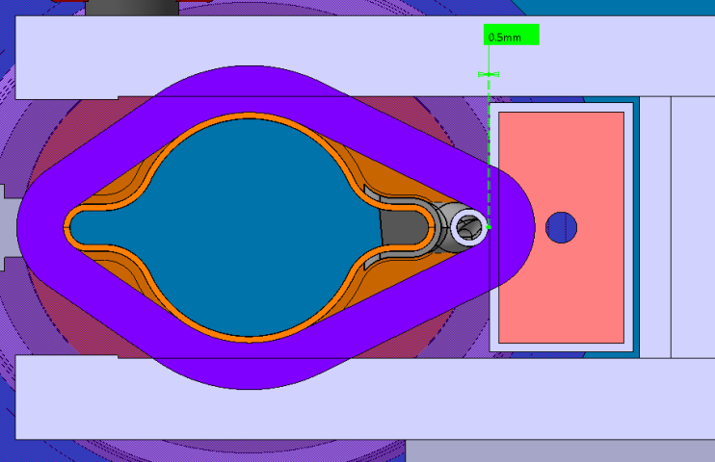
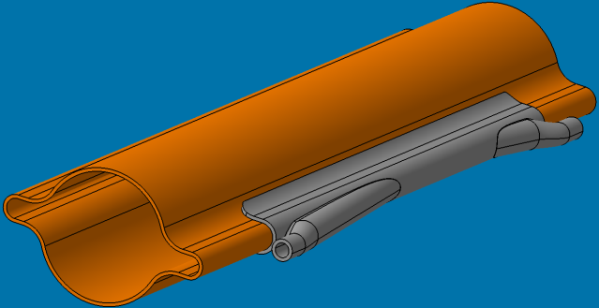
Inter-beam distance
  Recent mechanical design studies (arc half-cell mock-up WG)
  → Larger space required for SR absorbers (water cooling piping and fittings; safety distance to busbar (voltage))
  ➔ Inter-beam distance needs increasing up to 350 mm
  This would also help solving issues in other areas
  (see next slides)
Dipole cross-section with SMA flanges
Conflict:
SR absorber - busbar
CATIA model courtesy:
C. Tetrault
(EN-MME)
SR absorber integration in dipole
SR absorber

Slide 4
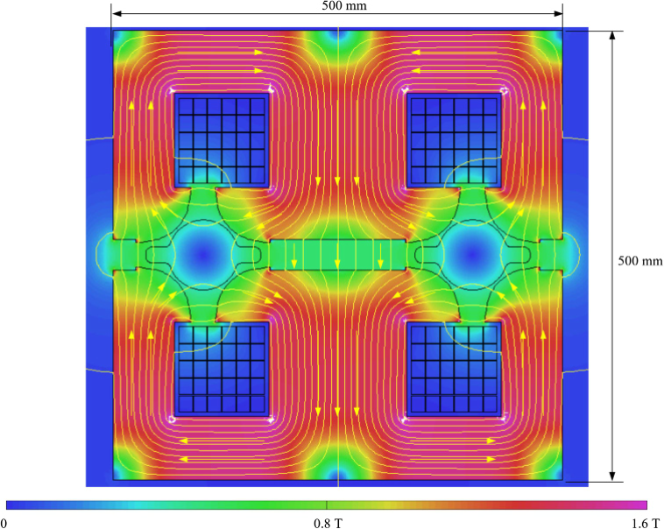
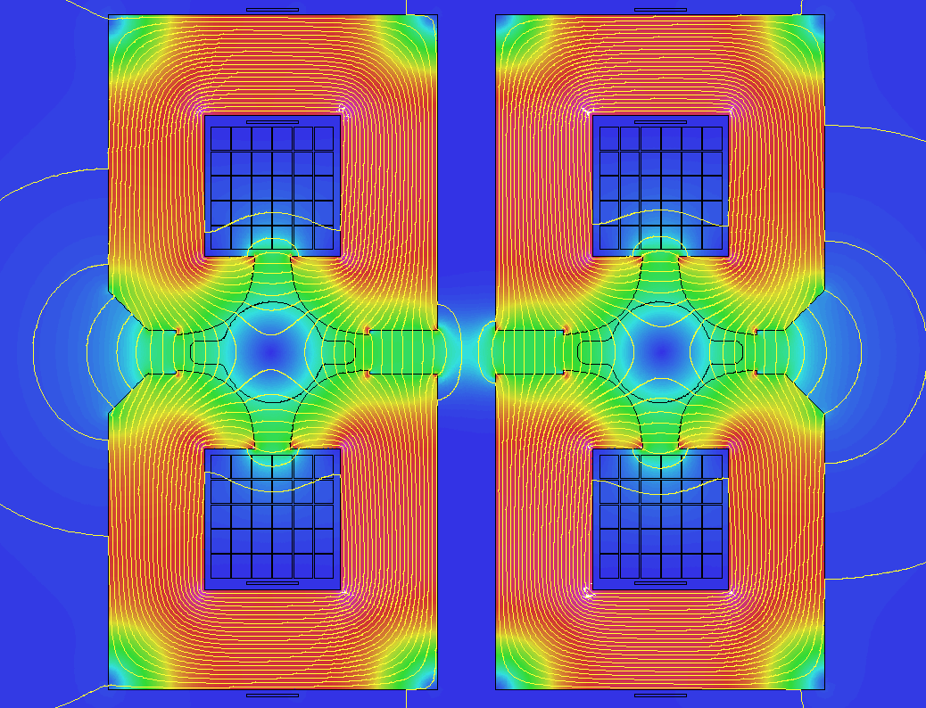
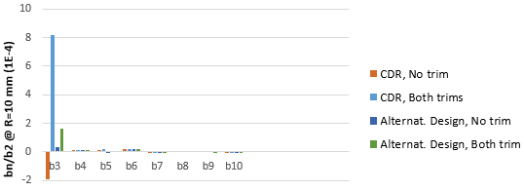
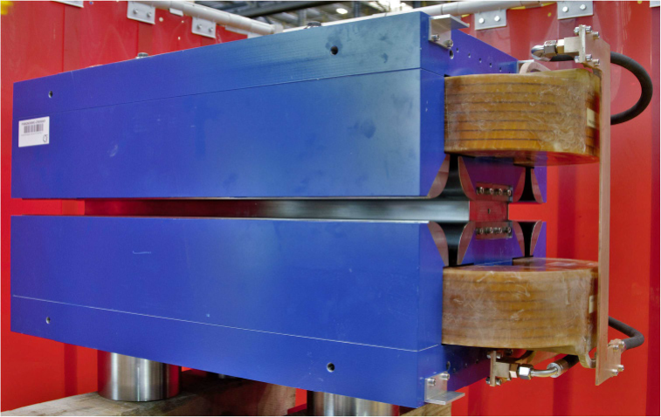
Quadrupole cross-section
  Aperture coupling, strongly enhanced by E saw tooth trim circuits (strong b3 and magnetic axis shift)
  Latest version features separation of magnetic circuits for each aperture (still mechanically assembled and sharing common coils)
  Increase of inter-beam distance will help mitigating further the coupling
CDR cross-section
Simulated normalized harmonics (FEM 2D)
Model magnet 1m-long (CDR)
Modified cross-section

Slide 5
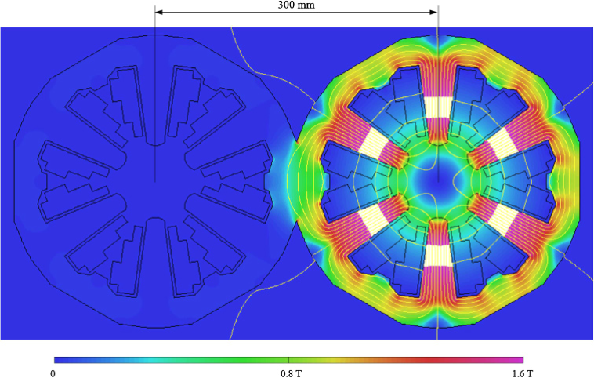
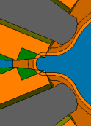
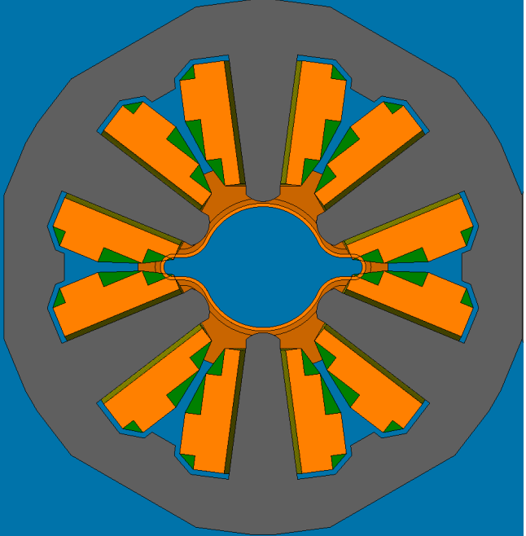
Sextupole cross-section
  Challenges of CDR version with single aperture:
  “Busy” cross section, current and flux densities at upper values, dissipated power > dipoles
  Integration of trim circuits (H/V orbit correctors, skew quadrupoles) to be performed, will require space
  Integration issues: vacuum chamber winglets vs. coils on mid-plane; space for vacuum bake-out insulation
    Presently only 1 mm between poles and VC, needs 3 ~ 5 mm
    Scaling aperture diameter from 76 mm to 84 mm (+10%) means:
    → Pole tip field scales from ~ 0.7 T to ~ 0.85 T… challenging
    → Power consumption scales from ~ 20 MW to ~ 37 MW (+80%)
  Increase of inter-beam distance will help relaxing the cross-section
  But… shall we reevaluate the specifications?
CDR cross-section
Conflicts:
Coil – vacuum
Yoke – vacuum
(bake-out insulation)
CATIA model courtesy: C. Tetrault (EN-MME)
Vacuum chamber integration

Slide 6
Conclusions
The inter-beam distance in the collider needs to be increased to 350 mm to solve magnet-vacuum integration issues in the dipole.
The increase of the inter-beam distance will benefit to the mitigation of the quadrupole aperture coupling issue.
For the sextupole magnet, the design needs to be reworked to solve integration issues and include additional features (trim circuits). The inter-beam distance increase will allow relaxing the cross-section, but as the power consumption scales with 6th power of the aperture, it would be wise to re-evaluate this specification.
→ Feedback from the optics most welcome!

Slide 7
Thank you for your attention.
7

