Slide 1
Future Linear Colliders
Carbon Footprint Study
21/10/2022
With reference to specification document:
2789006 V.1
EDMS: https://edms.cern.ch/document/2789006/1

Slide 2
Assessment/Scope
Assessment of the carbon footprint of future tunnel construction.
To cover all underground civil engineering works.

Slide 3
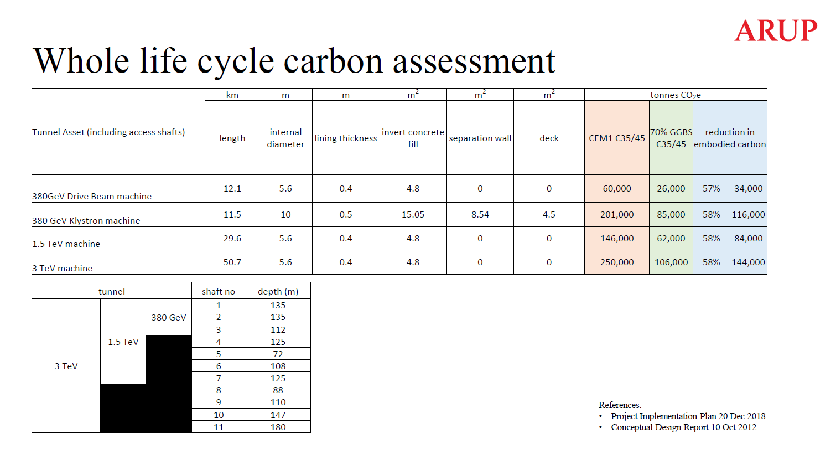
Previous Study
Extract from Thermal Heat Recovery meeting 22/04/2022

Slide 4
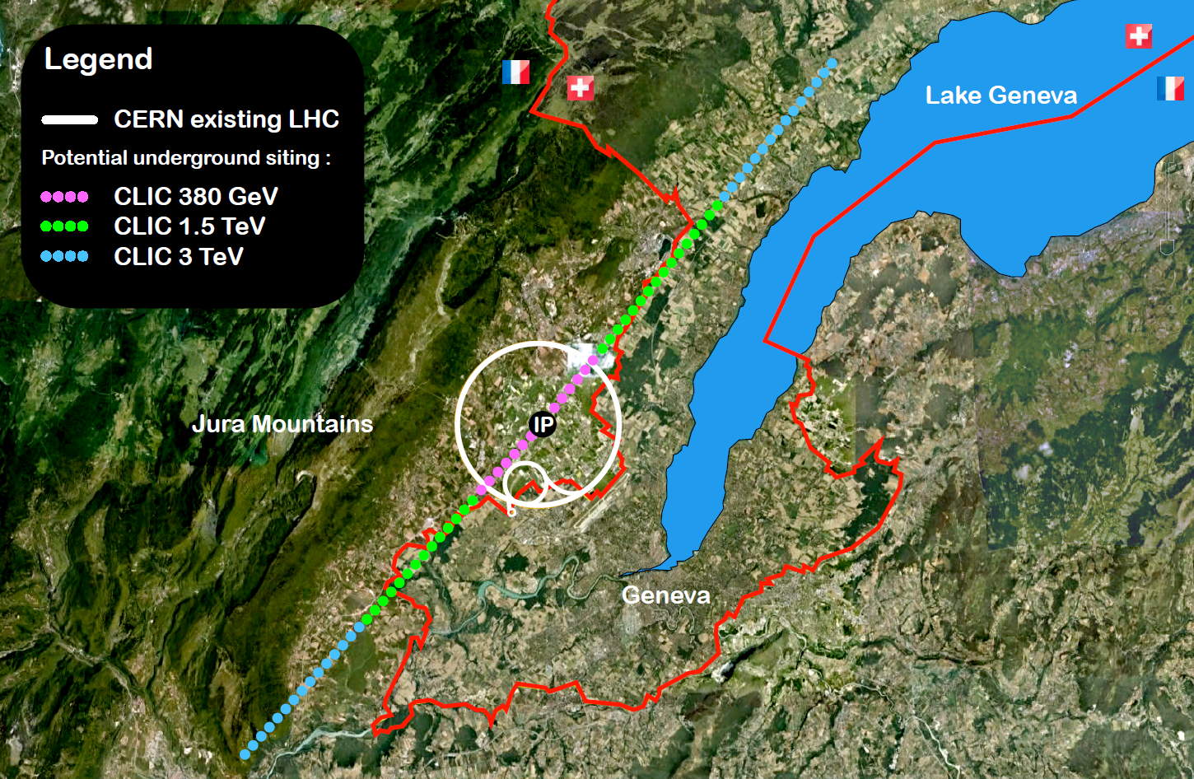
CLIC Overview
Geneva

Slide 5
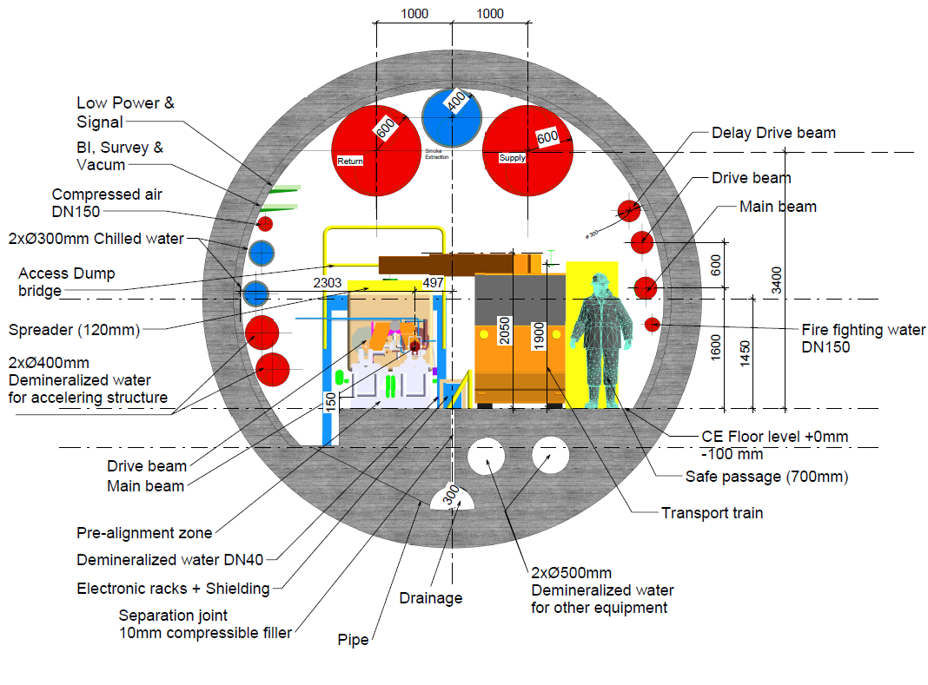
CLIC Drive Beam
Cross Section
Extract from CLIC PIP 2019
Drive Beam Option 5.6m internal diameter

Slide 6
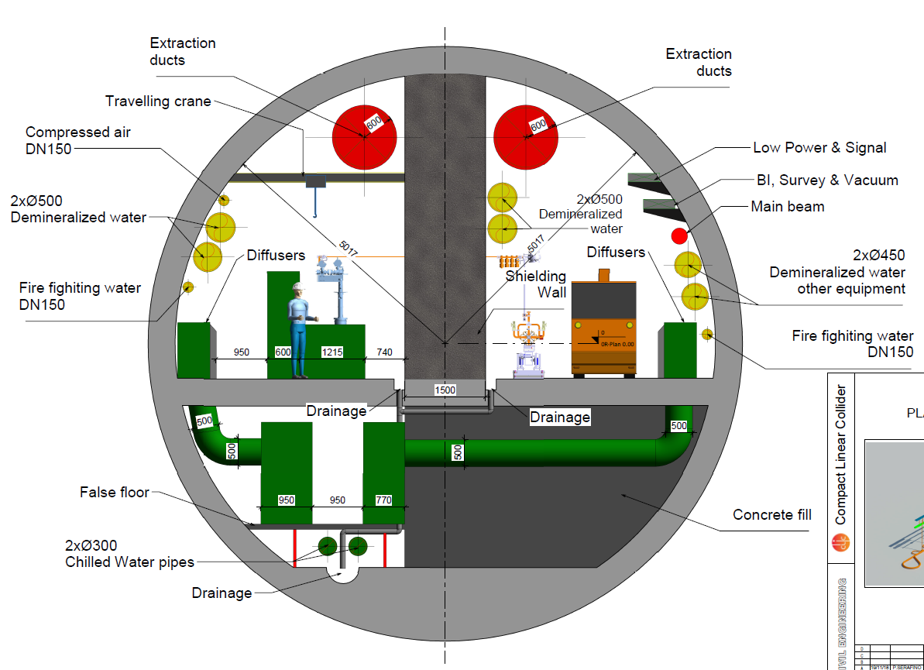
CLIC Klystron
Cross Section
Extract from CLIC PIP 2019
10 m internal diameter and 1.5 m thick shielding wall

Slide 7
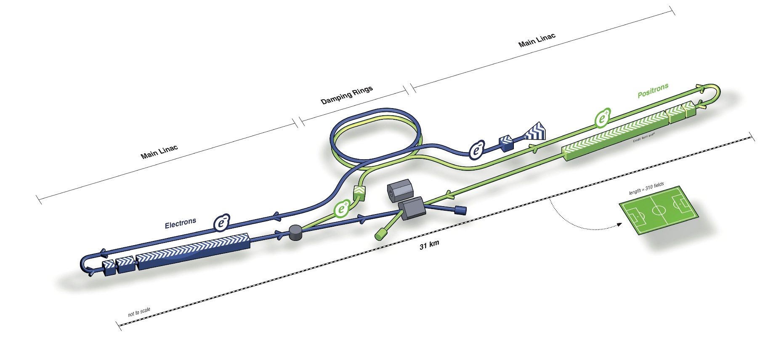
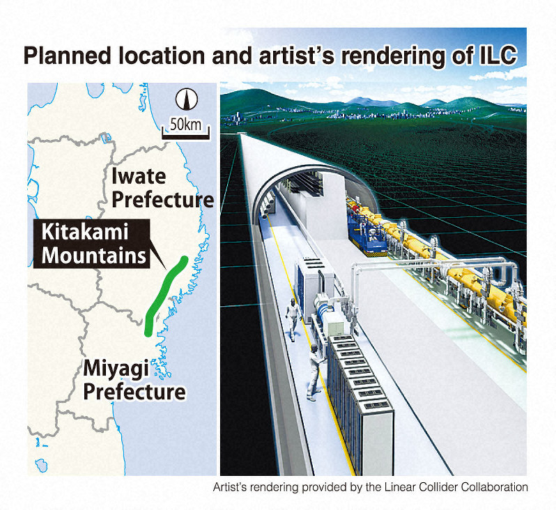
ILC Overview
Japan

Slide 8
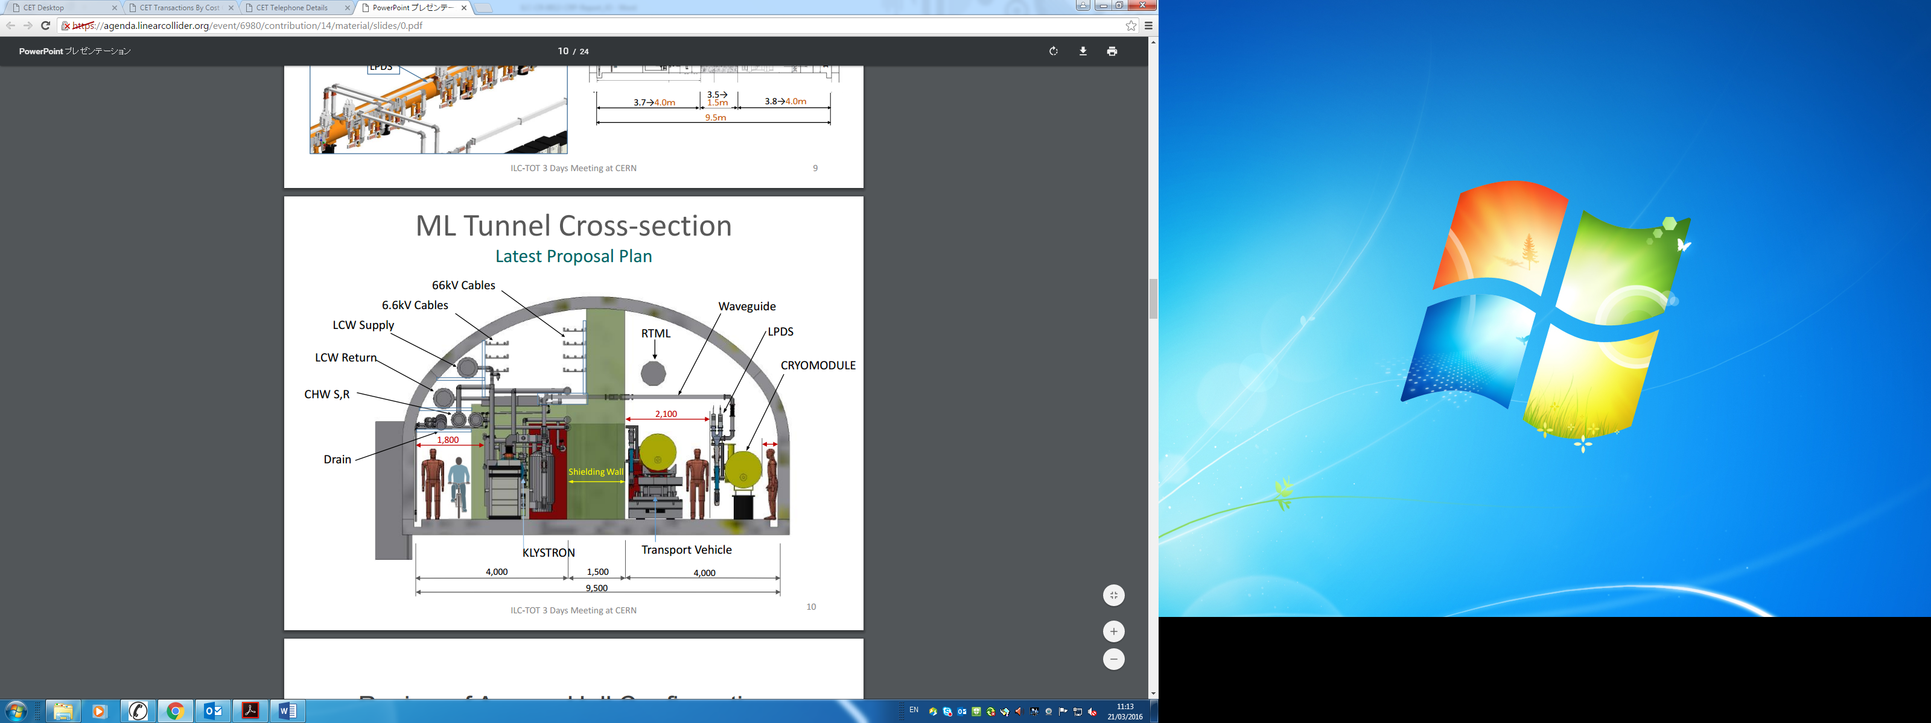
ILC
Cross Section
Extract from ILC Change Request 2016
9.5m wide tunnel and 1.5m thick shielding wall

Slide 9
Deliverables
4 or 5 online progress meetings with CERN as and when required.
Possible meeting at Linear Collider workshop to present study findings, SLAC San Francisco.
Interim report by March 2023, outlining progress.
Final technical report end of May 2023.

