Slide 1

Assessing resin and insulation limits and improving electrical robustness
Roland Piccin, Davide Tommasini, Diego Perini, Bharti Verma, Christian Scheuerlein, Susana Izquierdo Bermudez
December 14th 2022 – Follow-up Report on Ongoing actions for MQXFB

Slide 2
Content
Summary of the previous improvements to the insulation system
What we know about CTD1202 ceramic binder and fibers
Exploring alternatives and improvements

Slide 3
Summary of the previous improvements to the insulation system

Slide 4
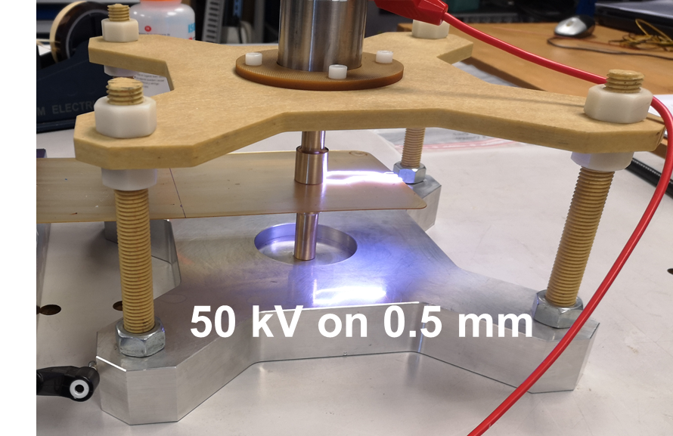
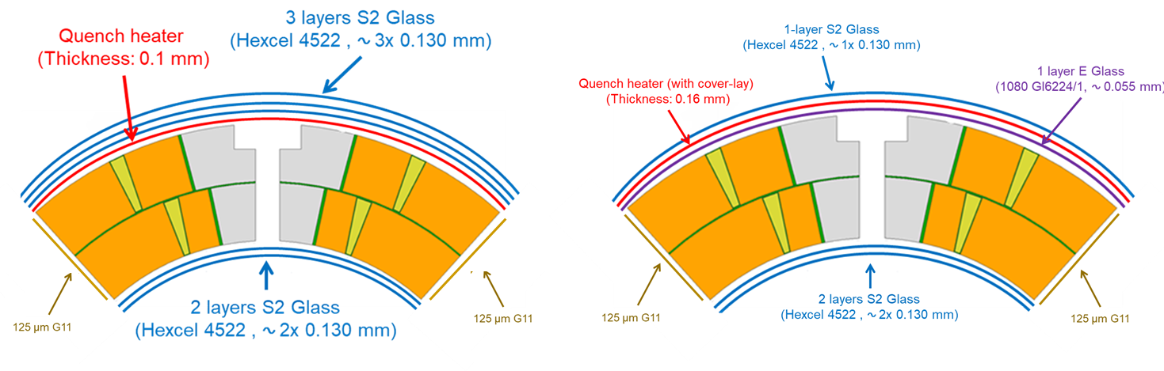
Improvements in QH robustness
To improve the reliability of the Quench heaters:
Sandwich construction: addition of a Polyimide coverlay to improve the mechanical robustness of the QH (heaters circuit on the neutral axis)
0.055 mm E-glass (EDMS 2519642 (v.1)) added after reaction between heater and coil to :
  Facilitate resin impregnation
  Provide additional dielectric insulation heater to coil
HV qualification tests on QH before installation from 3.7 kV to 5 kV
Initial Design
New Design
Presently implemented in coils 115/116 for MQXFS8
Implemented in MQXFB from coil 126.
So far, 2 copper coils (004 and 005) and 3 transition coils (126-128) have been implemented with this layout
MQXF QH Technical Meeting
https://indico.cern.ch/event/1077589/

Slide 5
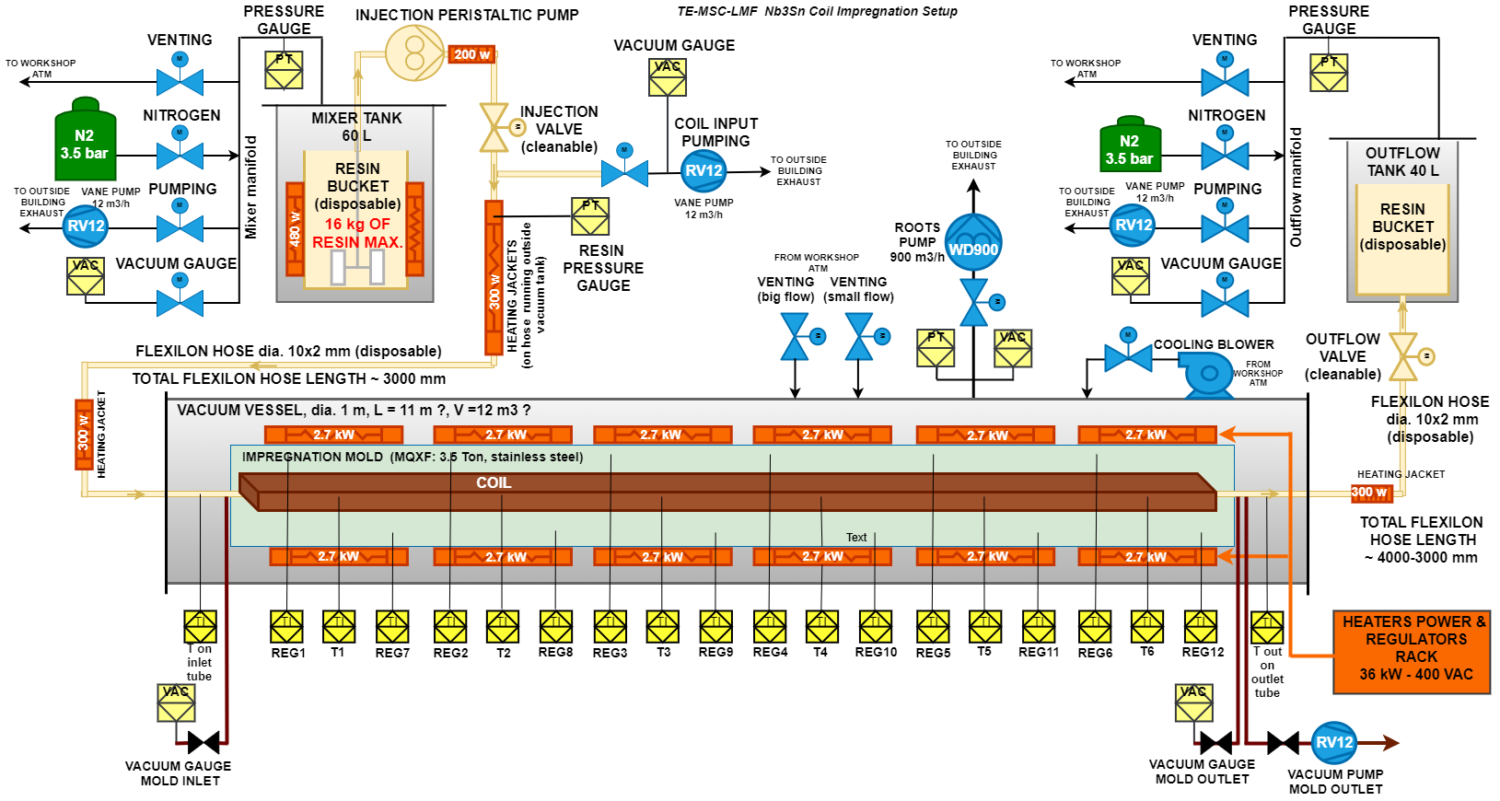
Improvement of the impregnation process starting from coil 120
Better degassing
  installation of an additional pumping unit at the mould exit
  better monitoring of local mould pressures with the introduction of local (at the mould inlet and outlet) pressure pickups and, consequently, adjustment of degassing time
  better conditioning of the injection tank
Increase of degassing temperature (coil + mould) from 80°C to 110°C
Tighter monitoring and control of the impregnation process, new rule of iteration of the milking process based on 100% absence of bubbles at the outlet resin tank
All these improvements are implemented from coil 120
(i.e., coils for MQXFB02 already produced)

Slide 6
What we know about CTD1202 ceramic binder and fibers

Slide 7
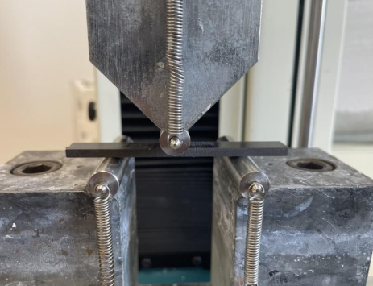
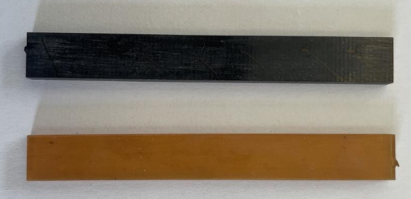
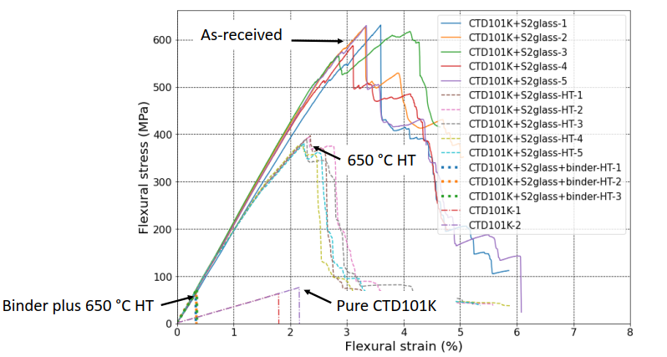
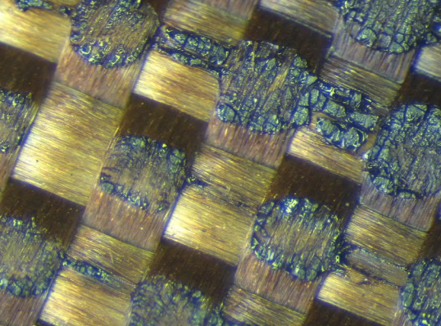
MQXFB interlayer and the binder CTD 1202
The binder CTD1202 in combination with the 650 °C coil reaction heat treatment leads to dramatic loss of the CTD101K- S-2 glass mechanical strength. The flexural modulus is not affected though [1].
The pyrolysis of the binder creates a dark and tough ceramic structure called silicon oxicarbide (SiOC). The loss of fiber strength occurs likely during the process of formation of SiOC [2].
Flexural test and beam samples
Interlayer with binder CTD1202 after heat treatment
[1] C. Scheuerlein, MQXF interlayer mechanical properties – TE-MSC 2022 - EDMS N 2735359
[2] D. Ternova, FTIR and XRF analysis of the S2 TEX glass-fibre with the CTD-1202 ceramic binder after several treatments, TE- VSC 2022 - EDMS 2732657

Slide 8
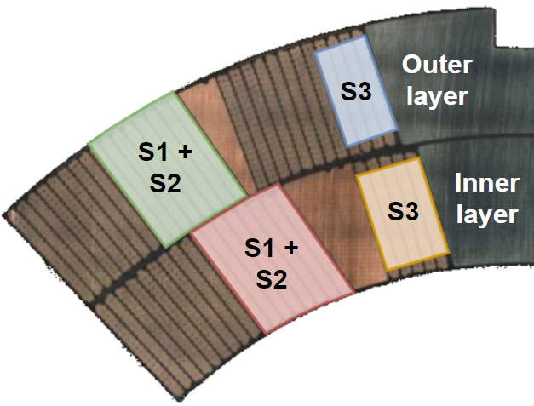
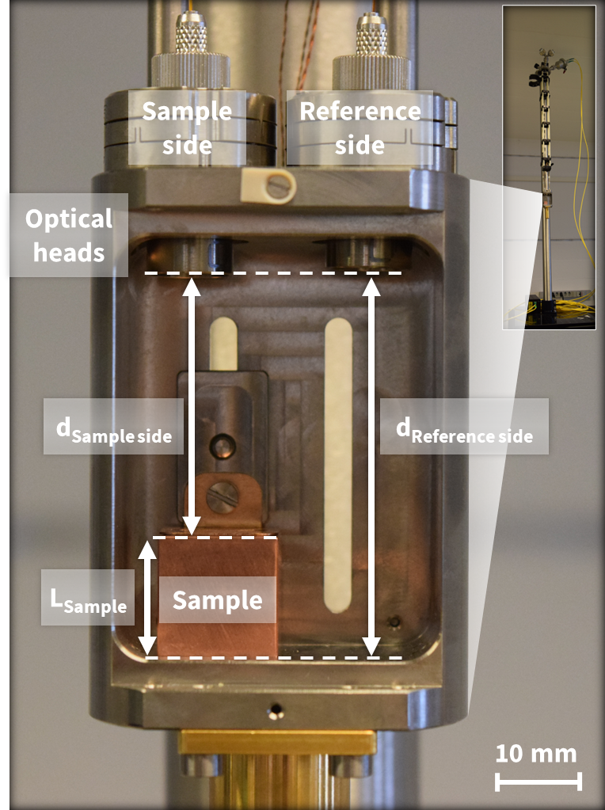
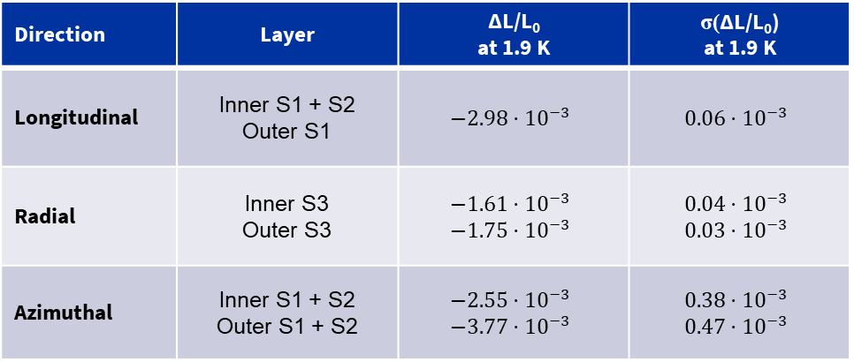
MQXFB – CTE measurement in coil 120
Ò. Sacristan, M. Guinchard, S. Hoell - EN –MME 2022
CTE measurements performed by MME on segments extracted from coil 120 show a significant difference in the CTE in azimuthal direction between IL (binder) and OL (no binder) https://indico.cern.ch/event/1224526/
Sample extraction is complex and might influence results which indeed shows a large error bar
→ ten stacks with and without binder to characterize mechanical properties of the coil in a simpler set-up
→ a sanity check missing on standard coil with binder on both IL and OL.
Direction | Layer | ΔL/L₀ at 1.9 K | σ(ΔL/L₀) at 1.9 K
Longitudinal | Inner S1 + S2 Outer S1 | $$−2.98⋅{10}^{−3}$$ | $$0.06⋅{10}^{−3}$$
Radial | Inner S3 Outer S3 | $$−1.61⋅{10}^{−3}$$ $$−1.75⋅{10}^{−3}$$ | $$0.04⋅{10}^{−3}$$ $$0.03⋅{10}^{−3}$$
Azimuthal | Inner S1 + S2 Outer S1 + S2 | $$−2.55⋅{10}^{−3}$$ $$−3.77⋅{10}^{−3}$$ | $$0.38⋅{10}^{−3}$$ $$0.47⋅{10}^{−3}$$
CTE measurements in coil 120
Uncertainty of $U_{coated}=0.03⋅{10}^{−3}$

Slide 9
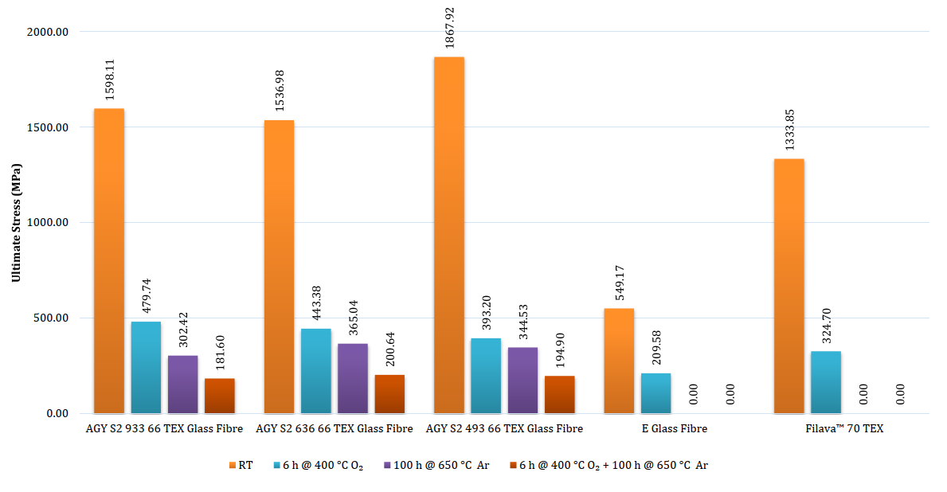
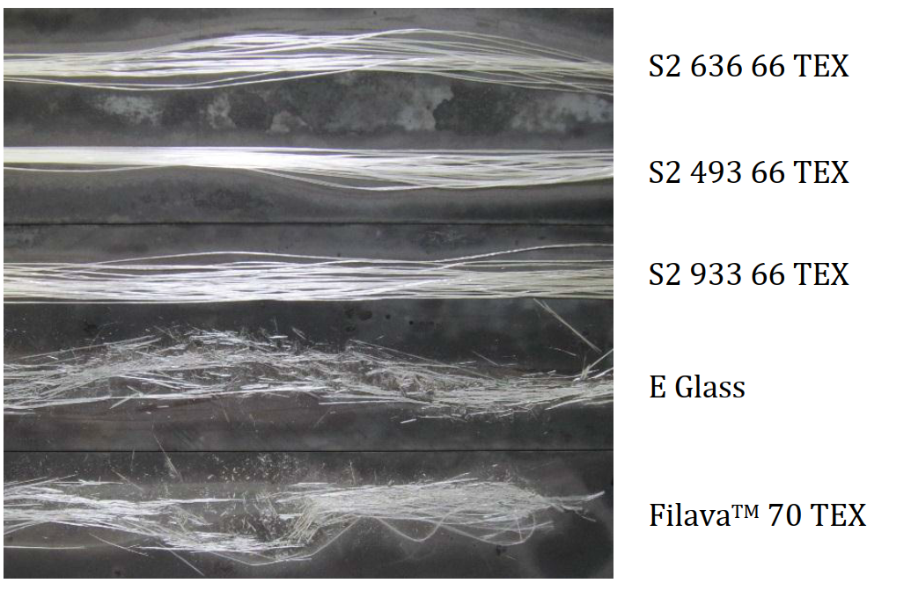
Effect of heat treatments on glass fibers tensile strength
As-received
De-sizing 400 ℃ O₂
HT 650℃ Ar
Regardless the sizing, the TEX and type of fiber, the heat treatments have a detrimental effect on fibers
MQXFB Interlayer
MQXFB Conductor insulation & interlayer
M.G. Lopes - Glass Fiber / Binder Characterization – TE-MSC 2014 - EDMS 1405346

Slide 10
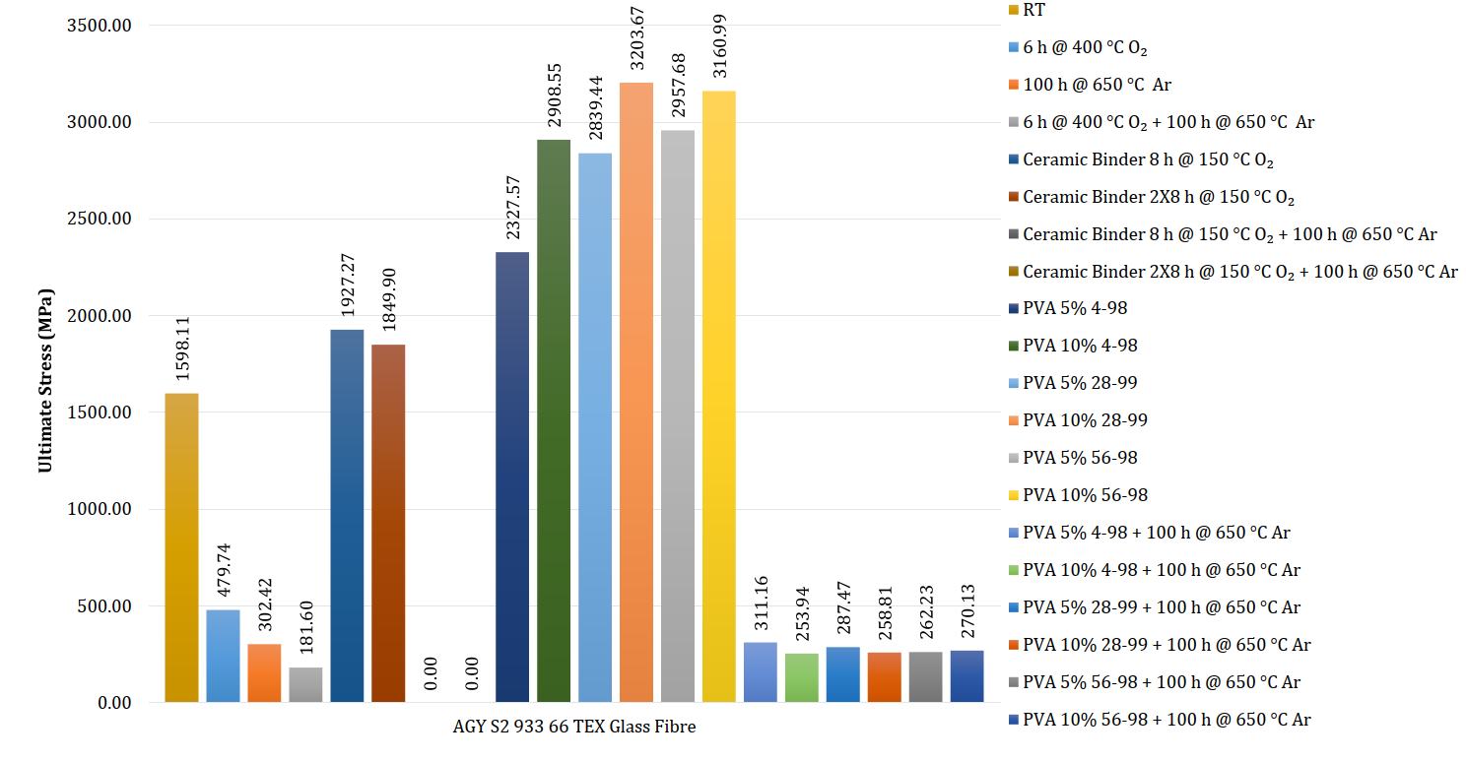
Effect of binders on S-2 fibers tensile strength
Cured ceramic binder
As - received
HT 650℃ Ar
CB + HT
As already shown, the combination of ceramic binder and HT destroys the mechanical strength of the fibers.
Note that tensile strength of the fibers with PVA + HT is comparable to the one of pure fibers after HT.
M.G. Lopes - Glass Fiber / Binder Characterization – TE-MSC 2014 - EDMS 1405346

Slide 11
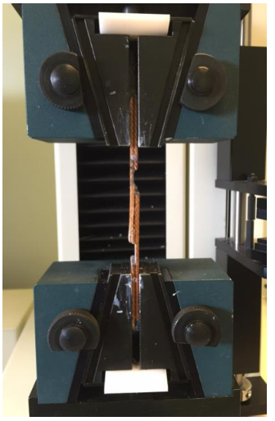
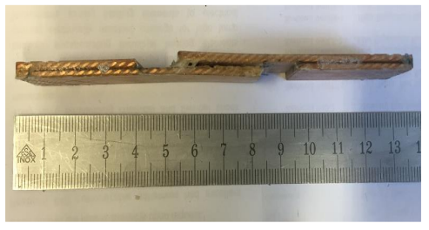
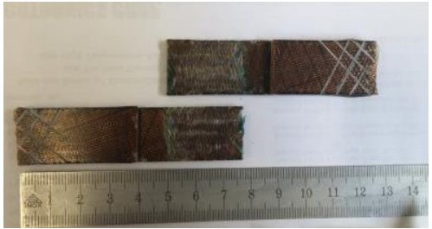
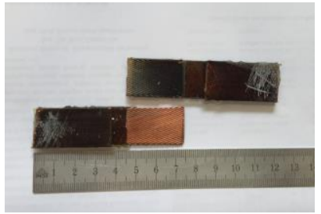
Shear strength on S-2 / TEX66 / 933 sizing
The ultimate shear strength of fibers with ceramic binder is factor 2 lower than the ultimate shear stress of as-received and heat-treated samples
In as-received and only-reacted samples failure occurs at the interface between the two conductor layers
In ceramic binder samples failure occurs at the level of the fibres
X. Deville - Shear test results - Influence of ceramic binder CTD-1202 and reaction cycle on MQXFS cable epoxy bonded joints- TE-MSC 2017 - EDMS 1719997

Slide 12
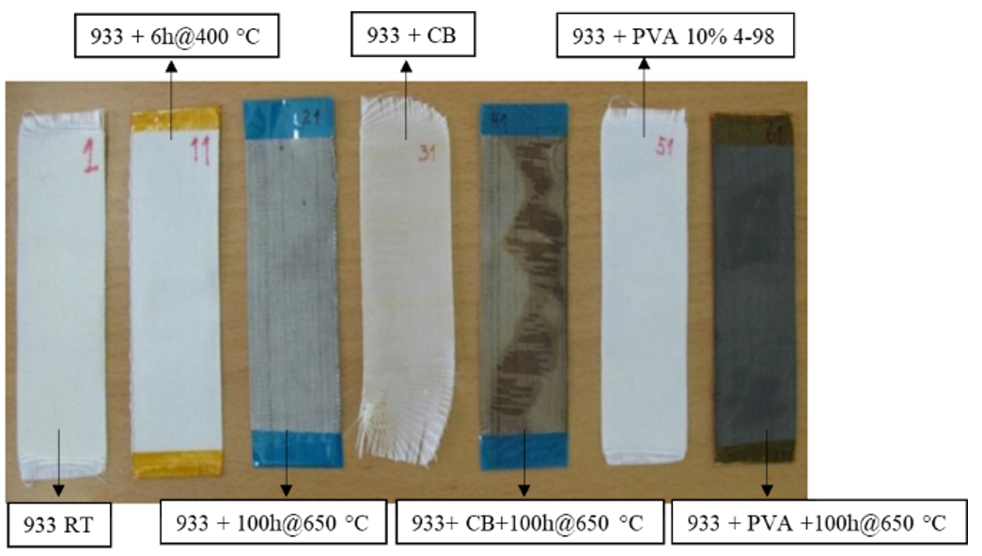
Effect of binders on electrical resistivity
The only samples with a measurable resistivity was the sample with PVA after the thermal cycle in Ar.
The heat treatment and the ceramic binder seems to not affect the electrical resistivity of the fibres
Dielectric and resistivity tests are planned with PVA and CB samples to confirm these findings
M.G. Lopes - Glass Fiber / Binder Characterization – TE-MSC 2014 - EDMS 1405346

Slide 13
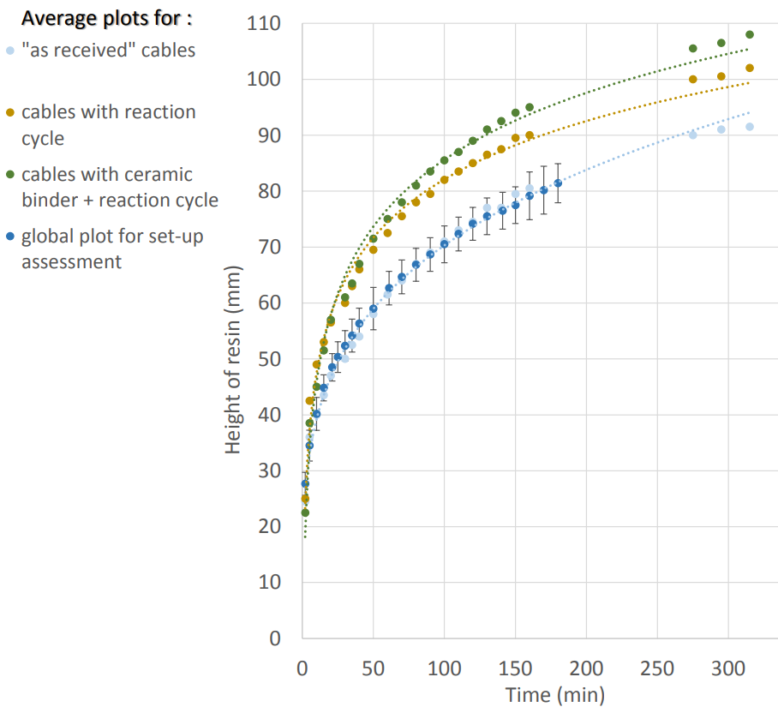
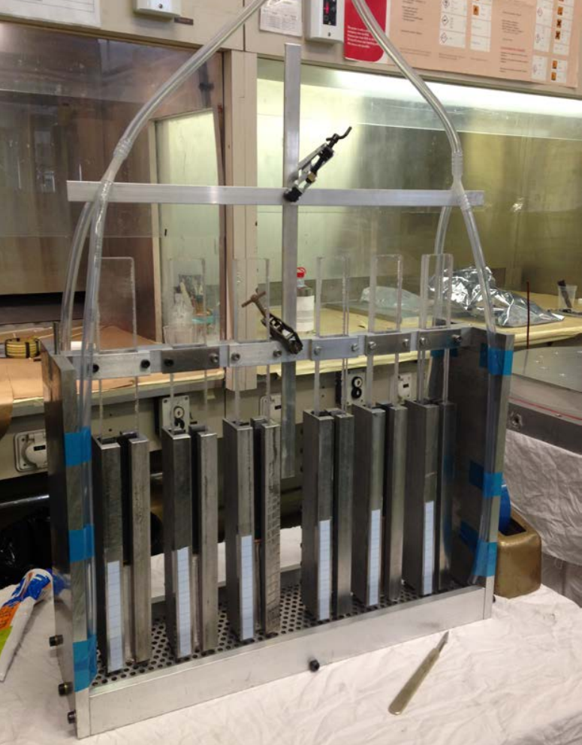
Wettability of S-2 / TEX66 / 933 sizing
Unexpectedly the cable insulation wettability is improved after reaction cycle (gold) and with the ceramic binder (green).
The method of application and curing profile of the binder CTD1202 is not described in the report.
S. Gayot - Characterisation of the wettability of MQXF cable, MCBXF cable, and 11T dipole cable by epoxy resin CTD-101K. – TE-MSC 2015 - EDMS 1563761

Slide 14
Exploring alternatives and improvements

Slide 15
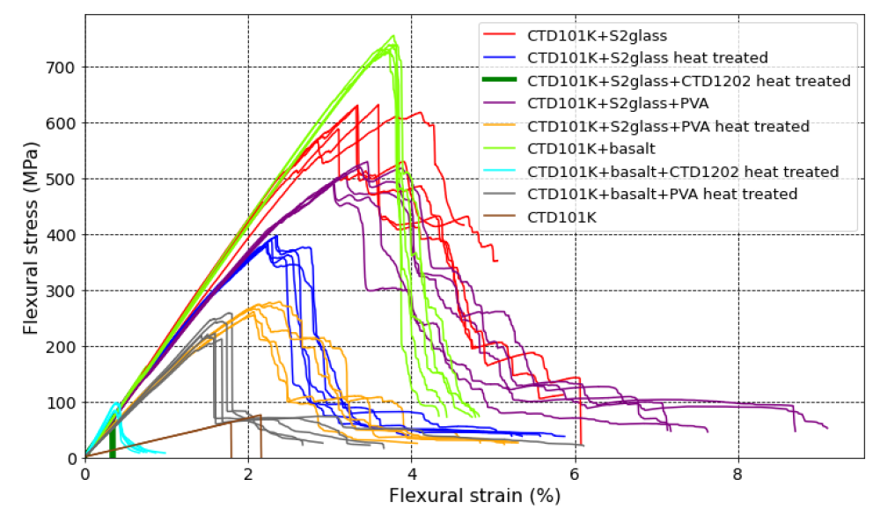
Exploring alternatives and improvements
The outcomes of this R&D is not in the timeline of the MQXFB production. Nonetheless, future magnets may benefit from it:
Polyvinyl Alcohol (PVA) grade 28-99 could be a potential candidate as binder material.
In addition, a review of alternative heat-resistant (and binder-resistant) fibers is in progress.
S2 glass/PVA
S2 glass/CTD1202
C. Scheuerlein, Flexural properties of S2 glass/CTD1202 binder/CTD 101K composite MQXF coil interlayer – TE-MSC 2022 - EDMS N 2744986

Slide 16
In summary
The S-2 glass mechanical strength (tensile, shear, flexural) is largely degraded by the combination of heat treatment and binder CTD1202. However, the presence of binder seems to improve the wettability of the fibers.
It is planned to characterize the impact on the E-modulus and CTE in dedicated 10-stack-like samples . The ‘new coil recipe’ considers a hybrid solution with binder in the IL but not in the OL.
The PVA could be a promising alternative to CTD1202 for future magnets as it seems to not impact the S-2 glass mechanical strength. Nevertheless, it was measured a light electrical conductive residues on the fibers after heat treatment. Methods to reduce the conductive residues are investigated (mix with TEOX).

