Slide 1

Feedback from MQXFA
E. Todesco, A. Devred, S. Izquierdo Bermudez, D. Perini, A. Milanese, D. Duarte Ramos, on behalf of WP3 and of the AUP collaboration
14 December 2022

Slide 2
SUMMARY
Next steps as presented in September meeting
  Foreseen for September: V test of MQXFA11 (with the caveat of incident) – successfully done in September-October
  Foreseed for November: V test of MQXFA08b (validation of coil replacement) – slipped to end of December (issues in cryogenics and commissioning of second insert)
  Foreseen for November-December: Horizontal test of first cold mass – slipped to January

Slide 3
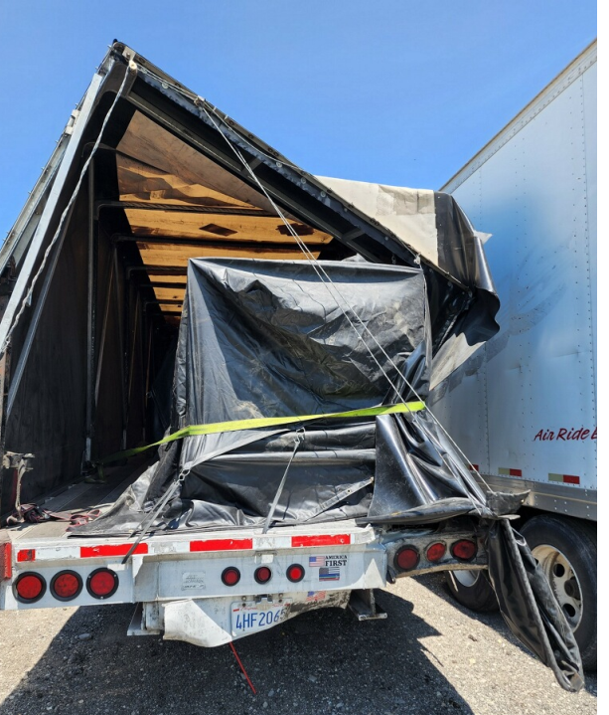
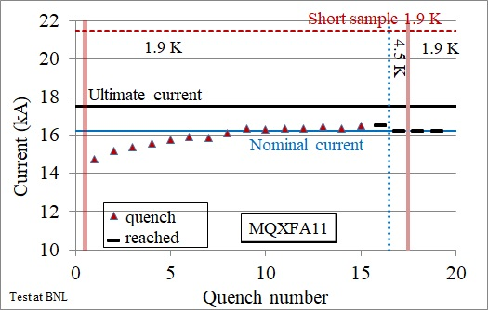
MQXFA11, MQXFA08b
MQXFA11 had an accident during transport between East and West coast, not far from Chicago
  Nobody got injured
  Inspection: no visible damage (on the magnet)
  Large acceleration well beyond spec (5 to10 g)
  Magnet reached performance (test ended October 20)
Power test of MQXFA11 (B. Ahia, et al)

Slide 4
COIL, COLD MASS, TEST
Coil manufacturing is approaching to completion (86 fully done out of 105, 11 in the pipeline)
  FNAL: 149 completed, 5 coil under manufacturing, 5 to do from scratch
  BNL: 237 completed, 6 coil under manufacturing, 8 to do from scratch
MQXFA8b to be tested in December-January
  After this test, clearance to assemble also MQXFA7b
  In the meanwhile, assembly of MQXFA13 and possibly MQXFA14
Issues found in the assembly of MQXFA12 - disassembly
  MQXFA13 being assembled
First cold mass not yet in the test station
  Should be moved in the test station before the end of the year
  Horizontal test in January-February
DOE review to approve the extra cost and revised schedule is ongoing this week

Slide 5
COMING SOON
December 2022: Test of MQXFA8b
  Assessing capability of coil replacement to cure issues in magnet performance due to one coil
January 2023: connection of first cold mass to test station and first quenches
  Assessing cold mass performance
February 2023: V test of next magnet (MQXFA13)

