Slide 1
Task3 Activities Kick-Off
F. Boattini
23 November 2022

Slide 2
Task 3: Accelerator magnets and powering system
For 2026: study a muon accelerator magnets+powering design for 10TeV with 3TeV stage with conceptual design of magnets and estimation of power system cost and total losses and land occupation.
Rapid acceleration 0.34ms ÷ 6.37ms
Bref shape, Linear Vs sinusoidal
Minimization of power system cost consumption and losses
Aperture of pulsating field dipoles / quadrupoles
RF design
Resistive impedance vacuum chamber
Hybrid synchrotron lattice
Maximum B in pulsed (resistive) and fixed (SC) dipoles
Keywords: Optimization, parametric models etc..

Slide 3

Task 3 – Milestones and deliverables for 2026
M5.3 Prelminary design of collider and pulsed synchrotron M15
(participation)
M5.1 Workshop on pulsed magnets M15
Milestones
WP submitted for INFRADEV
Official Kickoff
2022
2023
2024
2025
2026
REPORT
REPORT
D7.1 Interim report M33
D7.2 Consolidated report M45
Deliverables

Slide 4
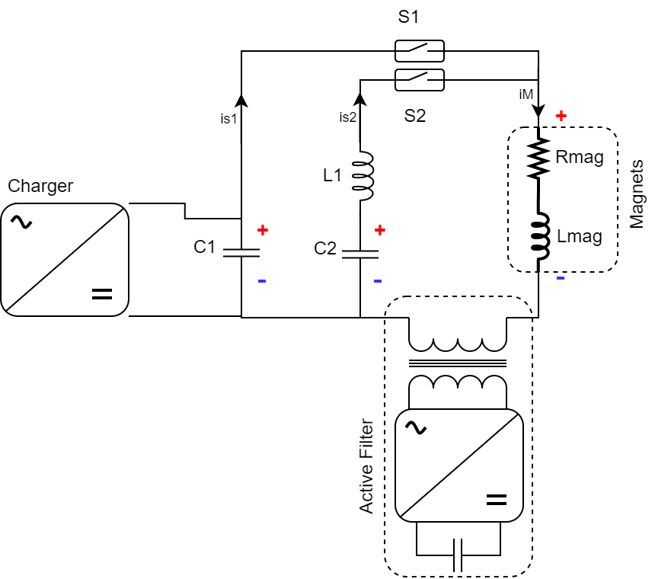
Task3 Power converters. Two harmonics circuit
Simple and generic circuit with double harmonics and active filter.
Two capacitor banks tuned to two different resonating frequencies
Two close-only switches that can be activated synchronously or asynchronously. Possibly based on semiconductor tech.
Two branches contribute to the total magnet current
CERN/LNCMI:
Brainstorming around other different power converter topologies

Slide 5
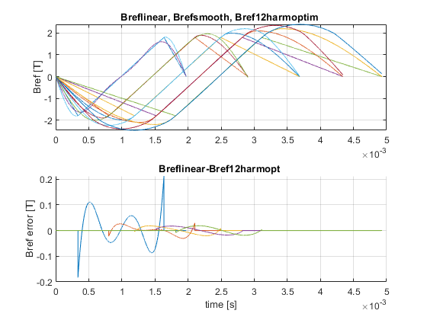

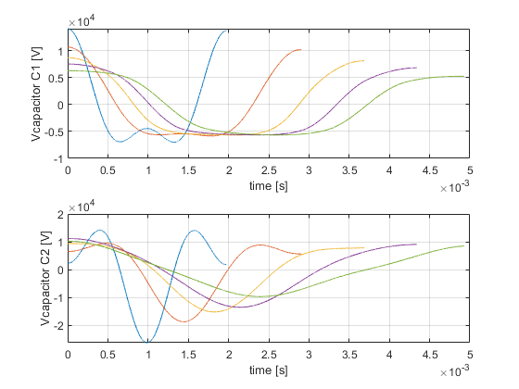
Task3 Power converters. Two harmonics circuit
Power from pure RLC discharge is cheaper than that from the AFE.
We can increase linearity without using the Active Filter if we drive the magnet into saturation and use the most linear part of the Bref.
Increased saturation
Increased B | Imag pk | Ucap pk | ErrB wr2 linear
+0 | 38kA | 26kV | ±0.2T
+0.1T | 51kA | 18kV | ±0.03T
+0.2T | 78kA | 15kV | ±0.02T
Decreased Berror wr2 linear ramp
Decreased Max capacitor voltage
From RF (preliminary)
CERN:
Reduced scale testing of capacitors to narrow sizing criteria

Slide 6
Task3 Power converters. Two harmonics circuit
PROBLEM:
Every sector has a separated power supply.
Active Filter should guarantee that the unavoidable errors of the RLC response are corrected to within the required precision
Power Converter
Power Converter
Power Converter
sector
Power Converter
Power Converter
sector
sector
Power Converter
sector
sector
CERN:
The control problem shall be better defined in order to correctly dimension the Active Filter. Also, a preliminary dimensioning of the AF power electronics has to be done.
One or several magnets in series
sector
sector
sector
sector
sector
sector
sector
Power Converter
sector
Power Converter
Power Converter
Power Converter
Power Converter
Power converter site / building
Power Converter

Slide 7
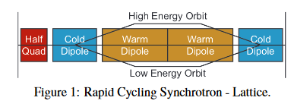
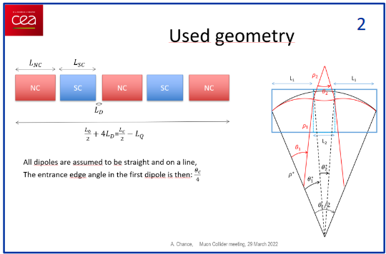
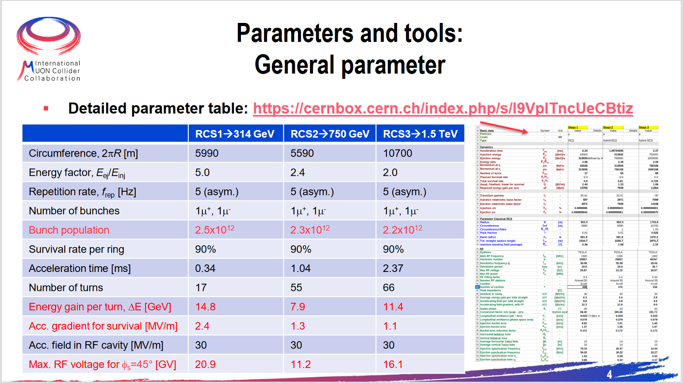
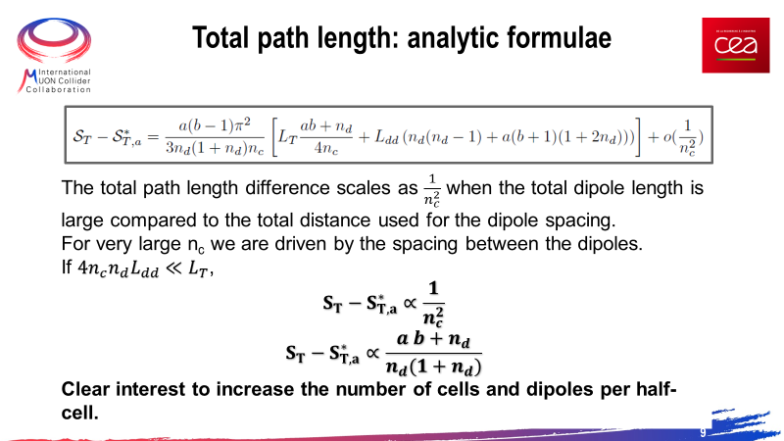
Task3 Resistive Magnets. Hybrid lattice
A. Chance
F. Batsch
Three acceleration stages are for the moment foreseen.
Because of the hybrid lattice, the beam has horizontal oscillation due to oversteering followed by understeering.
The total beam size and path length strongly depends upon the final lattices for each of the accelerator rings, which are not yet consolidated, but…

Slide 8
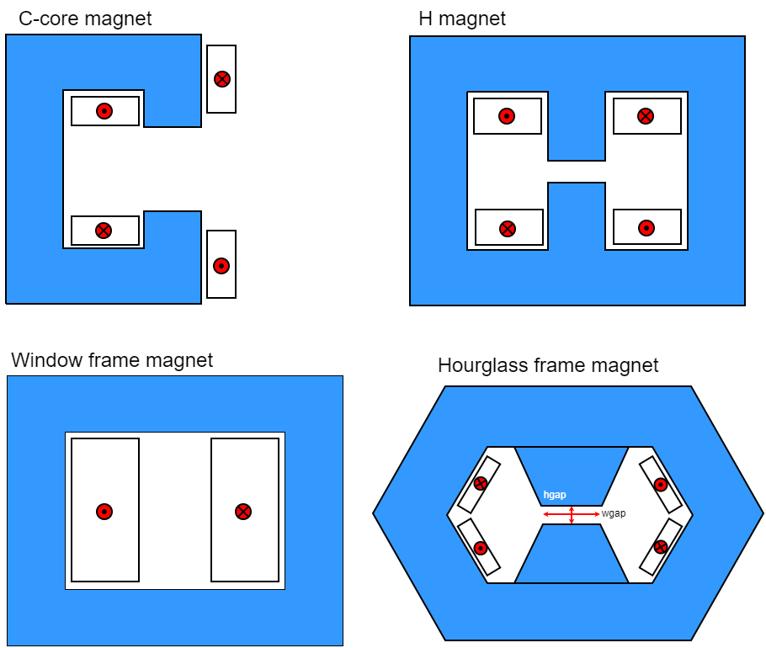
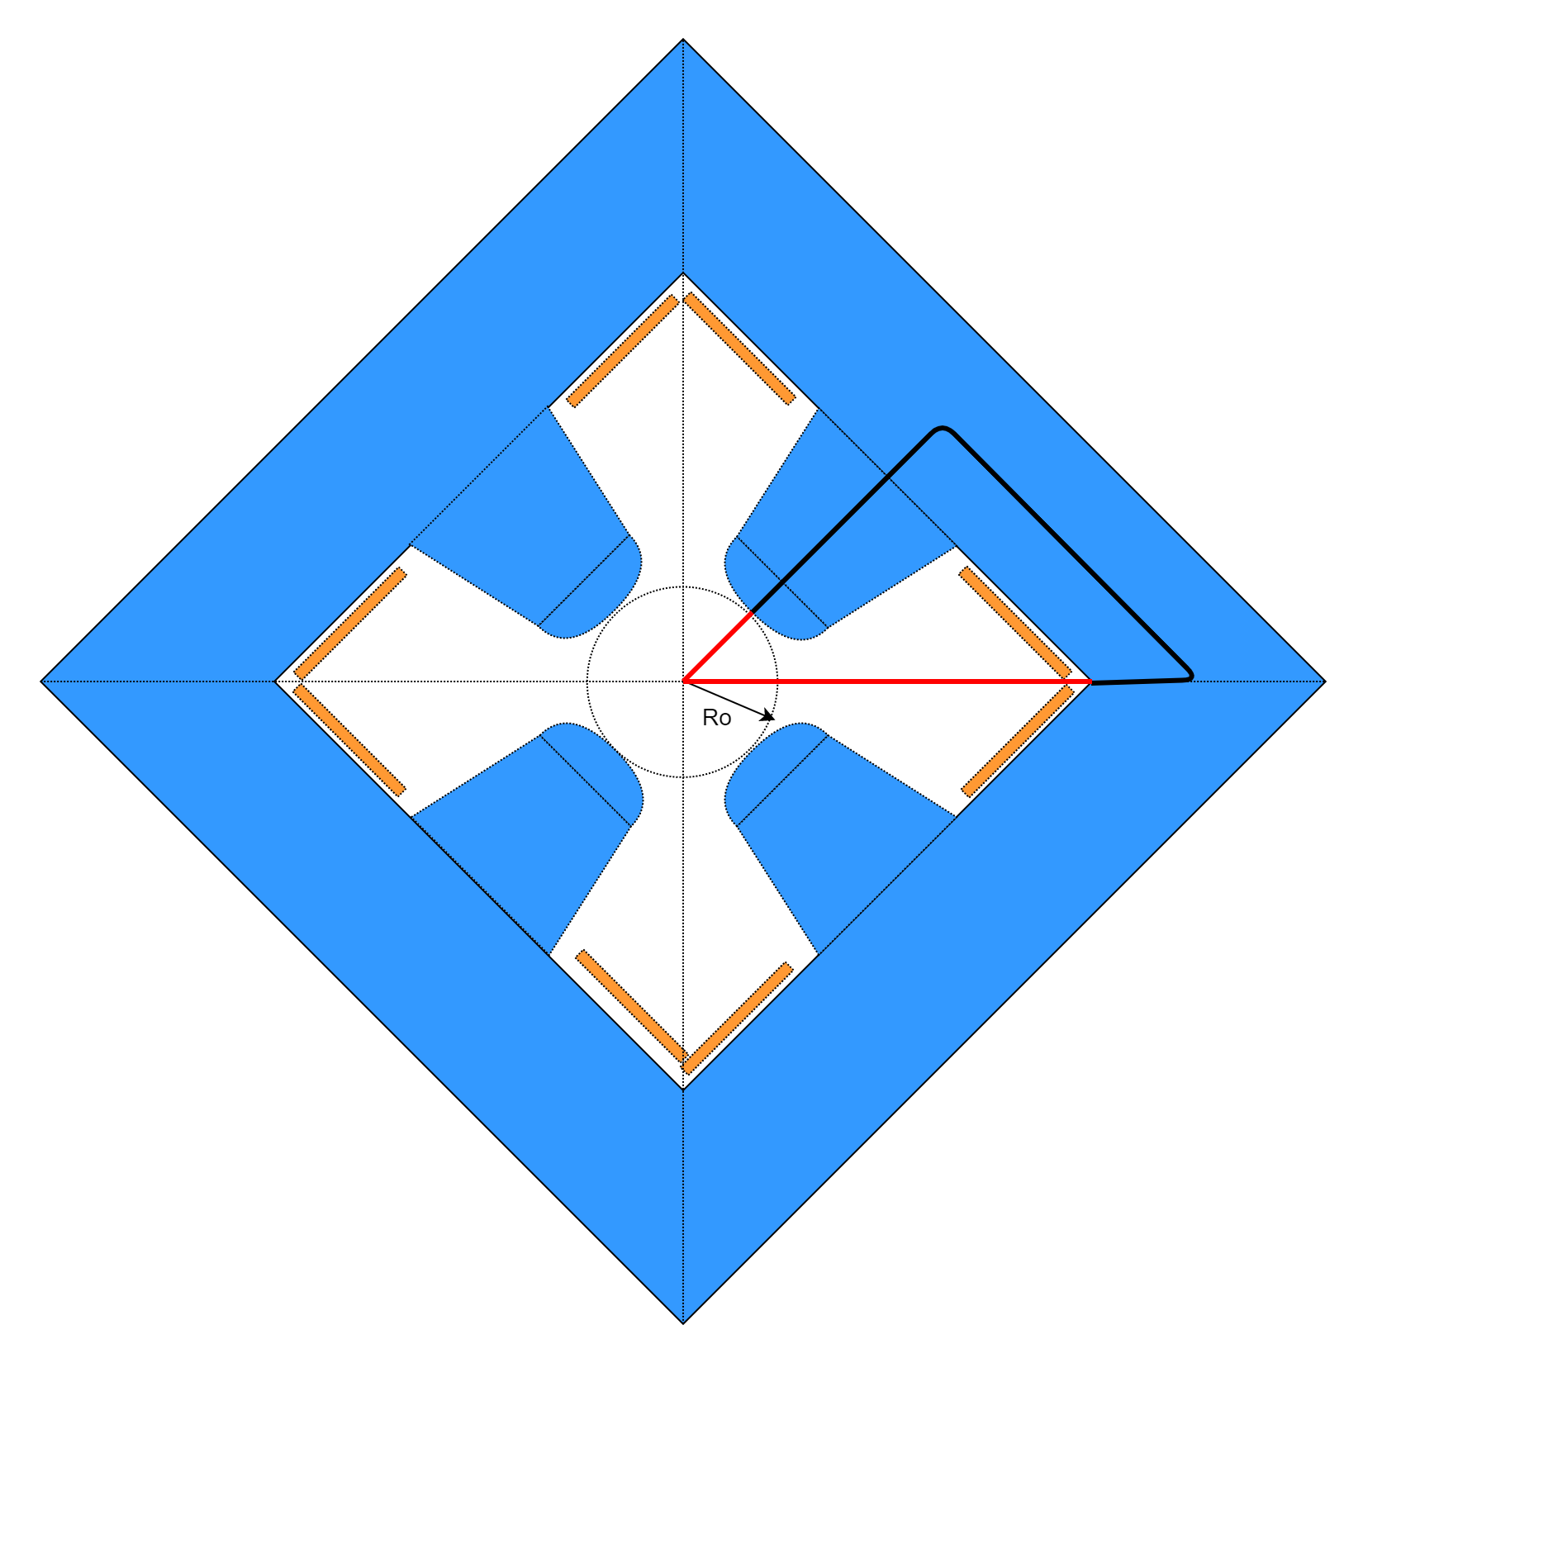


Task3 Resistive Magnets. Optimization Geometry/Material
Dipoles | MAP work dipole
Magnetic field in the airgap Bgap | 1.8 T
Max field in the gap saturated | 2.0 T
Magnetic field precision in good region | ~10⁻⁴ (not considered in the first analysis)
Airgap dimensions | 30x100 mm (hgap x wgap)
Quadrupoles | MAP work quadrupole
Magnetic field gradient in the airgap G | 30 T/m
Magnetic field precision in good region | ~10⁻³
Airgap dimensions Ro | 30mm
$$B_{gap}=\frac{μ_{o}∙N∙I}{h_{gap}}$$
$$G=\frac{{2∙μ}_{o}∙N∙I}{R_{o}^{2}}$$
UNIBO:
Analyze different topologies with different combination of electric steel types with the goal to minimize global energy content and losses and maximize the magnetic induction in the gap.
Poles:
FeCo (see next slide) steel
Low Si% steel
Grain Oriented steel
…?
Core:
High Si% steel

Slide 9

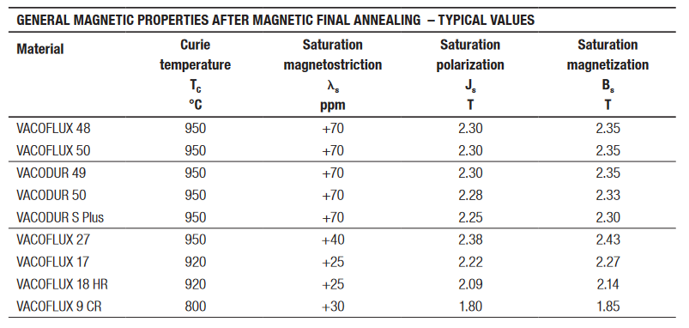
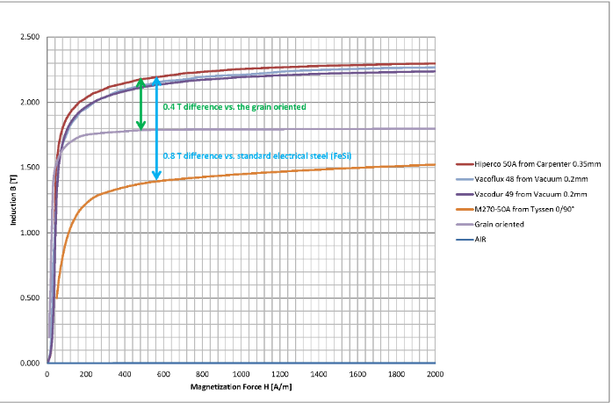
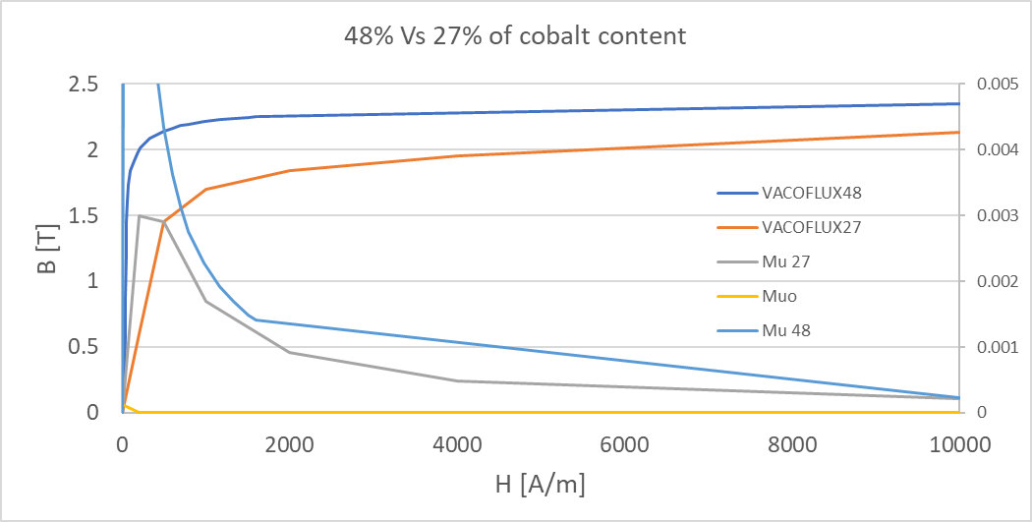
Task3 Resistive Magnets. FeCo utilization
High Co content steel allows higher induction values, but Co is highly activated by neutron radiation.
Typical recommendations are to reduce its content to few fraction of % in weight (HSE-RP guidelines on Cobalt content in stainless steel)
A study will be set up in 2023 to assess the impact on safety, but Co use should be limited. Avoid having it on the horizontal plane.
High Si? Steel for the rest (6%?) to limit losses
High Bsat steel in the poles
FeCo dipole magnet

Slide 10
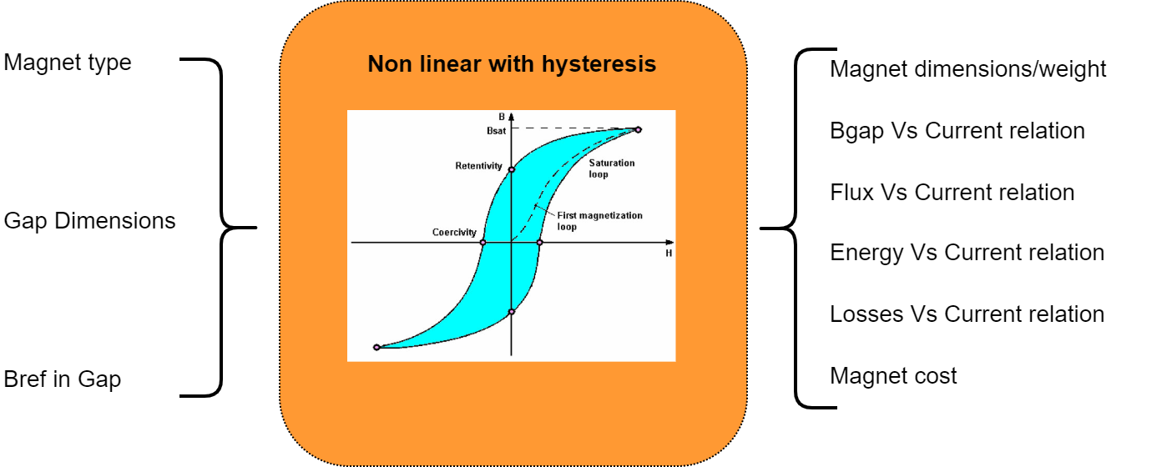
Task3 Resistive Magnets. Mathematical model
Models with different complexity.
For example Hysteresis models may be useful to study the effect of the AF in improving the uniformity of the magnetic field in the different sectors
Example of non linear model (no Hysteresis)
TUD:
Develop mathematical model of the magnets with nonlinearity and hysteresis included. The model will be used in conjunction with the power converter model to design the complete powering system.

Slide 11
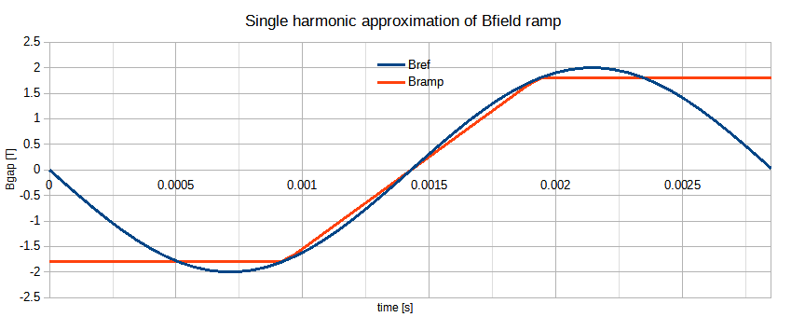
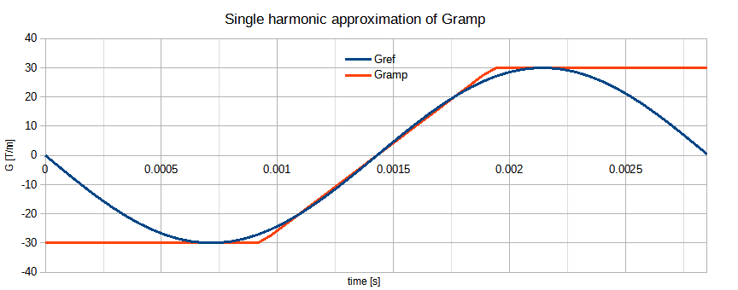


Task3 Resistive Magnets. Losses Model: calculation/measurement
Dipoles | MAP work dipole
Magnetic field in the airgap | 1.8 T
Max field in the gap saturated | 2.0 T
Magnetic field precision in good region | ~10⁻⁴ (not considered in the first analysis)
Airgap dimensions | 30x100 mm
Quadrupoles | MAP work quadrupole
Magnetic field gradient in the airgap G | 30 T/m
Max magnetic field gradient Gmax | 30 T/m
Magnetic field precision in good region | ~10⁻³
Airgap dimensions Ro | 30mm
$B_{gap}$= -$B_{max}∙\sin\left(2∙π∙f∙t\right)→B_{max}=2.0T;f=350Hz$;
$G$= -$G_{max}∙\sin\left(2∙π∙f∙t\right)→G_{max}=30T/m;f=350Hz$;
For losses calculations, we can use an equivalent single harmonic with Bmax/Gmax equal to max saturated field.
From the reference field/gradient we can calculate the desired current.
$$B_{gap}=\frac{μ_{o}∙N∙I}{h_{gap}}$$
$$G=\frac{{2∙μ}_{o}∙N∙I}{R_{o}^{2}}$$

Slide 12
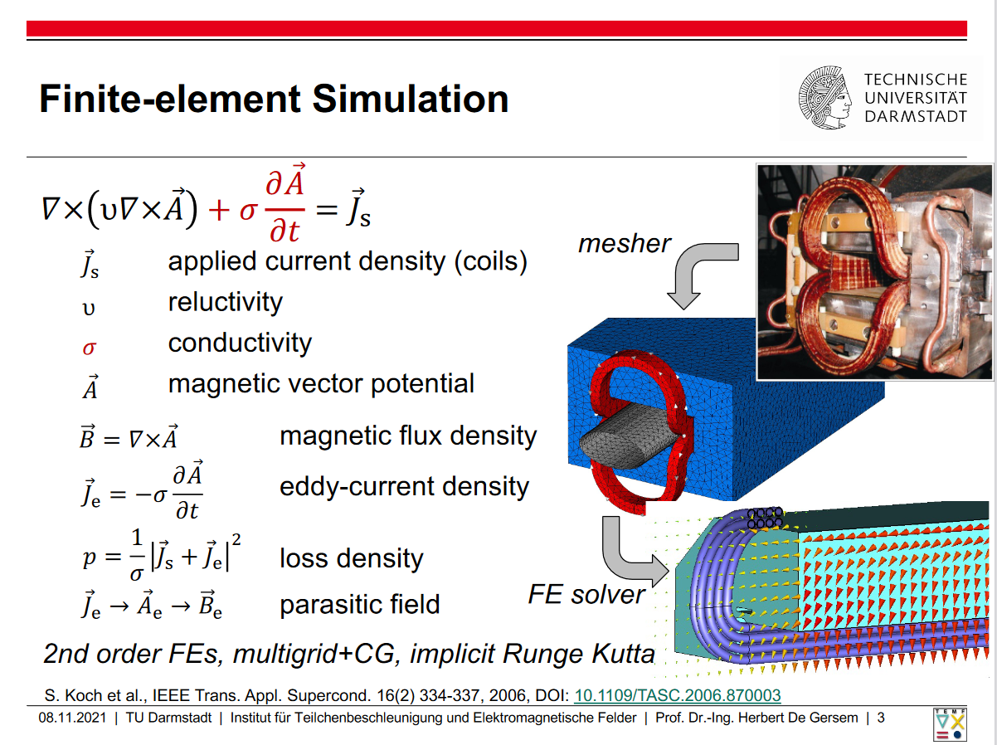
Task3 Resistive Magnets. Losses Model: calculation/measurement
FAIR SIS100 Superferric Dipole (NbTi) prototype (GSI Darmstadt) dB/dt=4T/s (DB=2T)
2D-3D time varying (low frequency) detailed modeling for losses computation of Dipoles/Quadrupoles selected topologies.
Effects of iron saturation on eddy currents and losses in general. Effects of end connections and plates on losses, magnetic length etc.. Effects of saturation on non magnetostatic B quality in the gap etc..
TUD:
Detailed losses computation and verification of selected design with 2D/3D models.
Proposal: Realize a small prototype for measuring magnetization and losses with real powering conditions.
Also useful for better evaluation of material costs.

Slide 13
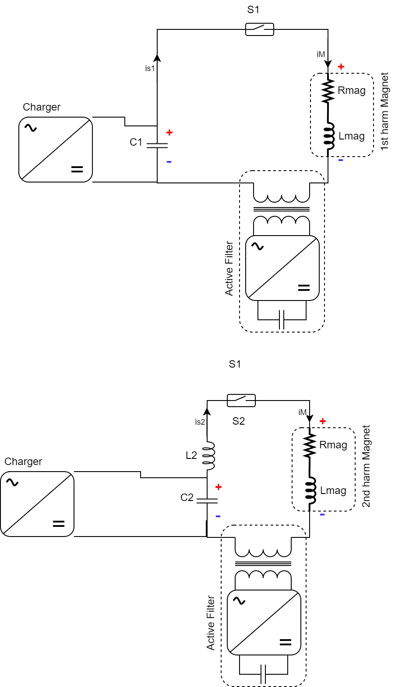
Task3 Resistive Magnets. Alternative approach.
Proposal: Shift from time sum to space sum of harmonics. An easier and cheaper powering system could be possible.
2nd harm Dipole
Sector
1st harm Dipole
sector
sector
sector
1st harm power converter
sector
sector
One or several magnets in series
2nd harm power converter
sector
sector
sector
CERN:
Brainstorm level idea should be developed with lattice and RF experts. Not in the official scope of the studies.
sector
sector
sector
sector
sector

Slide 14
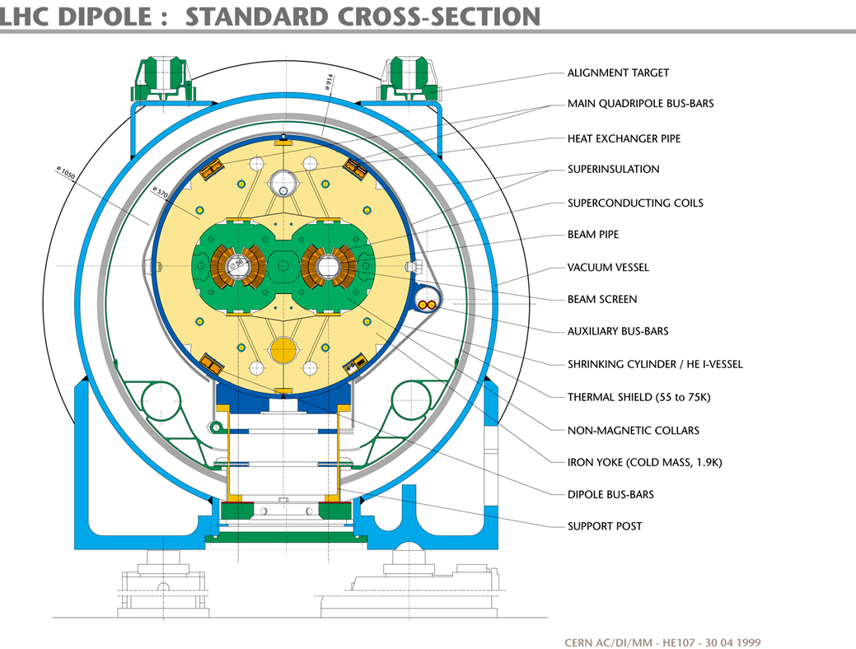
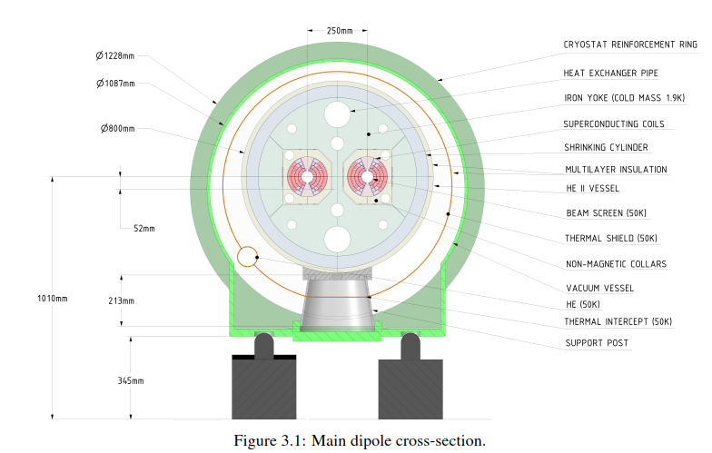
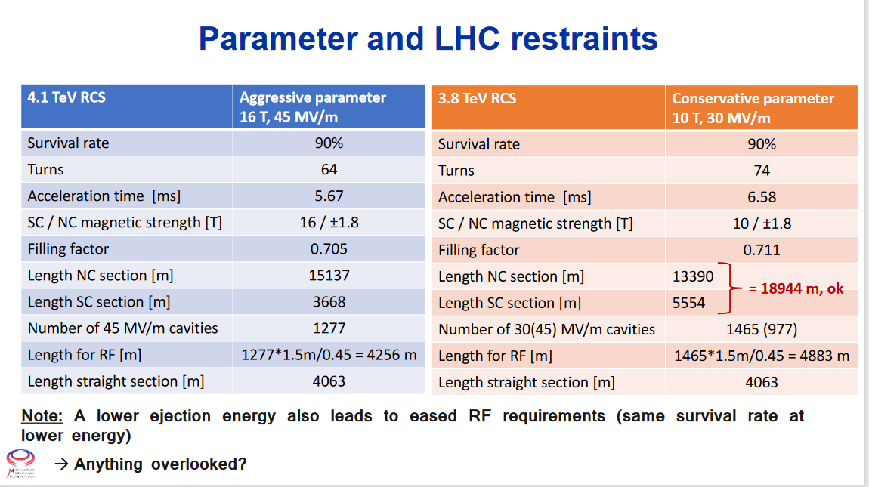
Task3: Superconducting magnets
LHC Dipole. Niobium-titanium, 8.33T, Ø56mm round gap
LCC Dipole. Nb3Sn, 16T, Ø50mm round gap
UNIBO:
Winding distribution, basic 2D simulation
10T not a lucky number?
Should we provide an “official” number for the studies?
13th meeting on HEMAC discussions

Slide 15
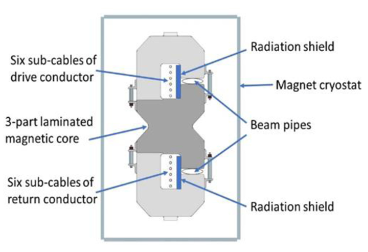
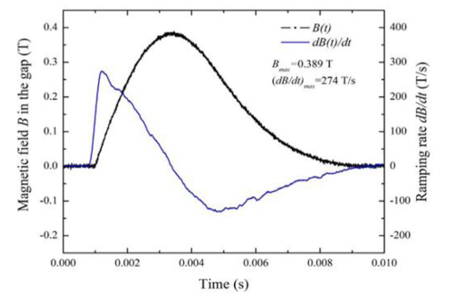
Task3 HTS with high dI/dt
A superferric prototype with HTS coils has been built and tested in Fermilab.
Tests proved a dB/dt of close to 300T/s which could be in the range of what requested for the last acceleration stage (see next slide)
UTWENTE:
Scoping studies for dB/dt application in then range of 300T/s and with DB of ±2T
Magnetic field is in the range of 0.4T

Slide 16
Task3. Conclusions
Power converter design and optimization (CERN / LNCMI)
Two harmonics circuit: role and design of AF in uniformization of the Bfield responses of each sector; Asynchronous switch of the two branches.
Alternative powering schemes
Capacitors limits testing
Design resistive magnets for pulsed operation (UNIBO)
Layout optimization of Dipoles/Quadrupoles with different mixed types of magnetic steel
Design resistive magnets for pulsed operation (TU Darmstadt)
Mathematical models (Matlab, Python…) including nonlinearity and/or hysteresis for design / simulation of the integrated accelerator powering system (and maybe for integrating all other technologies as well)
Advances 2D/3D low frequency transient analysis for detailed Losses model, effects of saturation, end plate/coils effects etc..
Design (conceptual) resistive magnets: separated dipols for first/second harmonics (CERN)
Development of the idea of spatial distribution of harmonics in the lattice.
Design SC dipoles for the accelerator (UNIBO)
Basic 2D design of the winding distribution / magnetic field / forces etc..
Alternative full SC (HTS) largest RCS realization (Uni Twente / Fermilab).
Scoping study based on future expected performances of HTS. Short report of few pages on the limits to foreseen.
TESTs (?)
Ageing tests of capacitors on reduced scale samples.
Magnetization and losses measurement in representative reduced scale model of the magnet.

Slide 17
Literature
[1] Hybrid rings of fixed 8T superconducting magnets and Iron magnets rapidly cycling between -2T and +2T for a Muon Collider https://arxiv.org/pdf/physics/0108001.pdf
[2] Quadrupole magnet for a rapid cycling synchrotron. https://inspirehep.net/files/ce341f3e4d3e5b4c5deac68a89782b9c
[4] Basic design and engineering of normal-conducting, iron-dominated electromagnets. TH. Zickler. https://cds.cern.ch/record/1334336/files/arXiv:1103.1119.pdf
[3] Iron Dominated Electromagnets Design, Fabrication, Assembly and Measurements. Jack Tanabe. https://www.slac.stanford.edu/pubs/slacreports/reports16/slac-r-754.pdf
[5] Design of accelerator magnets https://cds.cern.ch/record/865932/files/p118.pdf
[6] FeCo dipole magnet Conceptual Design Report https://edms.cern.ch/ui/file/1418866/2/InternalNote_2014_Tulip_Roberto_Lopez.pdf
[7] Record High Ramping Rates in HTS Based Superconducting Accelerator Magnet https://ieeexplore.ieee.org/stamp/stamp.jsp?tp=&arnumber=9712440
[8]Superconducting Fast-cycling Dipole Magnets For The Gsi Future Accelerator Facility https://accelconf.web.cern.ch/e02/PAPERS/MOPLE022.pdf

