Slide 1
Recombination chamber production Update for WP8
On behalf of TE-VSC J.Sestak
8th of November 2022

Slide 2
Content of the presentation
Documentation update
Quality assurance
Manufacturing strategy
Raw material & flanges
Preliminary welding plan
Qualification tests & Tooling
Foreseen schedule
Next steps

Slide 3
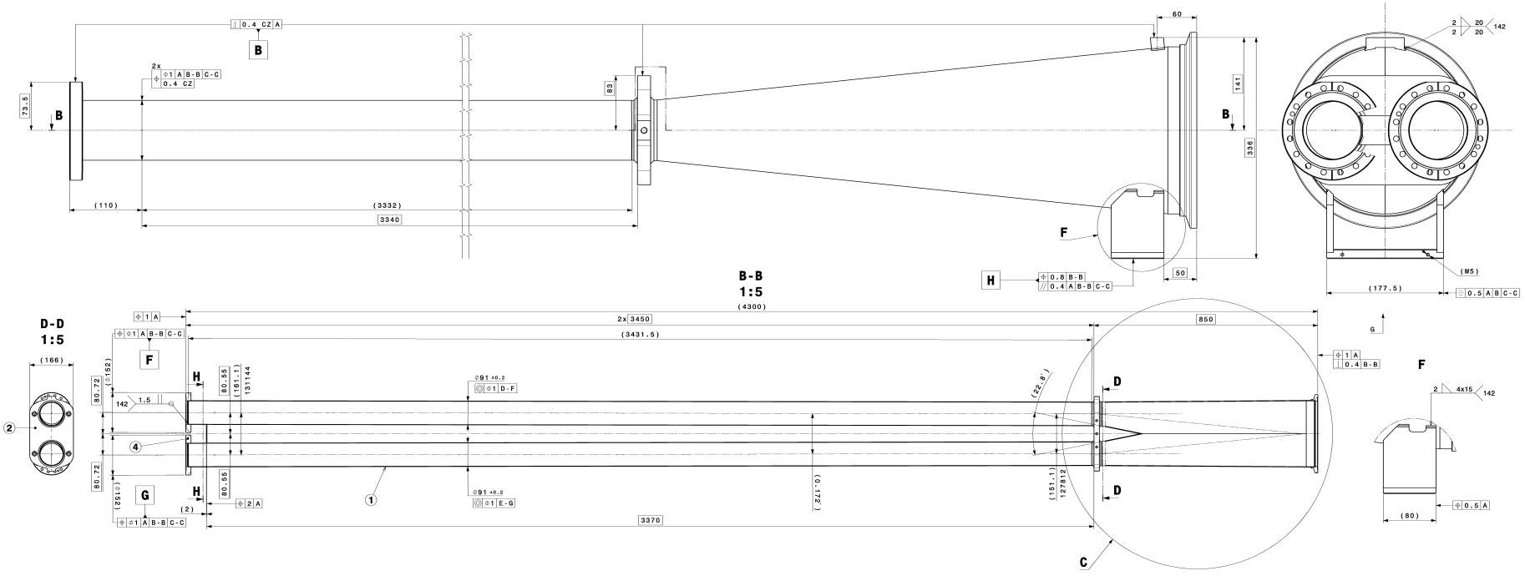
Documentation update
Master assembly LHCVCTYF0001 will be updated and released for production.

Slide 4
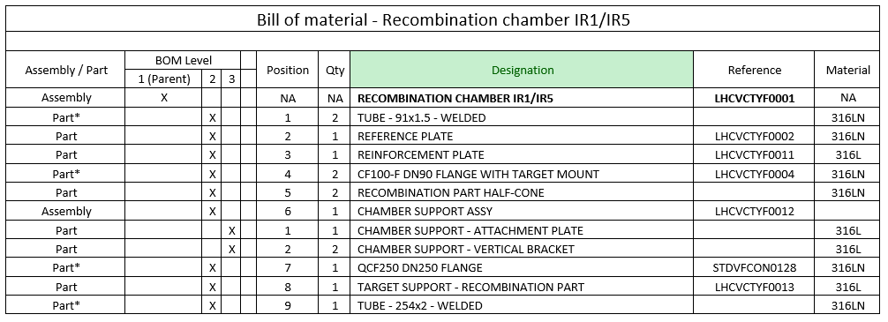
Documentation update
Reinstate the item status before the DOs.
Bill of Material corrections based corresponding production process (link with CRN code).
Minor changes (technological features, marking zones etc.) – Under Discussion.

Slide 5
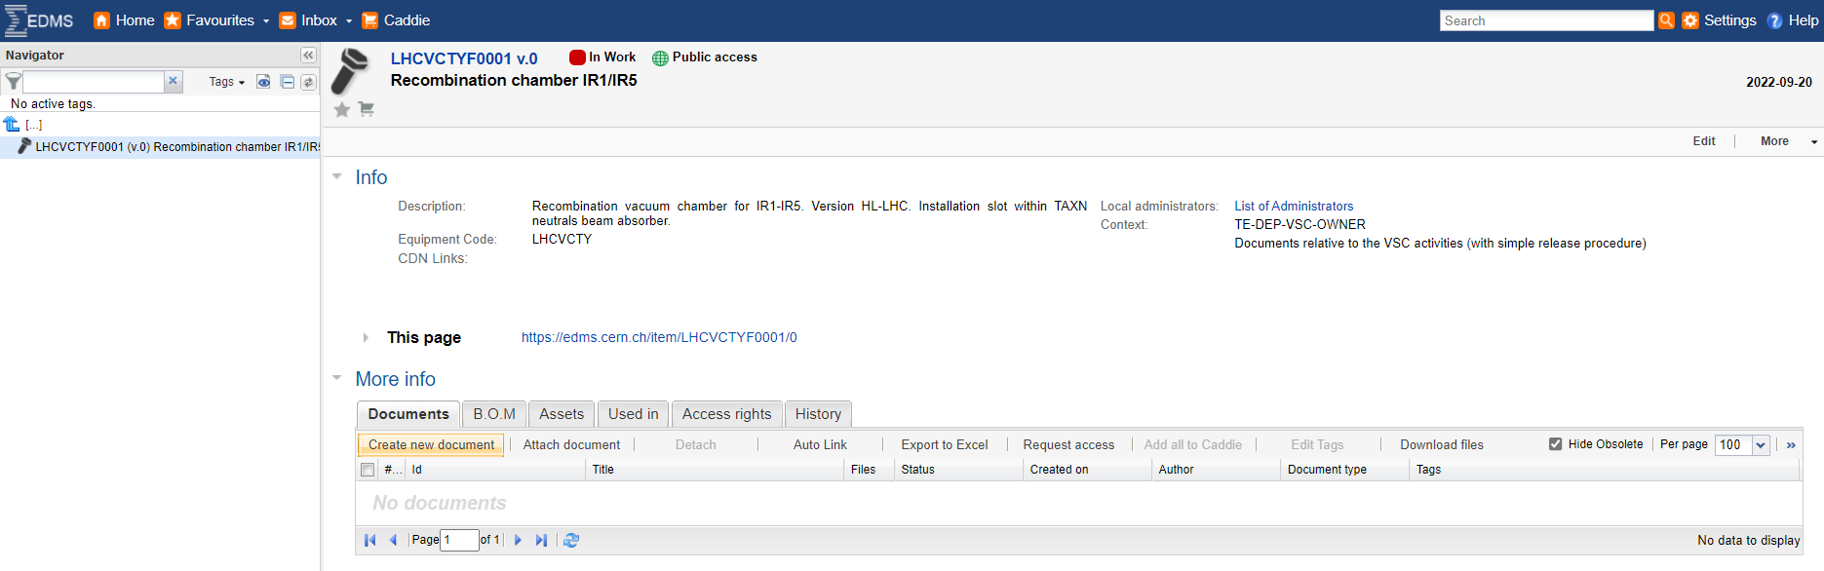
Quality assurance
ITEM LHCVCTYF0001 created to archive the specification & design file
Assets LHCVCTYF0001-CR000001 to LHCVCTYF0001-CR000005 (and qualification chamber) to be created once the production workflow is agreed between VSC & MME.

Slide 6
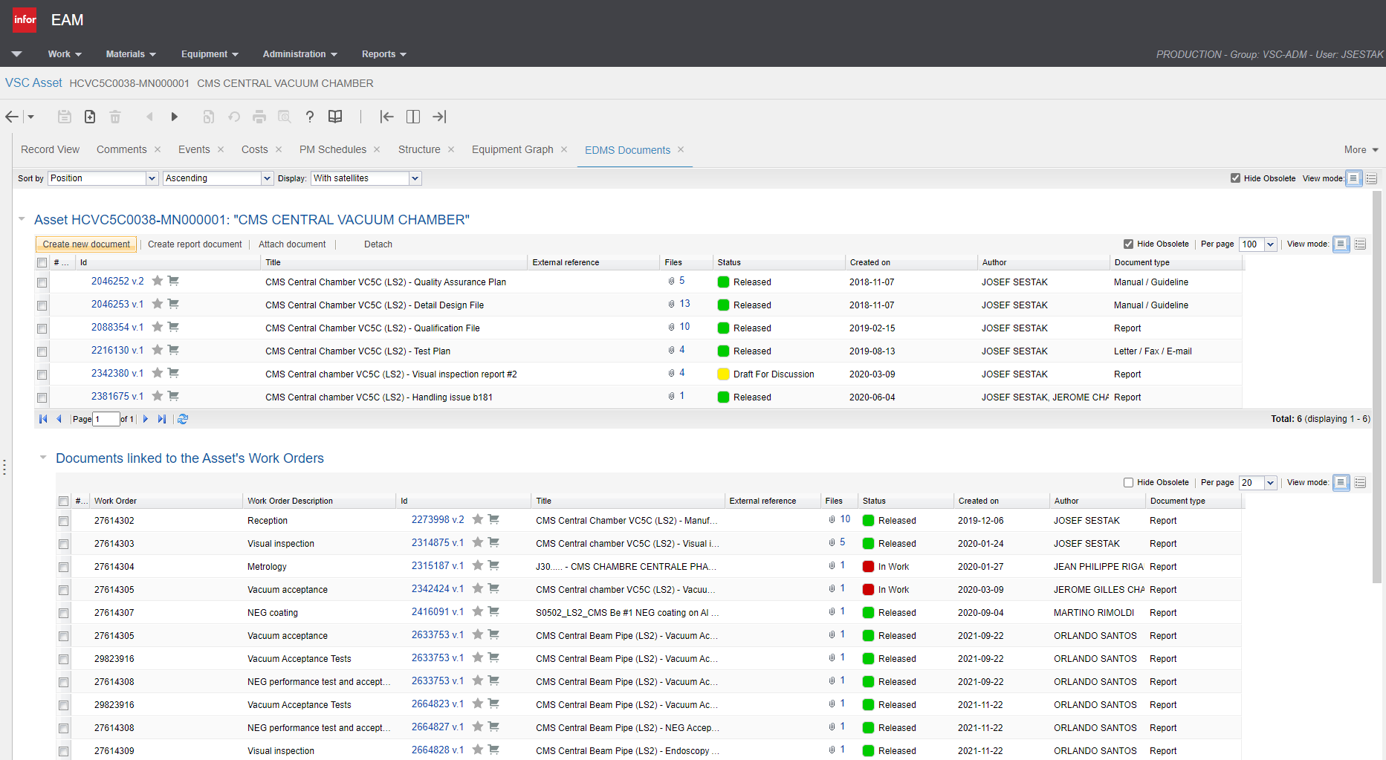
Quality assurance
Foreseen production tracking strategy via MTF & INFOR
To be recorded:
Raw material certificates
Raw material tests
Intermediate metrological inspections
Intermediate vacuum tests
X-rays inspections
Surface treatments protocols
Final metrology
Vacuum acceptance tests
….
Non-conformities

Slide 7
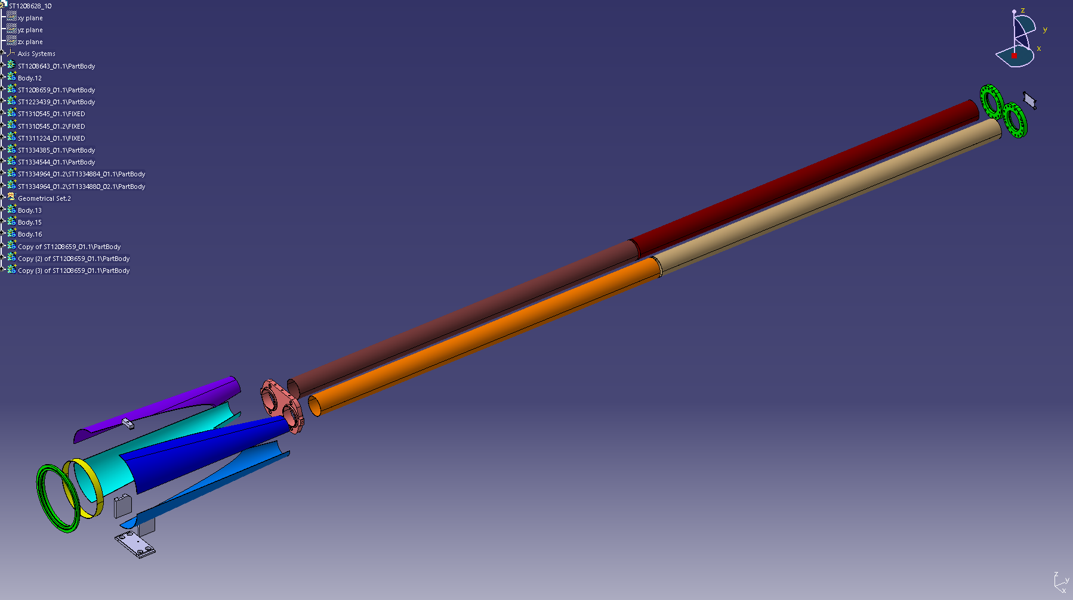
Manufacturing strategy
Non-parallel tubes
Rolled sheet;
Linear welded;
2pcs due to available raw material size.
Recombination part
Rolled sheet half-cones
Wire-cut
4pcs assembly
Bulk machined
Flanges
Reference plate
Support

Slide 8
Manufacturing strategy
Raw material & Flanges
Baseline is stainless steel 316LN for all vacuum components
To be vacuum fired according to procedure for NEG coated components.
Flanges (QCF250) to be made from 3D forged 316LN bulk.
Pros & Cons compared to 316L
Better mechanical characteristic.
Available vacuum specification EDMS 790774 (316L – we have no spec for sheets).
Less prone to material softening after firing.
Slightly higher price (Raw material for 6 chambers ≈ 20kCHF; 316L ≈ 15kCHF).
Non-vacuum components
May be both 316LN or 316L
Material order for 316LN placed

Slide 9
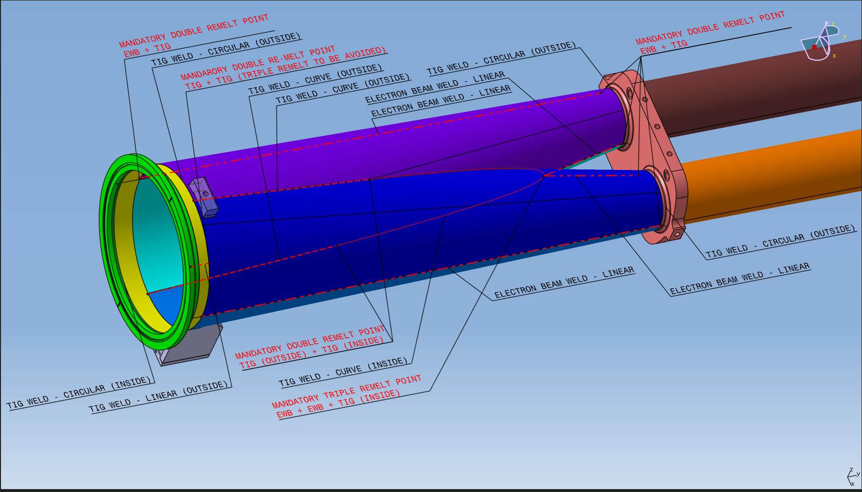
Manufacturing strategy
Preliminary welding plan

Slide 10
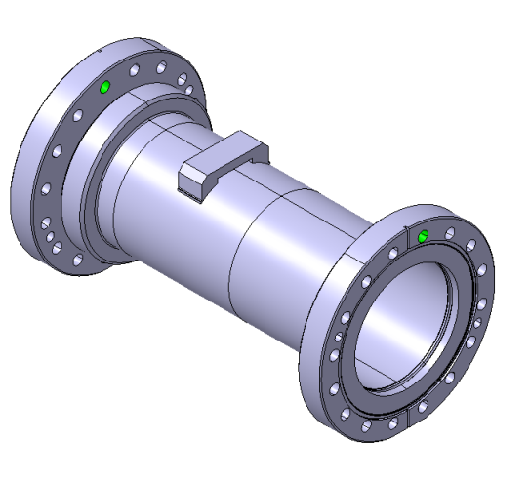
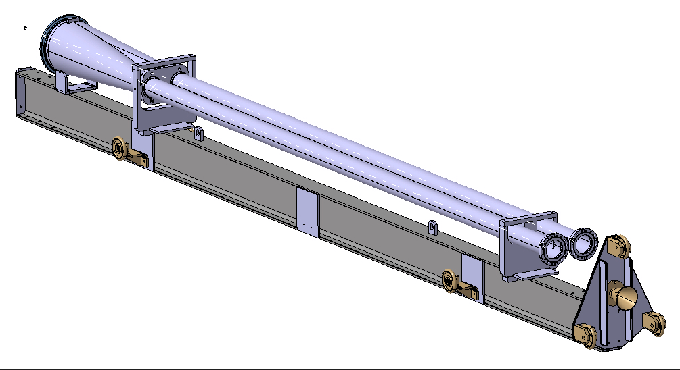
Qualification and tooling
Qualification tests – Under Discussion
Coupling welding methods, surface treatments to confirm adherence of the NEG coating.
Number and appearance of the qualification samples under discussion.
Tooling design under way
Handling, transport and processing support
All transitions needed for production and tests

Slide 11
Foreseen schedule
Job J3080459 RECOMBINATION CHAMBERS FOR HL-LHC
As agreed during the internalization of the activity:
1 x Recombination Chamber as demonstrator (SPARE) → Q2 2023
4 x Recombination Chambers (FOR INSTALLATION) → Q4 2024
Production will be continuous (no interruption after 1st chamber)
2 x Sample chambers for cleaning and NEG tests

Slide 12
Next steps
Documentation Release;
Confirmation of the Manufacturing Plan;
Start Quality Tracking (creating of the MTF assets);
Complete design of the tooling for production and processing;
Production of the 1st chamber starts by Q1-2023.

