Slide 1


RMM1a,b magnet
Assembly and test results of the RMM1a,b magnet, a CERN technology demonstrator towards Nb₃Sn ultimate performance
Emma Gautheron, Juan Carlos Perez, Susana Izquierdo Bermudez, Davide Tommasini, Hélène Felice, Michael Guinchard, Carlo Petrone, Gerard Willering, S. Mugnier, G. Campagna
24.10.2022 – Oral sessions – Nb3Sn Dipole Magnets – 1LOr1C-01

Slide 2
Content
RMM magnet program
Mechanical design and assembly
Powering tests

Slide 3
Context
Scope of the eRMC and RMM magnet program

Slide 4
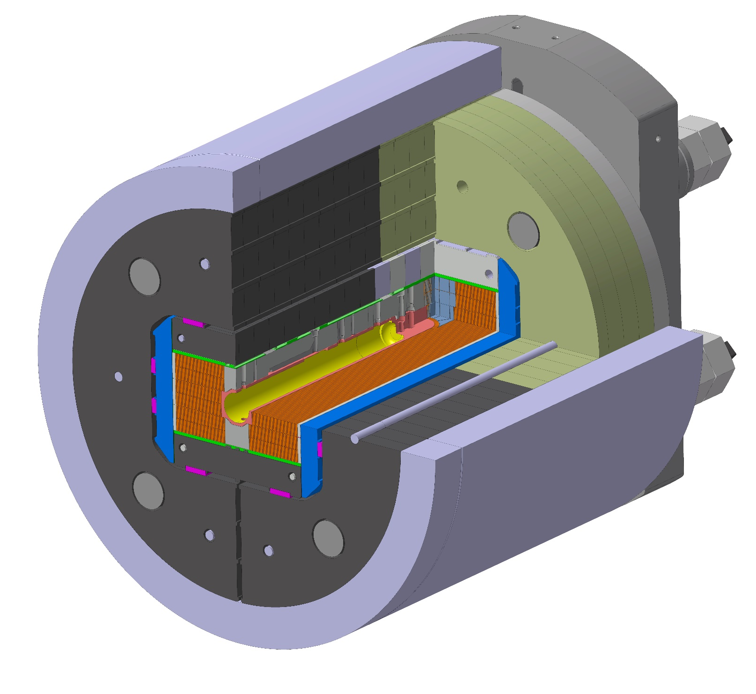
RMM: Racetrack Model Magnet
Explore the Nb₃Sn technology for high field accelerator magnets
RMM is a demonstrator:
    Nb₃Sn in high field (B_{target} > 16 T)
    Mechanical preload study
    Close cavity Ø 50 mm
  Towards Nb₃Sn ultimate performance:
    Conductor type HL-LHC
    B_{short sample} = 18.8 T at 1.9 K
    RMM1b reached 16.7 T Bp (88 % of SS)
L_{cavity_tot} = 526 mm
L_{cavity_D50} = 431 mm

Slide 5
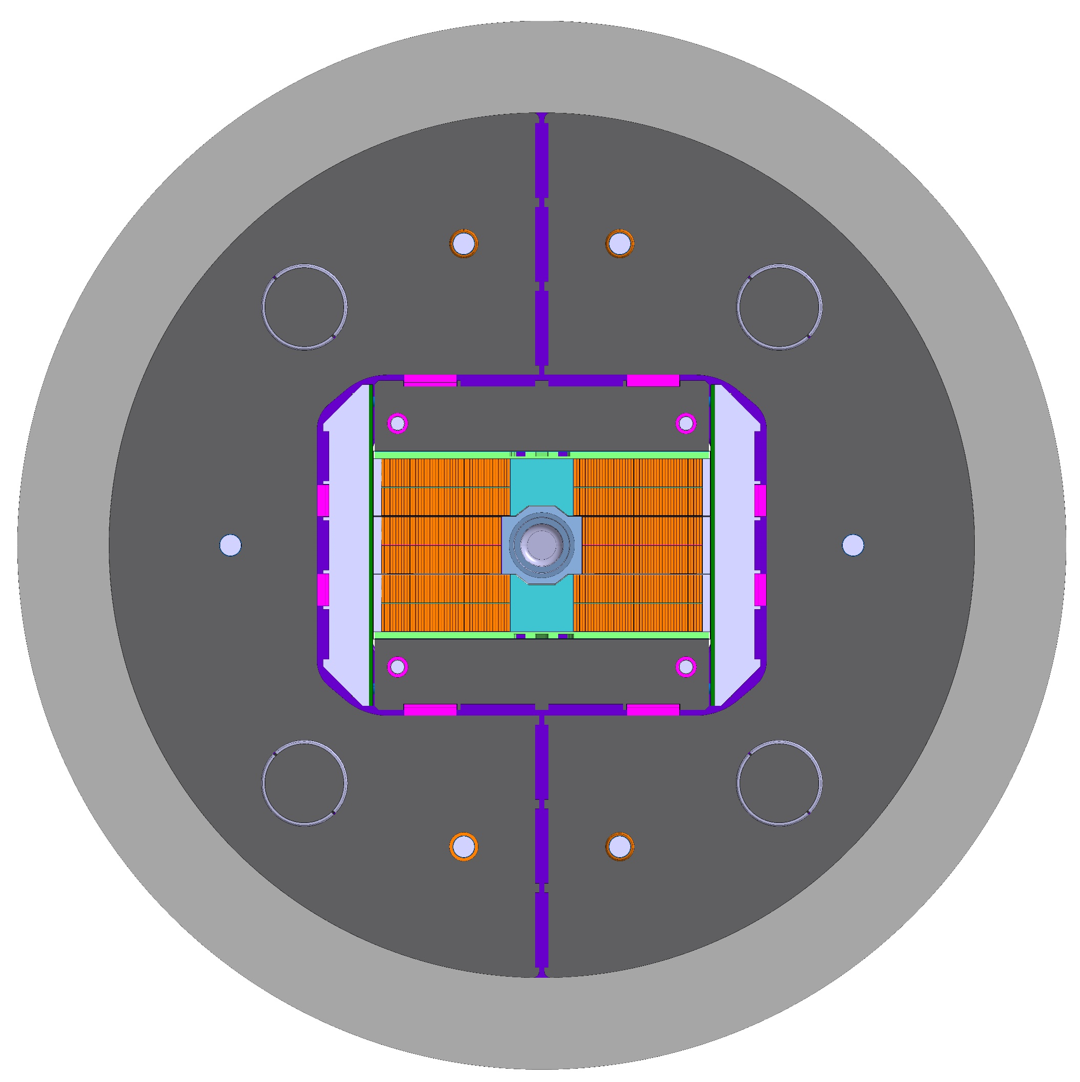
RMM: a big dipole magnet
Courtesy of E. Todesco
Relatively large coil width with low current density
Notes:
Ezio’s comments:
The line of 450 A/mm² corresponds to the case of an ironless magnet – therefore it is there just to guide the eye and give an order of magnitude
If a magnet sits on the 450 A/mm² line, it does not mean that this is its actual overall current density as the presence of iron reduces the current
In some magnets, grading is used, so for instance in the LHC dipole inner layer is at 360 A/mm² and outer layer is at 440 A/mm² – obviously this complexity is not visible in the plot

Slide 6
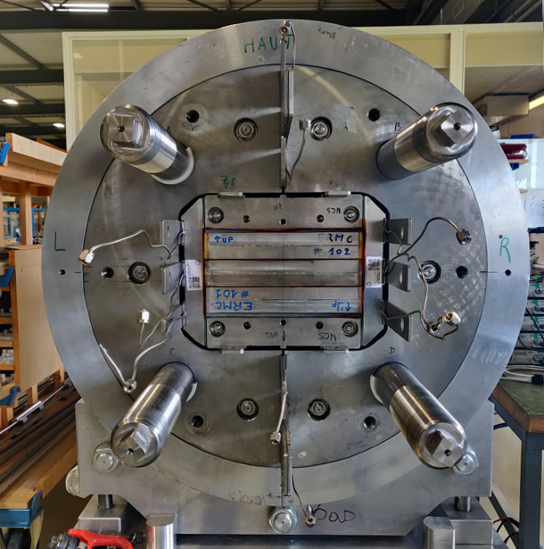
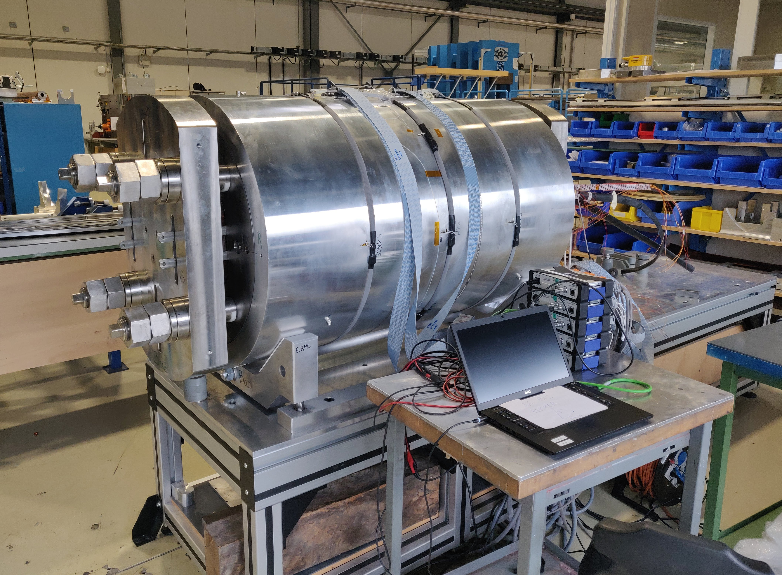
RMM: a big dipole magnet
0.8 m
1.2 m

Slide 7

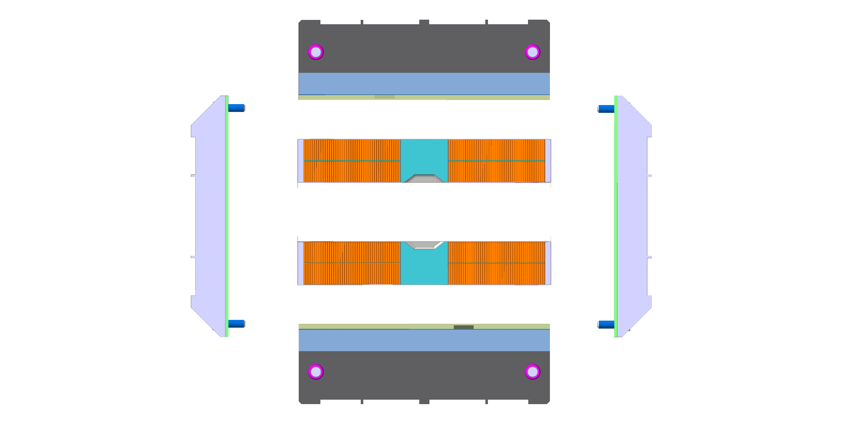
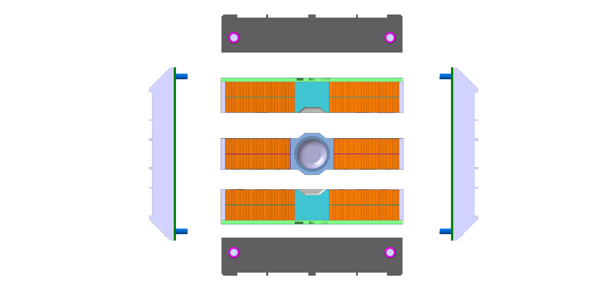
RMM: part of a more global strategy
Racetrack Coils
Racetrack Coils
with Cavity
Racetrack Coils
with Cavity
and Flared ends
→ eRMC magnet
→ RMM magnet
→ DEMO magnet (?)

Slide 8
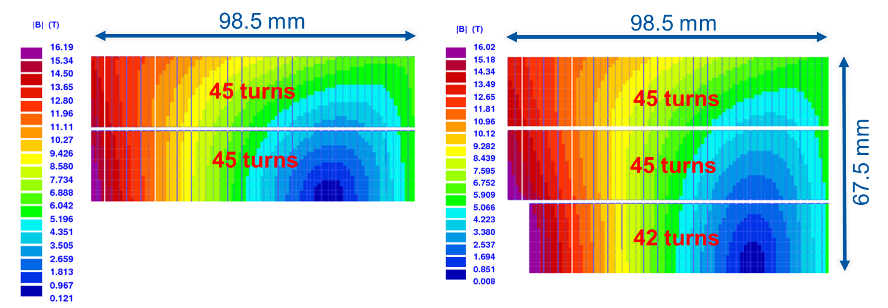
Magnetic design RMM
13.6 kA
18.8 T
12.3 kA
17.1 T
1 mm diameter wire, Cu/Sc ~ 1
40-strand Rutherford cable
eRMC pole in magnetic stainless steel ST 430
Bp/Bo ~ 1
R_{coil aperture} = 31 mm
3D design [6] : Peak field in the straight section

Slide 9
Mechanical Design and Assembly
Targets for pre-load, Fuji tests and final assemblies into RMM1a & RMM1b

Slide 10
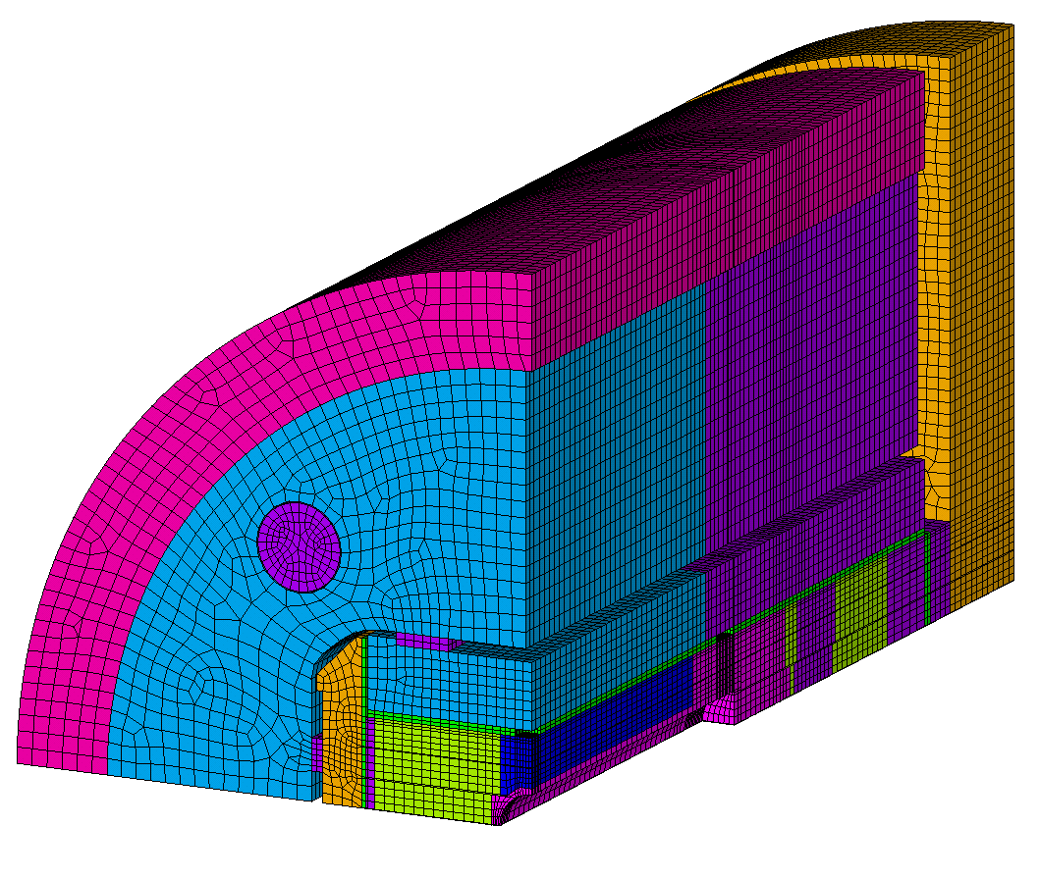
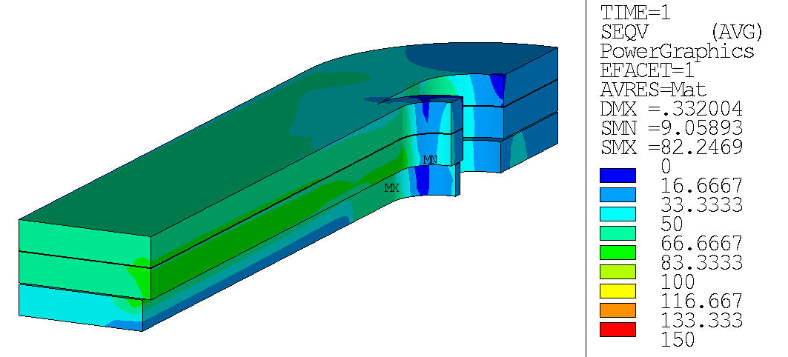
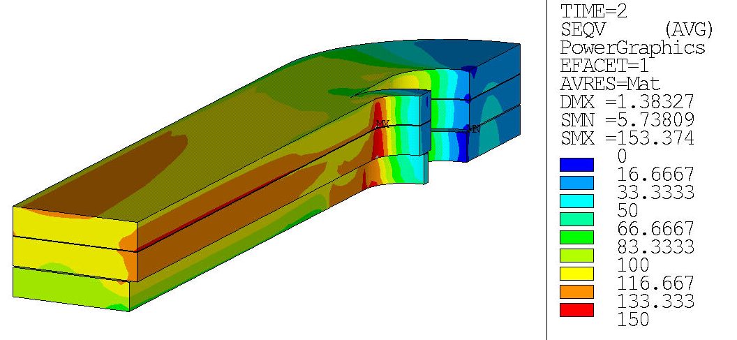
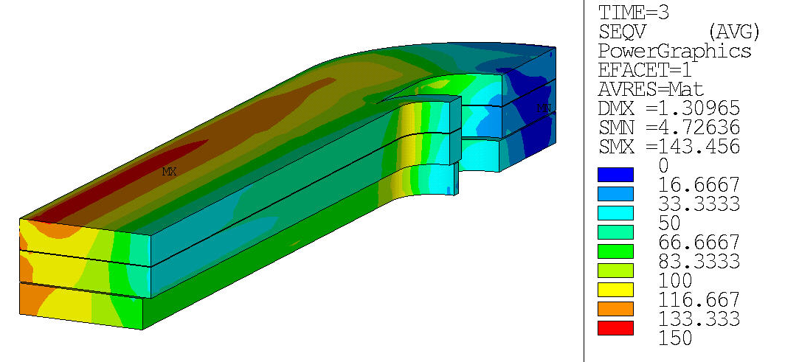
Mechanical design RMM
ANSYS APDL 3D Finite Element Model
Preload target: powering at 11.8 kA – i.e. 16.5 T Bp and 16.3 T Bo
  Preload strategy:
    Transverse: Small coil-pole detachment at powering
    Axial: 80 % of the Lorentz forces in the rods at cold
Upper stress limit: 150 MPa Von Mises in the coil blocks
RT preload:
Cold:
Powering:
Coil VM stress: 82 MPa max
Coil-Pole transverse pressure: 20 MPa min
Coil VM stress: 153 MPa max
Coil-Pole transverse pressure: 65 MPa min
Coil VM stress: 143 MPa max
Coil-Pole transverse pressure: 10 MPa min

Slide 11
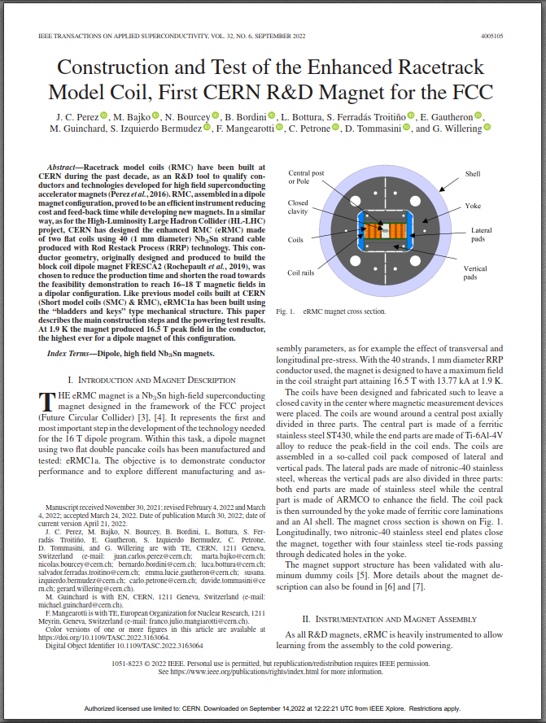
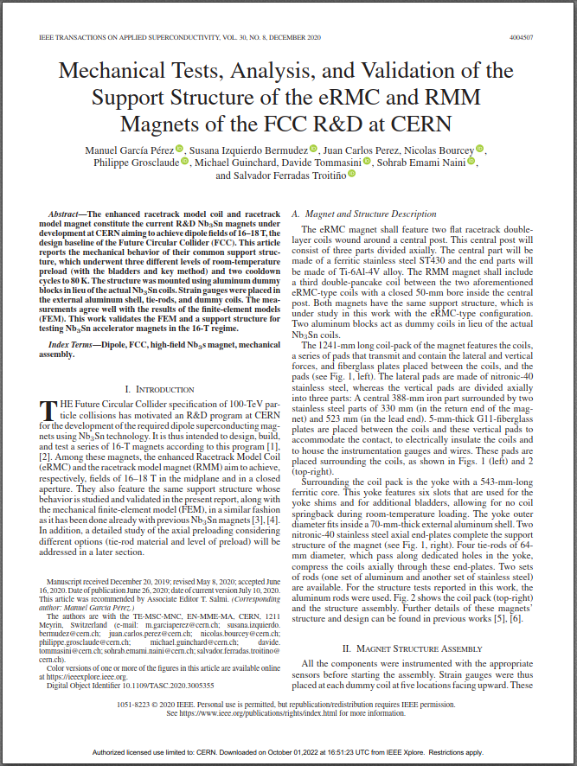
Summary of assembly iterations
Dummy assembly
Characterization of the mechanical structure
Aluminum coils
RMM1a
Coil pack & contact optimization
Fuji assemblies at half lateral preload & shimming fine-tuning
→ 16.6 T Bp at 1.9 K
RMM1b
Longitudinal re-assembly
Machining of the rods & reduction of the longitudinal preload target
→ 16.7 T Bp at 1.9 K
eRMC1a
Coil pack & contact optimization
Coil rails’ machining & lateral coil shimming
→ 16.5 T Bp at 1.9 K
2019-2020 [8]
2022
2018-2019 [7]
2021

Slide 12
Summary of assembly iterations
Dummy assembly
Characterization of the mechanical structure
Aluminum coils
(2018-2019)
RMM1a
Coil pack & contact optimization
Fuji assemblies at half lateral preload & shimming fine-tuning
(2021)
RMM1b
Longitudinal re-assembly
Machining of the rods & reduction of the longitudinal preload target
(2022)
eRMC1a
Coil pack & contact optimization
Coil rails’ machining & lateral coil shimming
(2019-2020)

Slide 13
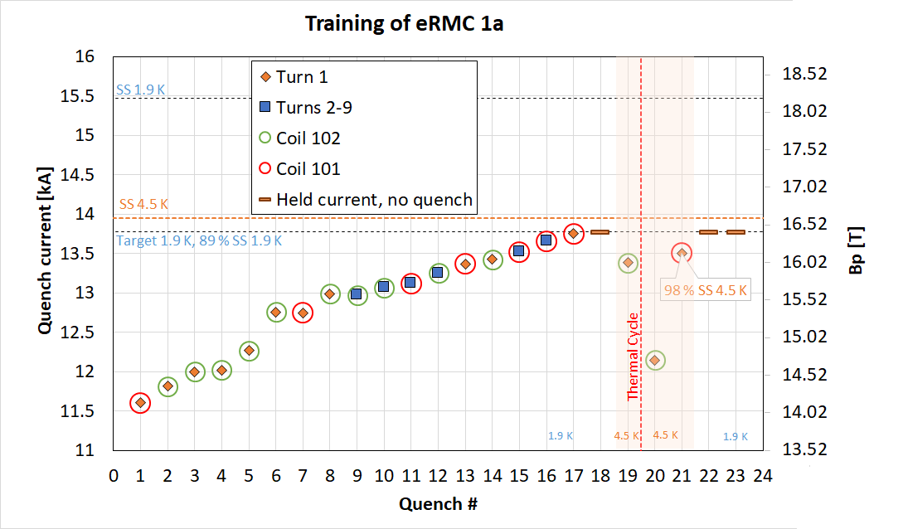
Reminder – eRMC1a performance
Reusing the 2 eRMC coils for the RMM magnet:
102
eRMC1a
101
20 A/s
eRMC 102
RMM
eRMC 101
Courtesy of S. Ferradas Troitino
RMM1a,b

Slide 14
Summary of assembly iterations
Dummy assembly
Characterization of the mechanical structure
Aluminum coils
(2018-2019)
RMM1a
Coil pack & contact optimization
Fuji assemblies at half lateral preload & shimming fine-tuning
(2021)
RMM1b
Longitudinal re-assembly
Machining of the rods & reduction of the longitudinal preload target
(2022)
eRMC1a
Coil pack & contact optimization
Coil rails’ machining & lateral coil shimming
(2019-2020)

Slide 15
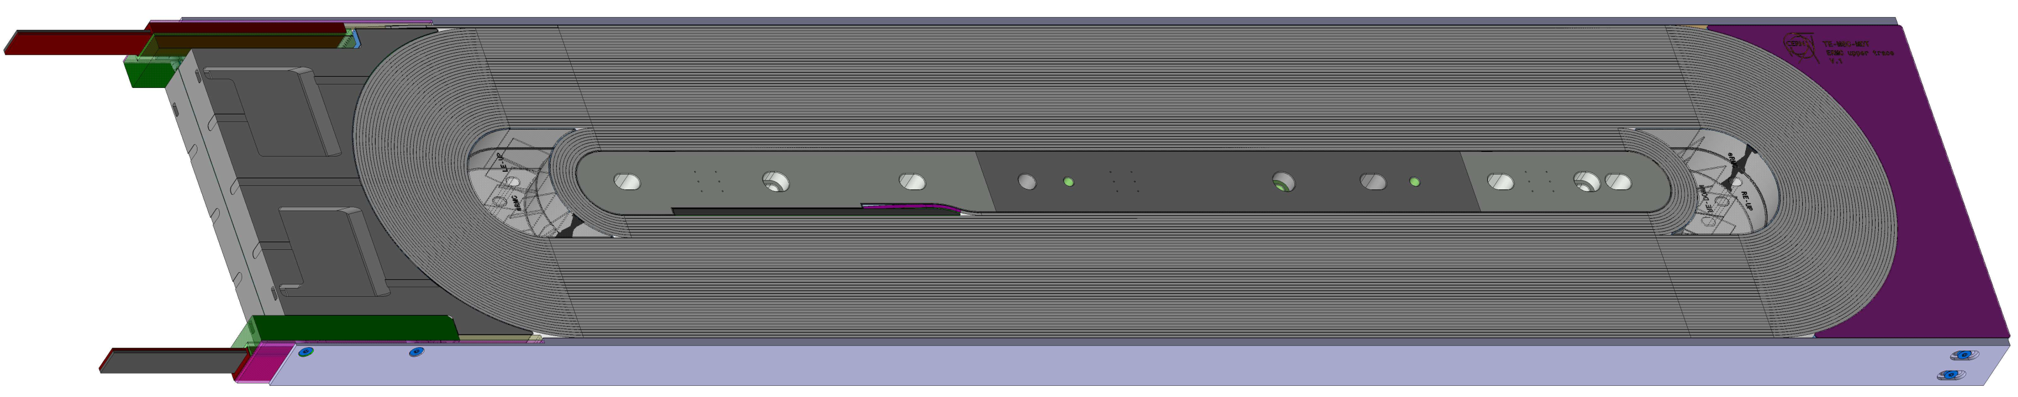
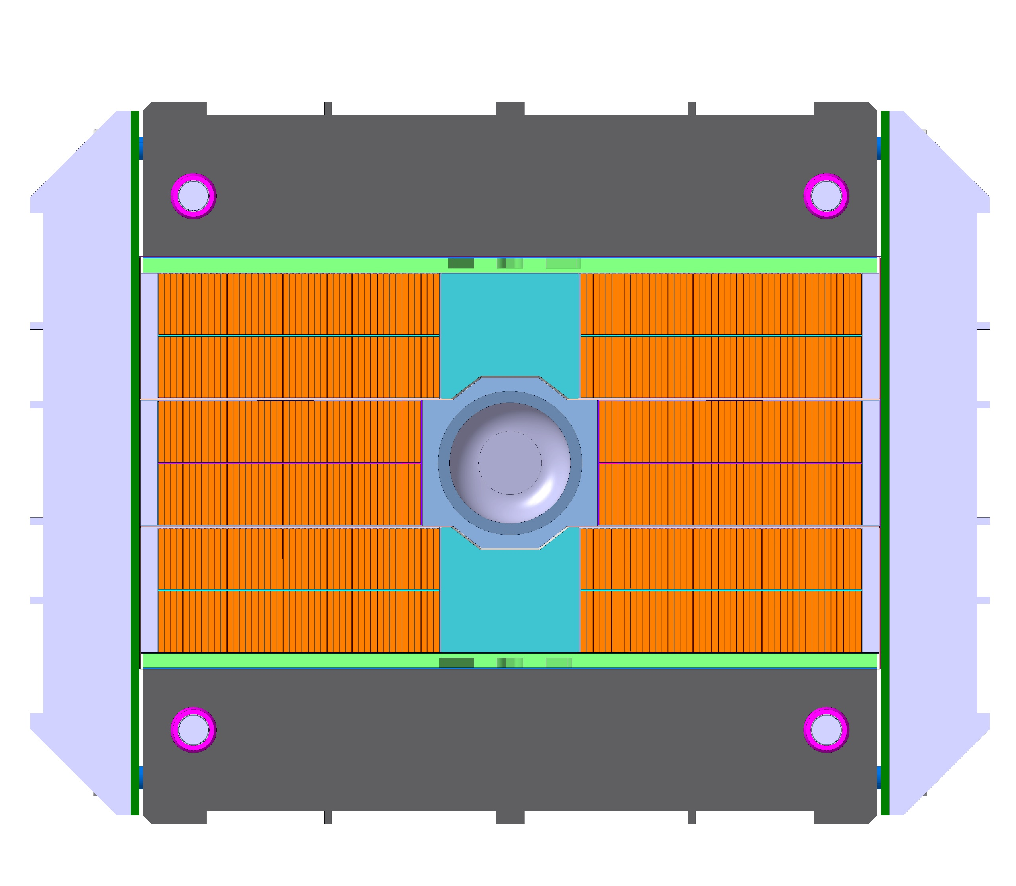
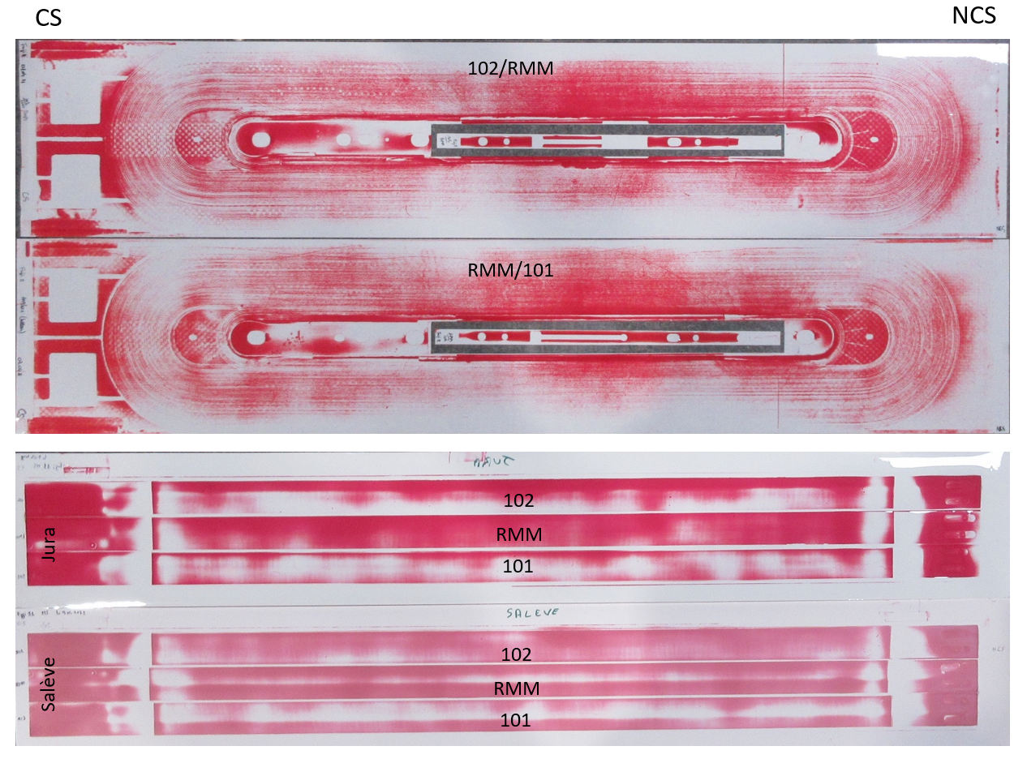
Coil pack – Contact optimization
Machining of the coil rails:
eRMC coils’ width reduced by 50 um after cold (SS)
RMM coil machined to their average width
→ all coils within 50-100 um in width in the straight section
Coil rail
Fuji tests & shimming optimization:
Pole-to-pole contact
  → fine-tuned shims
Transverse preload uniform on the coil straight sections
  eRMC coils: +150 um on each side
  RMM coil: +100 on each side
Notes:
+ based on Faro arm measurements

Slide 16
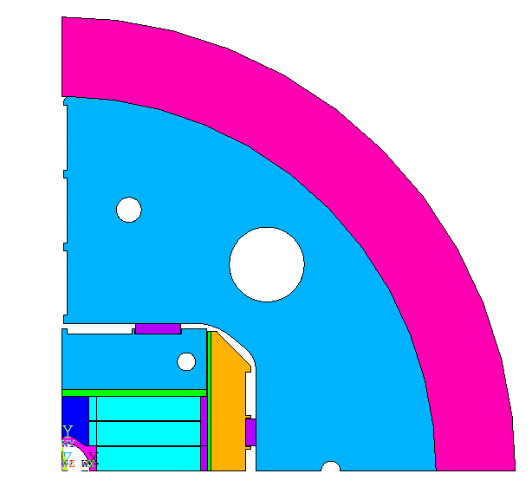
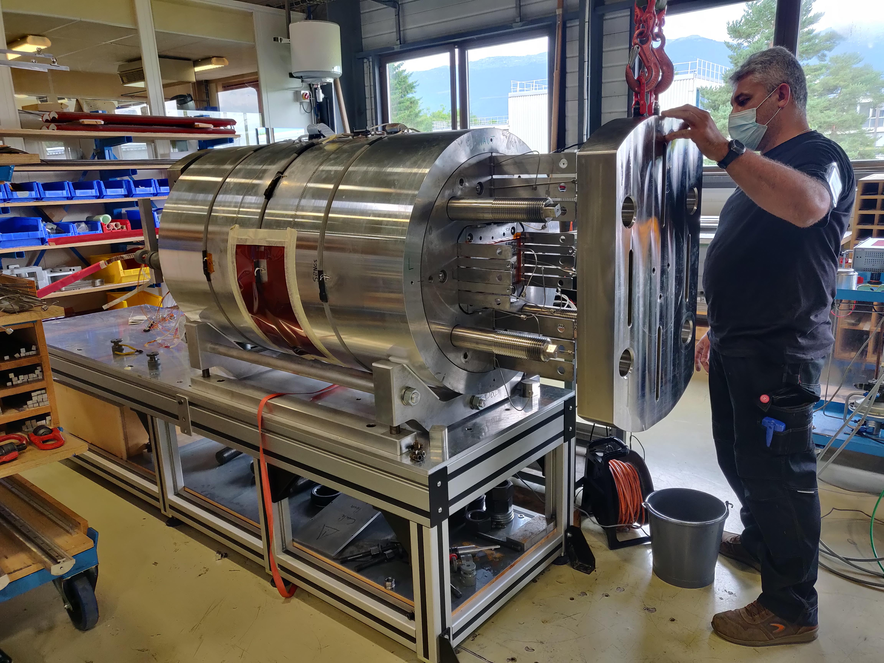
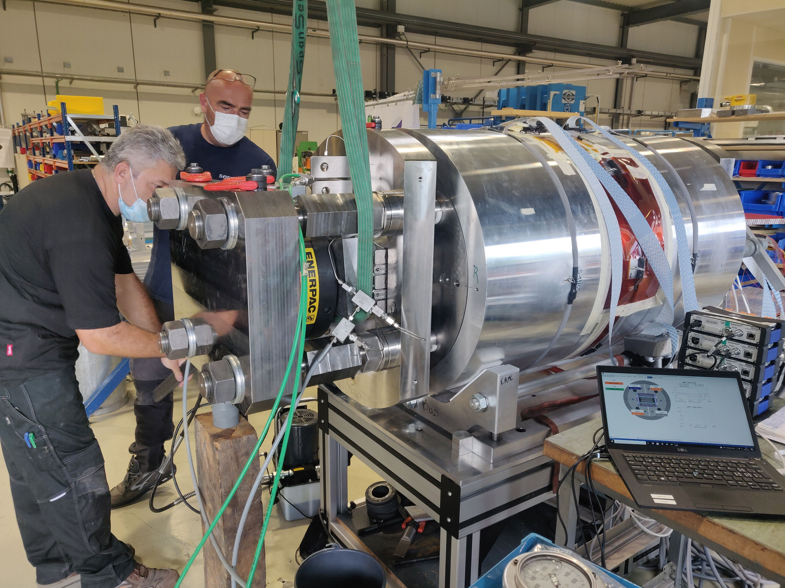
Preloading of the coil pack
Bladders
Bladders & Keys – RT preload driven by the monitored strain on shell midplane / on rod

Slide 17
Preloading of the coil pack
Bladders
Bladders & Keys – RT preload driven by the monitored strain on shell midplane / on rod
At cold: magnet less preloaded than expected & asymmetry in the rods
→ Transverse:
→ Axial:
Room temperature (RT)
1.9 K
RT
1.9 K
Measured
77 % of L.F.
Final RT preload step
D+1
D+4
cryostat
1.9 K
Following steps
D+4
1.9 K
RT preload
cryostat

Slide 18
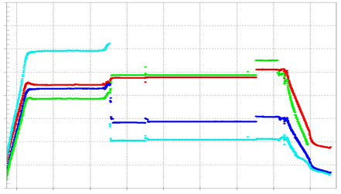
Rods’ behavior – during cool down
Observations during cool down:
Asymmetry of traction strain
Jumps in the rod strain gauges’ signals
→ Interference between rods and yoke at this level of transverse interference
RA
RB
900
RA_Z
RB_Z
RC_Z
RD_Z
Cooldown – RMM1a
Warm-up
800
Rods εz [um/m]
700
RC
RD
600
500
Tue 23
Thu 25
Sat 27
Mon 29
Wed 1
Nov 2021
Courtesy of S. Mugnier

Slide 19
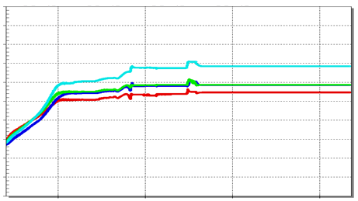
Rods’ behavior – during cool down
Observations during cool down:
Asymmetry of traction strain
Jumps in the rod strain gauges’ signals
→ Mechanical iteration: RMM1b
Machining of the rods (from Ø64 to 60 mm)
Longitudinal reassembly only
New axial target of 70 % of LF at cold
Courtesy of G. Campagna for the calculations
→ Interference between rods and yoke at this level of transverse interference
900
RA_Z
RB_Z
RC_Z
RD_Z
900
RA_Z
RB_Z
RC_Z
RD_Z
Cooldown – RMM1a
Warm-up
Cooldown – RMM1b
800
800
Rods εz [um/m]
Rods εz [um/m]
700
700
600
600
500
Tue 23
Thu 25
Sat 27
Mon 29
Wed 1
500
Sun 21
Fri 19
Nov 2021
Courtesy of S. Mugnier
Courtesy of S. Mugnier
Aug 2022

Slide 20
Summary of assembly iterations
Dummy assembly
Characterization of the mechanical structure
Aluminum coils
(2018-2019)
RMM1a
Coil pack & contact optimization
Fuji assemblies at half lateral preload & shimming fine-tuning
(2021)
RMM1b
Longitudinal re-assembly
Machining of the rods & reduction of the longitudinal preload target
(2022)
eRMC1a
Coil pack & contact optimization
Coil rails’ machining & lateral coil shimming
(2019-2020)

Slide 21
Powering Tests at Cold
Training, magnetic and mechanical performance, RMM1a & RMM1b

Slide 22
Training at 1.9 K
Precursors in quenches
No sign of degradation in the V-I measurements
16.6 T Bp (87 % SS)
16.7 T Bp (88 % SS)
4.5 K
4.5 K
16.0 T Bp (93 % SS)
16.2 T Bp (94 % SS)
15.4 T Bp (80 % SS)
16.1 T Bp (84 % SS)
Courtesy of G. Willering & C. Bockstiegel

Slide 23
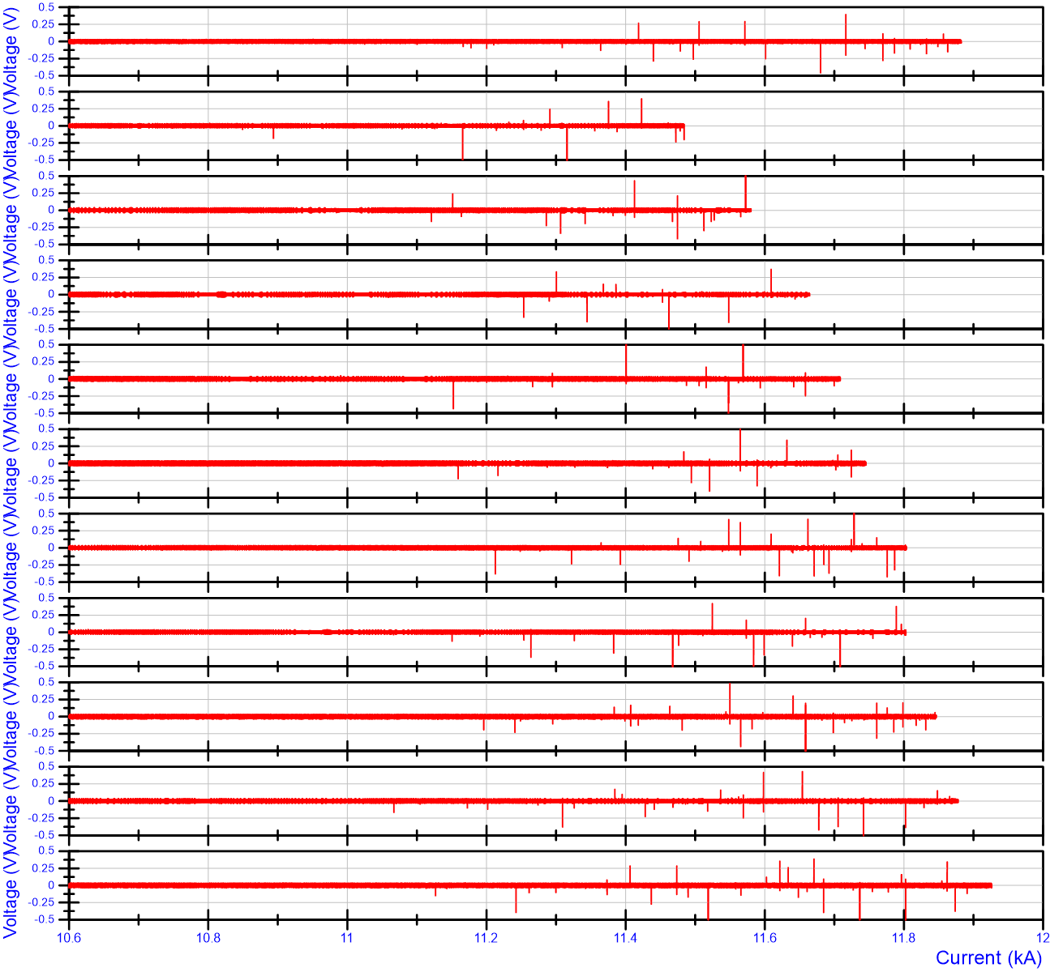
Voltage spikes during current ramps
RMM1a – last ramp at 1.9 K
RMM1b – ramp 1
RMM1b – ramp 2
RMM1b – ramp 3
RMM1b – ramp 4
RMM1b – ramp 5
RMM1b – ramp 6
RMM1b – ramp 7
RMM1b – ramp 8
Spikes starting from 11.2 kA in all the current ramps
RMM1b – ramp 9
RMM1b – ramp 10
Courtesy of G. Willering

Slide 24
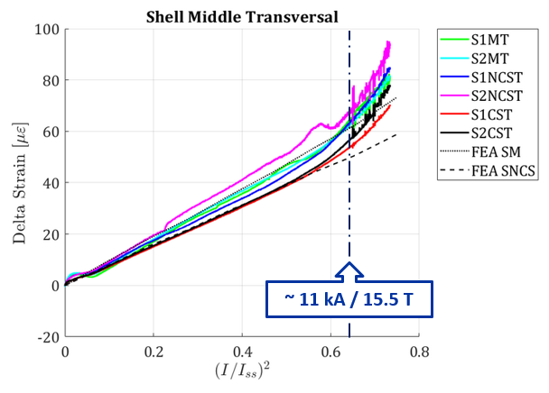
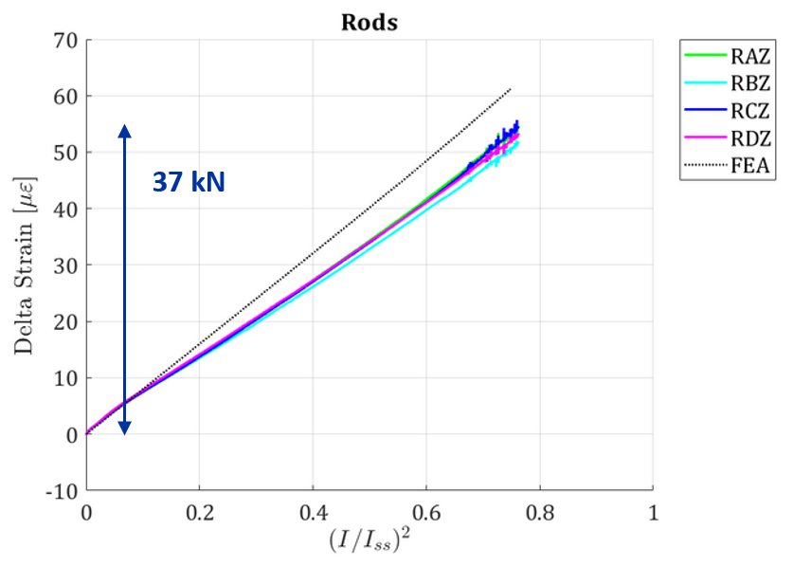
Mechanical performance
RMM1a - Quench 17 (11.90 kA)
Transversally:
Change of slope around 15.5 T
Vibrations observed from 11 kA
Axially:
7 % of the longitudinal Lorentz forces seen by the rods

Slide 25
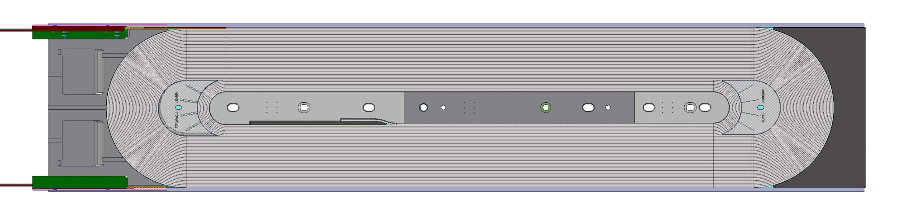
Quench locations
RMM1a & RMM1b: a total of 32 quenches
22 quenches in eRMC 102 LOWER:
eRMC 102 UPPER
eRMC 102 LOWER
RMM UPPER
RMM LOWER
eRMC 101 LOWER
eRMC 101 UPPER
Pole turn
1st block
(high field region)
eRMC 101 alone: 8
eRMC 102 alone: 18
RMM alone: 2
Simultaneous quenches: 4
The magnet quenches in the straight section.
Only 4 quenches in the RMM coil.

Slide 26
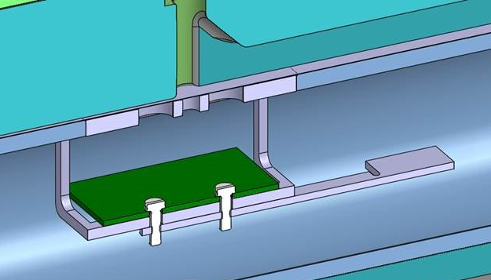
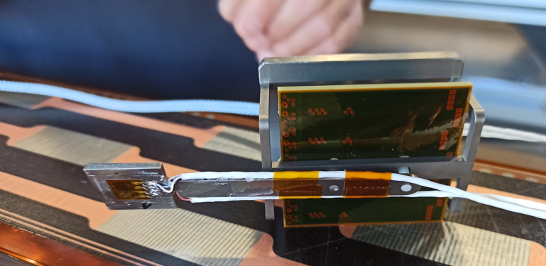
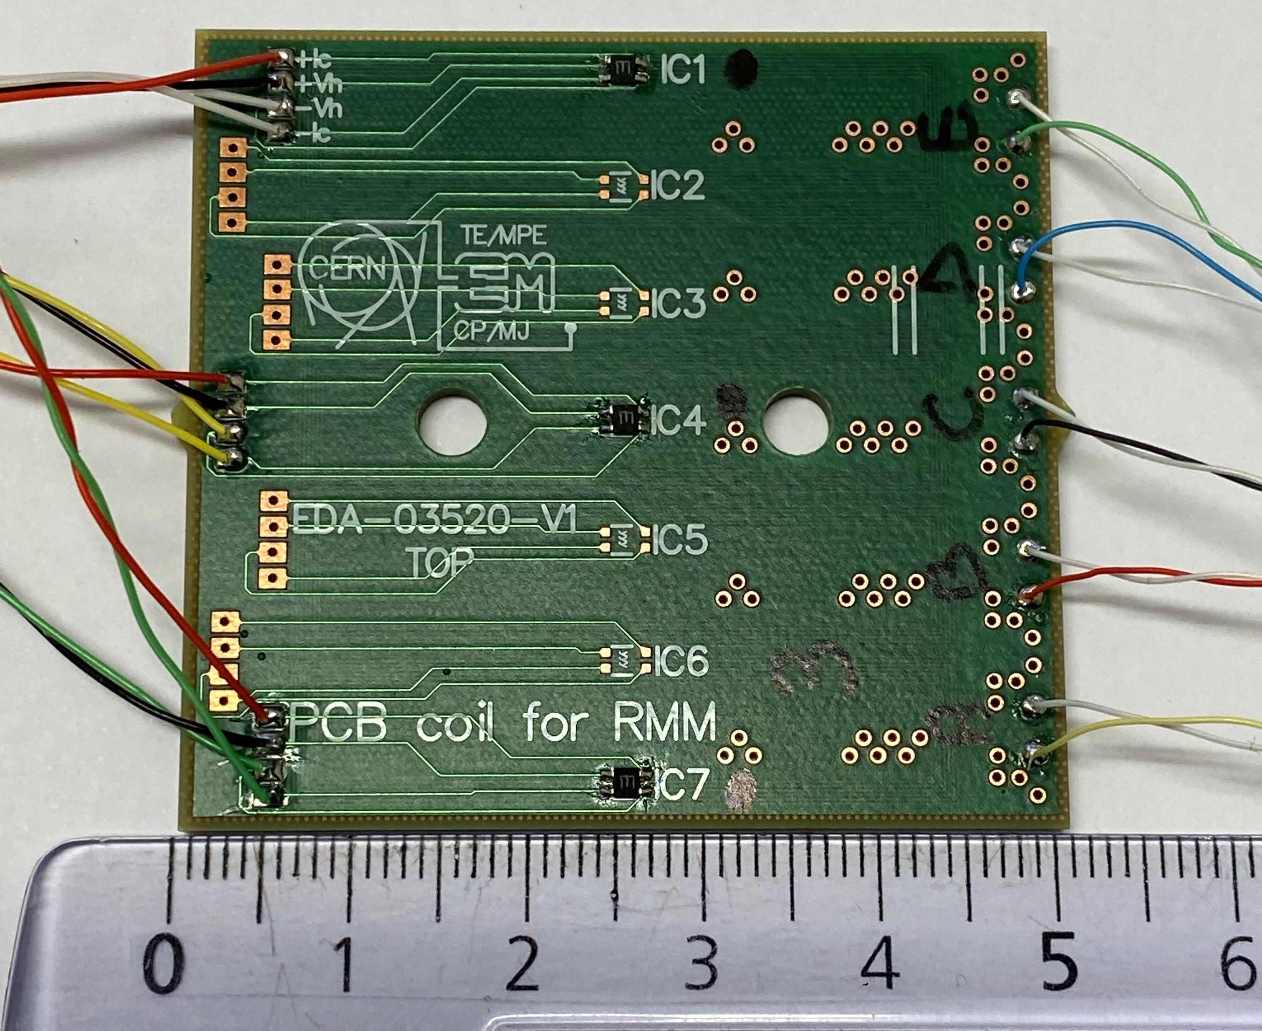
RMM1b – Record field in the bore
Magnetic measurements :
    7 induction coils and 3 cross calibrated Hall sensors
    On a Printed Circuit Board (PCB), inside the aperture
16.50 T measured
Courtesy of C. Petrone & M. Liebsch
Notes:
Measured 0.04 T more than calculated in the bore
0.3 % of error

Slide 27
Conclusion
    Exploration of high field in the straight section of a Nb₃Sn dipole block configuration
    Record field of 16.7 T (88 % of the short sample limit)
    No sign of conductor degradation
    Spikes observed in the differential voltage measurements during current ramps starting from 11.2 kA
    Change of slope observed in the mechanical measurements
    Suspicion of mechanical limitation
    Next step: transverse preload increase

Slide 28
References
[1] J. C. Perez et al., "16 T Nb3Sn Racetrack Model Coil Test Result," in IEEE Trans. on Appl. Supercond., vol. 26, no. 4, pp. 1-6, June 2016, Art no. 4004906, doi: 10.1109/TASC.2016.2530684.
[2] E. Rochepault and P. Ferracin. Nb3Sn accelerator magnets, chapter CEA-CERN block type dipole magnet for cable testing: FRESCA2. Particle Acceleration and Detection Series. Springer, 2019. https://doi.org/10.1007/978-3-030-16118-7_12
[3] M. Benedikt. Future Circular Collider: The integrated program (FCC-int), 2018. https://fcc-cdr.web.cern.ch/reports/EPPSU18_FCCint.pdf
[4] EUROCIRCOL-fcch2020project.
[5] S. Izquierdo Bermudez, R. Ortwein, J. C. Perez and E. Rochepault, "Design of ERMC and RMM, the Base of the Nb3Sn 16 T Magnet Devel-opment at CERN," in IEEE Trans. on Appl. Supercond., vol. 27, no. 4, pp. 1-4, June 2017, Art no. 4002004, doi: 10.1109/TASC.2017.2651403.
[6] E. Rochepault, S. Izquierdo Bermudez, J. C. Perez, D. Schoerling and D. Tommasini, "3-D Magnetic and Mechanical Design of Coil Ends for the Racetrack Model Magnet RMM," in IEEE Trans. on Appl. Super-cond., vol. 28, no. 3, pp. 1-5, April 2018, Art no. 4006105, doi: 10.1109/TASC.2018.2807803.
[7] M. G. Pérez et al., "Mechanical Tests, Analysis, and Validation of the Support Structure of the eRMC and RMM Magnets of the FCC R&D at CERN," in IEEE Trans. on Appl. Supercond, vol. 30, no. 8, pp. 1-7, Dec. 2020, Art no. 4004507, doi: 10.1109/TASC.2020.3005355.
[8] J. C. Perez et al., "Construction and Test of the Enhanced Racetrack Model Coil, First CERN R&D Magnet for the FCC," in IEEE Trans. on Appl. Supercond, vol. 32, no. 6, pp. 1-5, Sept. 2022, Art no. 4005105, doi: 10.1109/TASC.2022.3163064.

Slide 29
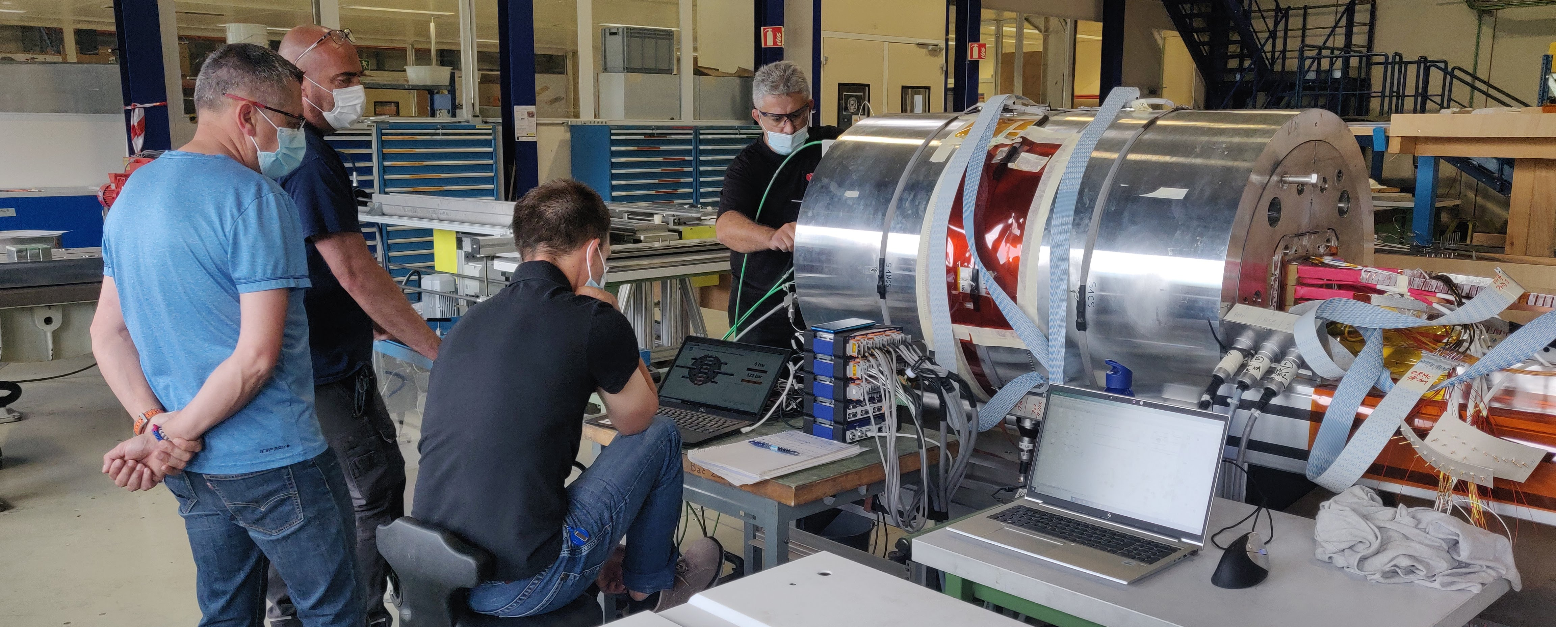
Thank you for your attention
A special and warm thank you to Juan Carlos Perez and Helene Felice for their support and supervision.
Many thanks to the complete 927 team, particularly Hugues Dupont and Nicolas Eyraud for their patience and rigor in the magnet assembly process.
Contact: emma.lucie.gautheron@cern.ch

Slide 30
Additional slides

Slide 31
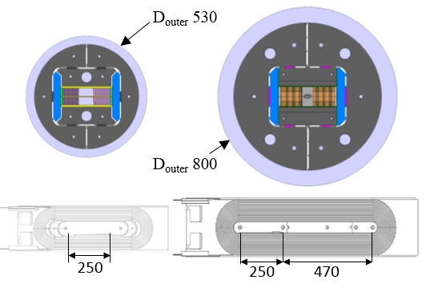
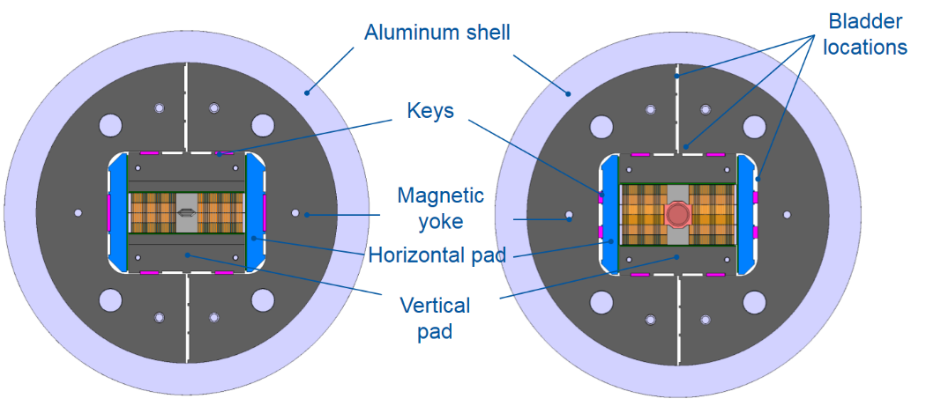
RMC
ERMC
RMM
530
800
16 mm closed cavity
50 mm closed cavity
RMC
ERMC/RMM
Courtesy of D. Tommasini

Slide 32
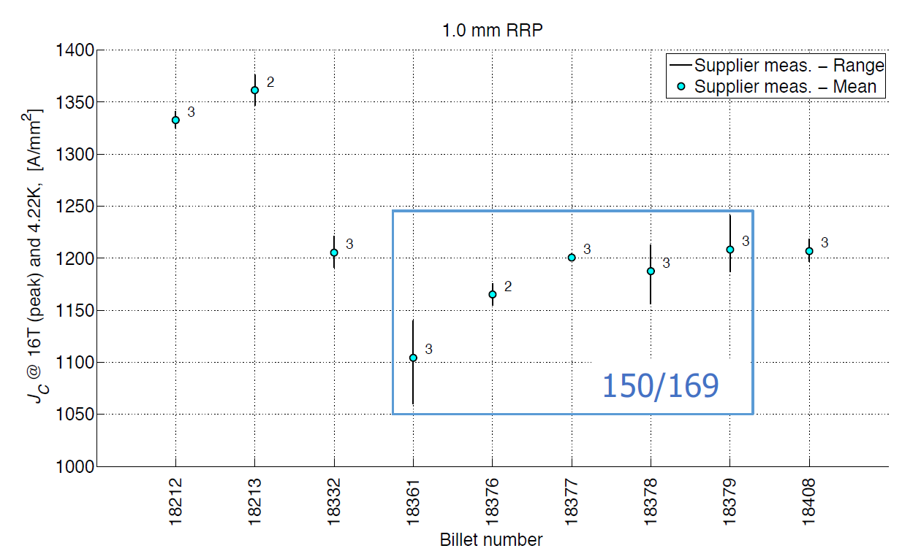
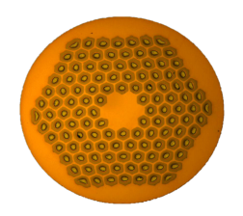
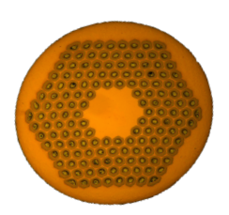
Conductor
53 km of 1.0 mm, RRP wire delivered in 2016 (scrapped OST for Hi-lumi)
4 billets 120/127
sub element size 64 μm
Cu/nonCu 1.05-1.10:1
5 billets 150/169
sub element size 55 μm
Cu/nonCu 1.05-1.10:1
RRR > 120 with exception of billet 18213 (RRR 90-100)
Courtesy of D. Tommasini

Slide 33
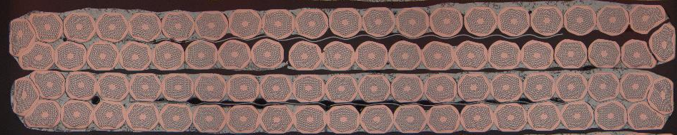
Strand & Cable Parameters
B. Bordini, J. Fleiter & A. Bonasia
 | eRMC #101 | eRMC #102 | RMM #101
Strand Type | RRP 120/127 | RRP 150/169 | RRP 120/127
1 mm diameter wire, Cu/Sc ~ 1
40-strand cable
Bare cable width x thickness: 20.95 x 1.82 mm (as built)
Assumed growth during HT: 0.8 % (width), 3.6% (thickness)
SS core 14 mm wide x 25 um thick
Mica 44 mm + S2 636, Braided, 0.145 mm

Slide 34
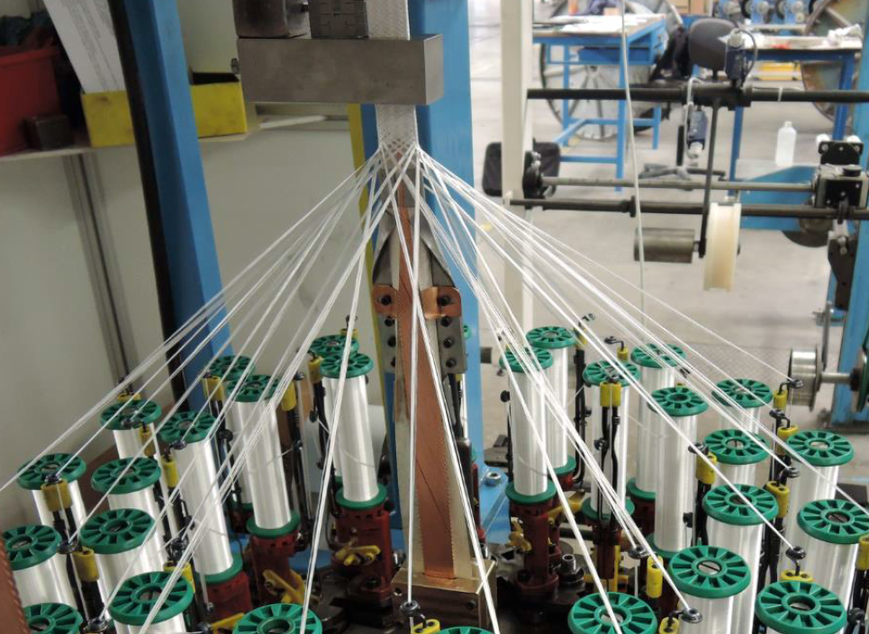
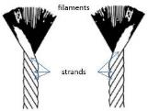
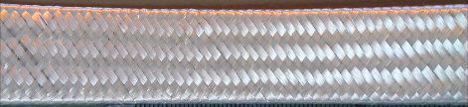
Insulation
Considering the needs for the FCC, we wanted to reinforce the state of the art (11 T) with thicker layers (150 μm).
0.150 ^{+0.00/-0.02 mm} Mica-Glass Insulation
Insulation tests preformed to define the best parameters:
  S2 glass 636 11 TEX yarn
  14 yarns (ply) per bobbin
  32 bobbins
  Speed (angle) set to guarantee full coverage and appropriate thickness
Courtesy of D. Tommasini
yarns

Slide 35
Magnetic design 2D
 | eRMC | RMM
Nominal current I_{nom} [kA] | 13.1 | 11.4
Overall current density [A/mm²] | 282 | 245
Bore field [T] | 15.7 | 16.0
Peak field [T] | 16.0 | 16.2
Stored energy at I_{nom} [MJ/m] | 1.5 | 2.1
eRMC
RMM
¹12 %;²14 %
eRMC pole in magnetic stainless steel ST 430
90 turns/quadrant
RMM pole in titanium Ti-6Al-4V
132 turns/quadrant
R_{coil aperture} = 31 mm
R_{closed cavity aperture} = 25 mm
¹18 %; ² 20 %
¹19 %;²21 %
S. Izquierdo Bermudez et al., "Design of ERMC and RMM, the Base of the Nb3Sn 16 T Magnet Development at CERN"

Slide 36
Mechanical Design – Overview
FE model in 2D and 3D
Coil block material properties: isotropic linear with a rigidity of 25 GPa at RT and cold
Friction of 0.15 in all contacts; except in yoke-shell which was fine tuned with a dummy assembly and is of 0.1
Impregnated coil as bonded contacts; except coil-pole contact as standard sliding with separation allowed
3 steps:
  RT preload: interference in keys + rods
  Cool down: with CTE coil block isotropic of 3.8 mm/m
  Powering: Lorentz forces from Opera 3D at 11.81 kA i.e. 16.5 T Bpeak

Slide 37
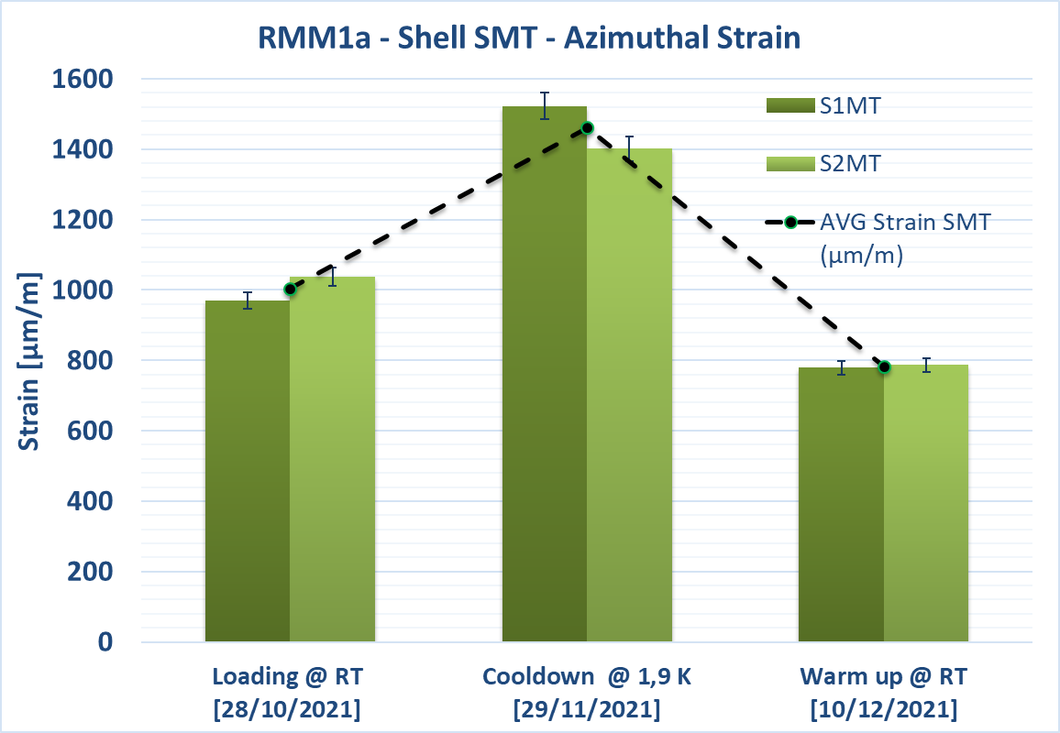
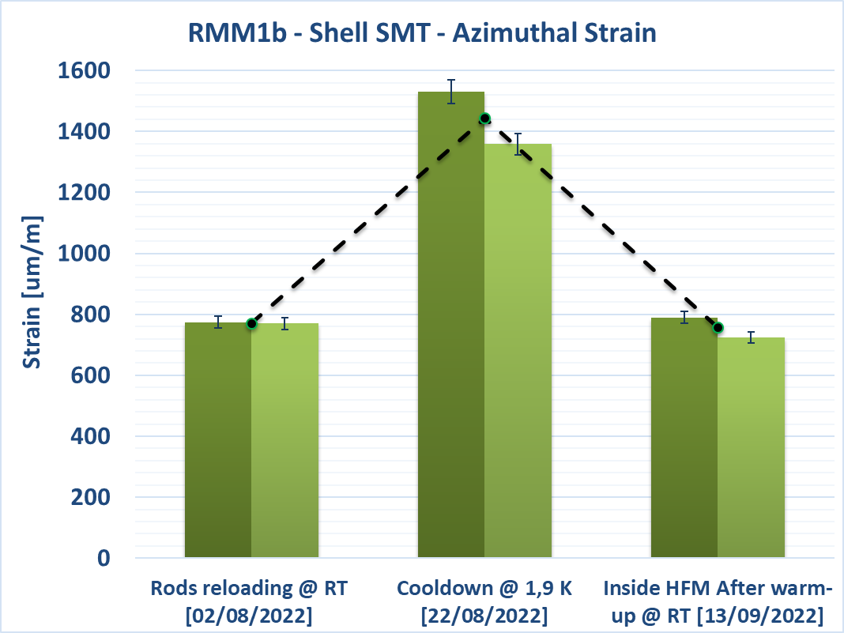
Shell overall behavior (RMM1a vs RMM1b)
➔ Similar shell behavior between RMM1a and RMM1b assemblies
Courtesy of S. Mugnier and M. Guinchard

Slide 38
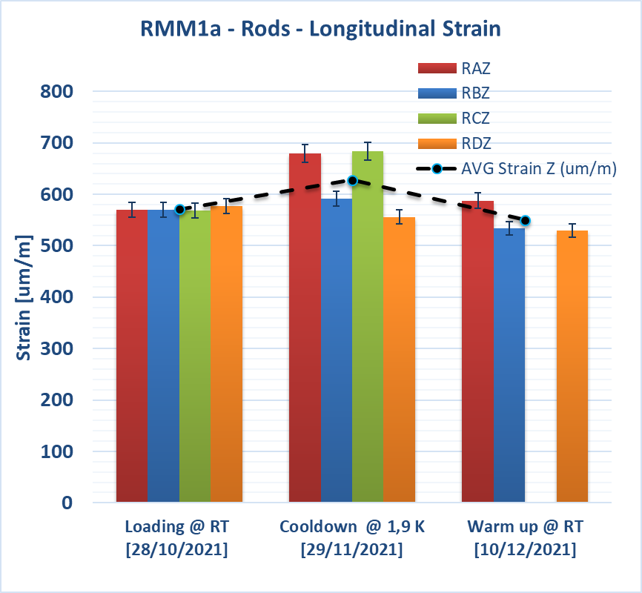
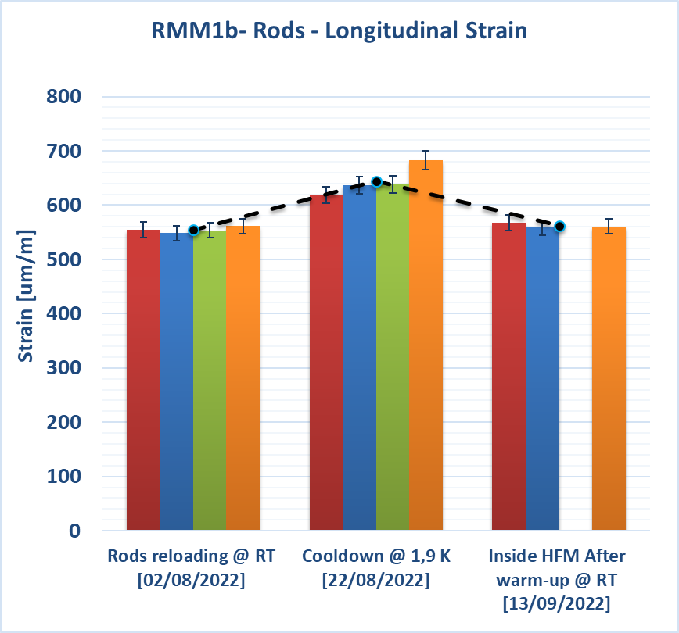
Rods overall behavior
➔ The rods unbalance at cold disappears in 1b version. Quite similar behavior between RMM1a and RMM1b assemblies
Courtesy of S. Mugnier and M. Guinchard

Slide 39
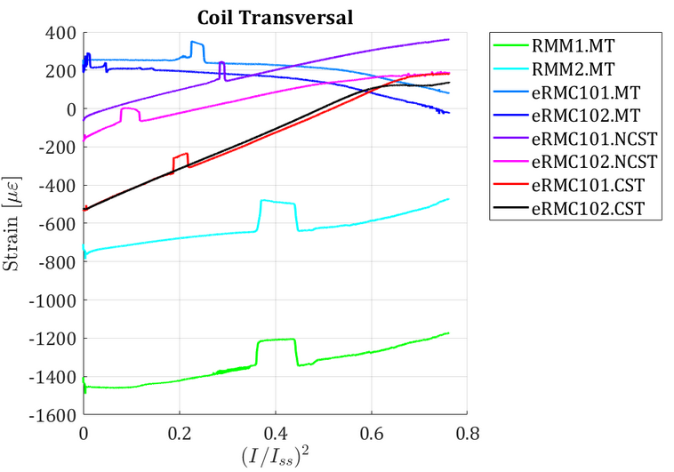
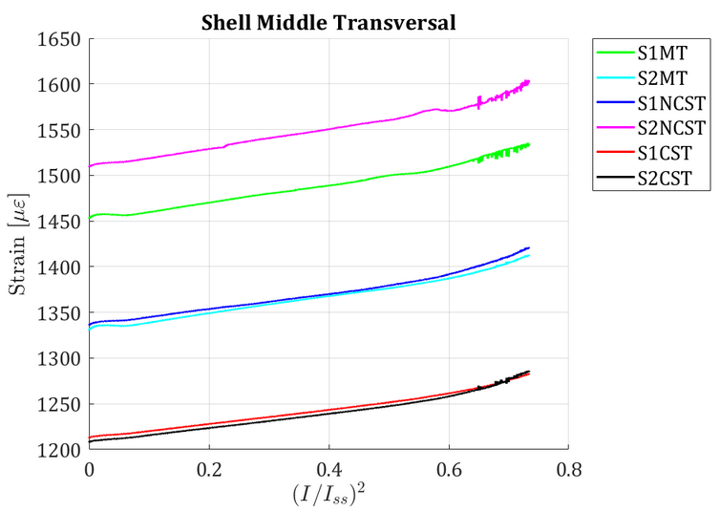
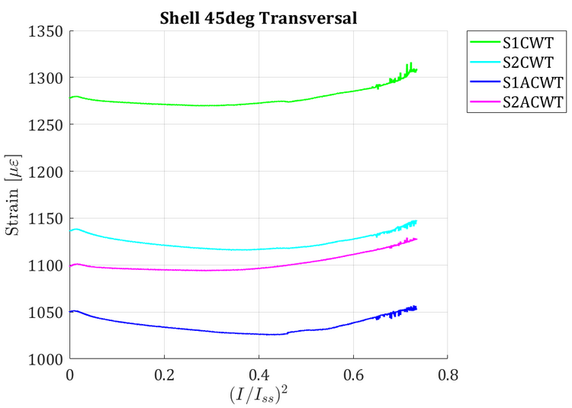
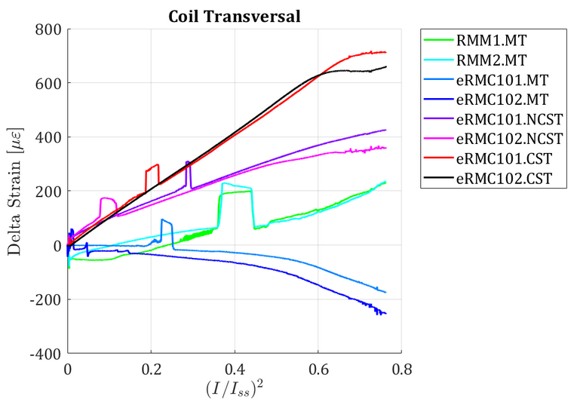
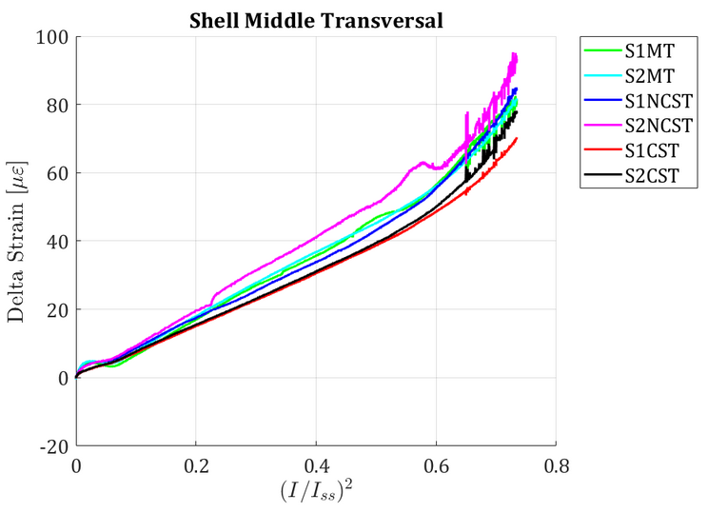
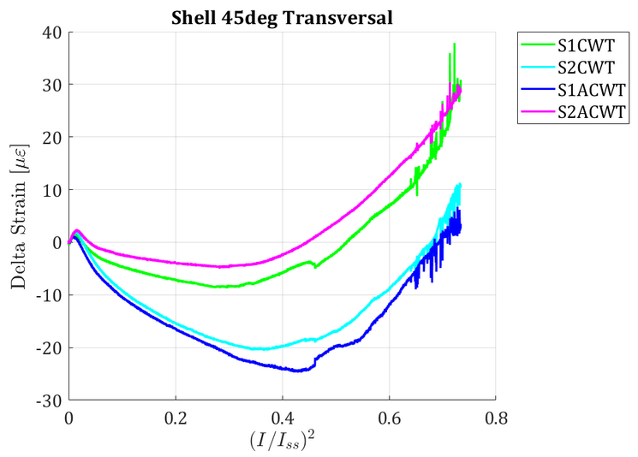
Mechanical response - during a quench
TRANSVERSAL
Quench #17 (1.9 K)
Imax = 11.90 kA
Absolute Strain
6 MPa
Relative Strain
All vibrations at
11.0 kA / 15.5 T
10.8 kA / 15.3 T

Slide 40
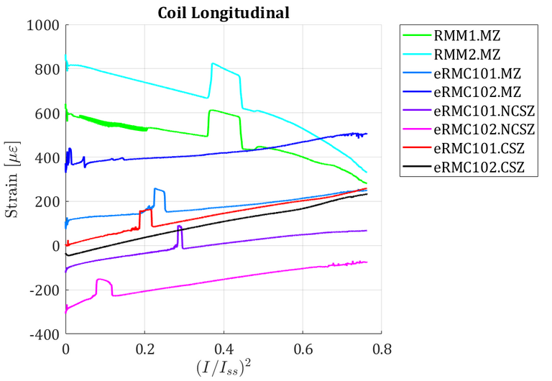





Mechanical response - during a quench
LONGITUDINAL
Quench #17 (1.9 K)
Imax = 11.90 kA
Absolute Strain
6 MPa
Relative Strain

Slide 41

V-I measurement RMM1a

Slide 42

Protection- Quench back studies
Specific energy extraction studies were performed for current between 1000 and 10000 A for both a resistance of 80 mΩ and 60 mΩ.
The measured quench integral is lower then expected from LEDET simulations. Assuming the inductive components were well calculated, one can assume that the quench back effect is stronger than expected.
LEDET simulations courtesy Emmanuele Ravaioli

Slide 43


Protection- Quench back studies
60 mOhm
80 mOhm
A lot of data from all segments is available for model refinement.
Here one can see in some of the smaller segments the quench(back) start in several segments varying as function of energy extraction resistance.

