Slide 1
TAN-to-TAXN conversion - Requirements for the LS3 worksite
O. Boettcher / WP8
124th HL-LHC WP8 Meeting, 13 December 2022

Slide 2
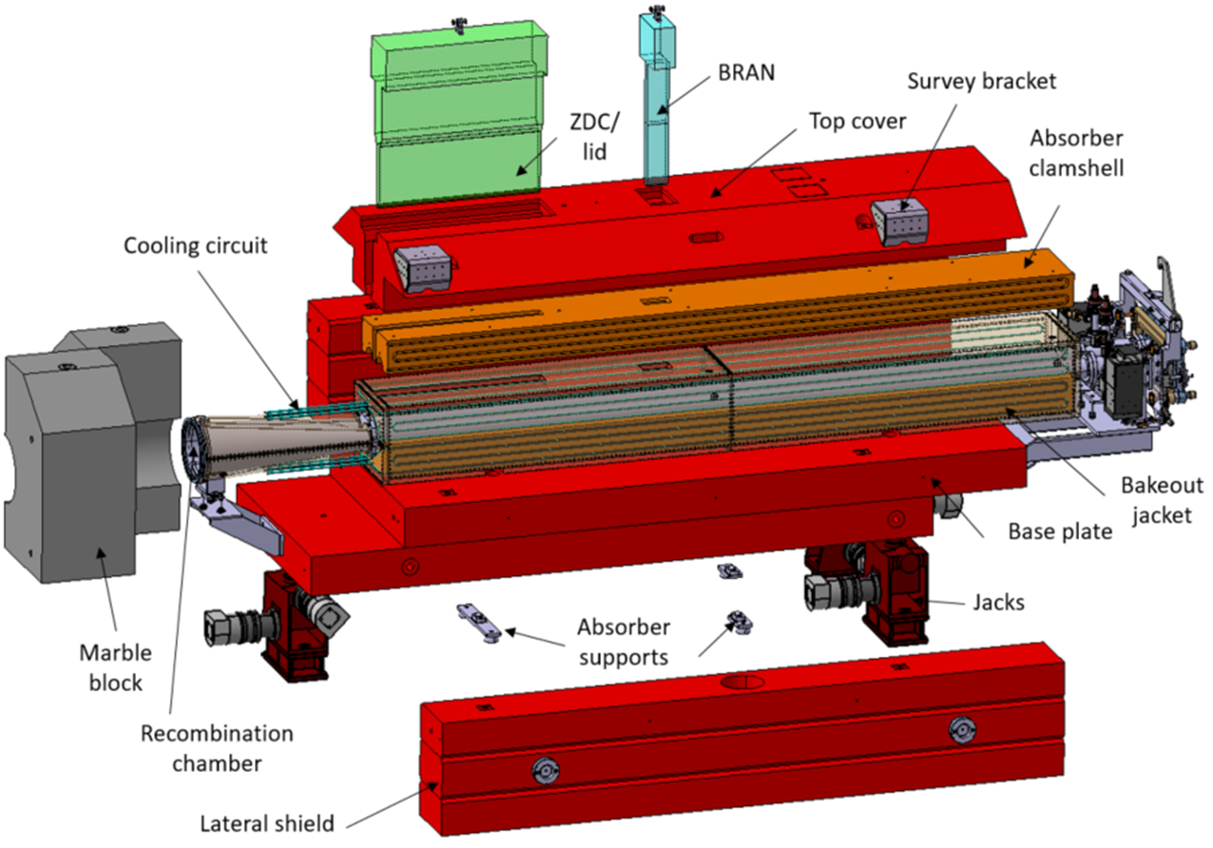
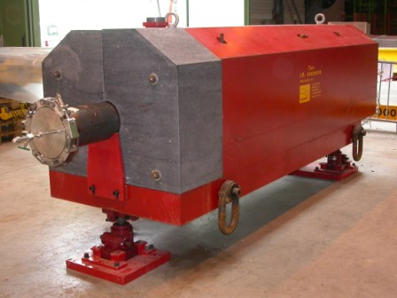

Content overview
Introduction TAN to TAXN conversion
WP8 space request for LS3 worksite
Discussion worksite requirements
Target Absorber Neutrals (TAN)
new TAXN (exploded view)

Slide 3
15th November 2022
Space request for TAN storage and conversion to TAXN during LS3
Oliver Boettcher, Francisco Sanchez Galan ( BE-EA / HL-LHC WP8 Machine – Collider Interface )
EDMS 2795064

Slide 4
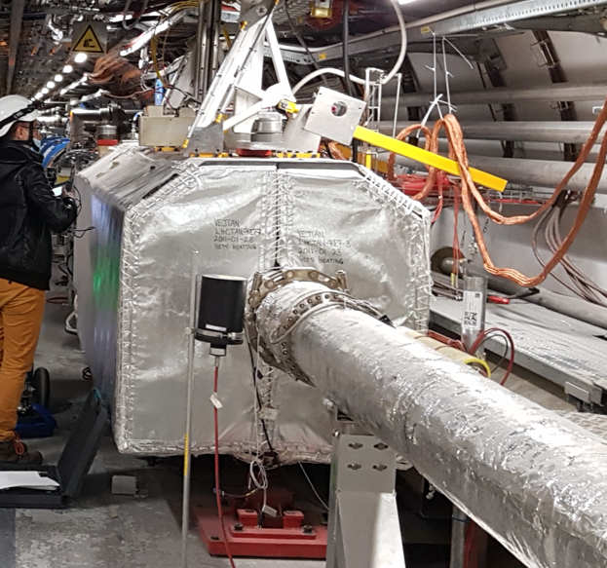
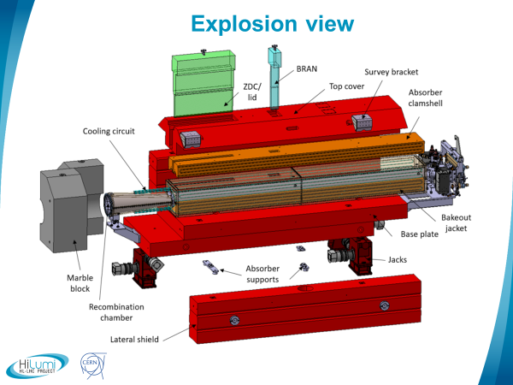
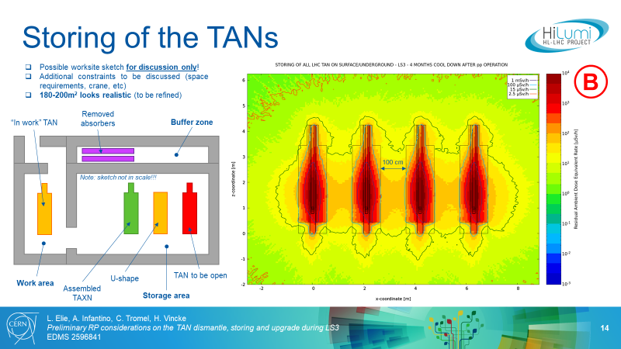
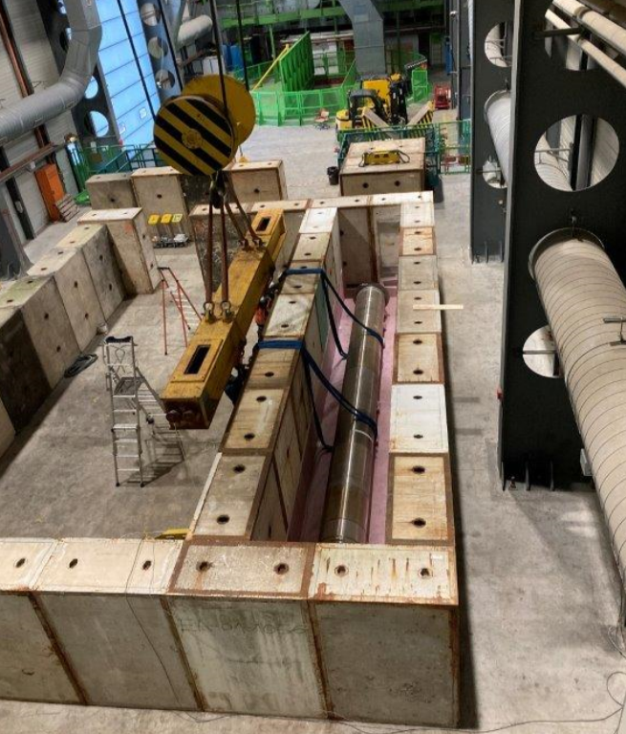
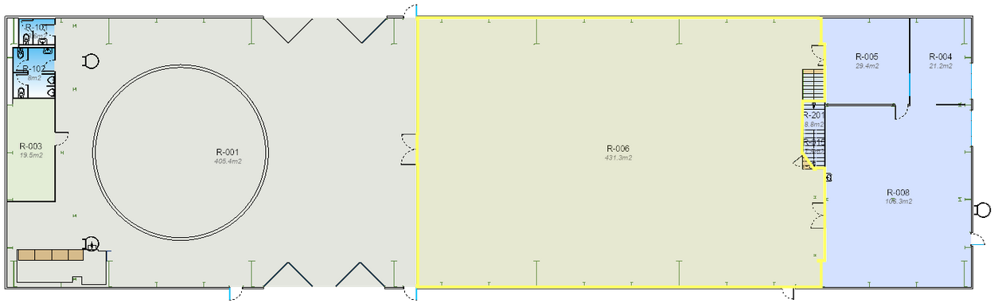
Space request for preparing the TAXN for the HL-LHC
Motivation: Storage and modification into TAXN of 4 radioactive TANs (50 μSv/h at 40 cm)
Reduction of 72t of radioactive waste and cost savings (re-using existing TAN U-shielding)
Storage and conversion from TAN to TAXN need 3-6 months activation cool-down
WP8 is looking for an adequate zone during LS3 becoming a temporary RP controlled area
Works to execute:
Storage of 4 TANs (30t each, LxWxH: 4,8 x 1,1 x 1,7 m):
Disassembly of obsolete absorbers components (total 48t, storage, transport to RWTC)
Minor modification works on TAN U-shielding (ALARA level 3)
TAXN production: Reception new absorber components (48t), assembly, alignment, tests
Location specifications and proposal:
Total surface needed: 200 m² (incl. sufficient shielding to create a RP controlled area)
30t handling capacity (arrival/evacuation), permanently 5t (disassembly/assembly)
Shielding: ~40 concrete blocks / Ground load: ~550 tons (shielding + TANs)
Duration: March 2025 to August 2028 (9 months before LS3 + entire LS3)
(reception of new components as from summer 2025, arrival TANs: March 2026)
Proposal: Bldg. 2685/R-006 in SX6
Remark: A similar operation was conducted in this zone by SY-STI for the beam dump destruction (see worksite picture).
Requested by:
HL-LHC WP8 - O. Boettcher - F. Sanchez Galan (BE-EA)
Installed TAN in LSS5
TAXN assembly for HL-LHC
(EDMS 262361348)
RP Fluka simulation: TAN storage and disassembly (EDMS 2649832)
Proposed area in SX6
200 m²
Beam dump destruction worksite in SX6 during LS2
430 m²

Slide 5
Spare request for preparing the TAXN for the HL-LHC
Motivation: Storage and modification into TAXN of 4 radioactive TANs (50 μSv/h at 40 cm)
Reduction of 72t of radioactive waste and cost savings (re-using existing TAN U-shielding)
Storage and conversion from TAN to TAXN need 3-6 months activation cool-down
WP8 is looking for an adequate zone during LS3 becoming a temporary RP controlled area
Works to execute:
Storage of 4 TANs (30t each, LxWxH: 4,8 x 1,1 x 1,7 m):
Disassembly of obsolete absorbers components (total 48t, storage, transport to RWTC)
Minor modification works on TAN U-shielding (ALARA level 3)
TAXN production: Reception new absorber components (48t), assembly, alignment, tests
Location specifications and proposal:
Total surface needed: 200 m² (incl. sufficient shielding to create a RP controlled area)
30t handling capacity (arrival/evacuation), permanently 5t (disassembly/assembly)
Shielding: ~40 concrete blocks / Ground load: ~550 tons (shielding + TANs)
Duration: March 2025 to August 2028 (9 months before LS3 + entire LS3)
(reception of new components as from summer 2025, arrival TANs: March 2026)
Proposal: Bldg. 2685/R-006 in SX6
Remark: A similar operation was conducted in this zone by SY-STI for the beam dump destruction (see worksite picture).
Requested by:
HL-LHC WP8 - O. Boettcher - F. Sanchez Galan (BE-EA)
Installed TAN in LSS5
TAXN assembly for HL-LHC
(EDMS 262361348)
RP Fluka simulation: TAN storage and disassembly (EDMS 2649832)
Proposed area in SX6
200 m²
Beam dump destruction worksite in SX6 during LS2
430 m²

Slide 6
Resource coordination and requirements
Collaboration is required with many HL-LHC WP’s and CERN groups
Components integration and acceptance tests include the following
(non exhaustive list, to be completed together with collaborating services):
  Fiducialization and alignment measurements
  Cooling system and water-cooling tests
  Heaters and thermocouples and continuity checks
  Bake-out jacket's installation and performance tests
  Y-chamber vacuum tests
  …
HL-LHC installation activities | Period | Location |  |  |  |  |  |  | HL-LHC WP |  |  |  |  |  |  |  |  |  |  |  | Group contribution for installation
 |  | P1 | P2 | P4 | P5 | P7 | P8 | SPS | 4 | 5 | 6B | 7 | 8 | 9 | 11 | 12 | 13 | 14 | 15 | 17 | EP-CMX | EP-ADO | ACE | BI | CRG | CV | EA | EL | EPC | HE | ICS | MME | MPE | MSC | RF | SMB | STI | VSC
TAN/TAXN | LS3 | X |  |  | X |  |  |  |  |  |  |  | X |  |  | X |  |  | X | X | X | X | x | X |  | X | X |  |  | X |  |  |  |  |  |  |  | X

Slide 7
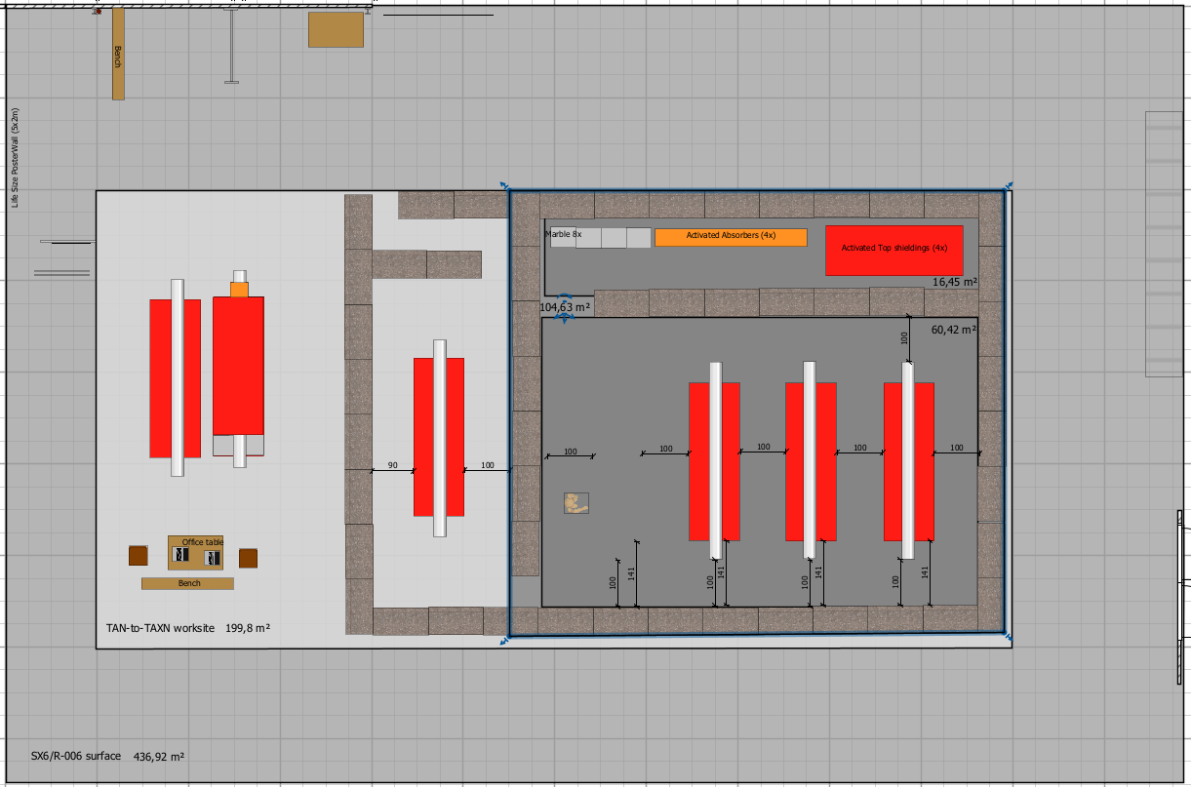
Worksite layout based on 200m²
Question: Does this layout comply to requirements of service units?

Slide 8
Space available in SX6/R-006 compartment
WP8 requested ~200m² of space
Preferred compartment offers some more space for optimization.
Worksite layout
will be adapted to the requirements of service units and collaborators.
Input will be requested in offline discussions in Q1 2023.
Arrivals, storage, tooling, pre-assemblies

Slide 9
Reference documents
  LHC to HL-LHC: TAS-TAN de-installation & TAXS-TAXN installation - EDMS 1868778
    S. Evrard, F. Sanchez Galan (7th HL-LHC Collaboration Meeting – Madrid – 13-16 November 2017) /
  TAXN mechanical design & Y-chamber - EDMS: 2467765
    P. Santos Díaz (EDR HL-LHC TAXN - CERN, 22 Jan. 2021)
  Preliminary RP considerations on the TAN dismantle, storing and upgrade during LS3 - EDMS 2596841
    A. Infantino + L. Elie (107th HL-LHC WP8 Meeting / 6 Jul. 2021)
  Radiation protection studies relevant for the LS3 TAN upgrade: usage of the existing shielding and preliminary considerations on the worksite - EDMS 2649832
    A. Infantino + L. Elie (HSE RP Technical Note / 21 Dec. 2021)
  Space request for TAN storage and conversion to TAXN during LS3 – EDMS 2795064
    O. Boettcher, F. Sanchez Galan (15 Nov. 2022)

Slide 10
Thanks for your attention!

Slide 11
Backup slides

Slide 12
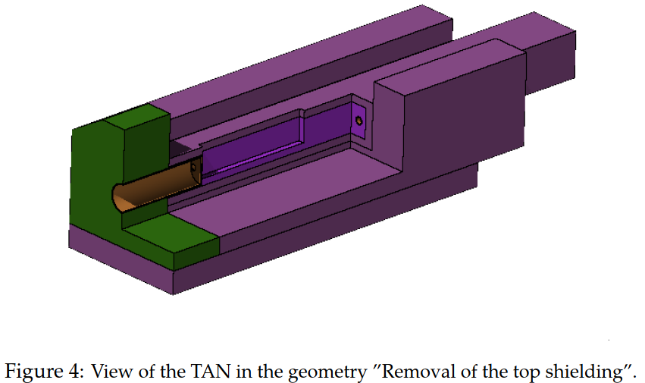
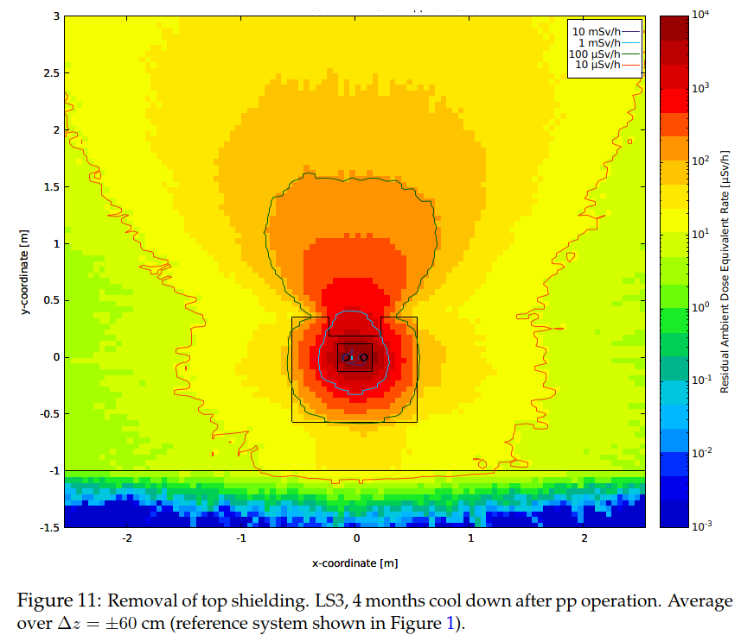
RP Technical Note (EDMS 2596841 – 2649832)
Remark:
  RP workload for realizing FLUKA simulations were extremely high, because of the complex simulation chain following the configuration changes of the TAN during disassembly, modification of reused shielding and new assembly considering also that all 4 TAN will be stored together in the same area.
  The upgrade can be summarized in the following main steps as provided from HL-LHC WP8 experts:
    1. Evacuation of the TAN from the tunnel.
    2. Storage of all four TANs on the surface or underground. Ideally, the four TANs will be stored together in the same area.
    3. Dismantling of the top shielding and the Cu absorber in order to leave only the so-called “U-shape”.
    4. Modiﬁcation/machining the existing shielding (”U-shape”).
    5. Assembling of the TAXN: installation of the new absorber into the existing shielding and the new top shielding.
    6. Storing of the upgraded TAXN.
    7. Installation of the TAXN in the HL-LHC tunnel.
Three different scenarios were studied:
  the storage of the four TANs on the surface/underground,
  the removal of the top shielding and
  modiﬁcation/machining of the U-shape.
Results:
  Evacuation of the TANs from the Tunnel:
  The TAN can be evacuated from the LHC tunnel ∼4 months after the end of the proton-proton operation. (… only for the de-installation of the TAN from the LHC tunnel …additional cooling time can be added before starting the upgrade works to further reduce the exposure of personnel working in the upgrade phase)
  Storage of the TANs:
  After four months of cool down, the 100 µSv/h isodose line is contained by the TAN shield. This result is relevant in terms of WDP. When in contact to the TAN, workers will not be exposed to a dose rate larger than 100 µSv/h.
  At 40 cm from the TAN the ambient dose equivalent rate is larger than 50 µSv/h so that the worksite area will be classiﬁed as limited stay radiation area.
  At 100 cm from the outer of the four TANs the ambient dose equivalent rate will be larger than 15 µSv/h. The 100 cm distance has been assumed as the minimum space required between the TAN and the shielding.
  Currently the possible worksite locations under discussion are classiﬁed as non-designated or supervised radiation area: therefore, depending on the ﬁnal location, a dedicated shielding might be necessary to withstand with the area classiﬁcation of the building/underground area.
  Removal of the top shielding:
  It’s reasonable to assume that only one TAN at the time will be in work/manipulated, while the other will be stored in dedicated area.
  In this conﬁguration at 100 cm from the TAN surface the ambient dose equivalent rate is expected to be higher than the limit for supervised radiation area.
  U-shape
  Compared to the values when the top shielding is removed, an overall reduction of the radiation levels happen upon removal of the copper absorber. Nevertheless, the 100 µSv/h isodose line unfolds outside the TAN shielding in the y-coordinate.

Slide 13
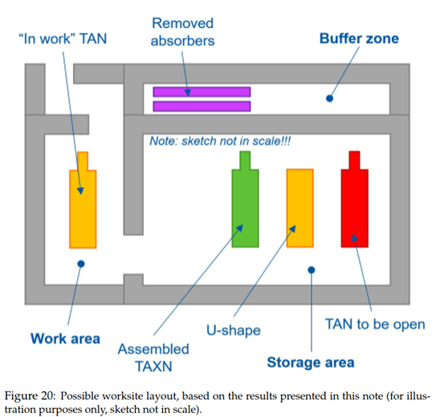
RP considerations – TAN convertion worksite
Preliminary consideration on the worksite layout
  The simulations in Section 3.2 considered a generic area of 90 m2. The worksite shall have three different areas to reduce workers exposure:
  A working area where one TAN will be in-work at a time.
  A buffer zone to store activated and not reused components, including removed absorbers.
  This area is assumed to be accessible by the crane.
  A storage area where to place TANs to be disassembled and/or already upgraded TAXN.
  As discussed in Section 3.2, it is reasonable to assume that the worksite will be placed in a Non-designated or a Supervised Radiation Area. Therefore, the worksite layout shall account for a shielding which will be designed based on the ﬁnal location and its radiological classiﬁcation.
  Additional constraints such as the presence of a crane need to be discussed. It’s important to pay attention at the vertical axis of the storage area as shown in Figure 16, to take into account the dose rate at gateways or passage areas (scaffolding, boardwalks, etc).
  The WP8 management estimated a worksite area of ∼150 m2, which is compatible with the preliminary layout of Figure 20. Different worksite possibilities are explored: SX6, UX65, SX4 (all considered suitable), UX45 (not considered suitable)
Conclusions:
  At the time of this note, the detailed step-by-step upgrade procedure is still under discussion while only the main steps are known … . Nevertheless, the data reported in this note will be useful for producing and optimizing a detailed WDP.

Slide 14
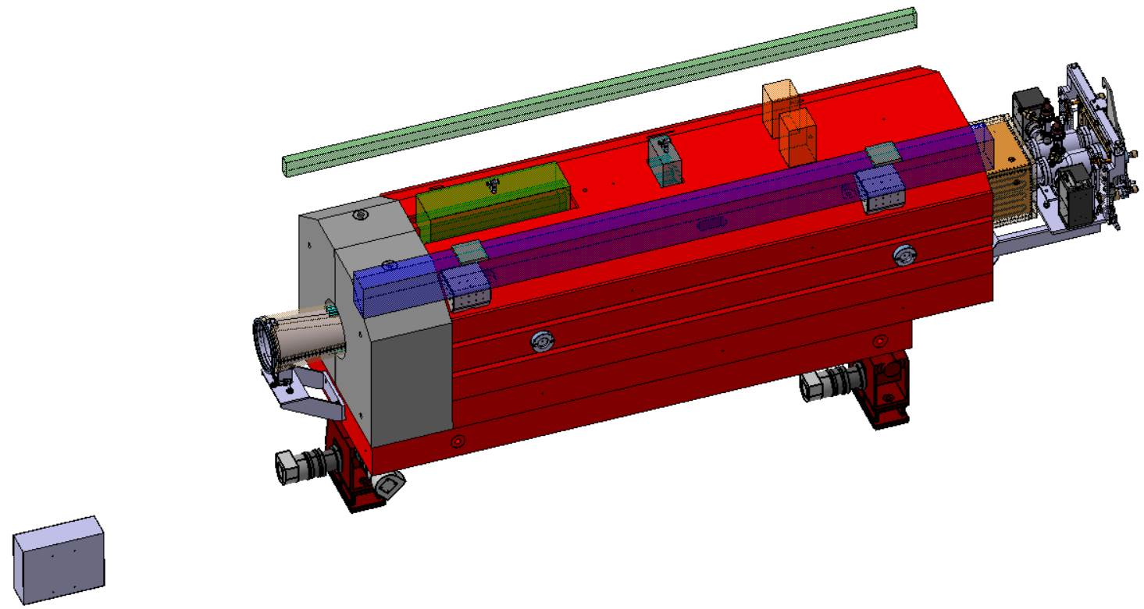
Overall view
Functionality [1] of the HL-LHC Neutral Beam Absorber:
    → protect the downstream magnets from the collision debris in the interaction point (ATLAS & CMS) via the copper absorber.
  It will became quite radioactive (<1mSv/h after 4 week cool down).
    RP study (see A. Infantino’s talk).
  Iron shield reused from the present TAN.
  It houses two forward detectors.
  Water cooled.
Absorber (Cu)
& bakeout jackets
Inclinometers
BRAN
ZDC/lid
Hydrostatic
Levelling system
(HLS)
Marble
Water cooling
IP flange
From IP:
131.144m
Y chamber
and bakeout jackets
x2 fiducials
Shielding
Wire Positioning System (WPS)
Bakeout box
Remote aligned
jacks
The geometry of the ZDC/lid and BRAN shown are space reservations.

Slide 15
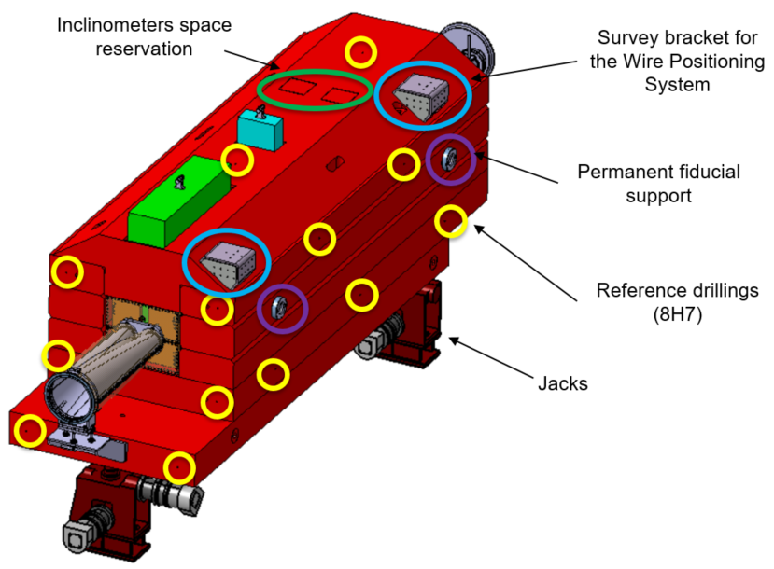
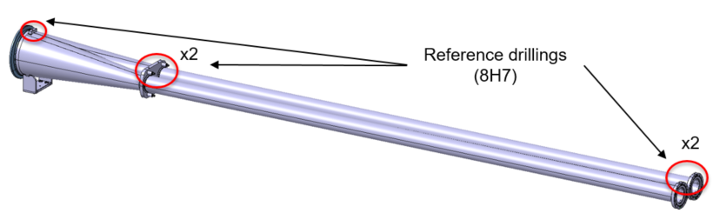
Alignment overview
WPS (Wire Positioning System).
Brackets for supporting the WPS sensors.
HLS (Hydrostatic levelling System).
  Not used for TAXN alignment but to be taken into account for integration purposes.
Space reserved on the top cover for inclinometers.
  Volume: 150x150x250mm³.
SU fiducials support on the lateral side of the TAXN shielding.
Fiducial references on the TAXN and Y-chamber.
  Strategy validated by shielding tests [3].
x3 remote aligned jacks [4].
  Interfaces plates to be design once the jacks design in fixed.

Slide 16
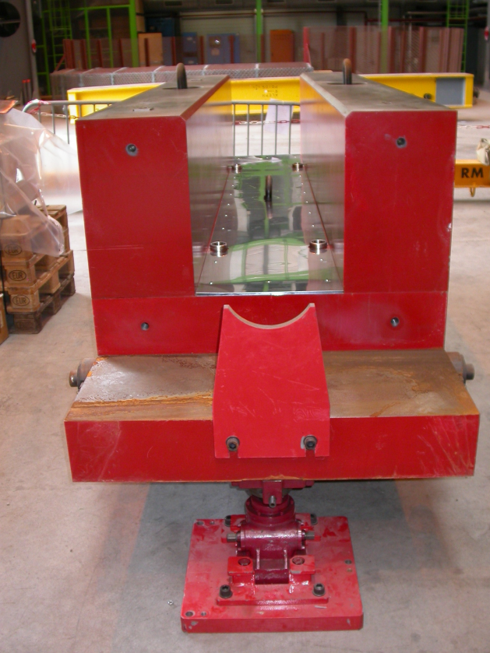
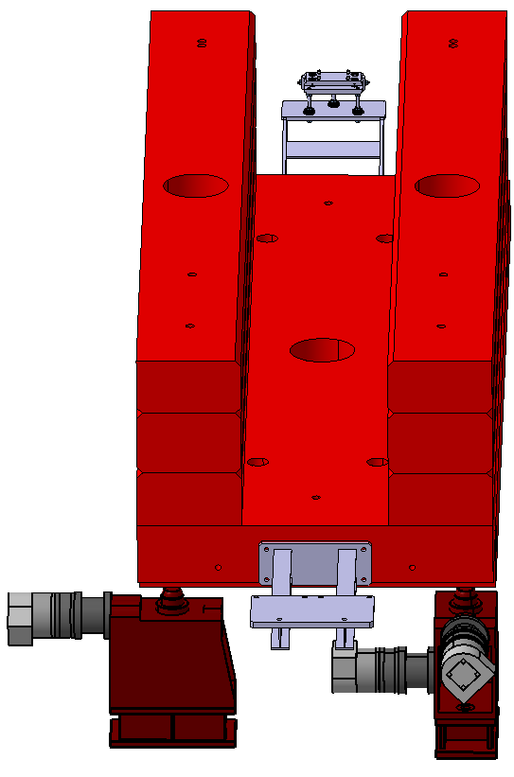
Supporting system
Absorber block to be supported on three points on the shielding.
  Currently there are four!
Current supports holes
Handling tooling will be removed

Slide 17
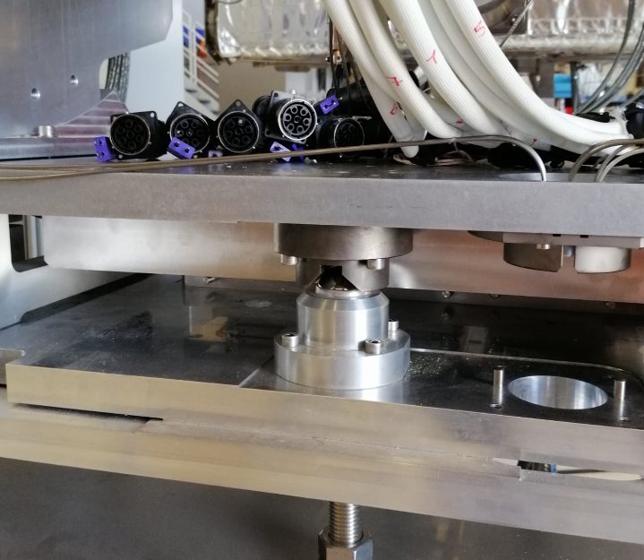
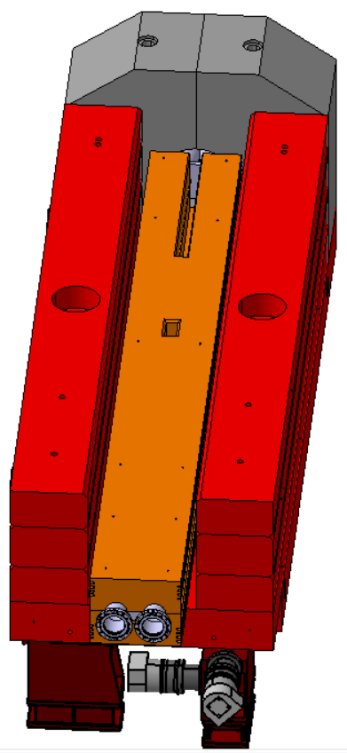
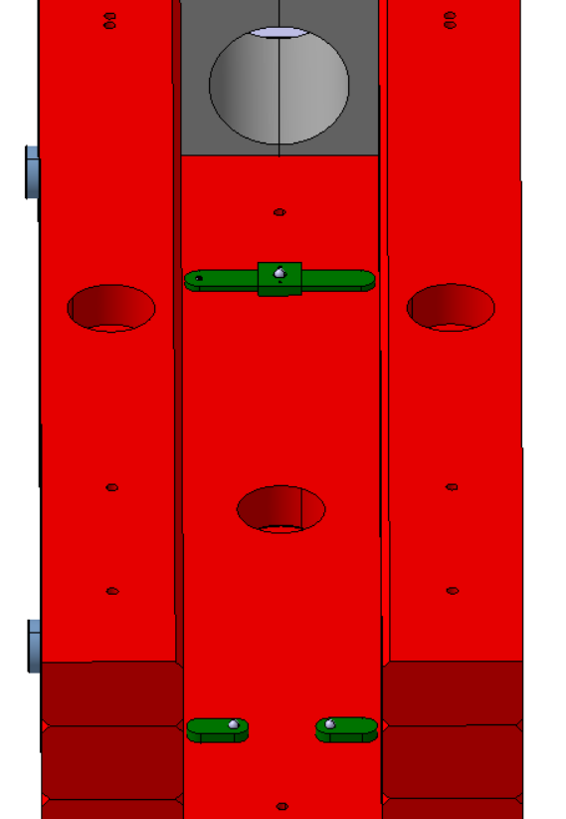
Supporting concept
x3 30mm spheres.
Round, slot + plane geometries.
Free in the beamline and transverse direction w.r.t the “fixed point”.
Inserts on the Cu foreseen to avoid Cu marking.
  Spheres-support materials similar to the collimators configuration [5].
    Plane configuration to be tested.
Vacuum forces withstood by two M8 screws (500kg).
Collimator configuration
Round:
“fixed point”
Slot & plane

Slide 18
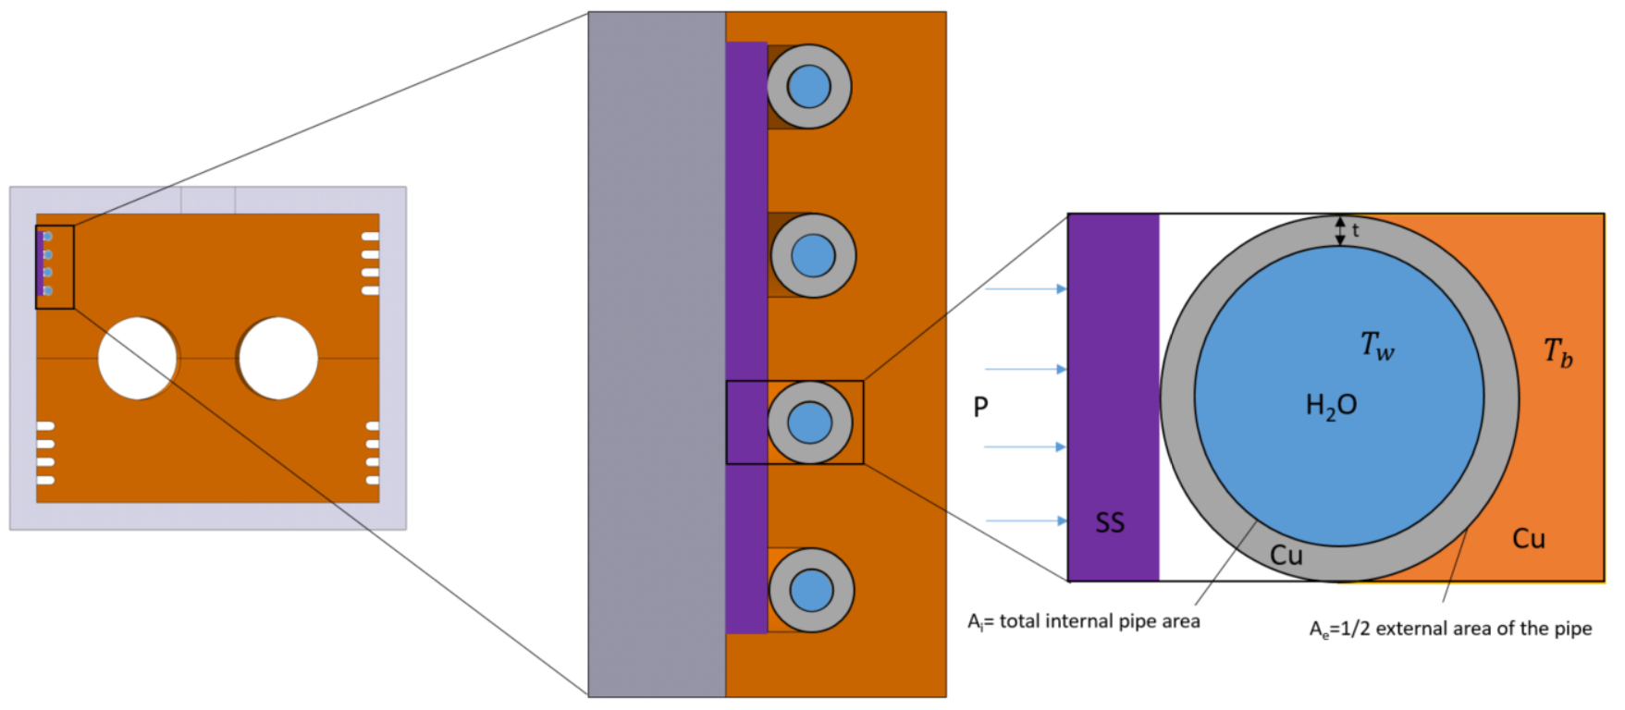
Principle and inputs
As there is a constant heat load coming from the collisions debris, a cooling system is required.
Heat deposition kindly provided by WP10 via FLUKA data.
  Heat load computed for ultimate luminosity (7.5·10³⁴cm⁻²s⁻¹), 85mb efficient section, proton-proton collision ,vertical crossing angle and the new TAXN geometry.
  Heat deposited: ≈1.7kW.
Cooling circuit-bakeout strategy foreseen as in the present collimators.
  Inlet circuit valve close while outlet opened during bakeout.
Deminelised water cooling connection requested to W17.3.
  Inlet temperature of the cooling water: 27°C.
  Minimum water throughput: 0.5 l/s.
  Water pressure: 10bar.
  ∆T_{water.max}: 20°C.
  Circuit drop pressure: 1.5bar.
Cooling scheme

Slide 19
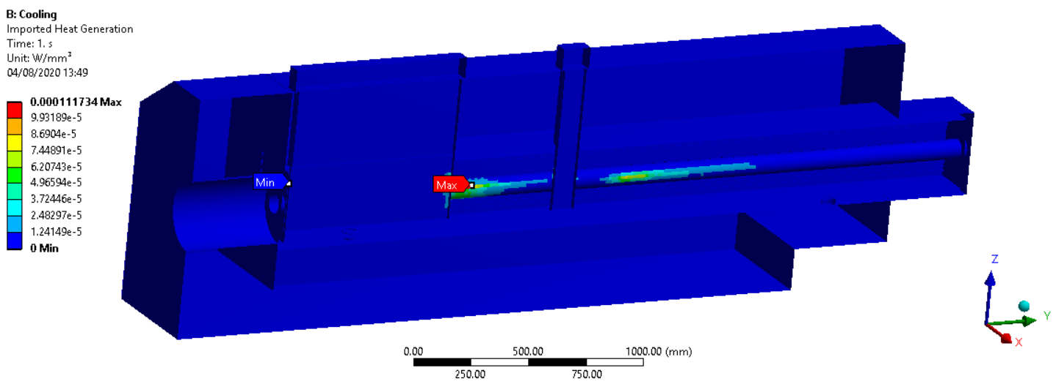
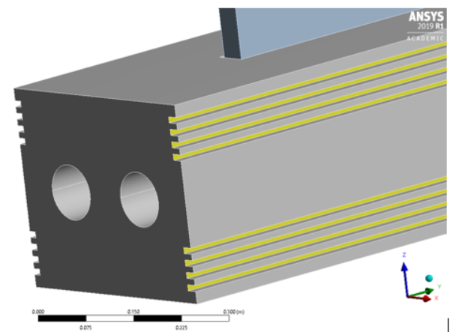
ANSYS cooling model
Steady thermal analysis.
Heat deposition implemented through the FLUKA data via a heat generation and convection applied on the cooling pipes.
Geometry simplified and perfect contact between chamber and absorber assumed.
Heat deposition in W/cm³ integrated in
ANSYS from the FLUKA data

Slide 20
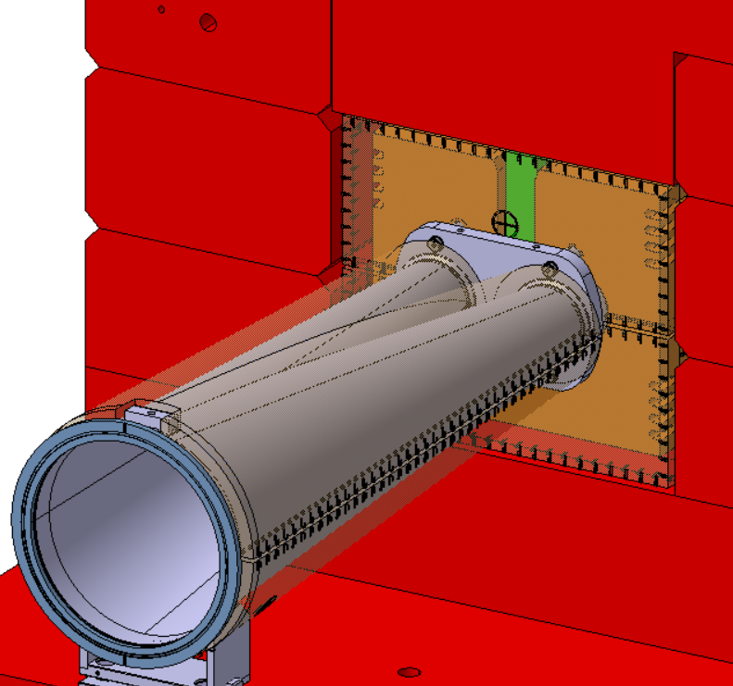
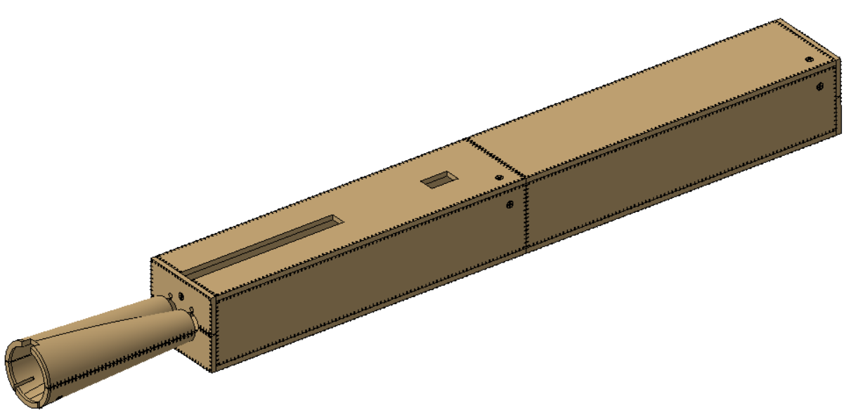
Bakeout system
Bakeout performed exclusively by bakeout jackets.
  30mm around the absorber and chamber are reserved for the bakeout jackets.
Requirements to reach the vacuum requirements and activate the NEG coating:
  250°C on the inner surface of the vacuum chamber.
  50°C/hour heating rate.
Design of the bakeout jackets.
Courtesy of WP12
Integration of the bakeout jackets and the reference plate

Slide 21
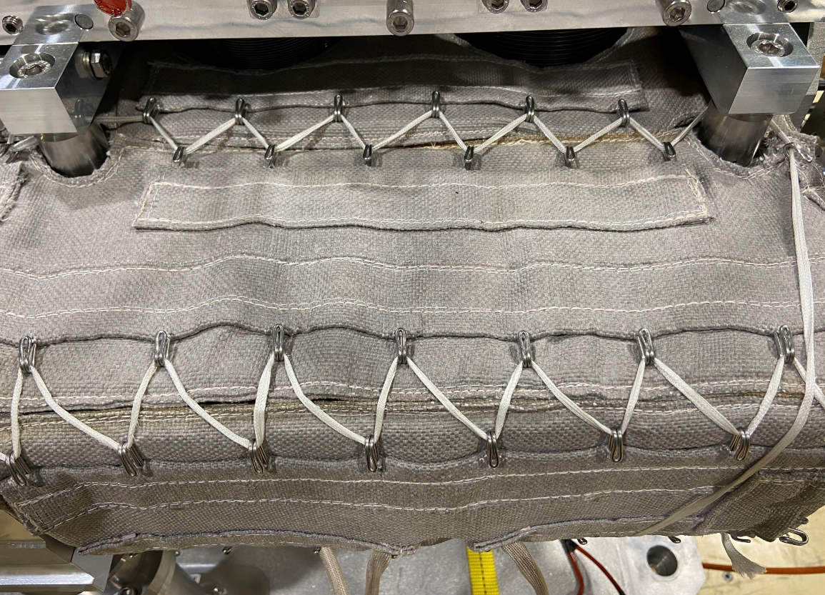
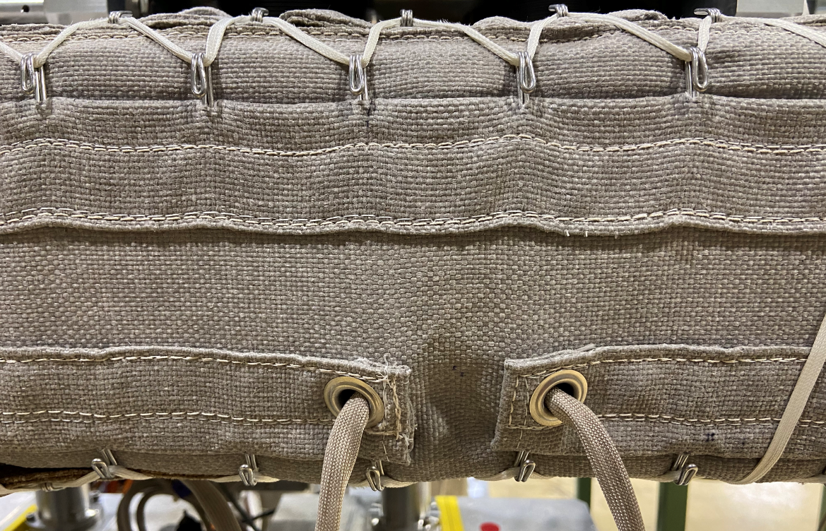
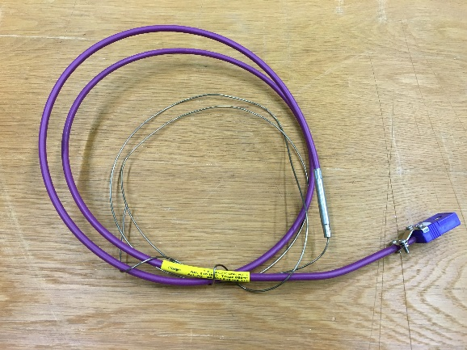
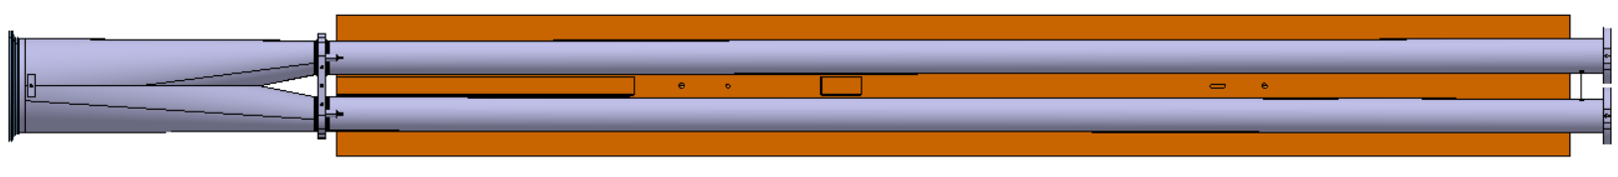
Jackets & thermocouples (cont.)
LHC consolidation & ELENA/TCLD [7] bakeout jackets taken as reference.
  Reduntant heating element per jacket.
  Connectors to be adapted to the space available.
  Halogen and sulphur free including the external envelope and all the cables & asbestos free.
  Radiation hardness: 15MGy.
Coaxial thermocouples type E without end welded plate, high radioative strength with ceramic insulation and connector and the required length.
Jackets cabling and thermocouples layout to be done in compliance with the cooling circuit.
  Cable exit expected on IP side.
Pictures & specs.
Courtesy of N. Zelko
TCLD jacket & connectors
Thermocouple type E «stardard» [8] for illustration
Preliminary thermocouples layout configuration

Slide 22
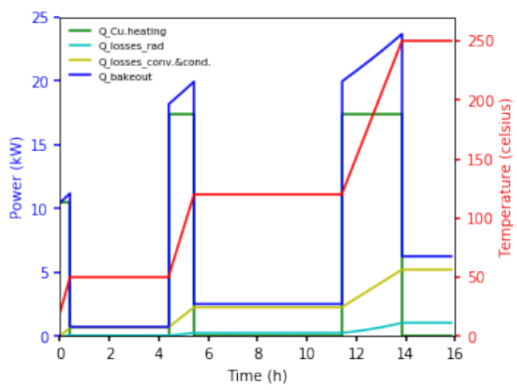
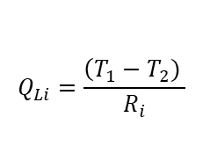


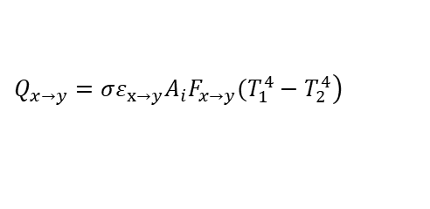

Analytical computation
Power required is the addition of the copper block heating, and power losses through the jacket, absorber supports and slots (convection and radiation).
Baking power of the absorber jackets simulated in Python based on bakeout cycle provided by WP12.
$${Q_{bake}=Q}_{Cu.heating}+Q_{L−b.j}+Q_{L−sup.}+Q_{L.slots.cv}+Q_{L.slots.rad}$$
$$Q_{Cu.heating}=\frac{c_{p.Cu} m_{Cu} (T_{0}−T_{bake}) }{bakeout time}$$
$$R_{i.cv}=\frac{1}{h_{i}A_{i}}$$
$$Q_{Li}=\frac{\left(T_{1}−T_{2}) \right.}{R_{i}}$$
$$R_{i.cond}=\frac{e_{i} }{k_{i} A_{i}}$$
$$\left.Q_{x→y}=σ{ε_{x→y}A}_{i}F_{x→y}(T_{1}^{4}−T_{2}^{4}\right)$$

Slide 23
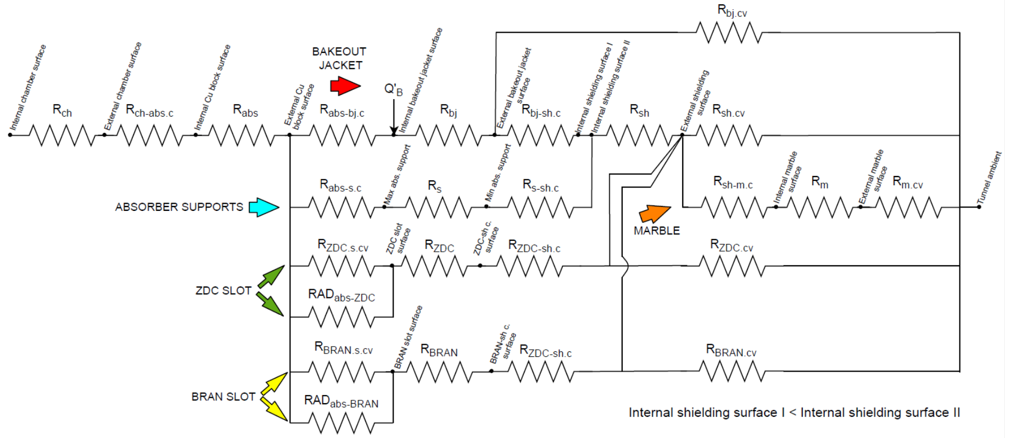
Thermal circuit
Tunnel ambient temperature
Temperature on the Y-chamber internal surface

Slide 24
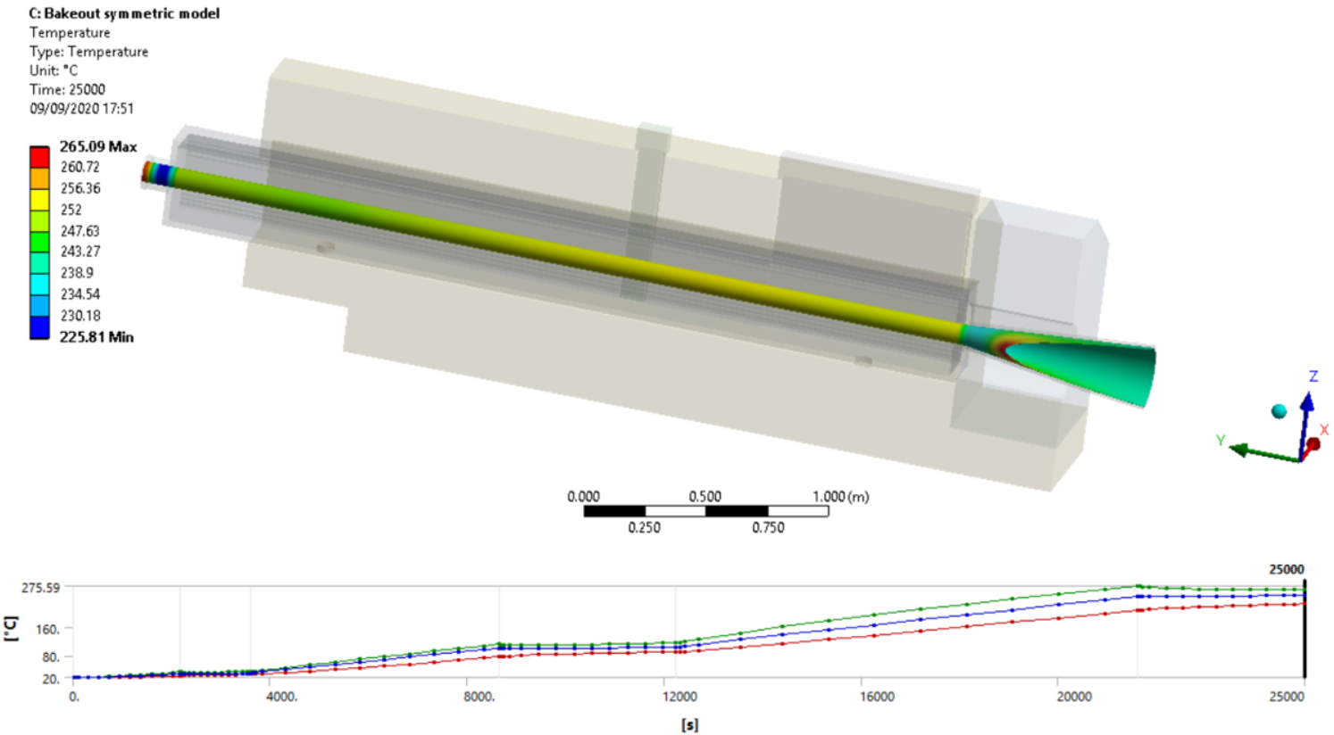
ANSYS bakeout simulation
Preliminary results -> for the heat losses described and bakeout cycle specified by VSC (see temperature cycle in slide 11) the minimum temperature on the vacuum chamber is about 245°C.
Full study and simulations documented in EDMS [5].

Slide 25
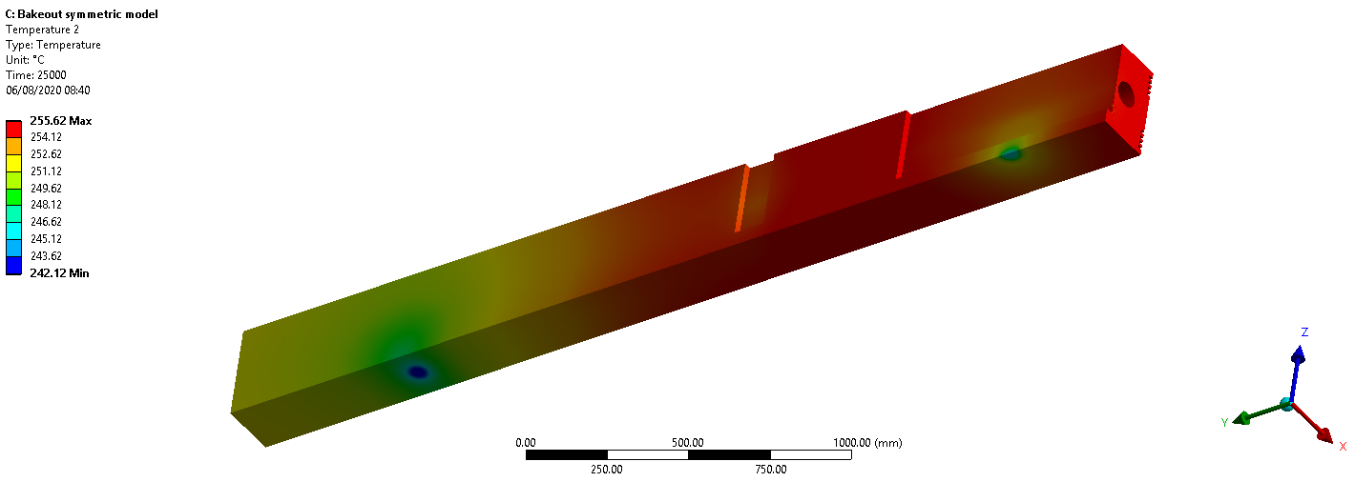
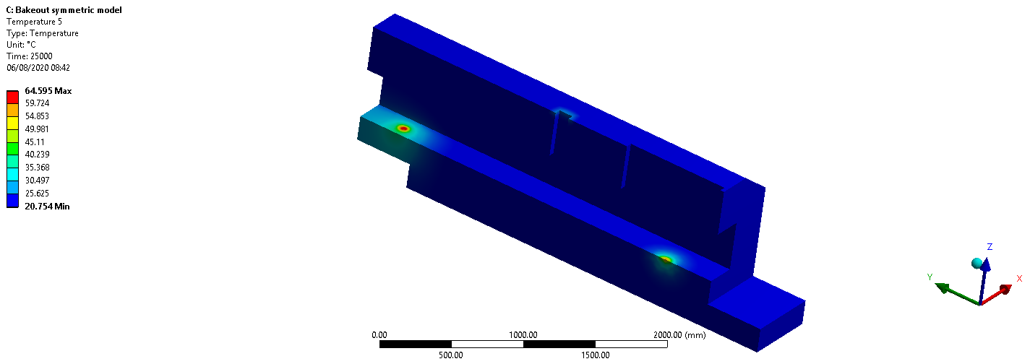
ANSYS bakeout simulation (cont)
Preliminary results show a low temperature on the supports region.

Slide 26
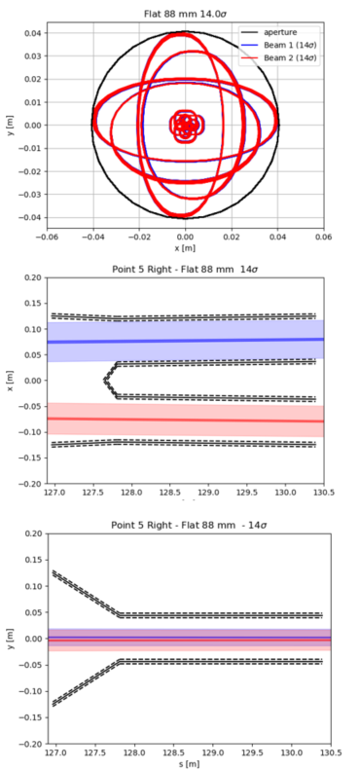
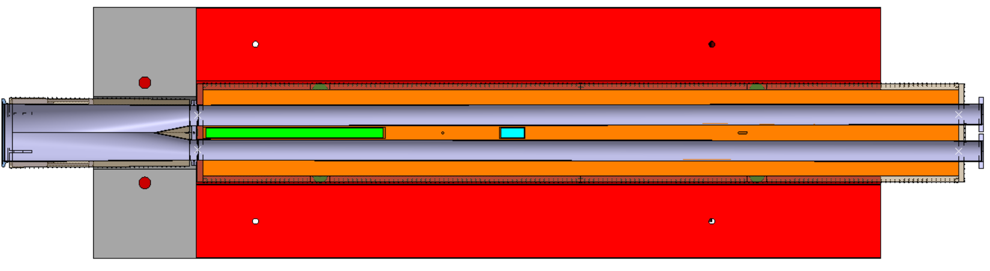
Inputs: beam separation & beam aperture
Absorber and Y-chamber geometry designed for the beam separation and beam aperture inputs provided by WP2.
  0.172deg angle between double pipes.
Mechanical and alignment tolerances approved in WGA [9] and being collected by WP2 [10].
The total recombination chamber and absorber lengths are 4.3m and 3.31m, respectively.
Beam separation:
151.1mm
DCUM: 127812
Beam aperture
DCUM: 131144
Beam separation:
161.1mm

Slide 27
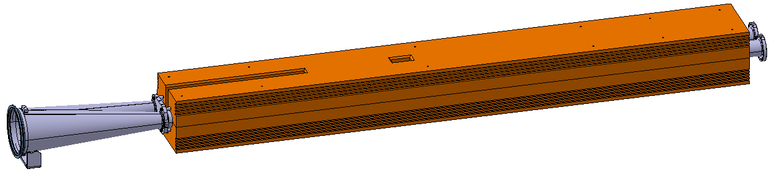
Tolerances update
CONCLUSION OF THE STUDY: the tolerance sum-up linearly depends on the
location along the absorber.
Accuracy /
Standard manufacturing [mm]
Tolerance type | n | Concept | OLD | A | B | C
Alignment | 0.1 | Precision of the measurement from the measured reference axis to the fiducials @ 3σ | 0.1 | 0.1 | 0.1 | 0.1
 | 0.2 | Precision of the transfer measurement from the fiducials to the permanent monitoring system @ 3σ | 0.15 | 0.15 | 0.15 | 0.15
 | 0.3* | The alignment precision with respect to the neighbouring element (via WPS and inclination sensors) @ 3σ | 0.9 (Q5-Q5) | 0.9 (Q5-Q5) | 0.9 (Q5-Q5) | 0.9 (Q5-Q5)
Mechanical | 1 | Pipe thickness | 0.2 | 0.2 | 0.2 | 0.2
 | 2 | Pipe circularity | 1 | 1 | 1 | 1
 | 3 | Position of the pipes with respect to each other | 2 | 2 | N/A | N/A
 | 3.1 | Reference plate holes | 0.5 | 0.5 | N/A | N/A
 | 3.2 | Welding of the pipes to the reference plate | 1.5 | 1.5 | N/A | N/A
 | 4 | Absorber groove cilindricity | 1.8 | N/A | 1.8 | 1.8
 | 5 | Bakeout cycle returning position (theoretical) | 0.5 | 0.5 | 0.5 | 0.5
 | 6 | Remaining movements of the absorber with respect to the shielding (theoretical) | 0.5 | 0.5 | 0.5 | 0.5
 | 7 | Maximum shimming adjustment offset | 0.7 | 0.7 | 0.7 | 0.7
 |  |  | TOTAL | 6.05 | 5.85 | 5.85
* https://indico.cern.ch/event/831552/contributions/3484755/attachments/1895465/3131221/2019-08-27_Simulation_HL_LHC_hmd.pdf
N/A → Not Applicable
C
B
A

Slide 28
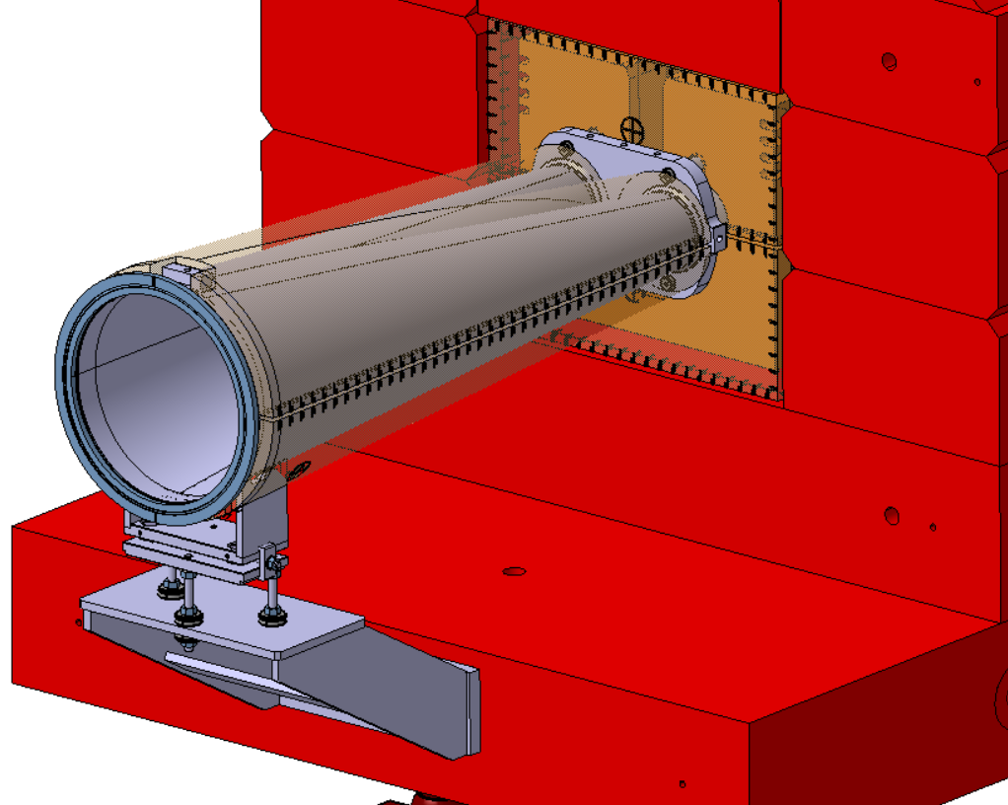
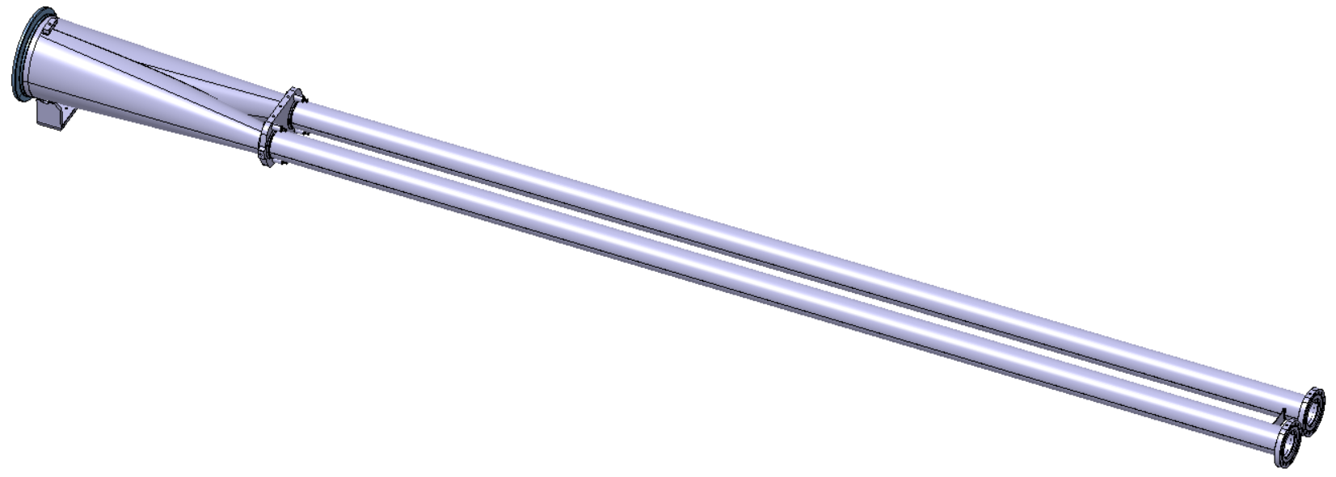
Recombination chamber
Bolted to the IP face of the absorber and clamped between the two absorber halves.
Made of stainless steel, NEG coated and bakeable.
88mm inner diameter in the legs pipes (approved by WP2, WGA & WP5).
  Tolerances defined together with the absorber (Alignment WG meeting #39).
  Beam aperture validated by WP2 (184th HiLumi WP2 Meeting).
  Heat deposition on the downstream collimators and D2 validated by WP10
  (ColUSM #133).
Beam impedance validated by the Impedance Working Group [11].
Technical specifications document updated [12].
Flange Øint 250mm
Reference plate fixed
to the absorber
Non parallel tubes
Integration of the bakeout jackets
and the reference plate
Recombination
part
Flange Øint 90mm
Ø_{int} 88mm
WP12 & WP8
LHCVCTYF0001

Slide 29
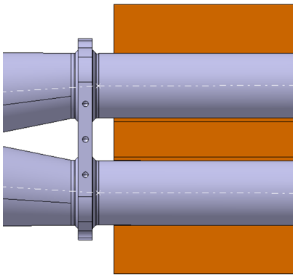
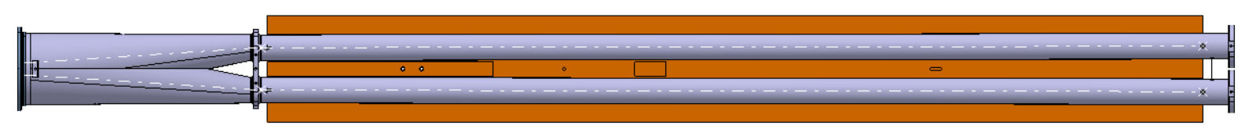
Fitting between the absorber and the chamber
The mechanical tolerances definition of the absorber and the pipes are defined in such away that,
in the worst-case scenario, the thermal contact between the absorber and the recombination chamber
is not compromised.
Tolerances on the groove and weld positioning have a big influence in the fitting.
  → dummy absorber or jig foreseen for legs welding.
Leg 1
Absorber/jig
Leg 2

Slide 30
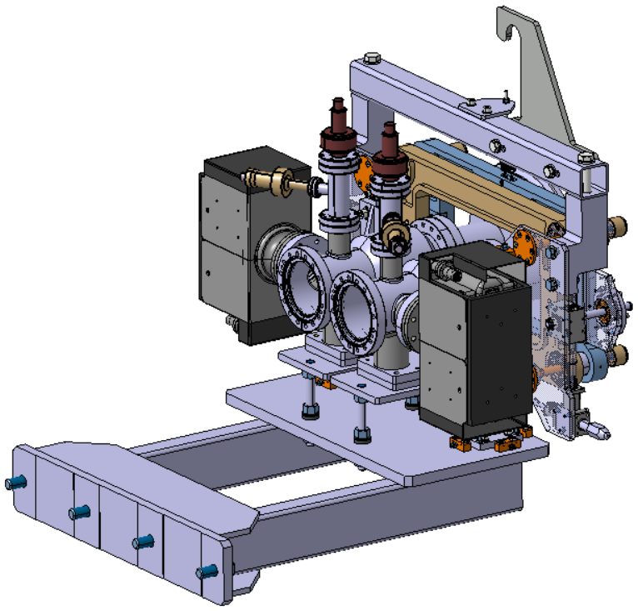
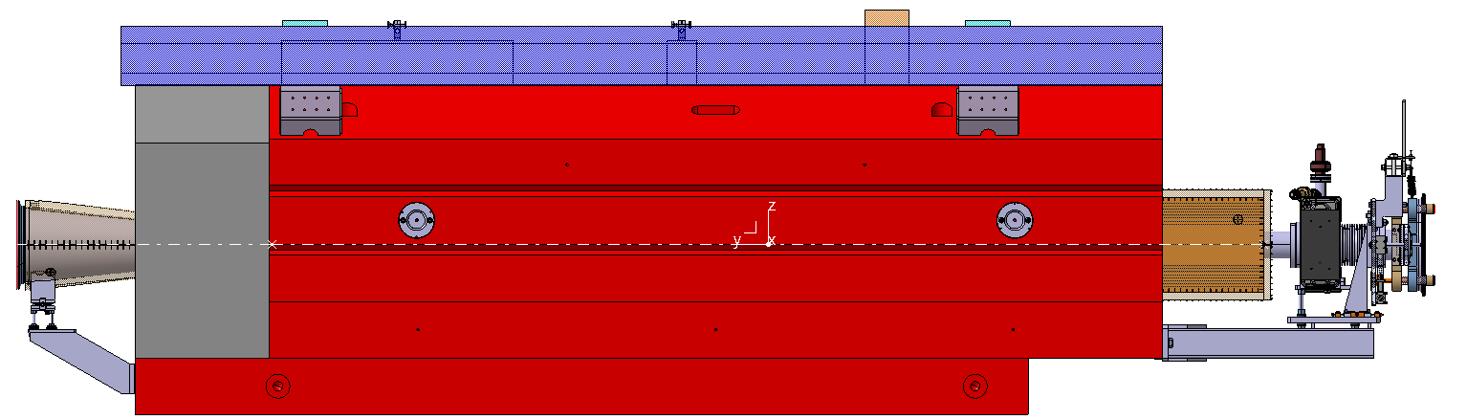
Vacuum module on D2 side
& recombination chamber support
Vacuum assemby (support + modules + coupling tool and connection flange) weigths around 160kg.
Both supports allows displacement in the beamline direction to
avoid termal stresses during bakeout.
Protection foreseen on the IP side for the recombination part.
Length of the TAXN assembly: 4.766m.
Courtesy of J. Meignan
4766 mm

