Slide 1
Status of services integration in ATLAS
Cradle modified
Sections (cabling & pumping lines) received 07/11/22
M1 3D received 12/12/22→ Starting
Need to shorten guiding columns

Slide 2
Information services VAX area - ATLAS
Module 1
Module 2
Component | Cabling | Bending radius
Sector valve | 1x NER4 – D6.8mm 2x Tube D8 mm. Hose D16mm. Connector 20mm | R50mm
Heating jacket | Power: 12x AXON FHT1619NPC– D1.73mm TCK: 12x Horst- ZD 00006 - D2.6mm | R30mm
Penning VGPB | 1x TFAR3 – D10mm | R103mm
Component | Cabling – Diameter | Bending radius
Angle valve VVFCD | 2x NER4 – D6.8mm 2x Tube D8mm compressed air. Hose: D16mm. Connector: 20mm | R34mm
Penning VGPB | 1x TFAR3 – D10mm | R103mm
Pirani VGRB | 1x NGR4 – D7.3mm | R36mm
NEG VPNCA | 1x NGR4 – D7.3mm | R36mm
Bayard-Alpert VGIA | 1x NER8 – D9.8mm 1x TCAR3 – D10mm | R50mm R103mm
Ion pump VPIXD | 1x SDF04_17 – D4.5mm | R45mm
Rupture disk
Heating jacket VEJ | Power: 48x AXON FHT1619NPC – D1.73mm TCK: 48x Horst- ZD 00006 - D2.6mm | R30mm
Module 3
Component | Cabling | Bending radius
Sector valve | 1x Position indicator: NER4 – D6.8mm 2x Tube D8 mm. Hose D16mm. Connecteur 20mm | R50mm
Penning VGPB | 1x TFAR3 – D10mm | R103mm
Heating jacket VEJ | Power: 12x AXON FHT1619NPC– D1.73mm TCK: 12 x Horst- ZD 00006 - D2.6mm | R30mm
Pumping lines
Pumping lines
Shielding | D tube: D63/60. → With heating jacket: D123mm D flange: 114mm → With collar: D122mm (connector on one side required: 2cm long) Thickness jacket: 30mm. Collar: 4mm. Ears: 10.5mm. Connector: 20mm
VAX area | D tube: D38/34. → With heating jacket: D98mm D flange: 70mm → With collar: D80mm (connector on one side required: 2cm long) Thickness jacket: 30mm
Experimental chambers
Component | Cabling – Diameter | Bending radius
Heating components | Power: 56x – D1.73mm TCK: 42x - D2.6mm | R30mm
2x Ion pump VPIXD | 2x SDF04_17 – D4.5mm | R30mm
2x VGPB | 2x TFAR3 – D10mm | R103mm

Slide 3
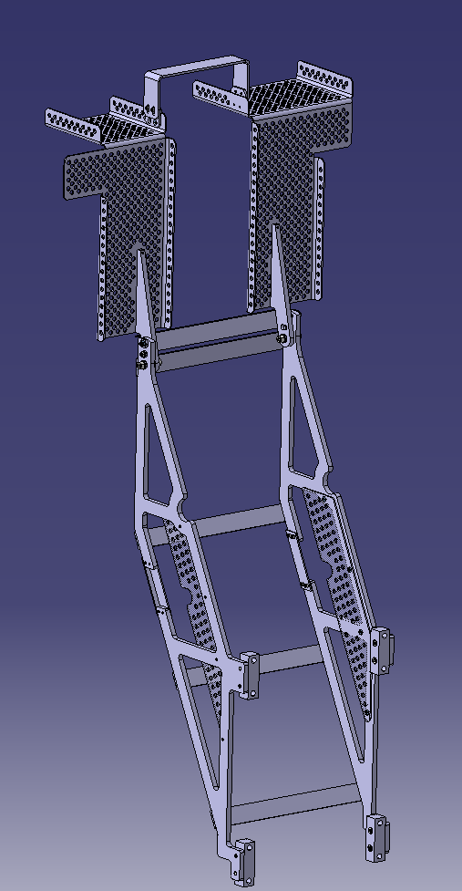
Modifications in Integration model
Support M1 → remove Staublis. Adjust structure to module dimensions.
Include rails that support cradle.
Cradle ? → remove material in VAX area to be sure the area that we can use.
Include metal grill ATLAS (ST0557649)

Slide 4
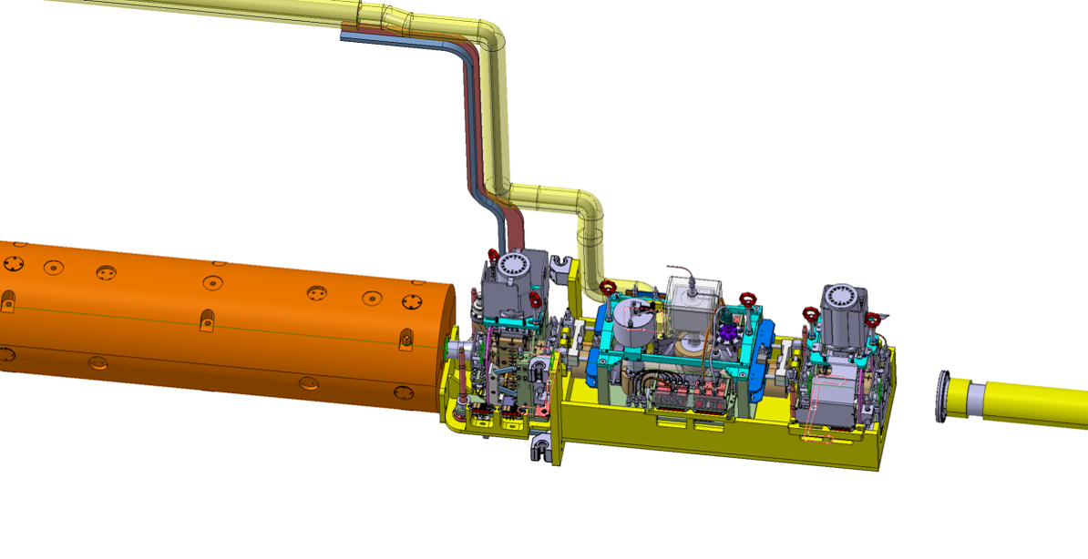
M1- Need of independent removal w. services if failure (no Staublis)
M2 & M3 - Need of independent removal if failure
M2 & M3+ Support- Need of removal every LS
Staublis to be removed, support plate width to be shortened

Slide 5
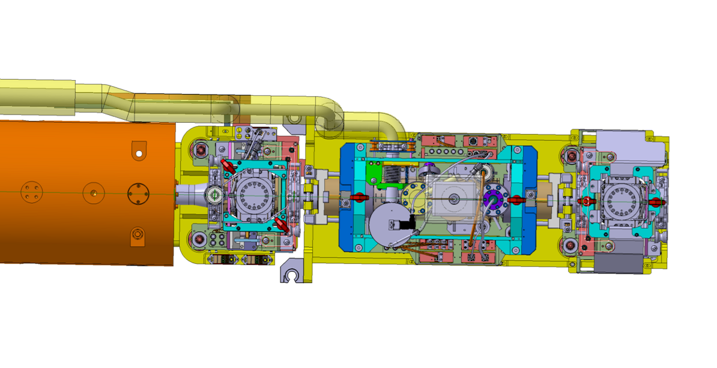
M1- Need of independent removal w. services if failure
M2 & M3 - Need of independent removal if failure
M2 & M3+ Support- Need of removal every LS
Staublis to be removed, support plate width to be shortened

Slide 6
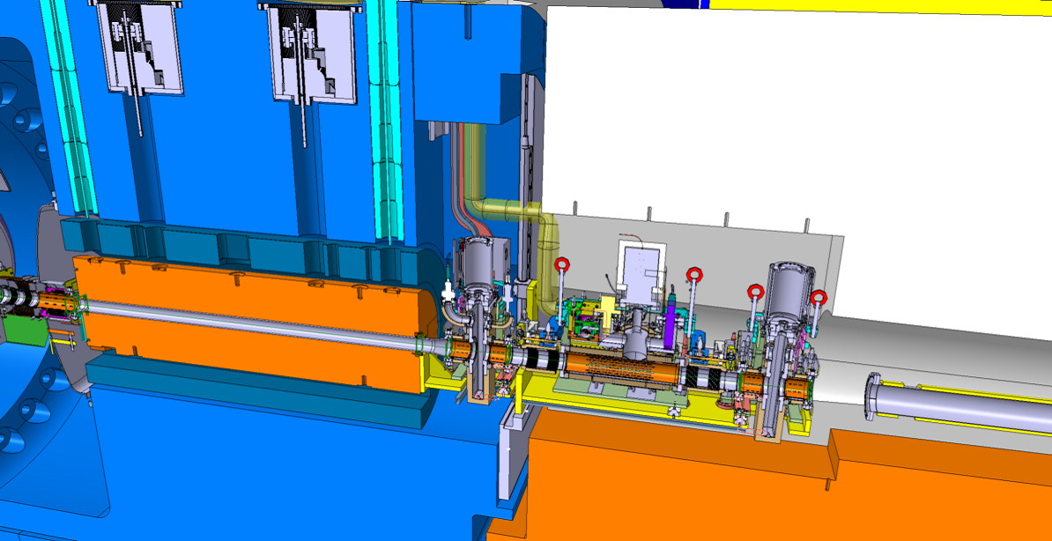

Slide 7
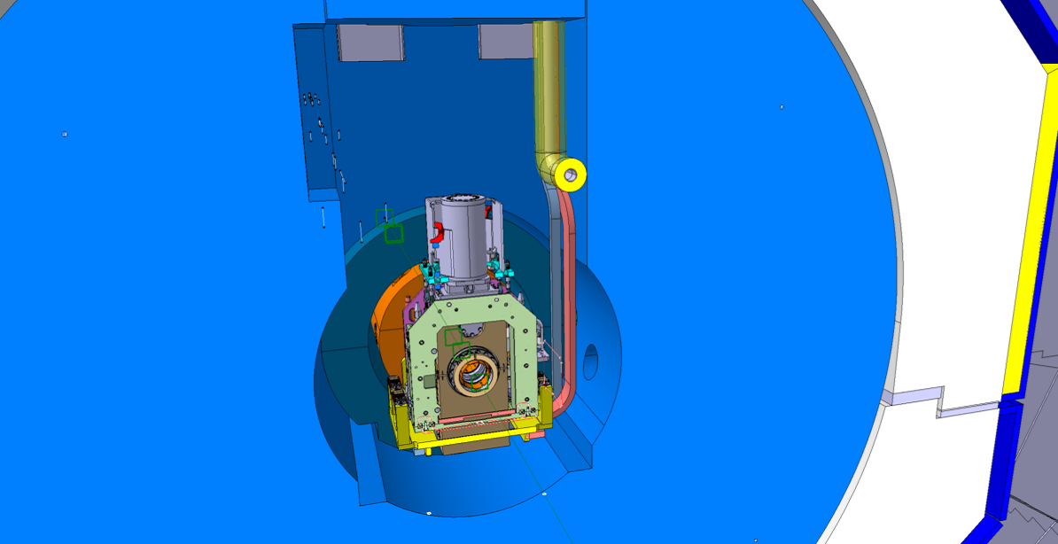

Slide 8

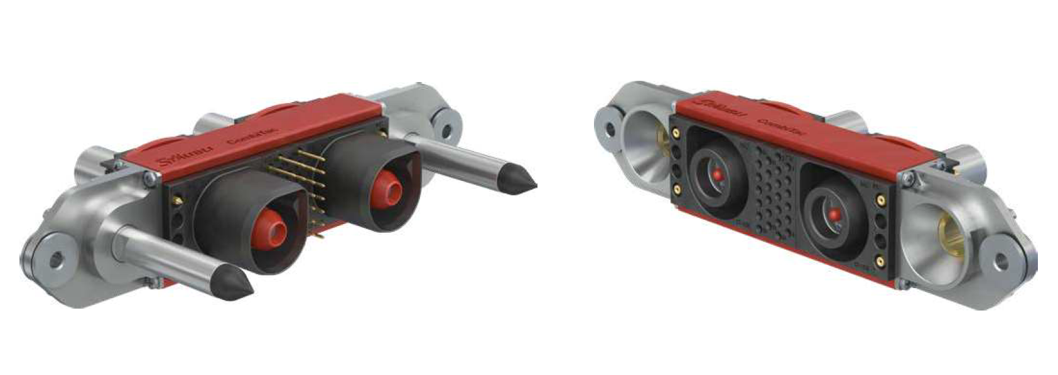
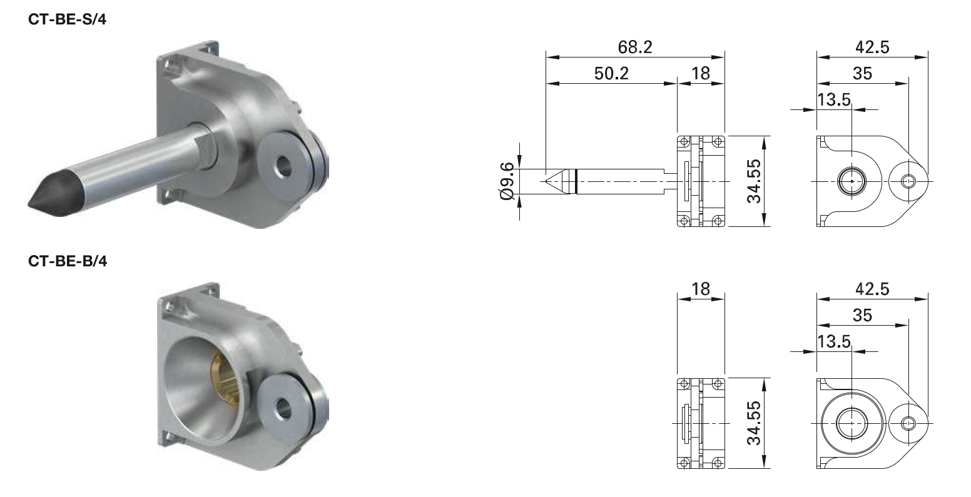
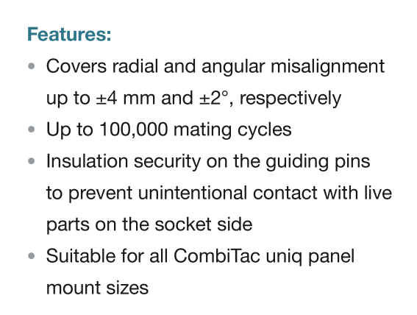

Slide 9
Next steps
Ad-hoc meetings

