Slide 1


Testing Grand Unified Theories with gravitational waves and proton decay
Luca Marsili (IPPP, University of Durham)
Based on 2209.00021 with S. Pascoli, J. Turner, S. King Y. Zhou and B. Fu
EuCAPT Annual Symposium, May 2023
Luca Marsili
Institute for Particle Physics Phenomenology

Slide 2
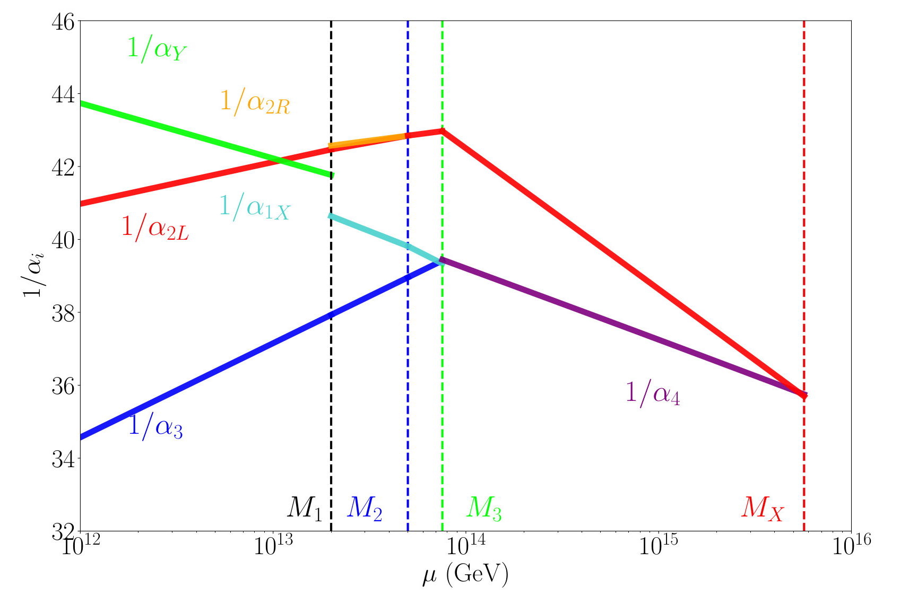
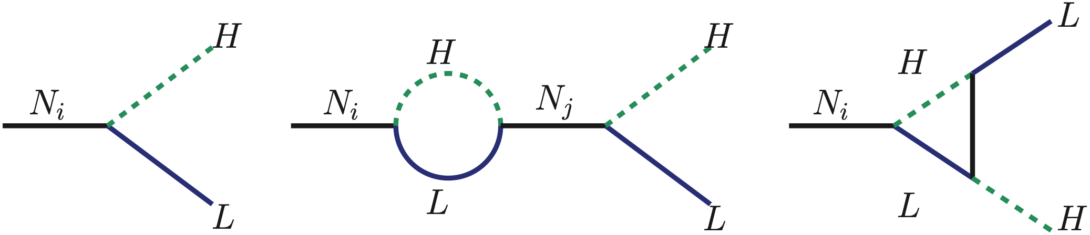
Why GUT?
Unification of the gauge couplings
SM may not be a fundamental theory at high scales
Predict fermion masses and mixing
Baryogenesis
Neutrino masses
Luca Marsili
1
Institute of Particle Physics Phenomenology

Slide 3
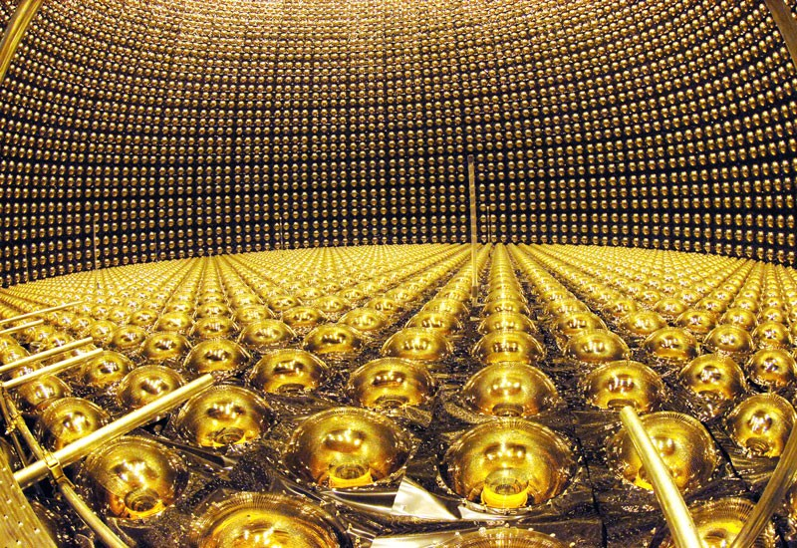
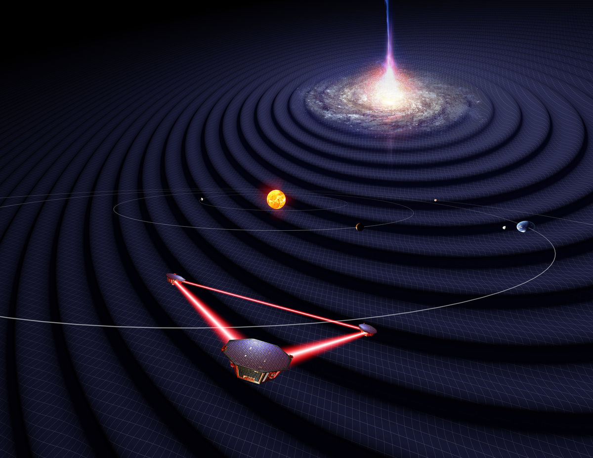
How to test SO(10)
Credit: SuperKamiokande
Credit: LISA
Proton decay
Gravitational waves
LISA
NANOGrav
PPTA, EPTA, IPTA
ET
Super-Kamiokande
Hyper-Kamiokande (future)
DUNE
JUNO
[2005.13549, 2106.15634]
1
<numero>
<numero>
<numero>
<numero>
Luca Marsili
<numero>
Luca Marsili
2
Luca Marsili
Testing GUT with gravitational waves and proton decay
Luca Marsili Fermion Masses, leptogenesis and gravitational waves in SO(10)
<numero>
Luca Marsili Fermion Masses, leptogenesis and gravitational waves in SO(10)

Slide 4
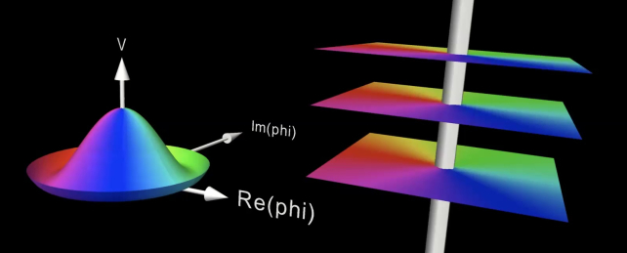

Gravitational waves from cosmic strings
U(1) breaking
Cosmic strings network
Cosmic strings network
Loops
Loops
Stochastic background
of GW
J. Blanco-Pillado, PIRSA
Luca Marsili
3
Institute of Particle Physics Phenomenology

Slide 5
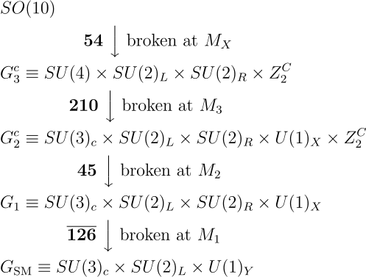
The model
Fu, King, LM, Pascoli, Turner, Zhou 2209.00021
Type IIIc breaking chain
Luca Marsili
4
Institute of Particle Physics Phenomenology

Slide 6
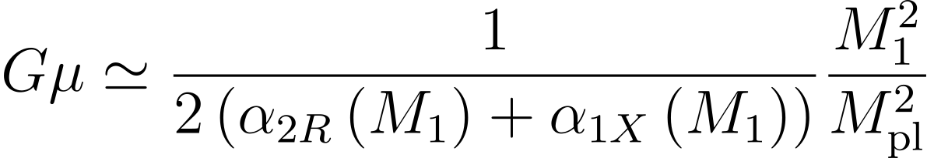
The model
Fu, King, LM, Pascoli, Turner, Zhou 2209.00021
Type IIIc breaking chain
String tension
Luca Marsili
5
Institute of Particle Physics Phenomenology

Slide 7
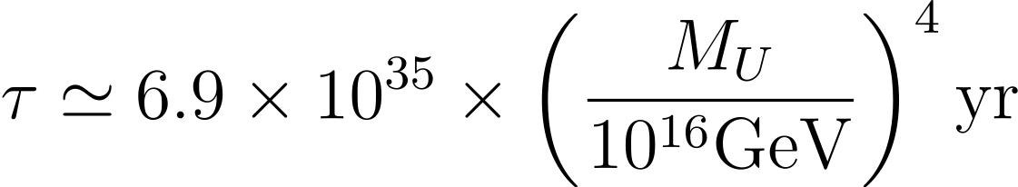
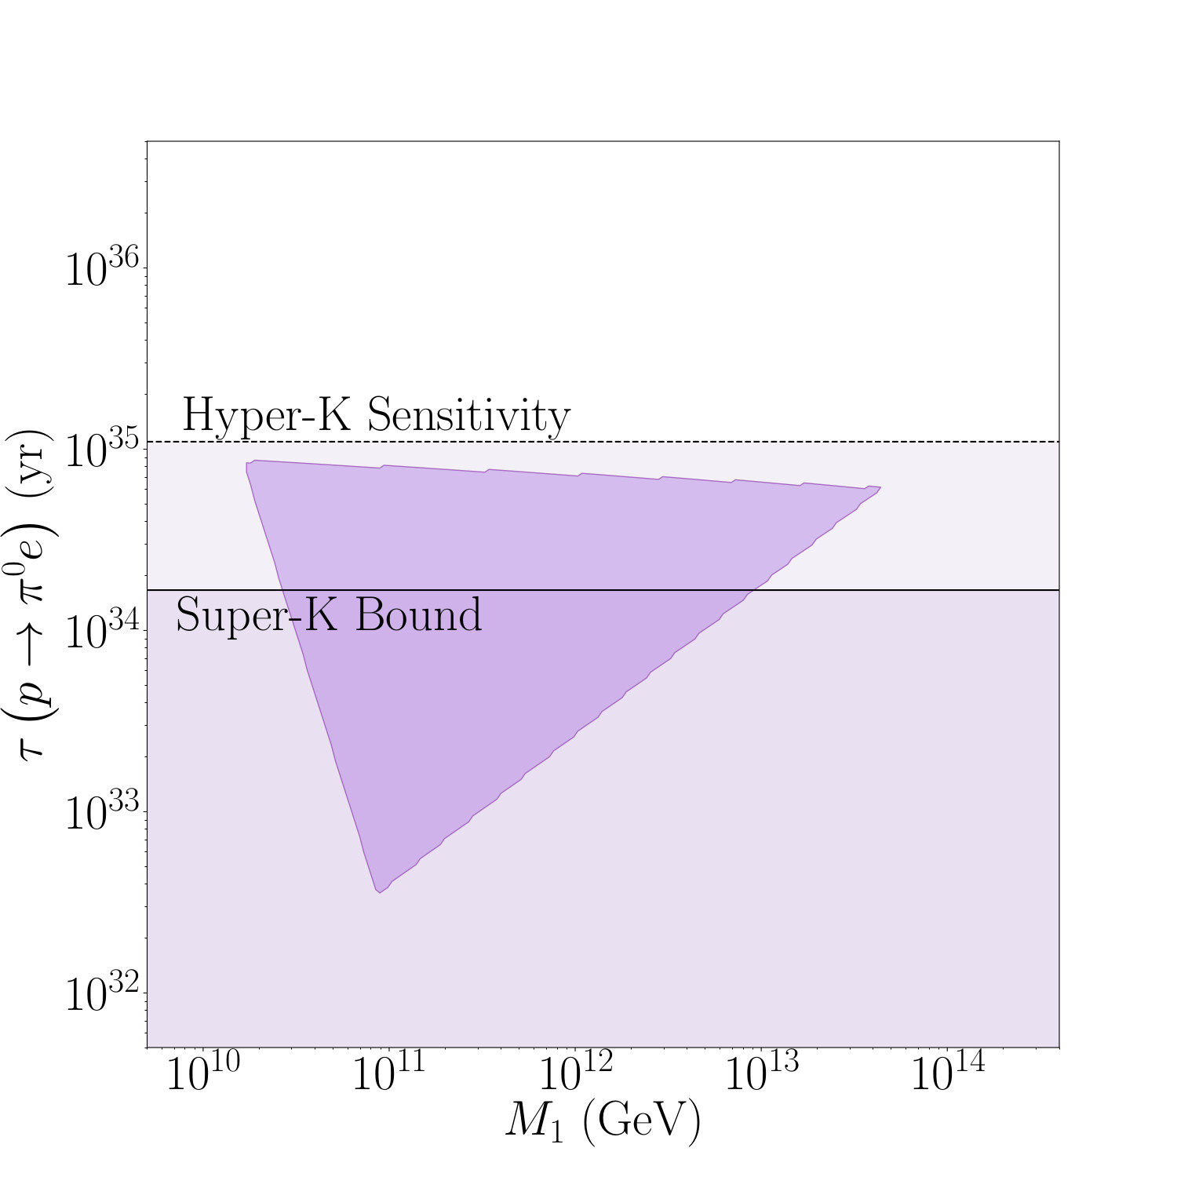
The model
Fu, King, LM, Pascoli, Turner, Zhou 2209.00021
Proton lifetime
Type IIIc breaking chain
The two scales are linked by gauge unification constraint
1
<numero>
<numero>
Institute of Particle Physics Phenomenology
Luca Marsili
6

Slide 8

Our model
Fu, King, LM, Pascoli, Turner, Zhou 2209.00021
Type IIIc breaking chain
Type IIIc breaking chain
Set RHN neutrino mass up to Yukawa couplings
Luca Marsili
7
Institute of Particle Physics Phenomenology

Slide 9
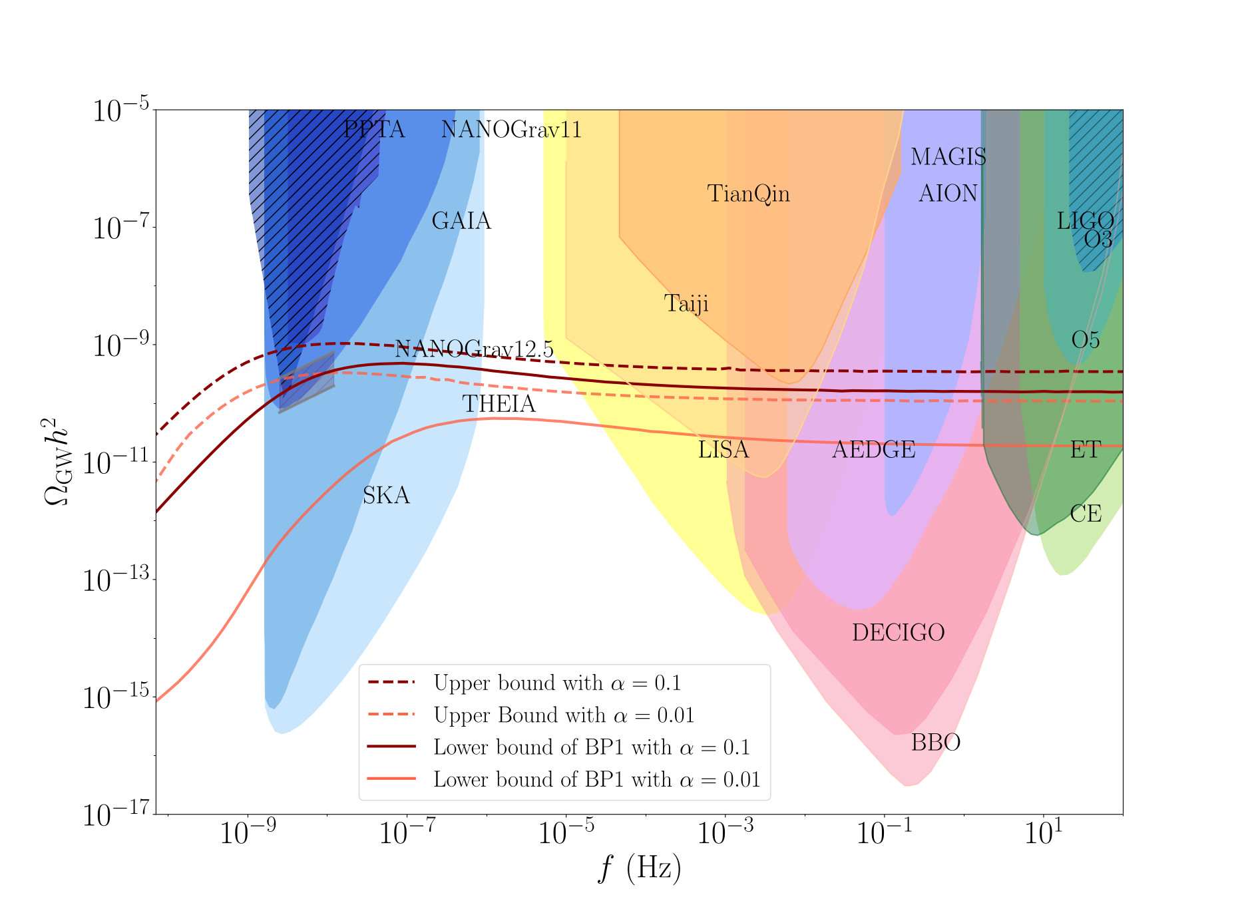


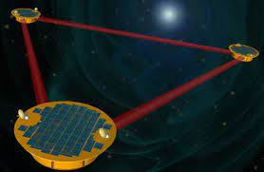
Results
Flat spectrum at high frequencies
Luca Marsili
8
Institute of Particle Physics Phenomenology

Slide 10
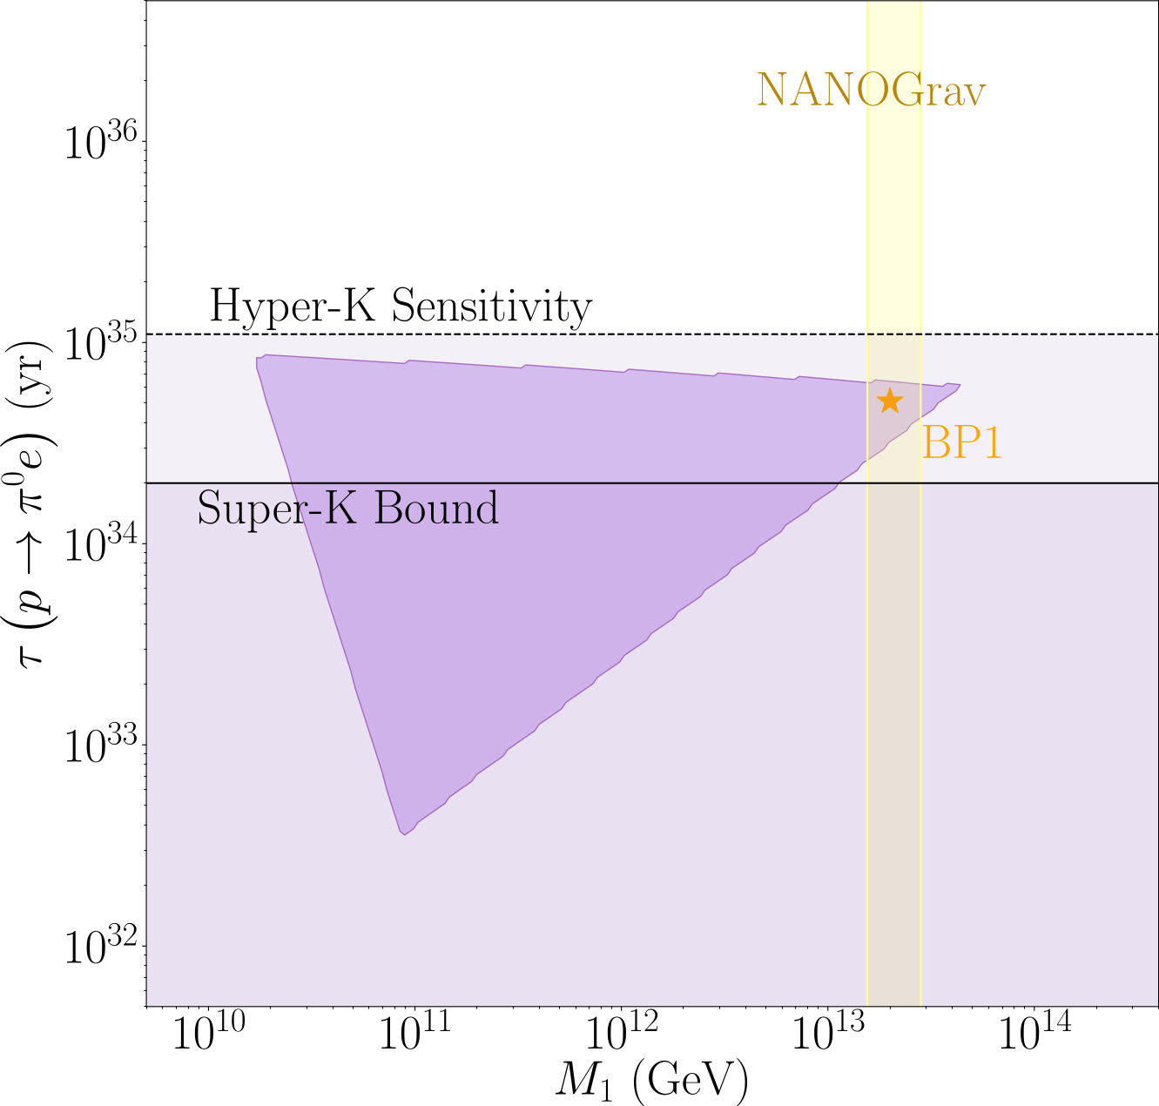
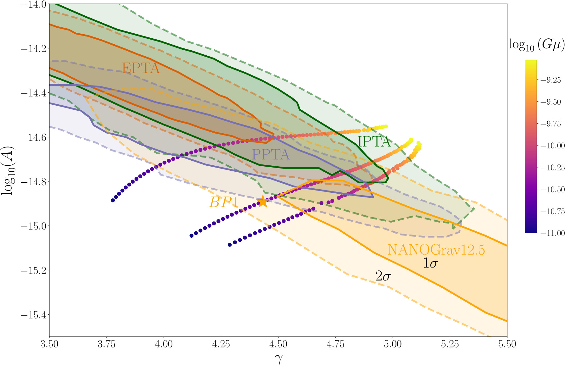
Results
Luca Marsili
9
Institute of Particle Physics Phenomenology

Slide 11

Conclusions
Succesful gauge coupling unification
Prediction of fermion masses and mixing angles
Testable with next-gen GW and proton decay experiments
The model is consistent with the current data from Pulsar Time Arrays
Luca Marsili
10
Institute of Particle Physics Phenomenology

Slide 12
Thank you
<numero>

