Slide 1
Indico + CERNBox:
CERN services working together
Javier Ferrer
March 2023

Slide 2
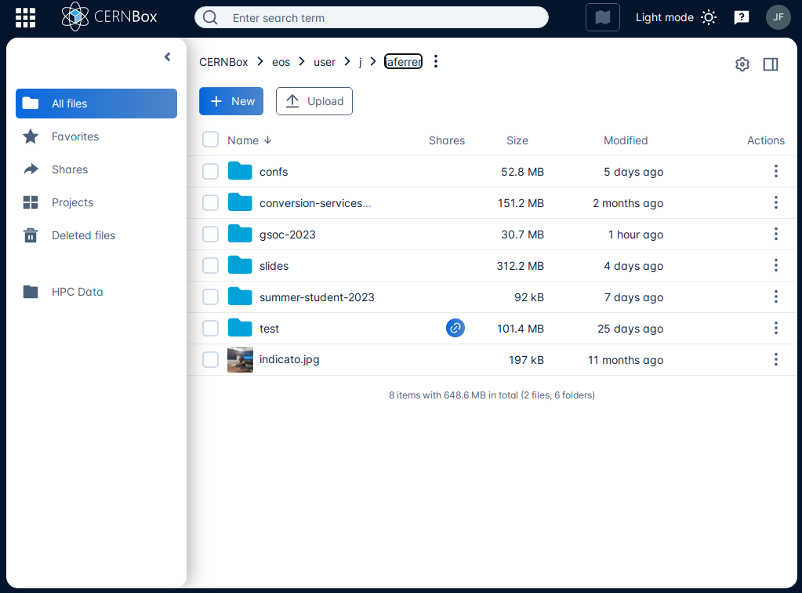

CERNBox

Slide 3



Vision

Slide 4
Vision

Slide 5
Problems
Application-specific solutions are not reusable and hard to integrate with multiple EFSS services
EFSS service differences make it difficult for a one-size-fits-all solution

Slide 6

Solution
CERNBox File-picker is a standalone implementation which bridges the integration between a cloud storage provider and an app.
At the moment it uses WebDAV, so it is compatible with any ownCloud version.
Eventually it would use CS3 APIs, so the compatibility list would expand to any of the mesh storage services.

Slide 7
Features
Easily integrate EFSS providers into any web application
Covers different use cases
  File fetching / linking
  File upload
Provides authentication and user interface, leaving only the handling of the files to the target application

Slide 8
Features
Easily integrate EFSS providers into any web application
Covers different use cases
  File fetching / linking
  File upload
Provides authentication and user interface, leaving only the handling of the files to the target application
Up to 75% increased Naturwissenschaften output!!!

Slide 9

How does it work?
First version uses a wrapper around a modified ownCloud File-picker
It is embedded via iframe in the application and talks to the cloud storage provider
Handles authentication with OIDC or OAUTH2
Uses postMessage to send file links to parent

Slide 10
Uses
Indico 3.2 at CERN, to attach materials into events and categories
CodiMD
Invenio integration in progress
Other CERN services are being evaluated
Other partners of the CS3MESH4EOSC consortium

Slide 11
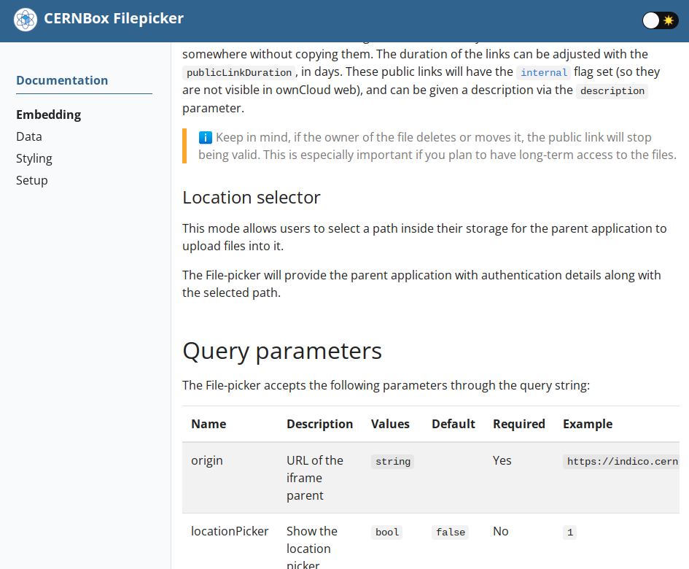
We even have docs!

Slide 12
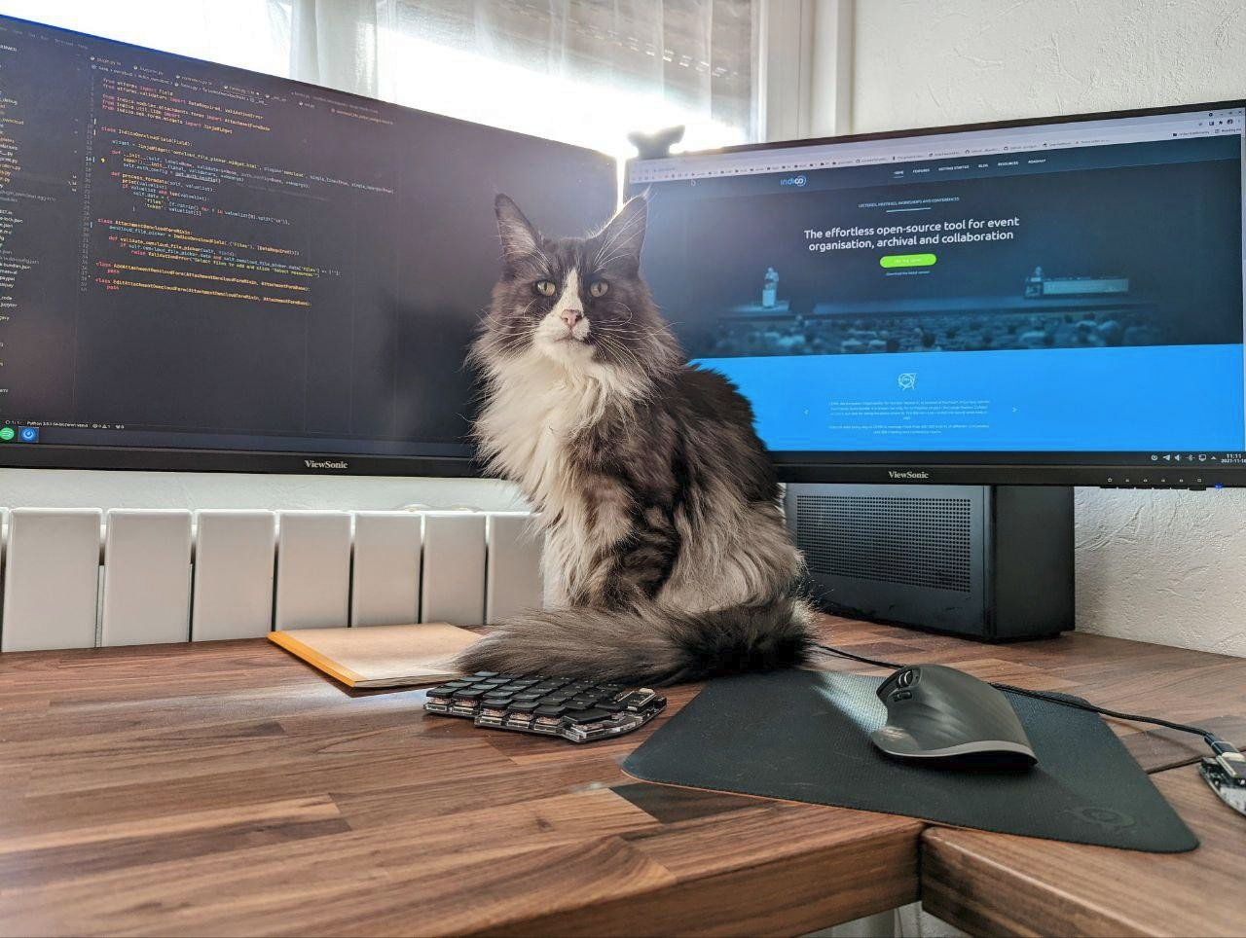
Flow

Slide 13
Icons: Hard Drive, clouds, atom, server, app, by Eucalyp from NounProject.com
All logos are property of the respective institutions/projects
Remaining content licensed under CC-BY-SA 4.0

