Slide 1
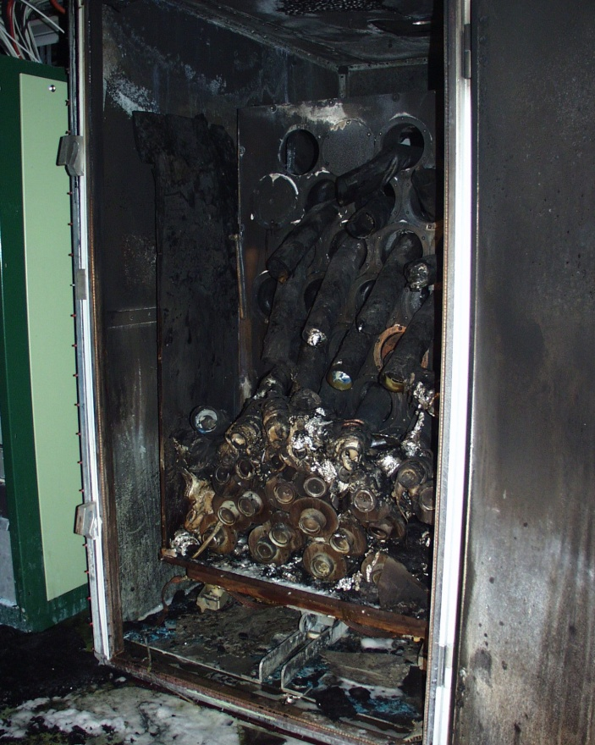
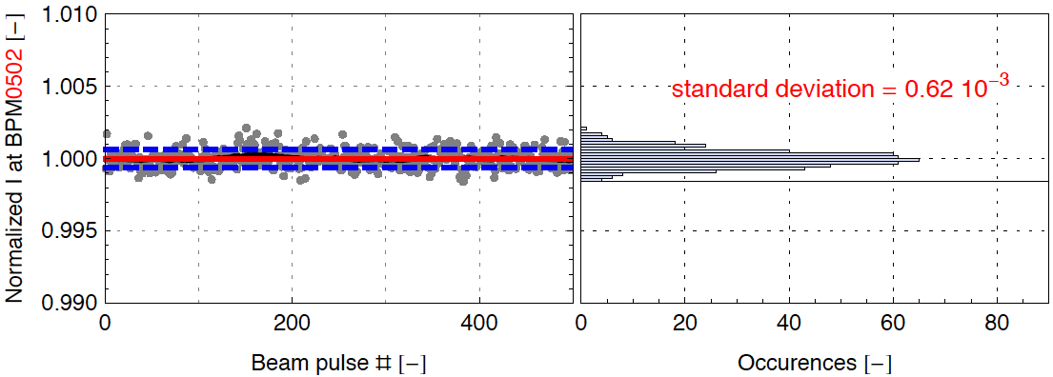
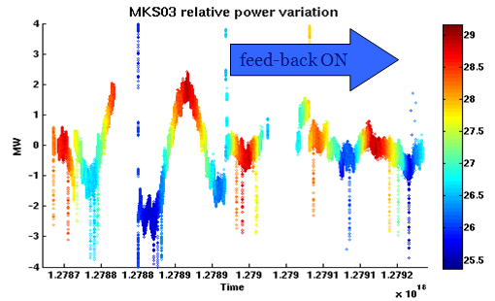
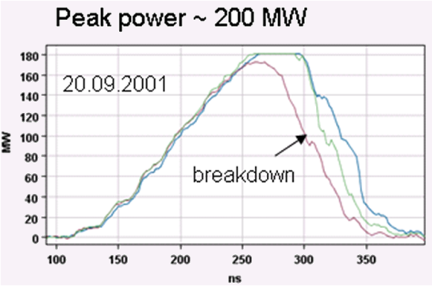
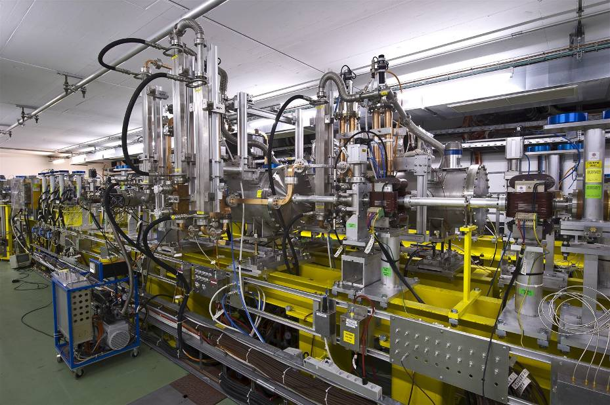
CTF3 in 2010
  Late start-up after fire in klystron gallery,
  but fast and efficient recovery
  Lots of operational improvements - optics, beam studies, procedures, hardware improvements, feed-backs…
  Demonstrated beam current stability (in linac) and klystron phase stability better than CLIC specs
  Fast RF conditioning of PETS to power levels (200 MW) well above CLIC nominal
  First two-beam acceleration test inCTF3 above nominal CLIC gradient of 100 MV/m
CTF3 pulse-forming network after fire
current stability
Klystron phase stability with feed-back
12 GHz RF power in PETS
Two-beam test stand in CTF3

Slide 2
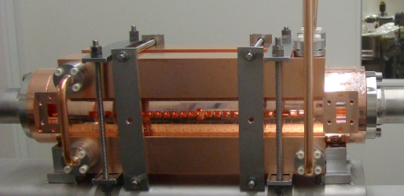
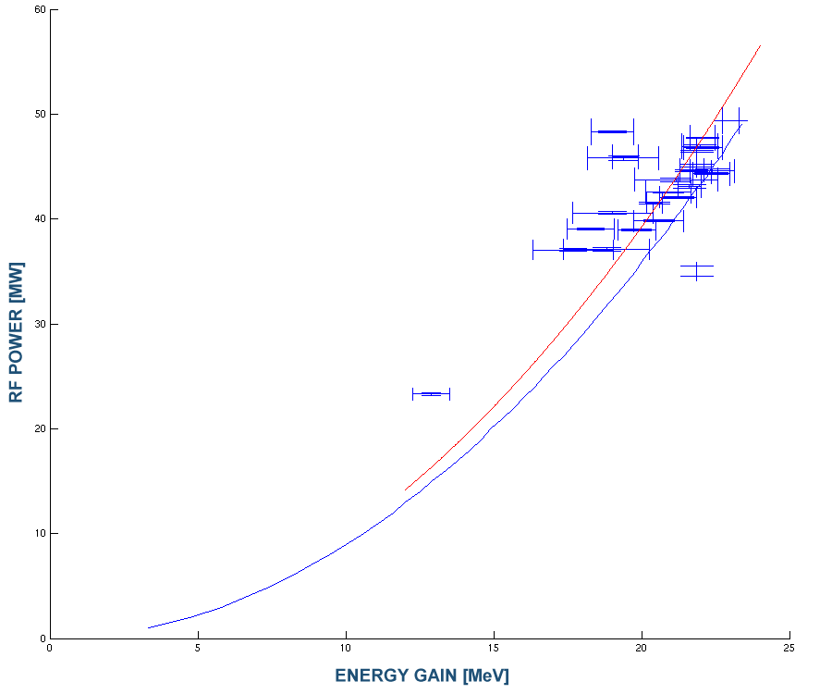
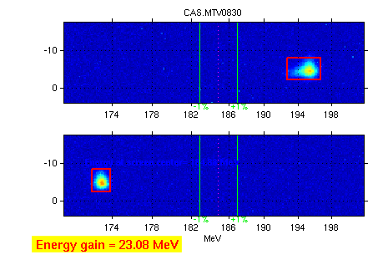
Two-Beam Acceleration demonstration in CTF3 Two-Beam Test Stand
Maximum probe beam acceleration of 23 MeV measured
⇒ Corresponding to a gradient of 106 MV/m
TD24
Drive beam ON
measurements
PRELIMINARY
fit
Drive beam OFF
expected
Lots of work still to be done, but on-time to complete feasibility benchmarks by mid-2011

Slide 3
