Slide 1
TBTS Phase 2.1
TD24 and T24 Ø45mm
G. Riddone, with the great collaboration of A. SOLODKO – 20.01.2011

Slide 2
Introduction
This presentation was already given at the RF structure meeting on 12.01.2011, and the remarks raised during the meeting were taken into account
For example the configuration for phase 2.1 was discussed and it was agreed to suppress the VPA on the accelerating structure side.

Slide 3
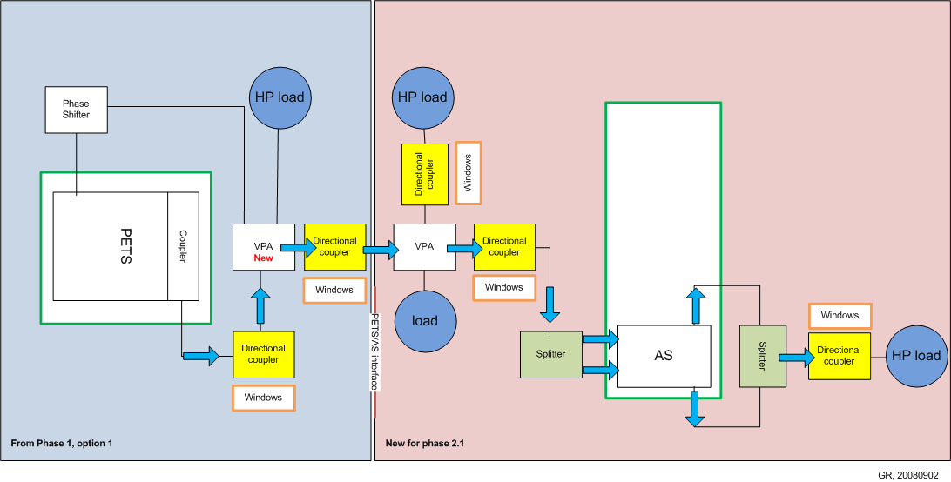
PHASE 2.1 - 2010 configuration
Problem!

Slide 4
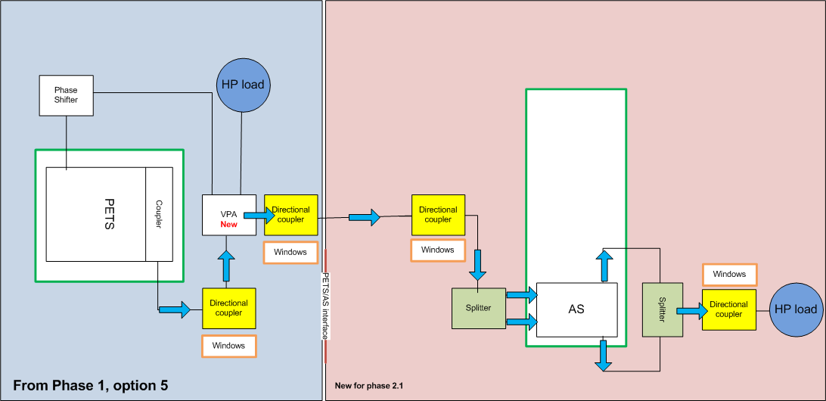
PHASE 2.1 - NEW configuration
VPA suppressed

Slide 5
Objective during shut-down for AS tanks
  Preparation of two AS tanks and one waveguide network
  Tank with the existing structure (problem: 15 MHz out of frequency – 2 MHz only before beam test)
  Tank with a new structure
  The aim is:
  - to progress with the two tanks in parallel and to decide which tank to install in CLEX at the end of the shut down period

Slide 6
TD24, existing

Slide 7
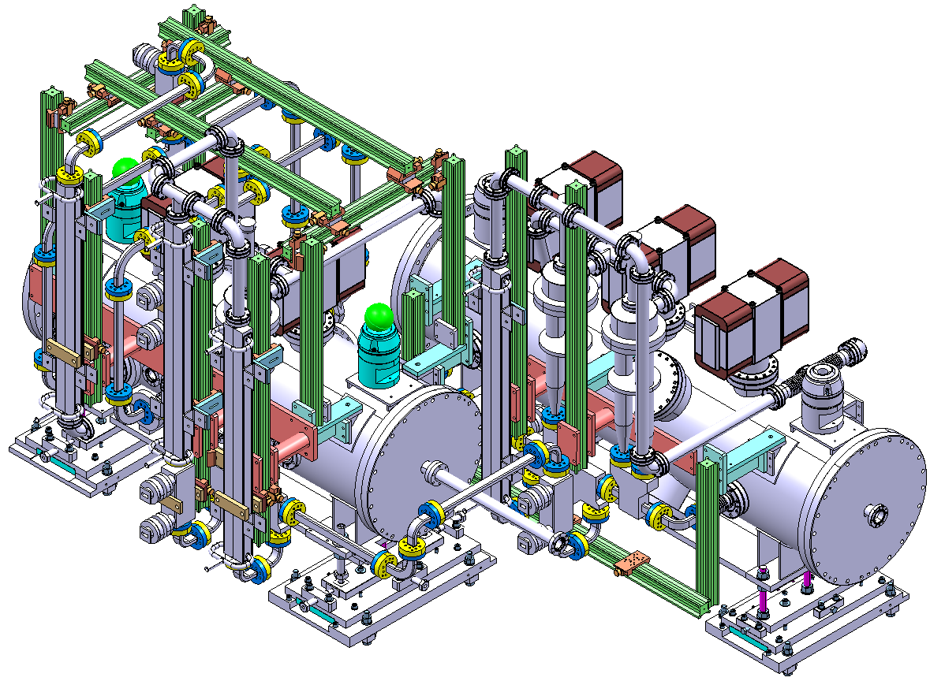
TBTS Phase 2.1 TD24 Ø80mm (2010 conf.)

Slide 8
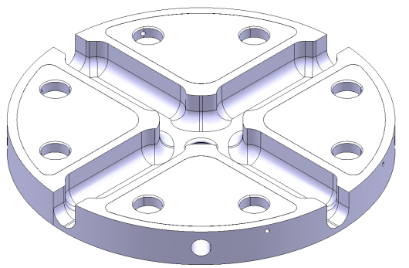
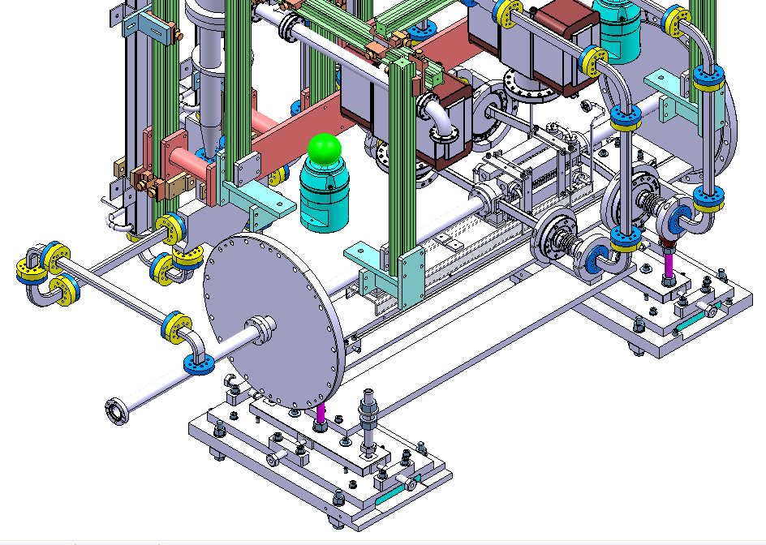
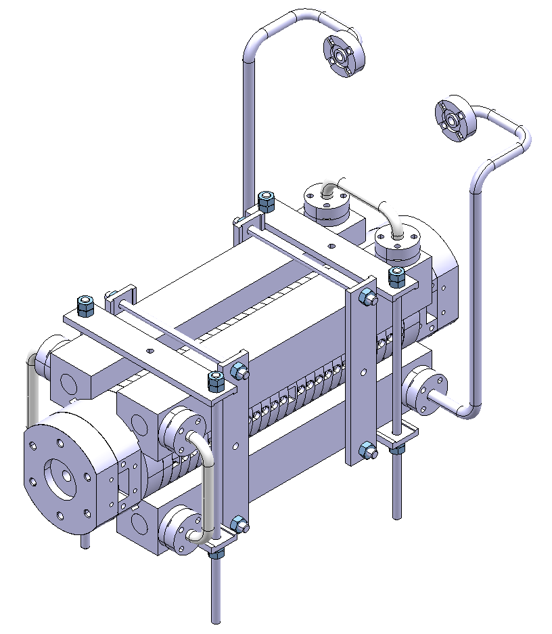
TBTS Phase 2.1 TD24 Ø80mm
STANDARD DAMPED DISK

Slide 9
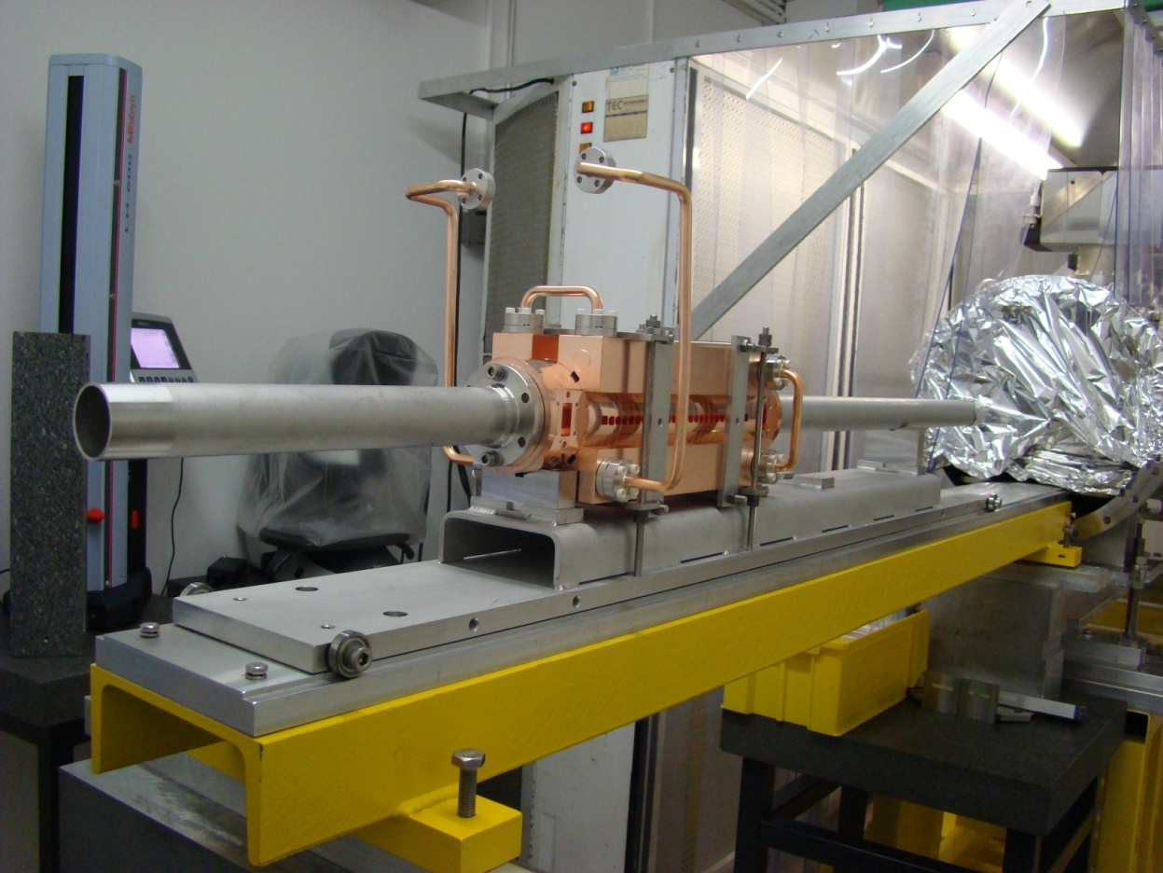
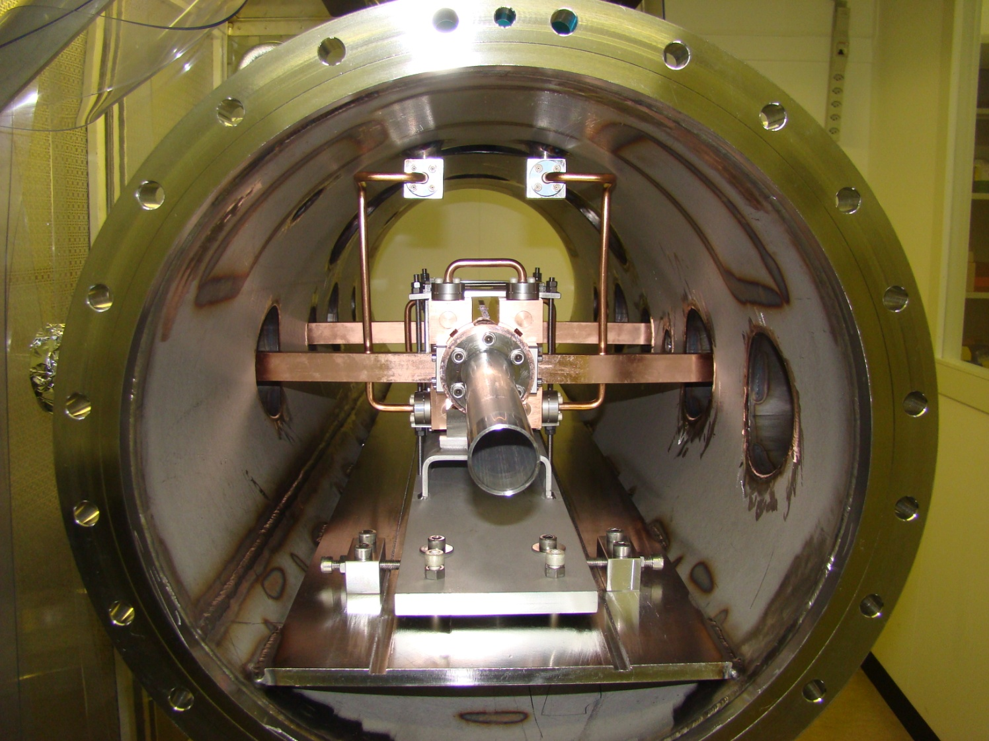
TD24 in tank

Slide 10
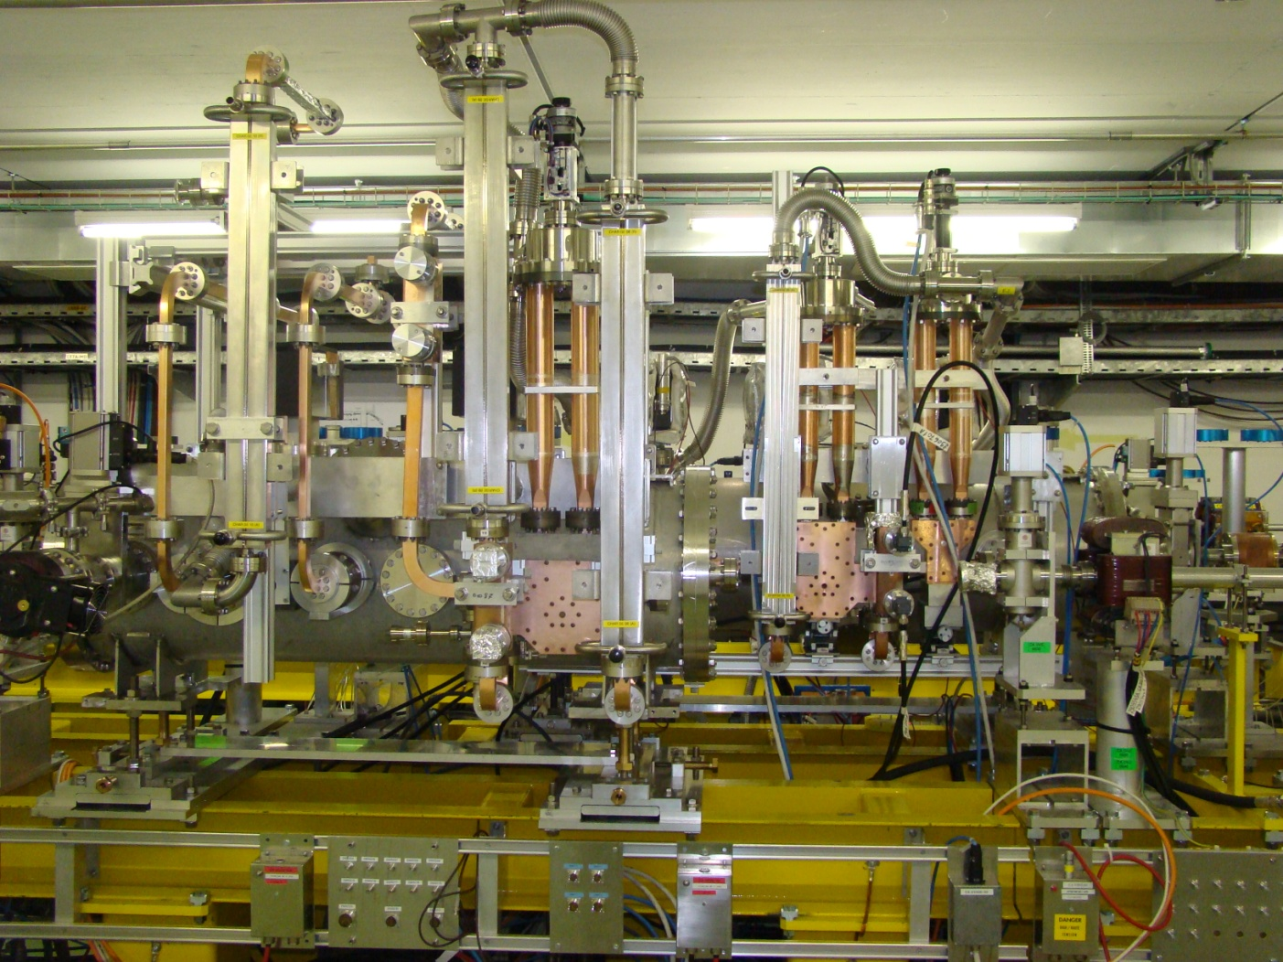
TD24 tank in CLEX

Slide 11
Main activities for TD24 tank
Tank with TD24 (existing)
  Dismounting from CLEX:
    vacuum broken,
    contacted RP measurement done, to be sure it has to be repeated far from PETS ,
    tank disconnected on 19.01,
    RF measurements on 19.01
    Contacted Gerry for big door opening to introduce the transport device
    2nd RP measurement 20.01
    Then Transport to 169 if allowed
  Brazing of tuning studs to allow for tuning by pulling + brazing of cooling circuits
  Tuning
  Short baking, 2 days
  Assembly
  RF measurements

Slide 12
T24, new

Slide 13
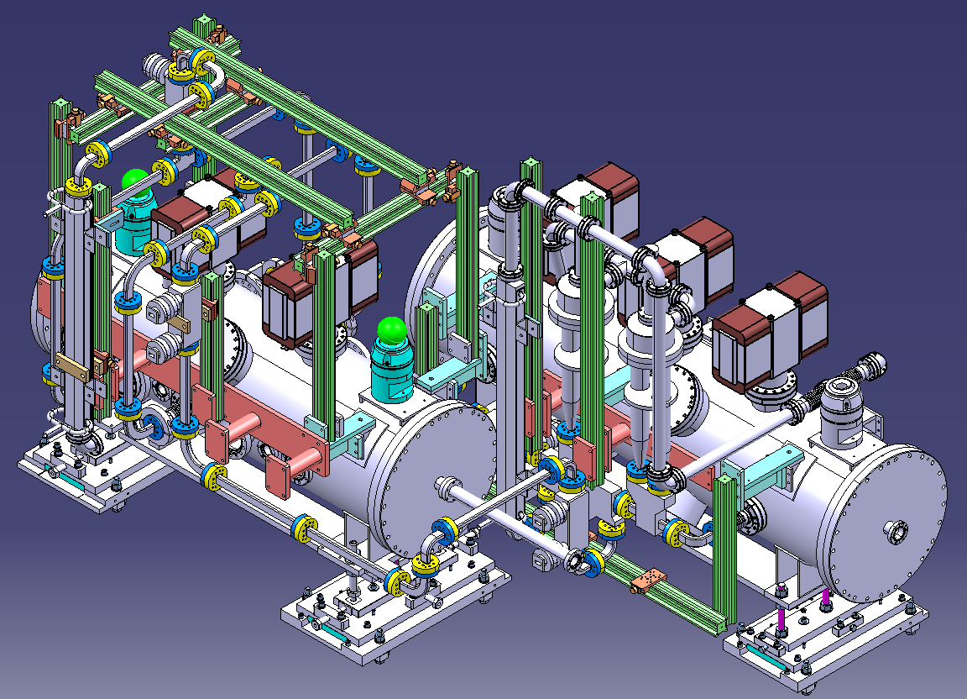
TBTS Phase 2.1 T24 Ø45mm (new conf.)
362 mm

Slide 14
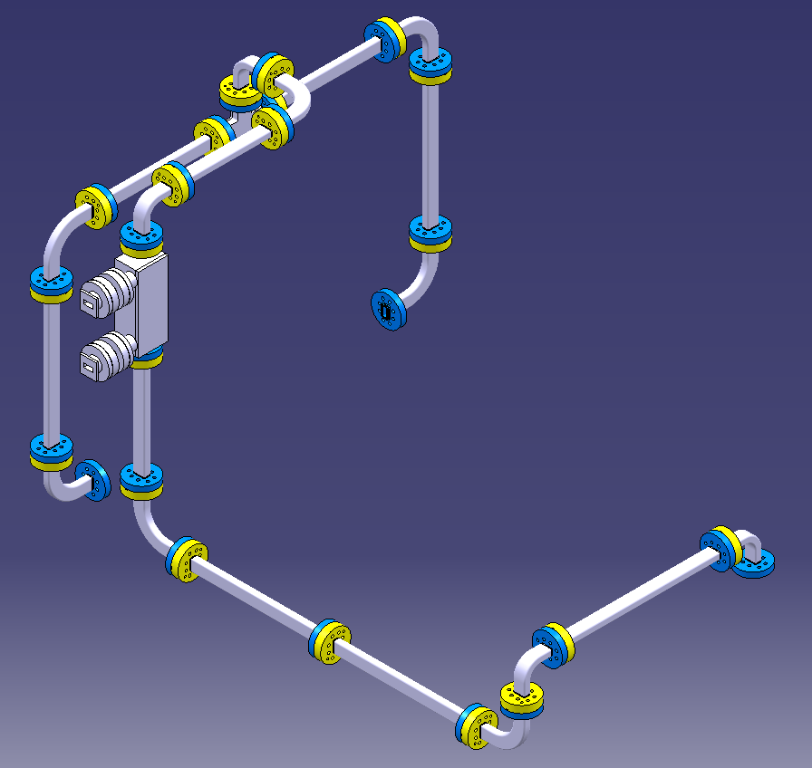
TBTS Phase 2.1 T24 Ø45mm
We will try to fit the pumping port (from Karl) here and to adapt the straight waveguide
Existing straight section waveguide

Slide 15
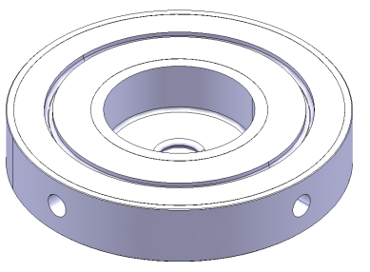
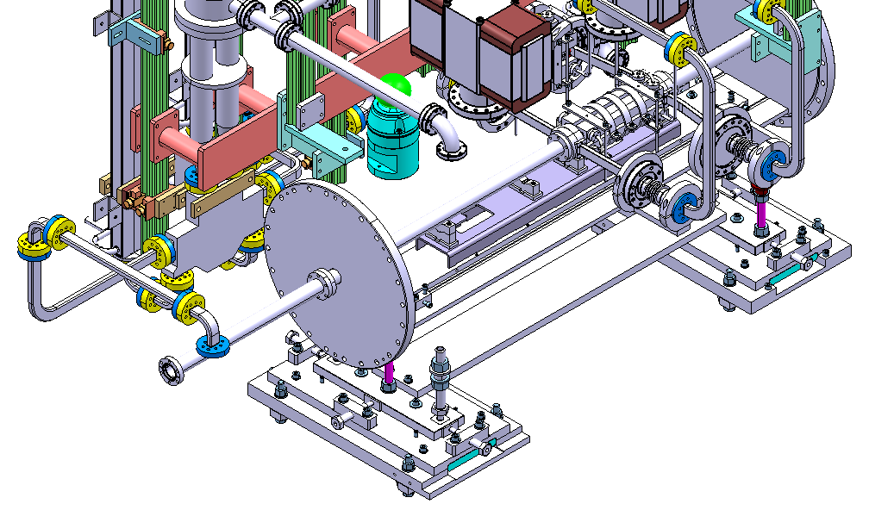
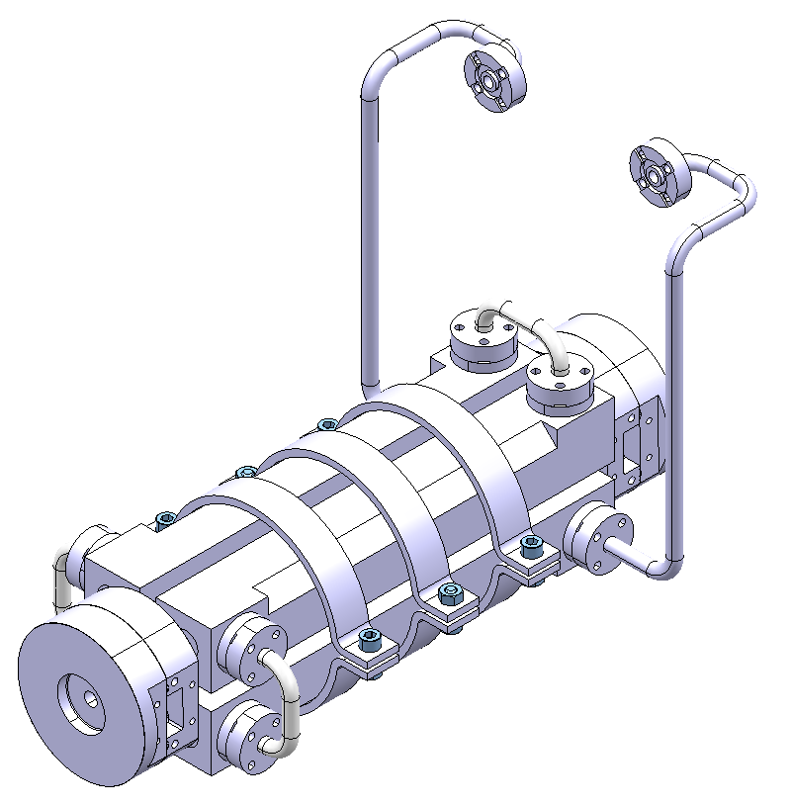
TBTS Phase 2.1 T24 Ø45mm
STANDARD UNDAMPED DISK
Smaller disk diameter, but 80 mm coupler
(the same as TD24)
Missing component

Slide 16
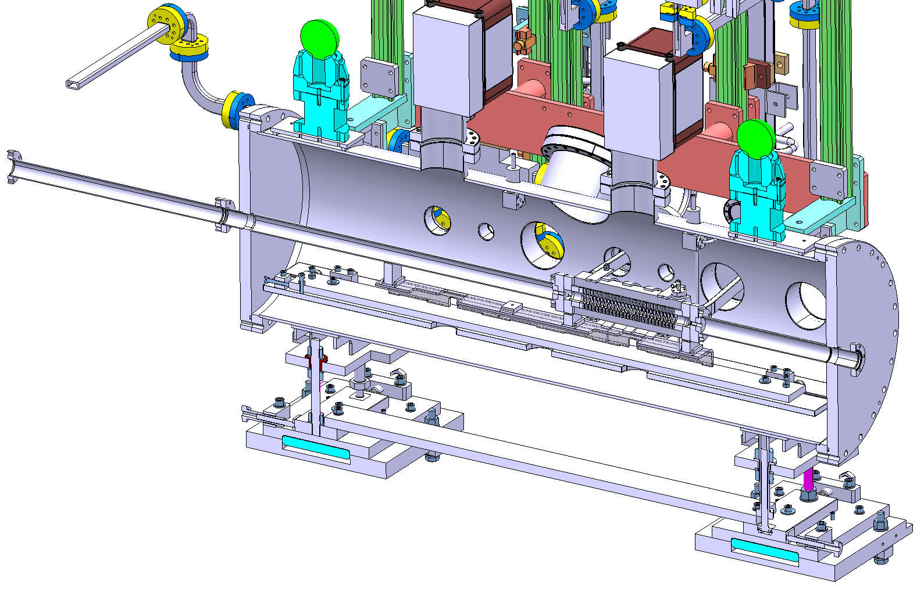
TBTS Phase 2.1 T24 Ø45mm (new components)
New cooling tubes

Slide 17
Main activities for T24 tank
Tank with T24 (new / tuned on 17.07)
  Brazing cooling blocks (done)
  Baking, 10 days (needed ad-hoc support under preparation)
  RF measurements
  Procurement of missing components
    2 cooling tubes
    1 new straight waveguide
  Assembly
  RF measurements

Slide 18
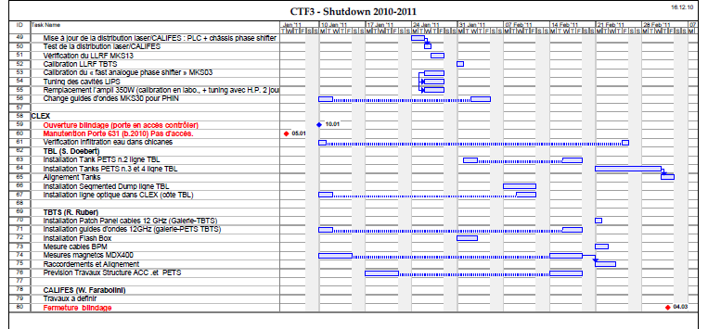
Conclusions
A lot of work during CLEX shutdown!
Aim: to be ready for installation on 18.02.2011 – end of installation 04.03.2011
https://edms.cern.ch/document/1108714/1

