Slide 1


Centrality Dependent Lévy Analysis of two-pion BEC Functions at PHENIX
Based on a recent talk at the EuNPC conference
T. Novák (for the PHENIX Collaboration)
MATE KRC, Gyöngyös, Hungary
15 Nov 2022

Slide 2
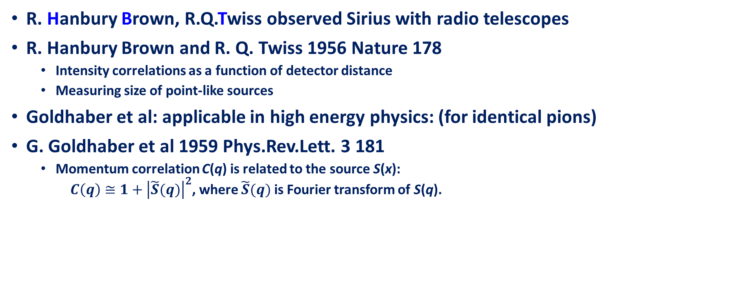
The HBT-effect in Femtoscopy
R. Hanbury Brown, R.Q.Twiss observed Sirius with radio telescopes
R. Hanbury Brown and R. Q. Twiss 1956 Nature 178
  Intensity correlations as a function of detector distance
  Measuring size of point-like sources
Goldhaber et al: applicable in high energy physics: (for identical pions)
G. Goldhaber et al 1959 Phys.Rev.Lett. 3 181
  Momentum correlation C(q) is related to the source S(x): $C\left(q\right)≅1+{\left|\tilde{S}(q)\right|}^{2}$, where $\tilde{S}(q)$ is Fourier transform of S(q).

Slide 3
Lévy Distributions in Heavy Ion Physics
Usual assumption that S(r) is Gaussian → Gaussian C(q)
Measurements suggest phenomena beyond Gaussian distribution
Lévy stable distribution: ℒ(𝛼,𝑅;𝑟)=(2𝜋)⁻³ ∫ 𝑑³𝑞𝑒^{𝑖𝑞𝑟}𝑒^{−1/2|𝑞𝑅|𝛼}
  From generalized central limit theorem, power law tail ~ r ^{–(1+α)}
  Special cases: α = 2 Gaussian, α = 1 Cauchy
Shape of the correlation functions with Lévy source:
𝐶₂(q)=1+𝜆⋅𝑒^{−|𝑞𝑅|𝛼}; 𝛼=2:Gaussian; 𝛼=1:exponential
A possible reason for Levy source: criticality, anomalous diffusion, many others
Csörgő, Hegyi, Zajc, Eur.Phys.J. C36 (2004) 67 78

Slide 4
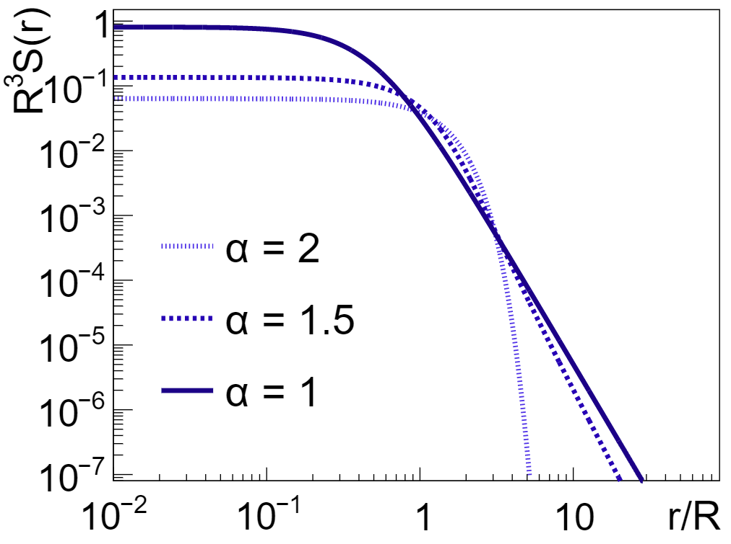
Lévy vs. Gaussian vs. Exponential
No tail if 𝛼=2, power law if 𝛼<2; tail strength depends on 𝛼
If S(r) Lévy, the distance distribution D(r) also Lévy with same 𝛼 and R → 2^{1/ 𝛼} R
Critical spatial correlation: ~𝑟 ^{−(𝑑−2+𝜂)}
Lévy source: ~𝑟 ^{−(1+𝛼)}; 𝛼⇔𝜂 ?
Csörgő, Hegyi , Zajc , Eur.Phys.J . C36 (2004)
Motivation for precise Lévy HBT!

Slide 5
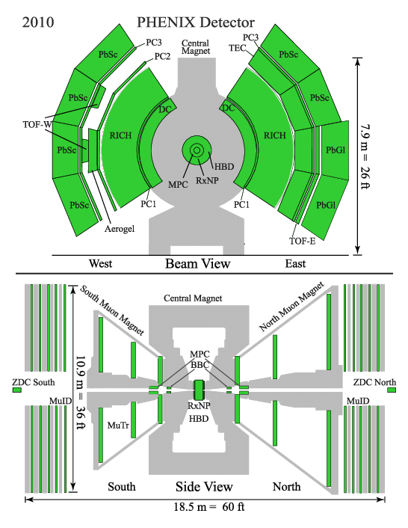
The PHENIX Experiment
Experiments of RHIC (Brookhaven):
    PHENIX, STAR, BRAHMS, PHOBOS
Tracking system:
    Drift Chamber (trajectories of charged particles)
    Pad Chamber (track coordinates)
    Time of Fligth detector
Observing collision of p+p, p+Al, p+Au, d+Au, h+Au, Cu+Cu, Cu+Au, Au+Au, U+U
Charged pion ID from ∼ 0.2 to 2 GeV
Typical Au+Au: √sNN = 130 GeV, 200 GeV

Slide 6
PHENIX Lévy-HBT Analysis Overview
Data set: √𝒔_{𝑵𝑵}= 200, 62, 39 GeV Au+Au , identified pions
Some details of the analysis:
  1D 𝝅±𝝅±corr. func . as a function of 𝑚_{𝑇} and centrality
  Investigation of systematic uncertainties:
    One and two particle criteria (PID, matching, paircuts)
    Other sources of syst. Uncertainties (e. g. fit stability , Coulomb effect)
  Fitting the measured correlation function with Lévy shape
  Investigation of the source parameters (𝝀, 𝑹, 𝜶)

Slide 7
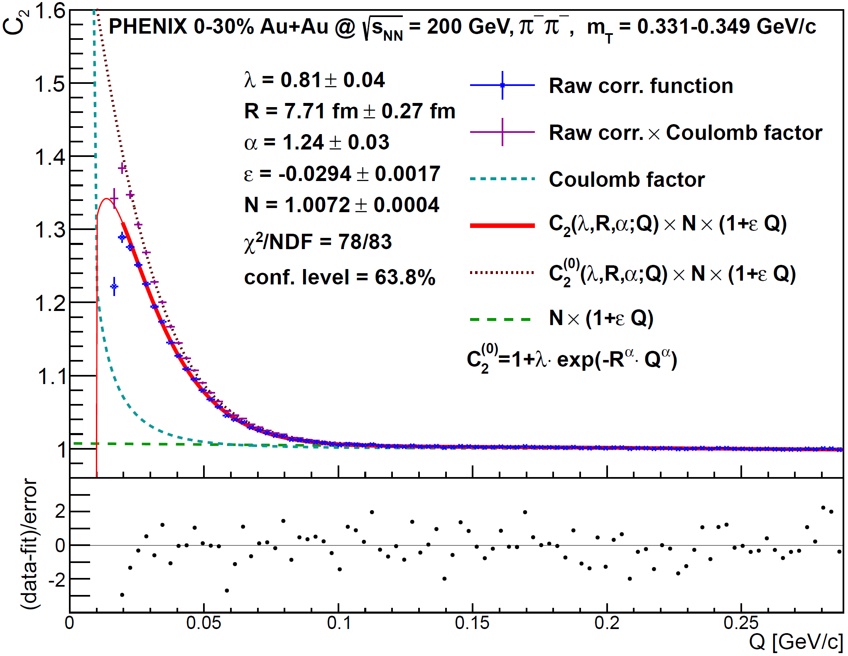



Example Correlation Function
Fit with calculation based on Lévy distribution
Physical parameters: R, α, λ measured versus pair 𝑚_{T}
R: homogeneity length, dynamics, sizes
α: shape, criticality, anomalous diffusion
λ: particle creation mechanisms, in-medium mass modification
Lévy works well
$$λ$$
$$α$$
$$R$$

Slide 8
R – Centrality and m_{T} dependence
D. Kincses, Universe 4 (2018) 11
Geometrical centrality dependence
Usual decrease with m_{T} is present

Slide 9
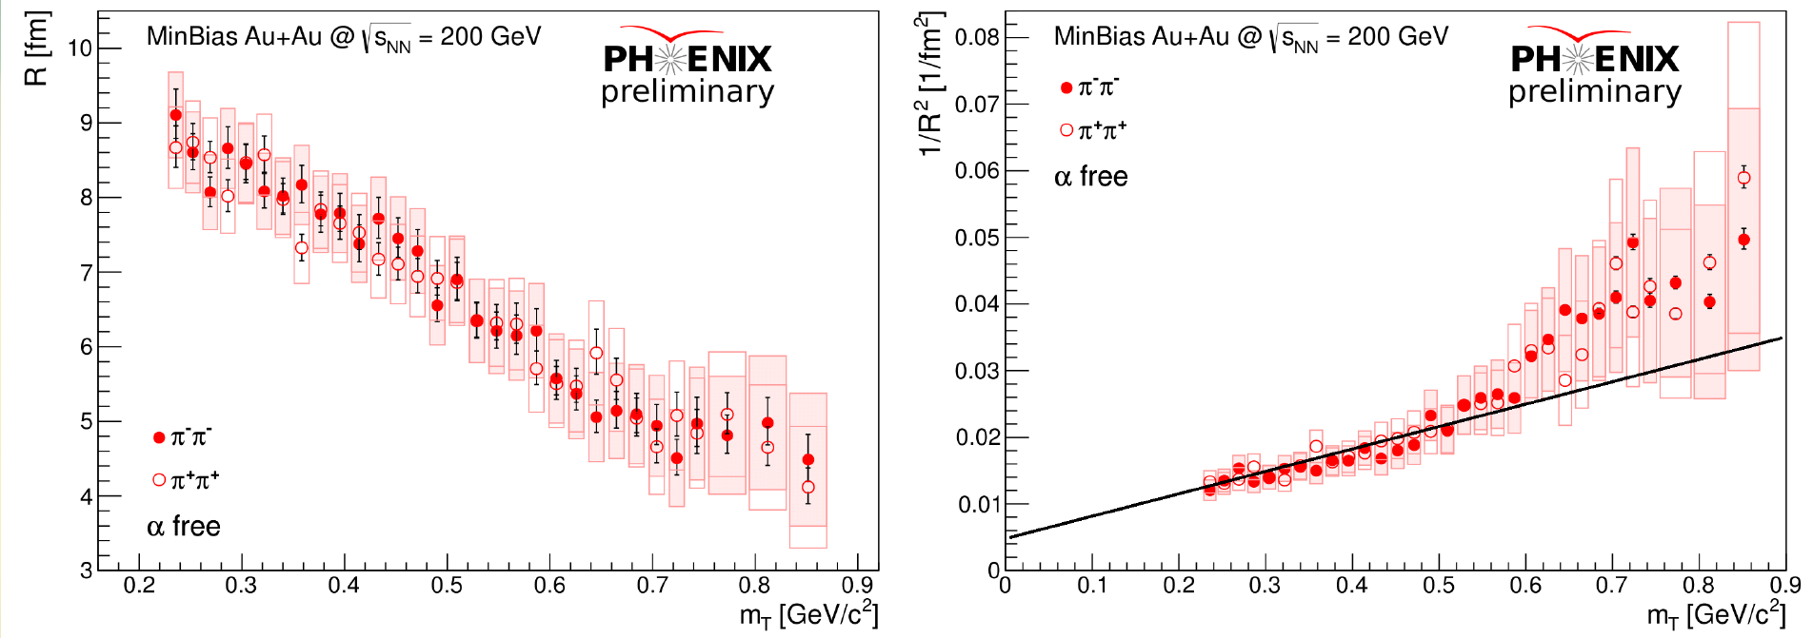
Lévy scale parameter - R
Phys. Rev. C 97, 064911
Hydro calculations for Gaussian radii → 1/𝑅² ~ 𝑚_{T}
In case of low m_{T} , the linear scaling of 1/𝑅² holds

Slide 10
Kaon Lévy Scale - R
Talk of L. Kovács, WPCF 2022

Slide 11
α – Centrality and m_{T} dependence
D. Kincses, Universe 4 (2018) 11
Measured value far from Gaussian (α = 2), inconsistent with expo. (α =1)
Far from random field 3D Ising value at CEP (α = 0.5)
Approximately constant (at least within systematic uncertainties)

Slide 12
Kaon Lévy shape - α

Slide 13
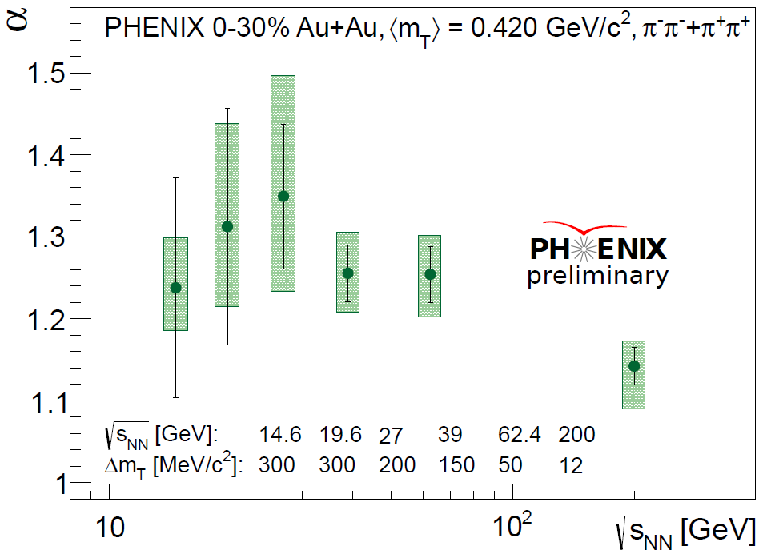
Collision Energy Dependence
S. Lökös, Universe 4 (2018) 31
𝛼 approximately monotonic versus √𝑠_{𝑁𝑁}
    No clear interpretation or understanding of this trend
    Important w.r.t. shape averaging interpretation of 𝛼 ≠ 2
Lévy exponent 𝛼 still far from conjectured CEP limit of 0.5

Slide 14
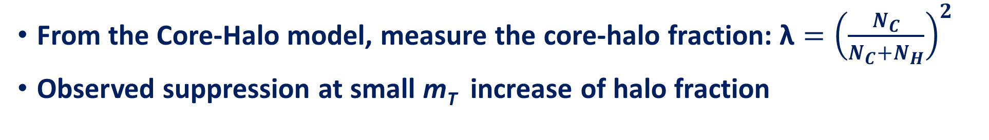
λ – Centrality and m_{T} dependence
S. Lökös, Universe 4 (2018) 31
From the Core-Halo model, measure the core-halo fraction: $\text{λ}={\left(\frac{N_{C}}{N_{C}+N_{H}}\right)}^{2}$
Observed suppression at small m_{T} increase of halo fraction

Slide 15
Hole in λ (m_{T}): λ/ λ_{max}
No effect

Slide 16
Summary and outlook
HBT in Femtoscopy
Lévy in HBT
Centrality and m_{T} dependence of Lévy physical parameters: R, α, λ
Comparison with Kaon data
Detailed Lévy analysis at Phenix coming soon
Thank you for your attention!

Slide 17
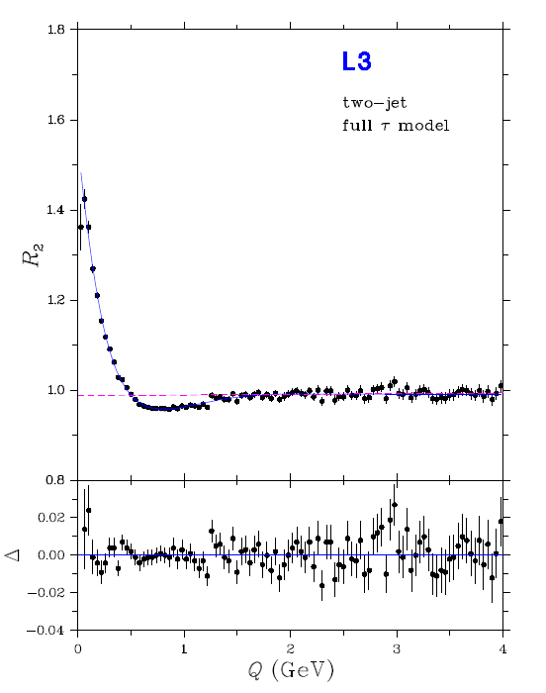
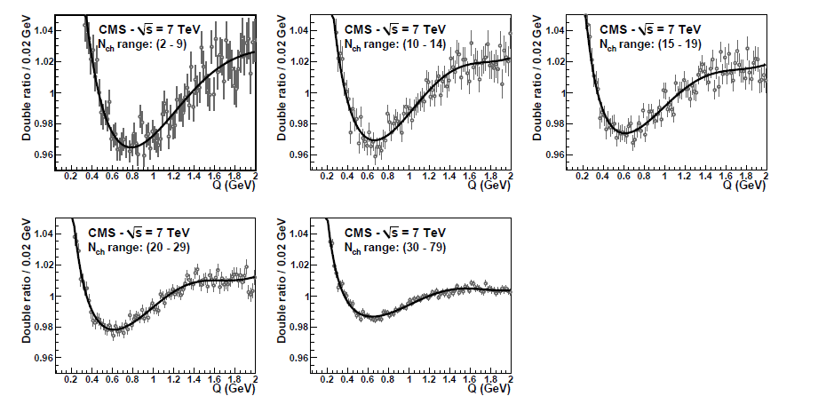
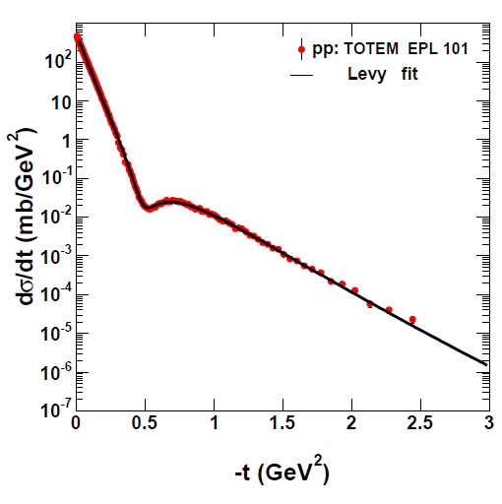
Earlier Experimental Applications of Lévy
Three experimental results:
  L3 e+e-at LEP
  CMS pp at LHC
  TOTEM at LHC

Slide 18
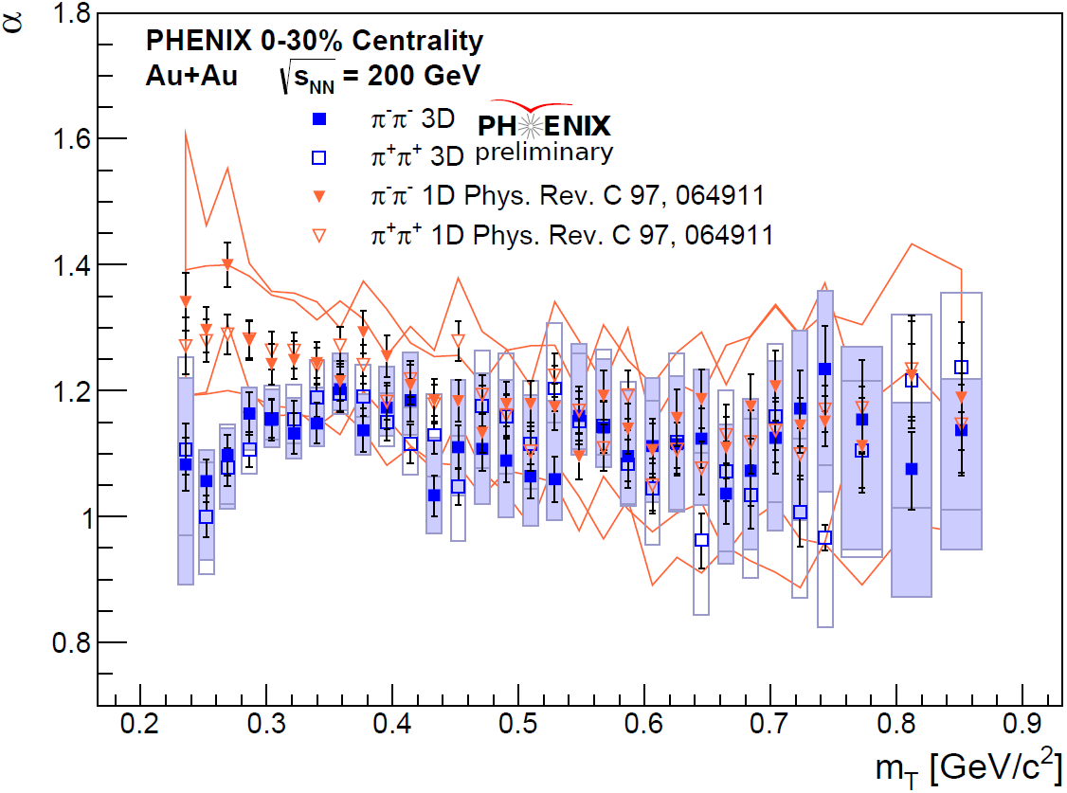

Cross-check with a 3D analysis
Lévy exponent $α$ in 3D analysis similar to 1D result
On average still far from 2
Observable differences
at low m_{T}
Maybe due to lack of
spherical symmetry?
Coulomb effect for
non-spherical sources?
  Approximation possible
  B. Kurgyis, arXiv:2007.10173

Slide 19
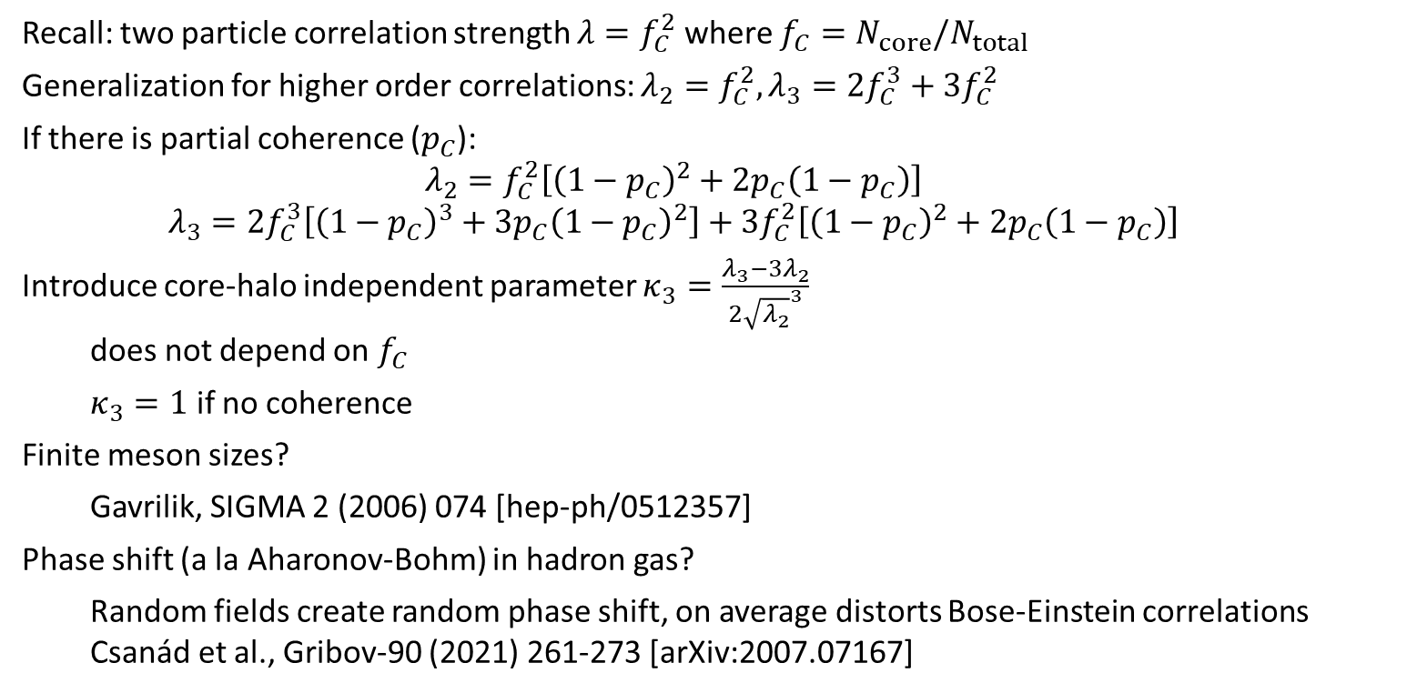
Coherence with three-pion Lévy
Recall: two particle correlation strength $λ=f_{C}^{2}$ where $f_{C}=N_{core}/N_{total}$
Generalization for higher order correlations: $λ_{2}=f_{C}^{2}, λ_{3}=2f_{C}^{3}+3f_{C}^{2}$
If there is partial coherence ($p_{C}$):
  $$λ_{2}=f_{C}^{2}\left[{\left(1−p_{C}\right)}^{2}+2p_{C}\left(1−p_{C}\right)\right]$$
  $$λ_{3}=2f_{C}^{3}\left[{\left(1−p_{C}\right)}^{3}+3p_{C}{\left(1−p_{C}\right)}^{2}\right]+3f_{C}^{2}\left[{\left(1−p_{C}\right)}^{2}+2p_{C}\left(1−p_{C}\right)\right]$$
Introduce core-halo independent parameter $κ_{3}=\frac{{λ_{3}−3λ}_{2}}{2{\sqrt{λ_{2}}}^{3}}$
  does not depend on $f_{C}$
  $κ_{3}=1$ if no coherence
Finite meson sizes?
  Gavrilik, SIGMA 2 (2006) 074 [hep-ph/0512357]
Phase shift (a la Aharonov-Bohm) in hadron gas?
  Random fields create random phase shift, on average distorts Bose-Einstein correlations
  Csanád et al., Gribov-90 (2021) 261-273 [arXiv:2007.07167]

Slide 20
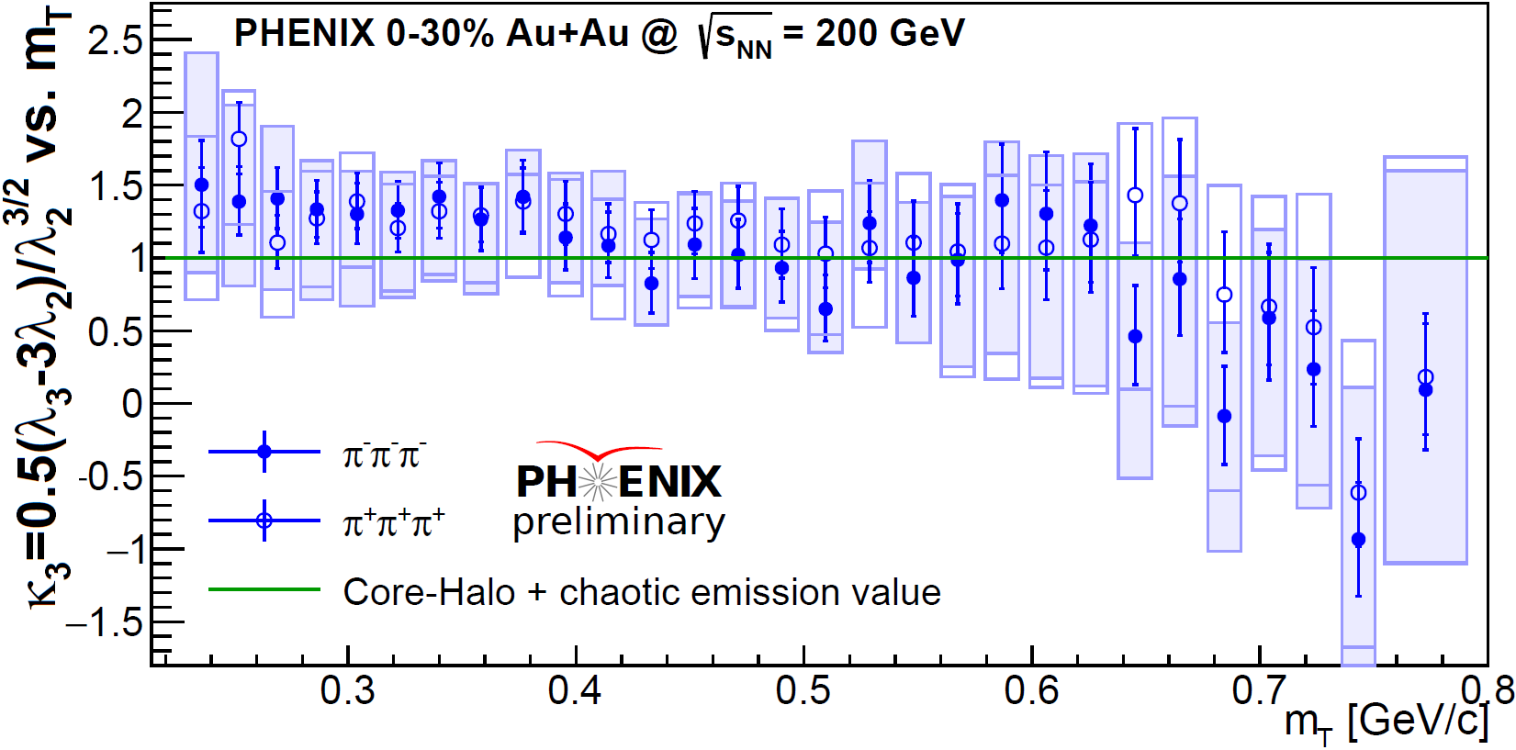
Test of core-halo model / coherence
Recall: $κ_{3}=1$ in pure core-halo model, $κ_{3}≠1$ if coherence
WPCF 19, B. Kurgyis, Phys. Part. Nuclei 51 (2020) 263-266

