Slide 1



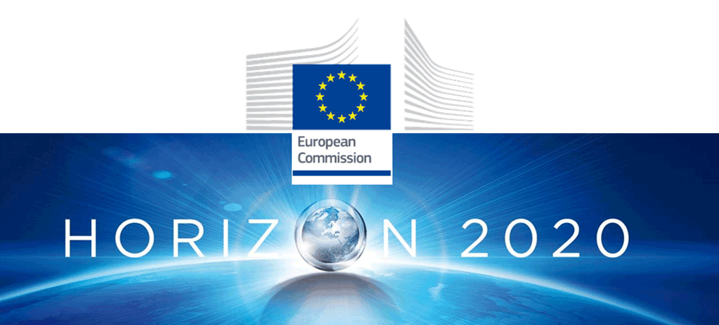
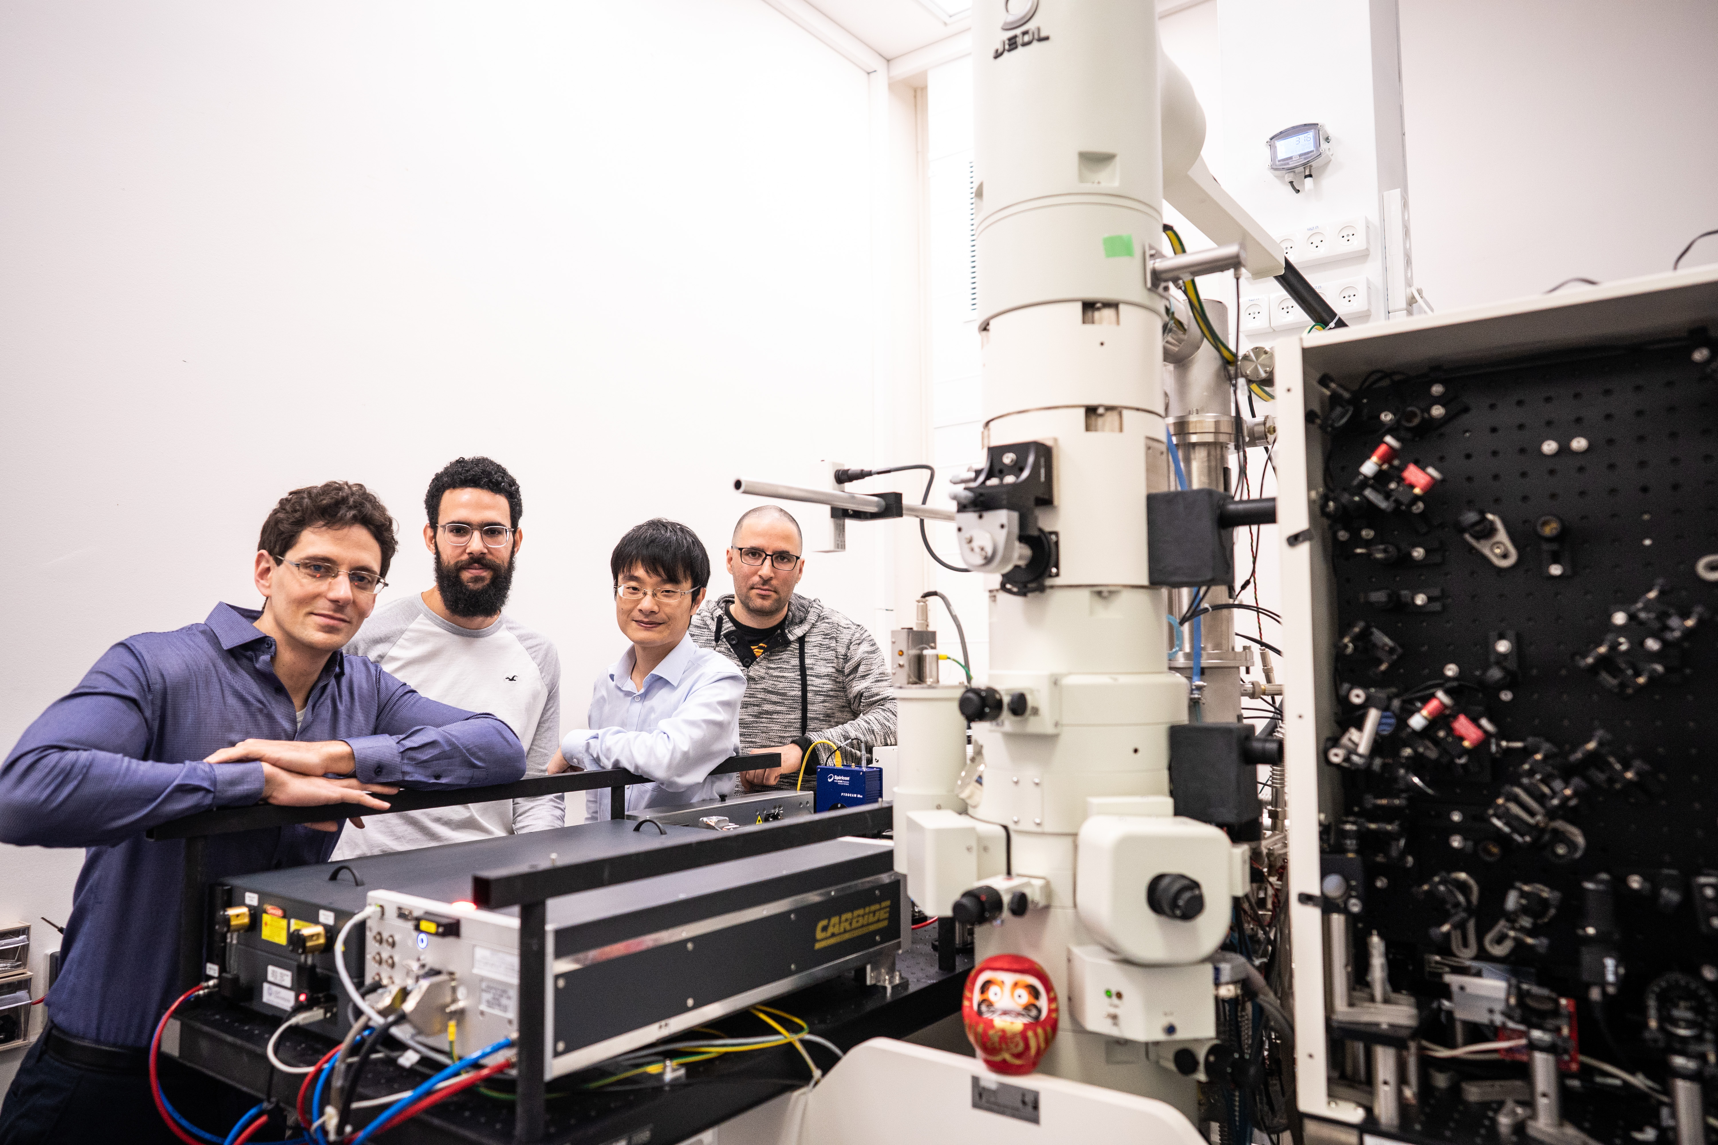
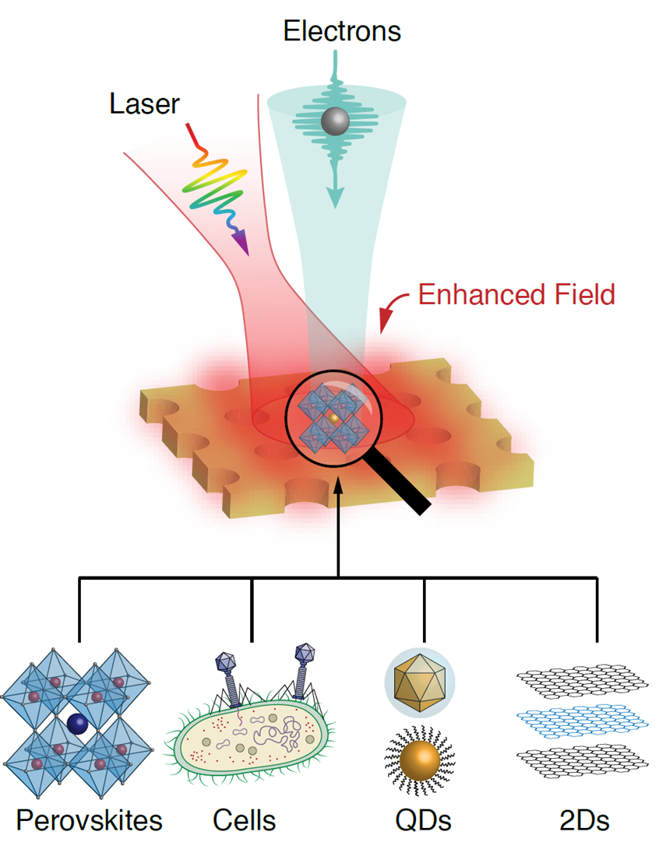



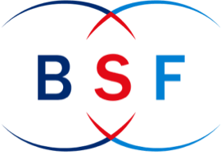

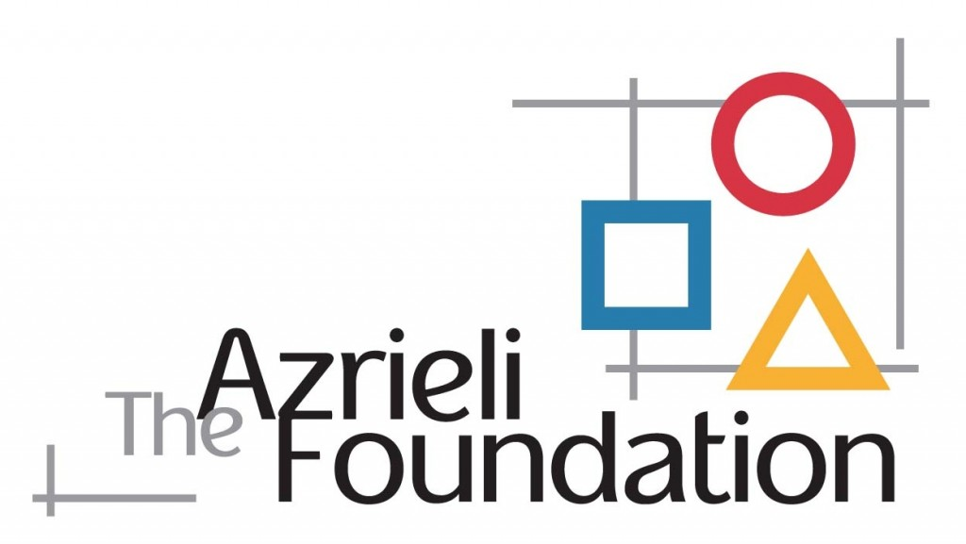
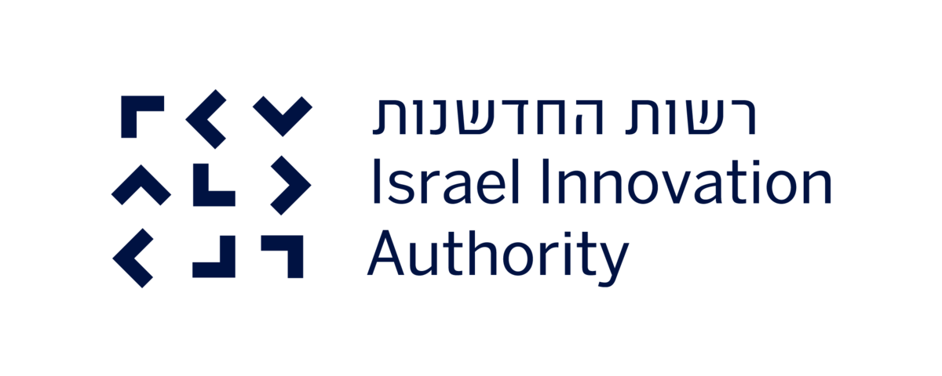
Nanophotonic particle detectors
+ how quantum optics can contribute to scintillators and Cherenkov detectors
Ido Kaminer
Our group: photonics and quantum tech experiment & theory
FET OPEN
available ERC-funded positions for experienced postdocs

Slide 2
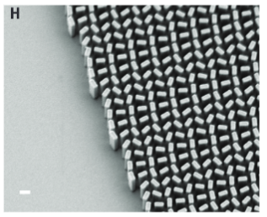
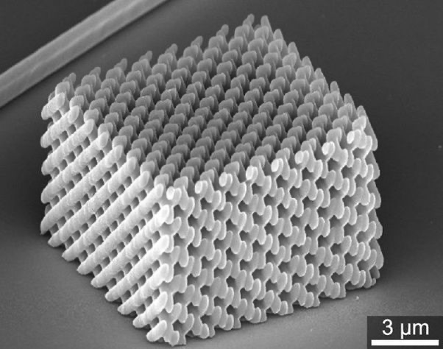
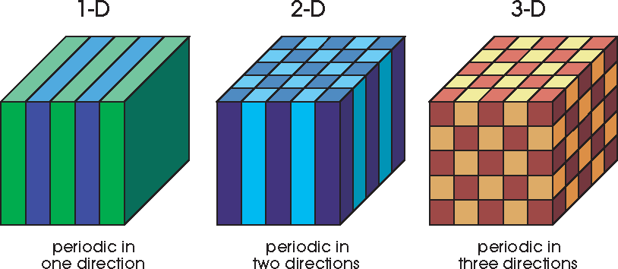
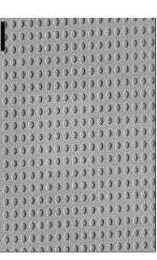
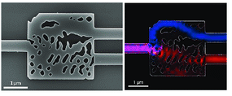
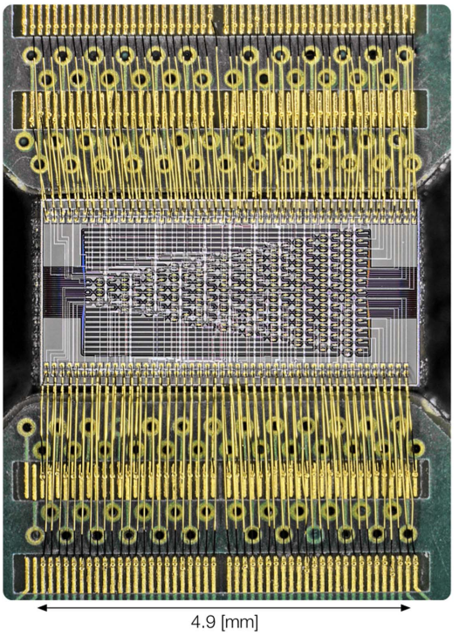
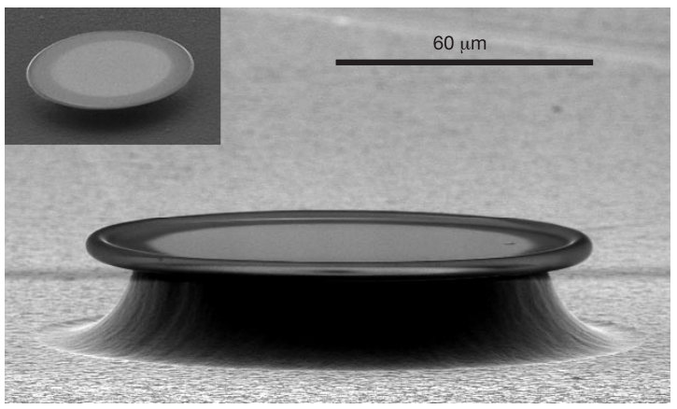
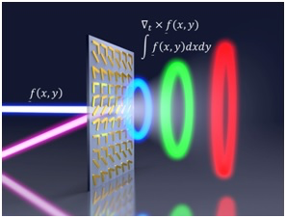
Nanophotonics
Image sources: Capasso (Harvard), Soljačić (MIT), Joannopoulos (MIT), Johnson (MIT), Polman (AMOLF), Vuckovic (Stanford), Vahala (Caltech), Englund (MIT) research groups.

Slide 3
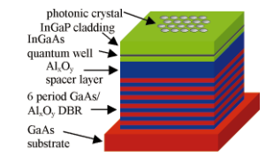
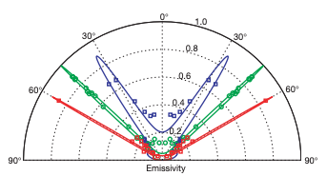
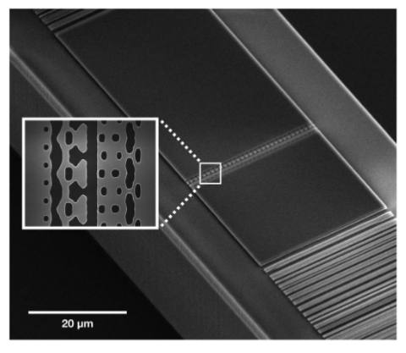
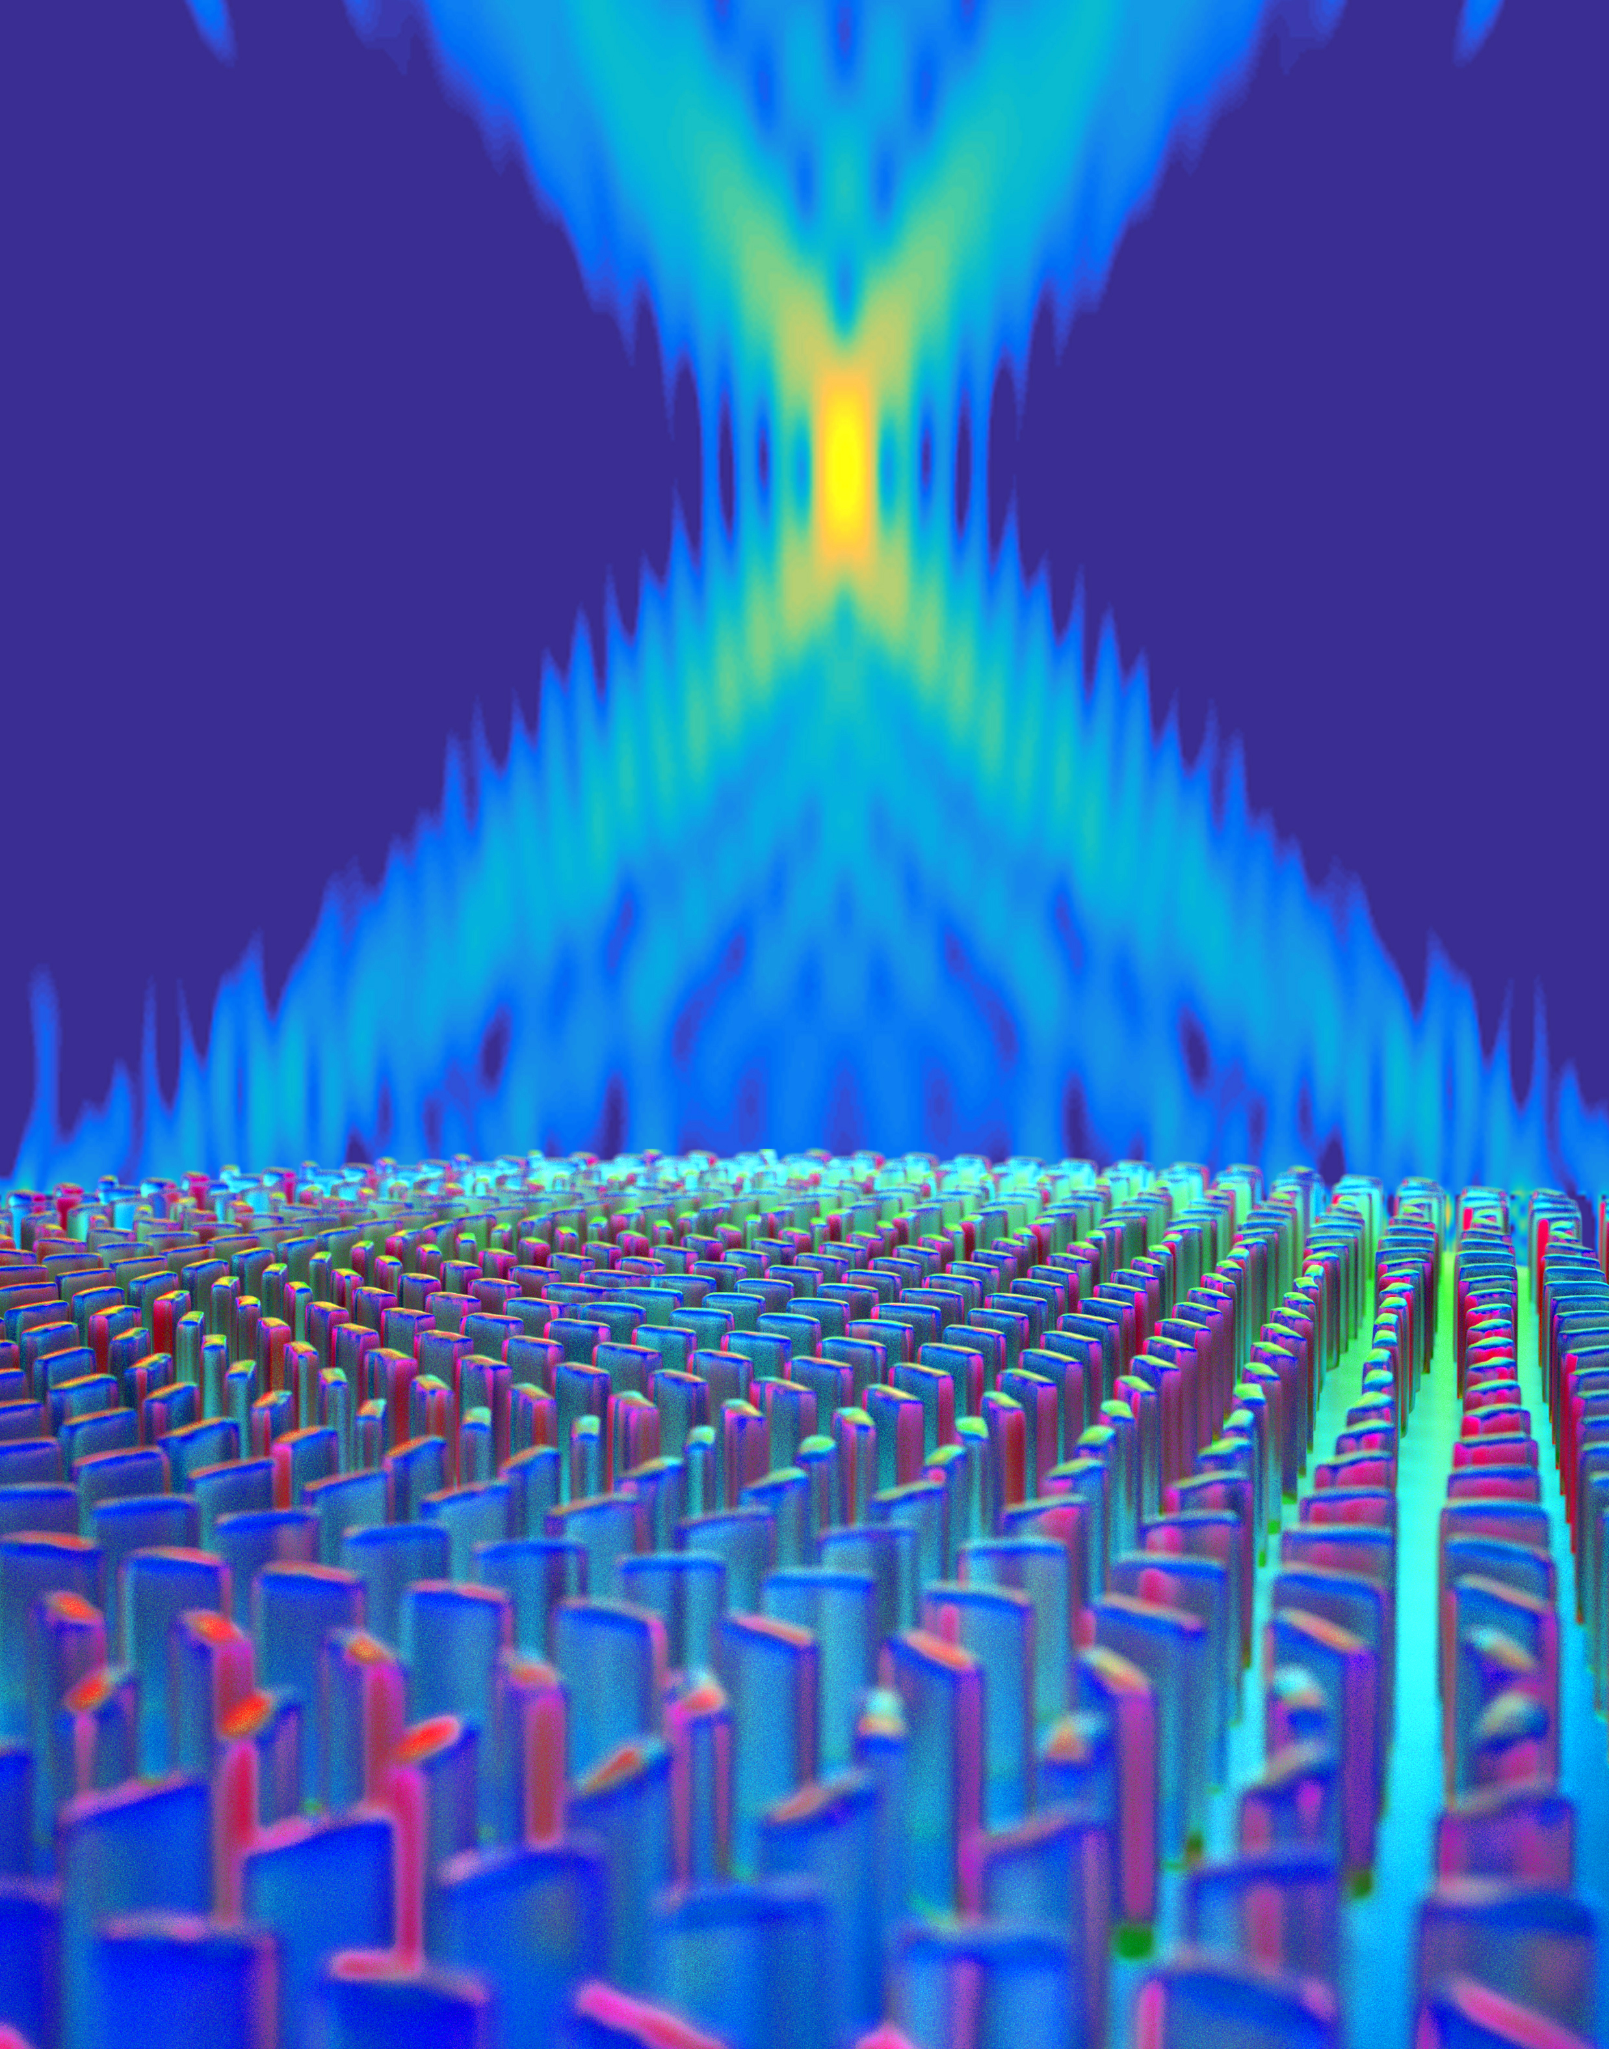
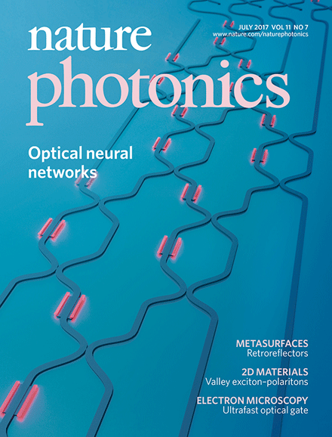
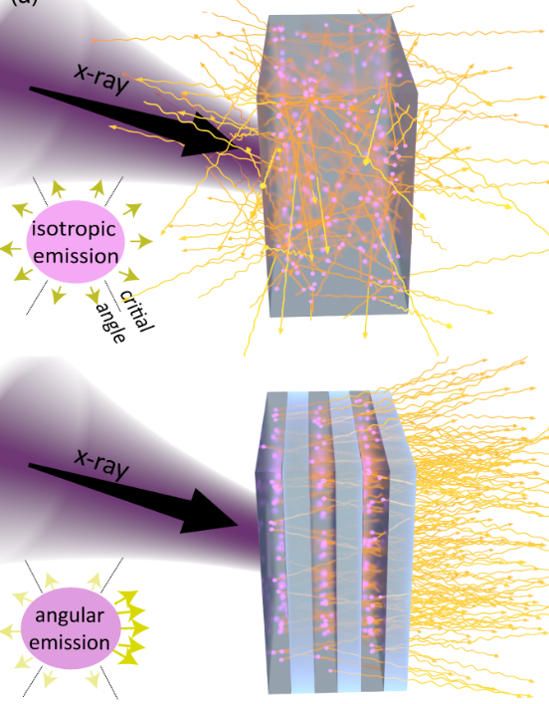
Applications of nanophotonics
LED and lasers
Thermal emitters
Particle accelerators
Flat optics
Photonic computing
nanophotonic scintillators

Slide 4
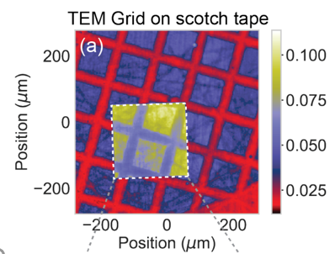
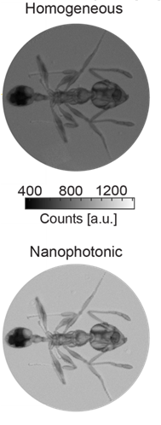
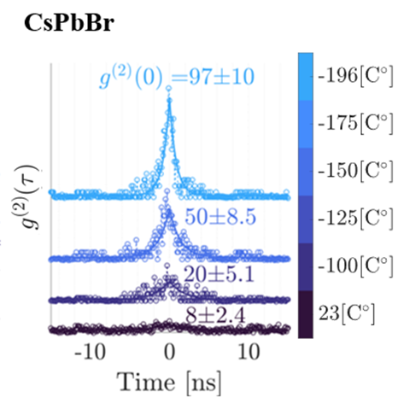
Apply nanophotonics to scintillator science?
Control light-outcoupling
  Nanophotonic scintillators
Enhance light-emission
  Purcell scintillators
Inspiration from quantum optics?
  Nanophotonic Cherenkov detectors, with S. Easo @ LHCb
  X. Lin, Nature Physics (2018), Nature Comm (2021)

Slide 5
Apply nanophotonics to scintillator science?
Control light-outcoupling
  Nanophotonic scintillators
Enhance light-emission
  Purcell scintillators
Inspiration from quantum optics?

Slide 6
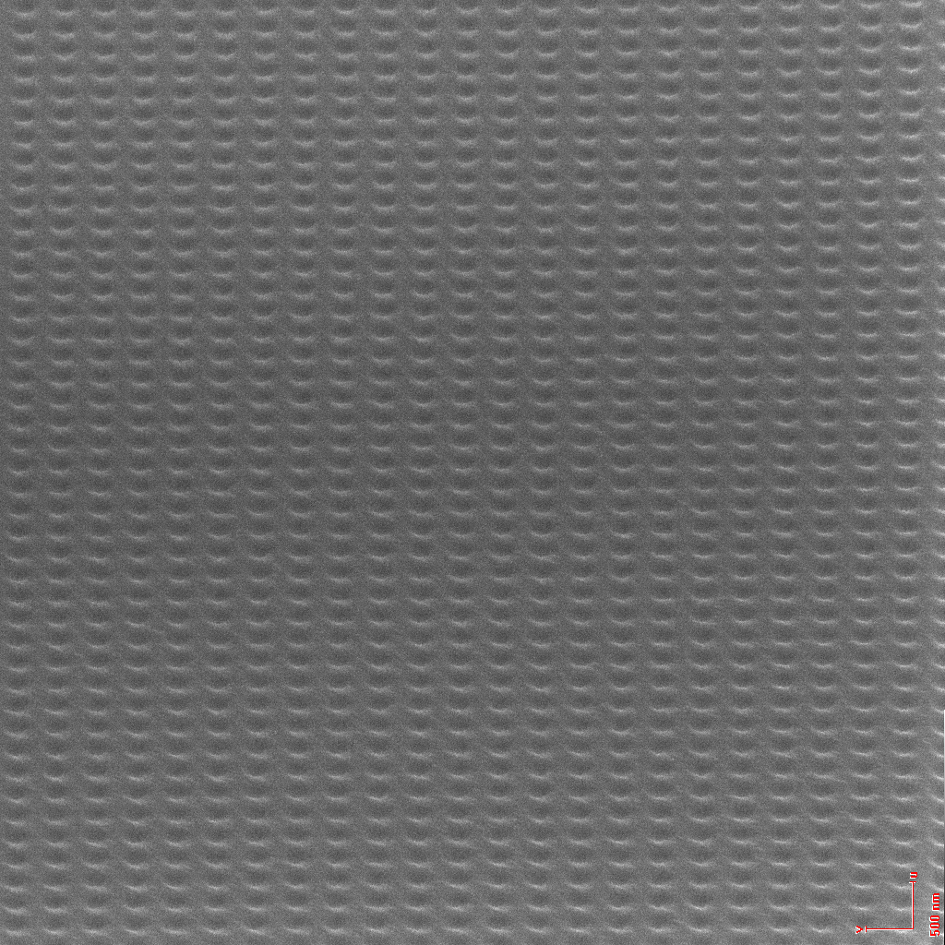
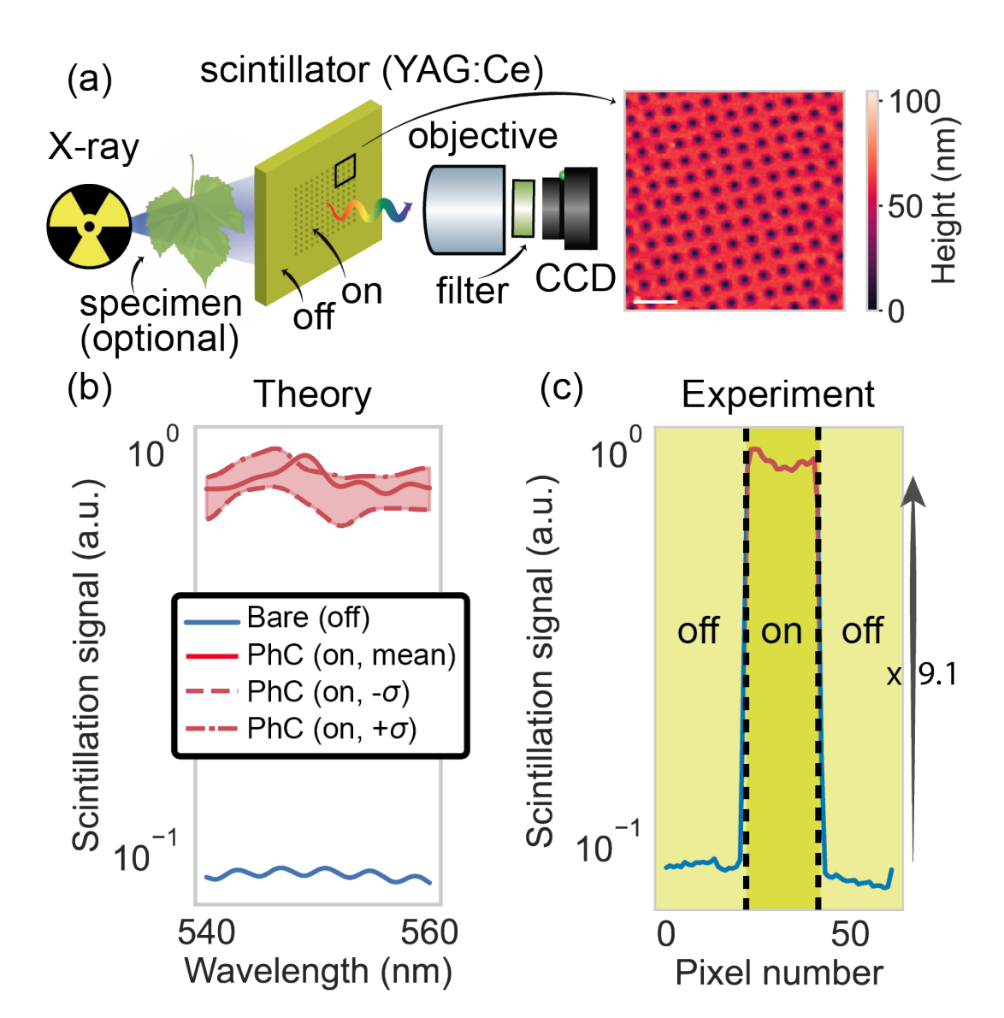
X-ray scintillation enhancement
SEM
Large scale patterns (430x430 microns)
Roques-Carmes*, Rivera*, et al., Science (2022)

Slide 7
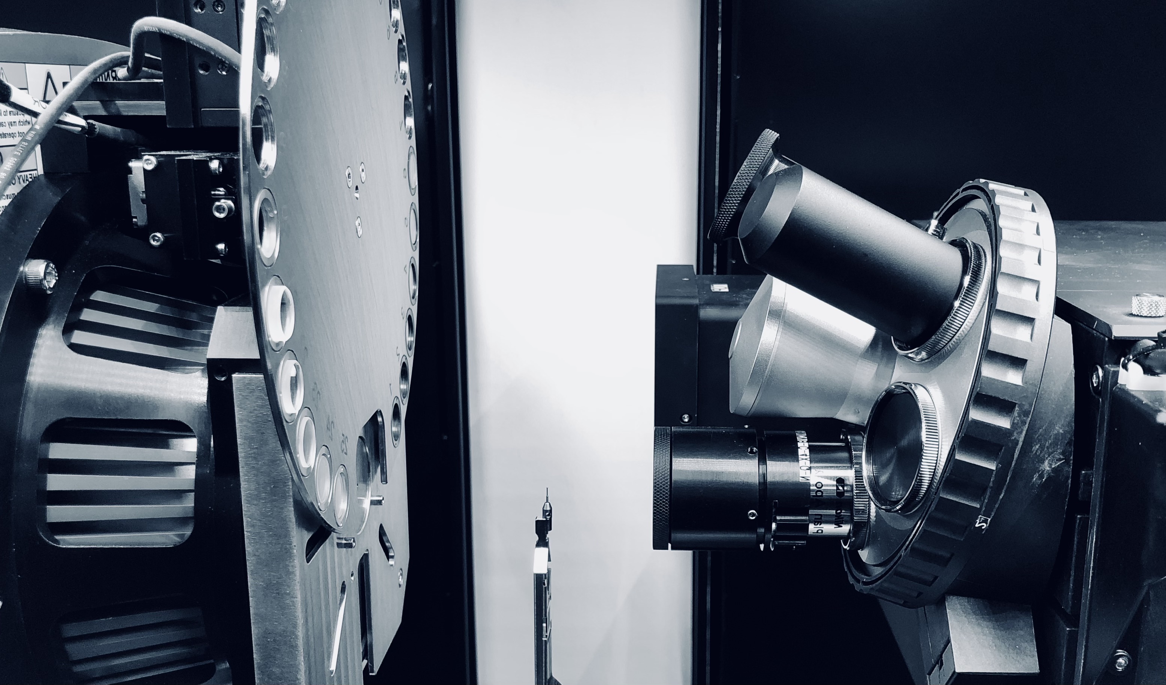

Setup at MIT (based on a micro-CT)
CCD
Source
Specimen
Scintillator
+
Objective
Roques-Carmes*, Rivera*, et al., Science (2022)

Slide 8
X-ray scintillation enhancement
Roques-Carmes*, Rivera*, et al., Science (2022)

Slide 9
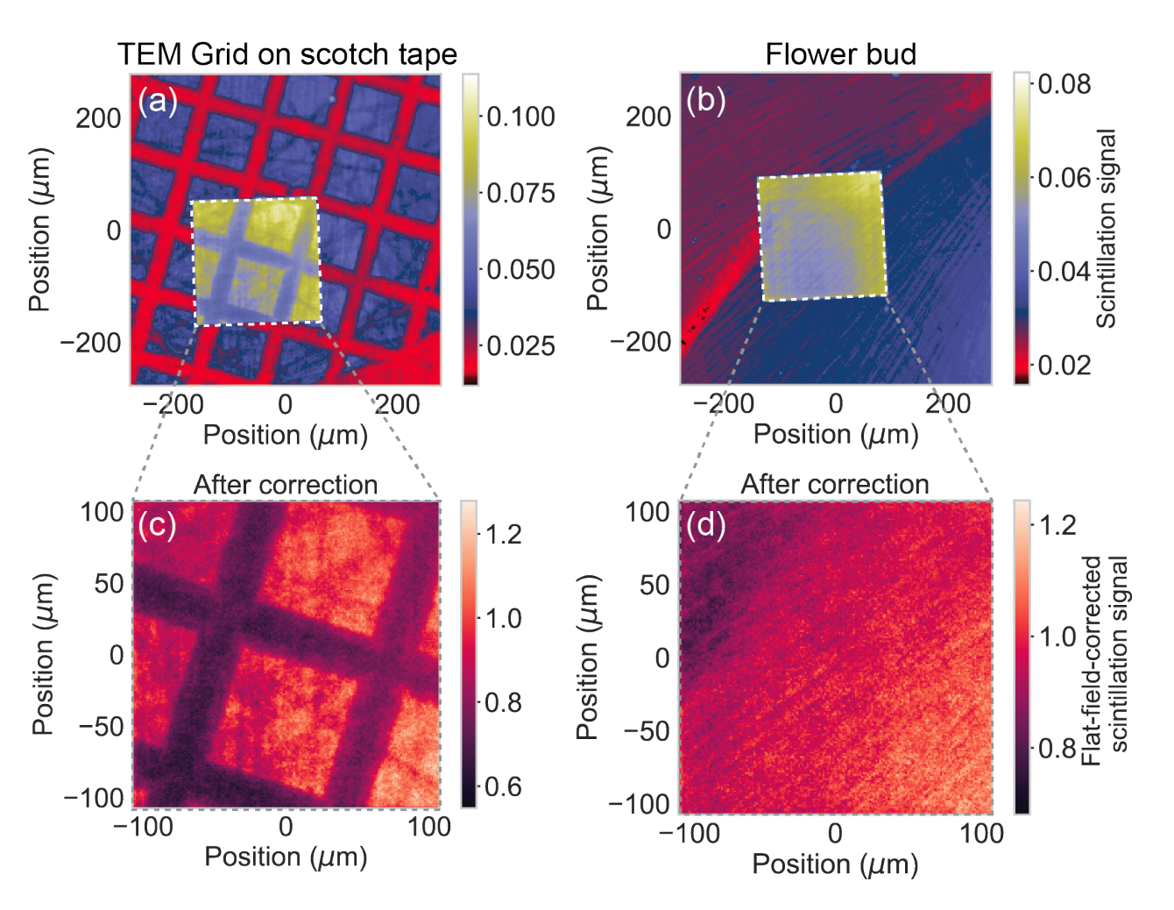
X-ray scintillation imaging
Roques-Carmes*, Rivera*, et al., Science (2022)

Slide 10
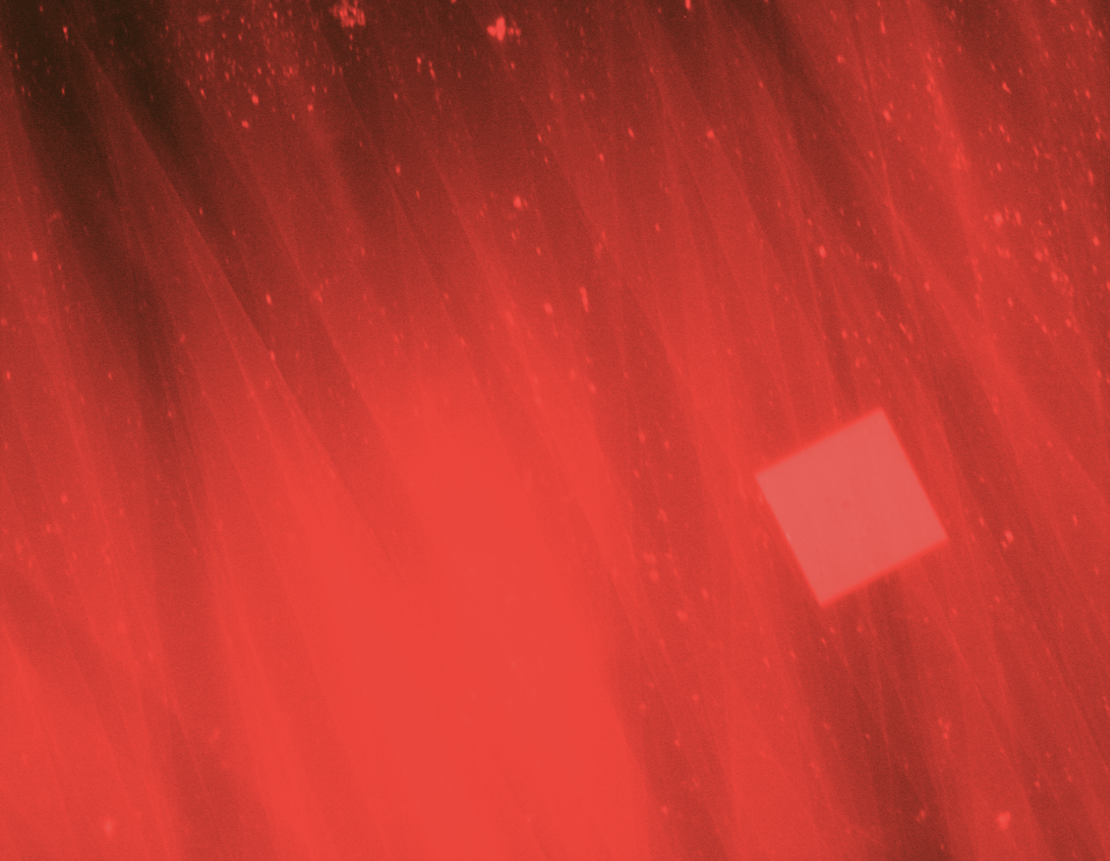
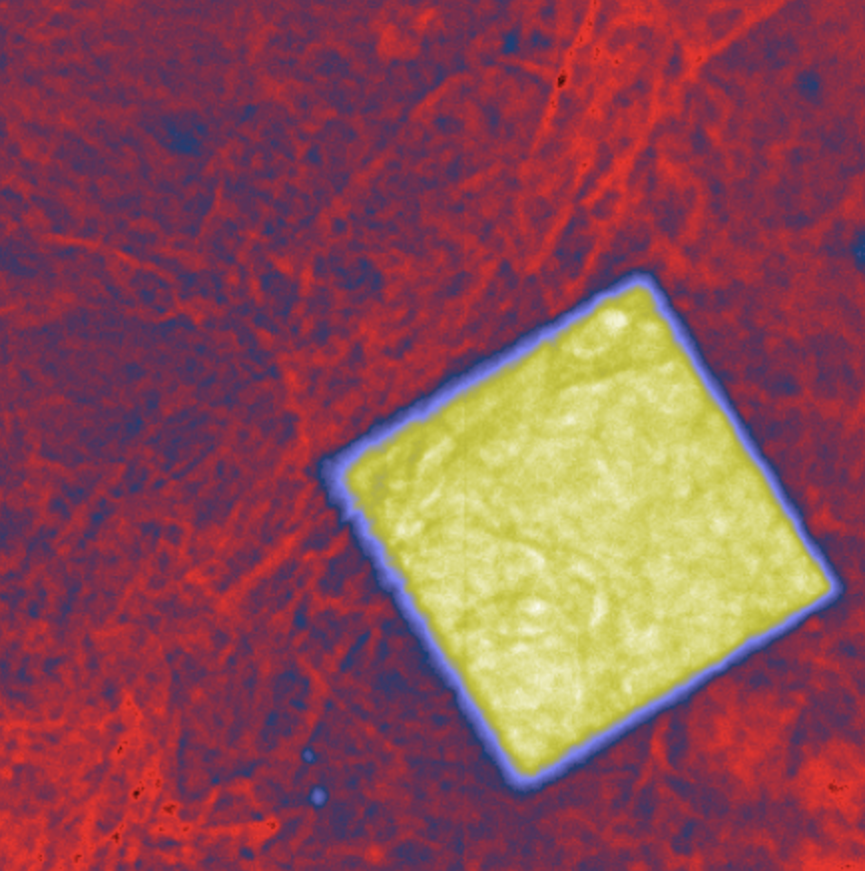
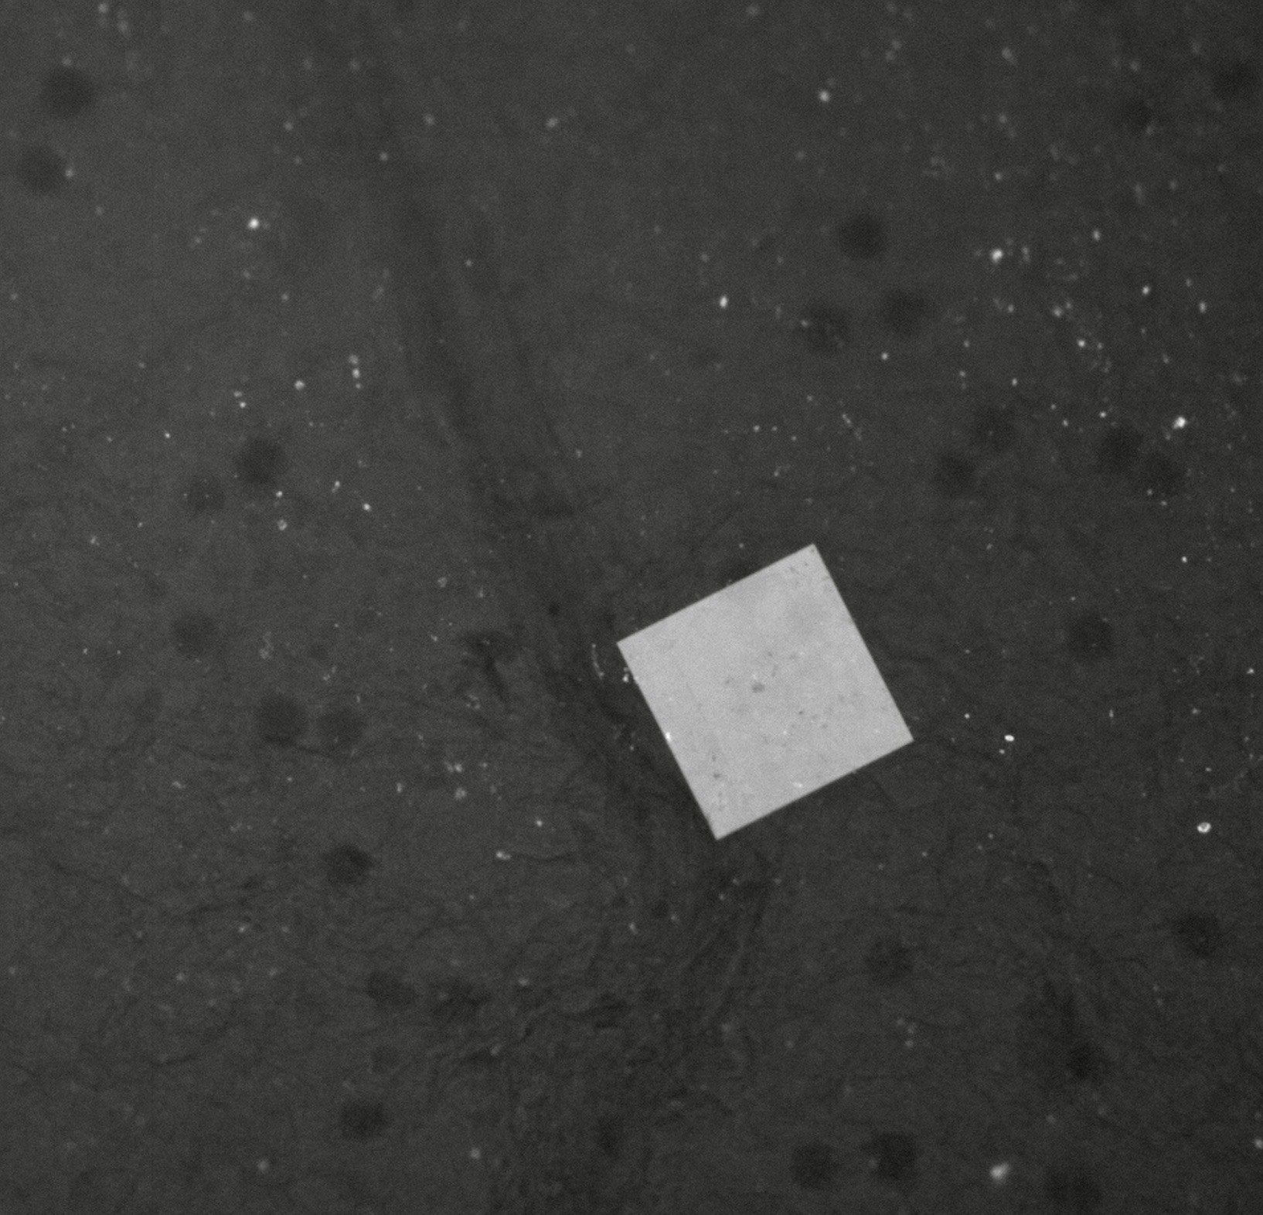
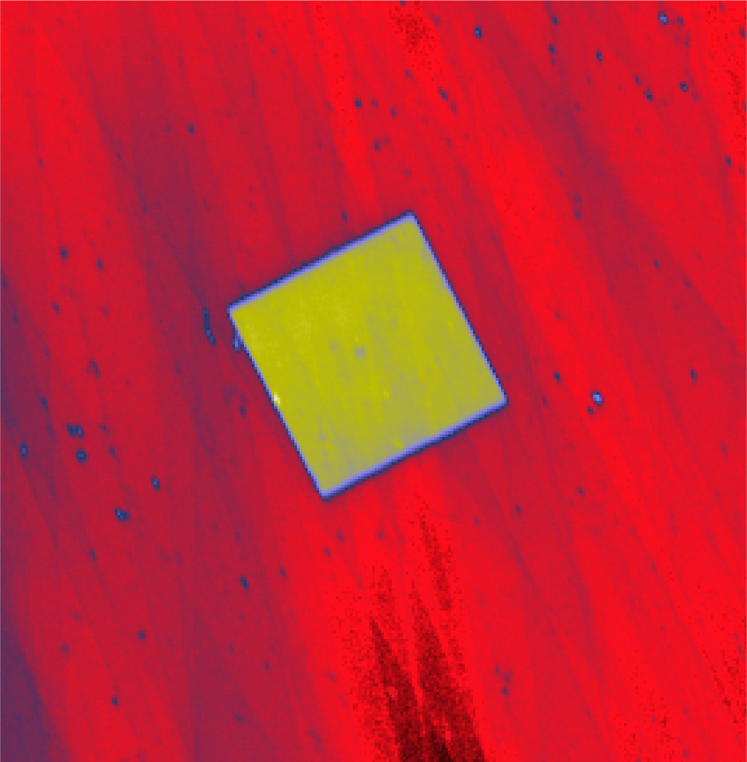
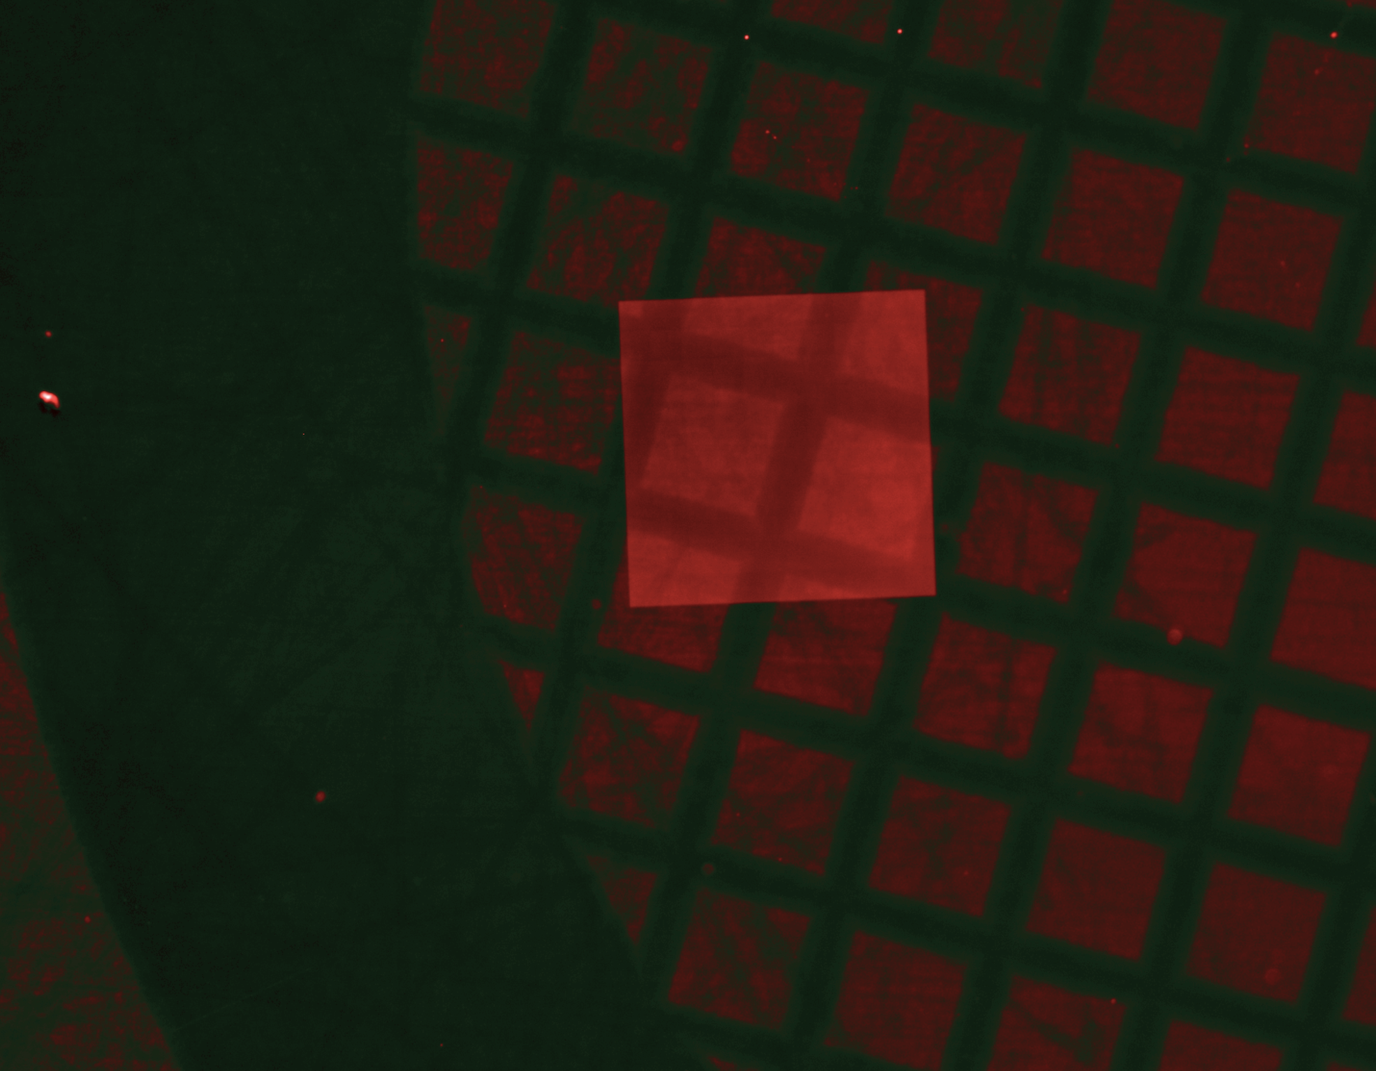
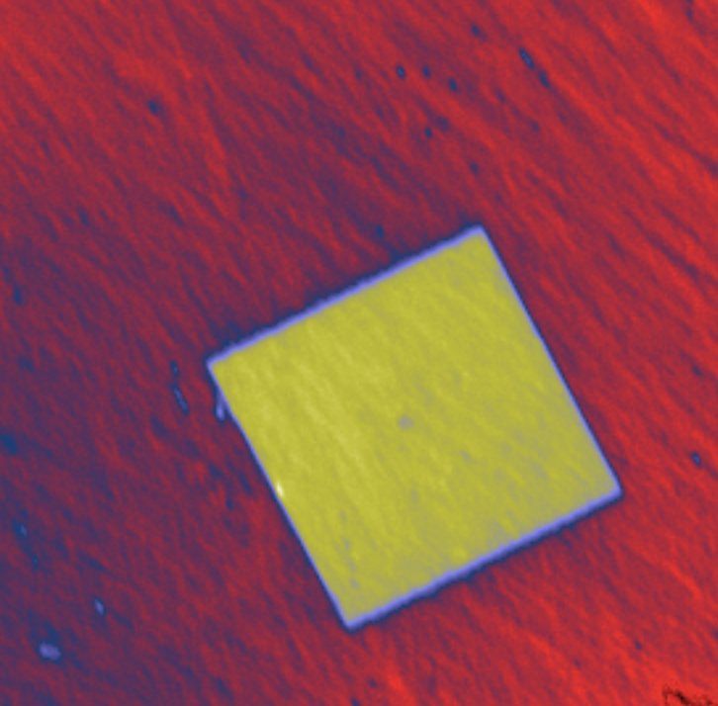
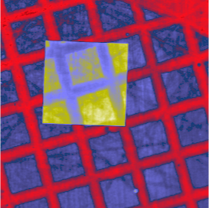
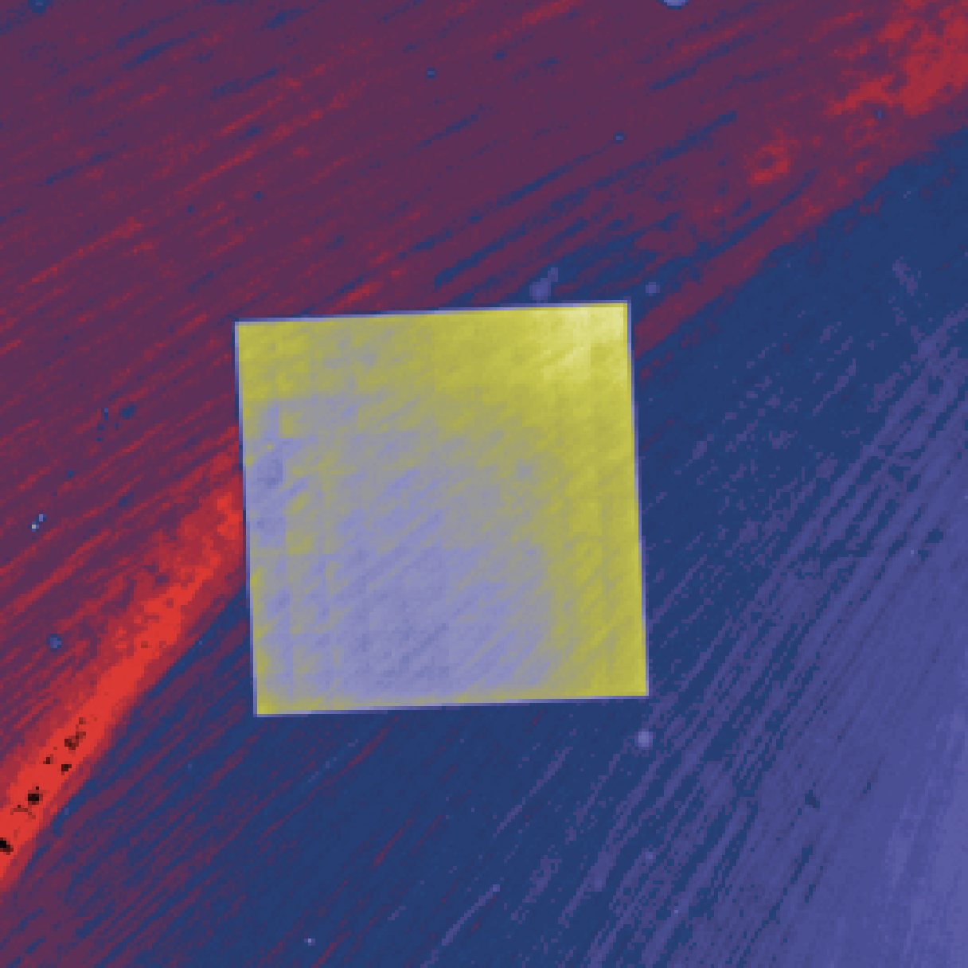
Other x-ray scans
Leaf
Leaf
Human hair
Human hair
Flower bud
TEM Metallic grid
Flower bud
TEM Metallic grid
Roques-Carmes*, Rivera*, et al., Science (2022)

Slide 11
Apply nanophotonics to scintillator science?
Control light-outcoupling
  Nanophotonic scintillators
Enhance light-emission
  Purcell scintillators
Inspiration from quantum optics?

Slide 12
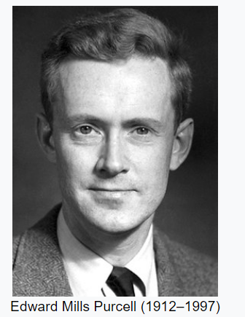
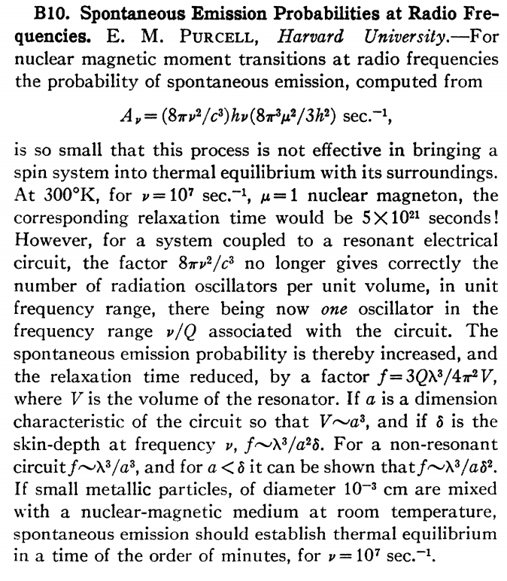
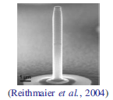
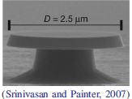
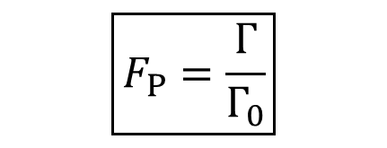
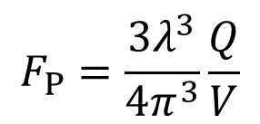
The Purcell effect
The spontaneous emission rate depends on the EM environment
$$\boxed{F_{P}=\frac{Γ}{Γ_{0}}}$$
The Purcell factor
$$F_{P}=\frac{3λ^{3}}{4π^{3}}\frac{Q}{V}$$
For a dipole in a cavity:
General design rule: highest Q and smallest V
Micropillar
Microdisk
E. M. Purcell Phys. Rev. (1946)
P. Lodahl et al. Rev. Mod. Phys. (2015)

Slide 13
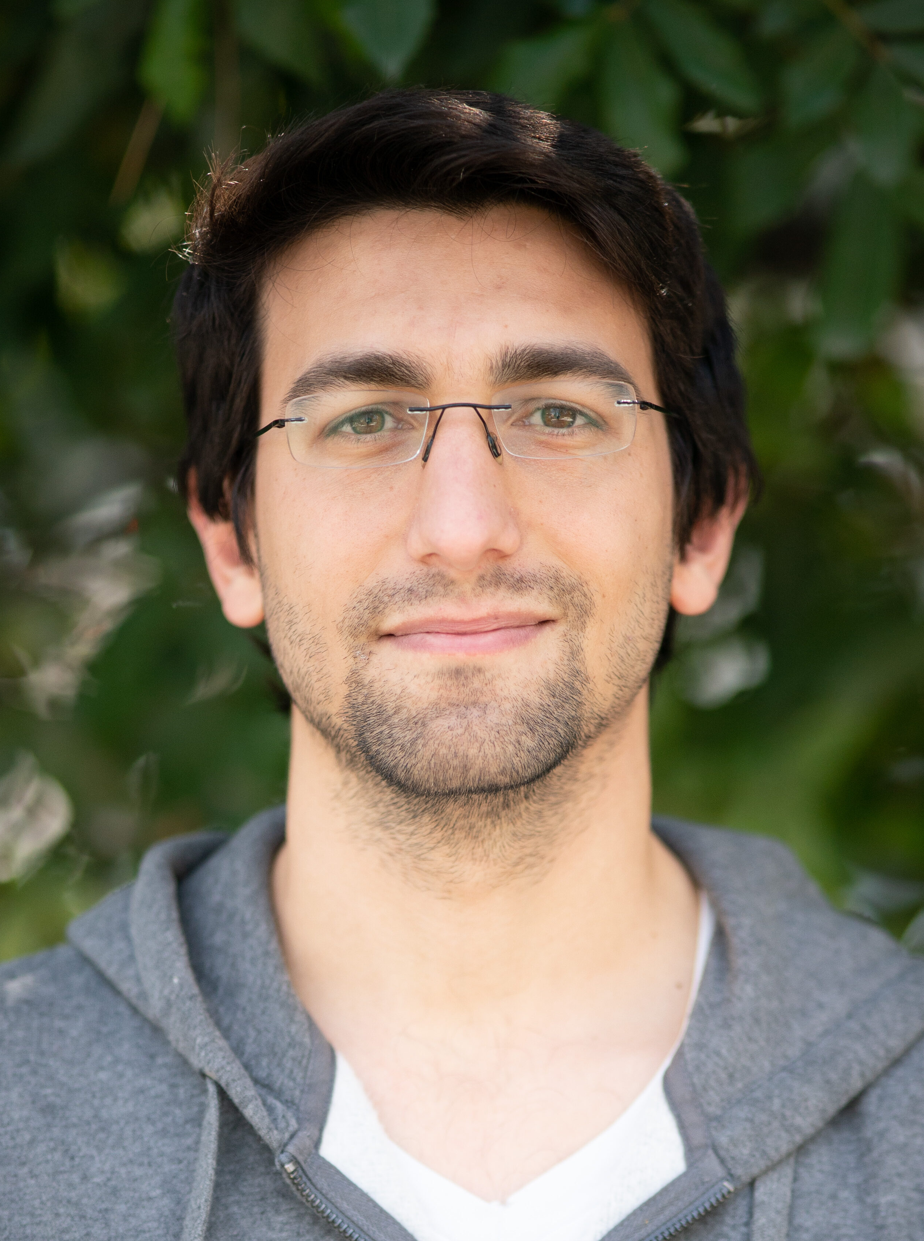
Purcell effect for scintillation applications
We proposed the concept of Purcell-enhanced scintillators
Yaniv Kurman
But we cannot use the Q/V design rule
The scintillator needs:
Large V for the optical modes
Low Q for good extraction
Use of the Purcell effect in an untraditional manner
Kurman, et al. "Photonic-crystal scintillators: Molding the flow of light to enhance X-ray and γ-ray detection." PRL 125, 040801 (2020).

Slide 14
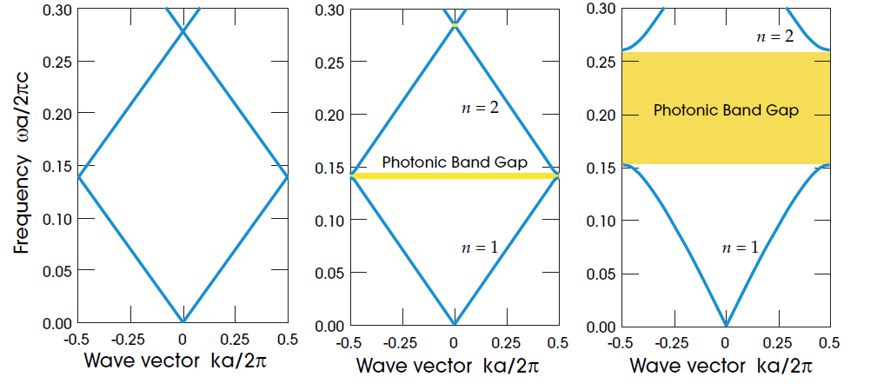
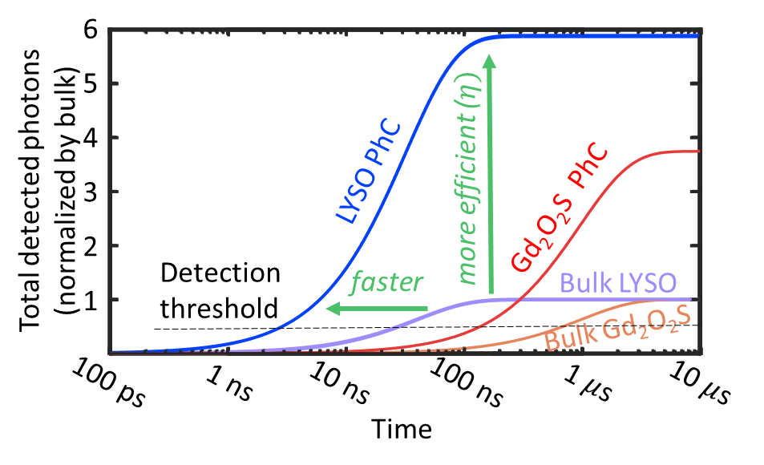
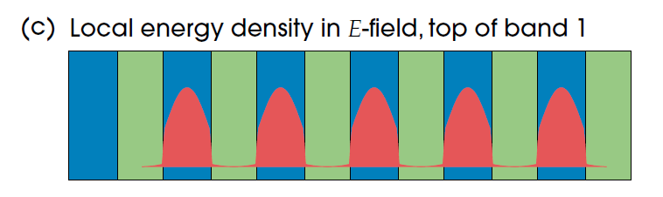
The Photonic-crystal scintillator
Use of the photonic band gap to increase emission in desired angles while reducing emission into undetectable directions
Yaniv Kurman
Angular Purcell Enhancement
Joannopoulos, et al.,
Molding the flow of light (2008)
Kurman, et al. "Photonic-crystal scintillators: Molding the flow of light to enhance X-ray and γ-ray detection." PRL 125, 040801 (2020).

Slide 15
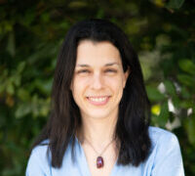
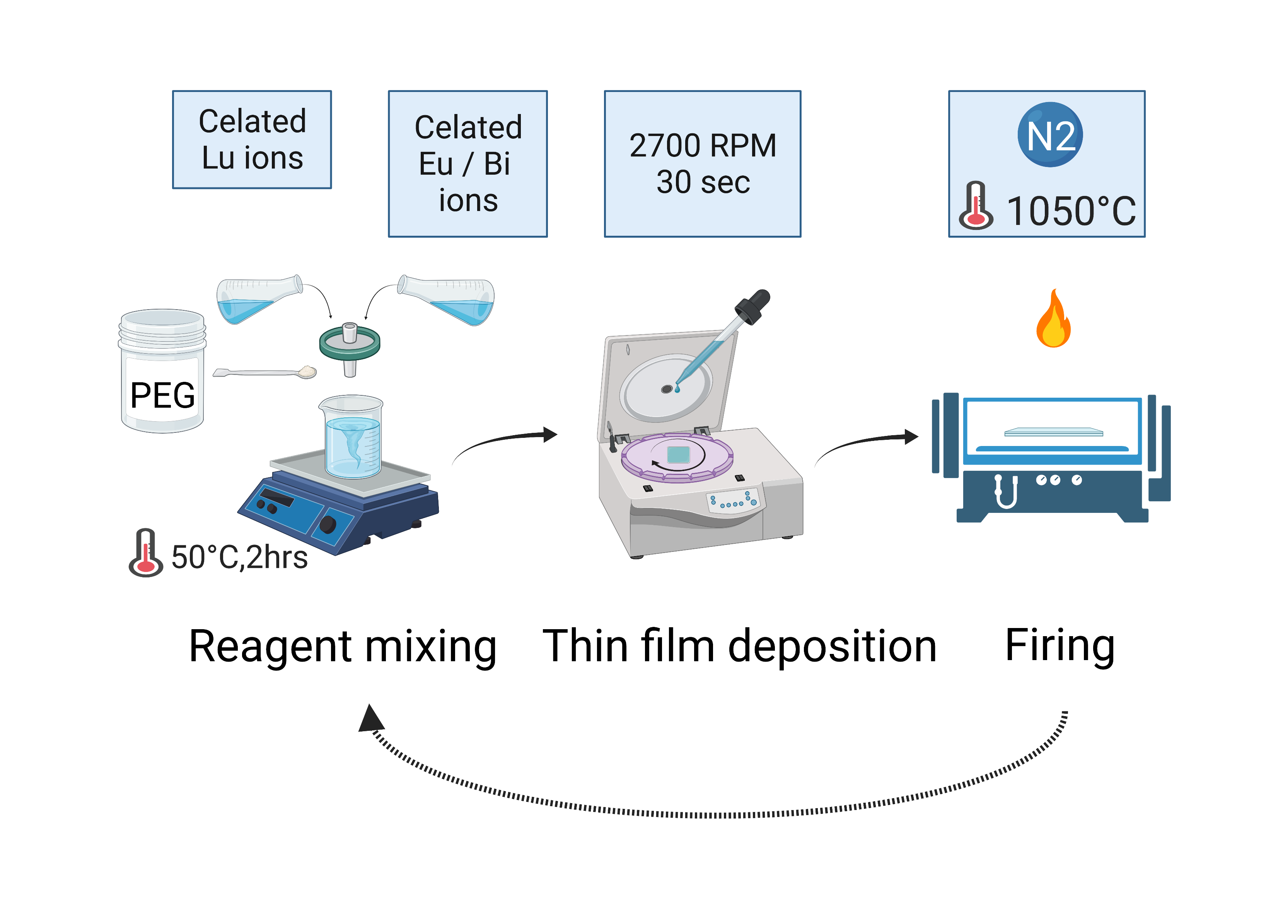
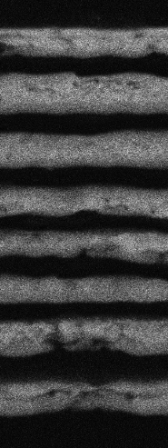
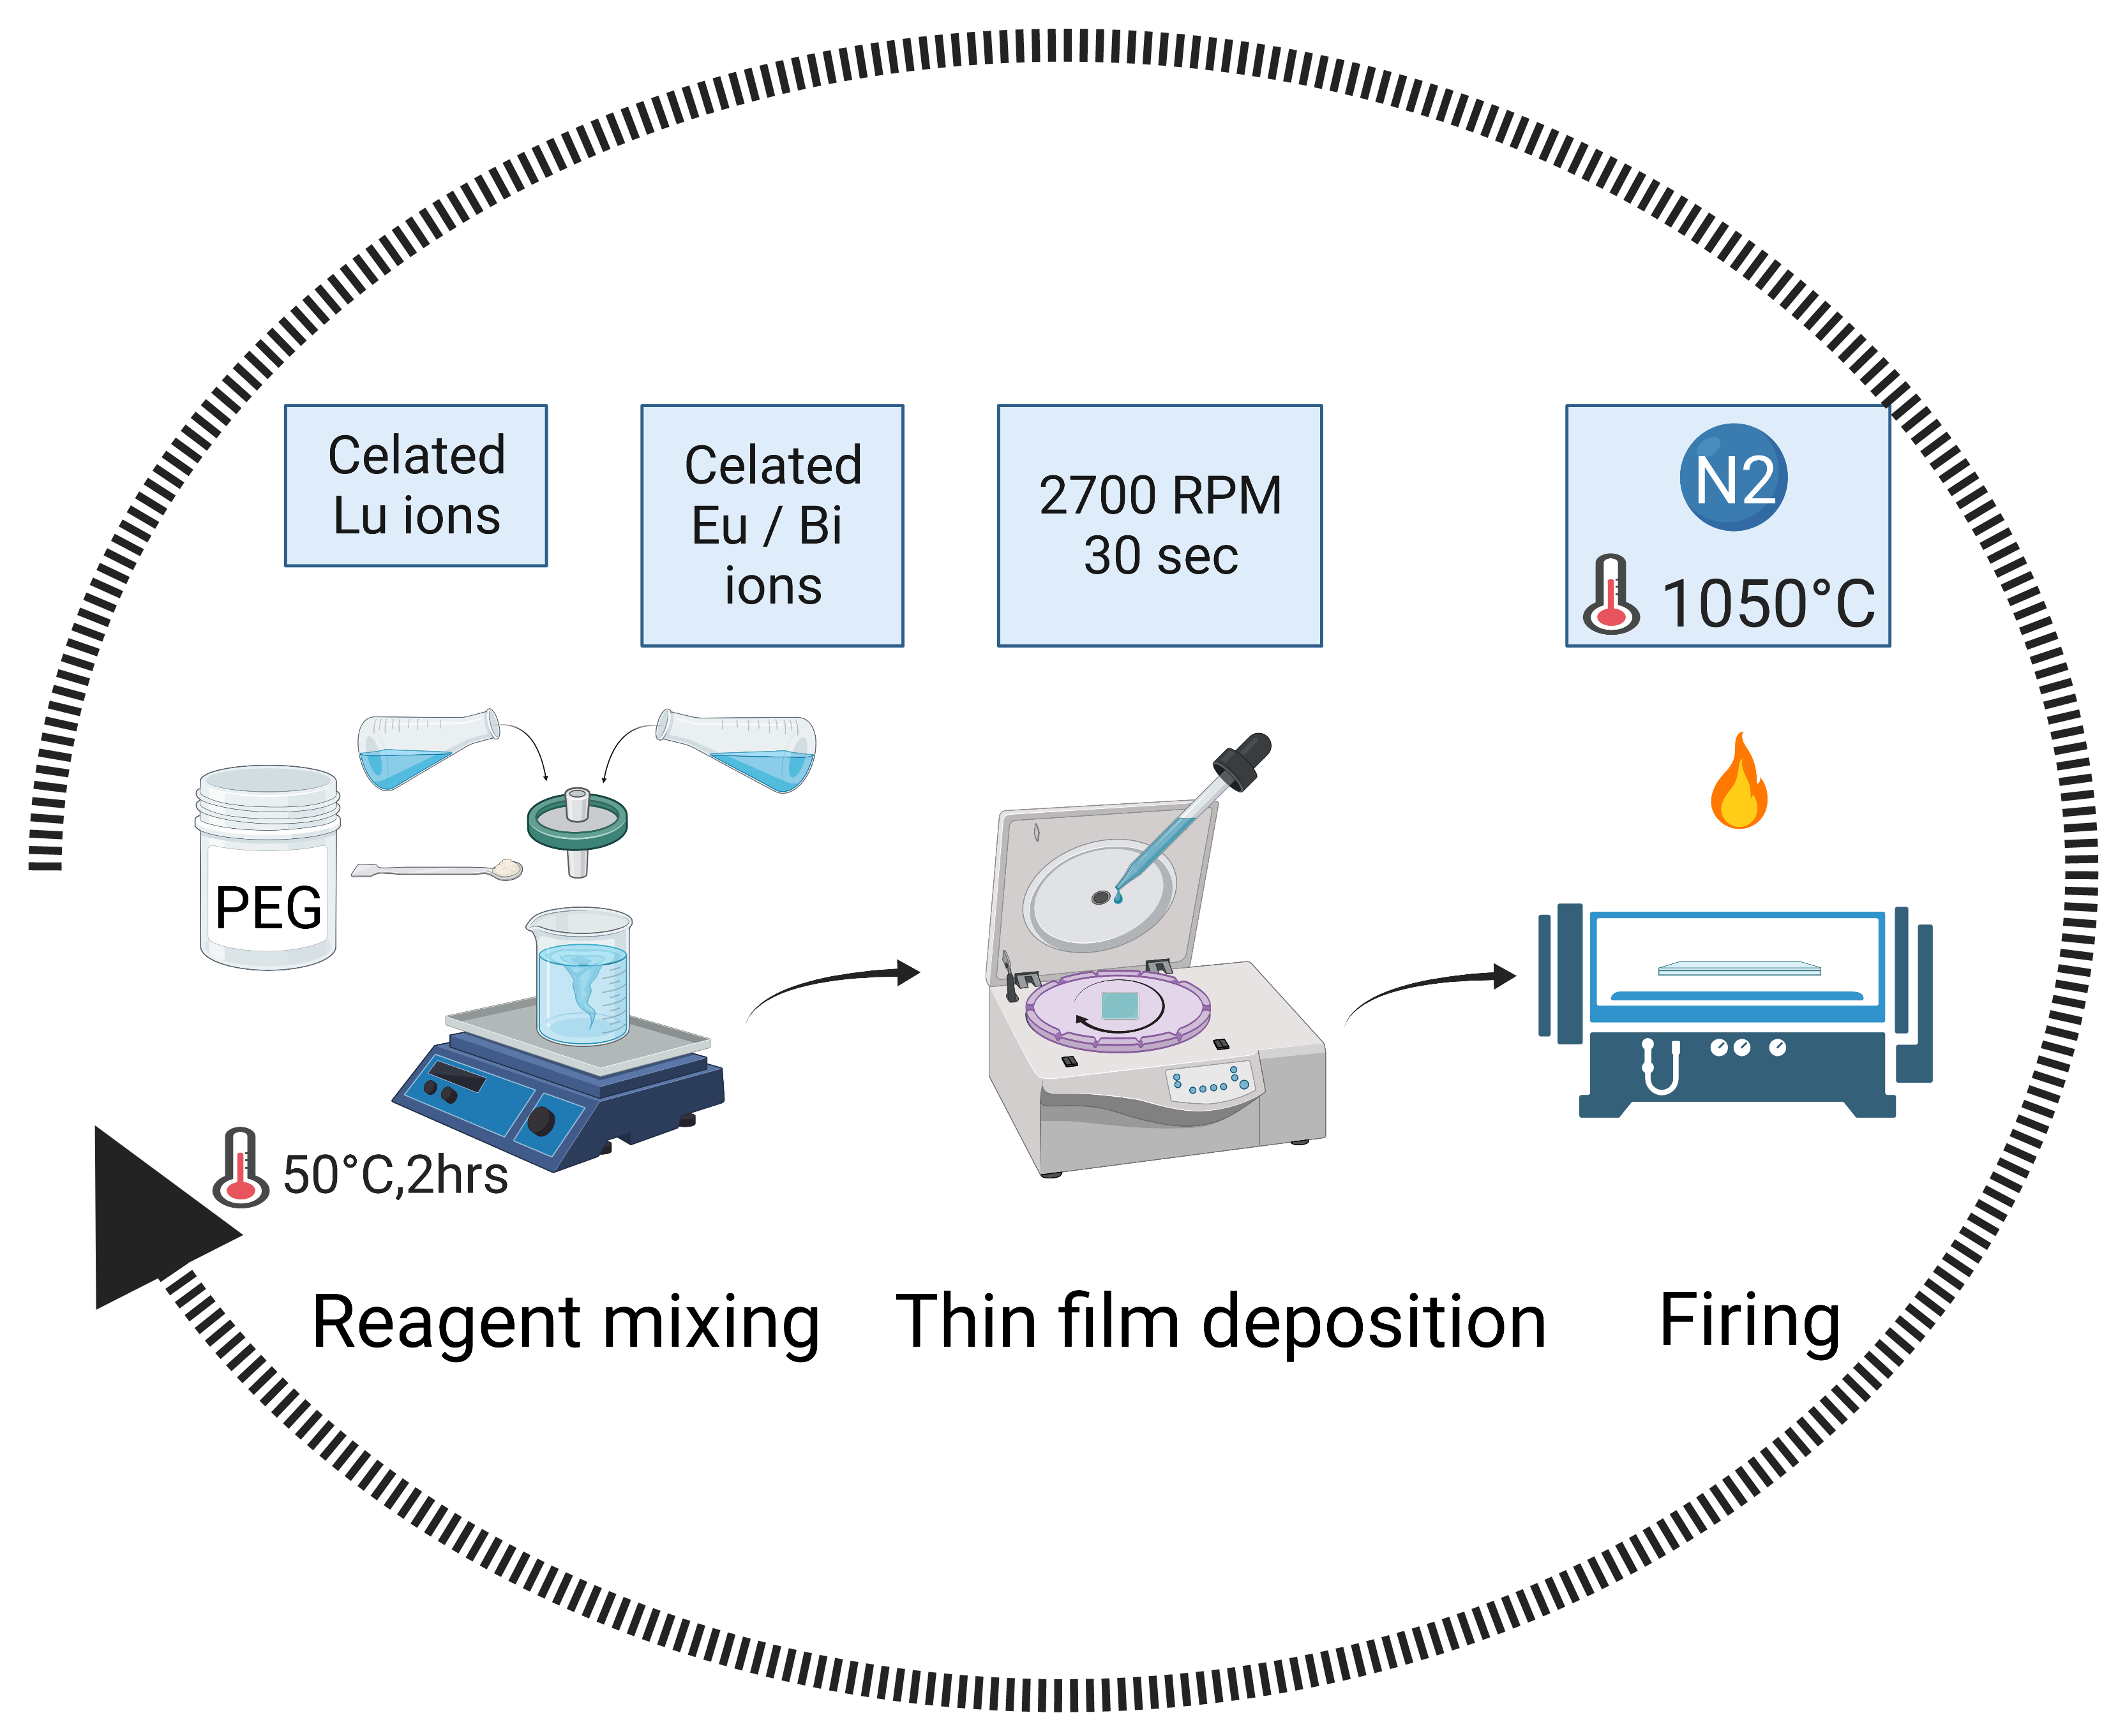
Experimental realization
Neta Lahav
Lu₂O₃:Eu-Bi
Growth method: sol-gel,
layer by layer
SiO₂
Morales Ramírez et al., J. Mater. Res. 28, 1365 (2013)
Nedelec, J. Nanomaterials 2007, 036392 (2007)
Review: Sol-Gel Processing of Nanostructured Inorganic Scintillating Materials
Co-dopant sensitizer
Kurman*, Lahav*, Schuetz*, et al. Purcell enhancement of X-ray scintillation, in preparation (2022)

Slide 16

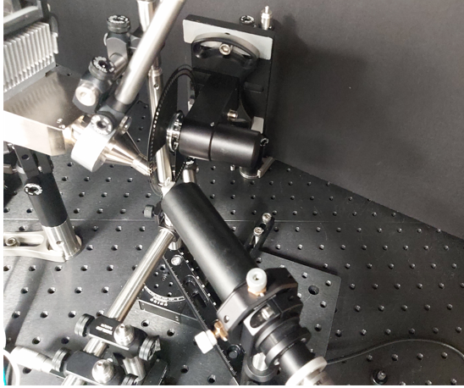


Building a new scintillation lab
Roman Schütz
@ Technion
rotating to extract lifetime
X-ray
scintillator
to spectrometer
analyze angle-depedence
optical
fiber
Kurman*, Lahav*, Schuetz*, et al. Purcell enhancement of X-ray scintillation, in preparation (2022)

Slide 17





Proof-of-concept measurements
More photons
Angular emission
Faster emission
Light yield
LYSO (literature): 22000 ph/MeV
Lu2O3 bulk (literature): 19750 ph/MeV
Our thin film: 14550 ph/MeV
With our PhC structure: 26000 ph/MeV
From $1.635 ms$ to $1.107 ms$
Kurman*, Lahav*, Schuetz*, et al. Purcell enhancement of X-ray scintillation, in preparation (2022)

Slide 18



Robustness to fabrication errors
Specific structures
Ensemble average with scattering
Kurman*, Lahav*, Schuetz*, et al. Purcell enhancement of X-ray scintillation, in preparation (2022)

Slide 19

Enhanced X-ray imaging
Kurman*, Lahav*, Schuetz*, et al. Purcell enhancement of X-ray scintillation, in preparation (2022)

Slide 20

Purcell nanophotonic scintillators
Kurman*, Lahav*, Schuetz*, et al. Purcell enhancement of X-ray scintillation, in preparation (2022)

Slide 21

High resolution X-ray detectors: breaking their intrinsic trade-off
regular scintillator
vs photonic-crystal scintillator
Shultzman*, Segal*, et al., Purcell-Enhancement of X-ray Imaging and Phosphor-Screens, under review (2022)

Slide 22
Apply nanophotonics to scintillator science?
Control light-outcoupling
  Nanophotonic scintillators
Enhance light-emission
  Purcell scintillators
Inspiration from quantum optics?

Slide 23
Inspiration from quantum optics
Sensitive light detectors:
  number-resolved single-photon detectors
Ultrafast light detectors:
  tens of ps time res
But it’s not just about counting the photons!
More information in photon correlations
  Can we use this information to improve the bottom line? image quality?
The duration of Cherenkov pulses (entanglement!)
  Karnieli et al., Science Advances (2021)
Photon bunching in scintillators

Slide 24

Quantum optical characterization of scintillators

Slide 25

Quantum optical characterization of scintillators

Slide 26



available ERC-funded positions
for students and postdocs
Roques-Carmes*, Rivera*, et al., Science (2022)
Shultzman*, Segal*, et al., under review (2022)
More on Cherenkov detectors, quantum optics, and other ideas:
Kurman, et al. PRL 125, 040801 (2020)
Kurman*, Lahav*, Schuetz*, et al., in preparation (2022)
Karnieli et al., Science Advances (2021)
kaminer.technion.ac.il

Slide 27





Why we like doing physics with free electrons
Radiation sources
Nearfield optical microscopy
tunable X-rays
Wang et al. Nature (2020)
4D imaging
Shentcis et al. Nature Photonics (2020)
Kurman et al. Science (2021)
Shaping single-electron wavepackets
the free-electron comb
Dahan*, Nehemia* et al. Nature Physics (2020)
Dahan et al. Science (2021)

