Slide 1
Mexico laboratory
Weizmann Institute
Meir Shoa

Slide 2
Some History
OPAL DETECTOR
OPAL (Omni-Purpose Apparatus at LEP) - one of four large detectors at the Large Electron-Positron collider (LEP)
  Started operation with the collider in August 1989
  Data taking ended - 2 November 2000
  Detectors dismantled the following year to –
  make room for construction of the Large Hadron Collider (LHC).
1980-1990 - Lab activity - TGC for the Hadron calorimeter
  R&D – TGC taken from prototype level to mass production
  Production of 500 units
  Installation

Slide 3
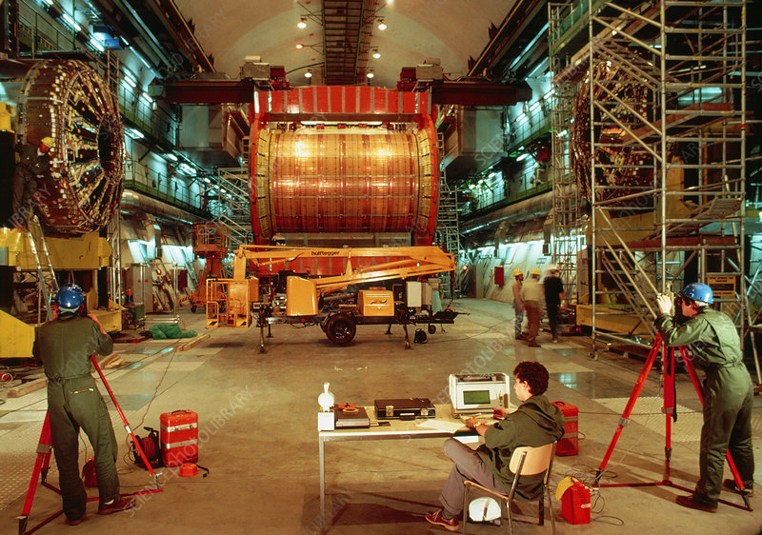
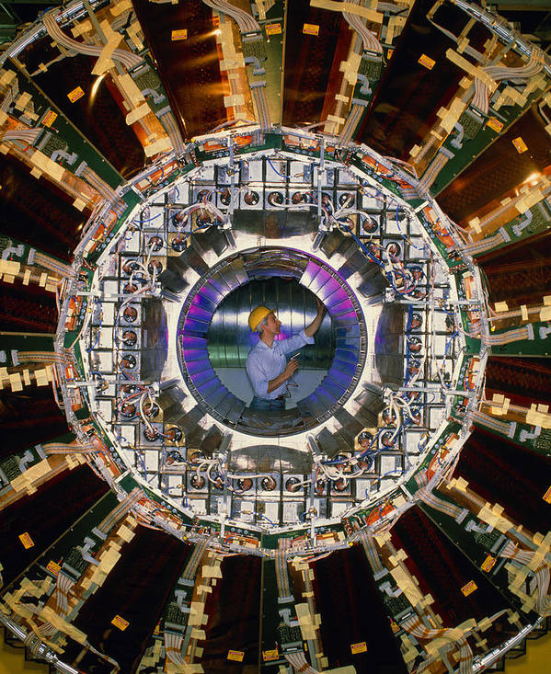
OPAL
Hadron Calorimeter
Presample chambers

Slide 4
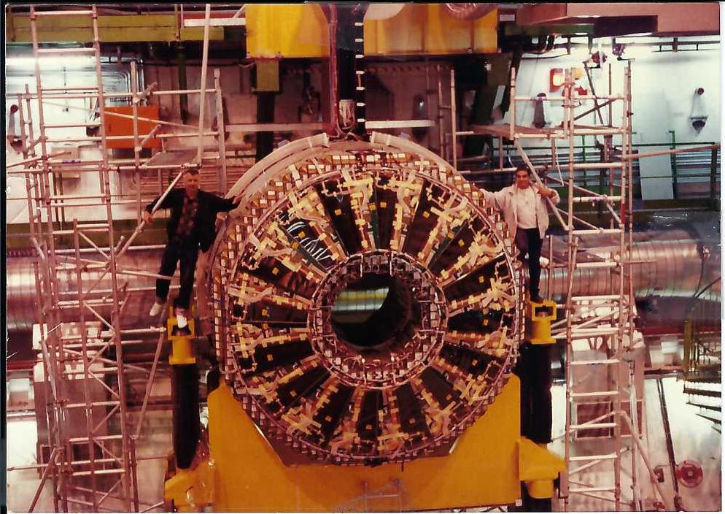
Hadron calorimeter

Slide 5
1990-2000 Activities
Maintenance of OPAL detectors
R&D of special pre chambers and installation in OPAL
Spaghetti project muon TGC chambers
  Planned and constructed at Weizmann
Start of R&D of TGC’s units for Atlas
End of decade – start production of TGC’s for the Atlas big wheels

Slide 6
2000-2008 Activities
Construction of about 2100 TGC’s
Transport to CERN
Mounting of TGC’s on separated sectors
Assembling of 6 big wheels and 2 small wheels
Placing the wheels on Atlas pit (include services)

Slide 7
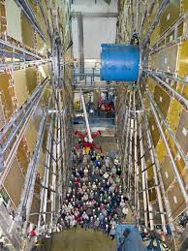
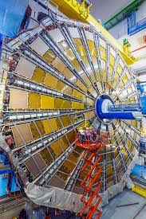
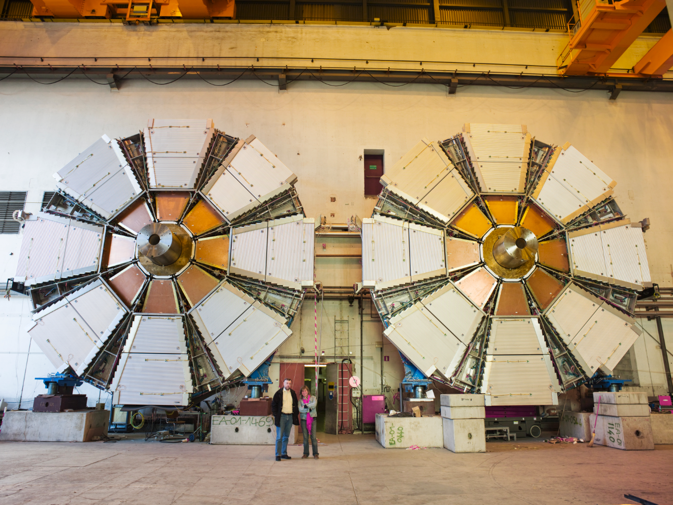
Big wheels Small wheel

Slide 8
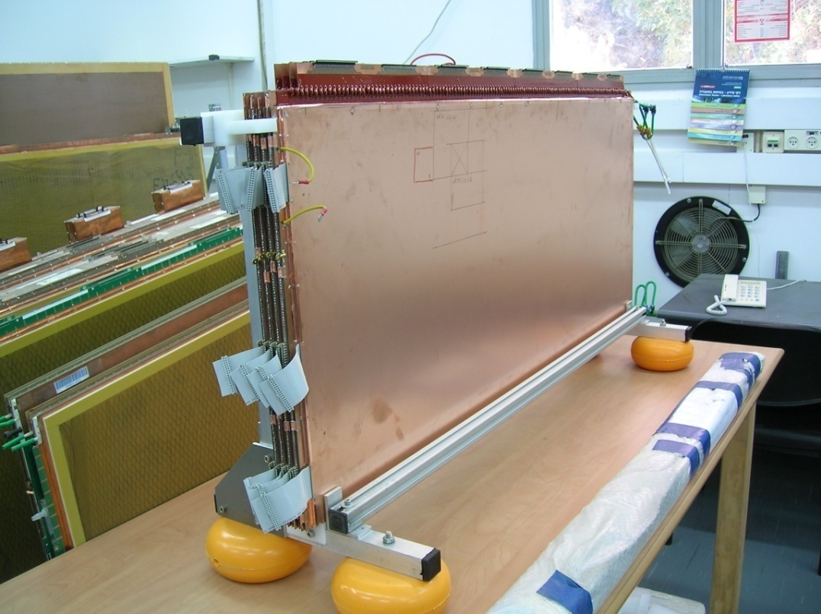
2008- 2014 Activities
Maintenance of TGC’s (big wheels)
R&D and full design for New Small Wheels small-strip TGC (sTGC)

Slide 9
2014-2021 Activities
Production of 64 sTGC’s quadruplets for the new small wheels
Support involved sites for production
Transport to CERN
Testing detectors at CERN including Beam test and GIF
Expert team for electronics and units assembly at CERN

Slide 10
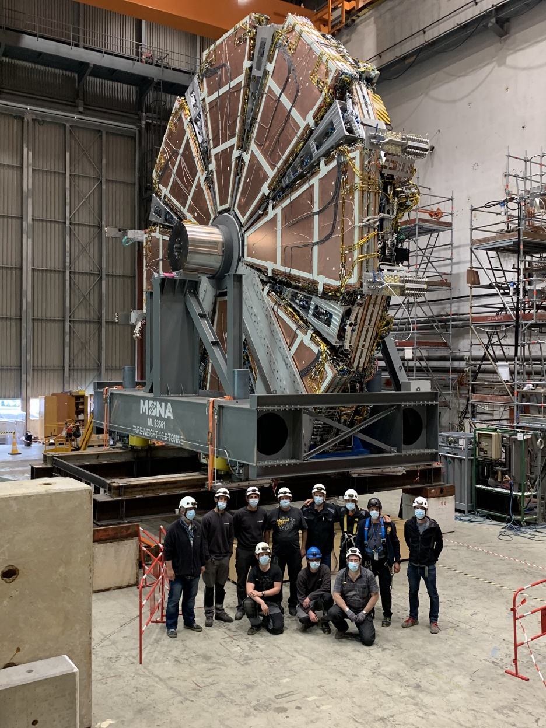
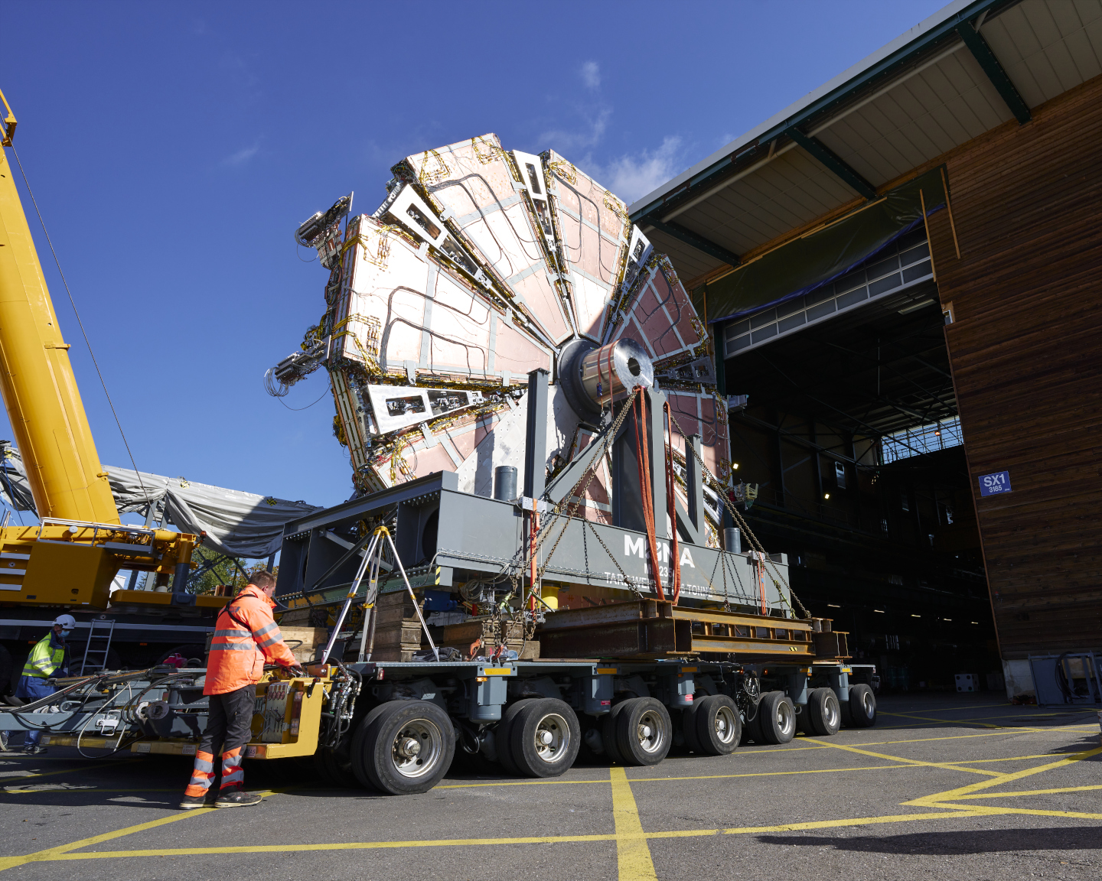
New small wheels
2 NSW are operating underground in the ATLAS pit

Slide 11
Current activities

Slide 12
Mexico lab
Maintenance for the big wheels in ATLAS
  DCS, Spare production and replacement
R&D projects
  Muon spectrometer NA60+
  EIL4 TGC - to replace on 2026
Production of the new EIL4 will start soon
Design and planning the new lab

Slide 13
Spare TGC’s units
22-23 – 7 units will be replaced next EYETS
  Production is taking place these days
LS3 – 23 units are needed to be replaced
  Production (ongoing) and spares.

Slide 14
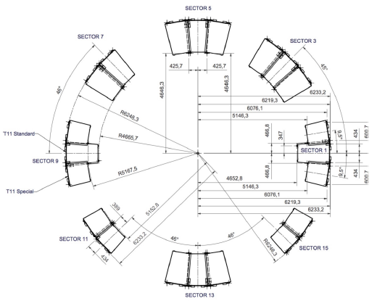
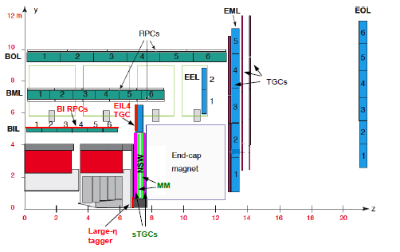
TGC-EIL4 Project
42 triplets will be produced and installed at ATLAS during LS3

Slide 15
Laboratory team
Part of the physics core facility unit at WIS
Scientific Personnel
  Overall scientific leadership – SB
  Two permanent physicists – IR, LM
  Physicist consultant – VS
  Per project leadership – SB, SM, NT
Technical team – 5 full time employees
  Management - MS
  Two project leaders – GC, FB
  Two engineers – BY, ZF
Temporary team – hired per project
  Currently 2 and up to 20 in intense mass production periods

Slide 16
Laboratory expertise
Multi wire proportional chambers
Transition for MPGD structure is straight forward
Transition to other technologies is doable
Fully equipped with necessary instrumentations
  Flat granite tables, PS, measurement equipment and raw material to produce detectors
Procurement of new instrumentation supported by the institute
  Provided decent scientific justification

Slide 17
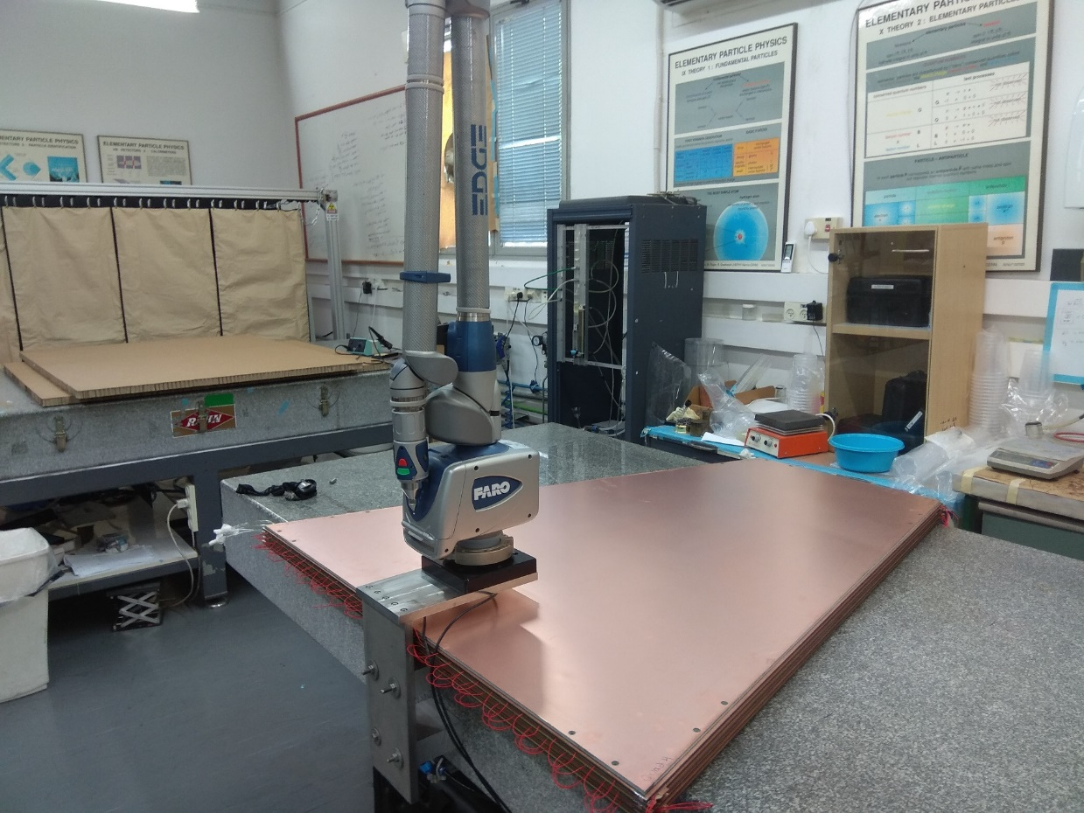
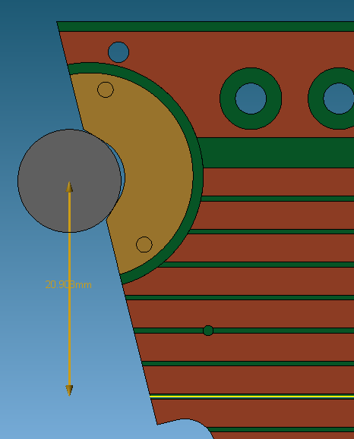
Example equipment – Faro arm
3D measurement to the 20 um level

Slide 18
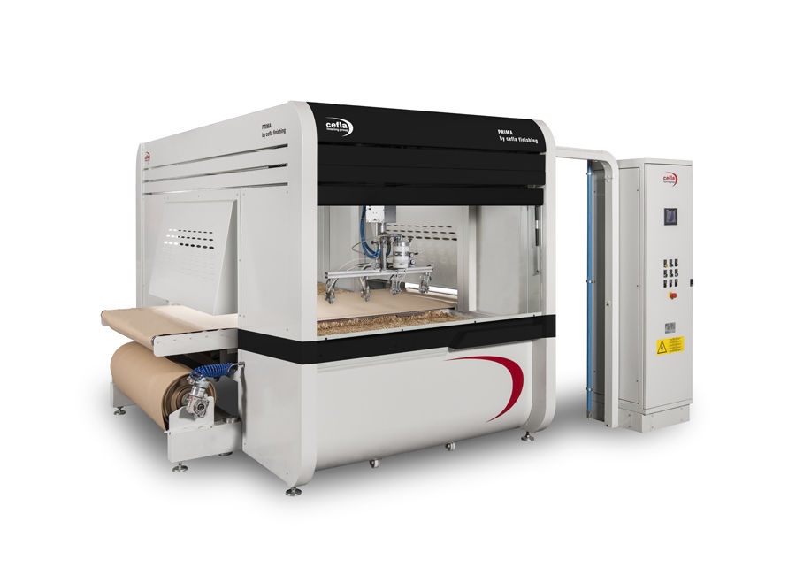
Example equipment – Graphite spraying machine
Capacity > 40 large area PCBs (TGC CB are 3 m²) per day
Good accuracy

Slide 19
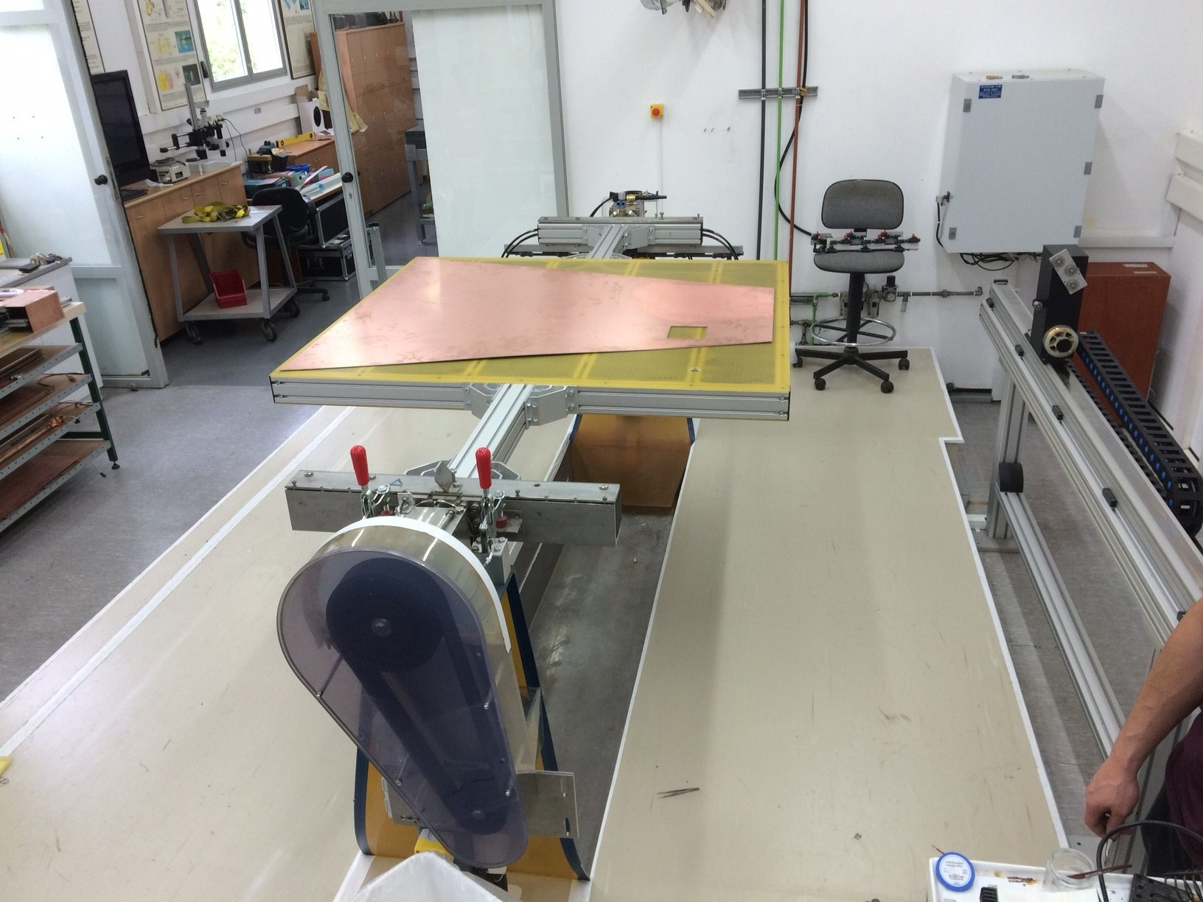
Example equipment – Adjustable winding machine
Custom made based on in house design
Adjustable table size – to cope with the different dimensions of the TGC types

Slide 20
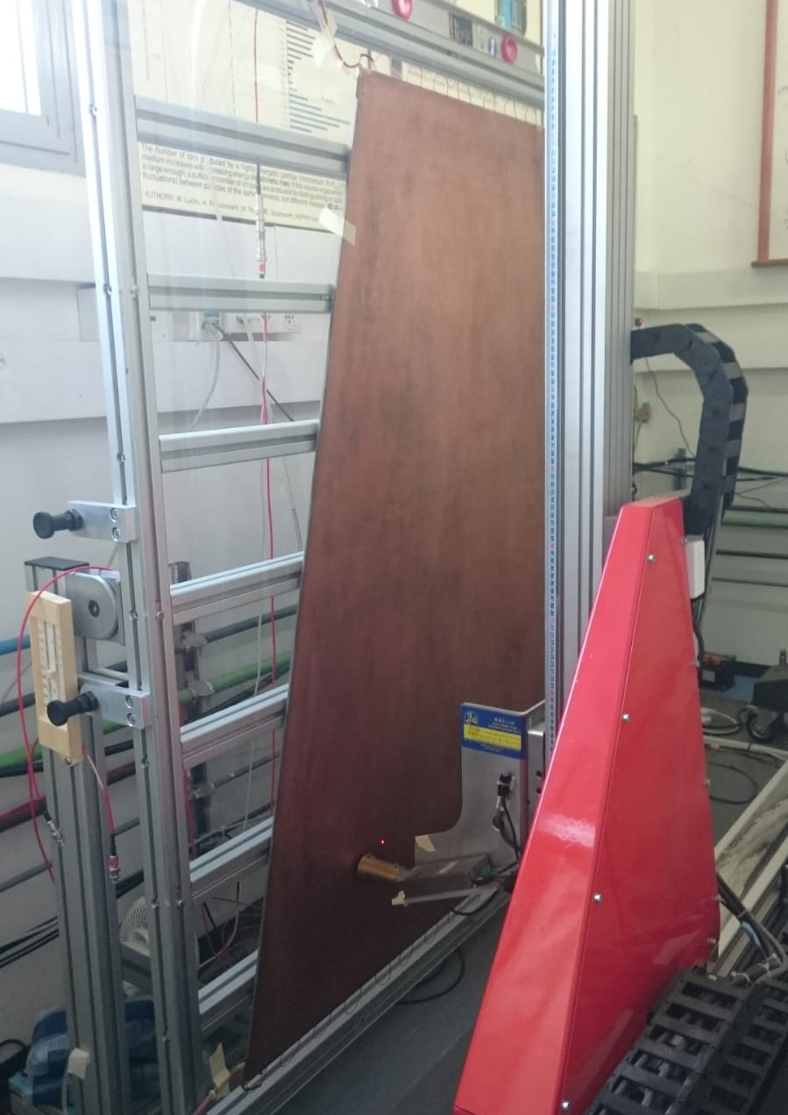
Example equipment – XY X-ray mahcine
Designed for the QA/QC of the sTGC
  By the Russian team
X-Y portable table synchronized with X-Ray tube and PS
Used for gain uniformity test and identification of hotspots

Slide 21
Transition to the new DPPA building
New building for the department of particle physics and Astrophysics
  Construction start next year and will take ~3 years
We are going to get a 850m² laboratory
  Double than what we have today
We will have all the facilities that we have today, but bigger and better

Slide 22
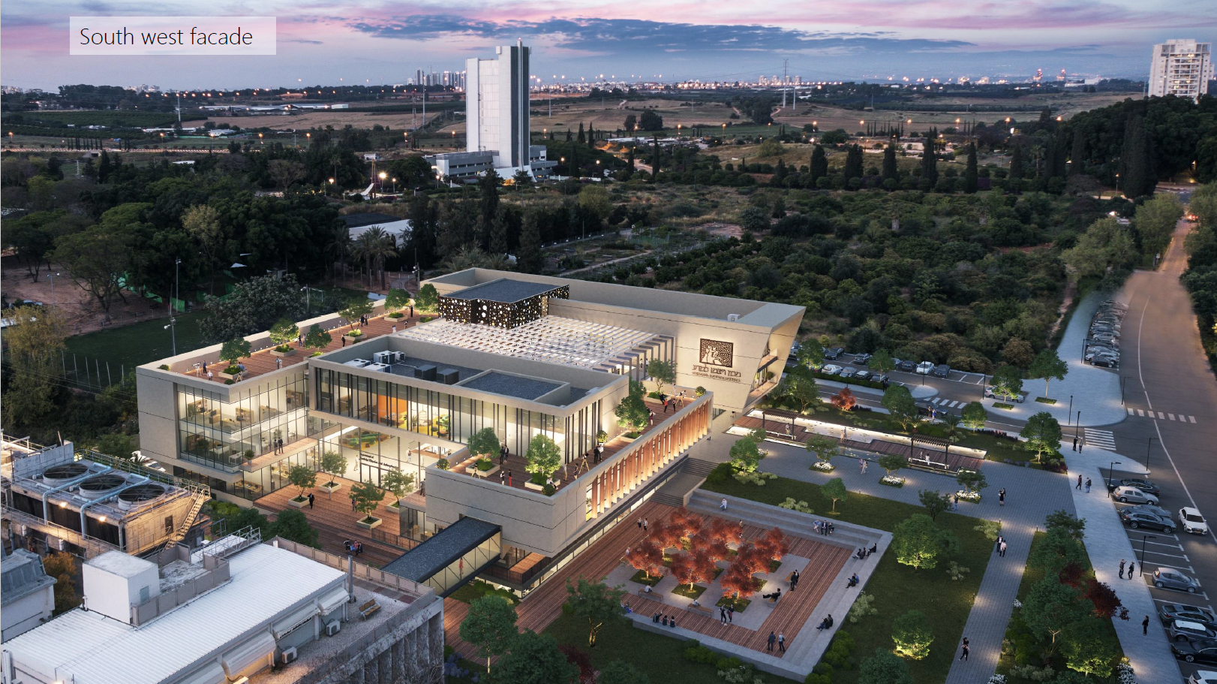
The new building

Slide 23
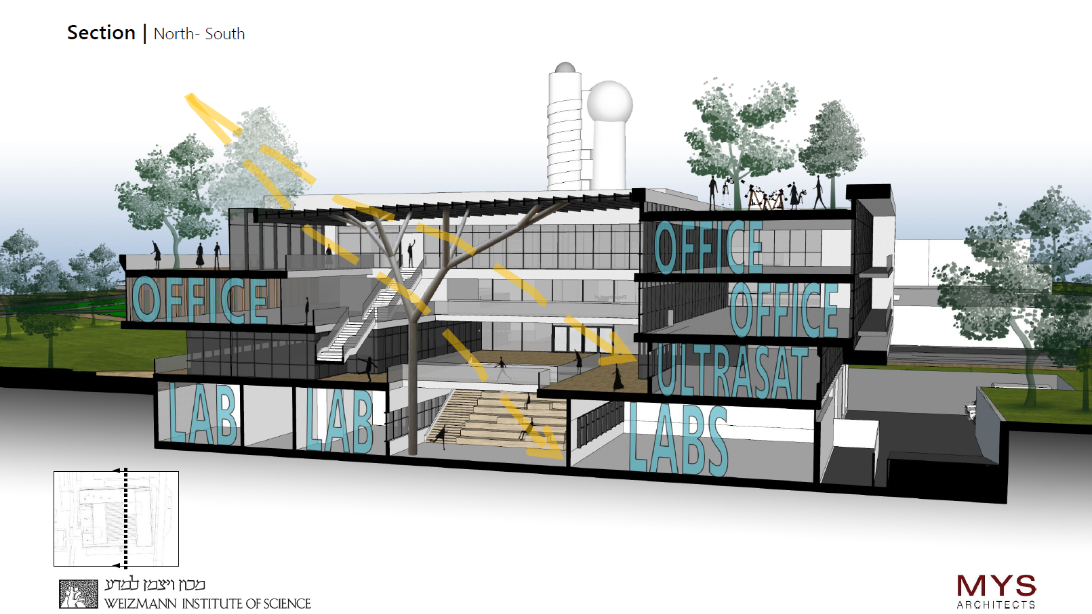
The new lab

Slide 24
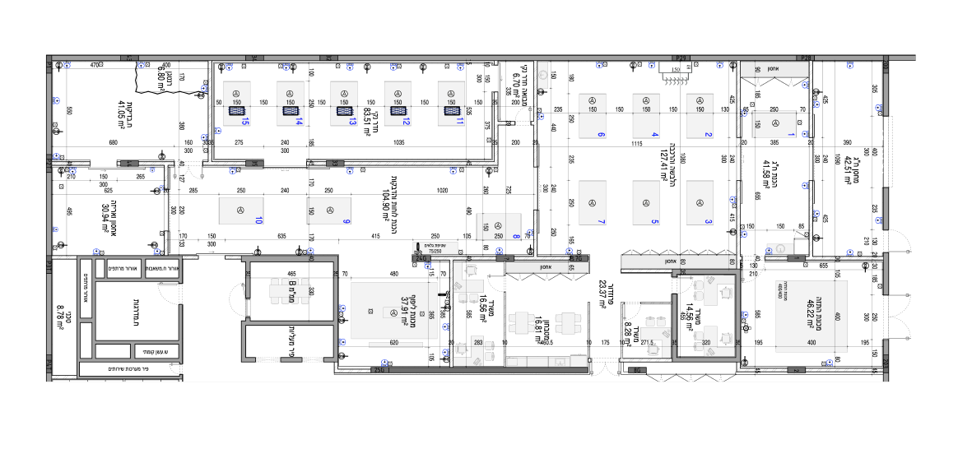
New lab

Slide 25
END
Thanks

Slide 26
Angle (Using the Faro arm)
 | Quad no' 1 | Quad no' 2 | Quad no' 3 | Quad no' 4 | Quad no' 5 | Quad no' 6 | Quad no' 7 | Quad no' 8 | Quad no' 9 | Quad no' 10 | Quad no' 11 | Quad no' 12 | Quad no' 13
1st layer angle (º) | -0.003 | 0.012 |  | -0.005 | -0.006 | -0.004 | 0.003 | 0.007 | 0.001 | 0.004 | 0.01 | 0.01 | 0.009
2nd layer angle (º) | -0.008 | 0.013 |  | -0.005 | 0.005 | 0.006 | 0.009 | 0.01 | 0.004 | 0.001 | 0.006 | 0.004 | -0.008
3rd layer angle (º) | 0.006 | 0.016 |  | 0.004 | 0.007 | 0.008 | 0.004 | 0.001 | 0.007 | 0.01 | 0.004 | -0.005 | 0.01
4th layer angle (º) | 0.002 | 0.001 |  | 0.004 | 0.006 | 0.001 | -0.011 | 0.005 | 0 | -0.007 | 0.005 | 0.01 | 0.008

Slide 27


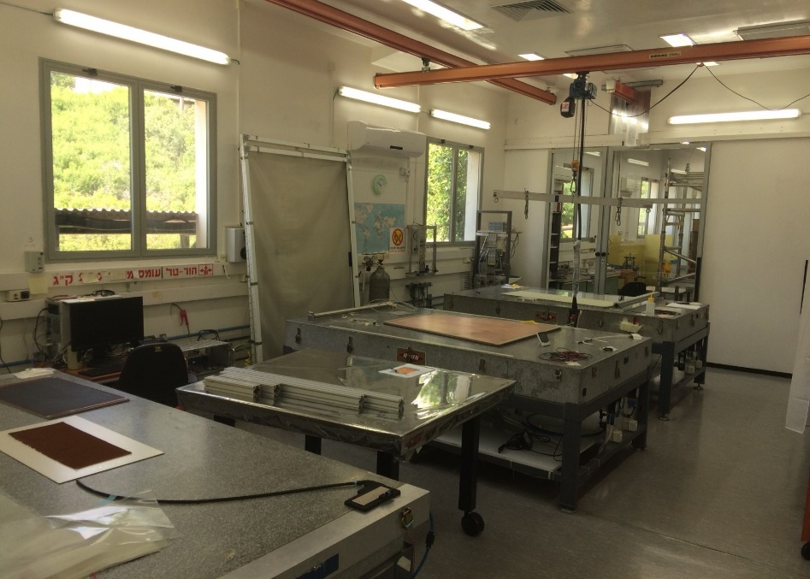
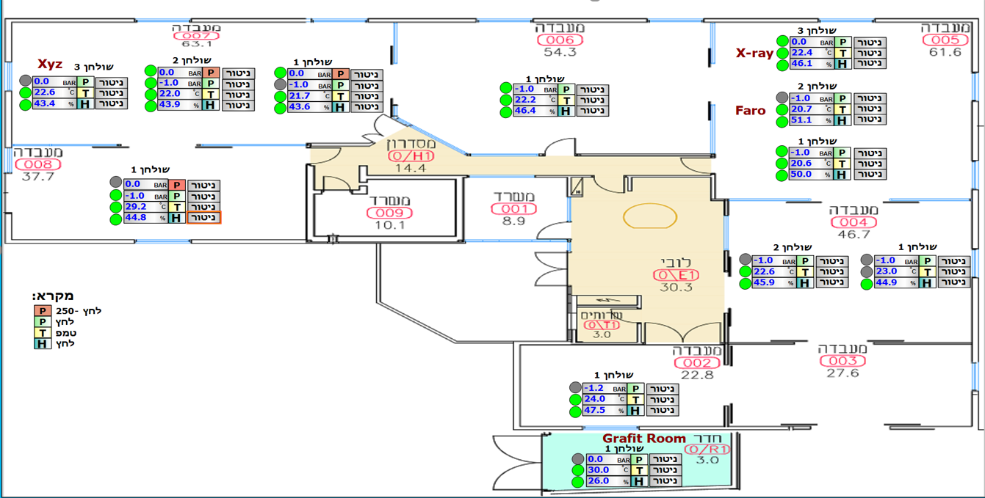

Slide 28
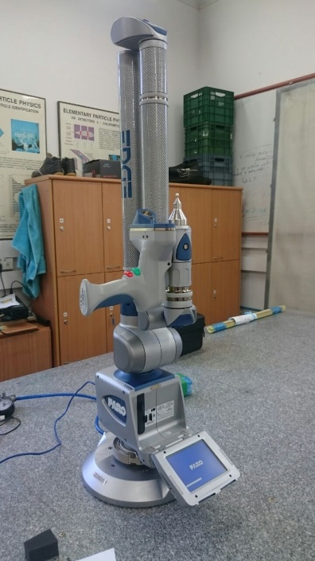
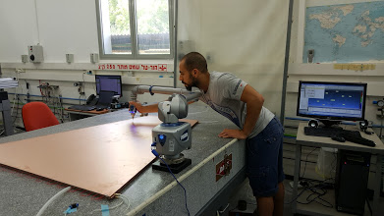
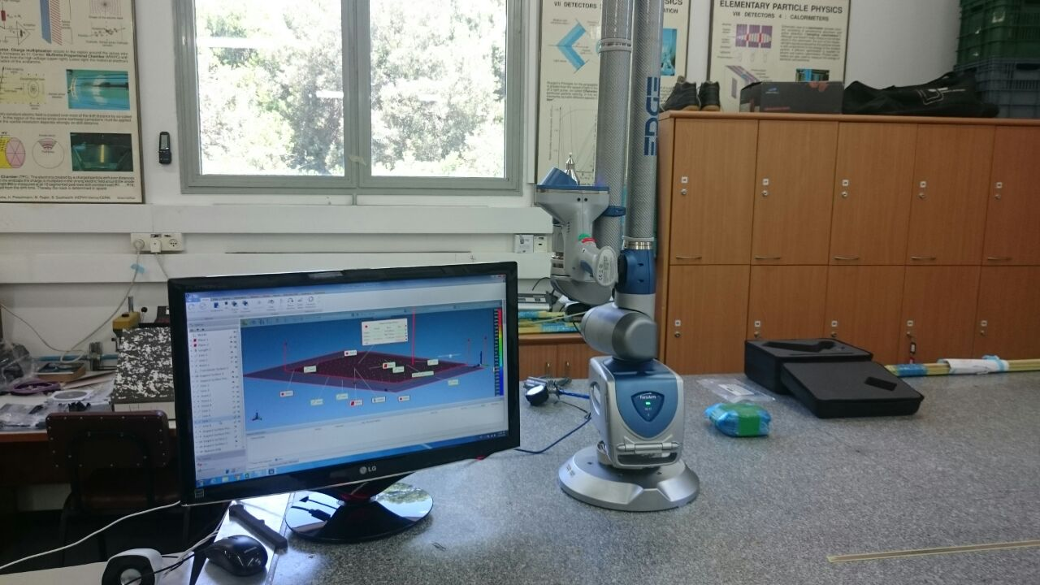

FARO ARM
This arm can move 2.7m around the connection point and measure any object by either touching points or scan it with laser.
Precision of the Faro is 27 Micron max.
We use the Faro for measuring cathode boards and also for final alignment test of quads.

Slide 29
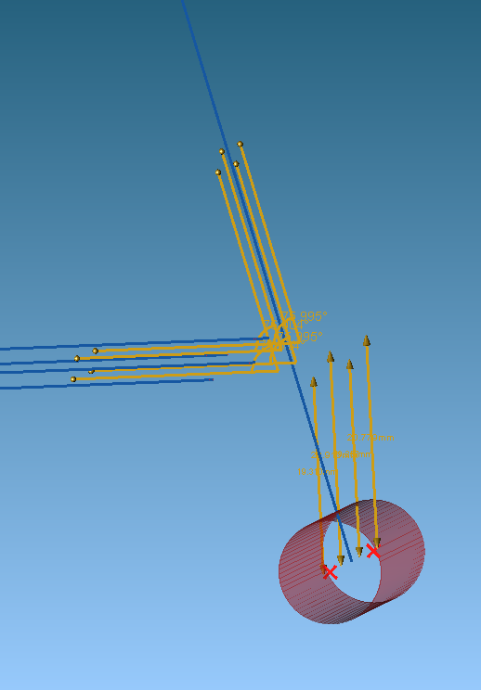
Isometric view actual measurement
The nominal distance between Vbrass to strip at 90°
Brasses line
Strips
90°
Vbrass

Slide 30
NSW
QS3
Our major responsibility was to produce 60 quads.
40 of type QL1
20 of type QS3
QS1
QL1
4 QS1 added in
the end of the project

Slide 31
IRRADIATION OF X-RAY MACHINE
All the detectors and material pass x-ray irradiation to check long term stability and week points

Slide 32
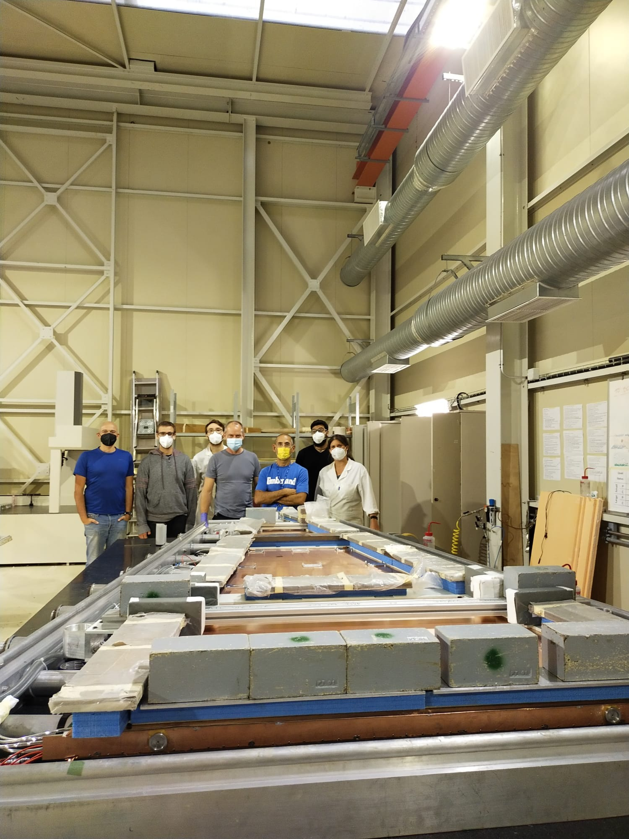
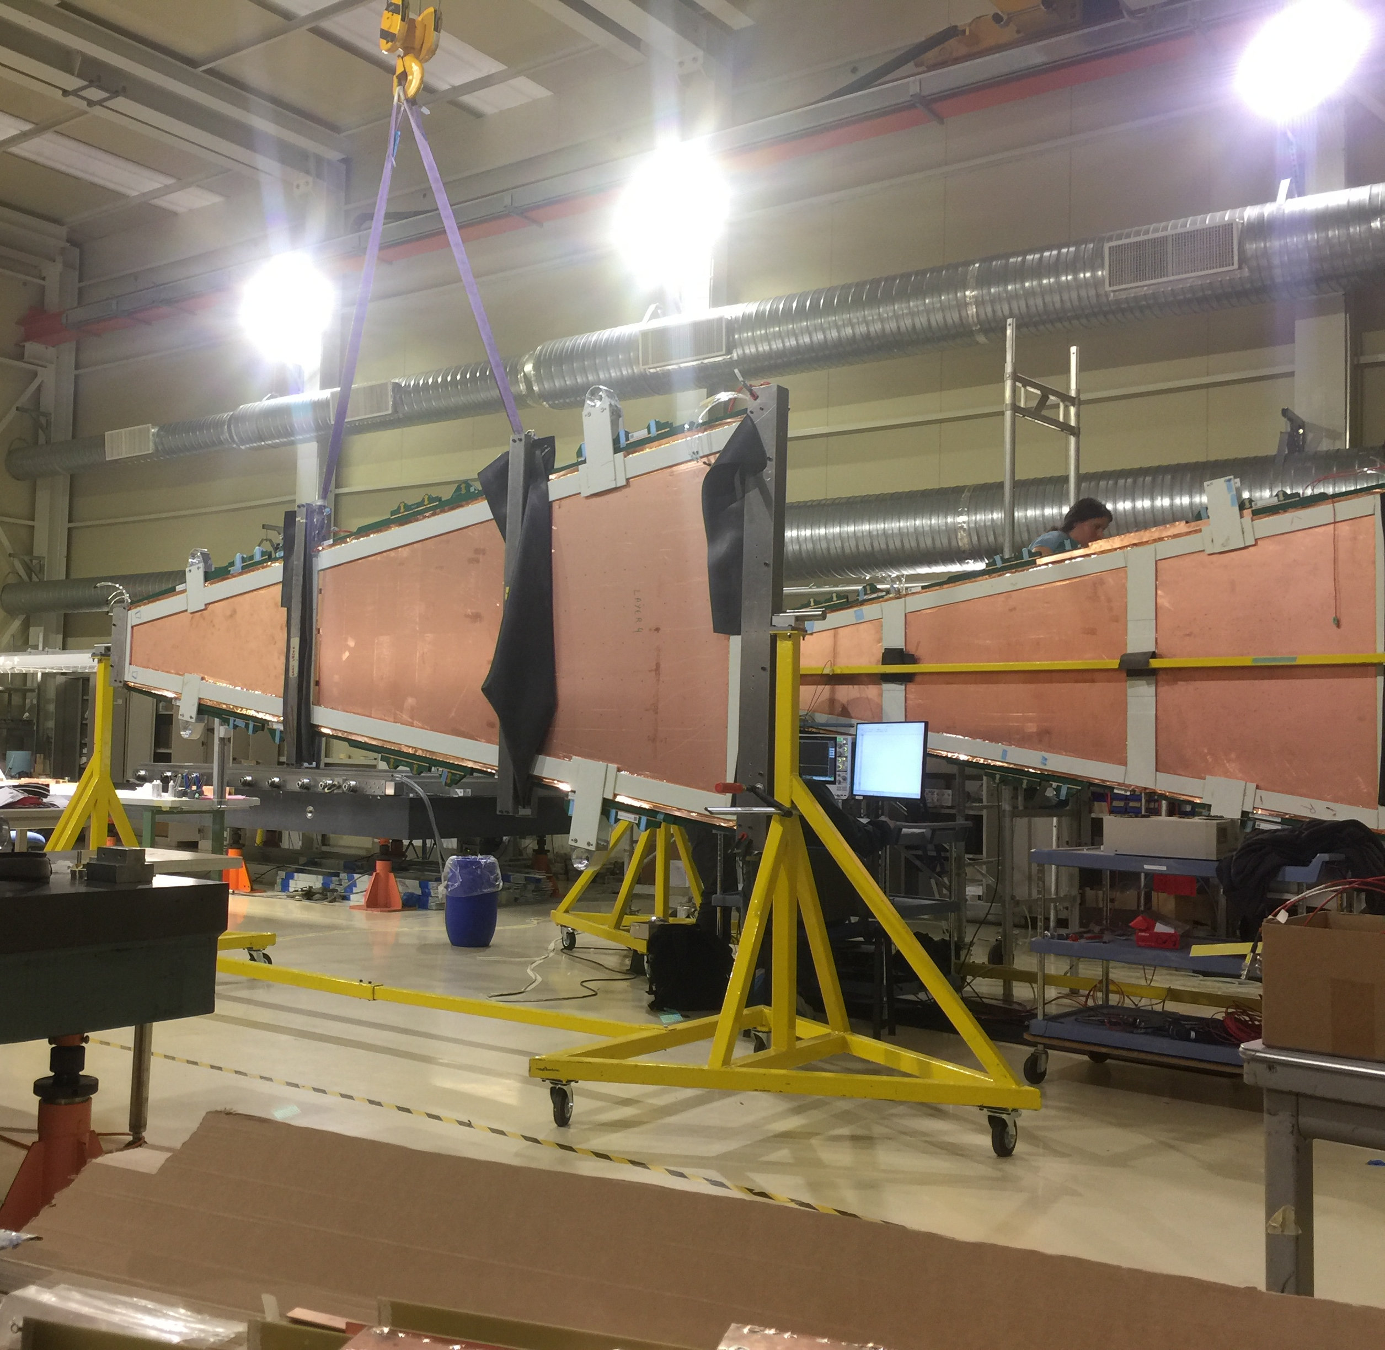
LAB contribution at CERN
Replacement and maintenance of TGC’s on the big wheels
Testing detectors at CERN including Beam test and GIF
Experts technician with

