Slide 1
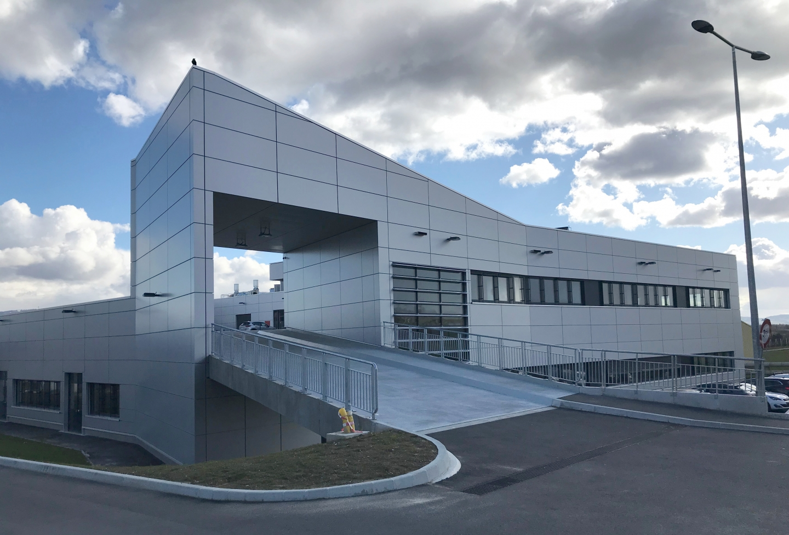
CERN MPT workshop
(Micro Pattern Technologies)
Rui De Oliveira December/11/2022

Slide 2

-20 persons
-13 persons from a contracting company → only productions using well established technologies.
-7 CERN staff → 3 administration and 4 dedicated to R&D prototypes.
-1400 square meters (new building finished in 2018).
-Making PCBs since 1965
-Mandate:
-Produce parts difficult to find in industry.
-Provide to CERN users expertise in interconnections technologies.
-Make sometime mass production.

Slide 3
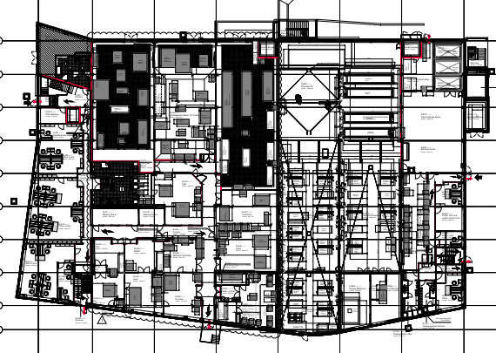
PCB Assembly Lab PCB design office
Building 107
PCB area
MPT workshop (EP Dept. -20persons)
Surface treatment workshop

Slide 4
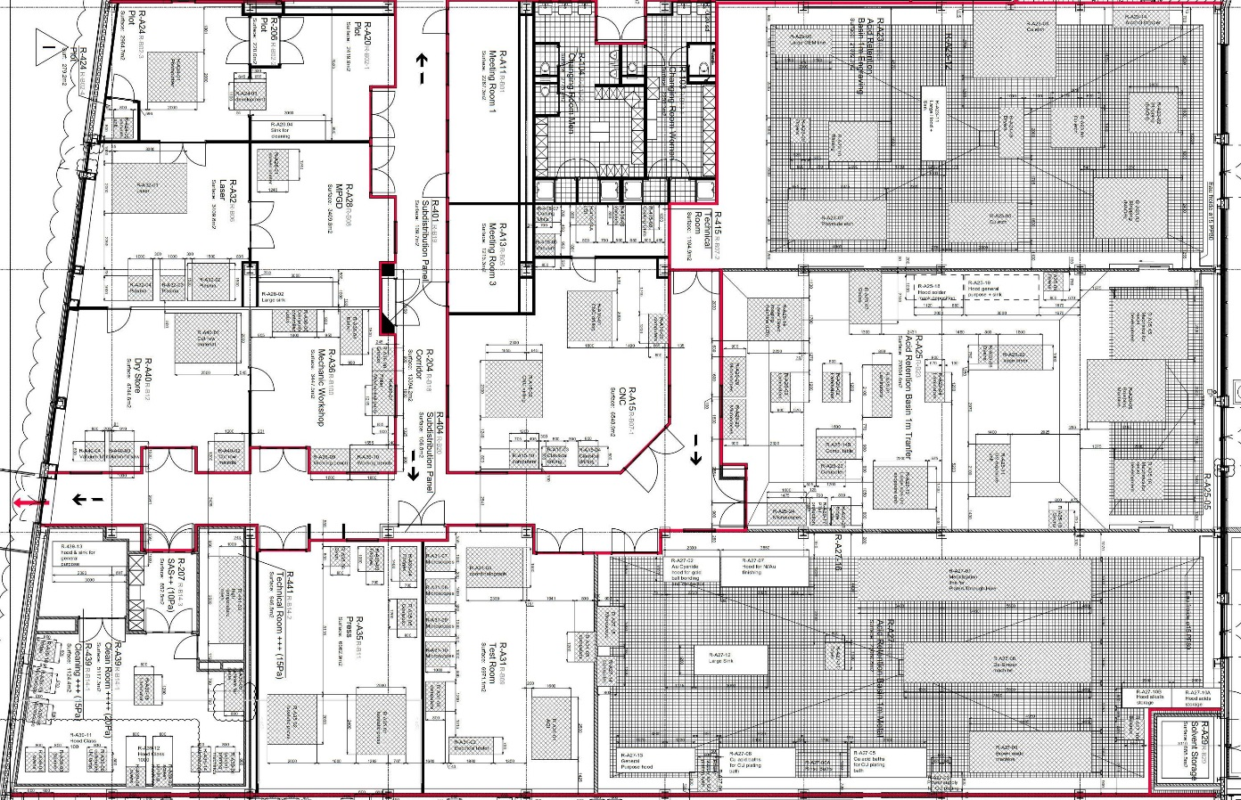
3
2
Wet processing Area
1/Plating facility
2/Photo processes
3/Chemical Etching
1
Dry processing Area
5/Drilling/milling
6/Test
7/Pressing
8/MPGD
9/Chemical analysis
10/Photo mask lab
11/Vacuum deposition
12/Dry store
5
6
7
9
8
10
11
12
Clean room

Slide 5
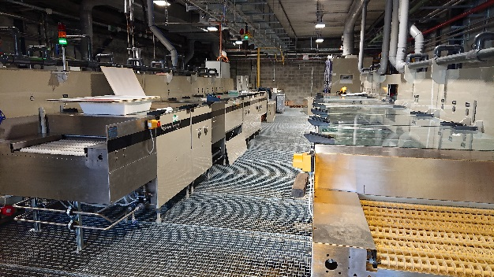
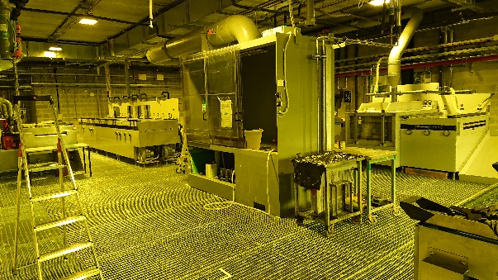
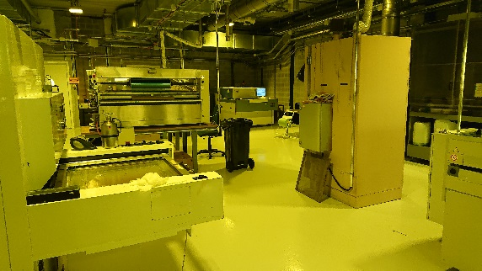
Wet area
Plating facility
-Cu : bath
-Ni : bath
-Au Bath
-Carbon Horizontal
-desmear Horizontal
-Cu oxide Horizontal
Chemical etching facility
-Cu,SS,Al,Ni Horizontal
-Ti ,W, in hood
-Stripping horizontal line
-Cu/Ni horizontal plating line
Photo processes
UV exposure : std and large size
Laser Direct imaging
Lamination : std and large
Soldermask spray deposition
Horizontal development:
-Solid resists
-Coverlays
-Solder masks
-Liquid resists

Slide 6
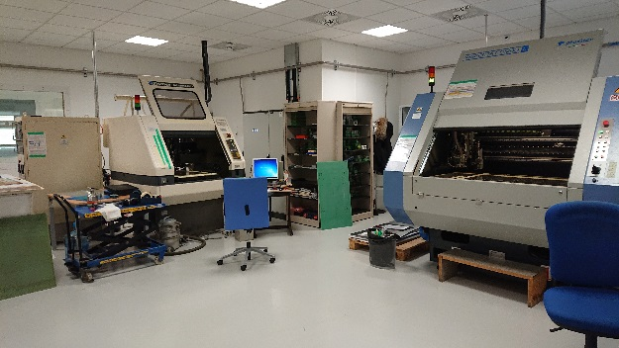
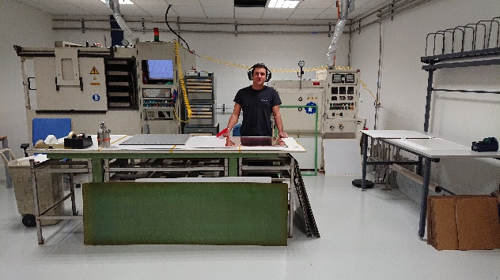
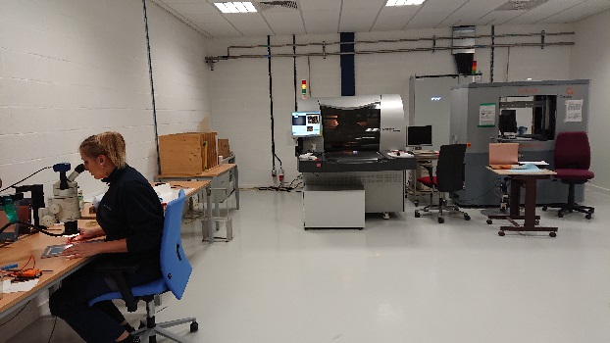
Dry area
CNC processes
-Drilling
-Milling
Press facility
-Multilayer gluing
-2 isostatic presses
Test facility
-Automatic Optical Inspection
-Electrical , flying probe tester
-microscopes

Slide 7
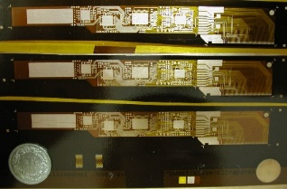
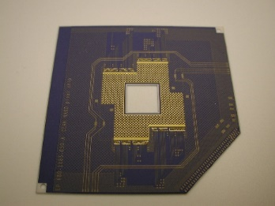
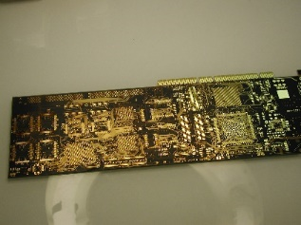
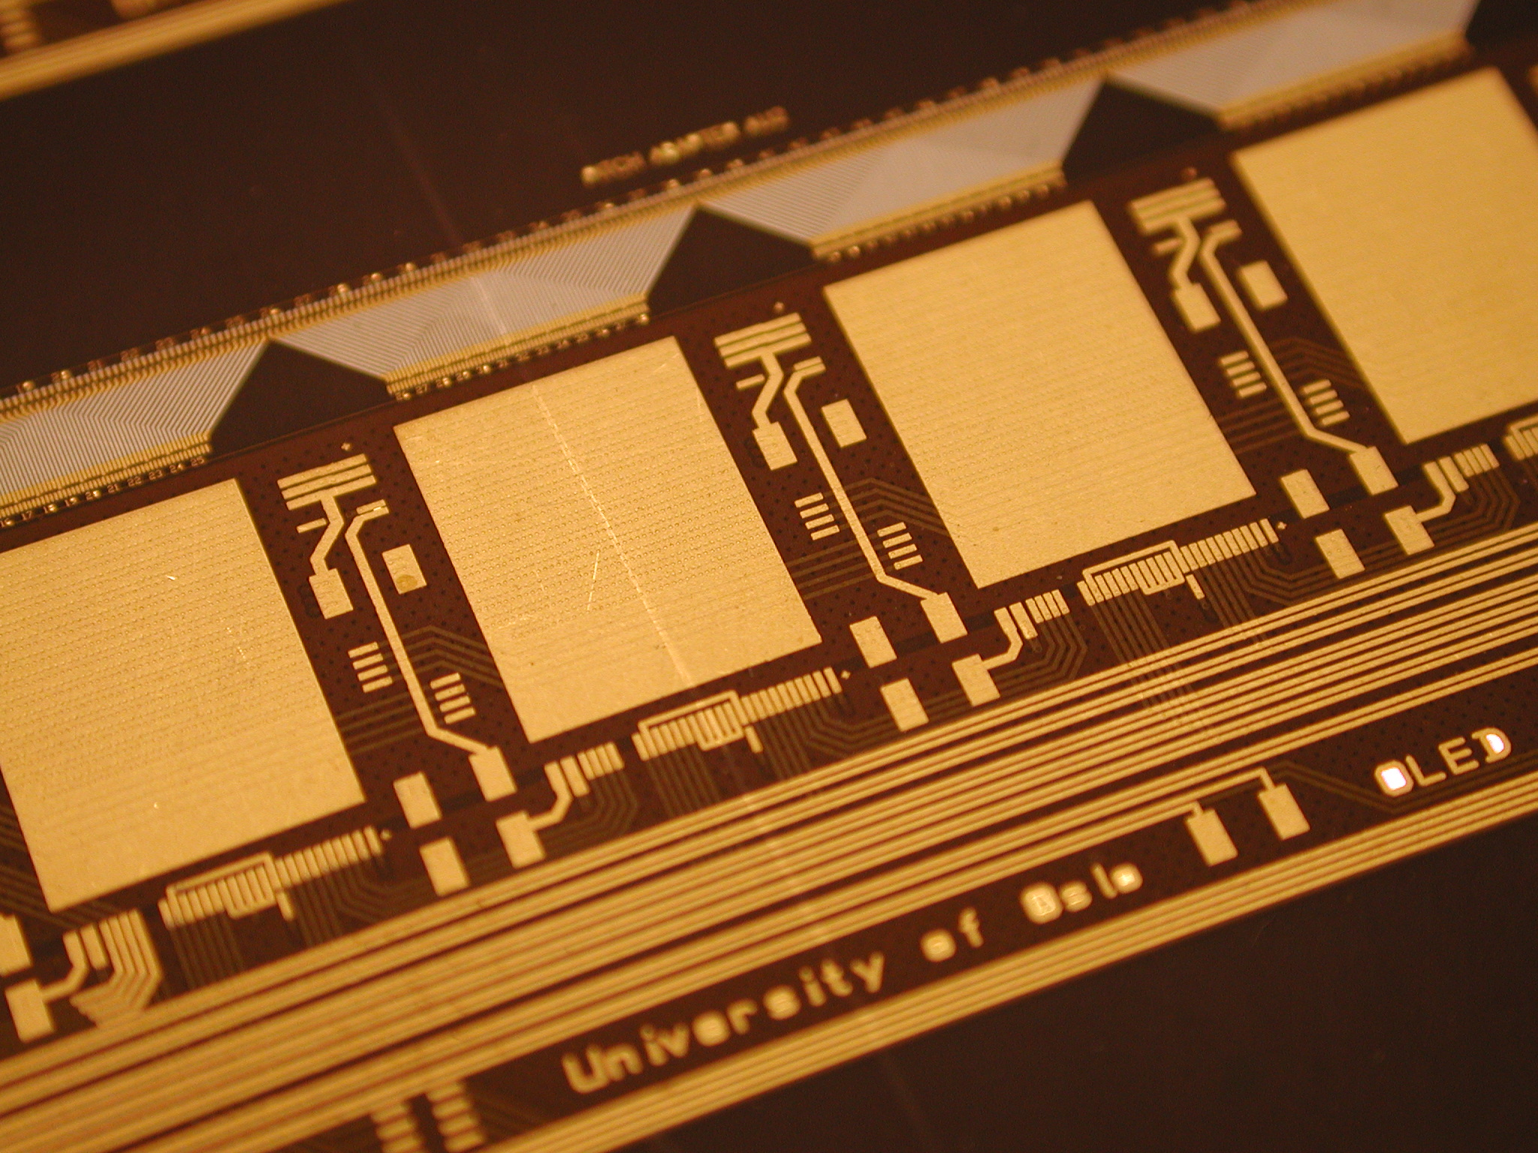
Core interconnections technologies available at MPT
Minimum line and space
10 um
MCM/Silicon
20um
MCM/Deposited
25um
Thin film hybrids
50um
75um
MCM/Ceramic
MCM/Laminated
90um
120um
Thick film hybrids
PCB
200um
MCM: Multi Chip Module
PCB: Printed Circuit Board
Screen printed circuits

Slide 8
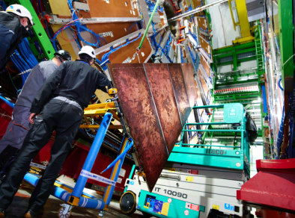
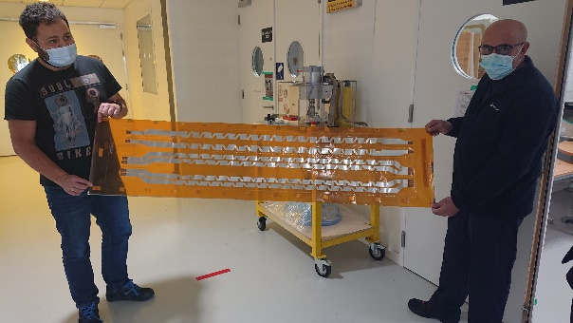
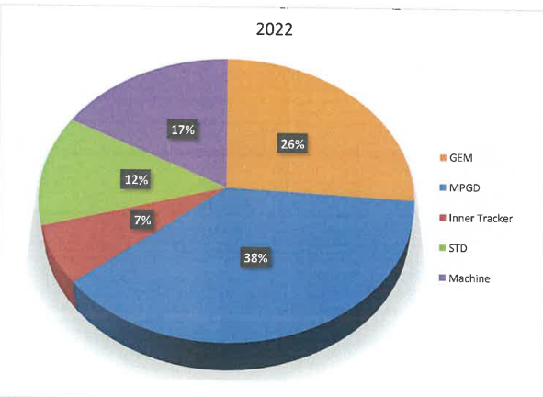
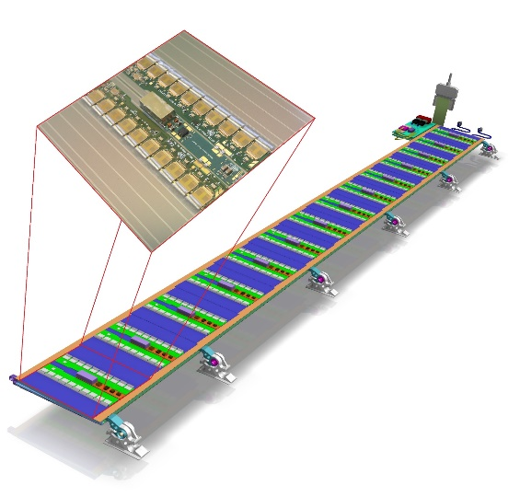
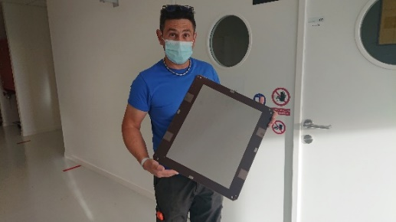
MPT activities
STD PCB
Component for LHC machine
Ex: Quench heater flexes
-Different flavors , up to 14m long
-More than 40 planned for 2023
GEM
Ex: CMS GE2.1
-Around 1000 GEM in total
-350 still to be produced in 2023
4 technicians dedicated to GEM productions
Heavy R&D program
-PEP uRwell large size detectors
-Capacitive sharing detectors
-High rate detectors (MM & uRwell)
-Resistive GEMs
-Low IBF detectors
-High dynamic range detectors
-Fast timing detectors
-Low mass
Inner trackers components
Ex: ATLAS ITK inner tracker long buses
-1.4m x 15cm
-900 pieces to be produced in 2023/24
Other detectors types
Ex: T2K upgrade
-Resistive Micromegas detectors
-40 pieces requested ,
-20 pieces still to be produced in 2023

Slide 9
We are working on many projects, but I want to highlight today 2 of them:
1/News on uRwell detectors production
2/New vacuum depositing machine

Slide 10
uRwell structure (reminder)
After Vacuum gluing
Copper
DLC
Prepreg
‘Wellize’ (GEM process)
Any R/O structure
-X/Y , UVW , Pads, Capacitive sharing
-Rigid , flex, ultra thin flex
-Copper, Chromium, Aluminum etc..

Slide 11
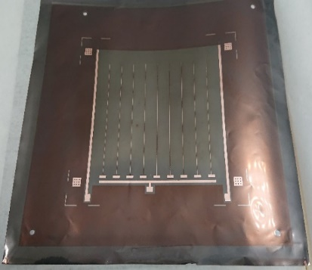
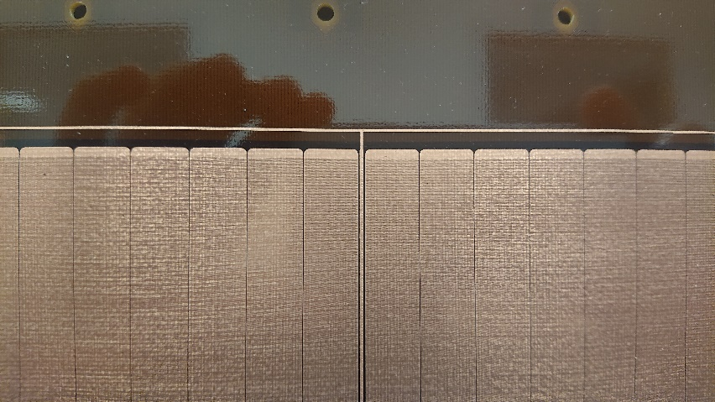
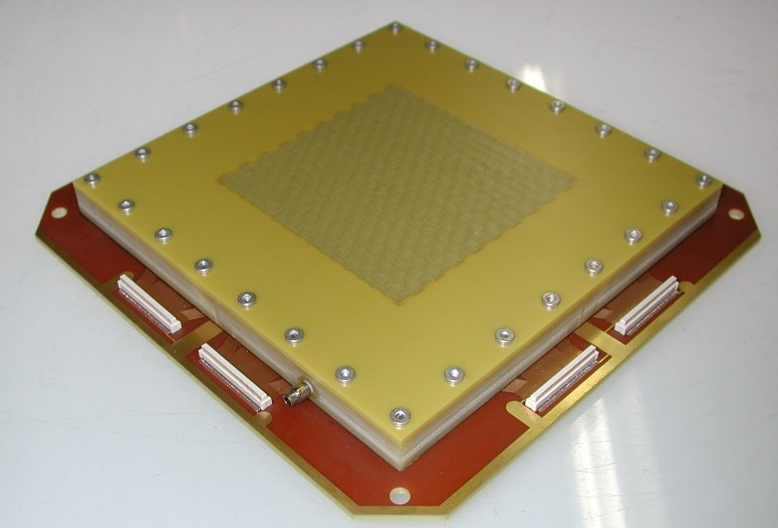
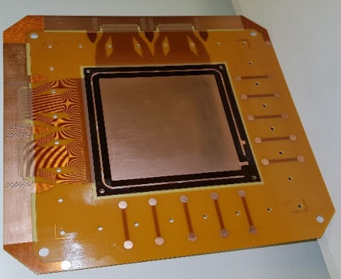
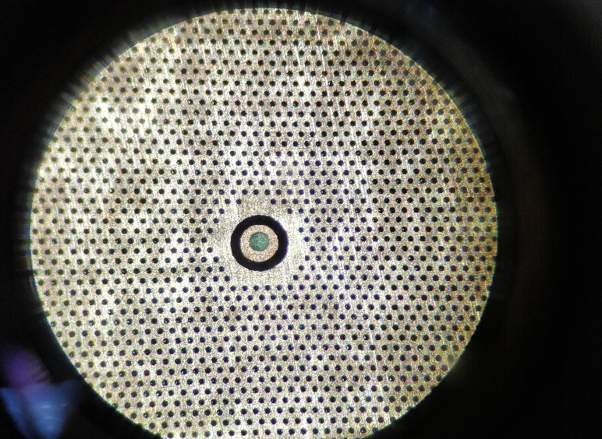
Many different ways to improve the rate capability
STD µRwell
High rate µRwell
DLC connected in the active area
DLC connected outside the active area
SG
DLC connected with Cu strips on the DLC
Medium rate capability
PEP
DLC connected by plated strips
SBU
10cm x 10cm
µRwell detector
“study kit”
2 DLC layers connected by plated vias

Slide 12
PEP uRwell is for the time being our target
Pin hole
Around 95% yield
Basic structure
P→ copper Plating
To hide the pin holes
E→ Etch copper and APICAL
No need for precise alignment
P→ Plate the holes or grooves
For DLC charge evacuation
Wellization , easy alignment on visible patterns

Slide 13
PEP uRwell without pin hole protection
Around 60% yield
Basic structure
Pin hole
E→ Etch copper and APICAL
P→ Plate the holes or grooves
Direct HV to GND
connection
HV
GND
Wellization

Slide 14
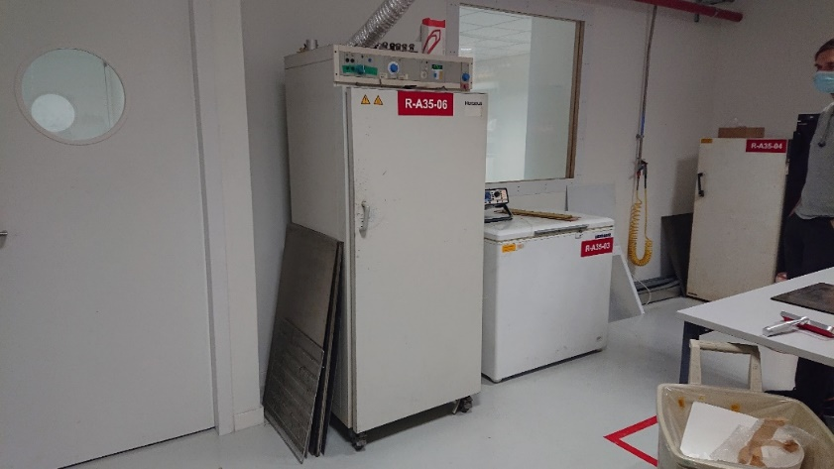
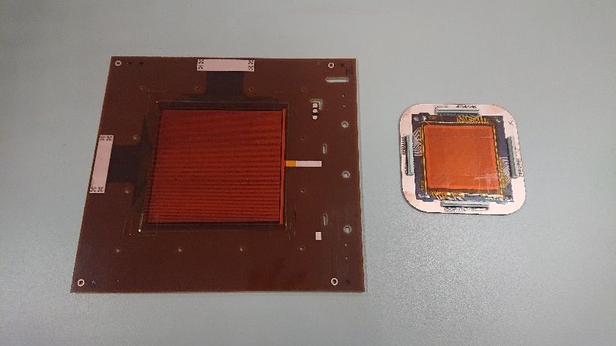
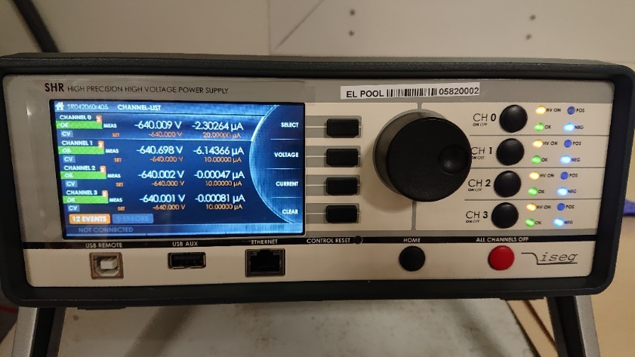
E-cleaning
Oven et at 100 deg
Detector with Kapton protection
HV connections
HV Power supply
10 to 20uA limitation
1/Minimum requirement → the detector should hold 250V in open air, leakage current <5nA.
2/We put a kapton protection on the detector.
3/We then put the detector in oven @100 deg for 8 hours.
4/We apply 250V , 10 to 20uA limitation
5/We wait to reach a leakage current <1 to 2nA and stay 2 hours with this current.
6/We then raise the voltage by 50V steps below 550V and then 20V steps.
7/We repeat step 3 and 4 till we reach 640V.
Depending on the detector size and the type of defect the E-cleaning can take a full week

Slide 15
Explanation tentative presented at RD51 February/09/2022
Correct polarization → improvement
Wrong polarization → degradation
Copper evaporation
0V
+HV
Ion
beam
Ion
beam
DLC evaporation
+HV
0V
Evaporated Cu + Pi compounds
are pulled out from the hole
Evaporated DLC + PI compounds
can condense on the walls

Slide 16
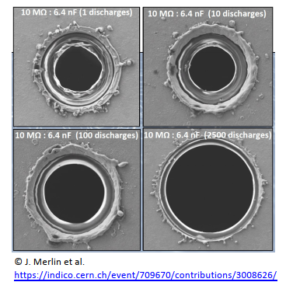
Explanation tentative presented at RD51 February/09/2022
Correct polarization → improvement
Wrong polarization → degradation
Copper evaporation
0V
+HV
Ion
beam
Ion
beam
DLC evaporation
+HV
0V
Evaporated Cu + Pi compounds
are pulled out from the hole
Evaporated DLC + PI compounds
can condense on the walls
In the GEM case we can clearly see material pulled out from holes after repetitive sparks
We do not see this with uRwell, but I do not see why the principle should be different

Slide 17
Explanation tentative presented at RD51 February/09/2022
Correct polarization → improvement
Wrong polarization → degradation
Copper evaporation
0V
+640V
WRONG
Ion
beam
Ion
beam
DLC evaporation
+640V
0V
Evaporated Cu + Pi compounds
are pulled out from the hole
Evaporated DLC + PI compounds
can condense on the walls

Slide 18
Second tentative , first type of defect
Structural defect on the copper
Max Voltage 250V in Air @ 100deg
After cleaning
640 V @ 100deg with 1nA
0V
0V
+HV
+HV
DLC is evaporated
near the defect

Slide 19
Second tentative , first type of defect
Structural defect on the copper
Max Voltage 250V in Air @ 100deg
After cleaning
640 V @ 100deg with 1nA
0V
0V
Electrons
Electrons
+HV
+HV
DLC is evaporated
near the defect

Slide 20
second type of defect (invisible)
Ionic remains from chemistries
Max Voltage 250V in Air @ 100deg
After cleaning
640 V @ 100deg with less than 1nA
Electrons
0V
0V
+HV
+HV
Unknown invisible pollutant
Oxidized copper
→ sign of activity
No DLC ablation
And no more pollutant

Slide 21
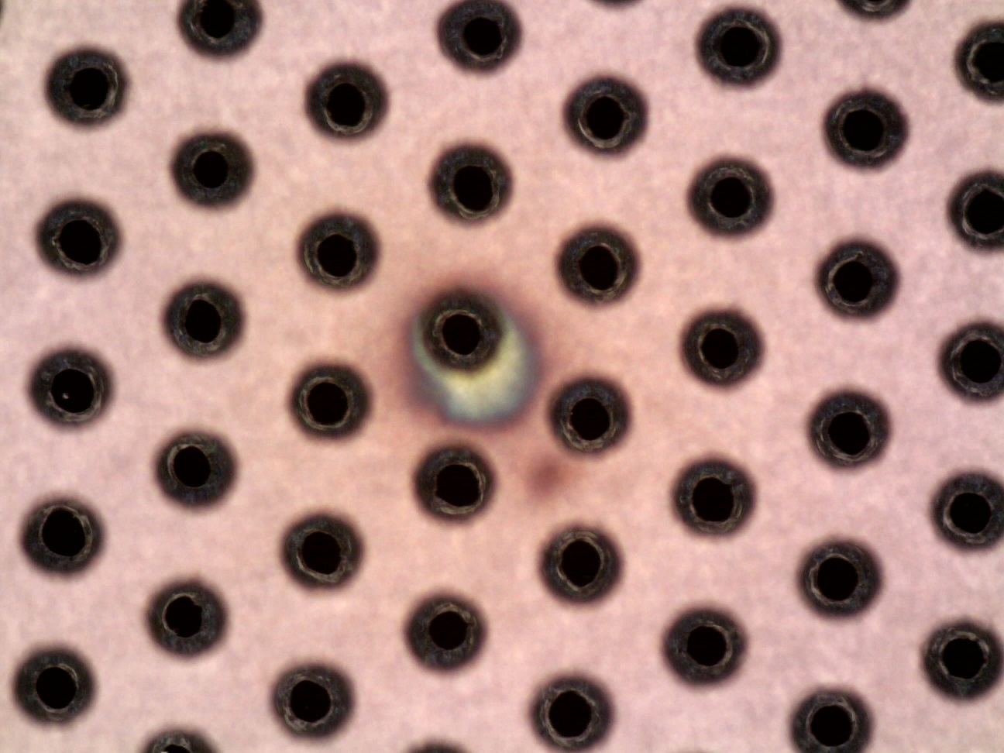
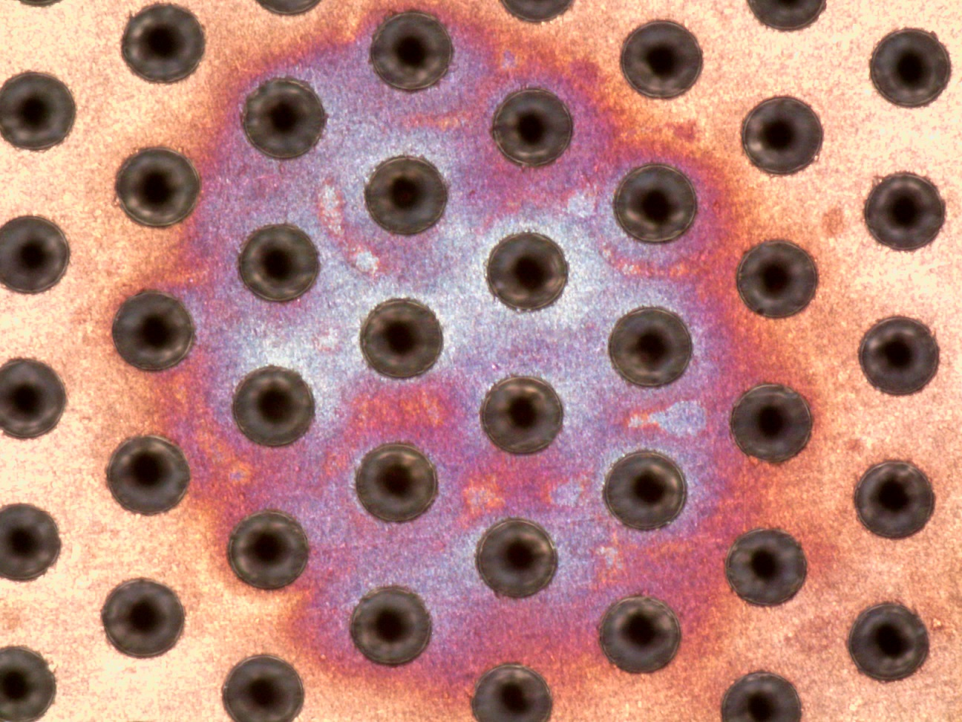
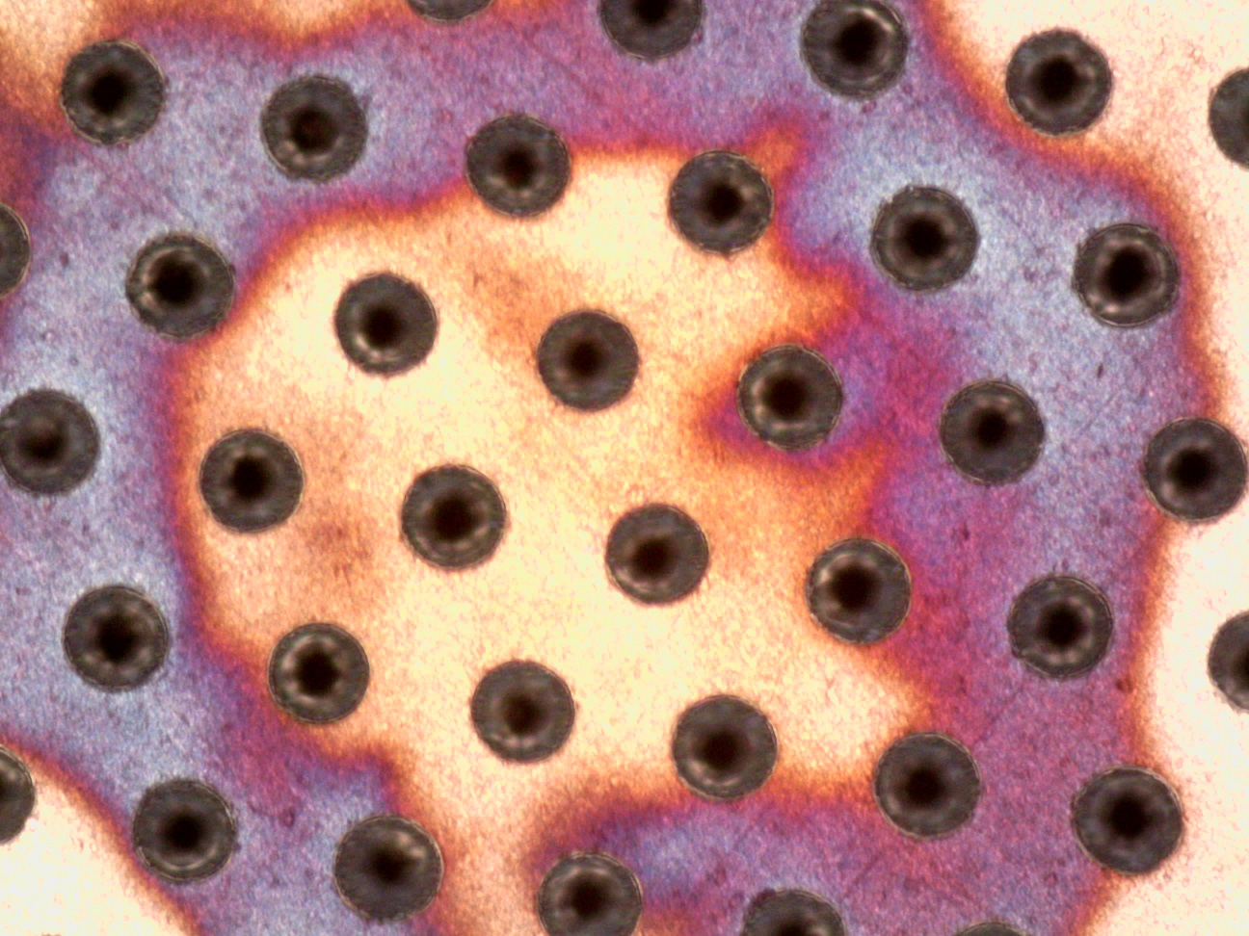
After a full week cleaning and billions discharges
Different than
the GEM sparking
process

Slide 22
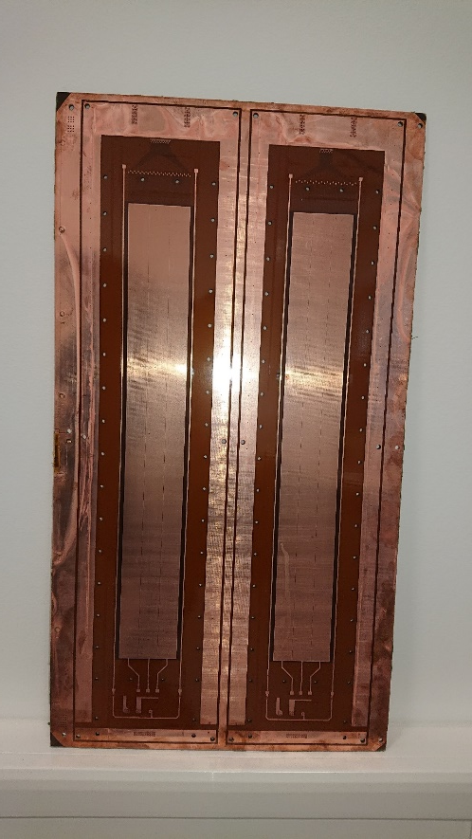
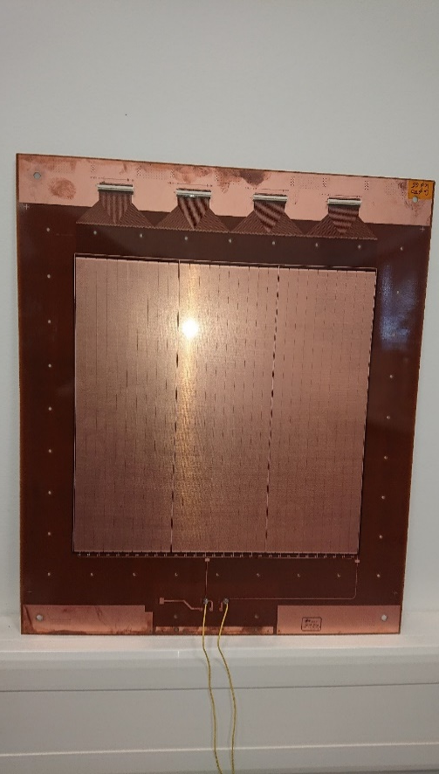
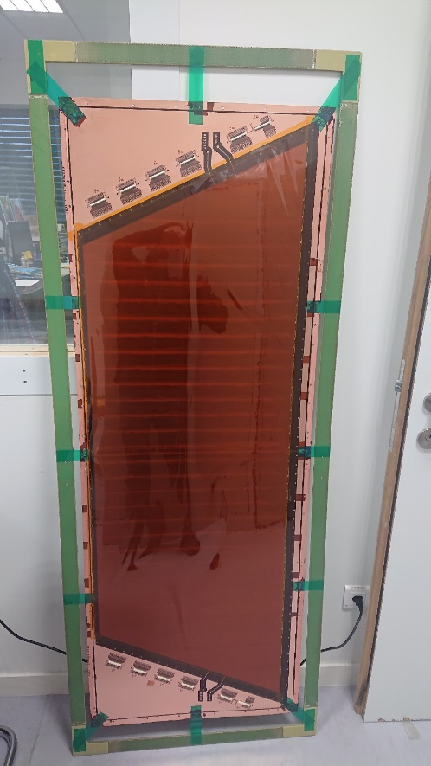
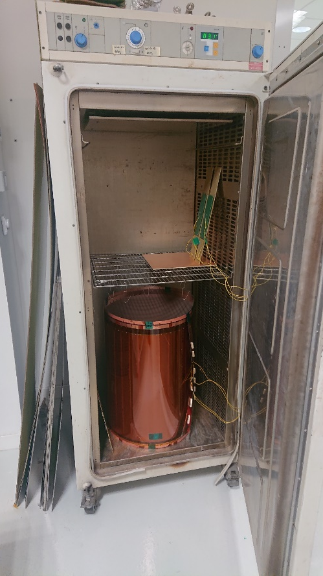
PEP examples
Frascati R&D
1D PEP uRwell
Active area:
40cm x 5cm
Frascati R&D
1D PEP uRwell
Active area:
30cm x 30cm
CLAS12 uRwell
2D PEP with 3 CS layers
Active area:
150cm x 50cm
CLAS12 uRwell
rolled in the oven
for E-cleaning
Whatever is the size, we can always reach a few nA @ 640V/100deg !

Slide 23
New machine

Slide 24
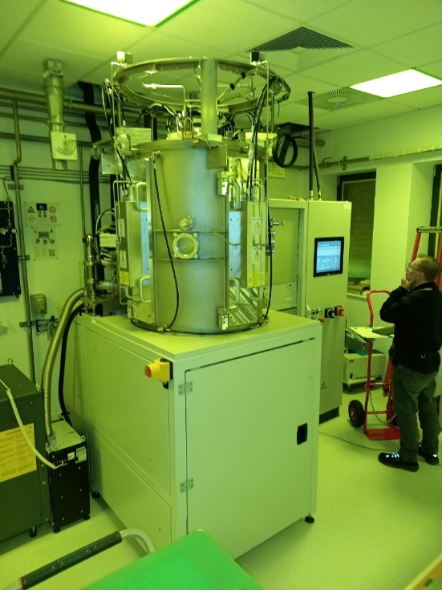
Pulsed DC magnetron reactive PVD
Machine cost (500kCHF) financed by:
-25% INFN
-25% CERN EP/DT group
-50% MPT workshop
Services cost (150kCHF) financed by:
-100% MPT workshop
Max foil size:
  -1.7m x 0.6m.
Resistive layers:
  -DLC, semiconductors.
Photocathodes:
  -Metallic, DLC, B4C, GaN, mix?
Metals:
  -AL, Cu, Ni, etc..
Market survey → 04/21
Invitation to tender → 05/21
Purchase order → 08/21
Delivery →10/22
Operation →11/22
Inner trackers
  Low mass flexes, Al conductors.
  Solid state detectors embedded in flex.
MPGD
  Resistive protection layers.
  High rate in difficult background.
  High granularity low channel count.
  Ps timing resolution robust cathodes.
  Layers for neutron detection.
Other
  TPC field shapers with continuous distribution.
  High rate RPCs.
5 targets.
3 simultaneous deposition.
3 gas inputs for reactive deposits:
  H2,N2,02,C2H2,Ar etc..
300 deg max built in heater.
Plasma cleaning
Fantastic help during from the DLC collaboration Team

Slide 25
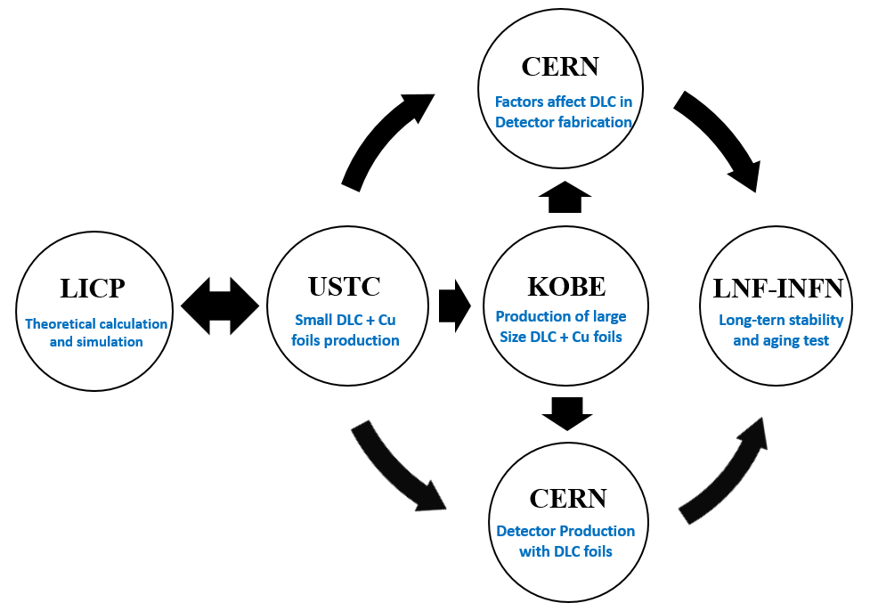
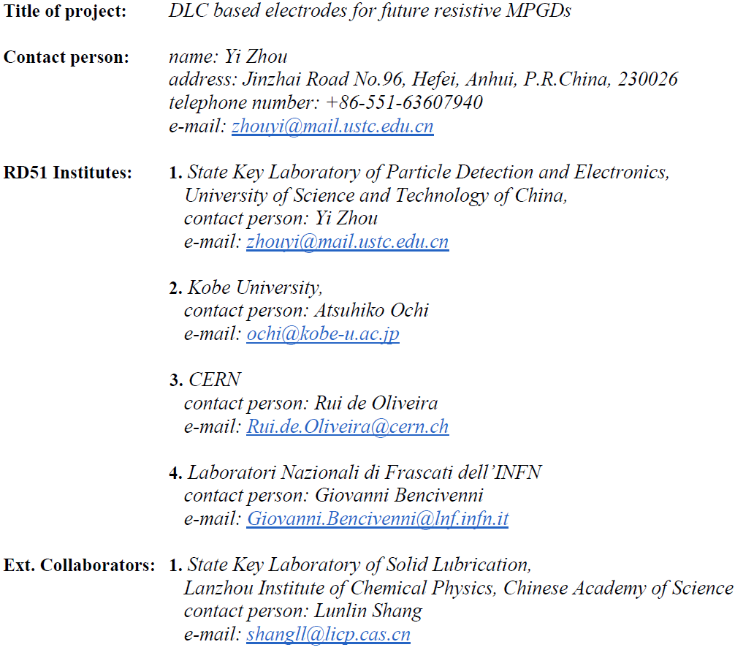

DLC collaboration
+

Slide 26
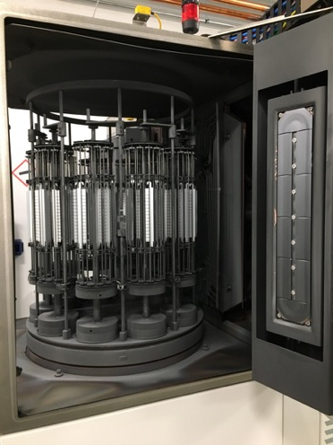
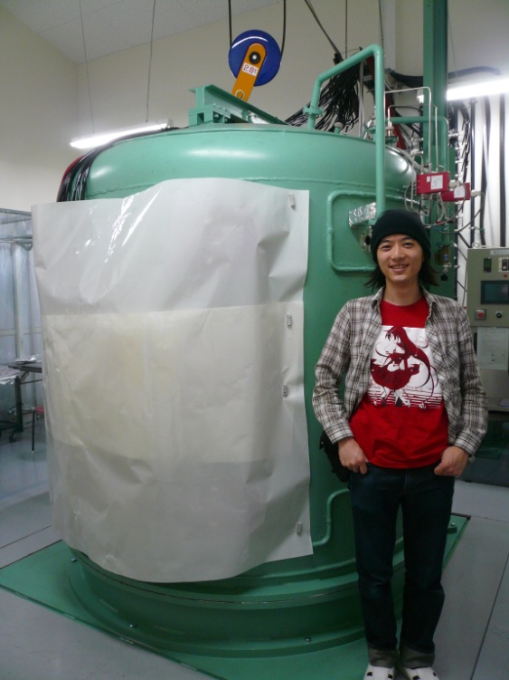
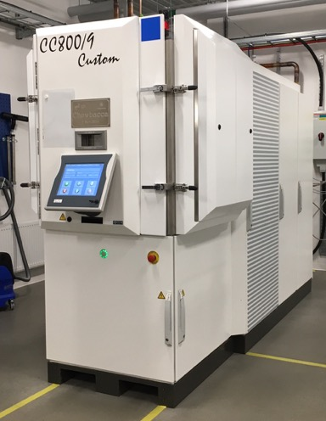
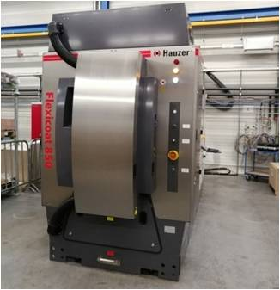
Kobe Japan
B-sputter
4 m x 1m real
ESS
2.1 m x 400mm
China USTC
1.2 m x 500mm

Slide 27
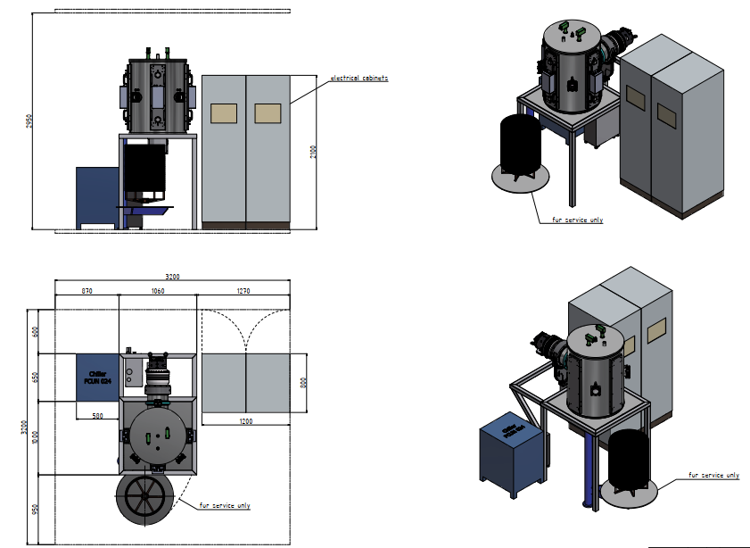


Slide 28
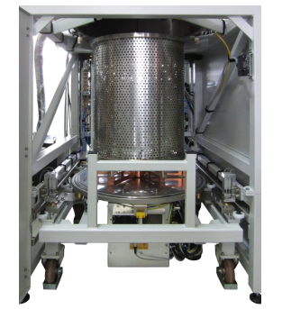
Drum holding the samples
Possibility to prepare several drums
to increase the throughput

Slide 29
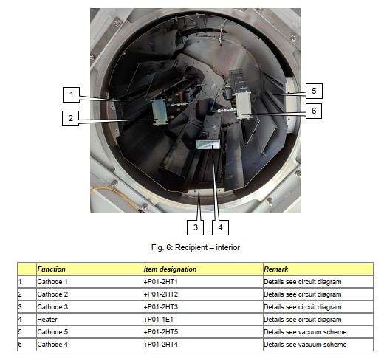

Bottom view of the
Vacuum chamber

Slide 30

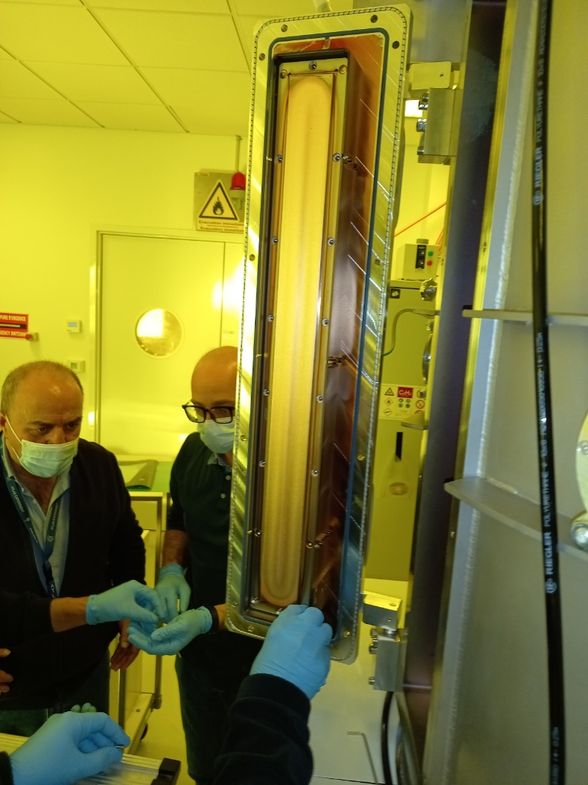
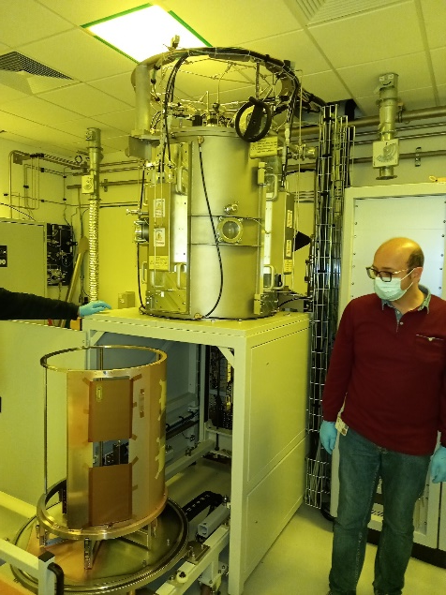
pictures
Drum unloading
after processing
Machine in operation
70cm copper target installation

Slide 31
Preliminary results obtained after few weeks
The team
Al , Cr and Cu (Ar)
  Done : excellent results → this was the commissioning test
DLC (Ar)
  Done : from 30K to 300K →just playing on the kapton roughness
DLC-Cr-Cu (Ar)
  Done : good adhesion, still need a little tuning to be perfect
DLC (Ar/N2)
  Done : from 30K to some Gohms/square
  Playing on deposit thickness, kapton roughness , N2 concentration.
DLC (Ar/C2H2) , DLC (Ar/CH4) , DLC (Ar/H2)
  Not Done
B4C , GaN , Si ,Sio2
  Not Done
Uniformity test
  Done : really encouraging →few % over 50cm
Serge Ferry (MPT)
  Expert in the field
  He co-designed the machine
  He wrote all the specifications
  He is now leading the preliminary test program
Givi
  He participated to the commissioning
  Participation to preliminary test program
Gianfranco Morello (Frascati)
  He participated to the commissioning
  Participation to preliminary test program
Better quantitative results will be given at the next RD51

Slide 32
Next
PEP uRwell:
  Produce 2 more 1.5m x 0.5m PEP uRwell
  Fully automatize the electrical cleaning to reduce the uRwell cost.
  Continue the uRwell technology transfer to industry
Vacuum machine:
  Improve our knowledge on N2 doped high resistive value DLC layers
  Start some test with C2H2
  B4C ?
  We are ready to accept requests from the community for DLC layers.
In next RD51 meeting I will give news on :
  High rate SBU MM
  High rate SBU uRwell
  Capacitive sharing

