Slide 1







A novel concept for dual-phase noble liquid detectors – Floating Hole Multiplier
V. Chepel¹, G.Martinez-Lema^{2,3}, A. Roy^{2,3}, A. Breskin²
¹Department of Physics of University of Coimbra and LIP, Coimbra, Portugal
²Dept. of Astrophysics and Particle Physics, Weizmann Institute of Science, Rehovot, Israel
³Unit of Nuclear Engineering, Ben-Gurion University of the Negev, Beer-Sheva, Israel
CERN/FIS-INS/0026/2019
CERN/FIS-INS/0013/2021
MPGD 2022, Rehovot, Israel, December 12-16

Slide 2
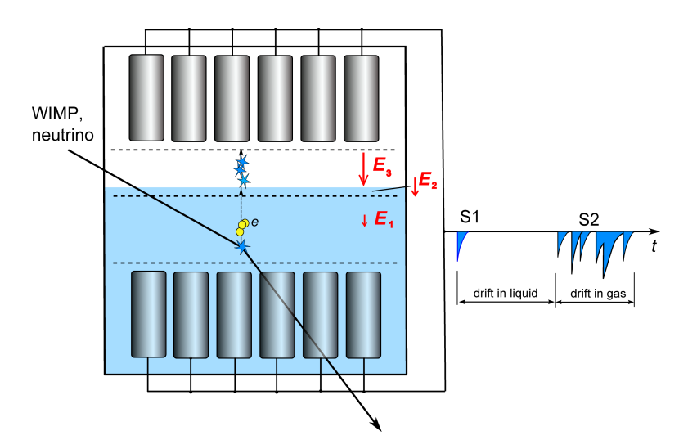
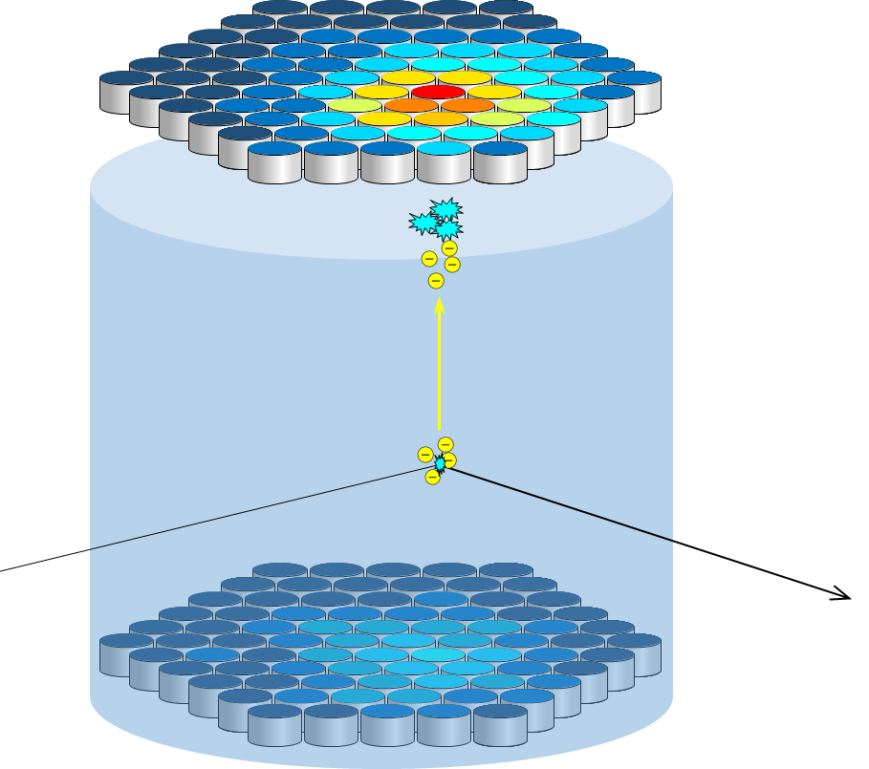
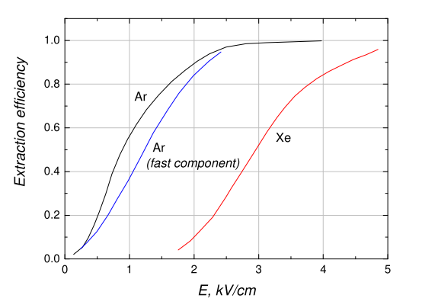




Generally accepted configuration of a 2-phase detector (for DM searches, at least)
Electron emission efficiency vs $E$
$$∼5 mm$$
$$∼4 kV/cm$$
LXe
$$∼100 V/cm$$

Slide 3
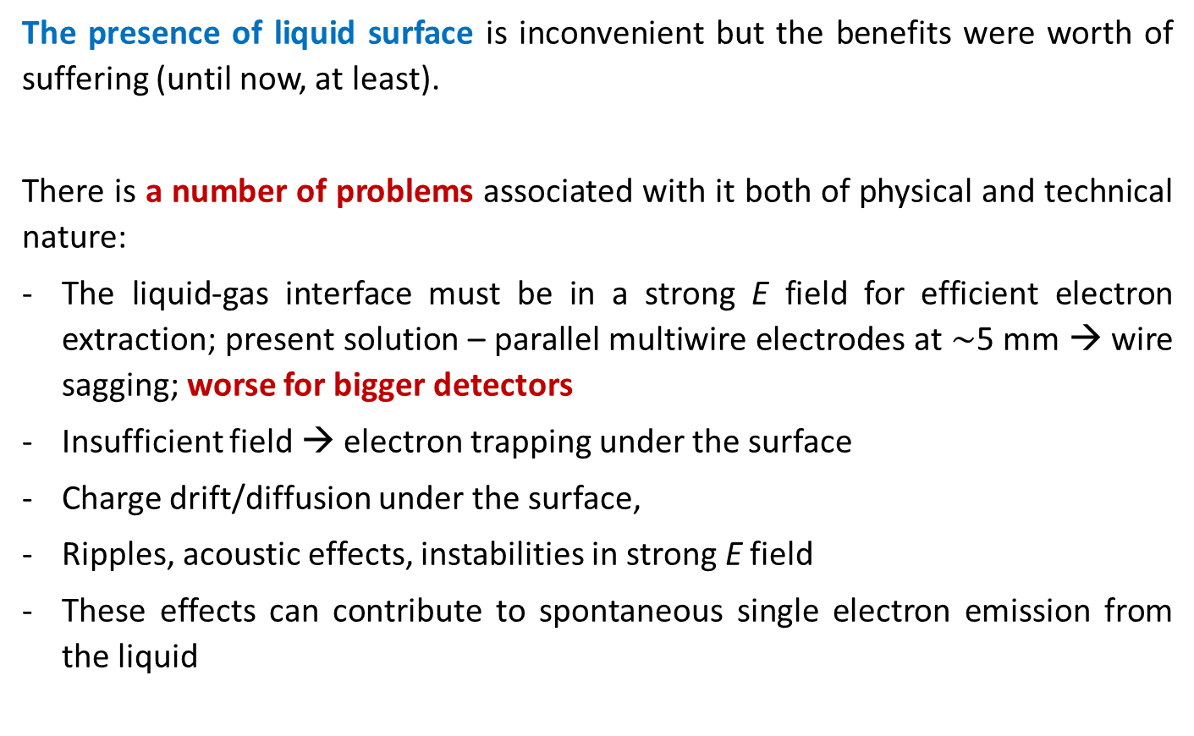
Motivation
The presence of liquid surface is inconvenient but the benefits were worth of suffering (until now, at least).
There is a number of problems associated with it both of physical and technical nature:
The liquid-gas interface must be in a strong E field for efficient electron extraction; present solution – parallel multiwire electrodes at $\sim$5 mm → wire sagging; worse for bigger detectors
Insufficient field → electron trapping under the surface
Charge drift/diffusion under the surface,
Ripples, acoustic effects, instabilities in strong E field
These effects can contribute to spontaneous single electron emission from the liquid

Slide 4
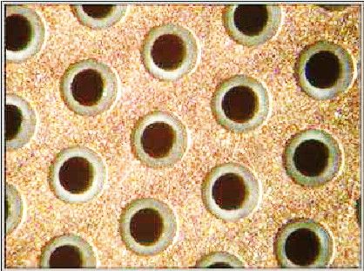

Still in love with 2-phases? What can you do, then?
How do we gain a better control of what is happening on the surface?
Ideally, one would like to separate the two phases with, say, a membrane transparent for light and electrons but not for Xe or Ar atoms.
Big question – what this membrane might be?
The liquid phase and the gas should be in thermal equilibrium (in the region of their contact, at least) → problem of gas condensation above the membrane and bubble formation in the liquid
Maybe, holes for electrons? → GEM, THGEM, etc
How do we control the liquid level precisely to have liquid below and gas above it?
Go natural, let it float !

Slide 5
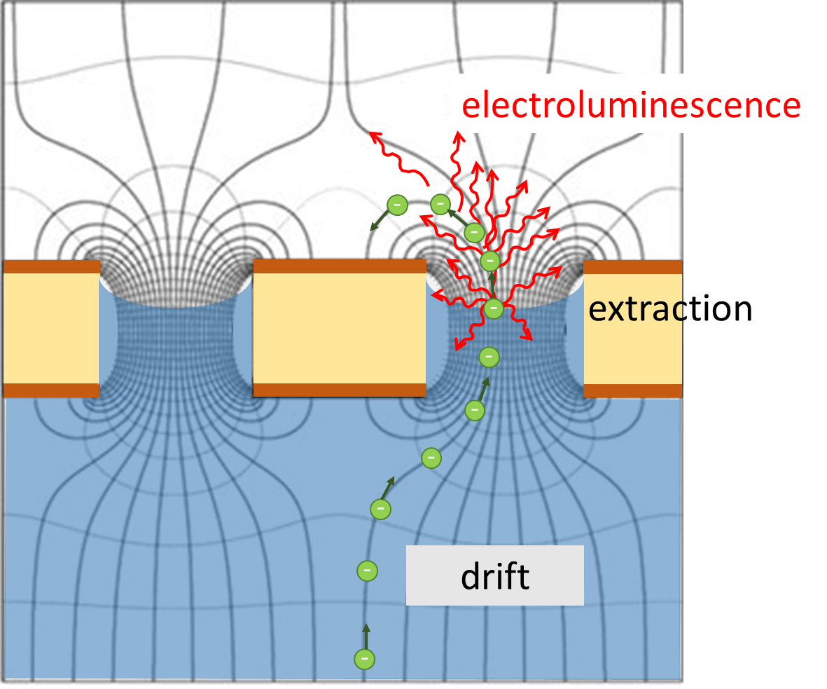
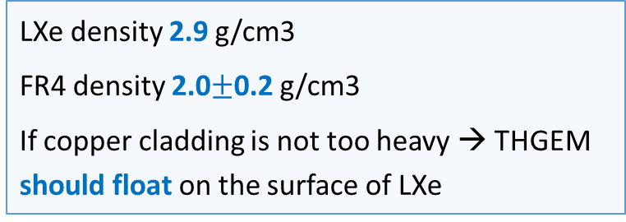
The idea
LXe density 2.9 g/cm3
FR4 density 2.0$±$0.2 g/cm3
If copper cladding is not too heavy → THGEM should float on the surface of LXe
How do we know that the liquid interface will stay between the two copper electrodes?
How do we know the liquid will enter the hole?
How do we know that the liquid will not spill over THGEM?
How do we know what is liquid surface profile in the hole?
Too many questions… Just try it!

Slide 6
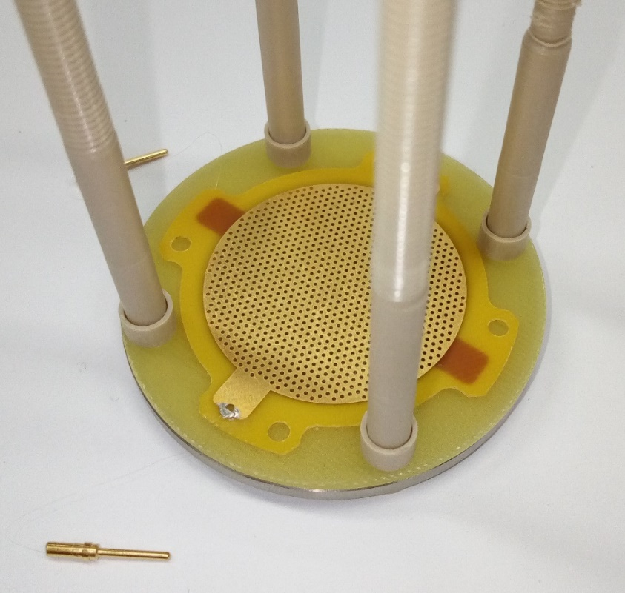
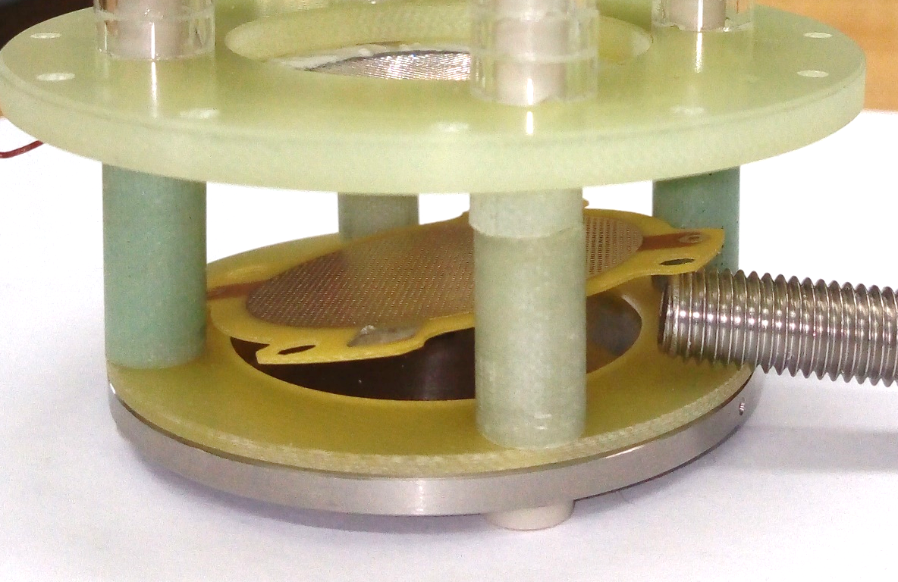
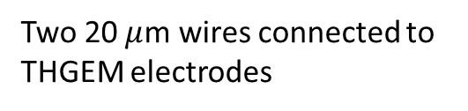
Experimental setup
THGEM:
0.4 mm thick
0.3 mm holes, 0.1 mm rim
1.0 mm pitch
Two 20 $μ$m wires connected to THGEM electrodes

Slide 7
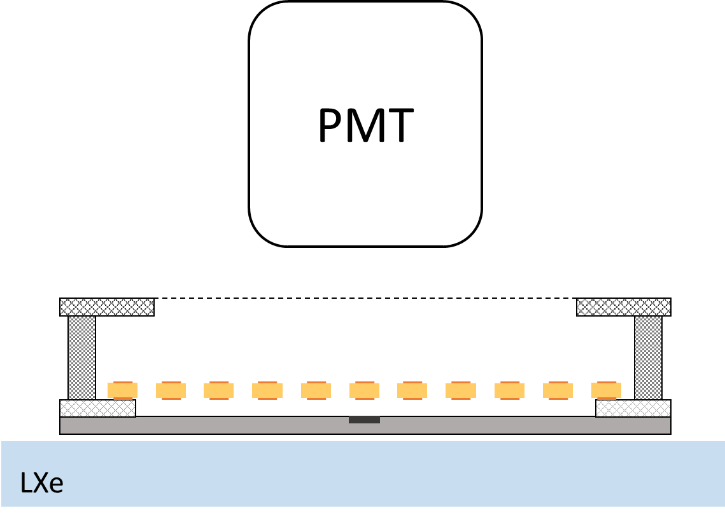
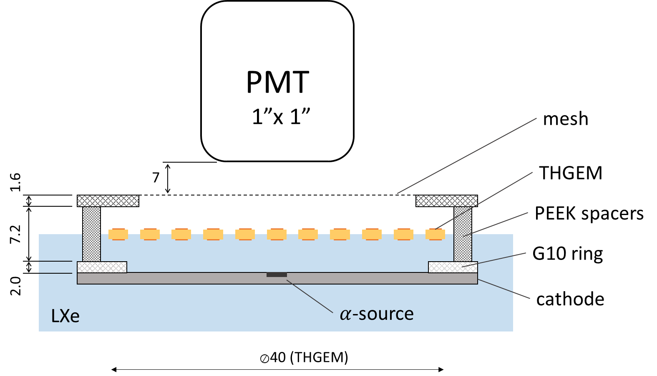




Experimental setup – voltages
THGEM position with LXe below the cathode
THGEM floats on LXe surface
tipical voltages:
0 to +…
$$V_{m}$$
0
$$V_{t}$$
or 0
-2500
$$V_{b}$$
E
-2900
$$V_{α}$$

Slide 8
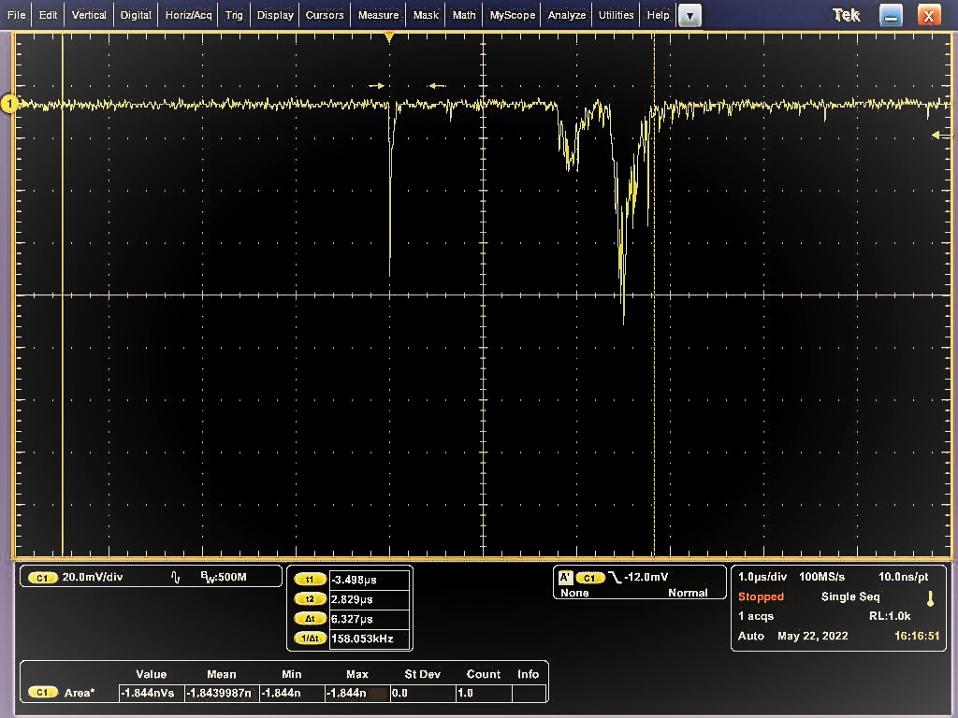
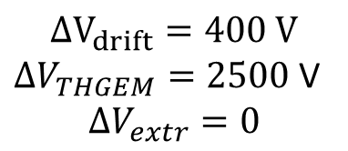
See something?
PMT signal
$$ΔV_{drift}=400 V$$
$ΔV_{THGEM}=2500$V
$$ΔV_{extr}=0$$
Estimated liquid thickness 6.8 mm

Slide 9
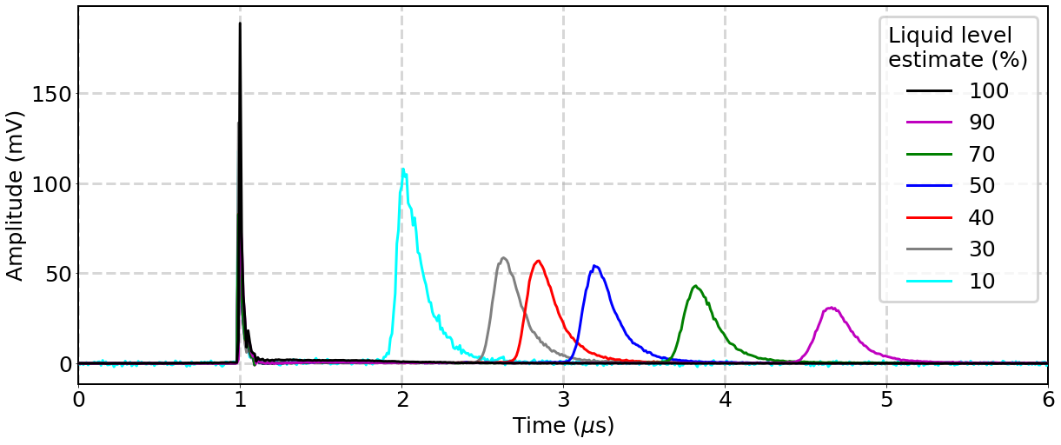
PMT waveforms for different liquid levels
S1
S2
more LXe
Drift time in the liquid
No S2 for fully covered THGEM

Slide 10
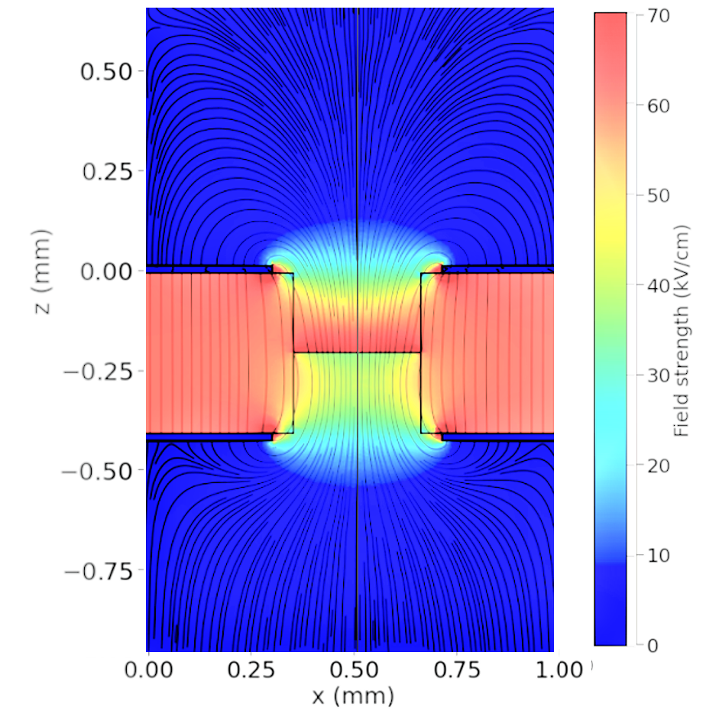

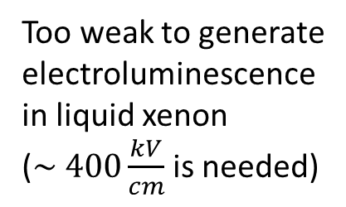
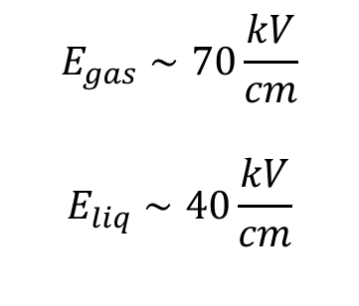


Field computation (COMSOL)
$$ΔV_{extr}=0$$
Fields near the interface:
$$E_{gas}∼70\frac{kV}{cm}$$
$$E_{liq}∼40\frac{kV}{cm}$$
LXe level
$$ΔV_{THGEM}=2500 V$$
Too weak to generate electroluminescence in liquid xenon
($\sim 400\frac{kV}{cm}$is needed)
$$ΔV_{drift}=400 V$$

Slide 11
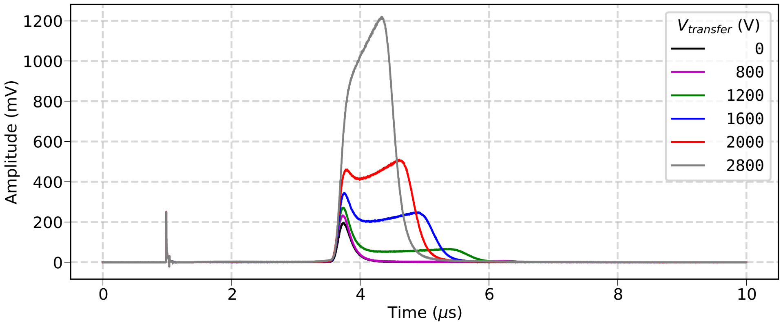
Waveform evolution with field above THGEM
THGEM
holes
Uniform field above

Slide 12
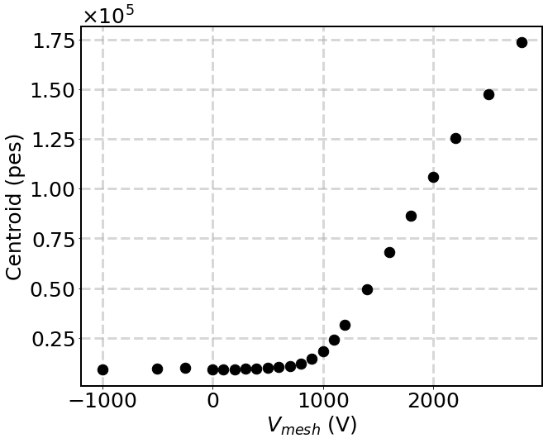
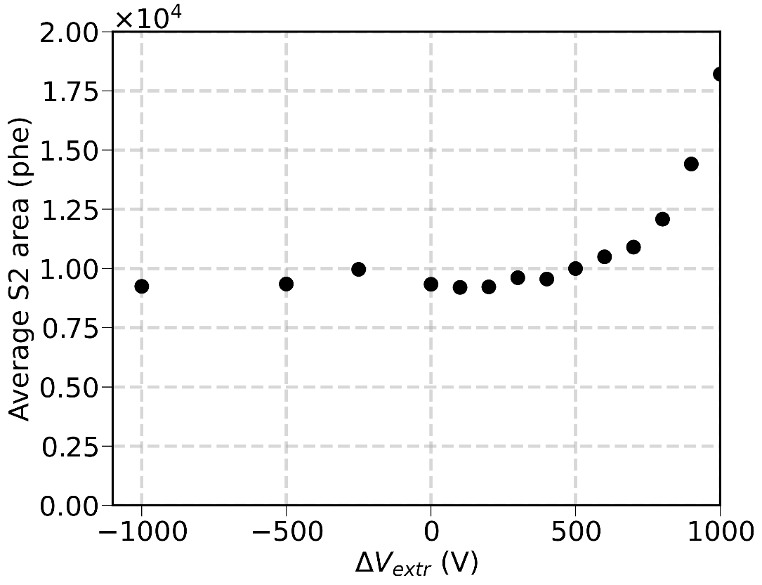
S2 area as function of the field above THGEM
~20x more light above THGEM than in the holes
zoom
V_{mesh}(V)
Reversed extraction field
Most of the light is produced in the holes and not in their vicinity

Slide 13
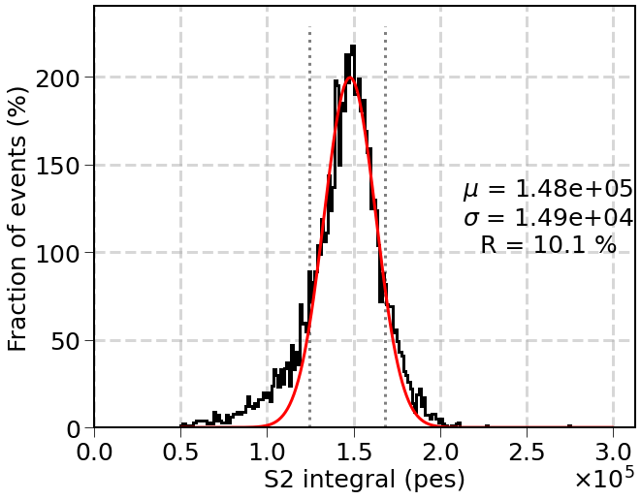
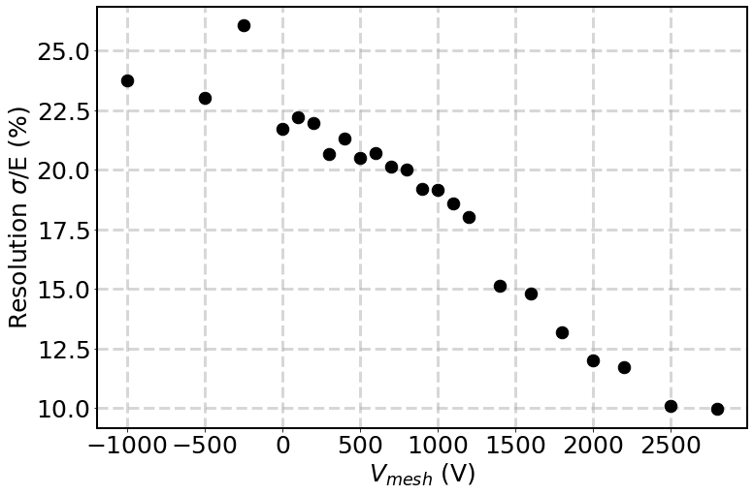

S2 from $α$-particles – resolution
Light in the holes only

Slide 14
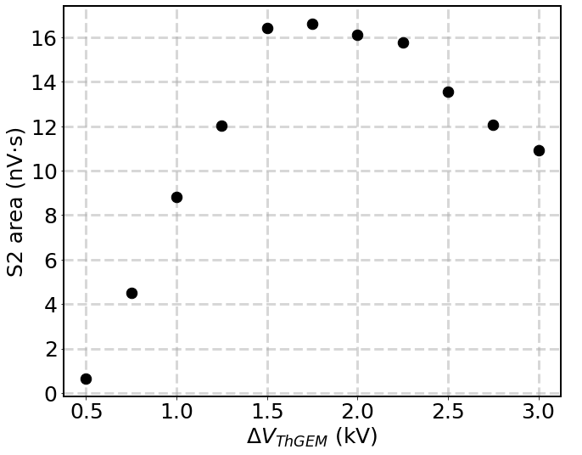
S2 area as function of voltage across THGEM
Can be due to dielectric retraction under the field

Slide 15
Benefits
Significantly smaller free liquid surface – reduced probability of any kind of surface instabilities (ripples, waves, microexplosions, etc.)
Electron drift/diffusion under the surface – eliminated or made local (within the hole pitch)
High electron extraction probability thanks to high field at the interface (unreachable in uniform field)
Positive ion feedback (if any) – likely to end up at the floating electrode
Result – reduced single electron noise
Parallelism between the gate and extraction electrodes – guaranteed for any dimensions
No sagging
No need for fine detector levelling and liquid level control

Slide 16
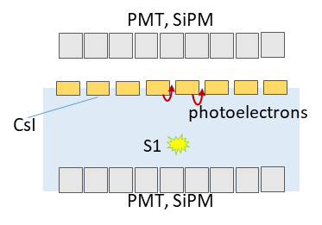
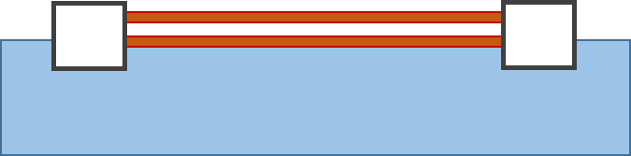
Remaining questions/futher work
Opacity for VUV (S1 problem) – CsI photocathode? Quartz substrate?
Physics – meniscus profile, wettability, field effects, electron transmission efficiency
Structure optimization – thicker THGEM? Bigger holes?
Works in LAr (1.4 g/cm³)?
Other possible configurations:
Many plastics float in LAr. The question is whether one can make a THGEM-like electrode from them.
LAr or LXe
floaters
LAr or LXe

Slide 17
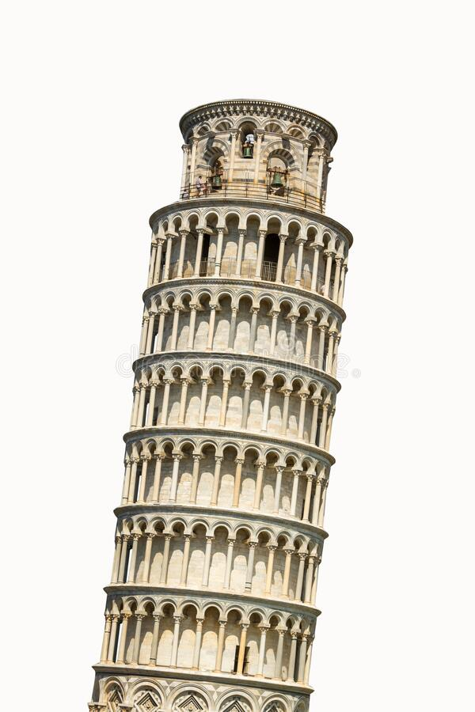

Conclusions
1. Prove of principle – successful
2. Next – study details – physics and optimization
3. There is much more to floating …

