Slide 1


The MPGD-based bubble-free
Liquid Hole-Multiplier
Charge and light detection in dual-phase noble-liquid TPCs
A. Roy^{1,2}, G. Martínez-Lema^{1,2}, A. Breskin², L. Arazi¹
¹ Unit of Nuclear Engineering, Ben-Gurion University, Beer-Sheva, Israel
² Department of Particle Physics and Astrophysics, Weizmann Institute of Science,
Rehovot, Israel
MPGD 2022
Rehovot, Israel, December 2022

Slide 2
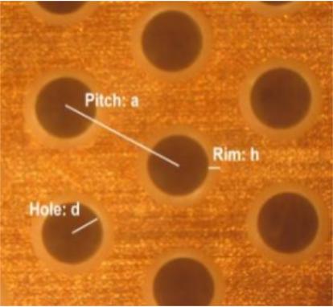
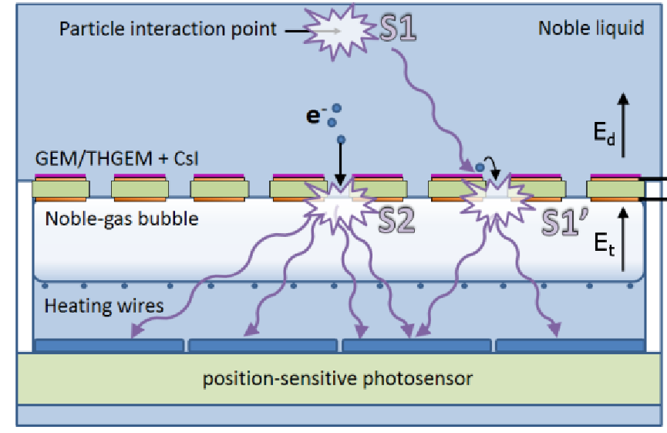
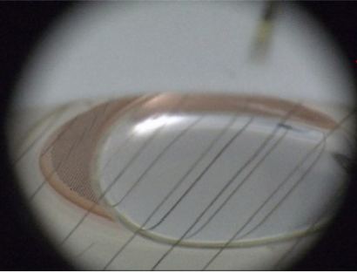
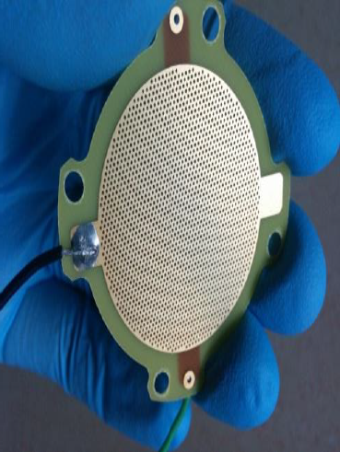
The bubble-assisted Liquid Hole-Multiplier (LHM)
CsI-coated perforated electrode (GEM/THGEM) immersed in LAr/LXe
GAr/GXe bubble trapped underneath
Electrons focused into the holes produce EL signal in the bubble
  S1-induced photoelectrons generated by CsI (S1’)
  S2 ionization electrons
A. Roy – Bubble-free LHM - MPGD22, Israel, 13/12/2022

Slide 3
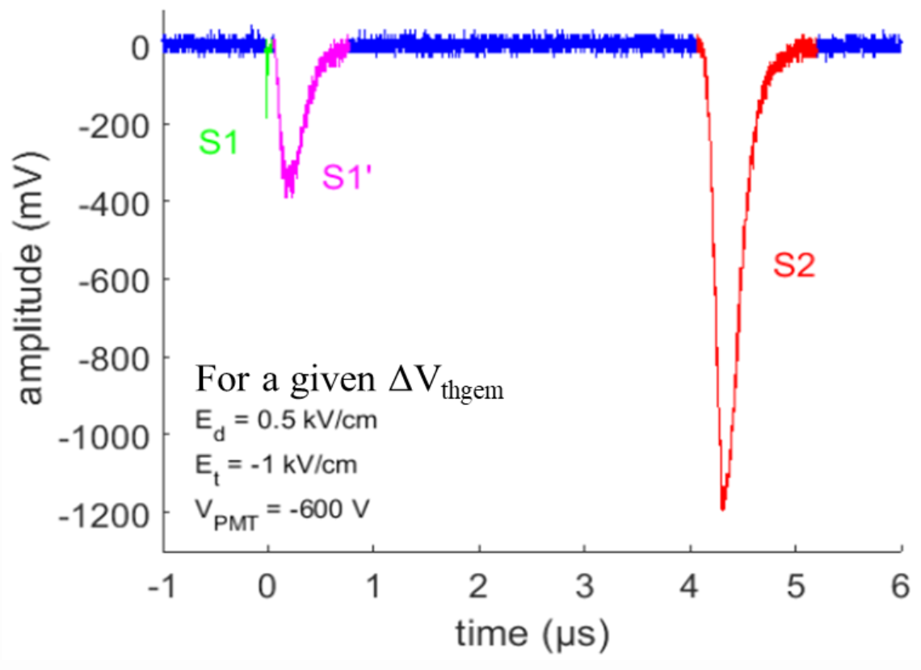
The bubble-assisted LHM
Light pulses detected by photosensors below
Stable Liq-Gas interface => good S1’ and S2 energy resolution
(σ/E ~ 6% for 5.5 MeV α’s)
Accurate position reconstruction (~0.2 mm)
Main publications
Arazi et al., 2015_JINST 10 P08015
Arazi et al., NIM A 845 (2017) 218
Erdal et al., 2019 JINST 14, P01028
Erdal et al., 2018 JINST 13 P12008
Erdal et al., 2019 JINST 14 P11021
A. Roy – Bubble-free LHM - MPGD22, Israel, 13/12/2022

Slide 4
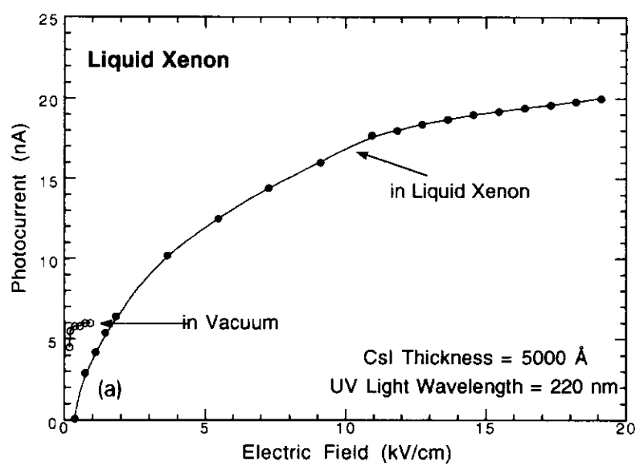
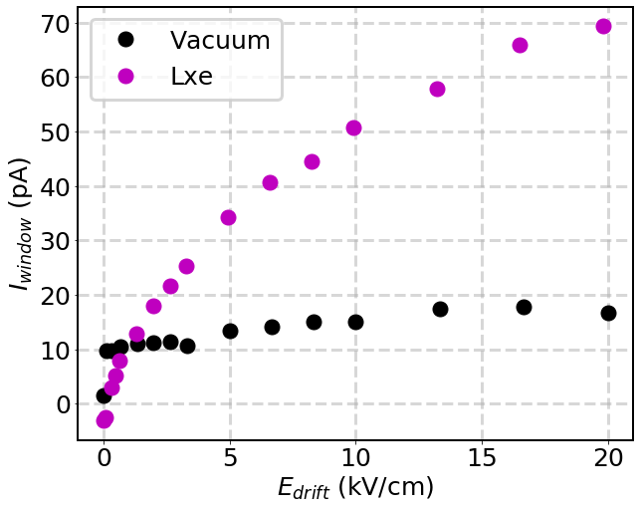
Quantum efficiency of CsI in LXe
QE_{LXe} ~ 30% > QE_{vac}
Original measurement by
E. Aprile et al., NIM A 338 (1994) 328-335
Reproduced by our group
Erdal et al. LIDINE 2019
Martínez-Lema et al. LIDINE 2022
QE_{eff} increased
by ~x3.5
* Higher QE attributed to a change in the work function due to polarization of the medium
A. Roy – Bubble-free LHM - MPGD22, Israel, 13/12/2022

Slide 5
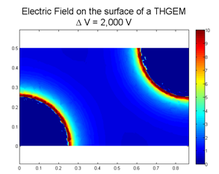
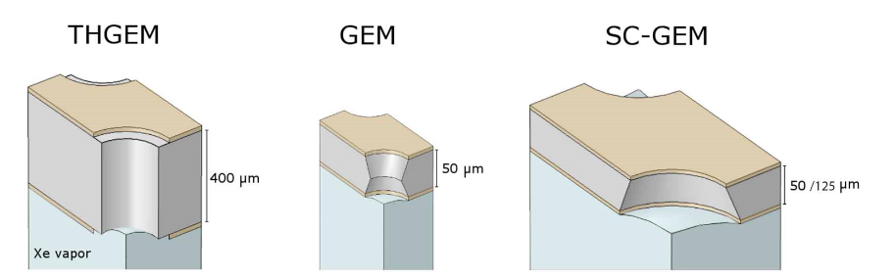
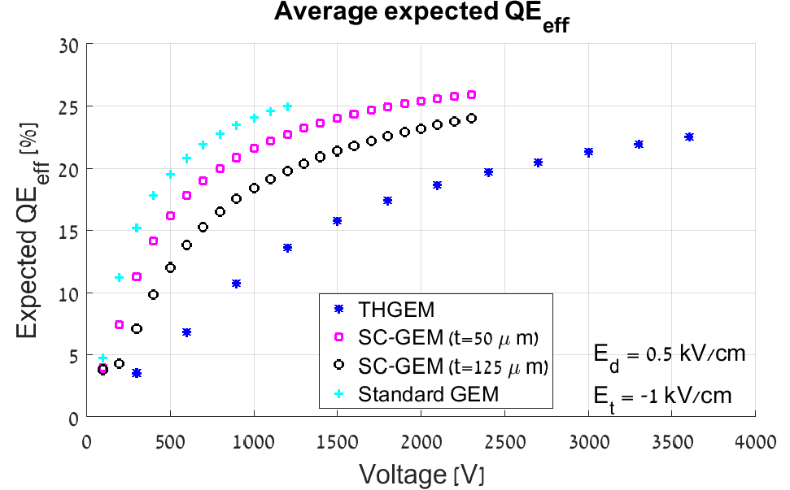
Bubble-assisted LHM: Photon detection efficiency (PDE)
PDE estimated from COMSOL + measured QE vs E in LXe
  Expected ~18 % for THGEM ~25 % for SC-GEM
  Measured ~1 % for THGEM ~3.5% for SC-GEM
Main hypothesis → Low e⁻ transfer efficiency across the interface (confined to the LHM holes)
Erdal et al., 2018 JINST 13 P12008
Erdal et al., 2021 JINST TH 002
A. Roy – Bubble-free LHM - MPGD22, Israel, 13/12/2022

Slide 6
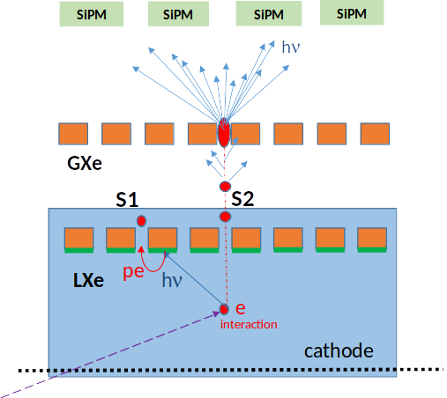
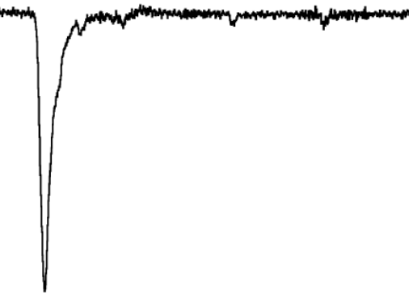
Bubble-free LHM
Liq-Gas interface moved away from the electrode
Two electrodes
  L-THGEM: fully immersed and coated with CsI on the bottom for VUV detection
  G-THGEM: kept in gas phase.
  Avalanche + EL amplification in holes
Ionization electrons & photoelectrons transfered efficiently through L-THGEM holes into gas
Strong extraction field between the electrodes
  high extraction efficiency into gas
Avalanche + EL light collected by photosensors on top
Avalanche
+ EL
G-THGEM
L-THGEM
CsI photocathode
A. Roy – Bubble-free LHM - MPGD22, Israel, 13/12/2022

Slide 7
Bubble-free LHM: Advantages
Liq-Gas interface not confined to a single hole
  Expected high PDE @ 175 nm
Single photons induce large signals
  Dark counts can not mimic S1 signal
  SiPMs, CMOS, etc. Can be used in LXe
Light yield localized to the G-THGEM holes
  Variations on the Liq-Gas interface not a concern
  Fast signals
Good expected position resolution
Avalanche
+ EL
G-THGEM
L-THGEM
CsI photocathode
A. Roy – Bubble-free LHM - MPGD22, Israel, 13/12/2022

Slide 8
Bubble-free LHM: Status
Demonstrated major improvement in electron transfer efficiency compared to the bubble-assisted LHM
  Photoelectrons and ionization electrons (RD-51 miniweek 02/2022)
Due to the presence of the G-THGEM
→ considerably less dependence on Liq-Gas interface
fluctuations
→ Better S1’ and S2 energy resolution
→ Larger and shorter EL signals compared to a
mesh electrode in the gas-phase
Sufficiently large EL-yield to safely detect single VUV photons
Avalanche
+ EL
G-THGEM
L-THGEM
CsI photocathode
A. Roy – Bubble-free LHM - MPGD22, Israel, 13/12/2022

Slide 9
Preliminary results
A. Roy – Bubble-free LHM - MPGD22, Israel, 13/12/2022

Slide 10
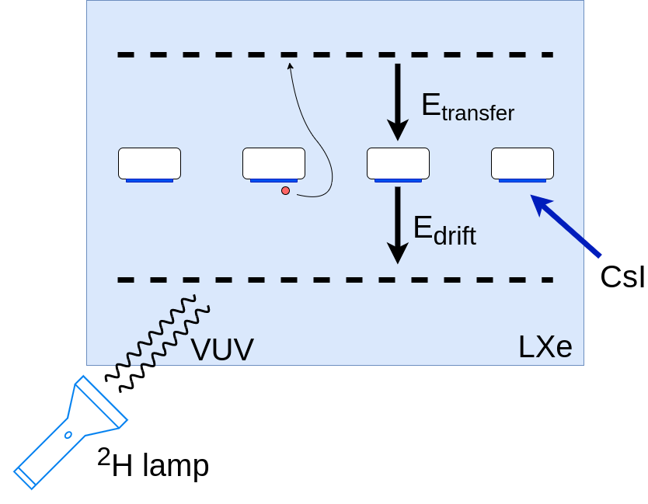
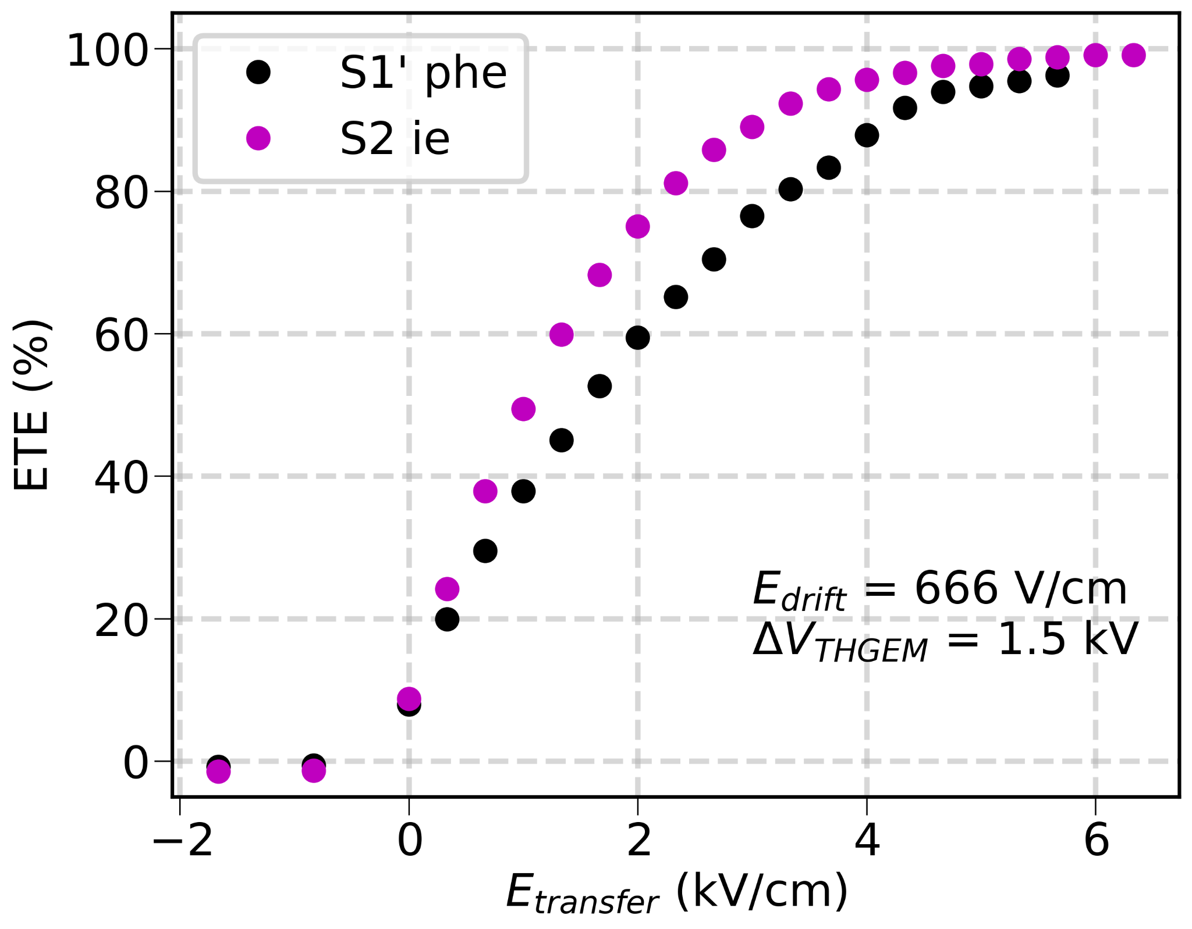
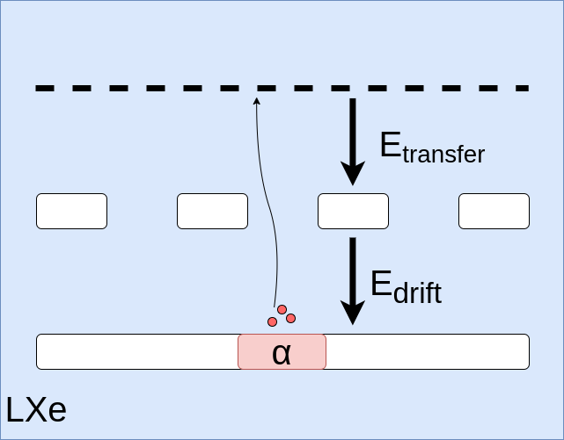
Electron transfer efficiency across the L-THGEM
High transfer efficiency for both S1’-like photoelectrons and S2 ionization electrons
Photoelectron
transfer
Ionization electron transfer
A. Roy – Bubble-free LHM - MPGD22, Israel, 13/12/2022

Slide 11
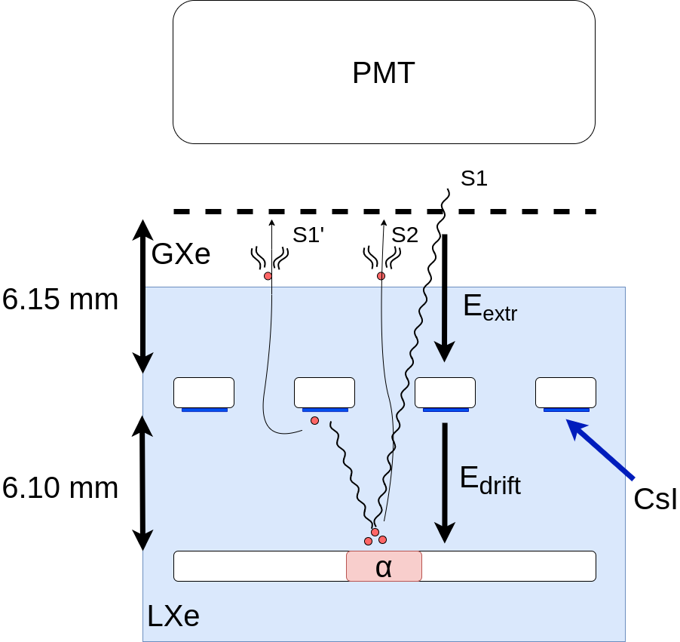
A simplified setup: dual-phase with single-THGEM
Simple dual phase setup
L-THGEM immersed and coated with CsI for VUV detection
Mesh in the gas phase to create an extraction field
  EL amplification in the gap
THGEM parameters
0.3 mm hole ⌀
50 μm rim
0.7 mm pitch
0.4 mm thickness
20 mm ⌀ CsI spot
A. Roy – Bubble-free LHM - MPGD22, Israel, 13/12/2022

Slide 12
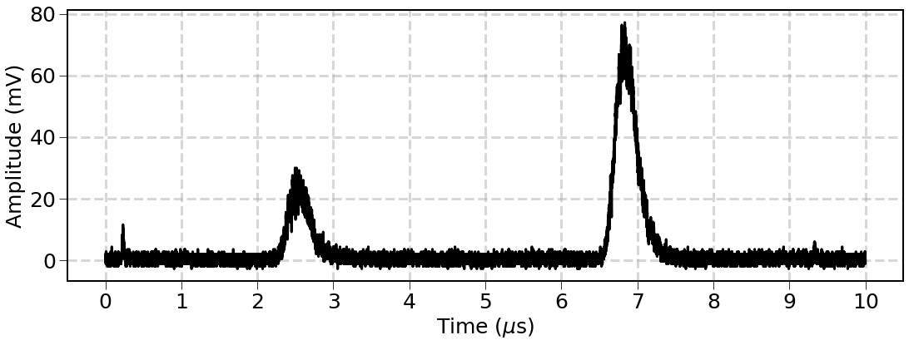
Typical waveform
A waveform produced by an ²⁴¹Am α interaction
S2
ΔV_{thgem} = 2.0 kV
E_{drift} = 0.66 kV/cm
E_{extr} = 6.8 kV/cm
S1’
S1
A. Roy – Bubble-free LHM - MPGD22, Israel, 13/12/2022

Slide 13
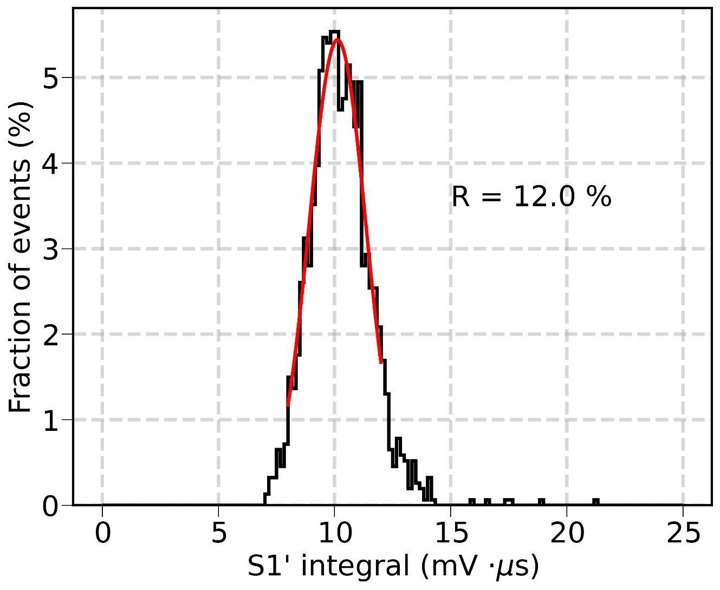
S1’ Energy resolution
~ 12% S1 energy resolution (σ/E) measured with the mesh
Experimental conditions:
ΔV_{LTHGEM} = 2.0 kV
E_{drift} ~ 0.65 kV/cm
E_{ext} ~ 7.8 kV/cm
A. Roy – Bubble-free LHM - MPGD22, Israel, 13/12/2022

Slide 14
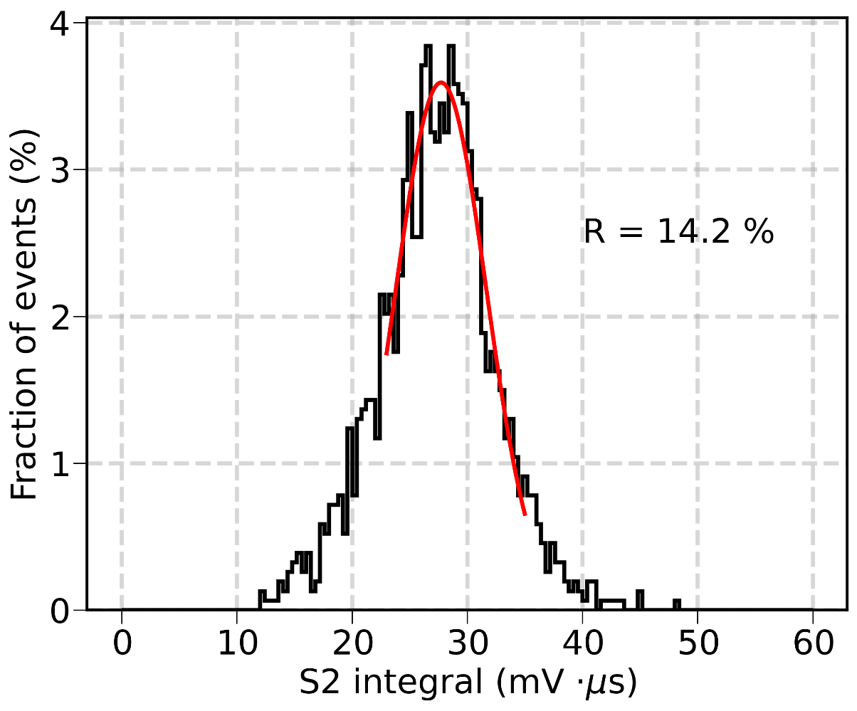
S2 Energy resolution
~ 14% S2 energy resolution (σ/E) with the mesh
Poor resolution due to interface instabilities
Experimental conditions:
ΔV_{LTHGEM} = 2.0 kV
E_{drift} ~ 0.65 kV/cm
E_{ext} ~ 7.8 kV/cm
A. Roy – Bubble-free LHM - MPGD22, Israel, 13/12/2022

Slide 15
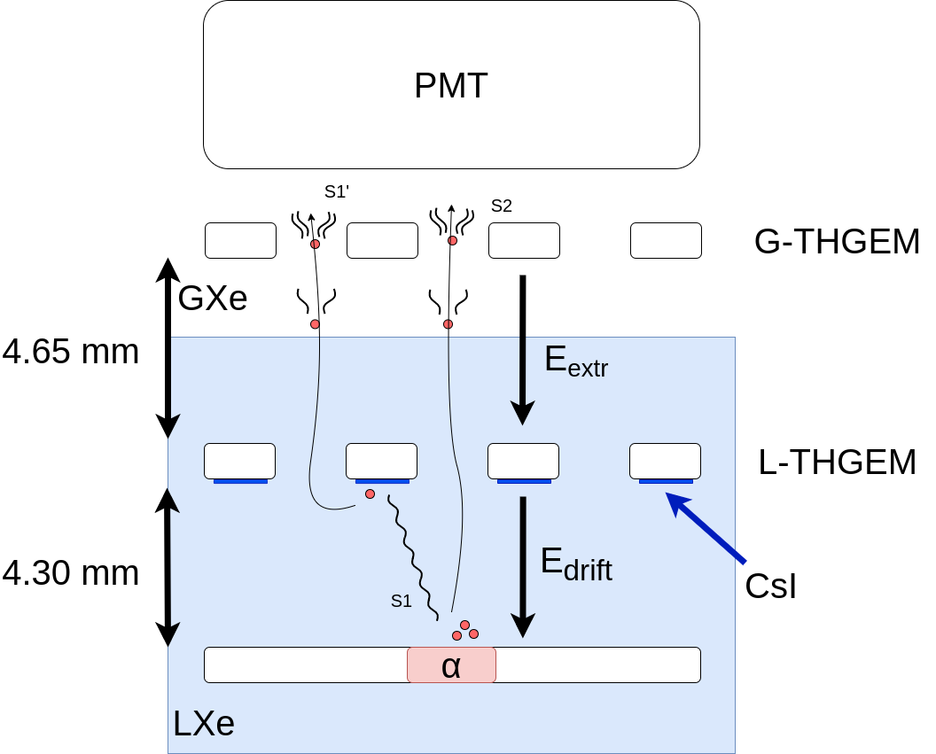
Double-THGEM configuration
L-THGEM immersed in LXe and coated with CsI for VUV detection
G-THGEM in gas phase for
EL stability
Identical THGEM electrodes
THGEM parameters
0.3 mm hole ⌀
50 μm rim
0.7 mm pitch
0.4 mm thickness
20 mm ⌀ CsI spot
A. Roy – Bubble-free LHM - MPGD22, Israel, 13/12/2022

Slide 16
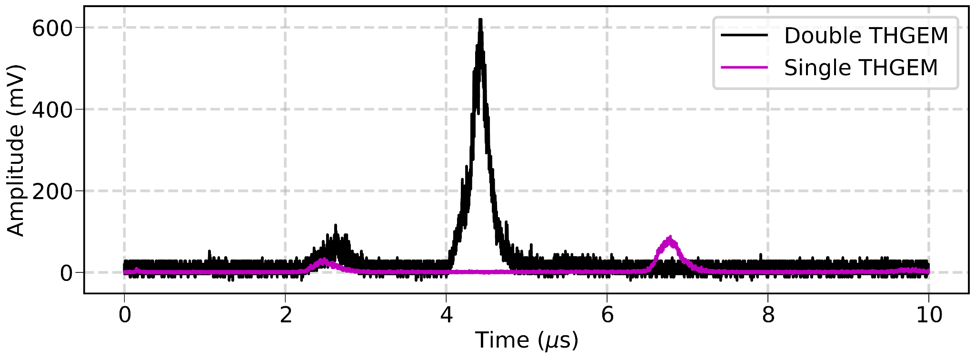
Example waveform: single-THGEM vs double-THGEM
Higher EL yield than with the single-THGEM configuration under similar conditions
S2
ΔV_{LTHGEM} = 2.0 kV
E_{drift} = 0.66 kV/cm
E_{extr} = 6.8 kV/cm
ΔV_{GTHGEM} = 1.4 kV
S1
S1’
A. Roy – Bubble-free LHM - MPGD22, Israel, 13/12/2022

Slide 17
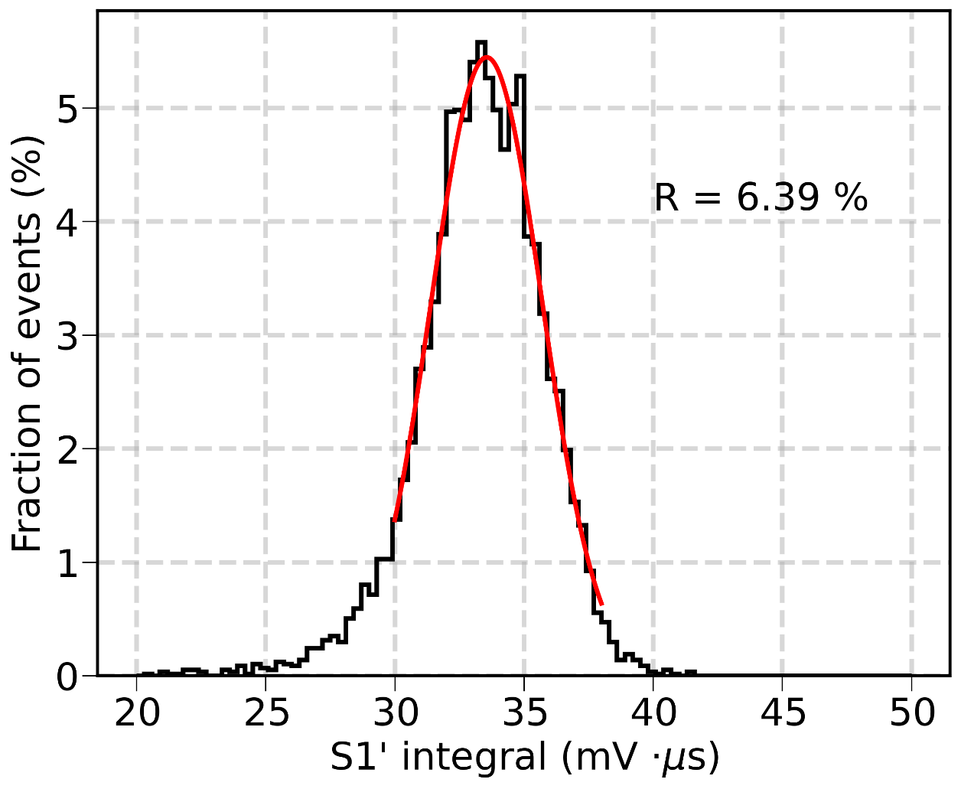
S1’ Energy resolution
~6.4% S1 energy resolution (σ/E)
Clear improvement noticed due to the presence of the G-THGEM
Experimental conditions:
ΔV_{LTHGEM} = 2.0 kV
E_{drift} ~ 0.65 kV/cm
E_{ext} ~ 6.5 kV/cm
ΔV_{GTHGEM} = 1.0 kV
A. Roy – Bubble-free LHM - MPGD22, Israel, 13/12/2022

Slide 18
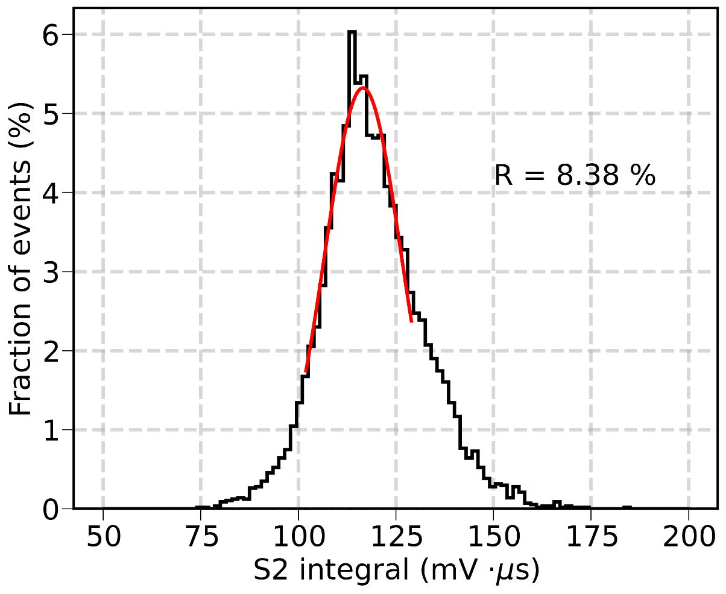
S2 Energy resolution
~8.4% S2 energy resolution (σ/E)
Clear improvement noticed due to the presence of the G-THGEM
Experimental conditions:
ΔV_{LTHGEM} = 2.0 kV
E_{drift} ~ 0.65 kV/cm
E_{ext} ~ 6.5 kV/cm
ΔV_{GTHGEM} = 1.0 kV
A. Roy – Bubble-free LHM - MPGD22, Israel, 13/12/2022

Slide 19
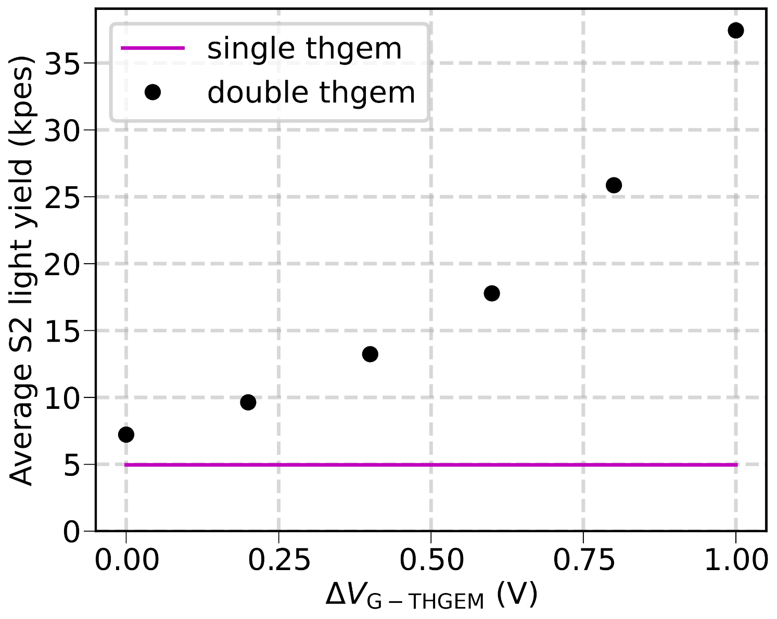
S2 light yield measurement
5 detected PEs/e⁻ emitted in the gas
phase

Slide 20
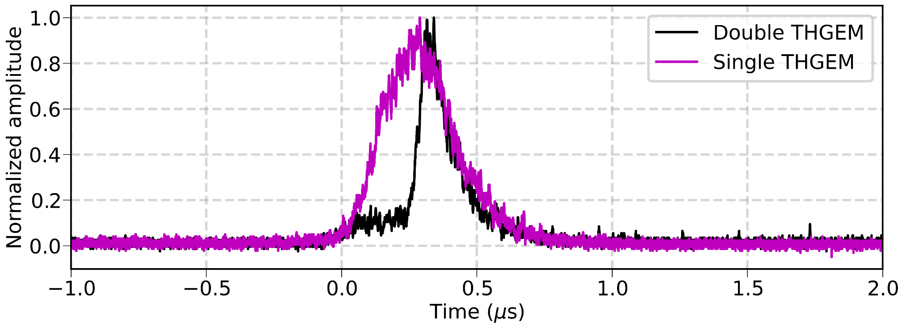
S2 width comparison: single THGEM vs double THGEM
Faster S2 signals under the appropriate voltage configuration
~90 mV
~800 mV
EL within the THGEM holes
ΔV_{LTHGEM} = 2.0 kV
E_{drift} = 0.66 kV/cm
E_{extr} = 6.8 kV/cm
ΔV_{GTHGEM} = 0.6 kV
EL in the transfer gap
(photons seen through THGEM holes)
A. Roy – Bubble-free LHM - MPGD22, Israel, 13/12/2022

Slide 21
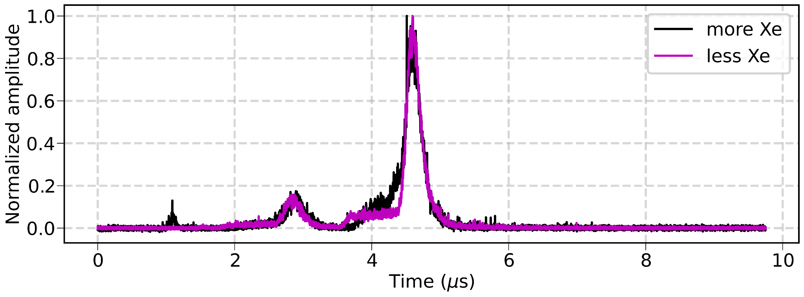
Variations in the liquid-gas interface
Liquid level changes, but EL happens mostly within the THGEM holes
A. Roy – Bubble-free LHM - MPGD22, Israel, 13/12/2022

Slide 22
Next steps
Compare different GEM structures
  SC-GEM is known to provide better PDE
Measure absolute PDE in dual-phase configuration
A. Roy – Bubble-free LHM - MPGD22, Israel, 13/12/2022

Slide 23
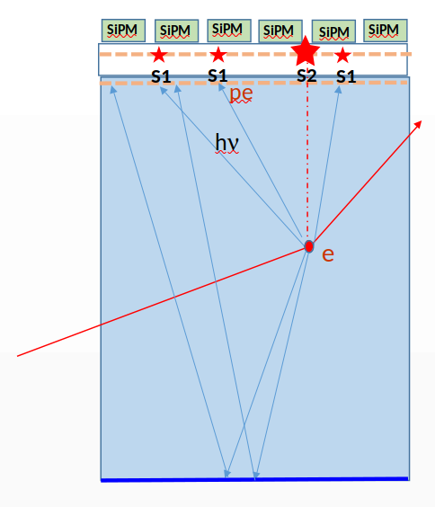
A potential dual-phase LHM TPC for Dark Matter
Expected High PDE
Unambiguous detection of single-photon S1s
  Dark counts are no longer a determining factor
  Lower detection threshold
  Possible to use SiPMs or CMOS-SPAD
EL + avalanche light localized to the G-THGEM holes
  Fluctuations on the Liq-Gas interface not critical
  Fast signals
No need for grid or meshes in the active volume
  Improved S1 light collection efficiency
No need for PMTs
  Better radiopurity
  No wasted LXe in the buffer region
G-THGEM
CsI L-THGEM
LXe
Reflective cathode
A. Roy – Bubble-free LHM - MPGD22, Israel, 13/12/2022

Slide 24
Thank you for your attention

Slide 25
Backup

Slide 26
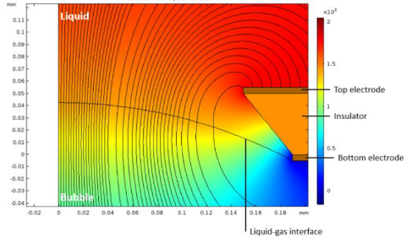
Low PDE: why?
Main hypothesis: low e⁻ transfer efficiency across the bubble interface
  e⁻ stuck and lost to the wall
Ongoing efforts to understand this effect
  Bubble physics (A. Tesi et al 2021 JINST 16 P09003)
A dual-phase configuration seems more adequate

Slide 27
Photon feedback
We haven’t observed a significant amount of photon feedback
More detailed studies to come
pe

Slide 28
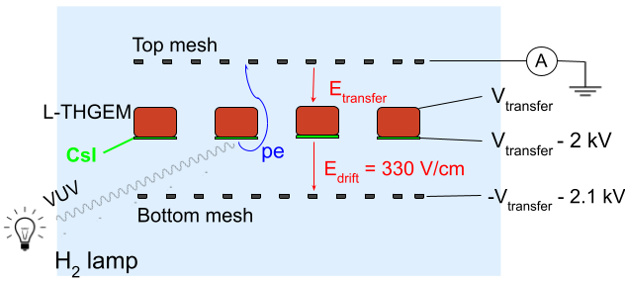
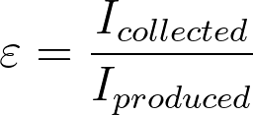
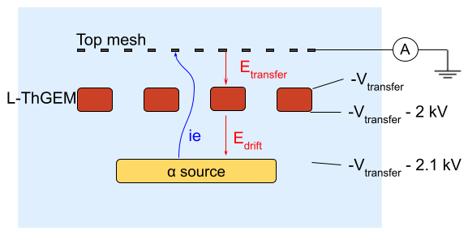
Methodology
S1’ photoelectrons
collected
Measure current on different electrodes
  Each electrode is measured separately
Transmission efficiency defined as
produced
S2 ionization electrons
collected
produced

Slide 29
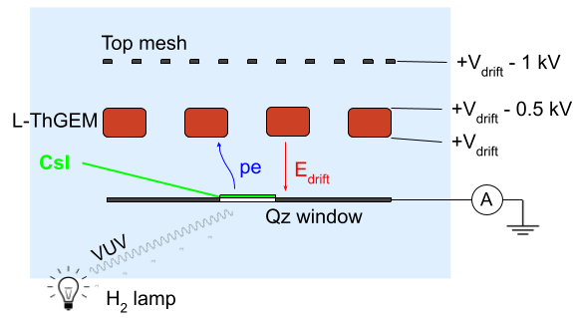
Photoelectron extraction efficiency
Photoelectrons are extracted from a CsI-coated window illuminated by a H₂ lamp and collected on the bottom side of the L-ThGEM
QE_{LXe} > QE_{vac}
LXe: increased QE_{eff} by ~x3.5
Reproduction of the results by
E. Aprile et al., NIM A 338 (1994) 328-335

Slide 30
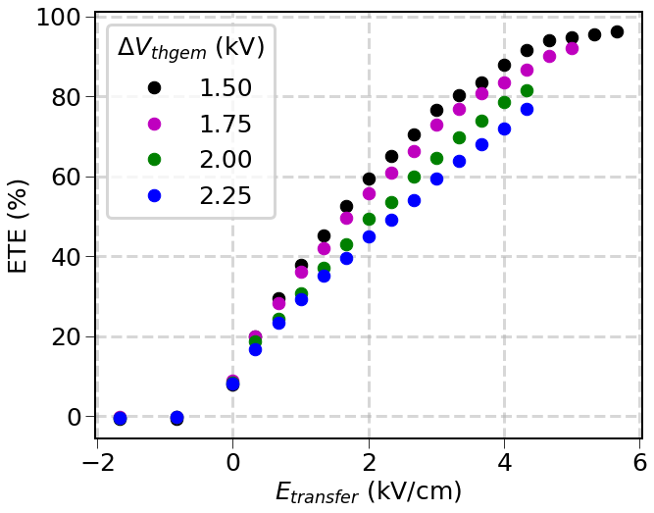
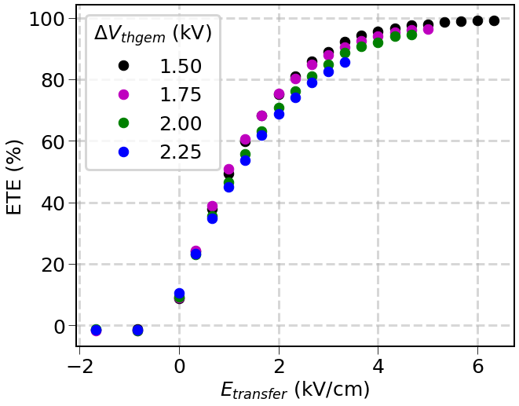
ETE vs ΔV_{THGEM}
S1’ phe
S2 ie
E_{drift} = 660 V/cm

