Slide 1
TMM: Triple MicroMegas with ultra-low ion backflow for gaseous photon detectors sensitive to visible light
Kunyu Liang, Zhiyong Zhang, Jianbei Liu, Ming Shao, Yi Zhou
State Key Laboratory of Particle Detection and Electronics
University of Science and Technology of China
MPGD 2022
Notes:
Hello, every one! This is Kunyu giving a talk for the USTC MPGD group. My topic is…

Slide 2
Outline
Motivation
Design and Fabrication
Performance Characterization
  Gas Gain and IBF Ratio
  Optimization for Electron Collection
  Laser Test
Summary
Notes:
Here is the outline, including the motivation, design and Fabrication of the detector, its Performance characterization, including the gas gain and IBF ratio, optimization for electron collection and laser test, and finally the summary

Slide 3
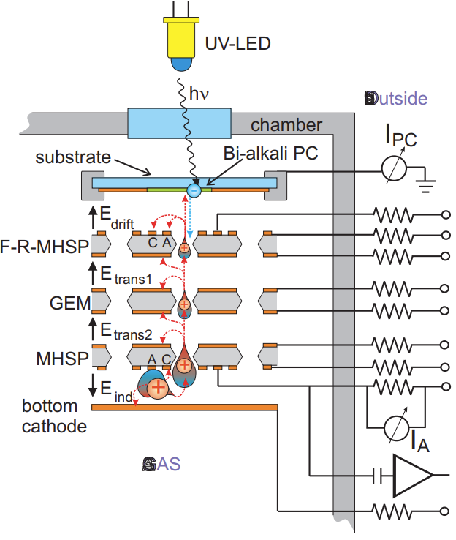
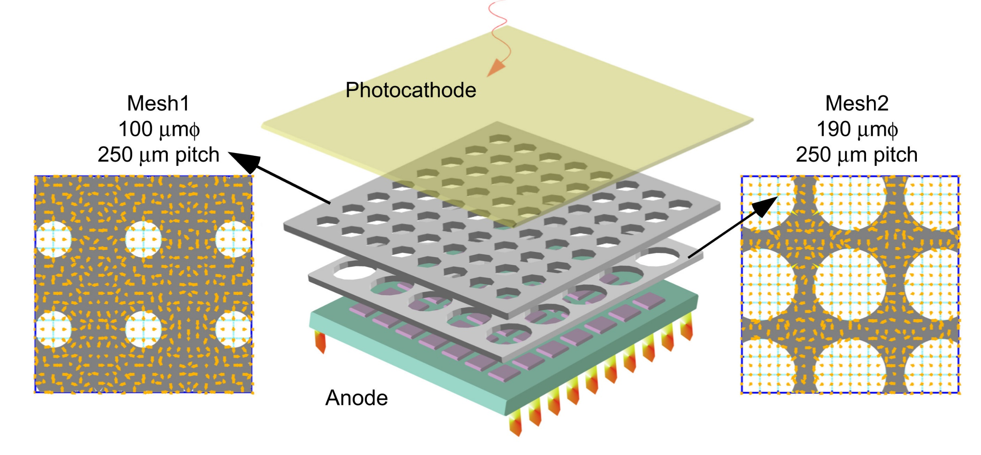


Motivation: GPD
Gaseous Photon Detector(GPD) based on MPGD
  large area, low cost, resistance to magnetic field, high spatial and time resolution, IBF suppression…
GPD sensitive to UV-light have been successfully applied
  Visible-sensitive GPD is challenging yet promising
Gas-PMT Mesh+Mesh, IBF ${\sim 6×10}^{−4}$
IBF ${\sim 3×10}^{−4}$
Bi-alkali
F. Tokanai et al. , NIM A 766 (2014) 176-179
A V Lyashenko et al 2009 JINST 4 P07005
Kunyu Liang
Notes:
As we know, gaseous photon detector, or GPD, based on MPGD have lots of advantages, including large area, low cost, good resistance to magnetic field, high spatial and time resolution, and great potential for IBF suppression. GPD sensitive to UV-light have been successfully applied, for example, in Cherenkov light detection. But, Visible-sensitive GPD is still challenging yet promising. Lots of efforts have been made to develop visible-sensitive GPD. For example, Gas-PMT based on double layers of mesh, and GPD based on Micro-Hole&strips plate and GEM. Their IBF ratio could reach down to about ten to the negative four.

Slide 4
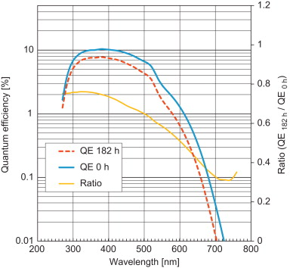


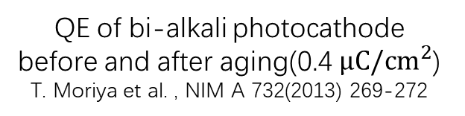
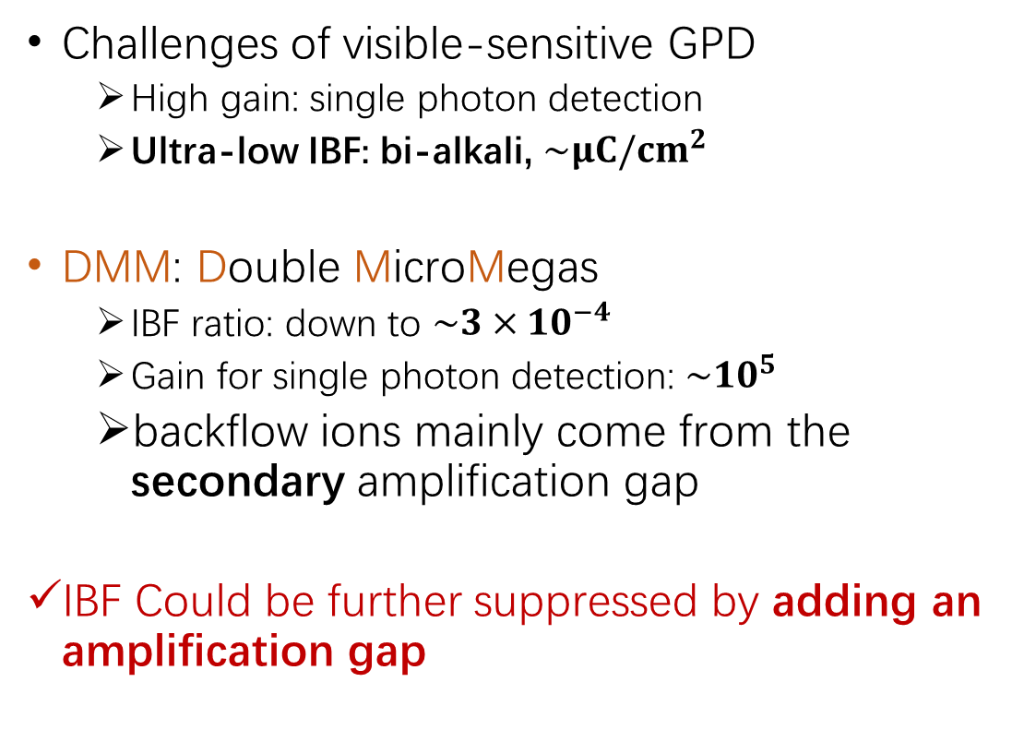
Motivation: Challenges
Challenges of visible-sensitive GPD
  High gain: single photon detection
  Ultra-low IBF: bi-alkali, $\sim μC/{cm}^{2}$
DMM: Double MicroMegas
  IBF ratio: down to $\sim 3×{10}^{−4}$
  Gain for single photon detection: $\sim {10}^{5}$
  backflow ions mainly come from the secondary amplification gap
IBF Could be further suppressed by adding an amplification gap
$>20\%$ degradation
IBF × Gain ~ ${10}^{1}$
QE of bi-alkali photocathode before and after aging(0.4 $μC/{cm}^{2}$)
T. Moriya et al. , NIM A 732(2013) 269-272
Kunyu Liang
Notes:
The main challenges of visible-sensitive GPD are that it needs high gain for single photon detection and ultra-low IBF to protect the photocathode. For bi-alkali sensitive to visible light, about micro coulomb per square centimeter of charge could degrade the quantum efficiency greatly. Aiming at these challenges, the USTC MPGD group have developed the double micromegas, or DMM, detector. It could achieve IBF ratio down to three times ten to the negative four. Considering that the gain needed for single photon detection is about ten to the five, that means one photon electron would result in tens of backflow ions. We hope to reduce it to one. In DMM, the backflow ions mainly come from the secondary amplification gap. So, We believe that IBF Could be further suppressed by adding an amplification.

Slide 5
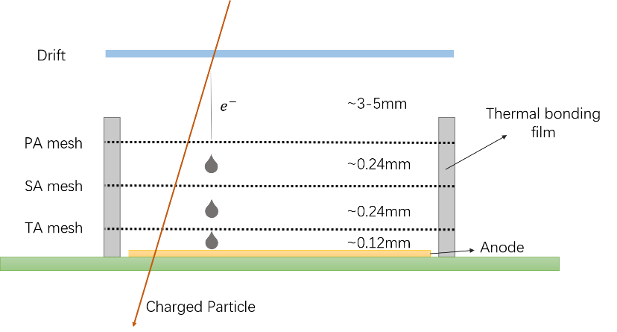
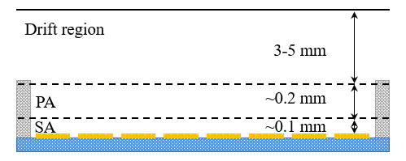
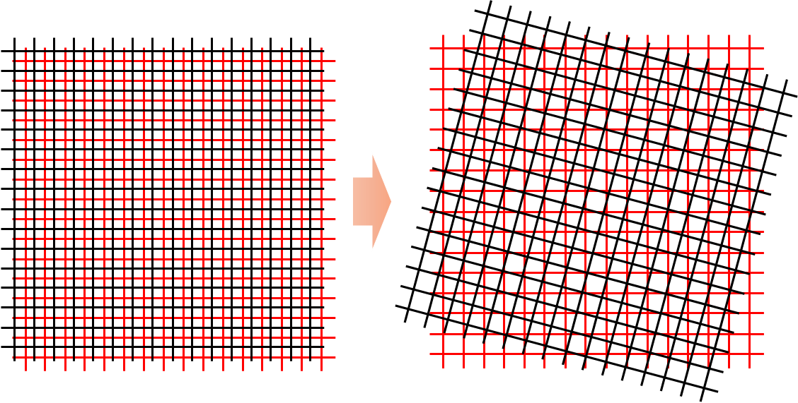
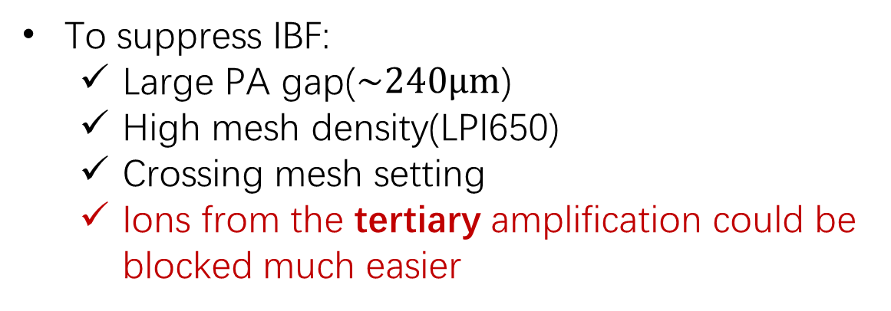
TMM Design
PA: PreAmplification
SA: Secondary Amplification
TA: Tertiary Amplification
Double MicroMegas
Triple MicroMegas
To suppress IBF:
  Large PA gap($\sim 240μm$)
  High mesh density(LPI650)
  Crossing mesh setting
  Ions from the tertiary amplification could be blocked much easier
from study of DMM
setting adjacent meshes with a crossing angle
Kunyu Liang
Notes:
So, we developed a Triple micromegas, or TMM, detector. As we can see from this figure, three layers of micromesh form three amplification gap. We call them PA for…, SA for …, TA for …. To suppress IBF, TMM is designed based on our previous study of DMM. it features …, and crossing mesh setting, which means that we set adjacent meshes with a crossing angle. Furthermore, We believe that Ions from the tertiary amplification could be blocked much easier.

Slide 6
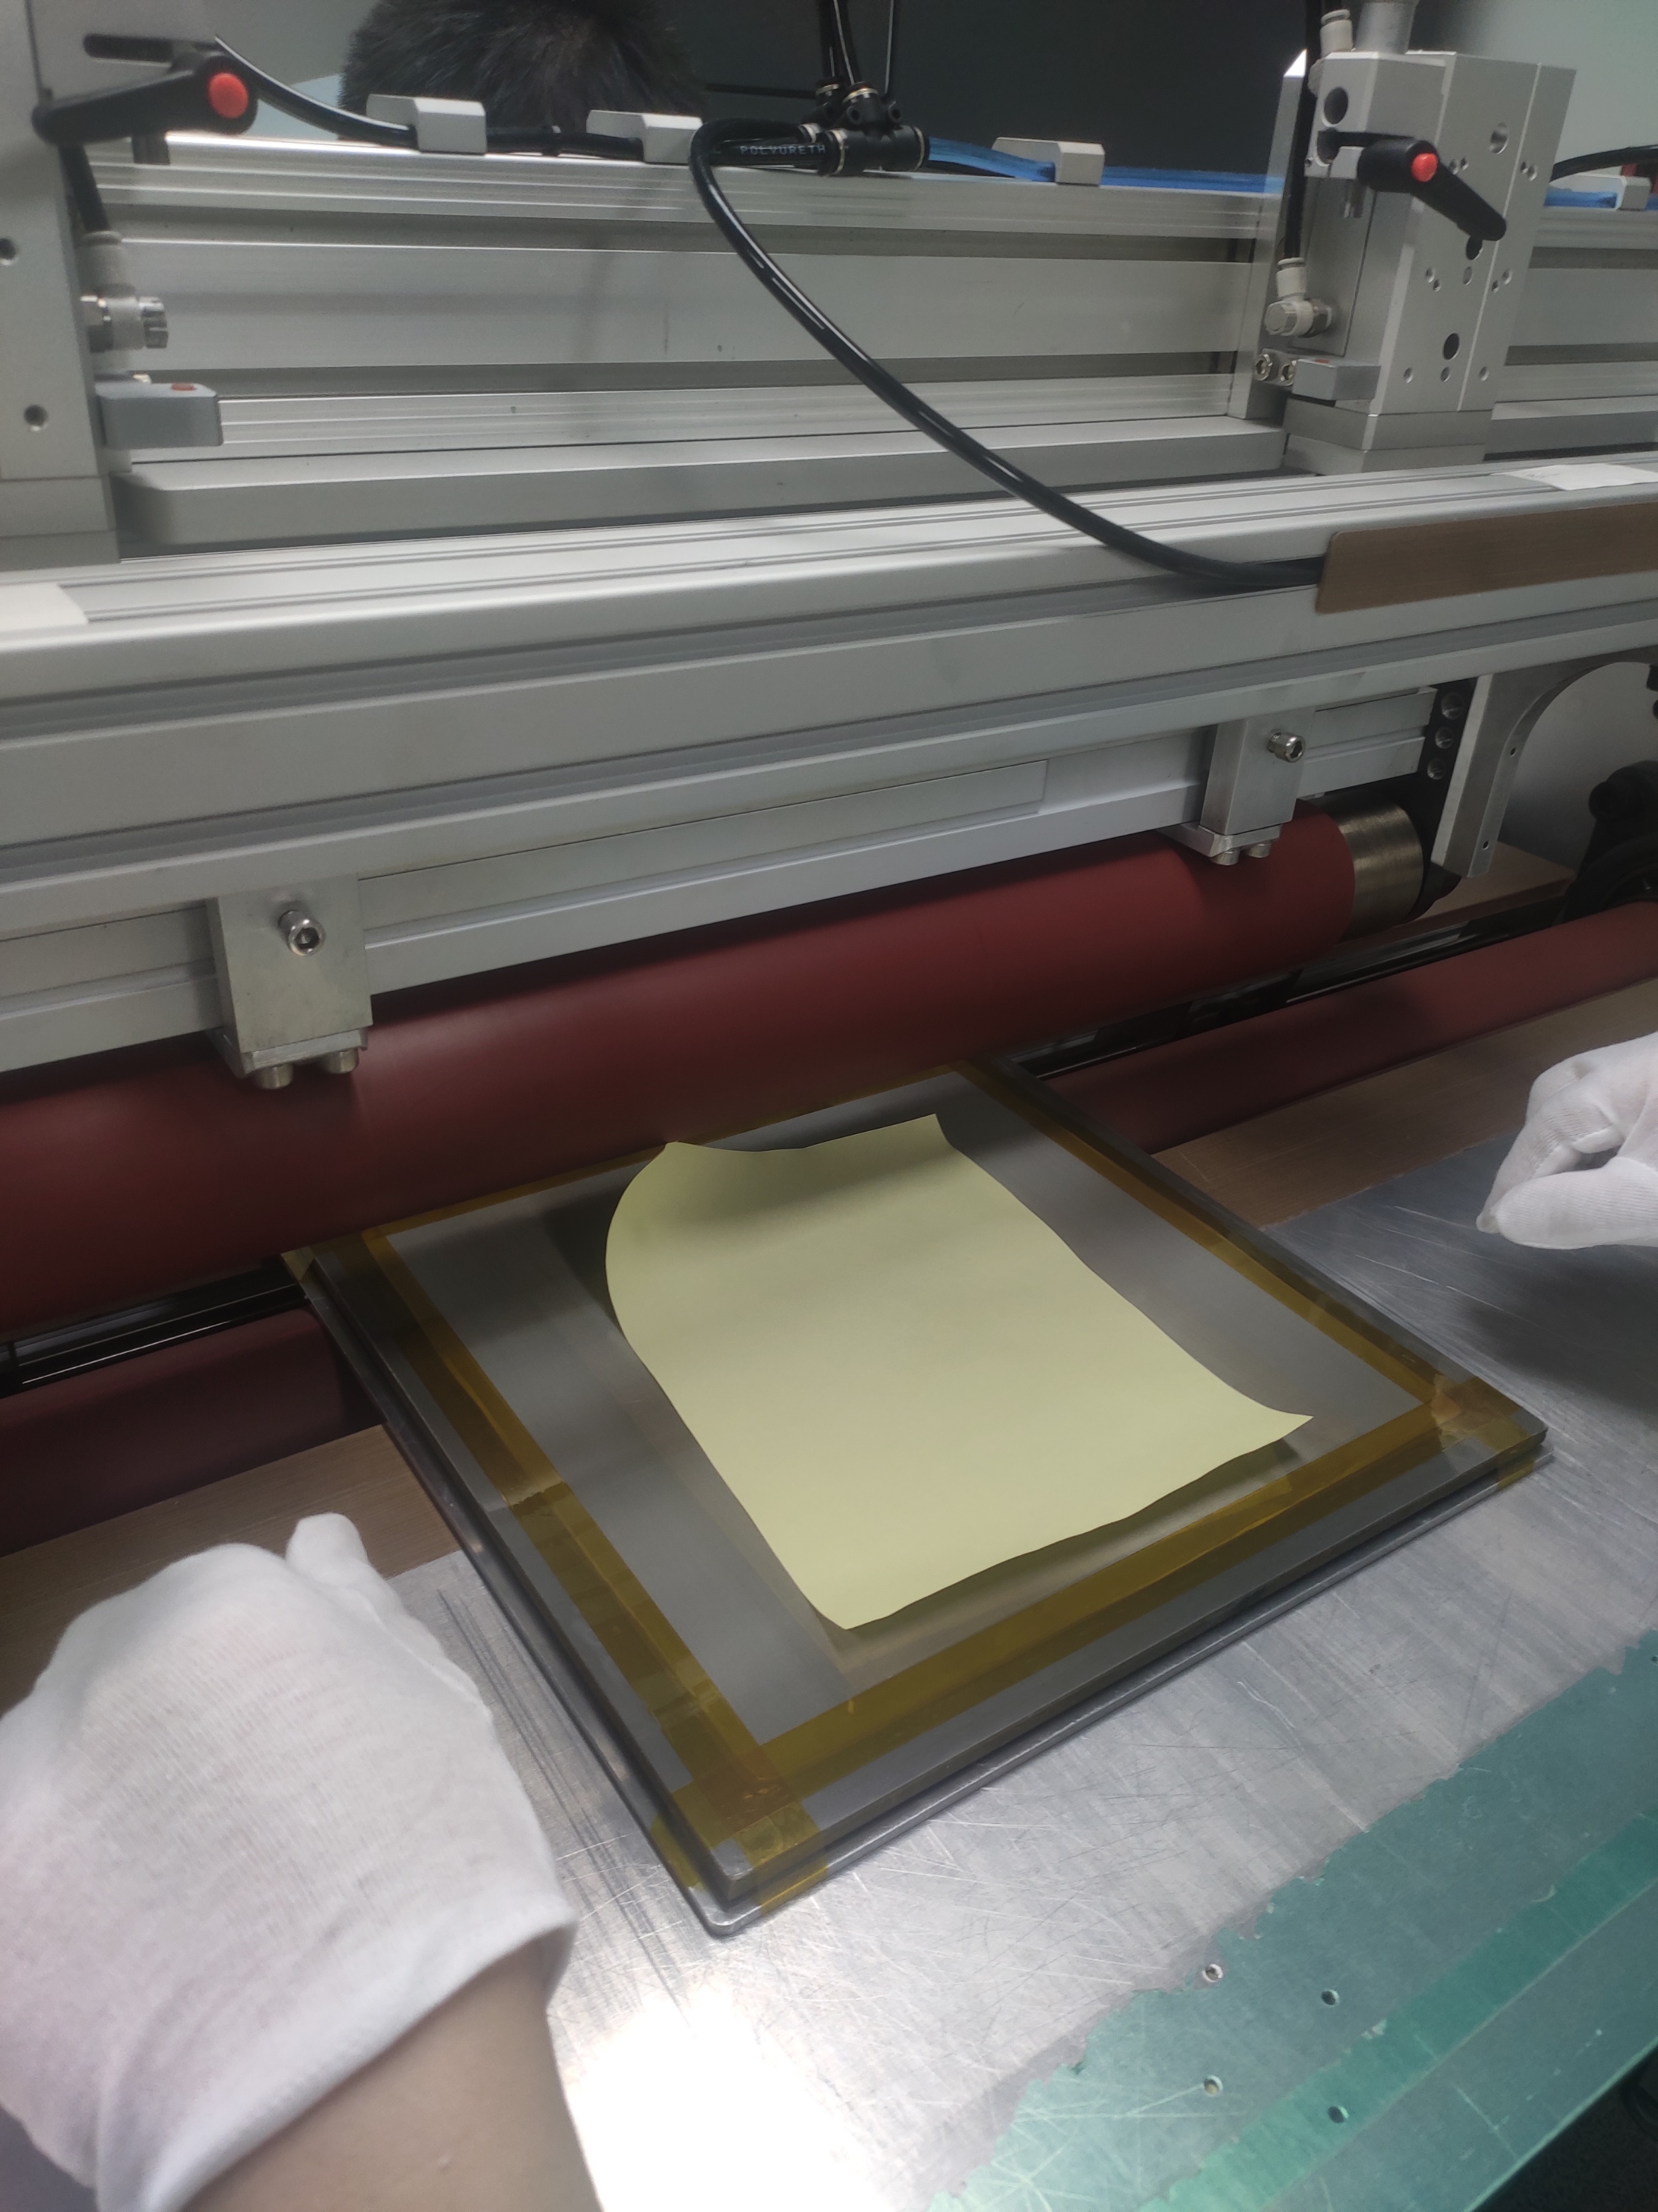
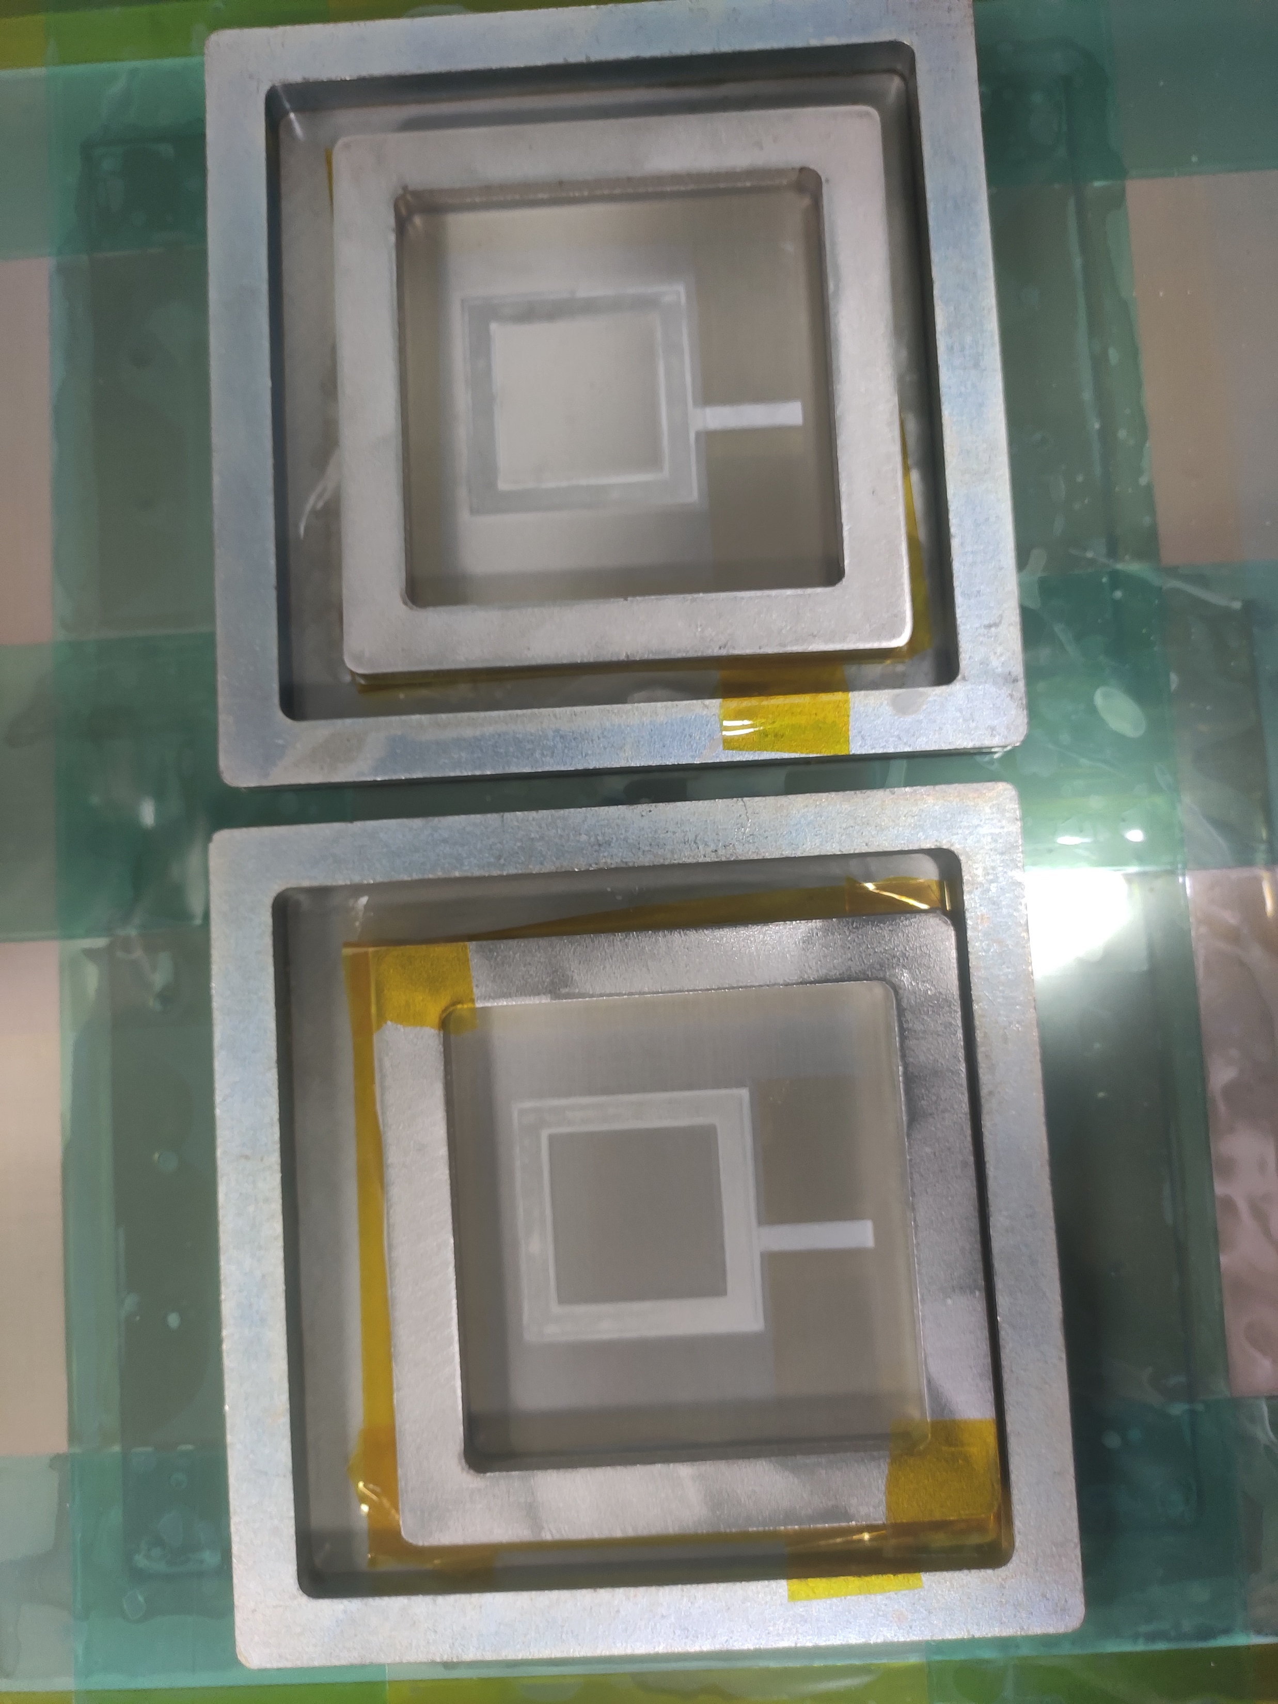
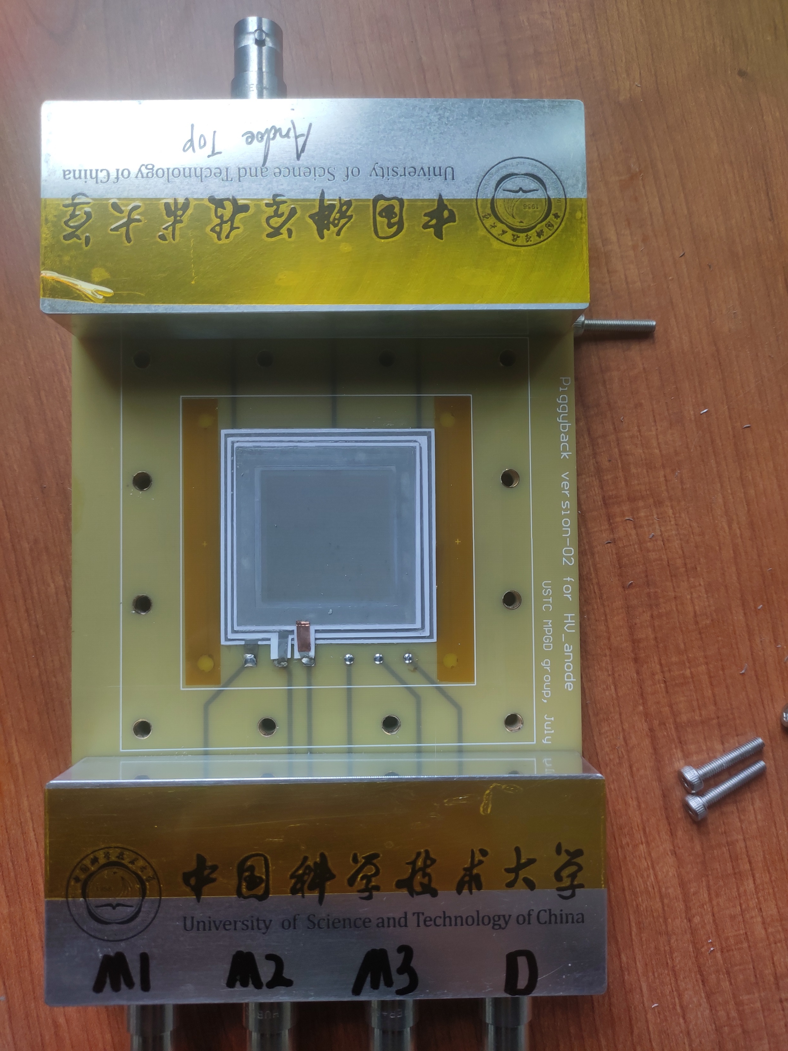
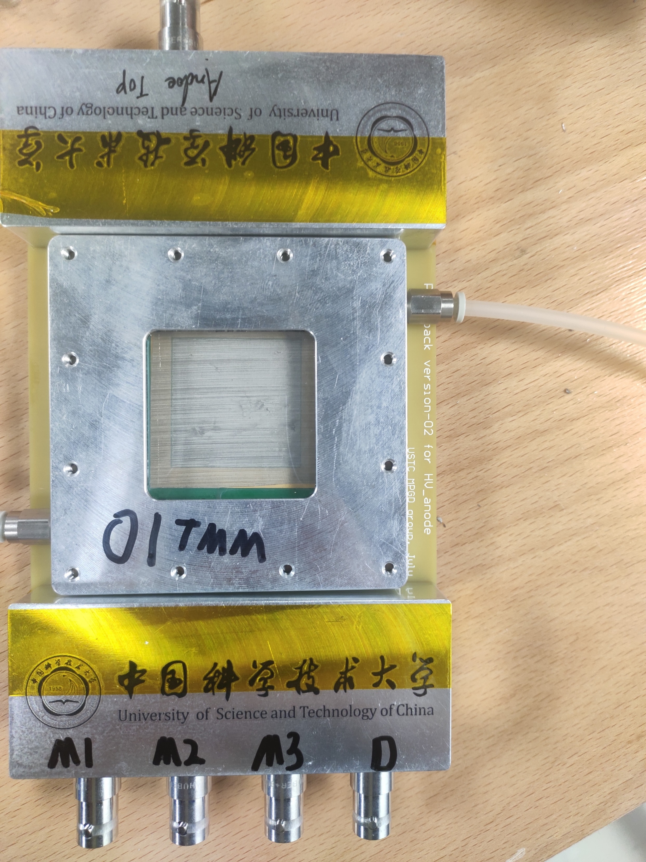
TMM Fabrication
TMM is Fabricated with the thermal bonding technique developed at USTC
Thermal bonding films were used to fix the mesh and keep appropriate avalanche gap
Thermal bonding
After bonding
Mesh cut
TMM prototype
Kunyu Liang
Notes:
TMM is Fabricated with the thermal bonding technique developed at USTC. Thermal bonding films were used to fix the mesh and keep appropriate avalanche gap. Here shows the main process of fabrication. We used a heating roller press to fix the mesh on the PCB. This is the mesh after bonding. Then we cut the excess mesh. Finally, a TMM prototype was fabricated.

Slide 7
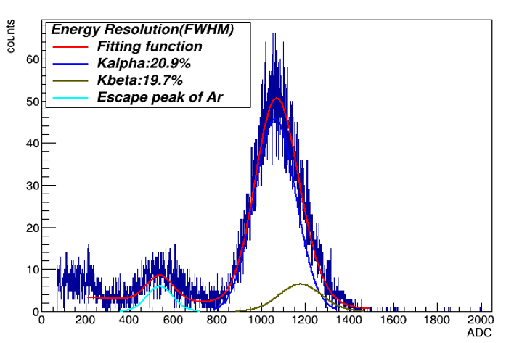
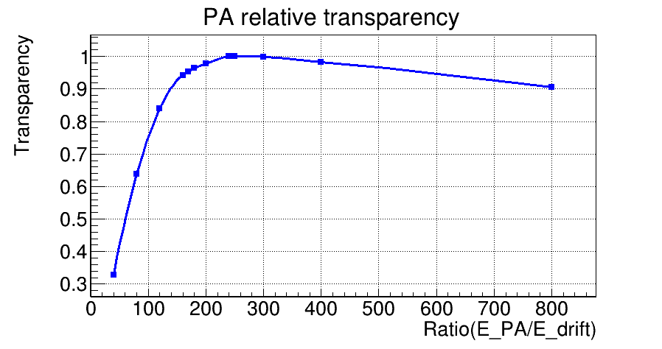


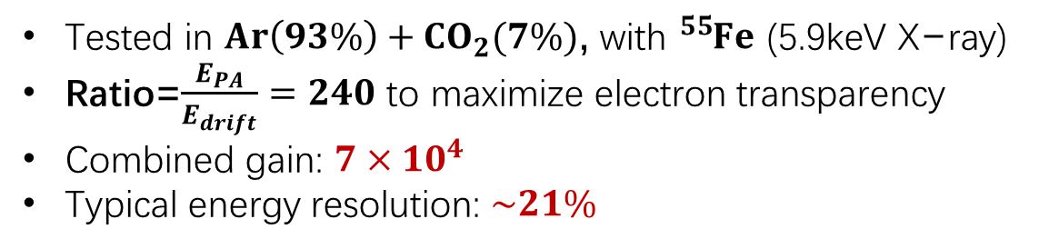
Gas Gain
Parameters of meshes
Tested in $Ar\left(93\%\right)+CO_{2}(7\%)$, with ${}_{ }^{55}{Fe}$ (5.9keV X−ray)
Ratio=$\frac{E_{PA}}{E_{drift}}=240$ to maximize electron transparency
Combined gain: ${7×10}^{4}$
Typical energy resolution: $\sim 21\%$
Detector | PA mesh | SA mesh | TA mesh
TMM1 | 650(40%)* | 650(40%) | 500(40%)
*: Line Per Inch(Opening Rate) $→$ LPI(OR)
A typical ${}_{ }^{55}{Fe}$ energy spectrum
PA
Kunyu Liang
Notes:
We made our first prototype, TMM1. Here is its parameters of meshes, including mesh density and Opening Rate, that is LPI and OR. Then we characterized its performance. Firstly, its gas gain. It was Tested in $Argon and Carbon dioxide$, with a ferrum X-ray source. The ratio of electric field strength of PA over drift gap is set to 240 to maximize electron transparency most of the time. We test the combined gain under different PA voltage at 240 Volt SA. It shows that Combined gain can reach up to seven times 10 to the 4. And the typical energy resolution is about 21 percent.

Slide 8



IBF measurement
$IBF ratio=\frac{I_{drift}−I_{primary}}{I_{anode}}$
$I_{drift}, I_{primary}$(without avalanche)
$$I_{anode}$$
Drift cathode (0V)
Drift cathode (-HV)
Pre-mesh (+HV)
Pre-mesh (-HV)
Sec-mesh (+HV)
Sec-mesh (-HV)
Ter-mesh (+HV)
Ter-mesh (-HV)
Anode (+HV)
Anode (0V)
Picoammeter
$I_{primary}:\sim pA, I_{drift}:10\sim 100 pA, I_{anode}:−10 \sim −300 nA$
Keithley(6482) Picoammeter with $\sim 10fA$ resolution in a range of $±20nA$
Kunyu Liang
Notes:
Then we measured the IBF ratio by current. The IBF ratio is defined as I-drift minus I-primary over I-anode, where I primary means the current induced by primary ionization on drift cathode. All these current were measured respectively by a Keithley picoammeter with about 10 femtoampere resolution. When we measured the current of one certain electrode, the electrode was grounded.

Slide 9

IBF Ratio
IBF ratio down to $\sim {3×10}^{−5}$ at a PA voltage of 450V
~One order of magnitude better than that of DMM
Kunyu Liang
Notes:
Here shows the result of IBF ratio. We measured IBF ratio under different voltage setting. This diagram shows the result of DMM and TMM. TMM achieved the IBF ratio down to about 3 times 10 to the negtive five. The ratio is higher for PA650V. And We could find that IBF of TMM is about one order of magnitude better than that of DMM

Slide 10
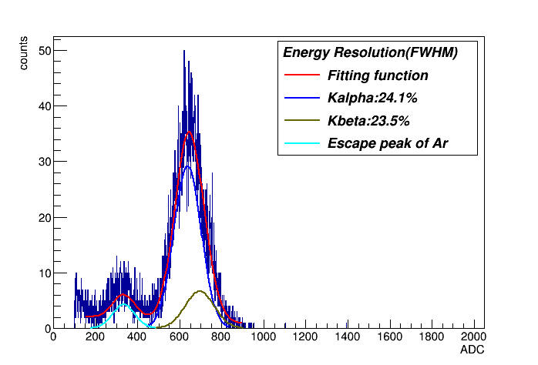
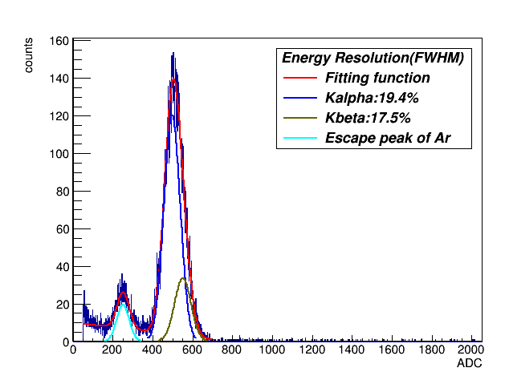
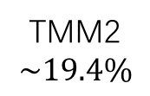
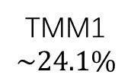
Optimization for Electron Collection
Detector | PA mesh | SA mesh | TA mesh
TMM1 | 650(40%)* | 650(40%) | 500(40%)
TMM2 | 500(50%) | 650(40%) | 500(40%)
TMM3 | 500(50%) | 650(40%) | 500(40%)
*: Line Per Inch(Opening Rate)
Low PA voltage would degrade electron collection efficiency
Two TMM prototype with PA mesh of higher Opening rate and lower LPI were fabricated
Energy resolution was improved
  Implies better electron collection
TMM1
$$\sim 24.1\%$$
TMM2
$$\sim 19.4\%$$
Combined energy resolution at PA550V+SA650V
Kunyu Liang
Notes:
We could see that Ultra low IBF requires low PA voltage, which would degrade the electron collection. So, we try to optimize the detector parameter for better electron collection. Two TMM prototype, TMM2 and 3, with PA mesh of higher Opening rate and lower LPI were fabricated. We could evaluate the electron collection efficiency by energy resolution. Test shows that the Energy resolution was improved, from 24% to 19%. This improvement implies a better Electron Collection

Slide 11
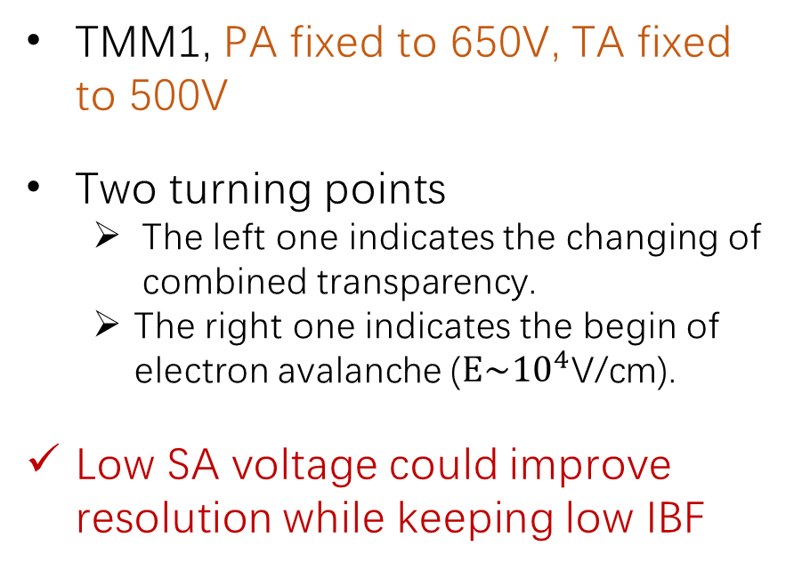
Various SA Voltage
TMM1, PA fixed to 650V, TA fixed to 500V
Two turning points
  The left one indicates the changing of combined transparency.
  The right one indicates the begin of electron avalanche ($E\sim {10}^{4}\text{V}\text{/}\text{cm}$).
Low SA voltage could improve resolution while keeping low IBF
Kunyu Liang
Notes:
We also measured the gain, resolution and IBF under various SA voltage. We tested TMM1, PA fixed to 650V, TA fixed to 500V. The first diagram shows gain and resolution. They have opposite trends. We could see that there are two turning points. We believe that the left one indicates the changing of combined transparency, while The right one indicates the begin of electron avalanche. The second diagram shows IBF times Gain. We could find that there is no turning points at low SA voltage. Following this result, we believe Low SA voltage could improve resolution while keeping low IBF ratio

Slide 12
Energy resolution of TMM2
Good energy resolution can be obtained with appropriate voltage
  Higher PA voltage
  High or very low SA voltage
Kunyu Liang
Notes:
Then we tested the energy resolution of TMM2 under various PA and SA voltage. For PA, we have 650 and 550V. For SA, 650, 240, 50 and 10V. These results shows that good energy resolution can be obtained with appropriate voltage, that is higher PA voltage, and high or very low SA voltage.

Slide 13
Effect on IBF
PA mesh of different LPI and OR may affect the IBF ratio
  LPI of TMM2 PA mesh is lower
Higher LPI and higher OR are preferred
Detector | PA mesh
TMM1 | 650(40%)
TMM2 | 500(50%)
Kunyu Liang
Notes:
We then tested the IBF of TMM2. Here we compare the results of TMM1 and TMM2, including PA alone and combined IBF ratio. They have different PA mesh. We could see that IBF of TMM2 is higher than that of TMM1, that is, PA mesh of different LPI and OR may affect the IBF ratio. According to our previous research, we believe that it is because the LPI of TMM2 is lower. So, we concluded that mesh of high LPI and high OR are preferred.

Slide 14
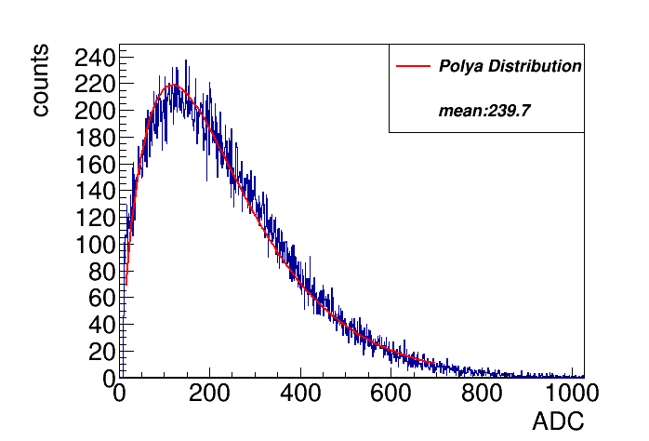

Single Photon-Electron Response
TMM3, Quartz coated with aluminum layer as photocathode
Tested in COMPASS gas: Ne (80%), CF₄ (10%) and C₂H₆ (10%)
Gas gain can reach up to ${5×10}^{6}$ for single electron
Detector | PA mesh
TMM1 | 650(40%)
TMM3 | 500(50%)
Avalanche charge distribution for single photon-electron
Kunyu Liang
Notes:
Finally, we conducted single photon-electron response test on TMM3. In the test, Quartz coated with aluminum layer was used as photocathode. It was tested in COPASS gas. We test under PA650Volt and different SA voltage, and the gas gain can reach up to five times 10 to the 6 for single electron. Which means it’s capable of single photon detection.

Slide 15
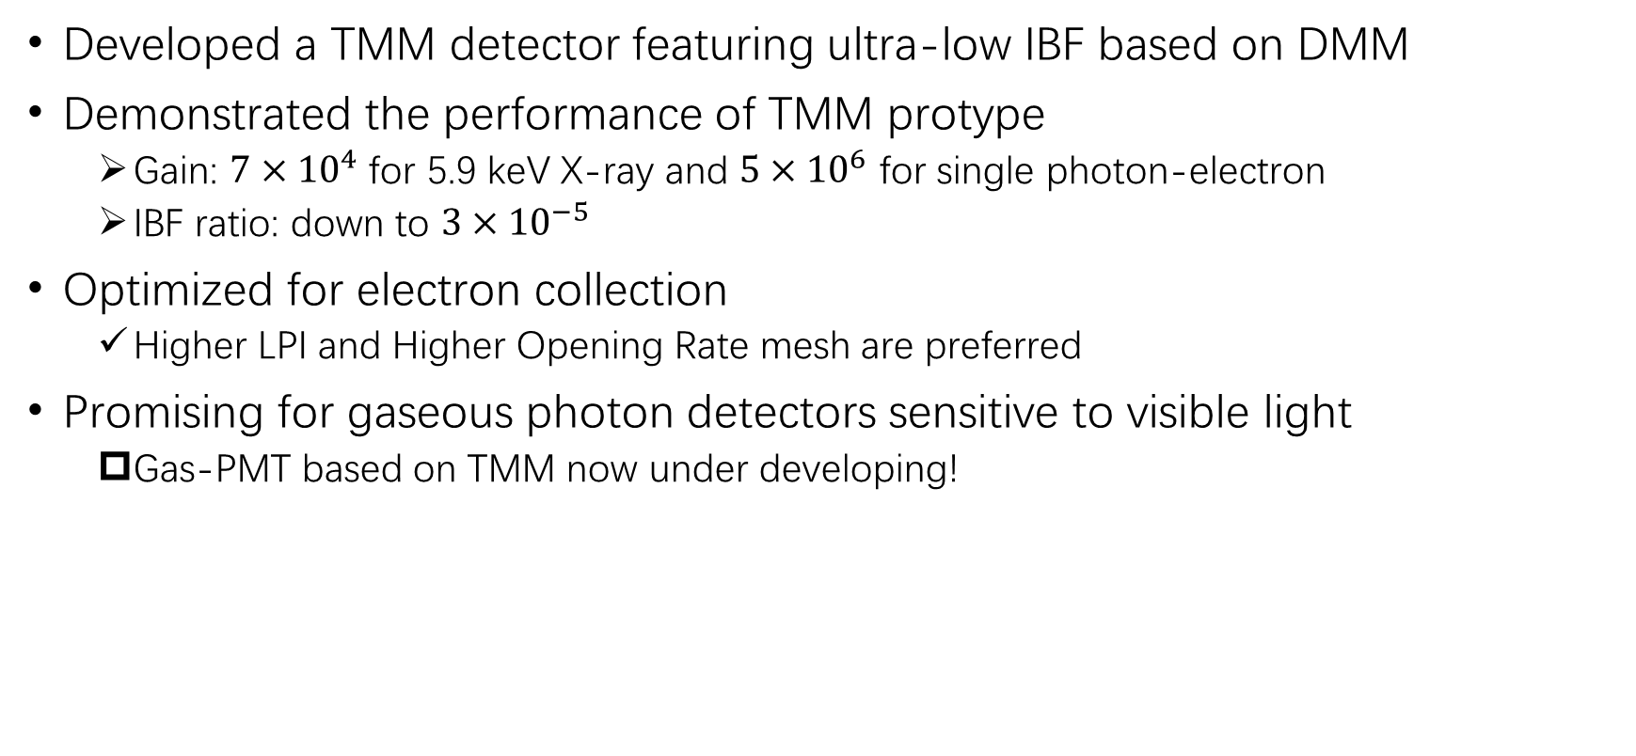
Summary
Developed a TMM detector featuring ultra-low IBF based on DMM
Demonstrated the performance of TMM protype
  Gain: ${7×10}^{4}$ for 5.9 keV X-ray and ${5×10}^{6}$ for single photon-electron
  IBF ratio: down to ${3×10}^{−5}$
Optimized for electron collection
  Higher LPI and Higher Opening Rate mesh are preferred
Promising for gaseous photon detectors sensitive to visible light
  Gas-PMT based on TMM now under developing!
Kunyu Liang
Notes:
Here is the summary of my talk. We developed a TMM structure featuring ultra-low IBF based on DMM. We demonstrated the performance of TMM protype, its gain could reach ${7×10}^{4}$ for X-ray and ${5×10}^{6}$ for single electron. And its IBF ratio could reach down to ${3×10}^{−5}$. Then we optimized for better electron collection, and found that higher LPI and Higher Opening Rate mesh are preferred. We believe that TMM is promising for gaseous photon detectors sensitive to visible light. And currently, gas-PMT based on TMM is under developing! OK, Thanks for listening!

Slide 16
Summary
Developed a TMM detector featuring ultra-low IBF based on DMM
Demonstrated the performance of TMM protype
  Gain: ${7×10}^{4}$ for 5.9 keV X-ray and ${5×10}^{6}$ for single photon-electron
  IBF ratio: down to ${3×10}^{−5}$
Optimized for electron collection
  Higher LPI and Higher Opening Rate mesh are preferred
Promising for gaseous photon detectors sensitive to visible light
  Gas-PMT based on TMM now under developing!
Thanks for Listening!
Kunyu Liang
Notes:
Here is the summary of my talk. We developed a TMM structure featuring ultra-low IBF based on DMM. We demonstrated the performance of TMM protype, its gain could reach ${7×10}^{4}$ for 5.9 keV X-ray and ${5×10}^{6}$ for single electron. And its IBF ratio could reach down to ${3×10}^{−5}$. Then we optimized for better electron collection, and found that high LPI and Higher Opening Rate mesh are preferred. We believe that TMM is promising for gaseous photon detectors sensitive to visible light. And g-PMT based on TMM is under developing! OK, Thanks for listening!

Slide 17
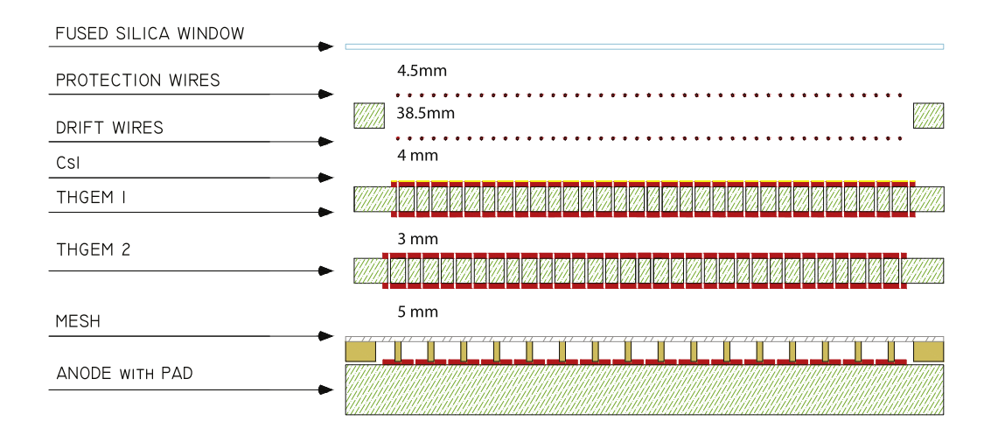
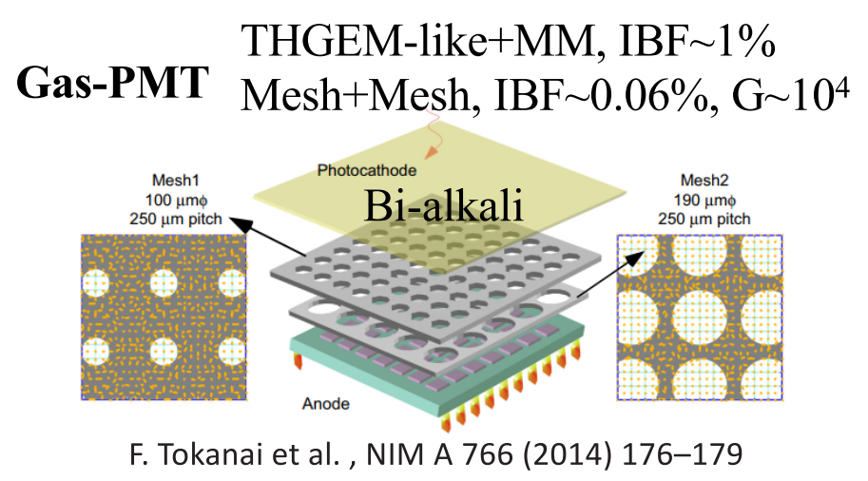
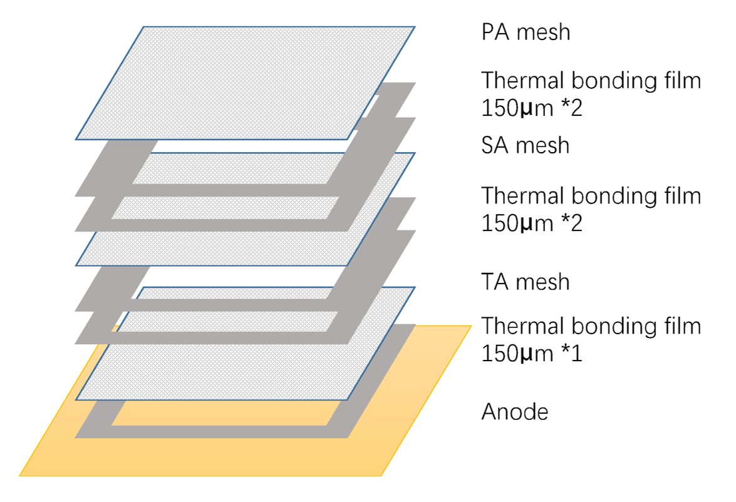
backup
GPD on COMPASS RICH-1

Slide 18
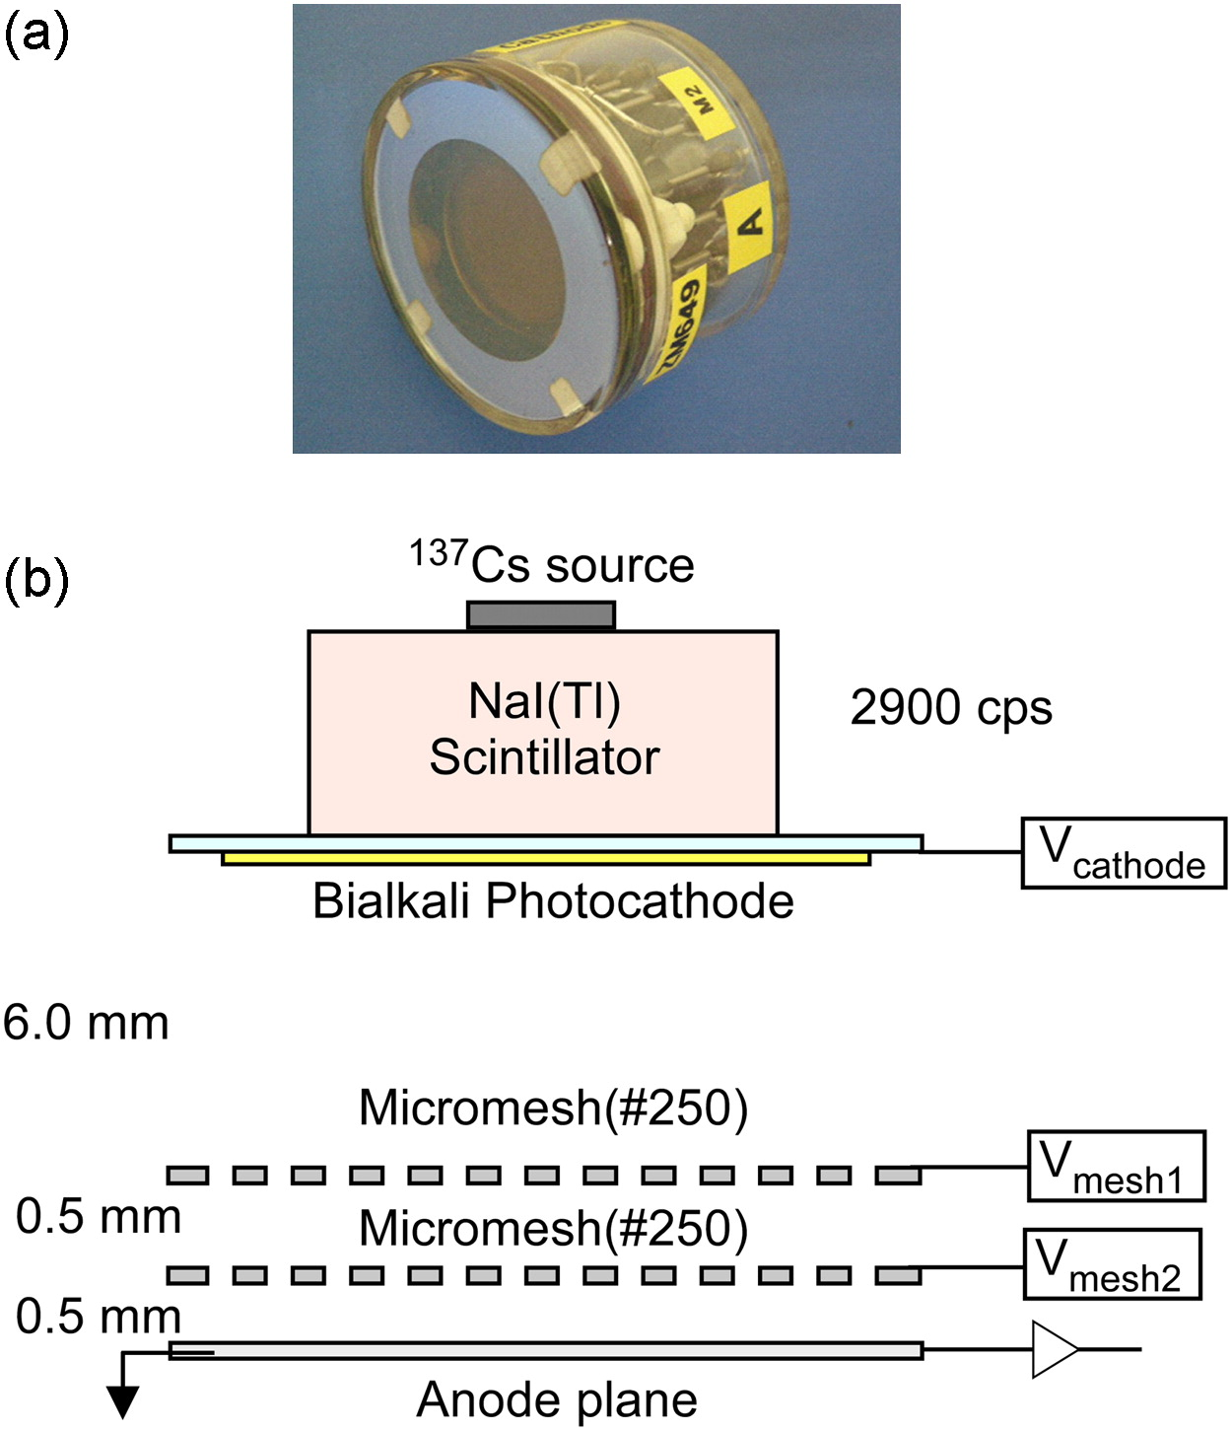
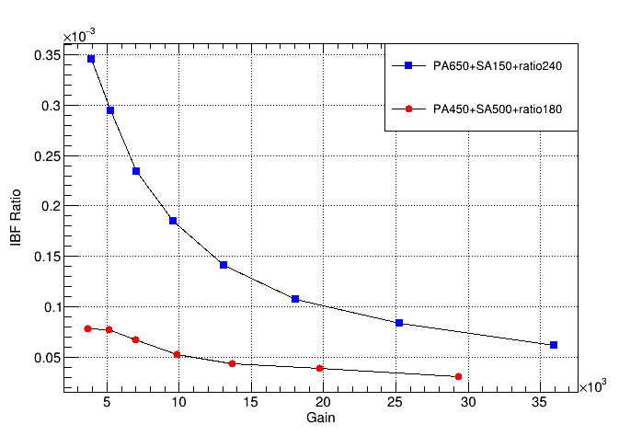
Backup

Slide 19
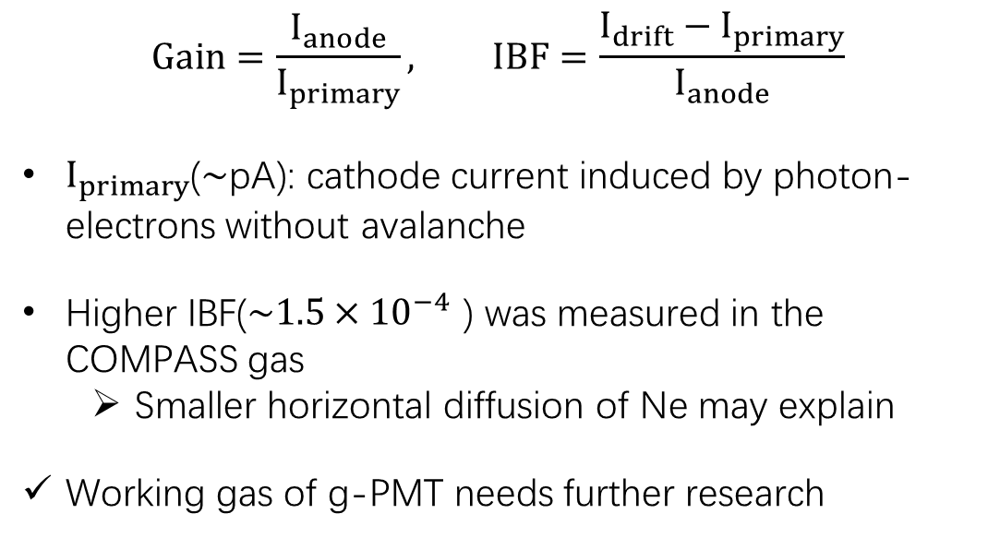
IBF Measurement with Laser
Laser：Max 400Hz
213nm
attenuators
TMM
Picoammeter
$$Gain=\frac{I_{anode}}{I_{primary}}, IBF=\frac{I_{drift}−I_{primary}}{I_{anode}}$$
$I_{primary}$($\sim$pA): cathode current induced by photon-electrons without avalanche
Higher IBF($\sim {1.5×10}^{−4}$ ) was measured in the COMPASS gas
  Smaller horizontal diffusion of Ne may explain
Working gas of g-PMT needs further research
Laser Test

