Slide 1
Development of DLC-RPC for Radiative Decay Counter of MEG II Experiment
Atsuhiko Ochi¹, Sei Ban², Kei Ieki², Rina Onda², Wataru Ootani², Atsushi Oya², Masato Takahashi¹, and Kensuke Yamamoto²
¹Kobe University
²The University of Tokyo
7th MPGD Conference at Weizmann Institute , 14/12/2022

Slide 2
Contents
Introduction : MEG II and RDC
DLC-RPC : first prototype
DLC-RPC : new prototype with HV line
Summary and prospects

Slide 3
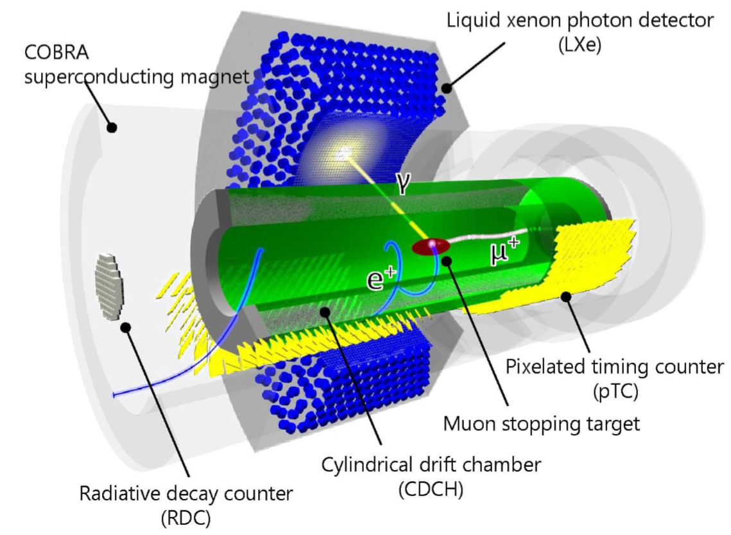
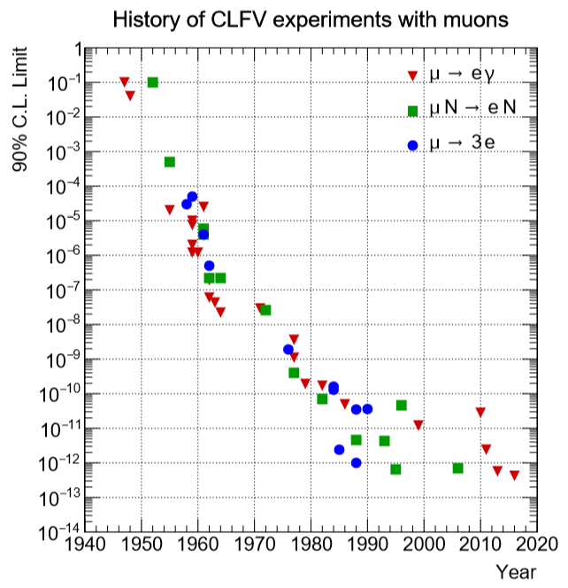
MEG II experiment on PSI
Lepton flavor violation search
  μ → eγ
  Already searched for < 4.2 x 10⁻¹³ level (MEG I)
Upgraded experiment : MEG II
  Up to < 6 x 10⁻¹⁴ level of branching ratio
A.M. Baldini et al., arXiv 1801.04688

Slide 5
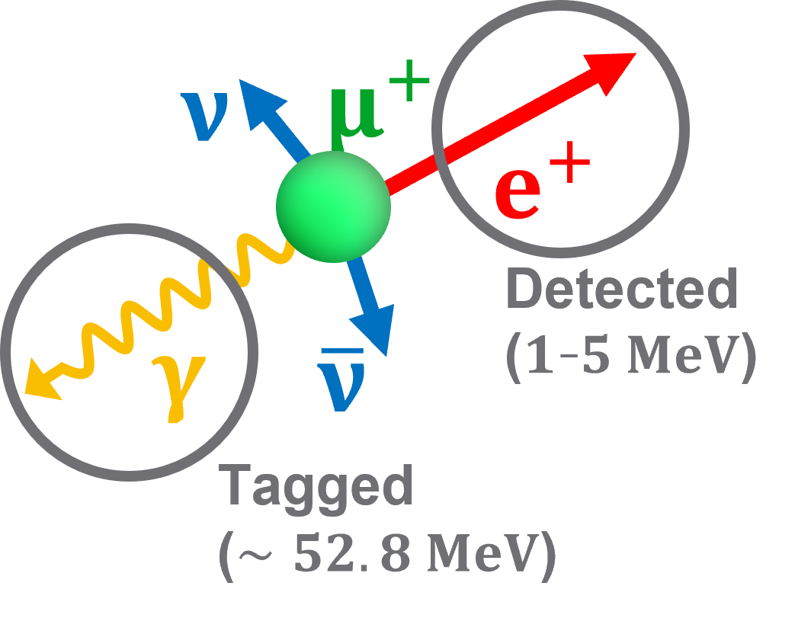
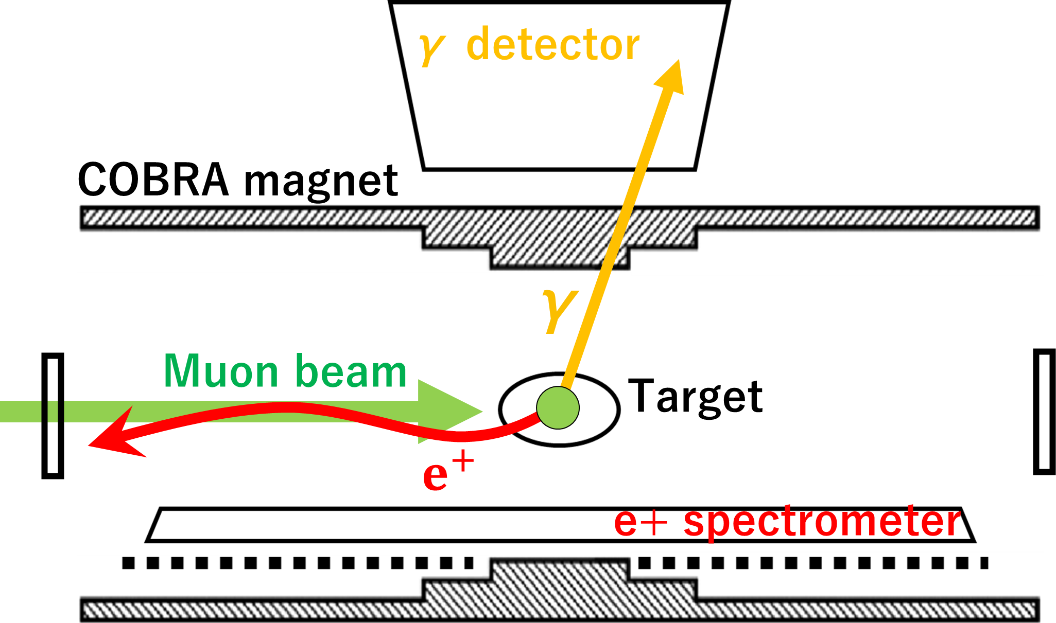
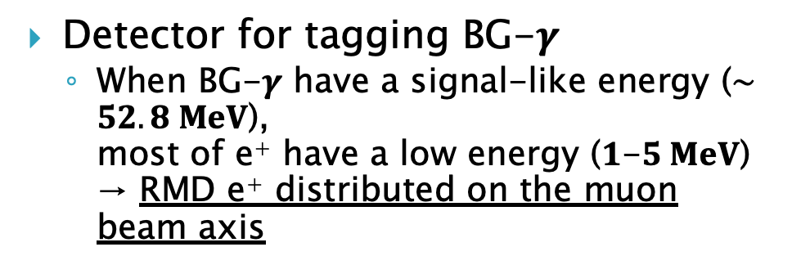
Radiative Decay Counter (RDC)
Detector for tagging BG-$γ$
  When BG-$γ$ have a signal-like energy ($∼52.8 MeV$),
  most of e⁺ have a low energy ($1$-$5 MeV$)
  → RMD e⁺ distributed on the muon beam axis
Under development
Upstream
RDC
Downstream
RDC
Already
installed

Slide 6
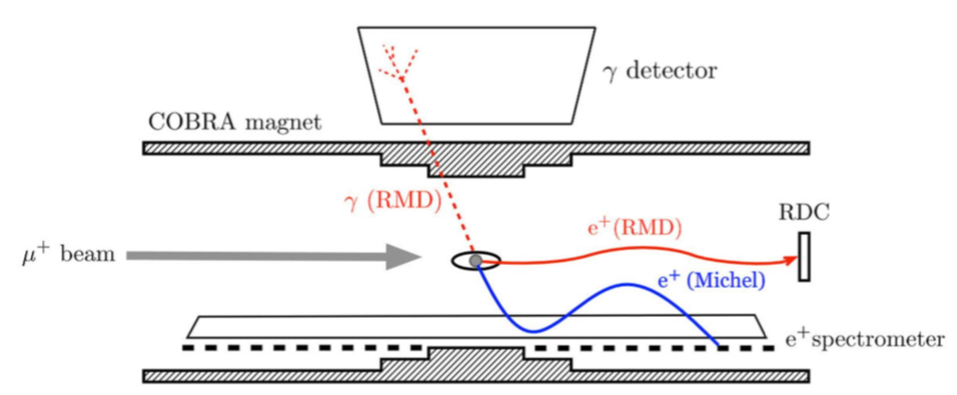
Requirement for upstream RDC
Signal: Positron of 1-5 MeV (Rare), >90% efficiency
Background: Muon of 28 MeV (100M cps)
Size: 20 cm diameter
Timing resolution: ~ 1ns
Material budget: < 0.1% X₀
Hit rate : Maximum count rate is ~ 4Mcps/cm²
Radiation hardness for > 30 weeks operation
Position resolution: doesn’t need
Upstream RDC

Slide 7
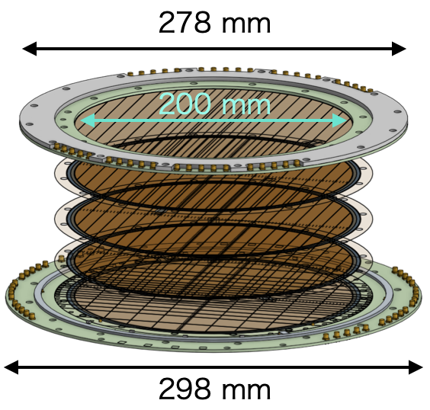
Our Solution : DLC-RPC
DLC: Diamond-Like Carbon
Surface RPC with DLC electrodes (DLC-RPC)
  DLC sputtered on 50 µm-thick polyimide (PI) foils
  Material budget meets the requirement
  Electrodes decoupled by Polyimide substrate
  HV applied for each layer independently
Design draft
Polyimide 50μm
+HV
Pillar
DLC
-HV
+HV
-HV
Gas flows inside chamber
+HV
-HV
+HV
~400 μm
-HV
Signal readout

Slide 8
by K. Yamamoto

Slide 9
Prototype of DLC-RPC
Manufactured using MPGD techniques
Detailed properties and performances are published in
Atsushi Oya et al 2022 J. Phys.: Conf. Ser. 2374 012143

Slide 11
(Dec. 2020)

Slide 13
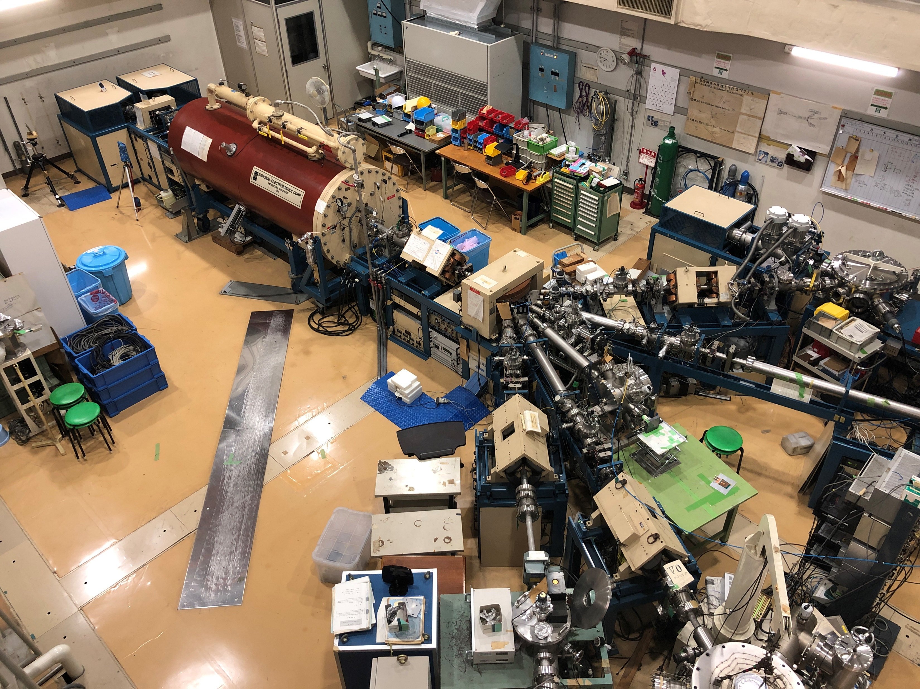
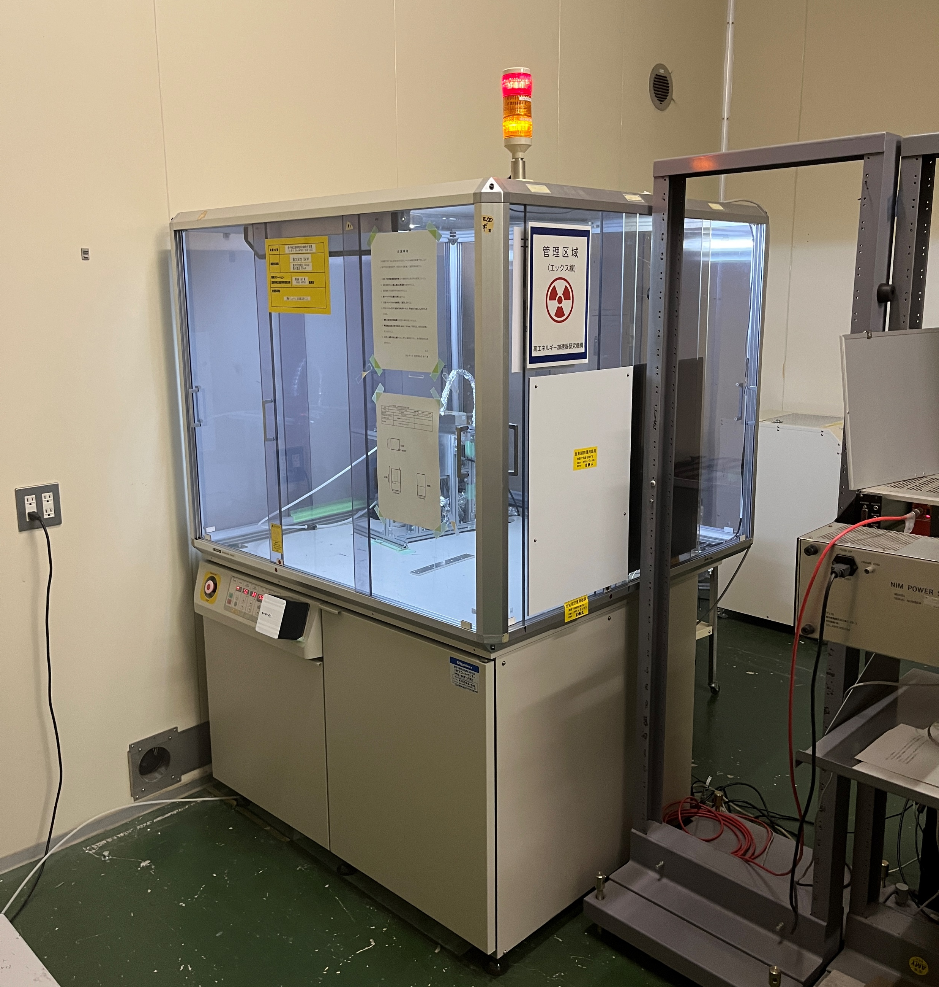
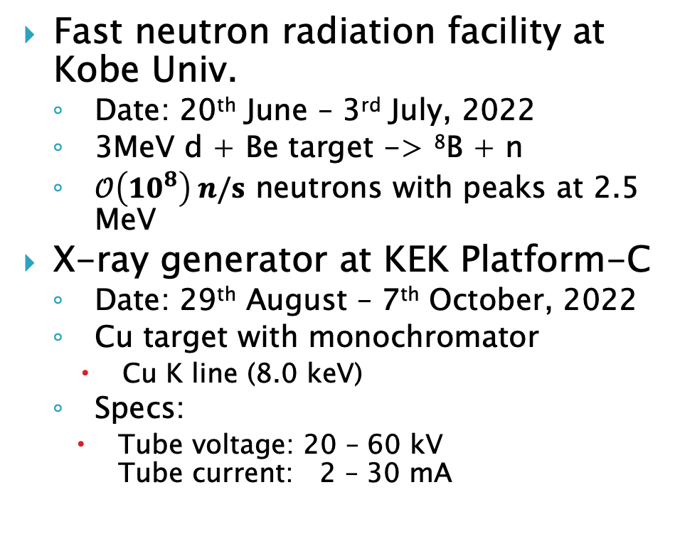
Aging studies using neutron/X-ray
Fast neutron radiation facility at Kobe Univ.
  Date: 20th June – 3rd July, 2022
  3MeV d + Be target -> ⁸B + n
  $𝒪\left(10^{8}\right) n/s$ neutrons with peaks at 2.5 MeV
X-ray generator at KEK Platform-C
  Date: 29th August – 7th October, 2022
  Cu target with monochromator
    Cu K line (8.0 keV)
  Specs:
    Tube voltage: 20 – 60 kV
    Tube current: 2 – 30 mA

Slide 14
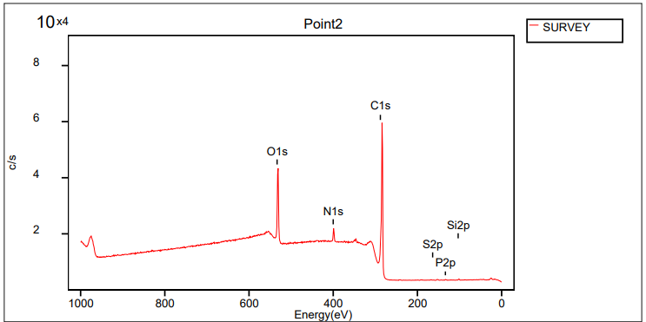
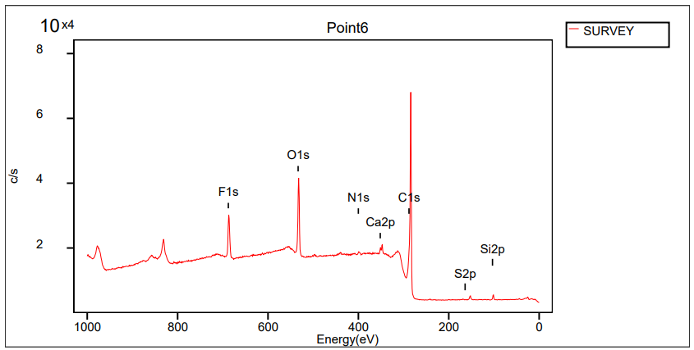
Preliminary results using aging studies
Neutron irradiation : 165 mC/cm²
X-ray irradiation : 272 mC/cm²
There are no significant changes in signal while those irradiation
However, those irradiations are ~10³ times smaller than expected dose in MEG II
We need more intense source
After irradiation tests, we found fluorine attachment on the DLC surface. But no effect found on the signals and gains.
NON-irradiation sample DLC
Irradiation sample DLC
%
Fluorine
%
C1s | 78.50
N1s | 3.92
O1s | 17.19
Si2p | 0.25
S2p | 0.06
P2p | 0.09
C1s | 76.85
N1s | 0.62
O1s | 14.44
F1s | 6.11
Si2p | 1.25
S2p | 0.06
Ca2p | 0.57

Slide 15
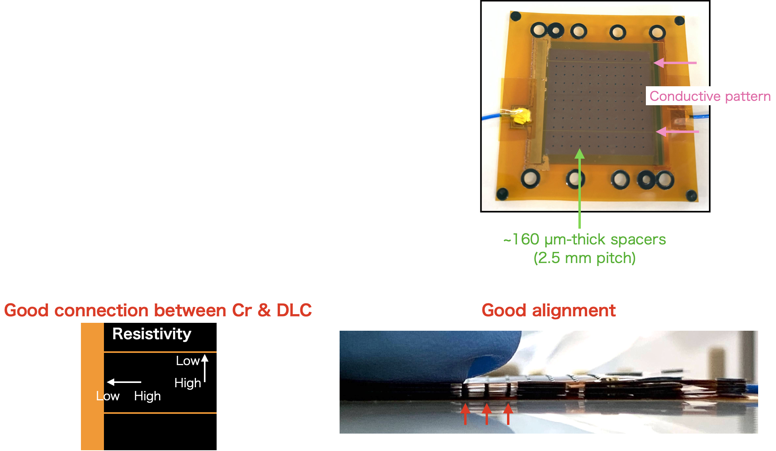
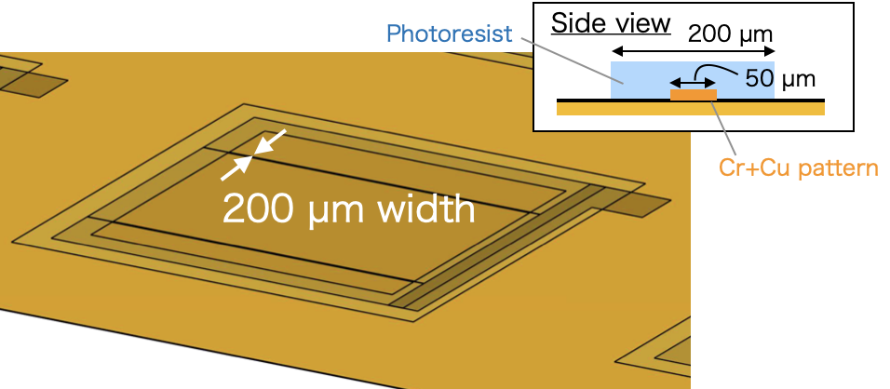
New prototype with HV feed lines

Slide 16
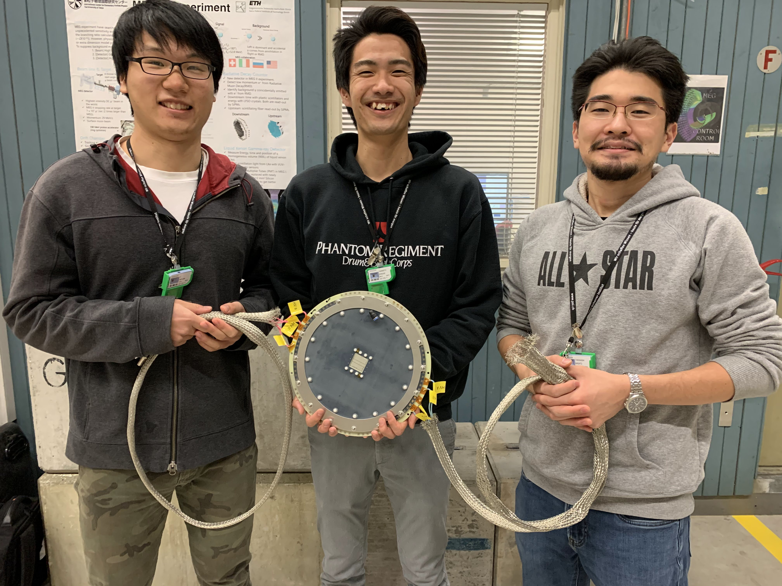
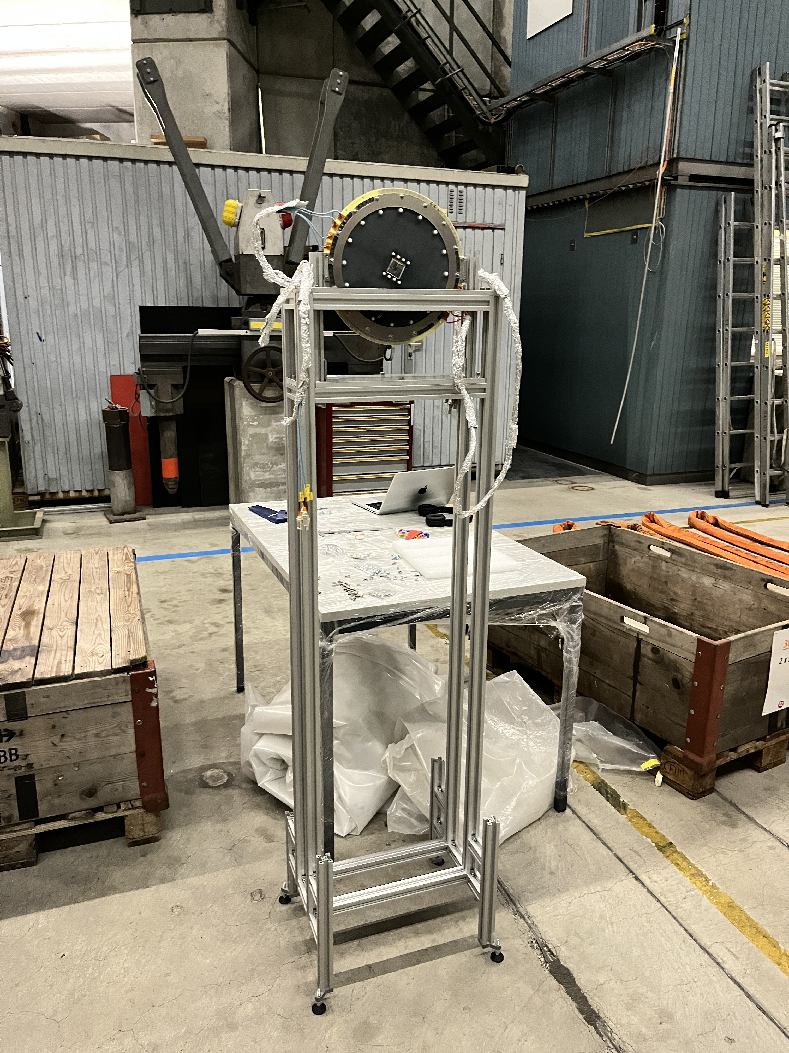
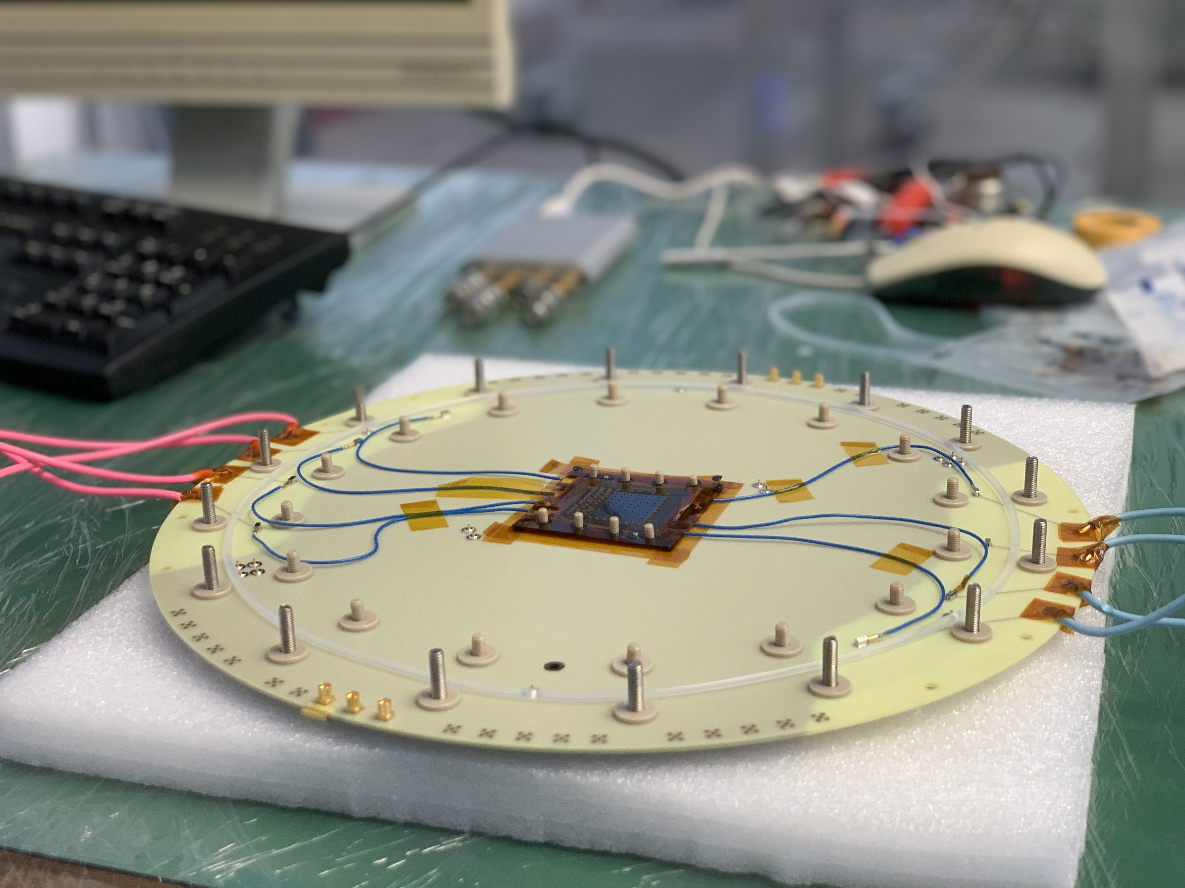
New prototype are tested in beamline Just Now
Testbeam campaign using
MEG II beamline
  13th – 18th Dec. 2022

Slide 17
Summary and prospects
Surface RPC with ultra-low mass (0.1% X₀) has been developed for MEG II upstream RDC, using DLC and MPGD techniques
High rate capability (>1M cps/cm²) has been attained for μ⁺ beam
Aging effect is not seen up to 272mC/cm²
New design with inline electrodes are being tested
Just NOW
DLC-RPC will be installed in MEG II at 2023
These researches are supported by
Grant-in-Aid for Scientific Research (No. 21H04991)
Kobe Univ. Reseach Facility Center for Science and Technology
KEK Detector R&D Center Platform C
RD51 collaboration

Slide 18
Backup

