Slide 1
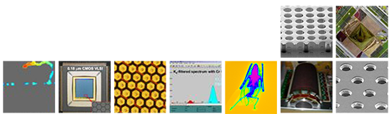


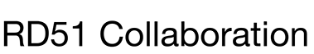
The 7th International Conference on
Micro Pattern Gaseous Detectors 2022
Studying signals in particle detectors with resistive elements such as the 2D resistive-strip bulk Micromegas
Djunes Janssens
djunes.janssens@cern.ch
Supervisors: J. D’Hondt , E. Oliveri, W. Riegler, H. Schindler and R. Veenhof.
December 14th, 2022
Presenter Name
Date

Slide 2
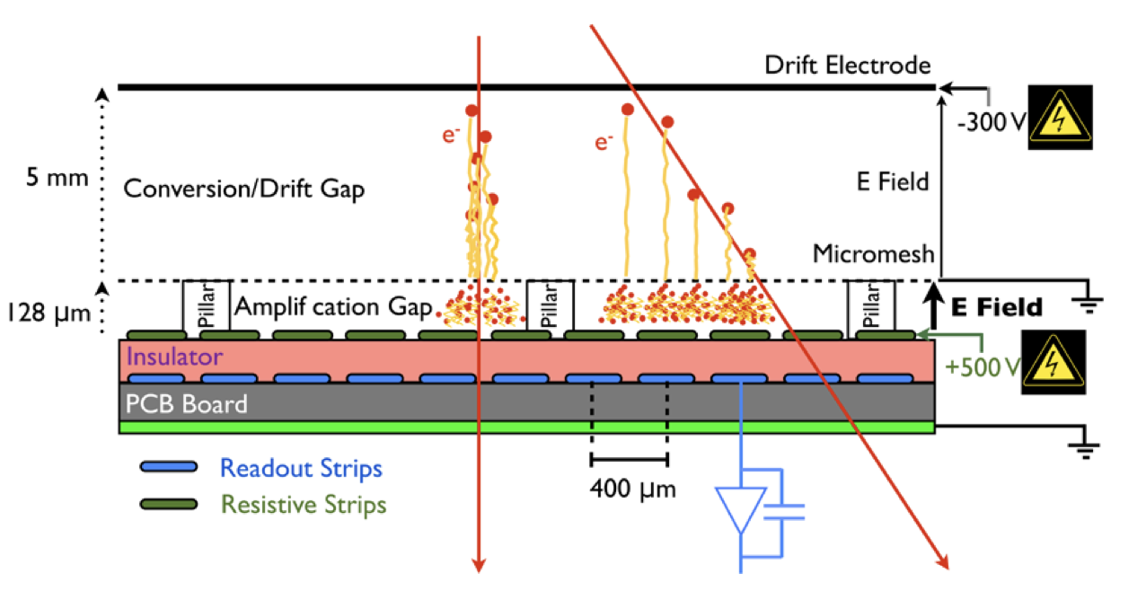
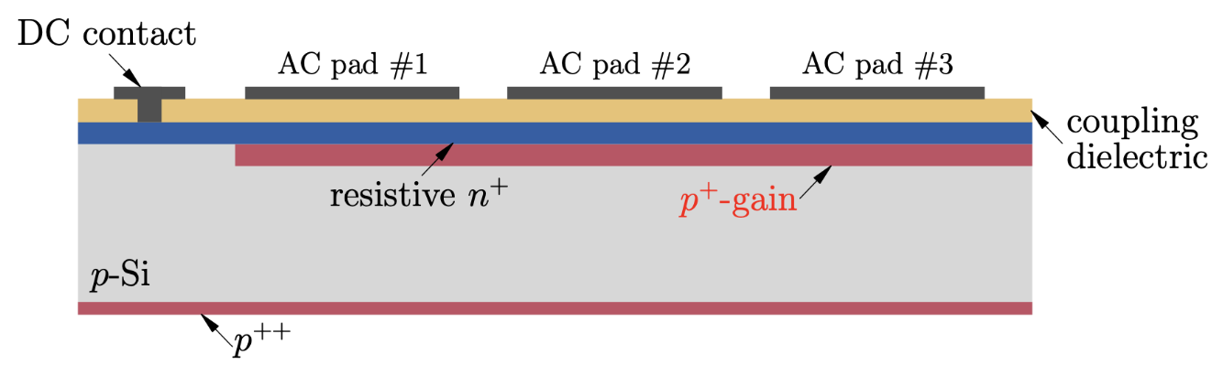
Introduction
  Novel detector structures are proposed regularly, mixing old and new ideas, with detectors containing resistive elements widening the landscape of possible configurations.
  The use of these technologies in experiments makes it necessary to understand and characterize its response for the design and optimization of the next generation of particle detectors and their application.
Resistive-strips micromegas
AC-Coupled LGAD
T. Alexopoulos et al., Nucl. Instrum. Meth. A 640 (2011) 110.
M. Tornago, R. Arcidiacono, N. Cartiglia et al., Nucl. Instrum. Meth. A 1003 (2021).

Slide 3
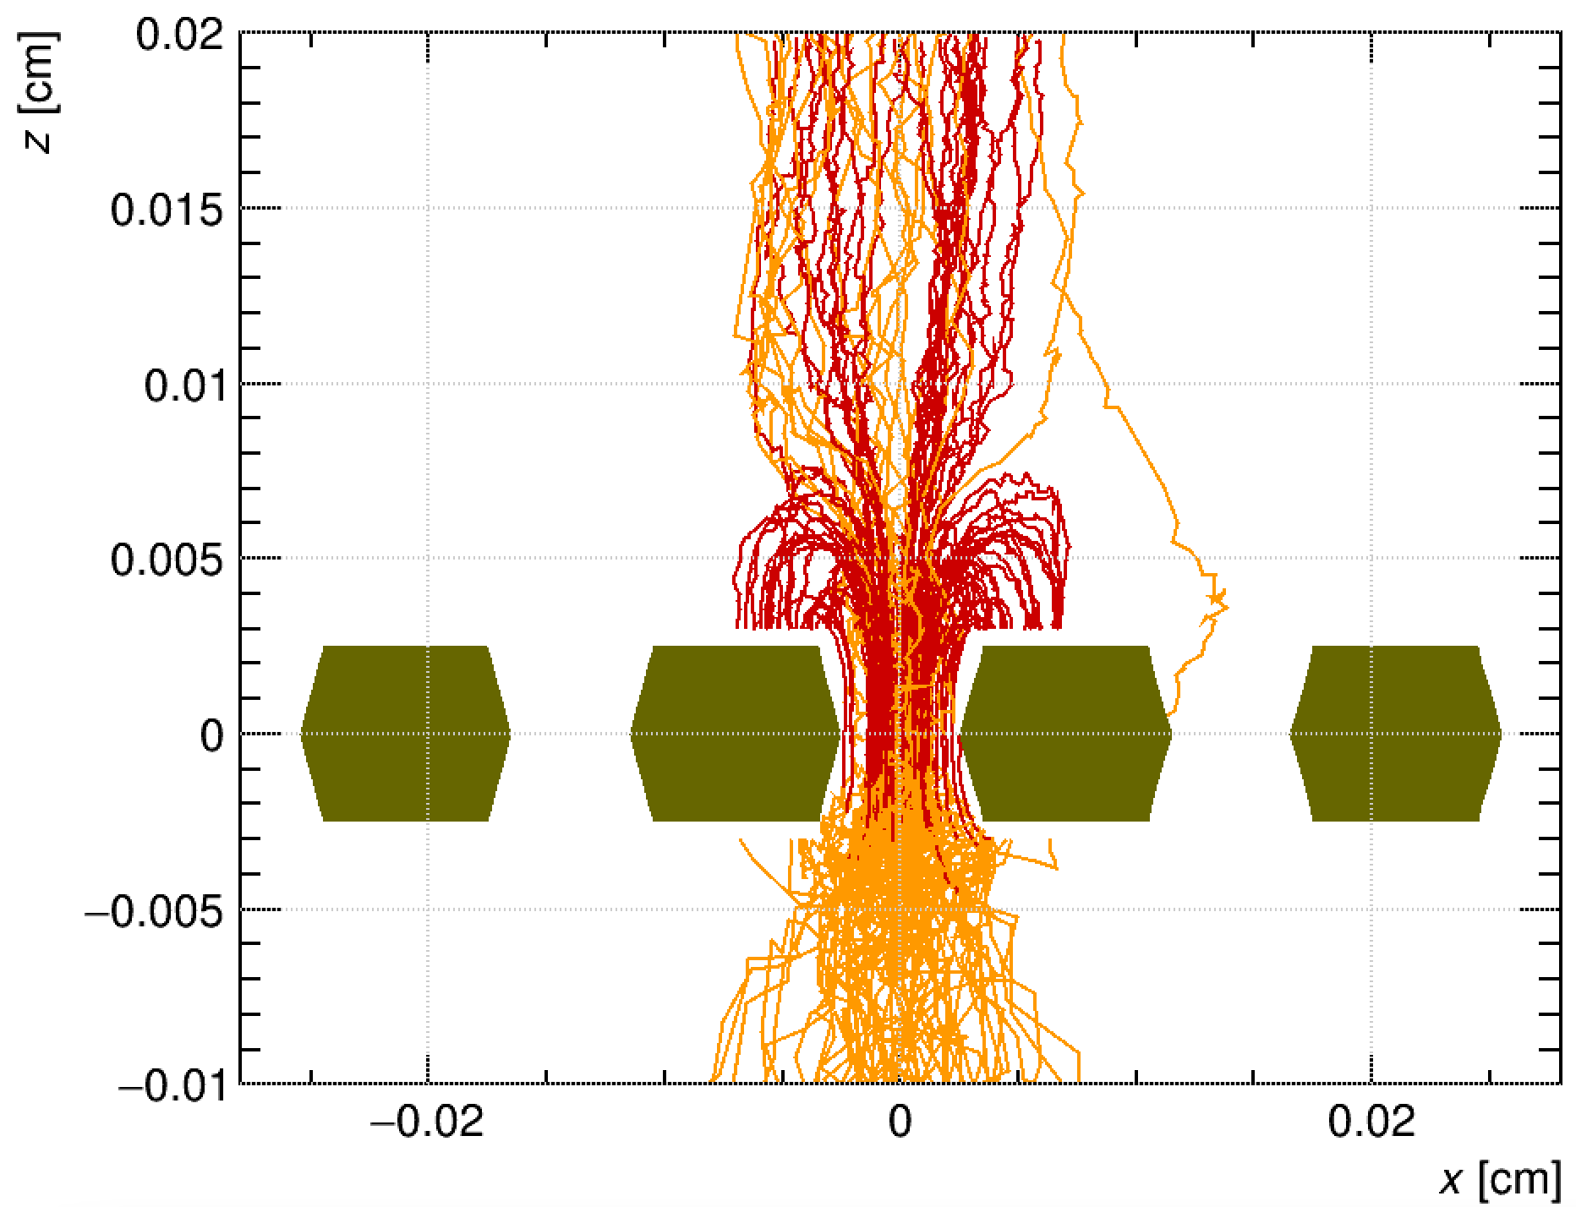

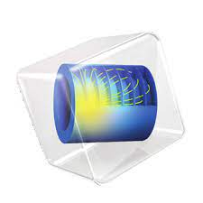
Introduction
  We want to use Garfield++ and COMSOL to model the signal formation in detectors with resistive elements by applying an extended form of the Ramo-Shockley theorem.
  Outline:
  Ramo-Shockley theorem extension for conductive media
  Overlook of the numerical approach
  Obstacles to modeling a full size MPGD
  Ongoing benchmarking of the modeling of a resistive-strip bulk Micromegas
  Cross-coupling
  Summary
Garfield++: https://garfieldpp.web.cern.ch/garfieldpp/
COMSOL Multiphysics: https://www.comsol.ch

Slide 4
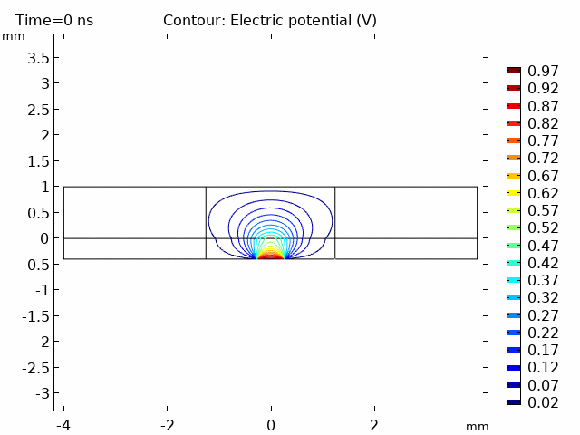
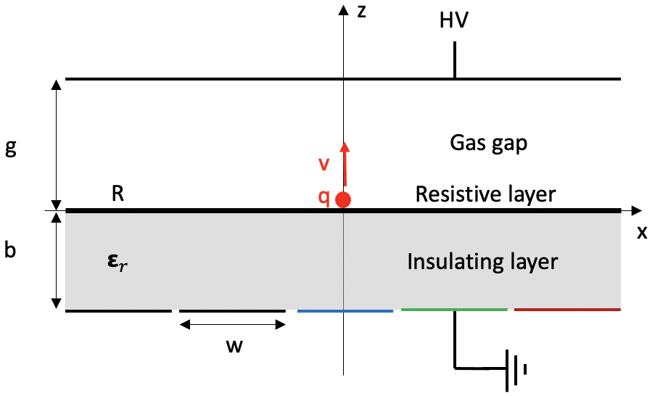
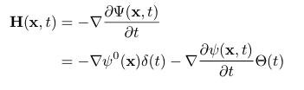
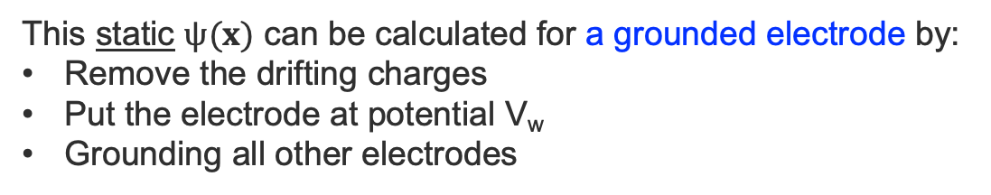

Ramo-Shockley theorem
  The Ramo-Shockley theorem allows the current induced by an externally impressed charge density on any electrode to be calculated by the usage of a so-called weighting potential $ψ(x)$.
This static $ψ(x)$ can be calculated for a grounded electrode by:
Remove the drifting charges
Put the electrode at potential V_{w}
Grounding all other electrodes
Weighting potential for only perfect insulators and electrodes with infinite conductivity.
Gas gap
Cathode/Mesh
Insulator
Readout strip
V_{w}
S. Ramo, PROC. IRE 27, 584 (1939).
W. Shockley, Journal of Applied Physics. 9 (10): 635 (1938).

Slide 5
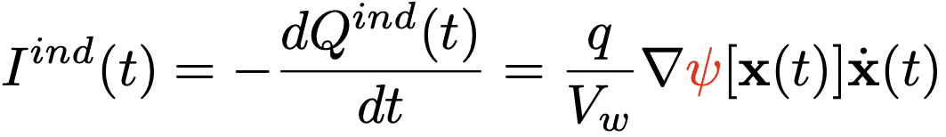
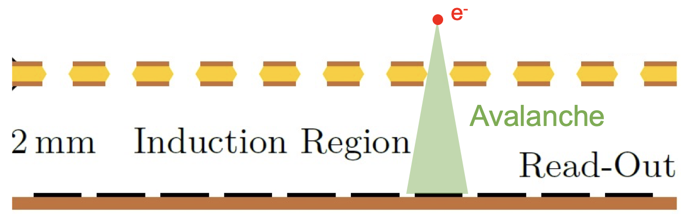
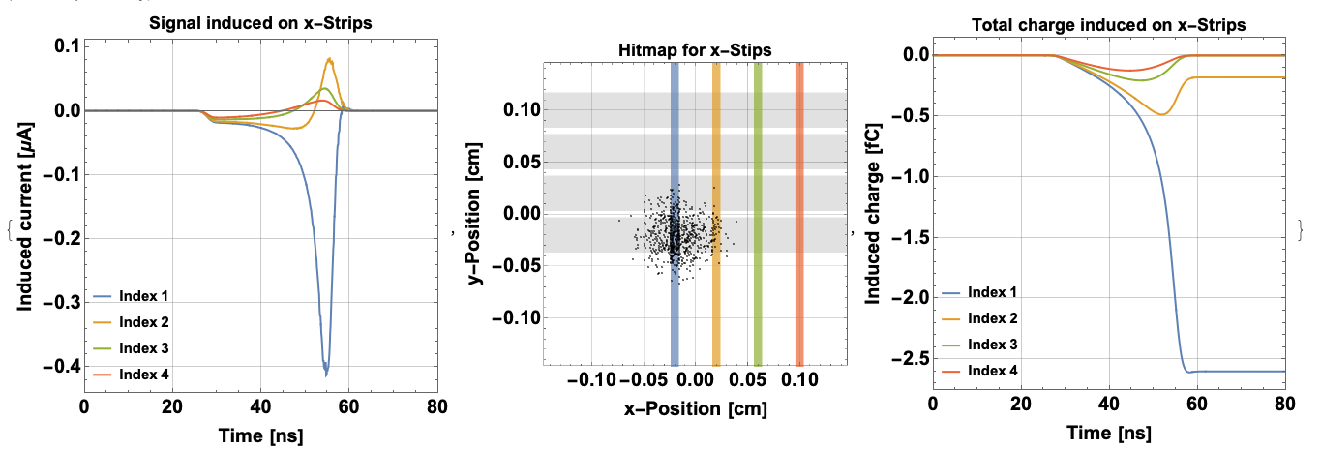
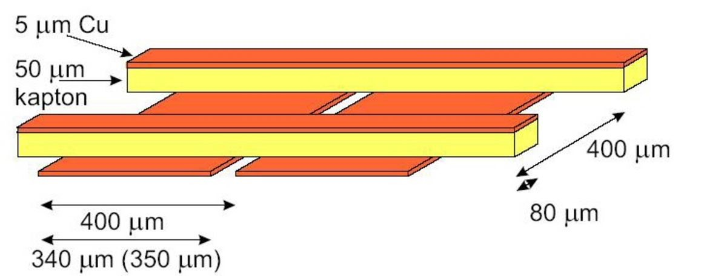
Ramo-Shockley theorem
  Using this framework, the induced current sourced by a point charge q can be calculated in a single using the calculated the weighting potential of the electrode.
This can be repeated for every charge in the avalanche created in the detector:
GEM
XY strip readout
e⁻ endpoints

Slide 6
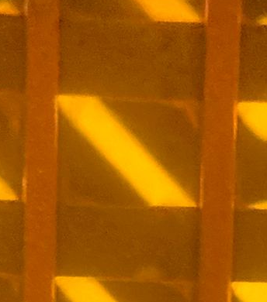
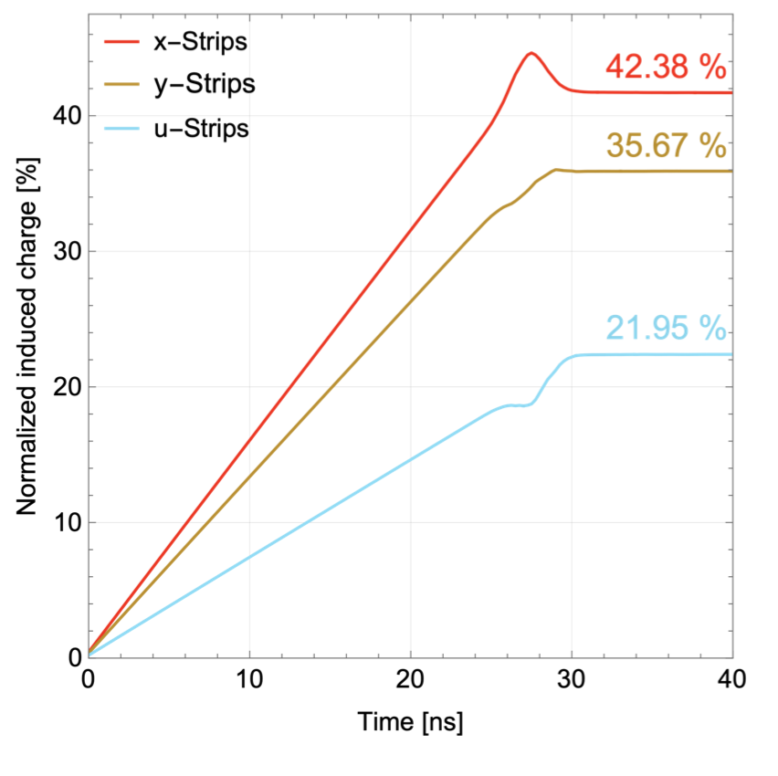
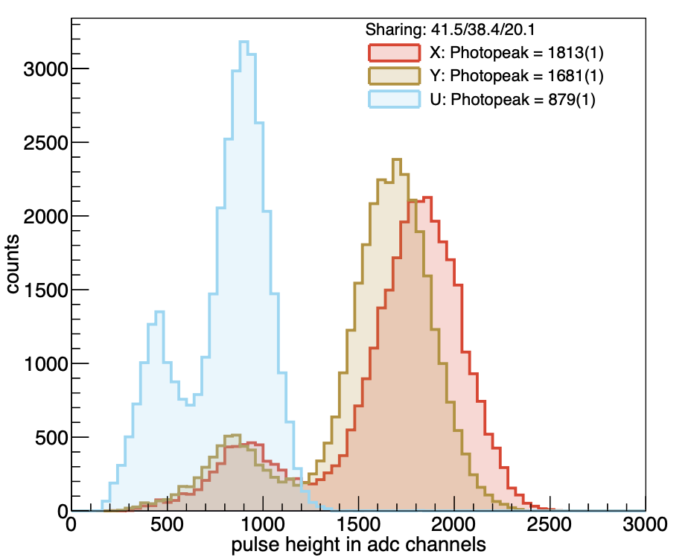
Ramo-Shockley theorem
  This theorem has been used to scan the parameter space to study the changes in charge sharing between the three sets of strips of an XYU read-out.
XYU read-out image
Simulated charge sharing
Measured PH spectrum
20 %
y
38 %
42 %
u
x
Submitted paper to NIM-A is available on the RD51 notes: RD51-NOTE-2022-09
K. Floethner’s conference poster: The novel XYU-GEM for ambiguity reduced tracking

Slide 7

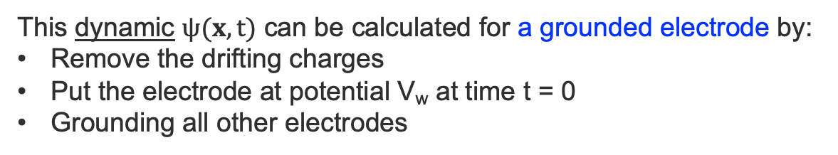
Ramo-Shockley theorem extension for conducting media
  For detectors with resistive elements, the time dependence of the signals is not solely given by the movement of the charges in the drift medium but also by the time-dependent reaction of the resistive materials.
Weighting potential for a resistive layer separating the gas gap and insulating layer.
This dynamic $ψ(x,t)$ can be calculated for a grounded electrode by:
Remove the drifting charges
Put the electrode at potential V_{w} at time t = 0
Grounding all other electrodes
V
Gas gap
Cathode/Mesh
R layer
Insulator
Readout strip
V_{w}ϴ(t)
W. Riegler, Nucl. Instrum. Meth. A 535 (2004), 287-293.
W. Riegler, Signals in Particle Detectors, CERN’s Academic Training Lecture Regular Programme (2019): https://indico.cern.ch/event/843083/

Slide 8
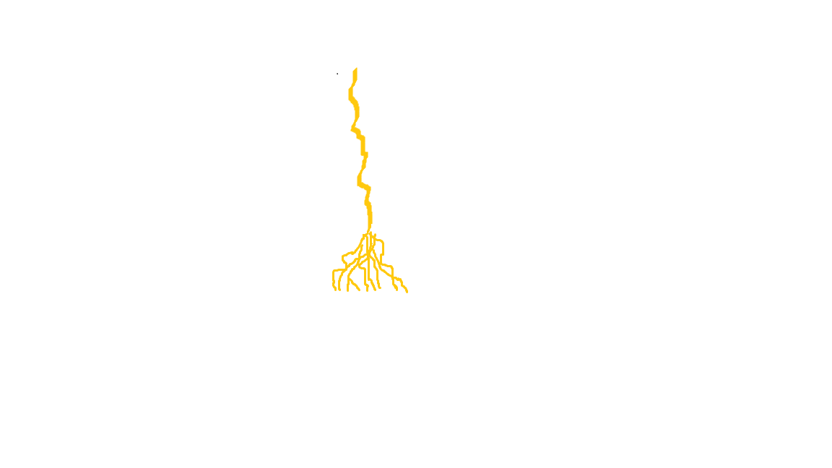
Overview of the numerical methodology
  These weighting potentials can only be obtained analytically for a small subset of the larger group of existing detectors; thus, a numerical method is used.
  COMSOL® :
  Numerically obtain the dynamic weighting potential.
  Garfield++:
  Detailed microscopic simulation of particle detectors based on ionization measurements in gases or semiconductors.
Cathode
e-
+
+
e-
μ
Mesh
Pillar
Via
Insulating layer
Resistive planes
Pads
1-3 mm
6 mm
Garfield++: https://garfieldpp.web.cern.ch/garfieldpp/
COMSOL Multiphysics: https://www.comsol.ch
D. Janssens et al., Nucl. Instrum. Meth. A 1040 (2022)

Slide 9
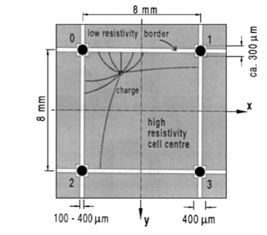
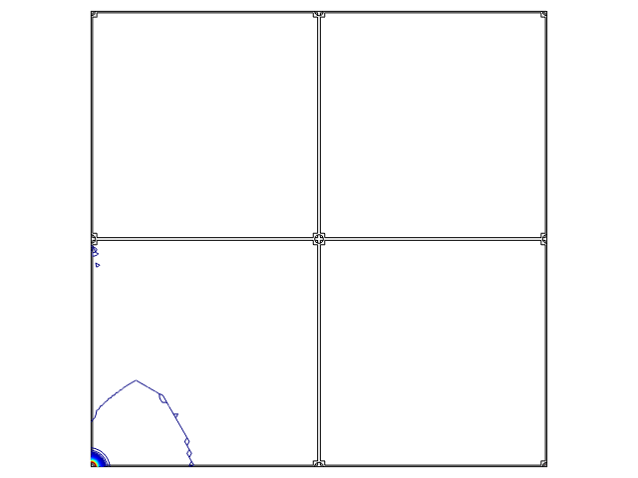
Signal formation in a MicroCAT detector
  The MicroCAT’s two-dimensional interpolating readout structure allows for a reduced number of electronic readout channels without loss of spatial resolution.
  This resistive readout concept has recently enjoyed renewed interest with the development of a DC-Coupled LGAD device: arXiv:2204.07226 [physics.ins-det].
Weighting potential map for one readout node
F. Bartol et al. J. Phys. III France, 6 (1996), p. 337
A. Sarvestani et al., Nucl. Instrum. Meth. A 410 (1998) 238–258
H. Wagner et al. Nucl. Instrum. Meth. A 482 (2002) 334–346

Slide 10
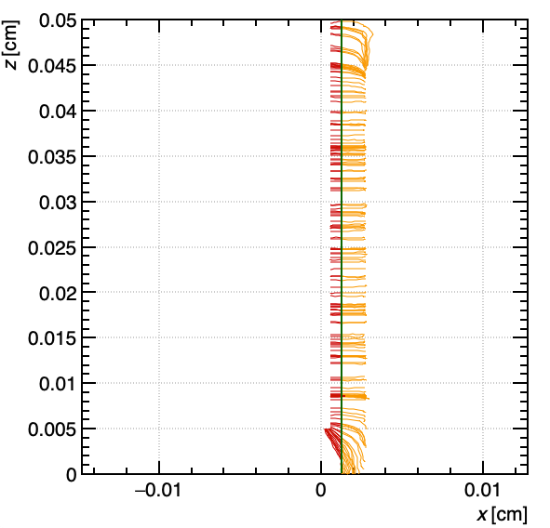
Some of the detectors containing resistive elements
We are working on extending the list of resistive detectors geometries that can be modelled. Some of the detector types will be used to benchmark the model.
Spatial resolution study:
MicroCAT’s two-dimensional interpolating readout
μ-Resistive-WELL
Small-pad resistive Micromegas
Resistive-strip bulk Micromegas
AC-Coupled LGAD
Timing resolution study:
Multigap Resistive Plate Chambers (MRPC)
Resistive PICOSEC Micromegas Detector
Diamond3D sensor
AC-Coupled LGAD
Electron
Hole
Pion
Readout Column
Bias Column
Preliminary
A comprehensive overview of the PICOSEC effort was given yesterday by A. Utrobicic and M. Lisowska.

Slide 11
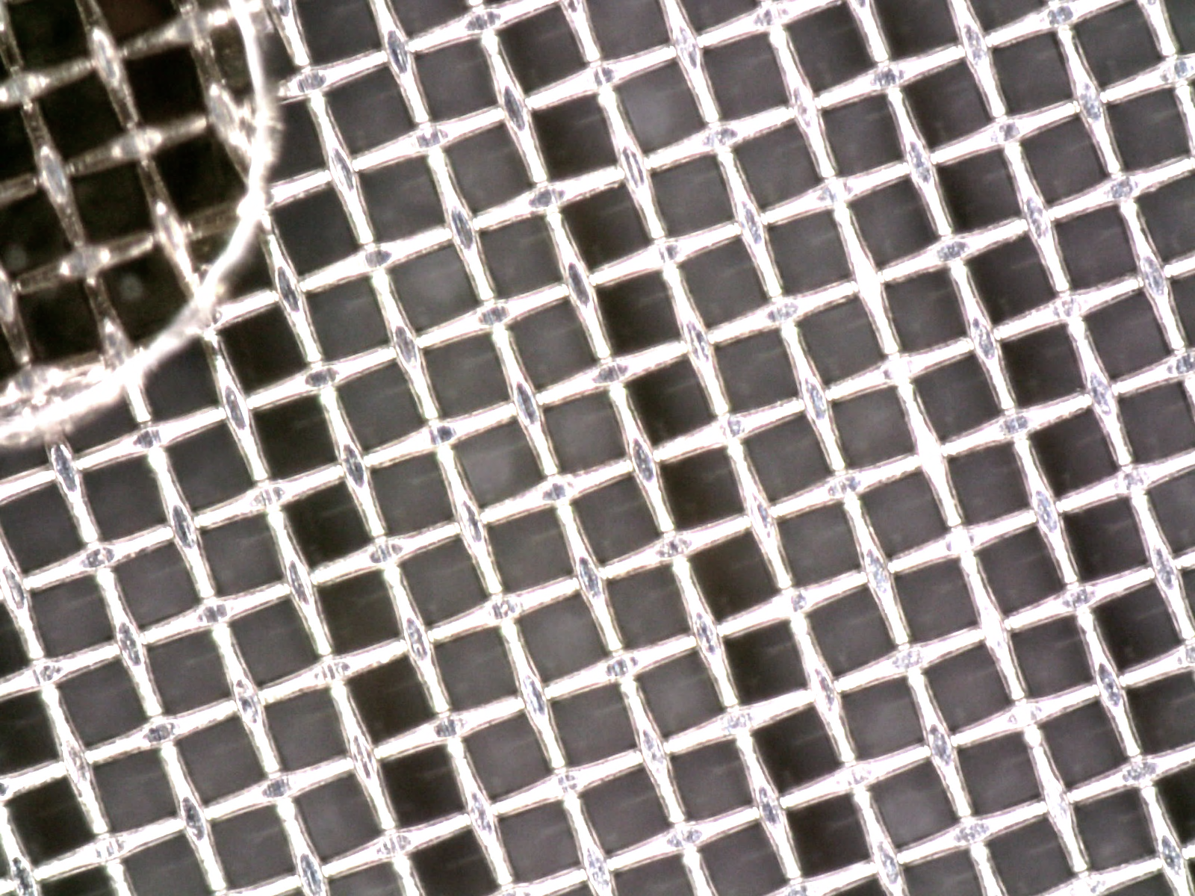
Signal formation in resistive-strip Micromegas
  The resistive-strips present in the geometry of this Micromegas geometry is known for its spreading of the signal over the strips orthogonal to them.
Cathode
Ar/CO₂
93/7
e-
+
5 mm
+
e-
μ
Mesh
128 µm
Pillar
Resistive-strips
Insulating layer
Read-out strips
250 µm
T. Alexopoulos, et al., Nucl. Instrum. Meth. A 640 (2011) 110.
M. Byszewski1 and J. Wotschack, JINST 7 C02060 (2011).

Slide 12
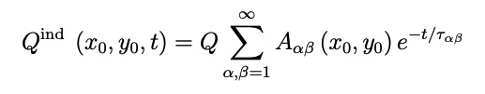
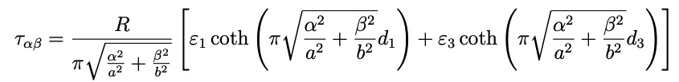

Size of the resistive layer
  Given a parallel-plate type geometry with a grounded resistive layer separated from the pad electrodes by an insulating layer.
  The induced charge on each pad can be analytically calculated to study the effect of the size of the resistive layer:
Q
(x₀, y₀)
b
Time-dependent part
w_{x}
w_{y}
  with the infinite number of time constants are given by
a
Top electrode
d₃
ε₂
Q
Resistive layer
  This sum is slowly converging for thin large-area detectors, where the number sums that need to be performed scales as
d₁
ε₁
Pads
w_{x}
As found in the notes of W. Riegler

Slide 13
Size of the resistive layer
  The size of the resistive layer does play a role in the evolution of the signal. For the initial part of the induced current for a large-area resistive detector can be approximated by a smaller counterpart.
Q
a
0.5 mm
a

Slide 14
Size of the resistive layer
  Coordinate mapping in COMSOL allows to represent large area detectors, such as a Resistive-strips micromegas, by pushing back the boundaries.
  This can be validated by comparing the numerical solution (markers) with the analytical result solution (full lines).
Scaled area
Q_{e}
0.5 mm
5 mm
10 cm
COMSOL coordinate mapping: link.

Slide 15
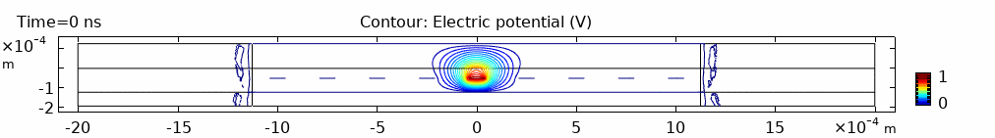
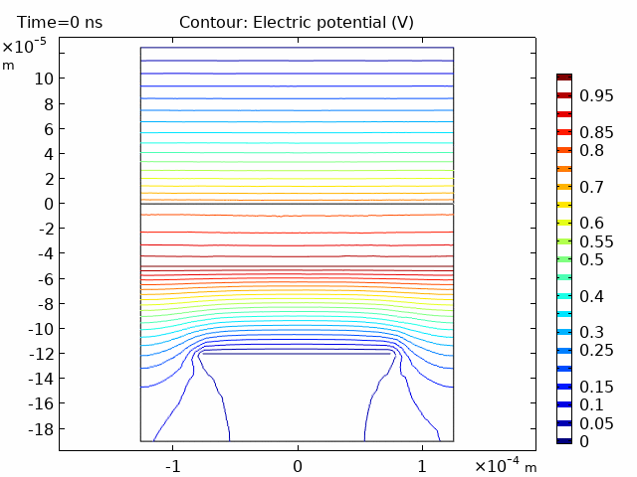
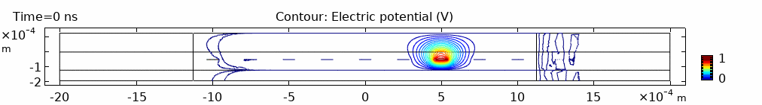
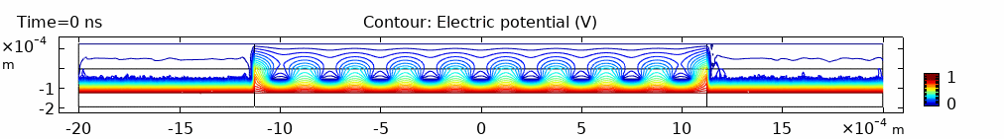
Signal formation in resistive-strip bulk Micromegas
With this scaling method we can accurately fix the boundary conditions of our numerical model to calculate the weighting potential.
Resistive-strip
Voltage [V]
Ground of R-strip
x-strip
Scaled area
y-strip
Scaled area

Slide 16
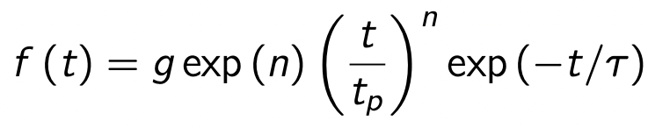
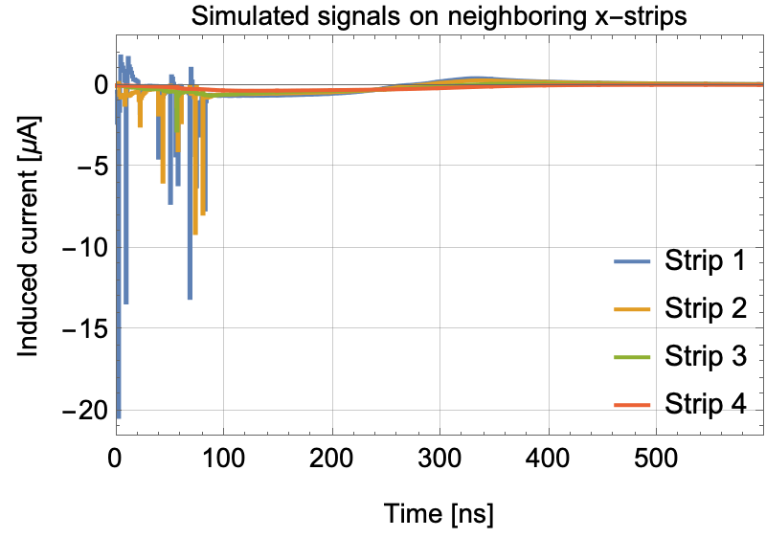
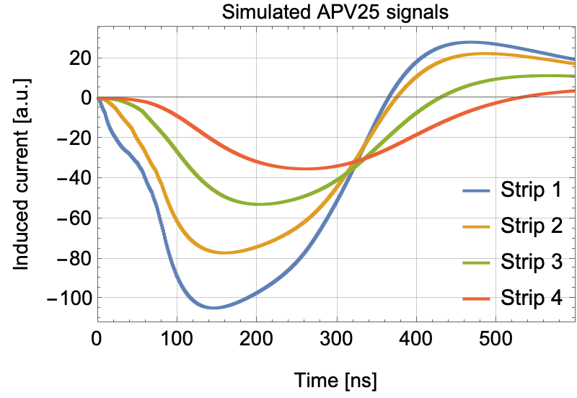
Signal formation in resistive-strip bulk Micromegas
Using this we calculate the induced signal caused by an 80 GeV/c muon for four neighboring strips.
The APV-25 ASIC is represented by a unipolar shaper using
with a time constant of 𝜏 = 50 ns and shaping order of n = 1.
μ
Cathode
Ar/CO₂
93/7
e-
+
5 mm
+
e-
Mesh
128 µm
Resistive-strip
1
2
3
4
Insulating layer
250 µm
APV25 parameters taken from this link

Slide 17
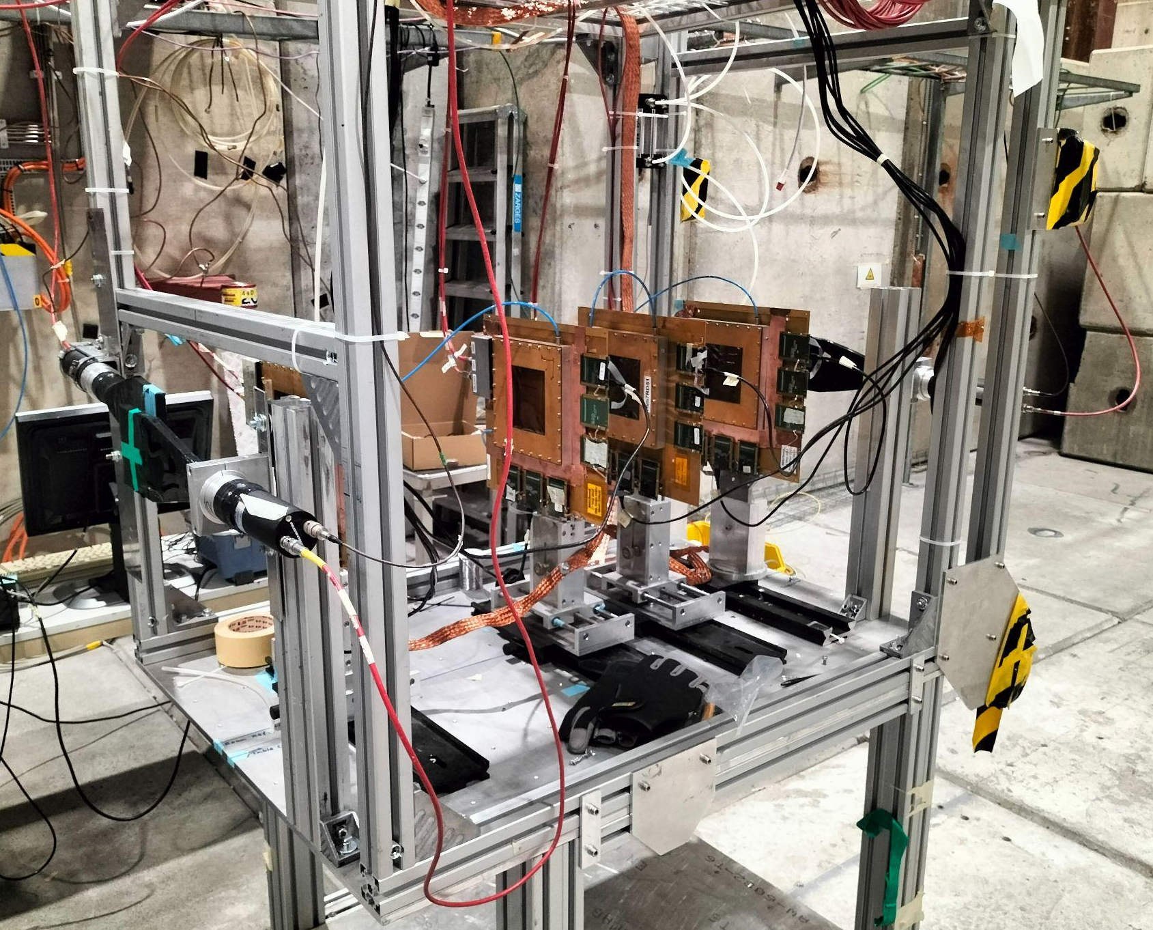
SPS test beam measurements
  During the latest RD51 test beam campaign at the CERN SPS we tested two different kind of resistive-strip bulk Micromegas tracking detectors are used to study the signals read out by the APV25’s.
Here the trigger comes from the coincidence of 3 scintillators.
1 MΩ/❑
μ
100 kΩ/❑

Slide 18
SPS test beam measurements
The lower resistivity spreads the signal over more strips resulting in a lower amplitude in each.
Preliminary
Preliminary
100 kΩ/❑ resistive-strips
Preliminary
Preliminary
1 MΩ/❑ resistive-strips

Slide 19
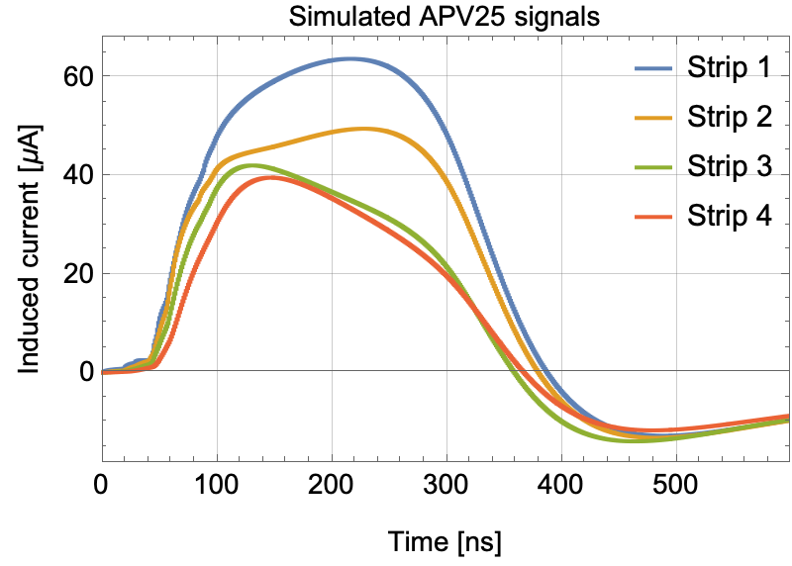
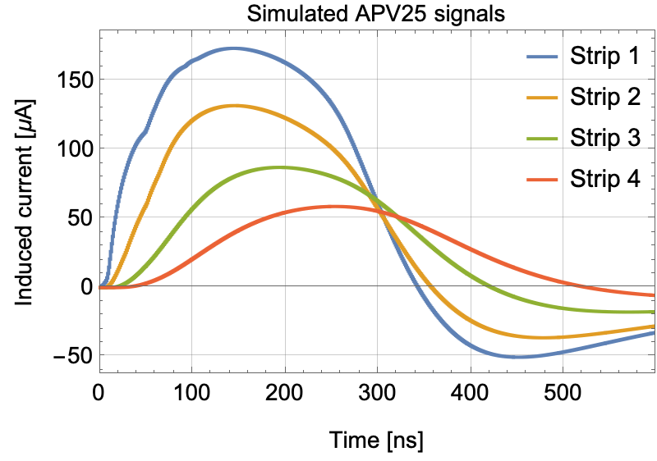
Benchmark of the modelling effort
The model still needs some work. There are discrepancies in the signal shapes compared to experiment.
Preliminary
Measurement
100 kΩ/❑ resistive-strips
Preliminary Simulation
Preliminary
Measurement
1 MΩ/❑ resistive-strips
Preliminary Simulation

Slide 20
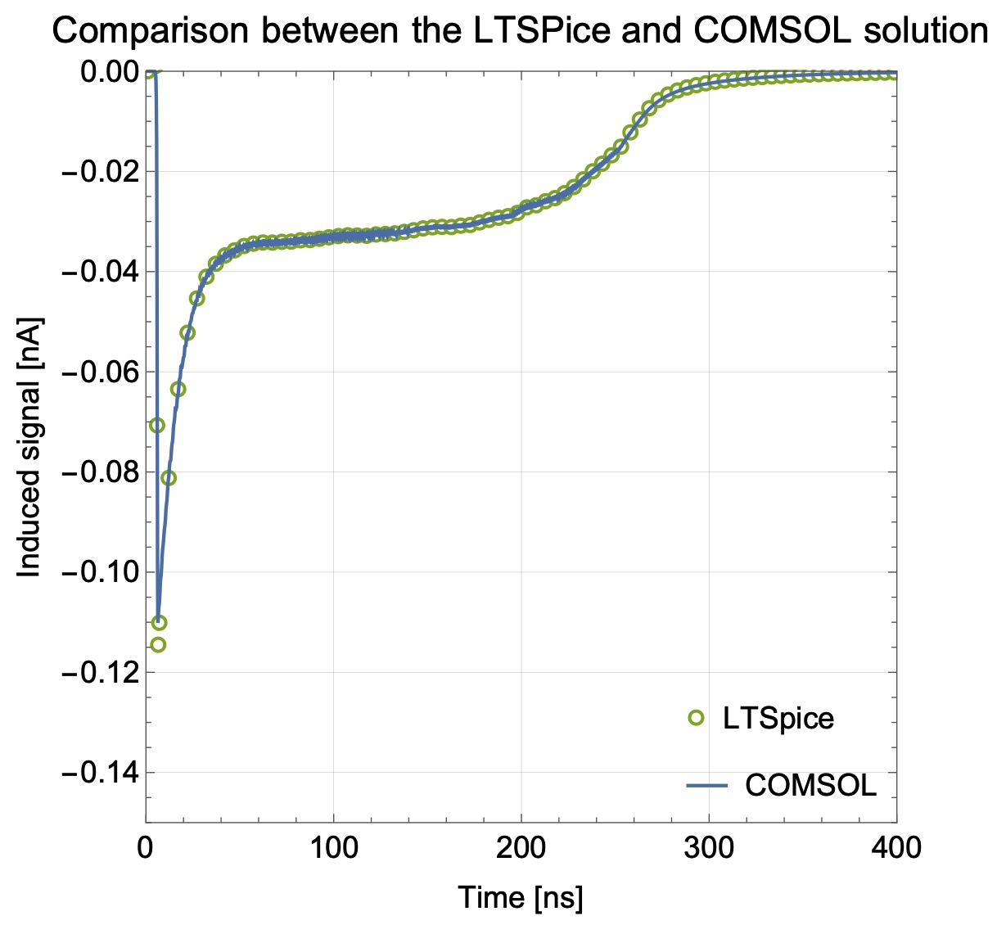
Outlook: coupling between the electrodes
To take external impedances and capacitive coupling into account, one calculates the currents and puts them into an equivalent circuit of the detector as ideal currents, adding the external circuit (LTSpice).
Alternatively, we can view the external impedance elements as a part of the detector medium and absorb them into the weighting potential (COMSOL).
R₁
Electrode 1
e-
Resistive layer
Electrode 2
V_{w}ϴ(t)
R₂
Gatti E., Padovini G., Radeka V., Nucl. Instrum. Methods, 193 (1982), pp. 651-653
COMSOL’s electrical circuit interface: link

Slide 21
Summary
  We want to use Garfield++ and COMSOL to model the signal formation in detectors with resistive elements by applying an extended form of the Ramo-Shockley theorem.
  We discussed the use of the extended form of the Ramo-Shockley theorem for the calculation of induced signals in resistive particle detectors.
  Techniques such as coordinate scaling are used to accurately represent the total size of the geometry and its boundary conditions
  This was applied to the resistive-strip bulk Micromegas to compare the simulated signal shapes with the measured ones during the latest RD51 test beam campaign at the CERN SPS. This comparison still needs to be better understood and worked out
  Outlook:
  Improving model such as the implementation of the external impedances to include coupling between electrodes
  Looking how to improve the spatial resolution of lower resistive detectors using the signal shape
  Thank you for your attention!

Slide 22
Backup slides

Slide 23
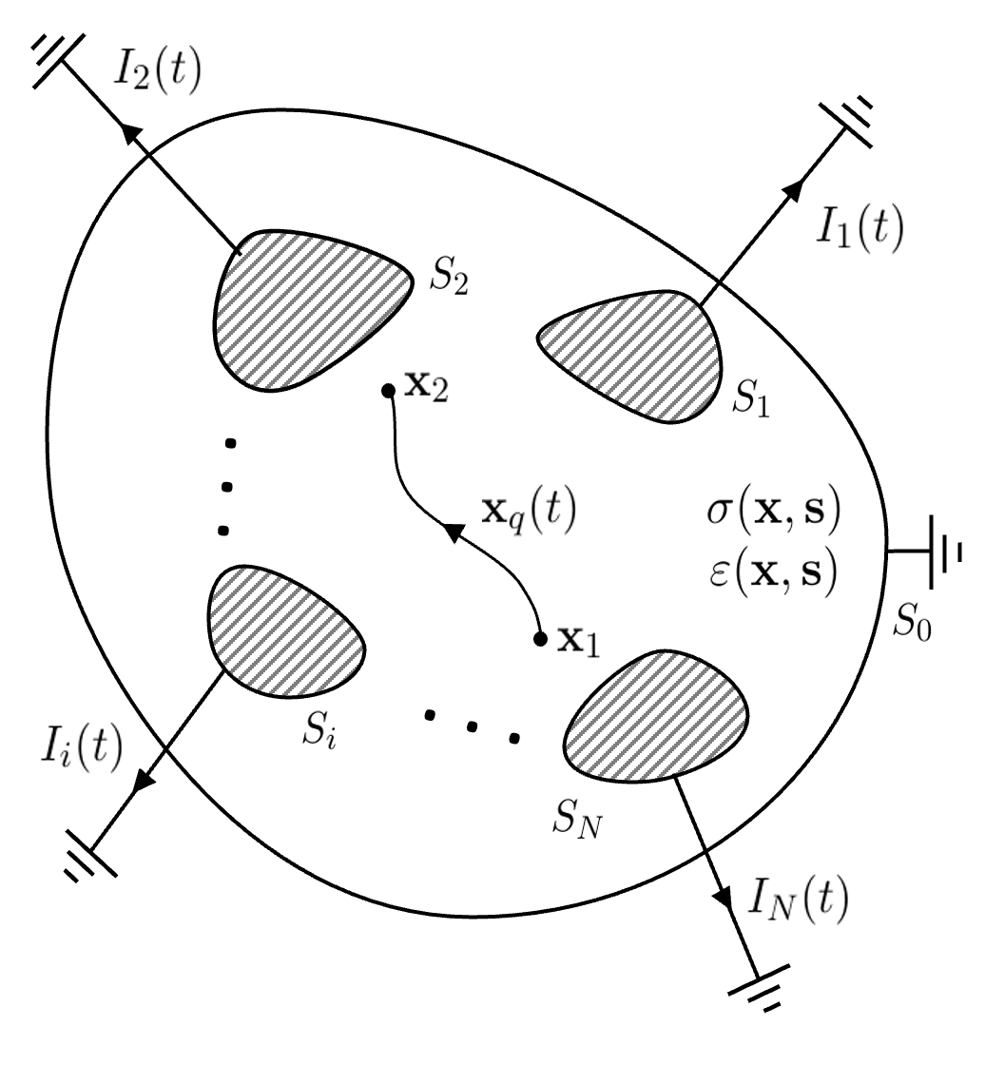
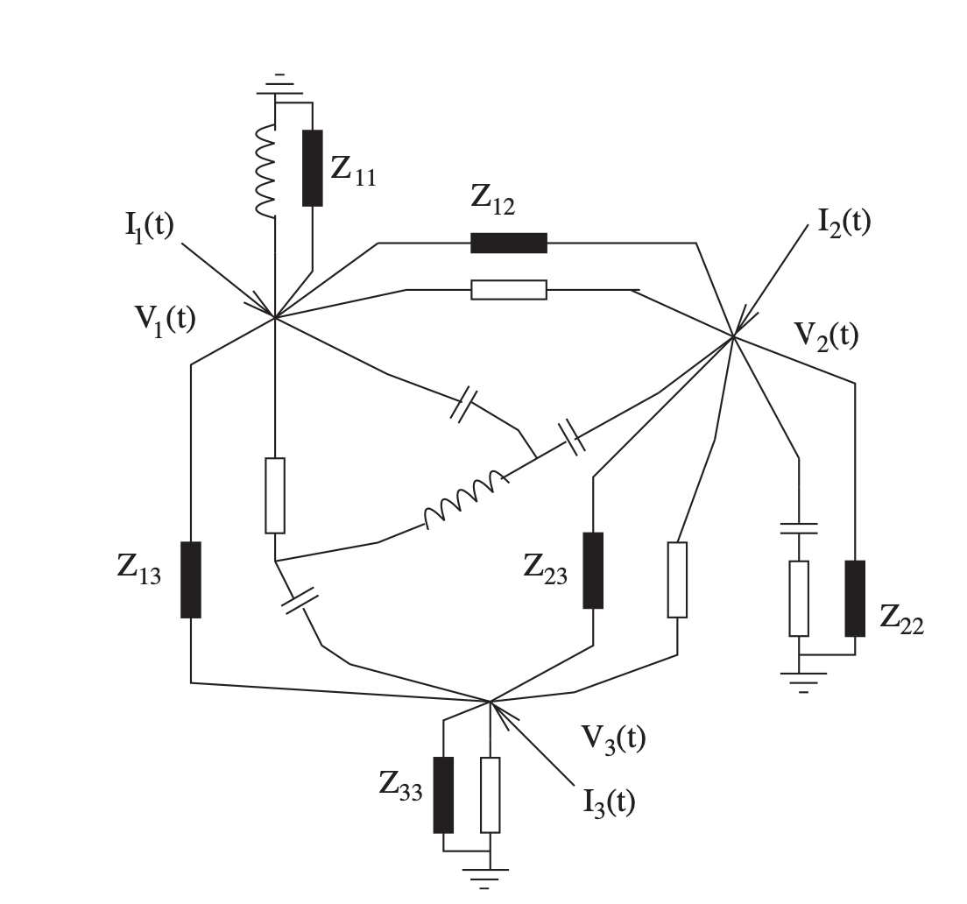
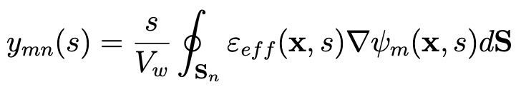
Outlook: coupling between the electrodes
To take external impedances and capacitive coupling into account, one calculates the currents and puts them into an equivalent circuit as ideal currents.
For this, the impedance between each electrode ought to be determined, which in general, can not be reduced to a circuit built of a series of resistors and capacitors.
Impedance matrix
Weighting potential
W. Riegler, Signals in Particle Detectors, CERN’s Academic Training Lecture Regular Programme (2019): https://indico.cern.ch/event/843083/

Slide 24
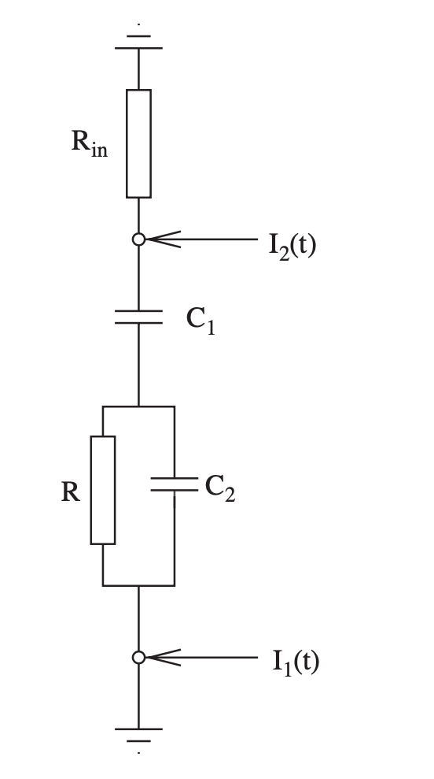
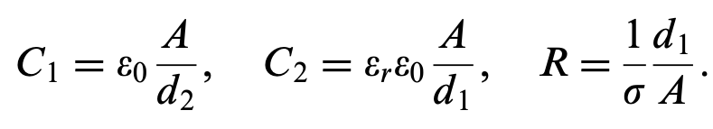
Outlook: coupling between the electrodes
An RPC type geometry is one of the few resistive geometries that can be represented by a discrete electrical circuit. We can calculate the cross-coupling when attaching external impedances.
R₁
Electrode 1
e-
d₂
Resistive layer
d₁
ε_{r} , σ
Electrode 2
R₂

Slide 25
Outlook: coupling between the electrodes
Alternatively, we can view the external impedance elements as a part of the detector medium and absorb them into the weighting potential.
This will show up as a time-dependent contribution on top of the one already provided from the resistive layer.
R₁
Electrode 1
e-
Resistive layer
Electrode 2
V_{w}ϴ(t)
R₂
Gatti E., Padovini G., Radeka V., Nucl. Instrum. Methods, 193 (1982), pp. 651-653
COMSOL’s electrical circuit interface: link

Slide 26
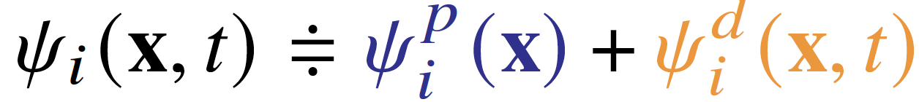
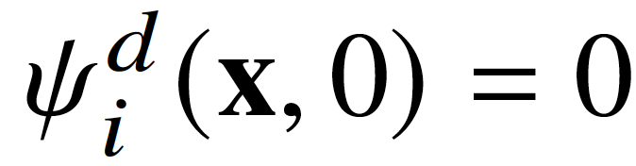
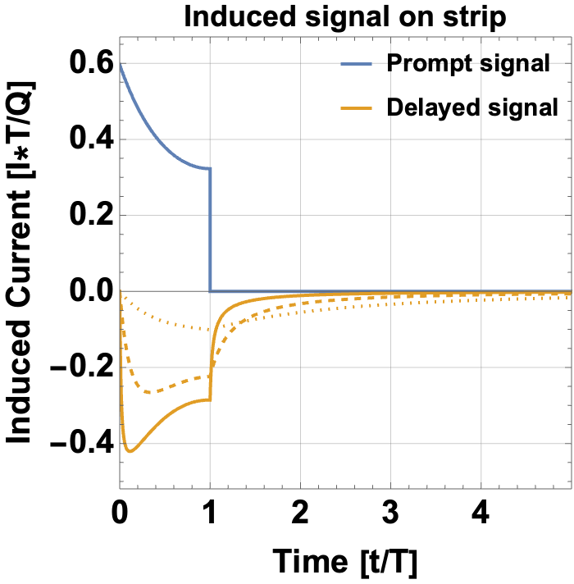
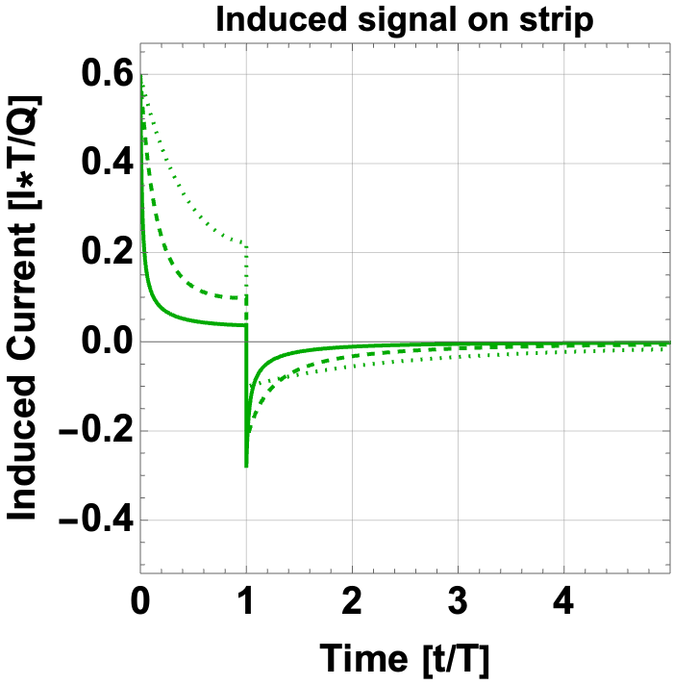
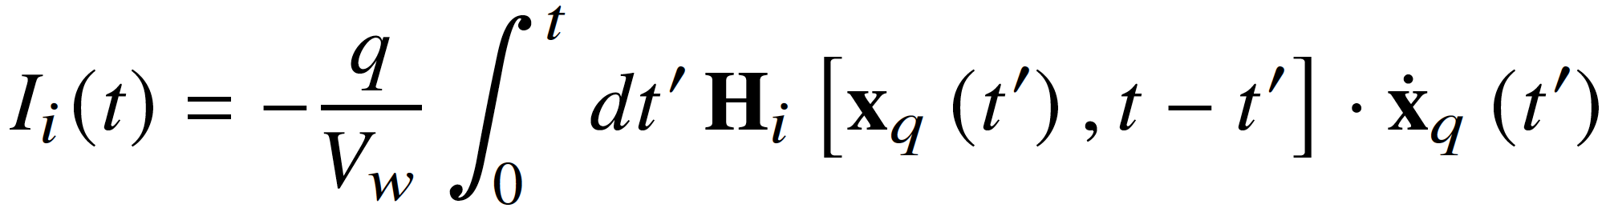
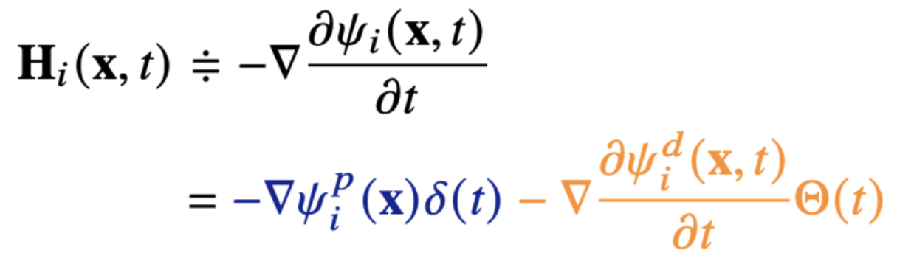
Ramo-Shockley theorem extension for conducting media
250 μm
  The time-dependent weighting potential is comprised of a static prompt and a dynamic delayed component:
10 μm
where .
400 μm
The current induced by a point particle q is given by:
Charge has reached the cathode at t = T
=
R = 10 kΩ/❑
R = 10 kΩ/❑
R = 1 kΩ/❑
R = 1 kΩ/❑
R = 100 Ω/❑
R = 100 Ω/❑
Direct induction
Reaction from resistive material
Examples of systems of which the weighting potential is analytically obtainable see W. Riegler, JINST 11 (2016) no.11, P11002.
Further reading: W. Riegler, P. Windischhofer, Nucl. Instrum. Meth. A 980 (2020)

Slide 27
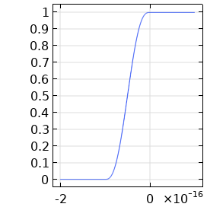
Overview of the numerical methodology
  COMSOL is a finite element solver capable of solving the electrodynamics field equations using the Electric Currents module and time solver.
  The ramping time of the step function for the V_{w} pulse is taken is taken smaller than the reaction time of the resistive material.
Resistive-strips micromegas
Mesh
Resistive Stips
V_{w} pulse [V]
y-Strips
Insulator
x-Strips
Time [s]

Slide 28
Size of the resistive layer
  The size of the resistive layer does play a role in the evolution of the signal. For the initial part of the induced current for a large-area resistive detector can be approximated by a smaller counterpart.
Q
a
0.5 mm
a

Slide 29
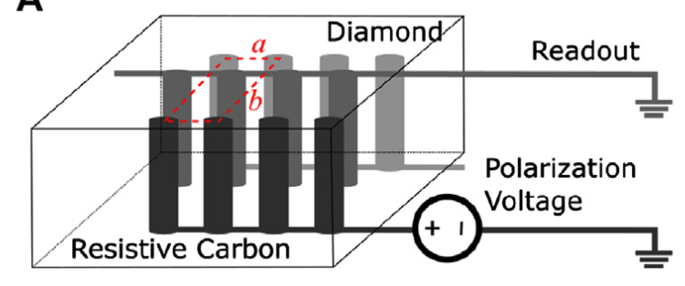

Diamond 3D Pixel Detector
A 3D geometry with thin columnar resistive electrodes orthogonal to the diamond surface, is expected to provide significantly better time resolution with respect to the extensively studied planar diamond sensors.
With the team of the INFN TimeSpot project, we are exploring the modelling of signal induction on the readout columns.
Weighting potential of a readout column at z = 250 μm.
Drift lines as modelled by Garfield++
v
Electron
Hole
Pion
y
Readout Column
Bias Column
Preliminary
x
Anderlini L. et al., Frontiers in Physics 8 (2020)
For timing measurements and first modelling results see talk by M. Veltri:
“A 4D diamond detector for HL-LHC and beyond”.

Slide 30

Signal formation in AC-Coupled LGAD
In collaboration with INFN Torino group of N. Cartiglia, we are currently looking at simulating the currents induced in the AC-Coupled Low Gain Avalanche Diode (LGAD) geometry.
When successfully benchmarked, it can be used to understand and explore novel readout designs.
M. Tornago, R. Arcidiacono, N. Cartiglia et al., Nucl. Instrum. Meth. A 1003 (2021).
See N. Cartiglia’s Friday VCI talk: “4d-tracking, LGADs, and fast timing detectors”.

Slide 31


Signal formation in AC-Coupled LGAD
The role that the prompt component plays can be understood by looking at the central pad on the bottom row.
Prompt weighting potential:
Full weighting potential:
x-axis [mm]
Total signal
200 μm
Delayed component
100 μm
100 μm
y-axis [mm]
AC Pad
Coupling dielectric
p-Si
Resistive n⁺

Slide 32



Simulation partition overview
Cathode
APV-25

Slide 33


Non-uniform resistivity
Non-uniformity map of the readout cell

Slide 35

MRPC simulation using grid based avalanche method

