Slide 1

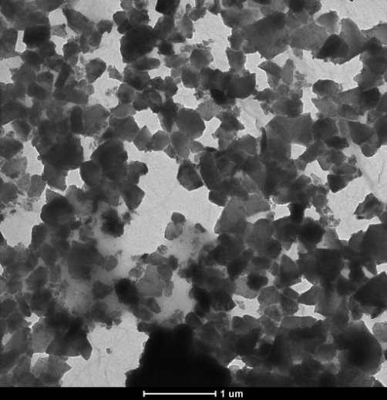

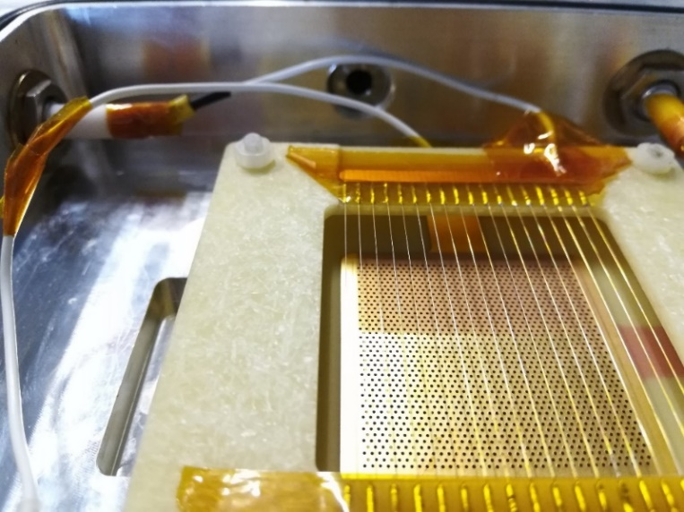
MPGD-based PDs with nanodiamond photocathodes: A Trieste-Bari-CERN effort
Chandradoy Chatterjee
On behalf of the nanodiamond-THGEM group
Motivation for the R&D
H-ND: production and spray coating
Photoemission measurements
THGEMs with nanodiamond coating
Measurements in different gas mixtures
Aging studies
Conclusions
Chandradoy Chatterjee, MPGD 2022, December 15th, 2022

Slide 2
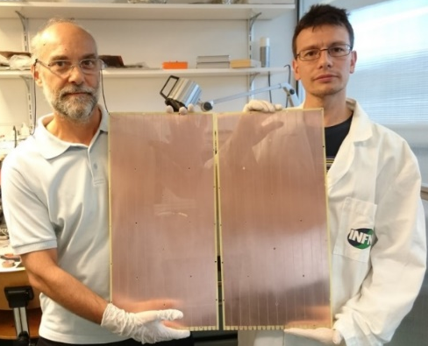
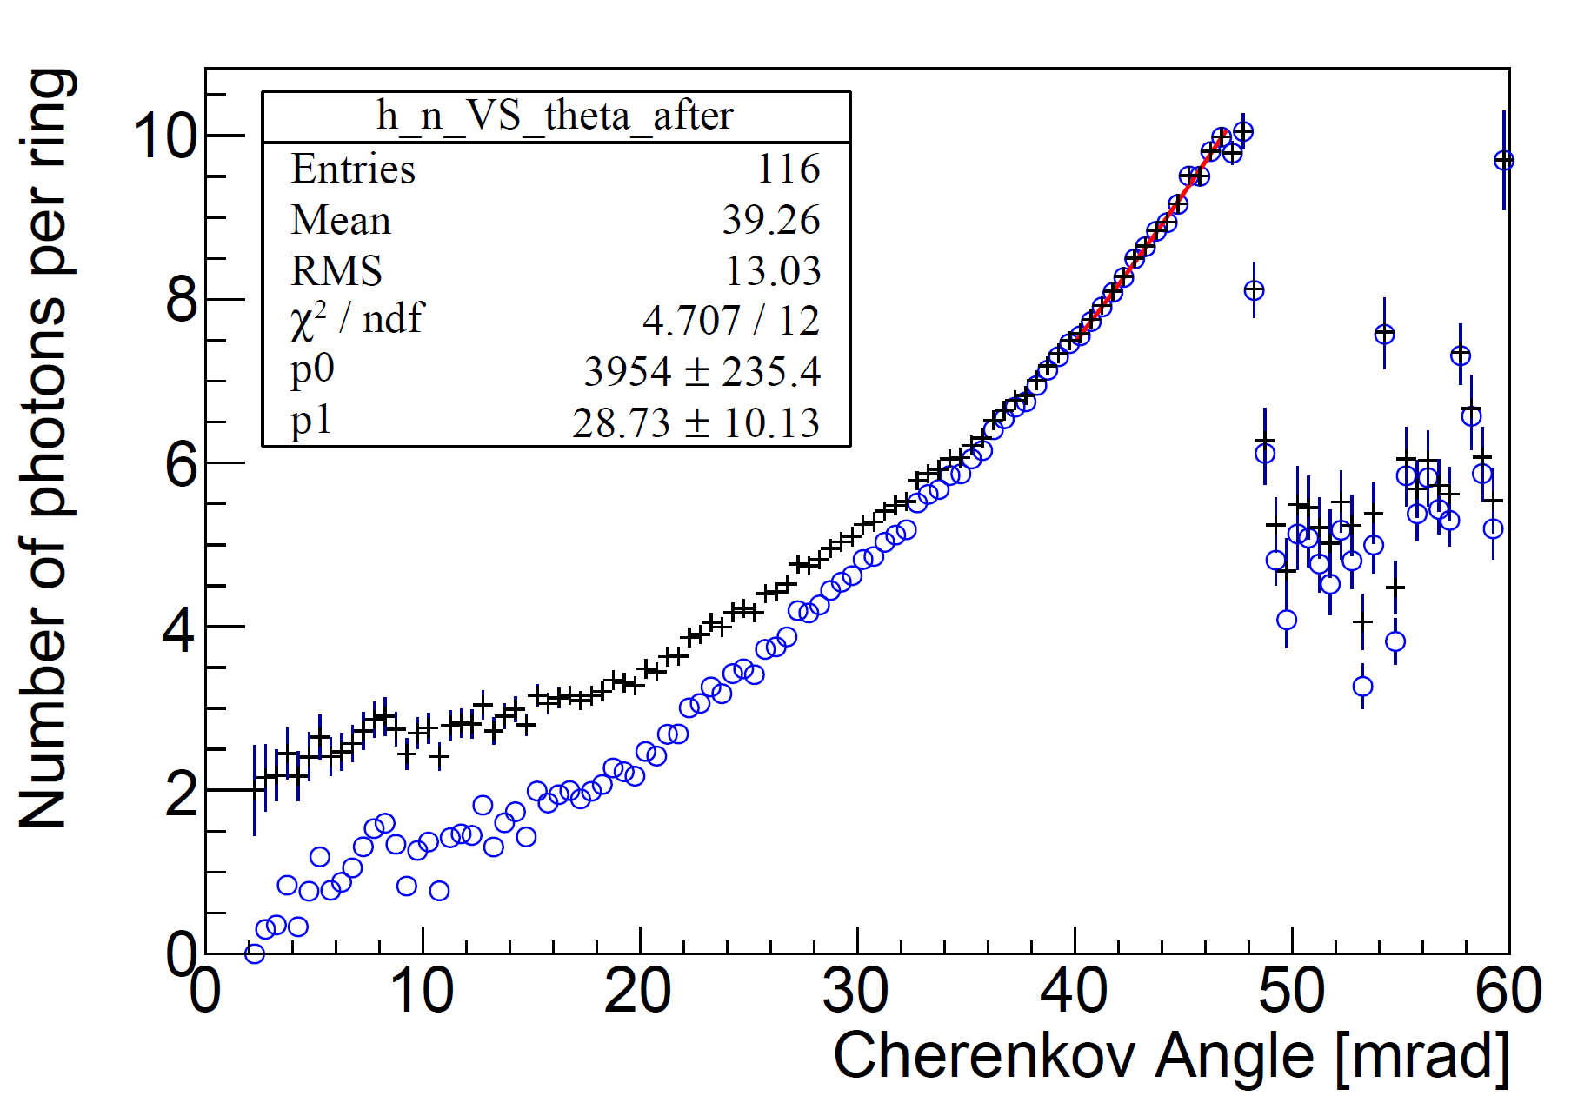


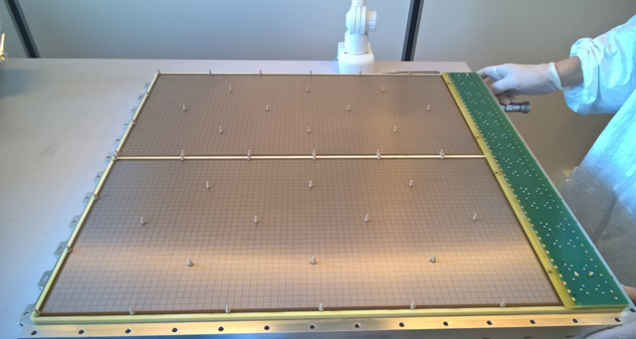
COMPASS Hybrid THGEM+MM PDs
Hybrid PD scheme
IBF = 3%
successfully
implemented in 2016 on
COMPASS RICH-1
active area = 1.4 m²
eff. gain ~ 15000,
gain stability 5% (p/T corr.)
single γ ang. res. 1.8 mrad
THGEMs
CsI
staggered
THGEMs
Standard Bulk Micromegas (CERN)
at ß=1 N_{ph} = 12.9
S = 11.5, B = 1.4
N(ϴ_{Ch}) = p₀sin²ϴ_{Ch}+ p₁ϴ_{Ch}
S. Dalla Torre, NIM A 970 (2020) 163768
Chandradoy Chatterjee, MPGD 2022, December 15th, 2022

Slide 3
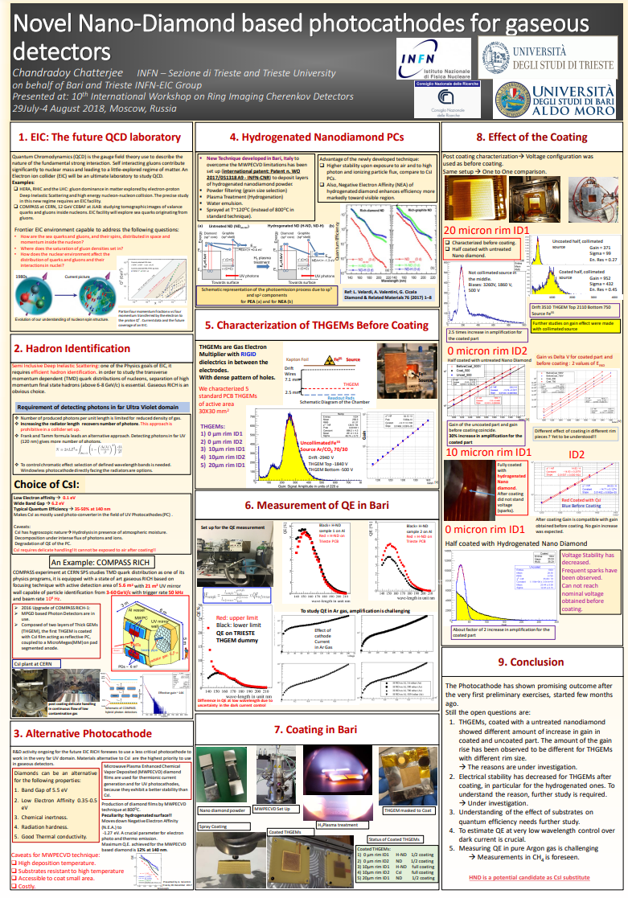
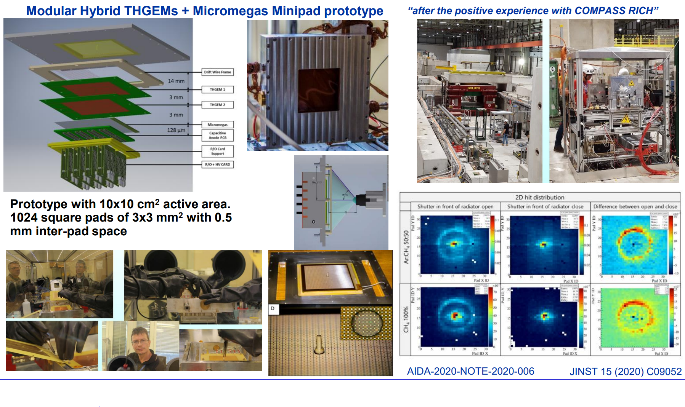
COMPASS upgrade legacy
RICH 2018; Moscow
COMPASS RICH upgrade motivated MPGD based photon detectors for future RICH applications.
Two streams of R&D
  To couple modular hybrid THGEMs + Micromegas with smaller size readout pads (3mmX3mm)
  To study performances of the MPGD based detectors coupled with alternative photocathodes.
A modular mini-pad photon detector prototype for RICH application at the Electron Ion Collider; J. Agarwala et al 2020 J. Phys.: Conf. Ser. 1498 012007
DOI 10.1088/1742-6596/1498/1/012007
Chandradoy Chatterjee, MPGD 2022, December 15th, 2022

Slide 4
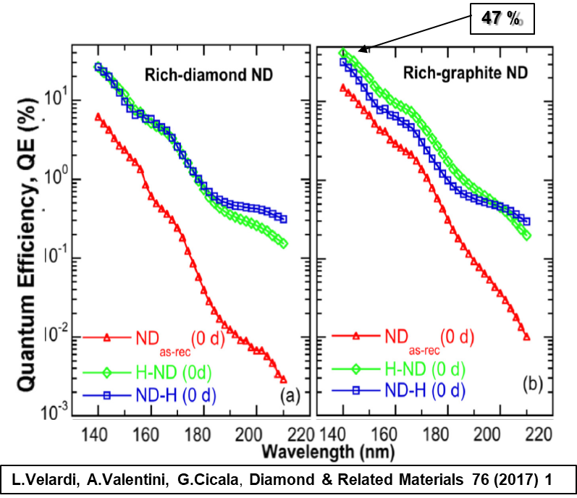
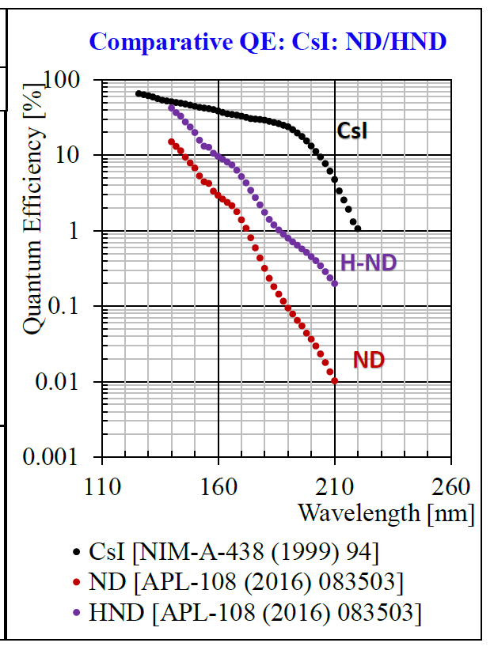
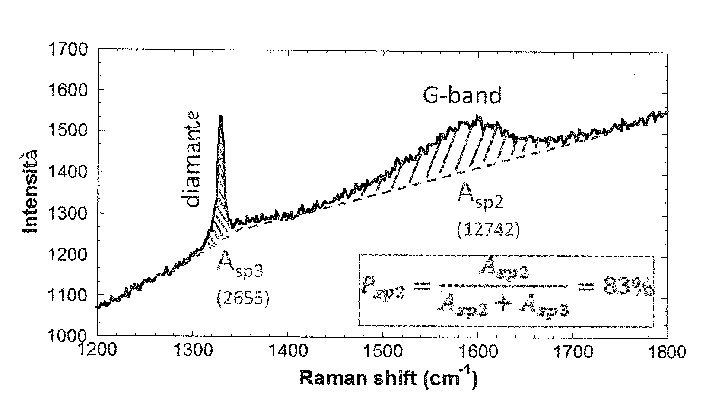
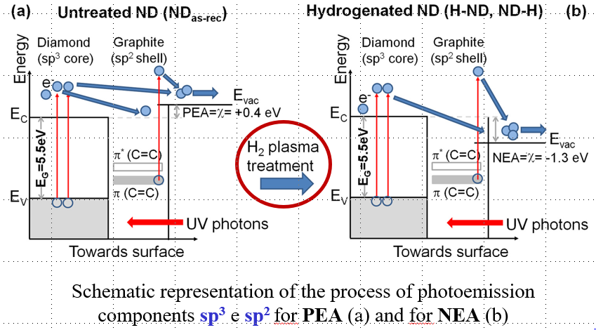
Rich-graphite Nano-Diamond film
CsI bandgap: 6.2 eV; electron affinity: 0.1 eV; hygroscopic; ages by ion bombardment (~mC/cm²)
Diamond bandgap: 5.5 eV; chemically inert and robust; if hydrogenated: electron affinity -1.27 eV
Hydrogenated chemical vapor deposited diamond films (4-6 μm) known to have QE ~15% @ 140 nm.
Heterogranular-structured diamond-gold nanohybrids proposed as stable field emission cathode material
Nano-Diamond grains (size: ~250 nm), with variable sp² (graphite phase) and sp³ (diamond phase) hybridized carbon contents treated in H2 microwave plasma show large QE: >40% @ 140 nm
Photocatodes: diamond film obtained with Spray Technique
Spray technique: T ~ 120° (instead of ~800° as in standard techniques)
Antonio Valentini’s studies on carbon nanotubes led to identify diamond nano-grains as the most promising robust and efficient photoconverter
Triloki: NDIP Troyes, France 2022
Chandradoy Chatterjee, MPGD 2022, December 15th, 2022

Slide 5
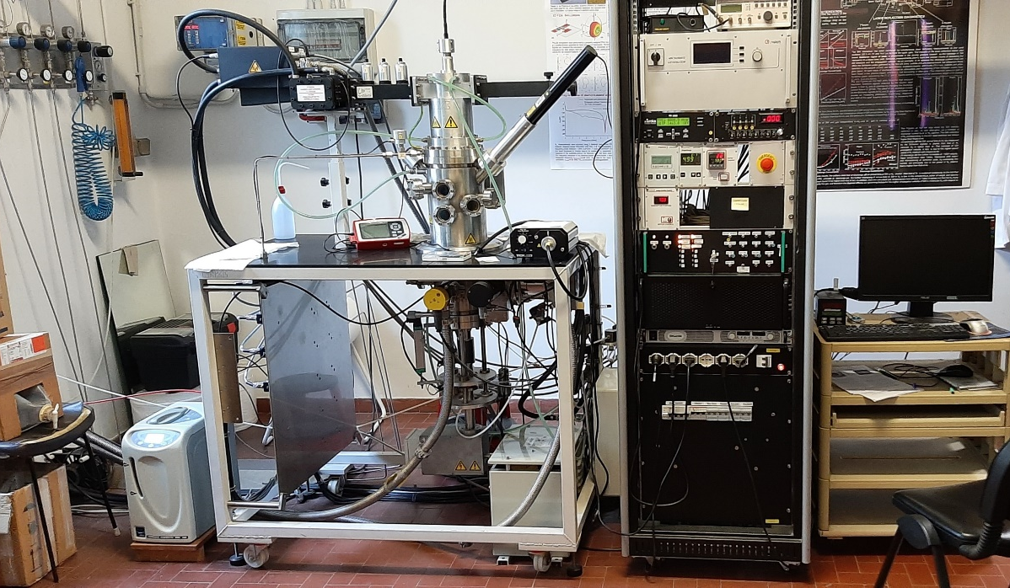
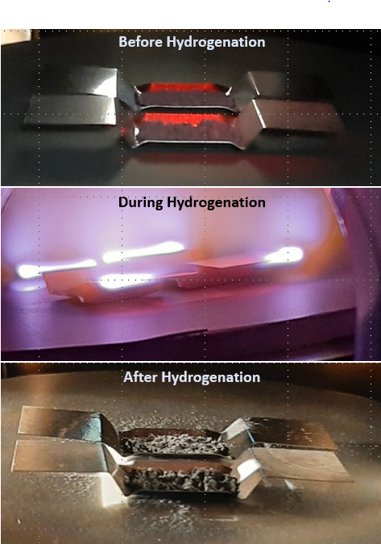
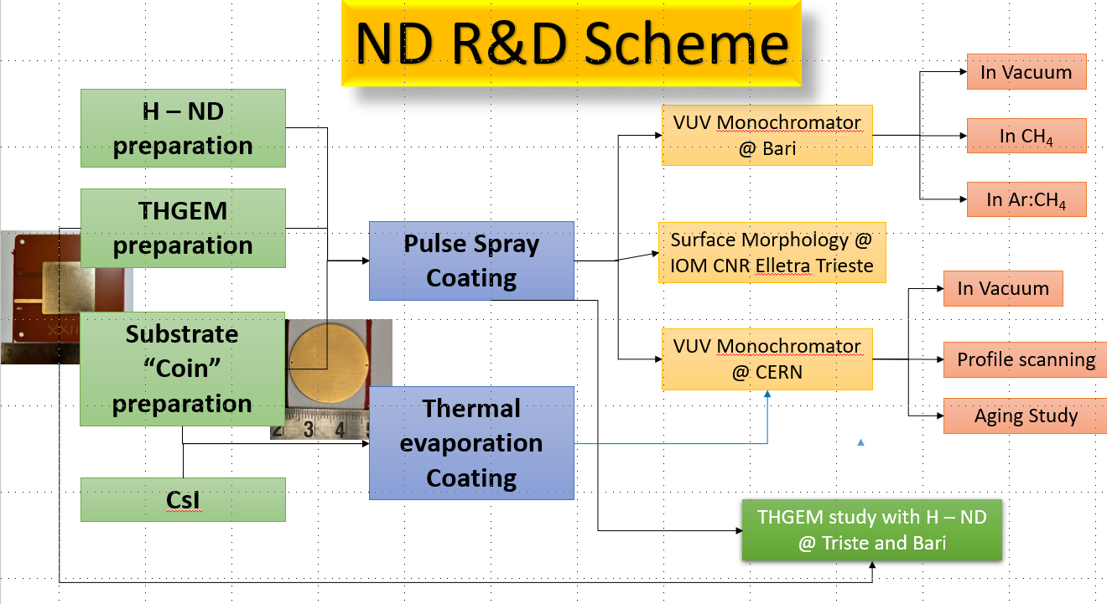
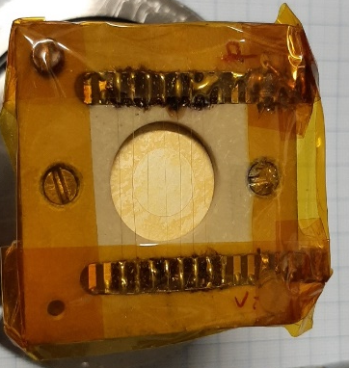

Hydrogenation: MWPECVD setup in Bari
Hydrogenation details:
Vacuum: ~6.5x10⁻⁶ mbar.
70 mm between H₂ source and ND powder.
H₂ gas generated by electrolysis from distilled water. H₂ gas flow rate controlled to 200 sccm.
Hydrogenation of ND powder: 1 hour at 43 mbar.
1380 W microwave power → 1000 ⁰C temperature with 830 ⁰C substrate holder temperature.
1250 W microwave power → 810 ⁰C temperature with 650 ⁰C substrate holder temperature.
Chandradoy Chatterjee, MPGD 2022, December 15th, 2022

Slide 6
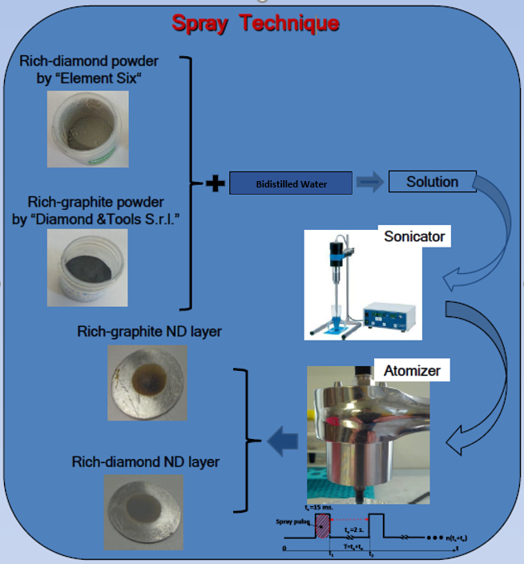
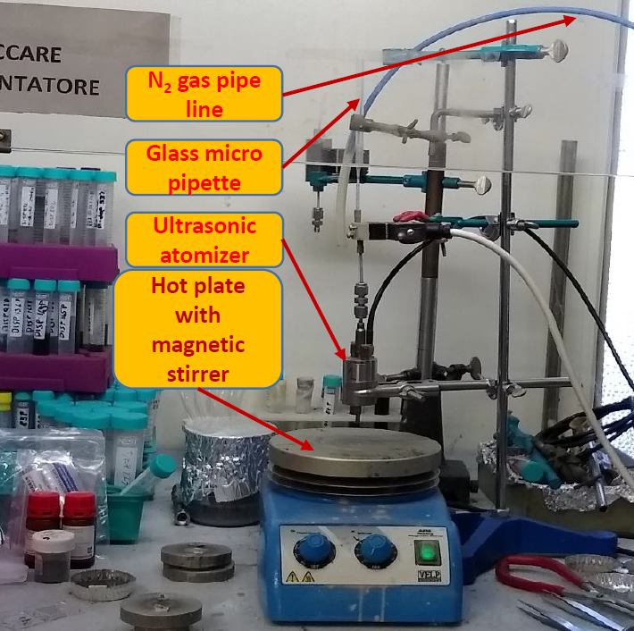
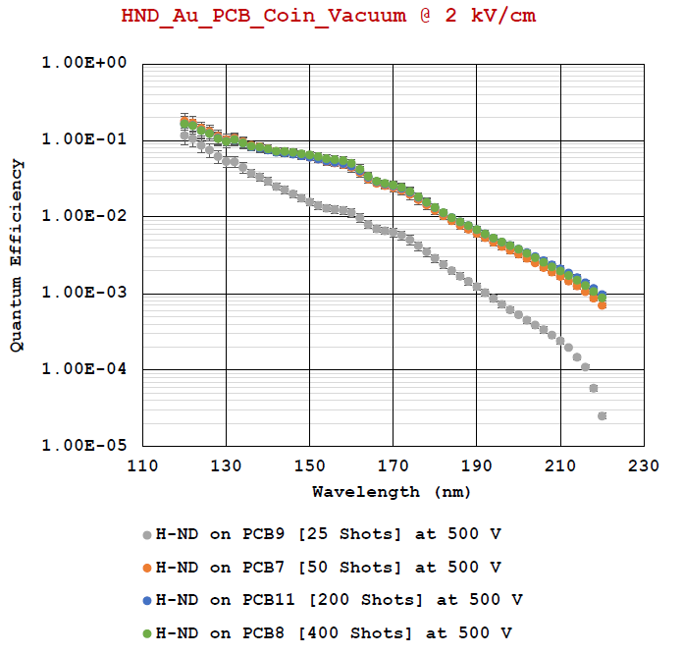
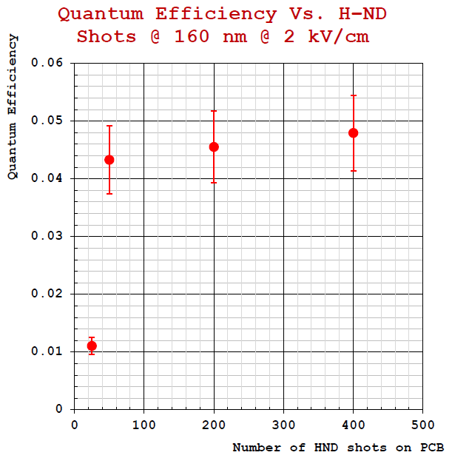
Pulsed spray coating and thickness studies in Bari
Types of Nano-Diamond Powder
▪ND -D&T
▪ND -E6
▪ND –BDD
[ChangSha3 Better Ultra-hard materials Co.,LTD]
SONICATED in distilled water with 1:1 ratio
Low Temperature Deposition ( ≤ 120 °C)
Good reproducibility technique
Scalable to cover large areas
Sufficient surface coverage is reached with “100 shots” thickness
Chandradoy Chatterjee, MPGD 2022, December 15th, 2022

Slide 7
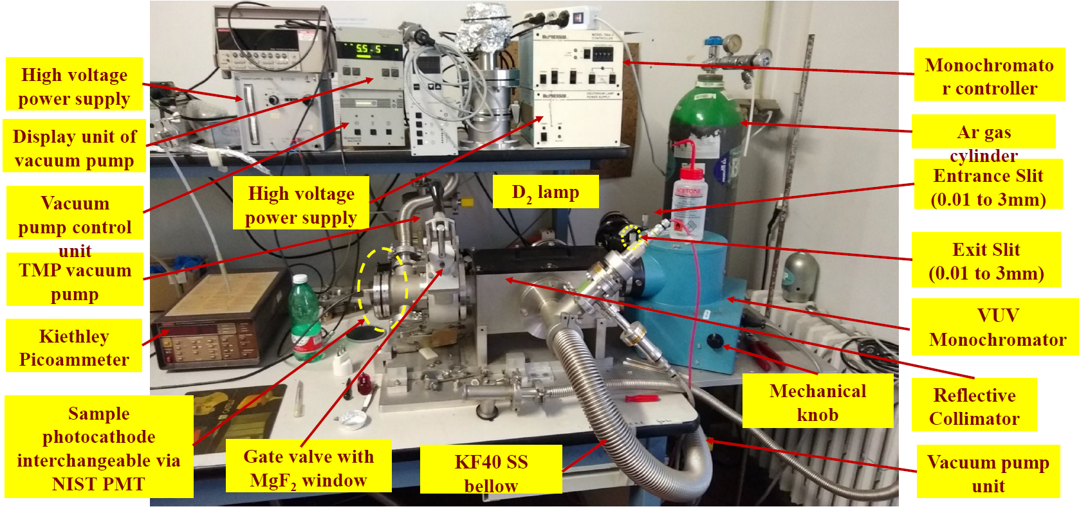
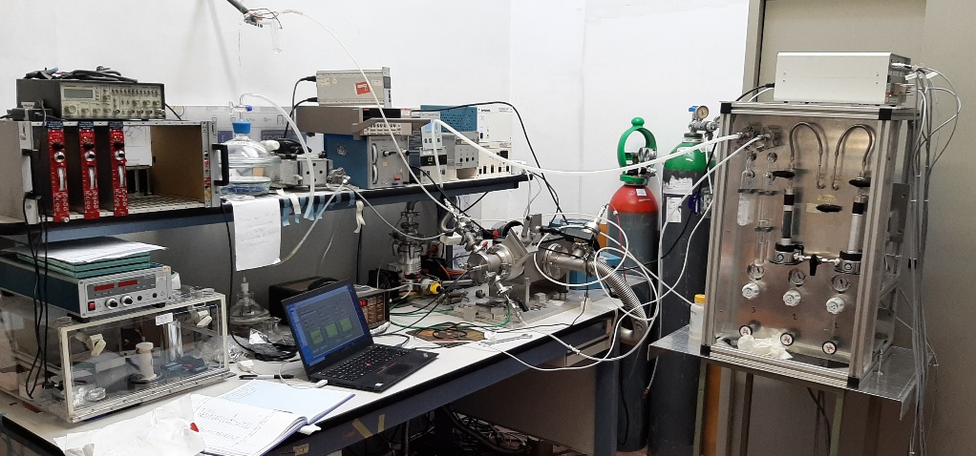
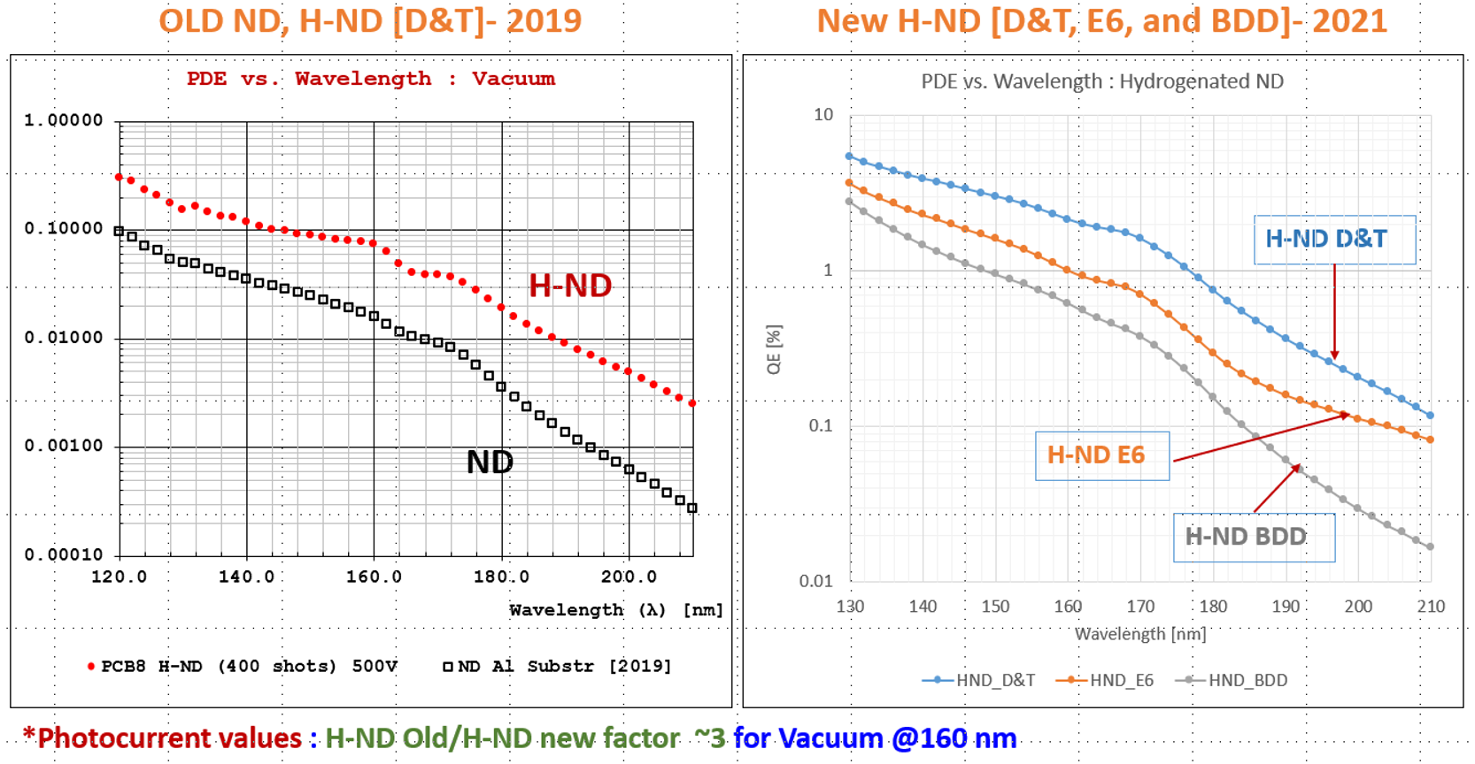
Measurement setup in Bari and QE of different ND and HNDs
ATEX compliant gas mixing unit
Chandradoy Chatterjee, MPGD 2022, December 15th, 2022

Slide 8
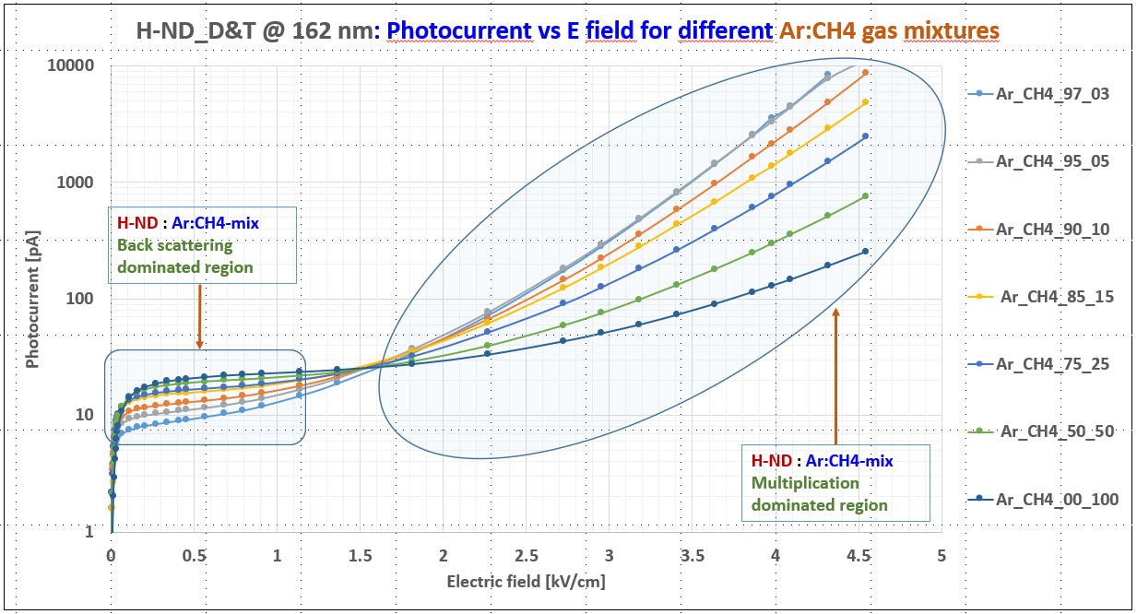

Photocurrent studies Ar/CH₄ gases
Gap between substrate and electric wire: 4.4 mm.
Scan performed with MgF2 window in vacuum and various Ar:CH₄ gas mixtures
λ = 162 nm
H-ND D&T
Substrate holder for
photocurrent measurement
Chandradoy Chatterjee, MPGD 2022, December 15th, 2022

Slide 9
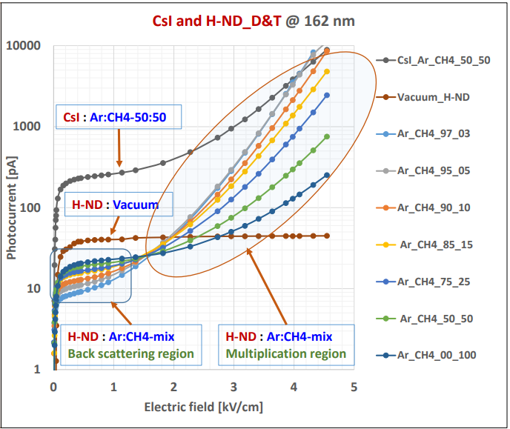
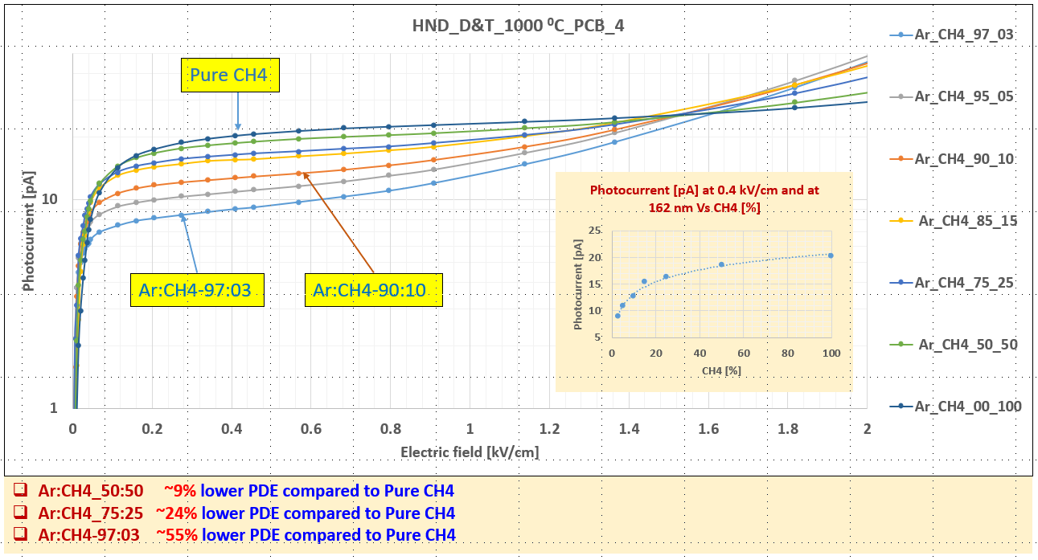
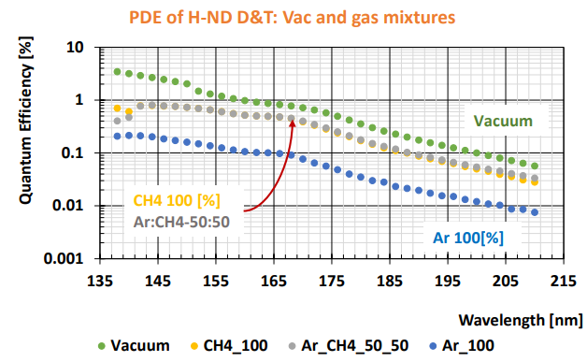
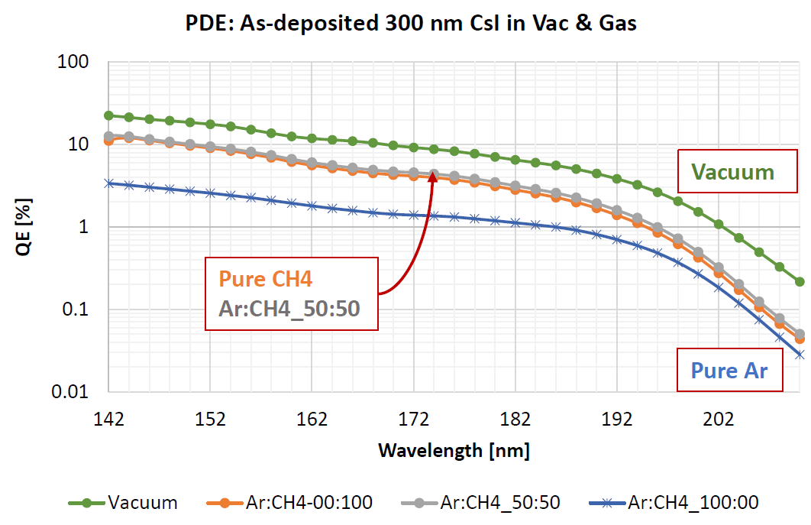
Photocurrent vs E in Ar/CH₄ gases
QE CsI/QE HND ~10 [Ar/CH4 50:50 @160 nm]
What about aging?
Chandradoy Chatterjee, MPGD 2022, December 15th, 2022

Slide 10
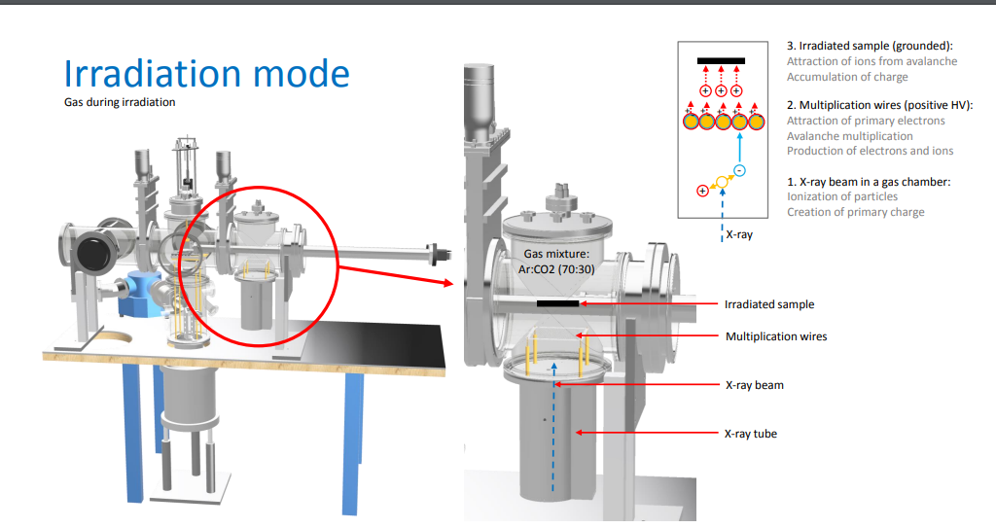
ASSET at CERN RD51 Lab
Aging tests performed thanks to the possibility to irradiate the sample inside the setup
Ref: Marta Lisowska| RD51 Mini-Week | 12-02-2020
Chandradoy Chatterjee, MPGD 2022, December 15th, 2022

Slide 11
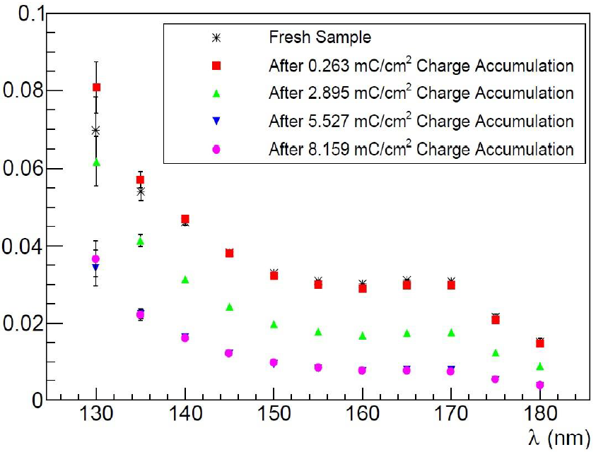
First aging measurements
Q.E.
preliminary indication:
H-ND is at least ten times more robust than CsI
against irradiation and ion bombardment
300 nm CsI
H-ND D&T
Chandradoy Chatterjee, MPGD 2022, December 15th, 2022

Slide 12

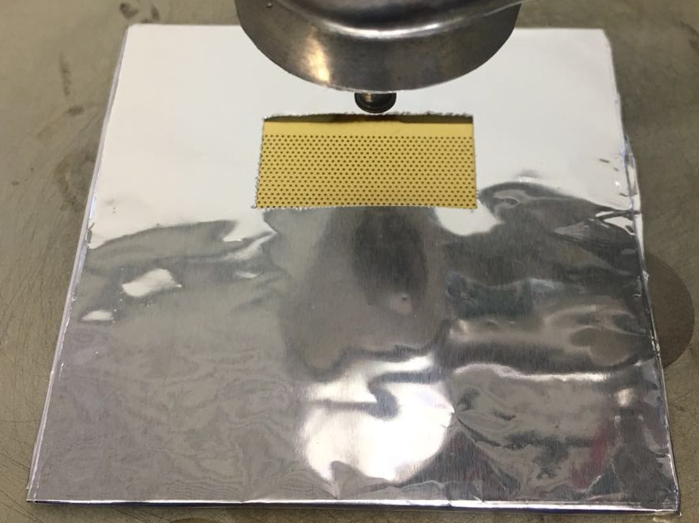
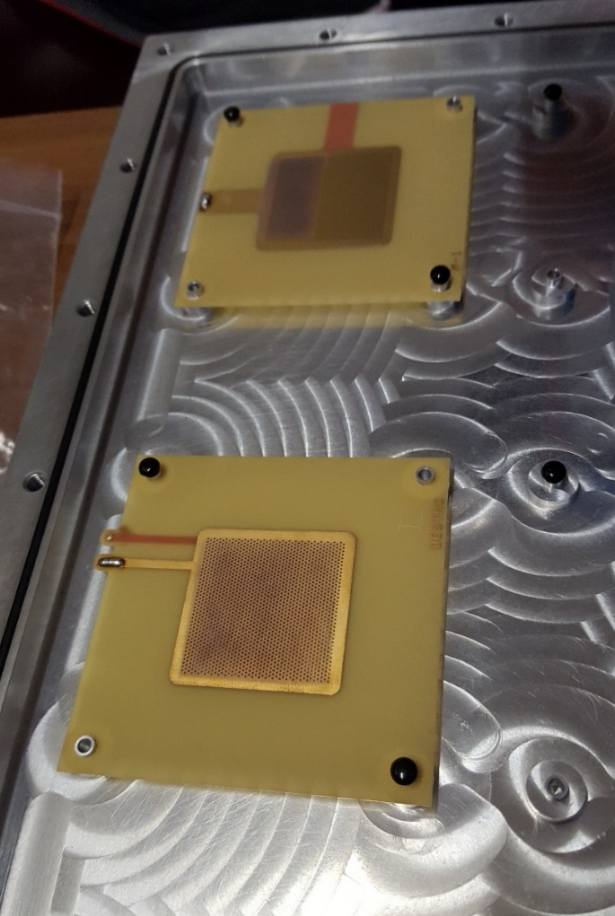
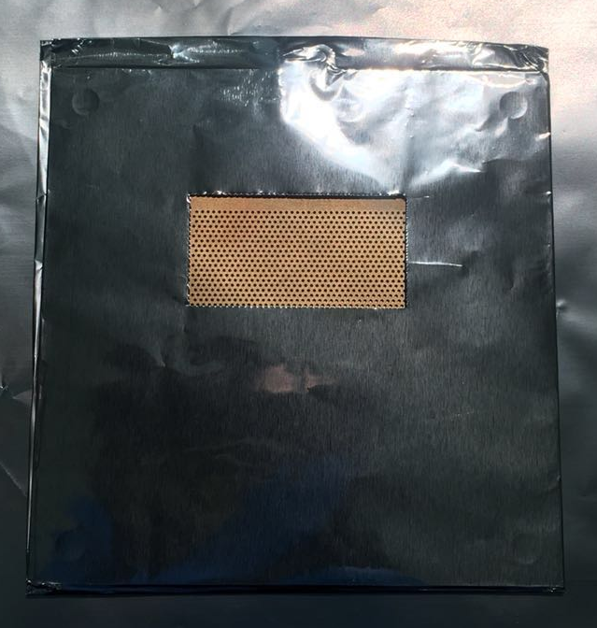
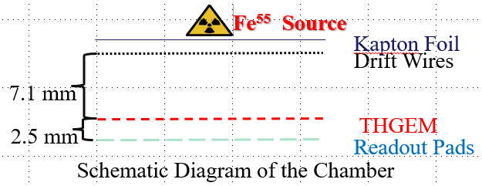
THGEMs + H-ND
First trial of THGEM + H-ND not successful: coated THGEMs lost electrical strength.
Second trial: both full and half-coated THGEMs
Chandradoy Chatterjee, MPGD 2022, December 15th, 2022

Slide 13
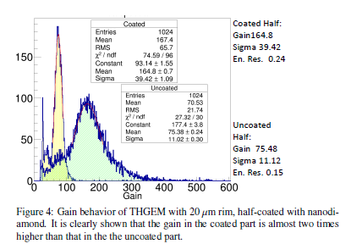
THGEMs H-ND
First results were puzzling:
Systematic studies: 15 THGEM samples characterized
J. Agarwala, et al.
Nuclear Inst. and Methods in Physics Research, A 952 (2020) 161967
Chandradoy Chatterjee, MPGD 2022, December 15th, 2022

Slide 14
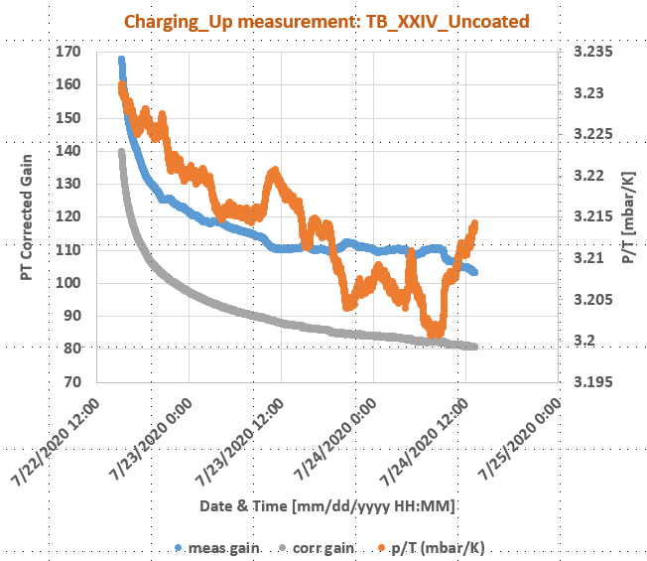
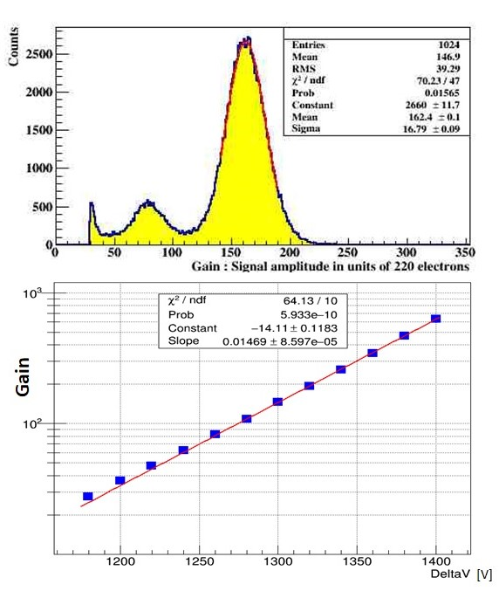
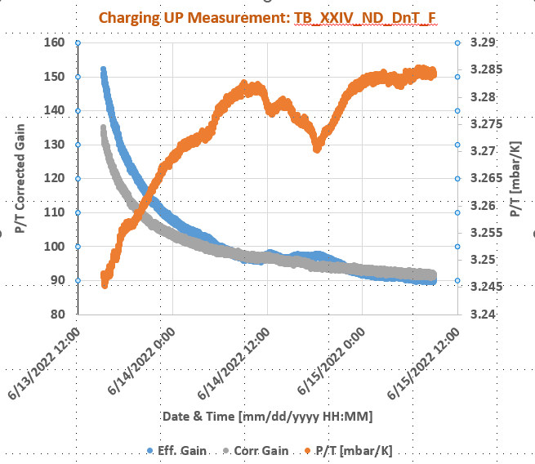
THGEM characterization
Full characterization including charging up measurements before and after H-ND coating
Voltage Applied:
Drift = 2250 V
T_top = 1750 V
T_bot = 500 V
Anode = 0 V
Gas Mixture:
Ar = 70 %
CO2 = 30 %
@ 10 l/h flow rate
X-ray Source:
Fe-55
THGEM active area:
30 mm x 30 mm
Electronics used:
CAEN N1471H HV PS
CREMAT CR-110 Pre Amp
ORTEC 672 Amp
CREMAT CR-150 Eva Board
AMPTEK MCA 8000A
Chandradoy Chatterjee, MPGD 2022, December 15th, 2022

Slide 15
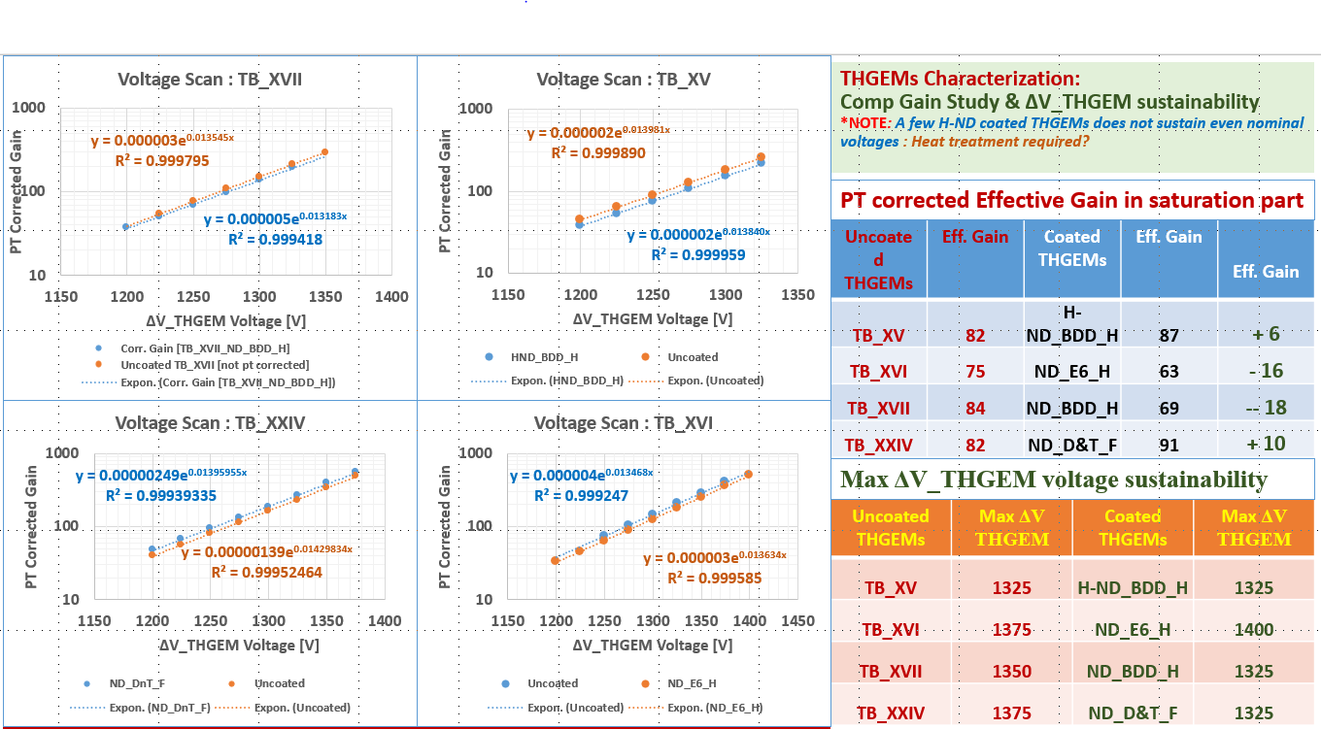
THGEMs are H-ND compatible
heat treatment after coating
and p/T corrections + charging-up are essential
The response of THGEMs as electron multipliers is unaffected by H-ND coating
Chandradoy Chatterjee, MPGD 2022, December 15th, 2022

Slide 16
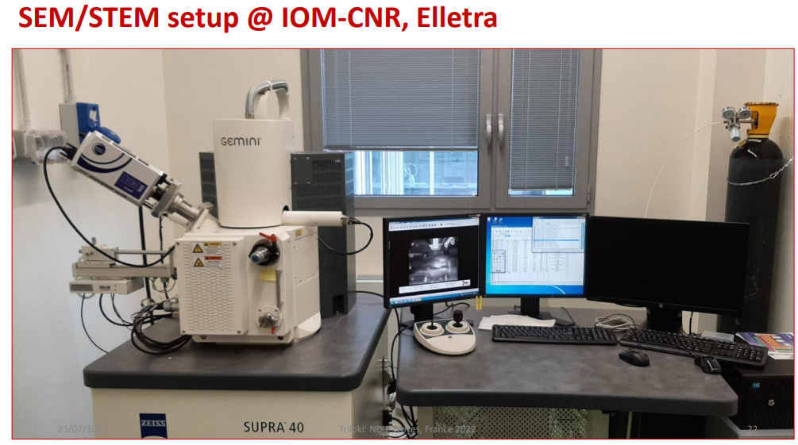
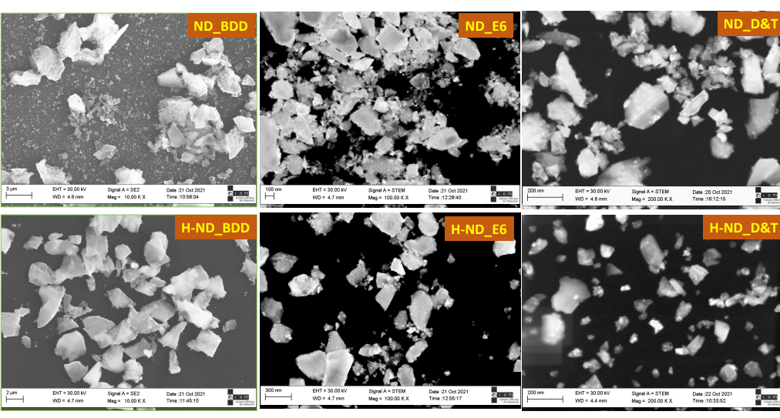
Surface morphology scan in Elletra Trieste
Preliminary observations:
• Facet like morphology is observed for all types of NDs & H-NDs
• Nanoparticle size is varying from 10 nm to 500 nm
• D&T and E6 grain sizes varying from 10 nm to ~ 200 nm.
• BDD NDs & H-NDs having large particle size
• NDs particles are having higher grain size compared to H-NDs particles
• Grain distribution are non uniform
• Non-hydrogenated grains found are in clusters, while, H-ND are scattered and dispersed
Detailed Analysis Ongoing
Chandradoy Chatterjee, MPGD 2022, December 15th, 2022

Slide 17
CONCLUSIONS
Exploratory investigation on H-ND photocathodes
  Promising values of Q.E. in the far UV but no clear reproducibility.
  High robustness against moisture, light irradiation, ion bombardment
  Surface morphology scans → Preliminary findings are interesting. Detailed analysis ongoing
Perspective of coupling H-ND with THGEM-based PDs
  Full compatibility (same electron multiplication response if correctly coated)
  Systematic study for gas, HV config. and detector geometry started
Potentially interesting for windowless gaseous PDs, Picosec, fire detection, …
Chandradoy Chatterjee, MPGD 2022, December 15th, 2022

Slide 18
Basic questions about H-ND and TGEM coupling
Is the H-ND layer on the THGEM:
- Reducing the electrical stability?
Changing the gain response?
Providing the same PDE as on PCBs?
Uniform and stable?
- More robust with respect to CsI?

Slide 19
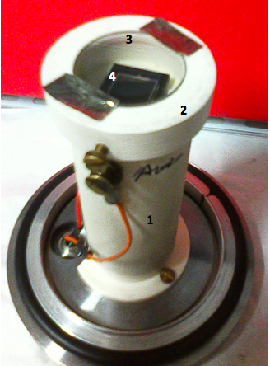
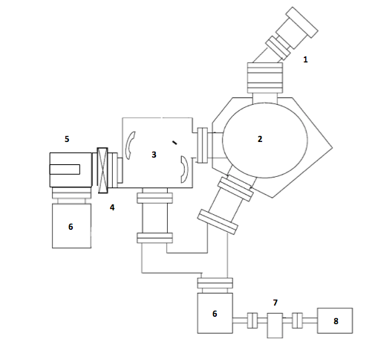
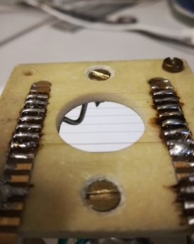
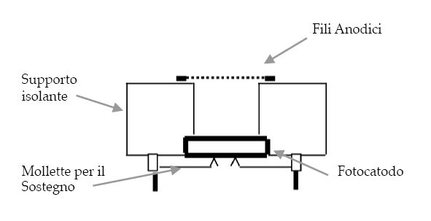
Q.E. measurement setup in Bari
Deuterium Lamp
Lock
Gate
Collimator
NIST Photodiode
Monochromator
NIST PD
or
Photocathode
Trap
Multiwire Proportional Chamber(MWPC)
Anodic wires
Insulating support
Turbo Pumps
RotativePump
Support clips
Photocathode

Slide 20
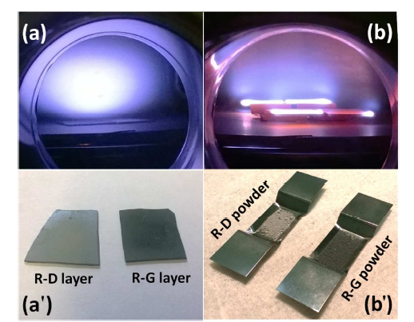
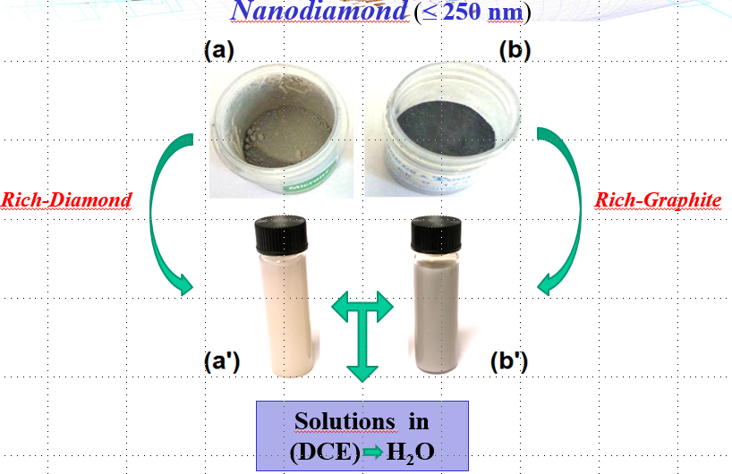
Hydrogenated Nano-Diamond

