Slide 1
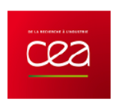



Neutron and beta imaging with Micromegas detectors with optical readout
MPGD 2022 – 15/12/2022
A. Cools, E. Ferrer-Ribas, T. Papaevangelou, E. C. Pollacco, T. Benoit, D. Desforge
(Université Paris-Saclay, CEA, IRFU)
F.M. Brunbauer, L. Ropelewski, E. Oliveri (CERN)
F. Beau, L. Devel, C. Malgorn (Université Paris-Saclay, CEA, Institut Joliot)
F.J. Iguaz-Gutierrez (Soleil Synchrotron)
A. Sari (Université Paris-Saclay, CEA, List)
1

Slide 2
CONTEXT
Light production mechanisms
Light detection devices
DETECTOR CHARACTERIZATION WITH X-RAY SOURCES
APPLICATIONS
B-imaging
Preliminary results with tritium samples
Neutron radiography
Preliminary results with a neutron source
CONCLUSION and PERSPECTIVES
2

Slide 3
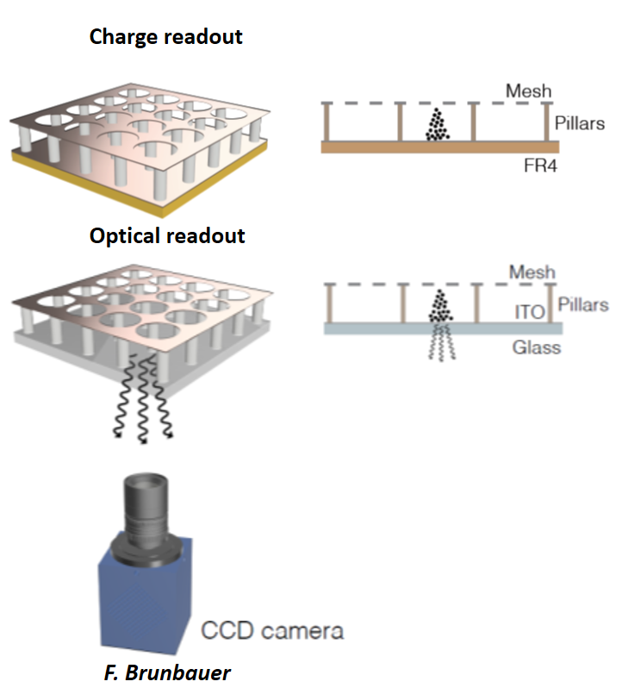
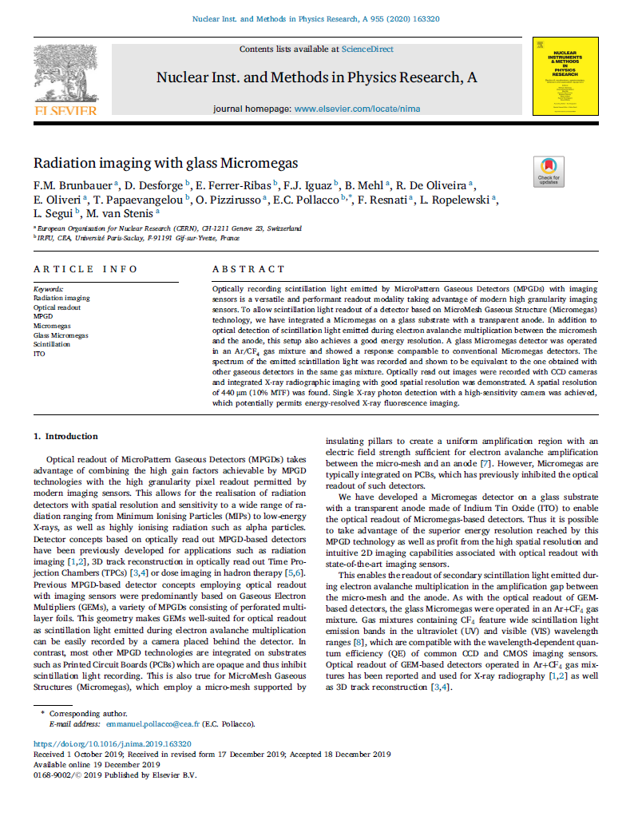
CONTEXT
Advantages:
2D pixelized readout of high granularity
Megapixel resolution from commercial cameras
Integrated imaging approach
Applications:
Real-time neutron imager
β imager for sub-becquerel activity measurements
3

Slide 4
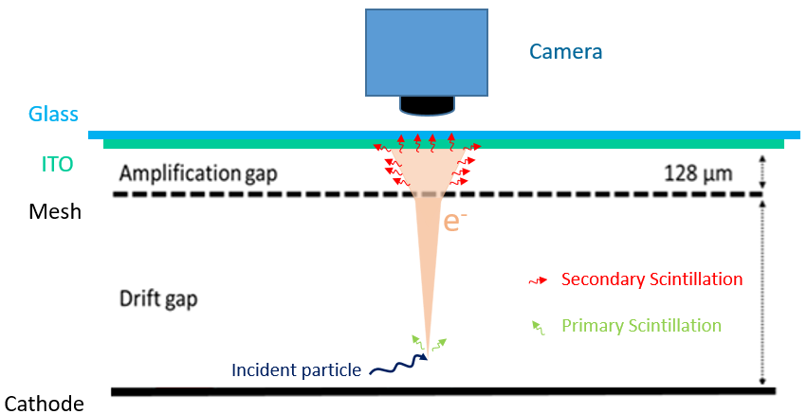
LIGHT PRODUCTION MECHANISMS
Scintillation
f Fluorescence
Prompt emission of photon after absorption of incident radiation.
(1 ns to 1 µs)
Primary scintillation
Secondary scintillation
Coming from the excitation of the gas due to incident particles.
Coming from avalanche amplification.
Gas mixture : Ar/CF₄
4

Slide 5
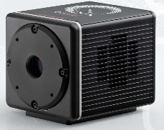
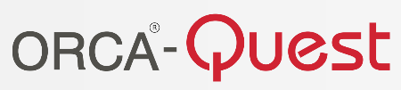
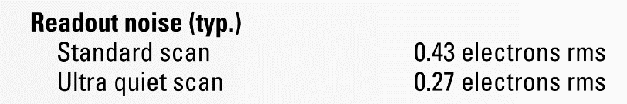
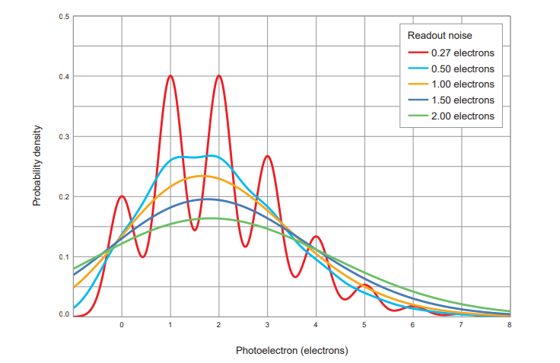
LIGHT DETECTION DEVICES
Hamamatsu CMOS camera
Readout noise
Photon number resolving
Pixels
Number Size
4096 x 2304 4.6 µm x 4.6 µm
Dark current
Cooling Sensor temperature Dark current
Air - 20 °C 0.016 e⁻ /pixels/s
Minimum exposure time
Mode Rate
Standard 1 µs/frame
Ultra quiet 100 ms/frame
5

Slide 6
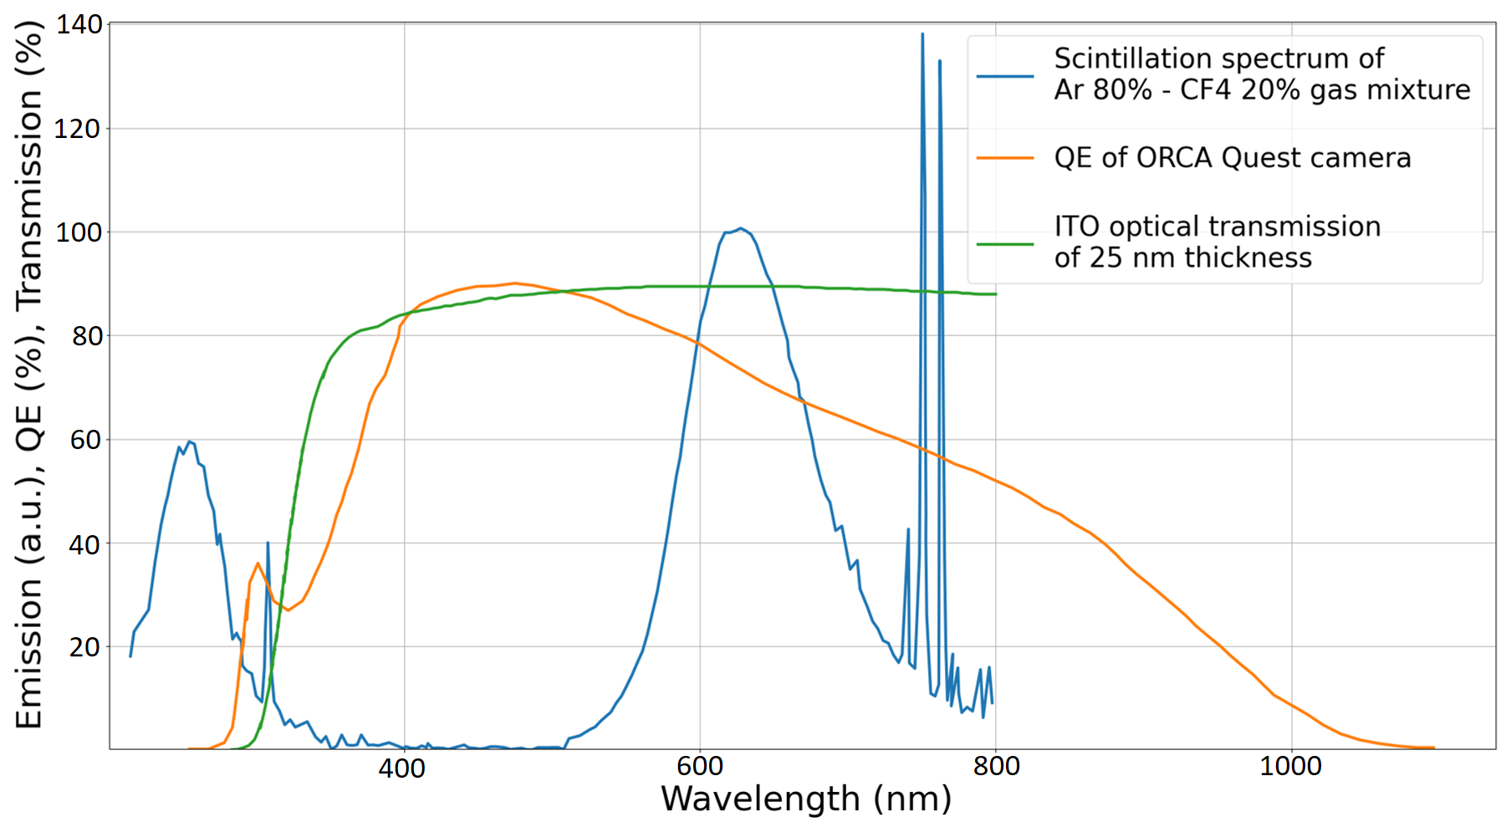
LIGHT DETECTION
6

Slide 7
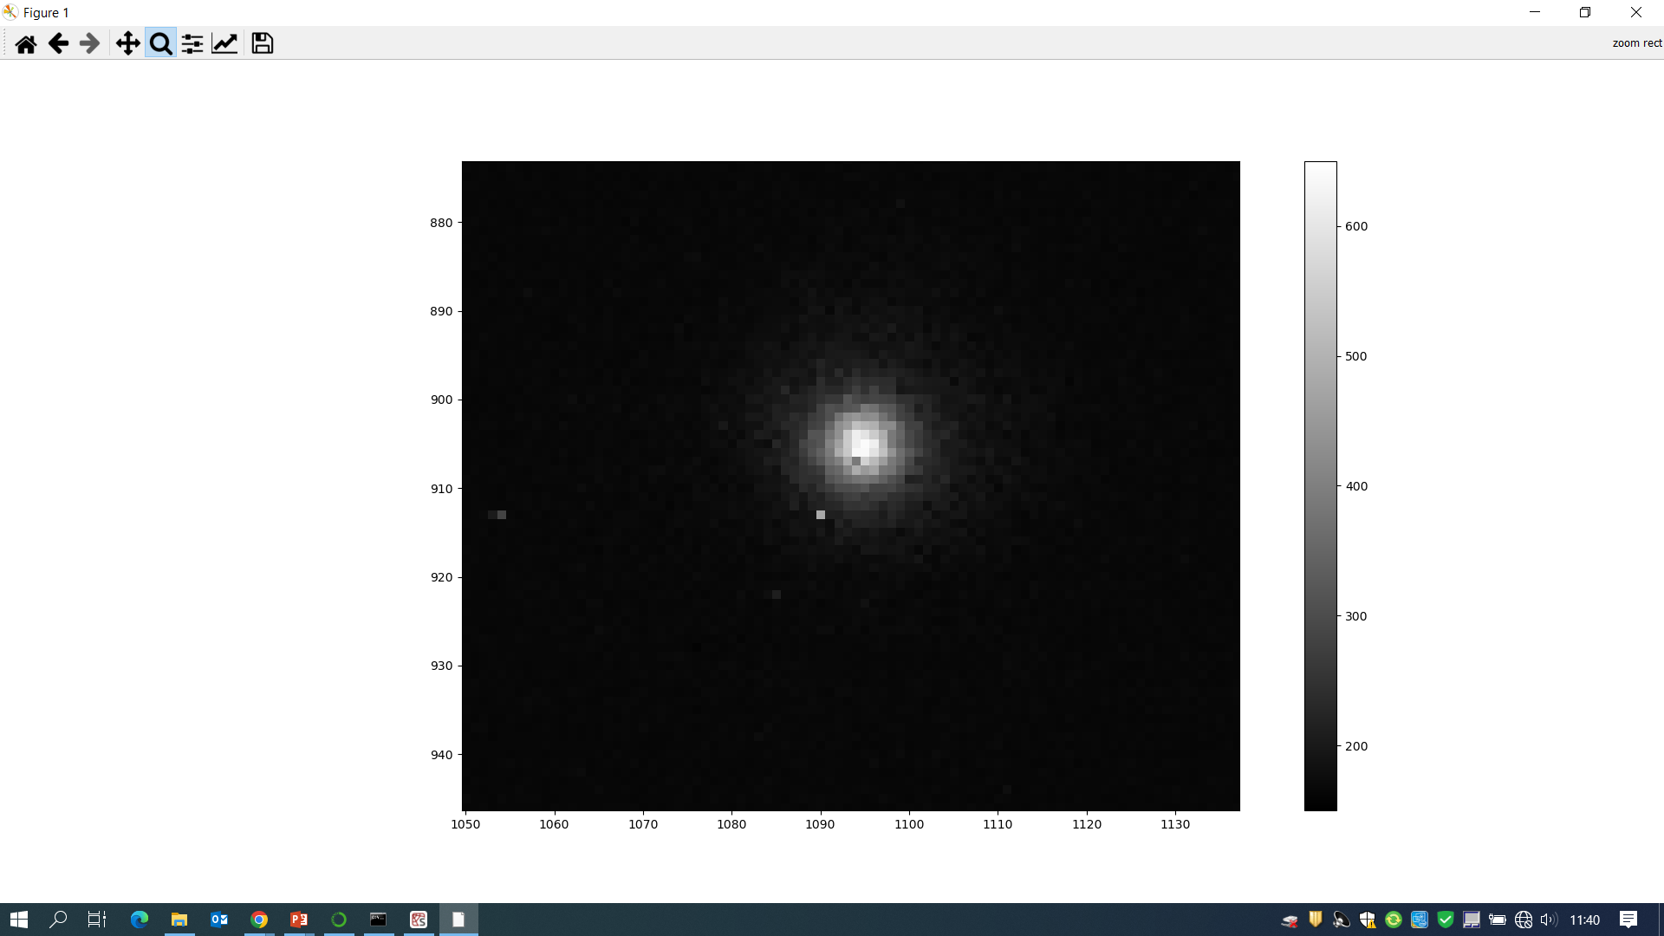
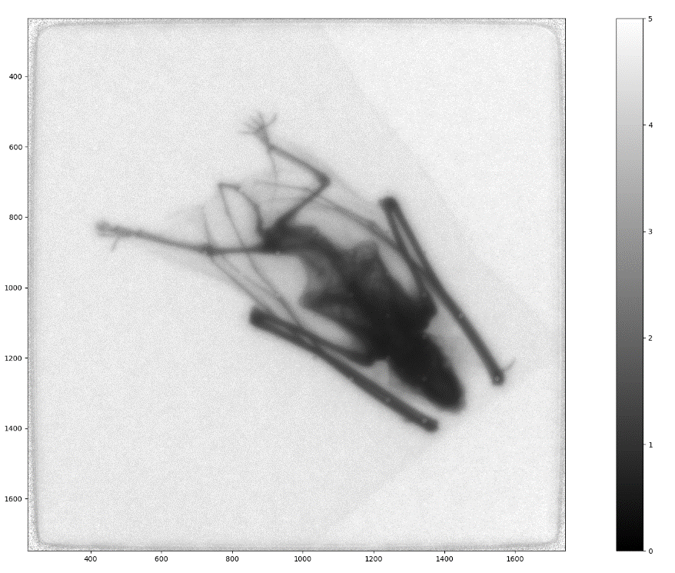
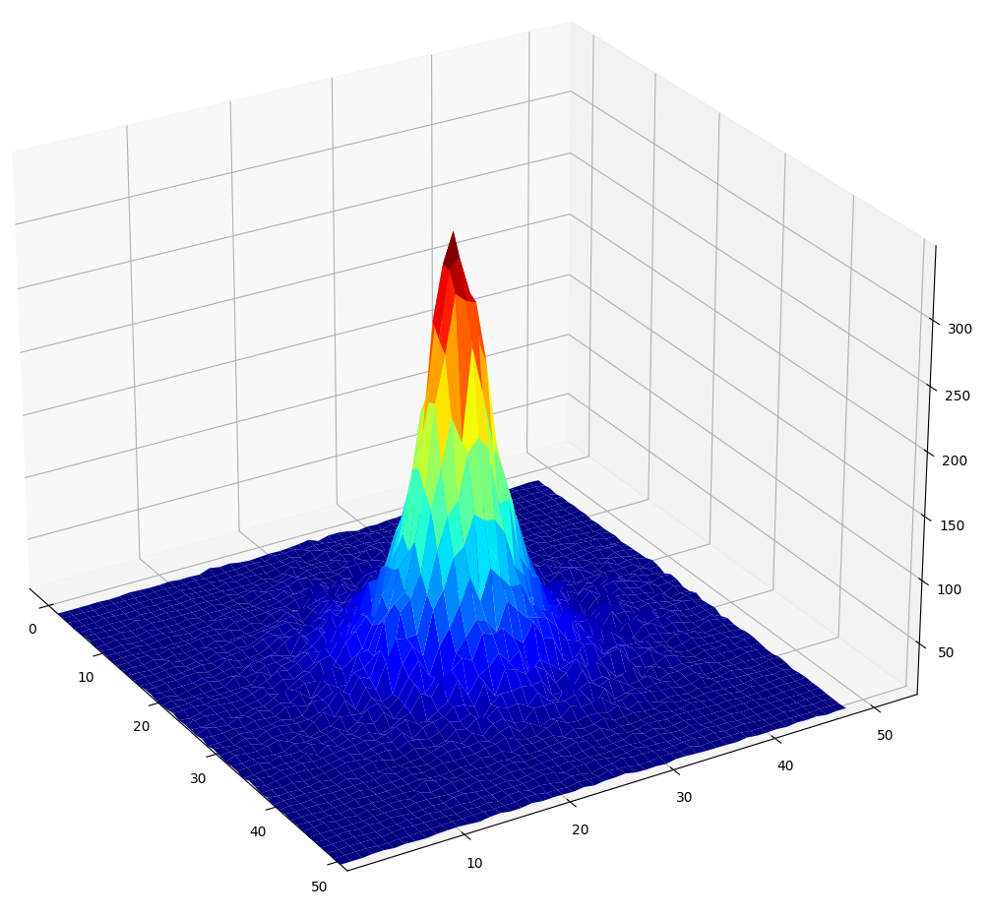
DETECTOR CHARACTERIZATION WITH X-RAY SOURCES
7

Slide 8
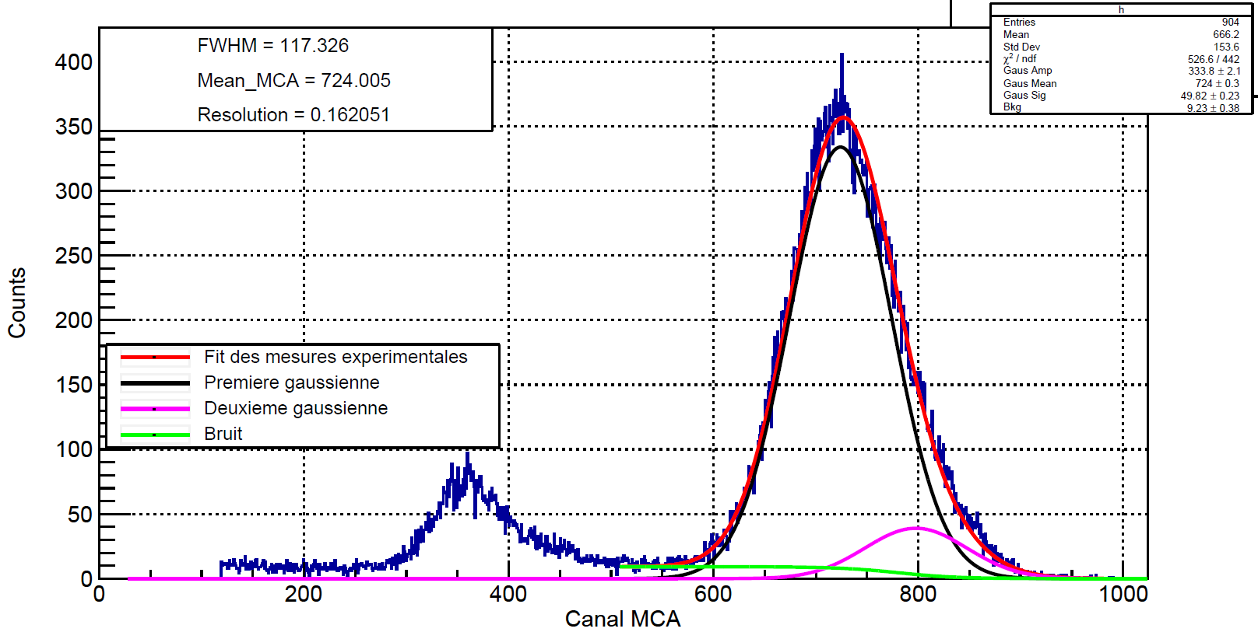
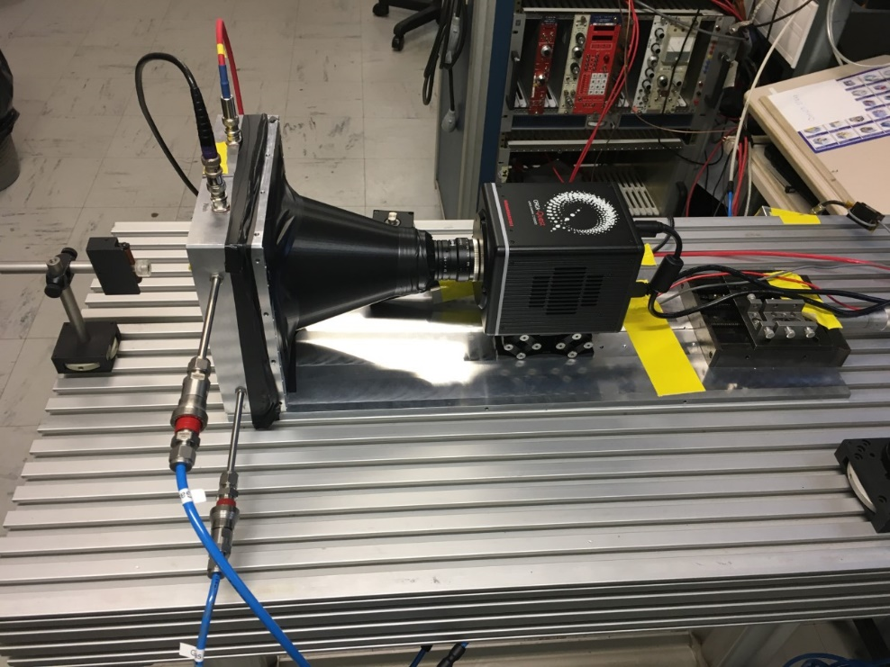
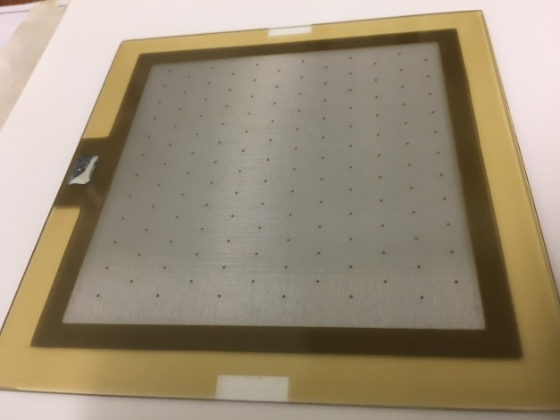
DETECTOR CHARACTERIZATION WITH X-RAYS
⁵⁵Fe
Experimental set-up for x-rays
Charge readout spectrum in Ar/Iso 5%
ORCA - Quest qCMOS
Bulk on glass from CERN and IRFU
Charge readout test in Argon+5%Iso:
  gain above 10⁴ and FWHM reaches 16%
Coated glass with 150 nm of ITO (Indium Thin Oxide)
Pillars with hexagonal pattern and large pitch (6 mm)
Lens 25 mm
Cover PLA
Glass Micromegas
S. Aune, T. Benoit, M. Kebbiri
Glass Micromegas
8

Slide 9
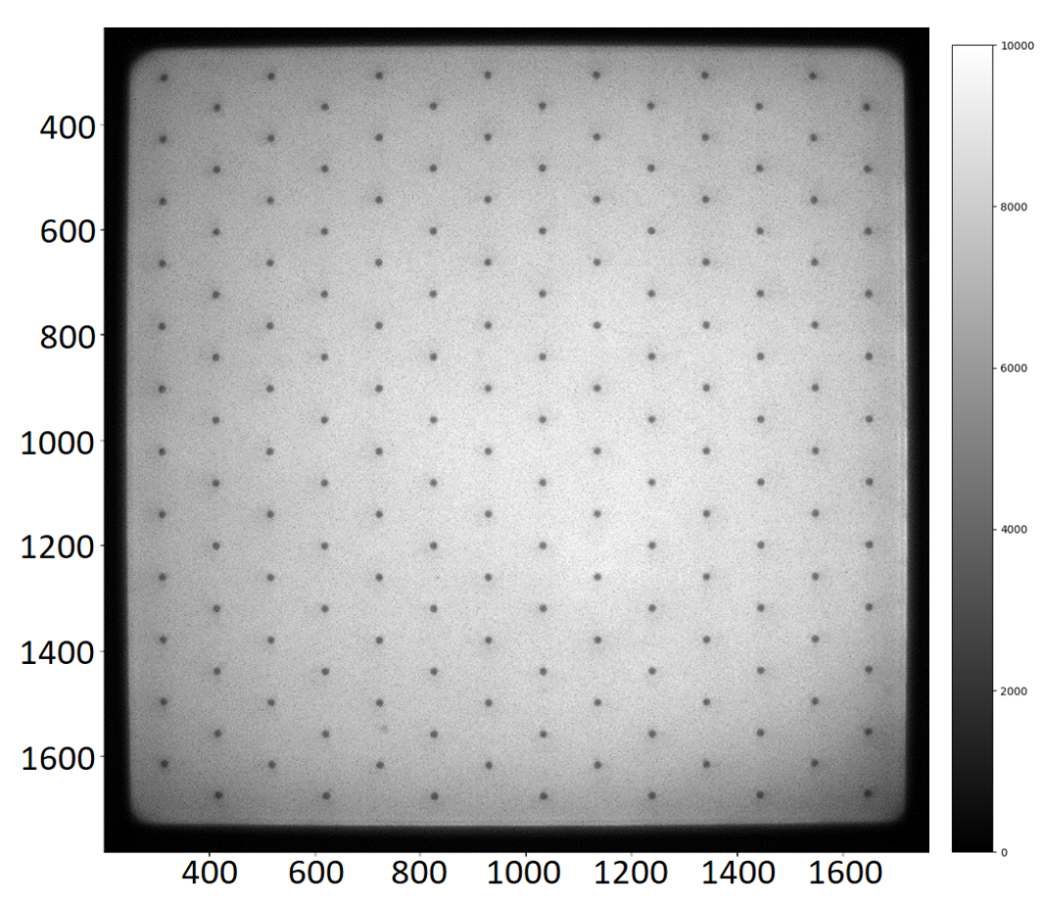
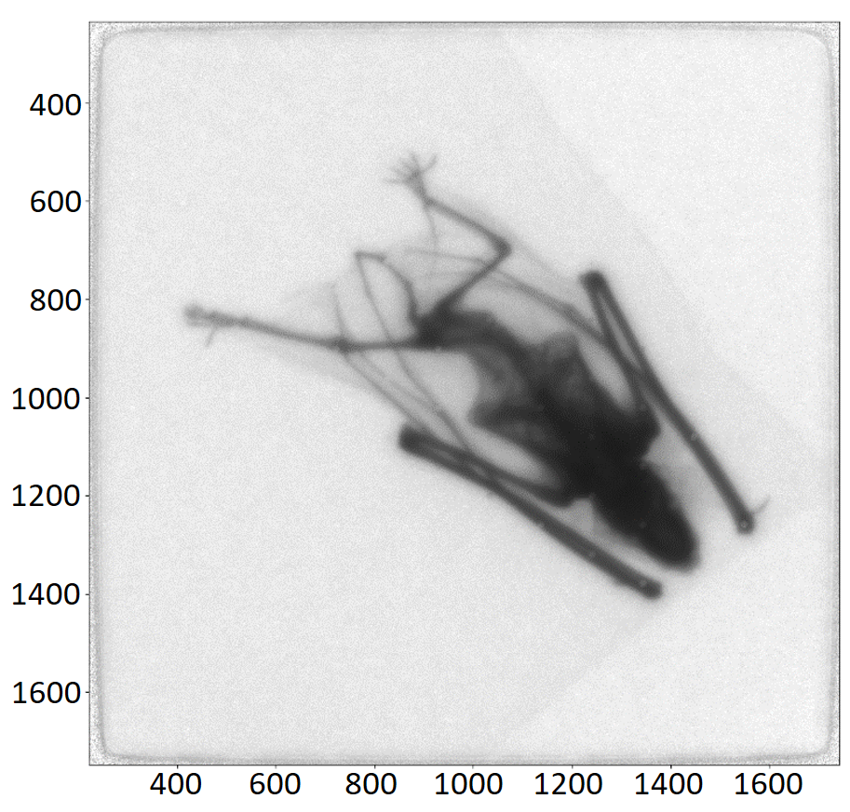
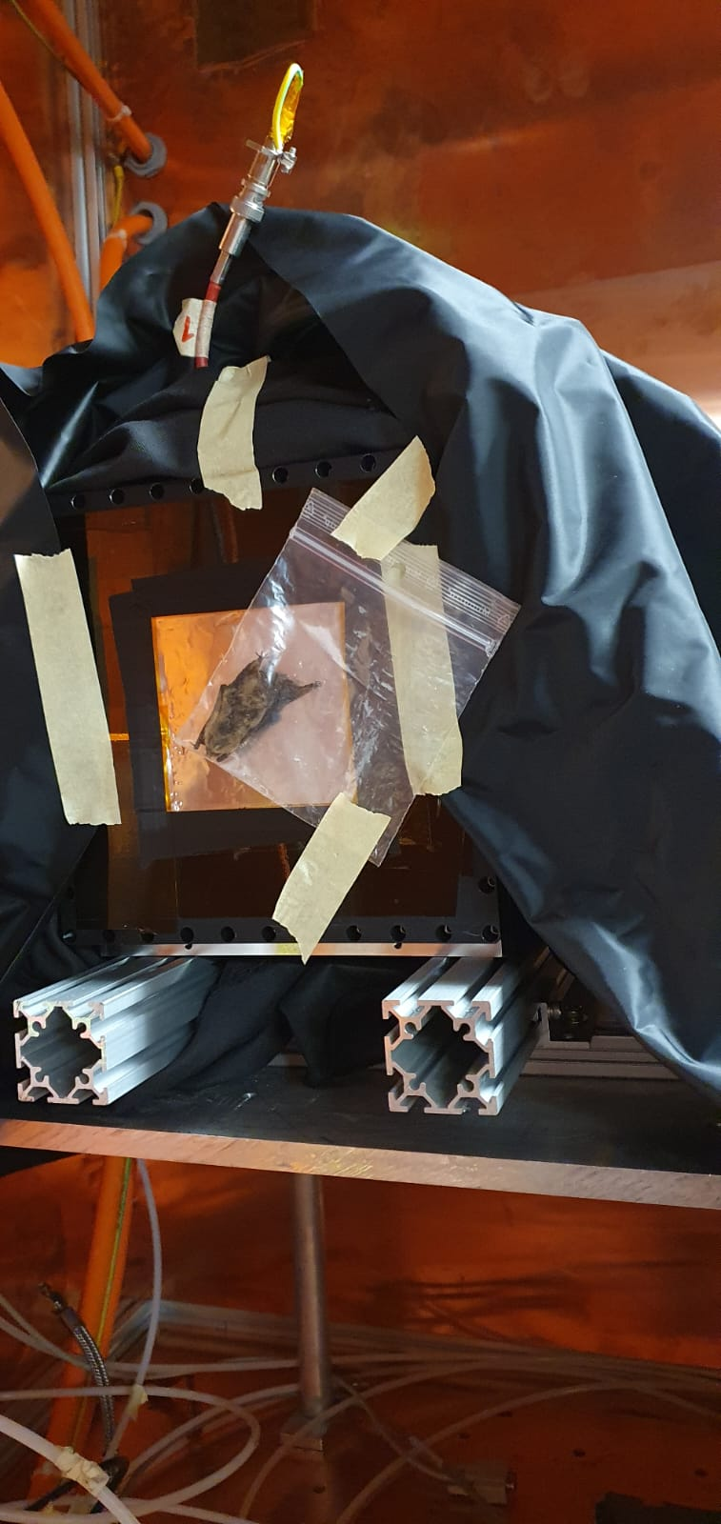
DETECTOR CHARACTERIZATION WITH X-RAYS (CERN GDD)
X-ray radiography (20 kV) – Ar/CF₄(20%)
High gain: 1 min exposure time gives images with good contrast
60 sec exposure time bat radiography with simple background suppression and beam profile correction.
9
60 sec full detector image with simple background suppression.

Slide 10
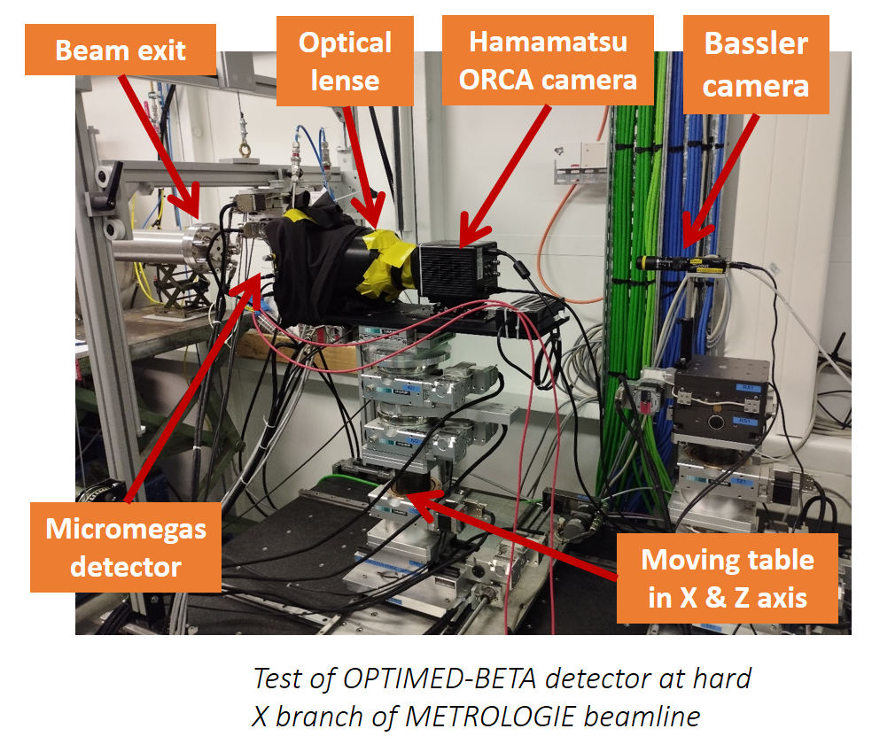
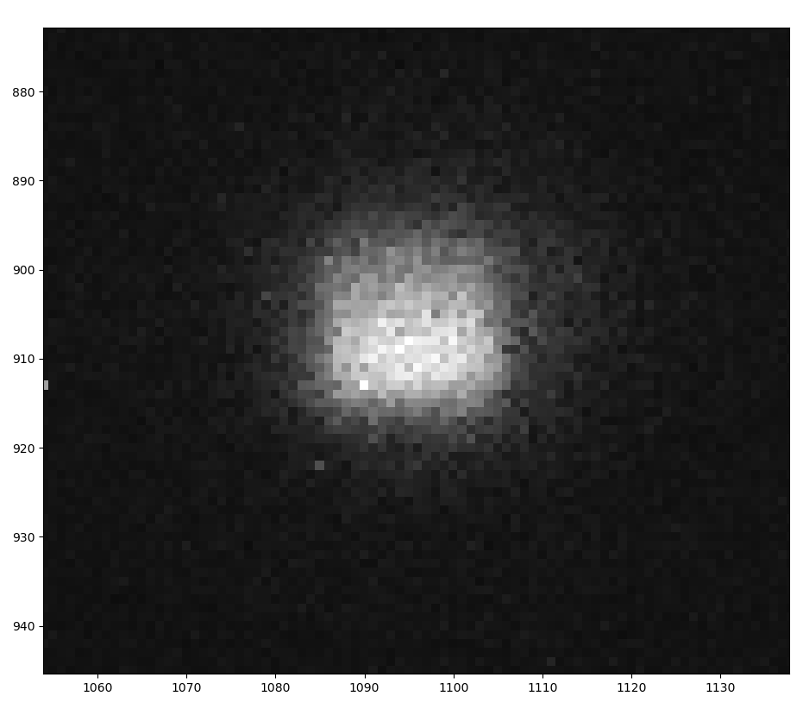
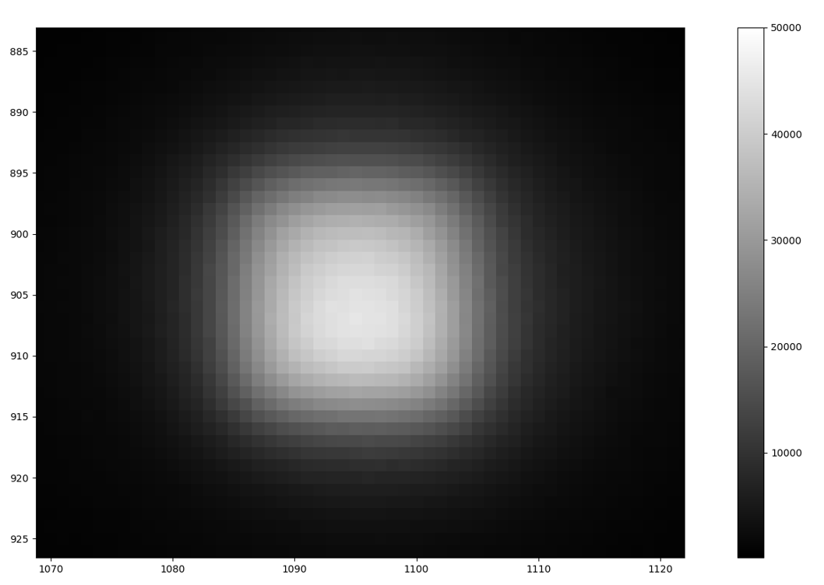
SOLEIL BEAM TEST (16/11-18/11)
Synchrotron Soleil (4 keV – 15 keV)
Goals
Determination of Point Spread Function
Spatial resolution dependence on drift gap, drift field
and beam energy
Detector homogeneity
PRELIMINARY
1x1mm beam, Primary Scintillation
(Va=0 V, Vd=0 V)
1x1mm beam, Amplification
(Va=400 V, Vd=210 V)
0.035x0.035mm beam, Amplification
(Va=400 V, Vd=210 V)
10

Slide 11
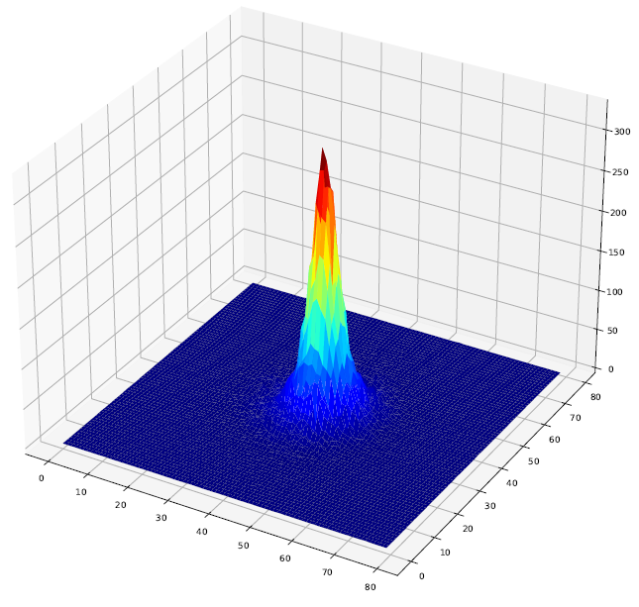
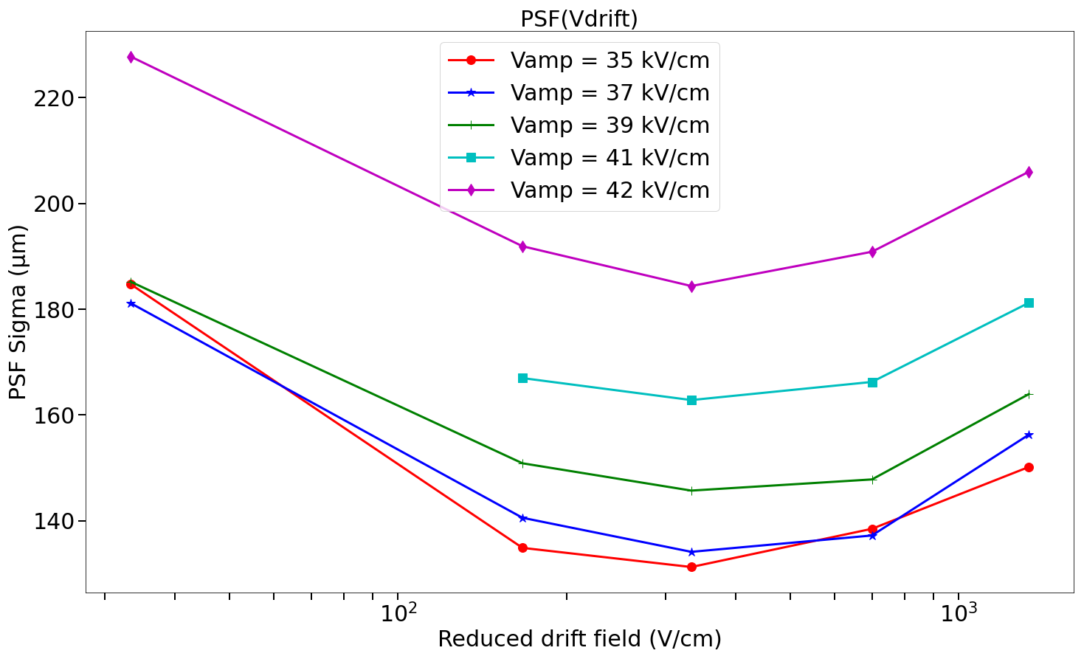
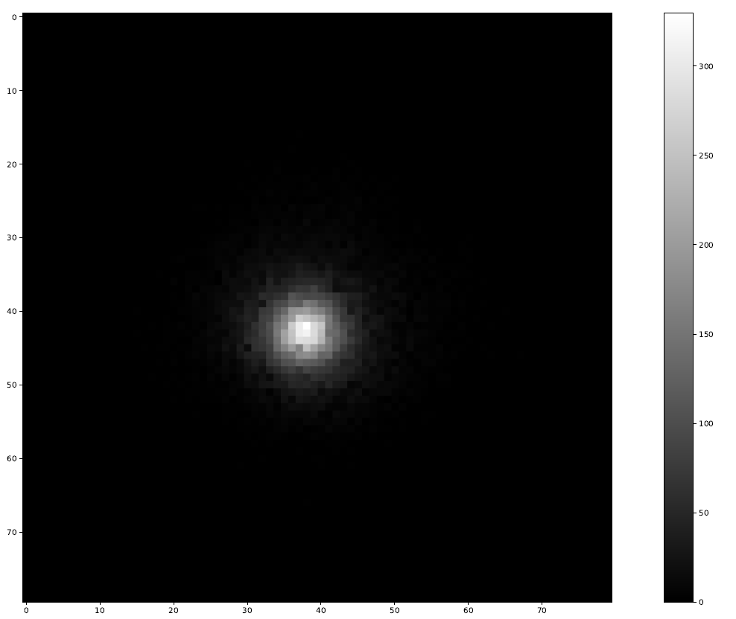
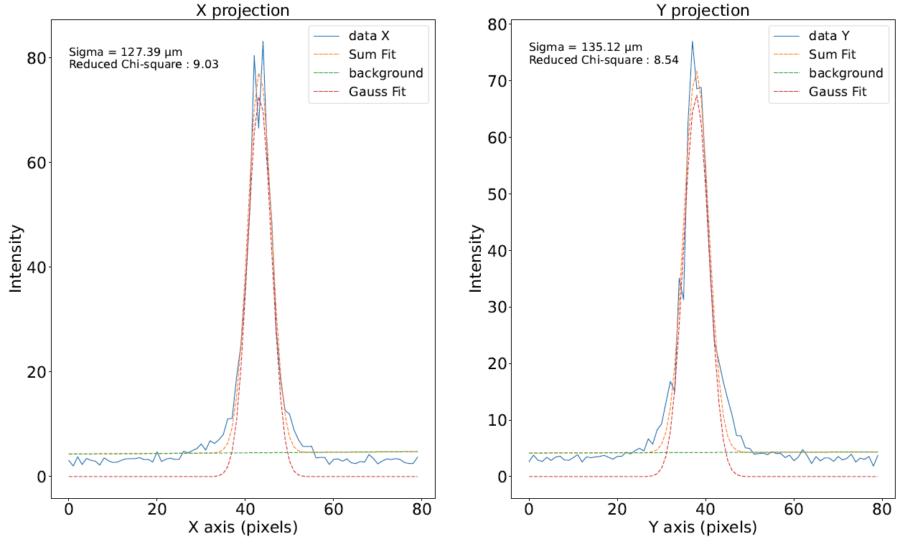
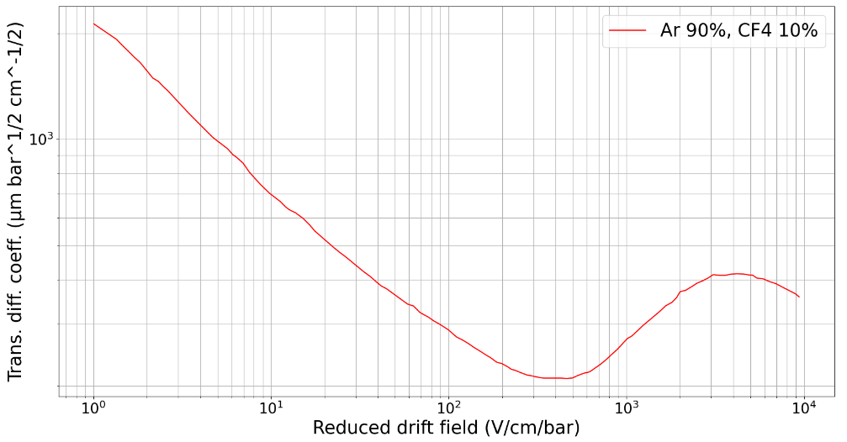
35 x 35 µm² beam, 6keV, Drift gap = 3 mm
PRELIMINARY
Va=450 V, Vd=100 V
11

Slide 12
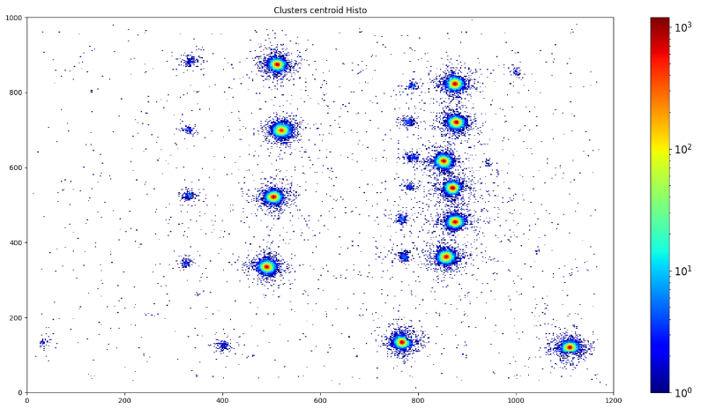
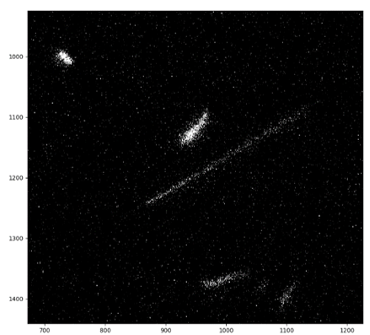
B-imaging
Preliminary results with tritium samples
Neutron radiography
Preliminary results with a neutron source
12

Slide 13
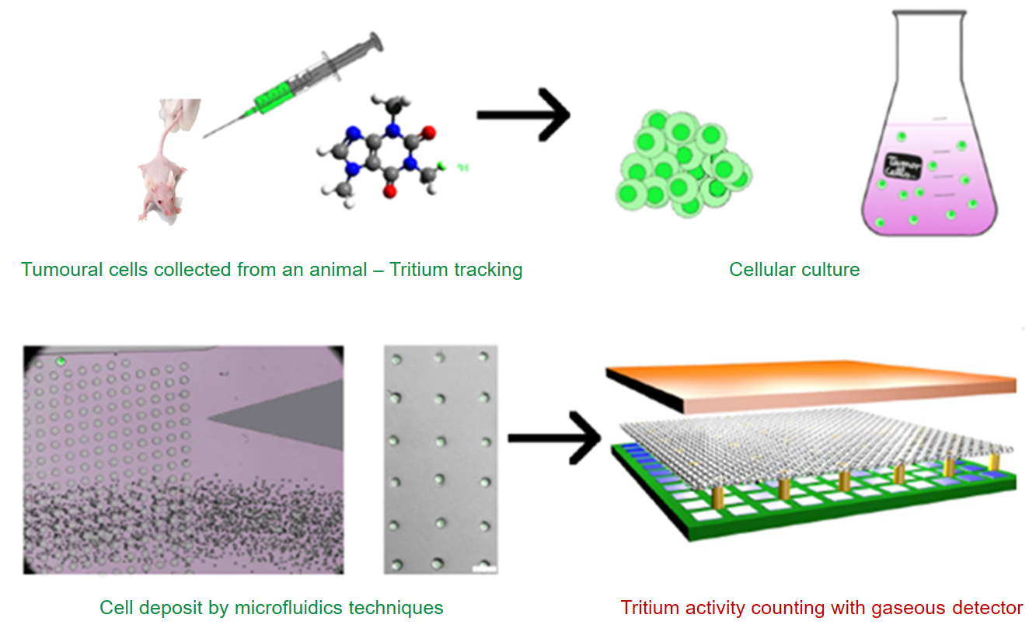
Β-IMAGING
Tumor heterogeneity: different cell types inside a tumor
  Heterogeneity effect on drug targeting?
  Will help the developing of more efficient drugs
  Requires better detection sensibilities
Molecule labelling and tracking with tritium
Pharmaceutical needs at the cell level for drug development:
  Assess the drug distribution among cells
  Evaluate the impact of the cell heterogeneity on drug biodistribution
  At the cell level: Quantification of ³H concentration in single cell samples
13

Slide 14
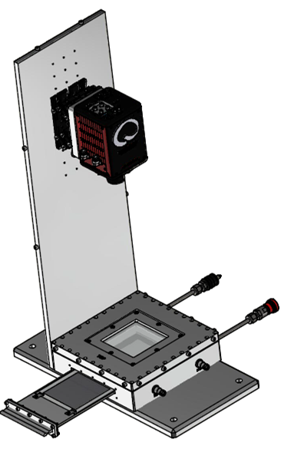
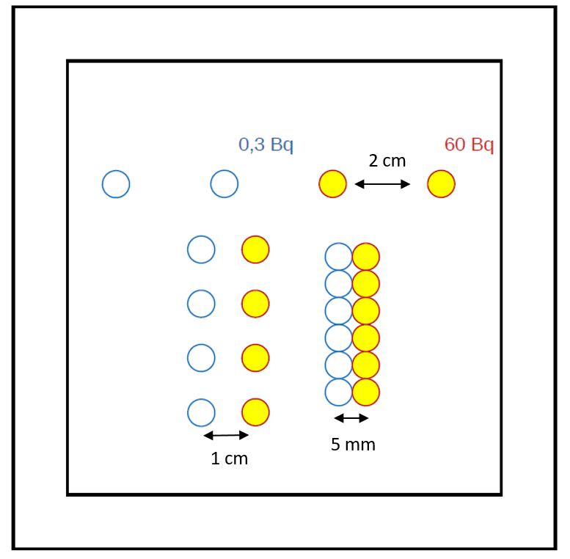
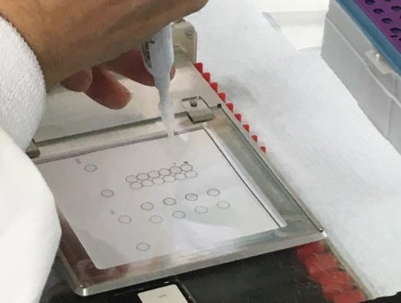
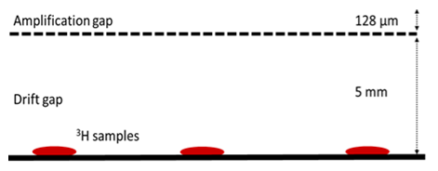
PRELIMINARY RESULTS WITH TRITIUM SAMPLES
First deposit : tritiated glucose
Camera
Light cover
Glass
VIS light
ITO
Mesh
e⁻
β
Cathode
Tritium deposits schema and picture
OPTIMED-BETA set-up scheme
Activity measurement limits and dynamic range → Activities: 0.3 Bq and 60 Bq
Spatial resolution → gap between drops: 2 cm – 1 cm – 5 mm
14

Slide 15
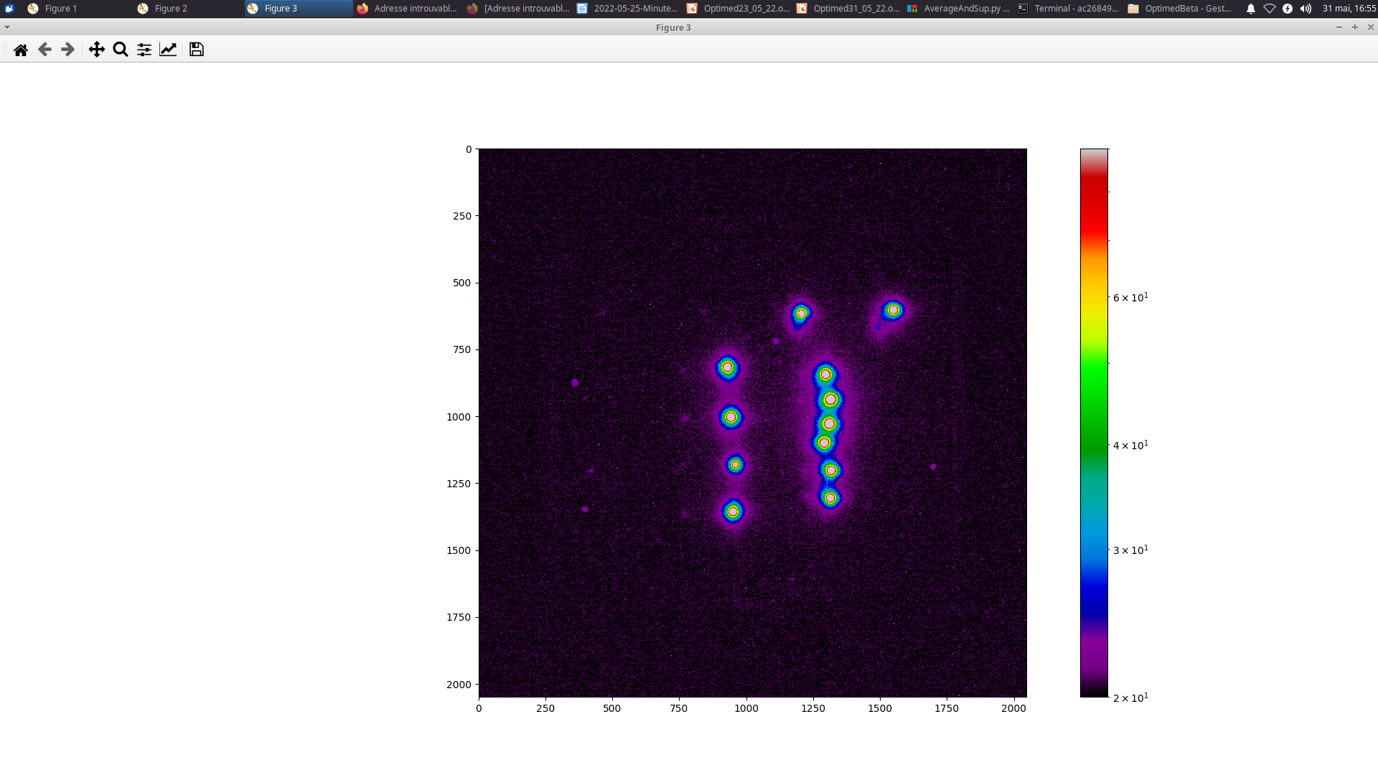
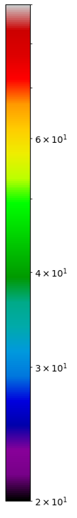
PRELIMINARY RESULTS WITH TRITIUM SAMPLES
Integration method :
Light intensity profile
60 Bq drops positions are well assessed
0.3 Bq drops hardly visible
Ar/CF₄(20%)
180 frames of 10 sec (30 min) added with simple background suppression 20% of CF4
15

Slide 16
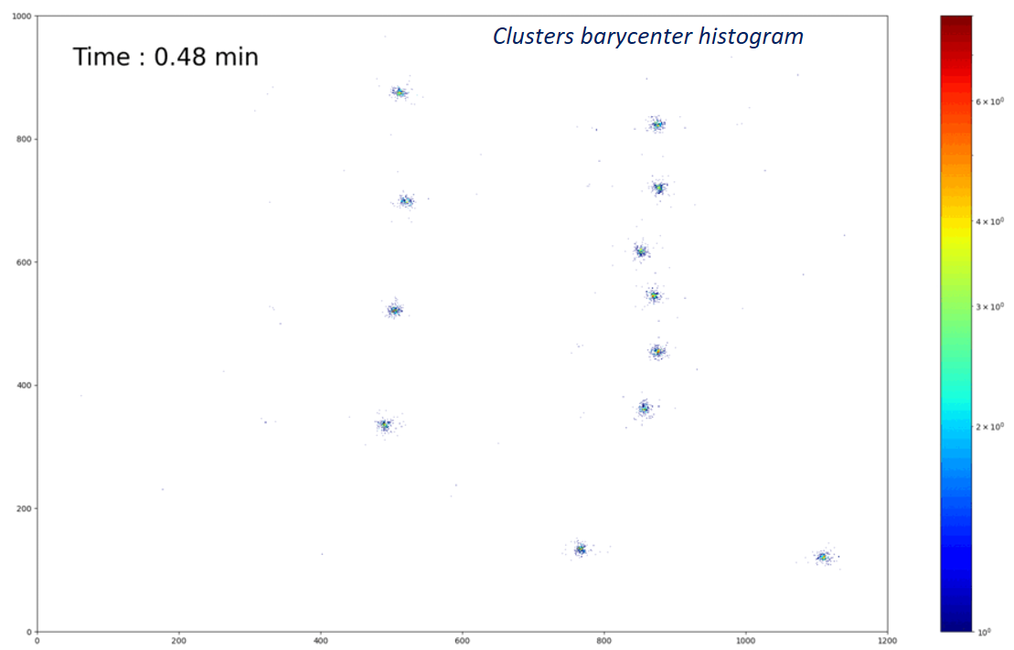
PRELIMINARY RESULTS WITH TRITIUM SAMPLES
Clustering method :
20000 frames of 100 msec (33 min), individual pixel background thresholding, 20% of CF4
Both 60 Bq and 0.3 Bq drops positions are well assessed
Better signal-to-noise ratio and counting events capability
16

Slide 17
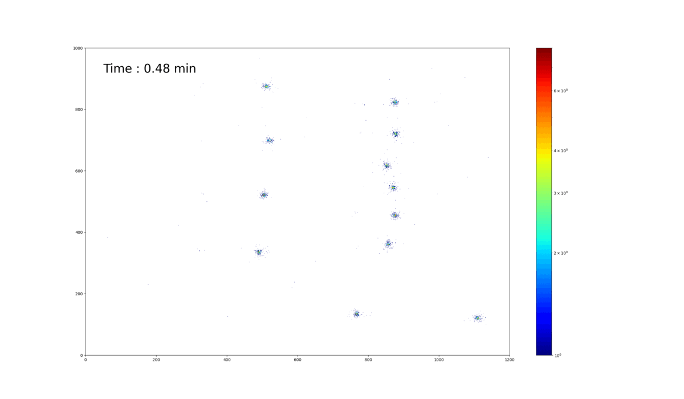
PRELIMINARY RESULTS WITH TRITIUM SAMPLES
Clustering method :
Clusters barycenter histogram
20000 frames of 100 msec (33 min), individual pixel background thresholding, 20% of CF4
Both 60 Bq and 0.3 Bq drops positions are well assessed
Better signal-to-noise ratio and counting events capability
17

Slide 18
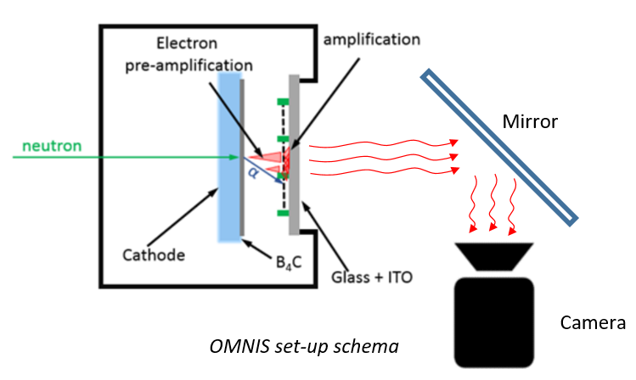
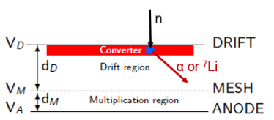
NEUTRON RADIOGRAPHY
Micromegas-based neutron imager
¹⁰B₄C neutron-to-charge converter
  Thermal neutrons absorbed by 2 µm thin ¹⁰B₄C layer
  Conversion efficiency: 5%
  (α or Li) fragments causes strong ionisation compared to electrons
  Drawback: fragments long range in the gas (5 mm)
Acquisition modes:
  Event-by-event: track reconstruction:
  potentially higher resolution (100 µm), better ɣ-to-n suppression
  Integrated: real-time radiography:
  ɣ-to-n suppression less efficient
Boron converter principle
18

Slide 19
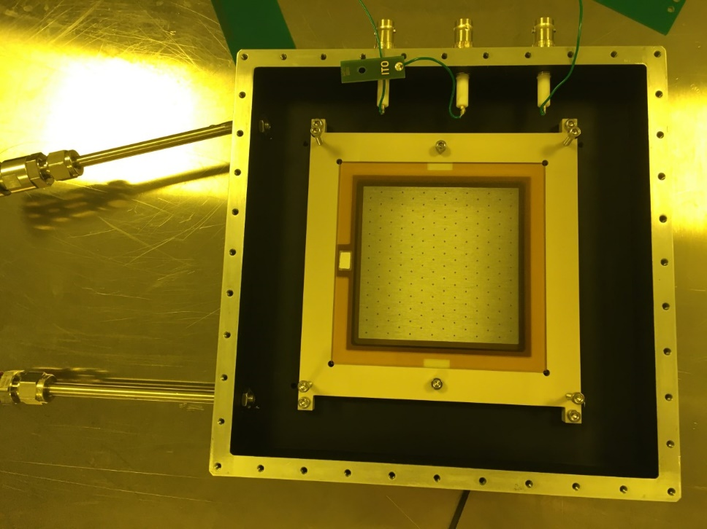
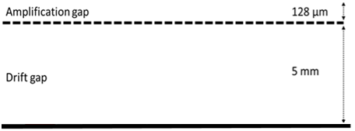
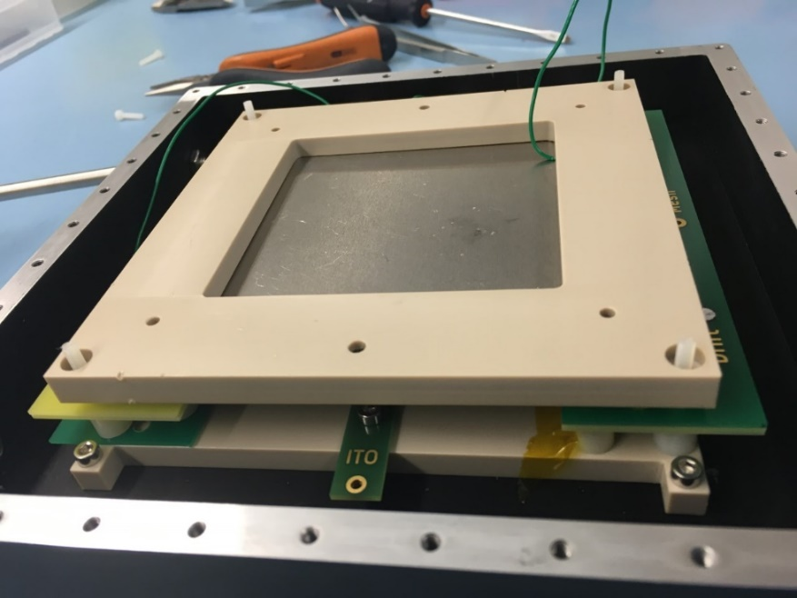
PRELIMINARY RESULTS WITH A NEUTRON SOURCE
Experimental set-up
Camera
Light cover
Glass
VIS light
ITO
Mesh
e⁻
10 mm
Cathode
α & ⁷Li
B₄C
Slow neutron
Neutron source
OMNIS set-up schema
19

Slide 20
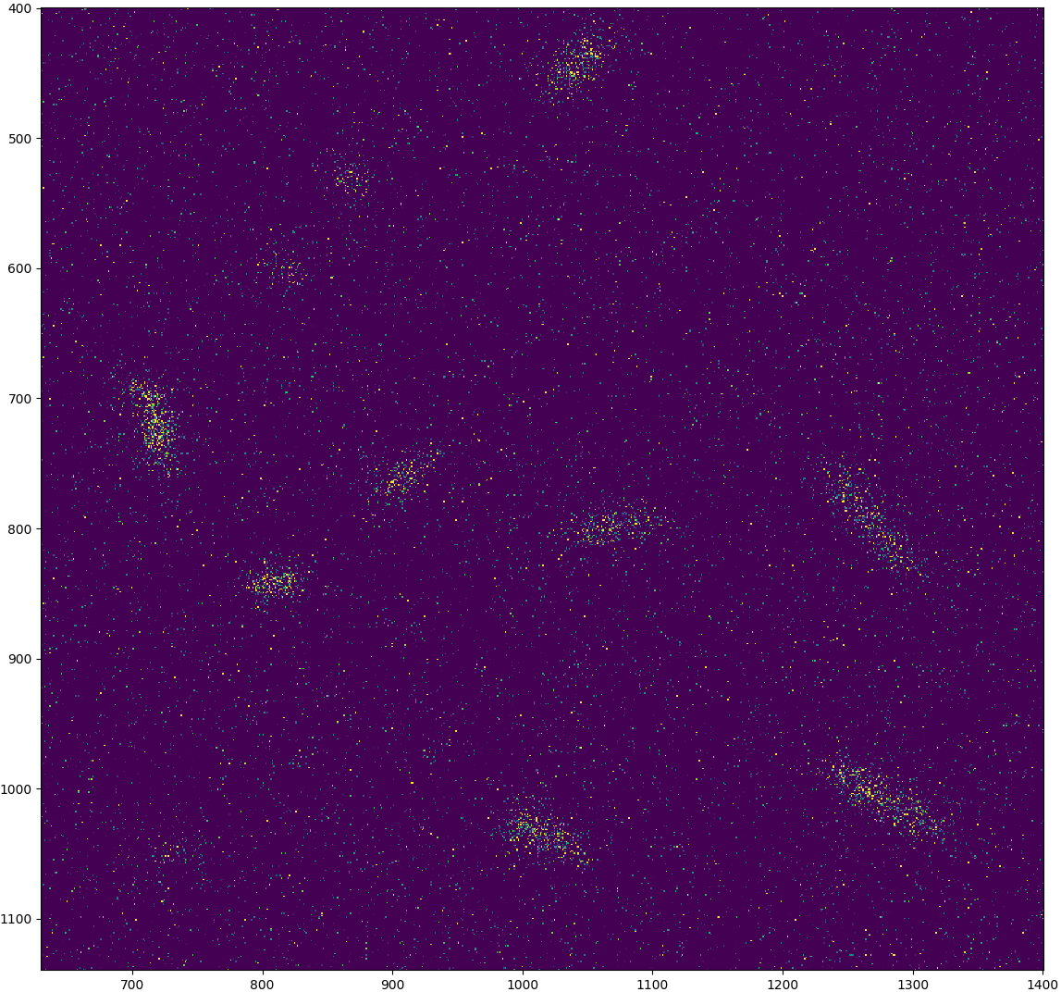
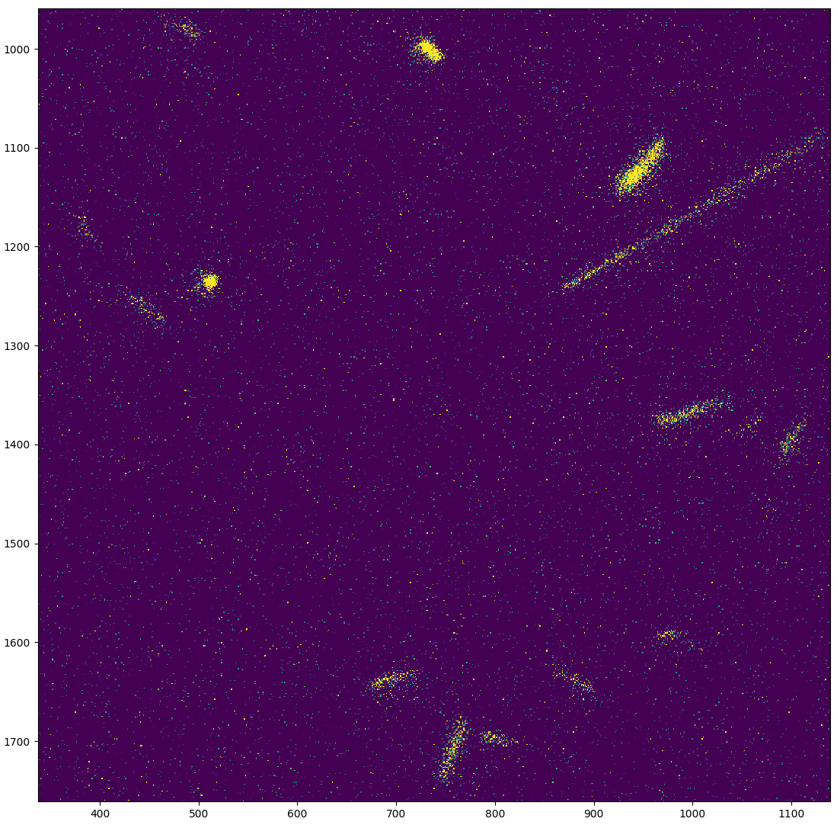
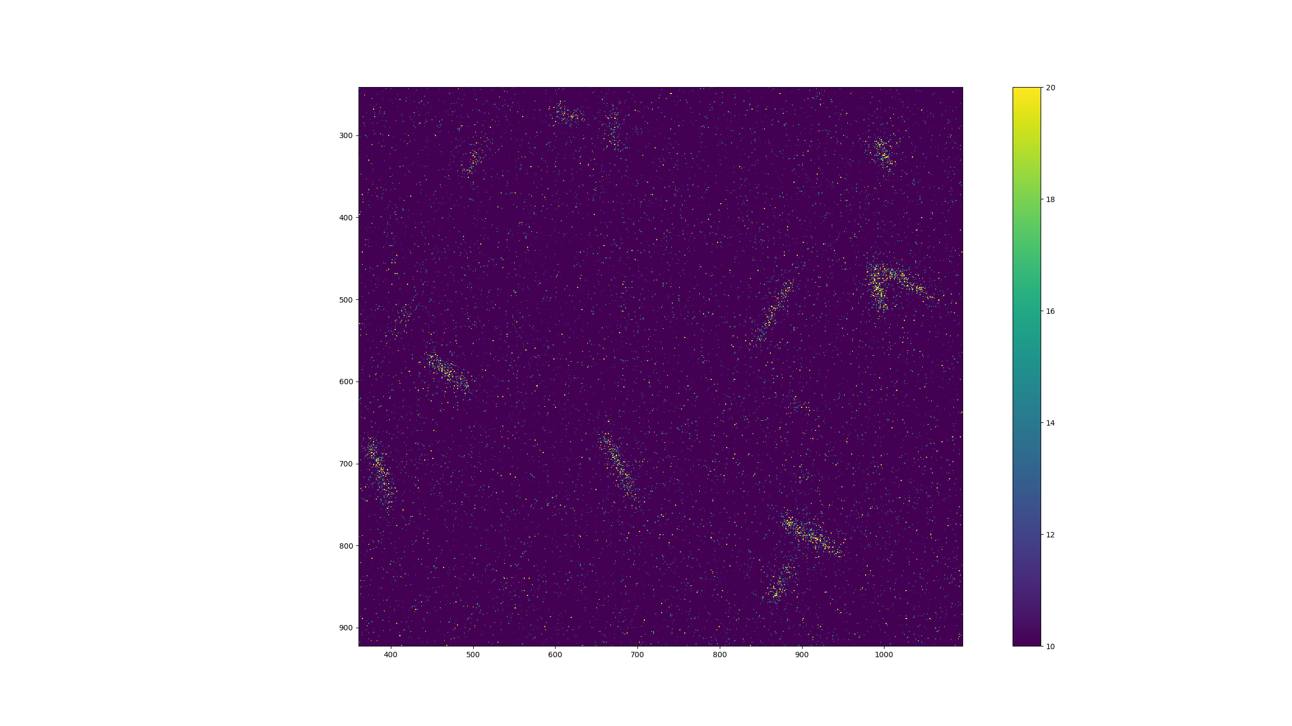
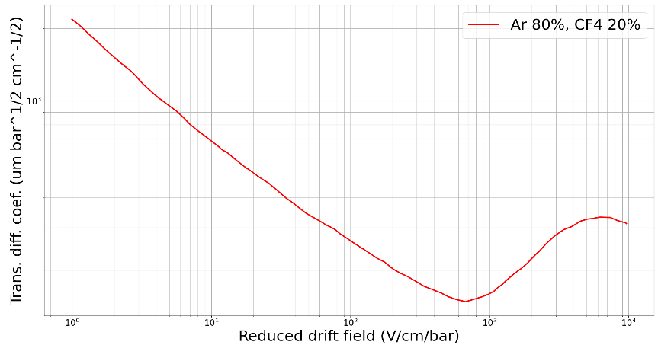
PRELIMINARY RESULTS WITH A NEUTRON SOURCE (CERN GDD)
50 V/cm drift field
800 V/cm drift field
2000 V/cm drift field
Transverse diffusion in 80% Argon + 20% CF4 gas mixture.
Drift field affects the diffusion in the gas
50 V/cm
800 V/cm
2000 V/cm
Diffusion spreads the light
PRELIMINARY
20

Slide 21
CONCLUSION
What we have done
Several types of Micromegas on glass were built and tested
Setups of optical readout detectors for neutron and beta detection
Detector characterization at X-ray facilities, with beta samples and neutron sources
Image processing in progress
Outlook
Beam test at Soleil accelerator: spatial resolution measurement and determination
of point spread function
Investigate image treatment methods
β-imaging: tests on isolated single tumor cells
Neutron radiography: Irradiation at neutron facilities
21

Slide 22
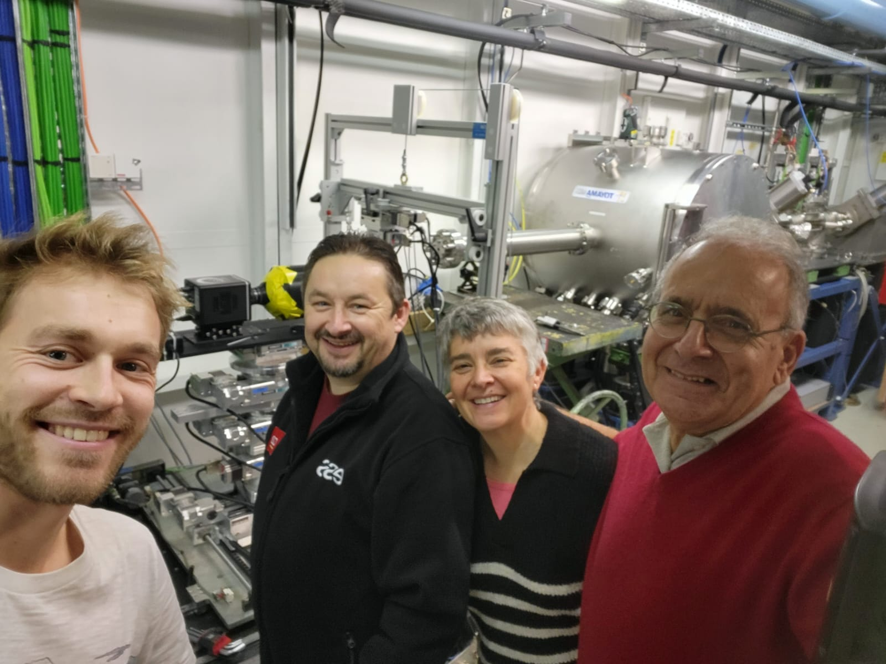
THANK YOU
22

Slide 23
BACK UP
23

Slide 24
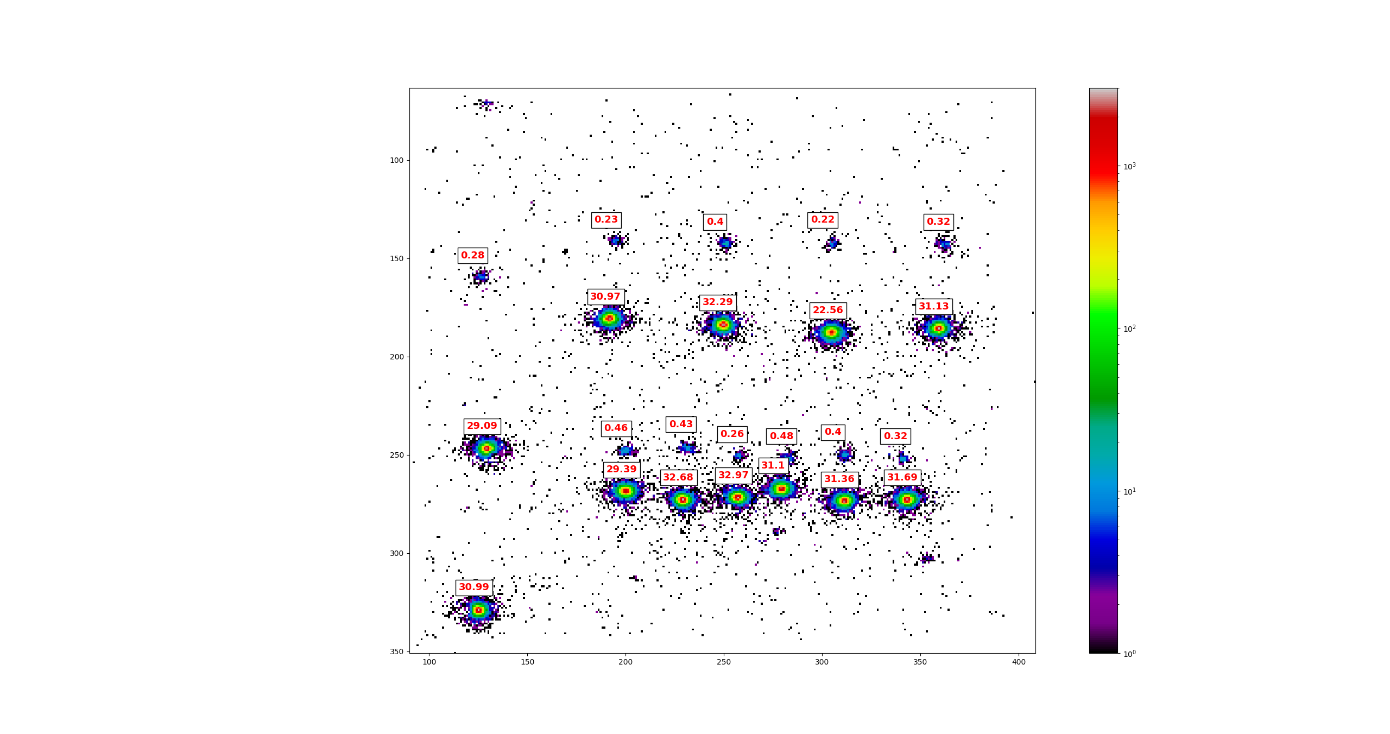
PRELIMINARY RESULTS WITH TRITIUM SAMPLES
Clustering method :
Charge readout coupling
Optical readout
 | Mean activity (Bq) | Mean STD (Bq)
High activity | 8,4 | 0,74
Low activity | 0,087 | 0,022
24

Slide 25
Light production mechanisms
Scintillation : excited atoms or molecules emit photons during de-excitation.
Scintillation
Phosphorescence
f Fluorescence
Electroluminescence
: Delayed emission of photons after absorption.
(1 ms to 100 s)
Prompt emission of photon after absorption of incident radiation.
(1 ns to 1 µs)
Electrons with energy lower than ionization threshold just excite atoms or molecules.
Primary scintillation
Secondary scintillation
From the creation of primary electron coming from the excitation of gaz due to incident particles.
From the creation of secondary electrons taking place during avalanche amplification.
Light yield : amount of light determines the signal to noise ratio. It depends on electric field, pressure and gas mixture.
25
Notes:
25

Slide 26
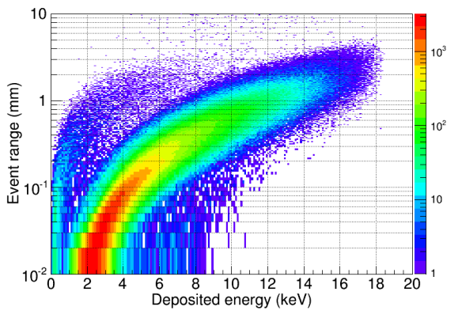
PRELIMINARY RESULTS WITH TRITIUM SAMPLES
β particle range in Ar-Isobutane gas mixture
26

Slide 27
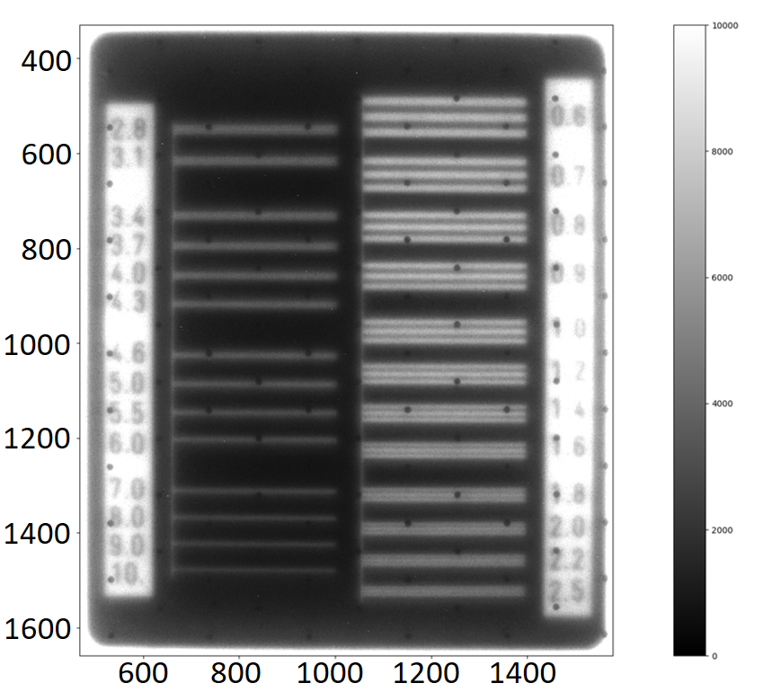


DETECTOR CHARACTERIZATION WITH X-RAYS
X-ray radiography
MTF measurement
60 sec exposure time lead target radiography with simple background suppression.
27

Slide 28



SOLEIL BEAM TEST (16/11-18/11)
Va=550 V, Vd=210 V
28

Slide 29

SOLEIL BEAM TEST (16/11-18/11)
Va=550 V, Vd=210 V
29

Slide 30

30

Slide 31



31

Slide 32

32

