Slide 1


Jet quenching in evolving anisotropic matter
Andrey Sadofyev
IGFAE (USC)

Slide 2
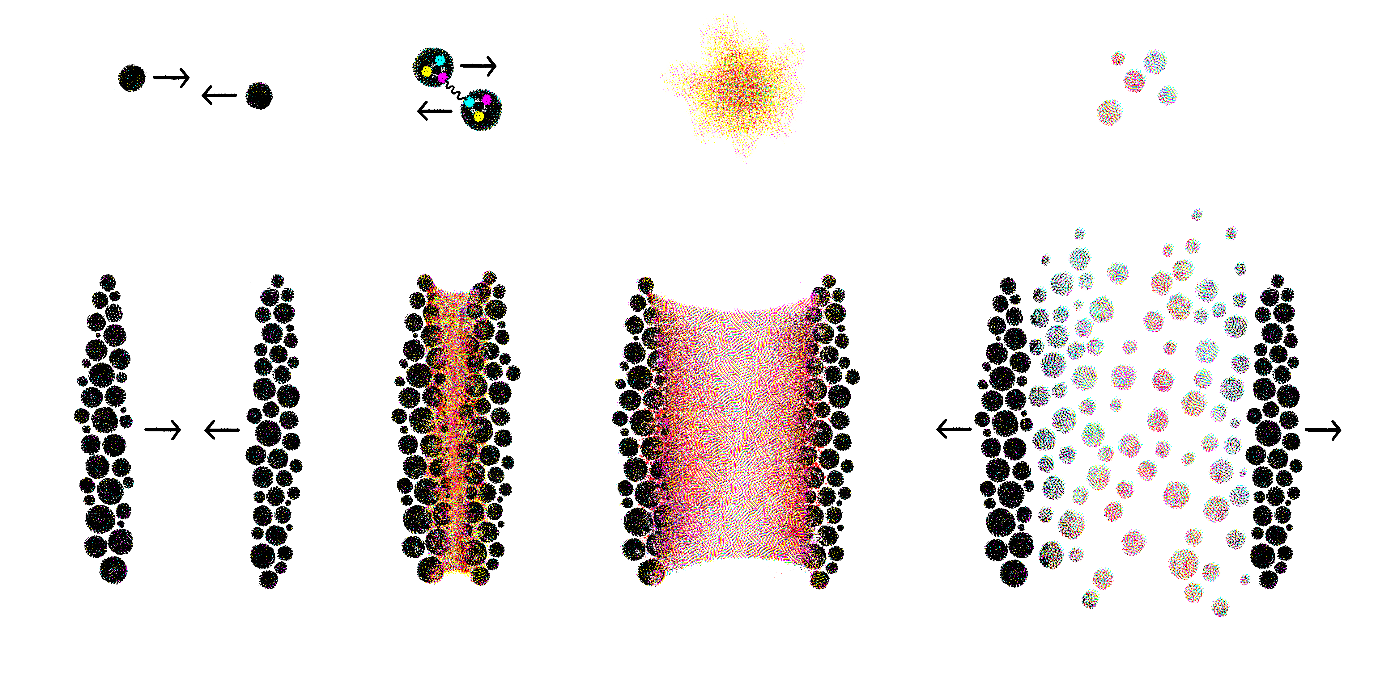
elementary
constituents
small
system
complex
nuclear matter
large
system
simplest
complex matter

Slide 3
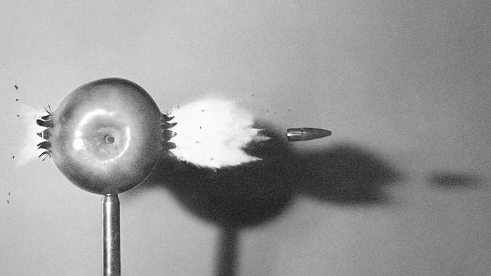
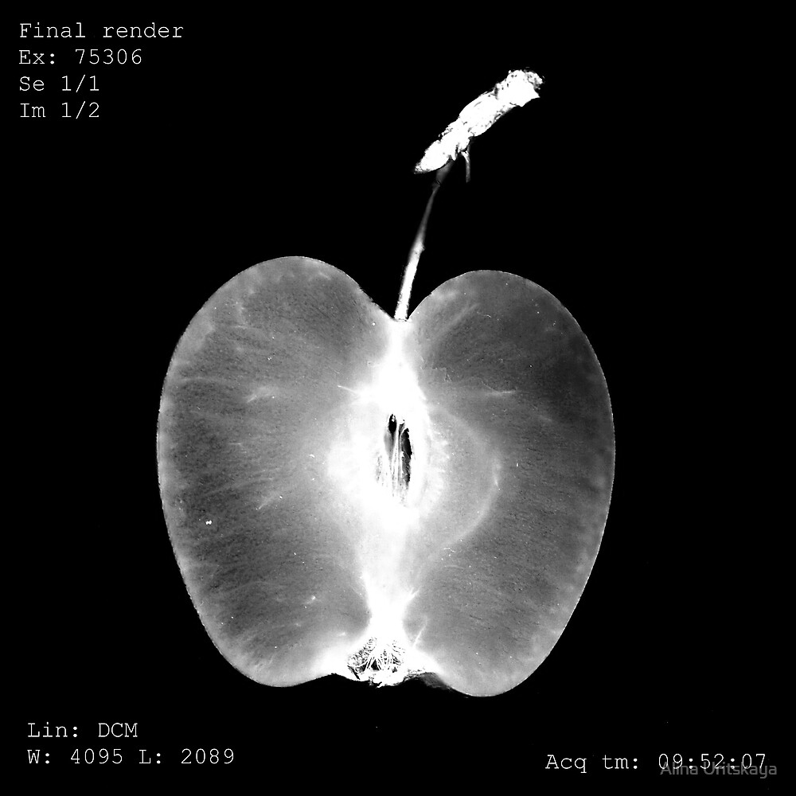

Slide 4
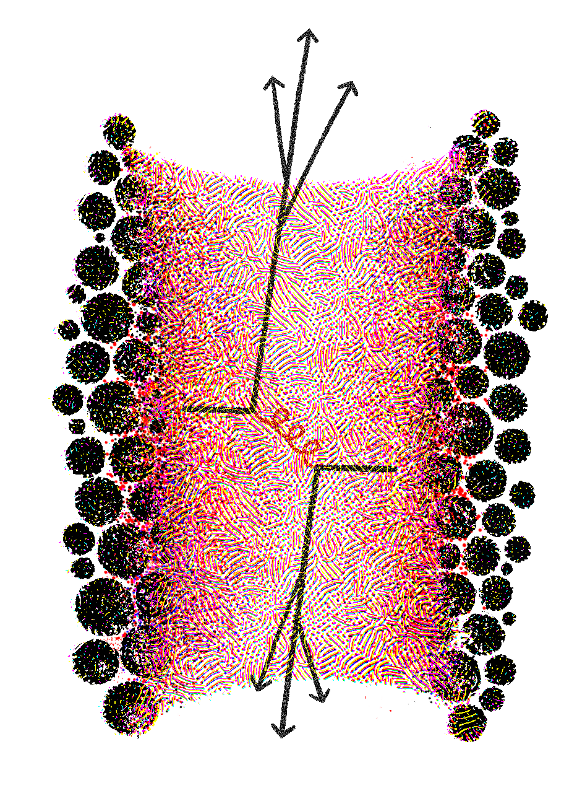
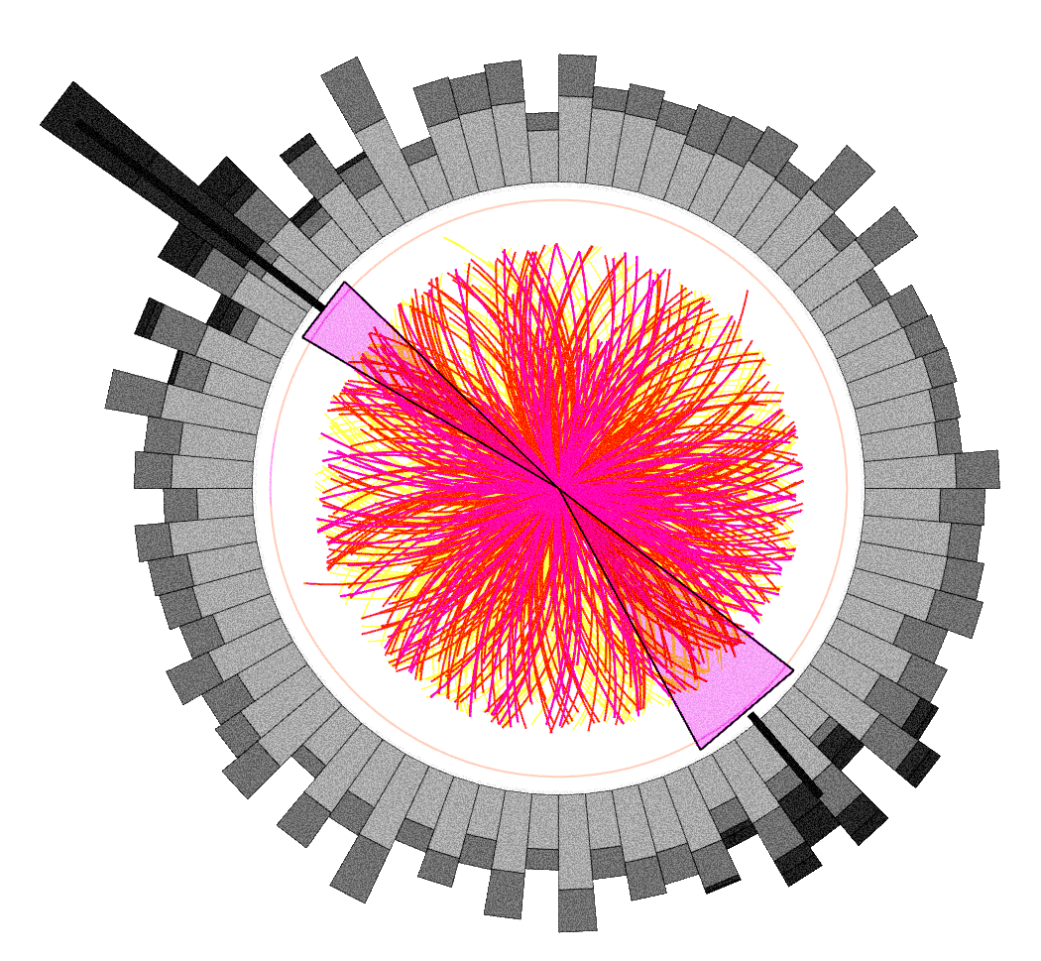
jet quenching
jets lose energy propagating through nuclear matter

Slide 5
Jet tomography
AS, M. Sievert, I. Vitev, PRD, 2021
J. Barata, AS, C. Salgado, PRD, 2022
C. Andres, F. Dominguez, AS, CS, PRD, 2022
J. Barata, AS, X.-N. Wang, arxiv 2022
J. Barata, X. Mayo, AS, CS, 2022 (?)
Jets see the matter in HIC at multiple scales, and essentially X-ray it;
The existing jet quenching theory is based on multiple simplifying assumptions: large parton energy, static matter, no fluctuations, etc;
There is a very recent progress on the medium motion and structure effects in jet quenching and this is the focus of this talk;
The developed formalism can be also applied to include orbital motion of nucleons and some of the in-medium fluctuations to the energy loss in cold nuclear matter;

Slide 6
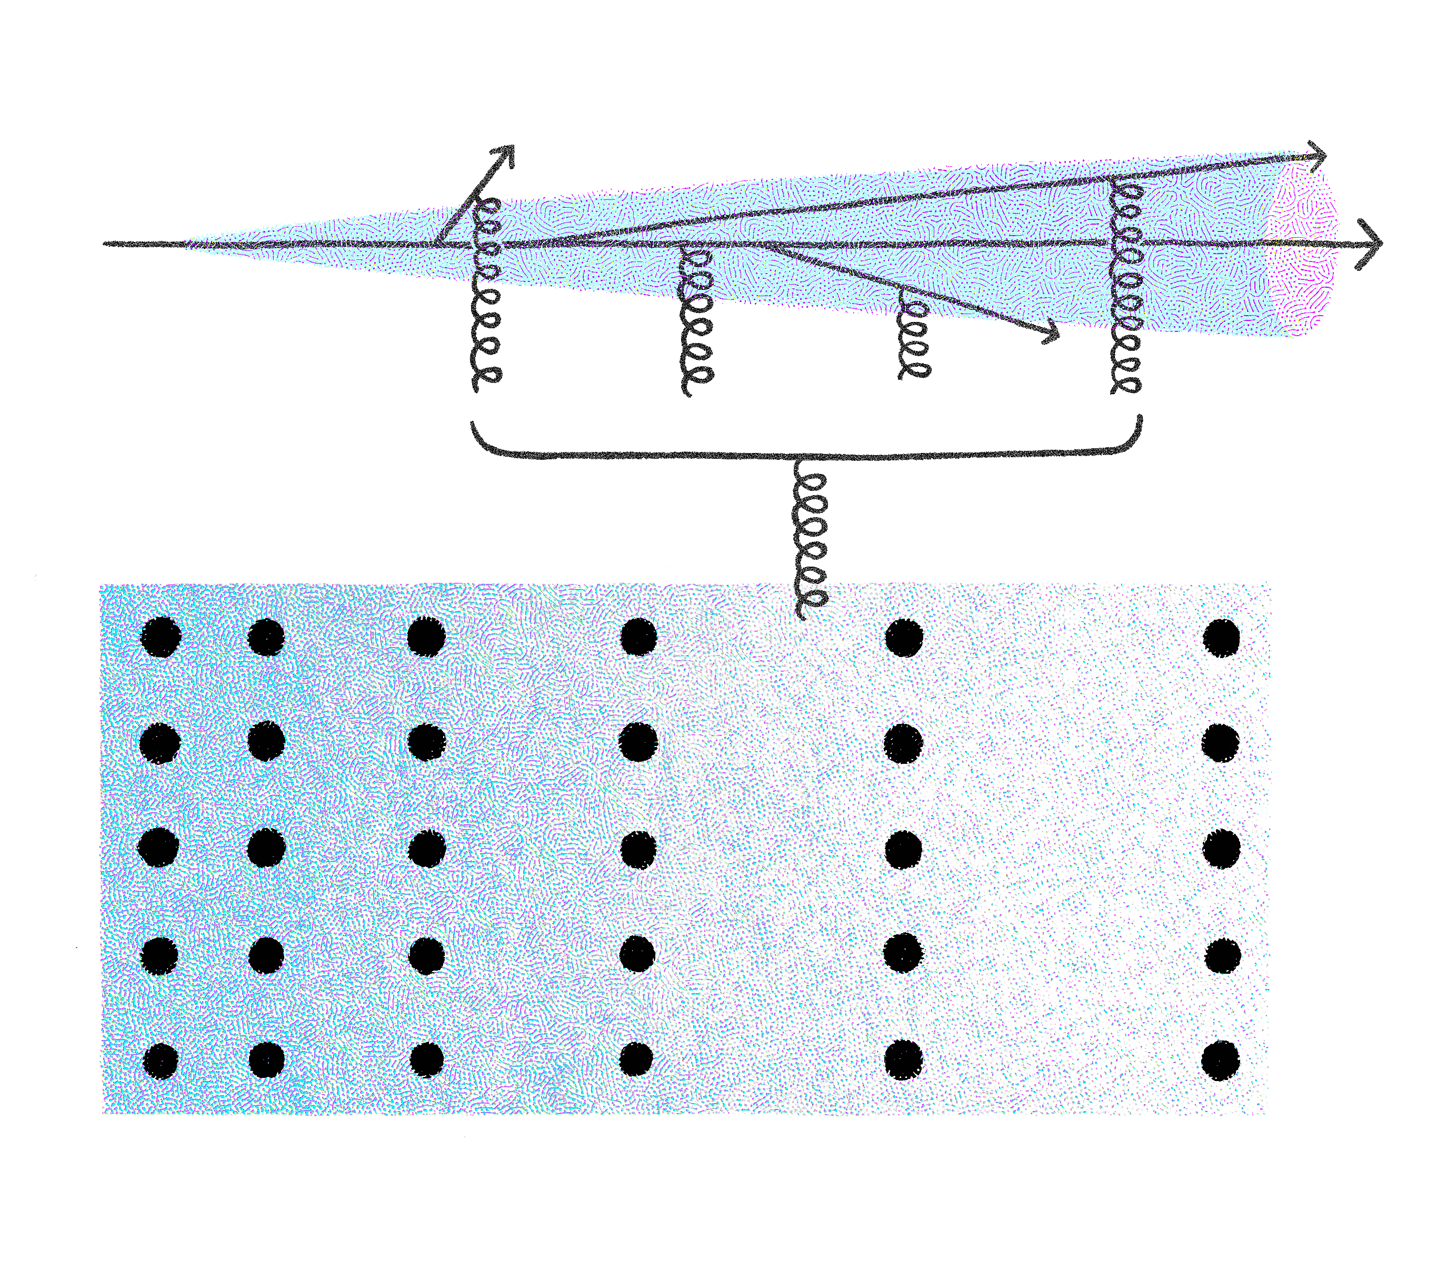
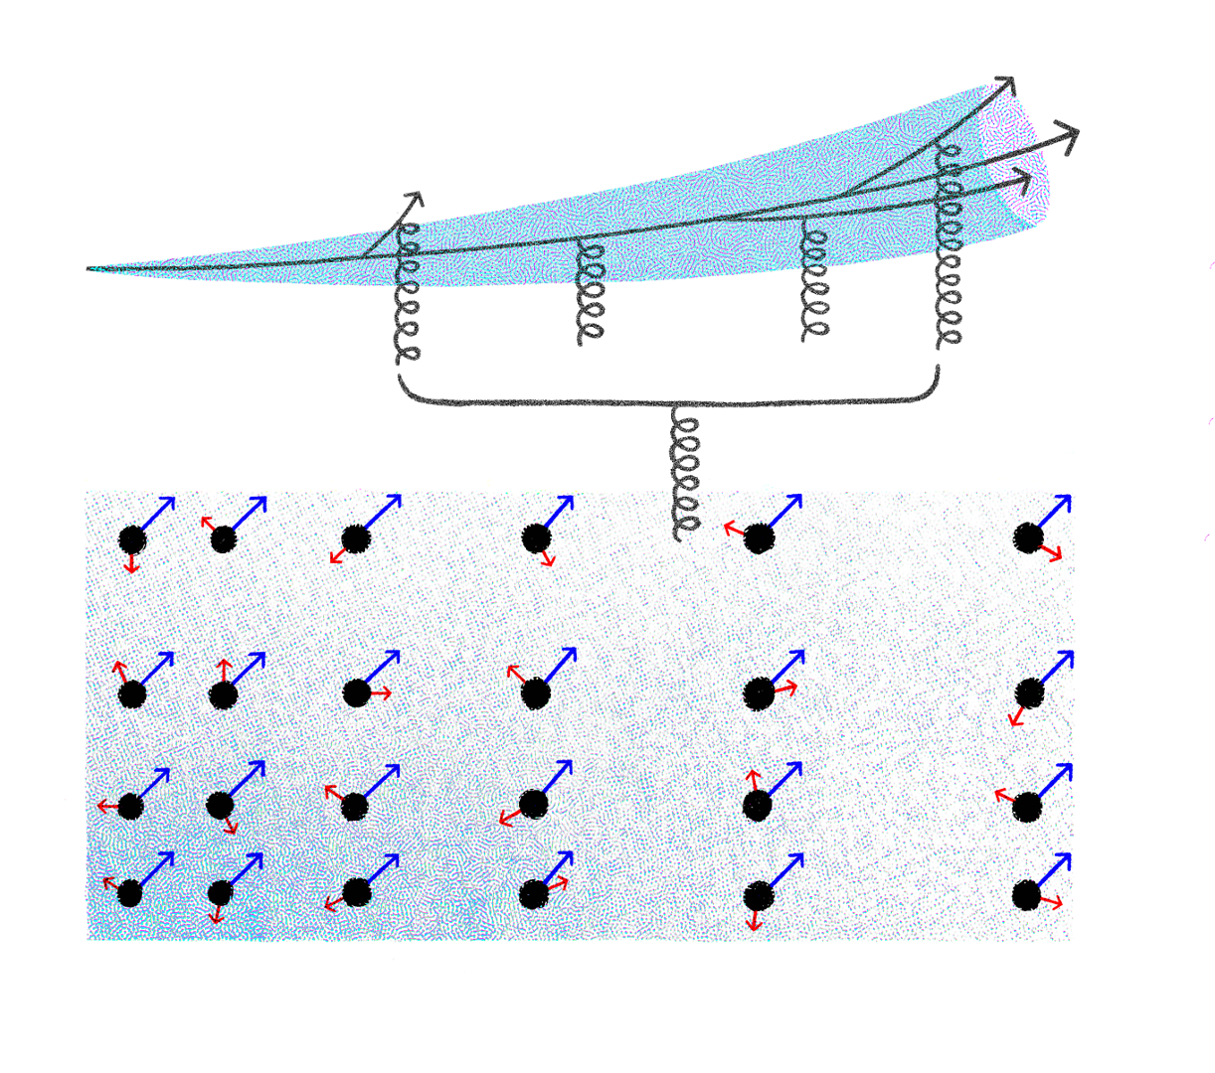
R. Baier et al, NPB, 1997
B. G. Zakharov, JETP, 1997
R. Baier et al, NPB, 1998
M. Gyulassy et al, NPB, 2000
M. Gyulassy et al, NPB, 2001

Slide 7
AS, M. Sievert, I. Vitev, PRD, 2021
Color potential
the initial
distribution
the fluid velocity
inhomogeneity

Slide 8
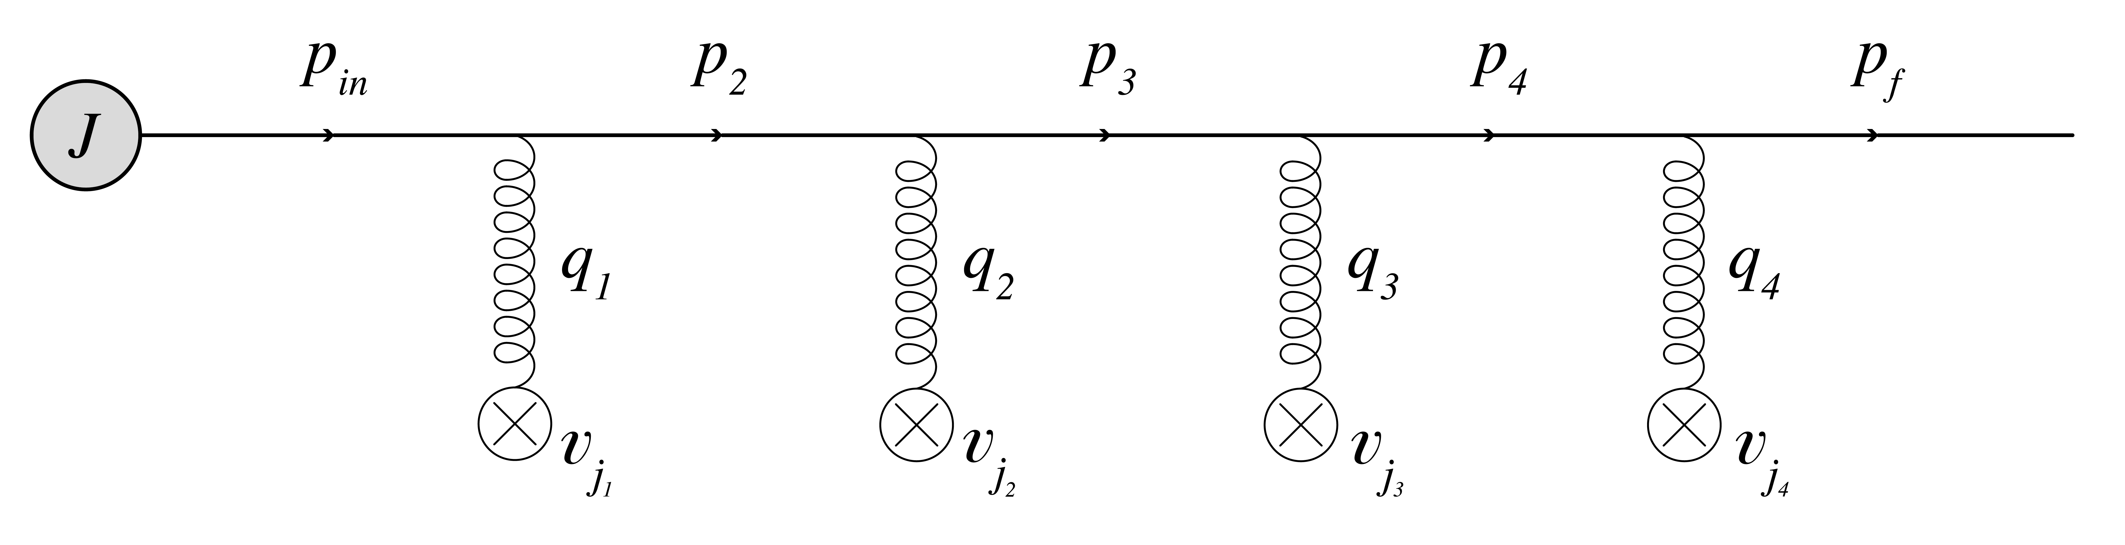
Medium averaging
2
color neutrality
source averaging

Slide 9
AS, M. Sievert, I. Vitev, PRD, 2021
Medium averaging

Slide 10
AS, M. Sievert, I. Vitev, PRD, 2021
Medium averaging

Slide 11
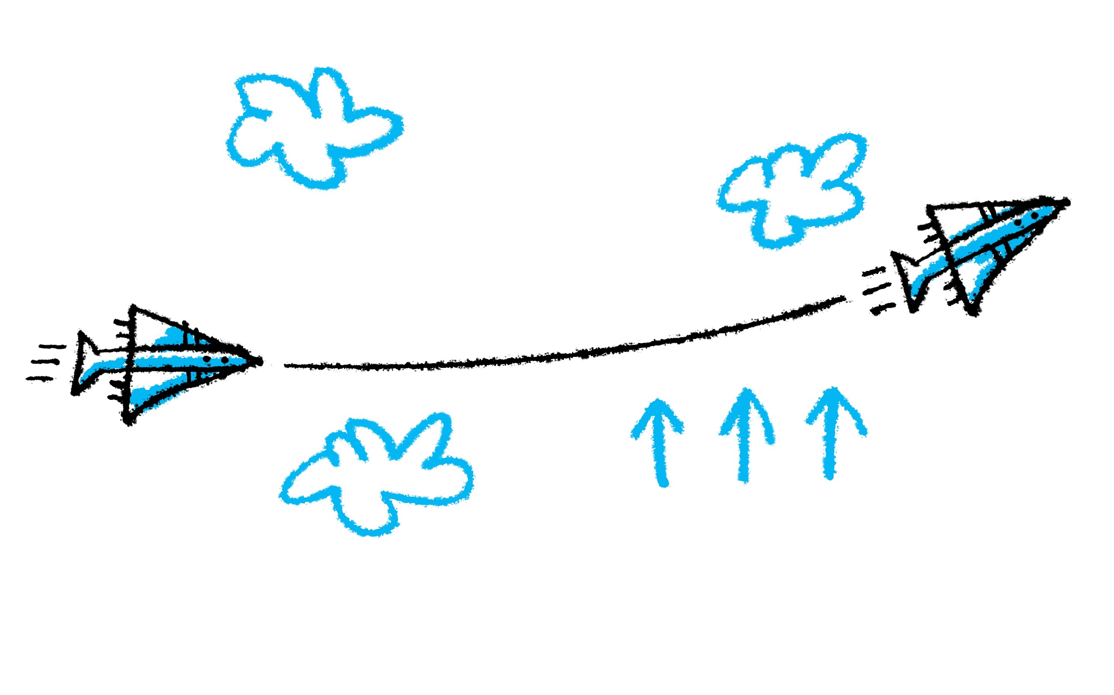

Slide 12
Jet broadening

Slide 13
Jet broadening

Slide 14
Jet broadening
not a convolution anymore
still can be solved
analytically

Slide 15
Broadening probability

Slide 16
Jet broadening
The odd moments are proportional to the transverse flow velocity, the even moments are unmodified;
The initial and final distributions are not factorized anymore in coordinate space (due to the energy derivative);

Slide 17
Jet broadening
uniform matter
Eikonal approximation --
Opacity expansion --
17

Slide 18
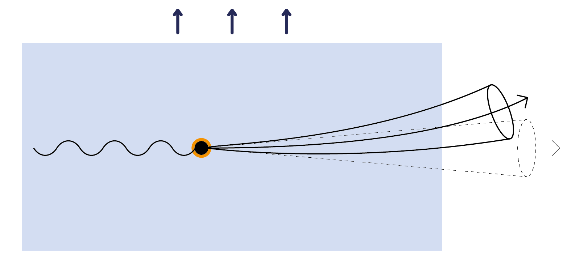

Slide 19
The propagator

Slide 20
J. Barata, AS, C. Salgado, PRD, 2022
Jet broadening

Slide 21
Jet broadening
inhomogeneous matter
21

Slide 23
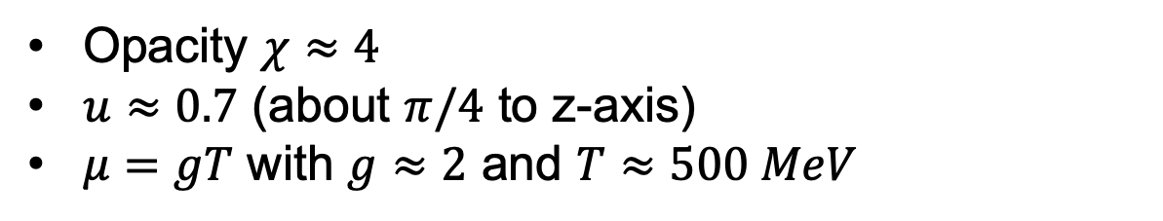


Jet broadening
uniform matter
Opacity $χ≈4$
$u≈0.7$ (about $π/4$ to z-axis)
$μ=gT$ with $g≈2$ and $T≈500 MeV$
What jet energy corresponds to $\left\langle θ\right\rangle ≈1^{o}$?
Jet energies: $E<50 GeV$
23

Slide 24
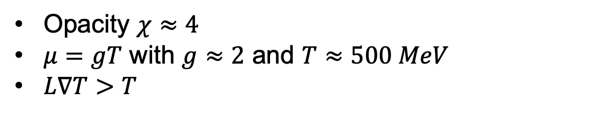
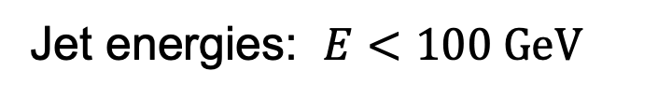

Jet broadening
inhomogeneous matter
Opacity $χ≈4$
$μ=gT$ with $g≈2$ and $T≈500 MeV$
$L∇T>T$
What jet energy corresponds to $\left\langle ”θ”\right\rangle ≈1^{o}$?
Jet energies: $E<100 GeV$
24

Slide 25
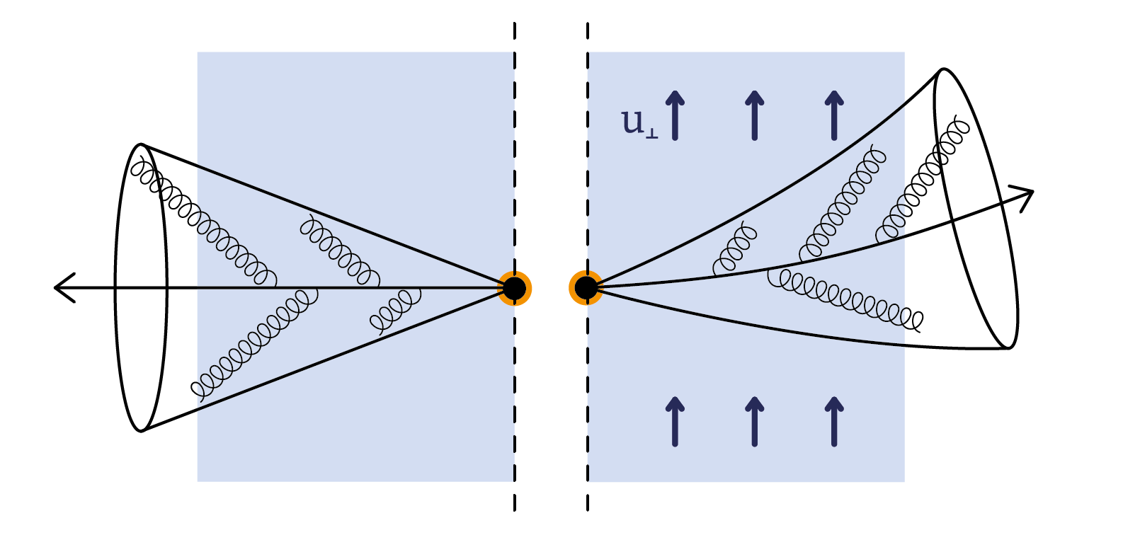

Slide 26
Summary
Jets do feel the transverse flow and anisotropy, and get bended;
The transverse flow and anisotropy are expected to affect the medium-induced radiation, bending the substructure of jets;
These effects can be in principle probed in experiment, leading us towards actual jet tomography;
The initial and final state effects are not factorized anymore;
One may also expect similar evolution-induced effects for other probes of nuclear matter, e.g. quarkonium;

