Slide 1




Model independent Odderon results based on new TOTEM data at 8 TeV
T. Csörgő^{1,2} T. Novák², R. Pasechnik³, A. Ster¹, I. Szanyi^{1,2,4}
¹ Wigner RCP, Budapest, Hungary
² MATE KRC, Gyöngyös, Hungary
³ University of Lund, Lund, Sweden
⁴ Eötvös University, Budapest, Hungary
Statistically Significant Observations of Odderon in 2021
Hungarian-Swedish Odderon:
Significance ≥ 6.26 σ
Hungarian-Polish Odderon:
Significance ≥ 7.08 σ
D0-TOTEM Odderon:
Significance ≥ 5.2 σ
New in 2022:
TOTEM data at 8 TeV published
Hungarian-Polish Odderon: a certainty
Hungarian-Swedish Odderon: confirmed
New relation between R and ρ
Supported by NKFIH:
K 74458, Hungary

Slide 2

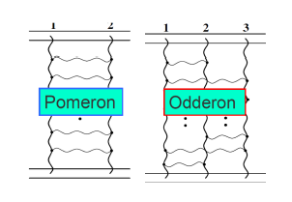
Odderon: 48 years old scientific puzzle
Odderon: L. Lukaszuk, B. Nicolescu,
Lett. Nuovo Cim. 8, 405 (1973)
Received: 31 July 1973
Odderon is an odd component of elastic scattering:
Changes sign for crossing
2
Odderon name coined: D. Joynson, E. Leader, B. Nicolescu, C. Lopez, Nuovo Cim. 30A, 345 (1975) - Well established in QCD by now !
Honorable mention: A. V. Efremov, R. Peschanski, JINR-E2-6350 (1972)

Slide 3
Odderon: elusive experimentally
Odderon search at ISR: indication but no conclusive result
Breakstone et al, Phys. Rev. Lett. 54, 2180 (1985): CL = 99.9 %
Indication of Odderon
CL = 99.9 %,
Significance: 3.35 σ
Terminology for this talk:
Agreement if statistical significance is < 3 σ
Indication of signal if 3 σ ≤ significance < 5 σ
Evidence or observation of signal if 5 σ ≤ significance
Discovery of signal if 5 σ ≤ significance for the first time.
3

Slide 4

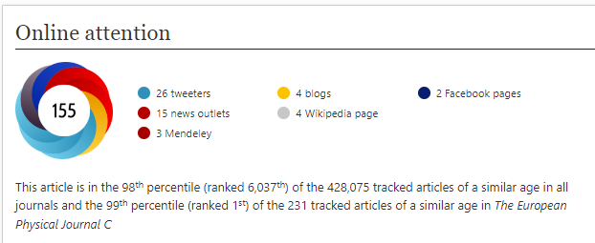
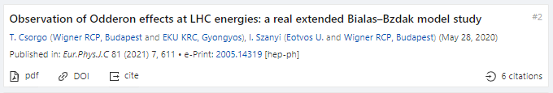
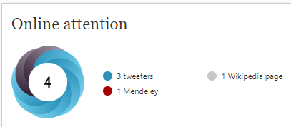
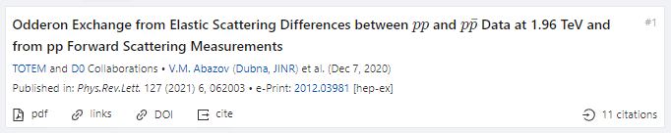
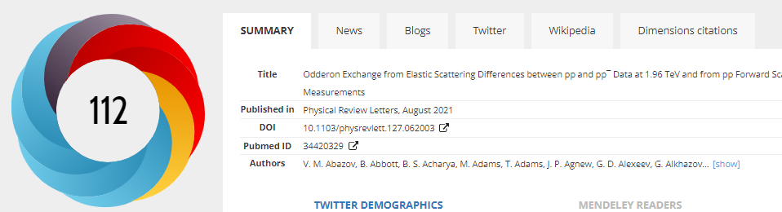
2021 observations of Odderon with > 5 σ
Hungarian-Swedish Odderon:
Eur. Phys. J. C (2021) 81: 180, Published: 23 February 2021
https://doi.org/10.1140/epjc/s10052-021-08867-6
Hungarian-Polish Odderon:
Eur. Phys. J. C (2021) 81:611 , Published: 13 July 2021
https://doi.org/10.1140/epjc/s10052-021-09381-5
4
D0-TOTEM Odderon:
Phys. Rev. Lett. 127 (2021) 6, 062003, Published: 4 August 2021
https://doi.org/10.1103/PhysRevLett.127.062003

Slide 5
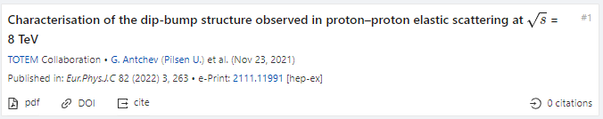
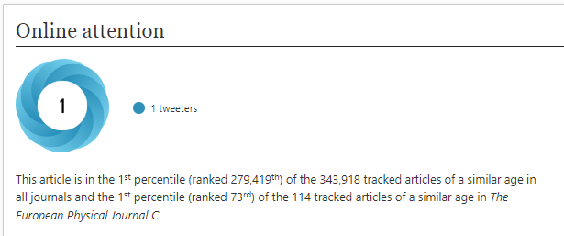
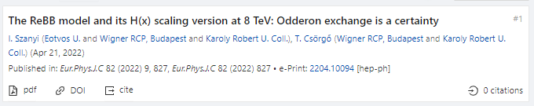
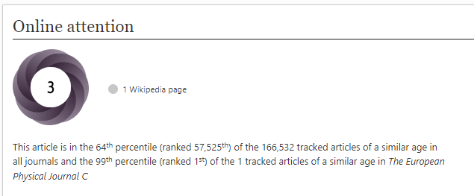
2022 observations of Odderon with > 5 σ
8 TeV: EPJ C (2022) 82, 263 (2022).Published: March 26, 2022
https://doi.org/10.1140/epjc/s10052-022-10065-x
Publishes final data for D0-TOTEM PRL published in 2021
New TOTEM 8 TeV data vs ReBB model predictions:
EPJ C 82 (2022) 9, 827. Published: Sept 19, 2022
In the ReBB model, Odderon exchange is a certainty
Presented at Diffraction-Low-X’22 by I. Szanyi
What about model independent results?
5

Slide 6



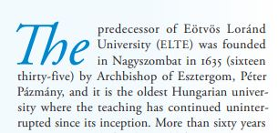
Three Oldest Hungarian Universities
University of Pécs: 1367
University of Pécs:
S: Oldest, C: in Hungary
University of Debrecen: 1538
University of Debrecen:
S: Oldest, C: in Hungary,
operating continuously and in the same city
(S,C) structure evident,
S: statement, valid if
C: condition is satisfied
See talk of R. Dardashti at ISMD21
C changes → S changes, examples follow
Eötvös University:
S: Oldest, C: in Hungary,
teaching continuously
6
Eötvös Loránd University: 1635

Slide 7

Hungarian-Swedish Odderon, 2019 -
Eur. Phys. J. C (2021) 81: 180, published February 2021
https://doi.org/10.1140/epjc/s10052-021-08867-6
H(x) = 1/(B σ_{el}) dσ/dt vs x = - B t
B ≡ B₀(s) from now on
x = - B t = - B₀(s) t
7
S: Model independent Odderon significance ≥ 6.26 σ
C1: All D0 and TOTEM published data at 1.96, 2.76 and 7.0 TeV
C2: domain of validity is still determined model dependently.

Slide 8
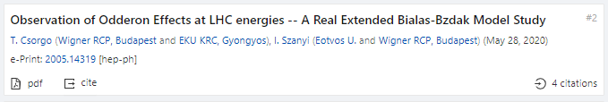
Hungarian-Polish Odderon, 2020-
Eur. Phys. J. C (2021) 81:611, published July 2021
https://doi.org/10.1140/epjc/s10052-021-09381-5
1.96 TeV
2.76 TeV
7 TeV
With new 8 TeV data:
Model dependent certainty
as presented by I. Szanyi
Eur. Phys. J. C (2022) 82, 827, published September 2022
https://doi.org/10.1140/epjc/s10052-022-10770-7
S: Model dependent Odderon significance ≥ 7.08 σ
C1: All D0 and TOTEM published data at 1.96, 2.76, and 7.0 TeV
C2: domain of validity extended to both pp and pbarp
But limited to 0.37 ≤ −t ≤ 1.2 GeV² and 0.546 ≤ sqrt(s) ≤ 7 → 8 TeV
8
Model dependent, Real Extended Bialas-Bzdak theory results,
Odderon significance ≥ 7.08 σ, from 1.96 and 2.76 TeV data only

Slide 9
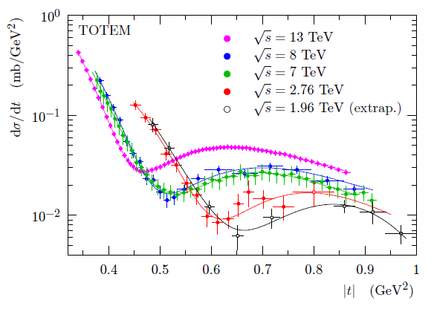
D0-TOTEM Odderon, 2020-
Phys. Rev. Lett. 127 (2021) 6, 062003, Published: 4 August 2021
https://doi.org/10.1103/PhysRevLett.127.062003
C0: IF models used for significance analysis form a
representative sample
S: Odderon significance ≥ 5.2 σ, IF
C1: if almost model independently combined
with √s = 13 TeV data at t = 0: σ_{tot} and ρ₀
C2: if a new pp dataset at 8 TeV and a new data point at 2.76 TeV,
C3: if only 8 out of the 17 D0 points are used
C4: if D0 pbarp data and TOTEM pp extrap.data are assumed to be equal at t=0
C5: ρ₀ (1.96 TeV) = 0.145
9

Slide 10


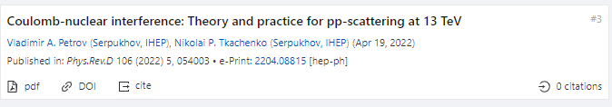
Status of D0-TOTEM Odderon search
Phys. Rev. Lett. 127 (2021) 6, 062003, Published: 4 August 2021
https://doi.org/10.1103/PhysRevLett.127.062003
sig₂ ≥ 3.4 σ
TOTEM: sig₁ (13 TeV, t = 0) ≥ 4.2 σ
TOTEM: combined (sig₁ + sig₂)/√2 ≥ 5.2 σ
Donnachie-Landshoff arxiv:2203.00290,
Phys. Lett. B831 (2022) 137199: sig₁ (13 TeV, t = 0) ~ 0 (!!)
Petrov-Tkachenko, arxiv:2204.08815,
Phys. Rev. D 106 (2022) 5, 054003 : sig₁ (13 TeV, t = 0) ≤ 1 (!!)
10
TOTEM – D0 detailed response :
in preparation, see K. Österberg’s talk
C0: if almost model independent result at t=0 and √s = 13 TeV
AND if sig₁ is not modified by new models: sig₁ ≥ 4.2 σ

Slide 11
Back to Scaling: Model independently
H(x|pp)
s-independent:
2.76 – 7(8) TeV
H(x|pp, 7 TeV)
≠
H(x|pbarp, 1.96)
Odderon,
IF scaling holds
in pp down to
1.96 TeV
Domain of validity:
ReBB model dependent
6.26 σ
Odderon effect
11
Energy range: tested both model independently and with modelling.
Modelling is useful, but model independent tests more important!

Slide 12
H(x) scaling of 7 and 8 TeV data
Energy range: H(x) scaling model independently up to √s= 8 TeV.
Uses final, published TOTEM dσ/dt data at 8 TeV

Slide 13
H(x) scaling of 2.76 and 8 TeV data
CL = 100 %: too good
Energy range: H(x) scaling valid between √s= 8 and 2.76 TeV.
Uses final, published TOTEM dσ/dt data at 8 TeV

Slide 14
H(x): Odderon signal, new 8 TeV data
Significance: 3.74 σ / all D0 points
4..55 σ / D0 signal region
H(x) scaling is violated between √s= 8 TeV pp and 1.96 TeV pbarp. Hungarian-Swedish Odderon signal confirmed with final, published TOTEM dσ/dt data at 8 TeV. Model independently.

Slide 15
H(x|pbarp)/H(x|pp): Odderon peak
Clear signal, even
w/o statistics
H(x) scaling is violated between √s= 8 TeV pp and 1.96 TeV pbarp. TOTEM dσ/dt data at 8 TeV. Odderon exchange, as a peak.

Slide 16
7 TeV: CLOSING DOORS/GATES
7 TeV data shifted
by ε_{B7,TeV} to minimize χ²
Type A errors are shown only
Both swing and dip regions important!
2020 → 2O2O

Slide 17
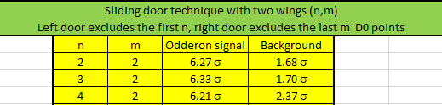
7 TeV RESULTS, CLOSING GATES
Two sliding gates of size n and size m:
(n,m): Leaving out the first n and last m D0 point
MODEL INDEPENT RESULT 1:
In best window, optimized Odderon signal is 6.33 σ
MODEL INDEPENT RESULT 2:
Best window: leaving out first 3 and last 2 D0 point
MODEL INDEPENT RESULT 3:
Outside the best window: H(x|pp) = H(x,pbarp)
pp and pbarp backgrounds agree within 1.7 σ

Slide 18
CROSS-CHECK: SIGNAL AT 8 TeV
Two sliding gates of size n and m:
(n,m): Leaving out first n and last m D0 point
(n+1,m): pull
vs (n,m+1) pull
Go direction of greater signal
Color code:
Best signal 4.55 σ
5.0 ≥ signal ≥ 4.0 σ
4.0 ≥ signal ≥ 3.0 σ

Slide 19
A model-independent relation: R~ρ
In the ReBB model: ρ = ρ₀ + ρ₁ ln(s/s₀)
In the TeV range: R = R₀ + R₁ ln(s/s₀)
Thus ρ (R) = A + B R : connects large t and small t signals!!

Slide 20
Scientific statements and conditions: philosopy and the evidence for odderon
Directly from HEPDATA
from D0-TOTEM PRL
If we just take data on R, both pp and pbarp, without any conditions
R values in D0-TOTEM PRL are different from available HEPDATA: signal changes, too, but only slightly…

Slide 21
Scientific statements and conditions: philosopy and the evidence for odderon
Directly from HEPDATA
from D0-TOTEM PRL
If we just take data on R, both pp and pbarp, without any conditions
R values in D0-TOTEM PRL are different from available HEPDATA: signal changes, too, but only slightly…

Slide 22
Scientific statements and conditions: philosopy and the evidence for odderon
from D0-TOTEM PRL
If we just take data on R, both pp and pbarp, without any conditions
R values are consistent with a combined fit, given in the plot
(using D0-TOTEM PRL values): CL = 6.6 % OK

Slide 23
Scientific statements and conditions: philosopy and the evidence for odderon
from D0-TOTEM PRL
If we just take data on R, both pp and pbarp, without any conditions
R values are consistent with a combined fit, given in the plot
(using D0-TOTEM PRL values): CL = 6.6 % OK

Slide 24
Cross-check: R~ρ
In the ReBB model: ρ = ρ₀ + ρ₁ ln(s/s₀)
In the TeV range: R = R₀ + R₁ ln(s/s₀)
Thus ρ (R) = A + B R : connects large t and small t signals!!

Slide 25
OBSERVATION OF ODDERON
Model-indepent H(x) signal confirmed at 8 TeV
THANK YOU FOR YOUR ATTENTION

Slide 26
BACKUP SLIDES

Slide 27
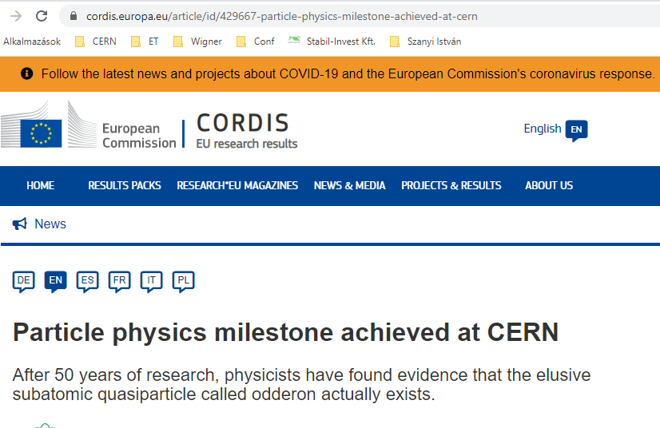
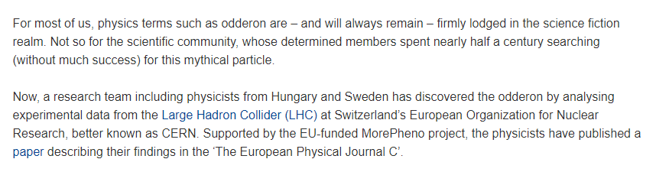
Hungarian-Swedish Odderon: CORDIS

Slide 28
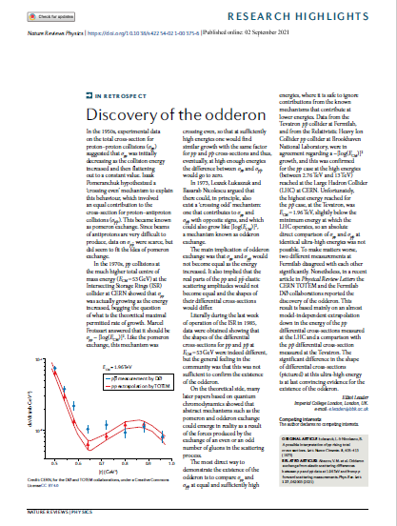


D0-TOTEM odderon: Nature, CERN

Slide 29
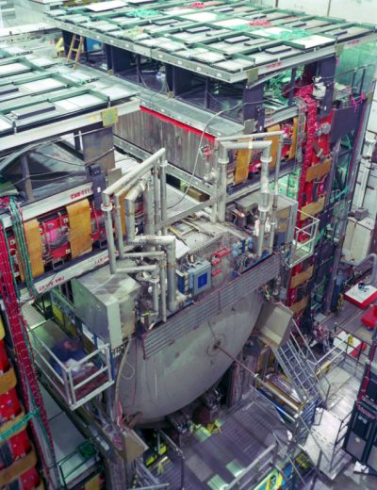
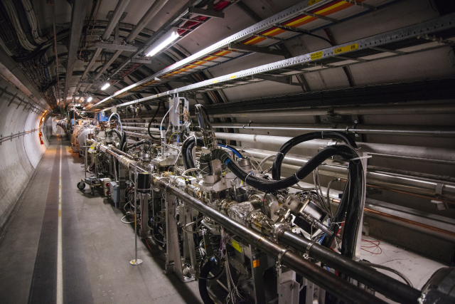
Illustrations: Odderon, TOTEM, D0

Slide 30
7 TeV: SLIDING WINDOW for 5 σ
Model independent results:
only datapoints,
without s-dependent extrapolations !
Where is the signal of Odderon from?
All possible sliding windows,
where the significance is at least 5 σ

Slide 31
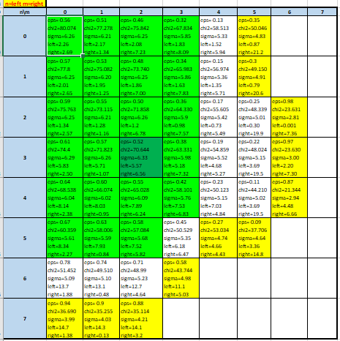
BEST SIGNAL AT 7 TeV
Two sliding gates of size n and m:
(n,m): Leaving out first n and last m D0 point
(n+1,m): pull
vs (n,m+1) pull
Go direction of greater signal
Color code:
Best signal 6.36 σ
Safe signal ≥ 5.5 σ
5.5 ≥ signal ≥ 5.0 σ
signal ≤ 5.0 σ

Slide 32
Passion for Discovery: Odderon
p+p → p+p
(RGB) + (RBG) → (BRG) + (BGR)
-
p+p → p+p
(RGB) + (RGB) → (GBR) + (GBR)
32
p₁
p₃
g₃
g₁
g₂
O = (g₁, g₂, g₃)
p₂
p₄

Slide 33


3+2 Oldest Hungarian Universities
Eszterházy Károly Catholic University: 1774 (or, 2020?)
MATE: 2021 (or, from 1787)
33

Slide 34
POMERON PROPERTIES
MODEL RESULT BASED ON EPJC 81 (2021) 7, 611
1st property:
Pomeron intercept normal: α_{P}(0)-1 = 0.075 ± 0.001

Slide 35
ODDERON PROPERTIES
EPJC 81 (2021) 7, 611
1st property:
Odderon intercept is large, α_{O}(0)-1 = 0.32 ^{+ 0.32} _{– 0.06}
Threshold effect, slowly decreases with s, but
Pomeron intercept normal: α_{P}(0)-1 = 0.075 ± 0.001
2nd property:
1 TeV ~ threshold energy

Slide 36
Summary: Odderon DISCOVERED in 3 papers,
New: focus on its properties
Bialas-Bzdak p = (q,d) model: certain Odderon effect
statistical significance » 5 σ
Odderon first discovered in three published papers:
three different analysis, each with a statistical significance > 5 σ
(S,C) structure evident,
Scientific Statement S is valid if Condition C is satisfied
0th property: Odderon exists! (Questioned: where, at 13 TeV and t=0?)
Odderon properties: from Bialas-Bzdak model, so far valid in a limited s and –t > 0.37 GeV² range only
Odderon intercept is large, α_{O}(0)-1 = 0.32 ^{+ 0.32} _{– 0.06}
Pomeron intercept normal: α_{P}(0)-1 = 0.075 ± 0.001
1.96 TeV – 8 TeV:
Threshold effect, just appearing
36
Ongoing debate: what is the significance of the D0-TOTEM PRL?
Is there any evidence for Odderon at t= 0? Response is coming…

Slide 37
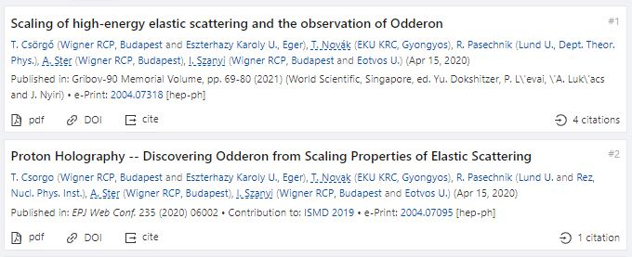
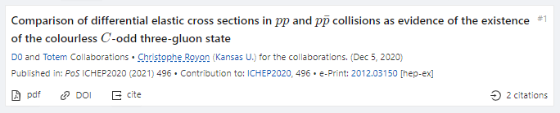
First three Odderon Proceedings, > 5 σ
EPJ Web Conf. 235 (2020) 06002, proc. ISMD 2019
https://doi.org/10.1051/epjconf/202023506002
Gribov’90 Memorial Volume, pp. 69-80 (2021)
https://doi.org/10.1142/9789811238406_0012
37
PoS ICHEP 2020 (2021)
https://doi.org/10.22323/1.390.0496

