Slide 1



Progress of Lithuania in Research and Education
Presented by dr. Ramūnas Aleksiejūnas
Vilnius
2022-11-24

Slide 2

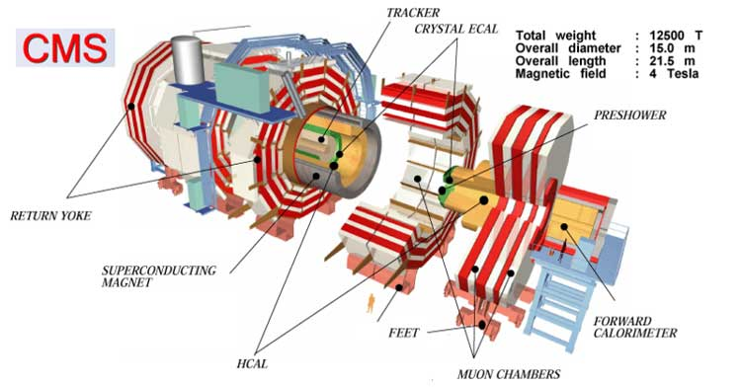
Development of scintillators for fast radiation detectors
(RD18)
Main goal is development of scintillation materials for fast radiation detectors for current updates and future CERN experimental facilities

Slide 3

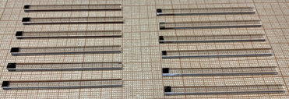
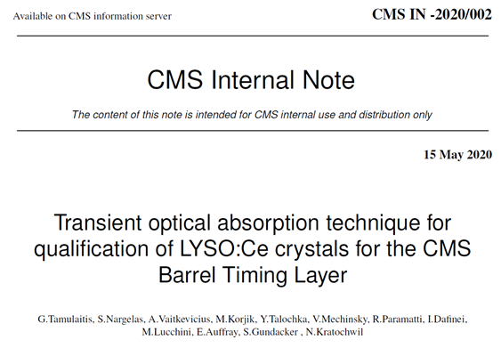
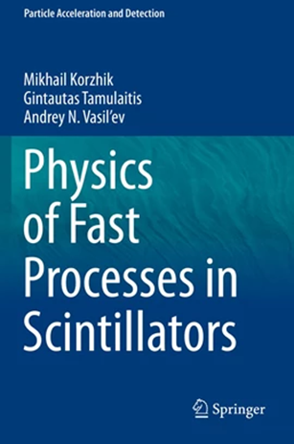
Development of scintillators for fast radiation detectors: evolution of the field
Testbench for routine testing of scintillators for the coming update of CMS experiment
31 research
papers
+
165 000 such crystals will be installed in the Barrel Timing Layer of CMS
Two Lithianian Science Awards on semiconductor spectroscopy as a background
As a result of 4 months of Experimental Physics Responsibilities (EPR) in 2021, one co-authorship in > 60 CMS research papers in 2022.

Slide 4
Development of scintillators for fast radiation detectors: theoretical studies
Study of carrier dynamics important for response time of multicomponent scintillators initiated in 2020;
PhD student Yauheni Talochka started his PhD studies on this topic in 2020;
At least 4 papers with substantial support by calculations of Yauheni in 2021-2022;
First basically theoretical paper by Yauheni on this topic in 2022:
Y. Talochka et al., Impact of compositional disorder on electron migration in lutetium–yttrium oxyorthosilicate scintillator, J. Appl. Phys. 132, 053101 (2022);
Development of the code to make it available for CERN users as a simulation tool in 2024-2025;
The model has been applied and compared with experimental data in another topic of charge transport in disordered semiconductors.

Slide 5
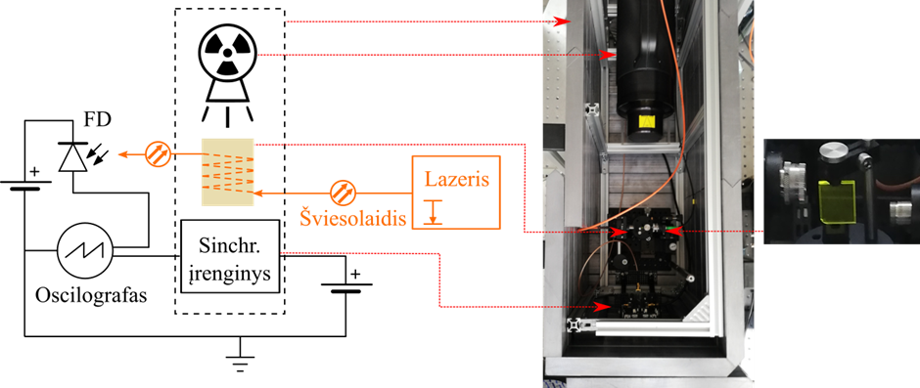
Development of scintillators for fast radiation detectors: national projects
The European Regional Development Fund project under grant agreement with the Research Council of Lithuania (project No. 01.2.2-LMT-L-718-01-0041) Neutron flux detection system with optical readout, 2018-2022, total budget 529 447 Eur.
The European Social Fund under grant agreement with the Research Council of Lithuania (project No. 09.3.3-LMT-K-712-01-0013) Fast scintillators for radiation detectors (FARAD), 2018-2022, total budget 591 144 Eur.
13 pier-reviewed papers published, mostly in Q1 and Q2 journals (10 such papers planned)
Local support from the Lithuanian Academy of Sciences for the Compact Moun Solenoid Barrel Timing Layer Upgrade.

Slide 6
Development of scintillators for fast radiation detectors: projects
Participation in CERN-lead Horizon project: Horizon 2020 programme RIA project „Advancement and Innovation for Detectors at Accelerators“, AIDAinnova (101004761) 2021 – 2025;
Application of Phase II for ATTEACT grant in collaboration with partners from Crystal Clear Collaboration and industry (rejected): Development of industrial technology for mass production of cost-effective Ce-doped gadolinium–silica scintillation glass for radiation detectors used in research instrumentation, medical imaging and security (SCINTIGLASS) (Phase I project is successfully completed in 2021).

Slide 7
Development of scintillators for fast radiation detectors: young researches
Arnoldas Solovjovas started his PhD work on nanostructures scintillators
3-4 undergraduates work in the research labs in the field of scintillators
Erasmus lecture course on radiation detectors for PhD students at CERN CCC partners institution Università Politecnica Delle Marche, Ancona (Italy)

Slide 8
Development of scintillators for fast radiation detectors: dissemination
Research papers:
S. Nargelas et al., Influence of matrix composition and its fluctuations on excitation relaxation and emission spectrum of Ce ions in (Gdx Y1-x)3Al2Ga3O12: Ce scintillators, J. Lumin. 242, 118590, (2022).
K. Nomeika et al., A new method for remote detection of ionizing radiation using transient optical absorption, Nuclear Inst. and Methods in Physics Research, A 1029, 166408 (2022).
M. Korzhik et al., Ultrafast PWO scintillator for future high energy physics instrumentation, Nuclear Inst. and Methods in Physics Research, A 1034, 166781 (2022) .
G. Tamulaitis et al., Transient optical absorption as a powerful tool for engineering of lead tungstate scintillators towards faster response, J. Materials Chemistry C, 10, 9521 (2022).
Y. Talochka, A. Vasil’ev, M. Korjik, G. Tamulaitis, Impact of compositional disorder on electron migration in lutetium–yttrium oxyorthosilicate scintillator, J. Appl. Phys. 132, 053101 (2022).
L. Martinazzoli et al., Compositional engineering of multicomponent garnet scintillators: Towards an ultra-accelerated scintillation response, Materials Advances, 17, 6842 (2022).
Presentations at scientific conferences: Keynote talk by prof. G. Tamulaitis in 16th Int. Conference on Scintillating Materials & their Applications, September 19-23, 2022, Santa Fe, USA; other 4 oral and 2 poster presentations.

Slide 9
CERN RD50 related activities
VU activities related to RD50 (Radiation hard semiconductor devices for very high luminosity colliders) research program:
Technologies and instrumentation for spectroscopy and contactless-remote dosimetry of the large fluences of high energy radiations.
Search of radiation hard materials and development of radiation tolerant structures.
Technologies and instruments for the remote in situ measurements in harsh irradiation environments.
Development of advanced material characterization techniques and instruments.
Engineering of defects for development of radiation hard particle and photo sensors capable to operate in cosmic space and modern particle accelerators.
Technologies and instrumentation for spectroscopy of high energy radiations for medical diagnostics and monitoring of radiation safety within nuclear power plants and storage facilities of radioactive waste.

Slide 10
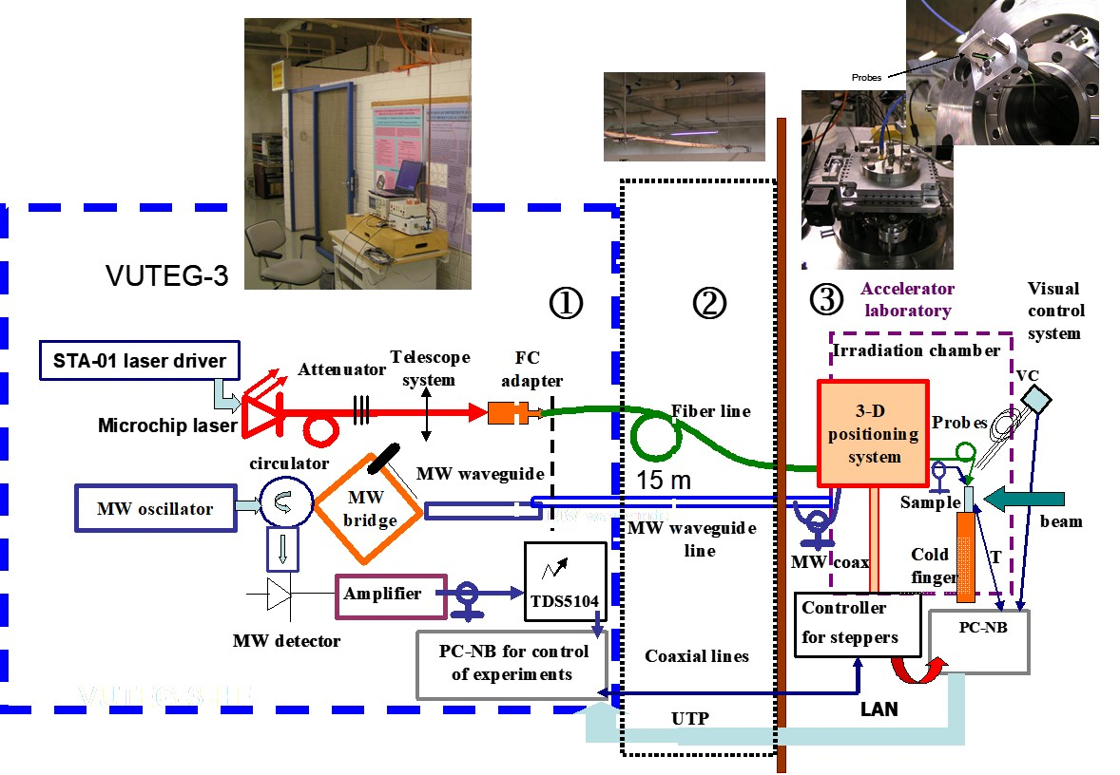
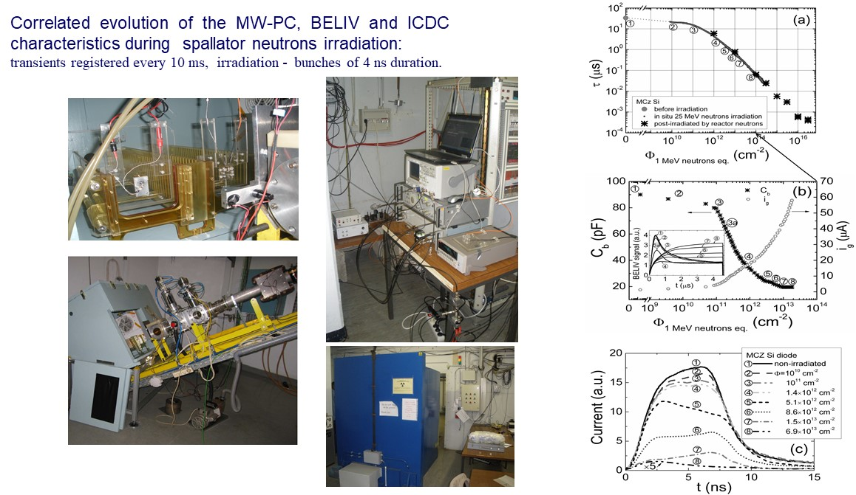
CERN RD50 related activities: evolution
In situ control of of the radiation defects introduced by 8 MeV protons at Helsinki University accelerator laboratory.
In situ variations of carrier recombination (a- MW-PC), of barrier capacitance (b-BELIV) and of detector response (c-TCT/ICDC) during irradiation by spallator neutrons.
E. Gaubas et, Appl. Phys. Lett. 101 (2012) 232104.

Slide 11
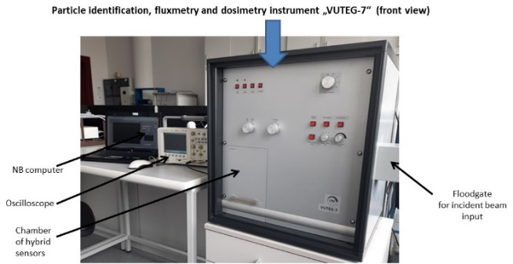
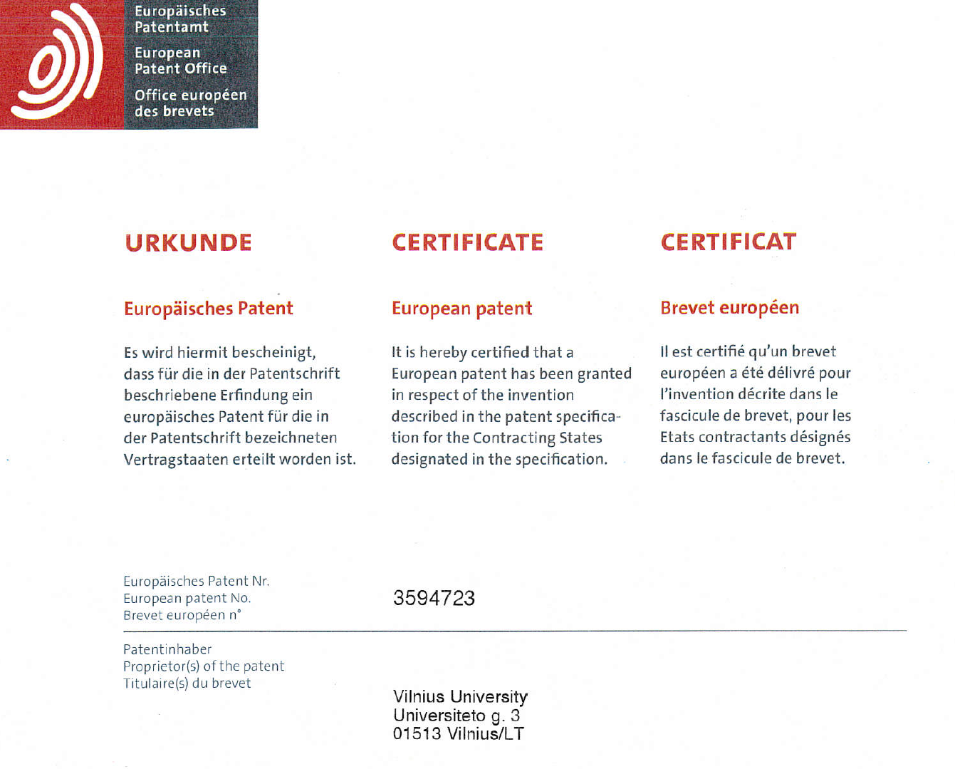
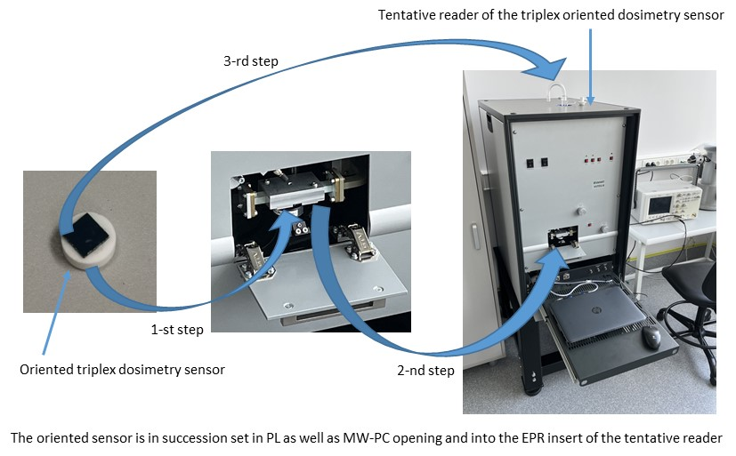
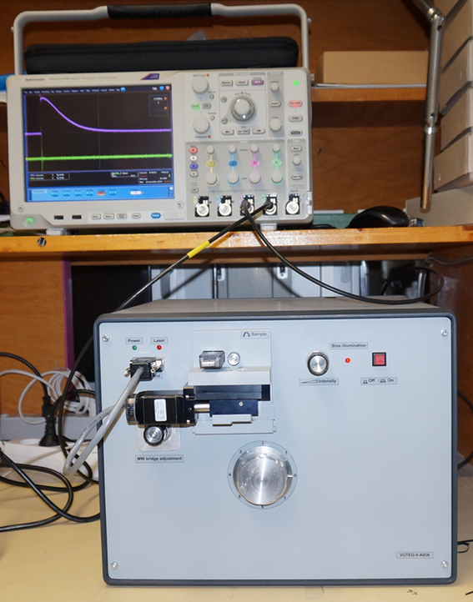
CERN RD50 related activities: evolution
Patented method and equipment for the measurements of high cumulative doses collected under ionizing irradiations by gamma rays, leptons and hadrons.
Instrument and technology for dosimetry and fluxmetry of high energy electromagnetic and particle radiations.
EU patent: E. Gaubas, T. Čeponis, et al, „DOUBLE RESPONSE IONIZING RADIATION DETECTOR AND MEASURING METHOD USING THE SAME“- App No.: 18213254.8, Patent No.: 3594723.
HYBRID MULTI-LAYER SENSOR AND METHOD FOR LARGE FLUENCE DOSIMETRY AND FLUXIMETRY, Authors: Eugenijus Gaubas, Tomas Čeponis, Laimonas Deveikis, Jevgenij Pavlov, Vytautas Rumbauskas. Application No. 21 165 145.0, submission date: 2021 03 26.
Dosimeter VUTEG-5-AIDA has been installed at CERN in 2012 for the RD50 program and other CERN research. The dosimeter VUTEG-5-AIDA is devoted for dosimetric control of hot irradiation zones of large areas.
The prototype system for the control of radiation doses in a wide range. This prototype system allows measuring low and very high fluences and to identify the spectrum of high energy radiations.
E. Gaubas, T. Čeponis, L. Deveikis, J. Pavlov, V. Rumbauskas, Oriented triplex sensor and method of identification of the radiation source location and its dosimetry, EU patent application No. EP22171639.2, submission date: 2022 05 04.

Slide 12
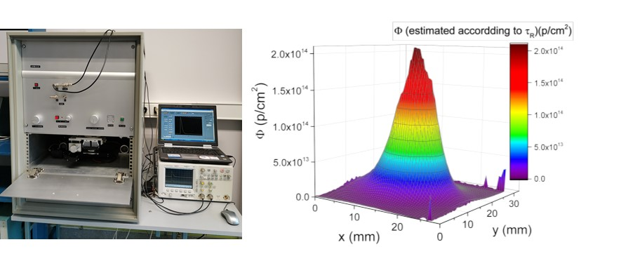
CERN RD50 related activities: Technology and instruments for particle beam profiling
The particle beam profiling techniques based on dosimetry of the hadron irradiated Si and GaN sensors have been developed. The fluence distribution profiles for high energy penetrative particles are recorded by carrier lifetime measurements within Si wafer. For beams of rather low energy particles, sensors with thin active layers are preferable. Then, the scintillation techniques are eligible to have recordable responses from thin sensor layers.
Recorded profile of 26 GeV/c proton beam.
L. Deveikis, J.V. Vaitkus, T. Čeponis, M. Gaspariūnas, V. Kovalevskij, V. Rumbauskas, E. Gaubas, Profiling of proton beams by fluence scanners, Lith. J. Phys. 61 (2021) 75–83.
T. Ceponis, L. Deveikis, E. Gaubas V. Rumbauskas, M. Moll, Particle beam profilers based on fluence dependent variations of carrier lifetime and scintillation intensity in Si and GaN materials, Presentation at RD50 workshop, CERN 2022-06.

Slide 13
CERN RD50 related activities: joining the project for developing novel particle detectors
In 2022 the VU group joined the project “Defect engineering in PAD diodes mimicking the gain layer in LGADs” within the frame of CERN RD50 collaboration.
The VU group will be responsible for direct measurements of carrier recombination lifetime and correlation with parameters obtained by electrical measurements in LGAD structures.
The unique instruments and techniques (developed by VU group) of carrier lifetime profiling and electrical characterization will be employed in this study.

Slide 14
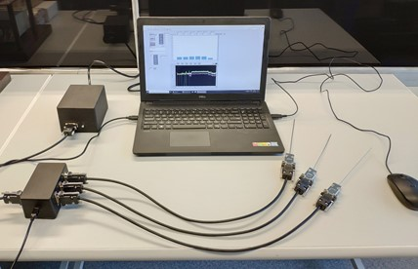
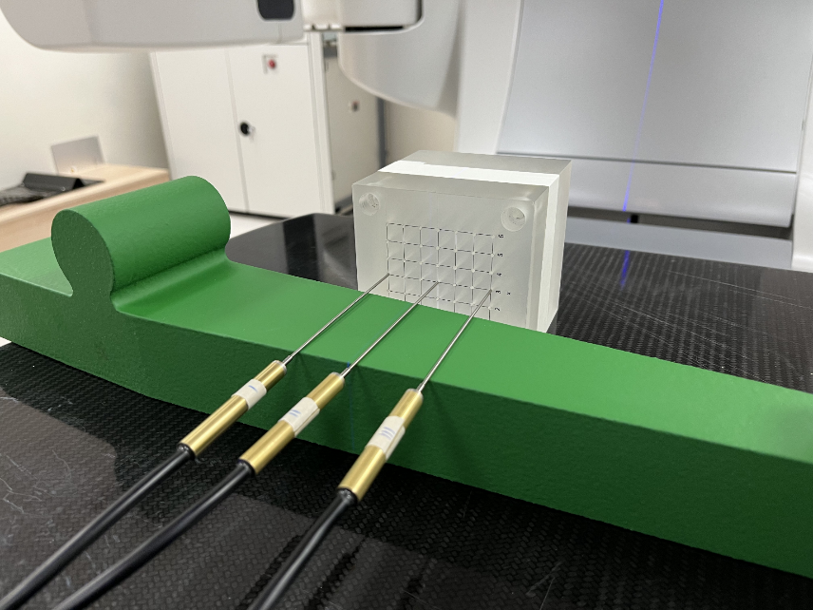
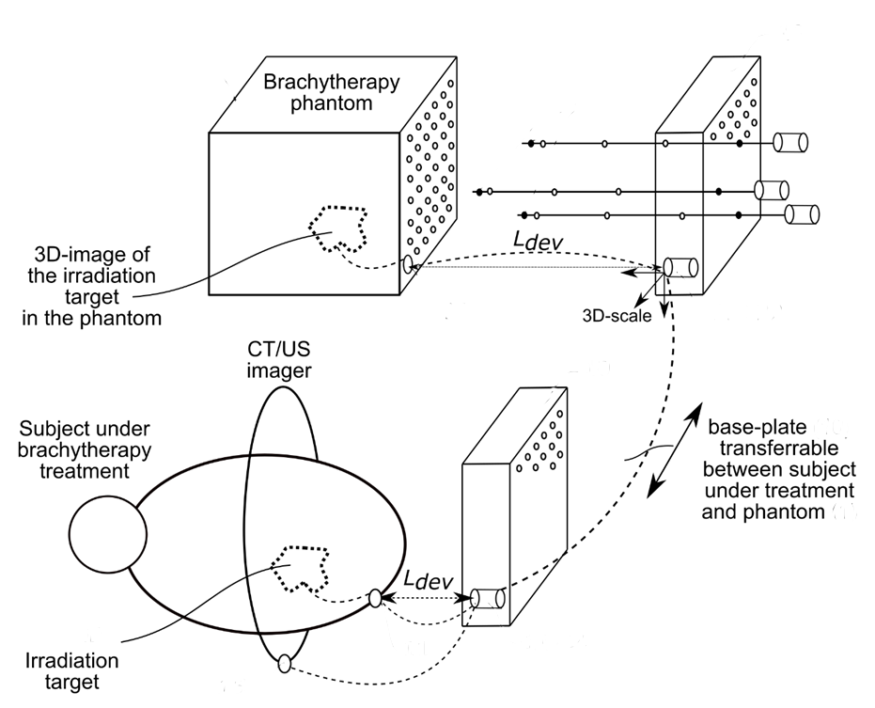
Radiation dose monitoring systems for medical applications
Development of technology and instrumentation for time-resolved positioning of radiation emitters and for dosimetry during the brachytherapy planning and a subsequent in vivo brachytherapy treatment stages, where the method and apparatus are based on triangulation of needle-type probes fixed within time-space resolved coordinates.
The technology and instrumentation have been approved at The National Cancer Institute.
The first in vivo measurement of radiation dose during brachytherapy therapeutic procedure has been performed in October 2022.
E. Gaubas, T. Čeponis, K. Pūkas, V. Rumbauskas, M. Užgirytė, J. Venius, K. Akelaitis, A. Cicinas. SYSTEM AND METHOD FOR BRACHYTHERAPY PROCEDURE PLANNING AND VERIFICATION, EU patent application No. EP21210650.4, submission date: 2021 11 26.

Slide 15
CERN RD50 related activities: main achievements during 2022
Published articles:
J. Pavlov, T. Ceponis, K. Pukas, L. Makarenko, E. Gaubas, 5.5 MeV electron irradiation-induced transformation of minority carrier traps in p-type Si and Si1-xGex alloys, Materials 15 (2022) 1861.
EU patent applications:
E. Gaubas, T. Čeponis, L. Deveikis, J. Pavlov, V. Rumbauskas, Oriented triplex sensor and method of identification of the radiation source location and its dosimetry, EU patent application No. EP22171639.2, submission date: 2022 05 04.
Presentations at conferences:
T. Ceponis, L. Deveikis, E. Gaubas V. Rumbauskas, M. Moll, Particle beam profilers based on fluence dependent variations of carrier lifetime and scintillation intensity in Si and GaN materials, Presentation at RD50 workshop, CERN 2022-06.
Implemented projects:
LMT „SMART“ project 01.2.2.-LMT-K-718-01-0013 „Creation of the prototype wide-spectrum dosimetry system for various purpose monitoring of irradiations“, 600000 EUR/2018-2022 yr.
Lithuanian Academy of Science project CERN-VU-2022-4 „Radiation tolerant semiconductor detectors for high luminosity colliders“, 33700 EUR/2022 yr.
PHD thesis defence:
Two students defended the PHD thesis in topics related with CERN activities.
Awards:
T. Ceponis, E. Gaubas, J. Vaitkus received the Lithuanian National Science Prize in the area related with CERN activities.

Slide 16
Physics of Subatomic Particles at CERN CMS experiment (project DaFi2021): Participation in the CMS experiment
Analysis of the proton-proton collision data recorded with the CMS detector is focused on precision studies of the Drell-Yan process
  Group uses data-driven methods to estimate the number of the background process events in data recorded in 2016-2018
  Collaboration with Université Libre de Bruxelles University, University of Nebraska in Lincoln, Univeristy of Montenegro, and Yonsei University
  Work towards differential cross section measurement is on-going, planning results in 2023
Calibration of the pixel silicon sensor for the CMS Tracker Phase II upgrade
  Work supervised by S. Mersi (CERN)
  Software development and remote testing on actual sensor (RD53B)
  Hands-on work during 1 month visit in August
30 remote CMS DAQ shifts to control data-taking with the detector
Participation in CERN LHC Electroweak Work group (EW WG) activities continues
  Impact of uncertainty correlations on the estimated data-theory (dis)agreement

Slide 17
Physics of Subatomic Particles at CERN CMS experiment (project DaFi2021): Phenomenological studies
Group theorists study several models beyond the standard model trying to address
Neutrino flavor oscillations
  Study of Grimus-Neufeld model (this is the standard model extended by one extra Higgs doublet, and one heavy Majorana neutrino) lead to general questions about the accepted theory-experiment matching (renormalization) procedures
  Acta Phys. Polon. Supp. 15 (2022) 2, 1, a15.
  Acta Phys. Polon. Supp. 15 (2022) 2, 1, a17.
Lepton flavor violating reactions
  Within the Grimus-Neufeld model
  JHEP 09 (2022) 174
  A 2HDM model with soft breaking terms
  JHEP 03 (2022) 106
Description of the stable dark matter
  Symmetry groups which could be used to describe the dark matter particles
  e-Print 2210.12133 [hep-ph]
Collaboration with Lisbon CFTP, Dresden TU, Warsaw NCBJ, CERN TH

Slide 18
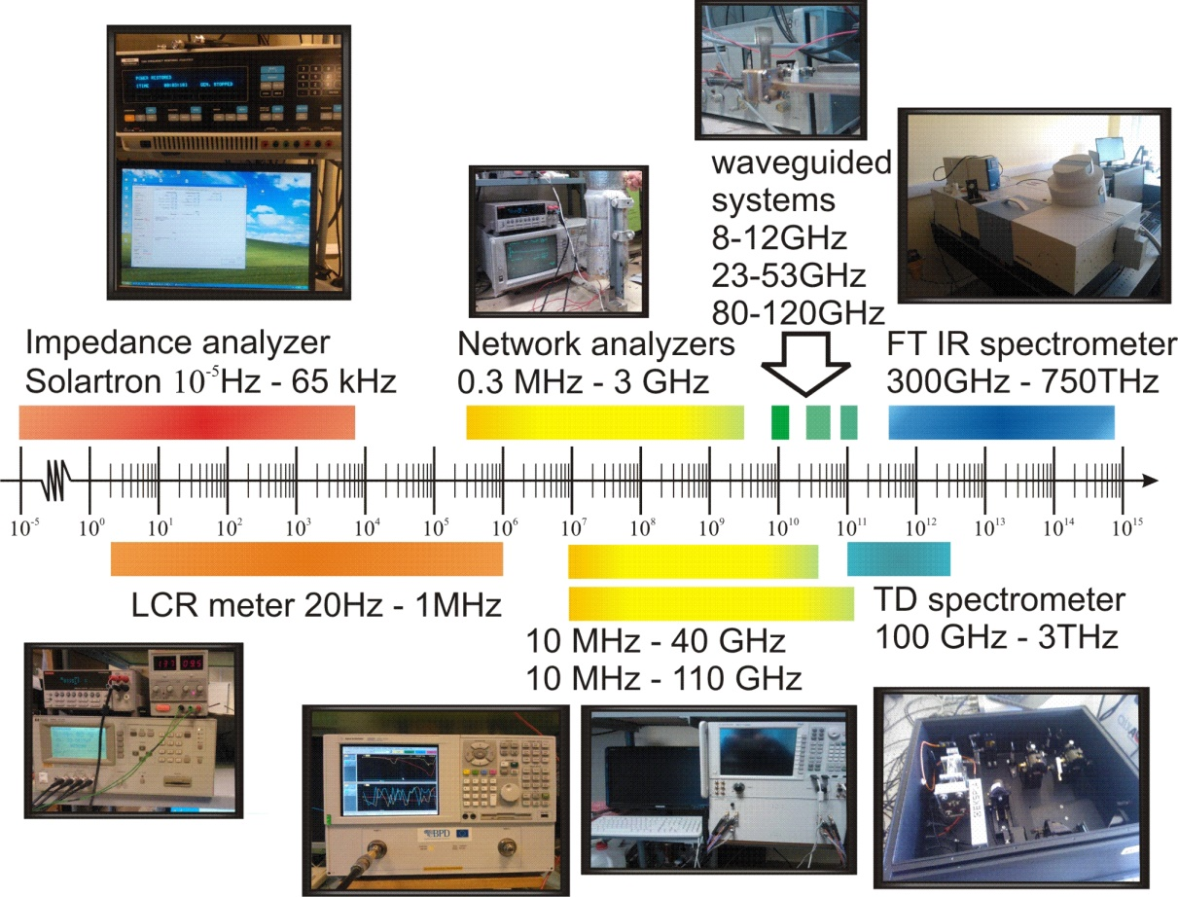
Investigation of ferrite materials
Microwave Spectroscopy Laboratory performs investigations of structural phase transitions in ferrite materials using broadband dielectric and magnetic permeability spectroscopy. Temperature dependence spectra of complex dielectric conductivity (4 - 500K) in a wide frequency range (10 mHz - 110 GHz) can provide important information about the type of phase transition, temperature and nature of phase transitions.

Slide 19
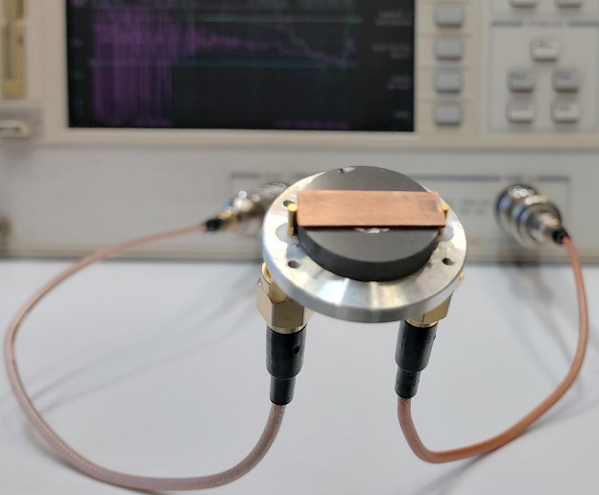
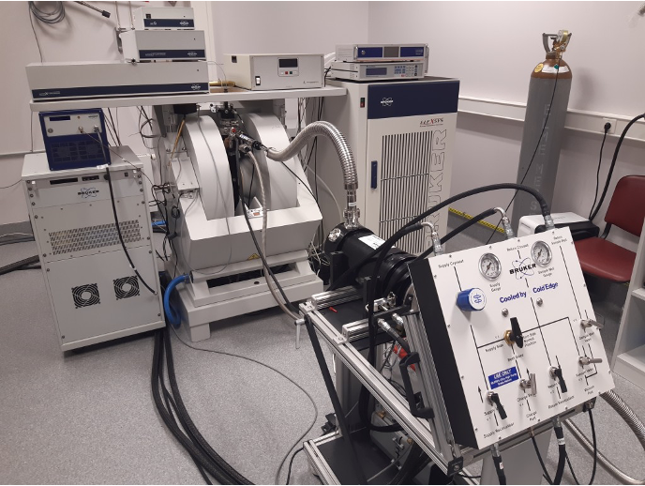
Investigation of ferrite materials
The aim of the research is to find out which ferrite materials are promising for CERN's particle beam introduction and extraction devices from the CERN accelerator rings.
Currently investigated ferrite materials will be used in the high-speed ferrite tuner, in one of the upgraded facilities at the proton synchrotron, which is one of the most important components in the CERN accelerator complex. This device will operate at a high frequency of about 80 MHz, which places special demands on the parameters of the ferrites used in it.

Slide 20
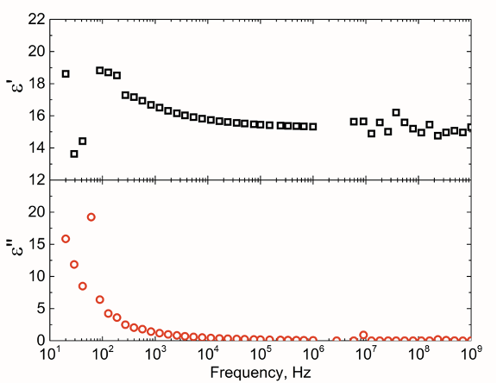
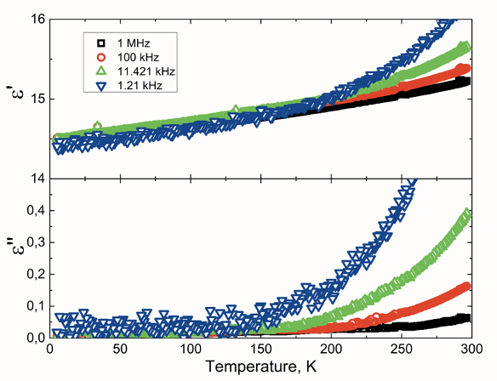
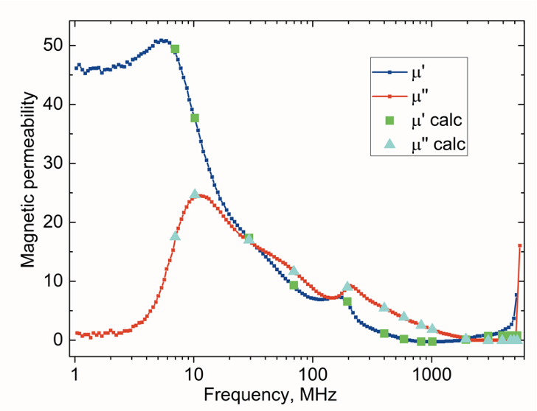
Investigation of ferrite materials: an example of data on AL-800 ferrite

Slide 21
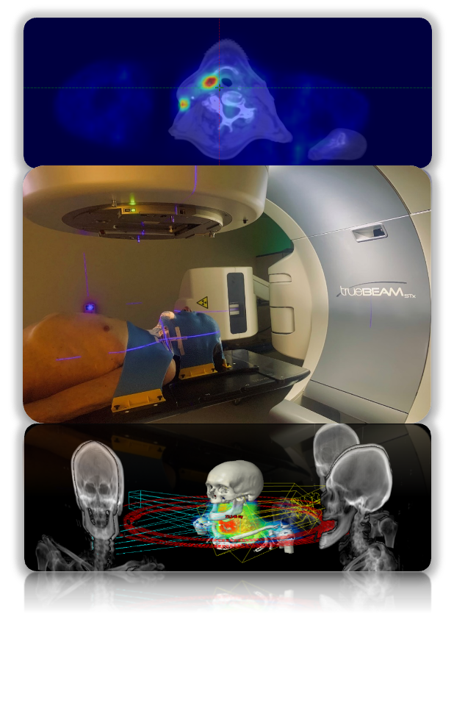
LSMU-CERN: research areas in radiotherapy and radiobiology
Prognostic and predictive molecular markers of solid tumors;
Molecular mechanisms of sensitivity and resistance to radiotherapy in breast cancer or other cell lines;
Radiotherapy optimisation using ¹⁸F-FDG-PET/CT images;
Association between common genetic variations with individual patient variability in normal tissue late radiation toxicities;
Linac-based fractionated stereotactic radiotherapy vs. intensity modulated radiotherapy;
New brachytherapy techniques.

Slide 22
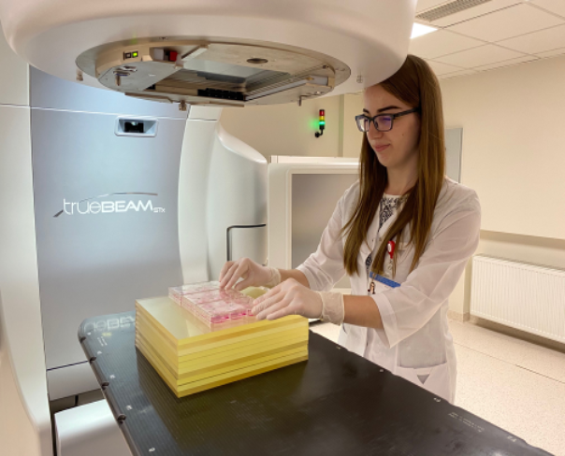
LSMU-CERN: evolution
During the last years training of medical physicists and radiation oncologists was organized in collaboration with CERN.
Development of nuclear medicine is closely related to the deployment of cyclotron at LUHS University Hospital.
Oncology institute: CERN- activities related to 4 projects in Radiobiology.
2017.07.01 – 2017.12.31
“Molecular mechanisms determining breast cancer cells resistance to radiotherapy”
2018.07.01 – 2018.12.31
“The identification of biomarkers responsible for head and neck cancer radioresistance“
2019.07.01 – 2020.12.31
“Molecular mechanisms of resistance to radiotherapy in breast cancer cells and the effect of radio-sensitizing agents“

Slide 23
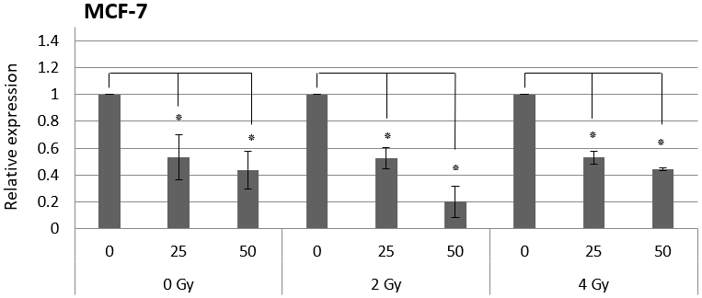
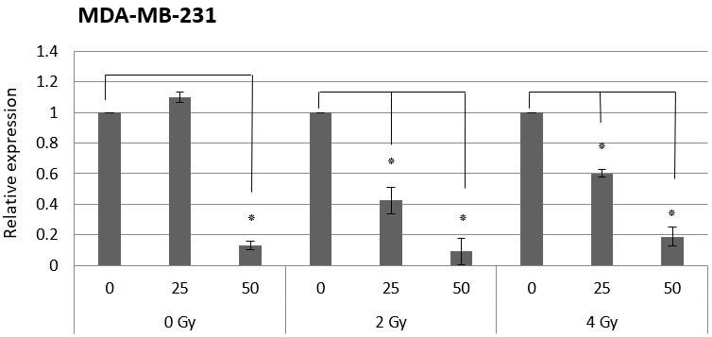
LSMU-CERN: current project 2021 – 2022
“The search for radiosensitizing phytochemicals and the analysis of their effect on apoptosis mechanism in breast cancer cells in vitro“
The purpose: to continue the search for radiosensitizing phytochemicals and their analysis on breast cancer cells.
Sulforaphane (SFN), which is one of the strongest natural antioxidants, was chosen for this study.
Cell viability, the intensity of apoptosis, apoptosis-related gene expression at RNA and protein levels following the combined effect of SFN and ionizing radiation are currently under investigation on MDA-MB-231 and MCF-7 breast cancer cells.
SFN and SFN+IR decreased the expression of BCL-2 gene in both cell lines.

Slide 24
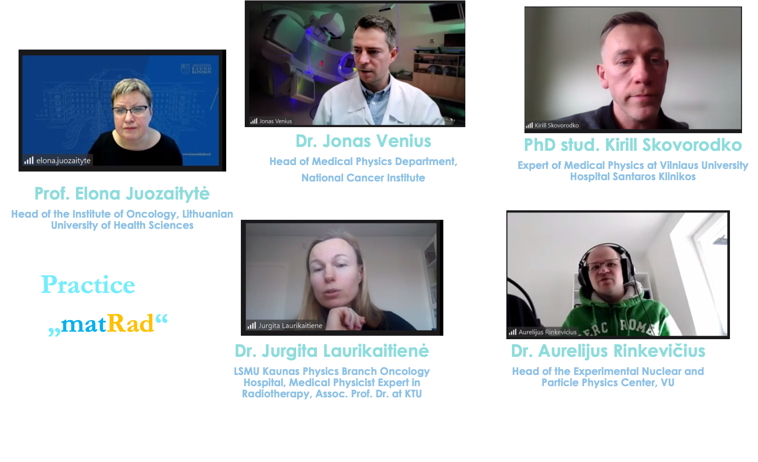
KTU in CERN activities: International Particle Therapy Masterclass, 11th of February, 2022
https://indico.cern.ch/event/1120845/

Slide 25
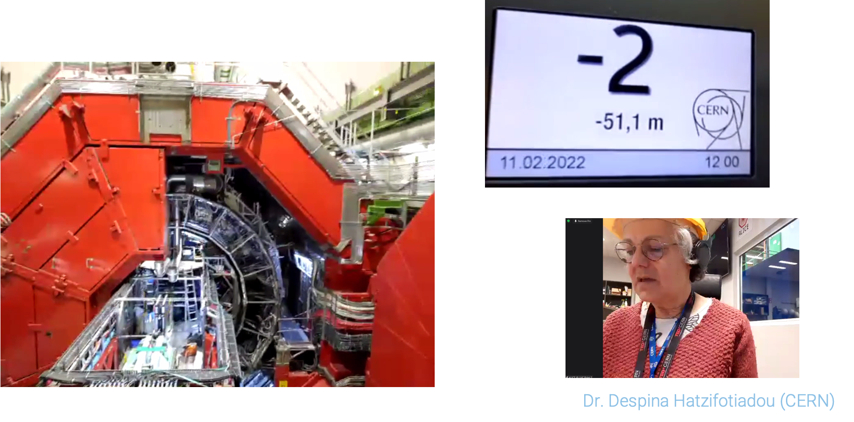
KTU in CERN activities: International Particle Therapy Masterclass, 11th of February, 2022
https://indico.cern.ch/event/1120845/

Slide 26
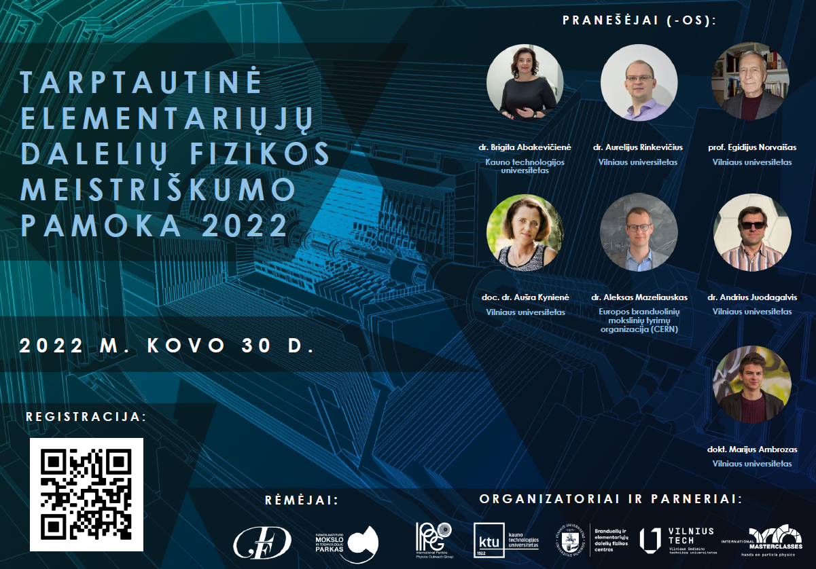
KTU in CERN activities: International CMS Masterclass, 30th of March, 2022
https://indico.cern.ch/event/1139363/timetable/

Slide 27

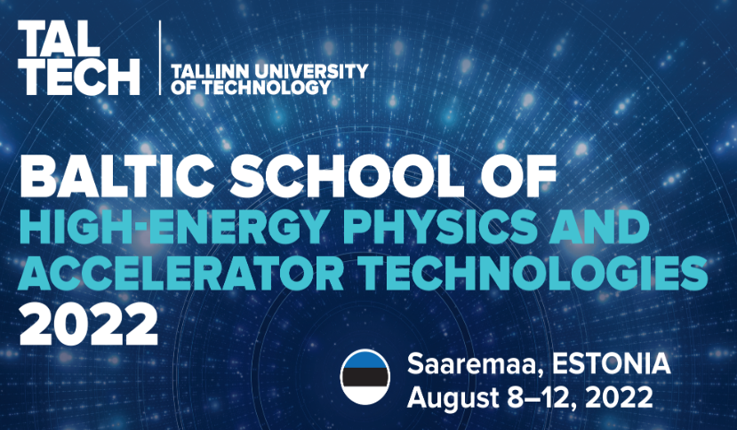
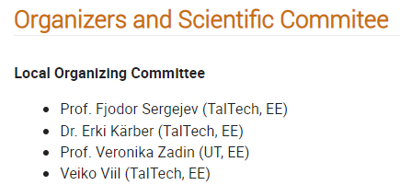
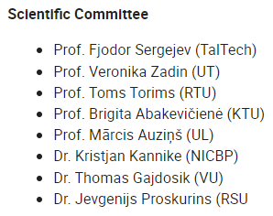
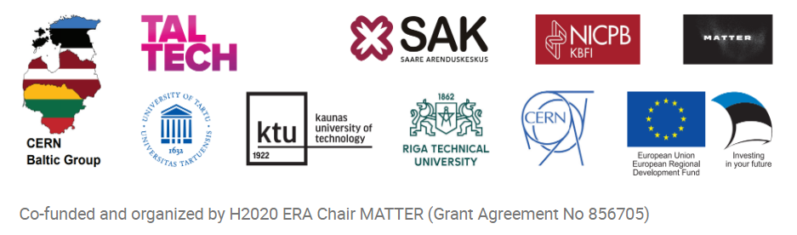
2nd Baltic School of High-Energy and Accelerator Technologies
https://indico.cern.ch/event/1123671/
Notes:
The school will focus on the fundamental aspects of high-energy physics theory and touch on the cutting edge research currently on-going. In addition, the school will also cover both the basic principles and the current cutting edge technologies of particle accelerators, as well as their applications.
The school is organised by the CERN Baltic Group, a collaboration of nine higher education and research institutions in the Baltic states, and is endorsed by CERN.

Slide 28
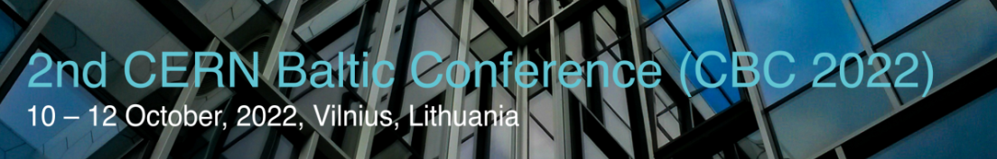
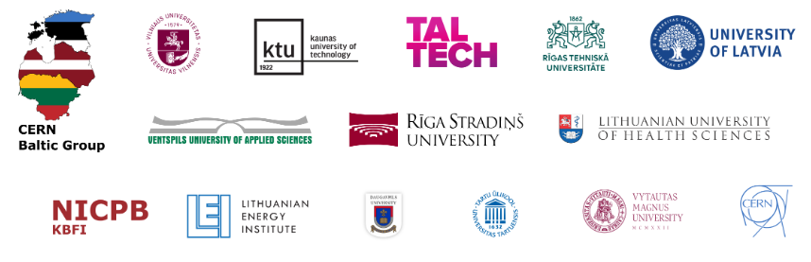
2nd CERN Baltic Conference
https://indico.cern.ch/event/1147717/
Notes:
The Scope and Topics
The scientific and technical CERN Baltic Conference covers the full spectrum of CERN and related activities (e.g. research, engineering, computing, industrial, and policy).
Topics are related, but not limited to: Accelerator, Detector and other Advanced Technologies, High Energy Physics, Data Science and Computing, Nuclear Medicine. From physics to engineering, from fundamental science to industry.
Topics will be logically linked to the CBG activities within the CERN collaborations, experiments and studies: such as CMS, CLIC, FCC, MEDICIS, AEGIS, CLOUD, and others.

Slide 29


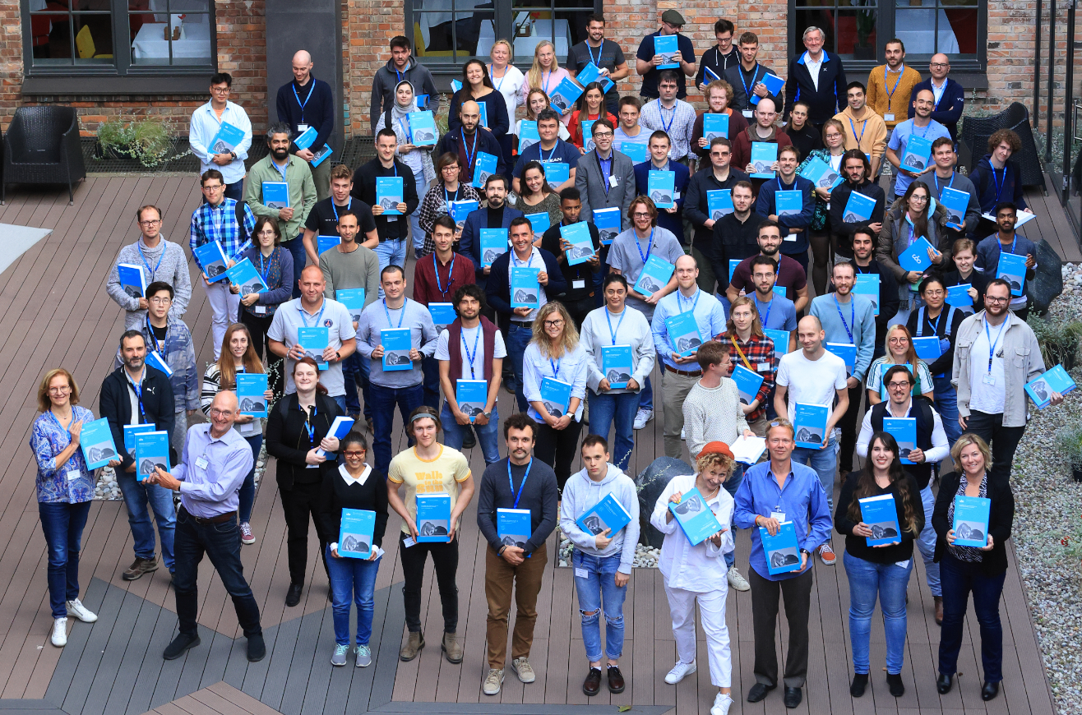

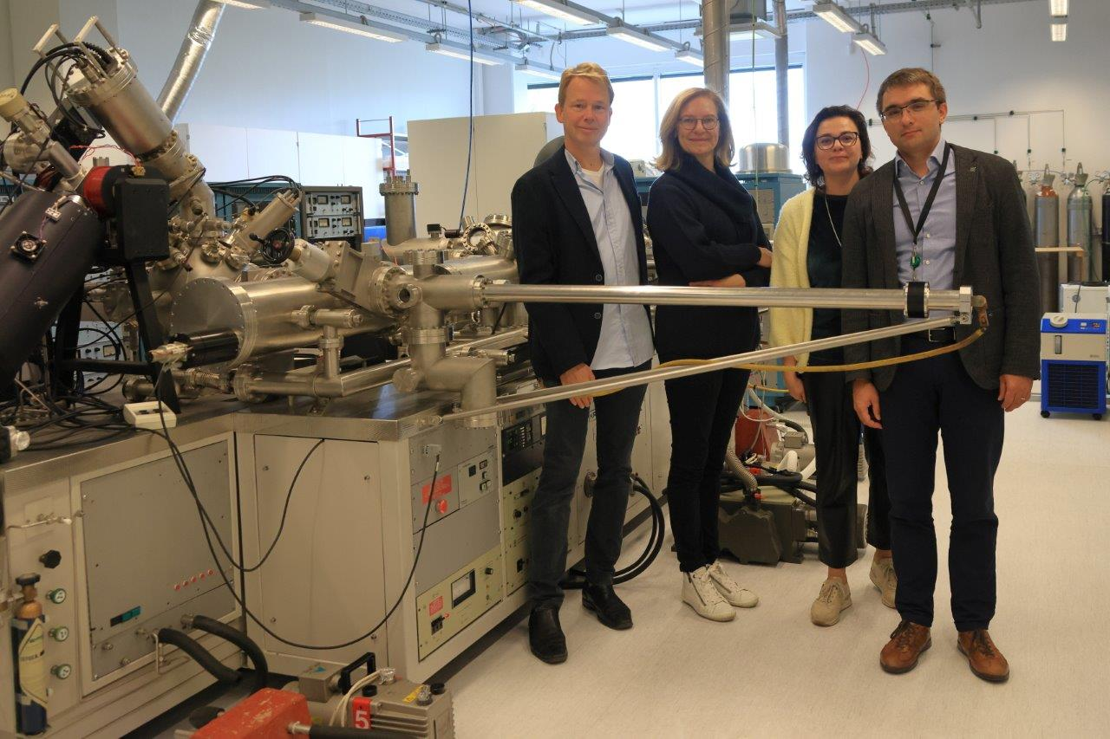
The CERN Accelerator School
Introduction to Accelerator Physics
https://indico.cern.ch/event/1117526/
18th of September – 1st of October, 2022, Kaunas, LITHUANIA
Franc Tecker, Christine Vollinger
Brigita Abakevičienė, Tomas Tamulevičius

Slide 30

Participation in projects
Lithuanian Academy of Sciences
Research and experimental development projects are related to the activities of the European Organization for Nuclear Research (CERN).
2021 - 2022 Materials and technologies for the high-gain Fast Timing
MPGD detector (FTM)
(20 kEUR in 2021)
(49 kEUR in 2022)
Project leader Prof. Sigitas Tamulevičius
(In colloboration with Dr. Piet Verwilligen, National Institute for Nuclear Physics and CERN)

Slide 31
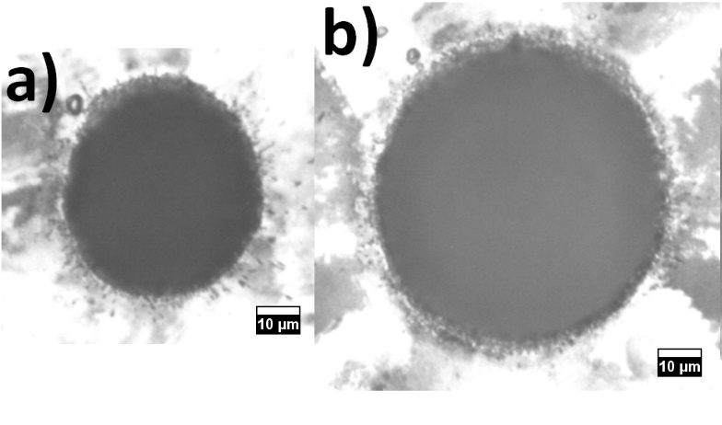
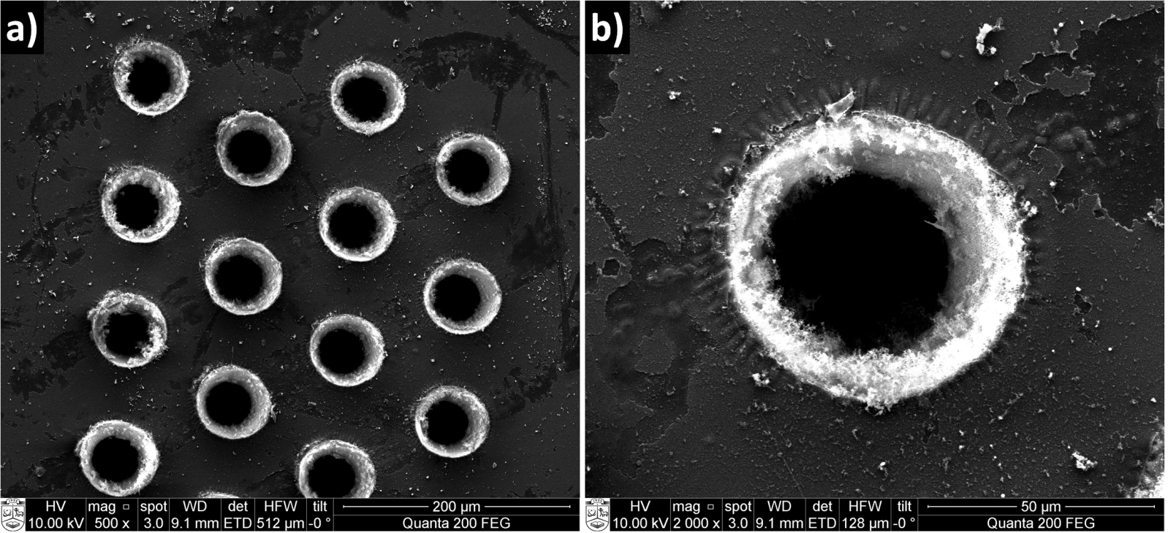
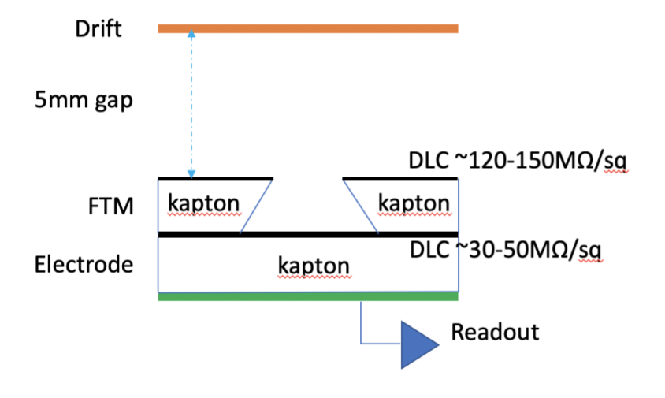
Materials and technologies for the high-gain
Fast Timing MPGD detector (FTM) (2021 – 2022)
KAPTON average hole diameters:
The project aim to improve the technology used in the production of a new type of Micro Pattern Gaseous Detectors (MPGD).
50 μm
70 μm
Schematic overview of a single layer of the FTM prototype
SEM images of holes formed in KAPTON coated with DLC: (a) small fraction of hole array formed by removing DLC prior to drilling,
(b) a single hole from the array, showing DLC crumpling.
Ch. Roskas, P. Verwilligen et al. Proceedings of Science,
EPS-HEP2019 (2020) 158. DOI: 10.22323/1.364.0158

Slide 32


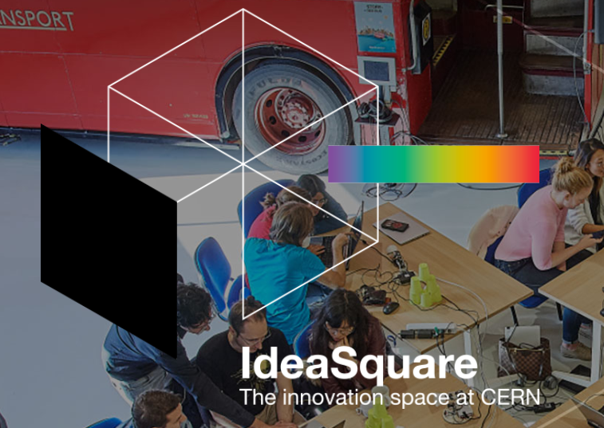
The Challenge Based Innovation Program (CBI)
10 students and lecturers
(Fall semester, 2022)
Contact person:
Assoc. Prof. Dr. Kristina Ukvalbergienė
Director of Department of Academic Affairs
kristina.ukvalbergiene@ktu.lt
Markus Nordberg
Development & Innovation (IPT-DI)
CERN 1211 Geneva 23 Switzerland
Mobile + 41 75 411 4452
markus.web.cern.ch
Notes:
IdeaSquare – innovation space at CERN
The Challenge Based Innovation (CBI) programme is a one-semester master’s level course for students in industrial design, business, engineering and architecture.
The students typically spend roughly one-third of the course at CERN interacting with teams of scientists, engineers and technicians from institutes and universities participating in CERN’s scientific programme.

Slide 33
CERN CMS TIER2 project
The main goal is to unite high-performance computing resources from multiple academic institutions in a federated HPC resource pool for efficient processing of CERN CMS TIER II workloads.
To establish framework between individual institutions IT teams for HPC resources availabilities and accessibilities
To create collaboration and experience sharing platform for best practices of managing HPC resources and serving them to TIER II community.
Using Baltic NREN’s and GEANT optical networks infrastructure interconnect institutional HPC resources at international-Baltic level for at least of 100Gbps lines
Contact person:
Arvydas Žiliukas
Director of Department of Information Technology Services
Computer Networks Centre
arvydas.ziliukas@ktu.lt

Slide 34
Teacher Engagement
The Baltic Teacher Programme 2021 (from 25-30 April 2021)
10 teachers were selected
The Baltic Teacher Programme 2022 (from 3-9 April 2022)
Cancelled due to COVID-19
The Baltic Teacher Programme 2023 will take place from 23-28 April 2023.
Lectures, on-site visits, exhibitions, and hands-on workshops will introduce its participants to
cutting-edge particle physics.
II. Modern physics is reinforced in the updated secondary and primary school curricula
III. Initial activities with pupils in STEM centres developed
IV. A "Modern Physics in School" qualification programme for teachers to implement new curricula
Notes:
Įvertinti integralaus gamtamokslinio ugdymo poveikį 5-8 klasės mokinių pasiekimams, mokymosi motyvacijai ir visuminiam pasaulio suvokimui;
Išanalizuoti ir įvertinti integralaus gamtamokslio ugdymo įgyvendinimo galimybes ir iššūkius (organizavimo, turinio valdymo, išteklių ir kitose srityse);
Ištirti taikomų gamtamokslinio ugdymo modelių privalumus ir trūkumus skirtingo tipo mokykloms;
Išanalizuoti gamtos mokslų mokytojų kompetencijų tobulinimo poreikį diegiant integralų gamtamokslinį ugdymą;
Gautų rezultatų pagrindu parengti integralaus gamtamokslinio ugdymo galimybių analizę ir rekomendacijas atnaujintų gamtamokslinio ugdymo Bendrųjų programų diegimui Lietuvos mokyklose, gamtos mokslų mokytojų kvalifikacijos tobulinimo tematikai ir organizavimui, mokymosi tyrinėjant organizavimui, ugdymui kitose netradicinėse aplinkose bei kitas svarbias sritis, kurias leistų išskirti atliktas tyrimas ir analizė.

Slide 35
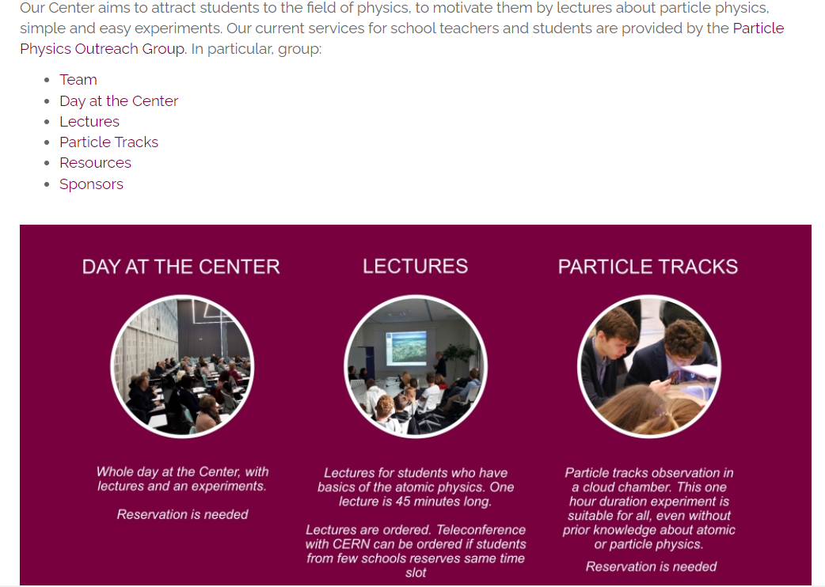
Science outreach center
Notes:
Tikslui įgyvendinti pasirenkamos tirti 38 mokyklų: 18 dalyvaujančių Integruoto gamtos mokslų kurso išbandyme ir 18 nedalyvaujančių, tačiau panašių į dalyvaujančias kitais parametrais (regionas bei mokyklos dydis), siekiant jas palyginti. Problema – karantino sąlygos, mokyklų nualinimas apklausa.
Dalyvavusios mokyklos, planuota po 19 kiekvieno tipo, viso 38
Administracija anketos Mokytojai anketos Gamtos mokslų testas Bendradarbiavimo testas Mokiniai anketos Dalyvavo visuose Nedalyvavo nė viename
Dalyvavusių mokyklų IGMK 16 17 17 17 17 14 1
Dalyvavusių mokyklų PUBP 16 17 19 17 18 13 0
Dalyvavusių mokyklų viso 32 34 36 34 35 27 1
Atsakomumas mokyklų 84% 89% 95% 89% 92% 71% 3%
IGMK dalyvių: IGMK 19 34 365 357 337 1112
PUBP dalyvių: PUBP 17 43 346 307 283 996
Viso 36 77 711 664 620 2108
Atlikant tyrimą, pirminius rezultatus pristatome suinteresuotoms šalims atviros diskusijos formatu, ir papildoma duomenų analizė diskusijos metu išryškėjusiomis įžvalgomis.
Mokyklose buvo tiriama po vieną 8-tą klasę. Prieš atliekant tyrimą, buvo analizuojamos bei atrenkamos Integruoto gamtos mokslų kurso temos ir galiojančios pagrindinio ugdymo temos, taip sukuriant pagrindą lyginimui. Sudarant testus bei apklausas ir tyrimo proceso organizavime buvo remiamasi ankstesnių tarptautinių (pvz., PISA, TIMSS) ir nacionalinių mokinių pasiekimų vertinimų viešai prieinamomis tyrimų metodikomis bei Integruoto gamtos mokslų kurso programa 5-8 klasėms. Tyrimams įgyvendinti VU Filosofijos fakultetas naudojo savo infrastruktūrą, t. y., mobilią įrašymo įrangą diskusijų grupėms, programinę įrangą kiekybinei ir kokybinei duomenų analizei (pvz., SPSS ir MAXQDA).

Slide 36
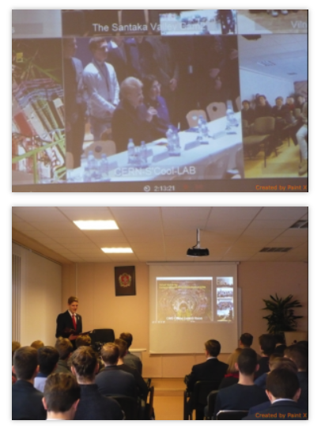
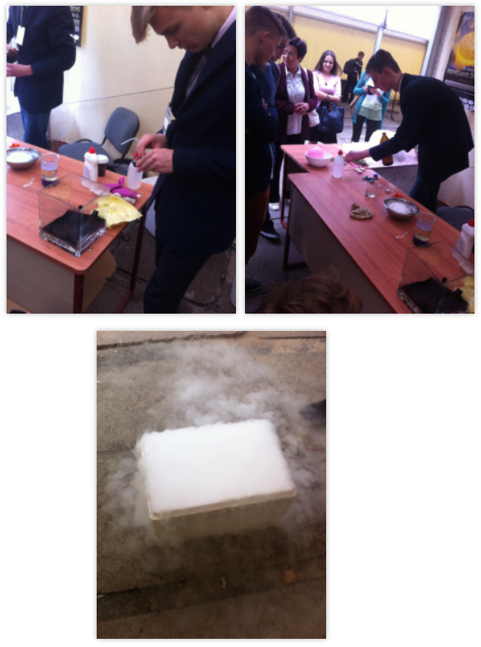
National Science festival “Spaceship Earth”
About 2 hands-on activities and 2 lectures annually starting from 2015. In 2022 – 2 hands-on activities and a lecture on Energy for Future.
CERN virtual tours for
students and publics
2014, 2016, 2017, 2018

Slide 37
Thank you for your attention!

