Slide 1
Activities of the Lithuanian Academy of Sciences
regarding the development
of Lithuanian Associate Membership at CERN
since acquiring the AM status
Jūras Banys, president of the Lithuanian Academy of Sciences
for CERN-Lithuania Joint Committee, 24 November 2022

Slide 2
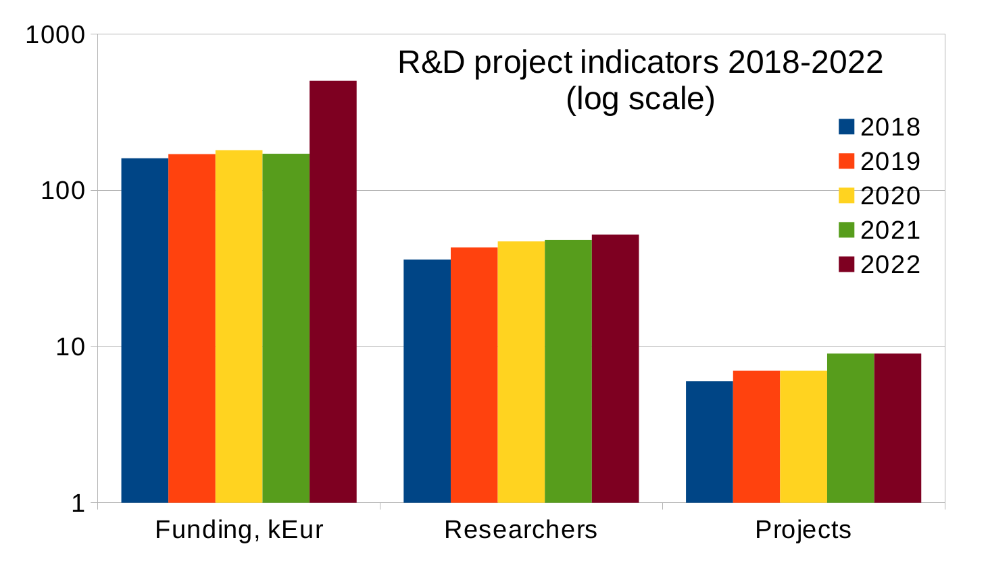
Jūras Banys, president of the Lithuanian Academy of Sciences
for CERN-Lithuania Joint Committee, 24 November 2022
Notes:
Projektams skirta lėšų ir dalyvavo tyrėjų 2018–2021 metais

Slide 3
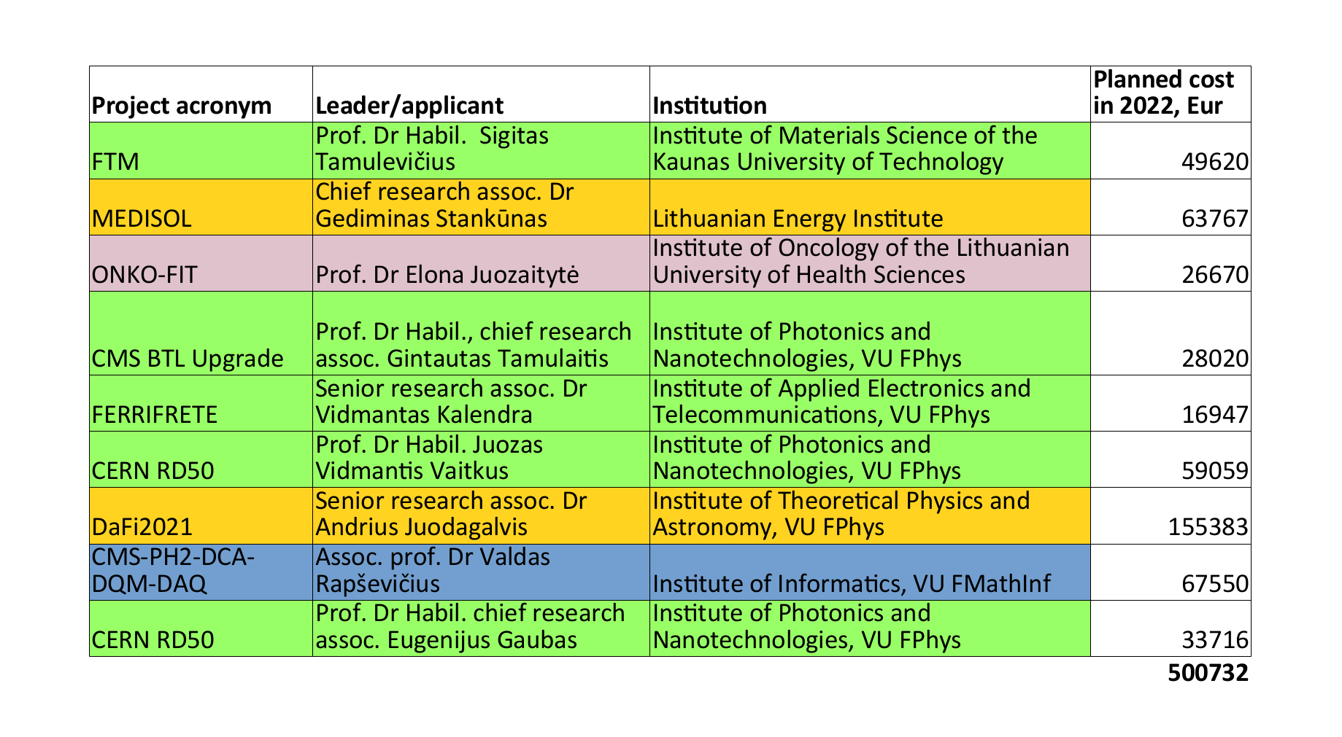
Jūras Banys, president of the Lithuanian Academy of Sciences
for CERN-Lithuania Joint Committee, 24 November 2022
Notes:
iš jų
• 2021 m. finansuoti 2021–2022 laikotarpio projektai

