Slide 1

Update on procurement
Lithuania
Daniel Schoerling
24/11/2022

Slide 2
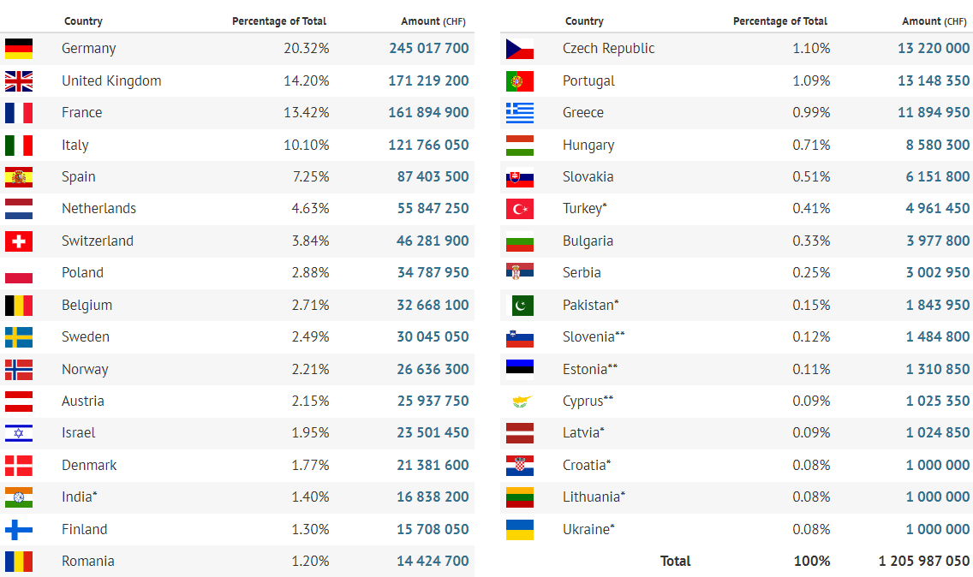
Yearly Budget (contributions 2022)

Slide 3
Reminder: Ceiling
“….when the combined total value of commitments for the country concerned for the year in question, covering all orders, contracts and personnel appointments, including the value of the contract under consideration, would exceed the size of that country’s financial contribution to CERN for the financial year concerned (the “ceiling”).”
kCHF | Contribution | Remaining | Procurement | Personnel
Lithuania | 1.000 | -131 | 209 | 922

Slide 4
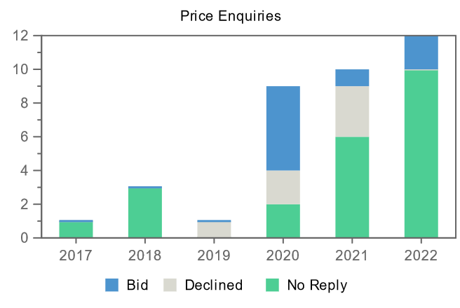
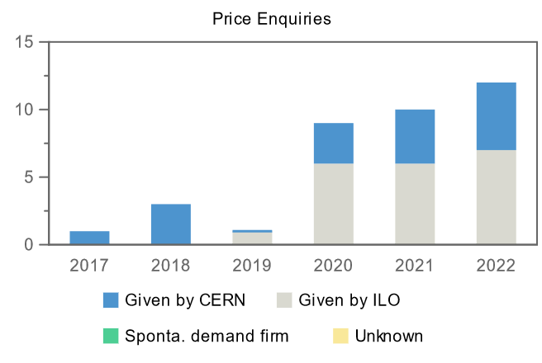
Price Enquiries above 50k CHF for Lithuania
Price Enquiries above 50k CHF for Lithuania
Number of firms contacted
Origin of firms contacted
Year
Firms Contacted
RANK (1)
RANK (2)
RANK (3)
2017
1
–
–
–
2018
3
–
–
–
2019
1
–
–
–
2020
9
1
–
–
2021
10
–
–
1
2022
12
–
1
1

Slide 5
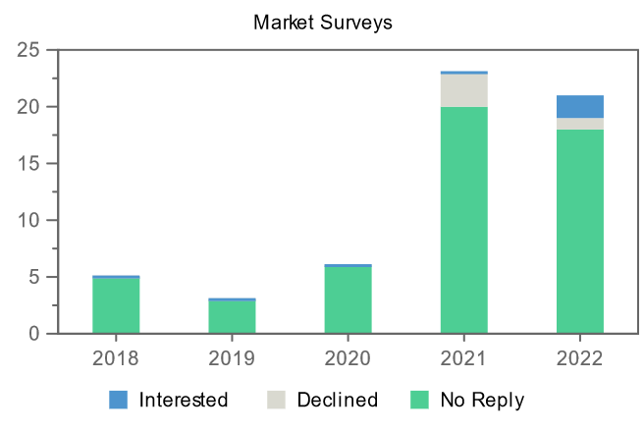
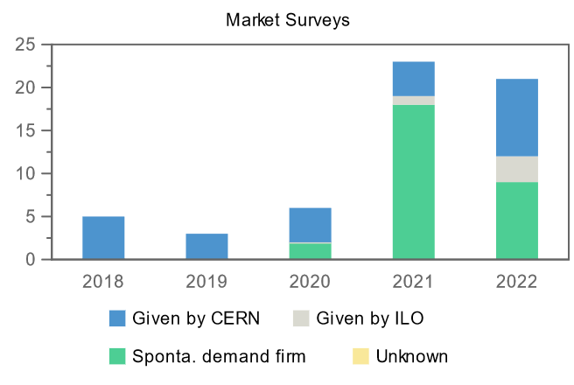
Market Surveys
Number of firms contacted
Origin of firms contacted
Market Surveys for Lithuania
Year
Firms Contacted
Interested
Declined
No Reply
Selected
2018
5
–
–
5
–
2019
3
–
–
3
–
2020
6
–
–
6
–
2021
23
–
3
20
–
2022
21
2
1
18
–

Slide 6
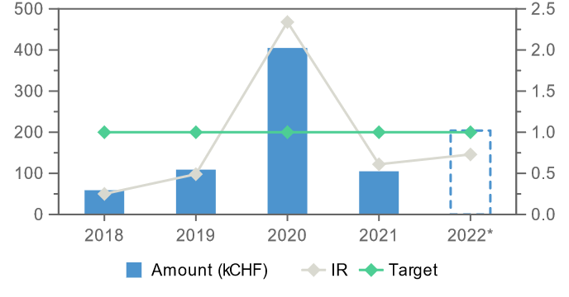
Summary
Supply: Annual Industrial Return
Lithuanian firms are contacted on a regular (and increasing) basis for Price Enquiries and Market Surveys.
At this stage, considering the “ceiling” and the spending on personnel (same order as contribution), it will unfortunately not be possible to place more procurement contracts in Lithuania
Lithuania is poorly balanced

