Slide 1
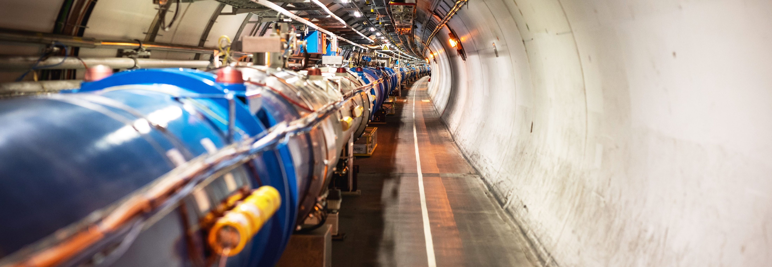
REPORT FROM CERN INTERNATIONAL RELATIONS
Emmanuel Tsesmelis
Head of Associate Member and Non-Member State Relations
Joint CERN-KEK Committee
8 December 2022

Slide 2

Science for peace
CERN was founded in 1954 with 12 European Member States
CERN’s annual budget
is 1200 MCHF (equivalent
to a medium-sized European university)
23 Member States
Austria – Belgium – Bulgaria – Czech Republic
Denmark – Finland – France – Germany – Greece Hungary – Israel – Italy – Netherlands – Norway
Poland – Portugal – Romania – Serbia – Slovakia Spain – Sweden – Switzerland – United Kingdom
3 Associate Member States
in the pre-stage to membership
Cyprus – Estonia – Slovenia
7 Associate Member States
Croatia – India – Latvia – Lithuania – Pakistan
Türkiye – Ukraine
(Brazil signed CERN Associate Membership Agreement
in March 2022, to be ratified in parliament)
6 Observers
Japan – Russia (suspended) – USA
European Union – JINR (suspended) – UNESCO
As of 31 December 2021
Employees:
2676 staff, 783 fellows
Associates:
11 175 users, 1556 others
Around 50 Cooperation Agreements
with non-Member States and Territories
Albania – Algeria – Argentina – Armenia – Australia – Azerbaijan – Bangladesh – Belarus – Bolivia
Bosnia and Herzegovina – Brazil – Canada – Chile – Colombia – Costa Rica – Ecuador – Egypt – Georgia – Honduras
Iceland – Iran – Jordan – Kazakhstan – Lebanon – Malta – Mexico – Mongolia – Montenegro – Morocco – Nepal
New Zealand – North Macedonia – Palestine – Paraguay – People's Republic of China – Peru – Philippines – Qatar
Republic of Korea – Saudi Arabia – Sri Lanka – South Africa – Thailand – Tunisia – United Arab Emirates – Vietnam
Notes:
The speaker can highlight CERN’s second mission as stated when it was established: to foster peaceful collaborations between nations that had recently been at war.
Additional information (OPTIONAL)
More than 40% of CERN’s budget is returned to industry through materials, utilities and services

Slide 3
A laboratory for people around the world
Distribution of all CERN Users by the country of their home institutes as of 31 December 2021
Geographical & cultural diversity
Users of 110 nationalities
19.4% women
Member States 6642
Austria 74 – Belgium 122 – Bulgaria 39 – Czech Republic 227 Denmark 42 – Finland 71 – France 811 – Germany 1129 Greece 133 – Hungary 69 – Israel 67 – Italy 1423
Netherlands 157 – Norway 69 – Poland 278 – Portugal 89 Romania 105 – Serbia 36 – Slovakia 66 – Spain 328
Sweden 88 – Switzerland 372 – United Kingdom 847
Associate Member States
in the pre-stage to membership 55
Cyprus 10 – Estonia 24 – Slovenia 21
Associate Member States 367
Croatia 36 – India 130 – Latvia 11 – Lithuania 12 – Pakistan 30
Türkiye 122 – Ukraine 26
Observers 2917
Japan 189 – Russia (suspended) 971 – United States of America 1757
Non-Member States and Territories 1194
Algeria 3 – Argentina 16 – Armenia 10 – Australia 20 – Azerbaijan 3 – Bahrain 2 – Belarus 24 – Brazil 106 Canada 189 – Chile 23 – Colombia 18 – Cuba 3 – Ecuador 6 – Egypt 16 – Georgia 36 – Hong Kong 17 Iceland 3 – Indonesia 6 – Iran 11 – Ireland 6 – Jordan 5 – Kuwait 5 – Lebanon 15 – Madagascar 1
Malaysia 4 – Malta 2 – Mexico 48 – Montenegro 5 – Morocco 18 – New Zealand 8 – Oman 1 – People’s Republic of China 314 – Peru 2 – Philippines 1 – Republic of Korea 113 – Singapore 3 – South Africa 52
Sri Lanka 10 – Taiwan 45 – Thailand 18 – United Arab Emirates 6
Notes:
THIS SLIDE WILL INCLUDE THE NUMBER OF MEMBERS OF PERSONNEL OF THE VISITORS’ COUNTRY OF ORIGIN

Slide 4
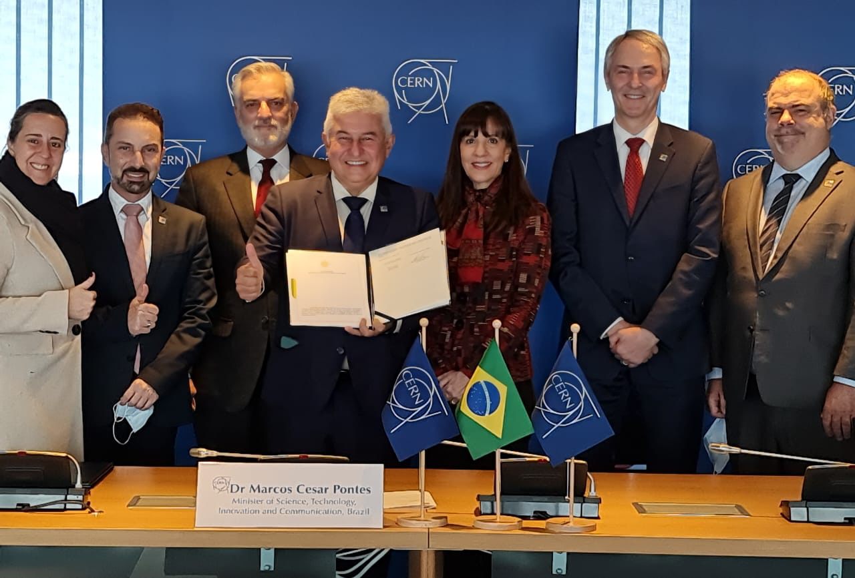
Associate Membership
Signature of agreement at CERN on 3 March 2022.
Ratification process in Brazil is in progress.
Mr. Marcos Cesar Pontes
Minister of Science, Technology and Innovation of Brazil
at CERN for signing of Associate Membership Agreement on 3 March 2022
Egypt and Morocco have expressed interest
in CERN Associate Membership.

Slide 5
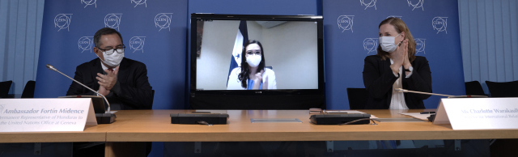
International Cooperation Agreement with Honduras
15 December 2021
Her Excellency Ms Karen Najarro, Vice Minister for International Cooperation and Promotion and Professor Manlio Dionicio Martinez Cantor, Executive Director Honduran Institute of Science, Technology and Innovation (IHCIETI) on the occasion of the remote signature of the International Cooperation Agreement between CERN and IHCIETI.

Slide 6

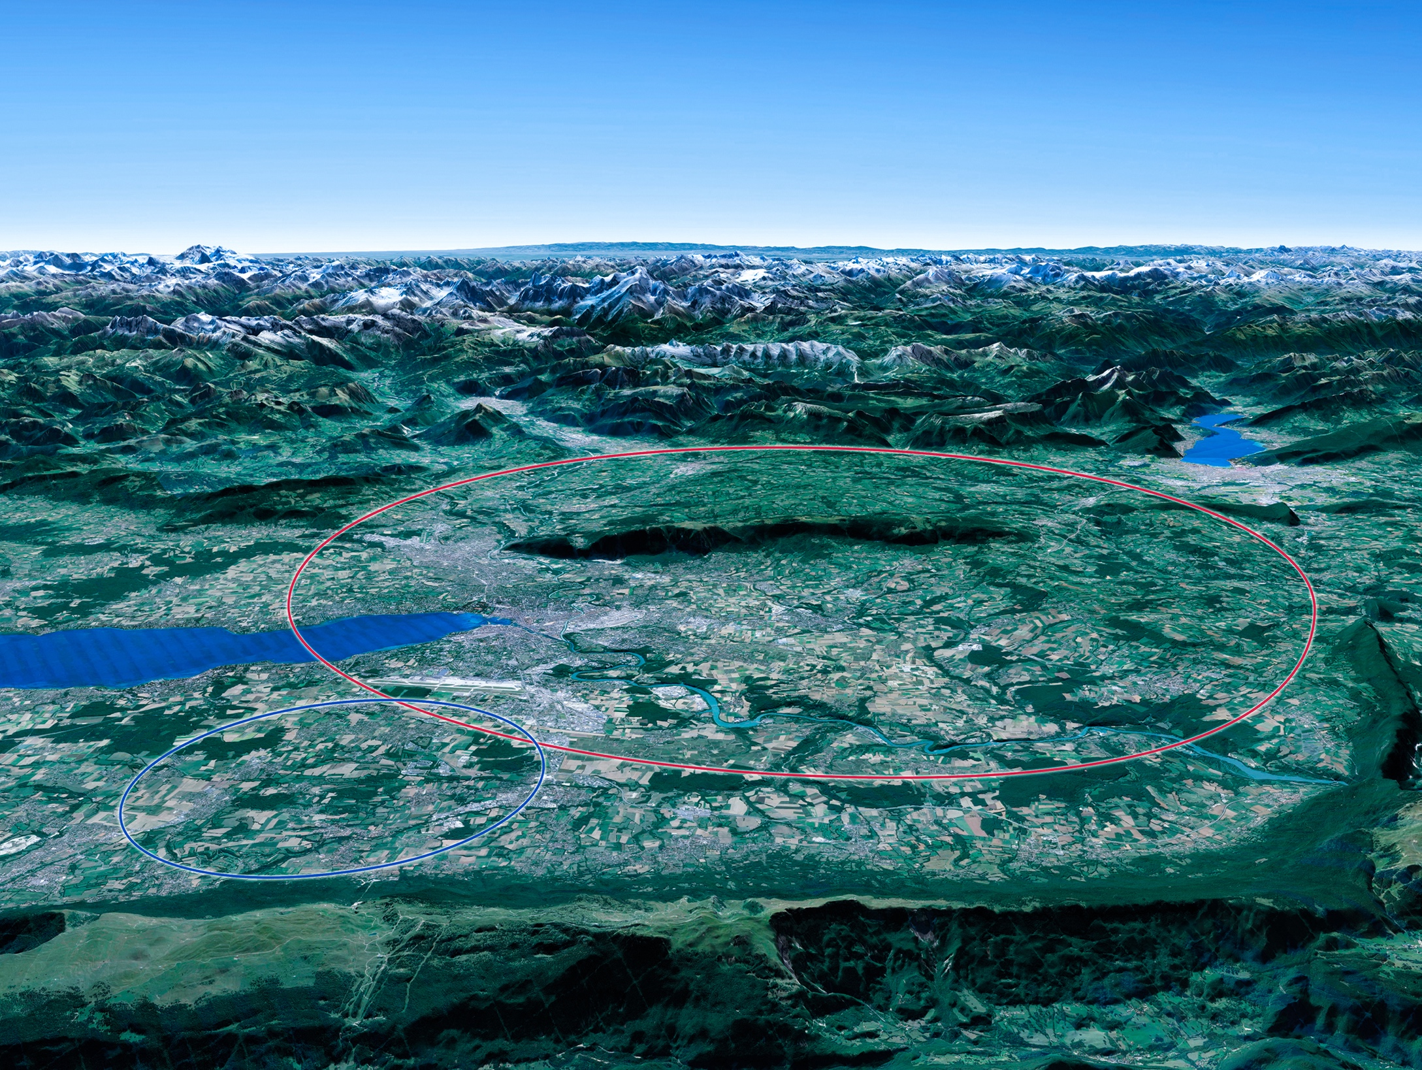

Scientific Priorities for the Future
Implementation of the recommendations
of the 2020 Update of the European Strategy
for Particle Physics:
• Fully exploit the HL-LHC.
• Build a Higgs factory to further understand this unique particle.
• Investigate the technical and financial feasibility of a future energy-frontier 100 km collider at CERN.
• Ramp up relevant R&D.
• Continue supporting other projects around
the world.
LHC
Notes:
For information, the ESPPU recommendations in more detail:
Full exploitation of the HL-LHC
An electron-positron Higgs factory is the highest priority after the LHC
Ramp up R&D efforts for advanced accelerator technologies
Support long-baseline neutrino projects in Japan and US
Investigation of feasibility of a future 100 TeV hadron collider at CERN
THIS IS THE LAST SLIDE IN THE “RESEARCH” SECTION

Slide 7


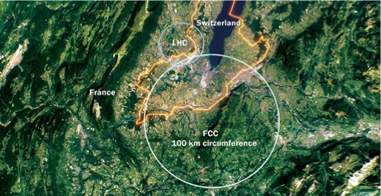
Future Circular Collider Study
Phase-1 started in 2014 Leading to CDR
International FCC collaboration (CERN as host lab) to study:
proton-proton collider (FCC-hh)
  defines infrastructure requirements
  80-100 km infrastructure in Geneva area
electron-positron collider (FCC-ee) as first step
proton-electron (FCC-he) option
~16 T ⇒ 100 TeV pp in 100 km

Slide 8

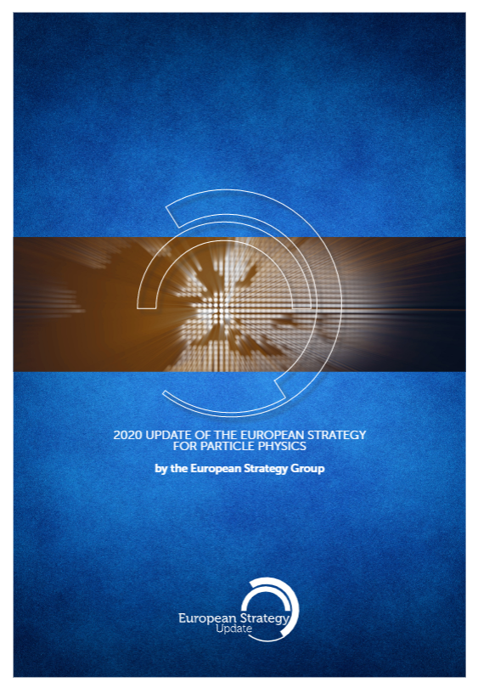
FCC Feasibility Study
FCC Feasibility Study (FS) will address a recommendation of the 2020 update of the European Strategy for Particle Physics (ESPP):
“Europe, together with its international partners, should investigate the technical and financial feasibility of a future hadron collider at CERN with a centre-of-mass energy of at least 100 TeV and with an electron-positron Higgs and electroweak factory as a possible first stage.
Such a feasibility study of the colliders and related infrastructure should be established as a global endeavour and be completed on the timescale of the next Strategy update.”
Complete Feasibility Study Report by end 2025

Slide 9
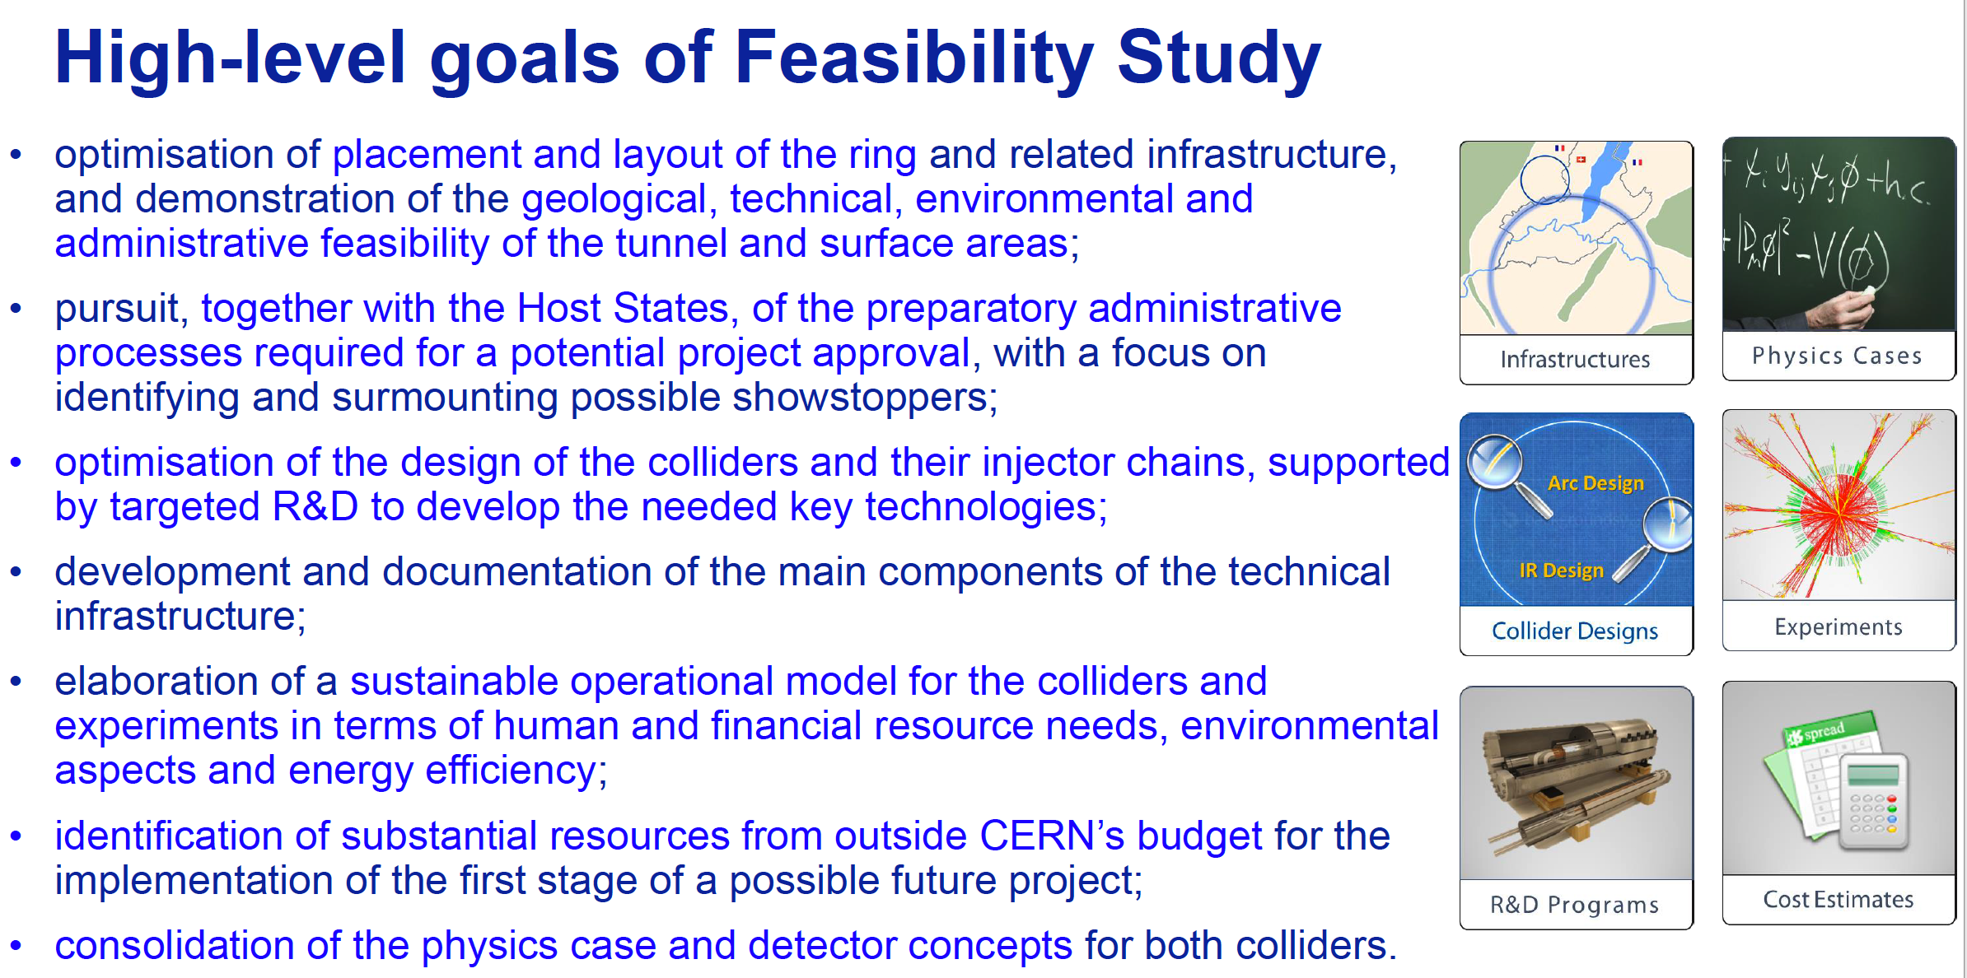
High-level Goals of Feasibility Study
Increasing international collaboration as a prerequisite for success:
links with science, research & development and high-tech industry will be essential to further advance and prepare the implementation of FCC

Slide 10

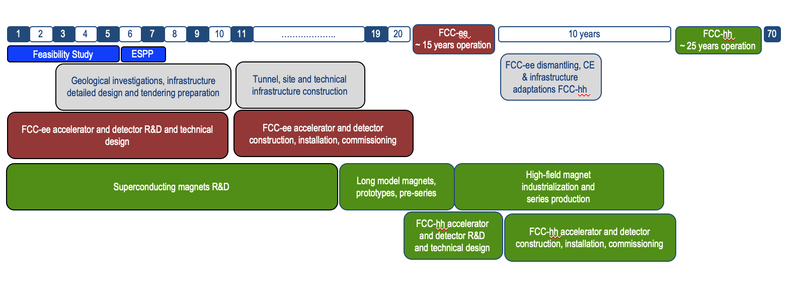
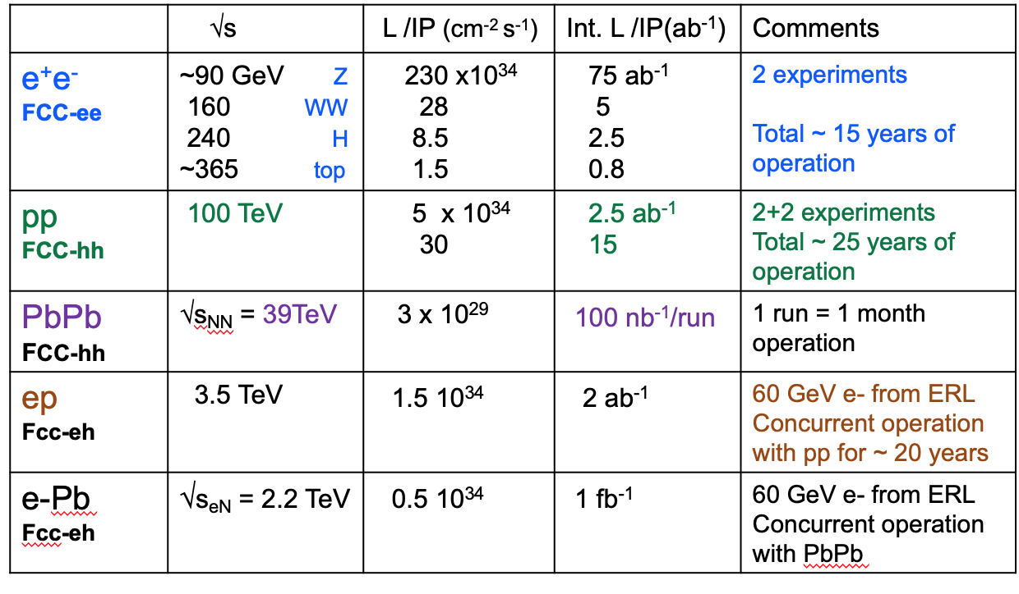
Timeline of the FCC Integrated Programme
Technical
schedule
2-4 experiments
20-30
Feasibility Study: 2021-2025
If project approved before end of
decade → construction can start
beginning 2030s
FCC-ee operation ~2045-2060
FCC-hh operation 2070-2090++
F. Gianotti

Slide 11
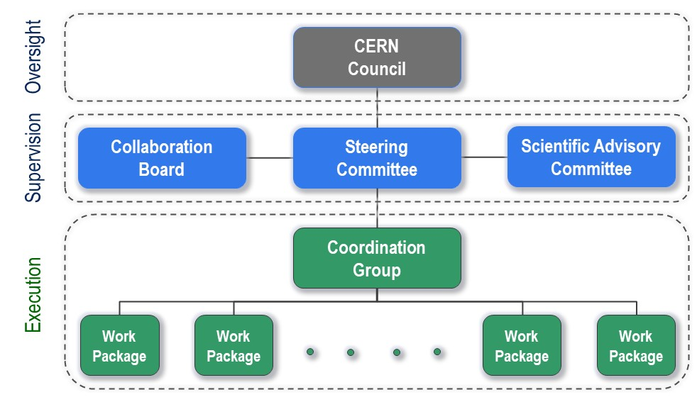
FCC Organisational Structure
  Ownership of the Feasibility Study by the Council.
  Effective and timely supervision.
  Integration of scientific and technical advice.
  Participation of stakeholders that can potentially make significant financial and technical contributions to a possible future project.
  Execution of Feasibility Study.

Slide 12

FCC Feasibility Study – Coordination Team and Contactpersons
EU Projects
NN
Study Support Unit
IT: Sylvain Girod
Procurement: Adam Horridge
Quality control: NN
Resources: Sylvie Prodon
Scheduling, quality mangement: NN
Secretariat: Julie Hadre
Collaboration building
Emmanuel Tsesmelis
Study Support and Coordination
Study Leader: Michael Benedikt
Deputy Study Leader: Frank Zimmermann
Communications
Panagiotis Charitos, James Gillies
Physics, Experiments and Detectors
Patrick Janot
Christophe Grojean
Physics programme
Matthew McCullough, Frank Simon
Accelerators
Tor Raubenheimer
Frank Zimmermann
Project organisation model
Technical Infrastructures
Klaus Hanke
Host State processes and civil engineering
Timothy Watson
Organisation and financing models
Paul Collier (interim)
FCC-ee collider design
Katsunobu Oide
FCC-hh design
Massimo Giovannozzi
Technology R&D
Roberto Losito
FCC-ee booster design
Antoine Chancé
FCC-ee injector
Paolo Craievich, Alexej Grudiev
FCC-ee energy calibration polarization
Alain Blondel, Jorg Wenninger
FCC-ee MDI
Manuela Boscolo, Mike Sullivan
Integration
Jean-Pierre Corso
Geodesy & survey
Hélène Mainaud Durand
Electricity and energy management
Jean-Paul Burnet
Cooling and ventilation
Guillermo Peon
Cryogenics systems
Laurent Delprat
Computing and controls infrastructure, communication and network
Dirk Duellmann
Safety
Thomas Otto
Operation, maintenance, availability, reliability
Jesper Nielsen
Transport, installation concepts
Cristiana Colloca
Administrative processes
Friedemann Eder
Placement studies
Johannes Gutleber, Volker Mertens
Environmental evaluation
Johannes Gutleber
Tunnel, subsurface design
John Osborne
Surface sites layout, access and building design
Detector concept
Mogens Dam
Physics performance
Patrizia Azzi, Emmanuel Perez
Software and computing
Gerardo Ganis, Clément Helsens
Financing model
Florian Sonnemann
Procurement strategy and rules
In-kind contributions
Operation model
Paul Collier, Jorg Wenninger

Slide 13

FCC Global Collaboration Working Group
From ESPP 2020: “Such a feasibility study of the colliders and related infrastructure should be established as a global endeavour….”
→ FCC Global Collaboration Working Group active since spring 2021
Engage with institutes/countries/regions with mature communities, and the potential to contribute substantially to the Organization’s long-term scientific objectives, to facilitate participation in FCC FS.
Work with national laboratories, institutes, universities and industry in MS, AMS, Observer States and NMS to:
  Encourage an expanded membership and explore opportunities for future prospective participants.
  Explore opportunities for future prospective participants in defining areas of collaboration.
  Prepare the foundations for research and contributions by industry.
  Liaise with national contact persons and forums.

Slide 14

Status of Global FCC Collaboration
Increasing international collaboration as a prerequisite for success:
links with science, research & development and high-tech industry will be essential to further advance and prepare the implementation of FCC
147
Institutes
30
Companies
34
Countries
EC
H2020

Slide 15
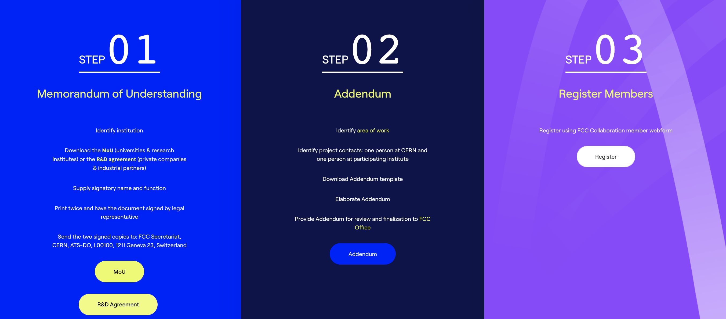
FCC Feasibility Study Collaboration Membership
Participation in FCC through MoU and Addenda.
The FCC MoU for the first phase of the study has been updated to cover the Feasibility Study.
The current participating institutes who wish to take part in the Feasibility Study can continue to participate on the basis of the previously signed MoU until the updated MoU is signed.
https://fccis.web.cern.ch/join-now

Slide 16


