Slide 1
CERN-KEK Collaborative Activities for
Linear Colliders
Steinar Stapnes – with information/slides from many others at KEK and CERN
2021-22 (also looking at 2023 and beyond):
LC studies in the CERN MTP (Medium Term Plan)
Agreements and activities: ATF (collaboration), klystron efficiency studies, X-band studies, CERN-KEK offices, SC RF (new), ILC IDT
ILC future planning and CERN’s role – prospects for 2023-24
  In addition to the above common studies related to: CE, Cryo, dumps, sustainability (power, energy, CO2), crab-cavities
EAJADE successful bid, kick off March 2023 (exchange programme with Japan (and Americas) for Higgs factories - ATF, SuperKEKb, sustainability studies, SCRF, etc

Slide 2
Goal | The design and implementation studies for the CLIC e⁺/e⁻ multi-TeV linear collider are at an advanced stage. The main feasibility issues, cost and project timelines have been developed, demonstrated and documented in a comprehensive project implementation plan for the accelerator, and a summary report covering the physics, detector and accelerator status, including future plans. An initial stage at 380 GeV was presented in detail for the European Strategy update (ESPP), together with upgrade paths to higher energy stages, 1.5 and 3 TeV. During 2019-21 further potential improvements in luminosity performance and components designs were introduced and remain a focus of further studies. On the design side the parameters for running at multi-TeV energies, with X-band or other RF technologies, will be studied further, in particular with energy efficiency guiding the designs. The work-programme, technical R&D, power/energy efficiency and design studies, are carried out by a collaboration of 53 institutes providing the overall (M&P) resources for the activities. The CLIC accelerator studies are closely connected with associated physics and detector studies, many of which are part of a larger Higgs-factory study framework in common with for example ILC and FCC-ee. During the coming years the focus will remain on core technology development and spread making use of existing facilities (High Gradient Test Stand and the CLEAR beam facility), optimising X-band components for performance and manufacturability towards full modules, and efficient use of the abovementioned collaborations with the many laboratories and universities now using the technology in compact linac systems. This allows CLIC to remain a future accelerator option for CERN, and increases the overall availability and knowledge of the technology, with modest investments. The use of the CLIC technology - primarily X-band RF, associated components and nano-beams - in compact medical, industrial and research accelerators in many of the CERN Member States has become increasingly important development and test grounds for CLIC, and is destined to grow further. An EC supported design study with 24 partners has pursued the use of the technology in future FELs facilities (CompactLight) resulting in a much expanded scientific and industrial community using it. The International Linear Collider (ILC) studies are progressing lead by an International Development Team (IDT) where CERN participates. The CERN linear collider studies support this effort through combined activities with CLIC, co-operation with KEK for specific technology developments where CERN has expertise, and studies using ATF2 facility. The future of the ILC focussed part of linear collider activities will depend on the progress of the ILC project in Japan, building on the commonalities between CLIC and ILC, common R&D interests between CERN and KEK, and extensive European activities and capabilities related to ILC studies and technologies, inside and outside CERN.
Organisation | A CLIC nucleus study team hosted at CERN and reporting to the CLIC Collaboration Board with representatives of all collaborating institutes. Work packages and agreements are defined, distributed and followed up by the CLIC Steering Committee and executed by CERN groups and/or external collaborators. The International Linear Collider (ILC) studies are led by an International Development Team (IDT) where CERN participates. The CERN team also plays an important role in organising and facilitating European planning for the ILC preparation phase.
2023 targets | Development of X-band technology with industry and collaboration partners using updated manufacturing procedures and designs; covering structures, RF network and high efficiency power units, as needed for CLIC and applications in compact linacs in general; Continue studies of the luminosity performance at 380 GeV and multi-TeV energies, including nanobeam hardware developments as needed for these, and including re-evaluation of the positron production yield based on recent studies; Power and energy reduction studies and re-evaluation and optimisation of these parameters, for 380 GeV and 3 TeV; Define and initiate the most important initiatives and agreements for the period 2023-25 for applications of the core technologies in compact research and medical linacs; Participate in relevant working groups for ILC and organize collaborative R&D efforts with KEK for ILC and CLIC; Continue to play a coordinating and facilitating role for European planning and contributions to the ILC as the project evolves.

Slide 3
ATF work in Europe limited to completion of theses, planning for next phase
ATF3 planning and preparation continuing with many European partners (lead IJClab and UK), including CERN
Talk yesterday with more on foreseen programme:
https://indico.cern.ch/event/1222411/contributions/5152664/attachments/2562595/4417257/ATF_CPM_37.pdf

Slide 4
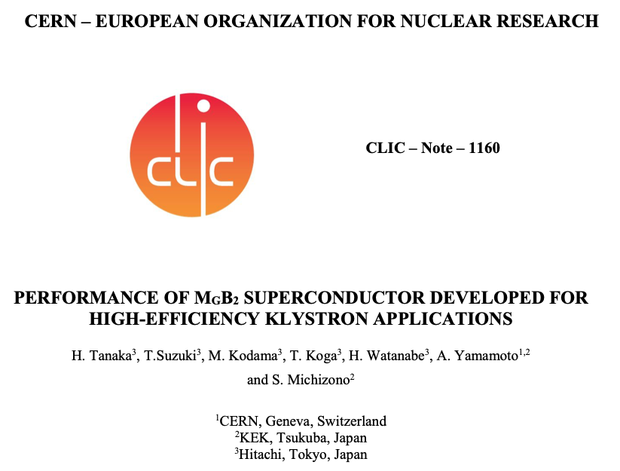
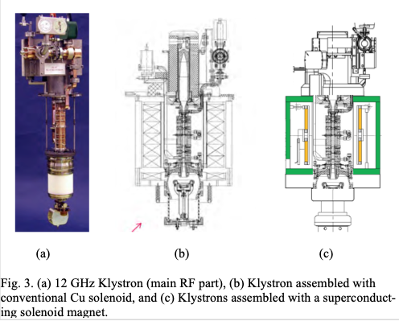
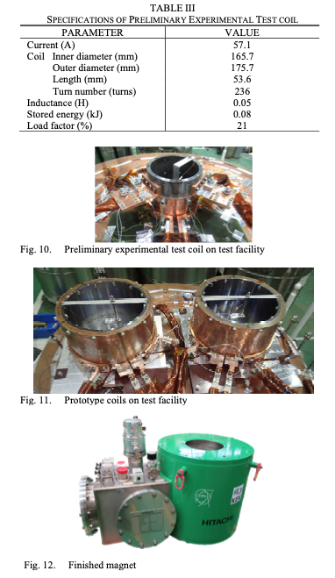
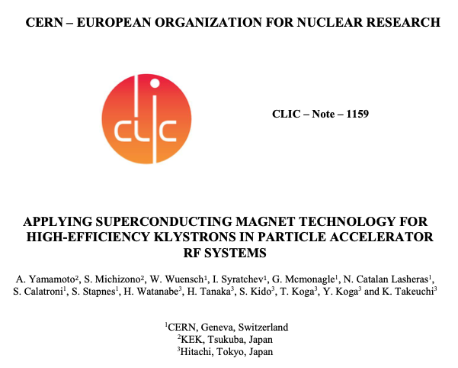
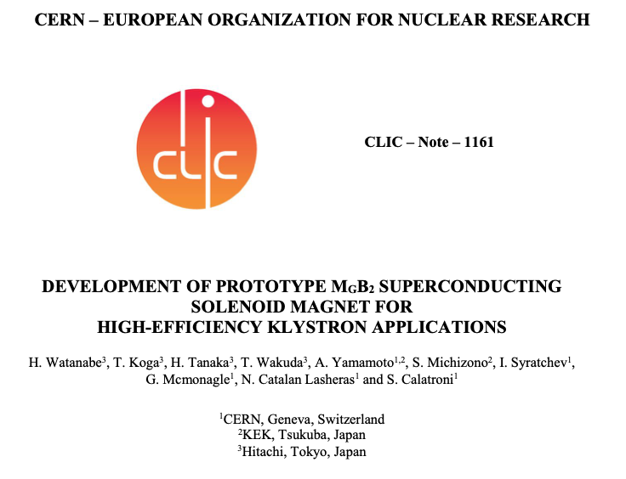
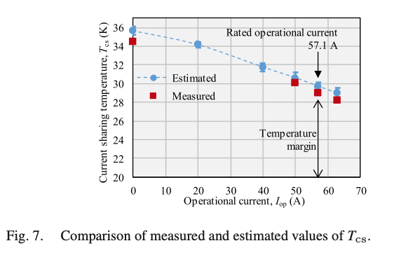
SC solenoid for HiEff klystrons - 2020

Slide 5
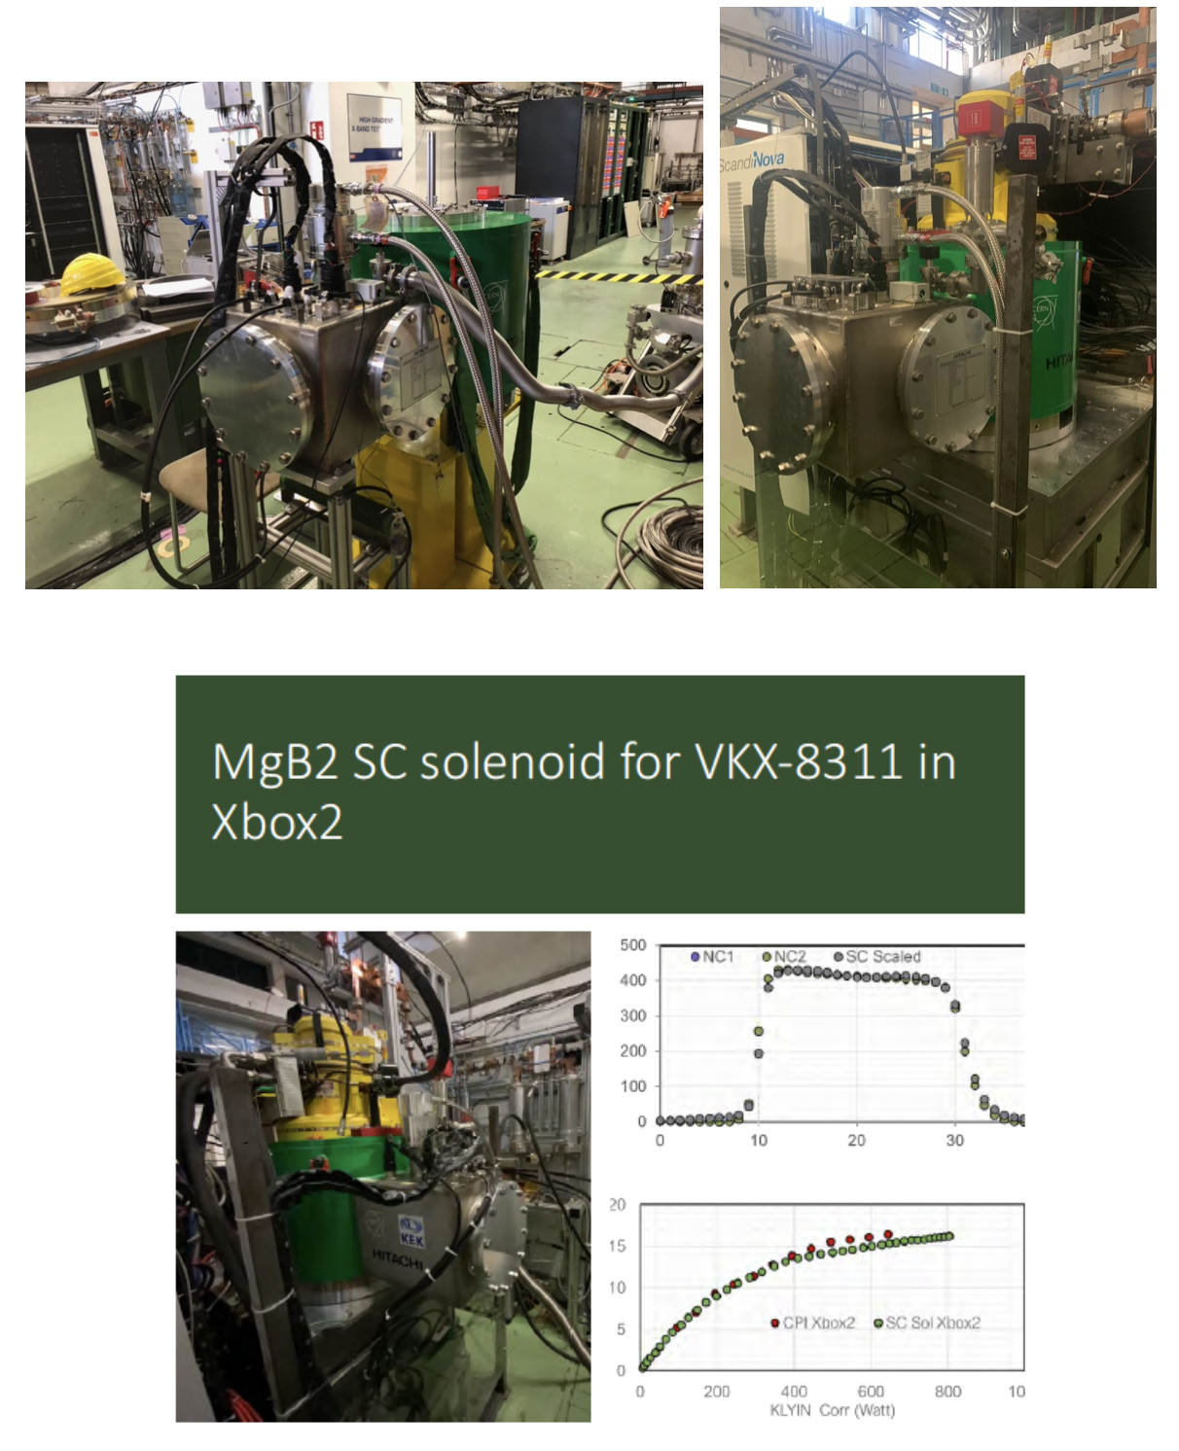
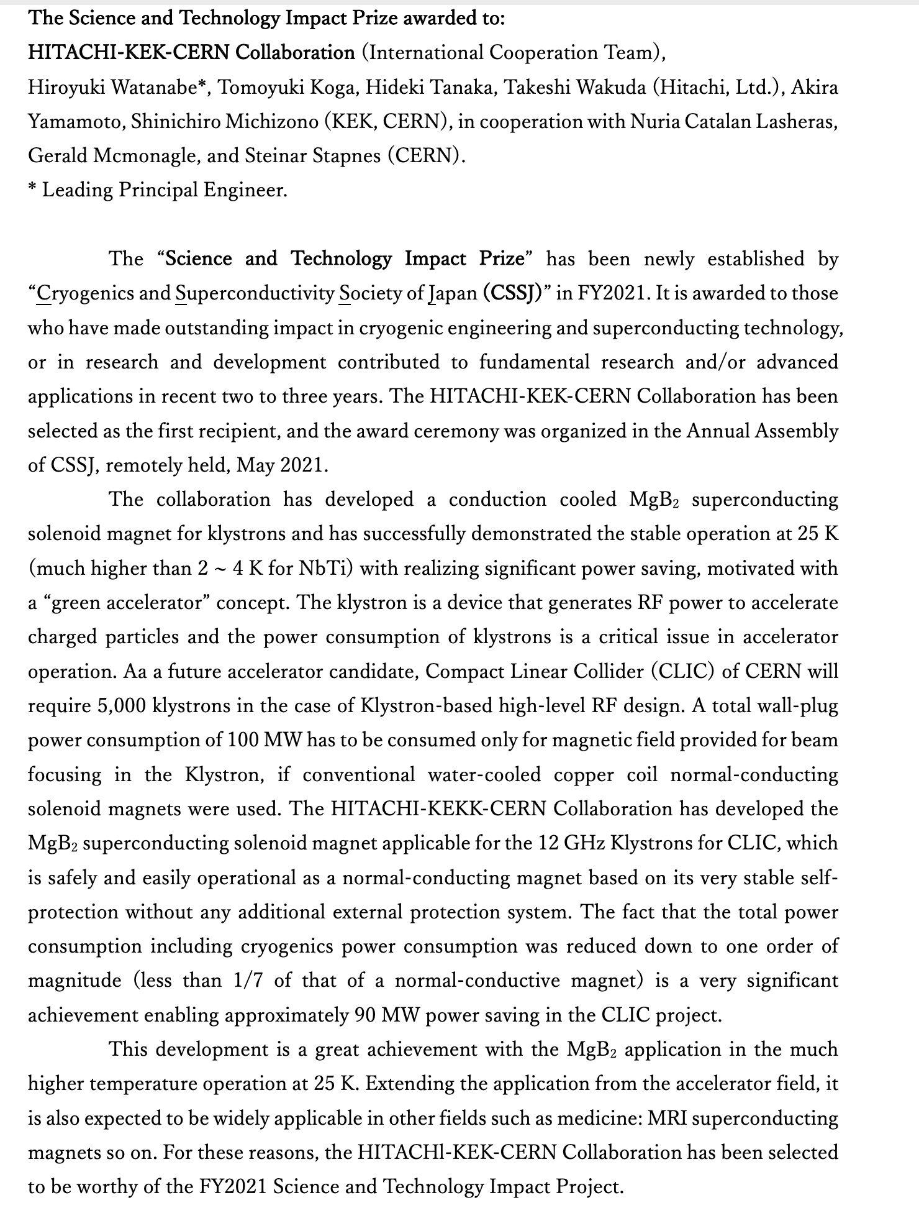
From report in 2021

Slide 6
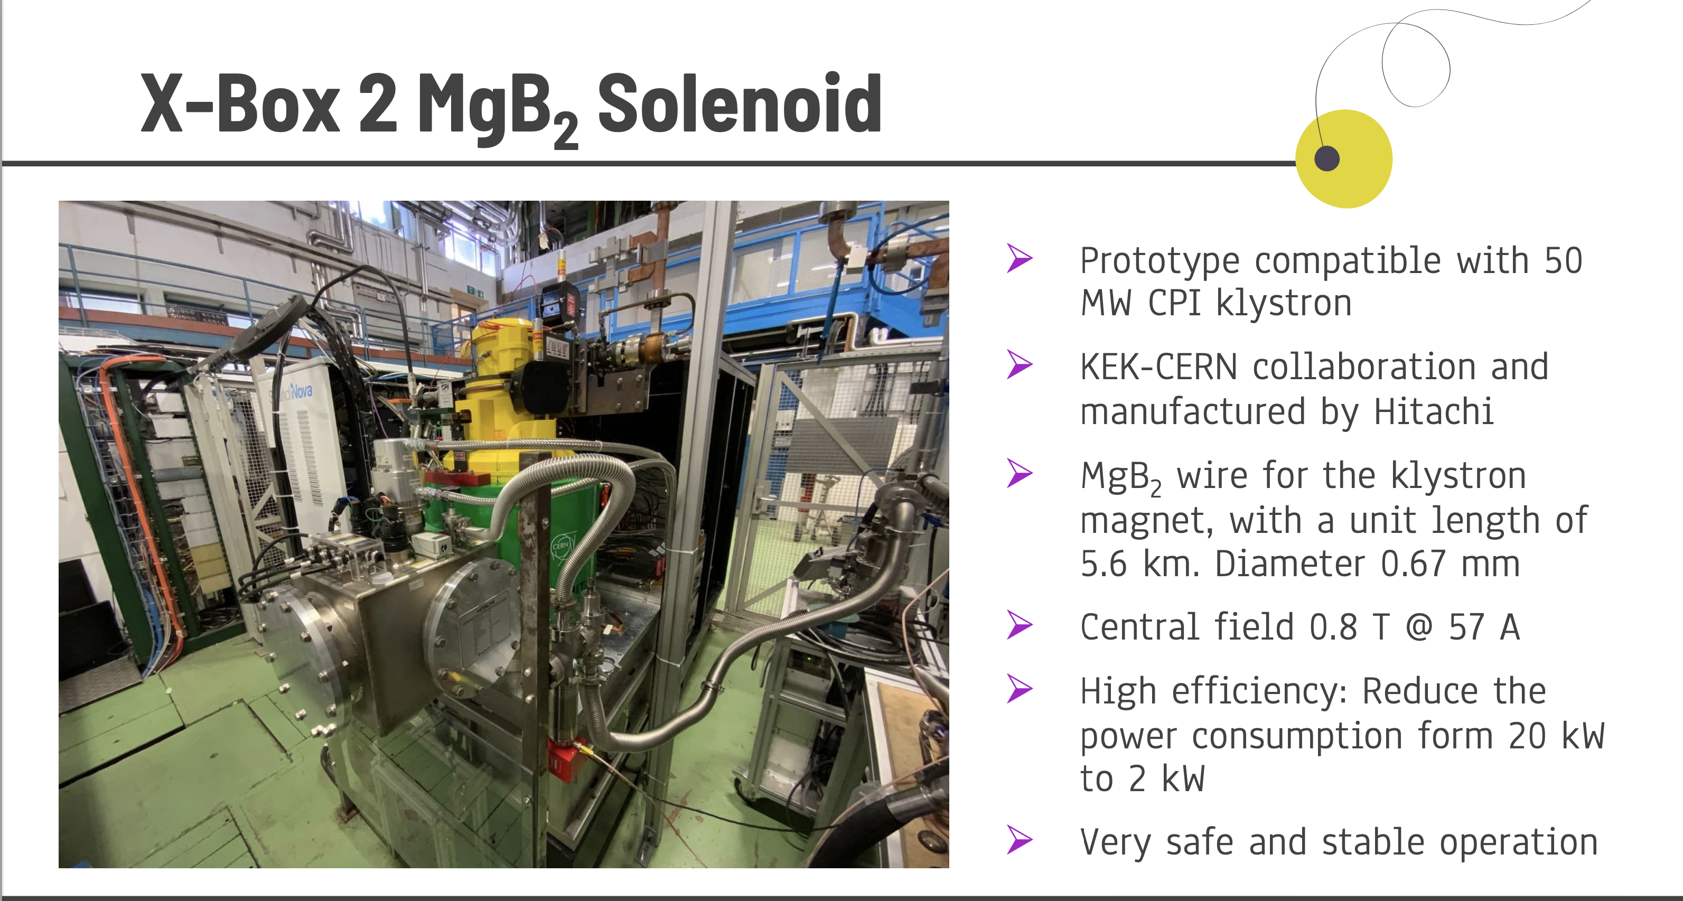
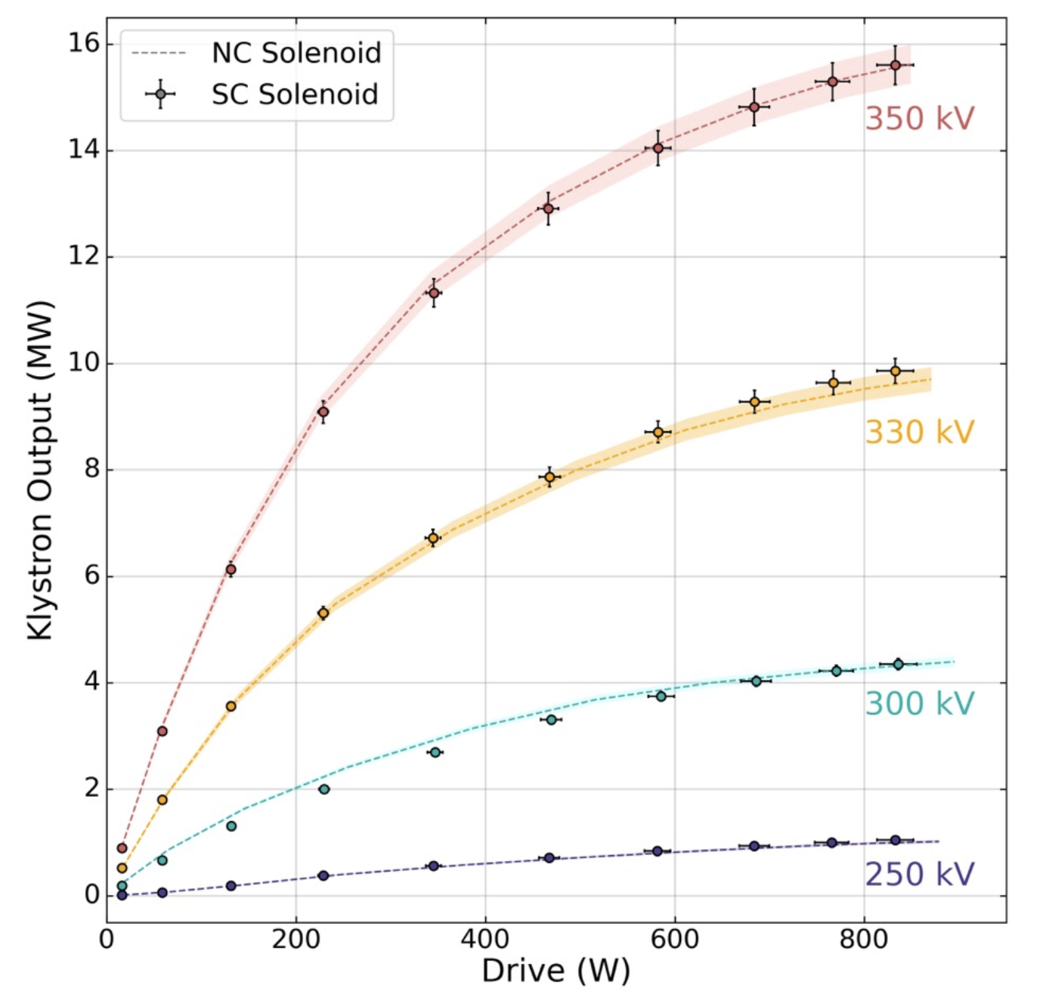
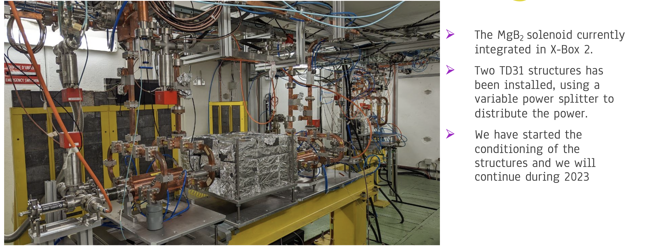
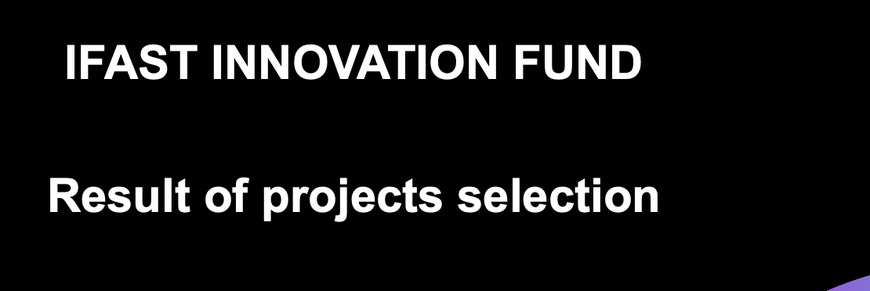
Recent report: https://indico.cern.ch/event/1222411/contributions/5142737/attachments/2562513/4417646/CLIC_PM43_Xboxes_MBA.pptx

Slide 7
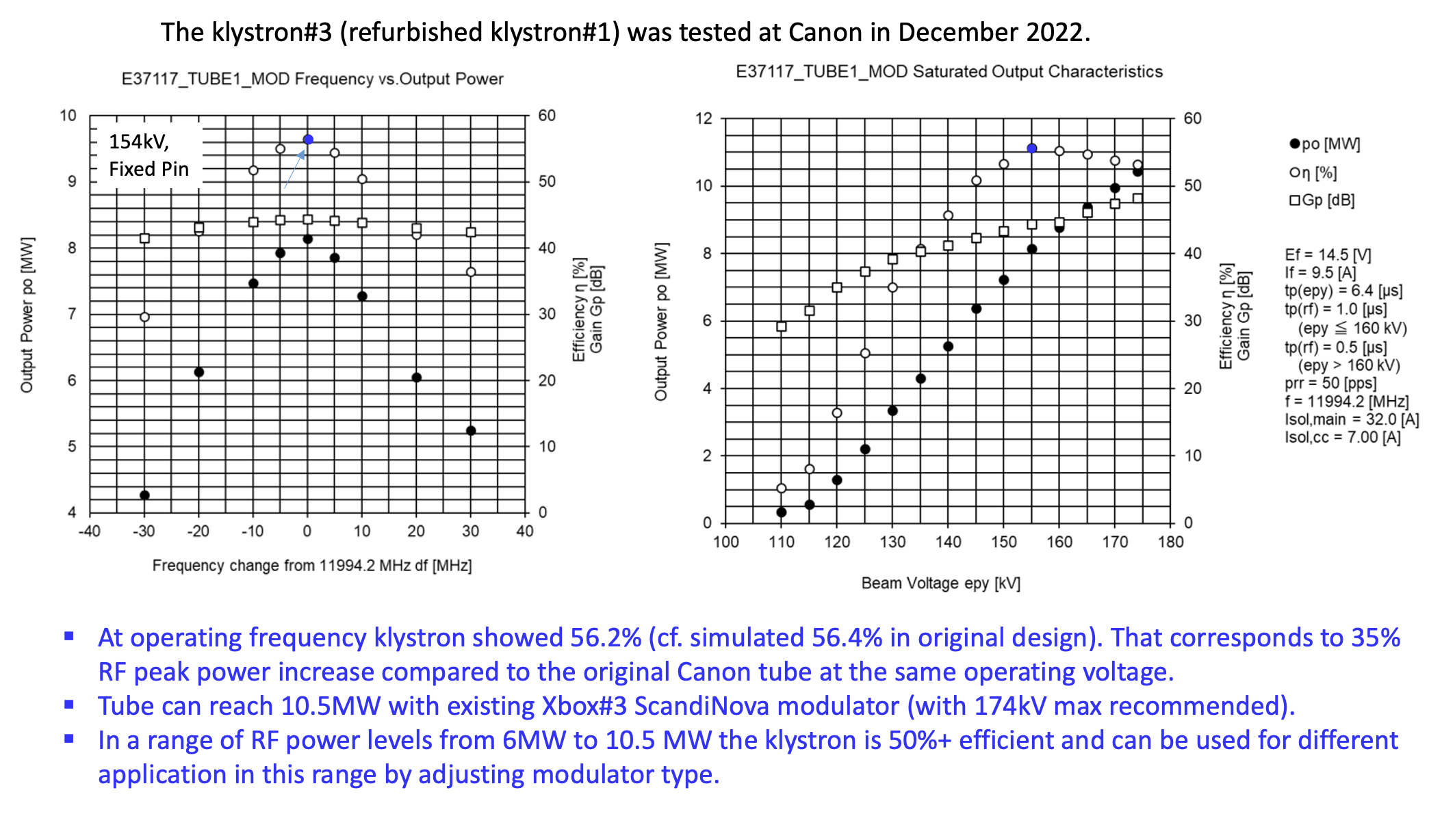
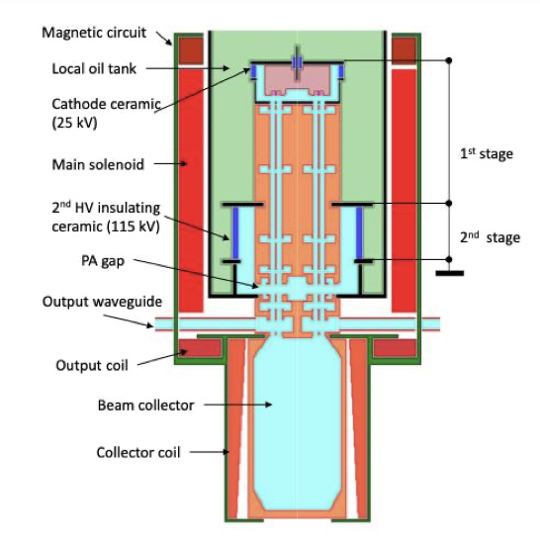
Recent report: https://indico.cern.ch/event/1222411/contributions/5142729/attachments/2562386/4416814/CLIC_2022_EOY.pdf

Slide 8
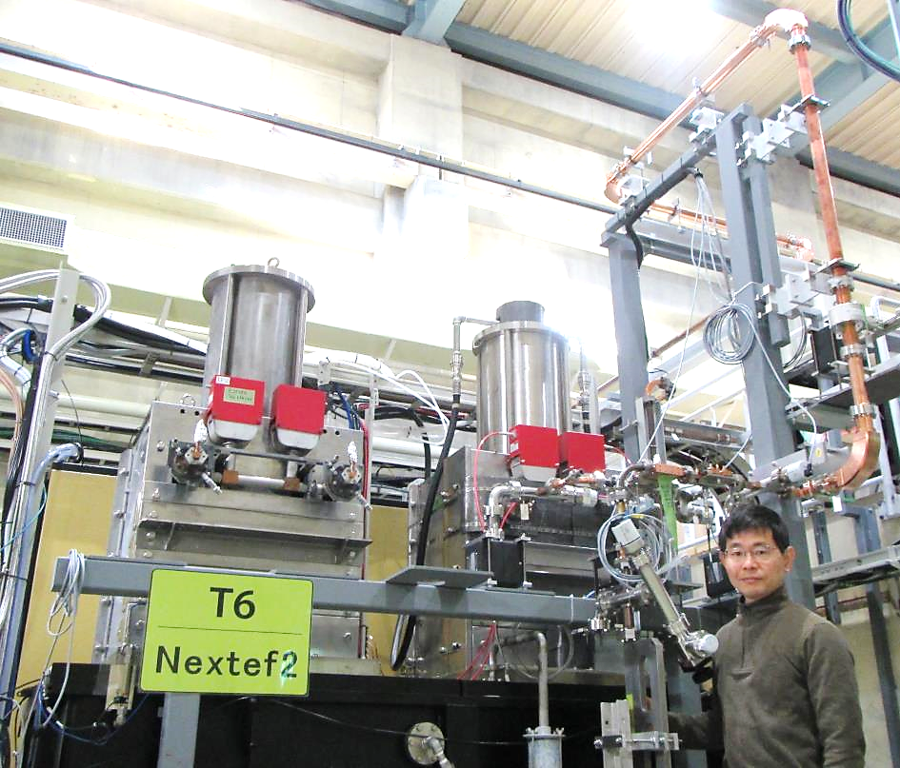
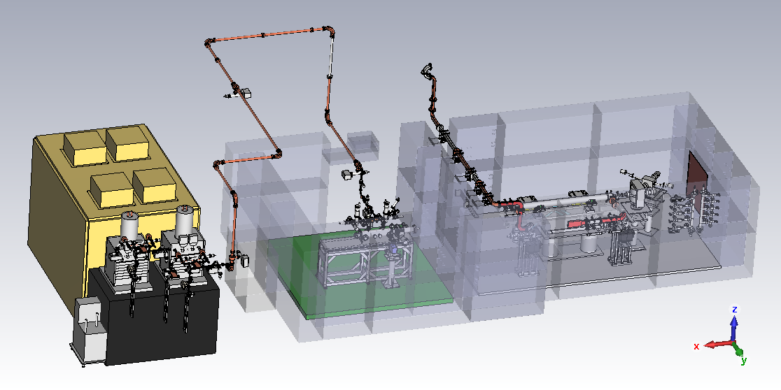
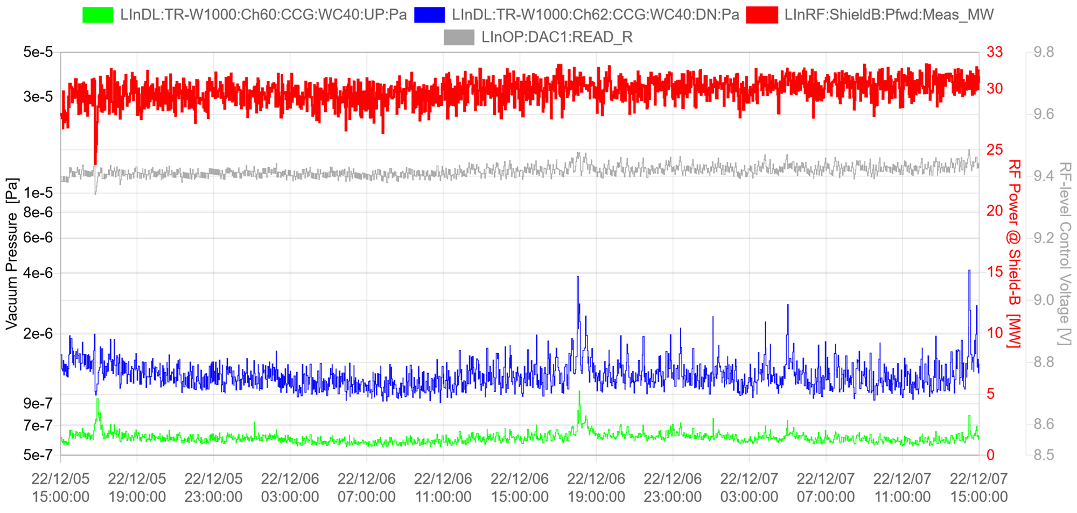
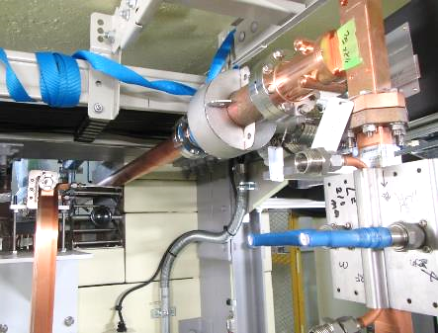
Nextef2: High RF-Power System Today
Nextef2 High Power
↓ X-band
Mod. & Kly.
50MW PPM
klystron2
offline
Low-loss circ. WG
to Shield-B
(S-band test stand)
↓
50MW PPM
klystron1
in use
↑ Shield-A
↑ Test area
(Shield-B)
Two-day operation at > 30 MW in Shield-B
Automaticall controlled 24hr/day
Power
Shield-B
30 MW
20
1. Today: One klystron operation
see right plot →
2. Soon: Inspection by gov.
Wireless Telegraphy Act
3. Early next year: Start real test
Vacuum
10
0

Slide 9
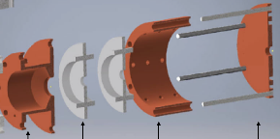
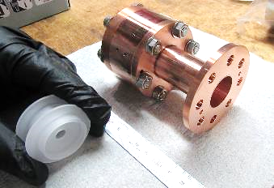
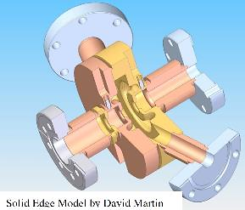
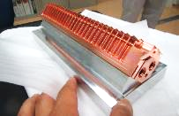
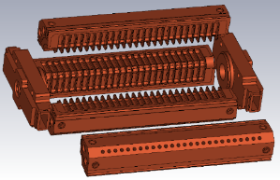
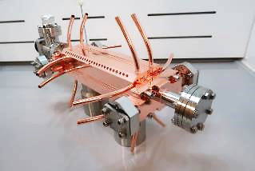
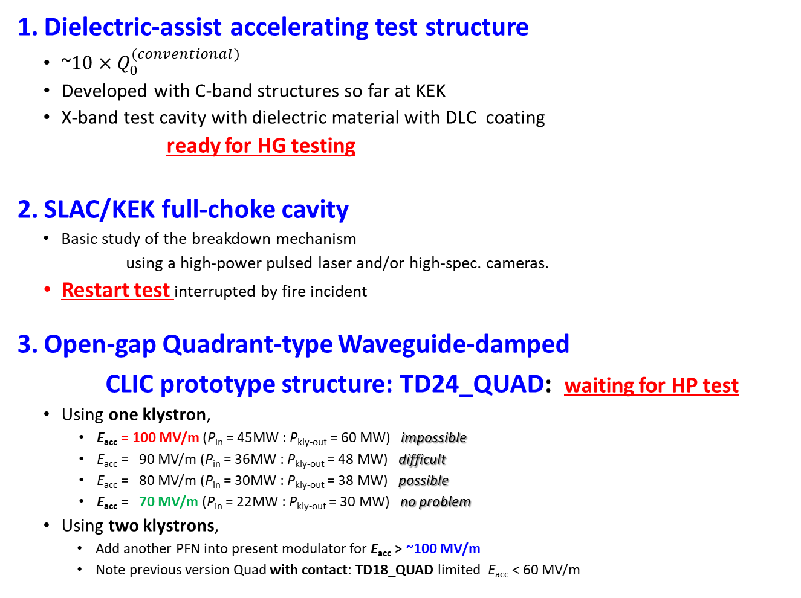
Examples of near-future test structures
Dielectric-assist accelerating test structure
  ~10 × $Q_{0}^{(conventional)}$
  Developed with C-band structures so far at KEK
  X-band test cavity with dielectric material with DLC coating
  ready for HG testing
SLAC/KEK full-choke cavity
  Basic study of the breakdown mechanism
  using a high-power pulsed laser and/or high-spec. cameras.
  Restart test interrupted by fire incident
Open-gap Quadrant-type Waveguide-damped
CLIC prototype structure: TD24_QUAD: waiting for HP test
  Using one klystron,
    E_{acc} = 100 MV/m (P_{in} = 45MW : P_{kly-out} = 60 MW) impossible
    E_{acc} = 90 MV/m (P_{in} = 36MW : P_{kly-out} = 48 MW) difficult
    E_{acc} = 80 MV/m (P_{in} = 30MW : P_{kly-out} = 38 MW) possible
    E_{acc} = 70 MV/m (P_{in} = 22MW : P_{kly-out} = 30 MW) no problem
  Using two klystrons,
    Add another PFN into present modulator for E_{acc} > ~100 MV/m
    Note previous version Quad with contact: TD18_QUAD limited E_{acc} < 60 MV/m
(DLC: diamond-like carbon)
RF
Laser or camera

Slide 10
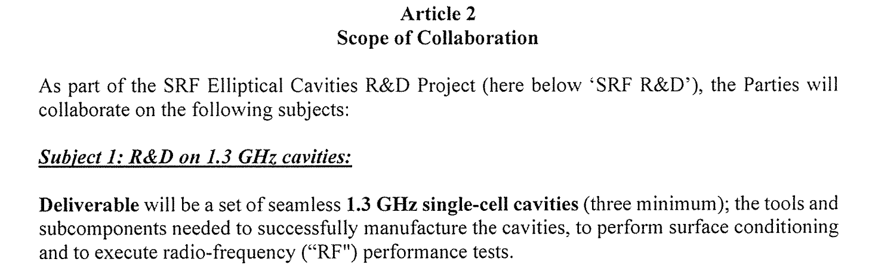
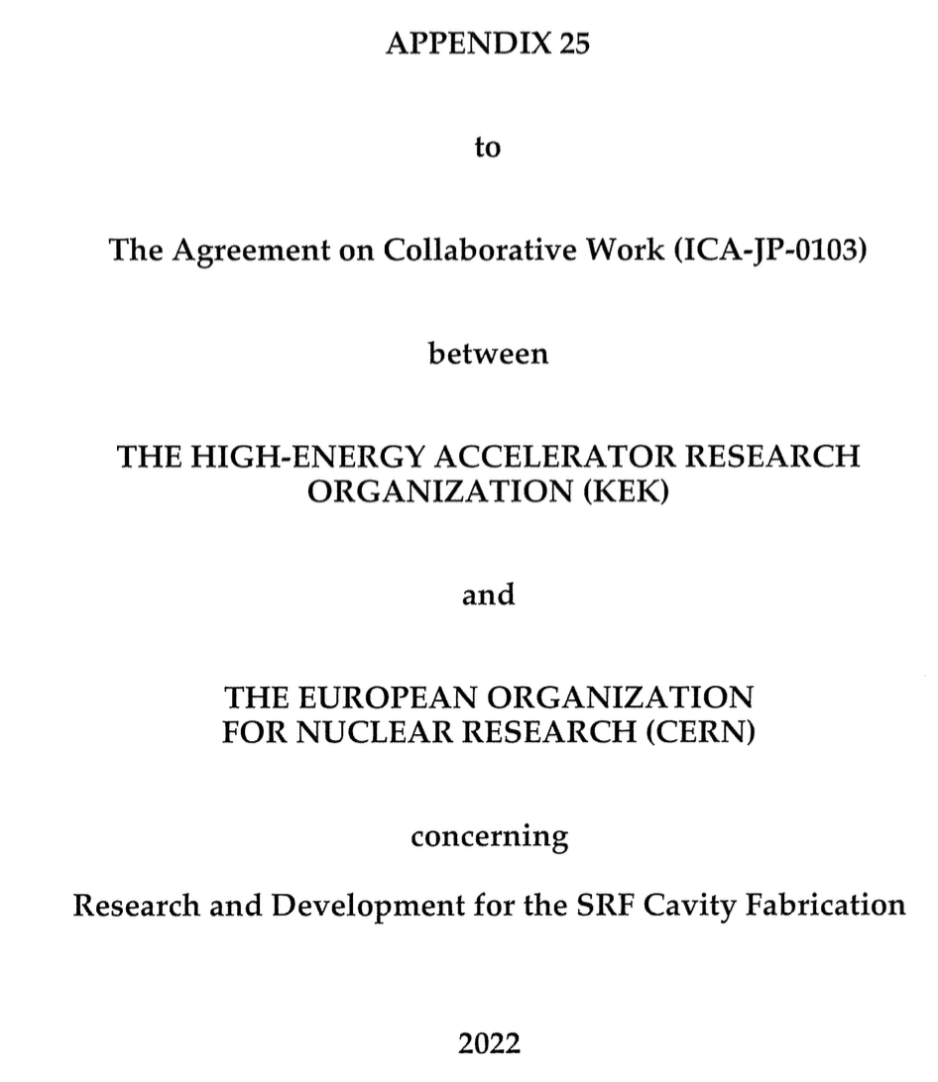
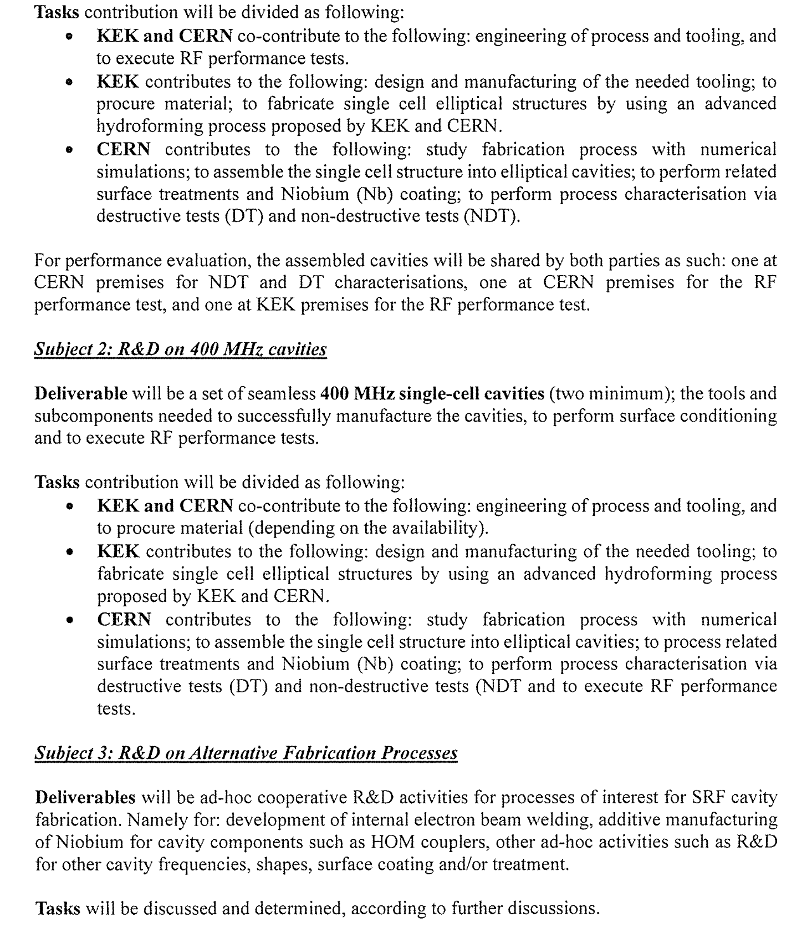
A new agreement on SCRF recently signed

Slide 11

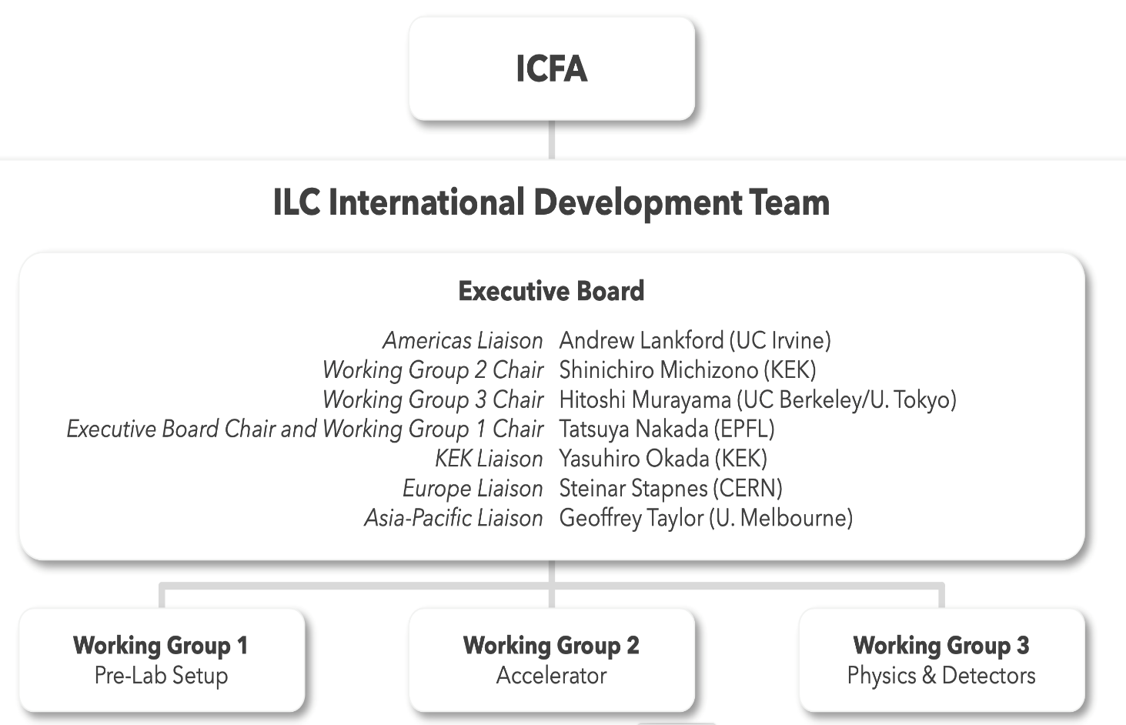
IDT organization
Jenny List (DESY)

Slide 12
CERN – KEK agreement for the ILC IDT resigned in 2022
Possible to add annexes for specific common studies, positrons, possibly klystrons, dumps, etc
In some areas – as mentioned in text - we have other appendixes ..
Notes:
aa

Slide 13
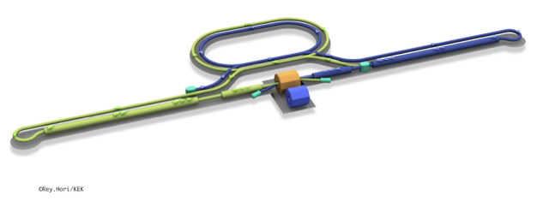
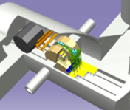
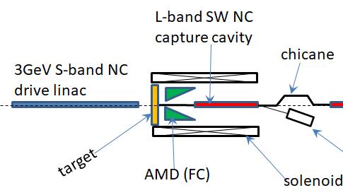
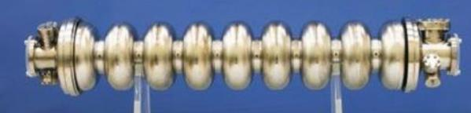
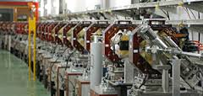
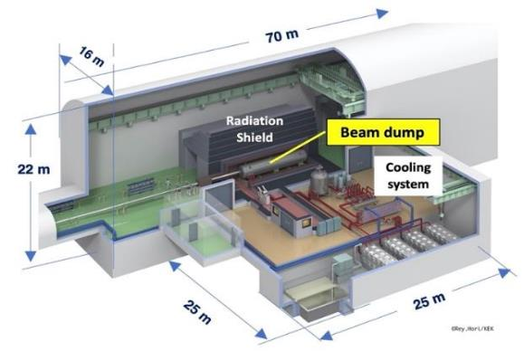
The ILC250 accelerator facility
Item | Parameters
C.M. Energy | 250 GeV
Length | 20km
Luminosity | 1.35 x10³⁴ cm⁻²s⁻¹
Repetition | 5 Hz
Beam Pulse Period | 0.73 ms
Beam Current | 5.8 mA (in pulse)
Beam size (y) at FF | 7.7 nm＠250GeV
SRF Cavity G. Q₀ | 31.5 MV/m (35 MV/m) Q₀ = 1x10 ¹⁰
Interaction point
Damping Ring
e+ Source
e- Source
e- Main Linac
Beam dump
Physics Detectors
e+ Main Liinac
Bunches of ~10¹⁰ e+/e-
Undulator positron source
Creating particles Sources
  polarized elections/positrons
High quality beam. Damping ring
  low emittance beams
Acceleration Main linac
  superconducting radio frequency (SRF)
Collide them Final focus
  nano-meter beams
Go to Beam dumps
Electron driven positron source

Slide 14
IDT-WG2
IDT WG2
Shin Michizono (Chair)
Benno List (Deputy)
ML&SRF group
DR/BDS/Dump group
The initial plan for the ILC preparation phase activities, and the subset currently emphasised in the ITN have been worked out by the IDT-WG2.
The WG2 group has important European involvement.
Yasuchika Yamamoto | KEK
Sergey Belomestnykh | FNAL
Nuria Catalan | CERN
Enrico Cenni | CEA
Dimitri Delikaris | CERN
Luis Garcia Tabares | CIEMAT
Rongli Geng | ORNL
Hitoshi Hayano | KEK
Bob Laxdal | Triumf
Matthias Liepe | Cornell
Peter McIntosh | STFC
Laura Monaco | INFN Milano
Olivier Napoly | CEA
Sam Posen | FNAL
Robert Rimmer | JLAB
Roger Ruber | JLAB
Marc C. Ross | SLAC
Kensei Umemori | KEK
Hans Weise | DESY
Akira Yamamoto | KEK
Toshiyuki Okugi | KEK
Karsten Buesser | DESY
Philip Burrows | U. Oxford
Angeles Faus-Golfe | LAL
Andrea Latina | CERN
Kiyoshi Kubo | KEK
Jenny List | DESY
Thomas Markiewicz | SLAC
Brett Parker | BNL
Ivan Podadera | CIEMAT
David L. Rubin | Cornell
Nikolay Solyak | FNAL
Nobuhiro Terunuma | KEK
Glen White | SLAC
Kaoru Yokoya | KEK
Mikhail Zobov | INFN LNF
Sources group
Dump sub-group
Kaoru Yokoya | KEK
Jim Clarke | STFC
Steffen Doebert | CERN
Joe Grames | JLAB
Hitoshi Hayano | KEK
Masao Kuriki | U. Hiroshima
Benno List | DESY
Jenny List | DESY
Gudrid Moortgat-Pick | U. Hamburg
Tsunehiko Omori | KEK
Sabine Riemann | DESY
Peter Sievers | CERN -retired
Tohru Takahashi | U. Hiroshima
Nobuhiro Terunuma | KEK
Toshiyuki Okugi | KEK
Civil engineering group
Nobuhiro Terunuma | KEK
John Andrew Osborne | CERN
Tomoyuki Sanuki | U. Tohoku
Crab sub-group
Peter McIntosh | STFC
Yasuchika Yamamoto | KEK

Slide 15
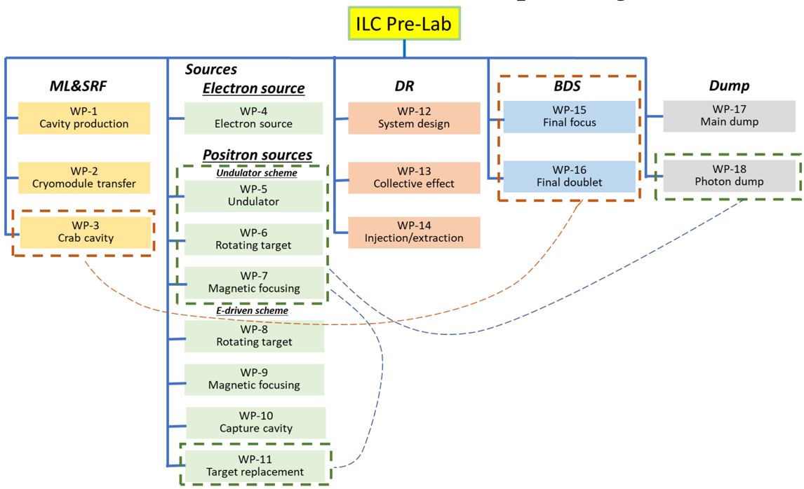
Recent developments
The initial planning for the ILC preparation phase (2022-2026) – see upper figure - leading to a complete Engineering Design as needed for construction was reviewed by a MEXT appointed committee and deemed premature, referring to that the prospects for an international sharing for ILC are not clear.
However increased support for technical developments was indicated as possible.
A result a subset of the technical activities of the full preparation phase programme have been identified as critical. We call this an ILC Technology Network (ITN) - see lower figure, and this presentation (briefly) summarized this work, with a European focus.
The goal is that in parallel with starting with these technical activities international discussion can proceed and open for addressing the Engineering Design in full, such that the changes in the ILC timescale are not too large overall.
Reducing the number of WPs
and reducing the size of the WPs:
From 60 M$ to 15 M$
From 360 FTEy to 112 FTEy
 |  | P1 | P2 | P3 | P4 | C1 C2 C3 C4 C5 C6 …
Previous |  | Pre-lab ~4 years |  |  |  | Construction ~10 year
 |  | Y1 | Y2 | Y3/P1? | Y4/P2? |  | C1 C2 C3 C4 C5 C6 …
Now |  | Time critical WPs ~4 years
 |  |  |  | Pre-lab 3~4 years |  |  | Construction ~10 year
Notes:
Please comment on this one

Slide 16
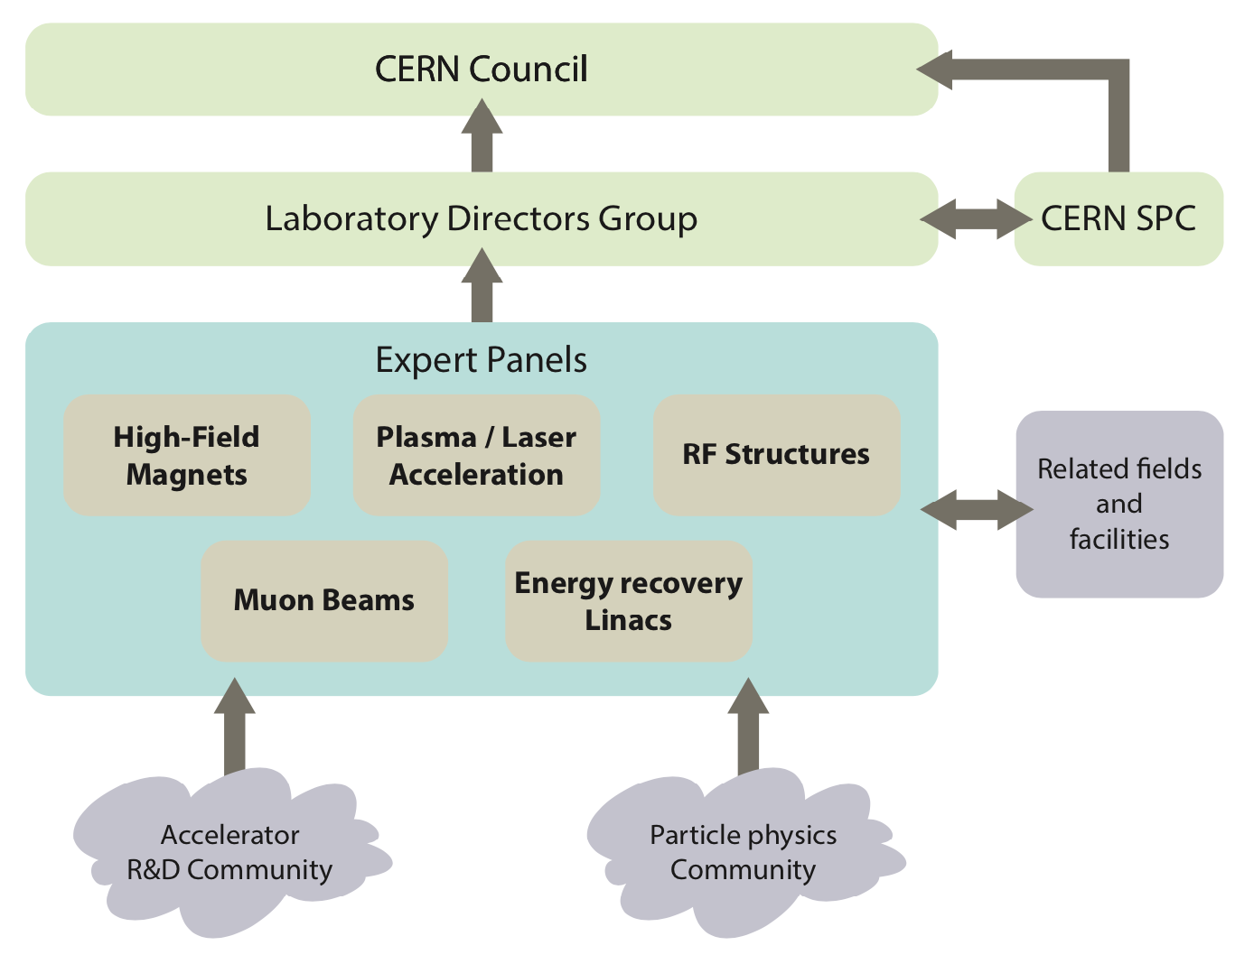
European process and LDG interactions
Mails sent to many of you during the summer to update you on the points mentioned in the slides above, called “Recent developments”.
A model for European participation also discussed over the summer, in particular in a series of ILC Europe meetings (covering all aspects of European ILC activities): LINK. The operation model has also been discussed with KEK and in the ILC IDT.
In parallel discussions took place between Fabiola Gianotti, Masanori Yamauchi, Tatsuya Nakada and myself on a contribution to the material cost from KEK, to enable the start of the European programme and the following activities.
Meeting with Fabiola Gianotti and Mike Lamont end of August concerning the European planning and CERN’s role, concluded that a report in the LDG meetings would be useful (hence the presentation today).
Reminder: ITN is not only relevant for ILC, it is also – in shorter term - relevant for our R&D planning and for many European labs and industries technology expertise and interests (and also other projects related the technologies pursued)
Notes:
Please comment in general – should I mention WG1 here

Slide 17
European Organisation of such programme
CERN plays coordinating role
KEK contribution to the material cost is essential
Main contract for flow of funds between CERN and KEK*
  CERN-KEK ILC IDT agreement already extended by 2 years
  Amendments/modifications would be needed for ITN
Subsequent contracts* – similar to what is done for other studies for future colliders – between CERN and European Labs in the cases where money flow is needed (limited number)
Establish a distributed Project Office, administratively anchored to CERN, to follow up the work.
Aim to involve CERN personnel, fellows, PJAS within the current LC resource planning at CERN (in many cases using long term collaborative links and common studies between CLIC and ILC)
*Additional collaboration agreements between KEK and FA/countries might be very beneficially, where these activities are recognised directly
CERN
KEK
Lab/Univ/FA n
Lab/Univ/FA 1
Notes:
Please comment

Slide 18
The European activities, and resources
Personnel with interest and skills in European labs/Univ., local infrastructure
Material funds as estimated (major/core part from KEK), in some cases complemented by local funding
EAJADE, MC exchange project supporting Higgs factory personnel exchange to Japan and the US
CERN LC, project office (~within existing LC resources at CERN)
European presentation of ILC studies, distributed on five main activity areas:
A1 with three SC RF related tasks
SRF: Cavities, Module, Crab-cavities
Might want to split into 3 separate WPs
A2 Sources
Concentrate on undulator positron scheme, consult on conventual one (used by CLIC and FCC-ee)
A3 Damping Ring including kickers
Low Emittance Ring community
A4 ATF activities for final focus and nanobeams
Groups active in ATF (including new ones)
A5 Implementation including Project Office
Dump, CE, Cryo, Sustainability, MDI, others (many of these are continuations of on-going collaborative activities)
EAJADE: Information at LINK

Slide 19
Resource estimate (core)
Estimated material funds 4 MCHF over 4 years
Top-down estimate of technical personnel purely for ITN deliverables ~30 FTY year
This rests of basis of technical expertise, infrastructure and technology in the European labs/Universities/Industries which are not included in this resource overview, plus the scientific community, including students, involved in ILC related studies.

Slide 20
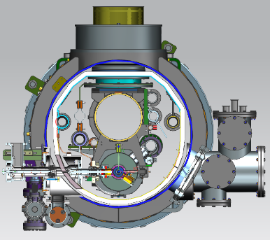


A1: SRF Cavities and Cryomodule design
(Global Industrial Production Readiness)
Research with single-cell cavities to establish the best production process
  Advanced Nb sheet production method
  Advanced surface treatment recipe
Globally common design compatible with High Pressure Gas Safety (HPGS) regulation
24 nine-cell cavities are to be developed for industrial-production readiness
  8 cavities (4 / batch) in each region
  Production process optimized in each region encouraged
RF performance/success yield to be examined (at least including 2nd pass)
  3rd pass to be examined if effective
Production process
Unify cryomodule (CM) design with ancillaries, based on globally common drawings and data-base, and
Establish globally compatible safety design base to be approved by HPGS regulations individually authorized in each region, most likely referring ASME guidelines.
 | # of cavities to be produced
 | Americas | Europe | JP/Asia
single-cell | 2 | 2 | 2
nine-cell | 8 | 8 | 8 (+ 12)
Material/Sub-component
QA of Material/Sub-C
Cavity Production
Surface Process
Vertical Test =
Cavity RF Test
Group involved on European side in discussions
of the programme:
CEA, INFN Milano primarily
Also potentially: IJClab, DESY, STFC/Daresbury+Lancaster, CERN, Uppsala, ....
CIEMAT (for SC magnet)
SCRF (Grad, Q) is a priority for most future high energy accelerators, and also beyond HEP

Slide 21
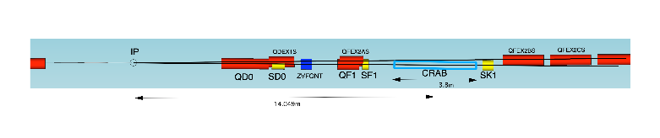
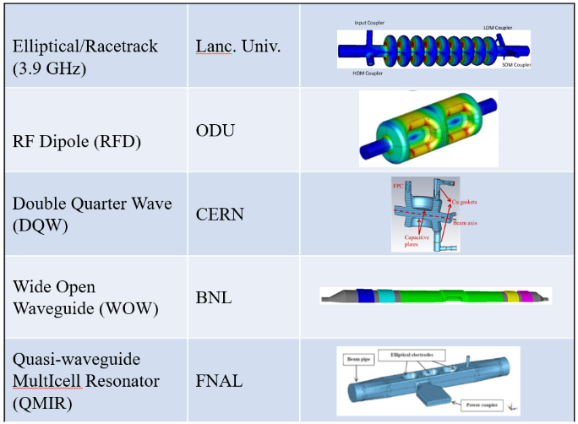
A1: Crab Cavity Development with down-selection
:
RF property simulation to optimize cavity design
Pre-down-selection to choose two primary candidates
Development and evaluation of two prototype cavities
Demonstration of synchronized operation with two prototypes
Down-selection to choose final cavity design
Cryomodule design based on final cavity design
two beamline distance
14.049m x 0.014rad = 197mm
Item | Recent specification (after TDR)
Beam energy | 125 GeV (e⁻)
Crossing angle | 14 mrad
Installation site | 14 m from IP
RF repetition rate | 5 Hz
Bunch train length | 727 μsec
Bunch spacing | 554 nsec
Operational temperature | 2.0 K (?)
Cavity frequency | 1.3/2.6/3.9 GHz
Total kick voltage | 1.845/0.923/0.615 MV
Relative RF phase jitter | 0.069 deg rms (49 fs rms)
Group involved on European side in discussions
of the programme: STFC/Daresbury and Lancaster Univ, and CERN
Links to general studies of crab cavity solutions:
(among others for HL-LHC, EIC and Elettra2.0)

Slide 22
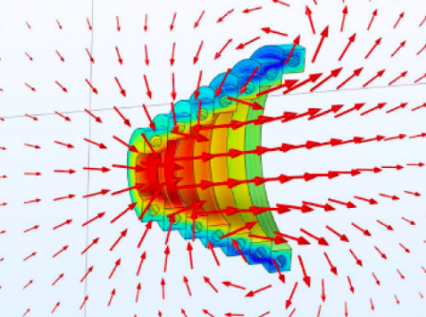
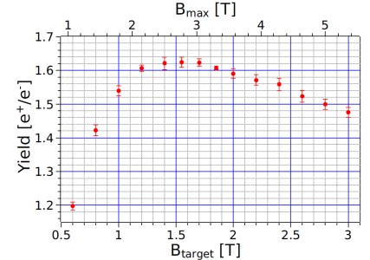
A2: Positron Source - Rotating Target and Focusing System for Undulator Scheme
Target specification
  Titanium alloy, 7mm thick (0.2 X₀), diameter 1m
  Rotating at 2000 rpm (≙ ~33 Hz) in vacuum
  Photon power ~60 kW, deposited power in target about 2 kW,
  efficient power/e+
  Radiation cooling
  Magnetic bearings, widely used for Fermi choppers (ESS etc.), vacuum pumps and fast rotating masses
R&D to be done as WP-prime
  Detailed simulations in close contact with OMD design on-going
  Design finalization, laboratory test of mock-up design (in the first 2 years)
  Magnetic bearings: technical speciﬁcations done, ready for feasibility study, engineering design, test (in the remaining years)
A priority item for the undulator scheme is the magnetic focusing system (OMD) right after the target
The mature candidate is a pulsed solenoid (PS)
R&D items to be done as WP-prime
  Detailed simulations (almost finished)
  Ready for engineering design for a prototype PS
  Field measurements with 1kA (pulsed and DC) and with 50kA both in a single pulse mode and finally in a 5ms pulsed mode at 5 Hz
  Prototype of plasma lens as OMD (funded study on-going), example for application of new technology for the ILC
Undulators are very popular photon sources, possible synergies
Yield versus field on the target
1
Group involved on European side in discussions of the programme:
Univ. of Hamburg, CERN, DESY, HZ Dresden-Rossendorf, SKF Jülich and possibly ESS-Bilbao.
For polarized positrons, providing physics advantages, linking also to FEL/undulators studies.

Slide 23
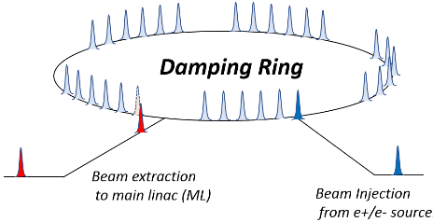
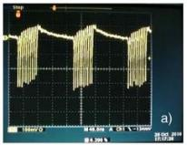
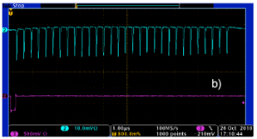
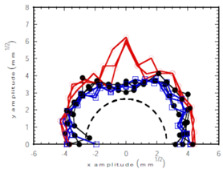
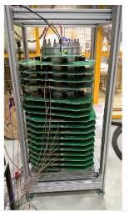
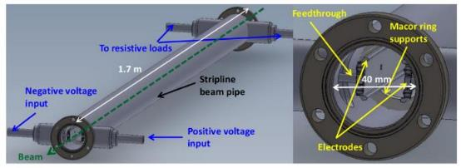
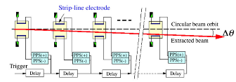
A3: Damping Ring optimization and injection/extraction
The ILC damping ring (DR) is required to satisfy the low emittance and the large dynamic aperture simultaneously.
The ILC DR will be further improved by incorporating the findings of the latest light source design. Increasing the dynamic aperture is also important in the design of DR.
By quantitatively evaluating the effect of fringe field to the dynamic aperture of magnets in ILC DR, the method for evaluating fringe field to the dynamic aperture in accelerator design will be established and the design of ILC DR will be optimized.
A fast kicker system using a semiconductor pulse power supply with nanosecond response was confirmed as proof of principle at KEK's ATF about 10 years ago.
Semiconductor technology has been evolving, and it is now possible to advance nanosecond response beam injection/excitation systems using the recent semiconductor technology.
The technical evaluation of the fast kicker power supply using the recent semiconductor technologies.
The evaluation of fast pulsed power supply technology will contribute not only to the fast kicker system but also to the performance and reliability of nanosecond-scale beam control technology and its application to a wide range of accelerator systems.
Beam extraction test at KEK ATF
ILC fast injection/extraction system
Stored beam in DR
Extracted beam from DR
Beam injection/extraction system
for CLIC damping ring
23
Many group can find this interesting and have capabilities to do it, there is a large and well organised low emittance ring community in Europe – and many also experience with similar studies for CLIC and FCC-ee.

Slide 24
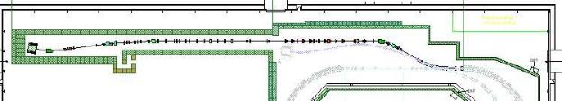



A4: ATF3 programme (final focus, nanobeams)
ATF2 beamline is the only existing test accelerator in the world to test the final focus system (FFS) of linear colliders.
The following 3 research topics are important topics to be pursued at the ATF.
  wakefield mitigation
  correction of higher-order aberration
  training for ILC beam tuning
The technical research at ATF2 beamline has proceeded, and should continue to be based on the ATF international collaboration, or its extension (welcome to new collaborators).
ATF2 beamline
Wakefield test station
Octupole magnets
for higher-order
aberration
Very relevant studies for any linac and Higgs factory closely related to low emittances and nano beams, e.g. alignment, stabilisation, instrumentation, beam-dynamics, etc.
Strong European leadership with several group from France, UK, Spain, Germany and also CERN, also extensively used for PhD training
A future ATF3 programme has been defined and reviewed internationally, supported also by MC researcher exchange programmes as EJADE and EAJADE (LINK)
Maximum search algorithms
to be applied to beam tuning
( Machine Learning )

Slide 25

A5: Implementation studies
Project Office to follow this effort, admin base CERN but can/should be distributed
  Linking to EAJADE and communication efforts, and the KEK-CERN offices
Continue existing collaborative efforts on CE and Cryo (CERN, DESY, KEK)
Common studies CLIC/ILC on sustainability issue (ongoing), e.g. power, energy and running models, CO2 (sustainability is also an EAJADE WP).
  the four activities above are all addressing optimisation of lum. to power, and/or power consumption directly for ILC
  will also connect to green ILC studies in Tohoku within EAJADE (e.g. facility integration in local environment and infrastructure, carbon emission goals, power availability and sources)
Connecting to ILC physics and detector developments, in particular MDI (also a focus of EAJADE)
One of the ITN studies also belong to this activity:
Finalize the engineering design of the main beam dump system
  Vortex water flow in the dump vessel
  Cooling water circulation and heat exchange
  Remote exchange of the beam window
  Countermeasure for failures / safety system
Involved: CERN, EAJADE community, ESS Bilbao for dumps. Many of these topics are
related to exploiting communalities between EXFEL, HL-LHC or CLIC and ILC
Notes:
B

Slide 26
EAJADE
EAJADE (Europe–America–Japan Accelerator Development and Exchange programme) is a training, education and staff exchange network in the field of accelerator research for high-energy elementary particle physics (HEP).
The key technical challenges for the future Higgs factories are many but the most important addressed in EAJADE are, all with important training, skill development and knowledge exchange elements:
Luminosity performance, hardware and method developments related to this, being addressed in smaller beam facilities, prototypes and laboratory tests (addressed in work packages 1,2 and 3 covering method studies and hardware evaluations in beam tests, development and tests of radio-frequency (RF) systems and special devices that are critical for nanobeam creation, conservation and diagnostics).
Upgrading to higher energies and accelerating gradients (addressed in work packages 2 and 5 covering RF developments and plasma acceleration studies).
Power efficiency and sustainability, importantly connected to RF (addressed in work packages 2 and 4 covering RF efficiency improvements and power/energy reductions and recovery, and sustainable facilities in a wider perspective).
Best practices, international collaboration, exchange of ideas and collaborative studies across Higgs factory proposals, training related to prototyping and tests in facilities and laboratory setup (all work packages).
For all the on-going R&D activities, and for the Higgs factory studies and potential later implementation, training of future accelerator experts will be crucial. These projects are very long term and today it is important to train the future scientists and engineers who will implement them. The training, networking and interdisciplinary focus of EAJADE create an ideal and very international career development environment for these future experts and leaders in the field. Providing such an environment is therefore the overarching goal of EAJADE.
Specifically for CERN-Japan, can support many of the common activities we have talked about earlier, kick off March 2023
EAJADE (Europe–America–Japan Accelerator Development and Exchange programme) focused in Higgs Factories, with participation of major EU (CERN, INFN, CEA, DESY, CNRS, CSIC, UOXF), Japan (KEK, Tokyo Univ., Tohoku Univ.) USA (BNL, FNAL, SLAC, JLAB, LBNL, Cornell Univ.) and Canada (VISPA) labs.

Slide 27
Concluding words and (possible) next steps
Interesting ongoing collaborative R&D with Japan and KEK with relevance for Linear Colliders (and Higgs factories in general), including ATF3 and EAJADE related exchanges of people.
  Post Covid we can expect increased activity
  CERN office at KEK almost dormant, will inject some limited funds early 2023
Initial planning in Europe for the ILC Technology Network is assuming a positive decision by the Japanese Ministry of Finance end of the year, including further positive discussion with KEK about contributions to the material cost.
With the two elements above in place we can move towards execution quickly. This might require new agreement(s) CERN-KEK in the coming year.
The existing and potential wider ITN activities are very well aligned with European accelerator R&D priorities (for Higgs-factories and the LDG roadmap), and builds on existing expertise, industrial capabilities and infrastructure – and a long history of technology developments for SC linacs and ILC in Europe, as well as common work between ILC and CLIC
Slides/plots and pictures from many colleagues in CLIC and ILC – many thanks

