Slide 1
ITAINNOVA R&D activities for physics detectors
Instrumentation for the future of particle, nuclear and astroparticle physics and medical applications in Spain
6–7 of March 2023 , Barcelona
Dr. Fernando Arteche
Technology coordinator of Sustainable and advanced electrical technology

Slide 2
OUTLINE
1. Introduction
2. Past activities – expertise gained
3. ITAINNOVA current and future DRD plans
4. Main Collaboration / Synergies & Technology transfer
5. Facilities

Slide 3
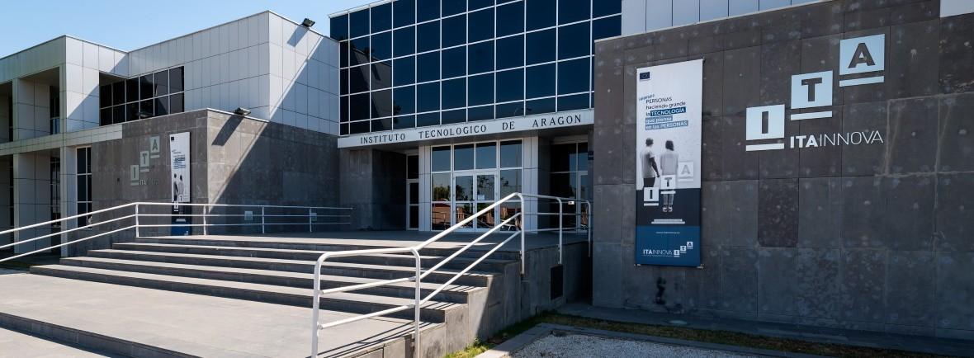

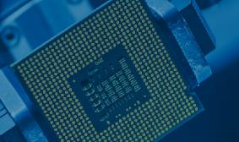


1. INTRODUCTION
ITAINNOVA (Instituto Tecnológico de Aragón) is a Public R&D Centre
We develop research projects and provide technological services in cooperation with other public agents (other institutes and universities) and private agents (companies).
We are based in Zaragoza
Our annual budget is 20 M€: (80%-SF)
  Annual investment is 2 M€
  280 Employees:18% are Doctors.
NEW MATERIALS AND COMPONENTS
MECHATRONICS
SYSTEMS
SUSTAINABLE & ADVANCED ELECTRICAL TECHNOLOGIES
DIGITAL
TECHNOLOGIES

Slide 4
1. INTRODUCTION
During the last 14 years, ITAINNOVA has been involved in activities related to particle physics detectors.
These activities have been focused on:
  Front end electronics (FEE) design
  Electromagnetic interference phenomena (EMI /EMC) characterization of physics detectors and facilities
  Power systems designs for physics detectors
  Distributed clock systems design for timing detectors
  RF instrumentation
18 members of the team
  10 engineers ( 5 phD & 5 Master) – 1 finishing PhD
  7 technical staff giving support & 1 student ( preparing his master thesis)
FTE involved in physics detectors per year - 5

Slide 5
2. PAST ACTIVITIES – EXPERTISE GAINED
AIDA 2020: Advanced European Infrastructures for Detectors at Accelerators”, Ref. H2020-INFRAIA-2014-2015 – 654168, Funding Agency: EU-H2020, Duration: 2015- 2019 PI: Dr. Laurent Serin, Type of participation: Investigator y WP12 leader
EMC studies for the DEPFET pixel detector at Belle II experiment, Company: Max Planck Institute of Physics (Germany) MPI, Principal investigator: Dr .Fernando Arteche, Duration 2011-2016,
REWARD: Real time Wide Area Radiation surveillance system” REF: FP7- 284845, 2011- 2014, Budget: 4 265 883 €. (ITAINNOVA´s Budget: 20.000 €.), IP: Dr. Manuel Lozano,
CMSRUN2-B: PARTICIPACION EN EL EXPERIMENTO CMS DEL LHC-PIXEL UPGRADE PARA ALTA LUMINOSIDAD”,Ref: FPA2017-85155-C4-3R, Ministerio de Ciencia e Innovación y Universidades, Duration: 2018-2020,, IP: Dr.Fernando Arteche.
CMSRUN2: PARTICIPACION EN EL EXPERIMENTO CMS DEL LHC: RUN 2 Y UPGRADE DE ALTA LUMINOSIDAD” , Ref. FPA2014-55295-C3-3R ,Ministerio de Economía, Duración: 2015- 2017, Principal investigator: Dr .Fernando Arteche.
DET4HEP: I+D en detectores para futuros Colisionadores” Ref. FPA – 2010 – 22163 – C02-01, Ministerio de Ciencia y Tecnología, Duration: 2011- 2013, IP: Dr. Ivan Vila (IFCA)
HDI4CMSPIX: Desarrollo y diseño del HDI (High Density Interconnection board) basado en el RD53A readout chip para el nuevo detector de pixeles de CMS – Fase II”, Ref. LMP170_18 , DGA , Duration: 2018- 2020IP: Dr. Fernando Arteche
Caracterización electromagnética y estudio de las medidas correctoras necesarias en el laboratorio subterráneo de Canfranc”, Company: ICTS- Laboratorio Subterráneo de Canfranc (Spain), Principal investigator: Dr .Fernando Arteche, Duration:2019-2021,
EU
PREVIOUS PROJECTS
National
Regional

Slide 6


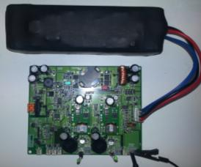



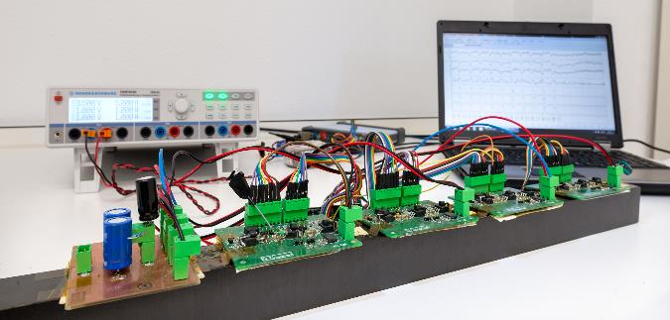



2. PAST ACTIVITIES – EXPERTISE GAINED
The REWARD project develops portable, intelligent radiation detectors (neutron & Gammas)
Design & Develop 100 W power unit for physics detectors
  UPS & low noise power unit
4 Layers – Low Noise
FTD-ILD sub-detector for International Linear Collider
Design and develop a power pulsing system based on supercapacitors
Supercapacitor radiation campaign

Slide 7
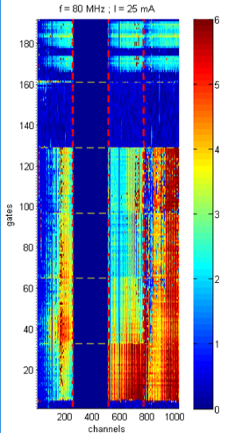
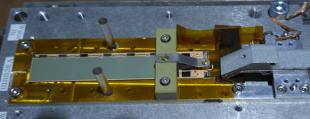
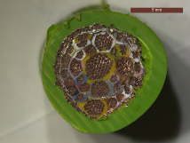
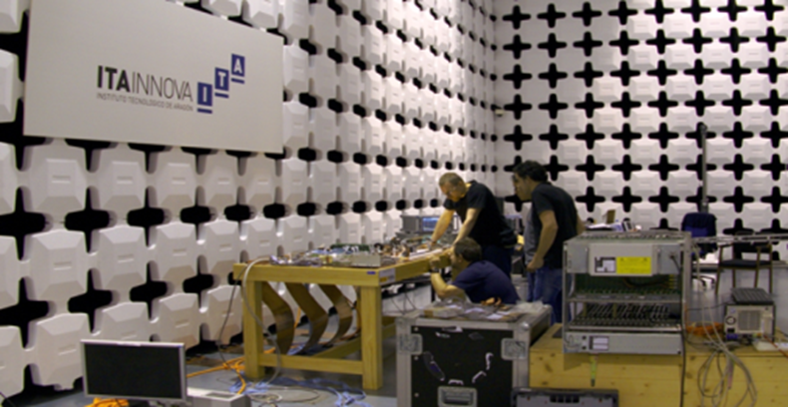
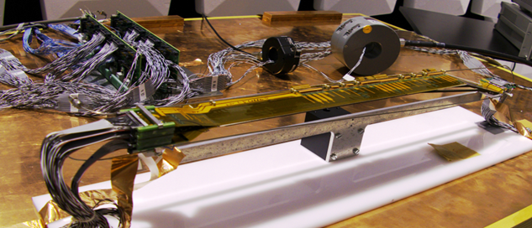
  Belle II DEPFET detector
  Noise sensor distribution
  Noise distribution on Belle II DEPFET detector MS cable
2. PAST ACTIVITIES – EXPERTISE GAINED
Belle II – SVD & DEPFET
EMI effects on sensors (DEPFET- Double Side µstrip)
Nosie propagation effects on multi-conductor cables (MTL models)
EMC Belle II: Electronics integration
  Belle II SVD detector – Full EMC campaign
  Belle II SVD detector
  Noise sensor distribution

Slide 8
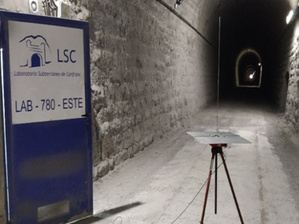
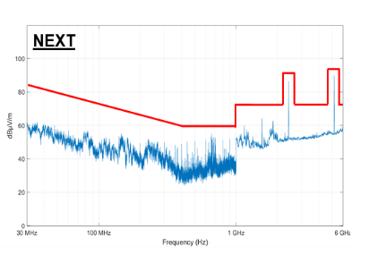
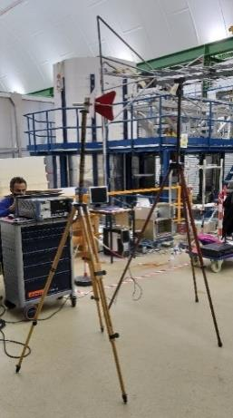
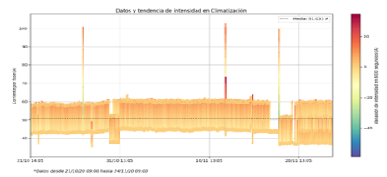
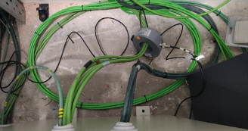
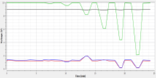
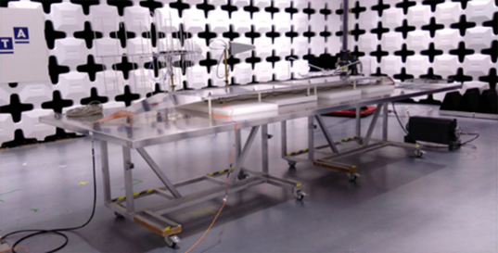
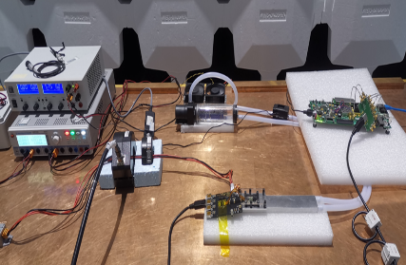

  Noise characterization campaings at LSC
2. PAST ACTIVITIES – EXPERTISE GAINED
LSC – Laboratorio subterráneo de Canfranc
EMI characterization of scientific installation
AIDA 2020 – Advanced European Infrastructures for Detectors at Accelerators
EMI of ROC & Susceptibility to High E fields
TA facility for EMI characterization of physics detectors - WP12 leader
  RD53 SCC – FE characterization
DOSFET – Dosimeter for synchrotron radiation facility (Elettra) & Laser Pulsed facility

Slide 9


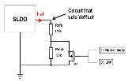
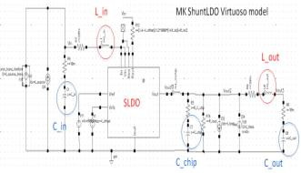
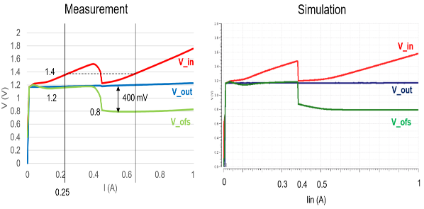

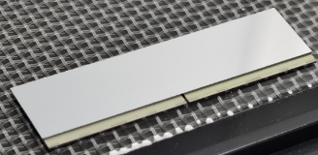
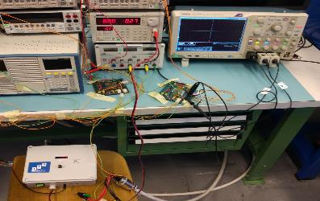
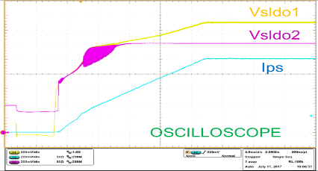
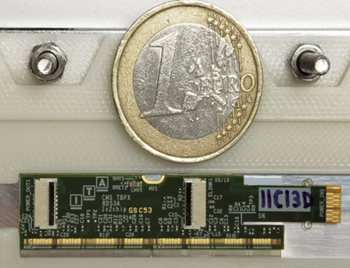

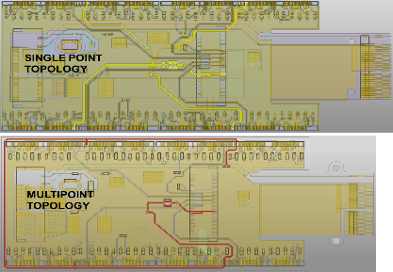
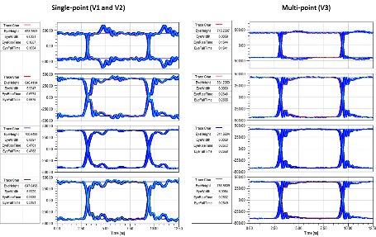

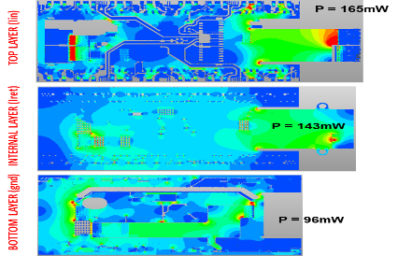
  RD53 Low power mode (ITAINNOVA circuit)
2. “PAST” ACTIVITIES – EXPERTISE GAINED
CMS- PIXEL Phase II
HDI design
RD53A chip design
Current source design
Serial powering –System design
  Current source for CMS pixel phase II
  1x2 3D-RD53A based module prototype (IFCA,IMB & ITAINNOVA)
CMS-Pixel modules - HEP
  HDI design - Data transmission & power dissipation CMS pixel phase II

Slide 10
3. ITAINNOVA CURRENT & FUTURE DRD PLANS
The group's activity will focus on activities similar to those carried out in the past (DRD7 & DRD3) but exploring new areas (DRD5) due to synergies and knowhow.
These activities will be focused on:
  Front end electronics (FEE) design for physics detectors (ASICs development-power stage, interconnection boards and electronics integration) (DRD 7)
  Electromagnetic interference phenomena (EMI /EMC) characterization of physics detectors and facilities (DRD 3 DRD 5 DRD7)
  Power systems designs (standard ,serial and power pulsing applications) (DRD 7)
  Distributed clock systems design for timing detectors (DRD 7)
  RF instrumentation and Digital Signal Processing covering system modeling, optimization and implementation of the LL RF chain for Accelerator & quantum technologies(DRD 5 ).
The activity will be strongly aligned with Spanish groups and ECFA.

Slide 11
3. ITAINNOVA CURRENT & FUTURE DRD PLANS
ITAINNOVA's areas of interest within DRD7 - Electronics and Data Processing
Front-End AISIC (Power stage models & protection circuits)
  High-granularity pixel readout chip in 28nm CMOS (DRDT 7.1, DRDT 7.2, DRDT 7.4) – Power stage
  3D integration technologies for high density interconnection of stacked layers of sensors and readout electronics, or for connection of ASICs and specialized PCBs (DRDT 7.1, DRDT 7.5); - (HDI)
Links, Powering and Interconnects. (HDI & Power converters)
  Small form-factor power modules compatible with the HEP environment, including optimized coils, capacitors, cooling interfaces, connectors and packages (DRDT 7.1, DRDT 7.4, DRDT 7.5) – (HDI)
  High conversion factor DC-DC converters based on new processes and materials, and associated power management circuit blocks (DRDT 7.1, DRDT 7.2, DRDT 7.4, DRDT 7.5) – (Power converters EMI control)
Back-end Systems (Clock distribution systems & Power distribution & System Prototyping)
  Next-generation pico-second precision timing distribution systems to enable 4D-detectors (DRDT 7.3, DRDT 7.4).
  Large-scale and realistic technology demonstrators, tracking relevant industry developments, with permanent integration and test-facilities (DRDT 7.1, DRDT 7.2, DRDT 7.5) – (EMI & Detector prototyping & Power distribution)

Slide 12
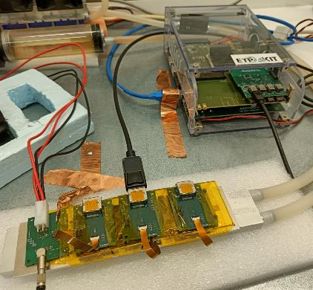
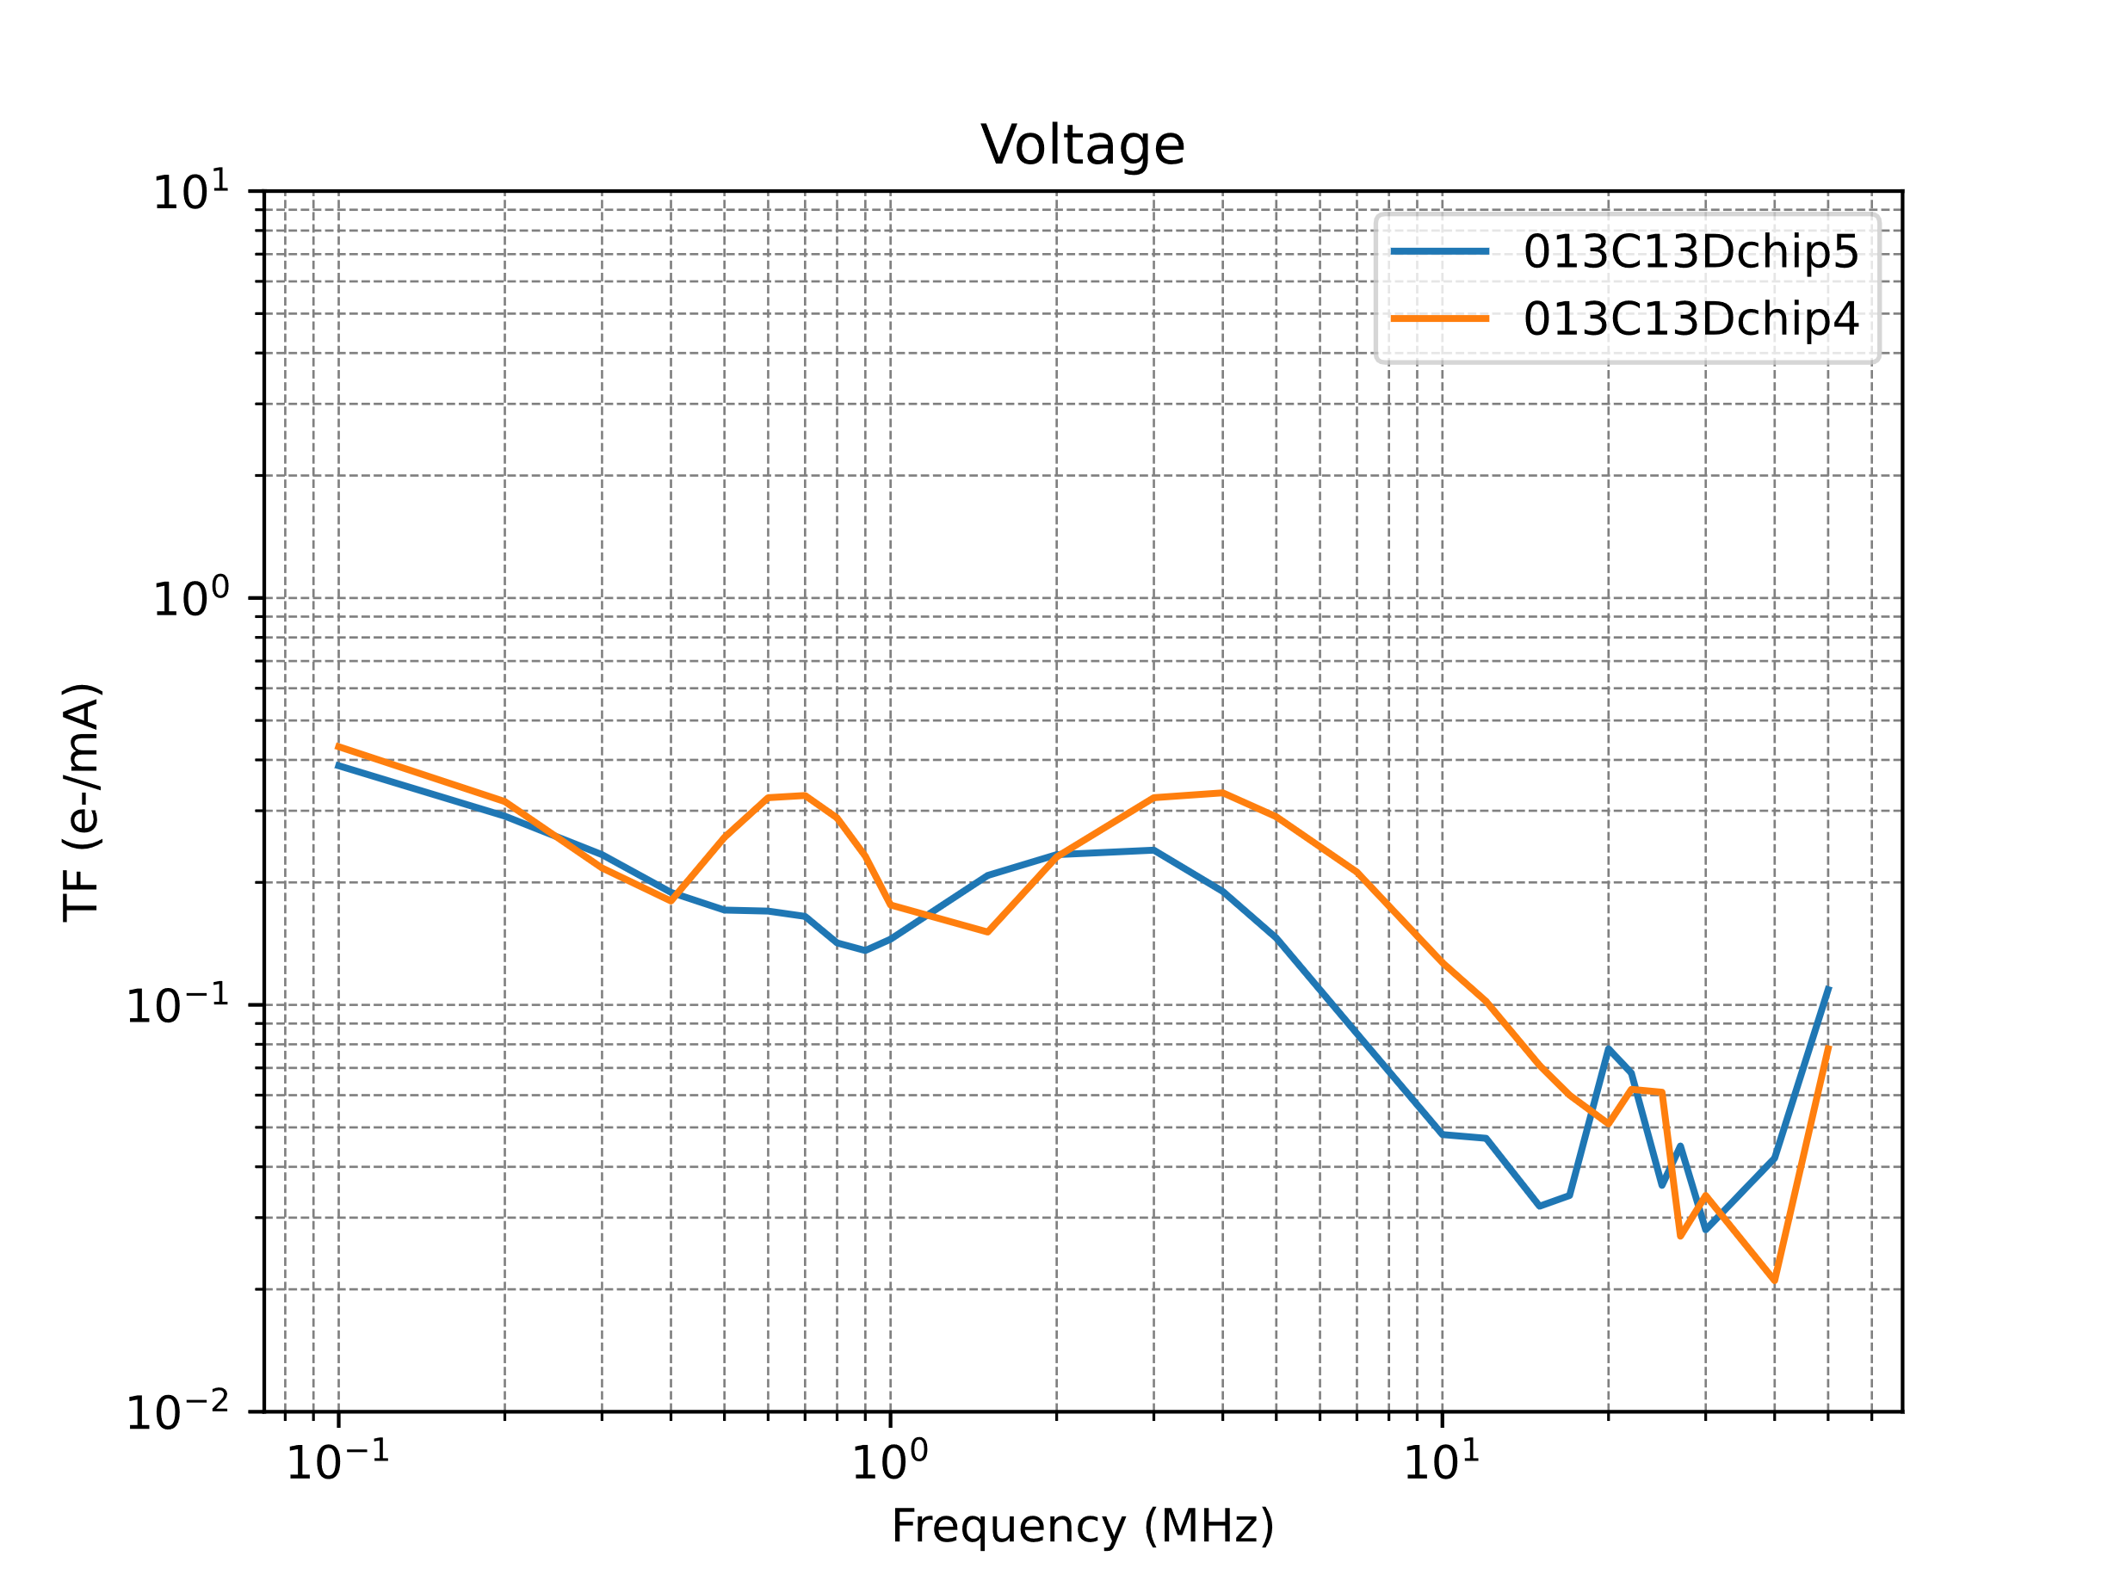
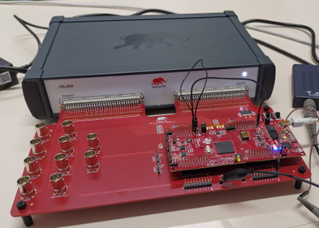
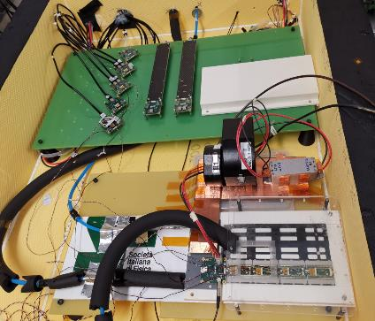
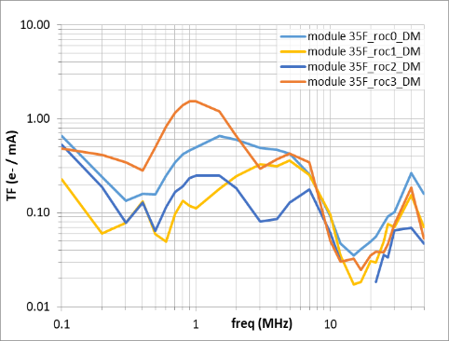
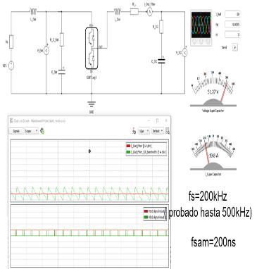
3. ITAINNOVA CURRENT & FUTURE DRD PLANS
3D – RD53A based Serial Powering protoype ( 3 modules) – TF test at ITAINNOVA
CMS DAQ Hardware: nanoCrate + FC7 (kintex7) + FMC board
HIL for GaN based DC-DC control board
ITAINNOVA's areas of interest within DRD7 - Electronics and Data Processing
1x2 TBPX-HDI-RD53A 3D sensors
CMS phase II current activities
  CROC simulation models & ETROC testing (FE AISIC)
  Pixel & ETL System prototyping - Electronics & DAQ (Power/BKE)
    GaN based DC-DC
    Serial powering
    Hardware, gate-ware and firmware for ASIC/DAQ comm. and control.
2x2 TBPX-HDI-RD53A Planar sensors
Plannar – RD53A based Serial Powering protoype ( 3 modules) – TF test at CERN (CMS TK Facility)

Slide 13
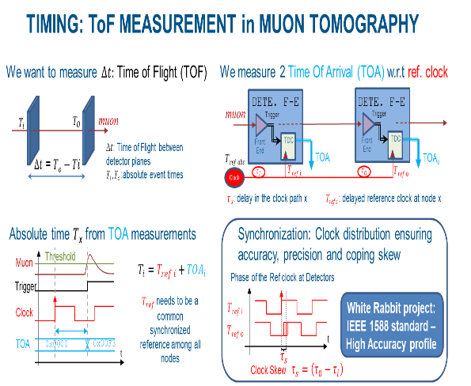
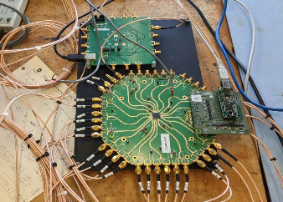
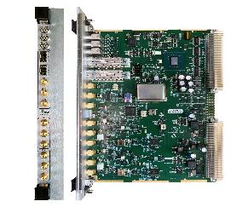
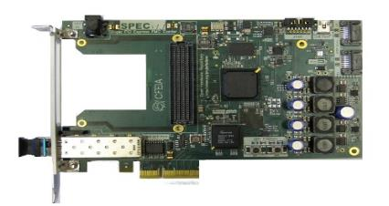
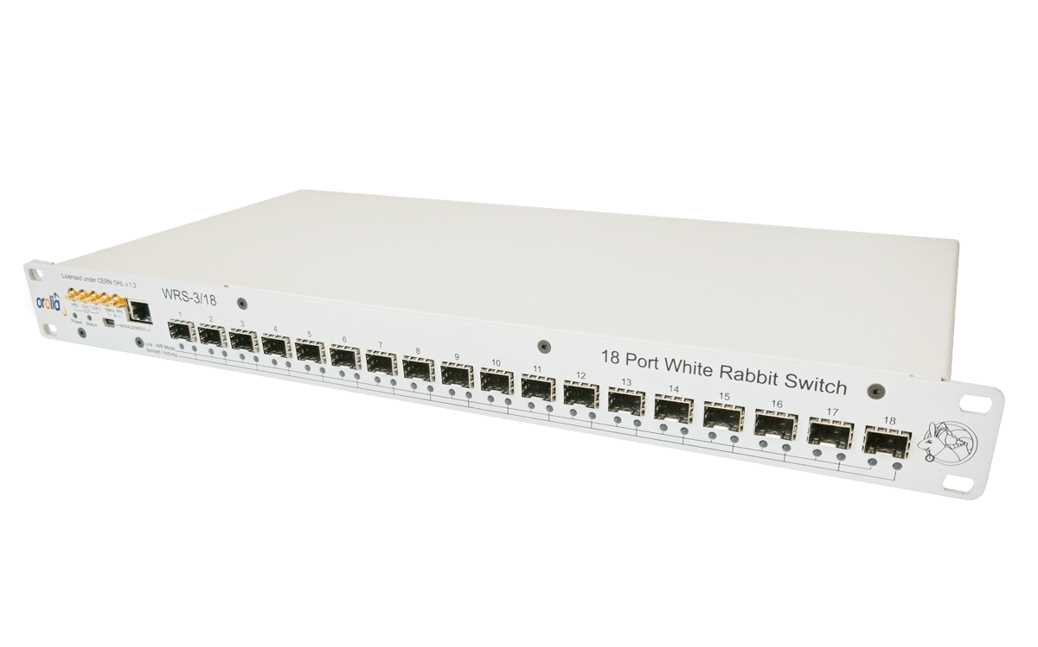
3. ITAINNOVA DRD ACTUAL & FUTURE PLANS
ITAINNOVA's areas of interest within DRD7 - Electronics and Data Processing
TOMULGAD-4D: Distributed Clock network and power distribution system design for the technology demonstrator of the Timing Muon Tomography concept- Current activities (Back-end / Timing)
  High Accuracy and High Precision Timing sub-systems:
  Dedicated system vs Scalable deterministic networks (White Rabbit - IEEE1588HA)
  Versatile, scalable and portable clocking architecture
  Prototype development
  Tomulgad ad-hoc clocking
  CERN WR2RF VME Card
  WR SPEC Card
  WR Switch

Slide 14
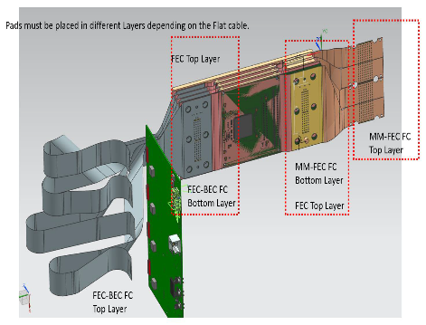
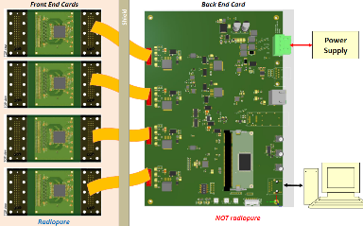
  BabyIAXO electronics
3. ITAINNOVA DRD ACTUAL & FUTURE PLANS
ITAINNOVA's areas of interest within DRD7 - Electronics and Data Processing
PC-MMR current activities
  Development of electronic instrumentation for pixel and timing detectors based on LGAD and 3D sensors with industrial applications (Back-end Systems – Timing & Prototyping)
  Implement new integration strategies for background reduction of Micromegas detectors for BabyIAXO, based on the analysis of the electronic architecture of the data acquisition system (DAQ) with EMI/EMC criteria and assessment of a WR based synchronization architecture.(Back-end Systems – EMI & Timing)
  Electromagnetic characterization of the TREX-DM experiment site at the LSC and its interactions with BabyIAXO. .(Back-end systems – EMI )
AIDAINNOVA (Advancement and Innovation for Detectors at Accelerators) current activities – EU-H2020
  Portable test bench to perform in-situ EMC conducted emission measurements of DC-DC in irradiation facilities (Powering & Back-end Systems – Power & EMI control)
  Barcelona RadioPure DAQ

Slide 15
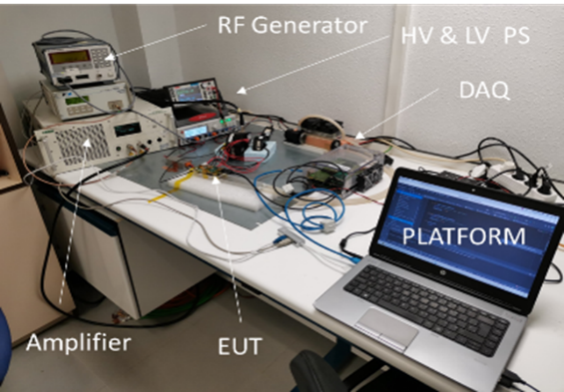

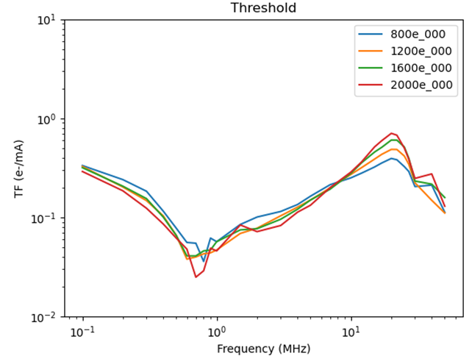

3. ITAINNOVA CURRENT & FUTURE DRD PLANS
Automatic test bench for EMC-TF test at ITAINNOVA
ITAINNOVA's areas of interest within DRD3 - Solid state detectors
New characterization techniques and facilities of common interest - EMI characterization of sensors
We have already submitted an expression of Interest for participation in DRD3
AIDAINNOVA current activities – EU –H2020
  ITAINNOVA are designing and development an automatic EMC test bench to measure the noise TF of physics detectors. (WP4 leader)
EUROLABs Current activities – EU – Horizon Europe
  ITAINNOVA is TA facility for EMI detectors characterizations
  We will improve the EMI system test with a new cooling system
RD53A linear FE – TF
(different configurations)

Slide 16
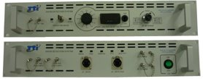
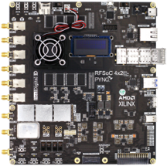

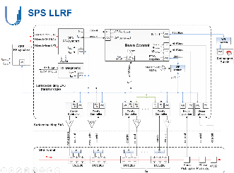
3. ITAINNOVA CURRENT & FUTURE DRD PLANS
ITAINNOVA's areas of interest within DRD5 – Quantum technologies
Technology transfer and development synergies for the superconducting roadmap:
  Packaging, EMI, environmental control.
  RF Readout and subsystem control electronics
Activities mainly focused on topic “DRDT5.2”: Investigate and adapt state-of-the-art developments in quantum technologies to particle physics”
PC-MMR current activities
  Assessment of an RF-SoC based DAQ system as alternative to current heterodyne DAQ for RADES cavities for DM axion search.
Collaboration to CERN RF group (synergies accelerator & quantum technologies)
  RF DSP based on resampling for Accelerator derived Bunch Synchronous Clock data
  Low noise Direct-sampling techniques for microwave frequencies
  Heterodyne DAQ
  RF-SoC DAQ
  RADES prototype
  cavity
  SPS LLRF Architect

Slide 17
3. ITAINNOVA CURRENT & FUTURE DRD PLANS
Current ITAINNOVA funding for DRD activities
EUROLABs: (EUROpean Laboratories for Accelerator Based Sciences ) Horizonte Europa - 101057511 (2022- 2026).
AIDAinnova: Advancement and Innovation for Detectors at Accelerators, H2020-101004761, (2021- 2025) , CERN (Suiza) y DESY (Alemania), WP4 leader and Steering Comitteee member.
CMSUPG: “Actividades de ITAINNOVA para los” Upgrades” de alta luminosidad del LHC: Inner Tracker y Endcap timing layer”. PID2020-113705RB-C33 (2021- 2024) , IP: Dr.Arteche
TOMULGAD: Distributed Clock network and power distribution system design for the technology demonstrator of the Timing Muon Tomography concept. Ref.:PDC2021-121718-C33 , (2022-2024). Prueba de Concepto, , IP: Dr.Arteche
PC de Física: Tecnologías avanzadas para la exploración del universo y sus componentes (2022- 2025). Planes Complementarios (PC-MMR)
GaNCap4CMS: Diseño y desarrollo de un sistema de protección contra transitorios basados en fuentes de corrientes con transistores GaN y superCondensadores integrados para el nuevo detector de Pixeles de CMS – Fase II (Ref: LMP239_21). (2021-2023). IP: Dr. Arteche).
EU
CURRENT PROJECTS
National
Regional

Slide 18
4. Main Collaboration /Synergies & Technology transfer
Also, a long collaboration with UNIZAR - Elec
The national cooperation will not be limited to these groups.
  New collaboration are on going
We have started to collaborate with CAPA – UNIZAR in the development of Baby IAXO and RADES experiment (DRD7-DRD5)
  Plan complementario de física
  We submitted recently a coordinated project.
  We plan to continue the collaboration with Laboratorio Subterráneo de Canfranc in EMI control. (DRD7)
NATIONAL COLLABORATION
We have been collaborating with IFCA , IMB-CNM on numerous research projects focused on physics detectors since 2008.
Today, we are carrying out 5 projects together on various topics related to the DRD lines defined by ECFA.
  DRD7, DRD3, DRD5
We plan to continue coordinating our DRD activities with IFCA and IMB-CNM.

Slide 19
4. Main Collaboration /Synergies & Technology transfer
INTERNATIONAL COLLABORATIONS
CERN, Switzerland: Collaboration agreement (KN3478) – Feb. 2017 / 1 Person at CERN for 1.5 years at Microelectronics group at CERN & IRRAD Group & starting novel support activity to SY-RF group
CMS experiment - Collaboration since 2008 (Upgrades): ITAINNOVA became an associate Institute in 2012
RD53 Collaboration - Read out chip design for CMS and ATLAS pixel upgrades – ITAINNOVA is member since 2018
ETHZ Zurich, Switzerland (2017-Today)
Institut Pluridisciplinaire Hubert CURIEN (IPHC)/CNRS (Strasbourg, France) – AIDAINNOVA H2020
FERMILAB, USA: 1 Person will move to FERMILAB - Spring 2023
ECPE – European Center of Power Electronics . ITAINNOVA became a Competence Center in 2019.
EUROPRACTICE Network – ITAINNOVA has been admitted within europractice in 2022

Slide 20
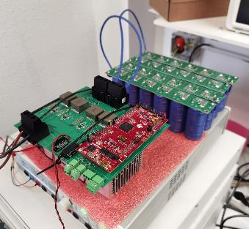
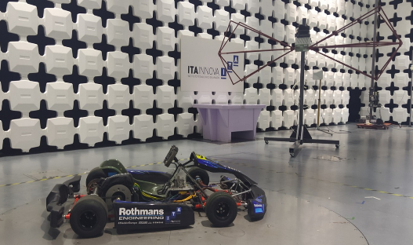
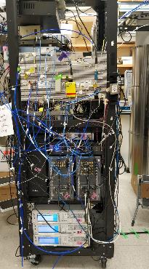
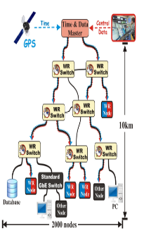
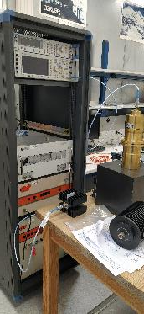
4. Main Collaboration /Synergies & Technology transfer
DC-DC GaN based
Synergies & Technology transfer
The special characteristics of the institute and its proximity to industry may help the development of some of the DRD activities in which the group will collaborate.
  They could benefit from synergies with industrial developments.
  Some developments could be carried out taking into account aspects that simplify the technology transfer of the technological developments carried out by the cluster.
  Traditional RF Quant System
  Synchronization of distributed power converters
ITAINNOVA RF

Slide 21




5. FACILITIES
The RF-EMC Lab
  2 X Semi-anechoic chamber
  Faraday cage
  Equipment to perform transient tests
  Electrostatic discharge (ESD) up to 30 kV
  Current probes from 20 Hz up to 400 MHz.
  Antennas from DC up to 18 GHz.
  RF Generators up to 20 GHz & Amplifiers up to 6 GHz.
  Spectrum Analyzers and EMI Receivers from 20 Hz up to 28 GHz
  2 channel oscilloscopes (2 Gs/s).
  Shielding effectiveness measurement system (20 MHz – 1 GHz).
Power Electronics & Instrumentation Lab Boards designs
  Power supplies
  Electronic loads (160A)
  Programming controllers
  PSIM, Cadence tools &MATLAB / Simulink
  Texas Instruments platforms
  Xilinx FPGA and SoC, RF-SoC development cards and ancillary elements
  White Rabbit dev-kits and Low Jitter switch
  dSpace & Typhoon platforms for rapid protyping.

Slide 22
Thank you

