Slide 1

CIEMAT CALICE ACTIVITIES
Linked to DRD1 & DRD6
Mary-Cruz Fouz
CIEMAT
Instrumentation for the future of particle, nuclear and astroparticle physics and medical applications in Spain
Barcelona 6-7 marzo 2023

Slide 2
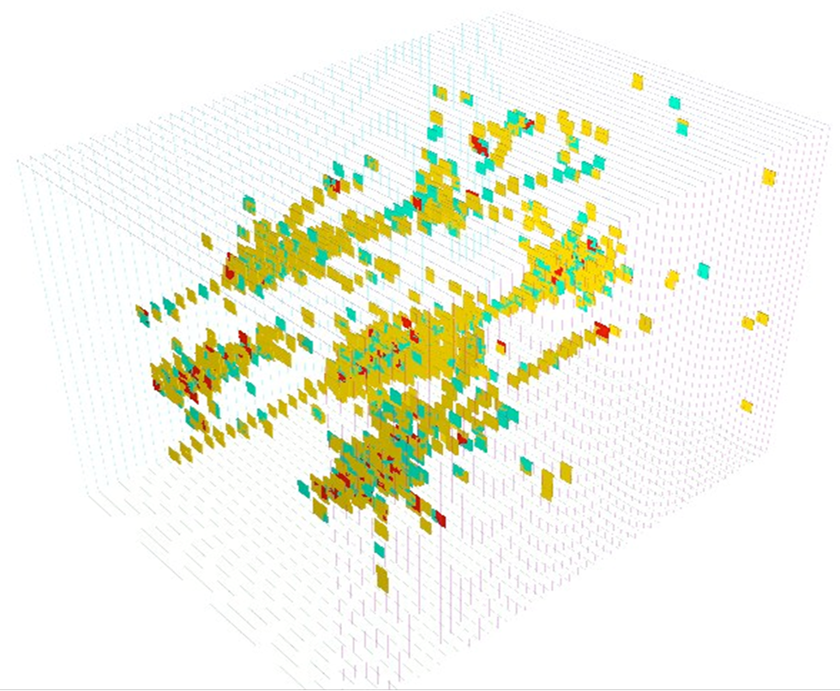
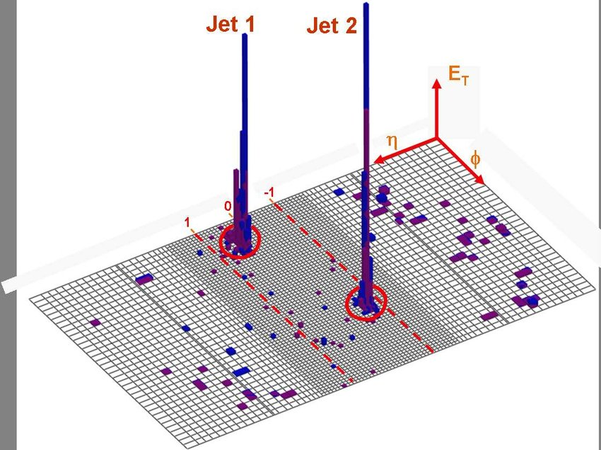


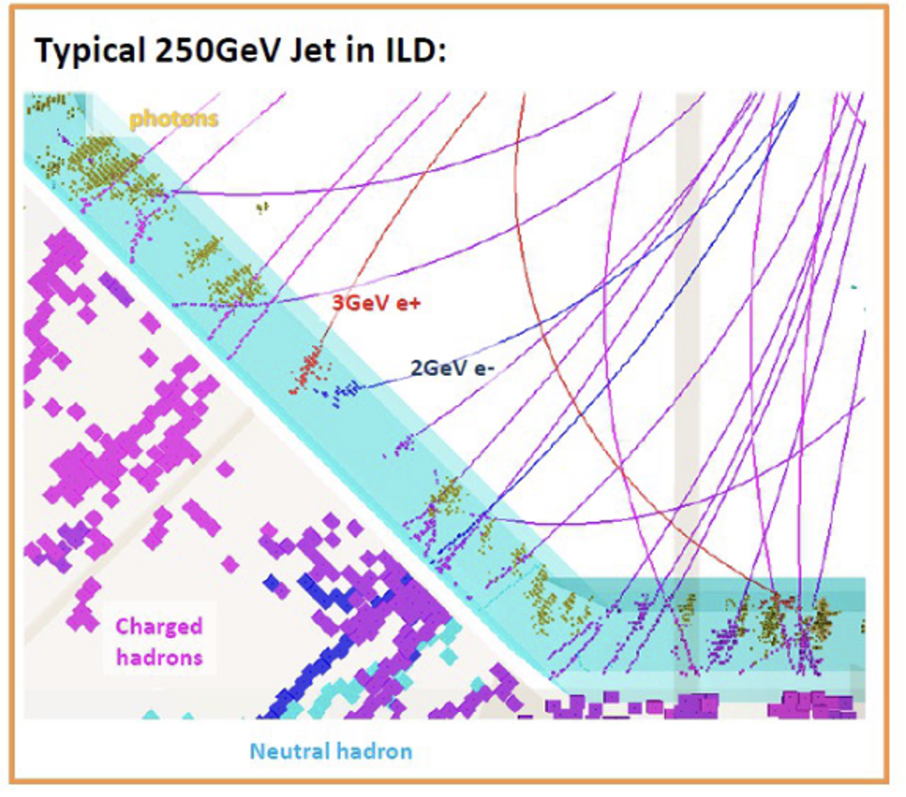
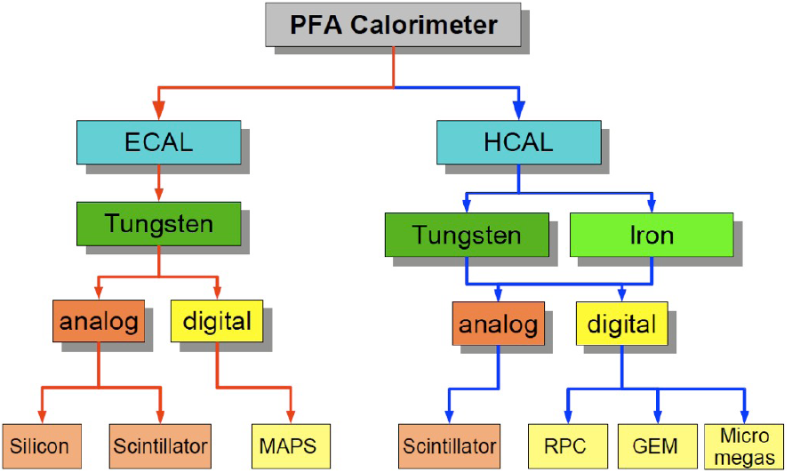
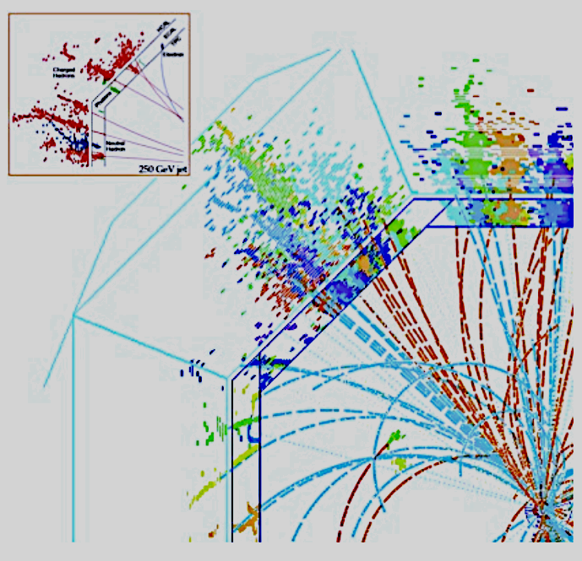
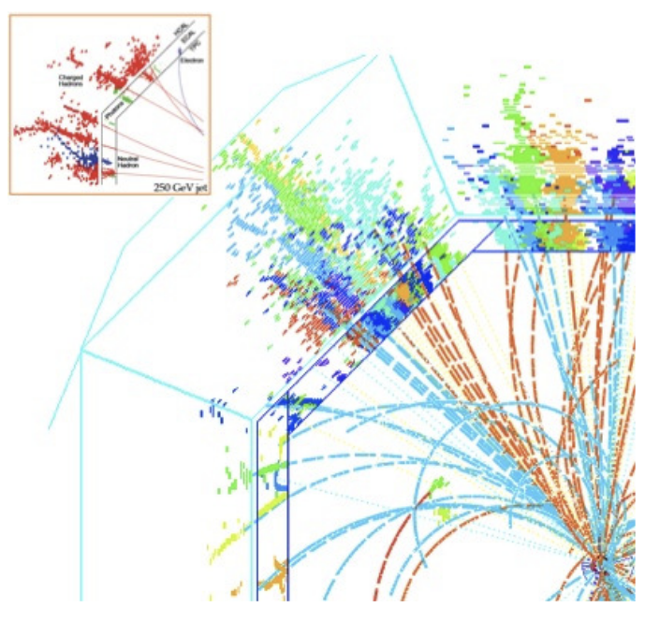
CALICE Collaboration
MOTIVATION
Physics at Higgs Factories requires a jet energy resolution a factor 2 better than the achievable with the present calorimeters.
Actual calorimeters©
High Granularity
Raw data
Several particles from test beam recorded by the SDHCAL
member since 2007
Developing highly granular calorimetry optimised for particle flow event reconstruction for future energy-frontier electron-positron coliiders.
ILD: Jet 250 GeV
Using PFA

Slide 3
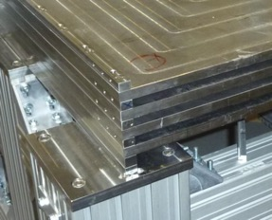
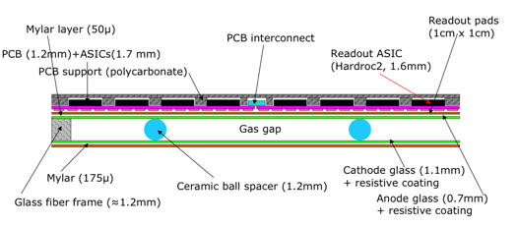
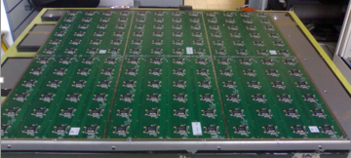

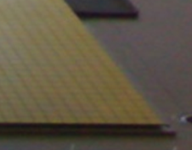
The Semi-digital Hadronic CALorimeter (SDHCAL)
CIEMAT participates in several CALICE technologies but the main activity is linked to the SDHCAL
SDHCAL: Semi-Digital Hadronic Calorimeter.
Fe+ Glass RPC, with 1cm2 pads with semidigital readout
Absorber: Stainless steel
Plates
Absorber plates up to ~3x1 m² .
Surface planarity < 1mm ,
Thickness 15mm, tolerance 50μm
Coordinadores grupo SDHCAL:
Resposible: I. Laktineh (Lyon)
Deputies M.C Fouz (CIEMAT) , G. Grenier (Lyon)
spacers
GRPC Sketch
Detector: GRPC (Glass Resistive Plate Chambers) operating in avalanche mode
1x1 cm² pads. Semi-Digital Readout, 2bits - 3 thresholds
➔ It counts how many and which pads have a signal larger than one of the 3 thresholds
Embedded electronics:
PCB separated from the GRPC by a mylar layer (50μm).
➔ Bottom: 1x1cm2 pads
➔ Top: ASICs (HADROC) & related connections
Power-pulsed electronics: In stand-by during dead time in between ILC Collisions or spills in beam tests
1 pad= 1cm² ,
interpad 0.5 mm
144 ASICs= 9216 channels/1m²

Slide 4
CIEMAT responsibilities at SDHCAL
CIEMAT participates at SDHCAL from the beginning of this R&D at CALICE , starting with GRPC chambers R&D and following with calorimetry prototypes
Responsible for mechanics developments and handling tools
Responsible for second version of DIF board electronics (Detector InterFace)
DIF is used for control and readout or the ASICS and the communication with DAQ
Prototypes tests with particle beams at CERN & DESY and data analysis
(development of algorithms, PID, and performance studies)
Some Challenges
High precision mechanics
Embedded electronics
Low power consumption
Very uniform response despite the large number of channels
1 PhD thesis presented on 2015
A new PhD thesis next week

Slide 5
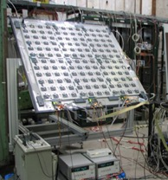
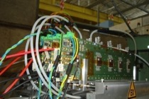
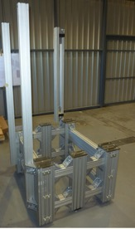
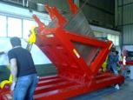
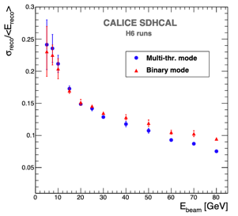
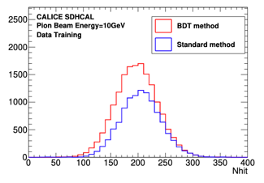
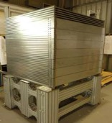
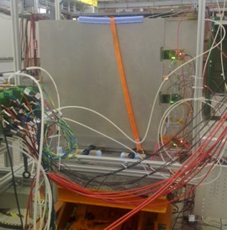
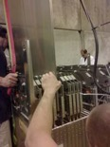
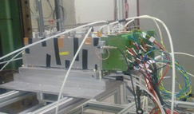
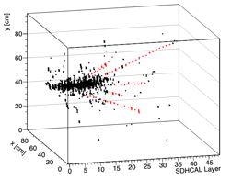
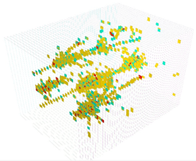
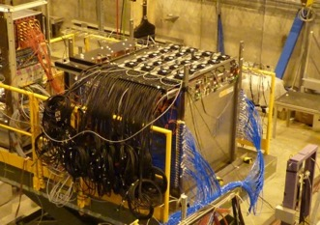
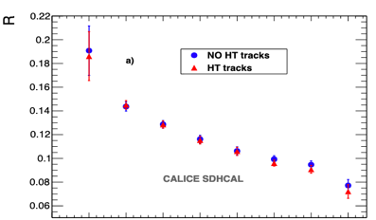
Snapshot of some SDHCAL achievements in the past
The assembly of 1.3m³ prototype
Technology Validation
1m³ - test beam data
PID: BDT & MVA technique
TB @ CERN 2009
Absorber plates QC
Rotation
tool
Small GRPCs
1m² GRPC
Special table with machined guide lines
@ CIEMAT
TB@ CERN
May 2010
GRPC
insertion
1m² GRPC
Assembly of
Mechanical
Structure
Energy Resolution
Small GRPCs
@ CIEMAT
@ CIEMAT
@ CERN
GRPCs Validation
Single track reconstruction with Hough transform techniques
500K Channels
1m³
50 GRPC
Improved resolution
TRACKER-CALORIMETER

Slide 6
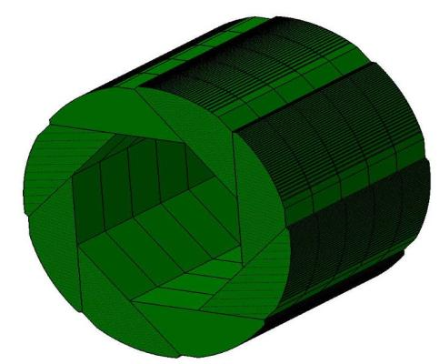

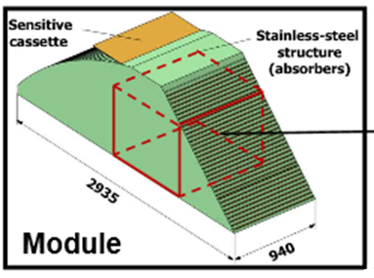
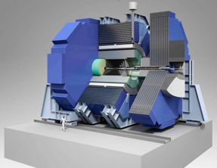
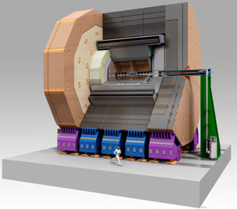



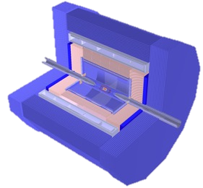
The SDHCAL & Higgs factories
(s)DHCAL is one of the technologies already under consideration for several experiments for the Future Higgs Factories
Module
Linear Colliders
member since 2009 (LOI 2010)
SDHCAL
Major responsibilities at ILD
– Editor of the calorimetry chapter of volume 4 of the ILC Technical Design Report. 2013.
(M.C Fouz)
– Since 2021. Technical coordinator and member of the executive team (M.C Fouz)
Circular Colliders
Other responsibilities related to Higgs Factories
No proposed jet
ILD is going to do viabilibility studies
Convener of the WG3: Detector R&D of the ECFA study on physics and experiments at e+e- Higgs/EW/Top Factories . Since June 2022 (M.C Fouz)
CEPC
Baseline

Slide 7
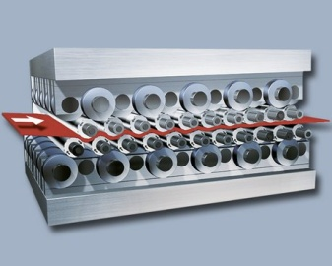
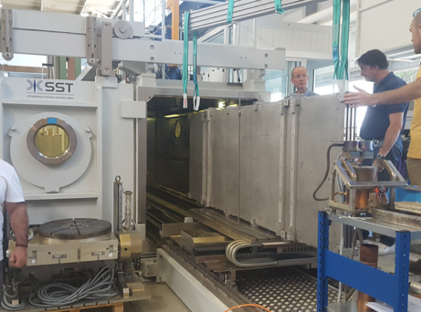
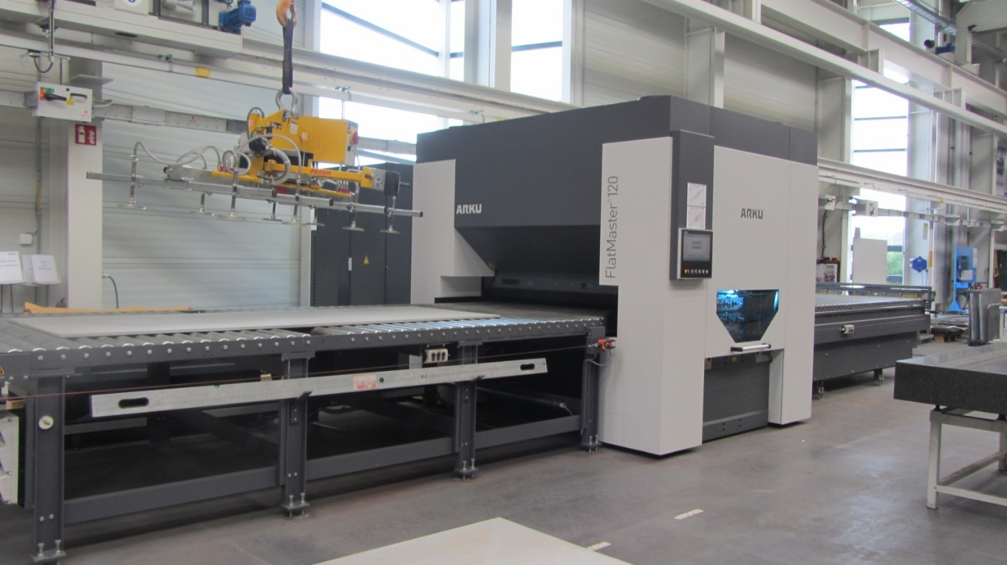
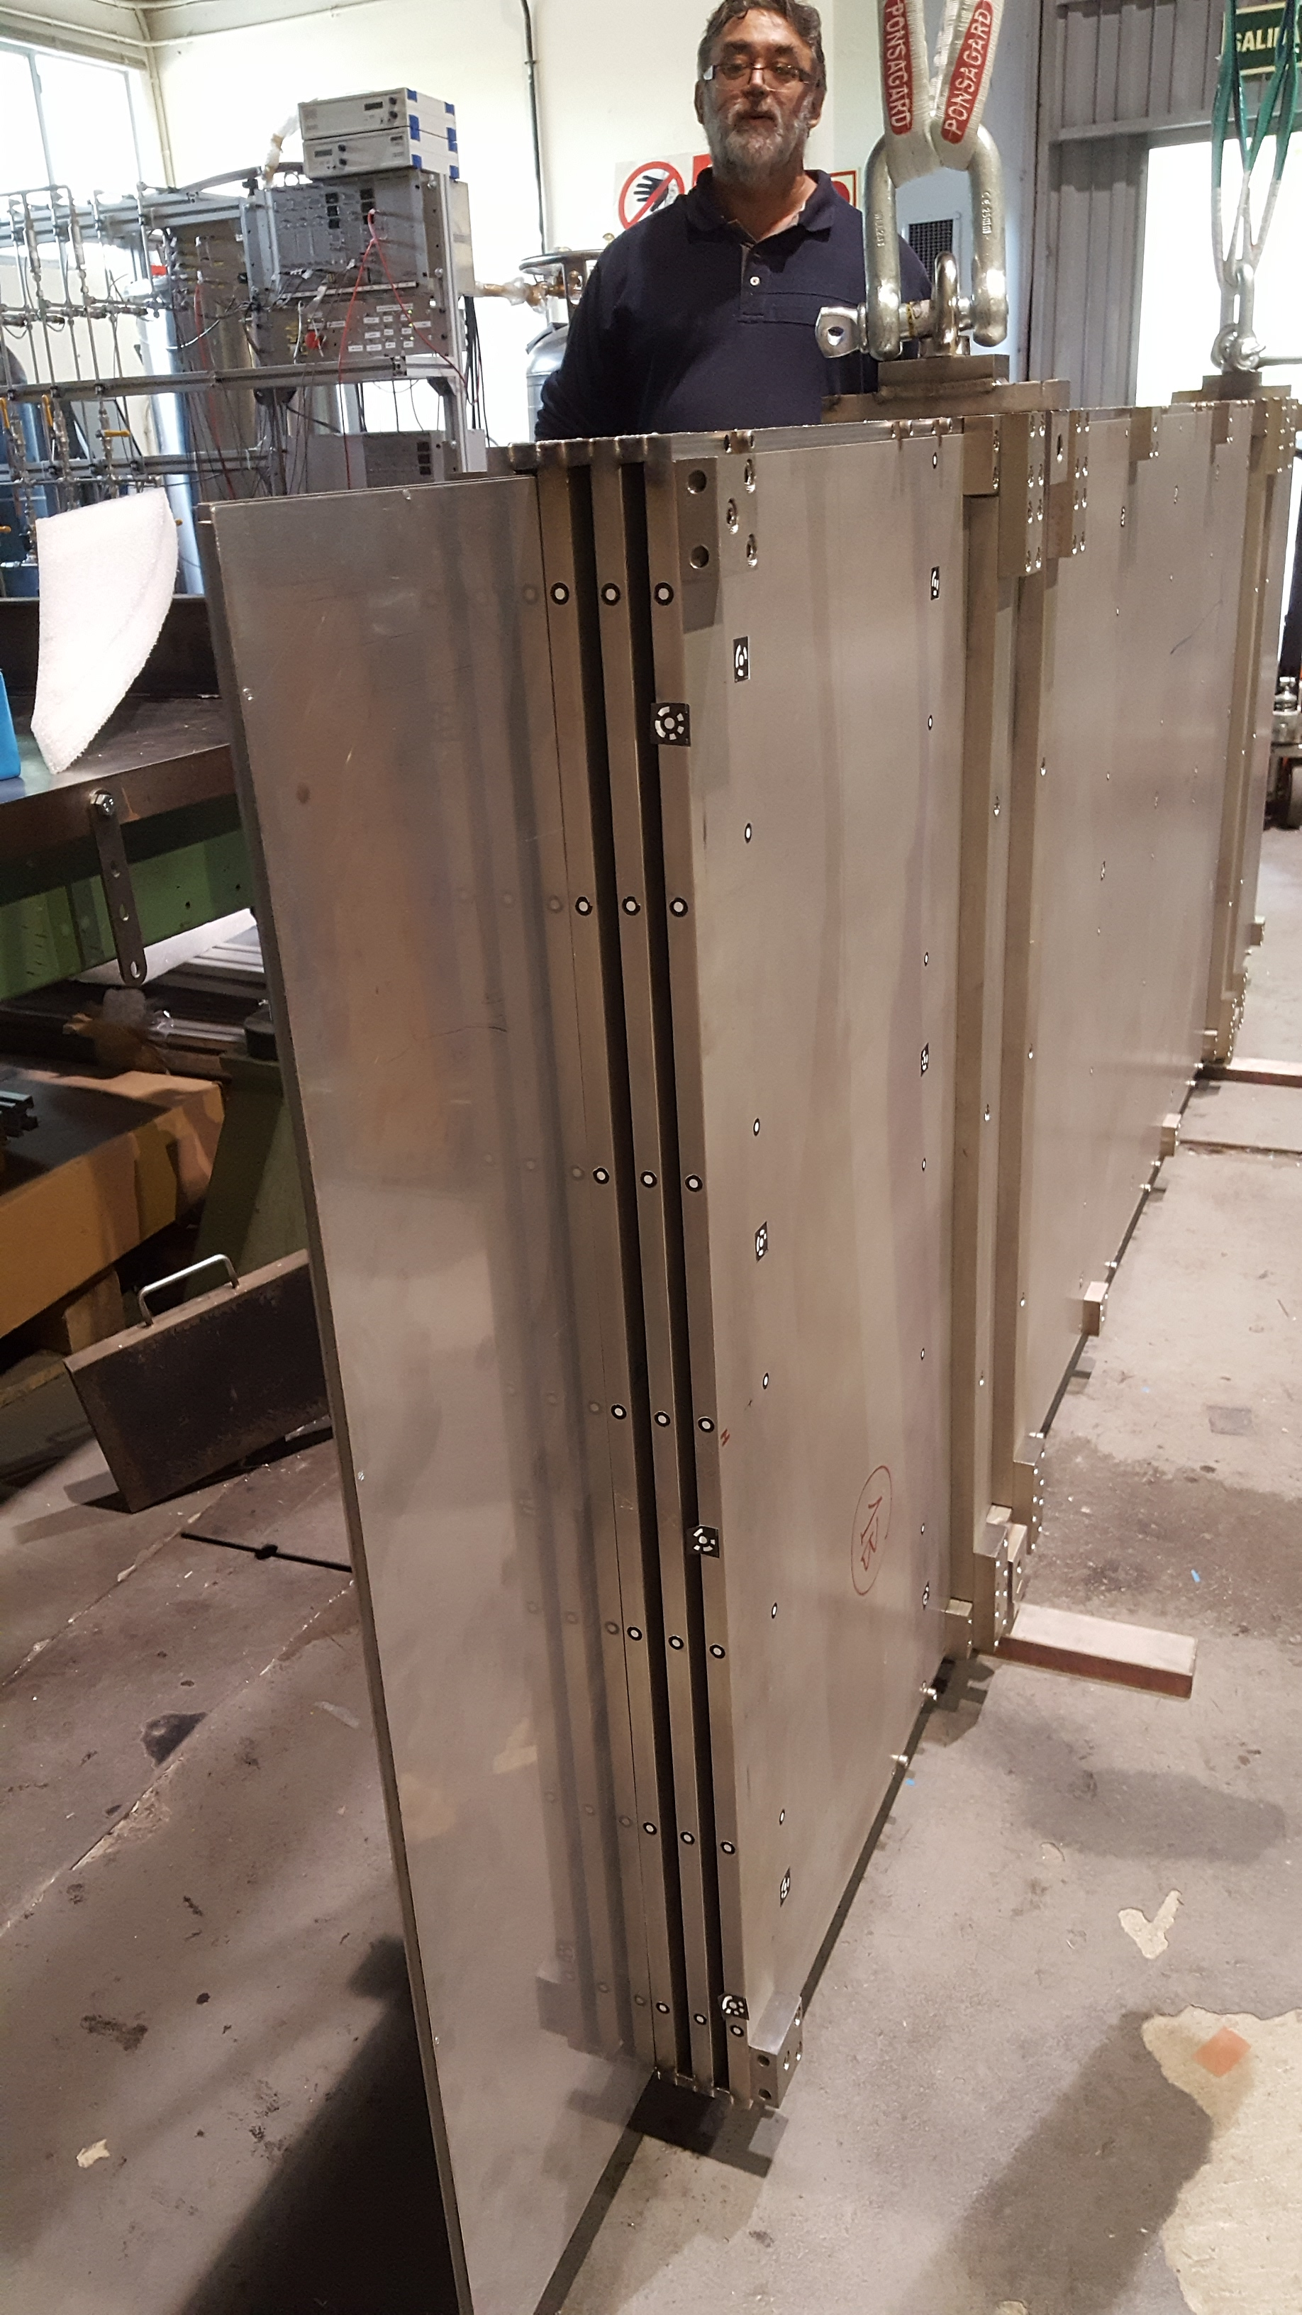
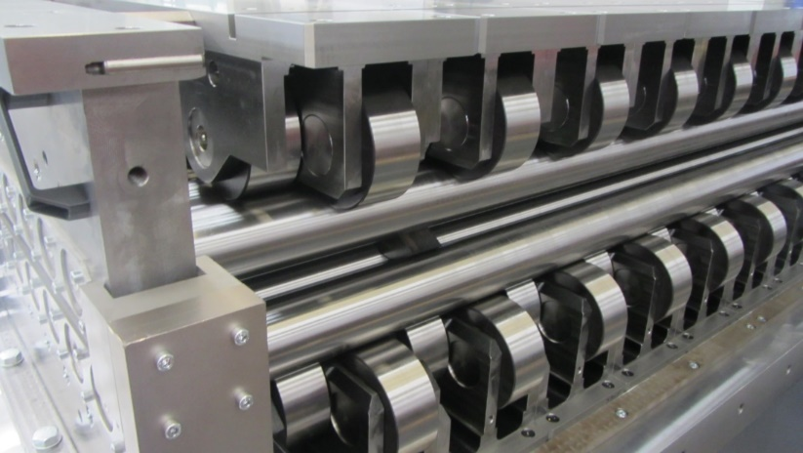

Present developments and future evolution: Mechanics
Procedures developed with roller leveling for improving planarity of absorber plates (1x3m²) from several mm to ~500 microns
Development of Electron Beam Welding assembly protocols to reduce deformations introduced by welding procedures below mm level (600 microns in this test)
Roller
Leveling
Plate
handling
tool
Plate
entering
5 plates 3x1m²
Welding zones
Future R&D
All work done by CIEMAT, funded by AIDA2020
  The structure was at the limit of the machine used at CERN, for larger modules a bigger machine will be needed but the handling of such heavy structure could be very complicated (The structure needs to be moved an rotated several times)
  A promising option is to build sub-modules and after weld them using laser welding. The procedure should introduce reasonable deformations (the rigidity of the modules is much higher than for individual plates.
      This will be tested using some of the prototypes already produced.

Slide 8
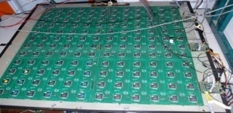
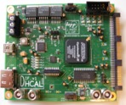
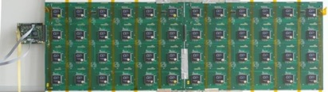
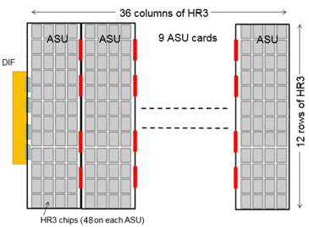
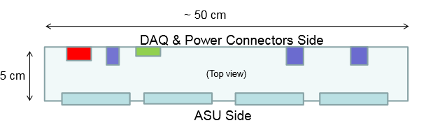

Present developments and future evolution: Electronics
Readout electronics for the 1m3 prototype
1 DIF for 2 ASU (Active Sensor Unit.- PCB+ASICs)
➔ 3 DIFs for ONE 1m2 GRPC detector
1m² board ➔ 6 ASUs hosting 24 ASICs
HADROC chip
3072 ch
DIF #1
144 ASICs= 9216 channels/1m²
USB
ASU1
ASU2
33 cm
DIF #2
HDMI
DIF
100 cm
DIF #3
New Readout electronics: New ASIC + new DIF
Only 1 DIF per GRPC (any dimension) with small dimensions to fit in the small space available at the final detector
DIF dimensions

Slide 9
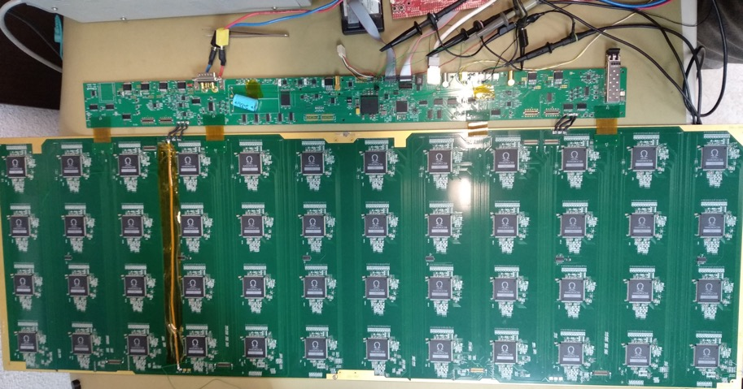
Present developments and future evolution: Electronics
New DIF capable to handle up to the 30000 readout channels of a 3x1m² RPC
ASU
HARDROC3
(HR3)
1x0.33 m2 with 12 layers
Designed, produced and tested by CIEMAT
@ CIEMAT
Now under integration with DAQ in collaboration with the Lyon Group
To be tested with RPC in beam tests
ASU
connector
TEXAS TM4C1294U
FPGA XC7A35TFGG484
6 cm
I²C
Drivers
DIF
Power
Power
I²C
Drivers
Power
Test signal
External
trigger
Power
supply
TTCX
70 cm

Slide 10
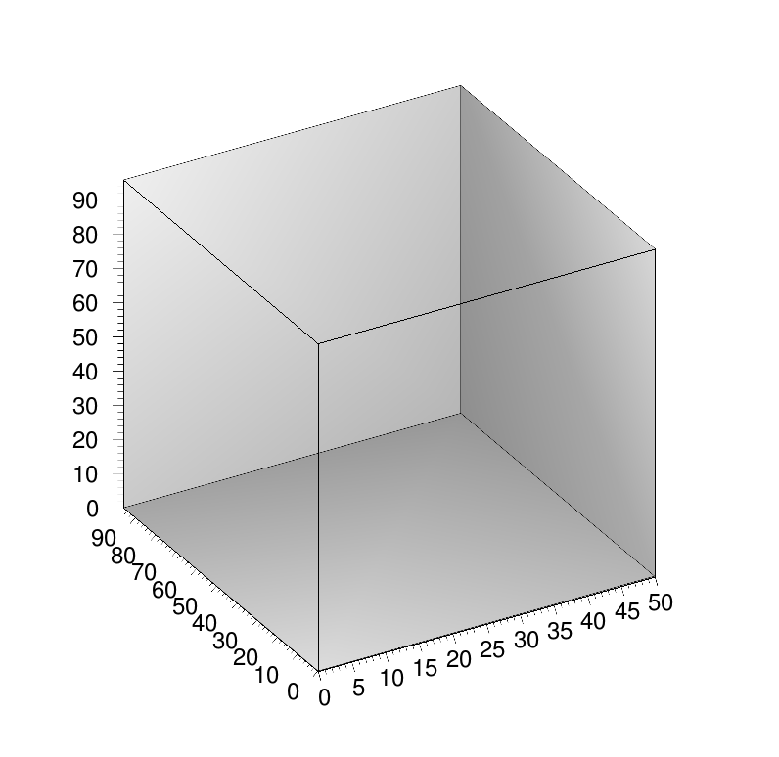
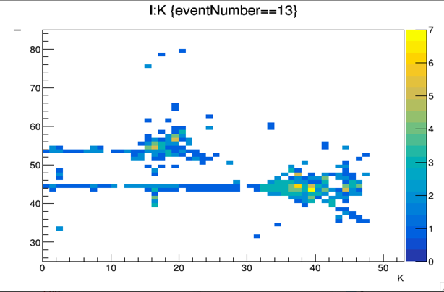
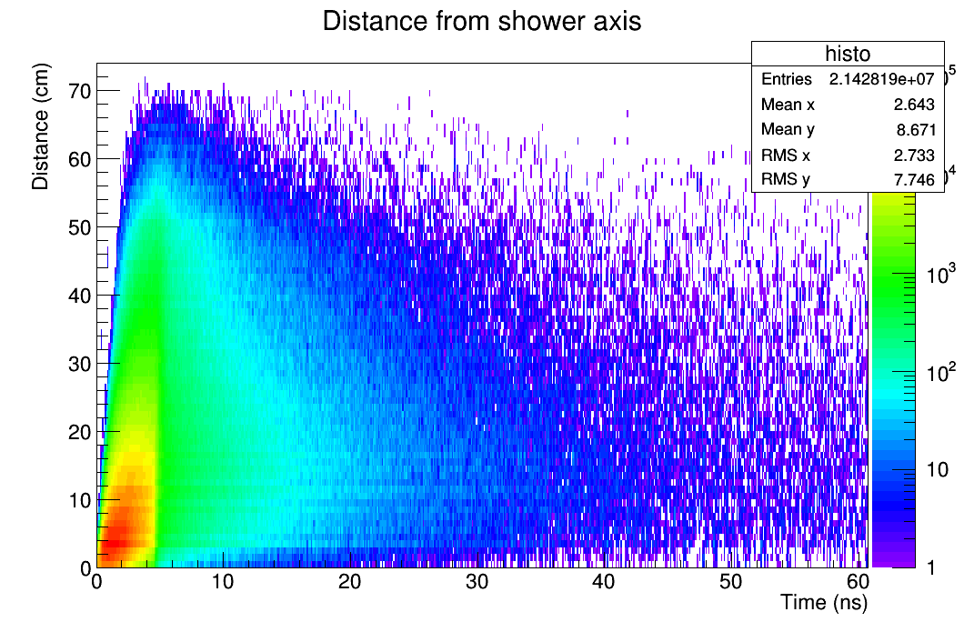
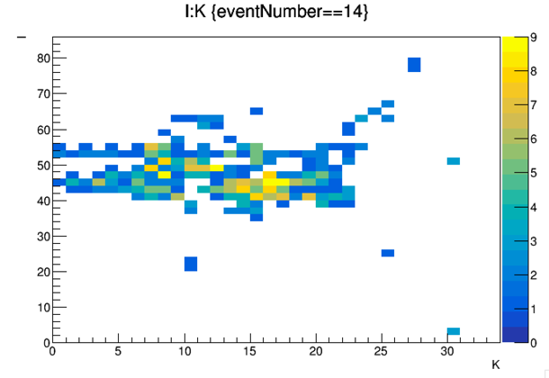
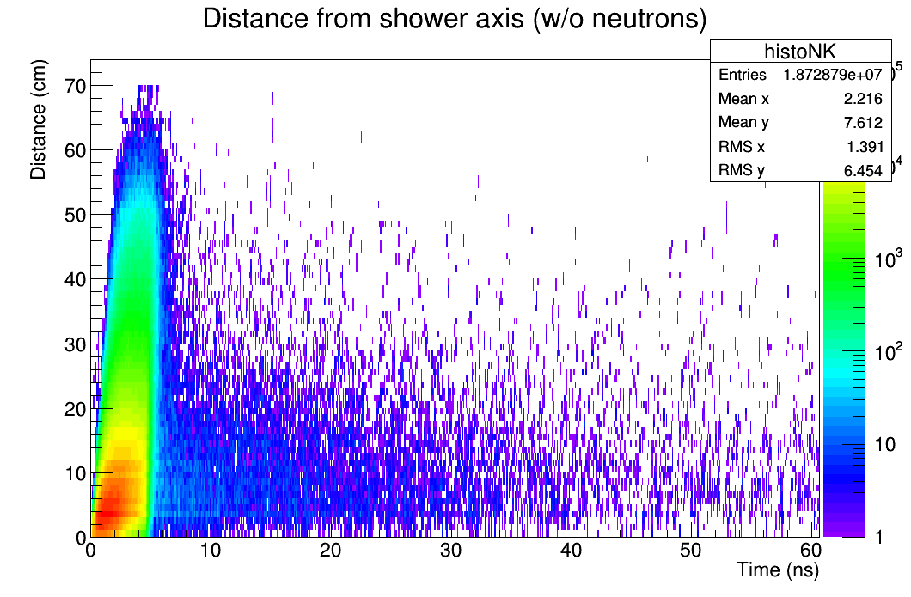
Short term evolution: 5D Calorimeter
Motivation for including time information
Time information can help to separate close by showers and reduce the confusion for a better PFA application.
Example: pi-(20 GeV), K-(10 GeV) separated by 8 cm.
Timing could be an important factor to identify delayed neutrons and better reconstruct their energy
Easy case
Depth
Difficult case
Time
Time
Depth

Slide 11
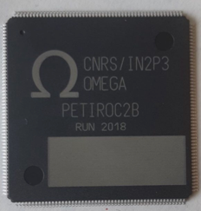
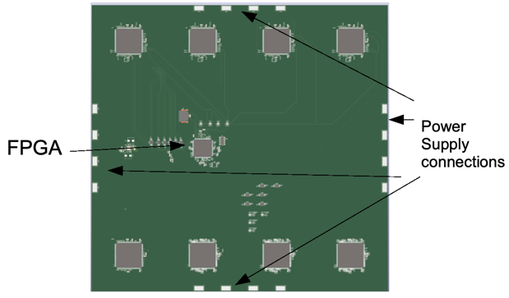

Short term evolution: 5D Calorimeter
General goal: Extending the Semi-Digital Hadronic CALorimeter (SDHCAL) to include timing information (100 -200ps resolution) for a 5D-calorimetry (space, amplitude & timing)
Implementation: Build small multi-gap RPC (MRPC) equipped with a new version of electronics with timing capabilities to prove the final performance
MRPC will improve the intrinsic timing of the detector
Present readout Chip HARDROC3. Time Stamping=200ns
➔ New chip needed
➔ New readout electronics (ASU, DIF, DAQ)
Under design
8 Petiroc ASICS to readout
a 50 cm x 30 cm detector with 2cm x 2 cm pads.
- 32 channels Time resolution below 40ps
PETIROC2
ASIC
Developed at CNRS-OMEGA partially thanks to AIDA2020 for CMS-muon upgrade
Top view
Embeds the preamp, the TDC , a QDC
Limited digital logic, difficult to chain, deadtime
LiROC (Weeroc, 2022) single-ended, 64 ch.
Time resolution 12 ps
Under study by our Korean collaborators

Slide 12
5D Calorimeter related activities planned at CIEMAT
Monte Carlo simulation studies and software developments to evaluate the impact of timing on shower reconstruction.
(Calorimeter level and some Physics benchmark channel)
Using the framework of the ILD concept group for ILC where the SDHCAL simulation is implemented
and simulation samples are available
New electronics with timing implementation
Detector mechanics for new Multigap GRPCs
Tests of new multigap GRPC prototypes.
Developments ongoing at U. Shanghai Jiao Tong (China) & IP2I (Lyon-France)

Slide 13
Future interesting tests using the 1m3 SDHCAL prototype
Tests with beams at CERN substituting part of the present GRPCs by the new Multigap GRPCs
Combined tests with SiWECAL
  Some attempt in the past but difficulties when trying to synchronizing the data
  ➔ Extra work needed at the DAQ and software levels to allow interesting studies
  Of interest for PID and new reconstruction algorithms
  In the longer term, the inclusion of several layers of tracking could be envisaged

Slide 14
Person power at CIEMAT & extra budget
1 FTE senior Physicist - staff
0.3 FTE mechanic engineer - staff
1 FTE electronic engineer (till last year, plan to hiring a new one along this year with the recent approved national project)
1 FTE technician (mechanics) – staff
Other CIEMAT support
Mechanical Workshop of CIEMAT
Electronic Workshops
1 PhD student during last 4 years, defending his thesis next week and no replacement foreseen due to lack of resources. (no FPI assigned to the project)
The project would benefit a lot from some PhD student and young post-doc
The lack of electronic technicians makes very difficult the implementation and tests of the electronic boards
Apart from the AEI project there is some mall budget from the EU AIDAInnova project. ~20Keuros for next 3 years
Gas detector WP, for timing developments with multigap RPC for calorimetry
M.C Fouz coordinator of those activities at AIDAInnova: 4 groups involved (CNRS - IP2I - France , CIEMAT – Spain,
Shanghai Jiao Tong University – China, Gangneung–Wonju National University – South Korea)
Caveat: Madrid Community Government does not consider fund any kind of experimental high energy physics projects, FPI like or postdoc figures.

Slide 15


Slide 16
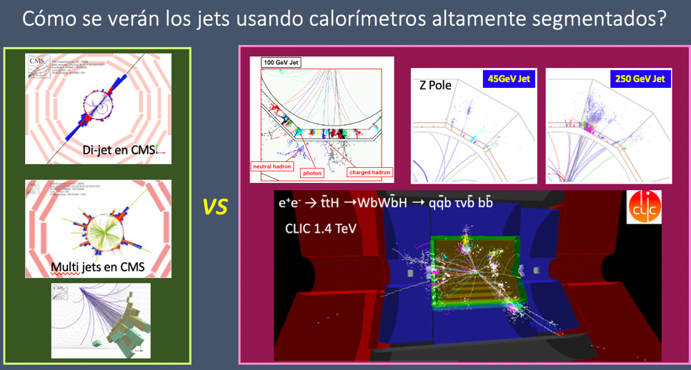
CALICE Collaboration
MOTIVATION
Physics at Higgs Factories requires a jet energy resolution a factor 2 better than the achievable with the present calorimeters.
Actual calorimeters
High Granularity
member since 2007
Raw data
Several particles from test beam recorded by the SDHCAL
Developing highly granular calorimetry optimised for particle flow event reconstruction for future energy-frontier electron-positron coliiders.

Slide 17
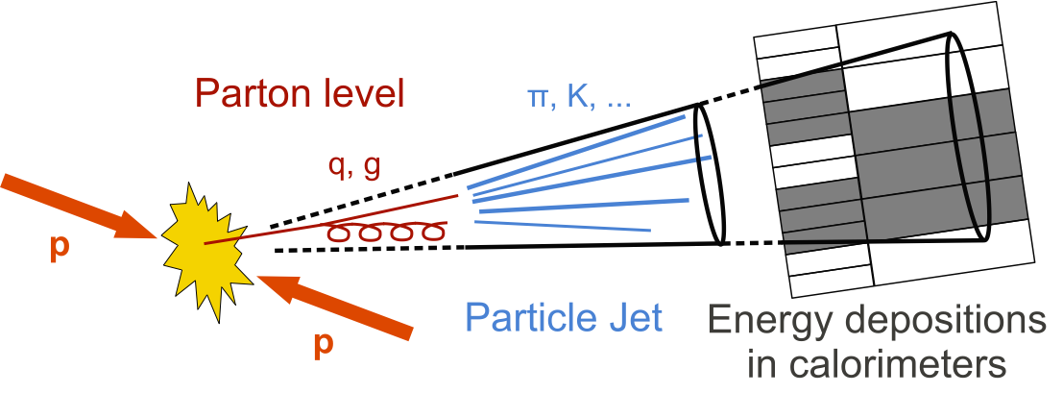
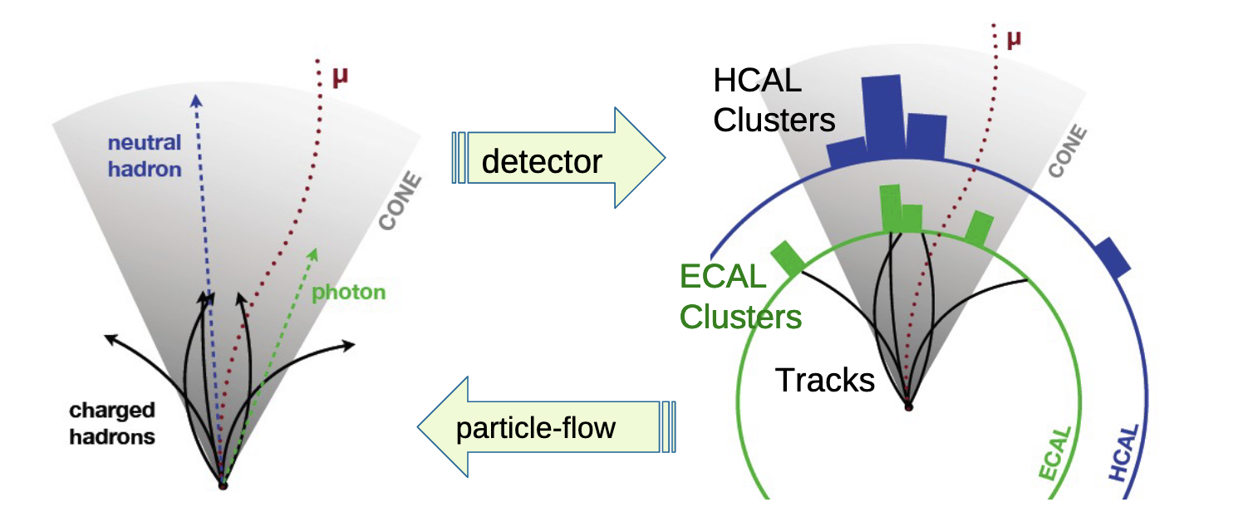

10%
Jets – Reconstrucción de la energía
25-30%
60-65%
Tradicionalmente
Medida de la energía en ECAL+HCAL. ( ~ 70% energía en HCAL, resol: σ/E ~ 60%/$√$E)
PFA. Particle Flow algoritms
Partículas cargadas SOLO en el tracker (se mide el momento, esencialmente perfecto)
Fotones – ECAL σ/E < 20%/$√$E
Sólo hadrones neutros ( ~ 70% energía en HCAL, resol: σ/E ~ 60%/$√$E)
PFA en la actualidad
Los hadrones neutros se identifican como E_{n} = E_{tot} – (E_{ECAL}+E_{HCAL})
PFA en el futuro
Reconstrucción directa de los hadrones neutros con calorímetros de altísima granularidad y software complejo

Slide 18


New electronics architecture
SDHCAL DAQ architecture
A central PC collects data from all the ASUs (containing de ASIC chips) through an Ethernet switch acting in such a way as data concentrator and generates the required commands for ASU and DIF (Detector Interface) configuration generating at the same time synchronization signal required for a correct data acquisition process.
DIF architecture
• Only one DIF per plane (instead of three at 1m3 prototype)
• DIF handle up to 432 HR3 chips (vs 48 HR2 in previous DIF)
• Clock and synchronization by TTC (already used in LHC)
• 93W Peak power supply with super-capacitors
(vs 8.6 W in previous DIF)
• Spare I/O connectors to the FPGA (i.e. for GBT links)
• Upgrade USB 1.1 to USB 2.0

Slide 19


