Slide 1
Physique et
Imagerie Médicale
Paul Lecoq
CERN, Genève

Slide 2
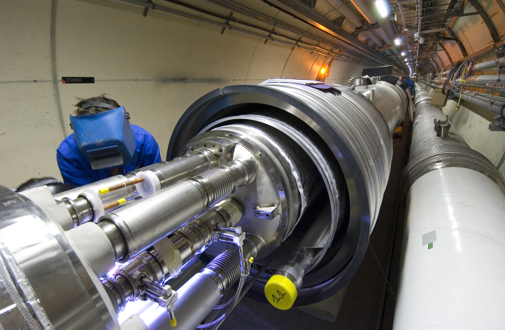
LHC - Installation des aimants supraconducteurs (27km)

Slide 3

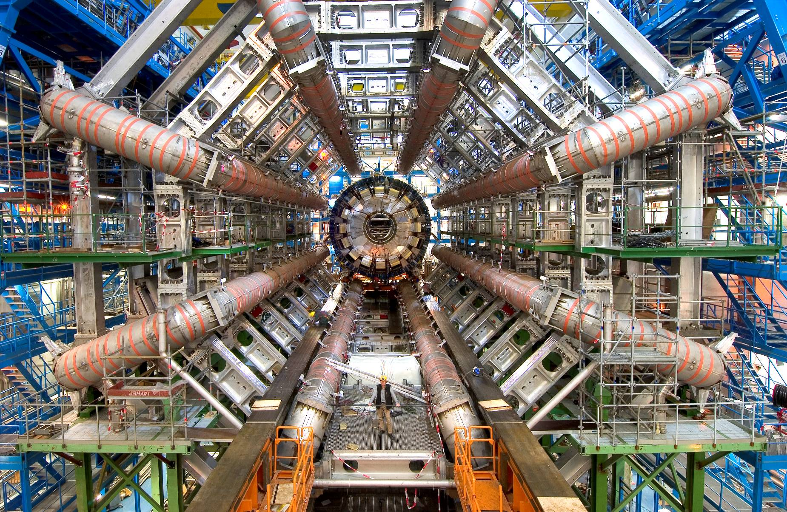
L’aimant toroïdal d’Atlas

Slide 4
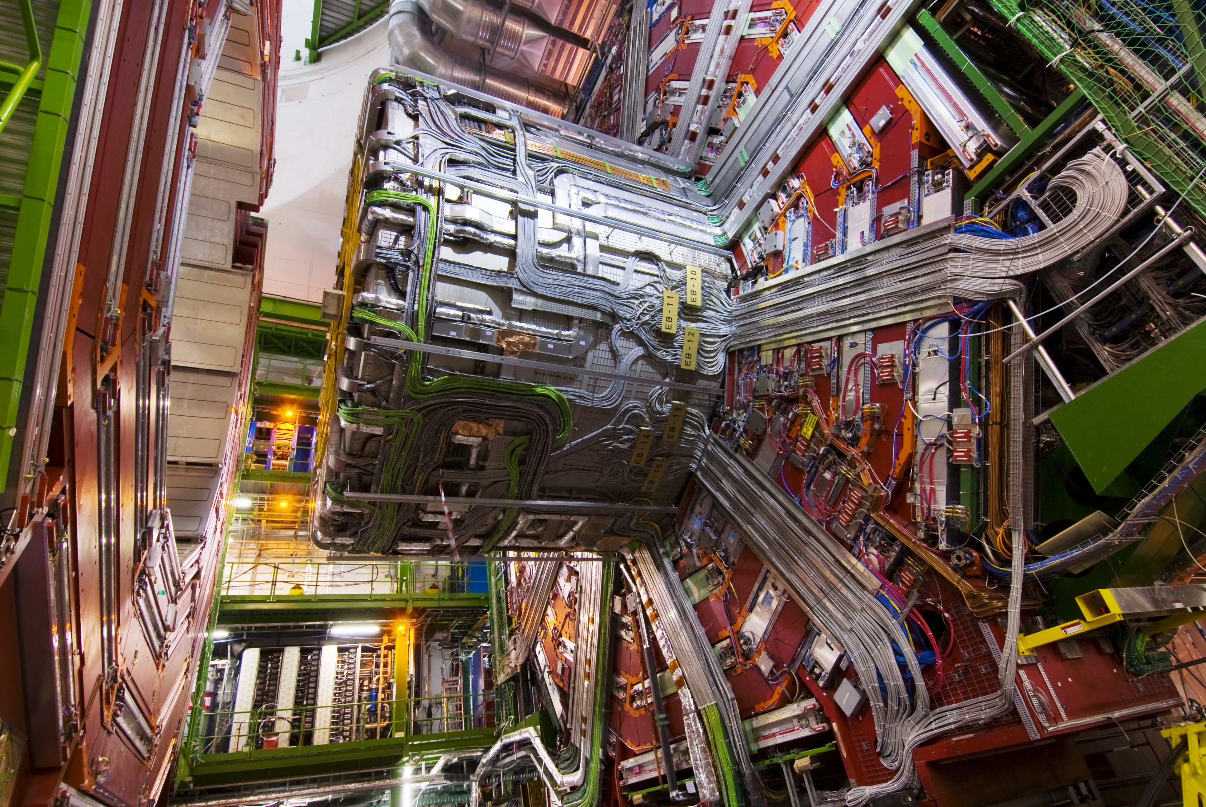
Montage de l’expérience CMS

Slide 5
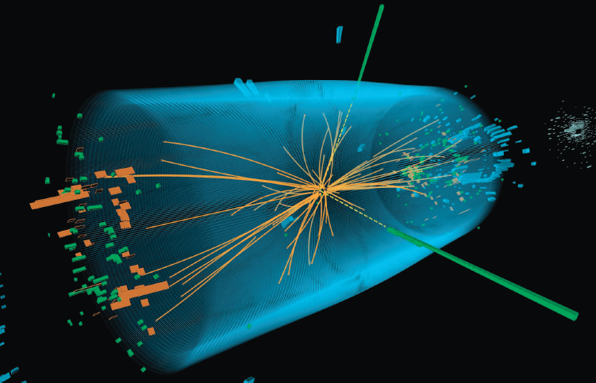
July 4, 2012 : The Higgs Boson!!
Δt ~ 20 years !!!
Notes:
And in 2012 we have been rewarded from these 20 years of efforts with the announcement in July 2012 of the discovery of the Higgs boson with magnificient signatures in our PWO calorimeter

Slide 6
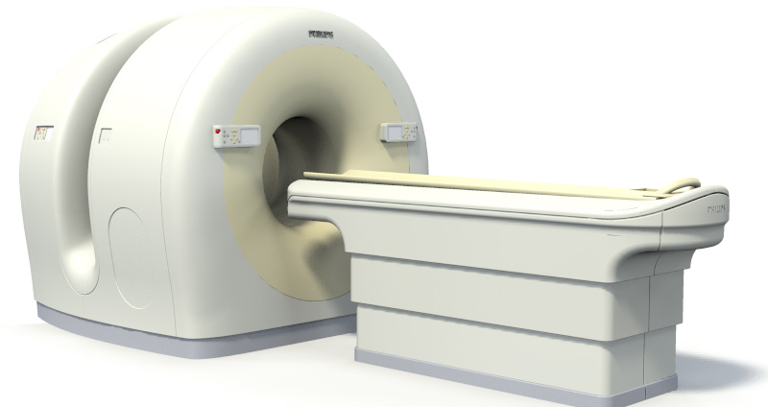
Scanner TEP/CT

Slide 7
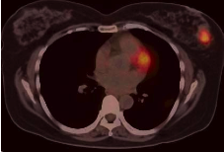
Imagerie anatomo-fonctionnelle non invasive
Patiente traitée pour un cancer du colon
révélant à l’examen un cancer du sein additionnel

Slide 8

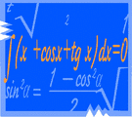
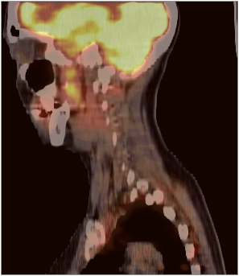




L’imagerie médicale: une approche pluridisciplinaire
Physique
Mathematiques
Médecine
Chimie
Biologie
Informatique
Notes:
Because physicians want better and better spatial resolution

Slide 9

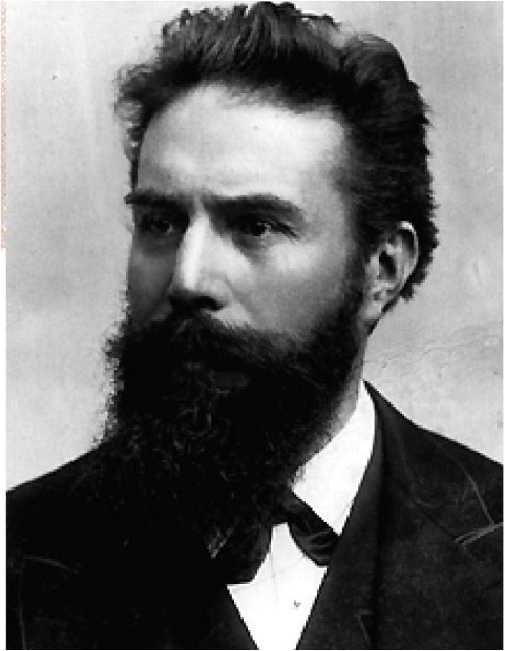
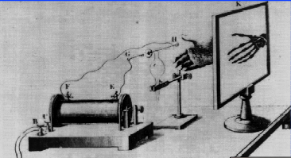
La découverte des Rayons-X
Le 8 November 1895 Röntgen découvre les Rayons X
Le 22 November 1895 il prend le premier cliché de la main de son épouse
500’000’000
d’examens RX
chaque année dans le monde
Röntgen obtient le 1er prix Nobel de physique en 1901

Slide 10
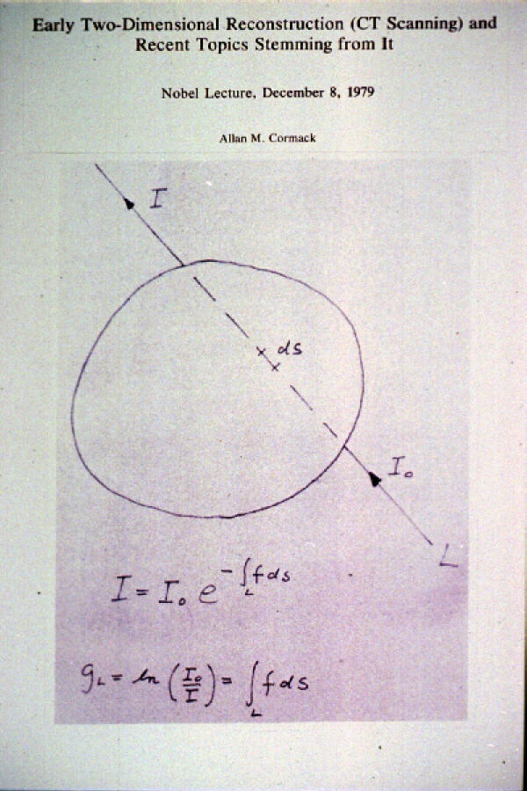
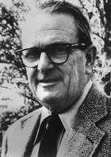
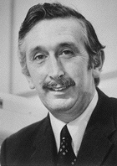
CAT Scanner
Le principe de la tomographie
Prix Nobel de Physiologie et Médecine 1979
Allan MacLeod Cormack
Physicien Nucléaire
Cape Town
Harvard University
Tufts University
Sir Godfrey N. Hounsfield
Ingénieur électricien anglais
EMI Research

Slide 11
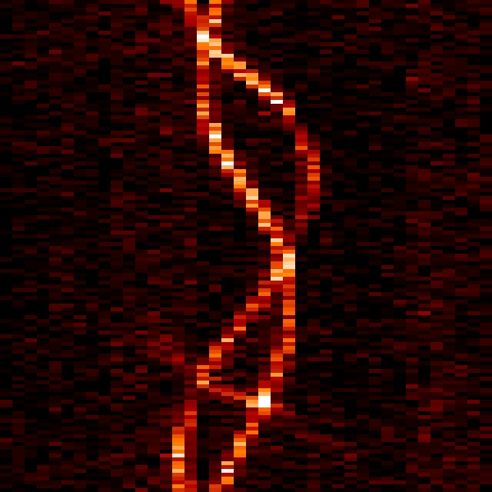

Principe de la Tomographie
β
y
❶
I
❸
u
❷
u
❶
❷
u
I
x
β
u
❸
β
z
I
u

Slide 12
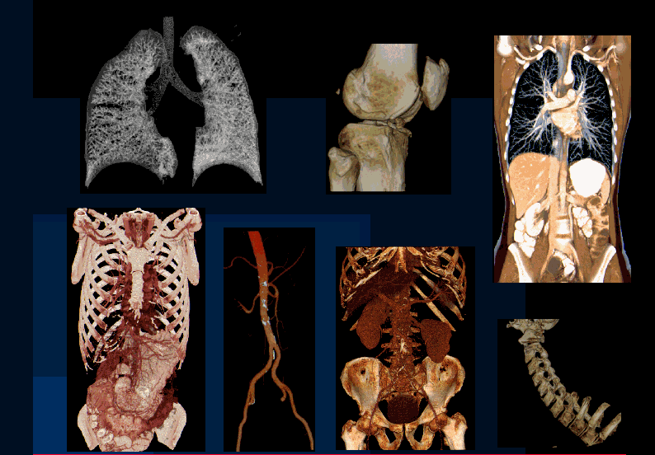
Tomographie volumétrique
< 0,4 sec/ rotation
Organ in a sec (17 cm/sec)
Whole body < 10 sec
Notes:
You can also go to a virtual journey inside the body

Slide 13
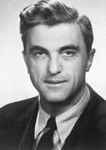
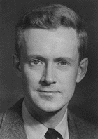
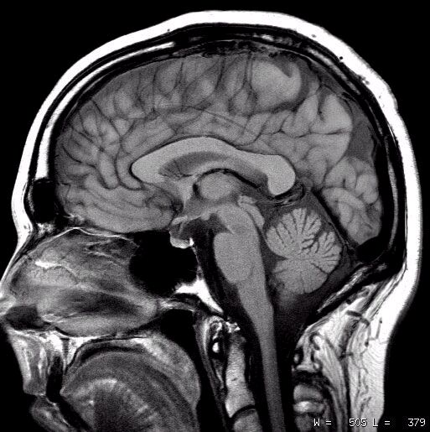
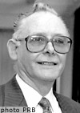
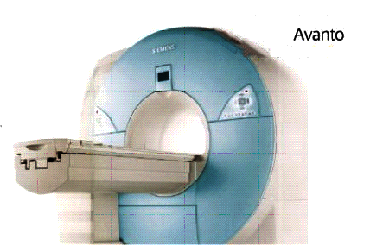
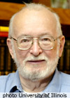
IRM, imagerie par résonance magnétique
Prix Nobel de Physique 1952
Felix Bloch
Physicien Stanford
Edward M. Purcell
Physicien Harvard
Prix Nobel de Physiologie et Médecine 2003
Sir Peter Mansfield
Physicien Nottingham
Paul C. Lauterbur
Chimiste Uni. Illinois
Notes:
J’ai une pensée particulière ici pour Félix Bloch qui a été le premier DG du CERN en 1954 et qui m’a enseigné le magnétisme au début des années 70

Slide 14
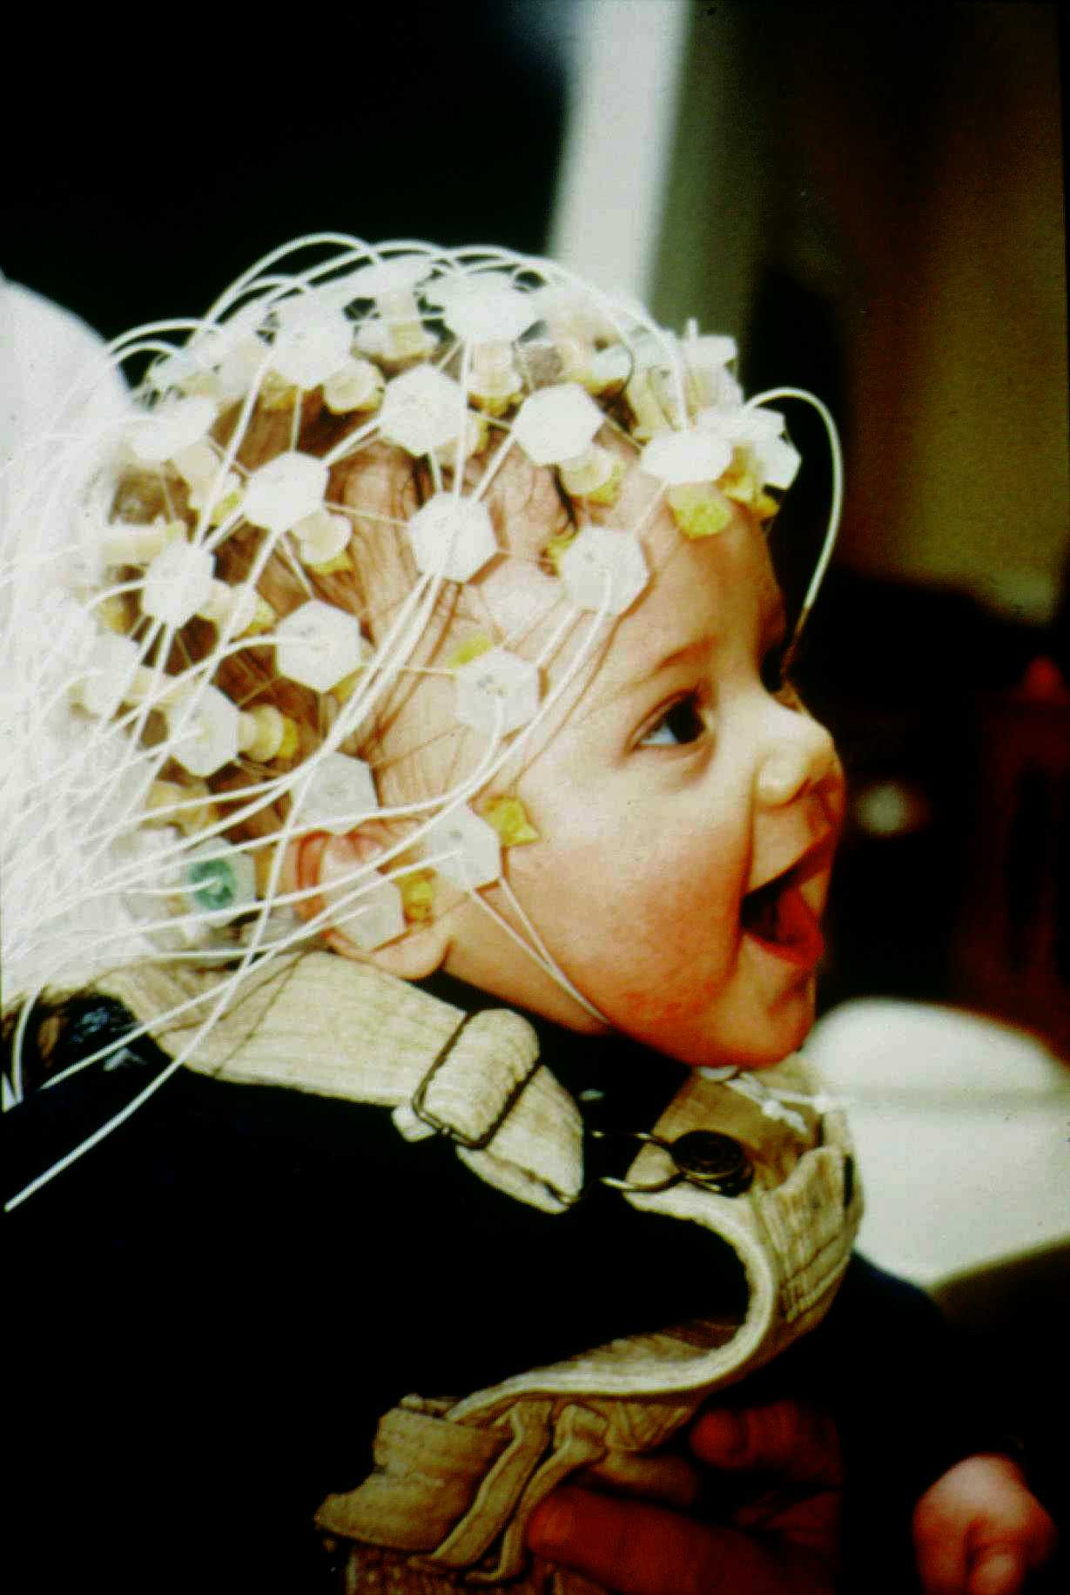
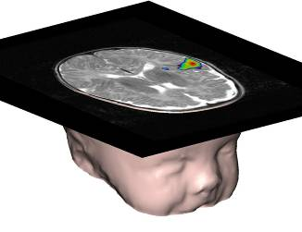
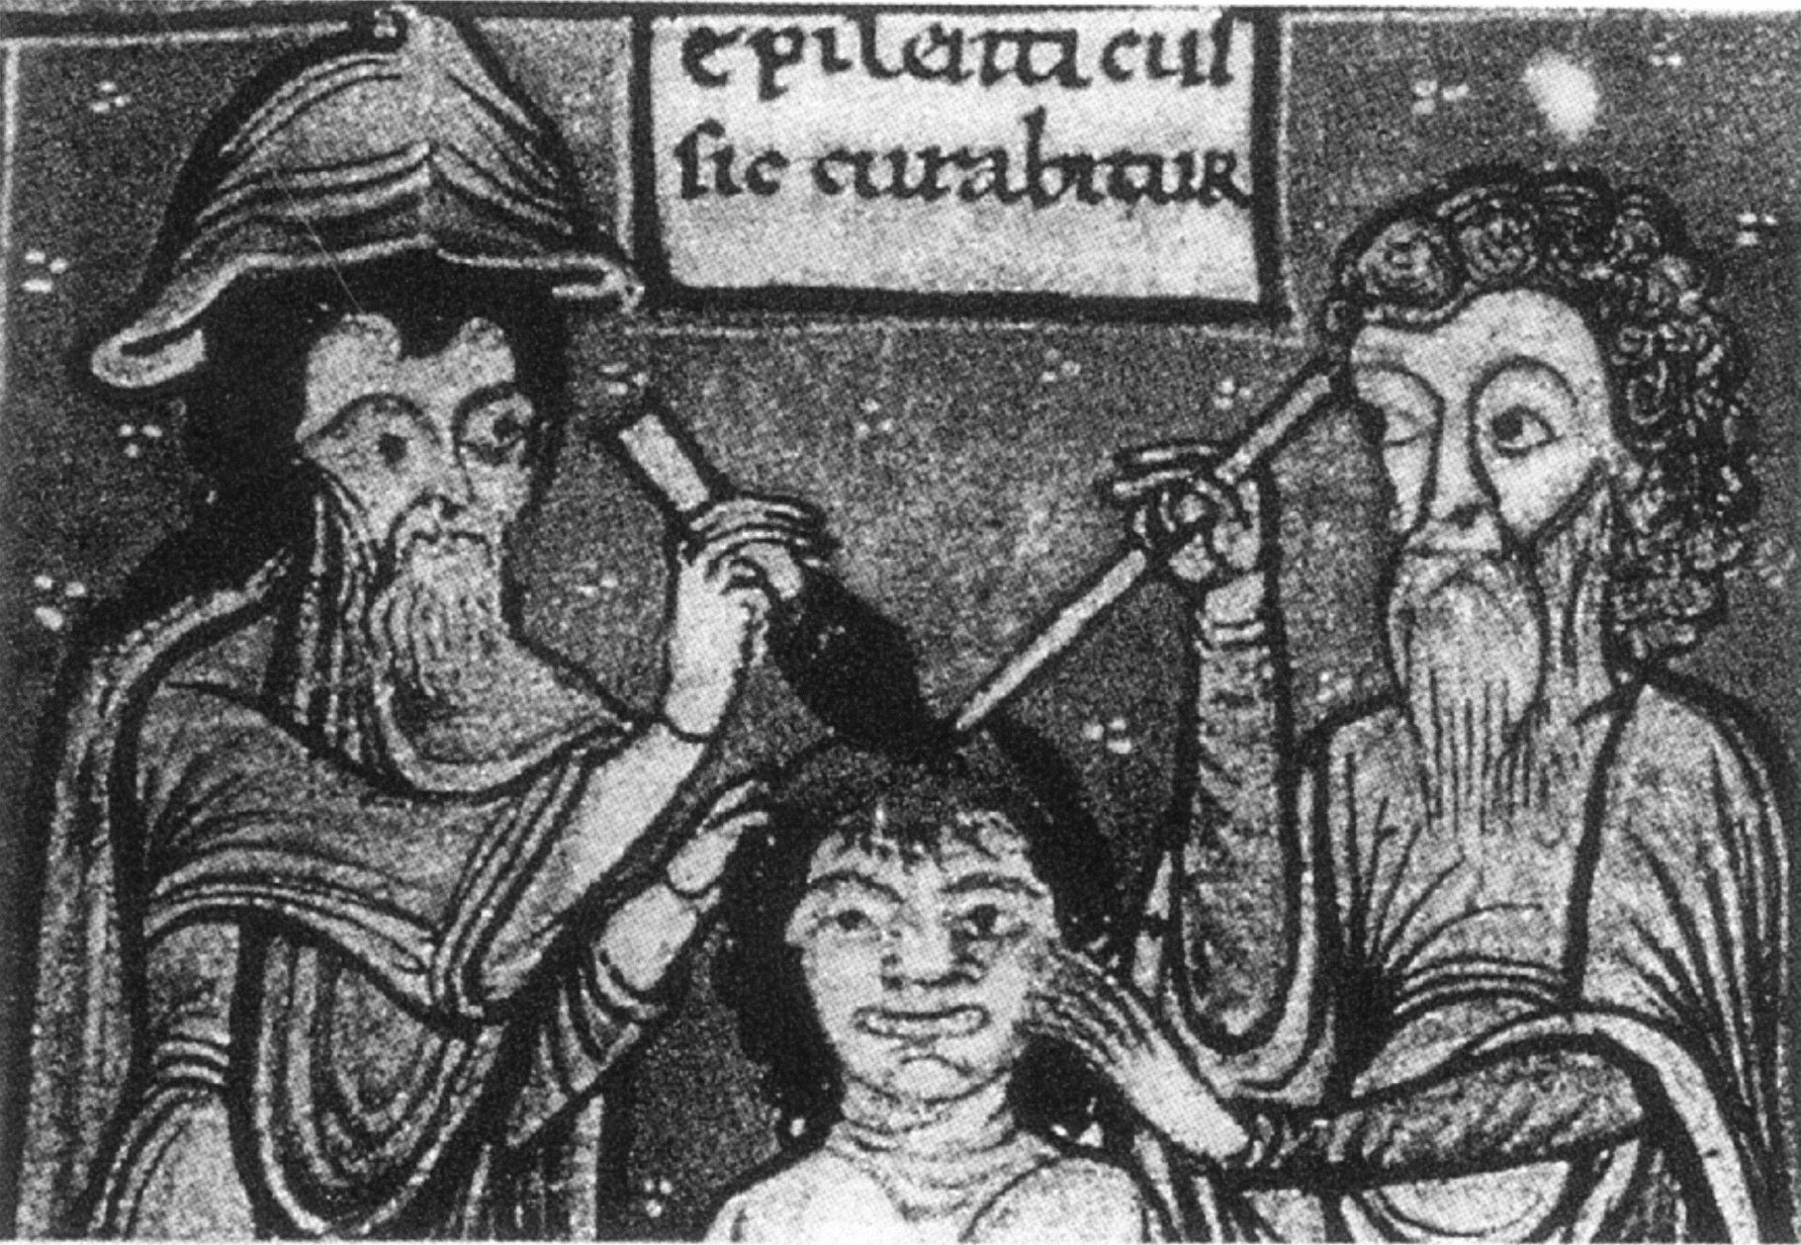
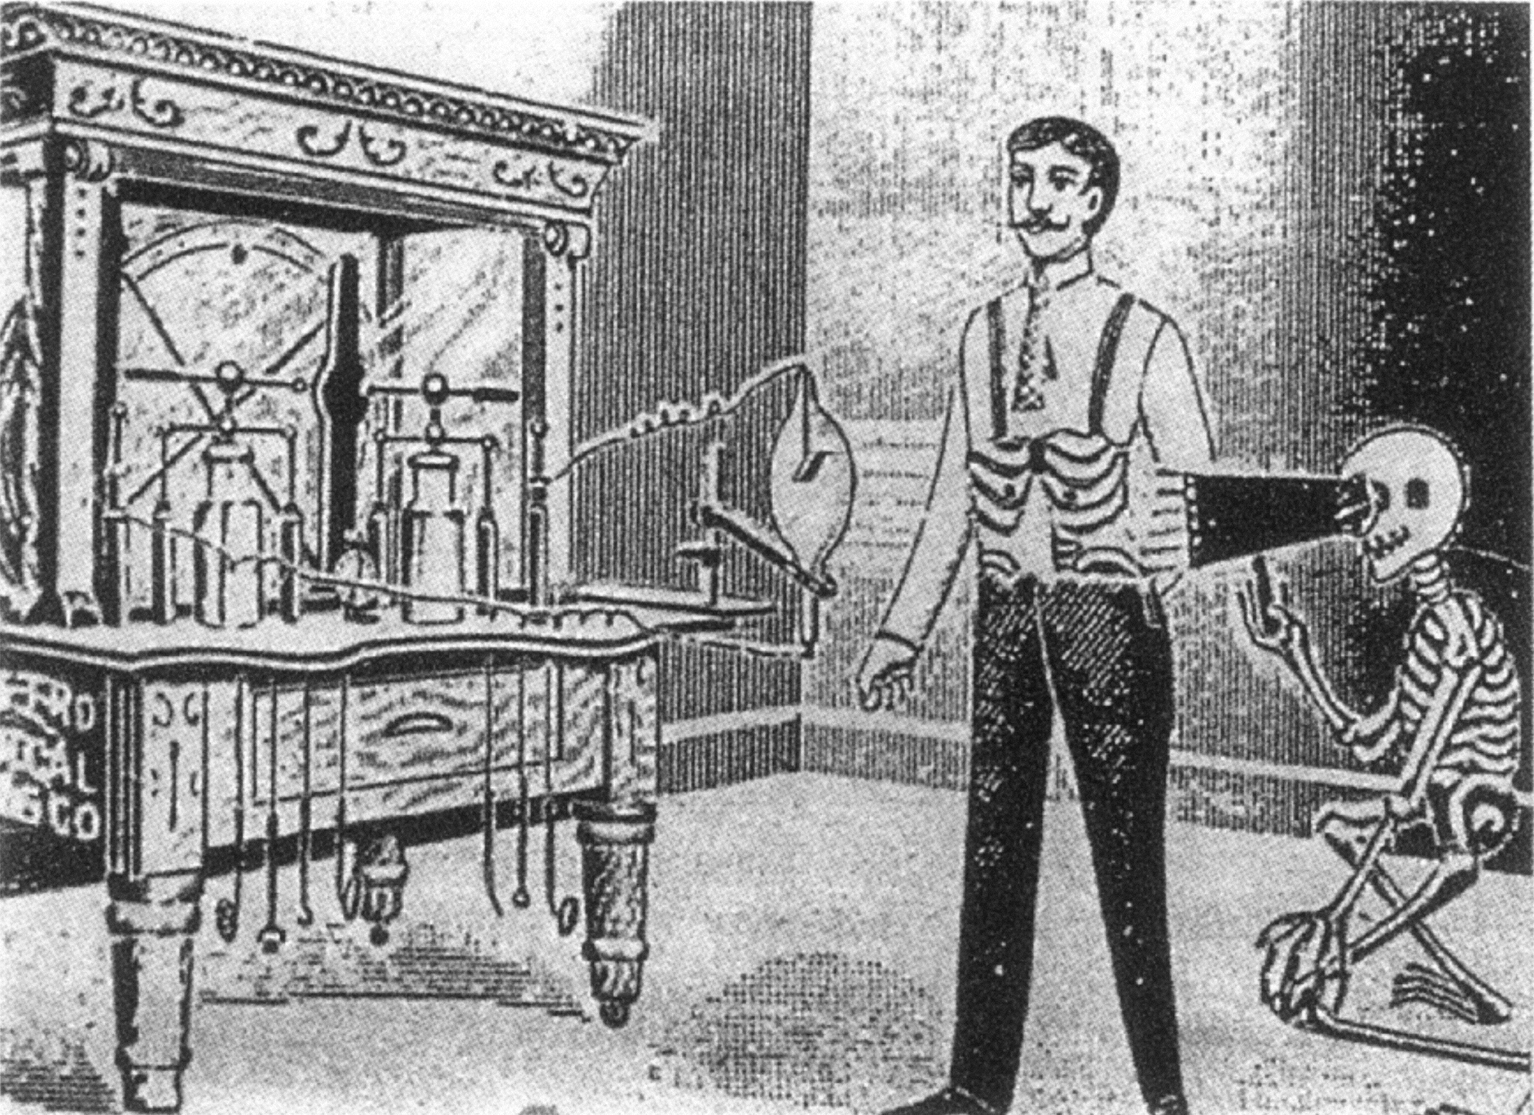
Petite histoire résumée de l’imagerie in-vivo
20ème siècle
21ème siècle
15ème siècle
De moins en moins invasive
Début 20ème siècle

Slide 15
Differents types d’imagerie pour différents types d’information
Imagerie anatomique
  Localiser des masses ou des lésions
  Optique, CT, ultrasons, IRM
Imagerie fonctionnelle
  Quantifier des modification dynamique du métabolisme au niveau des organes
  Ultrasons (Doppler), IRM (Bold), Imagerie nucléaire (PET/SPECT)
Imagerie cellulaire
  Etudier les échanges des cellules entre elles, et avec leur environnement (stroma)
  Optique, IRM, Imagerie nucléaire (PET/SPECT)
Imagerie moléculaire
  Etudier les chemins moléculaires impliqués dans la production de protéines, d’enzymes, différents métabolites (sucres, acides aminés, acides gras, etc…)
  Imagerie nucléaire (PET/SPECT)
Notes:
The imaging targets are also becoming more and more precise

Slide 16
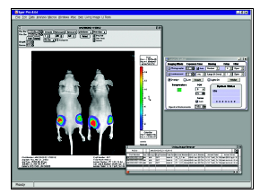
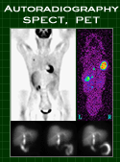
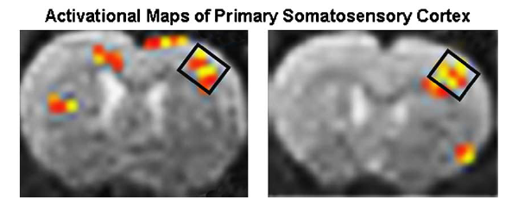
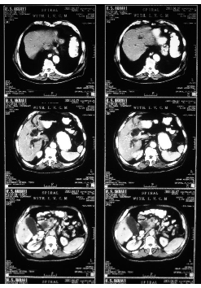
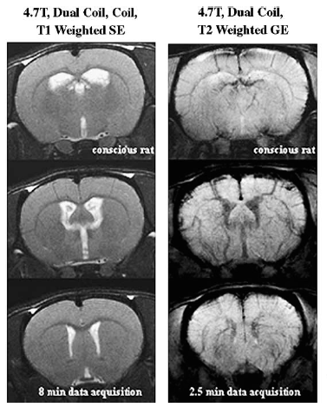
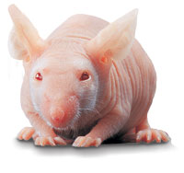
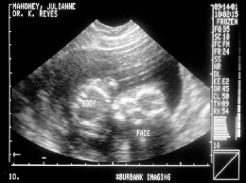
Imaging Modalities
Ultrasound
Optical
(Bioluminescence,
fluorescence)
A
F
Structure
A
M
0.1 mm
Doppler
Topography
µm to mm
CT
~10³ cells
≠ quantitative
A
Tissue Density, Z
20-50 µm
Photons
involved
PET/SPECT
MRI
F
M
Radiotracer
A
F
M
~1-2 mm
H Concentration
<10⁻¹² mole
= quantitative
0.1 mm
BOLD, DCE
β-galactocidase
0.1 µmole H / µmole ³¹P
Notes:
DCE: Dynamic Contrast Enhanced MRI
BOLD: Blood Oxygen Level Dependant MRI
There are different imaging modalities. Anatomic (through different parameters:tissue density, echogenicity, water concentration) ) , functional (either indirectly through blood flow measureent), molecular.
Aujourd’hui, en altérant le génome nous pouvons manipuler le métabolisme et recréer les conditions qui mènent au développement de différentes maladies.
L’intérêt ici est de pouvoir suivre l’expression de ces gènes dans le temps et au travers de différentes conditions.
C ’est dans des cas ici que les méthodes d ’imagerie prennent toute leur importance car elles permettent de visualiser ce qui se passe dans l’animal d ’une manière non invasive et non létale.
Presque toute les méthodes d’imagerie clinique sont maintenant disponibles pour l’imagerie animale, ce qui permet de faire des parallèles entre les études cliniques et les études animales.

Slide 17
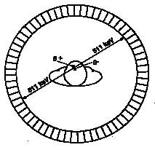
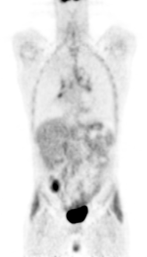
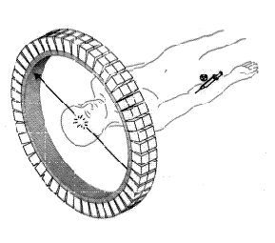
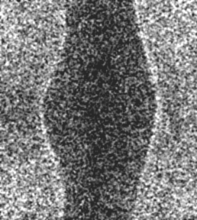
PET Principle
n
n
p
p
n
e⁺
e⁺
Acolinearity
(α D)
p
p
n
e⁺
e⁻
n
p
¹⁸FDG
injection
p
n
p
Positron range (r)
Neutron-deficient
isotope
Coincidences
2τ
(6p; 5n)➔(5p; 6n)
PET data acquisition
Projection
x
z
φ
φ
φ
s
Reconstruction
z
s
Parallel projections
PET data (sinograms)
PET images
Notes:
PET is by far the most sensitive molecular imaging modality.
PET uses Neutron defficient isotopes, for instance 18F, attached to a molecule involved in some metabolic process we want to study. Very often this is FDG, easily fixed in cancer cells and inflamatory areas.
PET is a fantastic tool to see organs at work.

Slide 18
July 4, 2012 : The Higgs Boson!!
Δt ~ 20 years !!!
Notes:
And in 2012 we have been rewarded from these 20 years of efforts with the announcement in July 2012 of the discovery of the Higgs boson with magnificient signatures in our PWO calorimeter

Slide 19
The PET World Picture
Need to Image
0.000000511 TeV*
Photons
*511 keV
Signal Levels Are Very Low

Slide 20
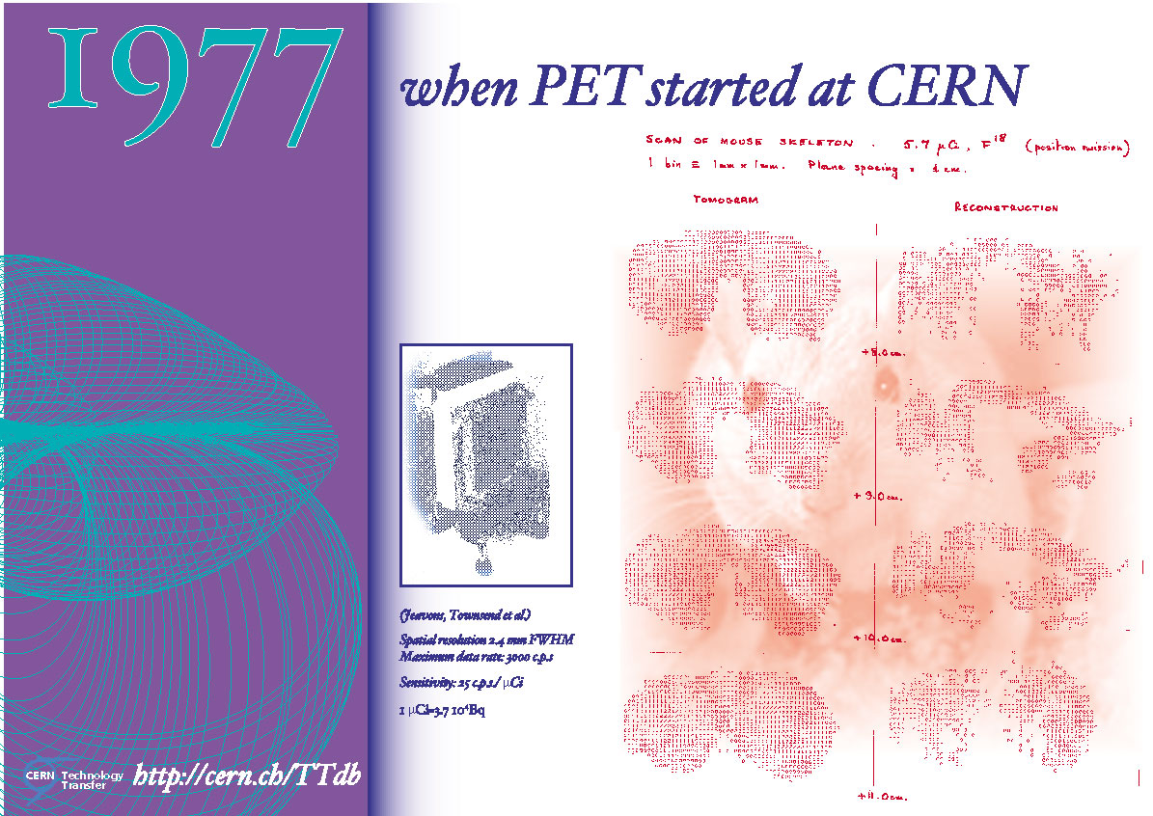
Un peu d’histoire

Slide 21
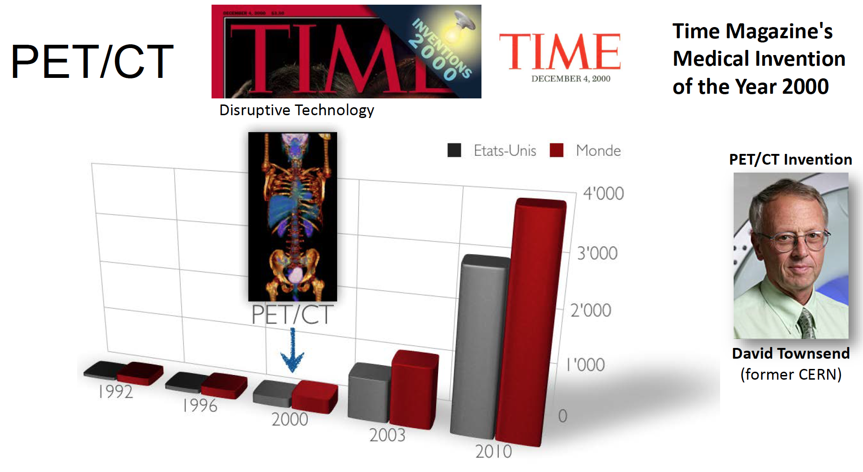
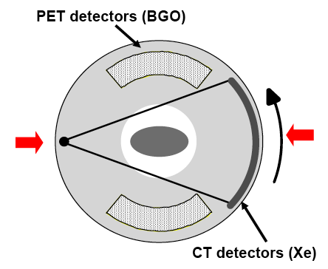
Invention of the PET/CT
Notes:
Some years ago David Townsend, who was working in collaboration with Prof. Donath at the Geneva Cantonal hospital had the brilliant idea to to fill-up the hole in an incomplete ring PET scanner with an X-Ray source and detector, launching the concept of the PET/CT.
This combination for the first time of an anatomic and a fucntional modalities has revolutionized the practice of medical imaging.
It was presented by Time Magazine as the invention of the year 2000
.............

Slide 22
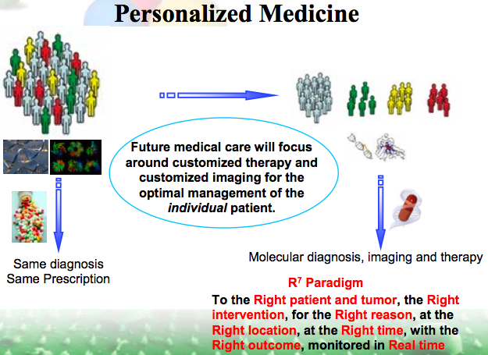
Médecine personnalisée
Approche globale
Médecine personnalisée
Diagnostic moléculaire
Imagerie moléculaire
+ Génomique
Traitement individualisé
Un diagnostic
Un traitement
Notes:
For medicine to be active instead of being reactive
Requires a global effort: IC PerMed even beyond Europe
Better health outcomes, quality of life and cost effective use of healthcare
Requires innovation in diagnosis, therapy , Prevention & ICT with economic valuse and fair access

Slide 23
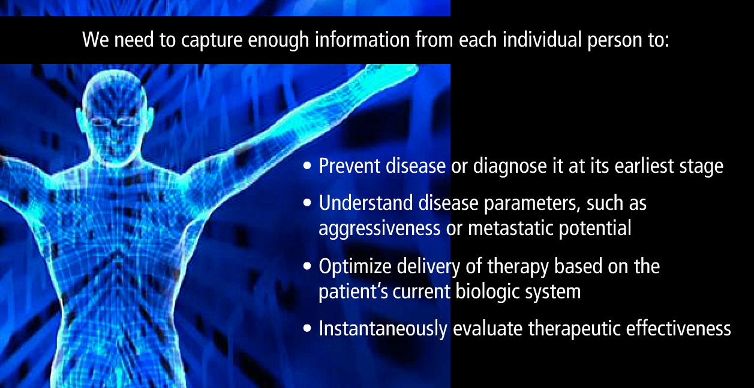
L’imagerie pour une meilleure prise en charge du patient
Recueillir une information détaillée de chaque individu pour:
Diagnostiquer la maladie à un stade précoce
Déterminer les paramètres de la maladie, comme
son agressivité, son potentiel métastasique
Optimiser l’action thérapeutique en fonction
du génotype du patient
Evaluer instantanément l’efficacité du traitement
Implique une nouvelle génération
de systèmes d’imagerie
Notes:
Medicine changes from reactive to predictive, personalized, preventive and participatory (P4) medicine

Slide 24
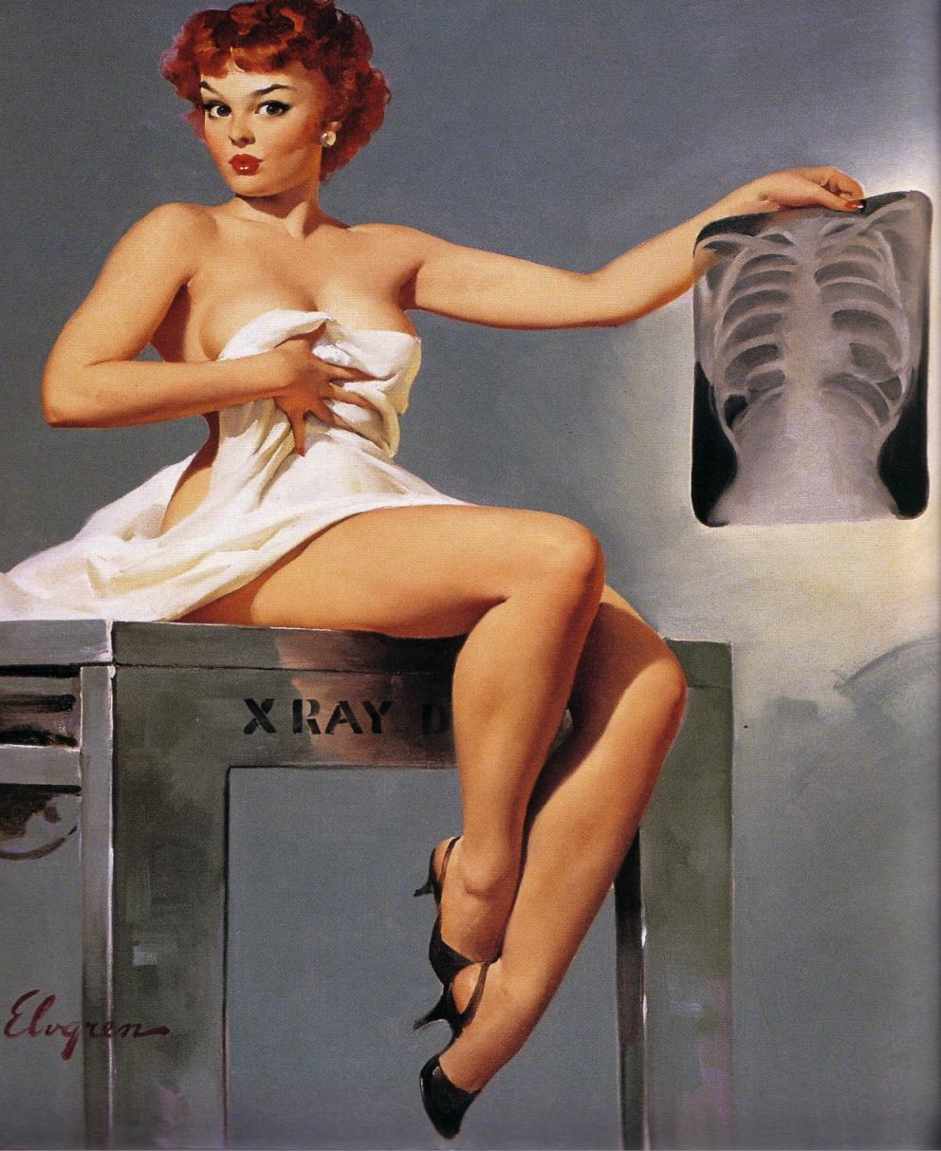
L’imagerie: quelle qualité pour voir quoi et dans quelles conditions?

Slide 25
L’imagerie médicale du futur
Voir des lesions plus petites
Examens plus rapides
Correction de mouvements
  Respiration
  Battements cardiaques
  Bolus digestif
Etudes dynamiques
Quantification
Multimodalité
Réduire la dose aux patients
AMELIORER
Résolution spatiale
Résolution temporelle
Rapport Signal/Bruit
Sensibilité
Notes:
Faster exams to minimize the burden on tghe patient and to increase the throughput for expensive machines
All parameters that we are dealing with in our physicists daily life

Slide 26
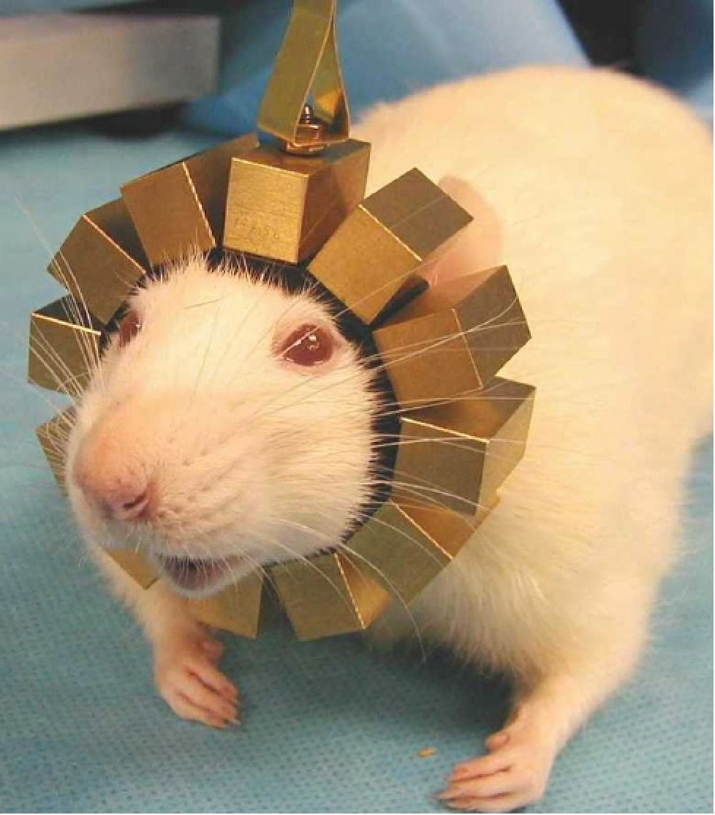
Etudes de plus en plus spécifiques sur modèles animaux
L’imagerie petit animal se fait généralement sous anesthésie
L’ anesthesie modifie les fonctions cervicales et biaise les études neuro-physiologiques
RATCAP, developé à BNL est un TEP miniaturisé et portable pour animal éveillé
12 blocs de 4x8 cristaux de LSO 2x2x5mm³ lus par des matrices de 4x8 APD et 0.18μm CMOS ASIC
  C. Woody et al. Several papers in conference records of NSS/MIC2004, Rome
Courtesy of C. Woody,BNL
Notes:
Going futher , some specific constraints require even higher level of miniaturization, as the imager must be portable

Slide 27
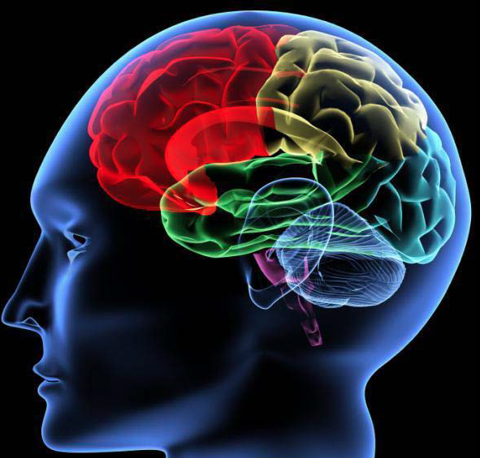
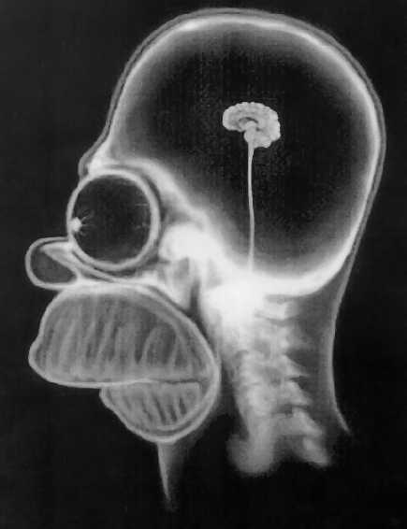
Brain Imaging

Slide 28
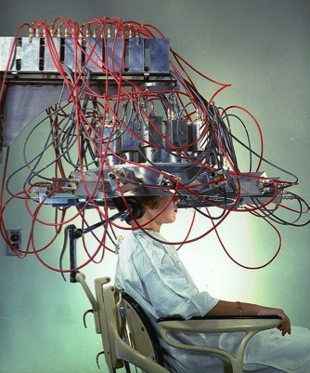
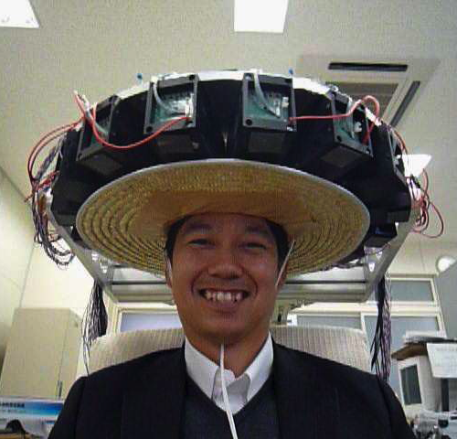
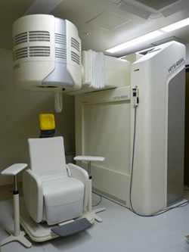
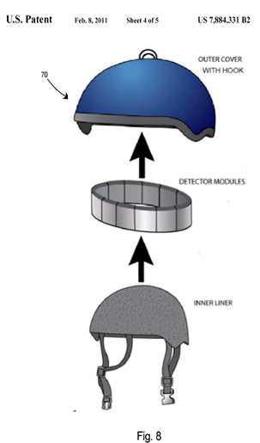
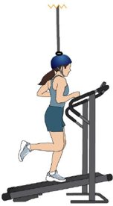

Brain Imaging
1961, Headshrinker, BNL
2011, PETHAT, Hamamatsu
Courtesy: S. Majewski, West Virginia University
2013, BrainPET, Hamamatsu
2008, RATCAP, BNL
2012, HELMETPET, Majewski
2015, HELMET_CHIN,T. Yamaga

Slide 29
Breast Cancer
5 mm
30 mm

Slide 30

ClearPEM-Sonic a collaborative project between physicians and physicists
Installed in Marseilles North hospital since December 2010
Reinstalled in San girardo hospital, Milano, in October 2013
ClearPEM: Metabolic information
Aixplorer: Morphologic and structural information
Objective: Detect 3mm tumors and define their cancerous status

Slide 31




Des technologies d’avant-garde:
ClearPEM
1 SuperModule =
6 matrices
FE Board
1 Module =
32 crystals
2x2x20mm
Front APD Matrix
Amplifiers
1 Plate 17,3x15,5x3cm =
16 SuperModules =
3072 crystals
Back APD Matrix

Slide 32
Des technologies d’avant-garde:
Ultrasons
Focus ultrasound beam in tissue
Propagate focal point a t supersonic speed in breast
Measure the deformation of the shock wave by a tumor
2 ms
12 ms
17 ms

Slide 33



Benefit of dedicated breast PET imaging
PET Whole Body (AC and Fused)
Tumor
Lymph Node
Coro
Sagital

Slide 34


PET/MRI complementarity
4 lesions identified on MR image
Only one suspicious lesion identified
on PET image
Subsequent biopsy and histology of all four lesions confirmed
that only the lesion seen on PET image was cancerous
Courtesy: Dr. José Ferrer, ERESA, Hospital General Universitario de Valencia, Spain

Slide 35





Other organ specific PET
ProsPET
GeminiTF ProsPET
State-of-the-Art results
Timing resolution < 250 ps
Energy resolution near 11.5@511keV
Spatial resolution 3 mm
CardioPET

Slide 36


Personalized medicine ➔
Organ-specific imaging devices
Whole body imaging device
Breast PET
IMAGING DEPARTMENT
Brain PET
- Whole body PET/CT
- Spatial resolution ~4 mm
- Sensitivity ~1%
- Cost ~$2 million +
Heart
Prostate
Colon
Liver
Pancreas
Lungs
Kidneys
Courtesy: D. Towsend, Singapore
Notes:
Today big industry is producing very nice multi-purpose whole body machines.
But with personalized medicine the trend will go to a series of organ-specific imaging devices, much less attractice, commercially for the big players in imaging ndustry. There are a number of niches for SMEs, and a number of opportunities for us for cutting edge instrumentation developpment.

Slide 37
Increasing effective PET sensitivity
PET is the imaging modality with the highest sensitivity, at the picomolar level
New medical challenges require a significant sensitivity increase
  Tracking small number of cells
    Stem cells biodistribution and differentiation studies
    Immune cells tracking for immonutheraty
  Precise pharmacodynamic studies
  Dose reduction and opening PET scans to new categories of patients (pregnant women, children, fœtus)

Slide 38

Improve solid angle coverage
The EXPLORER project
~40-fold increase for total-body imaging

Slide 39

Total Body PET cost issue

Slide 40



Time of Flight PET
Detector B
Δt = t_{A} – t_{B} = [(d+d₁) – (d-d₁)]/c
d₁ = c Δt/2
t_{B}
d
d₁
10ps TOF resolution
δx = 1.5mm
SNR_{TOF}/SNR_{CONV}= 16
Effective sensitivity gain
(SNR_{TOF}/SNR_{CONV})²/1.47 = 180
Patient
e⁺
e⁻
t_{A}
SNR_{TOF} = √(2D/cDt) · SNR_{conv}
Detector A
δt (ps)
δx (cm)
SNR*
10
100
200
500
0.151.5
3.0
7.5
16
5.2
3.6
2.3
Biograph Vision
State-of-the-art
* SNR gain for 40cm phantom
Notes:
But there is also a request for good timing resolution for another important application of scintillating crystals. PET scanners.
1.47 comes from the fact that the TOF kernel is more a gaussian than a box

Slide 41

The 10ps challenge:
  a spur on the development of fast timing
  an opportunity to get together
  an incentive to raise funding
  a way to shed light on nuclear instrumentation for medical imaging
One unique challenge launched for 5 to 10 years and operated by an international organisation with rules issued by the community based on the measurement of CTR combined to sensitivity
Several milestones and prices:
  3 years after the launch of the challenge: 1M€ expected for the Flash Gordon prices for the realisation of 3 important milestones
  until the end of the challenge: 1M€ expected for the Leonard McCoy price for the first team meeting successfully the specifications of the challenge
Officially endorsed by
EANM
European association of Nuclear Medicine
EIBIR
European Institute for Biomedical Imaging Research
WMIS
World Molecular Imaging Society
Crystal Clear collaboration
31 Institutions worldwide
+
a number of prestigious individuals
Following
an idea of
C. Morel in the Crystal Clear collaboration
Notes:
Since our first mention to a 10ps trget for TOFPET, scepticism about the associated technical challenges has gradually given way to an acceptance that the approach has great potential adn is technically feasible
In order to speed up the process, we have decided to launch a challenge, following an idea of C. Morel in the Crystal Clear Collaboration, with the objective the create incentives to federate and motivate a large community around this ambitious goal.
This challenge, which will be supported by a number of prices, is presently endorsed by …
The essence of a challenge is to think big and to gather the multidisciplinarity expertise for a real breakthrough
We have of course to assume the risk of an ambitious challenge
In my view the most important risk is to underestimate the physical barriers (ex. The Heisenberg uncertainty principle )
The two other risks that need to be considered are:
The technological risk:
can we find a technology or a combination of technologies that will provide a solution to the challenge
Answer: if there are no physical barrier, solutions will be developed, sooner or later
The cost:
Can be mitigated by the progress of the technologies and the importance of the impact

Slide 42


Image Better
> 15-fold improvement in SNR
  Reconstruct at higher spatial resolution
  Detect smaller lesions
  Detect low-grade disease
  Better statistics for kinetic modeling
Conventional PET
10ps TOFPET
Adapted from S. Cherry, UC Davis
Notes:
How to use the 40 x fold increase in SNR?

Slide 43

Image Longer
200-fold greater dynamic range
  can image for seven more half lives
¹¹C
  Up to 4 hours
¹⁸F
  Up to 20 hours
⁸⁹Zr
  Over 30 days
Conventional PET
time
10ps TOFPET
Adapted from S. Cherry, UC Davis
Notes:
Reveal kinetics inaccessible currently

Slide 44
Image Faster
10ps TOFPET
5 seconds/bed position
  Image in a single breathhold
  Reduce respiratory/cardiac/bolus motion
  Higher resolution
  Total-body kinetic imaging with high temporal resolution
Conventional PET
10-20 mins
10ps TOFPET
< 30s
Adapted from S. Cherry, UC Davis

Slide 45


Image Gently (Low Dose)
200-fold reduction in dose
  Whole-body PET at ~0.03 mSv
  Annual natural background is ~2.4 mSv
  Return flight (SFO-FRA) is ~0.11 mSv
  PET can be used with minimal risk – new populations
Conventional PET
10ps TOFPET
Adapted from S. Cherry, UC Davis

Slide 46
Image More Often
Conventional PET
10ps TOFPET
Adapted from S. Cherry, UC Davis
Notes:
Chronic disease
Follow disease trajectory

Slide 47

Radiopharmaceutical applications
⁶⁸Ga-PSMA + ¹¹¹In-PSMA for diagnosis and therapy of prostate cancer
⁶⁸Ga-DOTATATE and ¹⁷⁷Lu-DOTATATE for diagnosis and treatment of
neuroendocrine tumours
Notes:
What is theranotics? Using the same biologic vector to gransport an imaging contrast agent and a therapeutic molecule. In the case of cancer this therapeutic molecule can be a radioactive isotope to kill the cancerous cell.

Slide 48



CERN MEDICIS
α, β⁺
β⁺
Auger
β⁻
Notes:
Capitalizing on the ISOLDE infrastructure and CERN expertise in producing exotic atoms and radionuclides CERN and a few partners (ISREC, HUGE, HCUV) have decided to launch the CERN-MEDICIS project to produce new radioisopotes for theranostics.
ISREC: Institut Suisse pour la Recherche Experimentale sur le Cancer

Slide 49


Merci

Slide 50
Other advantages of 10ps TOFPET
TOF for direct 3D information
  Requires 10ps TOF resolution for 1.5mm resolution along LOR
Allows limited angle tomography without artifacts
Reduce the cost of radiotracer production infrastructures
Less sensitive to incorrect attenuation correction and normalization
  Less stringent requirements on CT: cost, dose reduction
  Reduce problems of not direct attenuation measurement in PET/MR
  M. Conti, Eur. J. Med. Mol. Imaging (2011) 38:1147-1157
More robust reconstruction in the presence of inconsistant data
  M. Conti, Phys. Med. Biol. 56 (2011) 155–168
Better quantification even at low statistics
  M. Conti, IEEE TRANSACTIONS ON NUCLEAR SCIENCE, VOL. 61, NO. 1, FEBRUARY 2014
Notes:
- 10ps resolution correspond to 1.5mm resolution along the LOR and opens the way to reconstructionless PET
- this would considerably reduce the constraints associated to the tomographic principle, which requires full angular coverage of the ROI, and allow limited angle tomography without artifacts
- 10ps resolution would bring a > 15 fold ...

Slide 51


Slide 52






Towards Molecular Imaging
ANATOMICAL IMAGING
FUNCTIONAL
IMAGING
MOLECULAR
IMAGING
Visual representation, characterization and quantification of biological processes at the cellular and sub cellular level within living organisms.
Gene expression (genomics, proteomics, transcriptomics, enzymatic activity, etc…)
Molecular signal transduction through cell membranes
Target specific cell receptors that are over-expressed in pathological situations (ex. neo-angiogenesis)
Multiple imaging capture techniques (Nuclear medicine/PET, MRI, MRS, Optical,…)
Haemodynamics
Vascular permeability
Tissue oxygenation/hypoxia
CNS activity
Metabolites
pH
Target-specific contrast agents
Functional receptor imaging
PharmacoKinetics
Morphology
Morphometry
STRUCTURE
MECHANISM
TARGET
MACROSCOPIC
MICROSCOPIC
Notes:
Molecular imaging allows to visualize the molecular processes of the human beings biology.
Like production of proteins by the genes
Molecular signal transduction through cell menbranes
And molecular pathways from the genes to the diseases

Slide 53
Des défis similaires pour l’imagerie
TEP et les détecteurs de physique
Cahier des charges pour la physique
Cristaux
  Densité élevée (> 6 g/cm³)
  Emission rapide (< 100 ns), spectre visible
  Emission lumineuse modérée à élevée
  Excellente résistance aux radiations
Photodetecteurs
  Compact
  Grande efficacité quantique et gain élevé
  Grande stabilité
Electronique de lecture
  Mise en forme rapide du signal, faible bruit
  Fortement intégrée
Architecture d’acquisition DAQ
  Intégrée et parallèle, temps mort réduit
Logiciels
  Simulation précise par Monte Carlo
Integration
  Sytèmes compacts avec un très grand nombre de canaux ( > 10’000)
Cahier des charges pour l’imagerie médicale
Cristaux
  Densité élevée (> 7 g/cm³)
  Emissionrapide (< 100 ns), spectre visible
  Emission lumineuse élevée
  Résistance modérée aux radiations
Photodetecteurs
  Compact
  Grande efficacité quantique et gain élevé
  Grande stabilité
Electronique de lecture
  Mise en forme rapide du signal, faible bruit
  Fortement intégrée
Architecture d’acquisition DAQ
  Intégrée et parallèle, temps mort réduit
Logiciels
  Simulation précise par Monte Carlo
Integration
  Sytèmes compacts avec un très grand nombre de canaux( > 10’000)
Transfert technologique
Transfert technologique
Transfert technologique
Transfert technologique
Transfert technologique
Transfert technologique

Slide 54

Molecular Imaging in Medicine & Biology
Molecular Imaging to answer challenge of modern biology
  Access real time genomics through in vivo imaging of molecular process
  Detect early transformations in a cell, which may lead to pathology (precancerous activity)
  Early detection, prognosis, treatment selection, response to therapy
  Identify molecular pathways from gene to disease (genomics, proteomics)
    Novel molecular targets
    Specific genetic pathways
    Signal transduction
    Cell cycle alteration
    Angiogenesis
    Apoptosis
Requires specific effort on imaging instrumentation
Sensitivity, Spatial and Temporal resolution
Requires targeting the cellular activity
with specific contrast agents
Notes:
Before Parkinson becomes symptomatic, the substentia nigra has lost up to 70% of its dopamine receptors .

Slide 55

Molecular processes targeted by radiopharmaceuticals
Notes:
Targeting specific cell menbrane receptors allows visualization and quantification of activity of quantity of molecular pathways such as:
Cell energetic consumption
Protein synthesis,
hormonal regulation
Cell profiferation
Cell communication with the extracellular matrix

Slide 56


Increasing effective PET sensitivity
Improve detector efficiency
Increase solid angle coverage
EXPLORER project UCDavis
Improve timing resolution
10ps TOFPET challenge
Adapted from S. Cherry, UC Davis

Slide 57



Improve detector efficiency
Higher stopping power materials
Improved packing fraction
Better handling of Compton scatter
Gain of ~1.4 to 2 fold achievable
Adapted from S. Cherry, UC Davis

Slide 58

The Future of EXPLORER
  Higher stopping power materials
  Improved packing fraction
  Better handling of Compton events
2m long scanner
100ps CTR
Effective
Sensitivity
Gain
40
X 5
X 2
= ~400

Slide 59


Sensitivity gain via Timing Resolution
Improve timing resolution
  Gain proportional to 1/Δt
  TOFPET with 10ps timing resolution would result in a ~200 fold sensitivity gain /non TOFPET
  ~20 fold sensitivity gain /Biograph Vision
Adapted from S. Cherry, UC Davis

