Slide 1
Analysis on coil 128
Nicholas Lusa, Susana Izquierdo Bermudez, Jose Ferradas Troitino, Attilio Milanese, Stephane Triquet, Beatriz Arias Alonso, Sebastien Luzieux and all MQXFB team
Acknowledgements: Ezio Todesco, Arnaud Devred
CERN: November, 2022

Slide 2
References
[1] 09/03/2022: Coil 108 limitation and possible root causes https://indico.cern.ch/event/1134061/
[2] 22/03/2022: Coil WG mtg re bananas https://indico.fnal.gov/event/53838/
[3] 24/03/2022:Analysis of coil 126 and plans for coil 127 https://indico.cern.ch/event/1142504/
[4] 13/05/2022: Inspection results coil 108, 1 m of coil
https://indico.cern.ch/event/1160197/
[5] 15/06/2022: Analysis of coil 126 and 127
https://indico.cern.ch/event/1170568/
[6] 15/08/2022: Thermomechanical FE analysis coil heat treatment
https://indico.cern.ch/event/1191448/
[7] 06/10/2022: Coil fabrication status, new observables + actions in coil 128 https://indico.cern.ch/event/1218534/

Slide 3
Outline
New features of coil CR128
Observables before reaction
Observables after reaction
Next steps

Slide 4
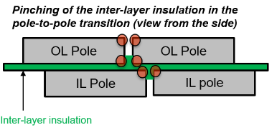
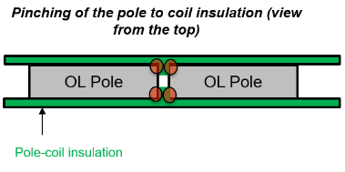
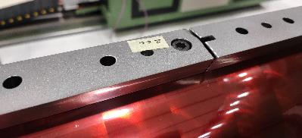
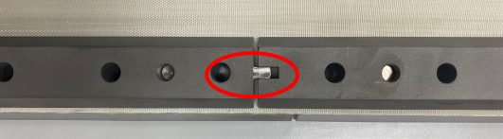
Input for coil 128
Purpose: acting in the azimuthal direction to reduce the friction during HT
Winding of the coil done keeping the modifications of coil CR127
  Slight rounding the edges of pole-to-pole transition to reduce the insulation pinching effect
  Increase of the initial pole-to-pole gap 0.9 mm → 1.5 mm (wedge gap is increased accordingly)
  Remove the alignement feature for IL poles
  Decrease the winding tension in the OL (19 kg → 14 kg) to have the same " Tension*Nturns" in the IL and OL

Slide 5
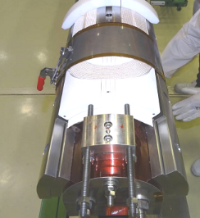
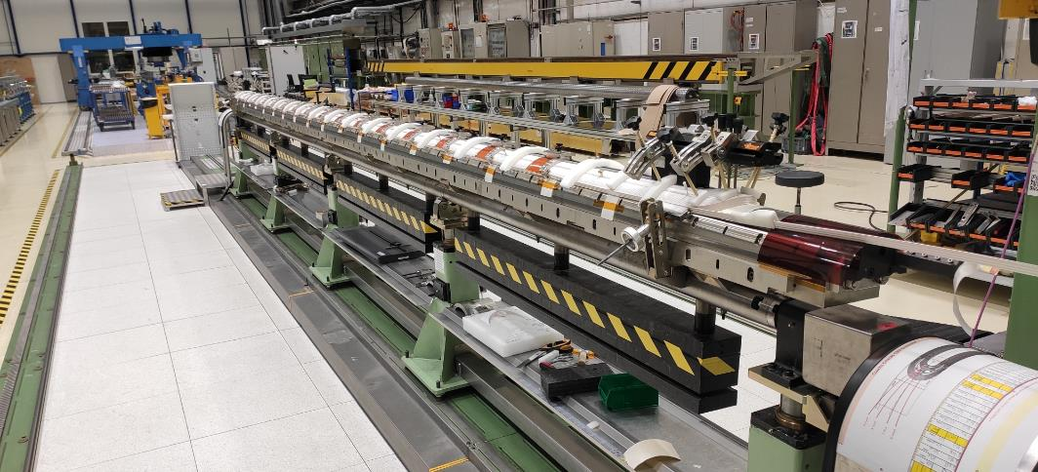
Input for coil 128
Curing:
    Remove the saddle stopper during curing cycle to not
    longitudinally constrain the coil (as for CR127)
Major changes applied:
    Compress more the midplane of each layer by adding 1mm shim along the length tapered towards the extremities to 0.20mm (between straight and curved pushers)

Slide 6
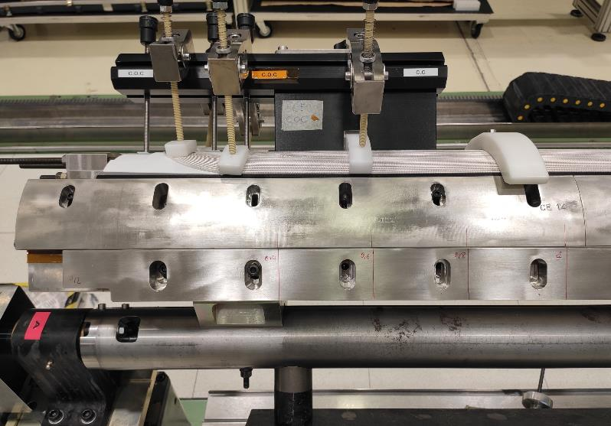
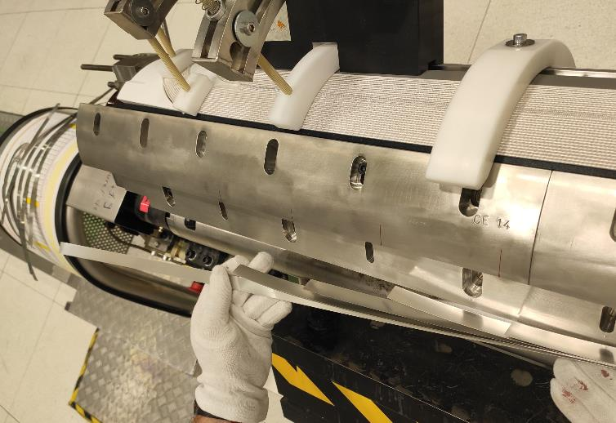
Input for coil 128

Slide 7
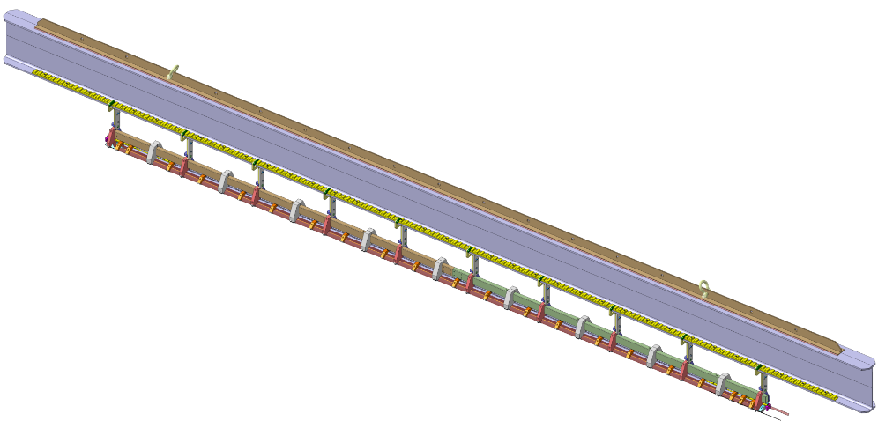
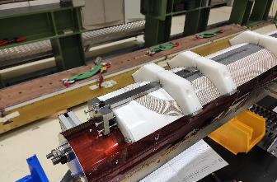
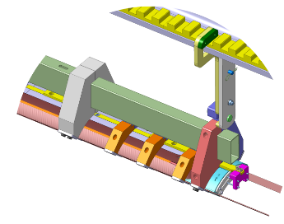
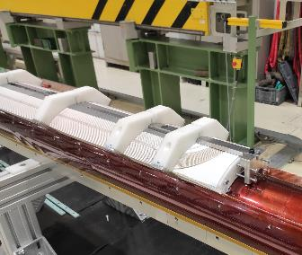
Input for coil 128
Major changes applied:
    Removal of the ceramic binder on the OL → dry curing to give the same azimuthal compression to the coil (as done on non-conformed coil CR120)
Handling of the coil from the winding mandrel to the reaction fixture more difficult:
Number of supports increased
Design of the support changed
Handling procedure updated

Slide 8
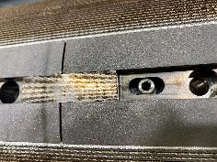
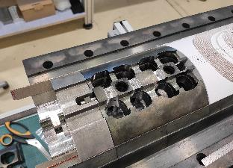
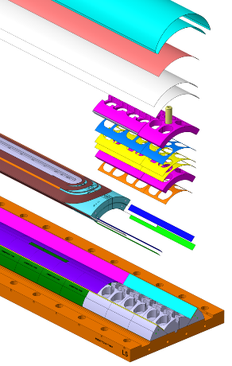
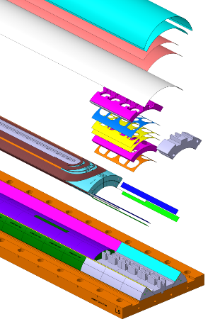
Input for coil 128
Preparation for reaction:
  Aligning plates material: stainless steel or titanium?
    In coil CR127 those plates got stuck after HT due to width increase
  During heat treatment, the coil will have space to move in both ends (already done in coil CR127)
  Sequence to close and open the fixture as for coil CR127
  For the opening post RHT, unbolting of M6 screws prior to M20 bolts
  Decrease the radial insulation in the reaction fixture
  by 0.125mm (consistent with the impregnation fixture)
Previous
configuration:
New
configuration:
Material | Thickness [mm]
S2 glass | 2 x 0.250
Mica | 0.200
Total thickness: 0.700 mm
Material | Thickness [mm]
S2 glass | 0.250
Mica | 0.200 + 0.125
Total thickness: 0.575 mm

Slide 9
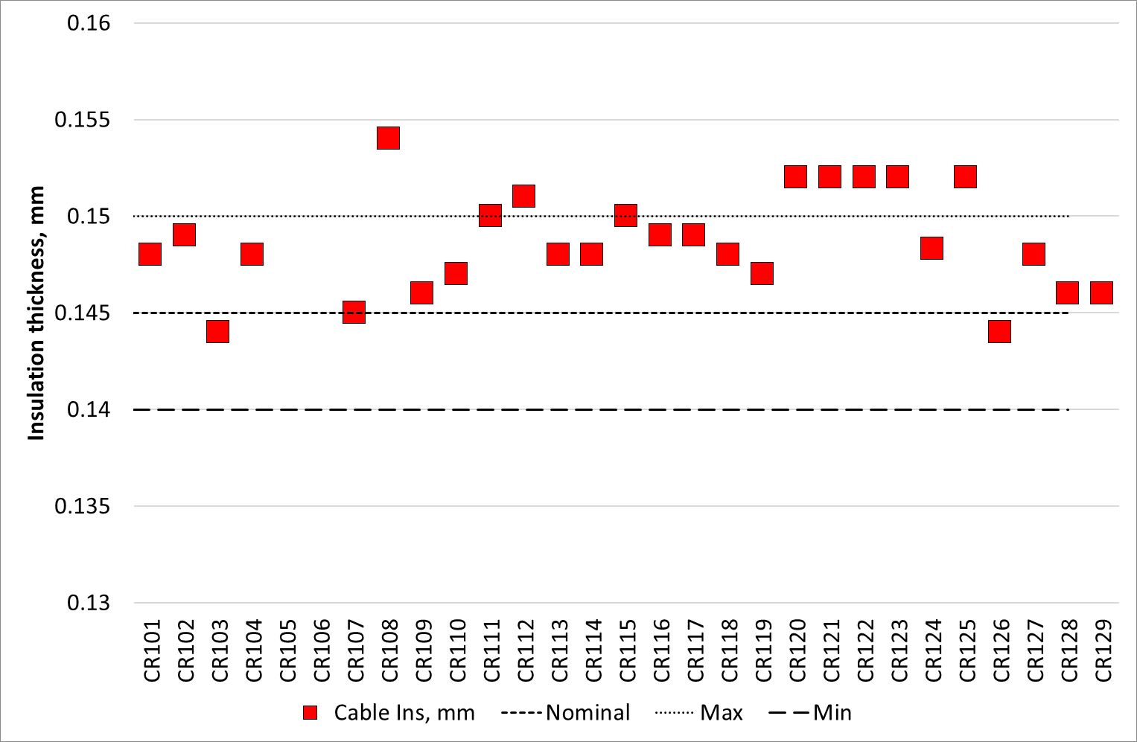
Input for coil 128
Pick a UL with an insulation thickness as close as posible to the nominal target
x
x
x
x

Slide 10
Outline
New features of coil CR128
Observables before reaction
  Curing
  Closure of the reaction fixture
Observables after reaction
Next steps

Slide 11
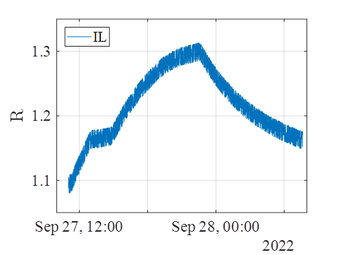
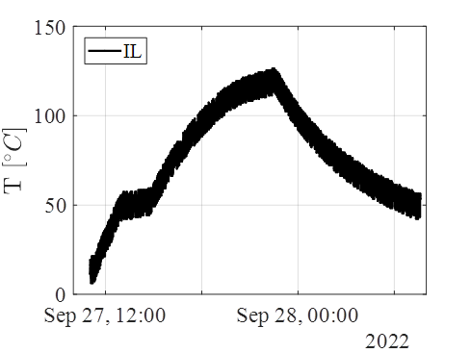
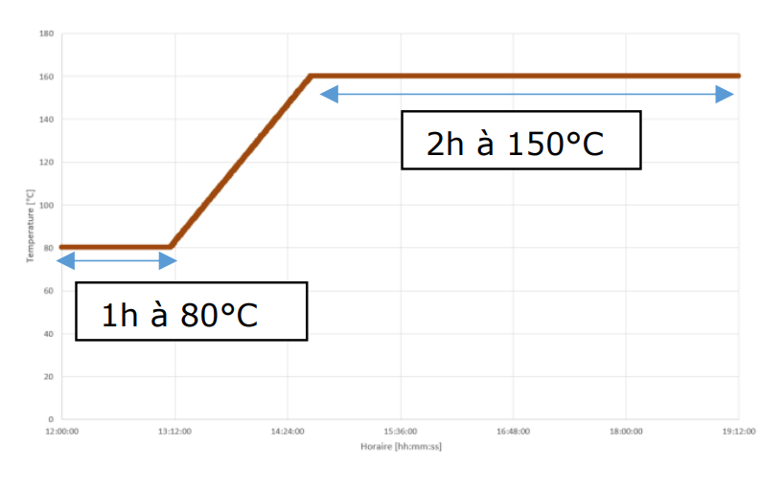
Curing
The curing in a 1 mm/side smaller cavity was smooth. Pressure to close the curing fixture as in previous coils (40 bars, but now we need not only the auxiliary pistons but also the main pistons)
Visual inspection after curing OK and electrical tests ok. For first time we measure the coil resistance during curing, to have an indirect measurement of the coil temperature
  We are below the recommended temperature by CTD, but the binder ‘holds’ the conductor, so we think is ok to stay as it is EDMS 1556624
NIST material properties: copper resistivity at RT: 1.6845e-8 Ohm*m.
Computed coil resistance at RT = 1.1074 Ohm
Measured = 1.09 – 1.10 Ohm
Error: ~ 2%

Slide 12
Closing of the RHT fixture
We needed slightly larger torque to close the fixture
As in previous coil, there is not signature of a ‘fatter coil’ before reaction
Torque applied to close the fixtures, Nm
 | CR005 (Cu) | CR126 | CR127 | CR128
Required to close the reaction fixture |  | 100 | 85 | 110
Final torque applied to the reaction fixture |  | 160 | 150 | 150

Slide 13
Outline
New features of coil CR128
Observables before reaction
Observables after reaction
  Tooling bow
  Pole displacements during unbolting
  Coil longitudinal elongation during unbolting
  Pole gaps
  Hump
Next steps

Slide 14
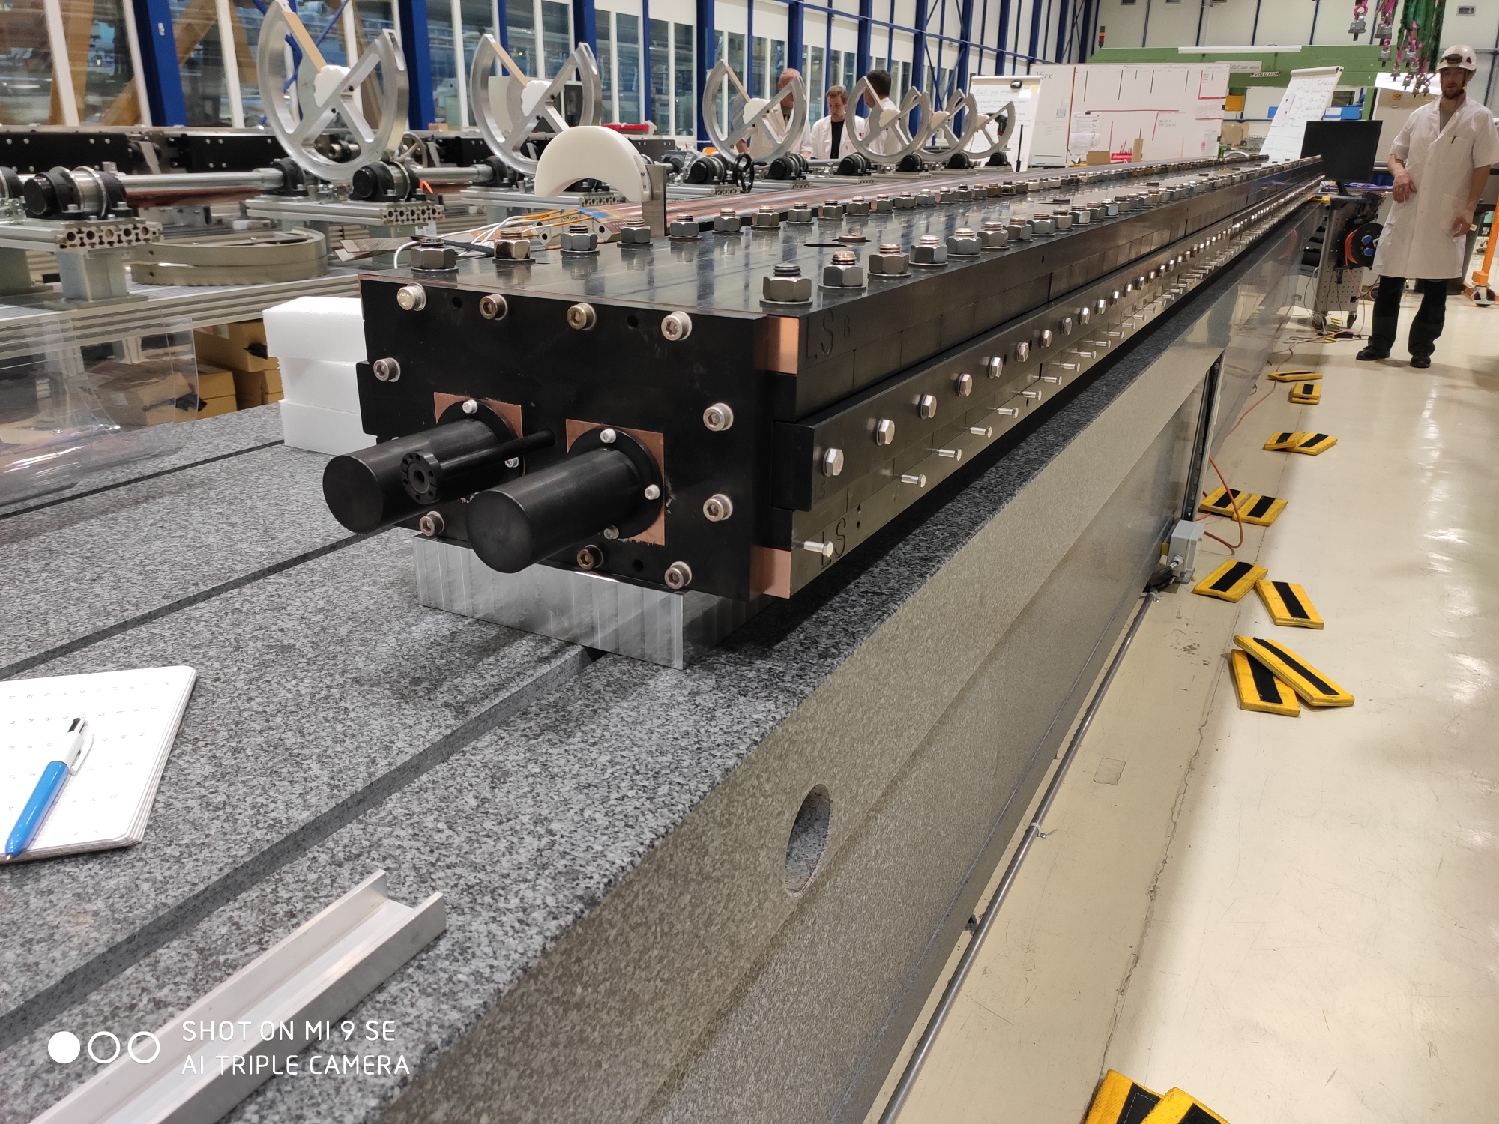
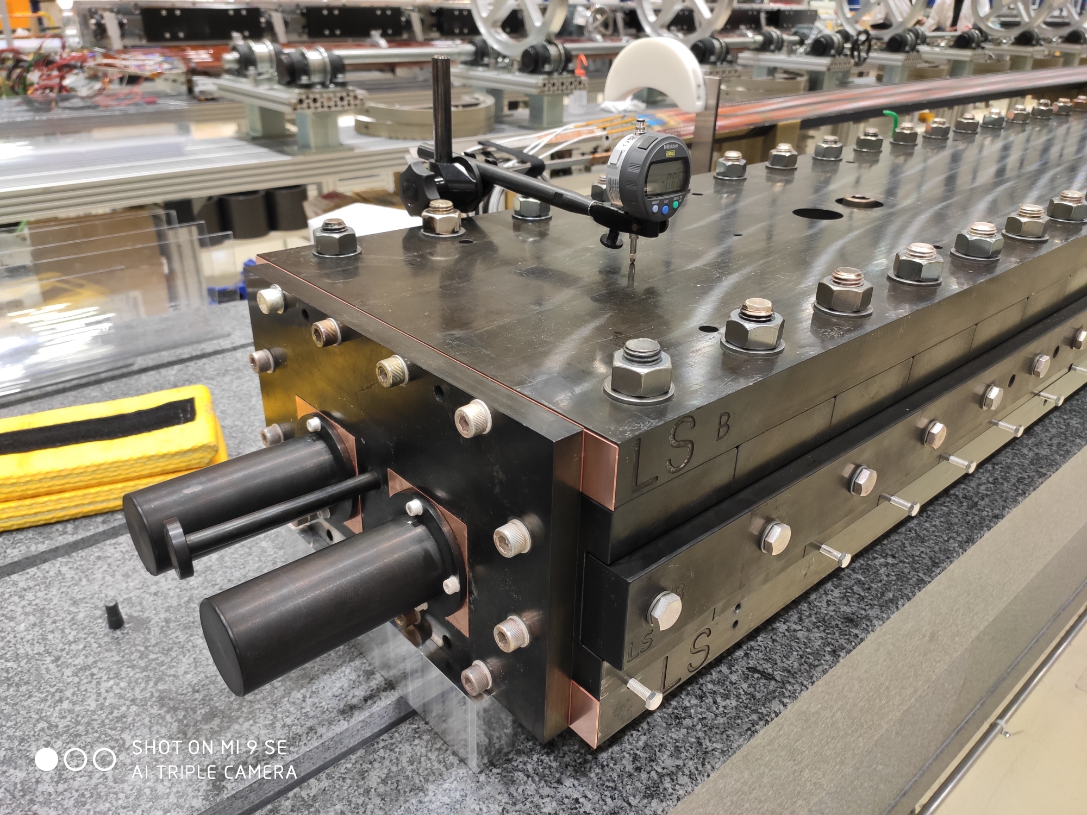
Tooling bow
For the first time, the shape of the tooling along the length was measured
Tooling is lift in the coil ends, around 3 mm in the NCS, 1.5 mm in the CS.
After unbolting the M20, the tooling gets straight
Plot from Nicholas on how it moves

Slide 15
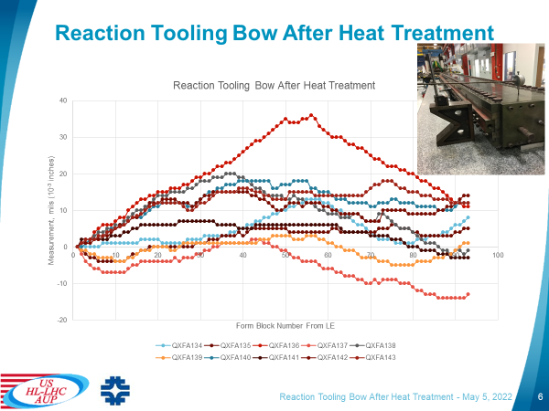
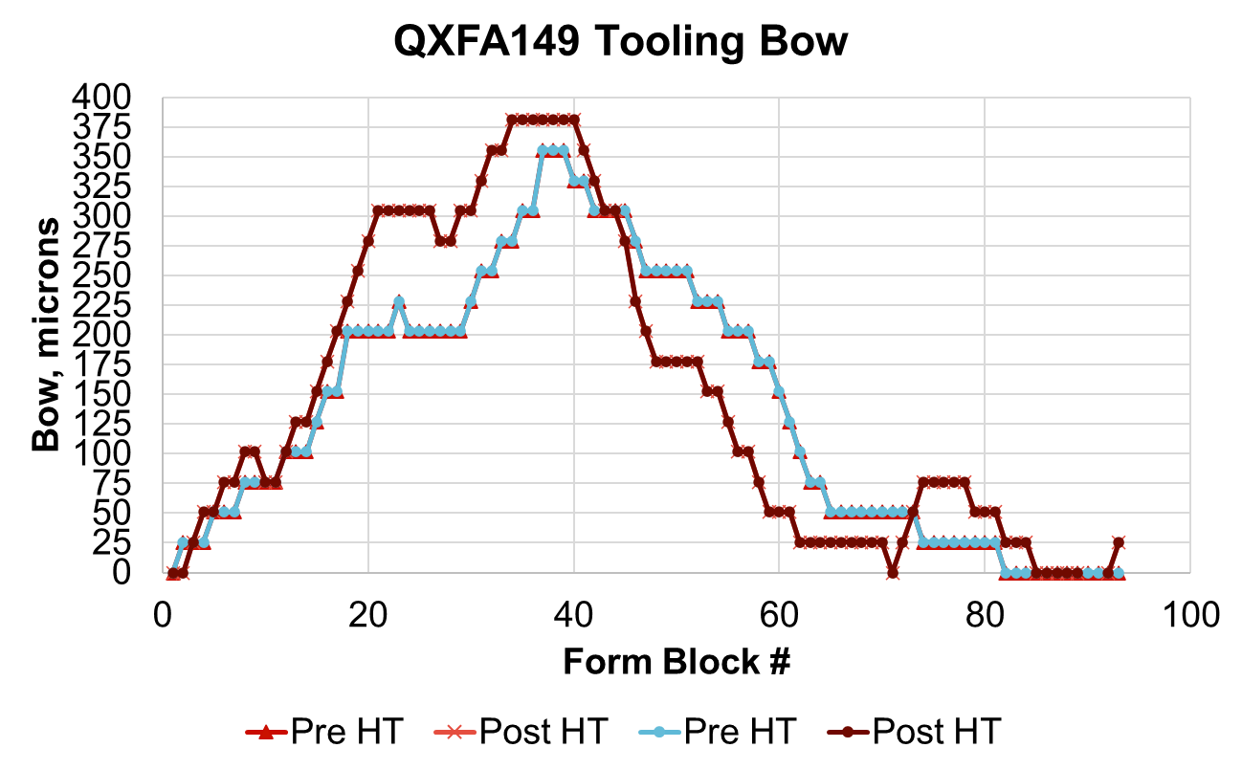
Tooling bow: FNAL
https://indico.fnal.gov/event/54388/
FNAL measures the shape of the top plate of the reaction fixture after reaction:
  In general, less than 0.5 mm. Measurements on one of the last coils (QXFA149) before/after reaction show that the bow is not due to the heat treatment, but the assembly tolerances/set up
  In one case, 0.9 mm (source cause for the outlier not identified.
See additional slides for the full set of available data
Tooling bow in QXFA149 before/after heat treatment
0.9 mm

Slide 16
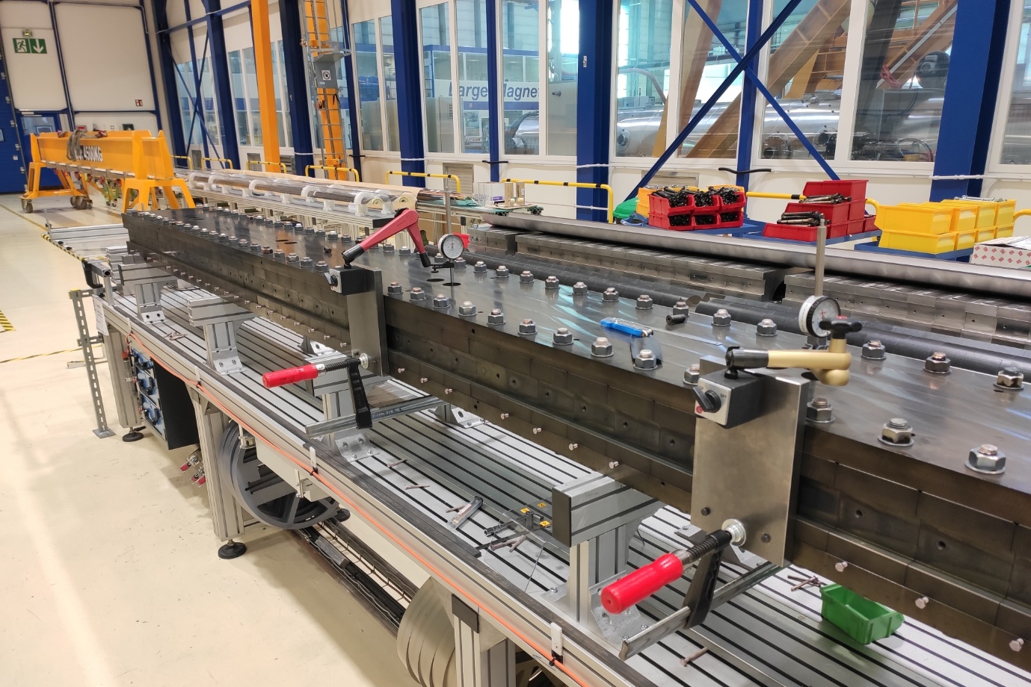
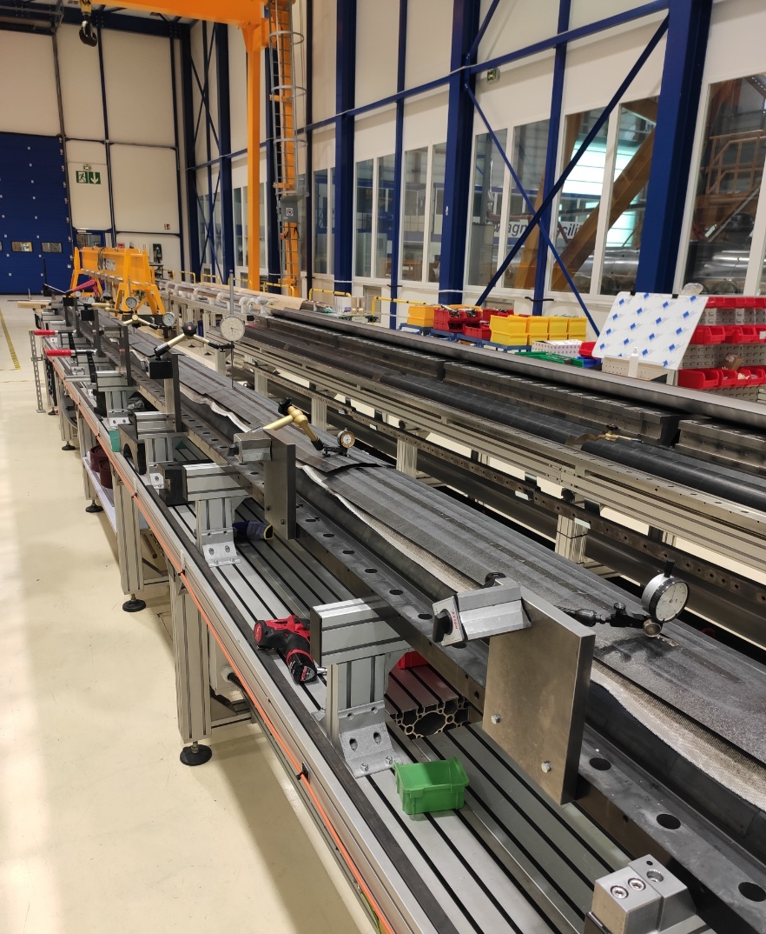
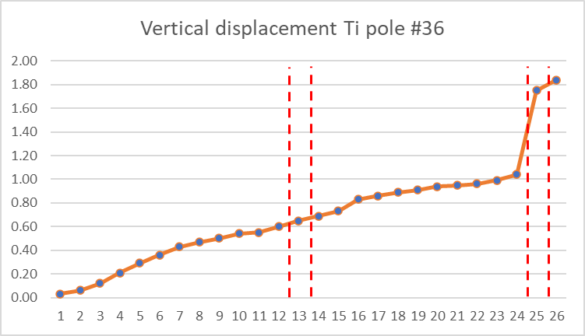
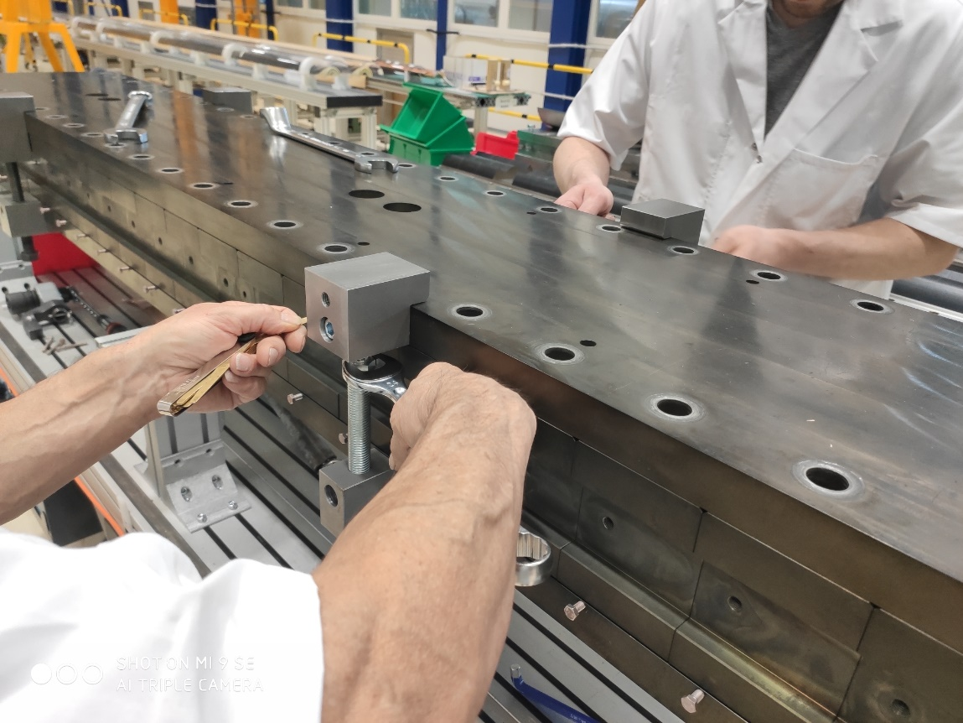
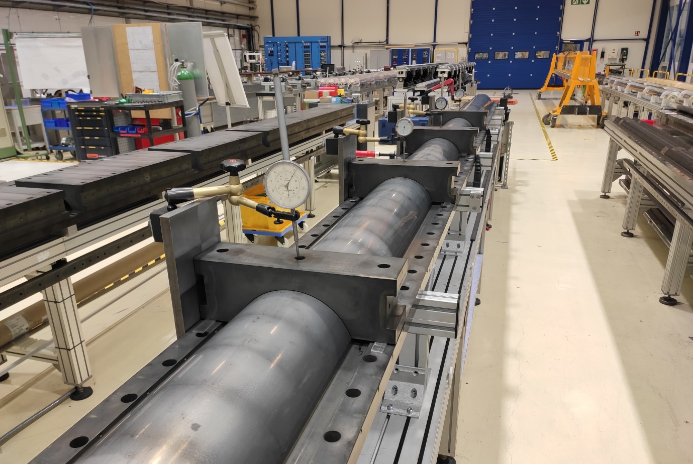
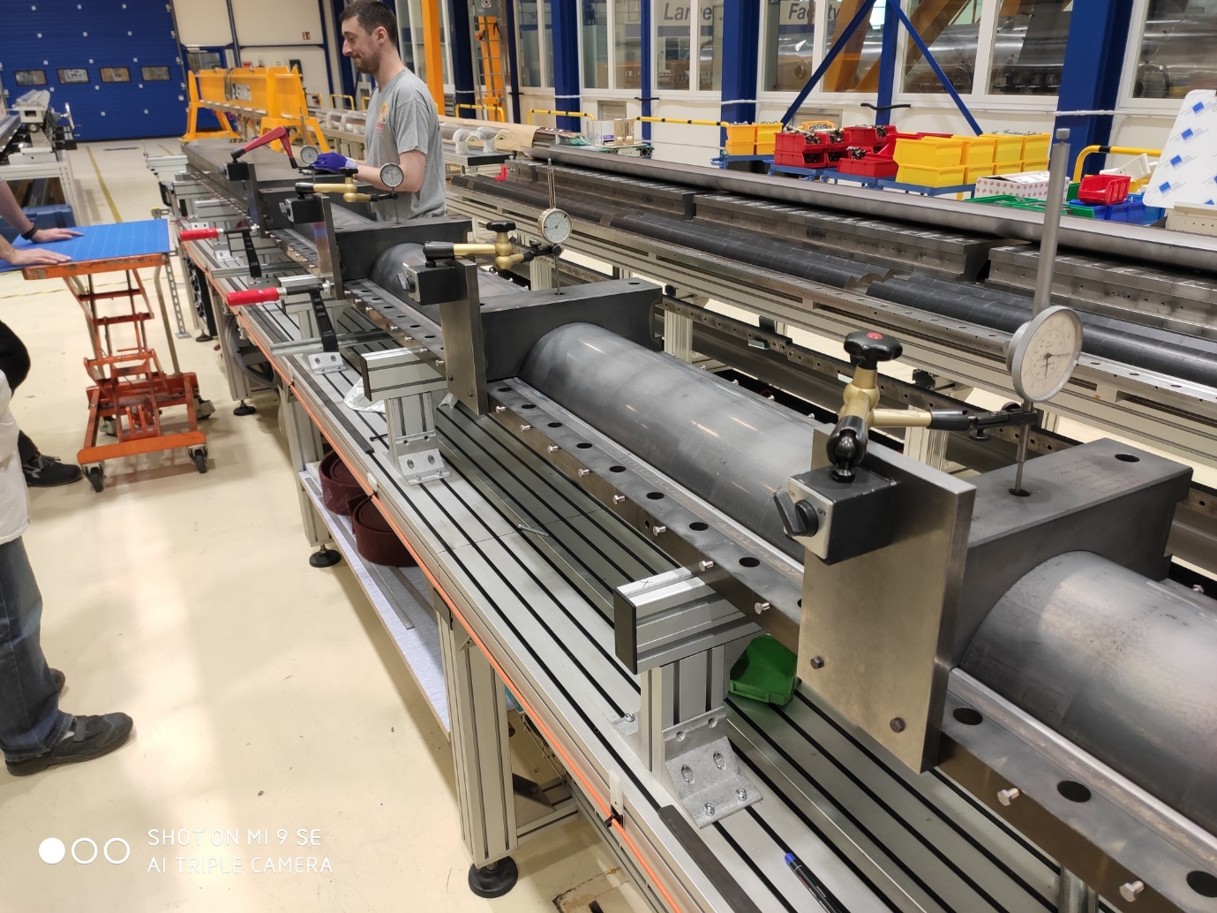
Unbolting procedure before coil 128
Nicholas Lusa
Unbolting the M20
Gradual lifting of the pole, starting 2 blocks before the unbolting of the concerned block. The vertical displacement stabilizes after unbolting 6-7 blocks
Unbolting the M20
Lifting of the blocks
Coil in free state
The pole moved by 0.1 mm in 4-5 hours; 0.1 mm more 24 hours later
#28
#20
#4
Vertical deflection, mm
#32
#36
#38
#23
#12
#34
#30
#40
Lifting the top plate
0.05 mm vertical displacement when the top plate is lifted
Lifting of the blocks
Gradual lifting of the pole, the 4 blocks before and after the concerned block have an impact on the vertical displacement
Unbolting the M6 (liner & filler)
Gradual lifting of the pole, starting 2 blocks before the unbolting of the concerned block. The vertical displacement stabilizes after unbolting 6-7 blocks

Slide 17
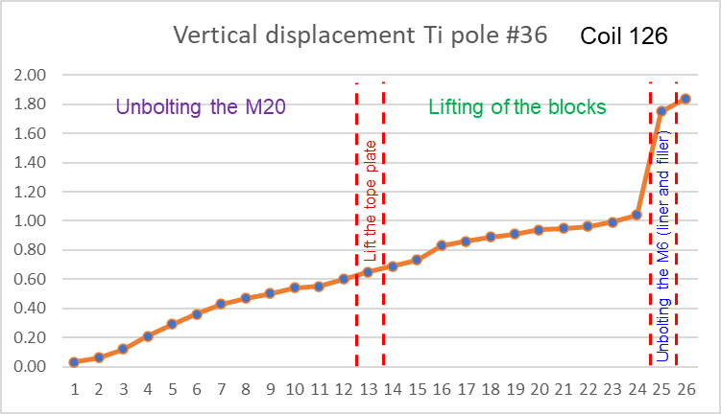
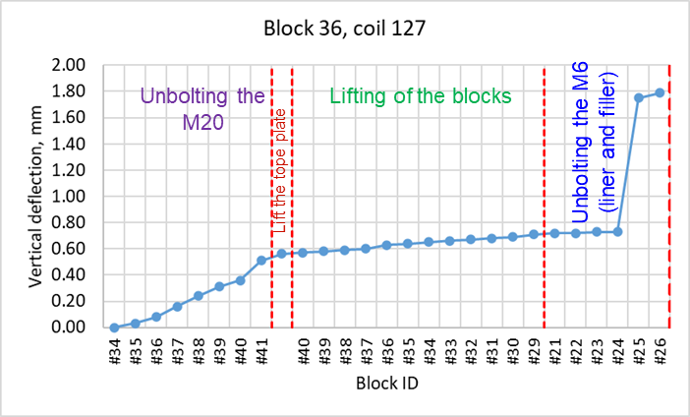
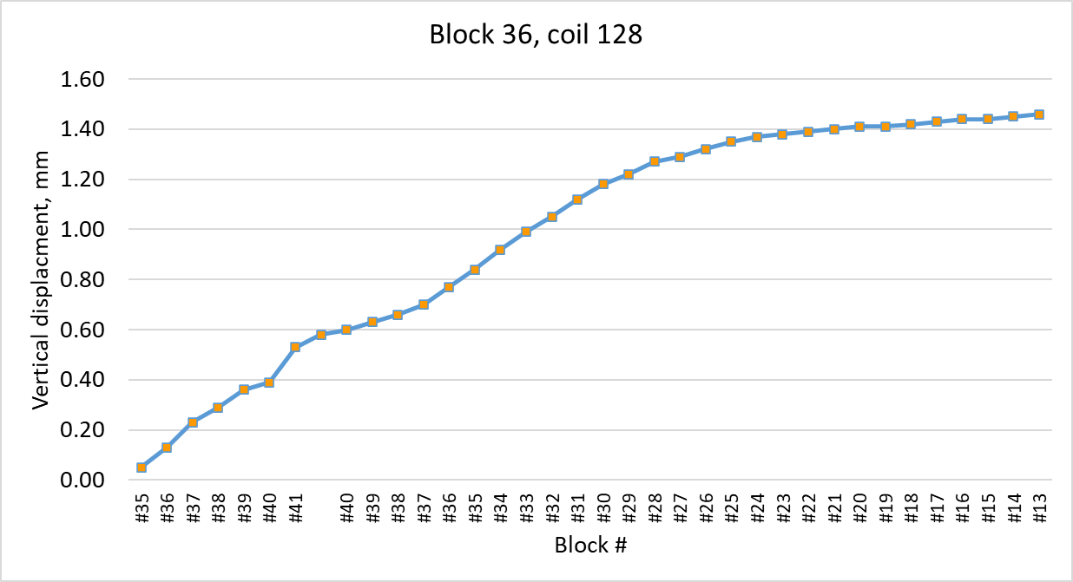
Coil 128 – displacements during unbolting
Total vertical displacement comparable to previous cases, but now there is not a sudden change when un-bolting the M6 side screws
We observe an inconsistency between the measurements during the opening (total vertical displacement 1.4 mm) and the final coil hump in that location (0.8 mm). We are trying to understand the origin.
Unbolting the M20
Lifting of the blocks
Lift the tope plate
Unbolting the M6 (liner and filler)

Slide 18
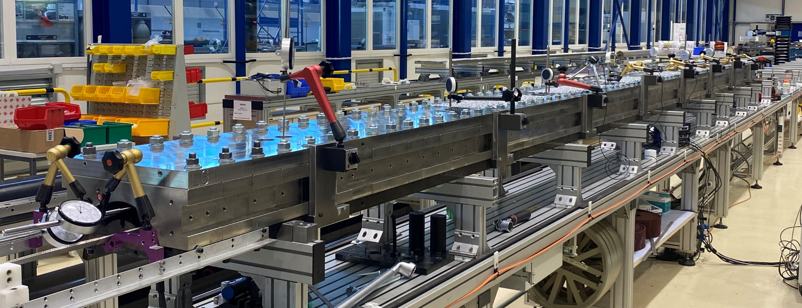
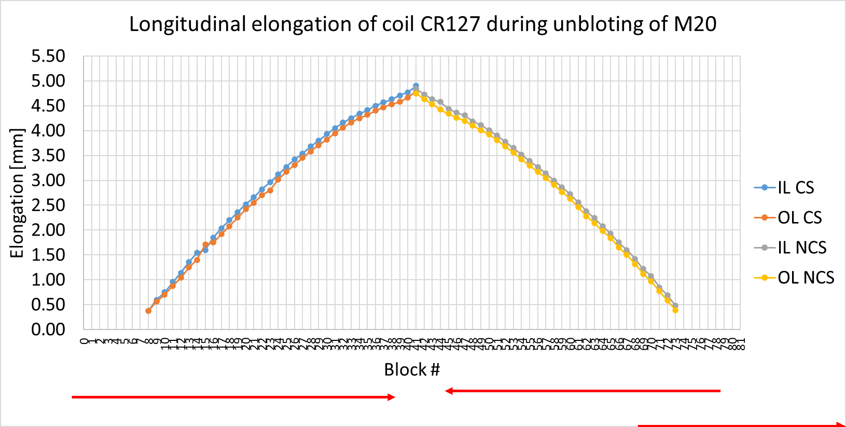
Coil elongation during the opening
Coil 127:
  For first time, we measured the displacement of the coil ends while we are opening
  The coil gradually move outwards by about 5 mm per side when we open the fixture. Most of the movement was during the unbolting of the M20 bolts.
  The overall length of the coil after heat treatment once the coil is in free stage is ≈ 10 mm shorter than before heat treatment (accurate measurements to be done).
    Before opening the fixture, the coil was ≈ 20 mm shorter than before heat treatment
Longitudinal elongation of coil CR127 during opening of the reaction fixture, mm
 | Unbolting M20 | Removal top plate | Removal formblocks | Unscrewing M6 | Day after
IL CS | 4.90 | 5.02 | 5.09 | 5.24 | 5.31
OL CS | 4.80 | 4.90 | 5.02 | 5.22 | 5.28
IL NCS | 4.84 | 4.96 | 5.39 | 5.54 | 5.58
OL NCS | 4.75 | 4.86 | 5.23 | 5.38 | 5.43
Coil 128: similar behavior, slightly smaller amplitude (4.19 mm CS/4.08mm NCS; total 8.27 mm)

Slide 19
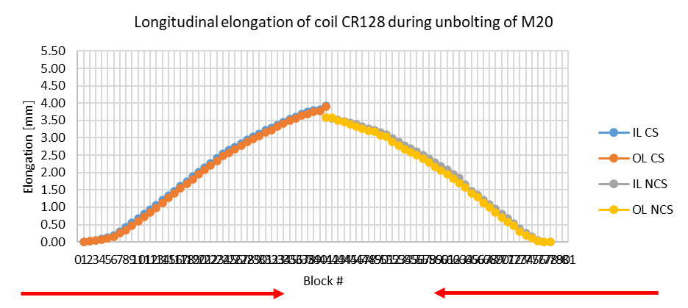
Summary on coil elongation during the opening of the RHT
AUP sees a similar elongation of their coils during the opening of the RHT
BNL coils elongate in both ends, as CERN coils, since the fixture is open form the middle to the ends
FNAL coils are open from the CS, so most of the movement happen in that end of the coils
 | CS | NCS | Total | Total/L_{m} (%)
CR127 | 5.30 | 5.51 | 10.8 | 0.15
CR128 | 4.16 | 4.08 | 8.24 | 0.11
AUP146 | 2.95 | 0.6 | 3.55 | 0.08
AUP147 | 3.56 | 0.39 | 3.95 | 0.09
AUP237 | ≈ 1.55 | ≈ 1.55 | 3.1 | 0.07
AUP238 | ≈ 2.05 | ≈ 2.05 | 4.1 | 0.10

Slide 20
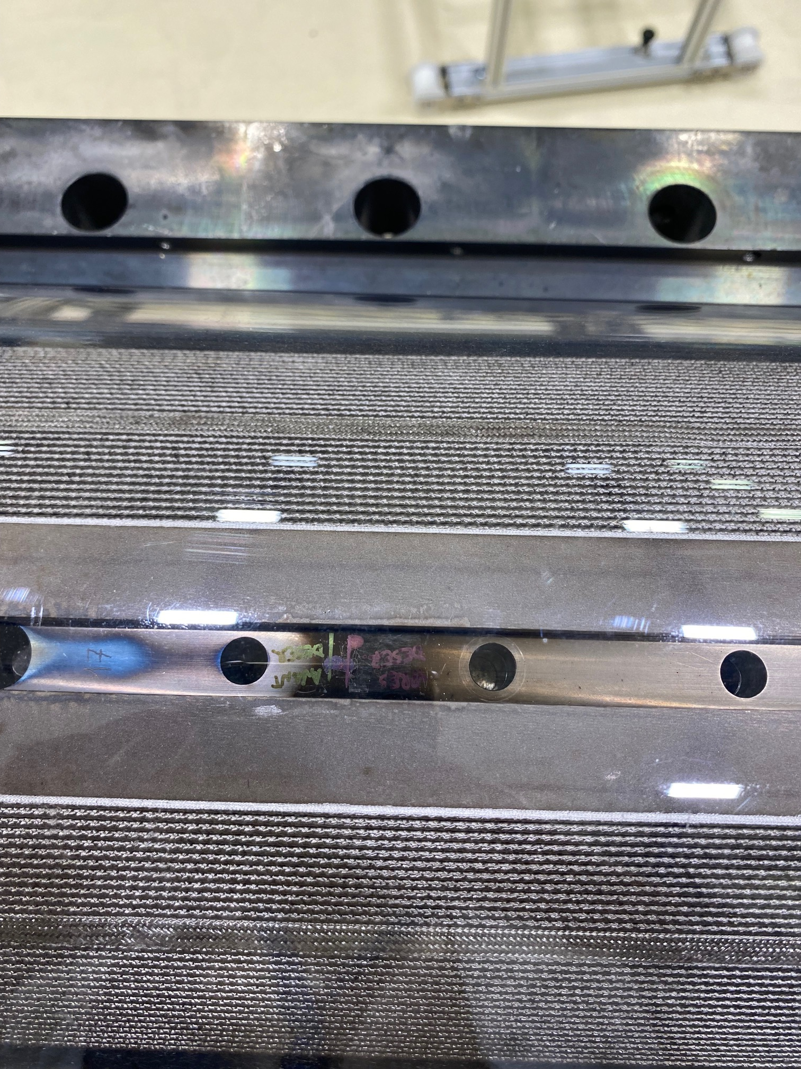
Coil elongation
In coil 128, we monitor also the longitudinal movement of the pole before/after opening the fixture
We can now confirm that the extra coil length is coming from a movement in the poles
The coil got 8 mm longer, we have 14.5 mm gap left, so it seems we had enough gap, and the poles were never closed.

Slide 21
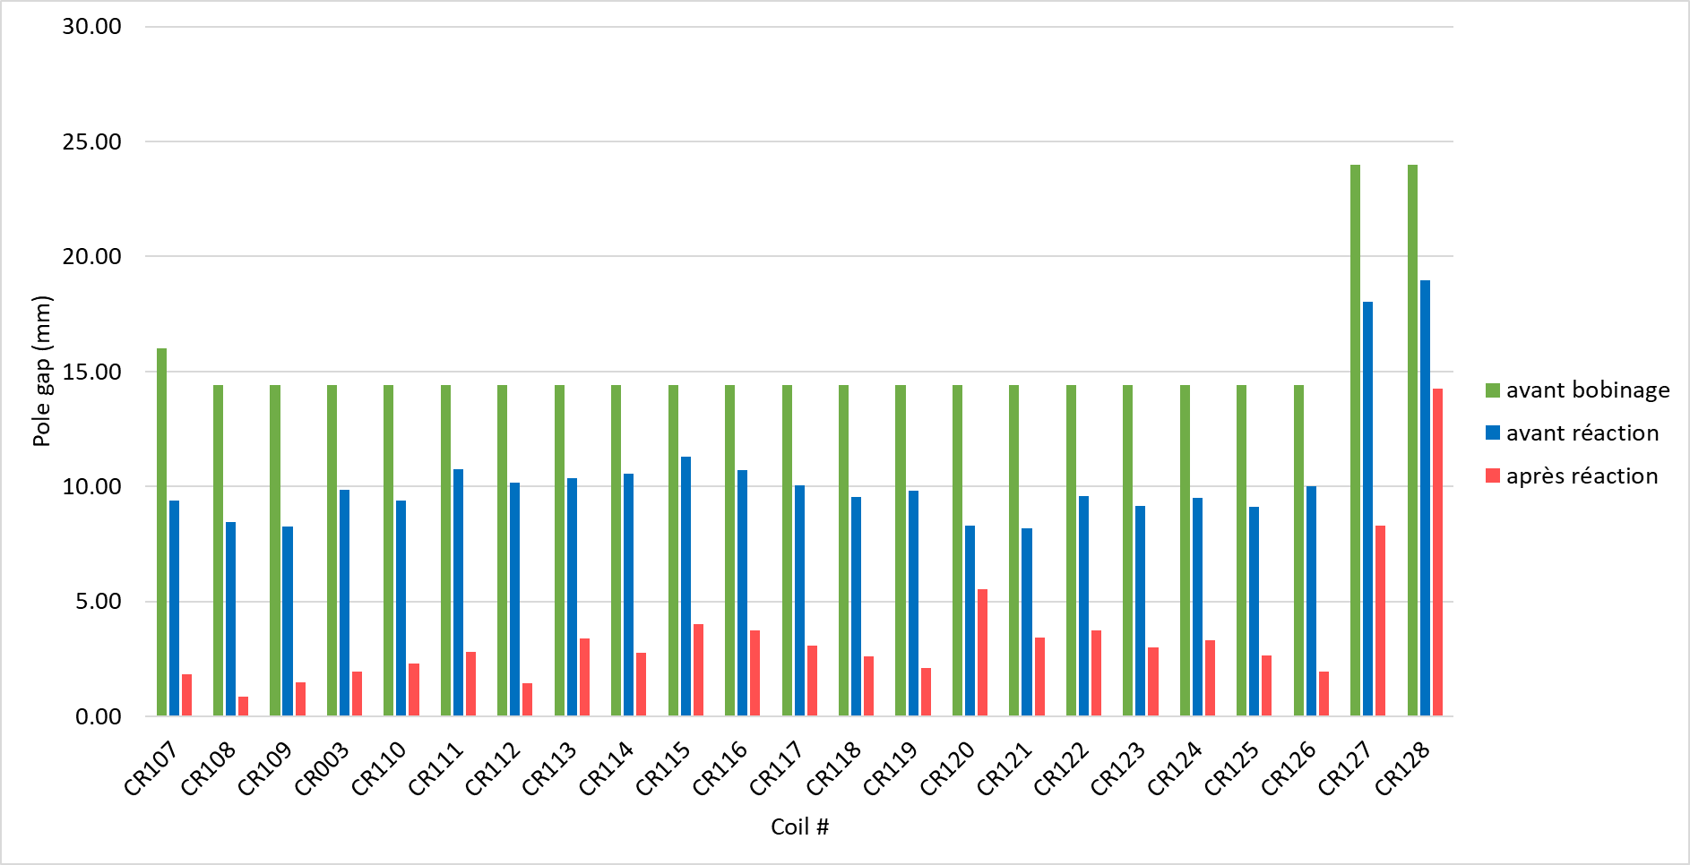
Pole gaps
Coils 108-126 |  | Original | Before reaction | After reaction
Total gap, mm | MQXFA | 12.70 | 6.84 | 2.06
 | MQXFB | 14.40 | 9.62 | 2.81
Gap mm/m | MQXFA | 3.02 | 1.63 | 0.49
 | MQXFB | 2.01 | 1.35 | 0.39
Pole gap design target is to have open after heat treatment.
In average, the pole gap closure due to the release of the winding tension is 0.67 mm/m and 0.95 mm/m due to the heat treatment
Comparing to AUP, we have similar relaxation due to the heat treatment, and about half the relaxation after winding
  At CERN we wind with lower winding tension (19 kg in the straight section, 7 kg in the coil ends)
Coils 108-126
 |  | Release of the winding tension | Reaction
Gap mm/m | MQXFA | 1.39 | 1.14
 | MQXFB | 0.67 | 0.95

Slide 22
Pole gaps
Gaps are still slightly open after reaction. But we also noticed some pinching of the inter-layer insulation and the pole to coil insulation
  → is the coil willing to move more in the longitudinal direction?
Pinching of the inter-layer insulation in the pole-to-pole transition (view from the side)
Average +- sigma for all RRP coils
OL Pole
OL Pole
IL Pole
IL pole
Inter-layer insulation
Pinching of the pole to coil insulation (view from the top)
OL Pole
OL Pole
Pole-coil insulation

Slide 23
Pole gap after reaction
AUP coils seem to have more ‘open gaps’ in the middle

Slide 24
Pole gap after reaction
AUP coils seem to have more ‘open gaps’ in the middle
Their data can be used to set what is a ‘safe’ gap after reaction: Up to 1.2-1.5 mm is ‘safe’ (coil 128 tested in A08, 142 still not assembled); 0.2-0.8 is ‘normal’

Slide 25
Pole gap delta during heat treatment
From the coil elongation measurements, it seems that the coil had enough gaps: got 8 mm longer, the remaining gap is 14.25 → extra gap 14.25-8 = 6.25 mm
Based on our previous experience, the change on pole gap during heat treatment of coil with no-binder is smaller. In coil 120 the delta_pole = -2.75 mm, in the rest of the Nb3Sn coils was -8.7 mm to -4.75 mm (I don’t take coil 127, since it was slightly different process). If we include this info, instead of an extra gap of 6.5 mm, we have an extra gap of:
  6.5 mm – (8.7 mm-2.75 mm) = 0.55 mm (i.e, initial gap 1.46 mm/pole instead of 1.5 mm per pole)
  6.5 mm – (8.7 mm-4.75 mm) = 2.55 mm (i.e, initial gap 1.34 mm/pole instead of 1.5 mm per pole)
Coil 129: keep the same gap of 1.5 mm per pole transition

Slide 26
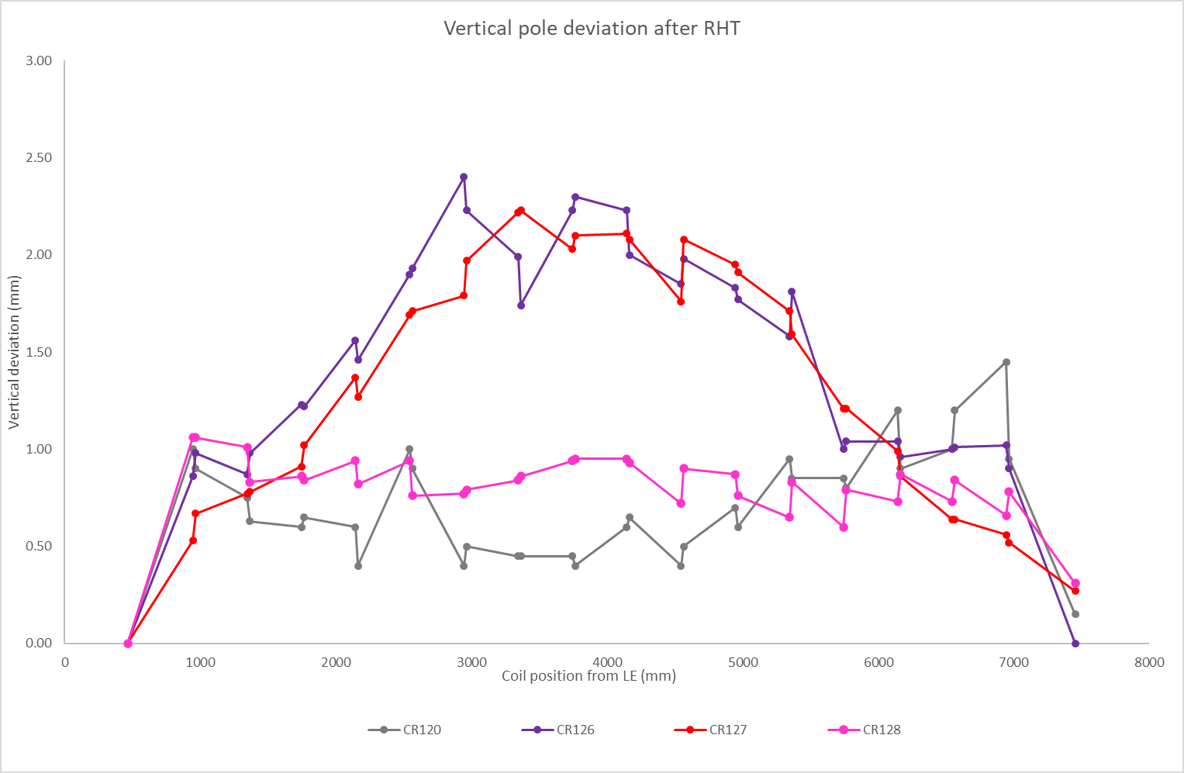
Coil hump

Slide 27
Coil hump

Slide 28
Coil hump
BP2
BP3
B02

Slide 29
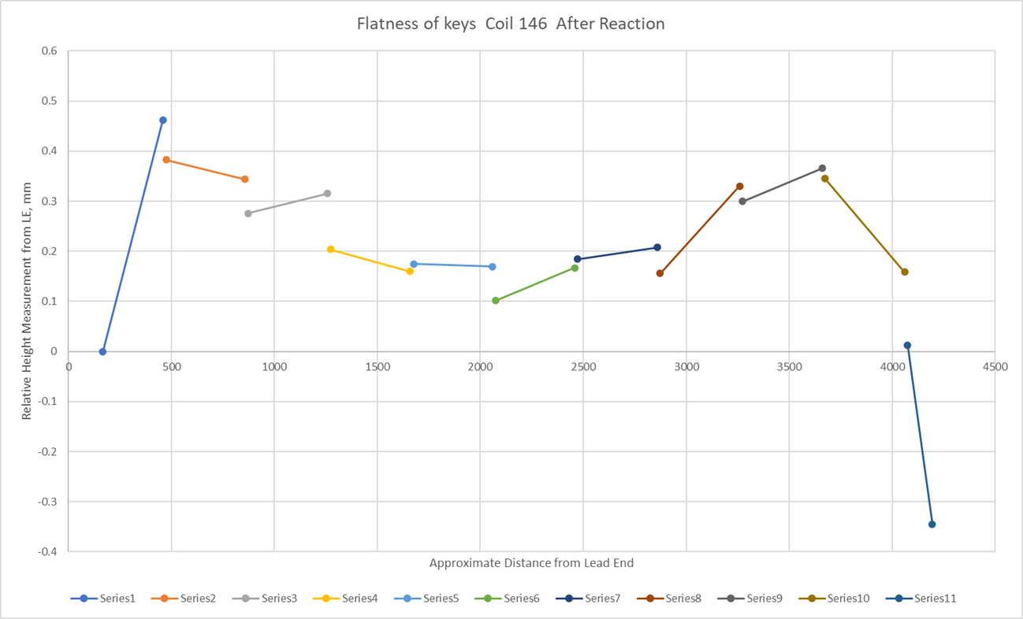
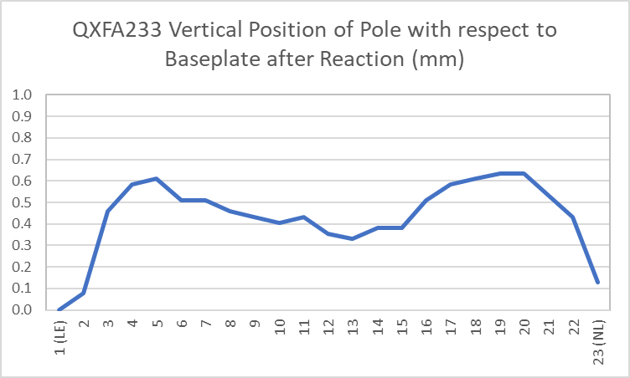
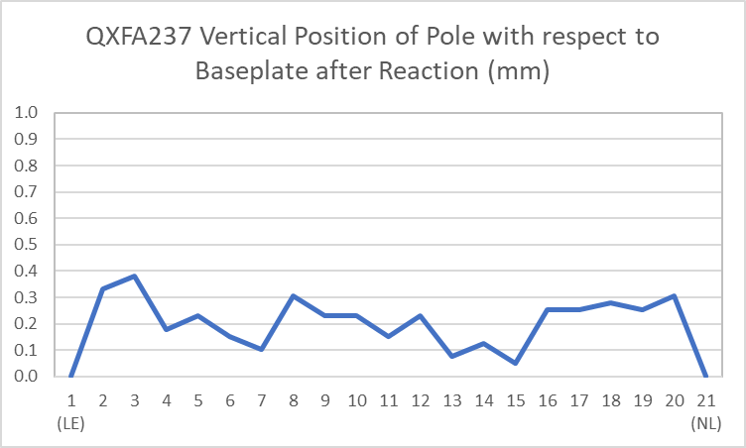
Coil hump in AUP coils
FNAL
AUP coils look like a ‘camel’, CERN coils more like a ‘dromedary’
The amplitude in AUP coils is 0.4-0.6 mm
BNL
BNL

Slide 30
Next key steps
Week 45-46:
  torque to closure impregnation fixture (intermediate closure for rotation)
Week 46-47:
  visual inspection of the IL pole turn after reaction
  metra-scan of the coil inner radius
  torque to closure impregnation fixture (final closure)
Week 49:
  visual inspection of the IL pole turn after impregnation
Week 51, maybe slips to next year:
  Impregnated coil dimensions

Slide 31
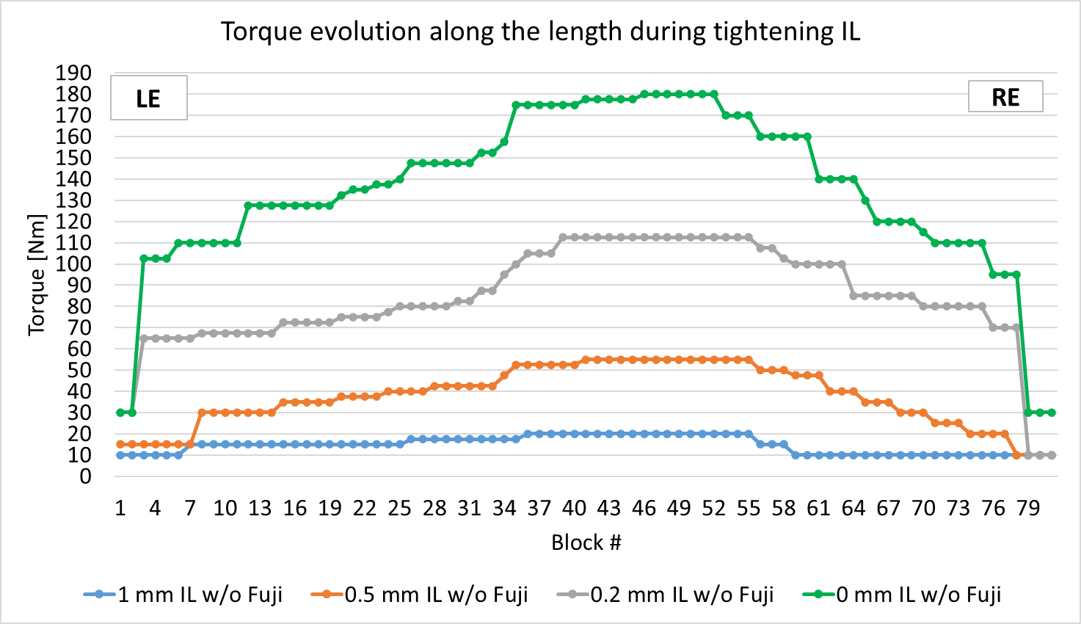
Closure of the impregnation fixture
The torque applied to close MQXFA reaction and impregnation fixture is 75 Nm - 135Nm (equivalent to 150 – 270 Nm in MQXFB fixture since the blocks are half length) according to the procedures (to be confirmed)
From the closure of the impregnation fixture, we have an indication of a ‘fatter’ coil in the middle
  This is not present in the copper coil CR005
  This is not present when closing the reaction fixture
The required torques in MQXFB coils seem comparable to those in MQXFA
Torque applied to close the fixtures, Nm
 | CR005 (Cu) | CR126 | CR127 | CR128
Required to close the reaction fixture |  | 100 | 85 | 110
Final torque applied to the reaction fixture |  | 160 | 150 | 150
Required to close to 0.2 mm gap the impregnation fixture, OL up | 80 | 95 | 130
Required to close the impregnation fixture, IL up | 130* | 180 | 220
*Maximum value to close in all the coil except around the layer jump where 200 Nm were needed

Slide 32
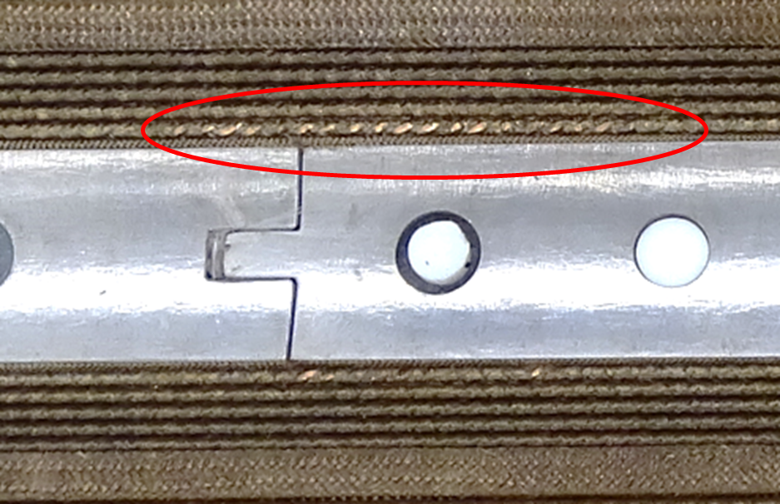
Pole turn visual inspection
A review of the pictures of the coil after reaction show clear indications of insulation damage in the pole-to-pole transitions of most of the coils produced up to date.
This effect is not present in MQXFS coils
BP1
BP2
BP3
B02
Coil | # transitions with damage insulation | Coil | # transitions with damage insulation
CR104 | 2 | CR117 | 9
CR105 | 8 | CR118 | 8
CR107 | 1 | CR119 | 6
CR108 | 4 | CR120 | 0?
CR109 | 6 | CR121 | 5
CR110 | 5 | CR122 | 1?
CR111 | 7 | CR123 | 7
CR112 | 4 | CR124 | 10
CR113 | 3 | CR125 | 6
CR114 | 9 | CR126 | 11
CR115 | 3 | CR127 | 11
CR116 | 2
CR110 / CR111 / CR112/ CR113 : EDMS 2737768.
CR115 / CR117 / CR118 / CR119 : EDMS 2737769.
CR121 / CR122 / CR123 / CR124 / CR125 : EDMS 2737770.
CR127: EDMS 2752954
Rest of the coils EDMS 2747963
Limited coil in each magnet assembly is indicated in bold

Slide 33
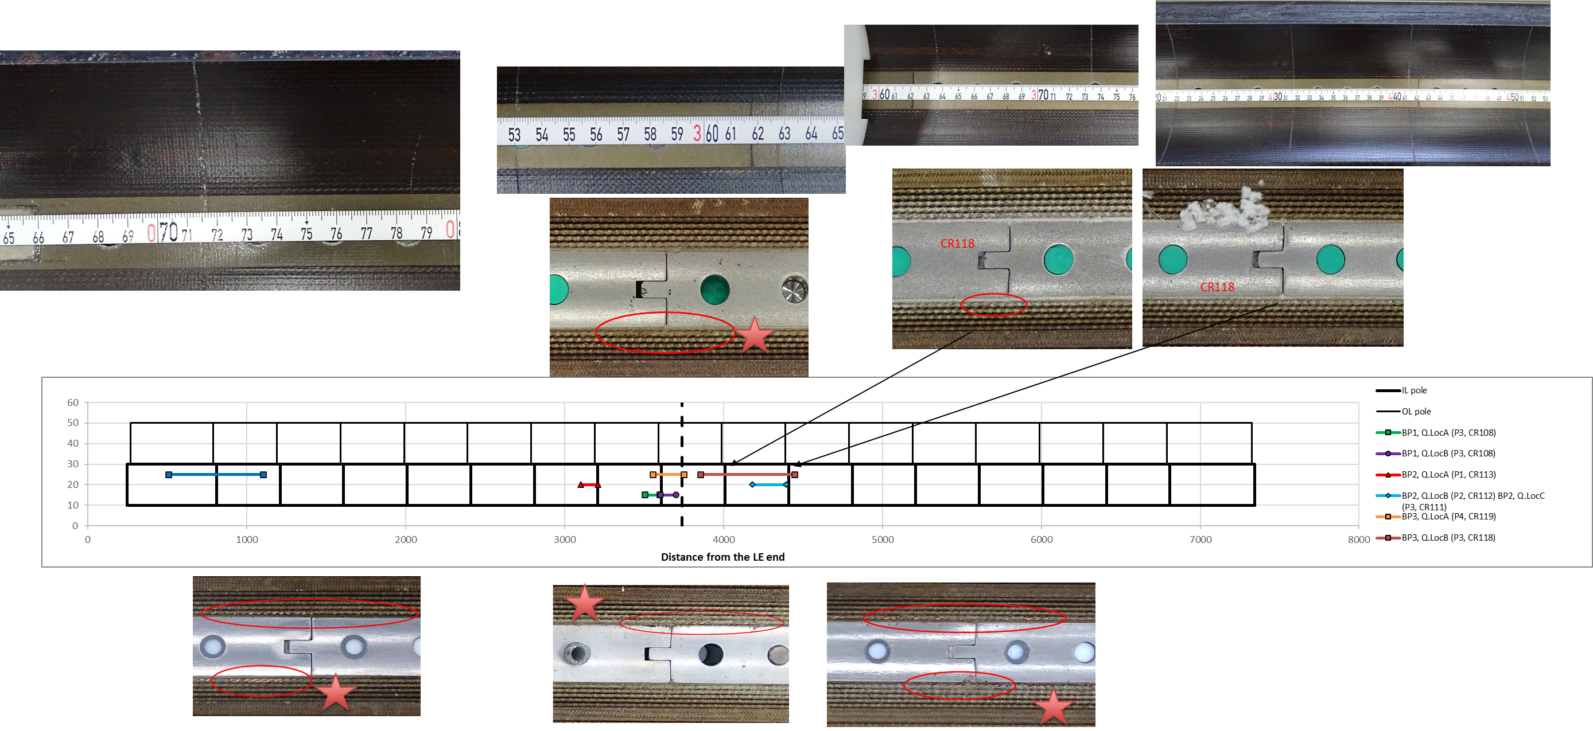
Pole turn visual inspection vs quench location
We didn’t find a quantitative clean correlation between damage and quench location:

Slide 34
Azimuthal arc length, impregnated coil
After impregnation, MQXFB coils are azimuthally larger in the middle, there is a systematic ‘belly’ shape in our coils.
  L+R arc excess typically 0.150 mm larger in the middle.
MQXFA coils are uniform in terms of azimuthal size along the length
Few ‘special’ coils, don’t have this feature of bigger azimuthal size in the middle (copper coils, CR120 and CR003 (low grade Nb3Sn coil))
MQXFBP2 coils
MQXFBP3 coils
MQXFB02 coils
https://indico.cern.ch/event/1075064/
Jose Ferradas Troitino

Slide 35
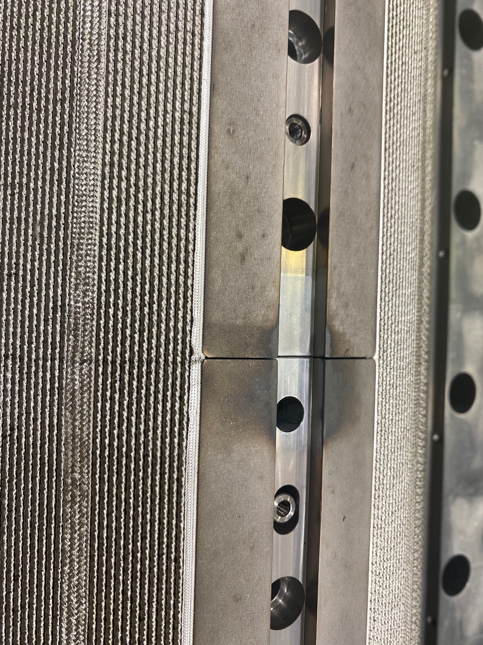
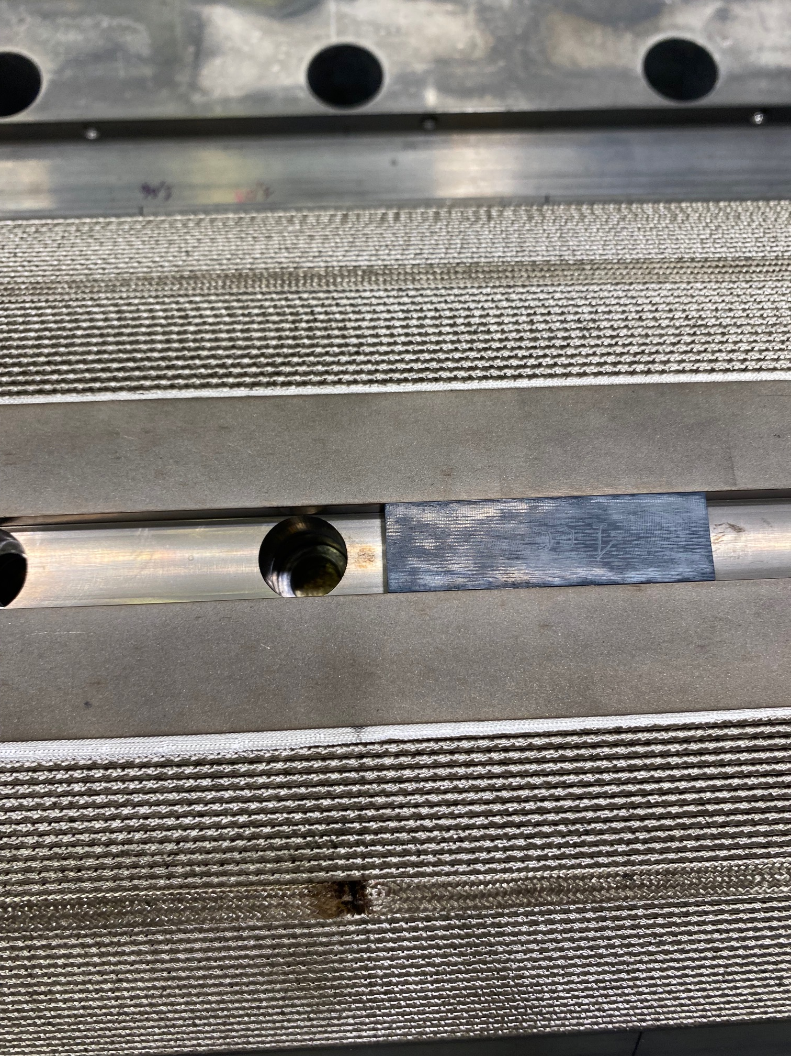
More interesting stories…the clavette
We went back to SS, but installed some Ti in the body of the poles just to check → they got stacked.

Slide 36
Additional slides: Tooling bow

Slide 37
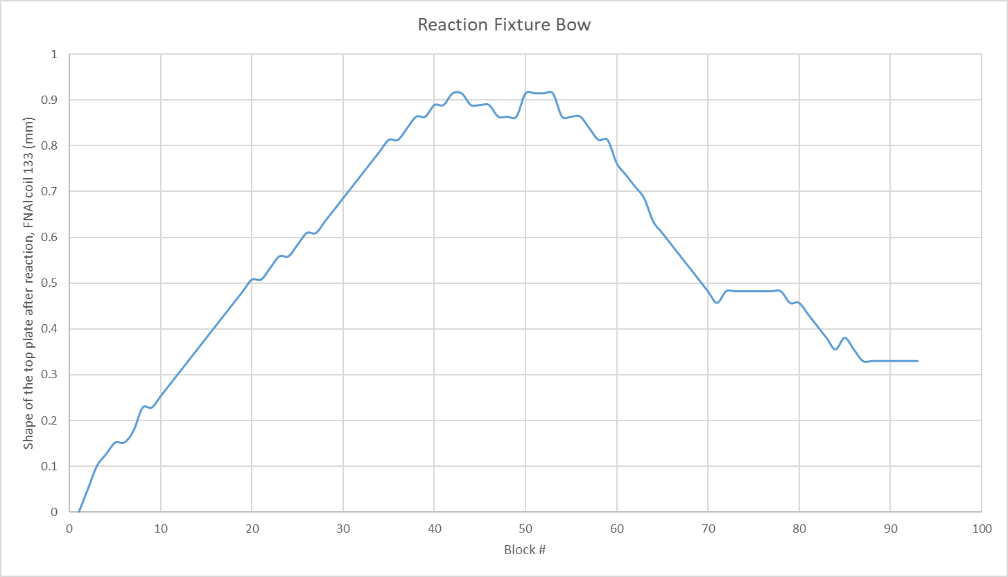
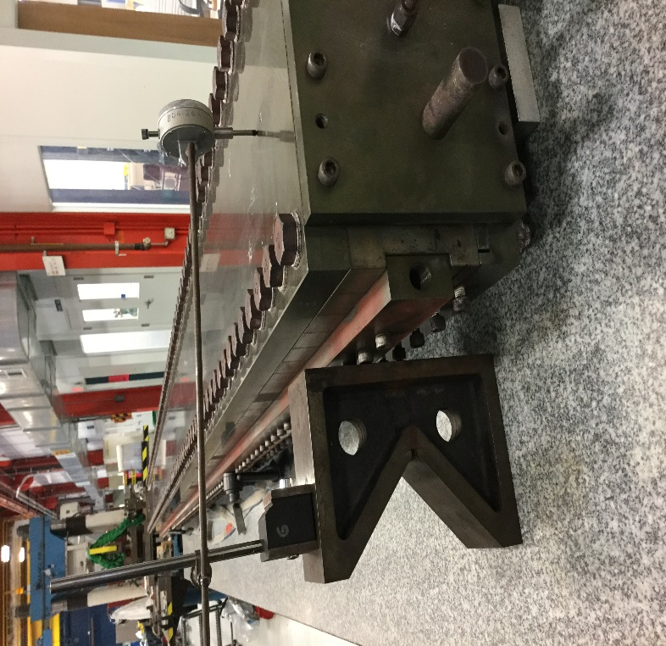
External shape of MQXFA tooling
FNAL measures the shape of the top plate after reaction, with the coil in a marble, and observes almost 1 mm bow
CERN never did this kind of measurement, but will be done for 127 coil before/after reaction, and in coil 126 before/after impregnation

Slide 38
Reaction fixture bow after heat treatment:
FNAL
https://indico.fnal.gov/event/54388/
0.9 mm

Slide 39
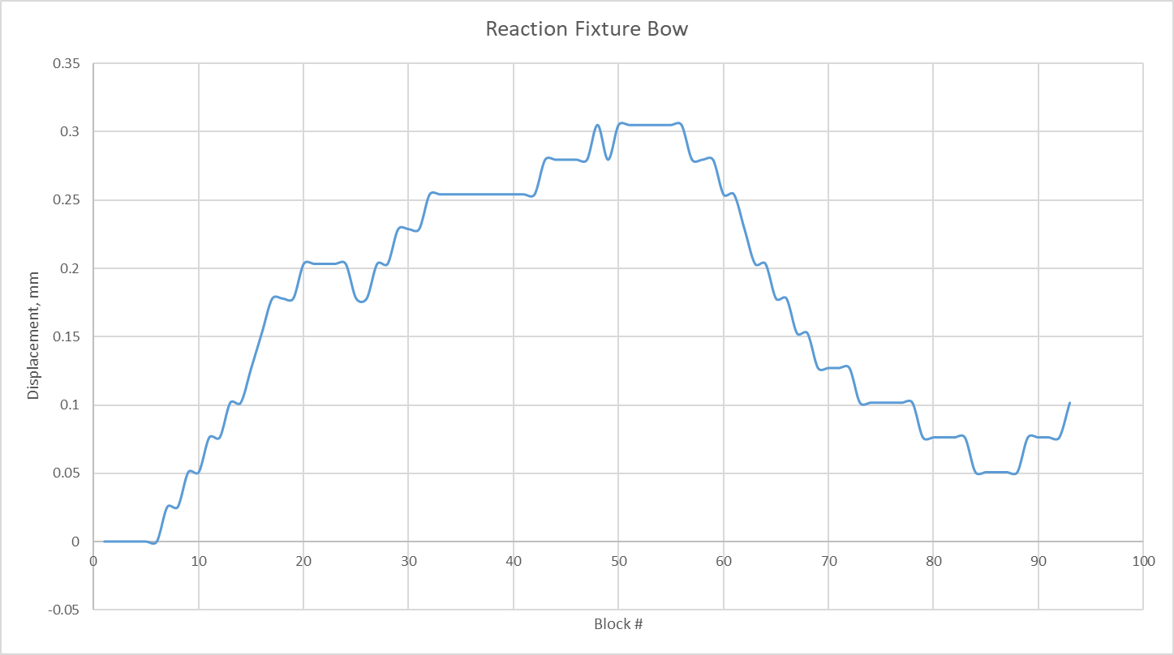
QXFA146
https://indico.cern.ch/event/1188496/

Slide 40
Pre/Post Tooling Bow: FNAL

Slide 41
Bow of Base & Top plates in Free State: FNAL

Slide 42
Additional slides: change coil length during RHT mould opening

Slide 43
QXFA146 Length Change
https://indico.cern.ch/event/1188496/
Caliper measurements from LE of baseplate to witness sample holder with tooling fully assembled and torqued: 48.16 mm
Caliper measurements from LE of baseplate to witness sample holder without tooling (top plate, form blocks, and filler/liner): 45.21 mm
LE difference: 2.95 mm
Caliper measurements from RE of baseplate to L2 RE saddle with tooling fully assembled: 42.00 mm
Caliper measurements from RE of baseplate to L2 RE saddle without tooling (top plate, form blocks, and filler/liner): 41.40 mm
RE difference: 0.60 mm

Slide 44
QXFA147 Length Change
Measurements taken from base plate to LE splice block and base plate to RE saddle.
*After 20 form blocks removed, the mandrel block on the LE of the coil moved outward 2.1 mm beyond the base plate. Once the filler/liner was removed, the same size gap was observed between mandrel blocks 3 and 4.

Slide 45


Coil Length Change
After heat treatment, micrometer measurements were taken from fixture base plate to coil at each end, at numerous steps during disassembly of reaction tooling.
Coil length increased by 3.3 - 4.1 mm.
Note – coil 237 and 238 order of operations differs slightly.

Slide 46
Additional slides: Coil hump

Slide 47



In Situ Laster Tracker Measurement Set Up
https://indico.fnal.gov/event/54388/
LE
RE
Pole measurements taken in the pole slot at approximate longitudinal center.
Base plate measurements take along the length at the same longitudinal location as the pole.
LE

Slide 48


QXFA143 Reaction Tooling Base Plate Measurements (Laser Tracker )
https://indico.fnal.gov/event/54388/
LE
RE
Measured
Maximum
Minimum
Mean
Std Dev
# of Points

Slide 49


QXFA143 Mid-Point of Each Pole Piece Slot
(Laser Tracker )
https://indico.fnal.gov/event/54388/
LE
RE

Slide 50


QXFA146 Pole Position Normalized to LE

Slide 51
Pole height: BNL
After heat treatment, dial indicator measurements of pole height relative to reaction fixture base plate.
https://indico.cern.ch/event/1188496/

Slide 52
Additional slides: Impregnated coil size

Slide 53

Vertical deflection of the coil after reaction and azimuthal excess of the impregnated coil
In coil 120 and in the copper coils, we don’t see vertical pole deflection after heat treatment in the middle of the coil, and the coil azimuthal excess after impregnation is uniform along the length → the two effects could be correlated

Slide 54
Azimuthal arc length, impregnated coil
Few ‘special’ coils, don’t have this feature of bigger azimuthal size in the middle
https://indico.cern.ch/event/1075064/
CR004 and COP2 are copper coils → cable smaller after reaction, different rigidity of the cable itself…
CR003 is low grade Nb₃Sn, but without impregnated heaters → only one layer of S2-glass in the OD instead of QH + 3 layers of S2 glass.
CR120 is Nb₃Sn, but the OL was cured without binder. During winding, the winding tension was released in the OL due to a critical NCR (cable collapsed). During impregnation, injection was slower (twice the time), a different peristatic pump was used and pressurization lasted also much longer than usual.
Jose Ferradas Troitino

Slide 55
Additional slides: attempts to correlate data

Slide 56
Coil size vs insulation thickness
No correlation between average coil arc excess and insulation thickness → based on our experience, the driver is the size of the impregnation fixture (we show clearly the effect of the change of the mid-plane shims in the impregnation mould)
Weak correlation between the insulation thickness and the difference between maximum an minimum coil arc excess. In addition, copper coils are better in terms of uniformity along the length.
  Based on this two elements, we propose to remove 0.130 mm on the OD to improve uniformity along the length

Slide 57
Coil size vs insulation thickness
If we based ourselves in the statistics of impact of insulation thickness on coil uniformity along the length, 0.130 mm radial would give us around 0.040 mm

Slide 58



Pole gap vs vertical deflection
Weak correlation of the total pole gap after reaction and the vertical deflection of the pole

Slide 59
Output from coil 127
  Comparison of the midplane excesses given by
    The metrology done with the Faro Arm on the impregnated coil
    The scan done with Metrascan of the same coil after RHT
  Overall good correlation

Slide 60
Additional slides: others

Slide 61


Pole turn visual inspection
We also observed delamination of the resin in the pole-to-pole transition (also present in some MQXFS coils)
It seems that just after impregnation this defect in not present → might appear with the handling
  We will keep monitoring this, but today we see it less critical that the observables after reaction
Coil 126 just after impregnation (no handling)
Coil 122 just after impregnation + handling

