Slide 1

Coffee breaks and sandwich lunches will be served in the room 30/7-010, next to the Auditorium, today and tomorrow
A group picture will be taken this morning in the Auditorium before the coffee break
HiTAT Workshop
High Temperature superconductors for Accelerator Technology
CERN, 9–10 March 2023

Slide 2
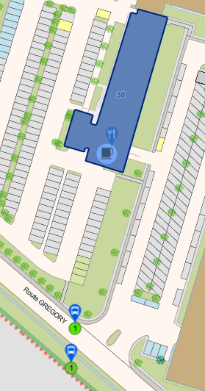
Dinner of this evening: restaurant Les Loges du Léman in Crozet.
The meeting points for the bus are:
at 19:00 along the Gregory Road (Shuttle stop, see map);
at 19:10 at CERN Hostel, building 39.
The bus will bring us back - from the restaurant to the CERN Hostel - around 22:30.
Car-sharing for people having a car is welcome. We meet at the restaurant at at 19:30
HiTAT Workshop
High Temperature superconductors for Accelerator Technology
CERN, 9–10 March 2023

