Slide 1


Iron Based Superconductors: status and prospects
Dongliang Wang, Yanwei Ma
Institute of Electrical Engineering, Chinese Academy of Sciences,
Beijing, China
1st High Temperature superconductors for Accelerator Technology (HiTAT) workshop, Mar 9-10, 2023

Slide 2
Outline
1
Background on iron-based superconductors (IBS)
Development of high J_{c} PIT 122 IBS wires
Recent advances in long-length wires, joints, pancake & racetrack coils, cables
Conclusions and outlook
2
3
4

Slide 3
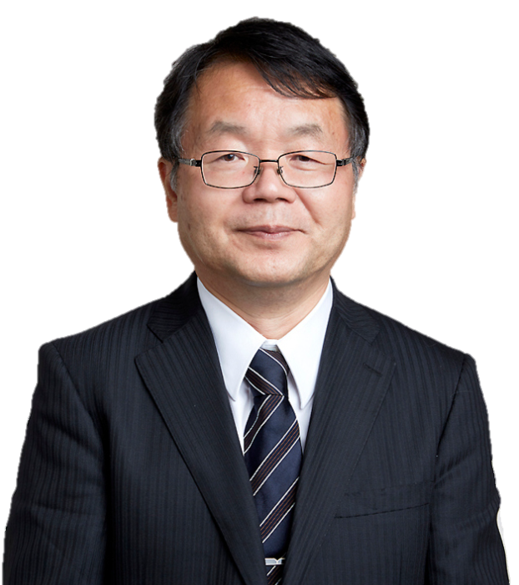
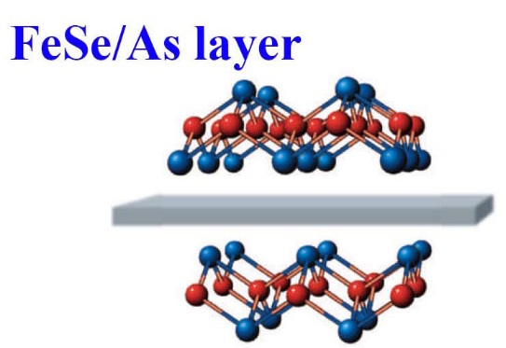
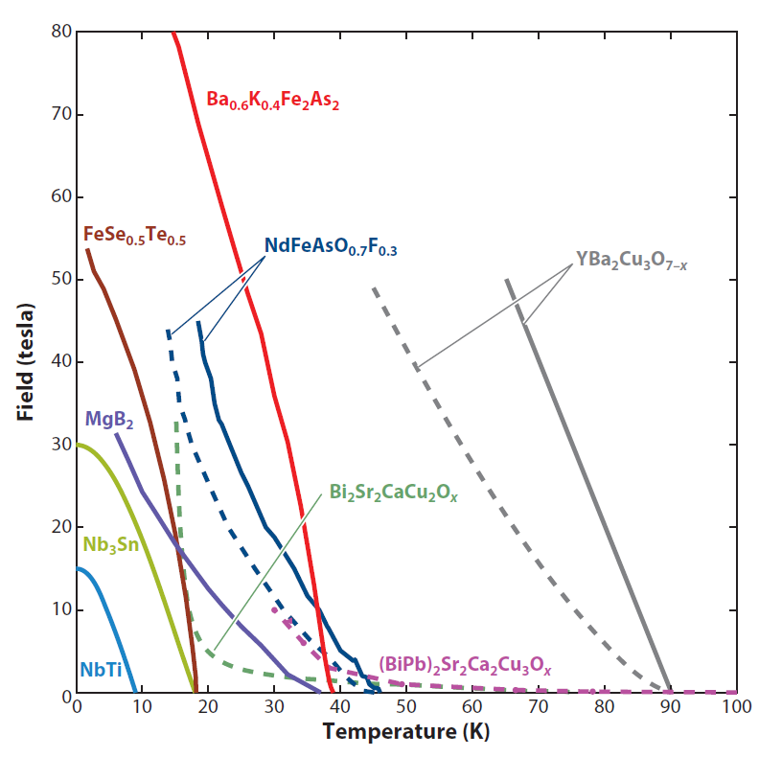

Iron-Based Superconductors (IBS)
Prof. Hideo Hosono 2008
At 20 K,
the H_{c2} can be >70 T
where IBS outperform both MgB₂ and Bi-2223.
Varieties of Iron-based superconductors (IBS)
High performance:
High T_{c}~55 K
High H_{c2}~100 T, H_{irr} very close to H_{c2}
Small anisotropy, γ<2
High J_{c}~6 MA/cm² & J_{c}-depairing~160 MA/cm²
 | Bi-system | YBCO | IBS 122 | MgB₂
γ | 50-90 | 5-7 | 1-2 | 2
ξ_{ab} | 2.3 | 2.1 | 2.4 | 8
Gi | 1 | 10⁻² | 10⁻⁴ | 10⁻⁵
3

Slide 4

IBS are considered as “Cheap conductor for high fields”
--Jan Jaroszynski, Supercond. Sci. Technol. 32 (2019) 070501
The cost of IBS wire can be four to five times lower than that of Nb₃Sn, making it more expensive than NbTi, but with much higher critical parameters than Nb₃Sn.
From a practical point of view, IBS are ideal candidates for applications.

Slide 5
High J_{c} of IBS wires: Very weak field dependence in high field region
122 IBS wire:
Large J_{c}, at B > 20T
J_{c} shows very weak field dependence in high fields
I_{c} data of Sr-122 tape,
measured in 2013 at HFLSM, Sendai

Slide 6
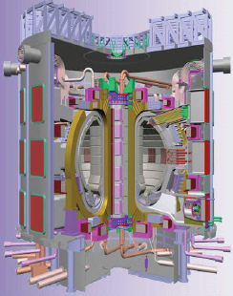
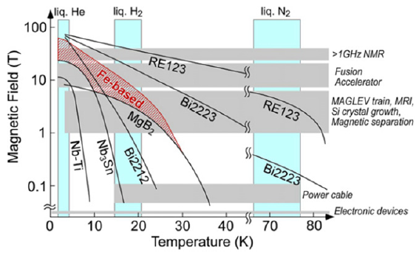
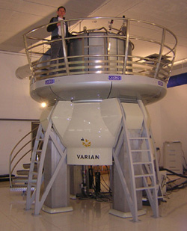
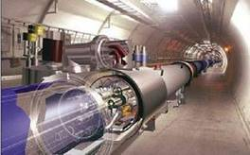
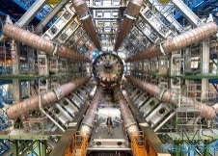
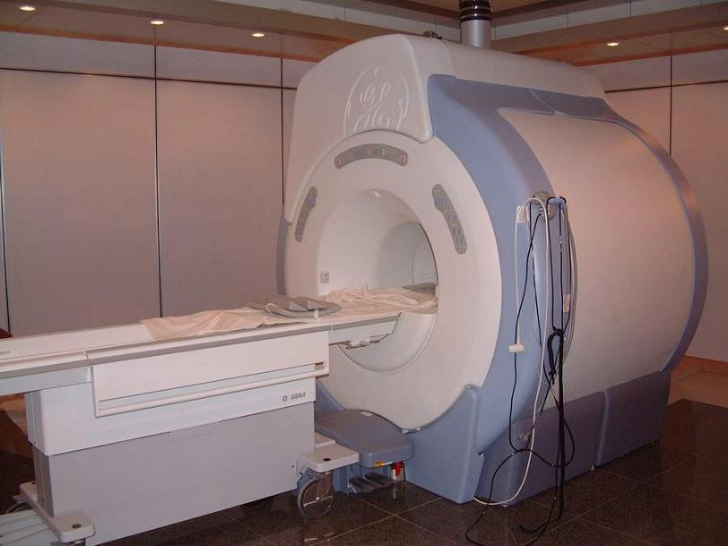
IBS have potential for high-field applications
Working Temp:
4.2 K – 30 K
ITER
10 m, 15 T (4.2 K)
>1GHz NMR
>23.5 T
Accelerator (20 T)
MRI
(14 T)
J. Shimoyama, SuST 27 (2014) 044002
Development of high-performance conductors is essential
6

Slide 7
Misorientation dependence of J_{c} :
GBs are less detrimental to current flow
θ_{GB} dependence of inter-grain J_{c} for various IBS bicrystals
M. Putti presented at EUCAS-2015
Iida et al., Appl Phys Rev 5 (2018) 031304
YBCO θ_{c}≈ 3° vs 122 IBS θ_{c}≈ 9°(The critical angle of GBs)
Misorientation angle of IBS grains < 9°usually do not impede the J_{c} flow
Highly textured templates are not necessary: PIT and low-cost CCs are possible
Notes:
These features are highly beneficial for the realization of cheaper conductors for high-field magnets at low temperatures.
Bicrystal experiments on Ba-122 and Fe(Se,Te) revealed the metallic nature of grain boundaries. The critical angle above which inter-grain Jc falls off is around 9.

Slide 8
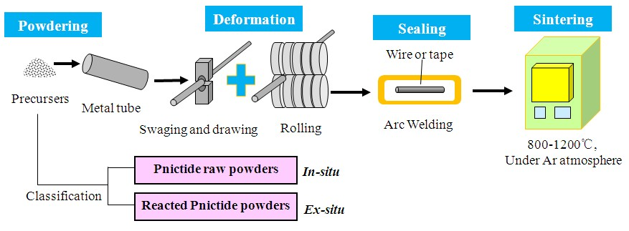
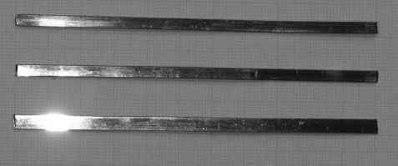
Fabrication process for IBS wires and tapes
(Powder-in-tube method )
－Low cost, simple deformation process
800-900ºC
Final Product
122 PIT wires are expected to be much cheaper than BSCCO conductors:
1. Many types of sheaths of Ag, Cu, Fe, and Ag-based composites (Ag/Fe, Ag/Cu, Ag/stainless steel) can be employed.
2. For BSCCO, Ag is the only material that is inert to the BSCCO superconductor and permeable to oxygen at the annealing temperature.
Notes:
The PIT process is very attractive from the aspect of applications, taking advantage of the low material costs and the relatively simple deformation techniques.

Slide 9
Outline
1
Background on iron-based superconductors (IBS)
Development of high J_{c} PIT 122 IBS wires
Recent advances in long-length wires, joints, pancake & racetrack coils, cables
Conclusions and outlook
2
3
4
9

Slide 10
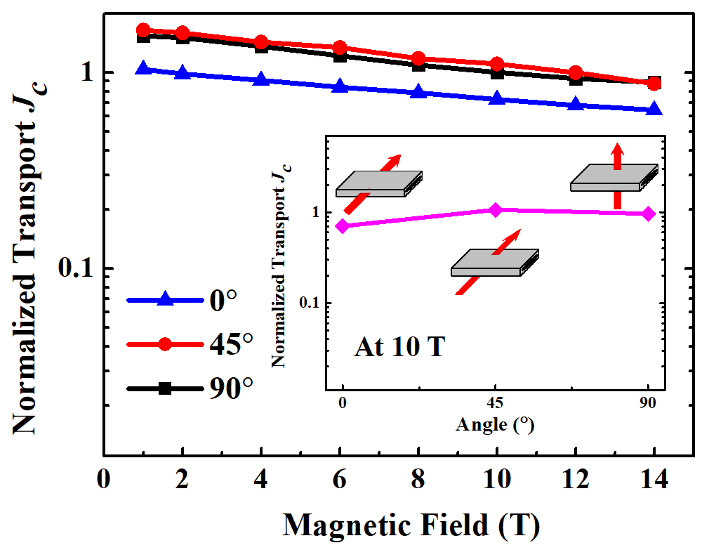
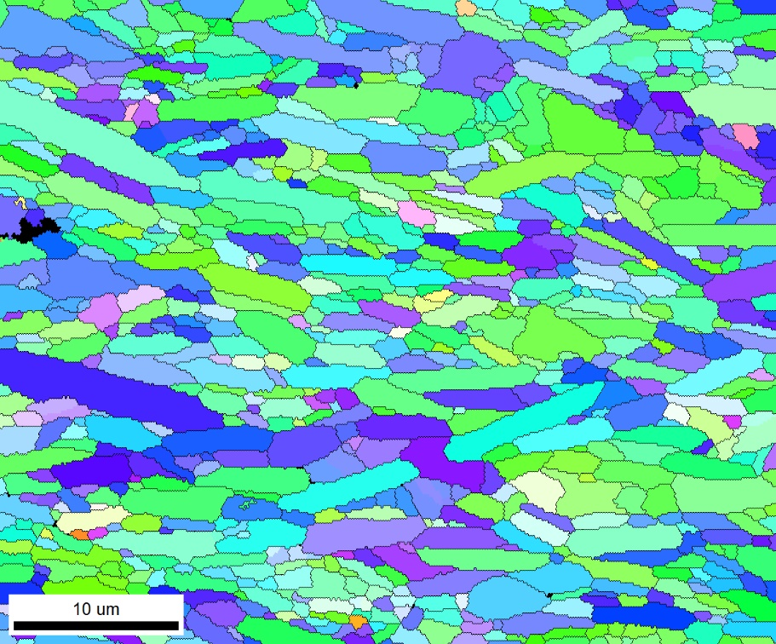
Powder-In-Tube 122 tapes: High J_{c}
High J_{c} values were achieved in hot pressed (HP) Ba122/Ag tapes
Huang et al., SuST 31 (2018) 015017
EBSD
The grains are aligned along the c-axis,
most of the misorientation angles are 5-20
At 4.2 K, 10 T: J_{c} ~ 1.5×10⁵ A/cm², I_{c}=437 A, γ = 1.37
18 T: J_{c} ~ 10⁵ A/cm²
27 T: J_{c} ~ 5.5×10⁴ A/cm²
Latest: Record J_{c} of HP Ba122 tape= 1.81×10⁵ A/cm² at 4.2 K, 10 T
No apparent in-plane texture was found

Slide 11
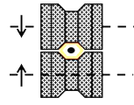
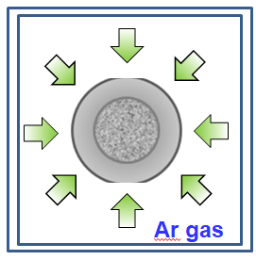
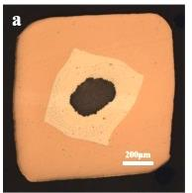
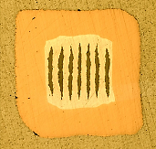
High-J_{c} Ba-122 HIP wires improved by GR+HIP
a
packing
b
cold work
c
HIP sintering
700 ºC,
150 MPa,
4 hours
Ba_{0.6}K_{0.4}Fe₂As₂ powder
Ag tube
groove rolling
Ba122/Ag+Cu
groove rolling
by enhancing the texture
mono-core wires
4.7×10⁴ A/cm²
(4.2 K, 10 T)
3.3×10⁴ A/cm²
(latest result)
improved by ~ 5 times
2 times higher
Physica C 585 (2021) 1353870
Cu/Ag sheath
tape-in-tube method
JMCC 11 (2023) 1460
Guo et al., SuST 34 (2021) 094001

Slide 12
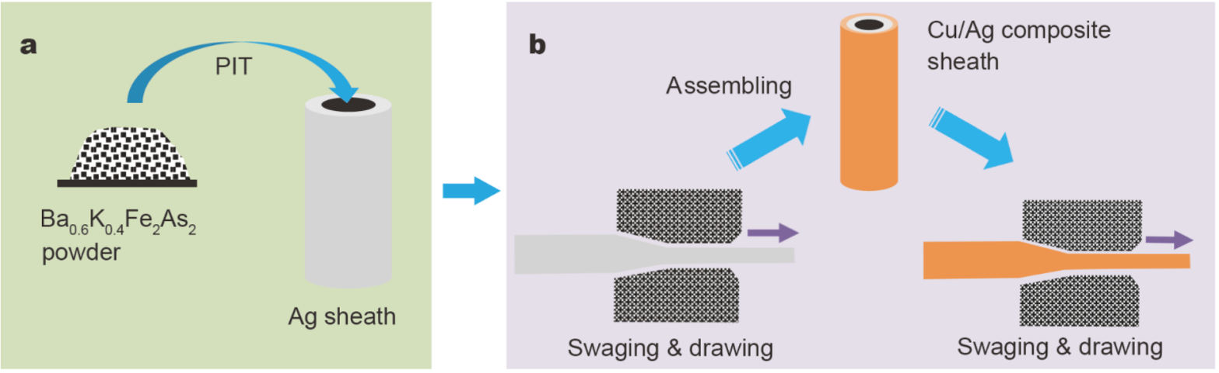
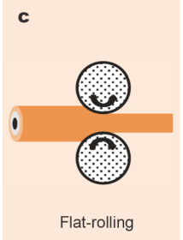
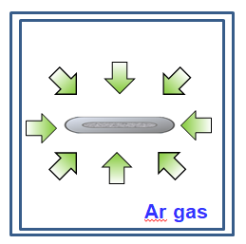
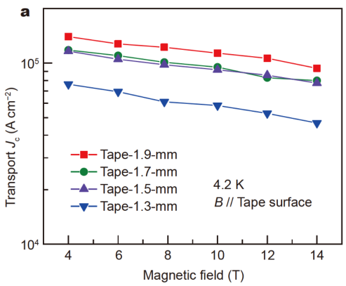
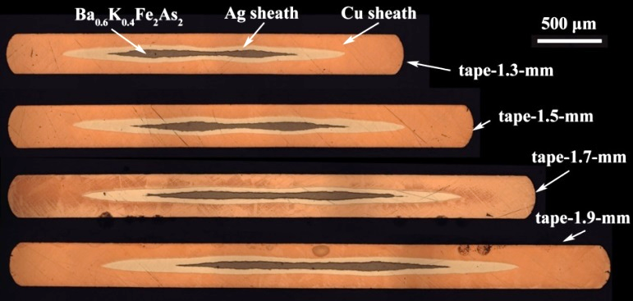
Cu/Ag sheathed Ba-122 tapes with practical level J_{c}
d
HIP sintering
740 ºC,
150 MPa,
1-4 hours
well textured grains
high core density
high transport J_{c}
J_{c} (4.2 K, 10 T) = 1.1×10⁵ A/cm²
J_{c} exceeding 10⁵ A/cm² for the first time for Cu/Ag sheathed tapes
A scalable and cost-effective fabrication route!
Liu et al., Sci. China Mater. 64 (2021) 2503

Slide 13
Comparison of hysteresis loops for HP and HIP 122 tapes
Hot Pressing
Hot Isostatic Pressing
HP Ba-122/Ag
HIP Ba-122/Ag/Cu
Courtesy: C. Senatore
Courtesy: S. Awaji
Fraction with θ<10º:~42 %
Bonura et al., SuST 33 (2020) 095008
Fraction with θ<10º:~10 %
J_{c}=1.8×10⁵ A/cm² (10 T)
J_{c}=1.1×10⁵ A/cm² (10 T)
HP Temperature (880℃)
Grain size: ~3 μm
Lotgering orientation factor F: 0.87
Hv: ~140
HIP Temperature (740 ℃)
Grain size: ~0.5 μm
Lotgering orientation factor F: 0.46
Hv: >230
Much room for the J_{c} improvement

Slide 14
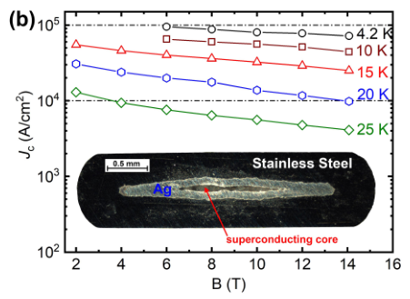
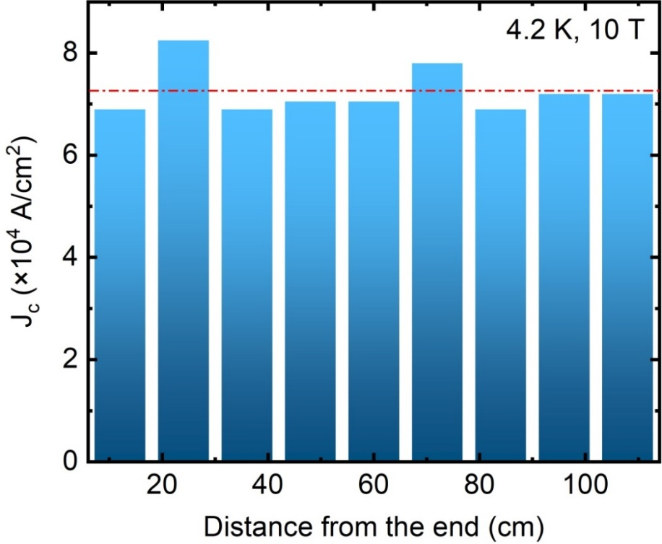
Powder-In-Tube 122 tapes: High J_{c} & high strength
High J_{c} values were achieved in Stainless Steel (SS)/Ag/Ba122 tapes, due to higher core density (Hv~230), the J_{c} is 8×10⁴ A/cm² at 4.2 K and 10 T .
J_{c} distribution of 1.08 m SS/Ag/Ba-122 tape
High n value：
@10 K，10 T，n~47
1.08 m long SS/Ag/Ba122 tape shows good J_{c} uniformity, the lowest J_{c} is over 7×10⁴ A/cm².
Dong et al., IEEE TAS 29 (2019) 7300504

Slide 15
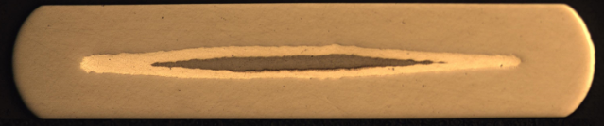
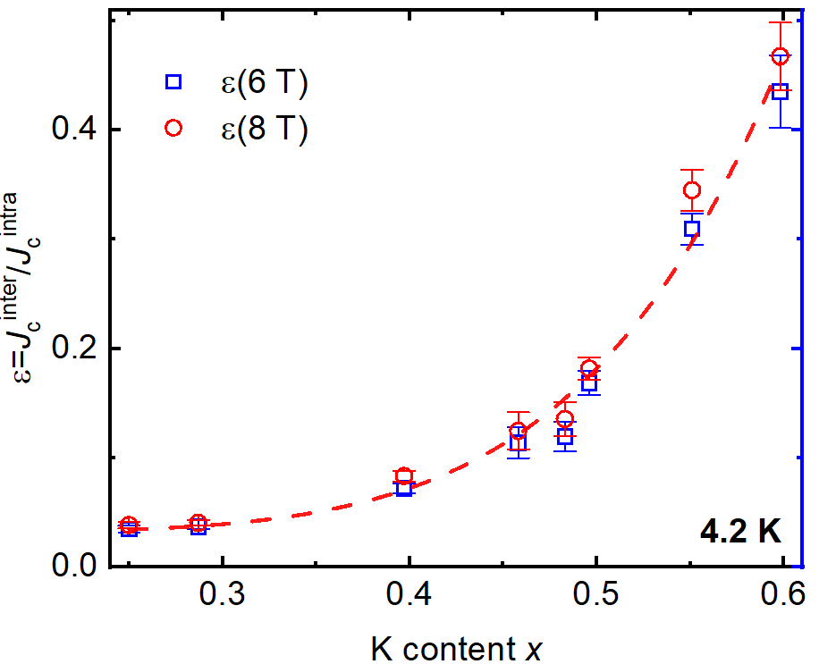
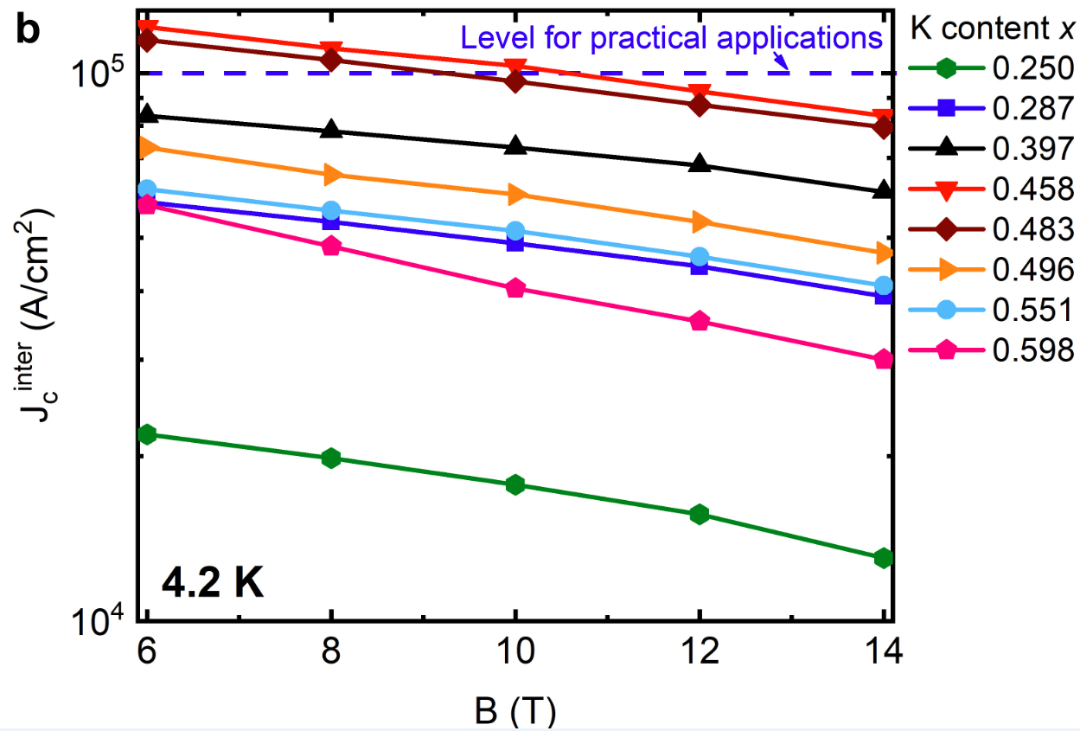
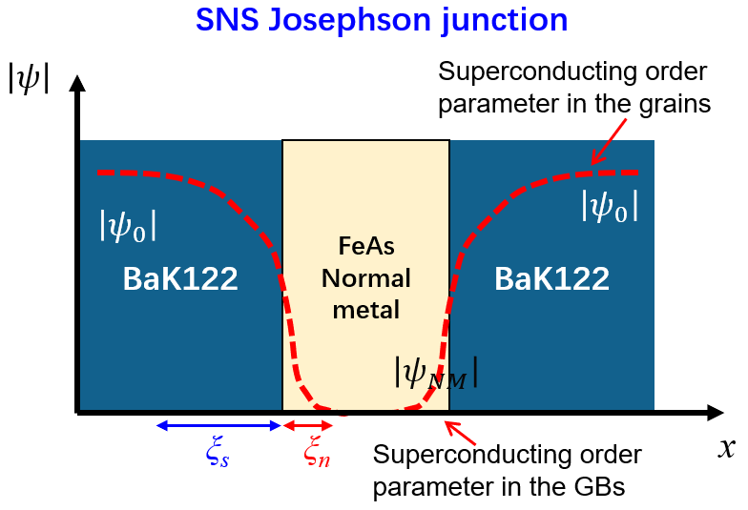
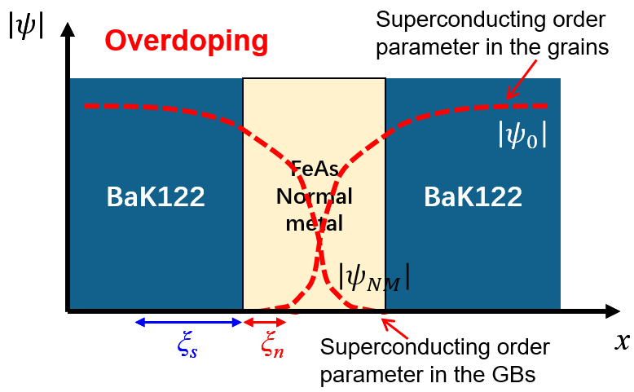
Critical current density of SS/Ag composite tapes
Stainless steel/Ag/Ba_{1-x}K_{x}Fe₂As₂ tapes were made with a wide doping range (0.25≤x≤0.6)
47 %
Proximity effect
Best J_{c}^{transport}
slightly overdoped
12.5 %
8 %
4 %
The highest J_{c}^{trans} >0.1 MA/cm² at x=0.458 @ 4.2 K, 10 T
Grain boundary transparency parameter ε=J_{c}^{inter}/J_{c}^{intra} continuously increases with doping
Grain boundaries are contaminated by FeAs, doping enhances proximity effect and inter-grain J_{c}.
Cheng et al., Mater. Today Phys. 28 (2022) 100848

Slide 16
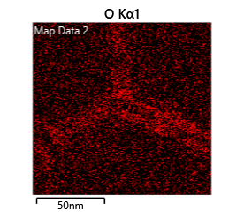
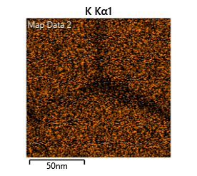
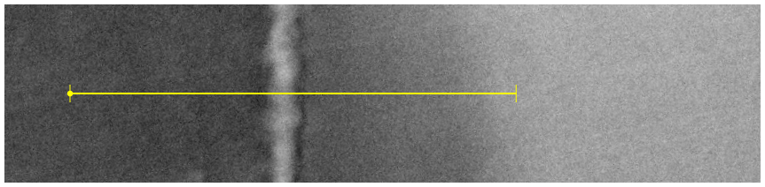
Bright field STEM for HP Ba-122 tapes: Second phases at GB
HAADF
-- analyzed by Prof. Larbalestier group at FSU
Ba-O
Bright GBs
FeAs
Fe particle
Dark GBs
Dark GBs
Bright GBs
significant O
segregation
EDS line scan
K depletion
Many clear GBs in HP-122 tape
The state-of-art high J_{c} tapes still contain many contaminated GBs which disconnect the Ba122 grains. The J_{c} can be largely improved if we can eliminate these secondary phases.
Courtesy of F. Kametani
Notes:
The second problem annoying us is the dirty grain boundary. ovides a continuous path for supercurrent.
These oxide phase or GB wetting phase are harmful to inter-grains transport. I suggest that these second phases mainly come from the oxidized starting materials
How to remove impurities is an urgent problem to be solved next.

Slide 17


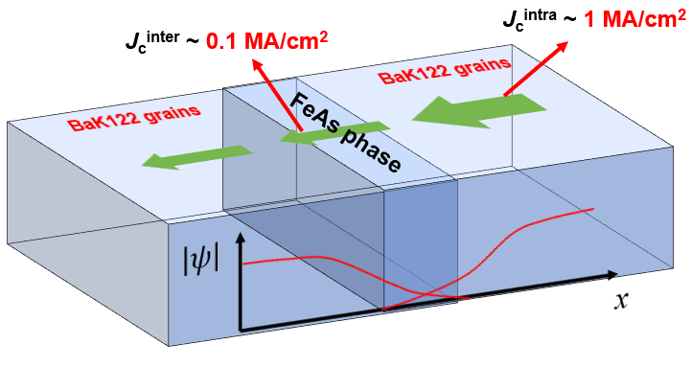
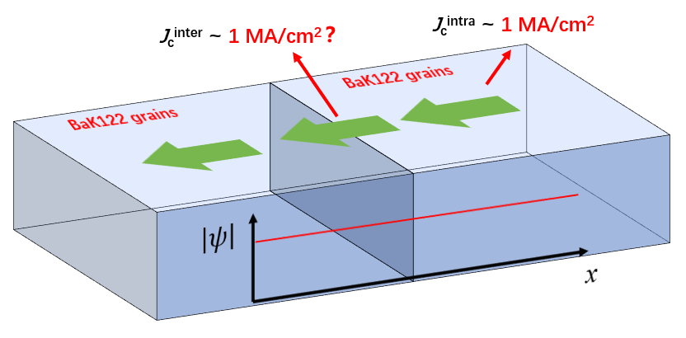
NEXT STEP for iron-based PIT wires？
Dirty grain boundaries
Clean grain boundaries
Most GBs are contaminated by FeAs, largely limiting intergrain current transport
  Slightly overdoping is a good way to enhance J_{c}^{trans}
Clean GBs without FeAs phase is always the best choice!
  ε~100% may be achieved in the GBs without FeAs (misorientation angle θ<9º)
But how to remove FeAs ?
Mater. Today Phys., 28, 100848 (2022)

Slide 18
New record high J_{c} in PIT SS/Ag Ba122 tapes
Special technique to remove FeAs wetting phase, details will be published soon.
New record！
High J_{c} @ 4.2 K :
  J_{c}~2.2×10⁵ A/cm² @ 10 T
  J_{c}>10⁵ A/cm² even @ 24 T
High mechanical strength
Low material cost
Easy fabrication process scalable to long length tapes
IEE
Hot-pressed tape
NIMS
SS/Ag tape by NIMS
Very promising to be used in high field magnets!
No published data

Slide 19
Outline
1
Background on iron-based superconductors (IBS)
Development of high J_{c} PIT 122 IBS wires
Recent advances in long-length wires, joints, pancake & racetrack coils, cables
Conclusions and outlook
2
3
4

Slide 20

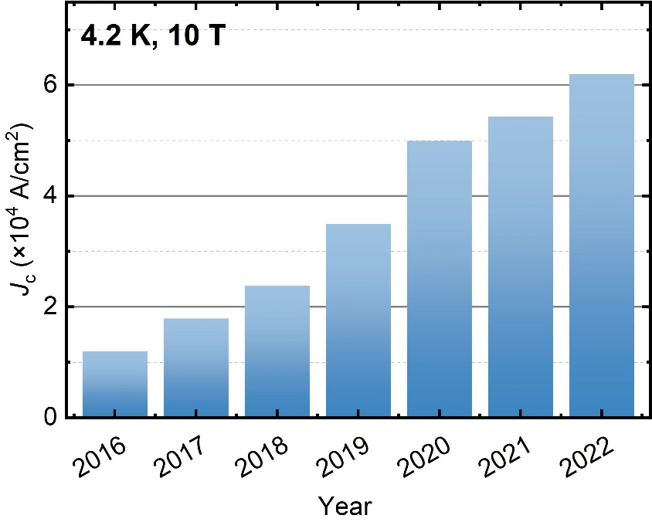
Powder-In-Tube 122 tapes: Long length
100 m long, 7-core Ba122 tapes are fabricated by rolling process, and the J_{c} is continuously improving.
@4.2 K, 10 T, transport J_{c} >60000 A/cm²
In 2022, the J_{c} of long wires has been increased above 6×10⁴ A/cm² @ 4.2 K, 10 T by optimizing fabrication process
Supported by the Strategic Priority Research Program of Chinese Academy of Sciences (Grant No. XDB25000000)

Slide 21
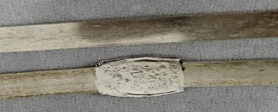
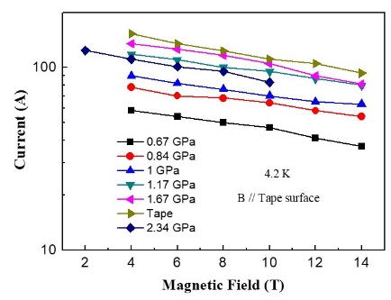
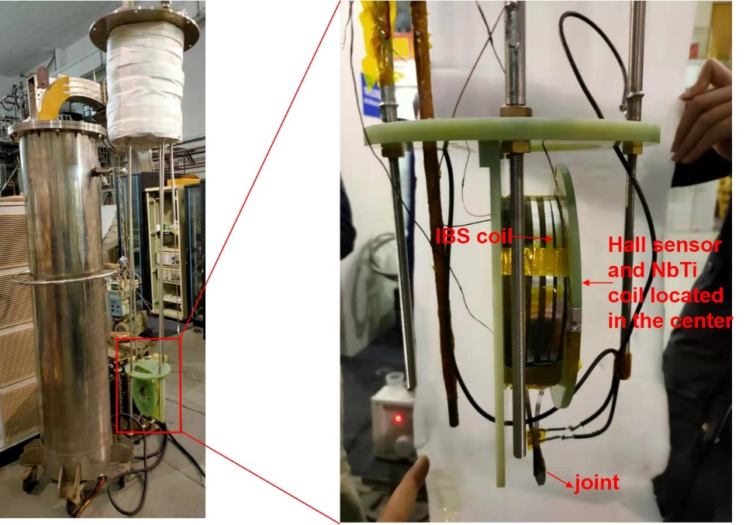
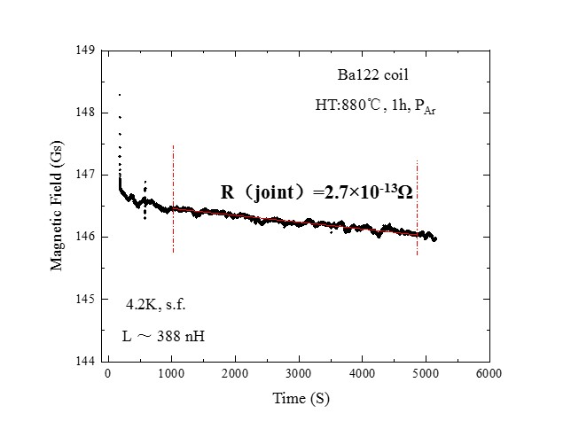
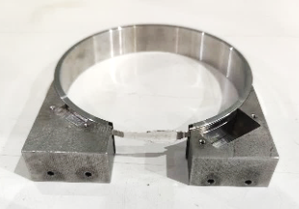
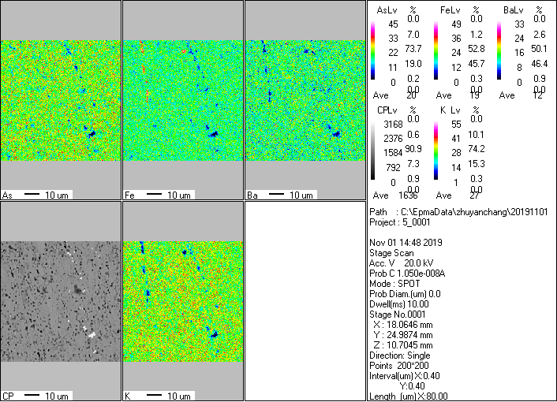
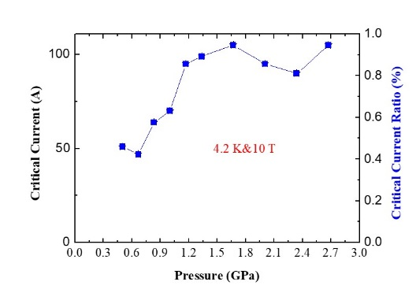
Powder-In-Tube 122 tapes: Superconducting joints
Cold pressing
95 % @ 4.2 K, 10 T
for persistent current operation
High-quality IBS joint
IBS closed-loop coil test
High-performance joints were developed for IBS tapes, with a high critical current ratio (CCR) of 95%.
The IBS joint was tested in a closed-loop coil, showing a low resistance of 2.7×10⁻¹³ Ohm.
Meet the application requirements in persistent mode MRI magnets.
Zhu et al., SuST 35 (2022) 03LT01

Slide 22
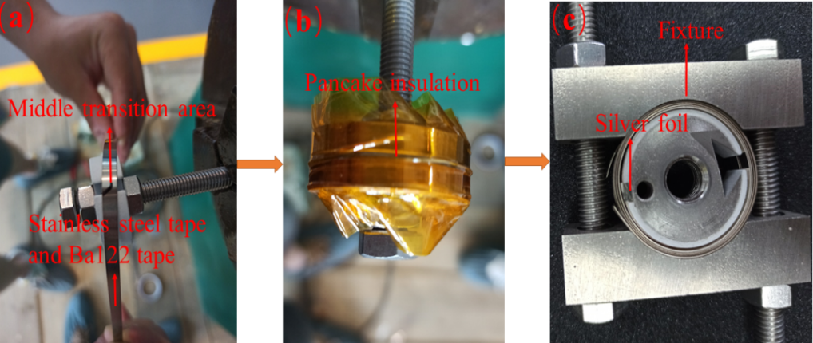
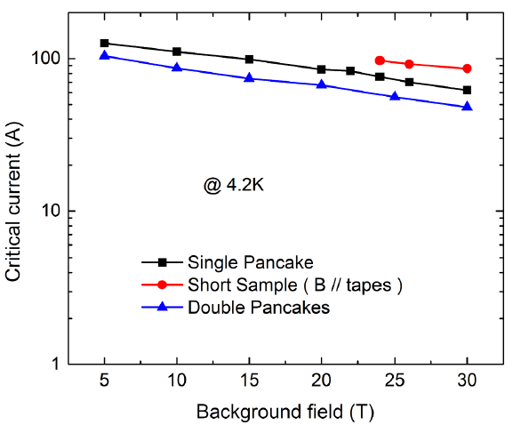
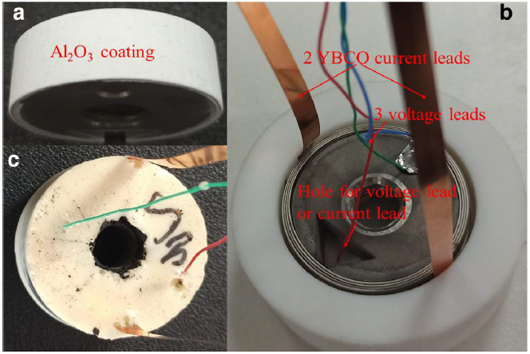
Powder-In-Tube 122 tapes: Pancake coils
New IBS pancake coils have been made, measured up to very high fields reaching 62 A @ 4.2 K, 30 T
35 T water-cooled magnet
(Hefei, China)
Qian et al., Physica C 580 (2021) 1353787

Slide 23

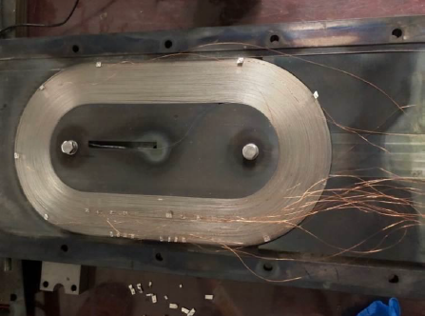
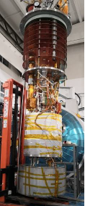
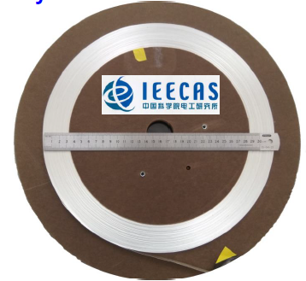

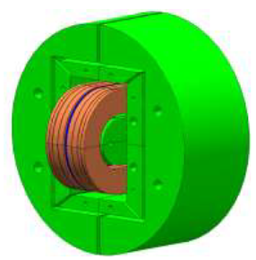
IBS Racetrack coils made using the 100 m long tapes
720 mm×257 mm
65 A
J_{c}(coil) = 87% J_{c}(short tape) @ 10 T
Parameters | Values (mm)
Thickness of coil winding | 57.6
Width of coil | 235.2
Width of coil winding | 4.66
Length of straight part of coil | 200
Thickness of SS tape | 0.3
Turns | 96
Bending radius | 60
Metal-as-insulation technique
Wind & react > 800 ºC
I_{c}~65 A @ 4.2 K, 10 T
  87 % of the short sample at 10T
7-filaments IBS 100-m long tapes
Tapes’ Parameters | Values (mm)
Thickness of IBS tape | 0.33
Width of IBS tape | 4.5
Non-SC/SC ratio | 5
Very promising for next generation accelerator!
Zhang et al., SuST 34 (2021) 035021

Slide 24

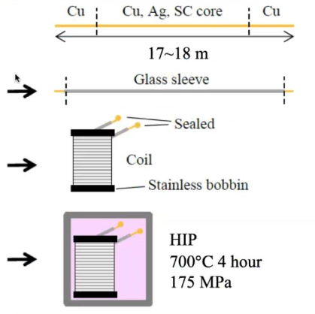



Powder-In-Tube HIP 122 wires: Coils
17~18 m mono- and 7-core Ba-122 wires
Wires covered by glass sleeve are wound on SS bobbins
HIP process is applied
(Wind & React)
Rapid increase in dissipation starts above 53 and 47 A for mono- and 7-core wires
segments of mono-core wire segments of 7-core wire
I_{c} of the whole coil wires are 30 and 18 A in self-field, corresponding H = 1.75 and 1.0 kOe for mono- and 7-core wires
A high J_{c} of 71 kA/cm² (I_{c} ~67 A) at 4.2 K, 10 T was measured in short segments picked up from the mono-core coil
Pyon et al., SuST 26 (2023) 015009

Slide 25







FeSe_{0.5}Te_{0.5} coated conductor tape and coil
FeSe_{0.5}Te_{0.5} single pancake coil (SPC) was fabricated and tested under magnetic field
(a)
laser
metal tape
Bare tape
heater
Target
PLD
One-meter long
Encapsulated tape
SPC
hybrid coil
test device
One-meter FeSe_{0.5}Te_{0.5} coated conductor tapes can be fabricated via PLD
The transport critical current of the SPC was 108 A at self-field and 17 A at 10 T, which is as same as the tape.
Wei et al., SuST 36 (2023) 04LT01

Slide 26







High Field Model Dipole Magnet: HTS Cable R&D
Courtesy of Prof. Qingjin Xu
Cable design
IBS transposed cable reached 1.3 kA
Schematic illustration of the transposed cable and the fabrication steps
The advantages of the designed cable:
High current-carrying compacity
Low dynamic loss
High mechanical stability
REBCO transposed cable reached 2 kA
J. Wang et al, Superconductivity 3 (2022) 100019

Slide 27







Platform for kilometer-scale IBS wire
Plant layout, ~3000 square meters
HIP furnace
Currently, a platform for the preparation of kilometer-scale long IBS wire is constructing in China.
Equipment in place
Wire drawing machine
Tape rolling machine
HIP furnace

Slide 28
Conclusions
Currently, iron-based wires and tapes are in the rapid development stage of research and development.
Transport J_{c} of 122-type IBS wires has been significantly improved, and has surpassed the practical level at 4.2 K & 10 T with a maximum of 2.2×10⁵ A/cm².
Transport J_{c} of 100-m-class Ba-122 IBS tapes was further improved to > 6×10⁴ A/cm² at 10 T & 4.2 K.
Highlights some remarkable advances of IBS relevant to practical applications, including superconducting joints, cable, the first IBS inserted coils and racetrack coils.
We believe that Fe-based wires are very promising for applications in high magnetic fields, e.g. >20 T at 4.2 K or >10 T at 20-30 K.

Slide 29






IBS Technology: Status and Outlook
Courtesy of Prof. Qingjin Xu
IBS solenoid at 32 T
Racetrack at 10 T
1.3 kA IBS Cable
Z. Zhao
IBS (T_{c} 55K)
100-m 7-core IBS tape fabricated
2008.02
2008.04
2008.09
2016
2018
2020
2022
Discovery of IBS
Discovery of
122 phase IBS
IBS solenoid at 24 T
Racetrack at 8 T
H. Hosono
IBS (T_{c} 26K)
The engineering current density of the long-length IBS still needs a significant improvement, to reach the similar level as ReBCO or Bi-2212 conductors.
The materials of stabilizer should be shifted to copper or any other low-cost metals to realize the low cost of IBS.
Structure and fabrication methods of IBS and corresponding coils should be further optimized to minimize the J_{c} degradation at high field and high stress.
Many other issues like detailed magnetic and mechanical properties study of IBS, quench detection and protection of the IBS coils/magnets and etc.

Slide 30
Contributors:
Xianping Zhang, Chao Yao, Chiheng Dong, Dongliang Wang, Zhongtang Xu, He Huang, Shifa Liu, Zhe Cheng, Yanchang Zhu, Meng Han, et al.
Institute of Electrical Engineering, CAS
Collaborators:
S. Awaji (I_{c}-B measurement)
HFLSM, Tohoku University, Japan
F. Kametani, C. Tarantini, E. Hellstrom, D. Larbalestier (STEM and GBs)
NHMFL, FSU, USA
Haihu Wen (Pinning properties)
Nanjing University, China
Huajun Liu (In-field I_{c} measurement)
IPP-CAS
W. K. Kwok, U. Welp (Irradiation)
Argonne National Laboratory, USA
T. Kiss (Characterizing local microstructure and homogeneity of wires)
Kyushu University, Japan
J. Hänisch, B. Holzapfel (J_{c} rising mechanism)
ITEP-KIT, Germany
Qingjin Xu (Coil design and fabrication)
IHEP-CAS
C. Senatore (I_{c} (T,B) measurement)
DQMP, Univ. Geneva

Slide 31









Projects on IBS & Financial support
CAS funded“Science and Technology Frontier Research for the Next Generation Superconducting Magnet Applications” within the Strategic Priority Research Program of CAS
MoST funded “Next Generation High-field Magnet Technology Based on Iron-based Superconductor” within the National Key R&D Program of China
NSFC funded “High-performance Fe-based Superconducting Materials for High Magnetic Field Applications”
within Major International (Regional) Joint Research Project

Slide 32


Thank you for your attention!
From a movie：Avatar

Slide 33

Strategies to further improve J_{c} in 122 PIT wires
To further reduce secondary phases at GBs.
To improve the texture degree,
especially increase the fraction of misorientation
angle <9º.
To further increase flux pinning force: (1) decrease grain size to make more GBs,
(2) increase point pinning sites, e.g. irradiation
or the introduction of nano-particle inclusion.
HP
Rolled
Ba122 tape
Courtesy: M. Bonura
& C. Senatore
Neutron Irradiation of
Ba122 Single Crystals
Courtesy: M. Eisterer

Slide 34

122 tapes – Strain properties
Sr-122/Ag tapes
7-filament Sr-122/Ag/Monel tapes
Liu et al., SuST 30 (2017) 07LT01
Yao et al. 2017 SuST 30 075010
Reversible critical currents under a large compressive strain of ε = –0.6%
Almost no J_{c} degradation under a large compressive strain of 0.6%
The I_{c} of 122 tapes exhibits less strain sensitivity than that of the Nb₃Sn, which is important for ITER application.

Slide 35



Straight
Bending test of 122 IBS tapes
Bent
Straighten
--Heated samples
122/Ag IBS tapes
SUS/(Ag-Sn)/Ba-122 tapes
width ~ 4.5 mm, thickness = 0.3 mm
Cooperated with Prof. Huajun Liu in IPP-CAS
Courtesy of H. Kumakura
The critical bending diameter is 4.4 cm for Sr-122/Ag tapes in thickness of 0.3 mm.
For high strength Ba-122 tapes, the bending diameter is even smaller, only of 2~3 cm.

Slide 36






Bending diameter of 7-filament 122/Ag tapes
By courtesy of Prof. Q. Xu at IHEP-CAS
Ratio = I_{c} (bending) / I_{c} (pristine~135A）
Good retention above Ф15 mm
Rapid decrease of I_{c} in the D10 sample
Cracks
Cracks in the D10 sample
Li et al., IEEE TAS 32 (2022) 7300304

Slide 37


122/Ag tape – Magnetization AC loss
single-core tapes
single-core tapes vs 7-core tapes
(Ag-etched)
Q _{1-Ba122/Ag – ecl} = Q_{1-Ba122/Ag} - Q_{ecl Ag-99%}
The AC loss for 7-core tapes reduced by ~50% at 20 K,
due to the negligible eddy current losses by using more resistive AgSn alloy outer sheath.
Due to highly conductive Ag sheath, large eddy current losses (ecl) was observed for single-core tape
Kovac et al., Cryogenics 116 (2021) 103281
*The difference observed between the extracted Q ecl (red lines) and those measured for etched Ag (green lines) could be attributed to different J_{c}s due to sample degradation

Slide 38


Thermal conductivity of composite Ba122 tapes
κ ∝B^{-α}
Thermal properties are dominated by the sheath materials
The thermal conductivity ranges from 1 to 1000 W/m K by adjusting the sheath materials
  @4.2 K：Cu/Ag: 400 W/m K at 0 T; >100 W/m K at 9 T--magnets
  SS/Ag: ~10 W/m K-- current leads
Atoms diffusion between different sheathes and superconducting cores
Supercond. Sci. Technol. 33, 075010 (2020)

Slide 39



J_{c} anisotropy of 122/Ag tapes
Awaji et al., SuST 30 (2017) 035018
Senatore et al., SuST 33 (2020) 095008
2.0
B= 10 T
B= 19 T
~2
1.5

C C
I / I
//
~1.5
4.2 K
~1
1.0
5
10 15
Temperature (K)
20
I_{c} < I_{c} only at low temperature and fields
//
┴
The I_{c} in applied magnetic fields is slightly higher in the perpendicular field (I_{c} ) than in the
//
parallel field (I_{c} ).
The anisotropy ratio (Г= I_{c} /I_{c} ) is quite low, less than 2, very good for applications.
⊥ ∥

Slide 40
n value of 122 tapes
Measured by Prof. Yang Univ. of Southampton, UK
Measured by Prof. Kiss Kyushu Univ., JP
Measured by Dr. Oguro HFLSM, Tohoku Univ., JP
I/Ic
At 20 K, the n value was over 30
At 4.2 K, 10 T, the n value was over 20

Slide 41




What makes a good superconducting wire?
Characteristics:
Superconductors
Commercial superconducting wires and tapes
Intrinsic
NbTi
Nb₃Sn
MgB₂
Low anisotropy
High J_{c}, H_{c2}
Chemically stable
Conductor design
Extrinsic
Low AC loss (Multifilament)
Thermal stability (Thermal quench)
Good mechanical strength (Lorentz force)
Scalable production (powders & wires)
Small aspect ratio: round wire
Low cost——Conundrum for HTSC
Bi2212
Ag
Bi2223
YBCO
Nature 414 (2001) 368

