Slide 1
Scaling law of the anisotropic magnetic field dependence of the critical current
of REBCO coated conductors
G. Succi, A. Ballarino, Y. Yang
HiTAT workshop, 9 March 2023
Information from [1]: CERN EDMS document no. 2747837, 2022.

Slide 2
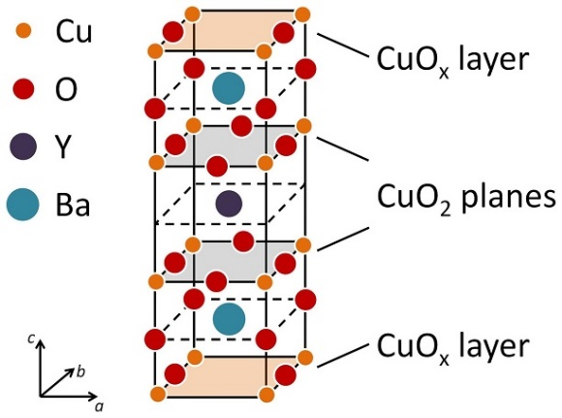
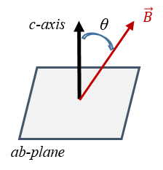

Introduction
Why do we need scaling laws?
Design and modelling of coils and other devices wound with REBCO tapes requires precise knowledge of their electrical properties.
REBCO is characterized by $I_{c}= I_{c}\left(B,T,θ\right).$
reproduced from [2]
Scaling laws describe tape properties over the full range of $B$, $T$, $θ$ with much lesser burden compared to a thorough experimental campaign.
[2] E. Stilp et al., Scientific reports, 2014.

Slide 3
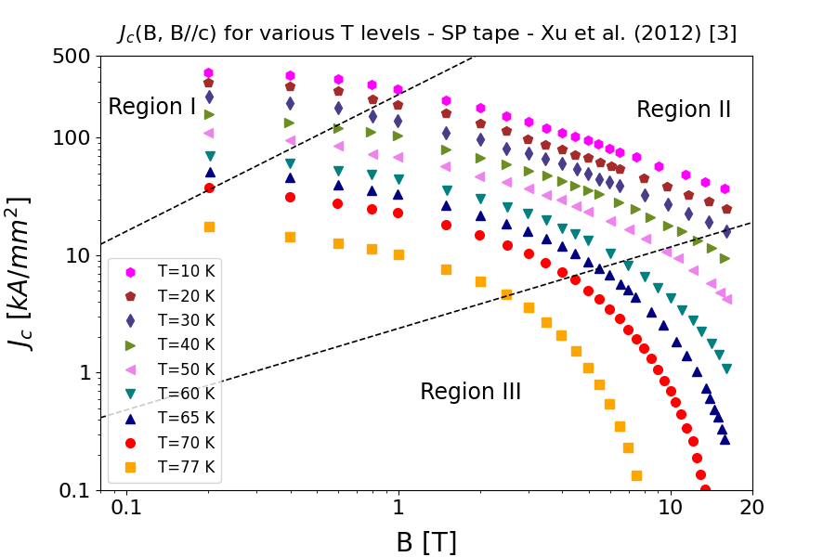


Phenomenology and physical interpretation
The $I_{c}(B)$ dependence is the combination of 3 regions in a log-log plot [3], [4].
[3] A. Xu et al., Physical Review B, 2012.
[4] C. Senatore et al., Supercond. Sci. Techn., 2016.
Region I: constant $I_{c,0}=I_{c,0}(T)$
Single vortex pinning regime
Region II: starts at $B_{0}=B_{0}(T)$, linear decrease
Collective pinning regime
Region III: approaching $B_{irr}=B_{irr}(T)$, rapid drop
Thermal activation towards transition to liquid vortex state

Slide 4
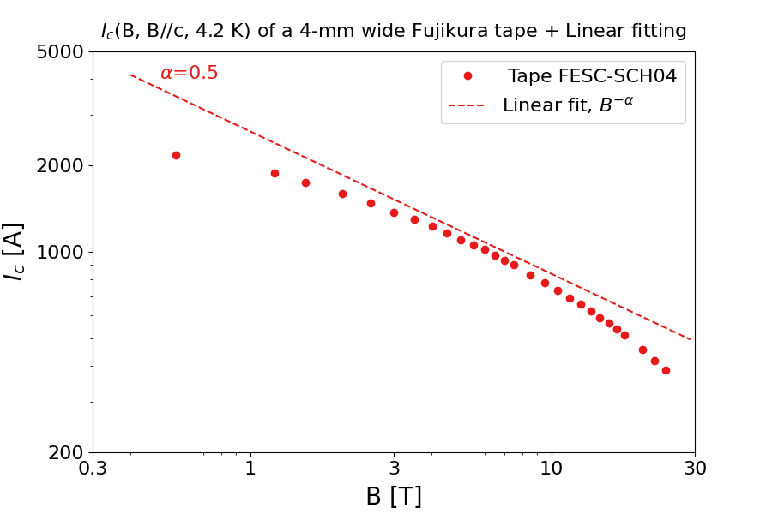




Past attempts at scaling laws
[4] C. Senatore et al., Supercond. Sci. Techn., 2016.
[5] A. Francis et al., Supercond. Sci. Techn., 2020.
[7] J. Fleiter and A. Ballarino”, CERN EDMS no. 1426239, 2014.
Data from [6]:
M. Daibo, “Recent progress of 2G HTS wires and coils at Fujikura”, AdvSCMws, 2019.
[8] J. van Nugteren, PhD thesis, 2016.
The scaling
Extending to the high-field region [7, 8]
$$I_{c}∝B^{−α}$$
$$I_{c}\left(B\right)=\frac{α}{B}⋅b^{p}⋅{\left(1−b\right)}^{q}$$
$b=\frac{B}{B_{irr}}$ , reduced field
$α$, $p$, $q$ fitting parameters
is valid over Region II
(3 T < B < 10 T) [4, 5].
This expression remains valid down to ~ 0.5 T - 1 T.

Slide 5
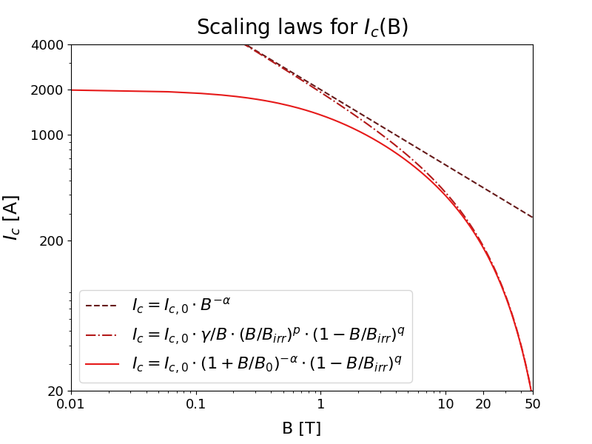
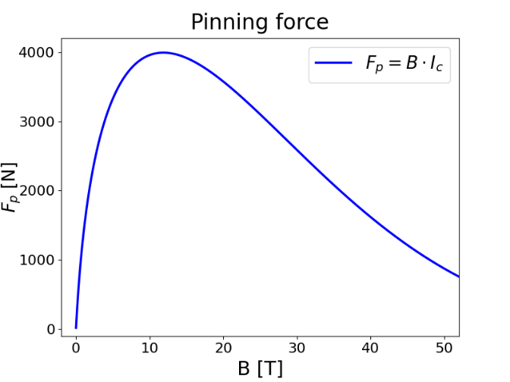

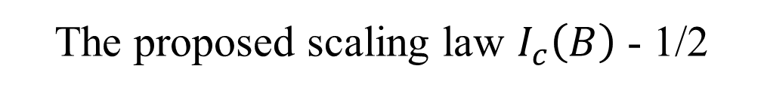

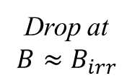



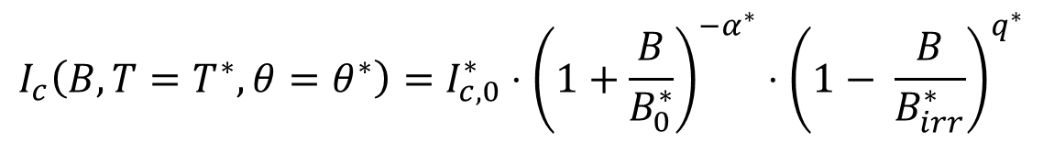

The proposed scaling law $I_{c}\left(B\right)$ - 1/2
$$I_{c}\left(B, T=T^{∗}, θ=θ^{∗}\right)=I_{c,0}^{∗}⋅{\left(1+\frac{B}{B_{0}^{∗}}\right)}^{−α^{∗}}⋅{\left(1− \frac{B}{B_{irr}^{∗}}\right)}^{q^{∗}}$$
$$I_{c,0}^{∗}=I_{c}(B=0, T^{∗})$$
$$B_{0}^{∗}=B_{0}(T^{∗}, θ^{∗})$$
$$α^{∗}=α^{∗} (T^{∗}, θ^{∗})$$
Plateau
Linear decrease
Drop at $B≈B_{irr}$
$$B_{irr}^{∗}=B_{irr}(T^{∗}, θ^{∗})$$
$$q=q (T^{∗}, θ^{∗})$$
Low-B plateau
Linear
decrease
Drop at
$$B≈B_{irr}$$

Slide 6
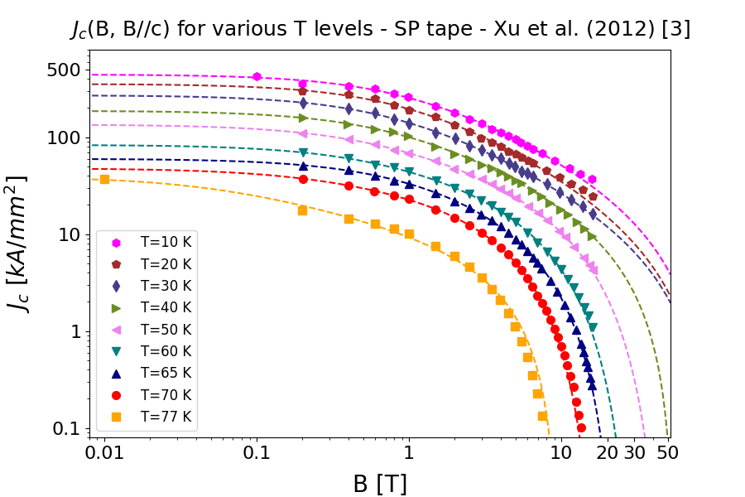
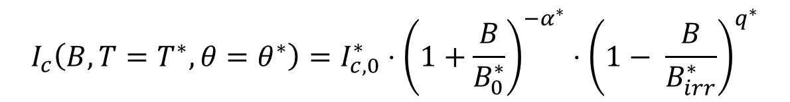
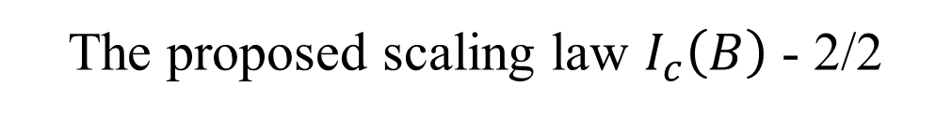
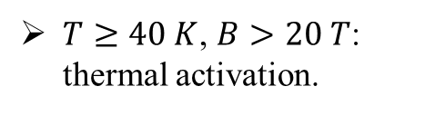
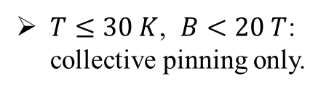
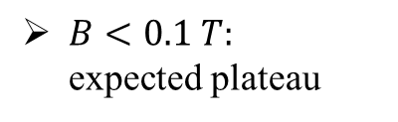
The proposed scaling law $I_{c}\left(B\right)$ - 2/2
$$I_{c}\left(B, T=T^{∗}, θ=θ^{∗}\right)=I_{c,0}^{∗}⋅{\left(1+\frac{B}{B_{0}^{∗}}\right)}^{−α^{∗}}⋅{\left(1− \frac{B}{B_{irr}^{∗}}\right)}^{q^{∗}}$$
[3] A. Xu et al.,
Physical Review B, 2012.
$B<0.1 T:$
expected plateau
$T≤30 K$, $B<20 T$: collective pinning only.
$T≥40 K$, $B>20 T$:
thermal activation.

Slide 7
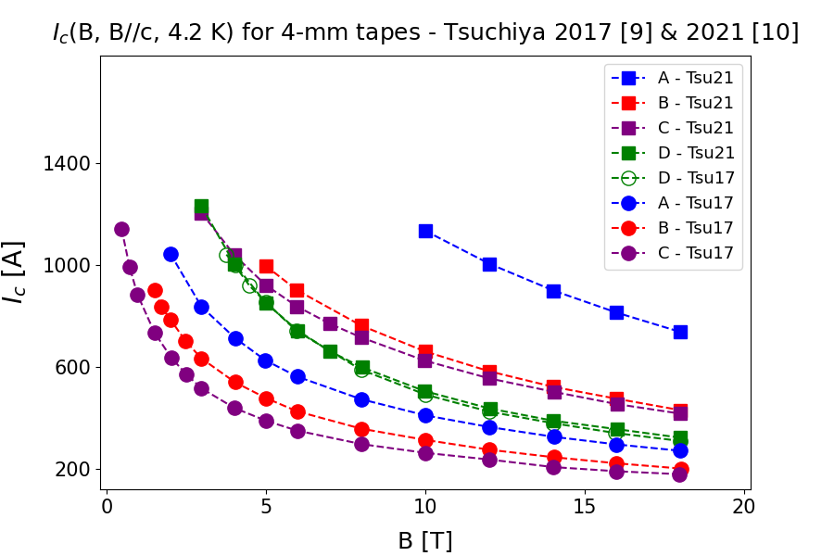
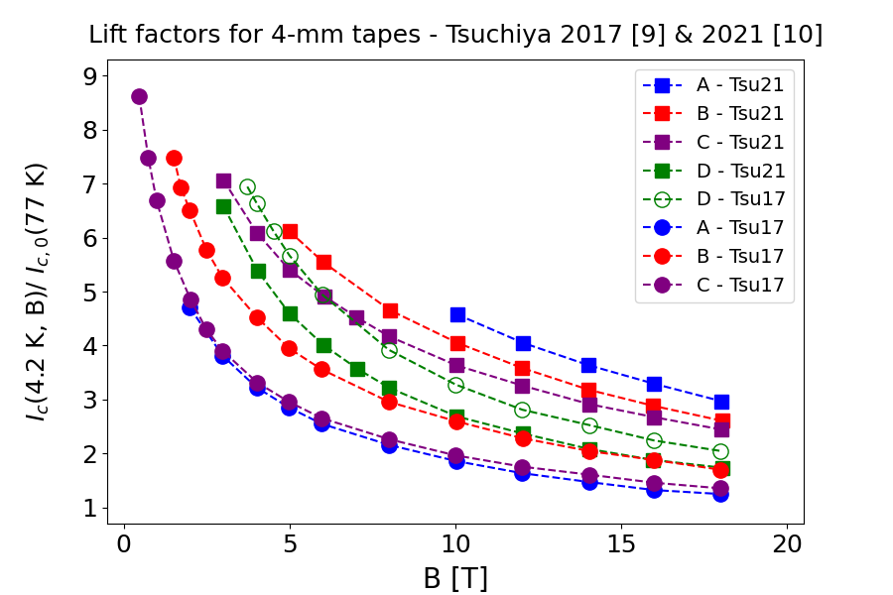
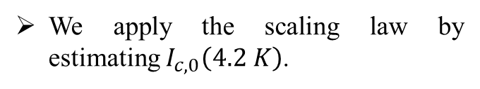


Data collected from literature - 1/2
Tsu21
Tsu17
Overall improvement of tape performance, for all manufacturers.
We apply the scaling law by estimating $I_{c,0}\left(4.2 K\right)$.
$I_{c,0}\left(4.2 K\right)=I_{c,0}\left(77 K\right)⋅ l_{f,0}$
$I_{c,0}\left(77 K\right)≈150 −200 A$ [10]
[9] K. Tsuchiya et al., Cryogenics, 2017.
[10] K. Tsuchiya et al., Supercond. Sci. Techn., 2021.

Slide 8
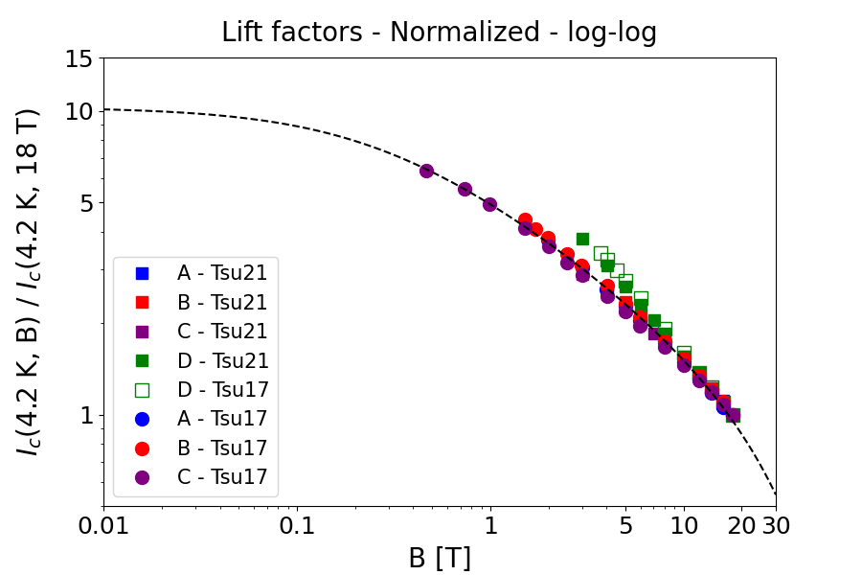
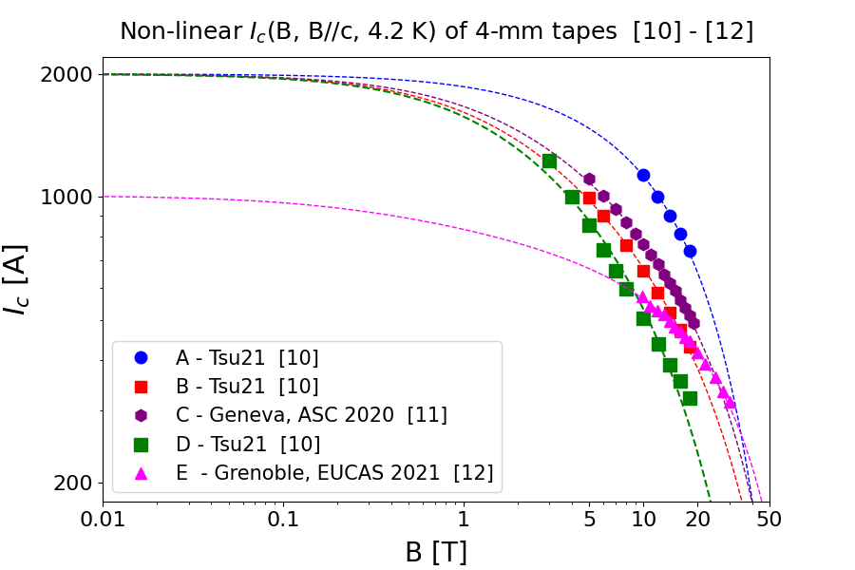
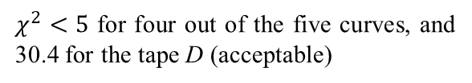
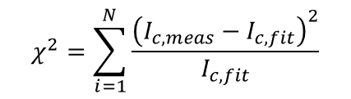



Data collected from literature - 2/2
$l_{f,norm}=\frac{l_{f}(4.2 K,B)}{l_{f}(4.2 K, 18 T)}=\frac{I_{c}(4.2 K,B)}{I_{c}(4.2 K, 18 T)}$
Scaling law used to extrapolate down to zero field (Data from D were excluded,
due to different pinning mechanism).
$$I_{c,0}\left(4.2 K\right)≈10⋅I_{c,0}(77 K)$$
  $=2000 A$ (upper limit)
Tapes tested in [10] - [12] dating back
to 3 years at most.
$$χ^{2}=\sum_{i=1}^{N}{\frac{{\left(I_{c,meas}−I_{c,fit}\right)}^{2}}{I_{c,fit}}}$$
$χ^{2}<5$ for four out of the five curves, and 30.4 for the tape D (acceptable)
[10] K. Tsuchiya et al., Supercond. Sci. Techn., 2021.
[11] “Recent advances in SuperOx 2G HTS wire”, Presented at ASC Conference, October 2020.
[12] W. Prusseit, “HTS-wire for high field magnet applications”, Presented at CERN, June 2021.

Slide 9
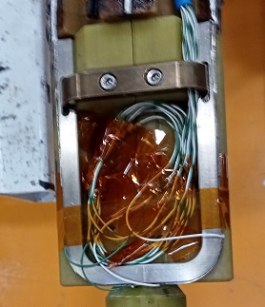
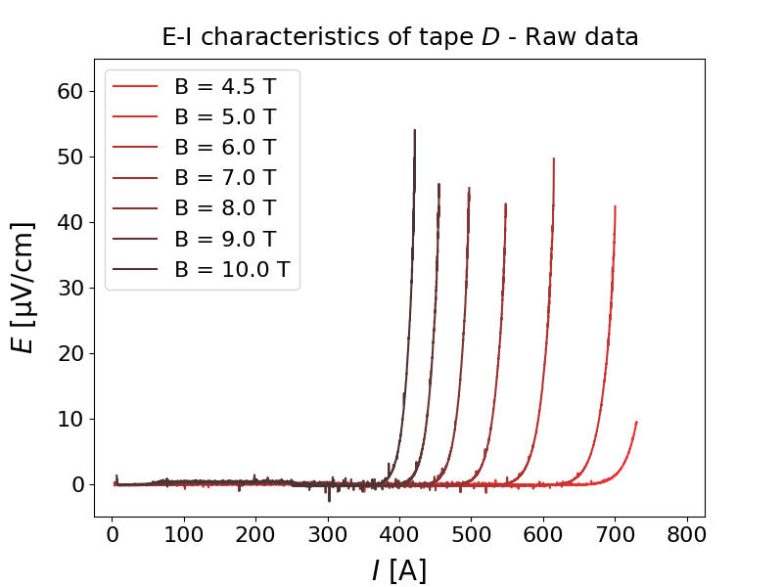
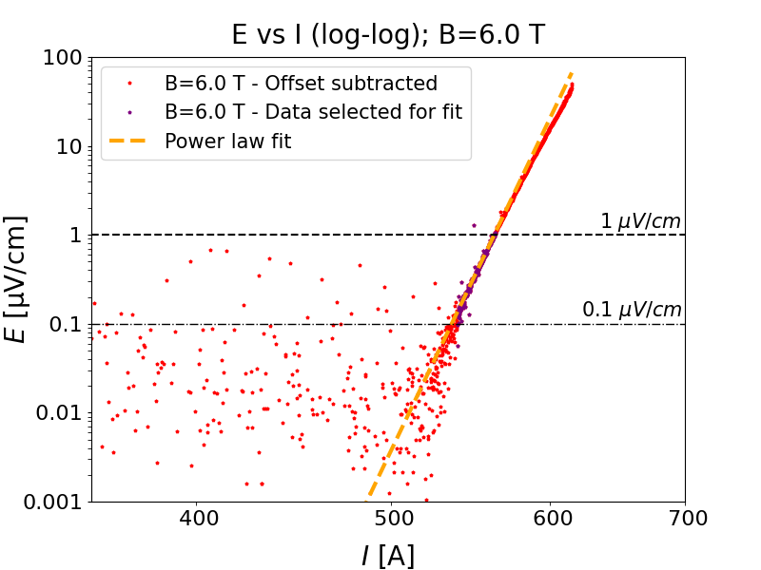
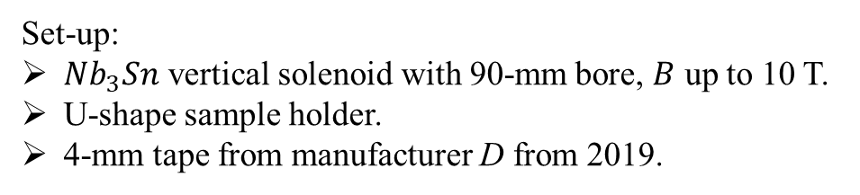
Exercise for performance extrapolation – 1/2
Our objective is to extend the data in the low-B region to validate the fit.
Set-up:
$Nb_{3}Sn$ vertical solenoid with 90-mm bore, $B$ up to 10 T.
U-shape sample holder.
4-mm tape from manufacturer D from 2019.

Slide 10
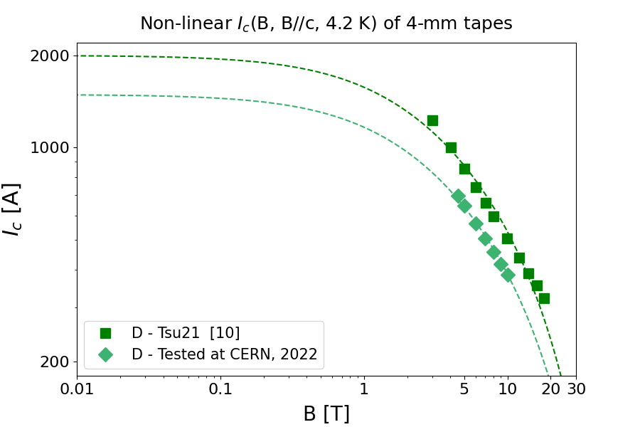
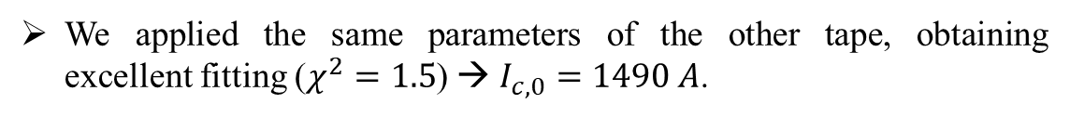
Exercise for performance extrapolation – 2/2
[10] K. Tsuchiya et al., Supercond. Sci. Techn., 2021.
Tape D measured at CERN was very similar to tape D tested in [10].
We applied the same parameters of the other tape, obtaining
excellent fitting ($χ^{2}=1.5$) → $I_{c,0}=1490 A$.

Slide 11
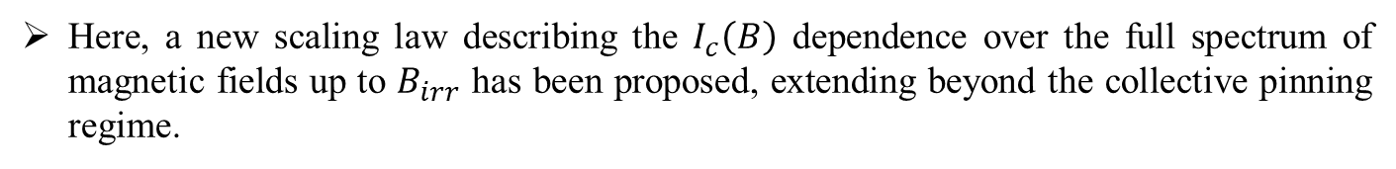
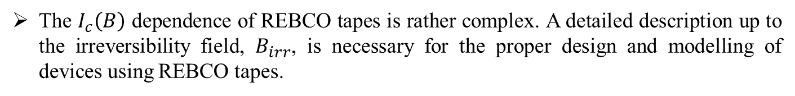
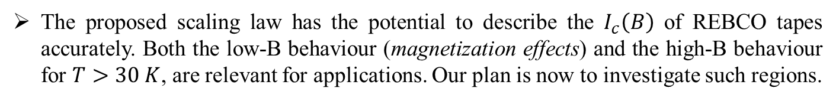
Conclusion
The $I_{c}\left(B\right)$ dependence of REBCO tapes is rather complex. A detailed description up to the irreversibility field, $B_{irr}$, is necessary for the proper design and modelling of devices using REBCO tapes.
Here, a new scaling law describing the $I_{c}\left(B\right)$ dependence over the full spectrum of magnetic fields up to $B_{irr}$ has been proposed, extending beyond the collective pinning regime.
The scaling law has been applied successfully to sets of data available over a complete range of fields (0 – 20 T) from an old publication [3], as well as on partial field ranges available for recent tapes [10] – [12].
The achieved fitting quality is good also in the case $B_{0}$ and $α$ are available from other measurements (e.g. from the manufacturer).
The proposed scaling law has the potential to describe the $I_{c}\left(B\right)$ of REBCO tapes accurately. Both the low-B behaviour (magnetization effects) and the high-B behaviour for $T>30 K$, are relevant for applications. Our plan is now to investigate such regions.
[3] A. Xu et al., Physical Review B, 2012.
[10] K. Tsuchiya et al., Supercond. Sci. Techn., 2021.
[11] “Recent advances in SuperOx 2G HTS wire”, Presented at ASC Conference, October 2020.
[12] W. Prusseit, “HTS-wire for high field magnet applications”, Presented at CERN, June 2021.

Slide 12
Thank you for your attention !!

Slide 13
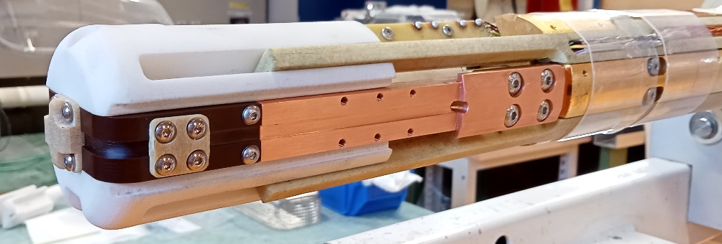
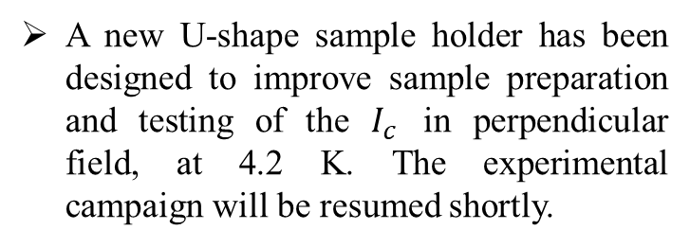
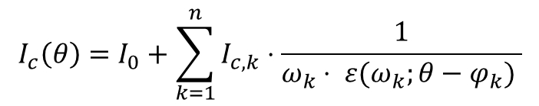
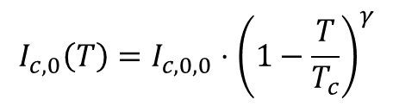
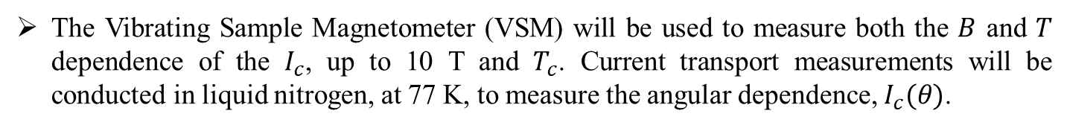
Next steps
A new U-shape sample holder has been designed to improve sample preparation and testing of the $I_{c}$ in perpendicular field, at 4.2 K. The experimental campaign will be resumed shortly.
The Vibrating Sample Magnetometer (VSM) will be used to measure both the $B$ and $T$ dependence of the $I_{c}$, up to 10 T and $T_{c}$. Current transport measurements will be conducted in liquid nitrogen, at 77 K, to measure the angular dependence, $I_{c}(θ)$.
This will be done with the aim to validate both the temperature and angular scaling:
$$I_{c,0}\left(T\right)=I_{c,0,0}⋅{\left(1−\frac{T}{T_{c}}\right)}^{γ}$$
$$I_{c}\left(θ\right)=I_{0}+\sum_{k=1}^{n}{I_{c,k}⋅\frac{1}{ω_{k}⋅ ε(ω_{k};θ−φ_{k}) }}$$
[13]

Slide 14
References
[1] G. Succi, A. Ballarino, Y. Yang, “Scaling law for the magnetic field, temperature, and angular dependence of the critical current of REBCO coated conductors”, CERN EDMS document no. 2747837, September 2022.
[2] E. Stilp et al., “Controlling the near-surface superfluid density in underdoped $YBa_{2}Cu_{3}O_{6+x}$ by photo-illumination”, Scientific reports, 2014.
[3] A. Xu et al., “Role of weak uncorrelated pinning introduced by $BaZrO_{3}$ nanorods at low temperature in $\left(Y,Gd\right)Ba_{2}Cu_{3}O_{x}$ thin films”, Physical Review B, 2012.
[4] C. Senatore et al. , “Field and temperature scaling of the critical current density in commercial REBCO coated conductors”, Supercond. Sci. Techn., 2016.
[5] A. Francis et al. , “Development of general expressions for the temperature and magnetic field dependence of the critical current density in coated conductors with variable properties”, Supercond. Sci. Techn., 2020.
[6] M. Daibo, “Recent progress of 2G HTS wires and coils at Fujikura”, AdvSCMws, 2019.
[7] J. Fleiter and A. Ballarino, “Parameterization of the critical surface of REBCO conductors at Fujikura”, CERN EDMS document no. 1426239, 2014.

Slide 15
References
[8] J. van Nugteren, “High temperature superconductor accelerator magnets”, PhD thesis, Twente University, 2016.
[9] K. Tsuchiya et al., “Critical current measurement of commercial REBCO conductors at 4.2 K”, Cryogenics, 2017.
[10] K. Tsuchiya et al., “Superconducting properties of commercial REBCO-coated conductors with artificial pinning centers”, Supercond. Sci. Techn., 2021.
[11] “Recent advances in SuperOx 2G HTS wire manufacturing facilities, performance and customization”, Presented at ASC Conference, October 2020.
[12] W. Prusseit, “HTS-wire for high field magnet applications. Future REBCO capability in industry”, Presented at CERN, June 2021.
[13] D. K. Hilton, A. V. Gavrilin, U. P. Trockiewitz, “Practical fit functions for transport critical current versus field magnitude and angle data from (RE)BCO coated conductors at fixed low temperatures and in high magnetic fields”, Supercond. Sci. Techn., 2015.

Slide 16
Appendix

Slide 17


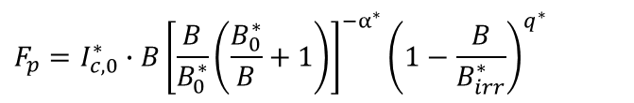



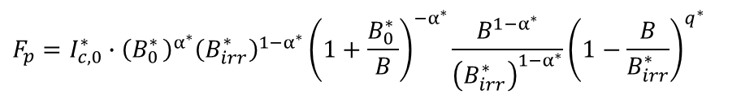

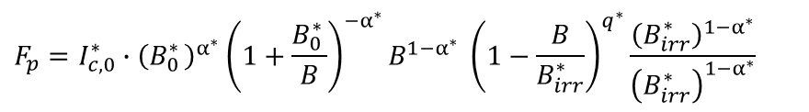



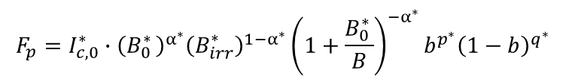

Calculations on the scaling law – Foundations in the physics of pinning
$F_{p}=I_{c}∙B=I_{c,0}^{∗}∙B{\left(1+\frac{B}{B_{0}^{∗}}\right)}^{−α^{∗}}{\left(1−\frac{B}{B_{irr}^{∗}}\right)}^{q^{∗}}$ ;
$$F_{p}=I_{c,0}^{∗}∙B{\left[\frac{B}{B_{0}^{∗}}\left(\frac{B_{0}^{∗}}{B}+1\right)\right]}^{−α^{∗}}{\left(1−\frac{B}{B_{irr}^{∗}}\right)}^{q^{∗}}$$
$F_{p}=I_{c,0}^{∗}∙B^{1−α^{∗}}{\left(B_{0}^{∗ }\right)}^{α^{∗}}{\left(1+\frac{B_{0}^{∗}}{B}\right)}^{−α^{∗}}{\left(1−\frac{B}{B_{irr}^{∗}}\right)}^{q^{∗}}$;
$$F_{p}=I_{c,0}^{∗}∙{\left(B_{0}^{∗ }\right)}^{α^{∗}}{\left(1+\frac{B_{0}^{∗ }}{B}\right)}^{−α^{∗}}B^{1−α^{∗}} {\left(1−\frac{B}{B_{irr}^{∗}}\right)}^{q^{∗}}\frac{{\left(B_{irr}^{∗ }\right)}^{{1−α}^{∗}}}{{\left(B_{irr}^{∗ }\right)}^{{1−α}^{∗}}}$$
$$F_{p}=I_{c,0}^{∗}∙{\left(B_{0}^{∗ }\right)}^{α^{∗}}{\left(B_{irr}^{∗ }\right)}^{{1−α}^{∗}}{\left(1+\frac{B_{0}^{∗ }}{B}\right)}^{−α^{∗}}\frac{B^{1−α^{∗}}}{{\left(B_{irr}^{∗ }\right)}^{{1−α}^{∗}}}{\left(1−\frac{B}{B_{irr}^{∗}}\right)}^{q^{∗}}$$
$$F_{p}=I_{c,0}^{∗}∙{\left(B_{0}^{∗ }\right)}^{α^{∗}}{\left(B_{irr}^{∗ }\right)}^{{1−α}^{∗}}{\left(1+\frac{B_{0}^{∗ }}{B}\right)}^{−α^{∗}}b^{p^{∗}}{\left(1−b\right)}^{q^{∗}}$$
$b=\frac{B}{B_{irr}^{∗ }}$ ;
$$p^{∗}=1−α^{∗}$$
$$F_{p,0}$$
where
$$F_{p,0}=I_{c,0}^{∗}∙{\left(B_{0}^{∗ }\right)}^{α^{∗}}{\left(B_{irr}^{∗ }\right)}^{{1−α}^{∗}}$$
$$\left[A\right]$$
$${\left[T\right]}^{α^{∗}}$$
$${\left[T\right]}^{1−α^{∗}}$$
$$\left[N\right]$$

