Slide 1
HTS magnet at CEA and HTS Cable for I.FAST CCT
Thibault Lécrevisse on behalf of CEA and I.FAST HTS team
thibault.lecrevisse@cea.fr

Slide 2
Outline
HTS dipole previous programs at CEA
MI technology and pancake coils for NOUGAT
MI approach for high field dipole (future CERN-CEA HTS collaboration)
Introduction to I.FAST CCT design and cable

Slide 3

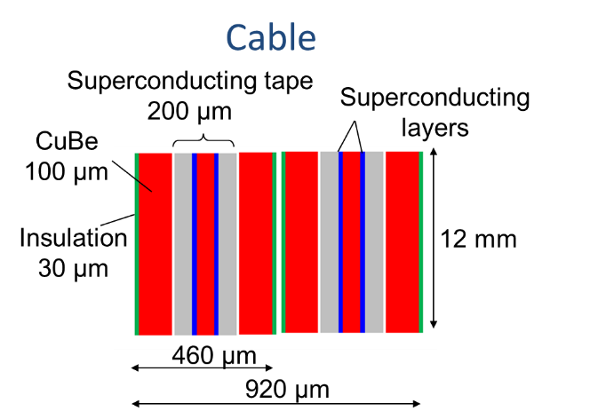
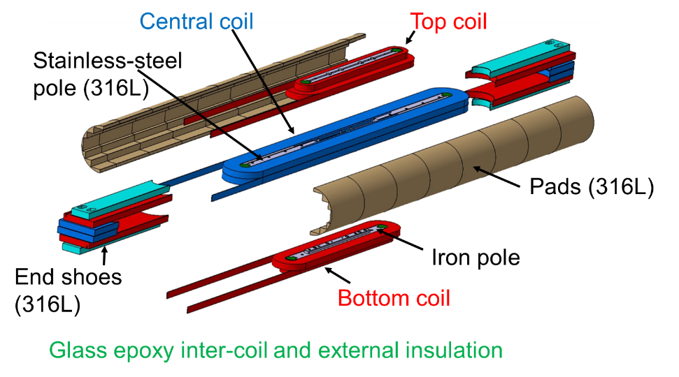
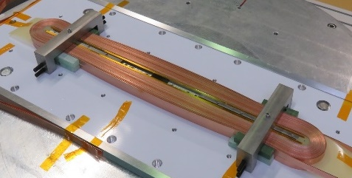
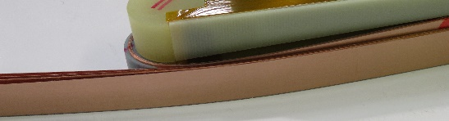
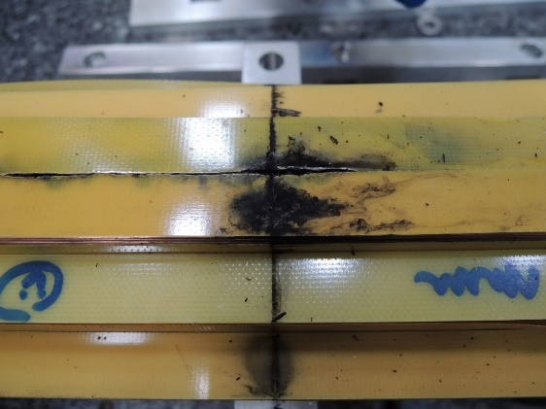
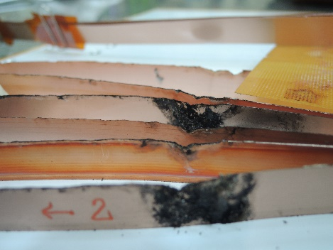
1. HTS dipole previous programs at CEA
EuCARD HTS insert : a racetrack block design without aperture
Smooth winding
No impregnation
After tests
Magnetic Field Generation fine even if damages (high margins)
Important screening currents
Insulation or mechanical issue ?

Slide 4

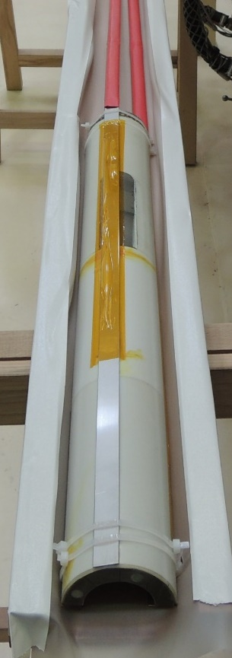
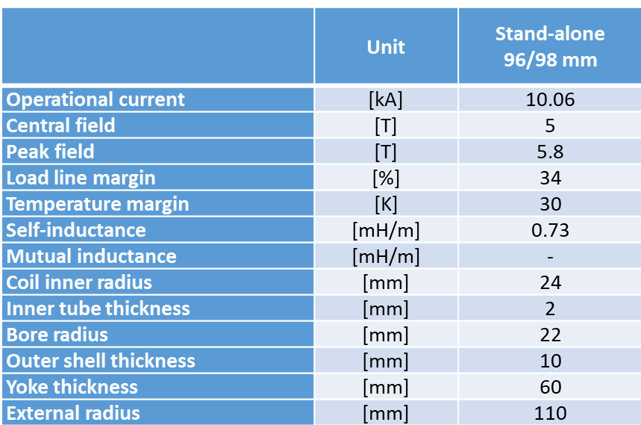


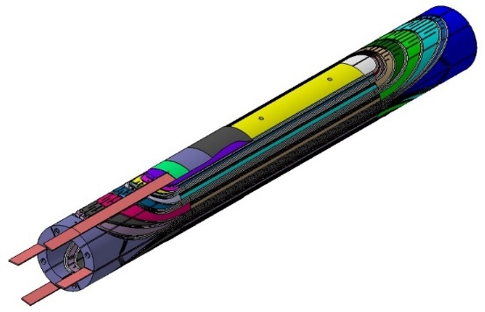
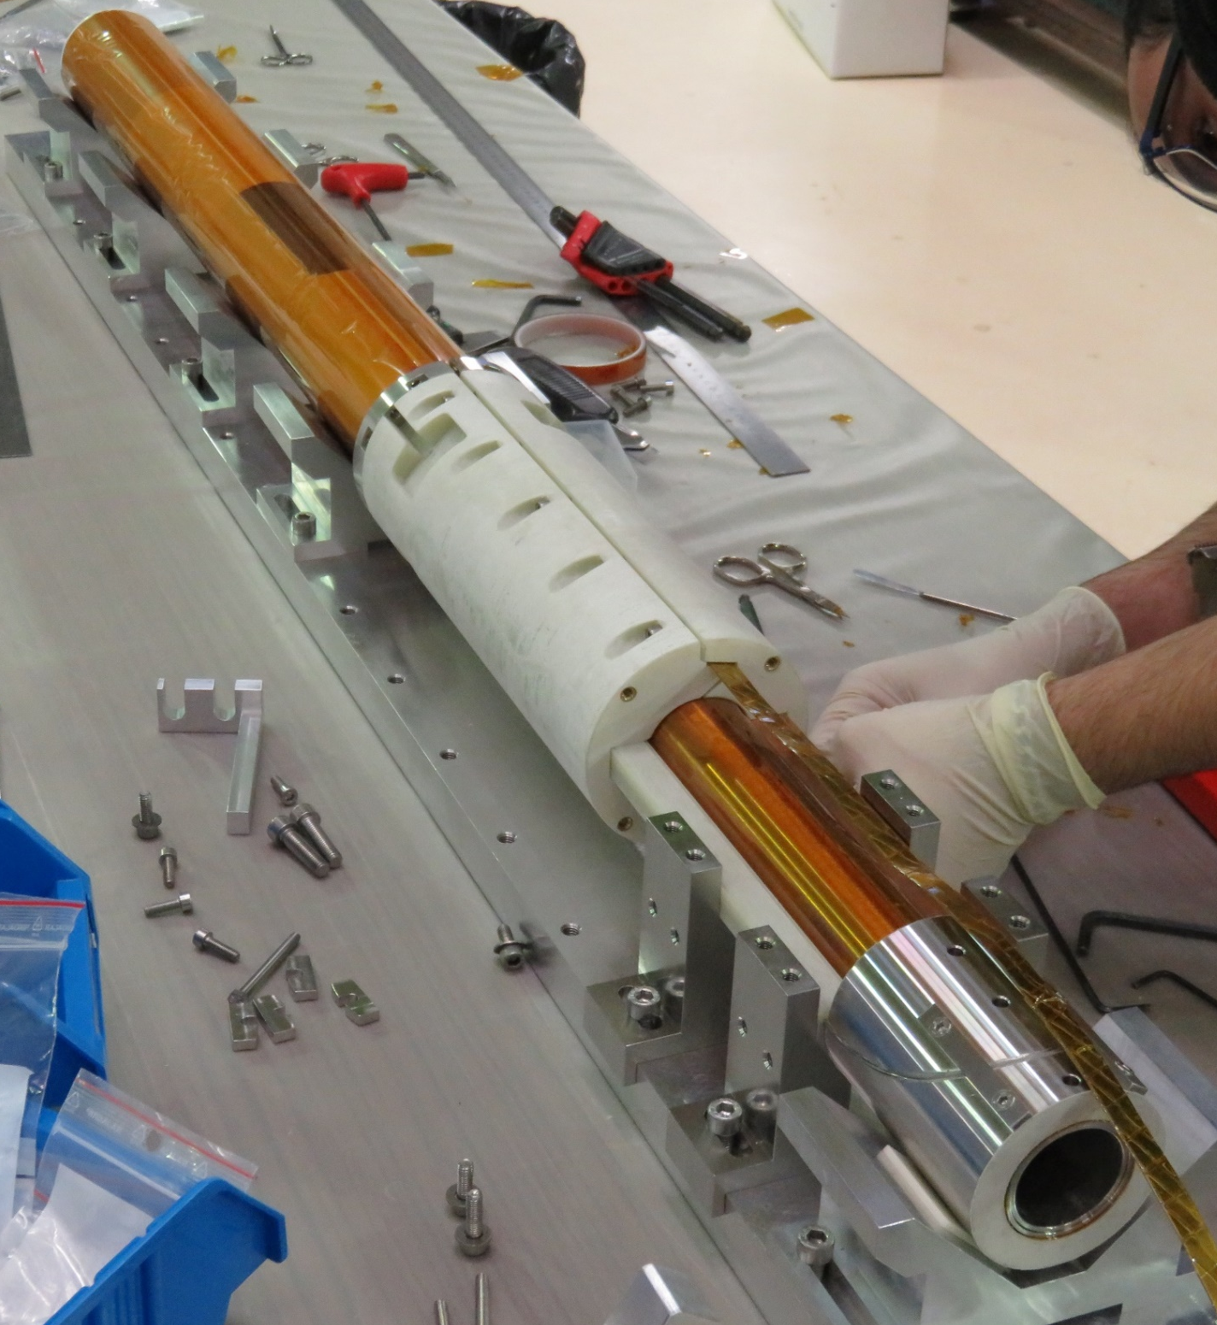

1. HTS dipole previous programs at CEA
EuCARD2 cosθ HTS insert
Roebel cable (CERN procurement)
3 kA
$\sim$ 1.5 T
X 3
insulated and impregnated
Current limited by SCB03 coil with homogeneous I_{c} degradation due to overheating during fabrication process (no quench)
Coils
Joint box
Leads
Standalone results measurements at CERN : see F. Mangiarotti’s talk 10/03 at 11:15

Slide 5


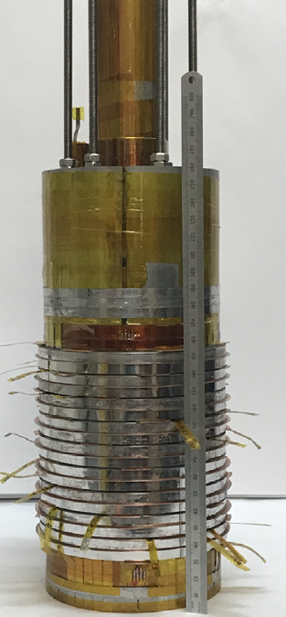
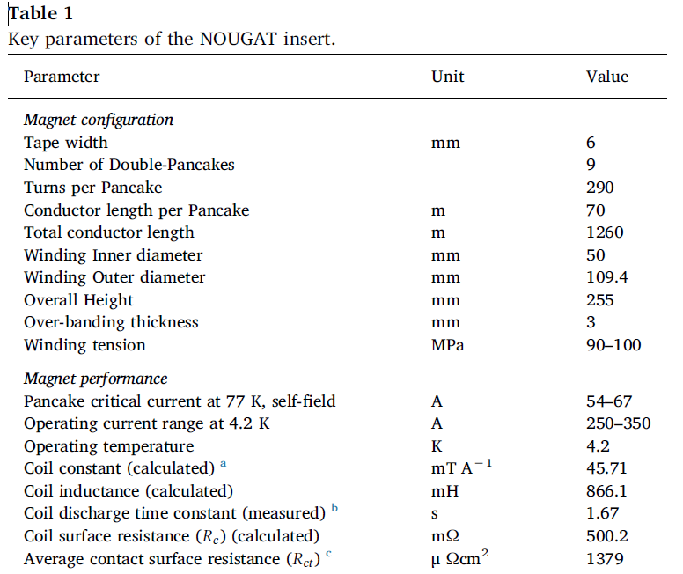
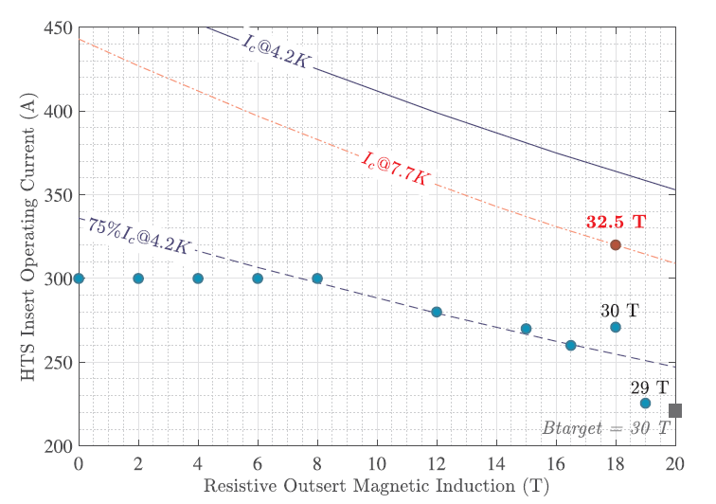
2. MI technology and NOUGAT pancake coil
MI technology : dry co-winding of one REBCO tape and one Durnomag® 30µm-thick tape
Relatively fast charging
High performances
Quench tolerant (Quench at full field)
Background issues tolerant
Mechanically weak electrical connections
Warming up during charging
Cooling issues (GHe bubbles trapped)
Quite a nice technology to lower the risks during the developments
https://doi.org/10.1016/j.cryogenics.2020.103053

Slide 6
3. MI approach for high field dipole (future CERN-CEA HTS collaboration)
Feedback from previous programs :
Need to start from standalone “simple coils”
Developments are required before going to complex cables (high current, low AC losses)
MI like winding might be a good way for improving knowledge on high field REBCO dipoles
  Develop tape/stack winding technology
  Develop low resistance and mechanically strong electrical joints
  Develop innovative magnet conception (dry winding with thin tape…)
  Test coils in strong conditions (J_{e}, mechanics, cycling…) with less risks on protection
  … Even if such technology might not be suitable for all magnets (AC losses/field quality…)

Slide 7
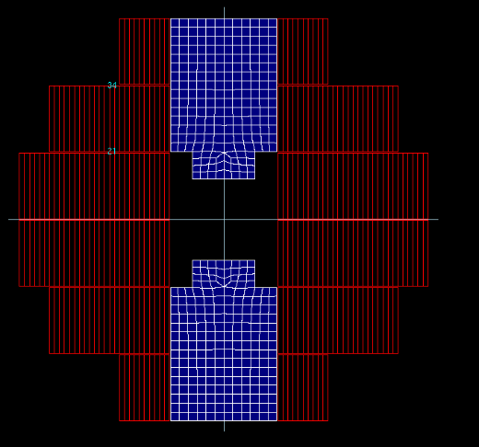
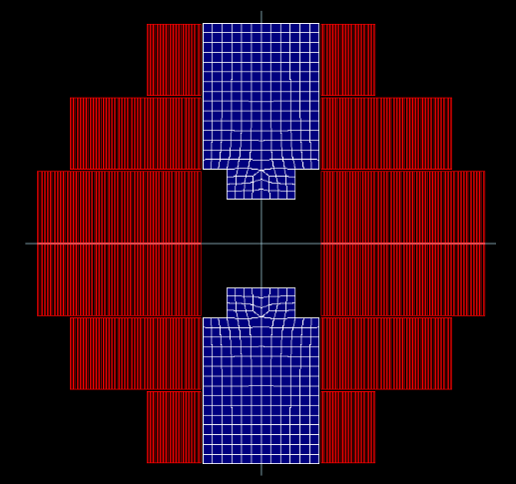
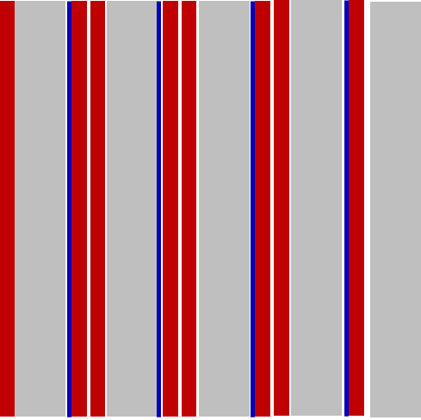
3. MI approach for high field dipole (future CERN-CEA HTS collaboration)
MI : very compact
Are existing models able to predict magnet behavior?
What winding parameters (R_{ct}, k_{r}) are adapted to accelerator magnets ?
Can we design and built reliable mock-up / magnet?
Can we reach very high dipole magnetic fields without damages ?
About 5 T @ 2800 A
J_{e} = 250 A/mm²
(225 m 12 mm-w cable)
About 16 T @ 2800 A
J_{e} = 850 A/mm²
(1800 m of 12 mm- w tape)
Insulated :
2 x 460 µm
(4 x Sc)
MI : 4 x 56 µm
+ 50 µm SuS
Easier protection
Compact magnet (HTS volume)
Start from existing work (EUCARD)

Slide 8
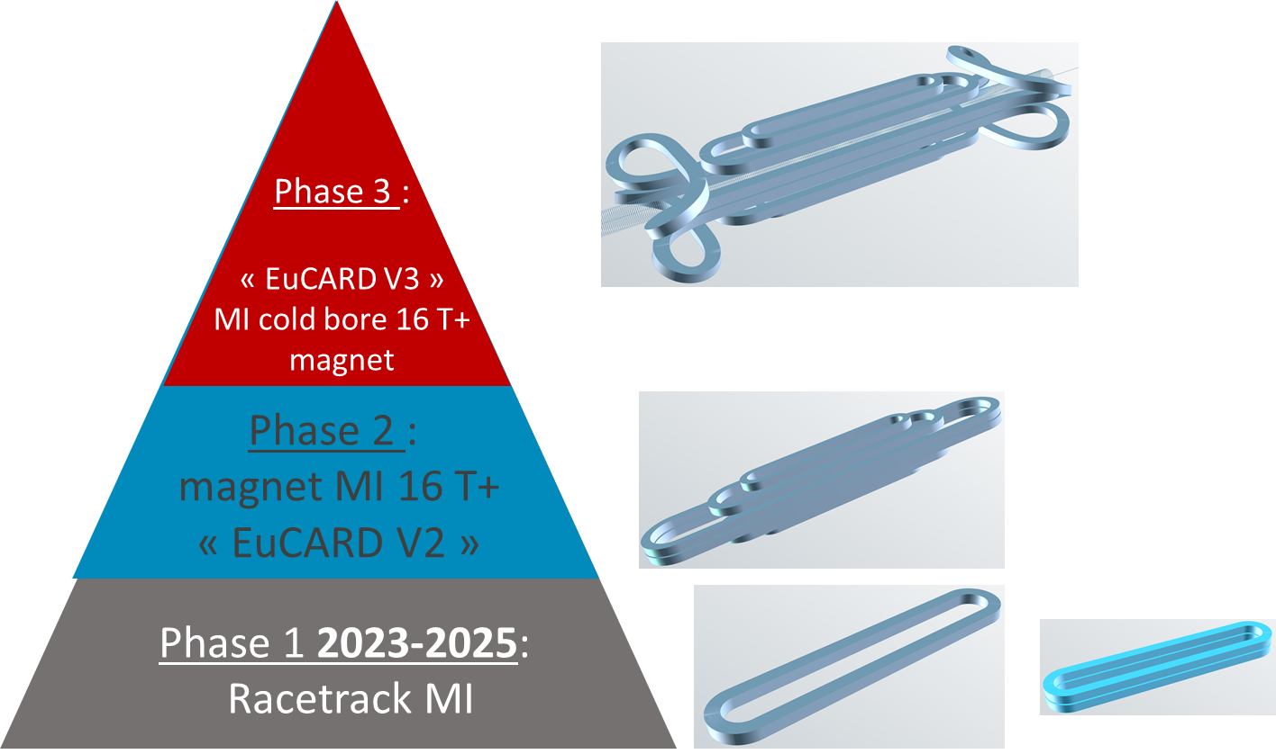
3. MI approach for high field dipole (future CERN-CEA HTS collaboration)
What kind of developments ?
What design for a cold bore?
“Eucard like block magnet”
“Simple Racetrack”
On final phase of approval

Slide 9
3. MI approach for high field dipole (futur CERN-CEA HTS collaboration)
Parametric study (R_{ct}, k_{r}, coil length, turn to turn pressure…)
Screening current effects
Quench / transient study
Prototype design for benchmark
Electromagnetic MI
PEEC model
Winding
Structure
Electrical connections
Conception / Mechanics
Fabrication and tests
Racetrack coil winding + assembly + tests
Radial thermal conduction measurements (dry stacks)
Validation of models for magnet designs

Slide 10
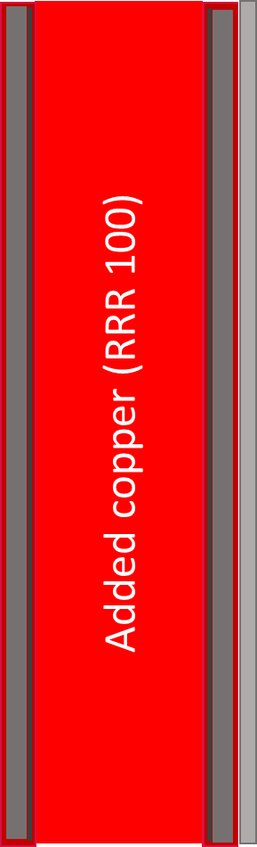
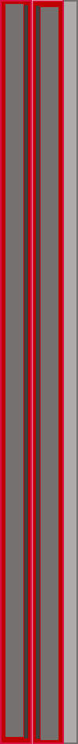
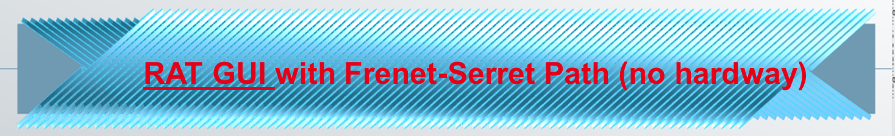


4. Introduction to I.FAST CCT design and cable
An introduction to the preliminary design and cable (update from Stefano Sorti’s (INFN) talk 10/03 at 10:00)
Parameters | Values | unit
Central magnetic field B₀ | 4 | T
Nominal current | < 2 | kA
Magnetic and physical length | 0.8, 1 | m
Bore diameter | 80 | mm
dB/dt | 0.4 | T/s
Operating temperature | 10 | K
Temperature margin at 10 K | > 10 | K
Superconductor | ReBCO | -
HTS cable : tape based (available/cost)
Limit AC losses : 4 mm wide tape
Thin HTS tape : 66 µm thick
Insulated or Metal-as-Insulation (Resistive)
Single REBCO tape
MI dual tape cable
Stainless
steel tape
Insulator
This project has received funding from the European Union’s Horizon
2020 Research and Innovation program under GA No 101004730

Slide 11
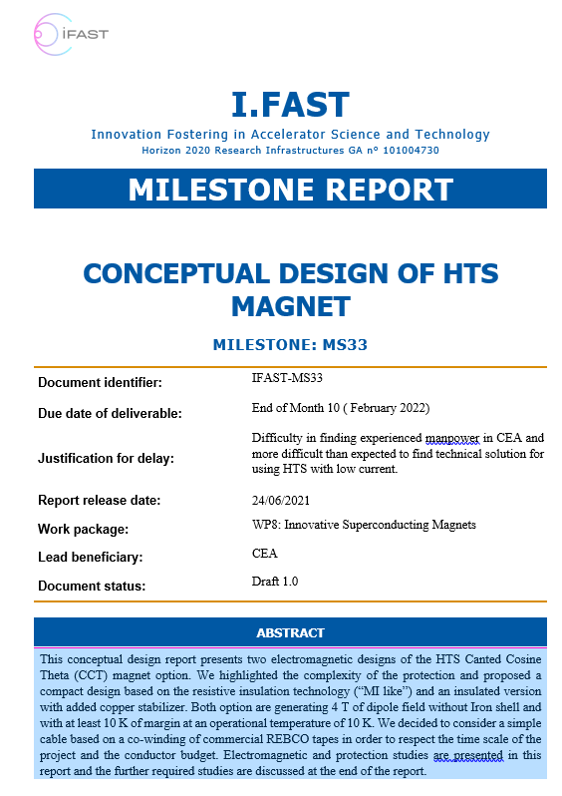
4. Introduction to IFAST CCT design and cable
Preliminary study (IFAST MS33) :
Parameter | Unit | MI | Insulated
Inductance | mH | 117.9 | 139.8
Stored Energy | kJ | 71.0 | 82.9
Cable current | A | 1100 | 1090
Groove current density | A/mm² | 1698 | 618
B₀ | T | 4
Turns per layer | - | 85 | 88
Cable per groove | - | 18 | 19
Cable path section | mm x mm | 4 x 2.9 | 4 x 8.4
Frame length (In / out) | m | 36.3 / 39.3 | 38.3 / 43.2
Total Length (cable / Tape) | km | 1.5 / 3.0 | 1.7 / 3.4
280 µm Copper thickness estimation (for insulated design) : hot spot criteria and quench propagation

Slide 12
4. Introduction to IFAST HTS CCT design and cable
Many open questions….
Protection CCT :
  Insulated : Require very fast, low voltage detection (< 5 mV in 13 V of inductive voltage, < 60 ms)
  MI : Unknown at this time (voltage limitation…)
Losses : Radial (MI design) and AC (both designs)
MI design : Turn to turn resistance (R_{ct}) requirement to reach acceptable radial losses / field quality ?
HTS tape amount (Dual tapes cable in MS33 → more tapes for thermal margins)?
Series electrical connections (18 cables from inner to outer layer) → conception & fabrication challenge
Developments : Grooves and winding
… which require 3D computing (ongoing, see Stefano Sorti’s (INFN) talk 10/03 at 10:00)

Slide 13

Thank you for your attention

