Slide 1
AC loss in round cables with helically arranged HTS tapes
Fedor Gömöry
Institute of Electrical Engineering, Slovak Academy of Sciences, Bratislava, Slovakia
Contributions:
Mykola Solovyov, Marek Mošať, Tomáš Kujovič, Ján Šouc
Institute of Electrical Engineering, Slovak Academy of Sciences, Bratislava, Slovakia
Tiemo Winkler, Kei Sugita
GSI Helmholtzzentrum für Schwerionenforschung GmbH, Darmstadt, Germany
Marc Dhallé, H.J.G. Krooshoop
TNW-EMS, University of Twente, Enschede, The Netherlands
AC loss in round cables from helically arranged HTS tapes I.FAST WP8 Task 8/6 Collaboration Presented at the 1st HiTAT workshop / 9-10 March 2023 at CERN, Geneva

Slide 2

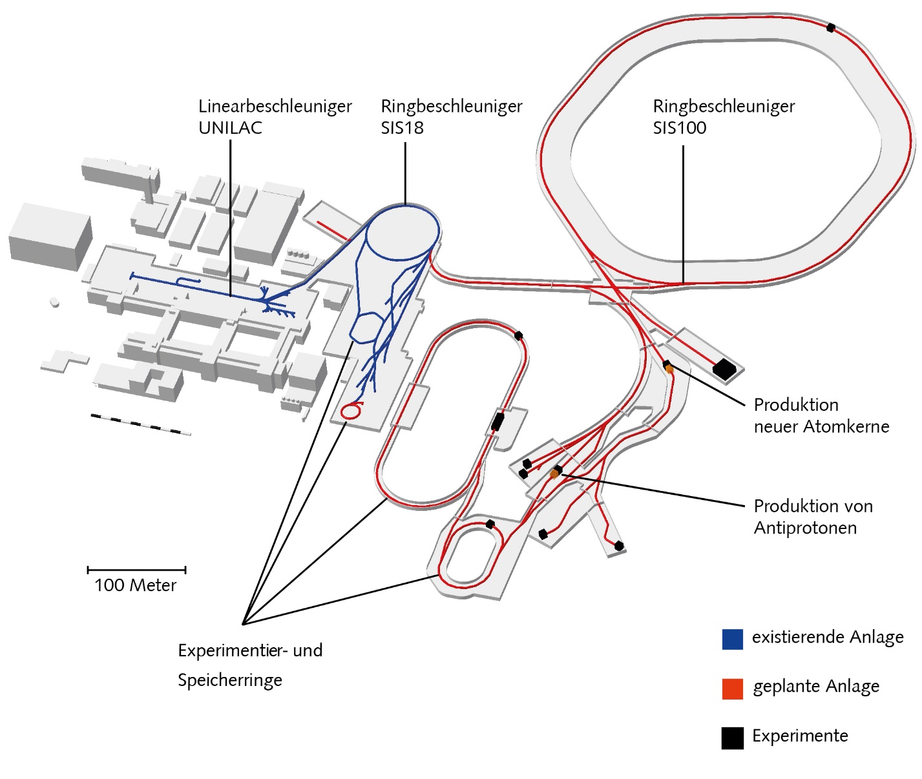

Motivation
Foreseen for SIS100 (FAIR):
F Kaether et al., (2021) 12th Int. Part. Acc. Conf.
doi:10.18429/JACoW-IPAC2021-TUPAB378
H G Khodzhibagiyan and A A Smirnov,
Proc. the 12th Int. Cryogenic Engineering Conf. (ICIC’12),
Southampton, UK, Jul. 1988, pp. 841–844. doi:10.1016/
B978-0-408-01259-1.50162-5
AC loss in round cables from helically arranged HTS tapes I.FAST WP8 Task 8/6 Collaboration Presented at the 1st HiTAT workshop / 9-10 March 2023 at CERN, Geneva

Slide 3
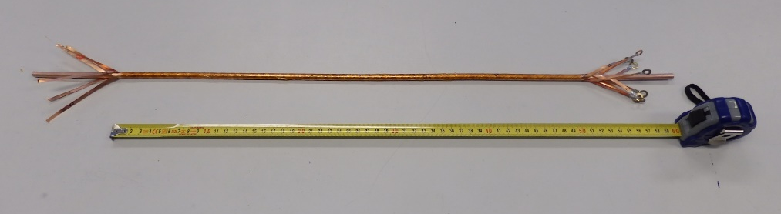



Motivation
Requirements on the cable:
13.2 kA at 1.9 T
Flexible
Forced flow of coolant
Low loss
Possible alternative: CORT
(Conductor-On-Round-Tube)
REBCO tapes
Central tube
X Wang et al., Supercond. Sci. Technol.
34 (2021) 015012
?
Forced flow of coolant
Flexibility
Transport capacity
AC loss
LHe (4.5 K)
AC loss in round cables from helically arranged HTS tapes I.FAST WP8 Task 8/6 Collaboration Presented at the 1st HiTAT workshop / 9-10 March 2023 at CERN, Geneva

Slide 4
Outline
Formula for estimating hysteresis loss in a round HTS cable
Comparison with low-T_{c} versions
Discussion and issues for further research
AC loss in round cables from helically arranged HTS tapes I.FAST WP8 Task 8/6 Collaboration Presented at the 1st HiTAT workshop / 9-10 March 2023 at CERN, Geneva

Slide 5


Formula for estimating hysteresis loss in round HTS cable
Assumption: magnetic field variation higher than the penetration field -> saturation of screening currents
Step 1: single tape (critical current I_{c}, width w) in perpendicular magnetic field
magnetic moment at saturation
$$m_{s}=\frac{I_{c}w}{4}L$$
B_{max} sin(2πft)
m_{s}
hysteresis loss per cycle and unit length:
m [Am²]
L
$$\frac{Q}{L}≈4B_{max}\frac{m_{s}}{L}=B_{max}I_{c}w$$
w
-m_{s}
-B_{max}
B_{max}
AC loss in round cables from helically arranged HTS tapes I.FAST WP8 Task 8/6 Collaboration Presented at the 1st HiTAT workshop / 9-10 March 2023 at CERN, Geneva

Slide 6



Formula for estimating hysteresis loss in round HTS cable
Assumption: magnetic field variation higher than the penetration field -> saturation of screening currents
Step 2: tape is wound in helical fashion, orientation of magnetic field changing from 0 to 360 degrees
hysteresis loss per cycle and unit length of the tape:
$$\frac{Q_{h}}{L}=\frac{2}{π}B_{max}I_{c}w$$
Step 3: tape is wound in helical fashion, at lay angle α
for the cable length L_{c} is needed the tape length
$$L_{T}=\frac{L_{c}}{cosα}$$
α
$$Q_{hT}=\frac{2}{πcosα}B_{max}I_{c}w$$
hysteresis loss per cycle in one tape in 1 meter of CORT:
AC loss in round cables from helically arranged HTS tapes I.FAST WP8 Task 8/6 Collaboration Presented at the 1st HiTAT workshop / 9-10 March 2023 at CERN, Geneva

Slide 7
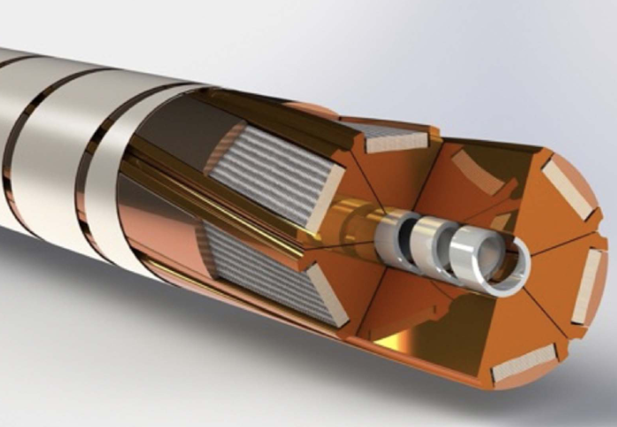
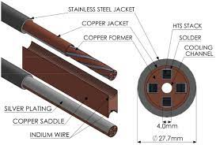
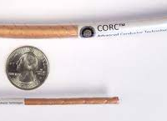
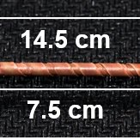
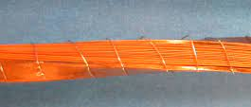


Formula for estimating hysteresis loss in round HTS cable
Assumption: magnetic field variation higher than the penetration field -> saturation of screening currents
Step 4: to reach the necessary critical current, in CORT there are N tapes
$$Q_{hCORT}=\frac{2N}{πcosα}B_{max}I_{c}w$$
hysteresis loss per cycle in N tapes in 1 meter of CORT:
loss in unipolar cycle is ∼½ of the loss in full cycle
$$Q_{hCORT,uni}=\frac{N}{πcosα}B_{max}I_{c}w$$
Notice: the formula(s) are valid for also for other cables from transposed CC tapes
AC loss in round cables from helically arranged HTS tapes I.FAST WP8 Task 8/6 Collaboration Presented at the 1st HiTAT workshop / 9-10 March 2023 at CERN, Geneva

Slide 8
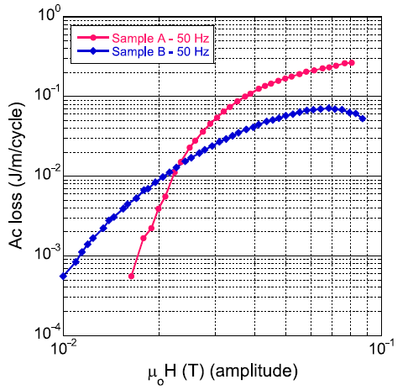
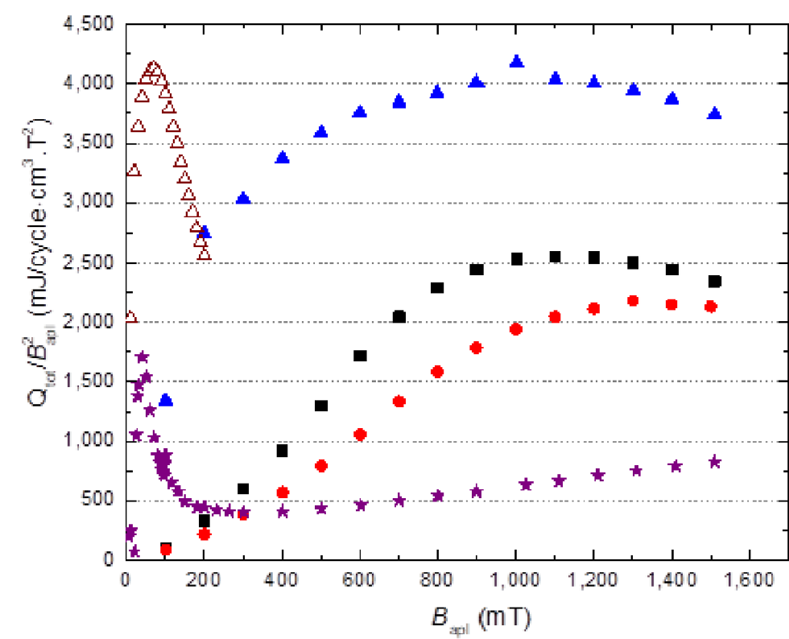
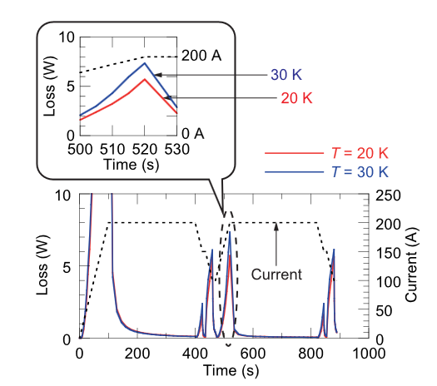
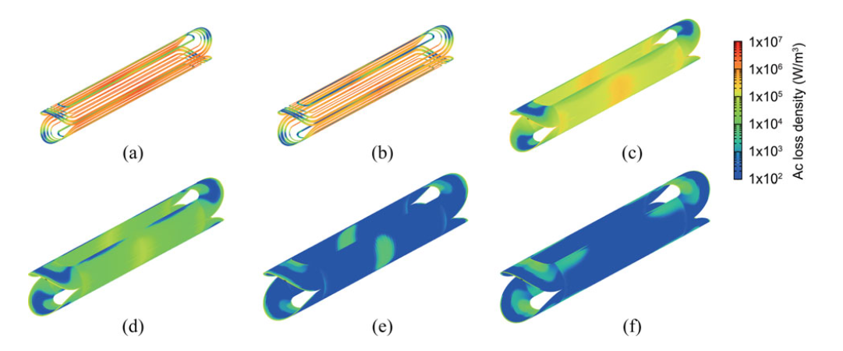
Formula for estimating hysteresis loss in round HTS cable
Experimental data:
M Majoros et al., Supercond. Sci. Technol.
27 (2014) 125008
K Yagotintsev et al., Supercond. Sci. Technol. 33 (2020) 065009
Numerical modeling:
Y Sogabe and N Amemiya, IEEE Trans. Appl. Supercond.
28 (2018) 8200705
AC loss in round cables from helically arranged HTS tapes I.FAST WP8 Task 8/6 Collaboration Presented at the 1st HiTAT workshop / 9-10 March 2023 at CERN, Geneva

Slide 9




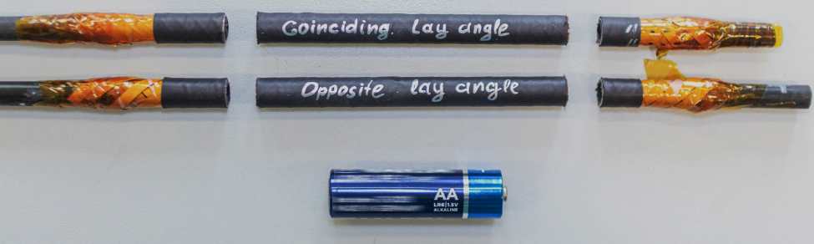
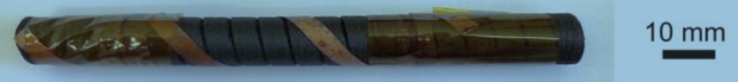
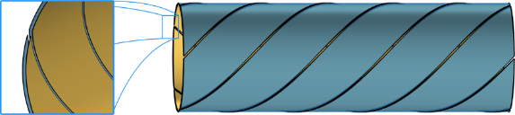
Experimental verification (AC field 72 Hz applied at 77.3 K)
3 samples:
2 x 5 tapes
(SCS3050-AP, 3 mm)
Opposite layers
Coinciding layers
tube: epoxy+ Carbon fibre
E Cuninková et al., IEEE Trans. Applt. Supercond., accepted
https://ieeexplore.ieee.org/document/10056272
Heat-shrink tubing
Kapton™ tape bandage
Carbon tube
(former)
Superconducting tapes
Coinciding layers, stacked tapes
AC loss in round cables from helically arranged HTS tapes I.FAST WP8 Task 8/6 Collaboration Presented at the 1st HiTAT workshop / 9-10 March 2023 at CERN, Geneva

Slide 10
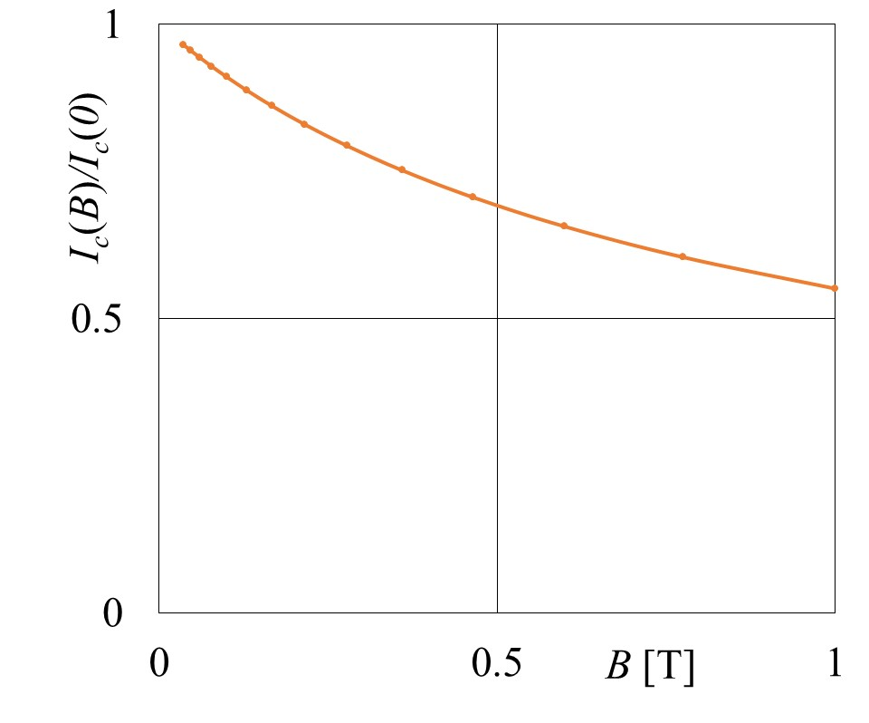
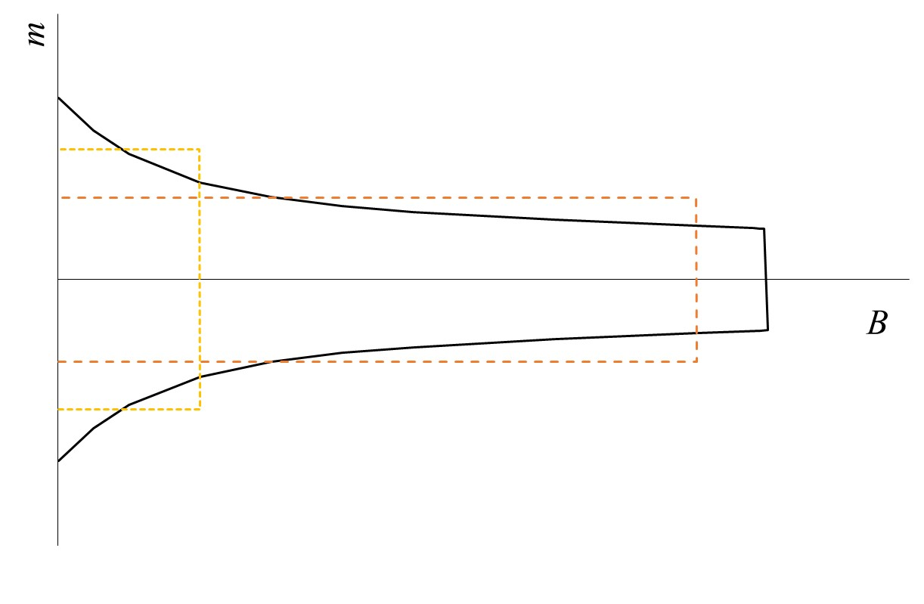




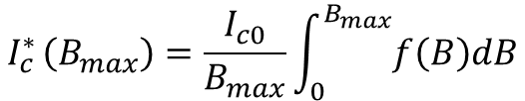


Experimental verification (AC field 72 Hz applied at 77.3 K)
$$Q_{hCORT}=\frac{2N}{πcosα}B_{max}I_{c}w$$
derived assuming I_{c} = const
Modification for I_{c}(B):
$$I_{c }^{∗}\left(B_{max}\right)=\frac{I_{c0}}{B_{max}}\int_{0}^{B_{max}}{f\left(B\right)dB}$$
$$I_{c}(T,B)=I_{c0}\left(T\right)f\left(B\right)$$
$f\left(B\right)=a_{1}exp\left(\frac{B}{B_{1}}\right)$+$a_{2}exp\left(\frac{B}{B_{2}}\right)$
$$m_{s}^{∗}=\frac{I_{c }^{∗}\left(B_{max}\right)w}{4}L$$
$$m_{s,1}^{∗}$$
$$m_{s,2}^{∗}$$
B_{max,2}
B_{max,1}
AC loss in round cables from helically arranged HTS tapes I.FAST WP8 Task 8/6 Collaboration Presented at the 1st HiTAT workshop / 9-10 March 2023 at CERN, Geneva

Slide 11
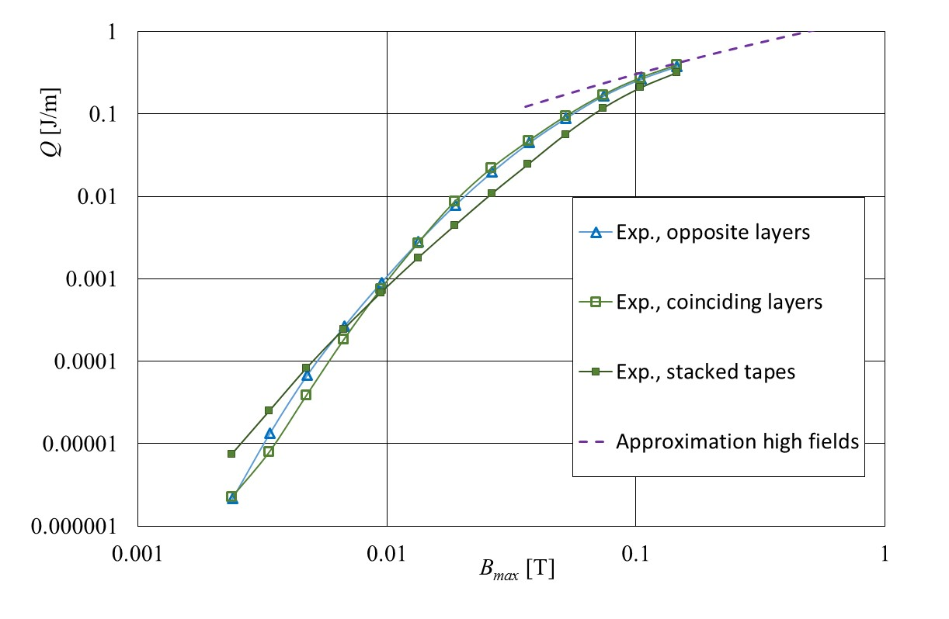

Experimental verification (AC field 72 Hz applied at 77.3 K)
$$Q_{hCORT}=\frac{2N}{πcosα}B_{max}I_{c}^{∗}\left(B_{max}\right)w$$
3 samples: 2 x 5 tapes
Opposite layers
Coinciding layers
Stacked tapes
AC loss in round cables from helically arranged HTS tapes I.FAST WP8 Task 8/6 Collaboration Presented at the 1st HiTAT workshop / 9-10 March 2023 at CERN, Geneva

Slide 12
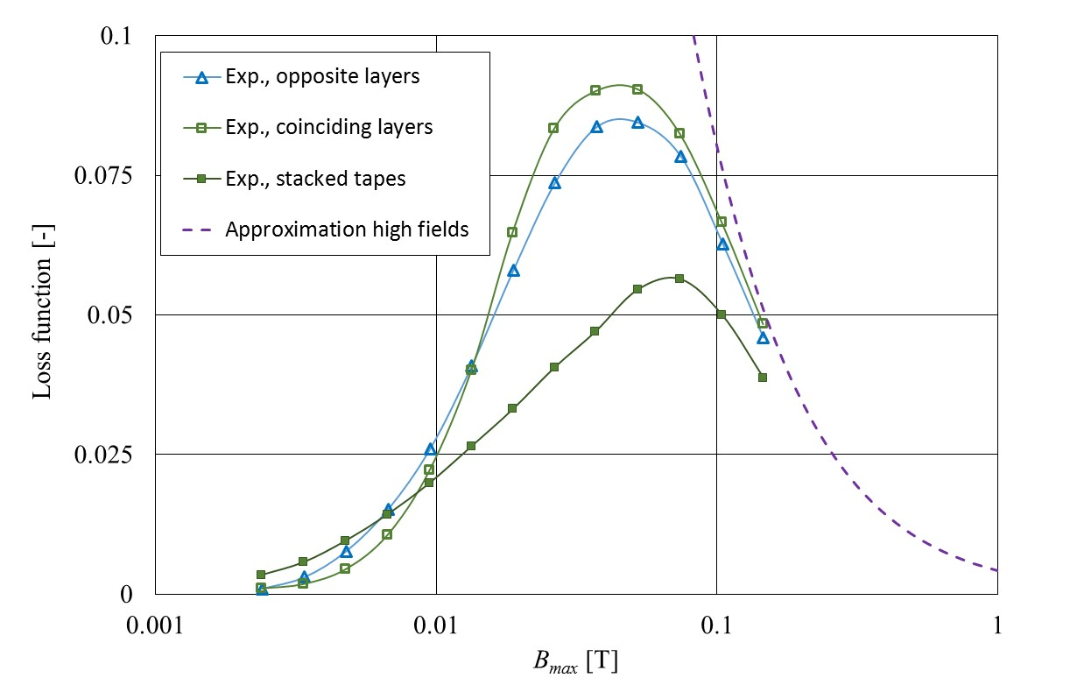
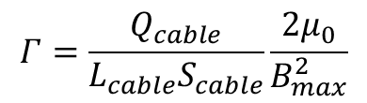
Experimental verification (AC field 72 Hz applied at 77.3 K)
$$Γ=\frac{Q_{cable}}{L_{cable}S_{cable}}\frac{2μ_{0}}{B_{max}^{2}}$$
3 samples: 2 x 5 tapes
Opposite layers
Coinciding layers
Stacked tapes
AC loss in round cables from helically arranged HTS tapes I.FAST WP8 Task 8/6 Collaboration Presented at the 1st HiTAT workshop / 9-10 March 2023 at CERN, Geneva

Slide 13
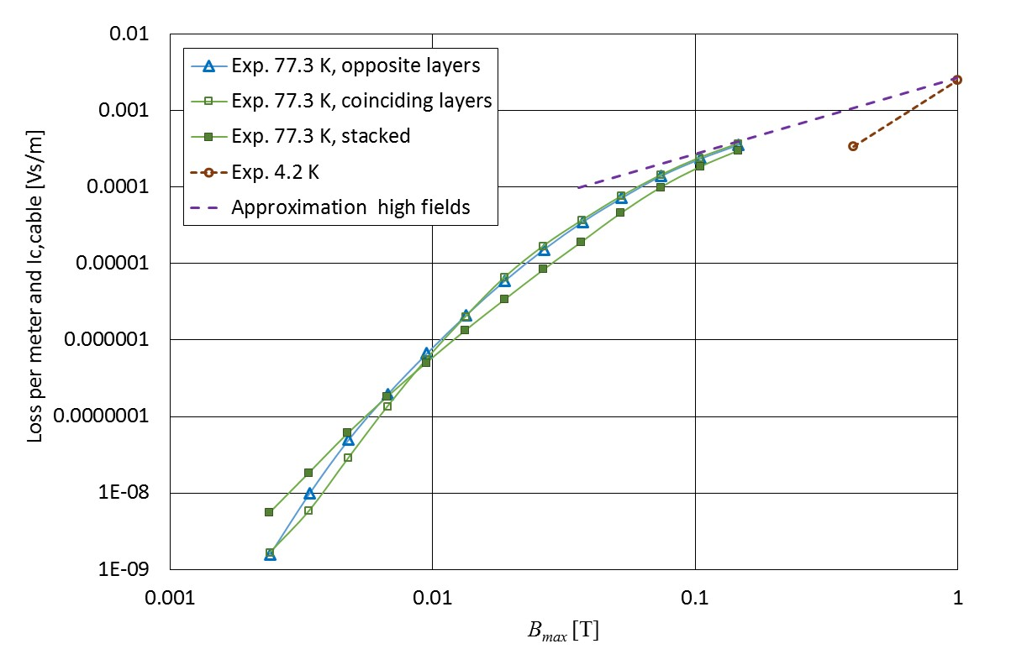


Experimental verification (72 Hz at 77.3 K, 1 mHz at 4.2 K)
$$Q_{hCORT}=\frac{2N}{πcosα}B_{max}I_{c}^{∗}\left(B_{max}\right)w$$
$$\frac{Q_{hCORT}}{NI_{c}^{∗}\left(B_{max}\right)}=\frac{Q_{hCORT}}{I_{c,cable}^{∗}\left(B_{max}\right)}=\frac{2N}{πcosα}B_{max}w$$
3 samples: 2 x 5 tapes
Opposite layers
Coinciding layers
Stacked tapes
I_{c0}(77.3 K) = 135 A
I_{c0}(4.2 K) = 2520 A
AC loss in round cables from helically arranged HTS tapes I.FAST WP8 Task 8/6 Collaboration Presented at the 1st HiTAT workshop / 9-10 March 2023 at CERN, Geneva

Slide 14




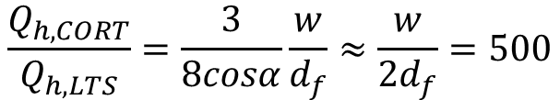
Comparison with the low-loss NbTi version
$$Q_{h,CORT}=B_{max}N_{tapes}I_{c,tape}\frac{1}{πcosα}w$$
In similar way, hysteresis loss in NbTi version, the filaments with diameter d_{f} :
$$Q_{h, LTS}=B_{max}N_{filaments}I_{c,fil}\frac{8}{3π}d_{f}$$
Condition of equivalent transport capacity of the cable:
$$N_{tapes}I_{c,tape}=N_{filaments}I_{c,fil}$$
$$\frac{Q_{h,CORT}}{Q_{h,LTS}}=\frac{3}{8cosα}\frac{w}{d_{f}}≈\frac{w}{{2d}_{f}}=500$$
Assuming w = 3mm and d_{f} = 3 µm:
D Uglietti et al., Cryogenics 110 (2020) 103118
Current CC cables have little chance in low-field (<10 T) accelarators
AC loss in round cables from helically arranged HTS tapes I.FAST WP8 Task 8/6 Collaboration Presented at the 1st HiTAT workshop / 9-10 March 2023 at CERN, Geneva

Slide 15


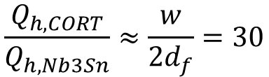
Competing in AC loss with the Nb₃Sn version
The best Nb₃Sn (filament diameter 50 µm), still no coupling:
$$\frac{Q_{h,CORT}}{Q_{h,Nb3Sn}}≈\frac{w}{{2d}_{f}}=30$$
E Barzi and A V Zlobin, 2015 FERMILAB-PUB-15-274-TD
E C Collings et al., IEEE Trans. Appl, Supercond. 28 (2018) 4006504
D Schoerling et al., IEEE Trans. Appl, Supercond. 29 (2019) 4003109
Considering further 50% contribution from coupling loss in Nb₃Sn strands,
plus some coupling loss because of inter-strand connections,
current target for CC cable can be formulated as:
Hysteresis loss reduction to 5% of the present value
No additional coupling loss introduced
AC loss in round cables from helically arranged HTS tapes I.FAST WP8 Task 8/6 Collaboration Presented at the 1st HiTAT workshop / 9-10 March 2023 at CERN, Geneva

Slide 16
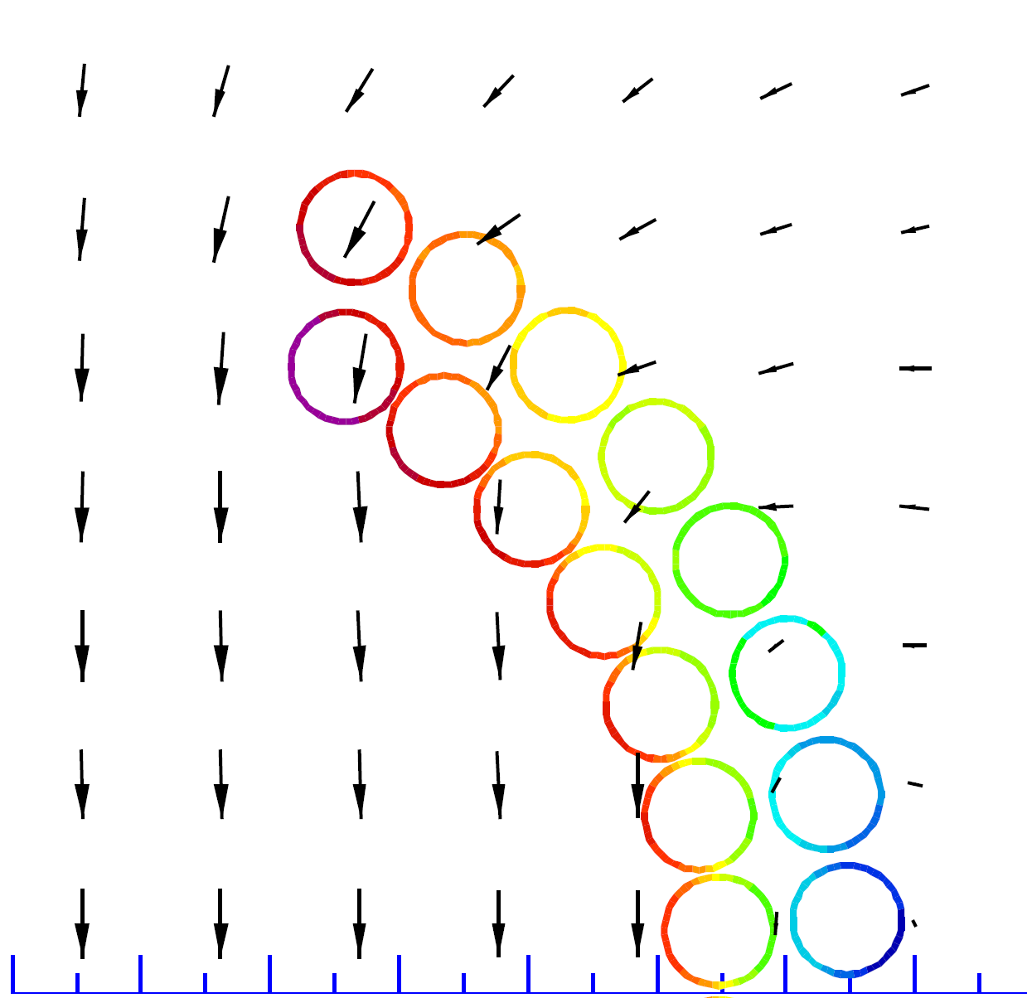
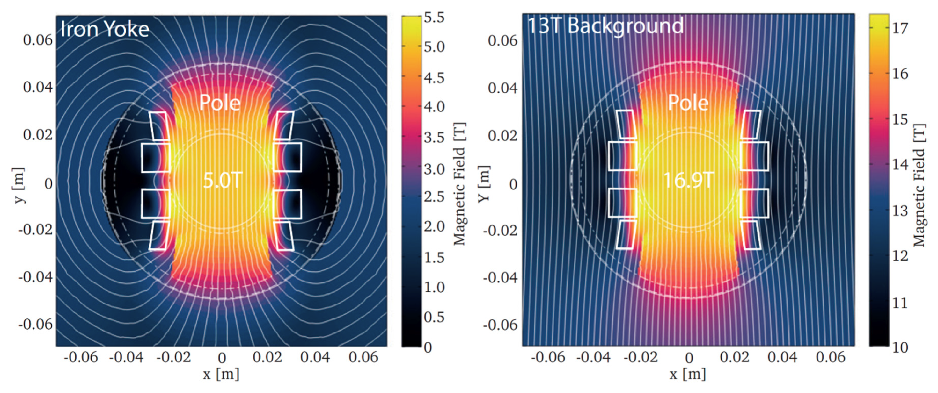

Goal: 20x reduction of hysteresis loss
$$Q_{h,CORT}=B_{max}I_{c,cable}\frac{1}{πcosα}w$$
Possible ways:
filamentized tape: 150 µm filaments
Y Li et al., IEEE Trans. Appl, Supercond. 33 (2023) 4400405
flattening the cable, corresponding magnet design
H Piekarz et al., Nuclear Inst. and Methods in Physics Research, A 943 (2019) 162490
???
Additional benefit by operating at higher temperatures:
at 20 K the cost of cooling > 4x lower than at 4.2 K
L Rossi and C Senatore Instruments 2021, 5(1), 8
AC loss in round cables from helically arranged HTS tapes I.FAST WP8 Task 8/6 Collaboration Presented at the 1st HiTAT workshop / 9-10 March 2023 at CERN, Geneva

Slide 17
Conclusions
Magnetic hysteresis is a serious drawback of CC tapes intended for use in pulsed magnets
With a substantial modification of the tape architecture (filamentization) CC could compete with Nb₃Sn
in high-field (> 10 T) accelerators
AC loss in round cables from helically arranged HTS tapes I.FAST WP8 Task 8/6 Collaboration Presented at the 1st HiTAT workshop / 9-10 March 2023 at CERN, Geneva

