Slide 1
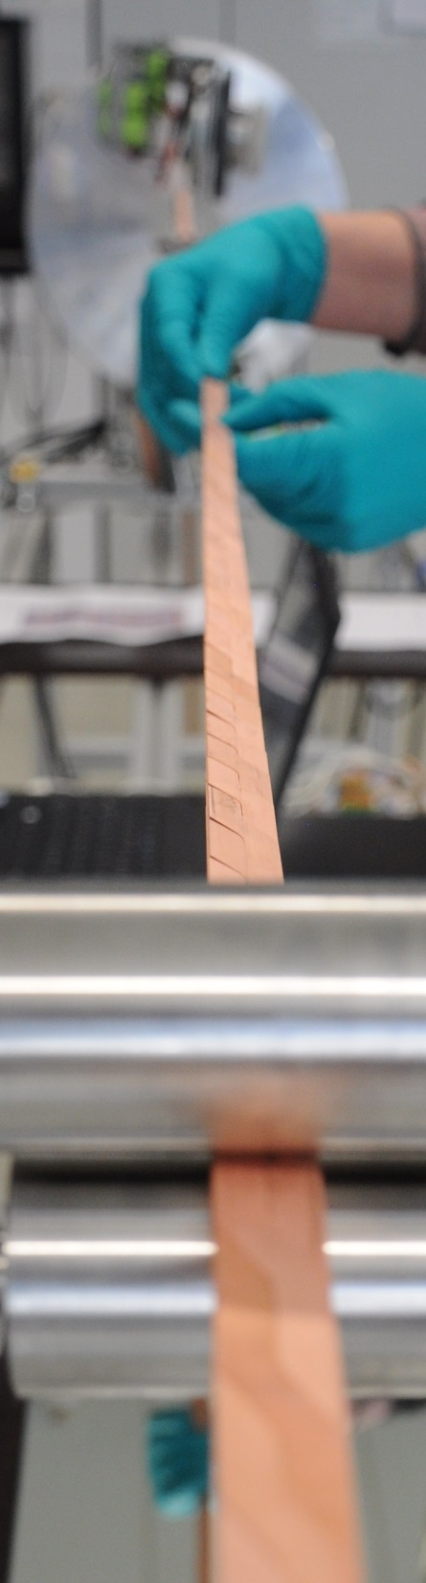

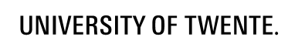



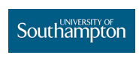


ReBCO Roebel cable
relevant to accelerator-type demonstrator magnet
EuCARD²
A. Kling, U. Mirasch, A. Drechsler, A. Kudymow, W. Goldacker
a
A. Usoskin, A. Rutt
L. Rossi, L. Bottura, G. Kirby, J. van Nugteren
A. Kario, M. Dhallé, S. Otten
C. Senatore
Y. Yang

Slide 2
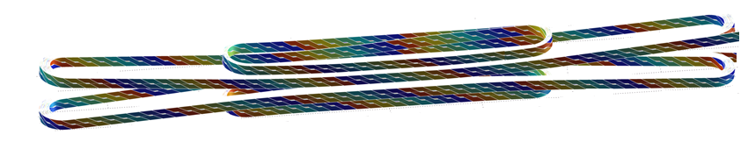
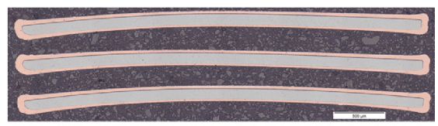
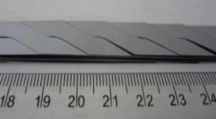

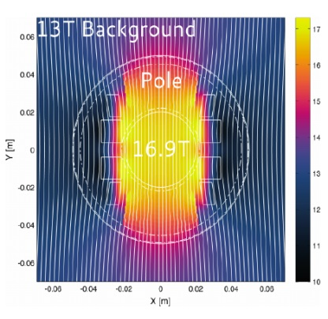
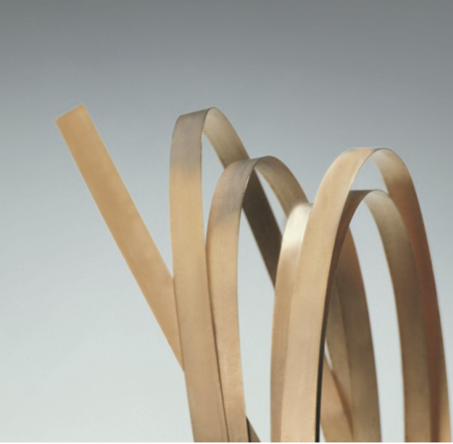
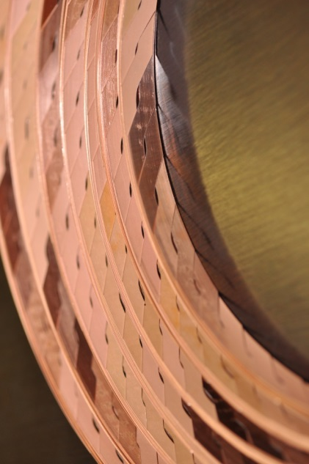
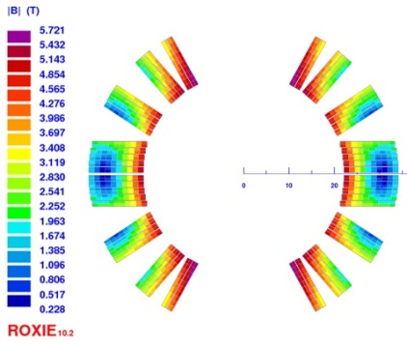
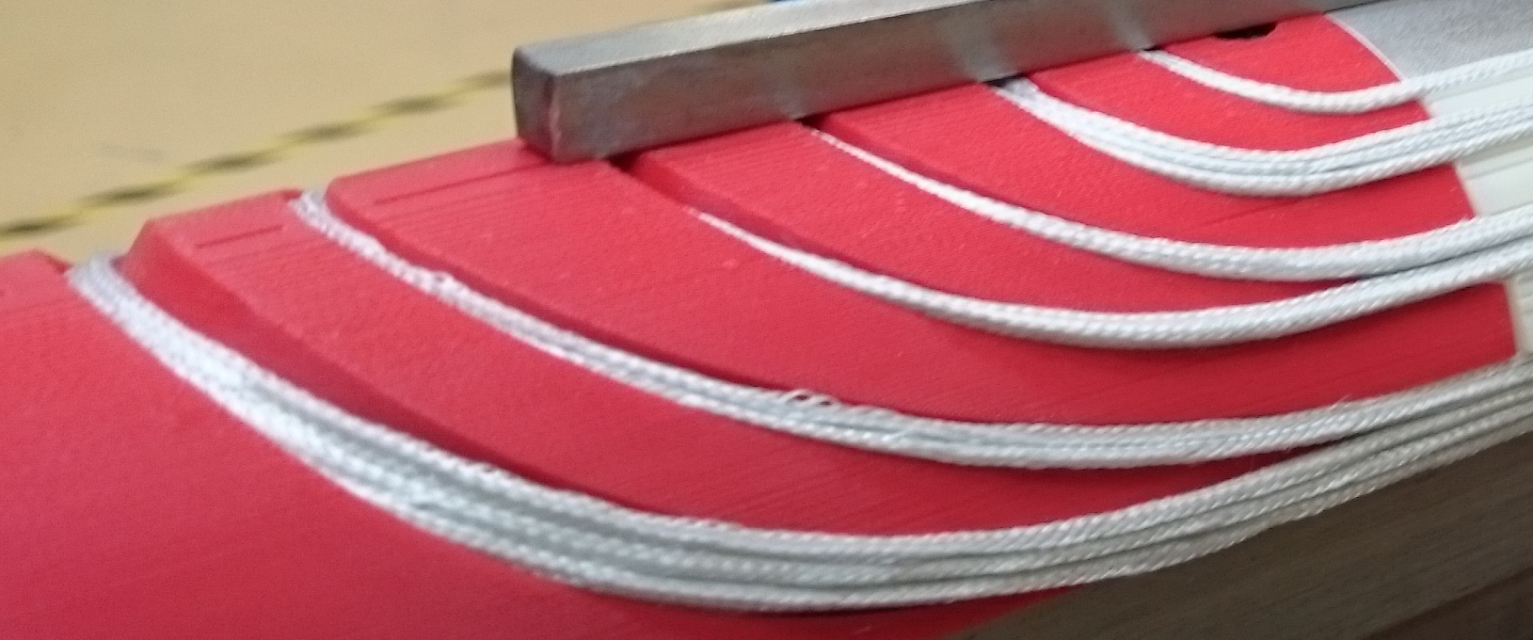
Optimization of Roebel cables for use in magnets
Conductor
choice
Cable design
Coil
design
CERN- block coil design
W_{c}
T_{p}
W_{l}
J. van Nugteren et al.
B(T)
CEA Saclay - Cos-theta design
C. Lorin et al.
B(T)

Slide 3
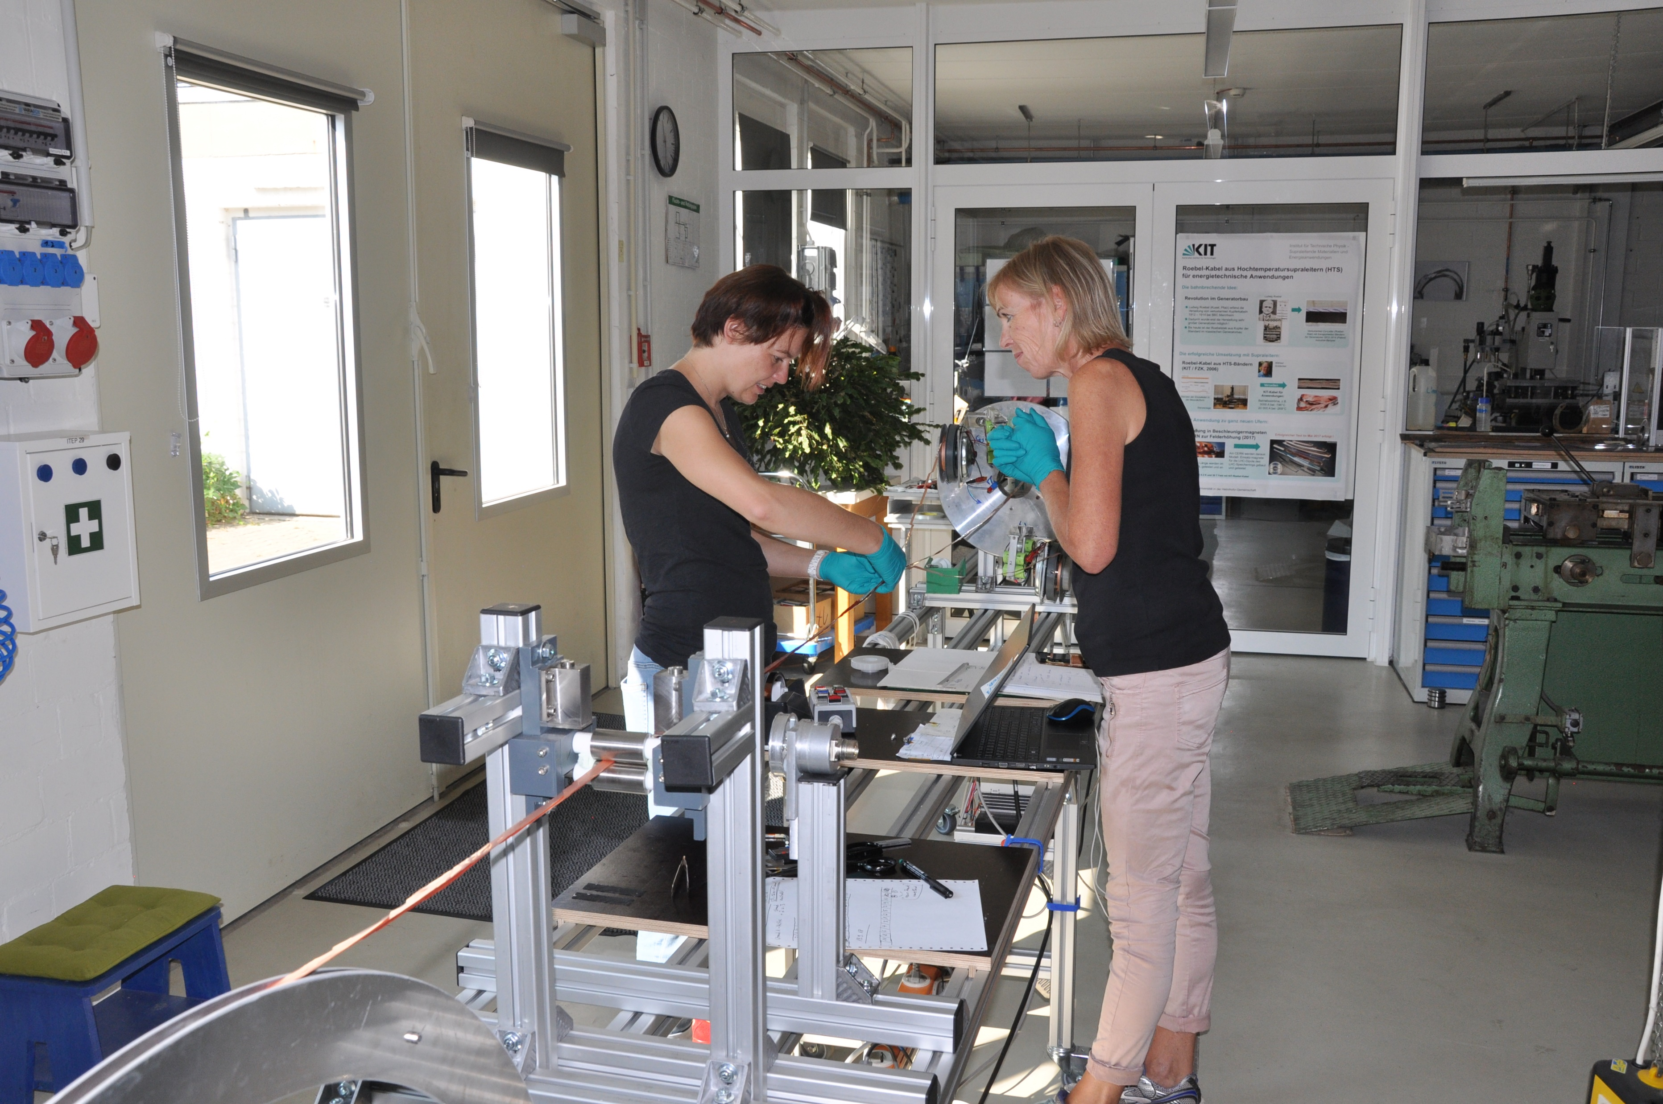
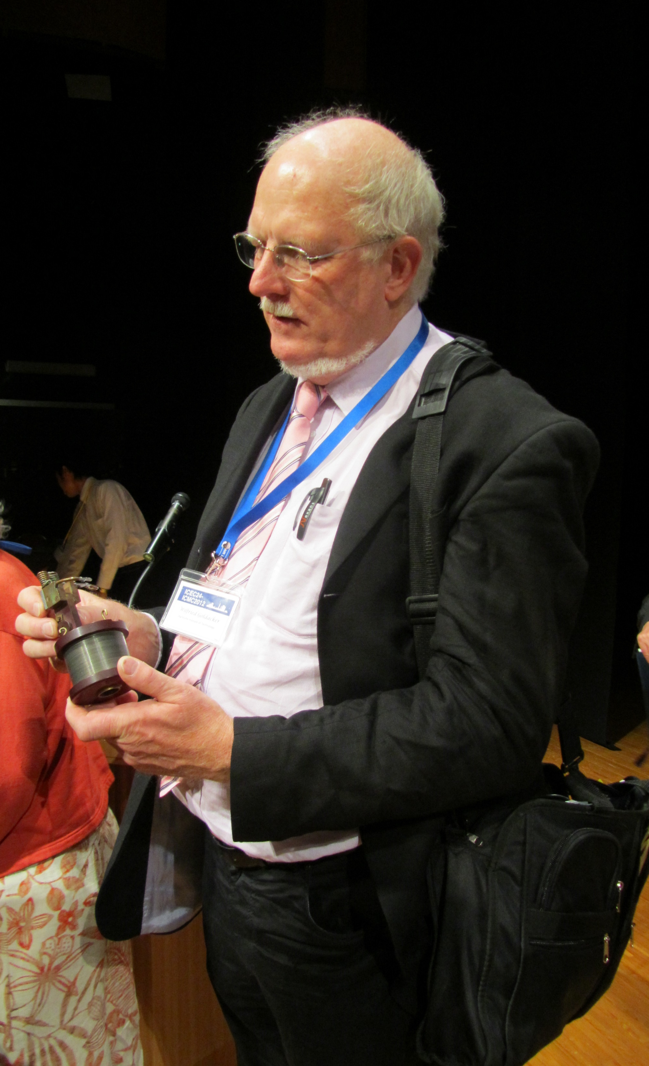
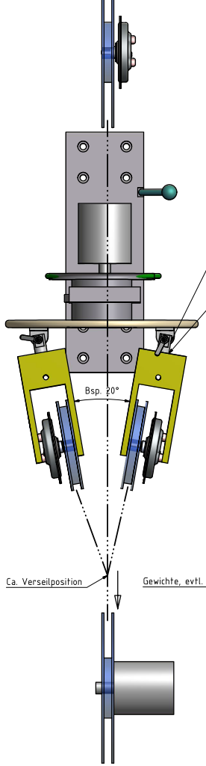
Cable lengths relevant to accelerator demonstrator
Reel-to-reel system for up to 100 m with possibility for upgrade up to 200 - 300 m
Modular system with room for extension to full-cable assembly in one run (no need for laboratory use)
Controllable tension on the tapes and cable
Suitable for different tapes, cable architectures and dense packing
(tape material, no. of strands, transposition length)
Wilfried Goldacker
Andera Kling assembling 24m Roebel cable
Point of cabling
Cabling direction

Slide 4
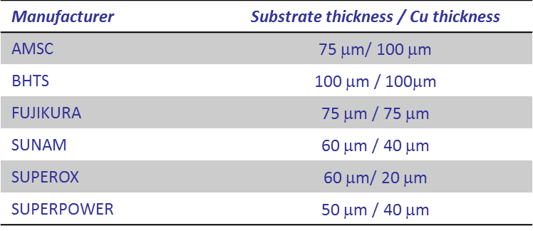
Coated conductors performance at 4.2 K
Target performance for RE123 tape at 4.2 K in perpendicular magnetic field:
J_{eng} = 450 A/mm² at 15 T
J_{eng} = 400 A/mm² – 600 A/mm² at 20 T

Slide 5
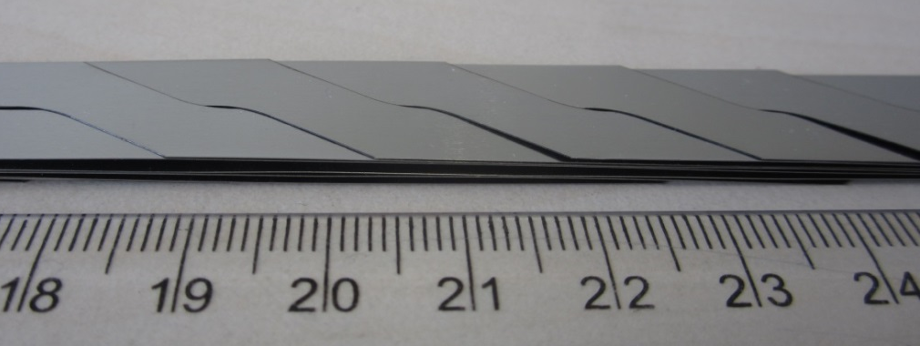
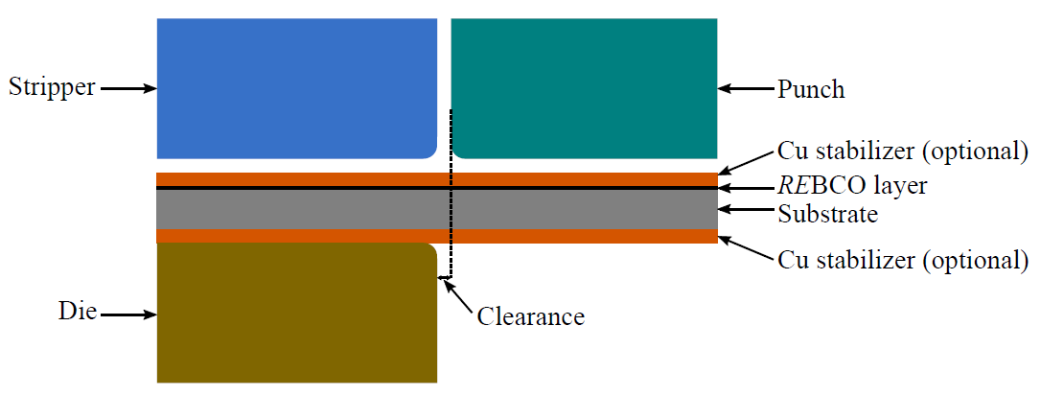
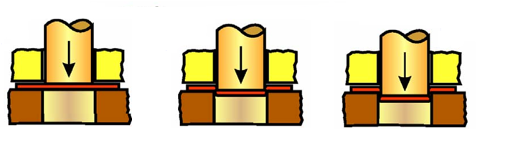
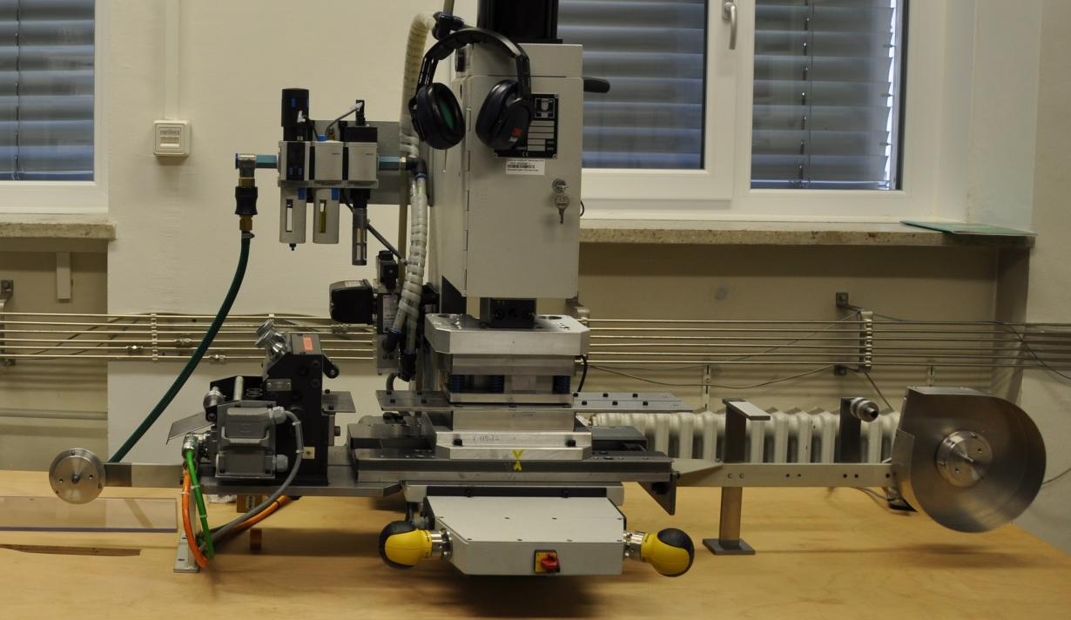
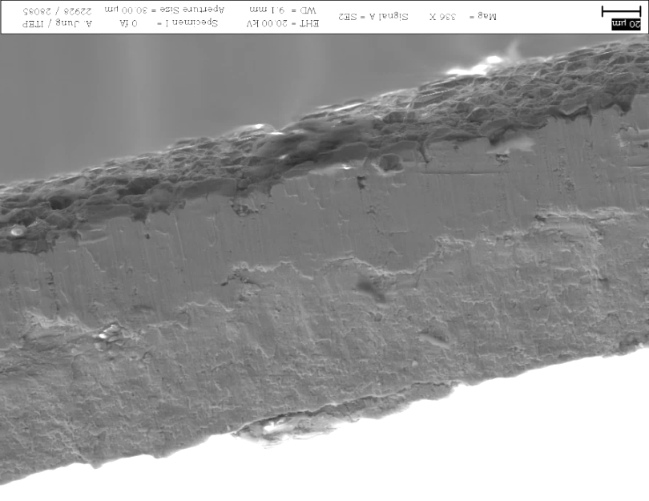

Development of the punching process
T_{p}
W_{l}
W_{c}
200 µm
α
R_{i}
Charging of
the punch
2. Shearing
and cracking
3. Break through
Punching
direction
20 µm
Punching die
Reel with
REBCO
Reel with
punched strand
Cu
1
2
REBCO
Stainless Steel
Tape directions

Slide 6
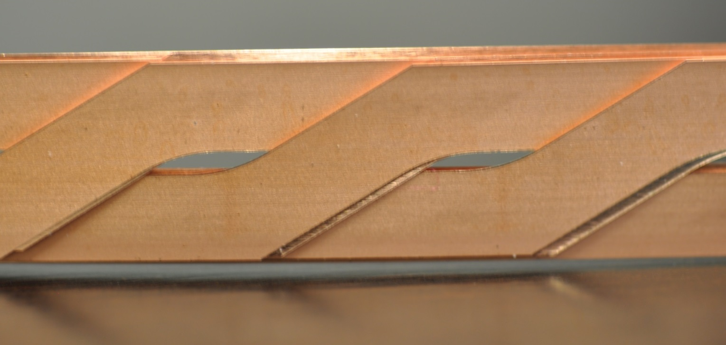
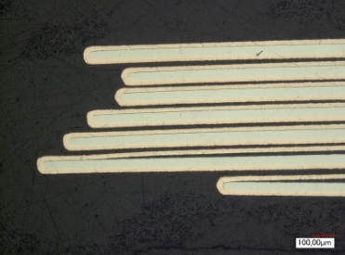
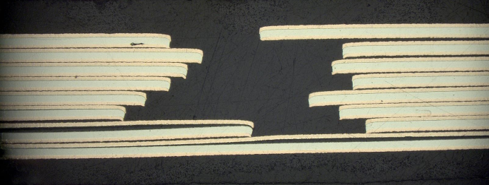
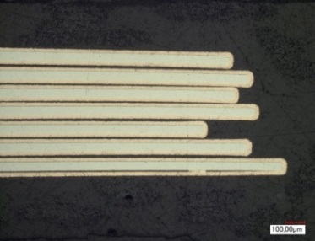
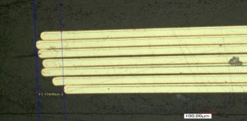
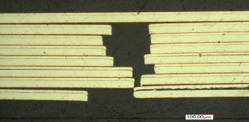
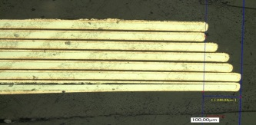
Search for optimal geometry with good alignment
of the strands in the cable
T_{p} = 126, 226, 300, 426
W_{c} = 5.5, 5.9
W_{l} = 5.5, 5.9
α
R_{i}= 10
Horizontal gap
Vertical gap
870 µm
421 µm
174 µm
240 µm

Slide 7
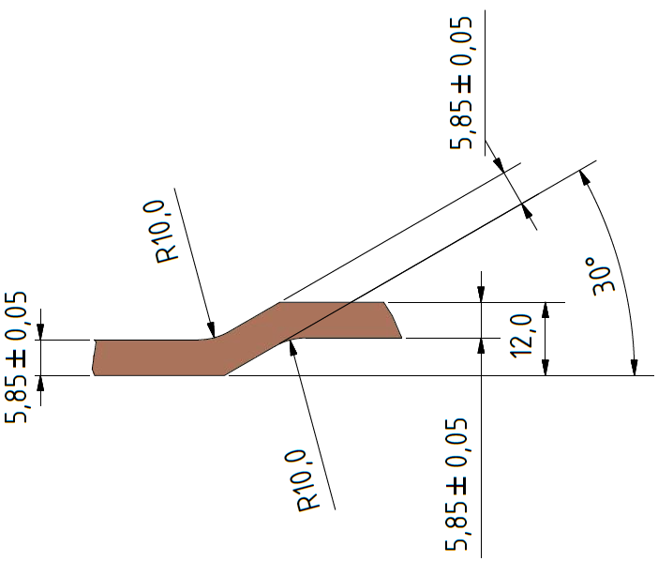
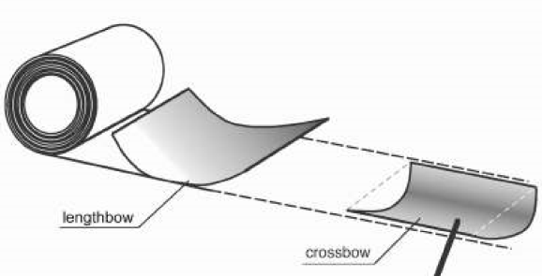
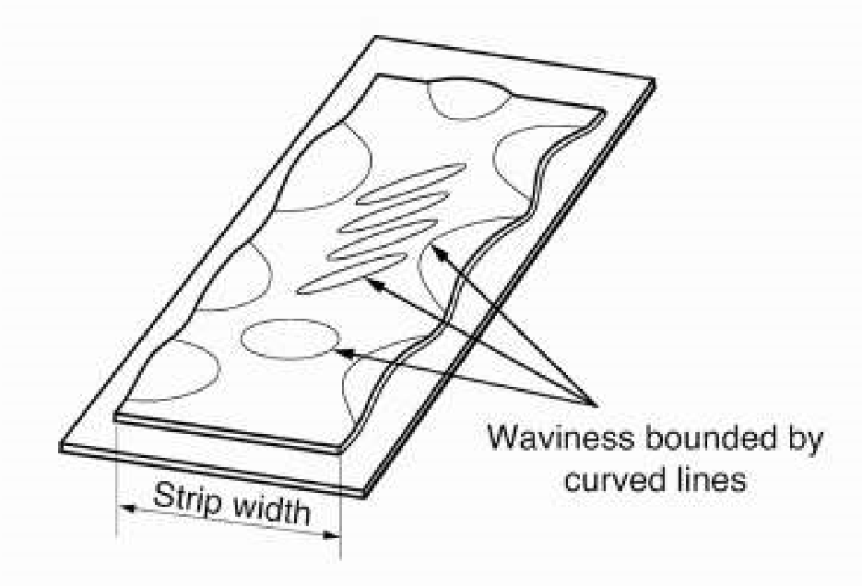
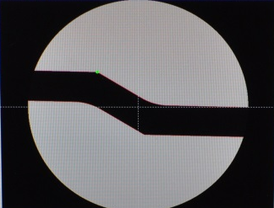
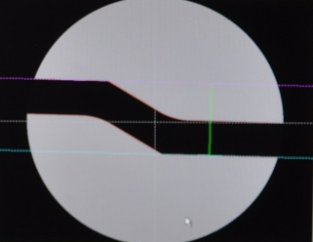
Reel-to-reel measurement system of tape geometry and transposition length feed-back system
Tape geometry measured
Feed back for punching
Transposition length set by a reel feed
( ± 0.05 mm precision)
Transposition error correction planned
width variations
camber
Measurement
window
Defined length
Signal to feed rolls
Shift error
- correction

Slide 8
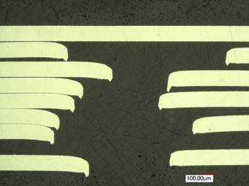
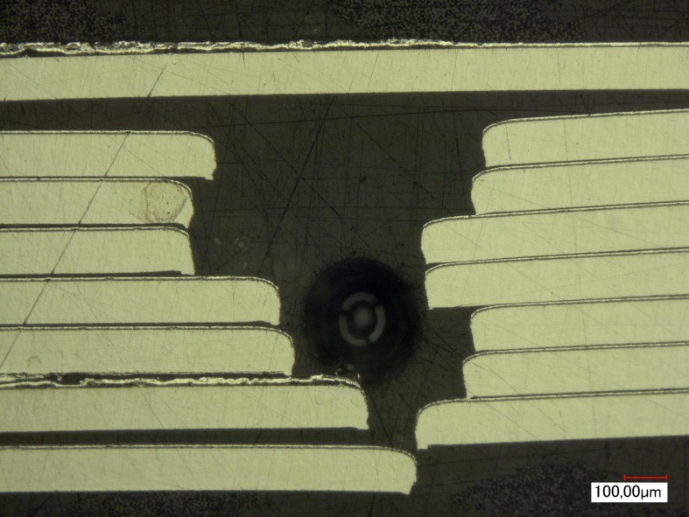
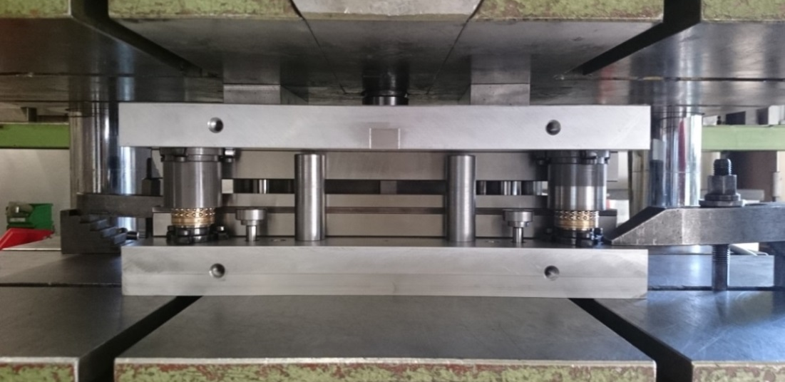
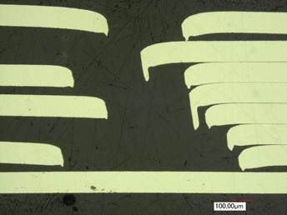

Burr size dependence on punched material and die clearance
17 µm die clearance:
7 µm die clearance:
One-step punching TL = 300 mm
2
1.
1
100 μm stainless steel tape
Bruker CC, 100 μm stainless steel substrate
Punching in one-step:
Within CERN collaboration agreement
Reduced tape transport error
Possibility of adjustment to the tape width
Tooling clearance 5 µm +/-2 µm
100 μm stainless steel tape
SuperPower CC, 50 μm Hastelloy substrate

Slide 9
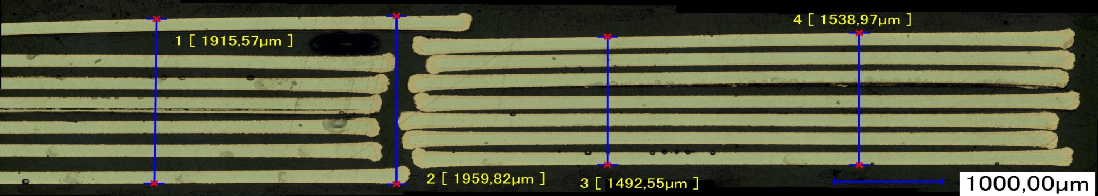
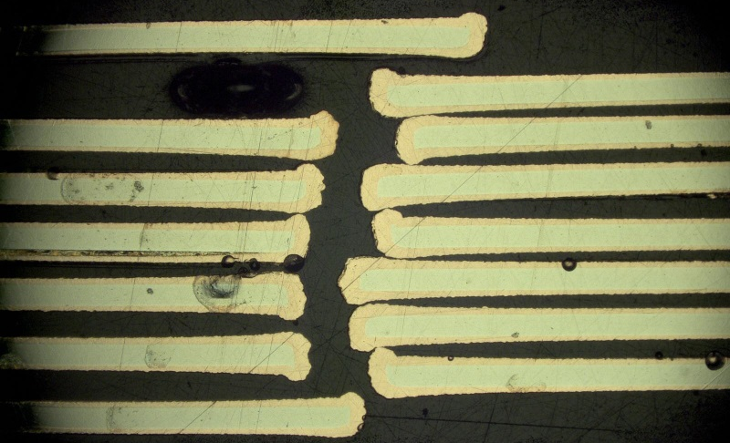
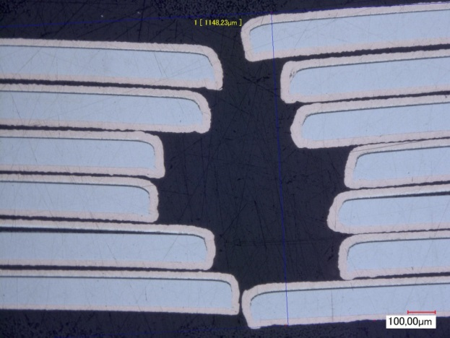

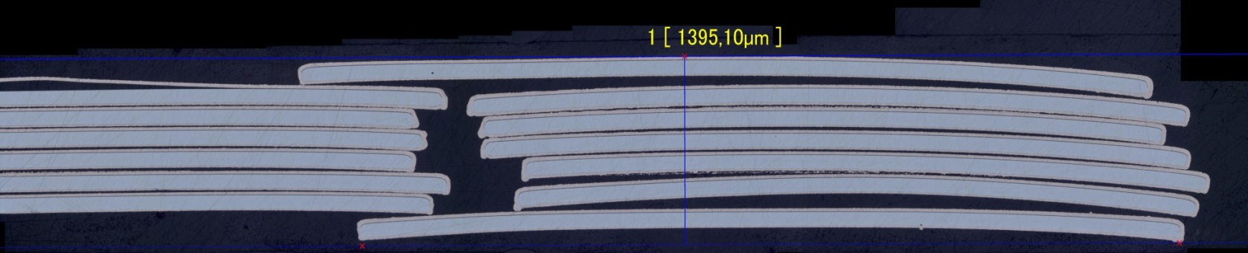

Homogeneous thickness of the cable with reduced dog – boning effect
The average critical current per unit width degraded by 6% after punching and copper plating.
No local defects were found.

Slide 10
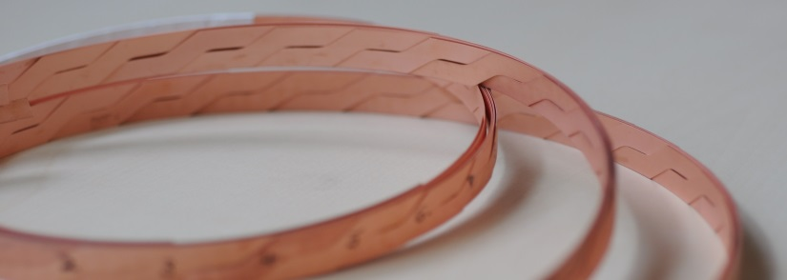
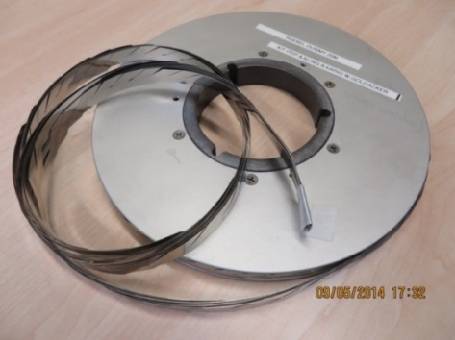
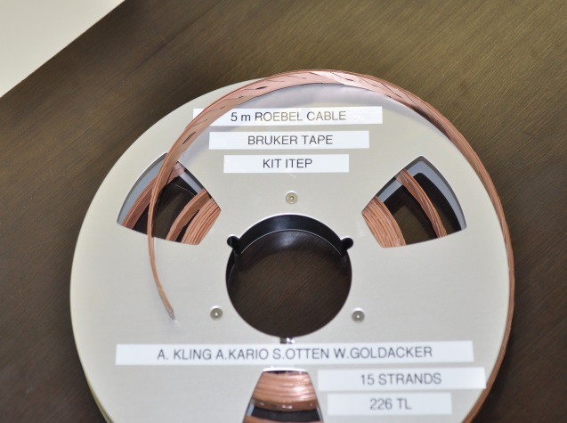
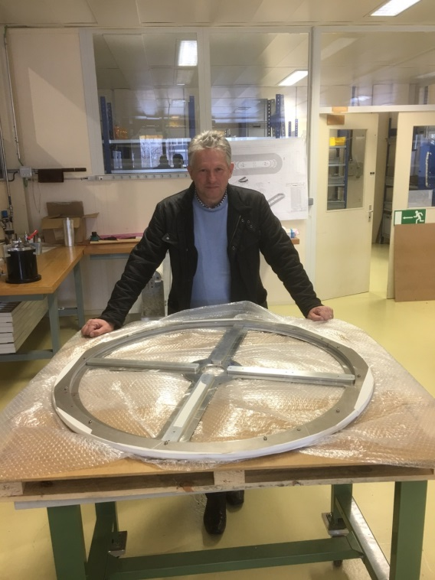
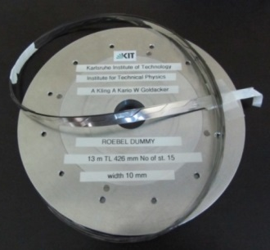
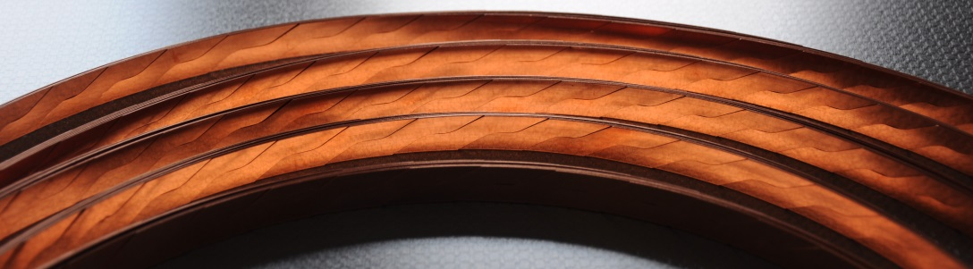
Assembled and delivered cables
2 m cable for I_{c} measurement at 4.2 K (punch and coat)
24 m Roebel cable from Bruker material for Feather-2 winding (punch and coat)
Superconducting cables of 5 - 6 m using tapes from: Bruker, SuperPower, SuNAM and SuperOx
5 m SC cable
Bruker tape
Dummy cables: stainless steel and copper tapes
Cable 130 m, used tape material 2 km
Superconducting cables:
Cable 54 m, used tape material: 0.5 km
G. Kirby, CERN

Slide 11
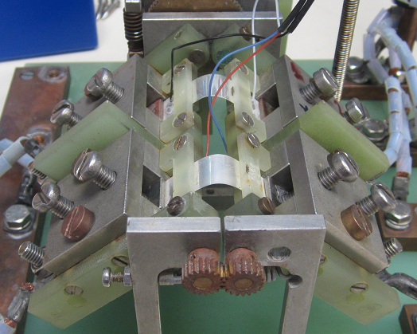
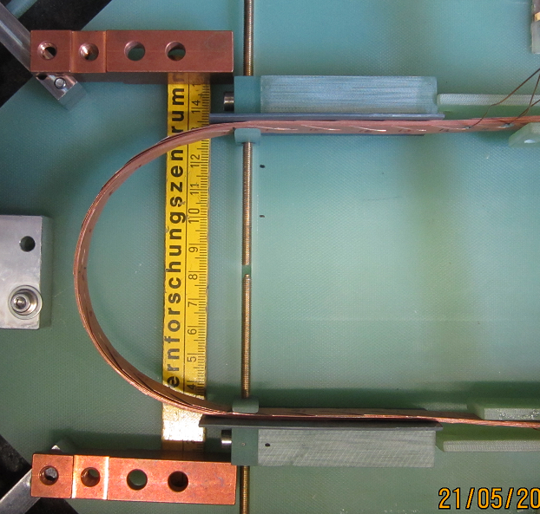
Out-of-plane Roebel cable and single tape bending
Reduced critical current
Bending machine for single tapes:
REBCO outside
Irreversibility point
REBCO inside
Aligned block coil
Cos-theta
coil
Bending machine for cables:
Bending radius [mm]
Measurements at LN_{2,} self-field
REBCO inside / compressive bending
I_{c} of the Roebel cables:
SuperPower: 1427 A
Bruker: 658 A
2R
REBCO inside
SuperPower
20 µm Cu, 50 µm Hastelloy
Bruker
20 µm Cu+, 100 µm SS

Slide 12
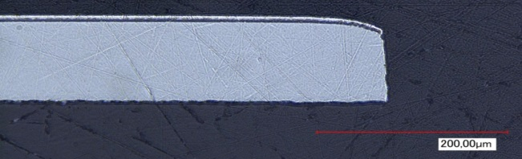
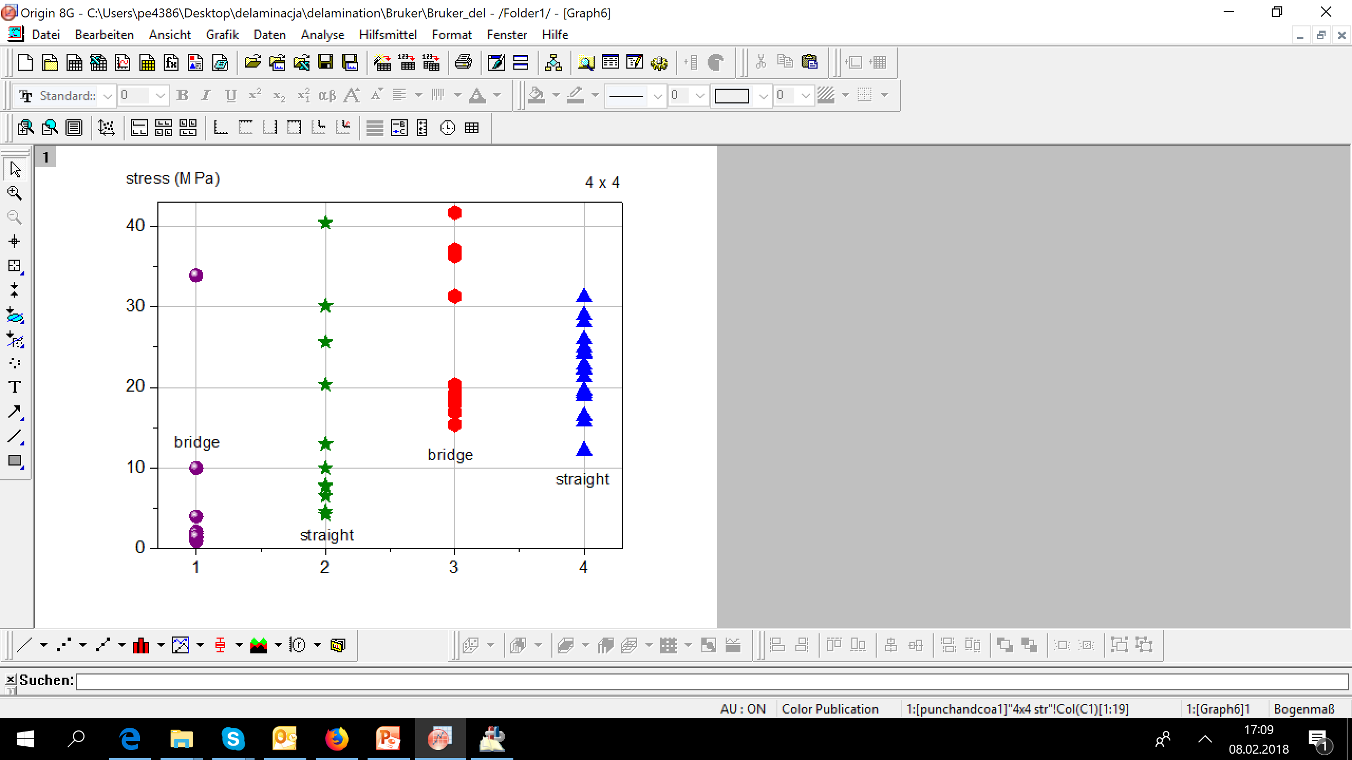




Mechanical properties - increased delamination strength with punch-and- coat method in Roebel
Delamination strength (MPa)
4 x 4 mm²
Delamination strength (MPa)
6 x 4 mm²
Punched after coating
Punch-and-coat strand
Punched after coating
Punch-and-coat strand
straight
straight
bridge
bridge
Maximum force 2.5 kN, LN₂
Tape/strand soldered with InSn to Cu block
Delamination is a weak point of ReBCO tape and Roebel strand.

Slide 13




Impregnated ReBCO Roebel cable withstand stresses up to 400 MPa
P. Gao et al 2019 Supercond. Sci. Technol. 32 055006
Bruker
SuperPower
J. Fleiter, A. Ballarino, L Bottura, P. Tixador, Supercond. Sci. Technol., Vol. 26, No. 6, 2013.
Importance of study ReBCO cables in transverse stress to understand the limits for future high field magnets
Relevance of electromagnetic and thermal cycling effect on critical current of ReBCO cables

Slide 14


Hysteresis and coupling in Roebel cable
Losses are dominated by hysteresis, inter-tape coupling is not visible
Hysteresis scales with H₀/H_{p} as expected (Norris strip)
Tapes are magnetically coupled, i.e. as a monolithic conductor, but not quite fully

Slide 15




ReBCO Roebel cables and the coils
Feather-M2
Feather-M0
J. van Nugteren, High temperature superconductor accelerator magnets
https://research.utwente.nl/en/publications/high-temperature-superconductor-accelerator-magnets
F.J. Mangiarotti et al, Feather magnets test overview, 2020.07.08 – EuCARD2/ARIES Roebel cable experience workshop

Slide 16

Roebel cable fabrication for magnet use:
Punch and coat method at Bruker with regular thickness of the Roebel cable
Strand geometry control system - increased precision in transposition length
One step- punching tool within CERN collaboration agreement result in ideally punched tape edge thanks to suitable clearance
The 24 m long Roebel cable with Bruker tape delivered to CERN for Feather-2 coil winding.
Bending in easy direction without permanent degradation down to 4.0 mm (SuperPower), 9.4 mm (Bruker), where bending close to tape properties
Impregnated Roebel cable with-stands transverse pressures in excess of 150 MPa
Roebel or not, geometry quality of ReBCO tape, strands contribute to wind ability, homogeneity and mechanical performance of the coil!
Homogeneity of electro-mechanical properties of ReBCO cables, including delamination and edge effects need to be studied!

