Slide 1
Muon Collider
Magnets
L. Bottura, F. Boattini, B. Caiffi, S. Mariotto, L. Quettier, M. Statera
on behalf of the Muons Magnets Working Group
10 March 2023

Slide 2
Scope of the talk
Why muons ?
The four magnet challenges of the muon collider
A short digression on HTS
Summary

Slide 3
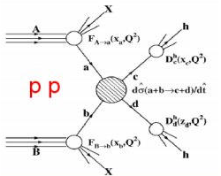
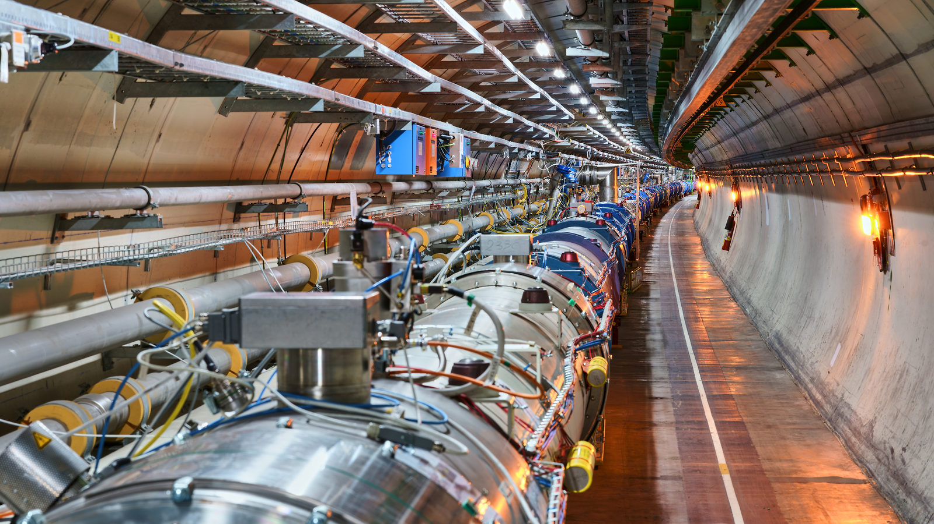
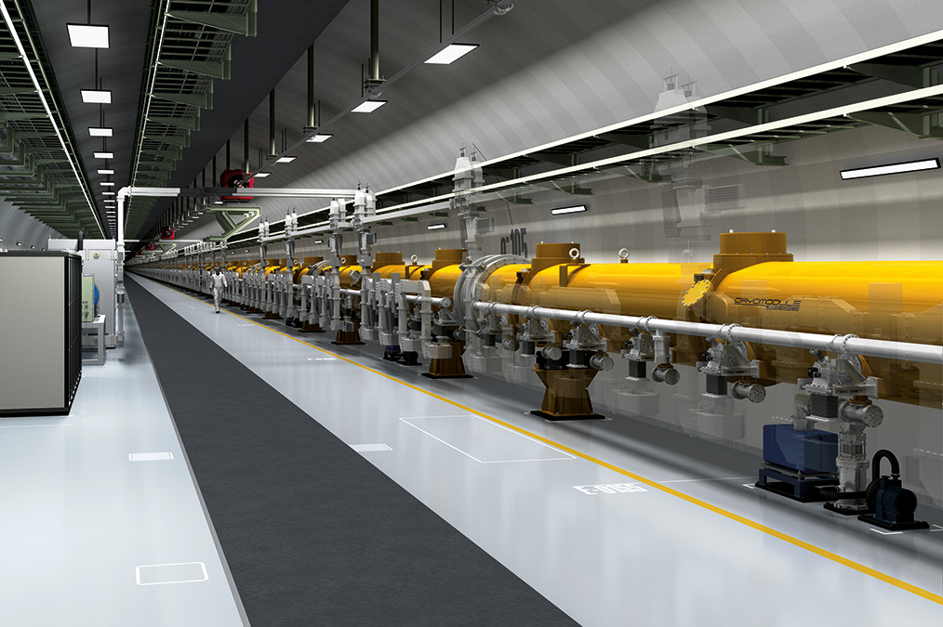
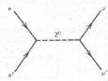
Collider Choices
Hadron collisions: compound particles
  LHC collides 13.6 TeV protons
  Protons are mix of quarks, anti-quarks and gluons
  Very complex to extract physics
  But can reach high energies
Lepton collisions: elementary particles
  LEP reached 0.205 TeV with electron-positron collisions
  Clean events, easy to extract physics
  Lepton collisions ⇒ precision measurements
  Hard to reach high energies
e⁺e⁻

Slide 4
Energy Limit
accelerating cavities
Electron-positron rings are multi-pass colliders limited by synchrotron radiation
Hence proton rings are energy frontier
N
N
S
S
Electron-positron linear colliders avoid synchrotron radiation, but are single pass
Typically cost proportional to energy and power proportional to luminosity,
Novel approach: muon collider
Large muon mass suppresses synchrotron radiation => multi-pass
Fundamental particle requires less energy than protons
But lifetime at rest only 2.2 μs (increases with energy)
Therefore the muon collider is part of the European Accelerator R&D Roadmap

Slide 5
Muon Collider: Physics ?
https://doi.org/10.48550/arXiv.2203.07261
Muon collisions in the range of 10 TeV have comparable discovery potential to hadron collision in the range of 100 TeV
Equivalence between proton (hadron) and muon (lepton) center of mass energy at collision for selected production and decay channels

Slide 6
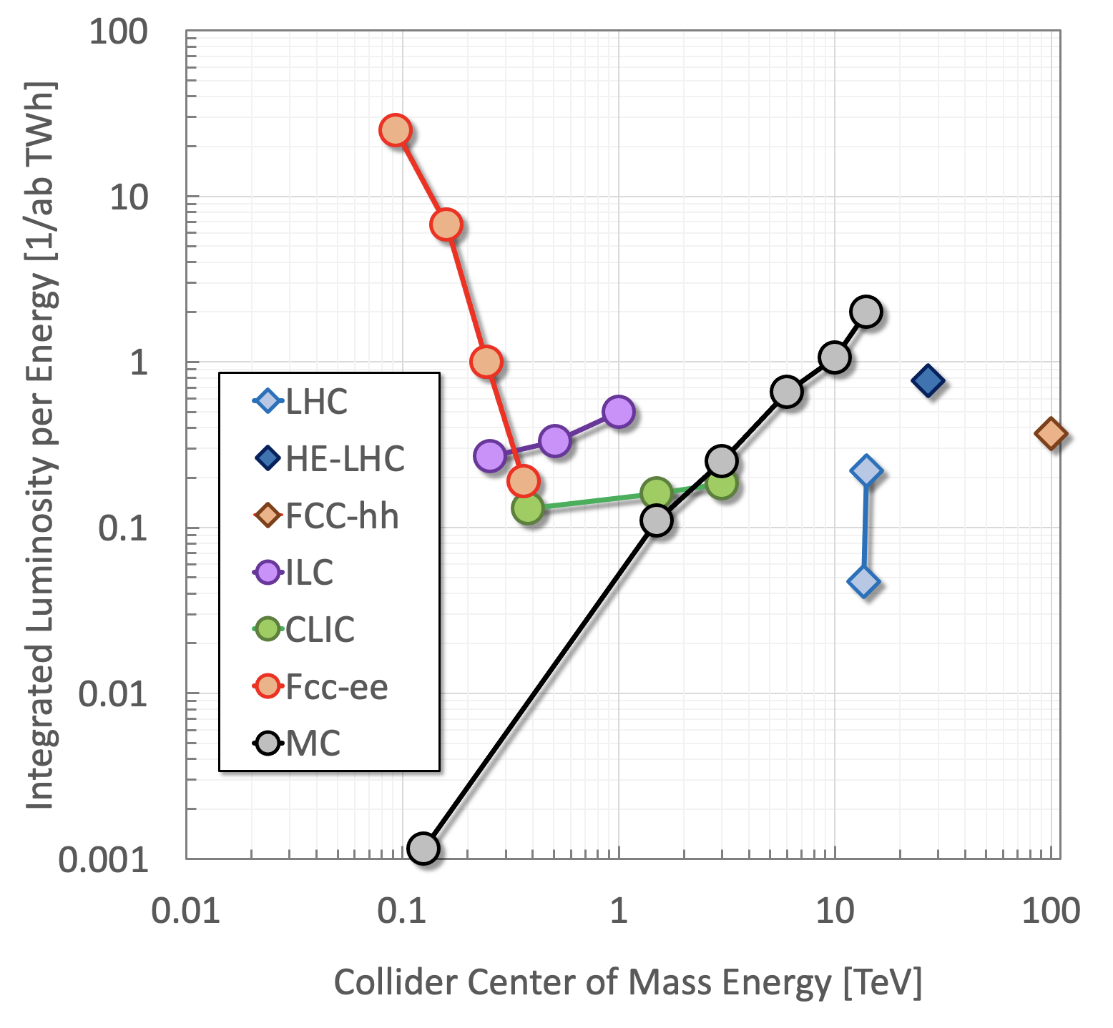
Muon Collider: Sustainable ?
K.Long et al, Nature Physics, v.17, p.289, 2021
A muon collider at 10 TeV can provide the highest integrated luminosity per unit energy consumption

Slide 7
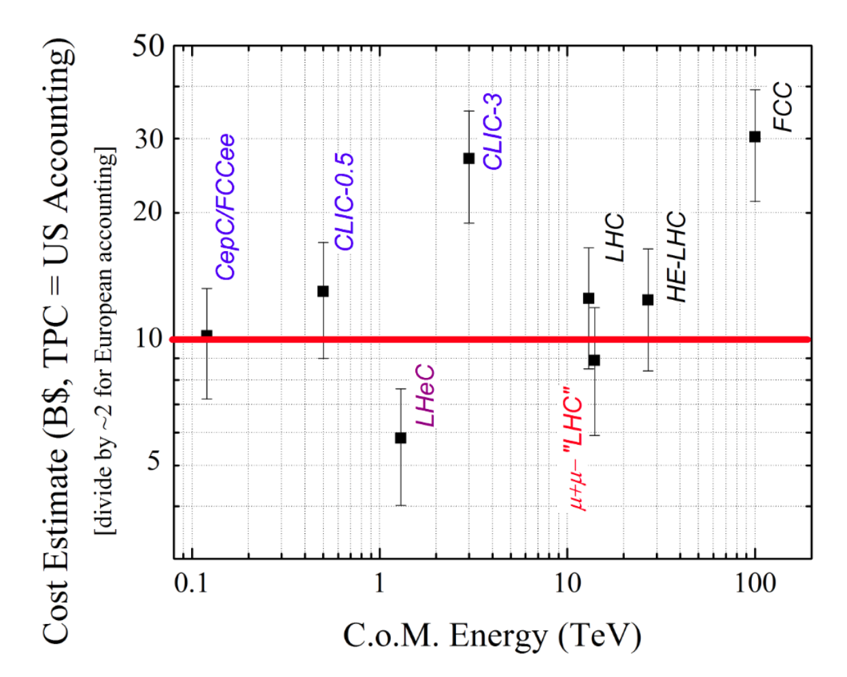
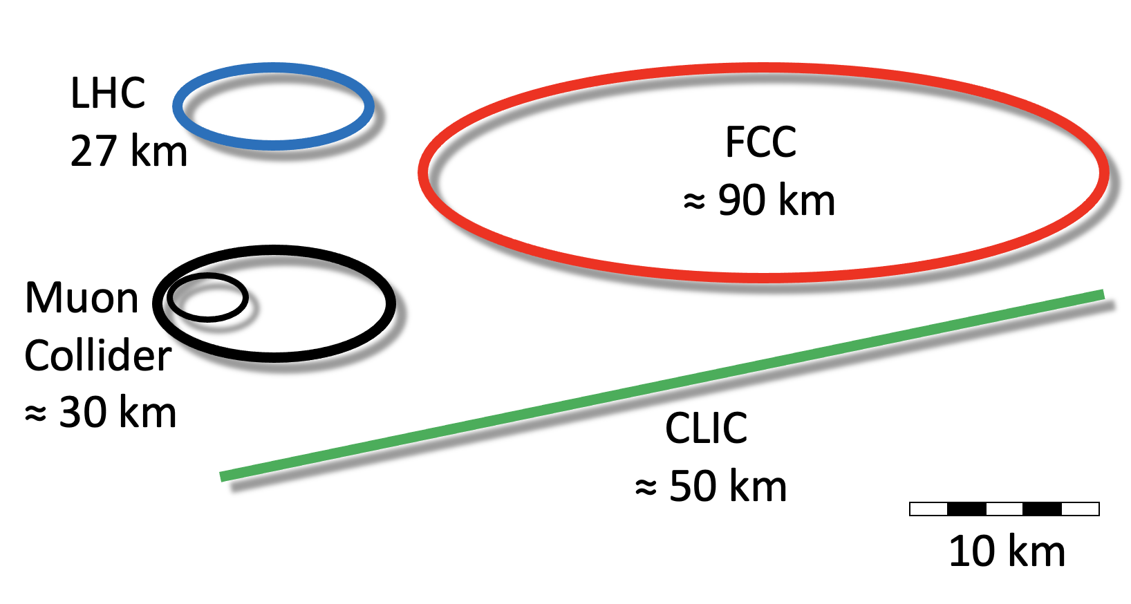
Muon Collider: Affordable ?
A muon collider at 10 TeV profiting from the LHC infrastructure could be the most cost-effective energy frontier collider
D. Neuffer and V. Shiltsev 2018 JINST 13 T10003

Slide 8

Proton-driven Muon Collider Concept
Credits to US-DOE MAP
Produce a low emittance muon beam…
… collide !
Steady state
Pulsed
Pulsed
Steady state
Steady state
pions
… accelerate muons…
Beam intensity
protons
muons
100…200 ms
Time

Slide 9
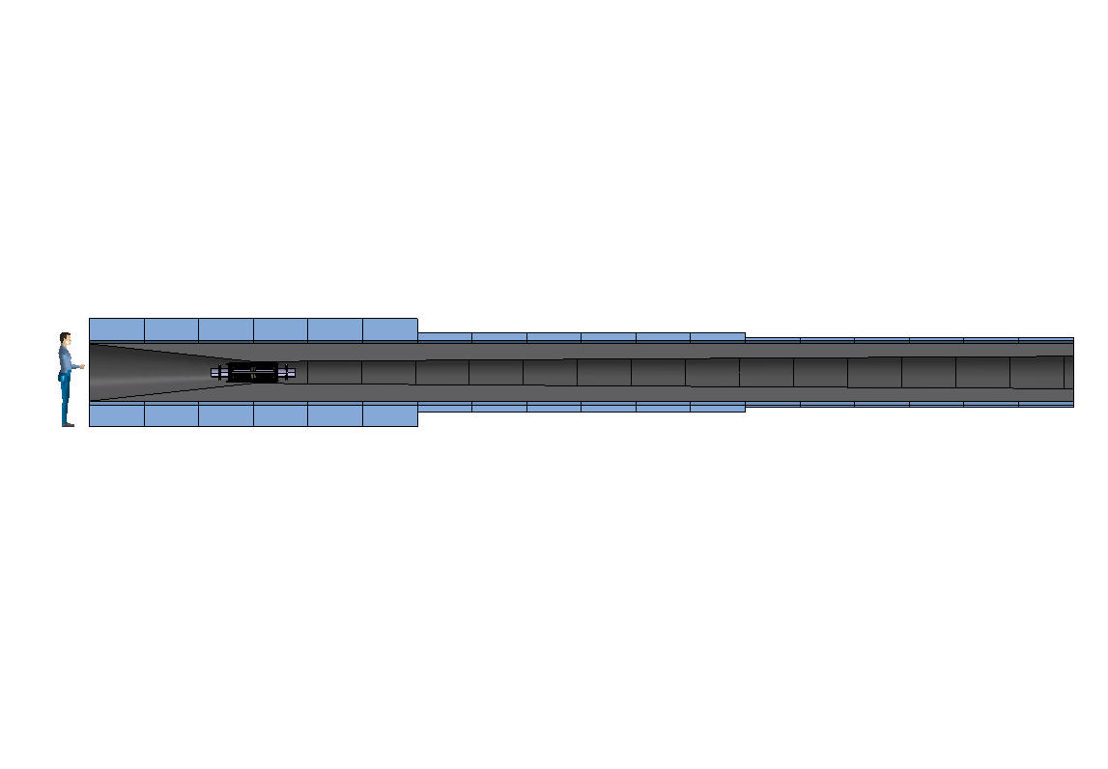
The four magnet challenges – 1
20 T, 200 mm
Radiation heat load ≈ 5…10 kW
Radiation dose: 80 MGy
Large stored energy o(1) GJ, mass o(300) tons, cost o(100) M
Considerable RT and cryogenic heat load: RT power o(1) MW
Radiation dose o(80) MGy and radiation damage o(10⁻²) DPA

Slide 10
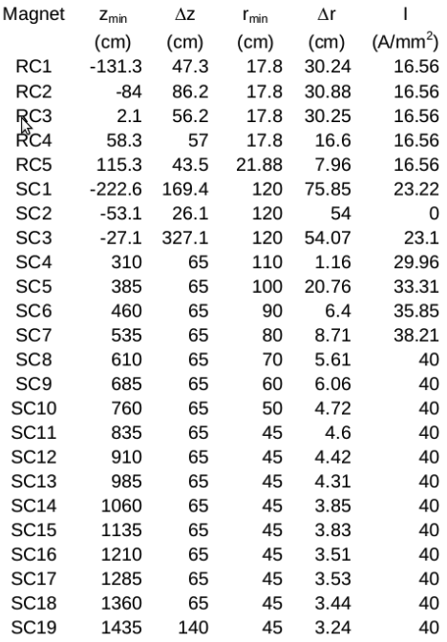
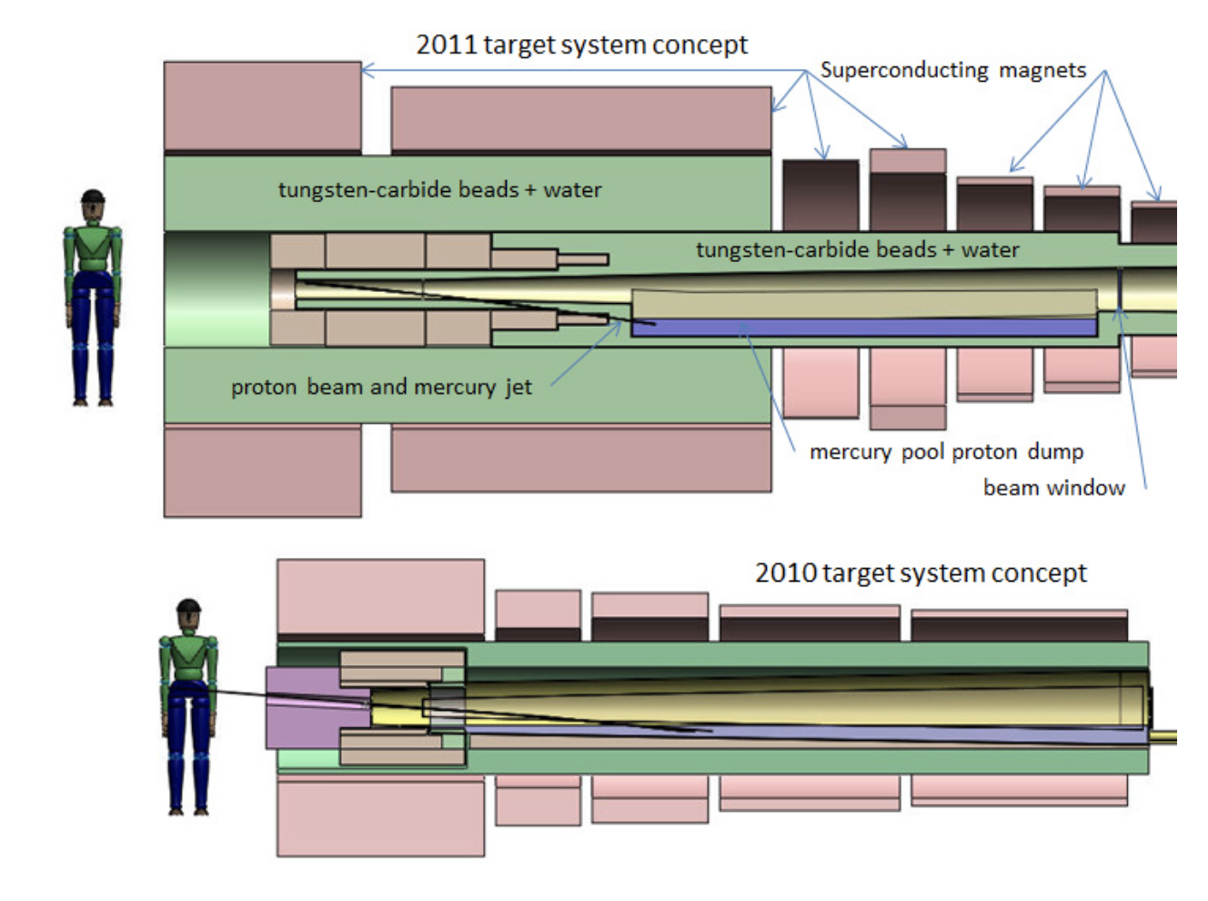
Target and capture – 1/3
Attempt to reduce the mass (CAPEX) of the system, and increase operating temperature to improve cryogenic CoP (OPEX)
US-MAP 2010 design
LTS (14 T) + NC (6 T)
US-MAP 2011 design
LTS (14 T) + NC (6 T)
MuCol 2022 design
HTS (20 T, 20 K)
H.G. Kirk, PAC 2011
A. Portone, P. Testoni, J.Lorenzo Gomez (F4E)
C. Accettura, L. Bottura, A. Kohleimainen (CERN)

Slide 11
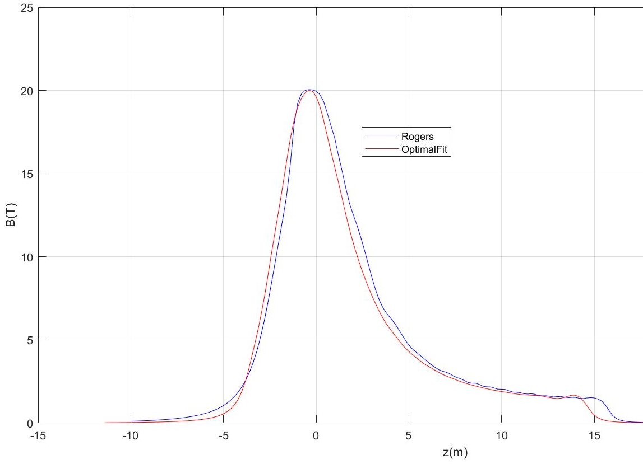
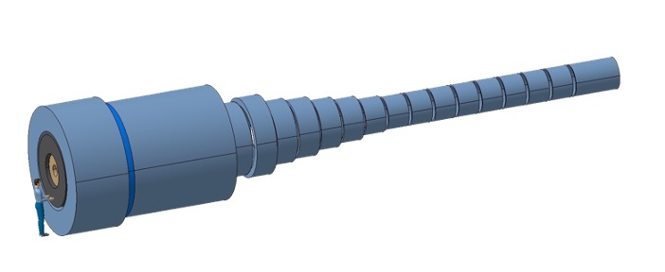
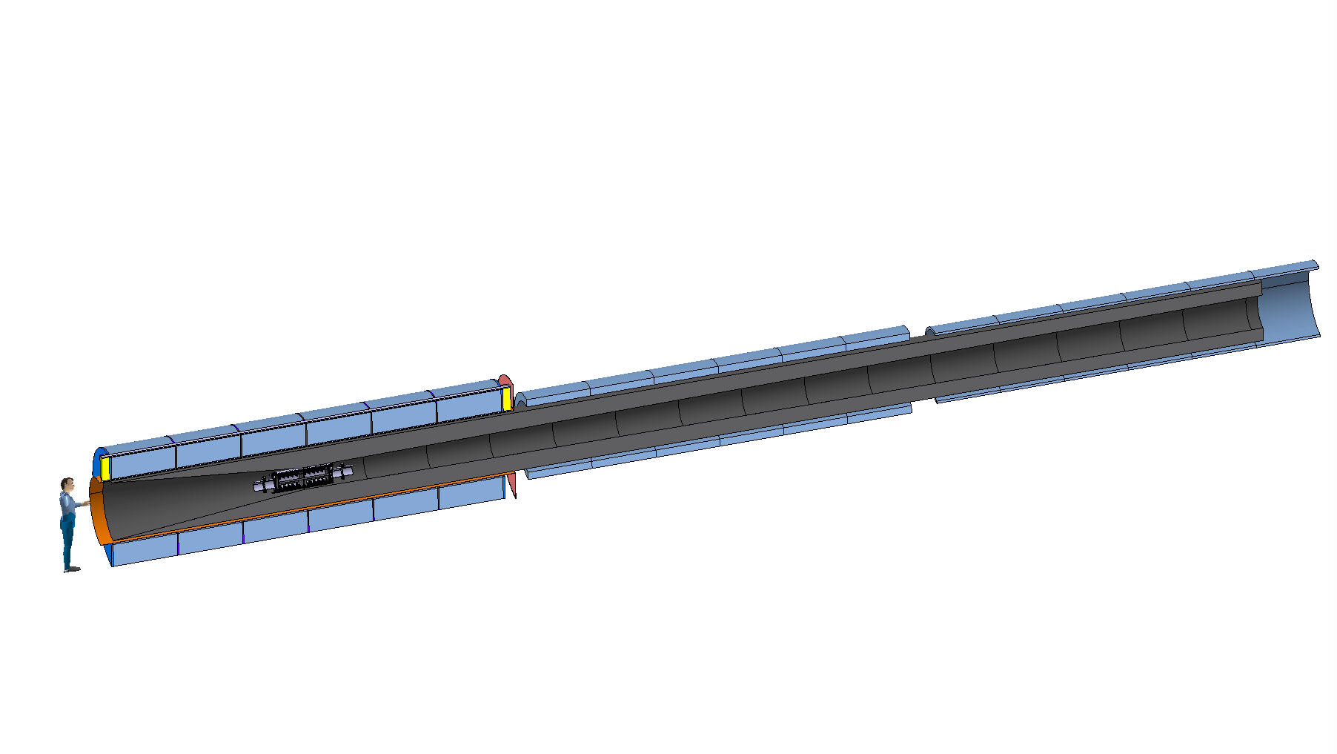
Target and capture – 2/3
E_{M} = 2.9 GJ
T_{op} = 4.2 K
M_{coils} = 200 tons
M_{shield} = 300 tons
P = 12 MW
US-MAP
Proposal
E_{M} = 1 GJ
T_{op} = 10…20 K
M_{coils} = 110 tons
M_{shield} = 196 tons
P = 1MW
A. Portone, P. Testoni, J.Lorenzo Gomez (F4E)
C. Accettura, L. Bottura, A. Kohleimainen (CERN)

Slide 12
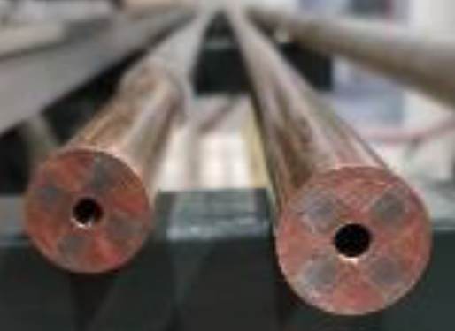
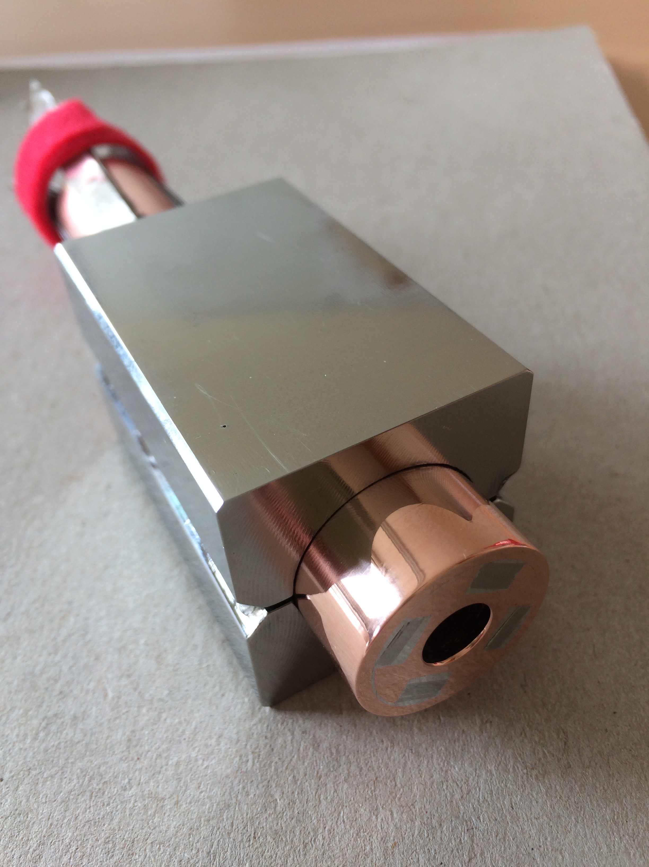
Target and capture – 3/3
Operating current: 58 kA
Operating field: 20 T
Operating temperature: 20 K
MIT “VIPER” conductor
HTS conductor design
STAINLESS STEEL JACKET
COPPER SLEEVE
COPPER FORMER
SOLDERED HTS STACK
COOLING CHANNEL
M. Takayasu et al., IEEE TAS, 21 (2011) 2340
Z. S. Hartwig et al., SUST, 33 (2020) 11LT01
8
25
38

Slide 13
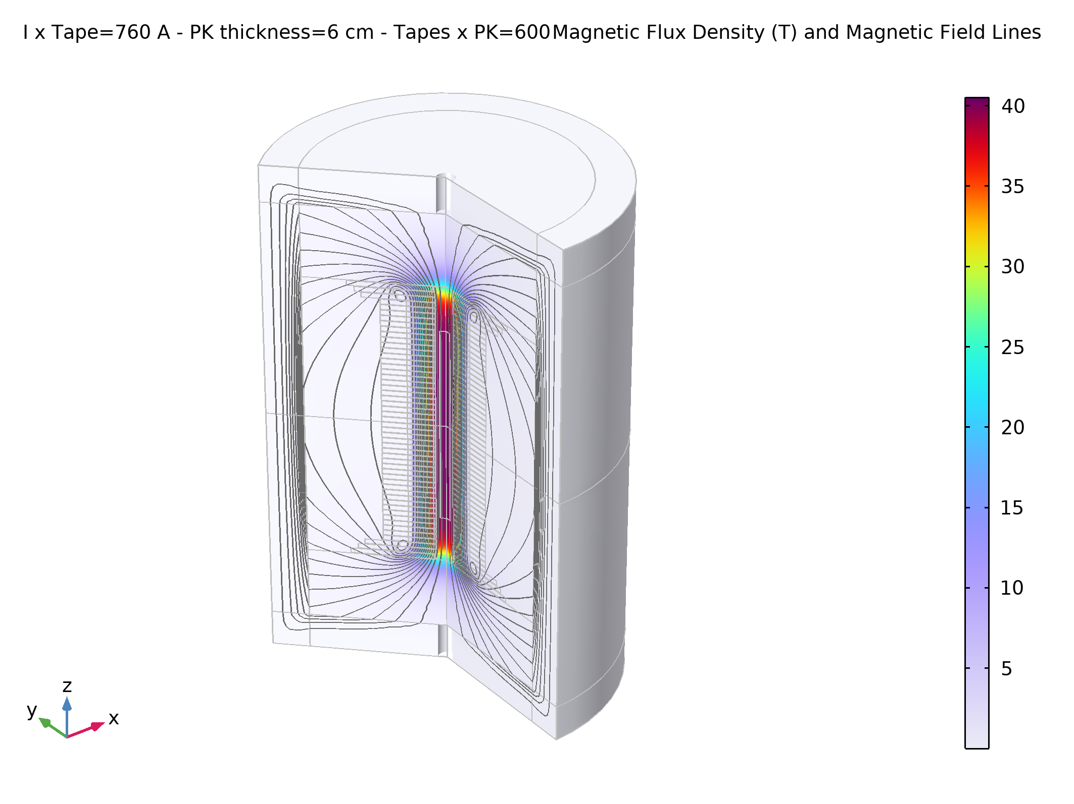
The four magnet challenges – 2
Total 1 km, o(1600) units of solenoid magnets up to o(20) T requires compact windings and careful cost optimization
UHF solenoids, with field beyond state-of-the-art o(40…60) T, calls for novel HTS technology
> 40 T, 60 mm

Slide 14
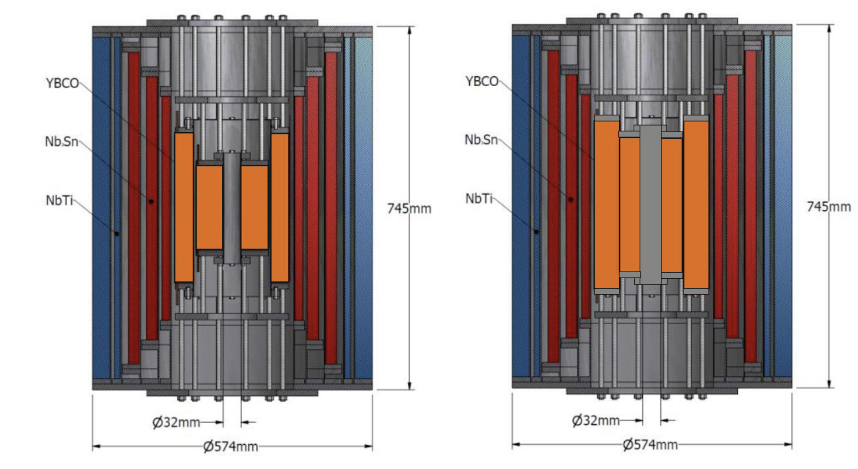
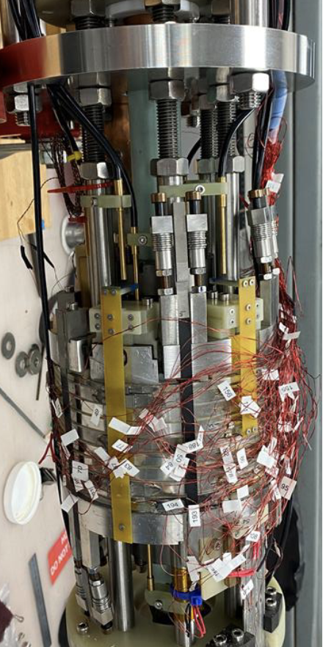
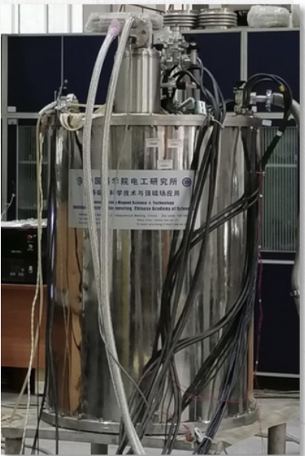
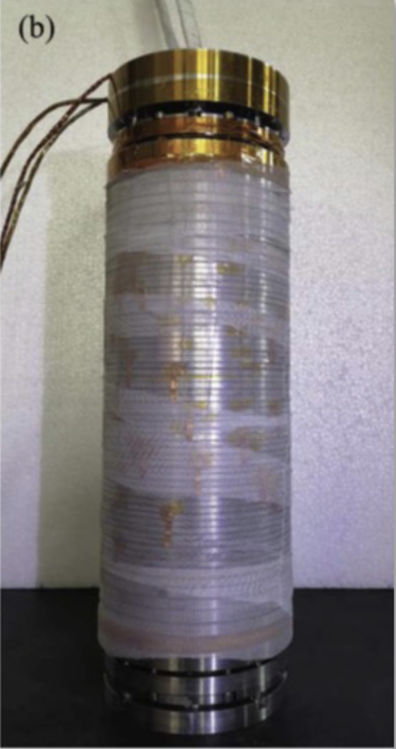
Final cooling – 1/3
Probe the limits of UHF solenoid magnets for the final cooling (performance)
Make windings compact to reduce mass (CAPEX)
LTS/HTS hybrids
Cross section of
32 T, 32 mm user facility solenoid
at NHMFL
Cartoon design of 40 T, 32 mm user facility solenoid (developmental)
Images of
32.35 T, 21 mm user facility solenoid
at CAS-IEE
R&D test
achieved 25.4 T
At NHMFL
I. Dixon, NHMFL

Slide 15
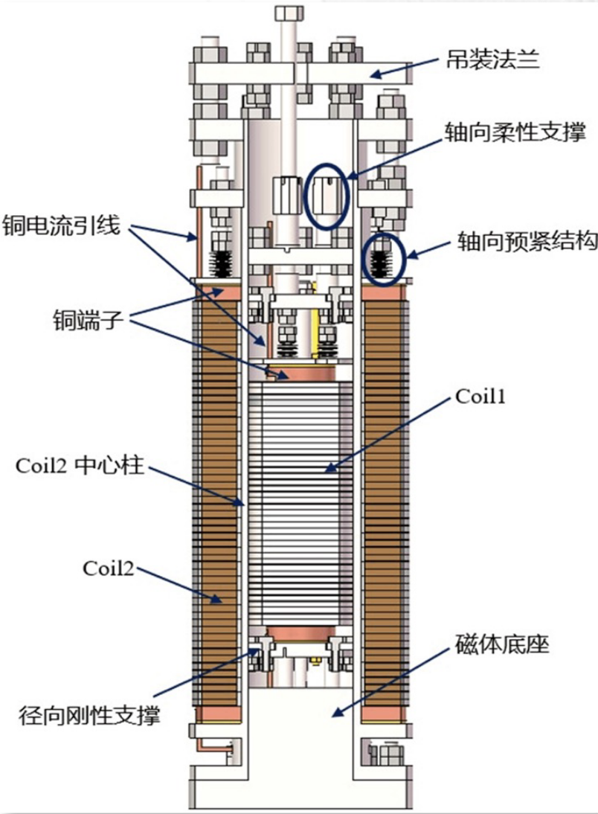
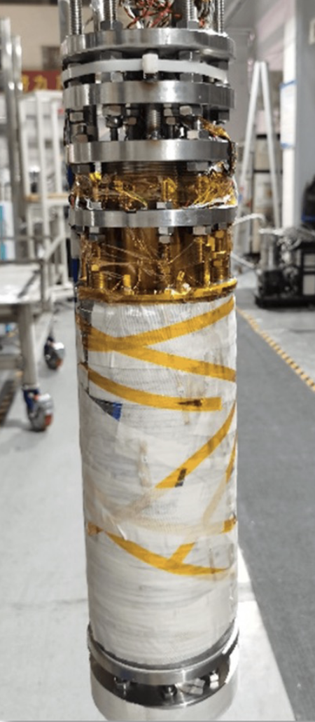
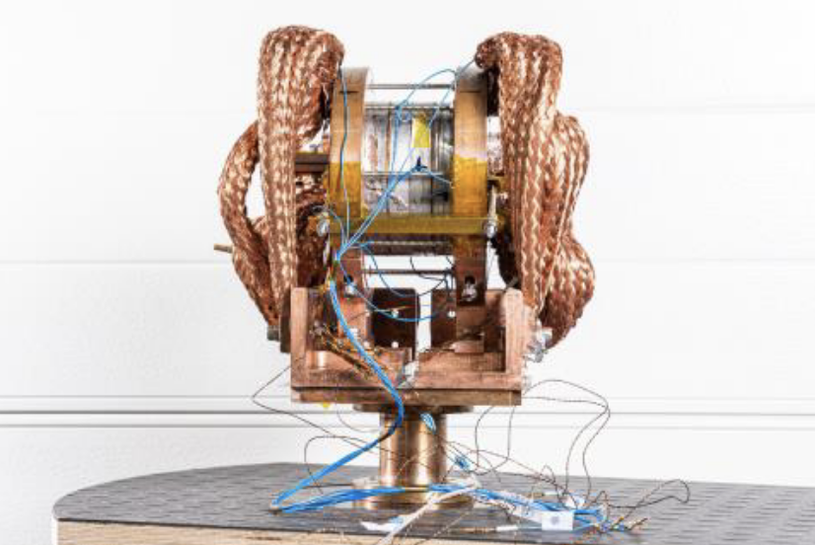
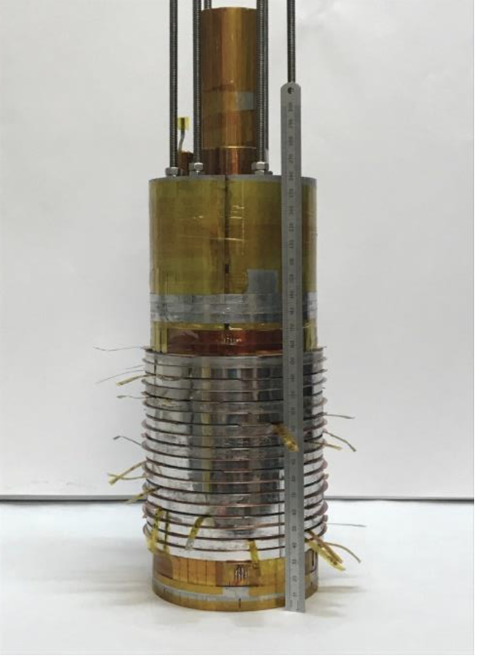
Final cooling – 2/3
Probe the limits of UHF solenoid magnets for the final cooling (performance)
Make windings compact to reduce mass (CAPEX)
All-HTS
REBCO insulated coil
achieved 24.1 T
at CAS-IPP
R&D NI coil achieved 18 T
at PSI
R&D NI insert coil achieved 32.5 T
at LNCMI
J. Kosse, PSI
J.-B. Song, LNCMI
B. Song, SST

Slide 16
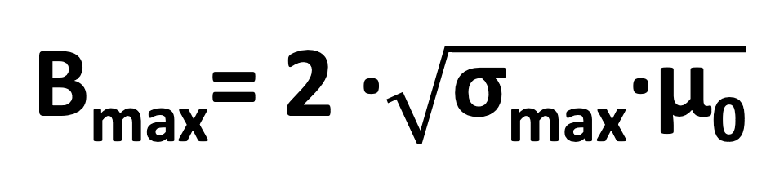

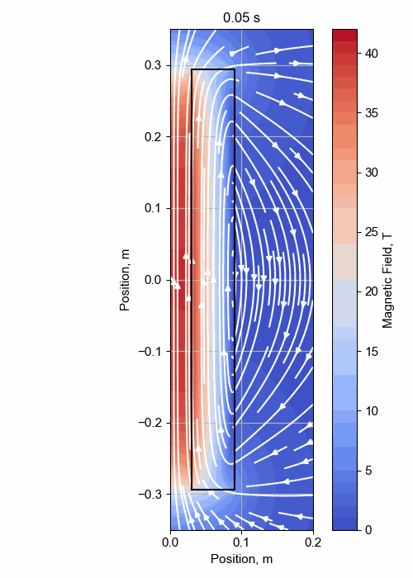
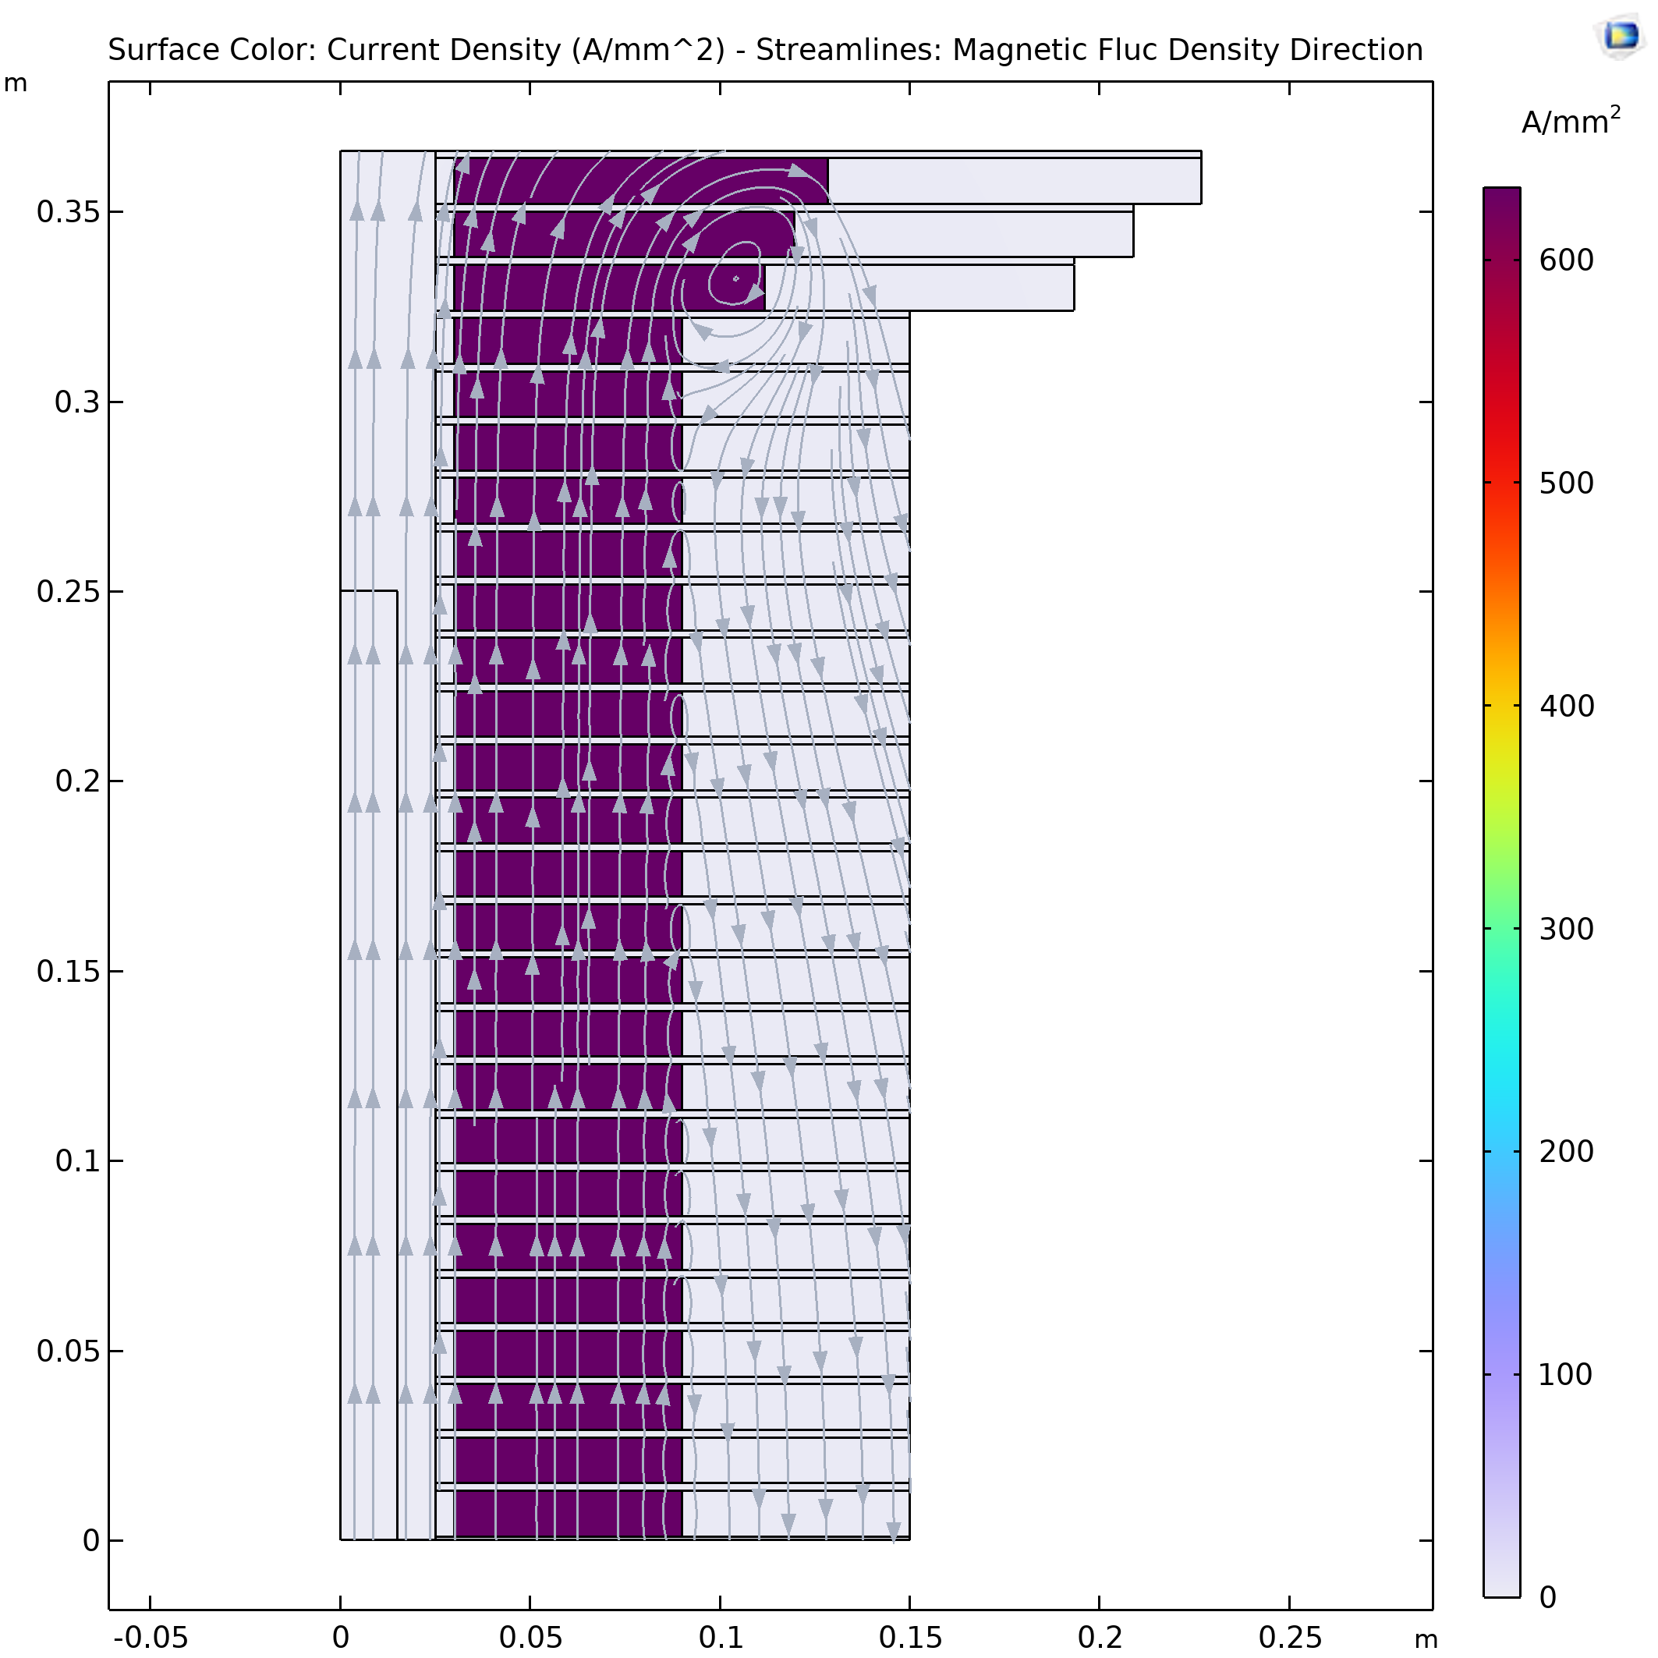
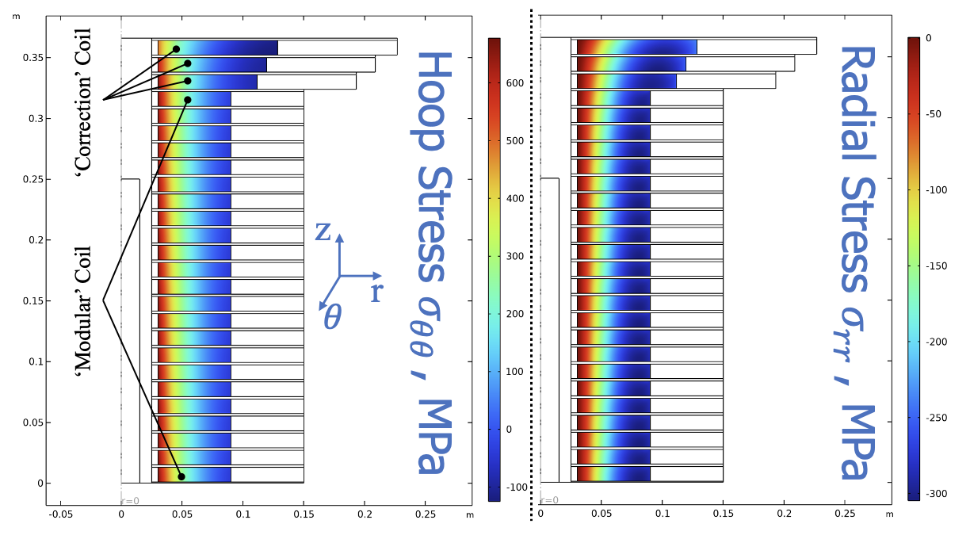
Final cooling (40 T) – 3/3
σ_{max} = 600 MPa
A. Dudarev, CERN
Inner Ring
‘Correction’ Coil
Outer Ring
Bore
‘Modular’ Coil
40 T solenoid design
1 % Field Homogeneity
Support Plate
B. Bordini, CERN
B. Bordini, CERN
T. Mulder, CERN

Slide 17
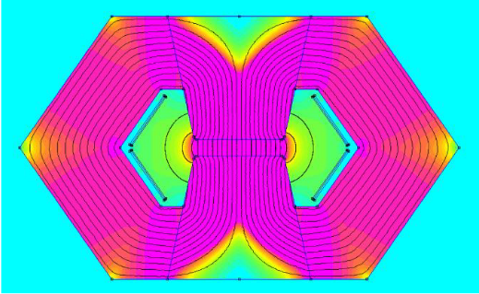
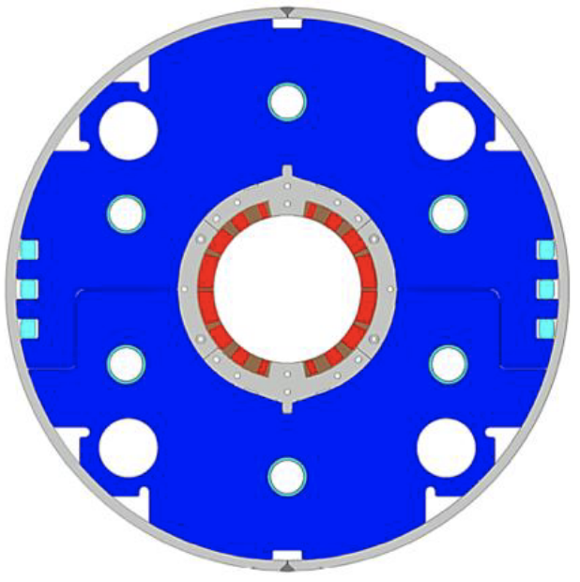
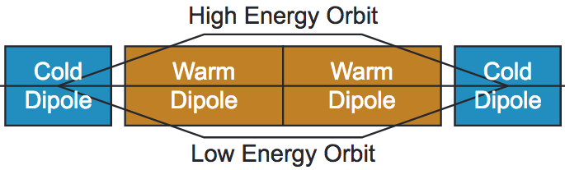
The four magnet challenges – 3
NC ±1.8 T, 400 Hz, 100 mm x 30 mm
SC < 10T, ≈ 100 mm
Energy storage and power management o(50) GW
Ramp linearity control, requirement (TBD)
Medium field o(10 T) SC dipoles subjected to radiation load

Slide 18

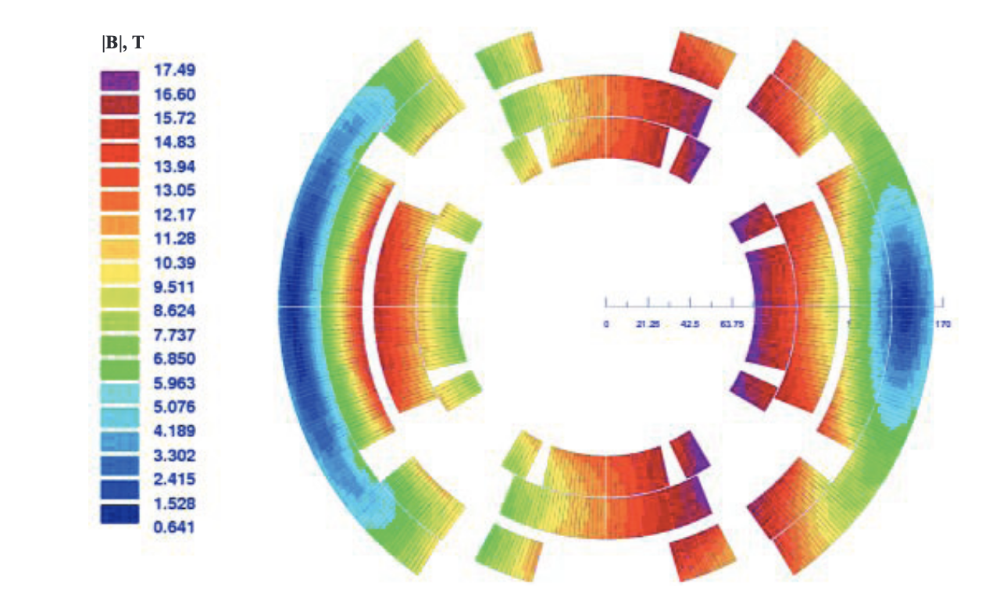
The four magnet challenges – 4
Large bore o(150mm), high field o(10…20T) arc and IR magnets result in large e.m. stress o(300…400MPa) and require novel stress management concepts
Significant Energy deposition o(5 W/m) and dose o(40 MGy)
Stress managed dipoles and quadrupoles
16 T peak, 150 mm
Radiation heat load ≈ 5 W/m
Radiation dose ≈ 20…40 Mgy

Slide 19
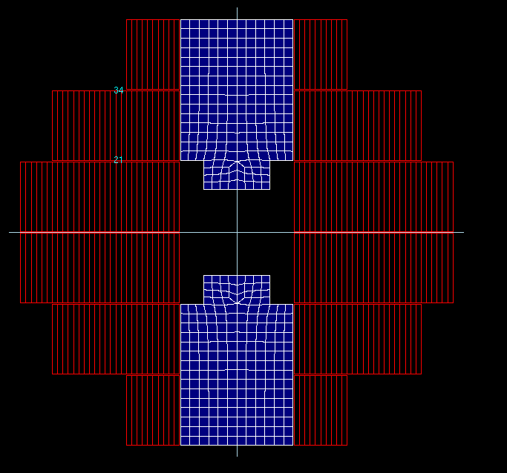
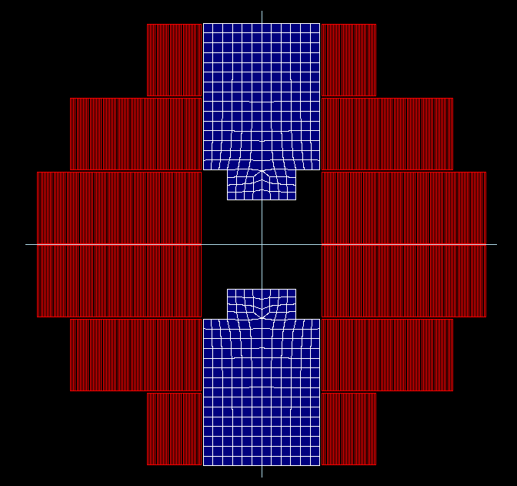
A short digression on HTS
Operate SC magnets at higher (gas) cryogenic temperature
Reduce energy consumption
(FCC-ee 350 MW, FCC-hh 580 MW)
Increase energy efficiency
(COP at 1.9 K is about 1000)
Avoid large liquid helium bath and operate at gas temperatures
Risk with helium supply chain
(FCC-hh would require 900 tons of lHe)
Reduce SC unit cost
Infrastructure (magnet) cost
(FCC-hh quoted at 9 BCHF)
Increase coil current density to decrease conductor inventory
Calculation example
(T. Lecrevisse, CEA)
Compact HTS windings
Target J_{E} 1000 A/mm²
Operation in gaseous He
Range of 15…25 K
5 T at 2800 A
J_{E} = 250 A/mm²
16 T at 2800 A
J_{E} = 850 A/mm²

Slide 20
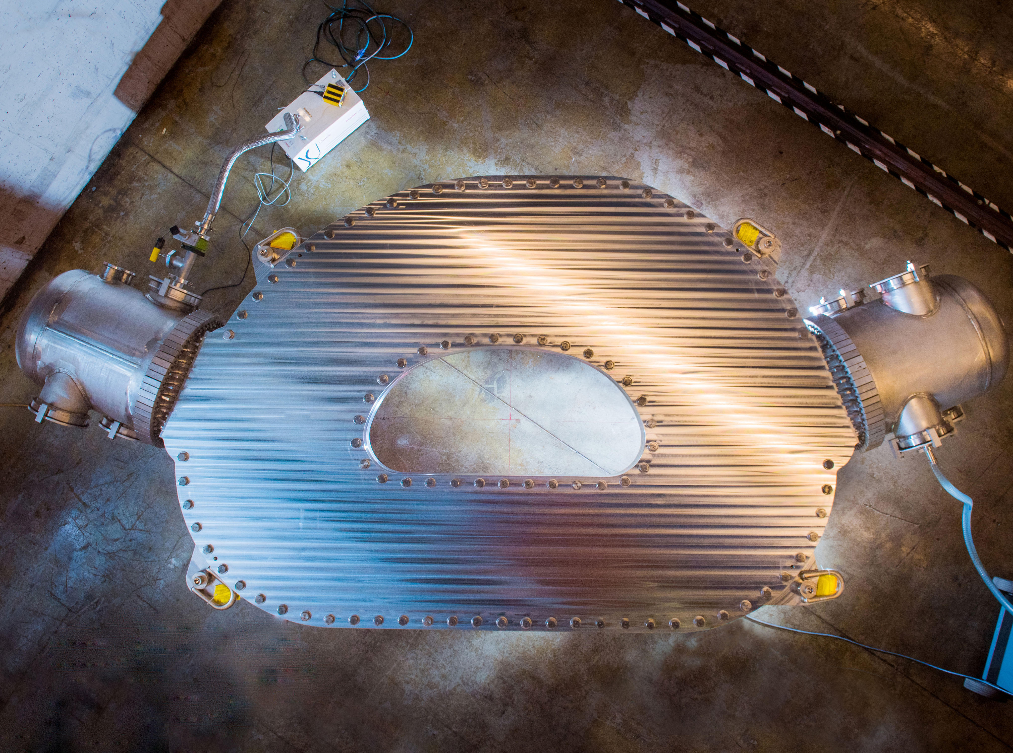
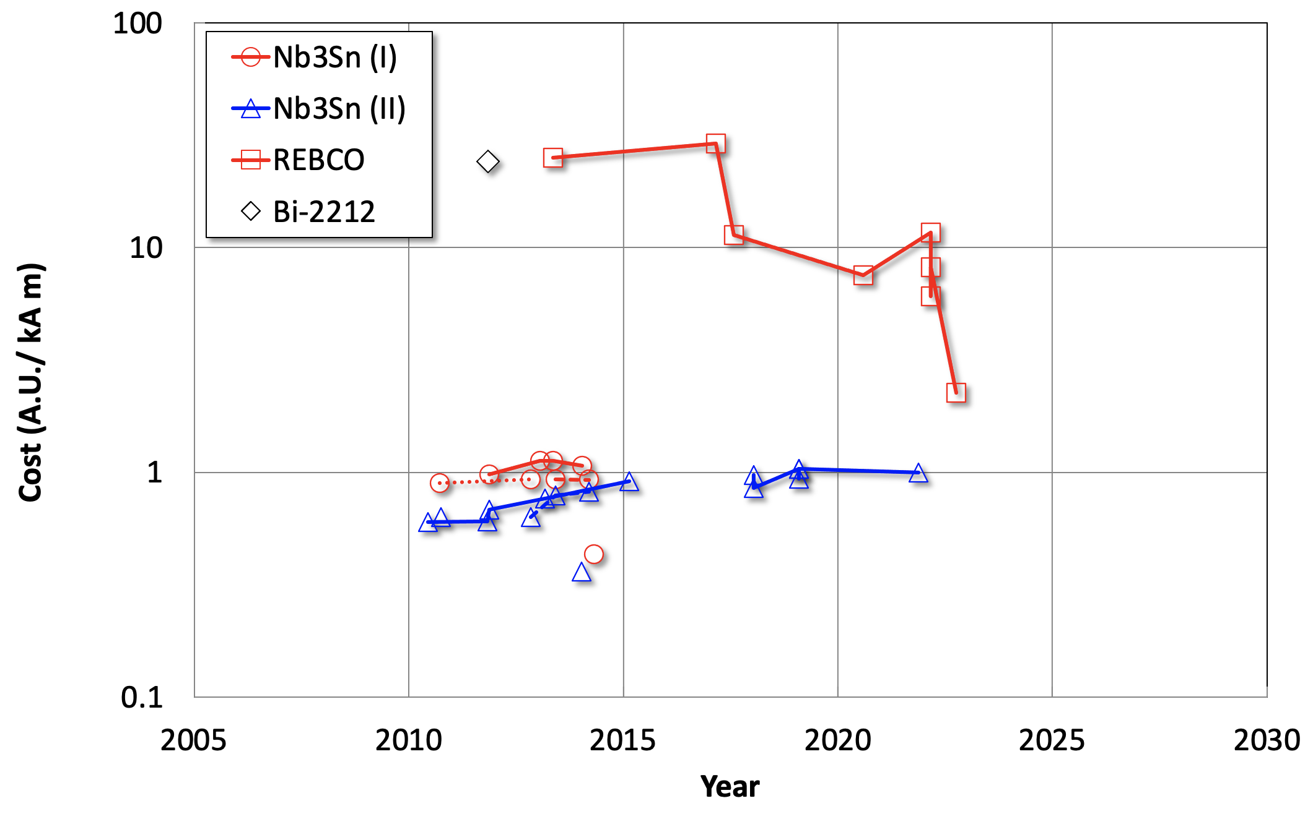



Conductor cost
Grateful thanks to fusion !
Based on CERN orders and requests for quotations 2010-2022
Normalised costs are referred to performance at 12 T, 4.2 K, not corrected for inflation
Impressive cost/performance reduction in HTS !

Slide 21
HTS for accelerators – DRAFT
 |  | Specification | Target
Minimum J_{non-Cu} (4.2 K, 20 T) | (A/mm²) | 1500 | 3000
Minimum J_{non-Cu} (20 K, 20 T) | (A/mm²) | 600 | 1250
σ(I_{C}) | (%) | 10 | 5
Minimum copper RRR | (-) |  | 20
Minimum Unit Length (UL) | (m) | 200 | 500
Minimum bending radius | (mm) | 15 | 10
Allowable σ_{longitudinal non-Cu} | (MPa) | 800 | 1000
Allowable compressive σ_{transverse} | (MPa) |  | 400
Allowable tensile σ_{transverse} | (MPa) |  | 25
Allowable shear τ_{transverse} | (MPa) |  | 20
Allowable peel σ_{peel} | (MPa) |  | TBD
Allowable cleavage σ_{cleavage} | (MPa) |  | TBD
Range of allowable ε_{longitudinal} | (%) | -0.1…0.4 | -0.1…+0.5
Internal specific resistance ρ_{transverse} | (nΩ/cm²) |  | 20
Width: 4…12 mm
Substrate (non-magnetic alloy): 40…60 μm
Copper stabilizer (total): 20…40 μm
Total tape thickness: 60…100 μm

Slide 22
HTS for accelerators – comments
Use non-Cu as basis of comparison independent of the amount of stabilizer added
J_{E} targets are within reach, comparable to fusion specifications
Main attention on mechanics, which is a major challenge of high fields. Need to understand and characterize systematically
Other parameters may be important, but we do not know yet

Slide 23
Summary
A muon collider at the energy frontier of high energy physics needs (among others)
  High fields (dipoles and quadrupoles from 16 T up to 20 T, solenoids from 20 T up to 40 T and more)
  Energy efficiency (increase operating temperature to profit from Carnot, minimal cryogen usage)
  Economics (high J_{E}, compact magnets, to reduce construction costs, sustainable Maintenance and Operation)
HTS may offer it all, provided…
  We develop a new magnet technology palette, higher current density, higher operating temperature (large degree of innovation required), using present conductor: do not wait for better
  Deploy rapidly for users: they get to know the features of the new devices, cope and (may) adapt demands
  Profit from cost reduction: one more “factor two reduction” possible ? That would be disruptive (HTS/LTS cross over)
Notes:
The reason for this talk is that we have received a strong recommendation from the group that proposes priority for particle physics in Europe. The recommendation, received in March 2020 and approved at the Council session of June 2020, contains a very strong statement on the need to ramp-up R&D effort on high-field accelerator magnets

Slide 24
Acknowledgements
Grateful thanks to many:
C. Accettura, N. Amemiya, B. Auchmann, J.S. Berg, A. Bersani, A. Bertarelli, F. Boattini, B. Bordini, P. Borges De Sousa, M. Breschi, B. Caiffi, X. Chaud, F. Debrais, A. Dudarev, M. Eisterer, S. Fabbri, S. Farinon, P. Ferracin, H. De Gersem, A. Kario, A. Kolehmainen, J. Kosse, J. Lorenzo Gomez, R. Losito, S. Mariotto, M. Mentink, T. Mulder, R. Musenich, D. Novelli, T. Ogitsu, M. Palmer, J. Pavan, H. Piekarz, A. Portone, L. Quettier, E. Rochepault, L. Rossi, T. Salmi, H. Schneider Muntau, C. Senatore, M. Statera, H.H.J. Ten Kate, P. Testoni, G. Vallone, A. Verweij, M. Wozniak, A. Yamamoto, Y. Yang, Y. Zhai, A. Zlobin
and the Muon Magnets Working Group at large
For discussion, development of concepts, design and anlyses, comments and critics, participation and fun !

Slide 25


Slide 26
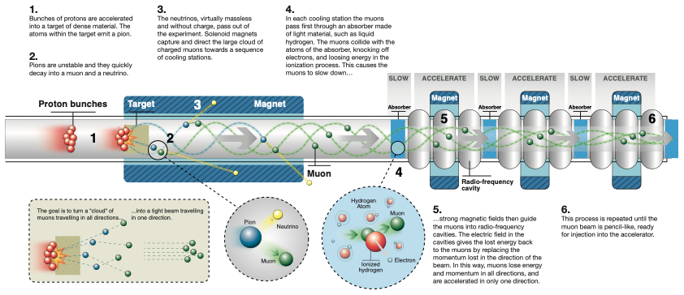
Muon beam generation
Absorber
RF field
“cooled” muon
p⊥
Decreased p⊥
Increased p//
p//

Slide 27
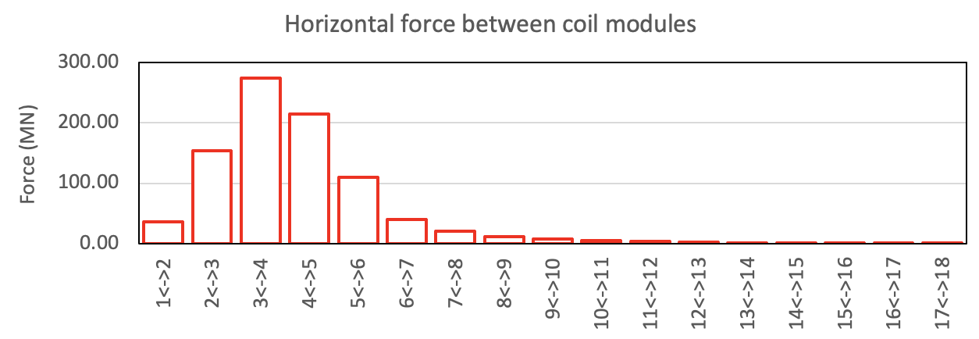
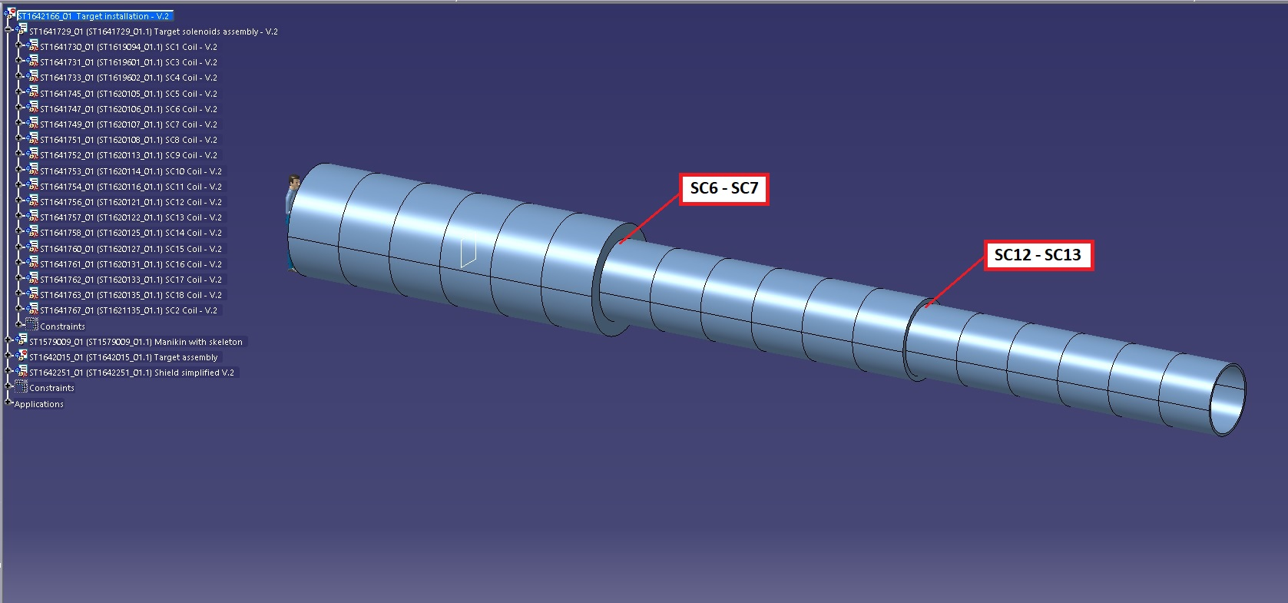
Target and capture – 4/4
A. Portone, P. Testoni, F4E
A. Kohleimainen (CERN)
2750 tons
2750 tons
100 tons
100 tons
50 tons
50 tons
Under study (among others)
  Magnetic configuration
  Mechanical support of coils and W-shield (195 tons)
  Integration in a cryostat
  Cooling and cryogenics
  ….

Slide 28
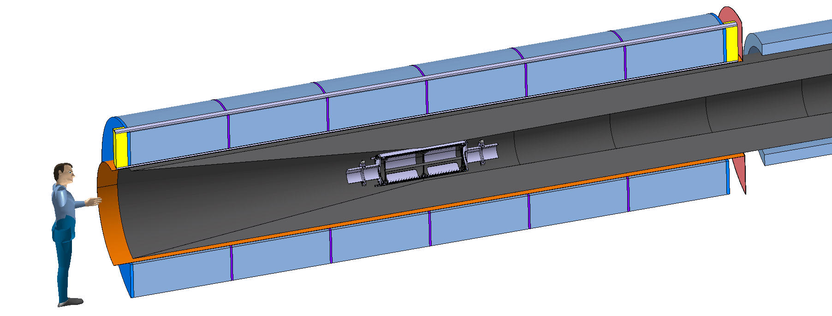
Many questions…
Pre-compression structure
Add space for beam dump ?
Composition, cooling ?
Maintenance ?
Beam OK ?
Vacuum requirements ?
W Shield
Thermal shield
Target
Coil module
Thermal shield
A. Kohleimainen (CERN)

Slide 29
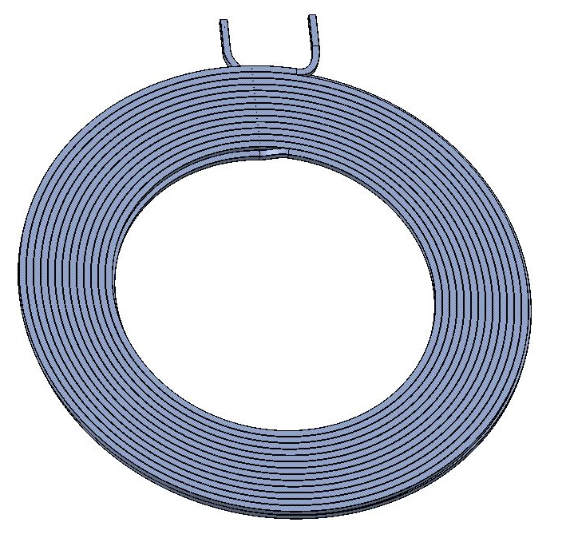
Solenoid manufacturing
Double pancake winding before HTS tape soldering
Joints and inlet/outlet (at low field)
HTS tape soldering by injection of solder at low end of each turn
Unspringing for insulation (cf. ITER TF coil manufacturing)
Stacking of double pancakes and impregnation of the module
A. Kohleimainen (CERN)

Slide 30
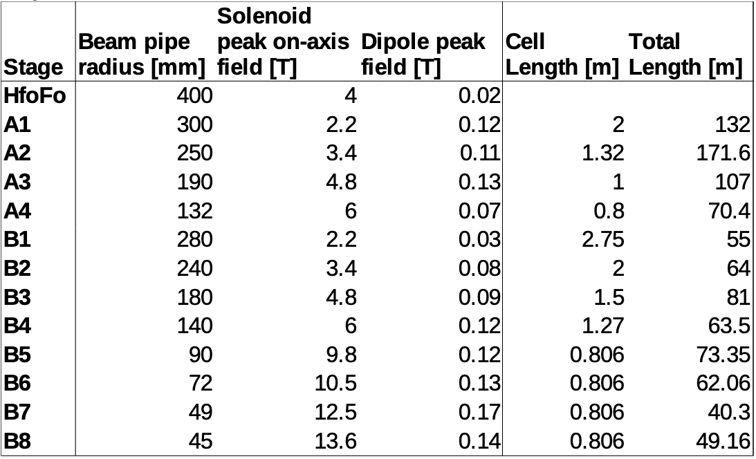
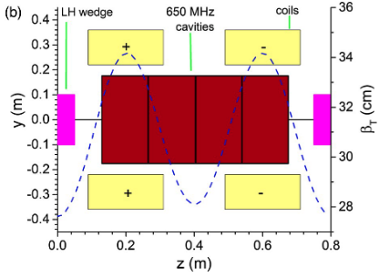
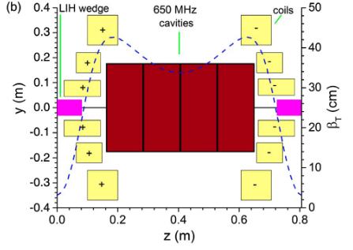
6D cooling
On-axis field and field profile B(s)
Aperture and clearances
Energy deposition, radiation dose, DPA’s
Good starting point, magnet work will start in 2023
https://indico.cern.ch/event/1147941/contributions/4851978

Slide 31
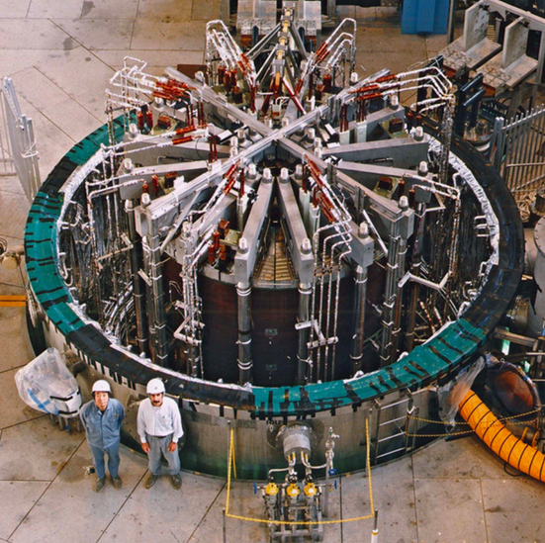
Thermonuclear fusion
ITER Central Solenoid Model Coil
13 T in 1.7 m (LTS)
MIT/CFS SPARC TF Coil prototype
20 T at 20 K (HTS)
Large bore (2 m), high-field solenoids (13 T) and toroids (20 T), cooled by a forced-flow of helium, adapted to the removal of significant nuclear heating and AC loss. Both LTS (Nb₃Sn) and HTS (REBCO) technologies are developed up to the level of industrial readiness. The push is towards higher fields solenoids (flux swing) and toroids (fusion power). Particularly interesting the operation at 20 K, improving on cryogenic efficiency with respect to liquid and supercritical helium at 4.5 K.

Slide 32
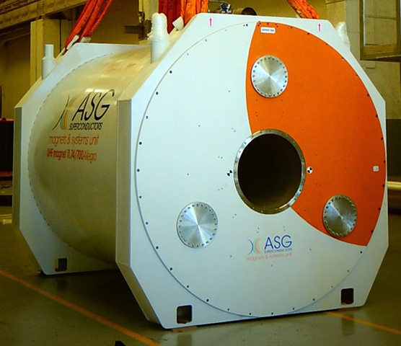
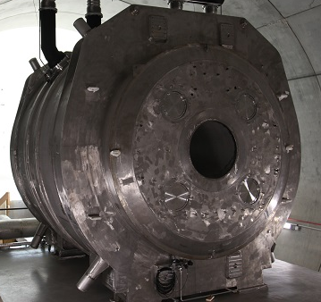
Magnetic Resonance Imaging
Large bore (800 mm), high-field (11.7 T) and high-homogeneity solenoids, in persistent- or quasi-persistent mode. LTS (Nb-Ti) technology is dominant, with interest in MgB₂ and HTS, especially for cryo-free operation. Nb₃Sn is considered for a next step, with interest in increased fields (e.g. full-body, 14 T MRI).

Slide 33
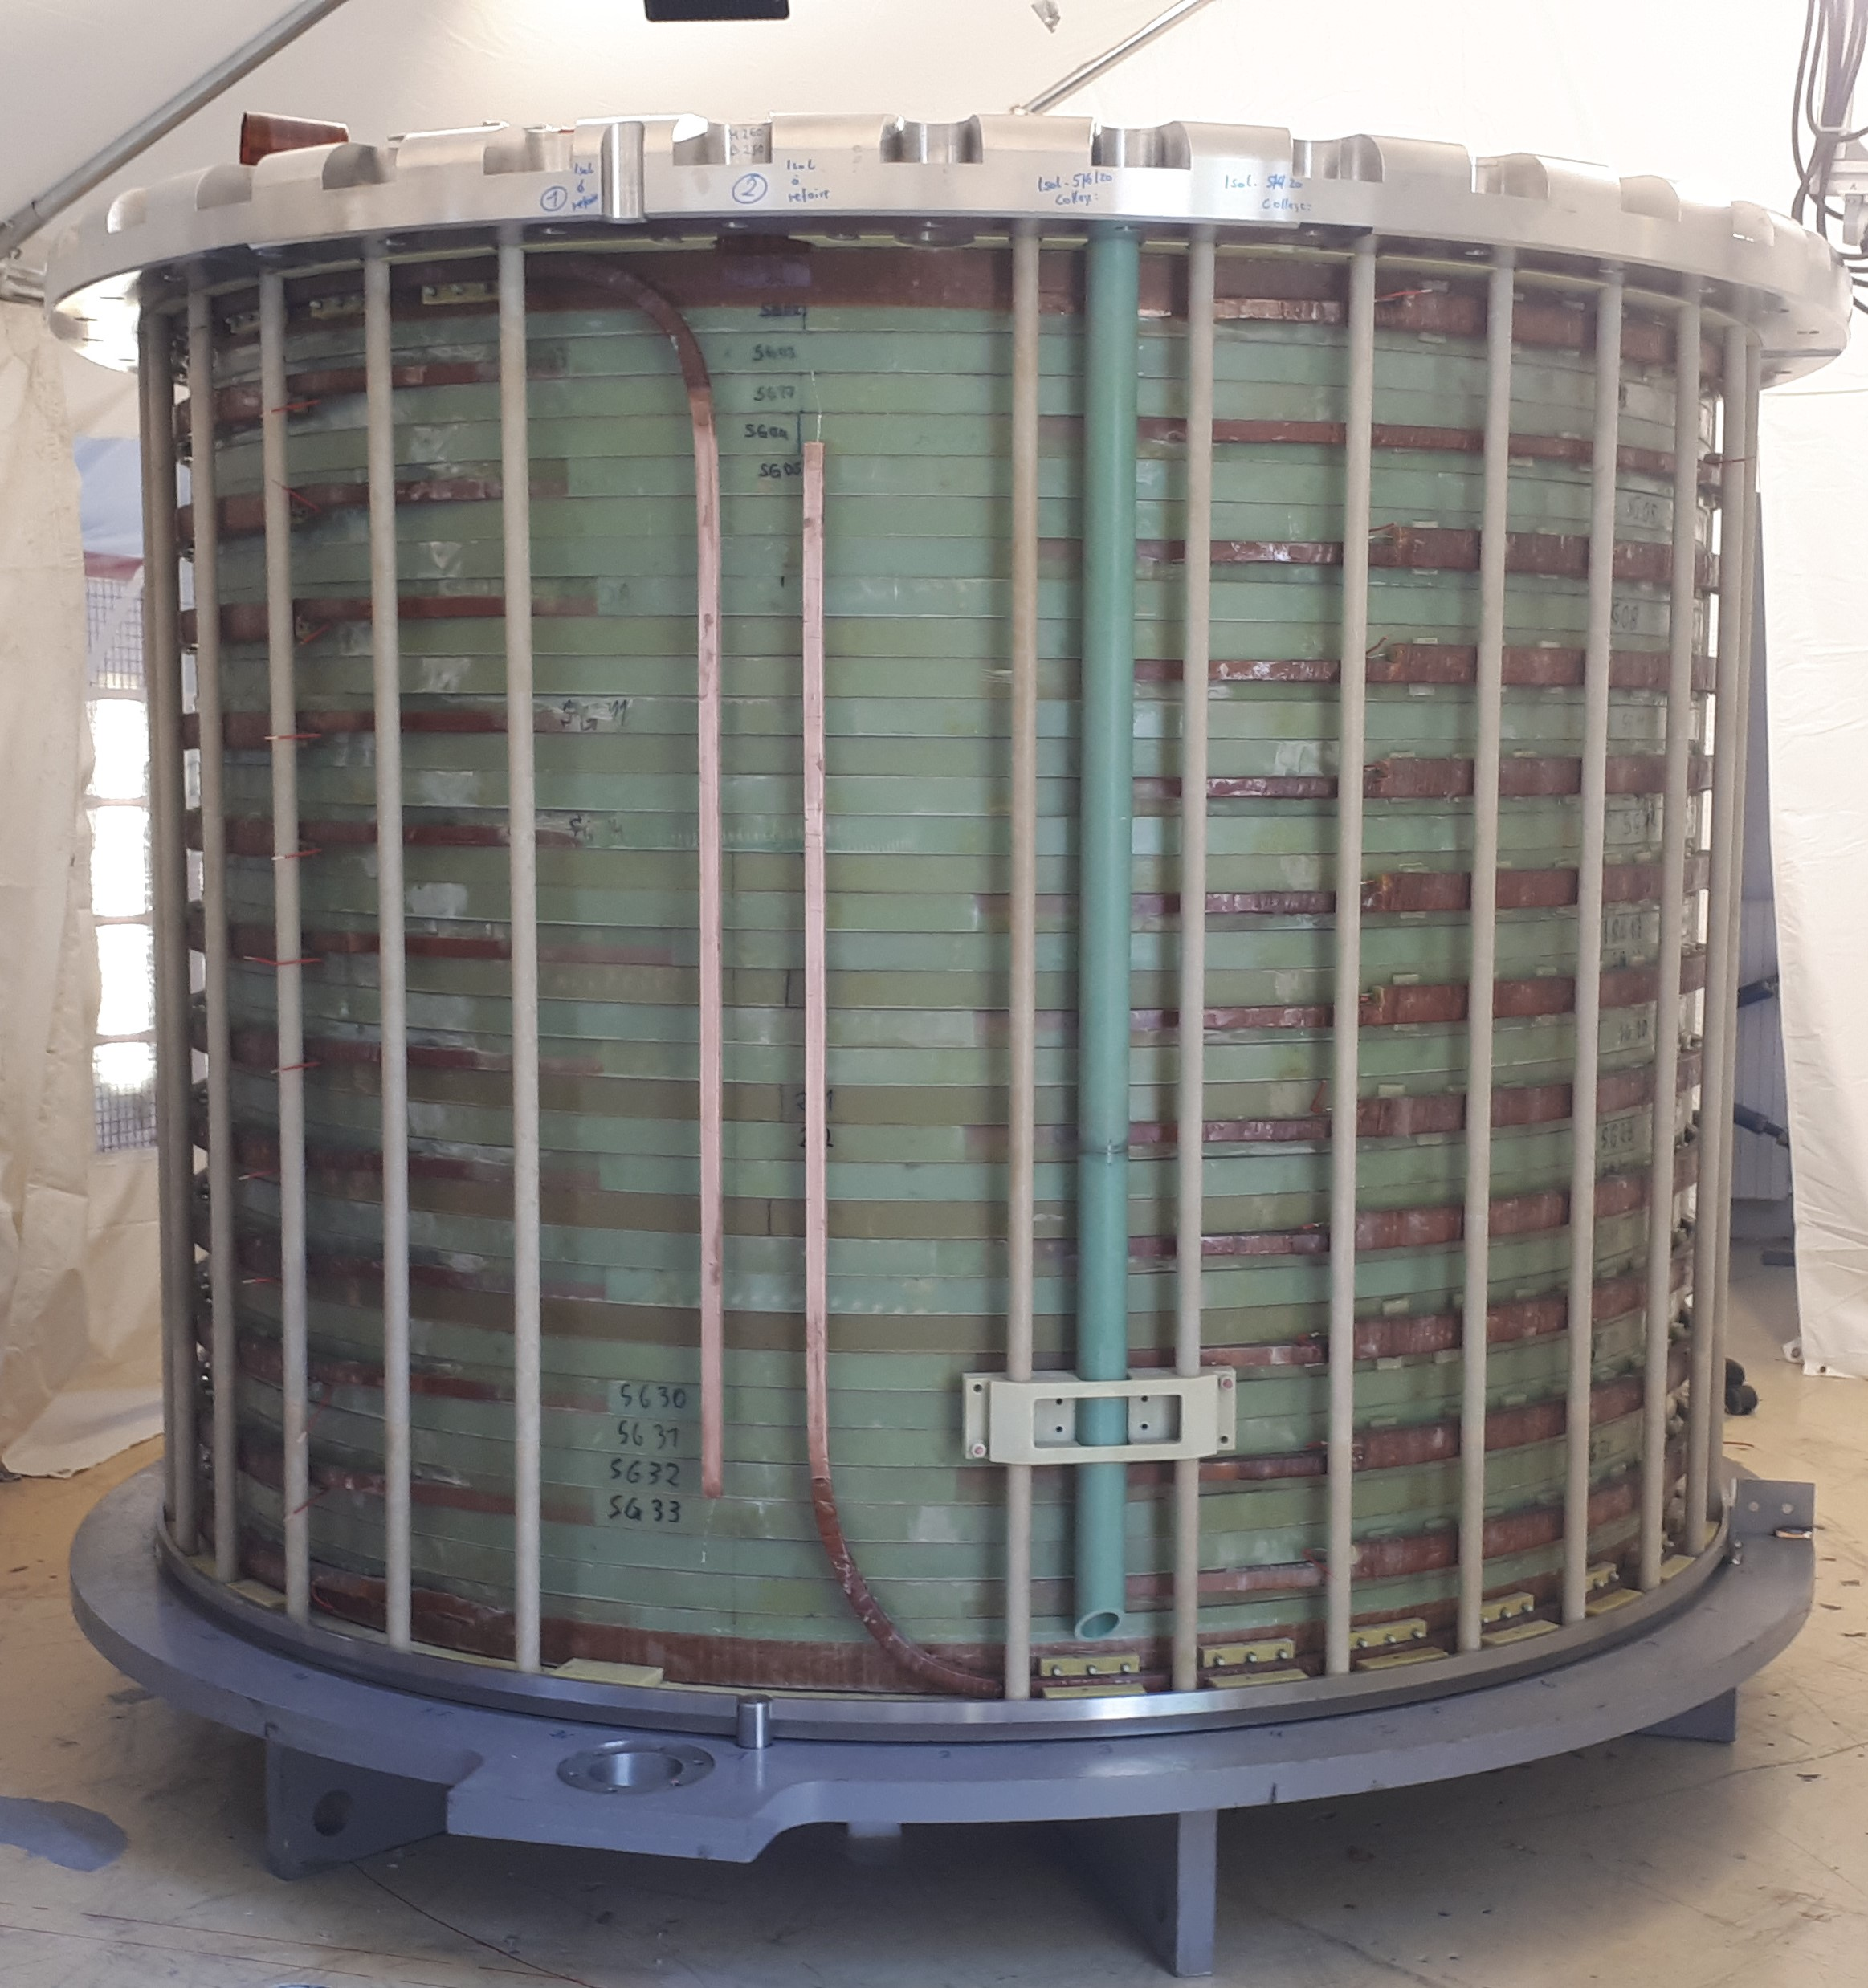
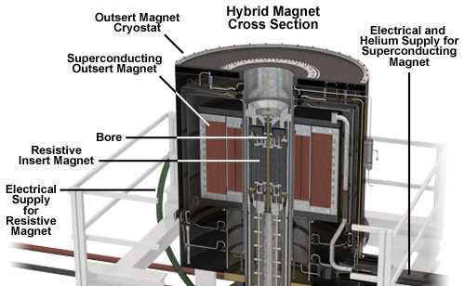
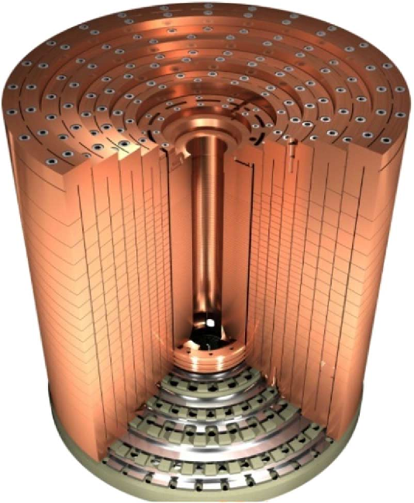

High Magnetic Field Science
LNCMI outsert magnet for the 43 T hybrid
8.5 T in 1.1 m
NHMFL 45 T hybrid
LNCMI resistive
(poly-helix) insert
for hybrid magnets
10…20 T in 30…50 mm
NHMFL series connected hybrid
36 T in

Slide 34




High Magnetic Field Science
LNCMI/CEA Nougat
HTS insert
32.5 T in 50 mm
(12. 5 T HTS + 20 T resistive)
HTS insert of NHMFL all SC 32 T
32 T in 40 mm (15 T LTS + 17 T HTS)
Sunam NI one-body
HTS magnet
26.4 T in 35 mm
(26.4 T HTS multi-width)
NHMFL HTS Little Big Coil
45.5 T in 14 mm (14.5 T HTS + 31 T resistive)
Small bore (< 50 mm), ultra-high-field (32 T) solenoids. LTS (Nb-Ti/Nb₃Sn) outsert with HTS insert, or all-HTS technology is considered, various options for HTS (insulated, non-insulated or partially-insulated). The push is towards higher fields to explore physical phenomena in an affordable installation (all-SC). Existing projects for all-SC 40 T steady state (EMFL, NHMFL), and target all-SC 60 T steady state

Slide 35


Nuclear Magnetic Resonance
JEOL 1.02 GHz
24 T (LTS+HTS)
Bruker ASCEND 1.2 GHz
28.2 T in 54 mm (LTS+HTS)
Small bore (< 50 mm), ultra-high-field (28.2 T) solenoids. LTS (Nb-Ti/Nb₃Sn) outsert with HTS insert. The push is towards higher fields to improve resolution of the resonance spectra as well as acquisition speed. Next target is 1.5 GHz (35 T).

Slide 36
Work in progress (μCol CM 2022)
R&D NI coil achieved 18 T at PSI
Cross section of 32 T, 32 mm user facility solenoid (existing)
Cartoon design of 40 T, 32 mm user facility solenoid (planned)
R&D test
achieved 25.4 T
J. Kosse, PSI
R&D NI insert achieved 32.5 T at LNCMI
NI solenoid design for 40 T
I. Dixon, NHMFL
There is a technology path towards compact 40 T solenoids
Higher fields may be possible (upper limit around 55 T ?), but the magnets will be:
More complex
Larger
More expensive ?!?
J.-B. Song, LNCMI
B. Bordini, CERN

Slide 37




Accelerator magnets – 1/4
US-MAP
Field ramp linearity can be obtained driving the magnets into saturation (≈ 0.1 T)
Field quality ?
Losses ?
Reproducibility ?
Powering based on a two harmonics circuit
but… expensive AF!
F. Boattini, CERN

Slide 38

Accelerator magnets – 2/4
To limit the stored energy, power, and voltage the string of NC dipoles will be “broken” in many individually powered circuits
A capacitor discharge is largely influenced by
  Capacitor temperature
  Ageing
  Any other changes in R-L-C characteristics
Active control will be necessary (active filter)
The specification on the field tracking can have a significant impact on the design and cost of the active filter in the power converter
Tracking on the 24 main circuits of the LHC achieved control accuracy of ppm’s of nominal current

Slide 39





Accelerator magnets – 3/4
M. Breschi, R. Micelli, P. Ribani (UniBo), F. Boattini (CERN)
 | Active power (MW/m) | Reactive power (MVA/m) | Energy in gap (J/m) | Energy in air (no gap) (J/m) | Energy in coils (J/m)
Hourglass magnet | 0.15 | 15.7 | 3.8 | 1.2 | 0.07
H-magnet (3 coils) | 0.36 | 16.3 | 3.8 | 1.3 | 0.55
H-magnet (2 coils) | 0.18 | 19.9 | 3.9 | 3.1 | 0.14
Windowframe magnet | 1.24(*) | 14 | 3.7 | 0.7 | 1.49
Highly optimized cross section
Does not seem interesting
Higher loss but marginally lower stored energy
(*) mainly due to skin effect, can be limited by subdividing the copper conductors
Configuration to be studied
The magnet stored energy is directly proportional to iron gap and pole width: keep them as small as possible
Fe-Co seems the only practical way to reach fields in the range of 1.8 T, but may pose RP issues (to be quantified)
Fe-Co saturation curve

Slide 40
Accelerator magnets – 4/4
SC magnets
  10 T is an “unfortunate” number for Nb-Ti
    LHC heritage, resulting from the years if competition with the SSC. Only a couple of models (MFISC, FRESCA) and 10m prototypes made it to (or close to) 10 T
    LHC ultimate field (magnet design) is set at 9 T. This field level was reached in a large part of the series production
    For practical reasons the LHC dipoles operate at 8 T
    Set the Nb-Ti design dipole field to 8…9 T (see later)
  NOTE: 16 T is similarly un “unfortunate” number for Nb₃Sn
    Set the Nb₃Sn design dipole field to 13…14 T (see later)

Slide 41




Magnet powering alternatives
Local correction
B₁⁵
B_{SC}
B₁¹
B₁³
1 + 3
1 + 3 + 5
Global correction
< 1 %
B₁¹
B₁¹
B₁¹
B₁³
< 0.1 %
B₁¹
B₁¹
B₁¹
B₁¹
Compatible with beam specs ?

Slide 42



Collider magnets – 1/3
On-axis peak field | 10 T
On-axis peak gradient | 300 T/m
Bore diameter | 150 mm
Magnetic length | 15 m
Field Quality | 10 units
Technology | LTS/HTS
Temperature range | 1.9/4.2 K (LTS) or 10 to 20 K (HTS)
The combination of these three is not possible
B_{max}$=$15.4 T @ 4.2 K
W_{eq}$=$90 mm !!!
G_{max}=175 T/m @ R=75 mm
W_{eq}=120 mm !!!
B=13…14 T
G=160…170 T/m
DIPOLE
QUADRUPOLE
S.Mariotto, B.Caiffi, D. Novellini, INFN

Slide 43


Collider magnets – 2/3
Stress limit
Margin limit
Dipoles
Quadrupoles
Work in progress to provide analytical expression for the magnet design limits
  Maximum field and gradient vs. magnet aperture in LTS and HTS
  Combined function limits B+G and B/G
Proposal: take provisionally 9 T for NbTi and 14 T for Nb₃Sn

Slide 44



The need for energy
CERN uses today 1.3 TWh per year of operation, with peak power consumption of 200 MW (running accelerators and experiments), dropping to 80 MW in winter (technical stop period)
Electric power is drawn directly from the French 400 kV distribution, and presently supplied under agreed conditions and cost
Supply cost, chain and risk are obvious concerns for the present and future of the laboratory

Slide 45






Energy efficient cryogenics
Credits to P. Borges De Sousa and R. Van Weelderen, CERN
LHC
(FCC)
Need efficient cryo-plant and heat removal scheme in the range of 10…20 K (see work at ESS)
RHIC
Tevatron
HERA
LHC
Nb-Ti
8T
5T
ESS
The 60…80 K range would be a dream…
Nb₃Sn
16T
12…14T
This could be the best range of operating temperature of a future HEP collider
HTS
40…60T
20…40T
a few T
1.9
4.2
77
HTS may be the only path towards a future collider

Slide 46



Future helium supply is limited and entails a substantial economical and availability risk
F. Ferrand, CERN

Slide 47


The need for economics
A large component in the magnet cost is the amount of superconductor (coil cross section)
High-field superconductors are (significantly) more expensive than good-old Nb-Ti
Need to work in two directions:
  Reduce the coil cross section (increase J !)
  Reduce unit conductor cost
$$B=\frac{2μ_{0}}{π} Jw sin\left(φ\right)$$
R_{in}
ϕ
$$A_{coil}=2φ\left(w^{2}+2R_{in}w\right)\sim \frac{1}{J^{1.5}}$$
w
HTS may offer both

Slide 48





On a slimming diet !
Single coil conductor cross section
Multiply by ≈20 for kUSD/m
380 A/mm²
580 A/mm²
550 A/mm²
630 A/mm²
480 A/mm²
Achieve 20 T with the 16 T FCC-hh dipole x-section
540 A/mm²
720 A/mm²
Reduce 16 T FCC-hh dipole x-section by factor 2
900 A/mm²

Slide 49







New winding technology needed
T. Lecrevisse, CEA
920 µm
5 T at 2800 A
J_{E} = 250 A/mm²
16 T at 2800 A
J_{E} = 850 A/mm²
HTS windings can profit from “NI” technology

Slide 50

Collider magnets – 3/3
A first attempt to compile a physical radial build for the various components in the collider bore and magnet, to be continued
S.Mariotto, B.Caiffi, D. Novellini, INFN

Slide 51


Collider wobbles
Mechanical actuation
h: beam height
p: wave period
Neutrino emission angle ≈ h/p
The same angle can be obtained changing p and h by the same ratio
p = 600 m
h = 150 mm
Magnetic steering ?
MB
10 T
5 m
MB
10 T
5 m
MB
10 T
5 m
p = 60 m
h = 15 mm
δy
3 T
1 m
δy
3 T
1 m
δy
3 T
1 m

Slide 52

MuCol EU study

Slide 53

MuCol EU study

Slide 54

Muons Magnets WG
Twenty-one meetings to date, with participants from m ost collaborating institutes and universities
Since April we meet:
  to “learn” about the previous work (MAP) and advances in relevant fields,
  to discuss in an informal setting initial ideas and options, and
  in preparation of upcoming activities, in particular the EU MuCol
Site: https://indico.cern.ch/category/13958/
Mailing list: muoncollider-magnets@cern.ch

Slide 55
Tasks
Task 1
Technical Coordination and Integration
The organization of the tasks overlaps with the EU MuCol study
The scope of the work in most tasks, however, extends beyond the EU proposal (e.g. target solenoid study, HTS tape procurement and measurements, test of HTS pancakes, …)
Most tasks activities also rely on advances and synergy with other projects and programs (e.g. HFM, UHF solenoid R&D, HTS fusion magnets R&D, HTS generators R&D, …)
Task 2
Target, Capture and Cooling Magnets
Magnet Systems
Task 3
Fast Cycled Accelerator Magnets
Task 4
Collider Ring Magnets

Slide 56
The Team and the work – 1/4
Task 1
Technical Coordination and Integration
Participants
  CERN (LB, SF)
  CEA (LQ)
Activities
  Periodic meeting of the “muons magnets Working Group”
  Machine configuration (“magnet catalogue”)
  Interface to physics, radiation, vacuum, cryogenics, safety and RP
  Review of radiation hardness of superconductors and insulation systems (joint activity with radiation studies)
  Documentation and reporting
Task 2
Target, Capture and Cooling Magnets
Magnet Systems
Task 3
Fast Cycled Accelerator Magnets
Task 4
Collider Ring Magnets

Slide 57
The Team and the work – 2/4
Task 1
Technical Coordination and Integration
Participants
  INFN (MS)
  CEA (LQ, PhD)
  CERN (AD, BB, TM, LB, AK, CA, AB)
  CNRS (XC)
  F4E (AP, PT)
  KIT (TA)
  PSI (JK)
  SOTON (YY, post-doc)
  UNIGE (CS)
  TWENTE (HTK, AK, post-doc)
Activities (≈ 12 months)
  Conductor review and specification
  Design of target and capture channel solenoids
  Design of final cooling solenoid
  Procurement and electro-mechanical characterization (UHF) of test HTS material
  Pancake model coils, engineering design, manufacturing solutions, mechanical and powering tests
Task 2
Target, Capture and Cooling Magnets
Magnet Systems
Task 3
Fast Cycled Accelerator Magnets
Task 4
Collider Ring Magnets

Slide 58
The Team and the work – 3/4
Task 1
Technical Coordination and Integration
Participants
  CERN (FB, LB, TECH)
  UNIBO (MB, PR, RM)
  LNCMI (JB)
  TWENTE (HTK, AK)
  TUDa (HVG, post-doc)
Activities (≈ 12 months)
  Power converter conceptual design and optimization, including energy storage
  Components tests (capacitors)
  Conceptual design and 2D optimization of resistive magnets for RCS
  Initiate detailed 2D/3D analysis of resistive magnets for RCS, including saturation, end effects, anomalous loss
  Conceptual design of SC magnets for RCS
  Study of HTS options for pulsed magnets
Task 2
Target, Capture and Cooling Magnets
Magnet Systems
Task 3
Fast Cycled Accelerator Magnets
Task 4
Collider Ring Magnets

Slide 59
The Team and the work – 4/4
Task 1
Technical Coordination and Integration
Participants
  INFN (SM, BC, DN)
  CERN (LB)
  UNIMI (SM)
Activities (≈ 12 months)
  Establish limits of SC dipoles and quadrupoles, considering LTS and HTS as well as combined function options
  Agree on arc dipole specification
    Field and gradient
    Aperture
    Nested/asymmetric windings
    Operating conditions
  Initiate conceptual design of main arc magnet
Task 2
Target, Capture and Cooling Magnets
Magnet Systems
Task 3
Fast Cycled Accelerator Magnets
Task 4
Collider Ring Magnets

