Slide 1

HTS MSC Activities at CERN
A. Ballarino, CERN
HiTAT Workshop
High Temperature superconductors for Accelerator Technology
CERN, 9–10 March 2023

Slide 2
Outline
HTS for HL-LHC
Prospects for future applications
HTS Program for HFM
A. Ballarino

Slide 3
HTS for LHC – SC Link System
Ten Systems for HL-LHC : 5 for the Triplets and 5 for the Matching Sections
A. Ballarino

Slide 4
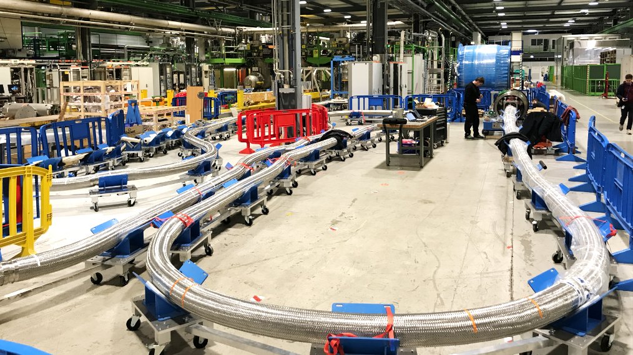
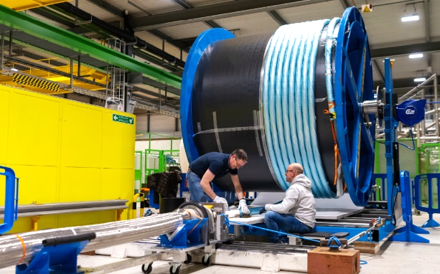
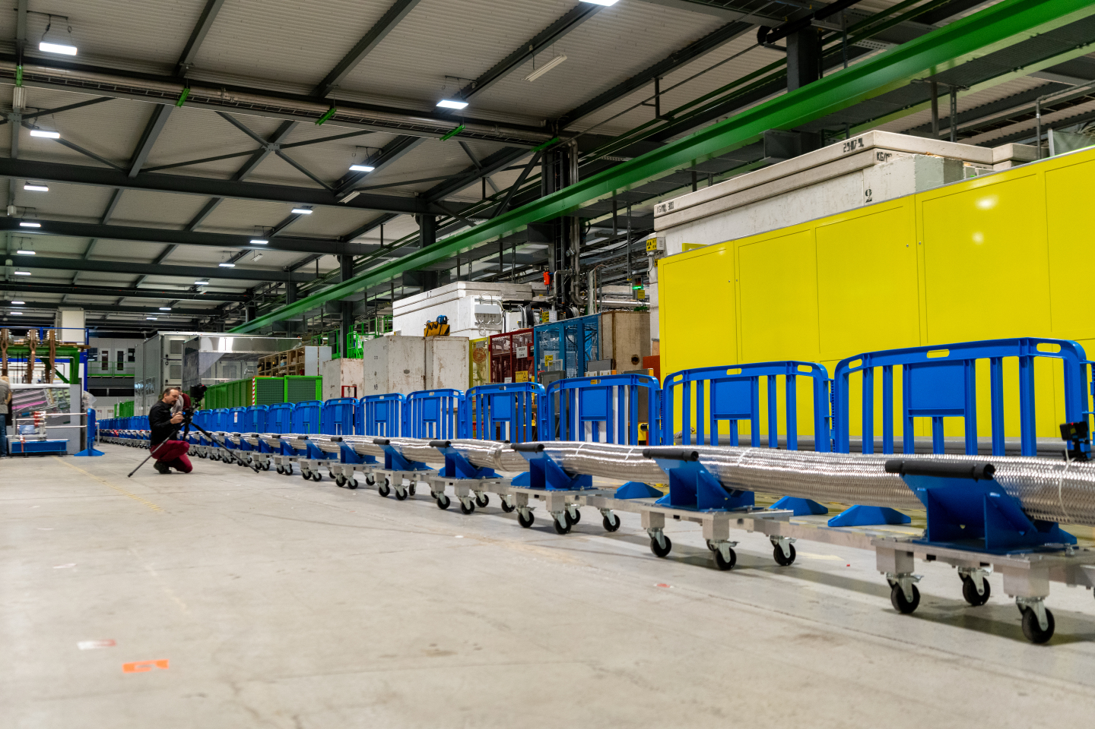
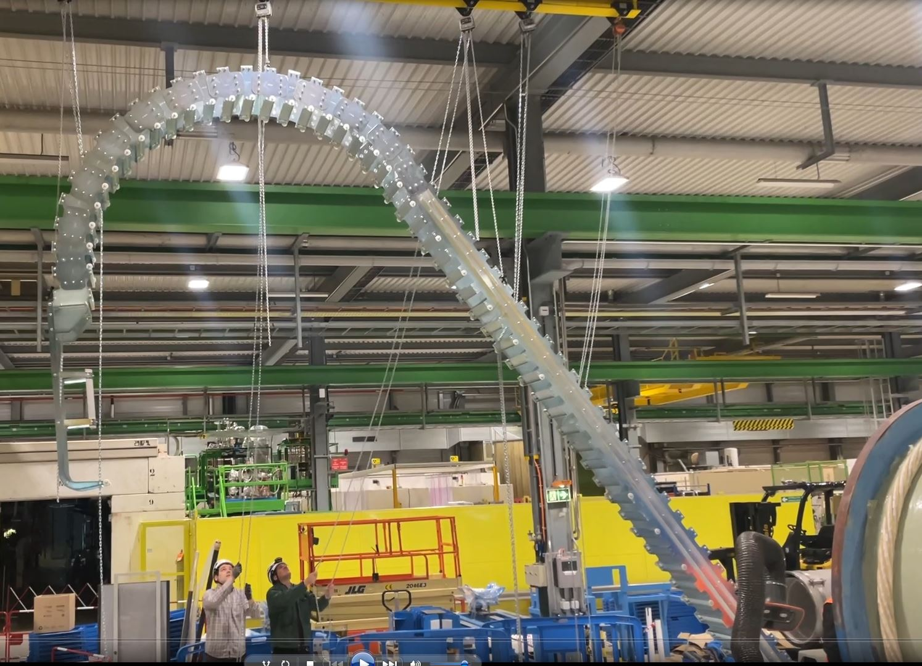
HTS for HL-LHC – MgB₂ SC Link
Procured in total 1430 km of MgB₂ wire (Φ = 1 mm). Delivered by ASG in unit lengths of up to ∼ 4 km
Industrialized cabling: 70 % of the production completed
120 KA @ 25 K
120 kA @ 25 K and 1 T
Φ∼90 mm
A. Ballarino

Slide 5
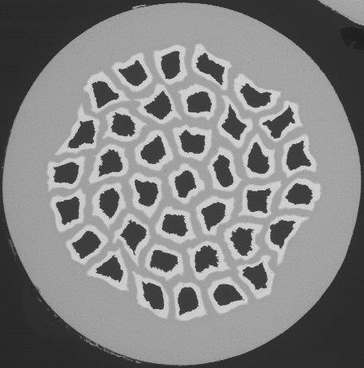

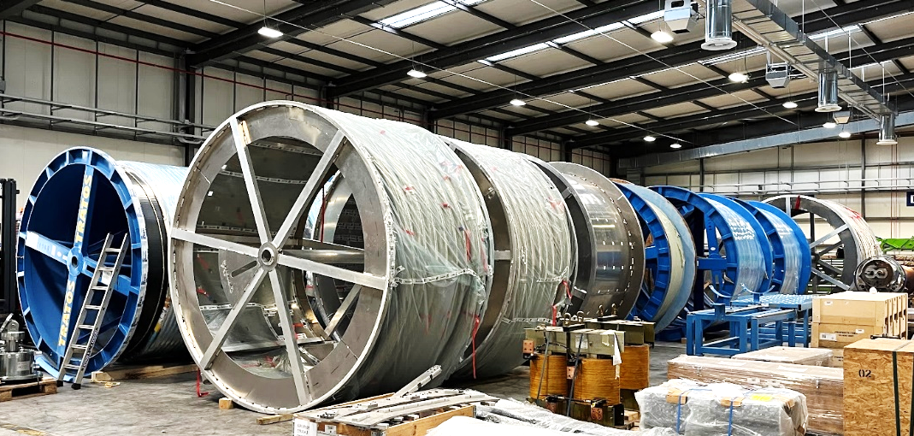
HTS for HL-LHC – MgB₂ Wire and Cables
MgB₂ wire, Φ = 1 mm
MgB₂ wire specification
Cabling made from reacted wire
3 kA @ 25 K
Series cabling at
TRATOS/ICAS
3 kA coaxial @ 25 K
7 kA @ 25 K
Spools of MgB₂ cables, 120 kA
18 kA @ 25 K
Distribution of piece lengths (by length)
A. Ballarino

Slide 6
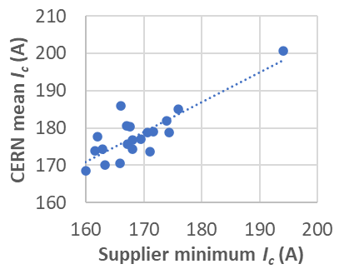
HTS for HL-LHC – REBCO Tape
Procured 4.8 km of REBCO Tape – 4 mm wide
To be procured ∼ 17 km
Termination of SC Link, from ∼ 20 K to 50 K,
made with REBCO HTS conductor
In total: 18.8 km of REBCO tape
Technical specification
Grade | Length (m) | Min I_{c} (60 K 0.7 T)
1 | 3980 | 200
2 | 730 | 180
Parameter |  | Requirement
Width |  | 4 mm
Substrate thickness |  | 40– 60 µm
Copper thickness, each face |  | 20 µm
I_{c} (60 K 0.7 T), all orientations |  | ≥ 200 A
Minimum out-of-plane bend radius |  | ≤ 11 mm
Maximum internal resistance, 77 K | 200 °C 0 h | ≤ 60 nΩ cm²
 | 200 °C 1 h | ≤ 80 nΩ cm²
77 K sf
A. Ballarino

Slide 7
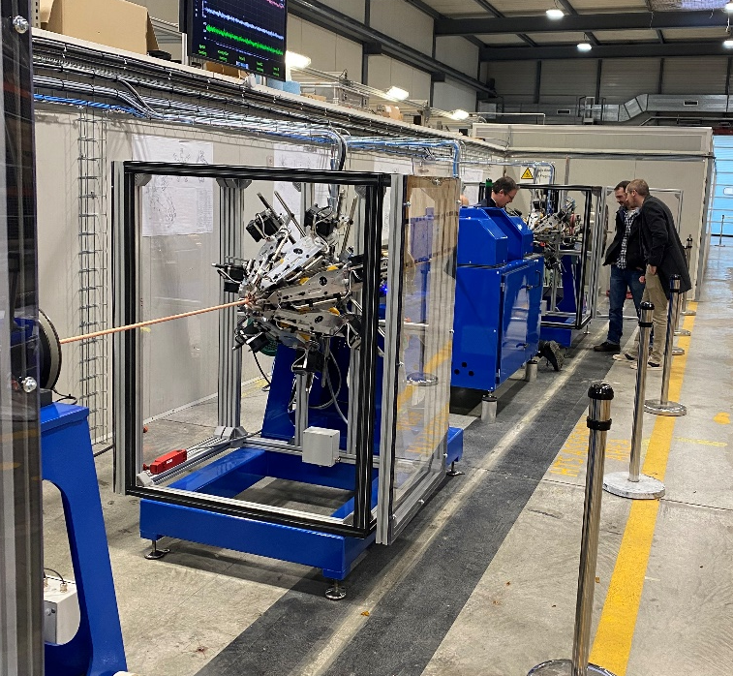
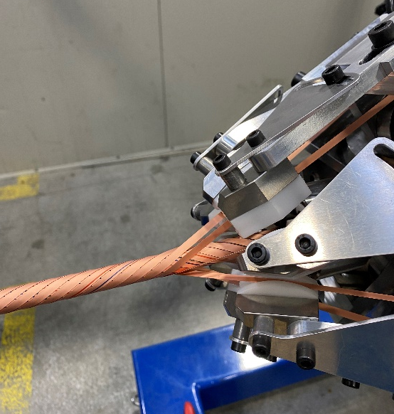
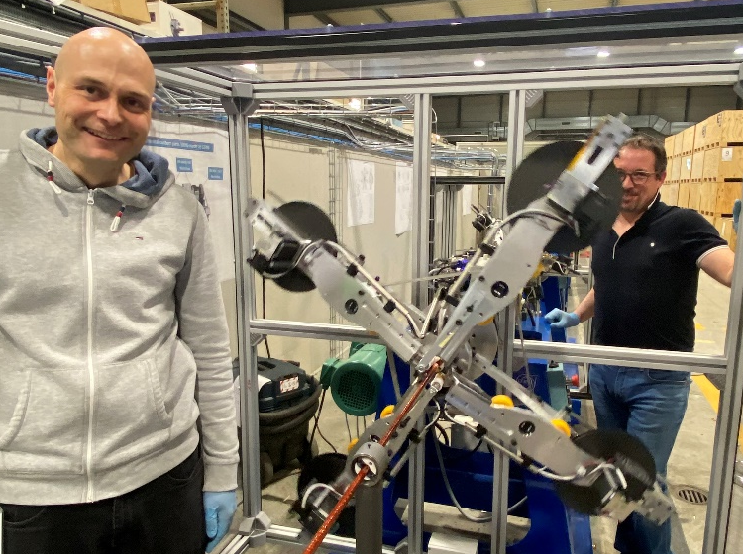
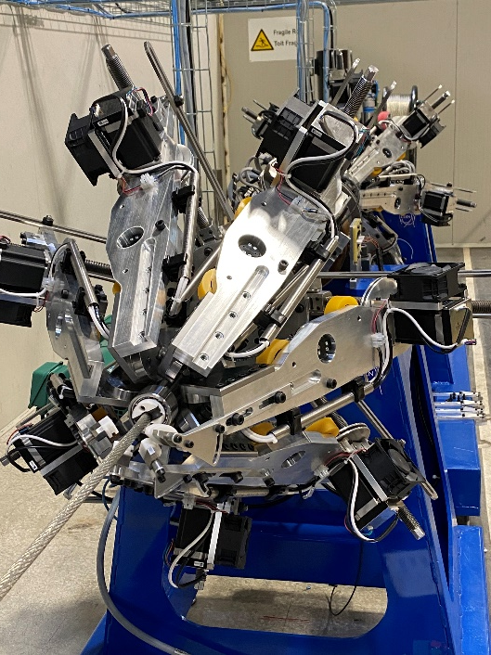
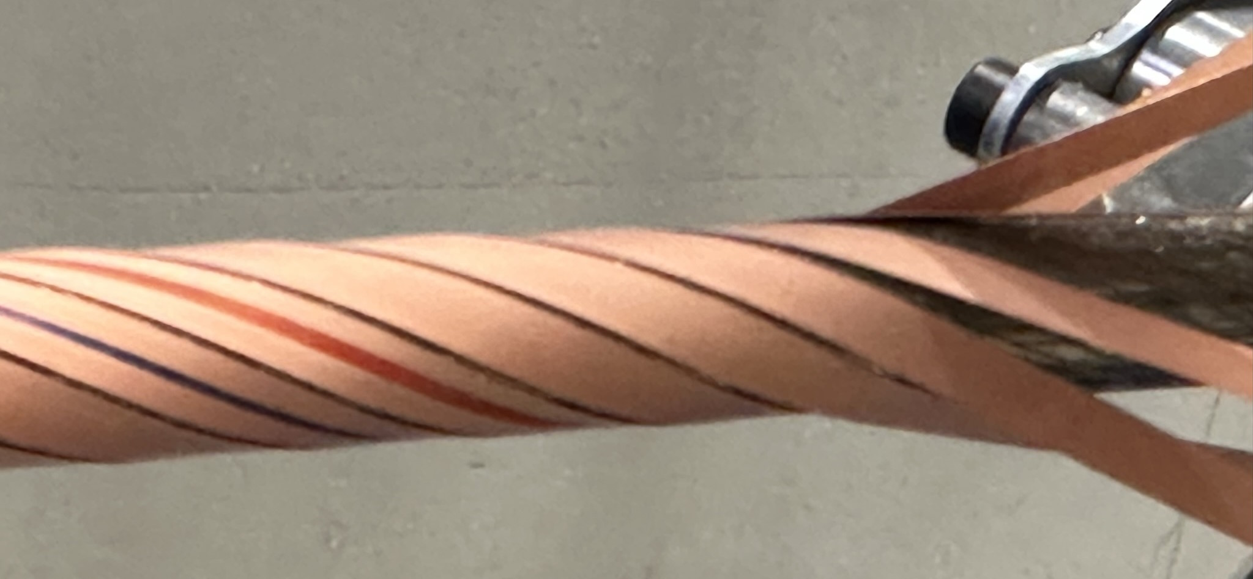
HTS for HL-LHC – REBCO Cables
Round, flexible, electrically insulated REBCO cables
No measurable critical current degradation of tapes after cabling
Current rating of REBCO cables: 600 A, 3000 A, 7000 A and 18000 A @ 60 K (∼ 0.7 T)
Cabling machine designed and constructed at CERN
Two layers of tape
On-line Polyimide insulation
REBCO
3 kA @ 60 K (B = 0.7 T)
See presentation of Ch. Barth
A. Ballarino

Slide 8
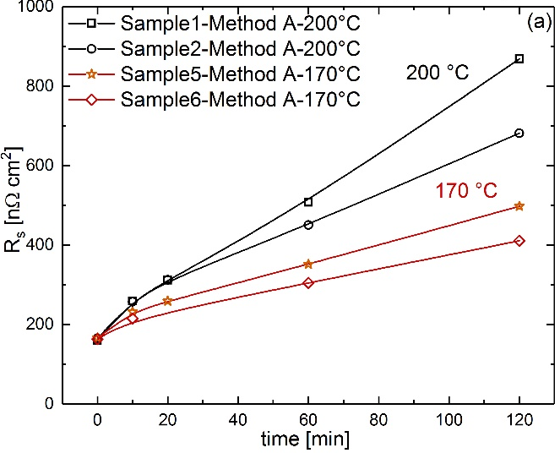
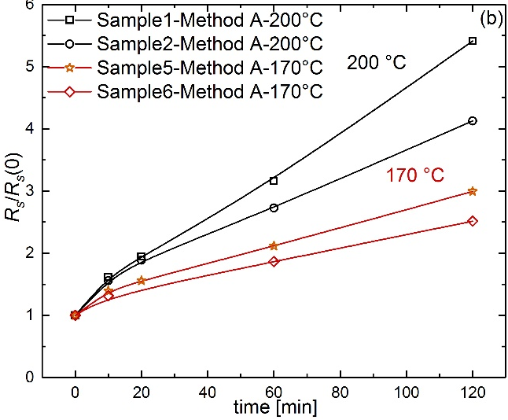
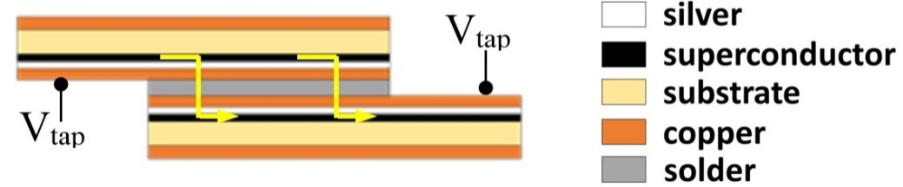
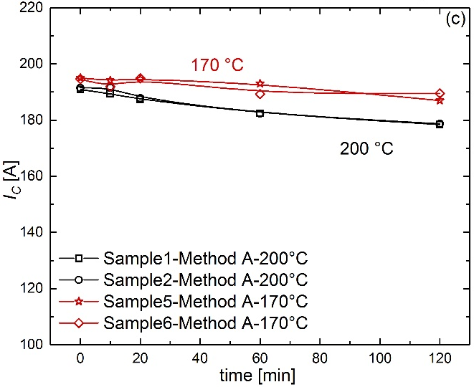
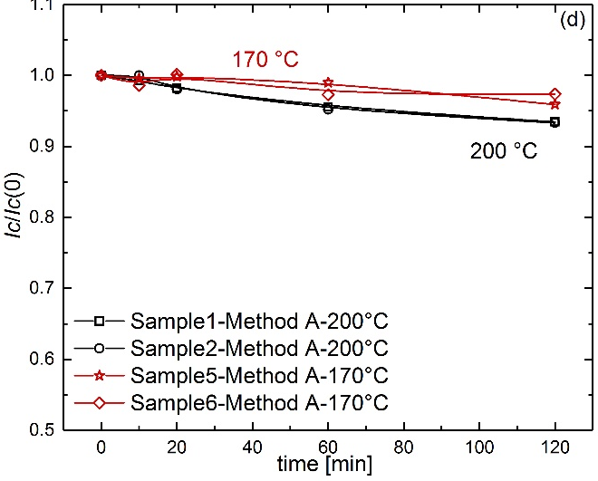
REBCO for HL-LHC – Electrical resistance (1/2)
Supplier A – 4 mm wide tape – 50 μm substrate
For the same heating time, 25-40% reduction in contact resistance if the heating temperature is lowered to 170◦C
Critical current degradation is less severe: 2-3% after 1 hour plateau at 170◦C against 5% reduction at 200◦C
Electrical splices are critical
Type 0
  Soldering along 2 cm
  SnPb (with MOB39) for splices at 200◦C
  SnIn (with Spirflux 330) for splices at 150◦C
A. Ballarino

Slide 9
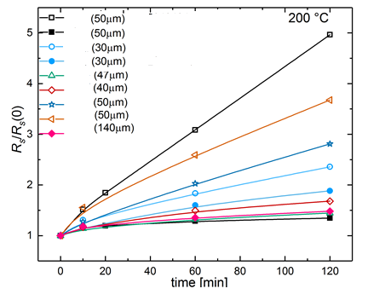
REBCO for HL-LHC – Electrical resistance (2/2)
For the same heating time. 25-40% reduction in contact resistance if the heating temperature is lowered to 170◦C
Supplier A – 4 mm wide tape – 50 μm substrate
Critical current degradation is less severe: 2-3% after 1 hour plateau at 170◦C against 5% reduction at 200◦C
Tapes from 5 suppliers
A
A
Electrical splices are critical
A
A
B
C
D
E
F
A. Ballarino

Slide 10
Superconducting Magnets for future HEP
 | Dipoles | Quadrupoles | Undulators/Wigglers | Detectors | Field (T)
FCC-ee |  | IR Quad |  | × | < 3 T
CEPC |  | IR Quad |  | × | < 5 T
ILC | × | × | × | × | < 2 T
CLIC |  |  | × | × | < 2.5 T
FCC-pp | × | × |  |  | 16 T -20 T
SppC | × | × |  |  | 12 T- 24 T
Muon Colliders | × | × |  |  | Solenoids > 10 T-20 T
Higgs Factories
Energy Frontier
A. Ballarino
Notes:
FCC-ee: solenoids are detectors.

Slide 11
Superconducting Magnets for future HEP
 | Dipoles | Quadrupoles | Undulators/Wigglers | Detectors | Field (T)
FCC-ee |  | IR Quad |  | × | < 3 T
CEPC |  | IR Quad |  | × | < 5 T
ILC | × | × | × | × | < 2 T
CLIC |  |  | × | × | < 2.5 T
FCC-pp | × | × |  | × | 16 T -20 T
SppC | × | × |  | × | 12 T- 24 T
Muon Colliders | × | × |  | × | Solenoids > 10 T-20 T
Beneficial Technology
Higgs Factories
Enabling Technology
Energy Frontier
HTS for Sustainability: operation at higher temperatures (> LHe)
to minimize power consumption
A. Ballarino

Slide 12
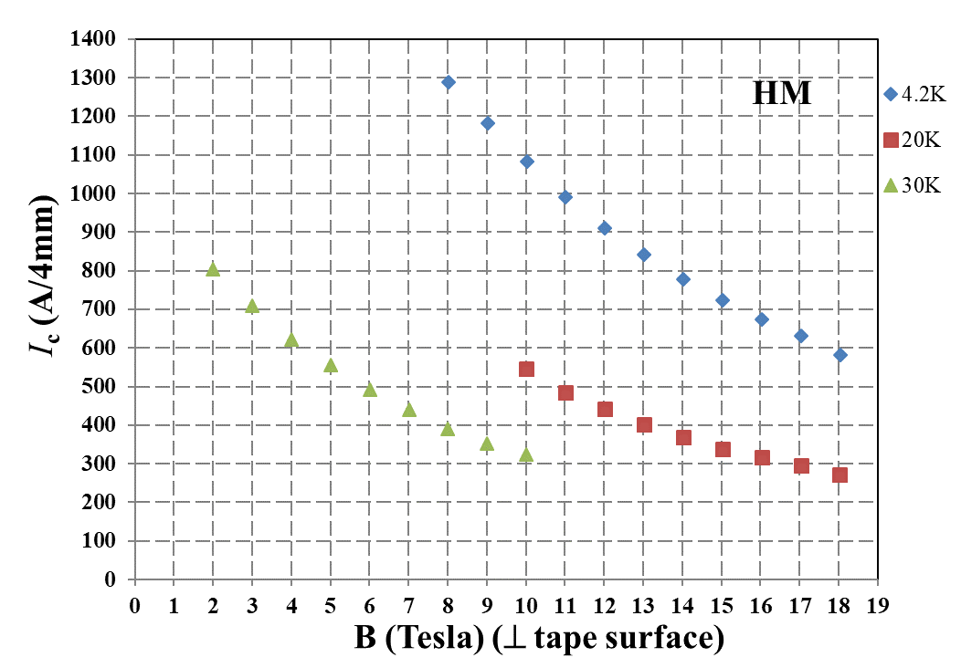
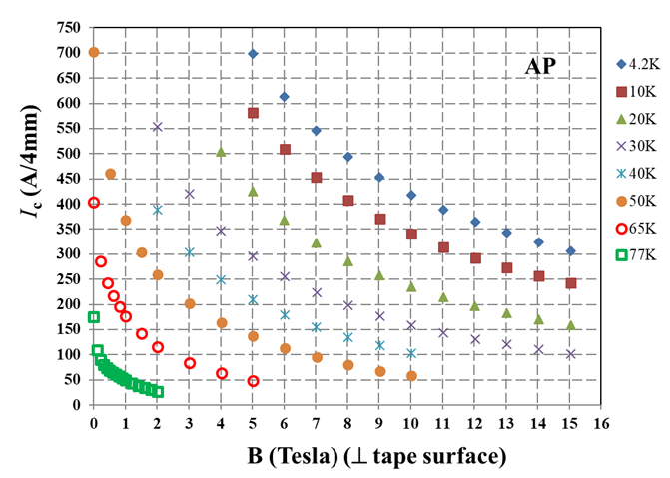
Sustainability for future HEP
https://www.superpower-inc.com/specification.aspx
A. Ballarino

Slide 13


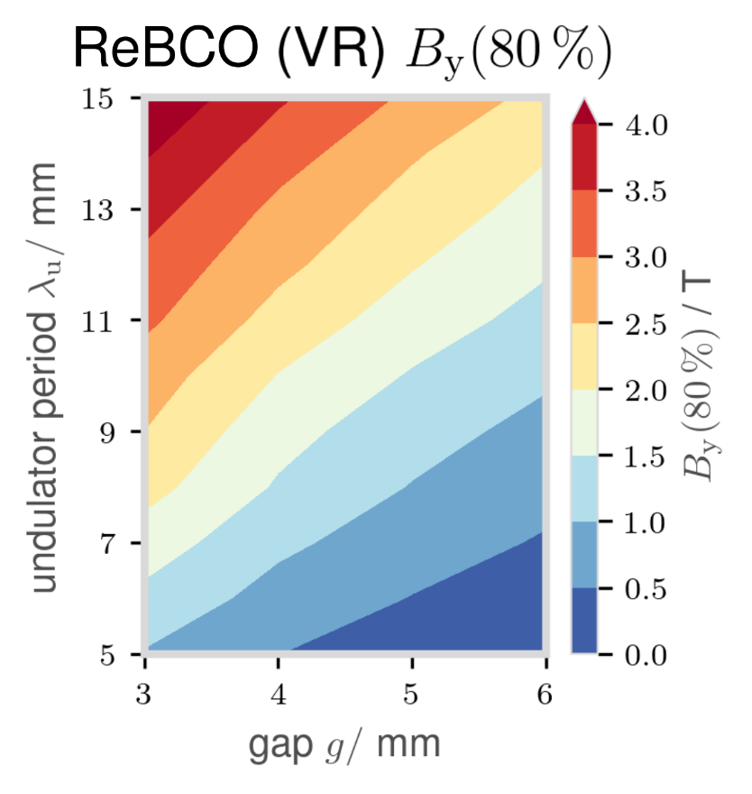
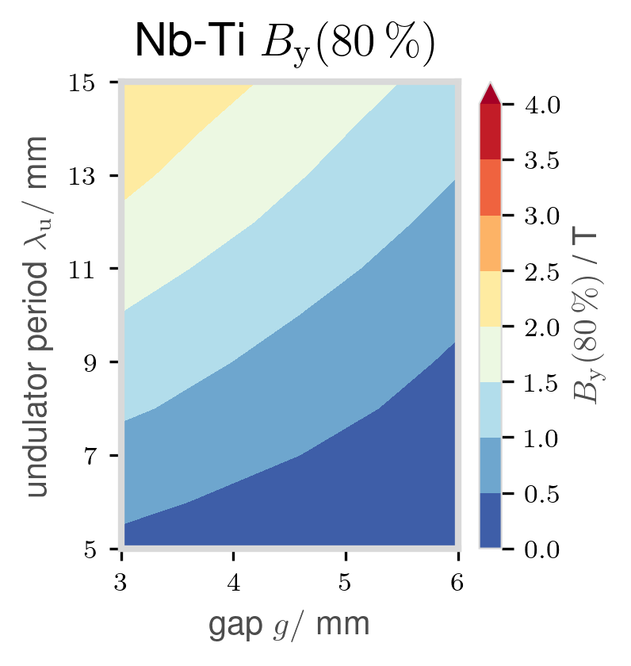
HTS Undulators
HTS undulators:
High field, short-period, compact undulators operated at higher temperatures
Vertical (VR) and Helical (HL) prototype coils manufactured and tested
Challenges:
• Bending radius < 5 mm
• Quench protection
• Field quality (during ramping)
Planar
Undulator
S. Richter
F. Nguyen et al. “XLS - D5.1: Technologies for the CompactLight Undulator” (2019), doi: 10.5281/zenodo.5024409

Slide 14
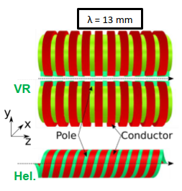
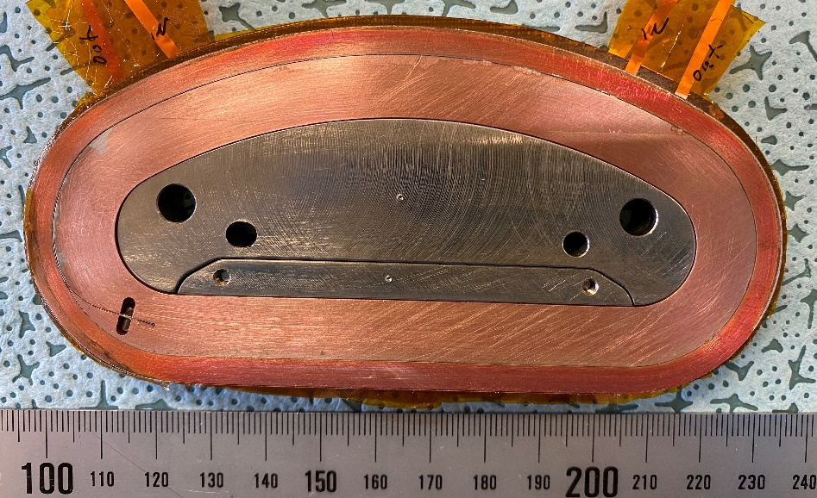
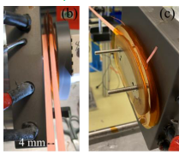
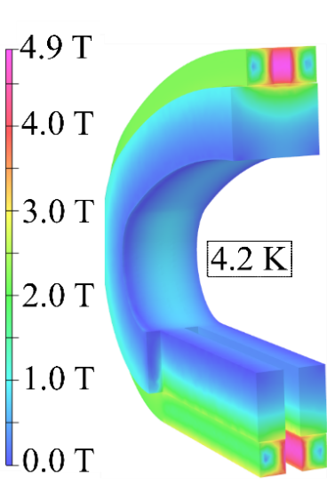
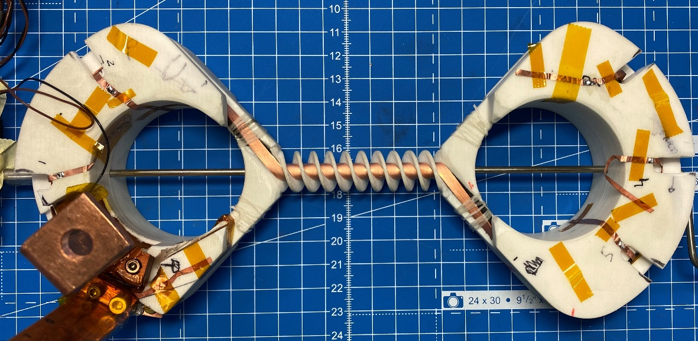
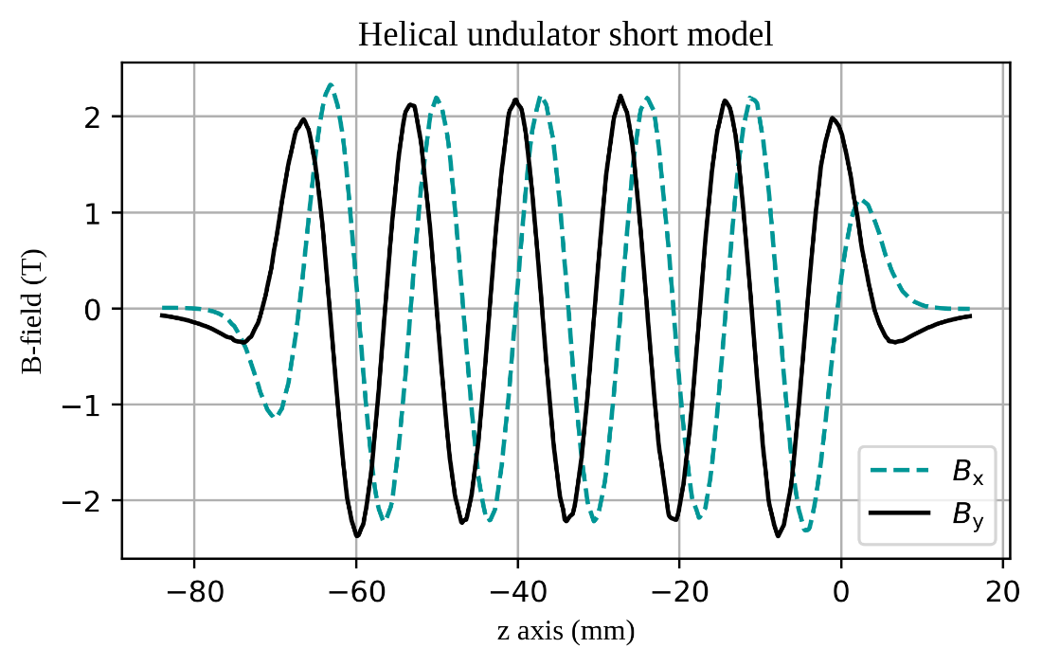
HTS Undulators
No-insulation coils for quench protection
  Cu-stabilized for transverse current bypassing
  4 mm wide REBCO tape
Vertical
J_{e} = 2 kA/mm²
One-period coil
λ_{u} = 13 mm
Tested at 4.2 K:
B ≈ 1.5 T, Je=2.3 kA/mm²
B ≈ 2 T, Je=3.6 kA/mm²
B (T)
Helical
Short model simulations at 4.2 K
Very compact design !
12 turns, 2-tape stack
Goal:
λu = 13 mm
Gap 5 mm, 2 T @ 4.2 K
120 turns
Courtesy of S. Richter

Slide 15
MSC HFM HTS Program
2022 - 2027
Cable/coil activities on REBCO
R&D on other superconductors
CERN EDMS N. 2685835
A. Ballarino

Slide 16
HFM Activities – REBCO
Objective: demonstrator of 5 T in a background field of 15 T
Development of electrically insulated cables. Target: 10 kA @ 20 T, 5 kV .
  Specification and procurement of tape. We need to work with the tape manufacturers
Assembly model racetrack coils. Scope:
  Test different cable layouts in a coil configuration;
  Study field quality;
  Validate modelling;
  Generate material database – see also presentation on scaling laws by G. Succi;
  Study quench detection and quench protection aspects – and test/implement technological solutions;
  Demonstrate field capability;
  Validate technological aspects, e.g. windability, electrical high-current splices, impregnation, insulation, mechanical structure…
  Develop racetrack coils to be used in a common coil configuration
A. Ballarino

Slide 17
HFM Activities – REBCO
CERN EDMS N. 2685835
A. Ballarino

Slide 18
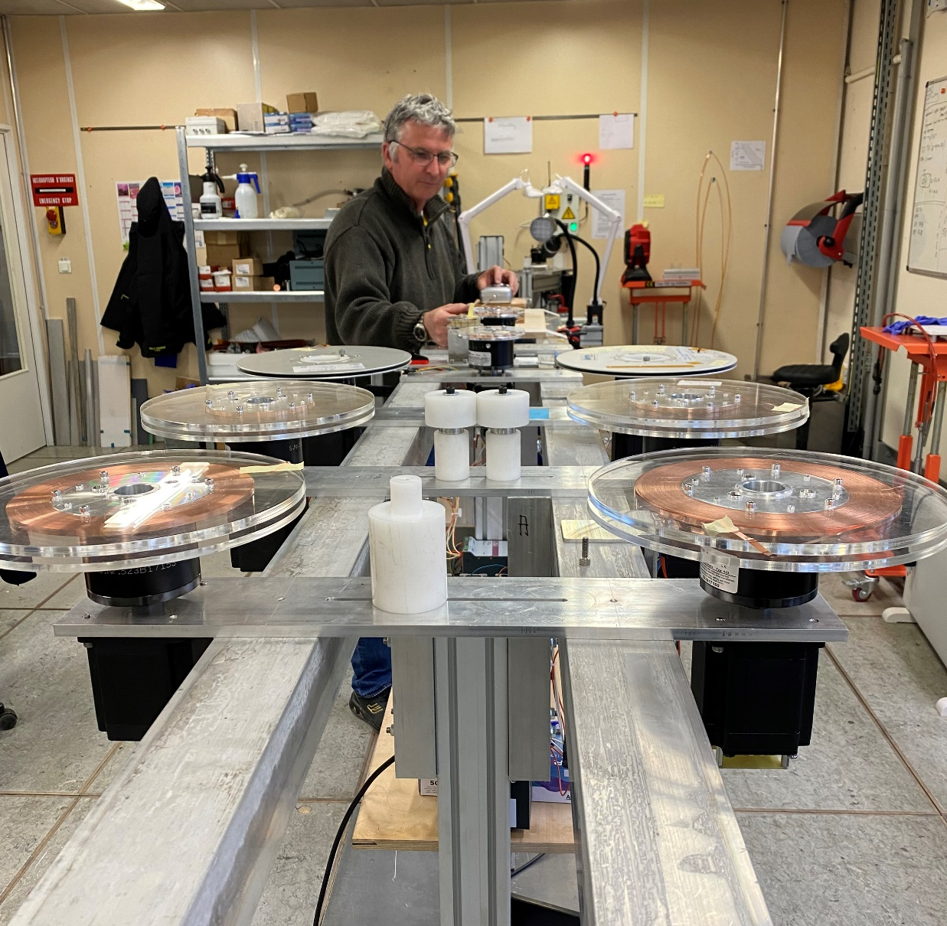
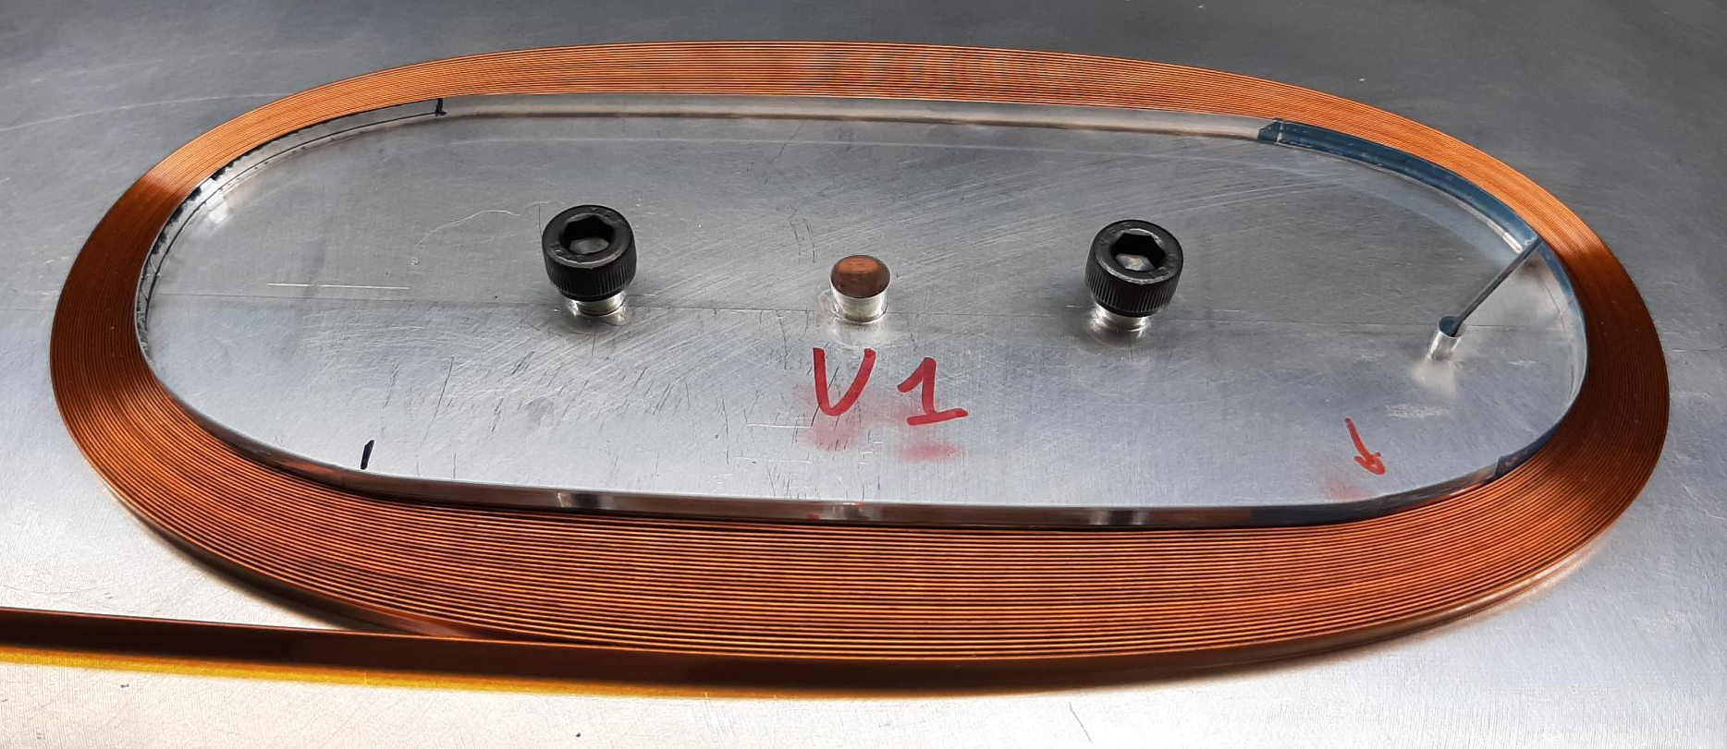
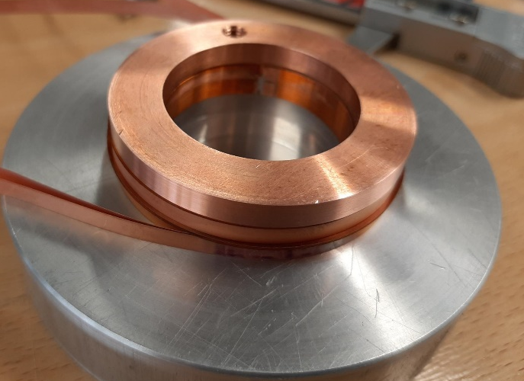
MSC HFM Activities – REBCO
Winding machine - up to 14 tapes
Stacks of insulated tapes
160
Ø int 37 mm
Ø ext 57 mm
With layer jump
A. Ballarino

Slide 19
HFM Activities – Test facilities
New test station enabling in-field critical current measurements of wires/tapes in fields of up to 20 T (solenoid with bore of 100 mm diameter) – present peak field is 15 T
New spilt-coil magnet for in-field critical current measurements at up 10 T (including angular dependence)
Fresca 2 test station for measurement of cables - up to 50 kA - in a background field of 13 T @ 1.9 K, 4.5 K and higher temperature (gas mixing chamber) - operational in Q2 2023
HTS coil measurements in external magnetic fields: D1 HL-LHC superconducting magnet – 6 T in a bore of 150 mm diameter. In a medium term, higher magnetic fields will also be accommodated
A. Ballarino

Slide 20
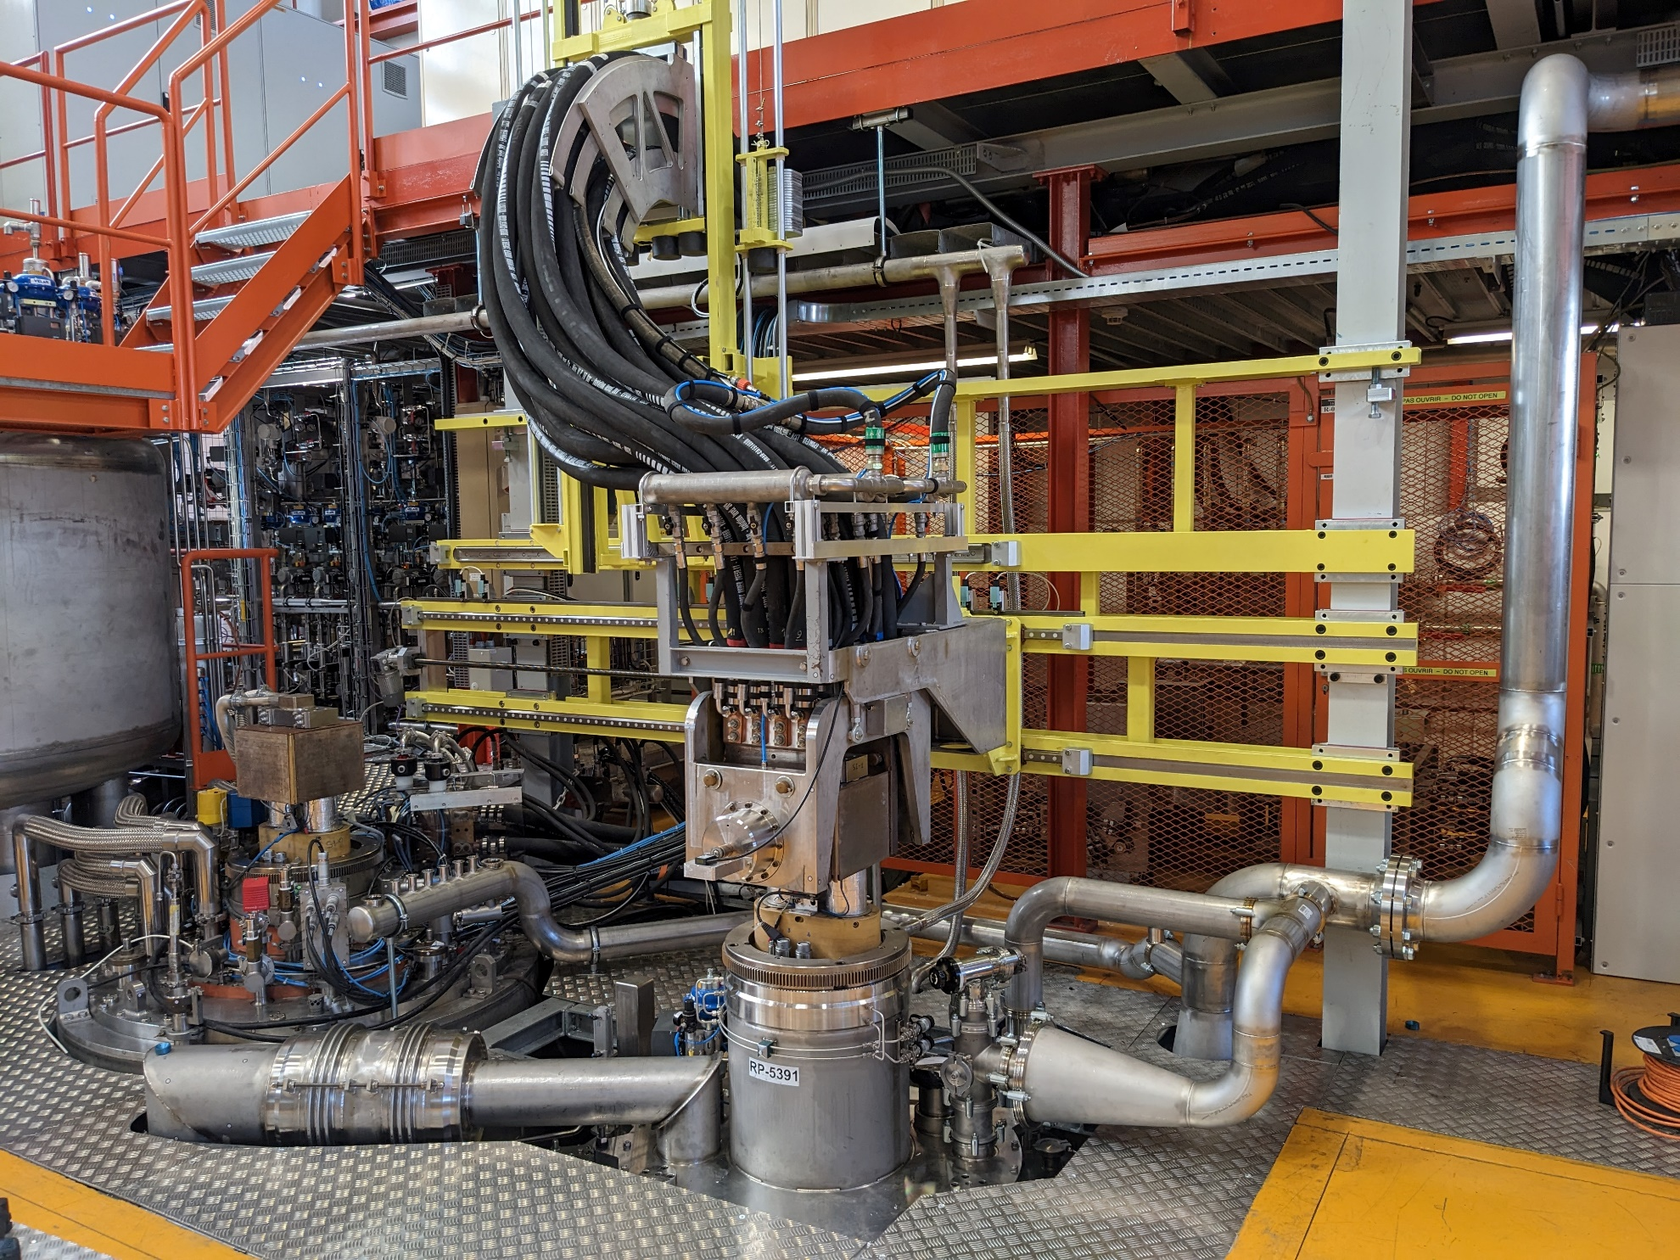
Fresca 2 at CERN - Building 163
A. Ballarino

Slide 21
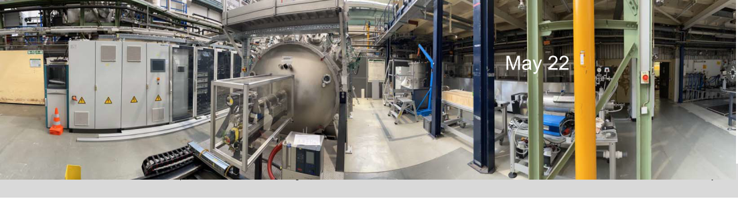
Collaboration Agreement CERN/KIT
HTS Coated Conductor synthesis Laboratory
Scope: laboratory for testing at a small scale new scientific ideas, both on REBCO tape and REBCO cables
Phase 1: installation of machine, setting-up the laboratory
Commissioning by end 2023
Phase 2 / Phase 3: production of coated conductor – to lengths of up to 100 m
Laboratory at KIT
See presentation of B. Hopzafel
A. Ballarino

Slide 22
HFM Activities – Other Superconductors
Future collaboration CERN/CNR-SPIN – Iron Based Superconductors
Tc (122) ∼ 38 K
High H_{c2}
H_{irr} close to H_{c2}
R&D on Iron Based Superconductors (IBS) wires
Critical current density (J_{c}) through reliable, simple and scalable techniques that could enable industrialization
PIT 122 tape and wire
Target Jc ≥ 10³ A/mm² at 16 T
From mono to multi-filamentary wire
Courtesy A. Malagoli
A Gurevich, Ann. Rev. Cond. Matt. Phys 5 (2014) 35
C Yao and Y Ma, iScience 24 (2021) 102541
A. Ballarino

Slide 23
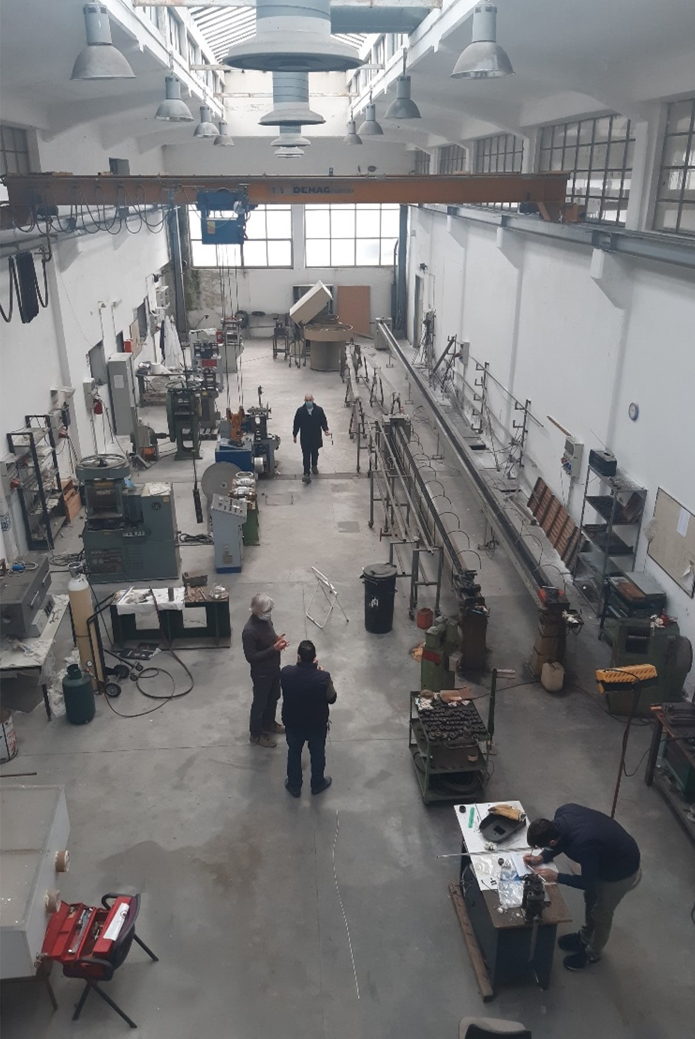
HFM Activities – Other Superconductors
Future collaboration CERN/CNR-SPIN – Iron Based Superconductors
Drawing machines
Groove rolling machines
Flat rolling machine
Courtesy A. Malagoli
CNR- SPIN, Genova

Slide 24
Conclusions
HTS for power transmission has been adopted for HL-LHC – and will be an asset for future machines
Sustainability considerations for accelerator and collider facilities promotes HTS for operation at higher temperatures
HTS is the enabling technology for high (> 16 T) magnetic fields. The HFM programs tackles the HFM HTS R&D program

