Slide 1
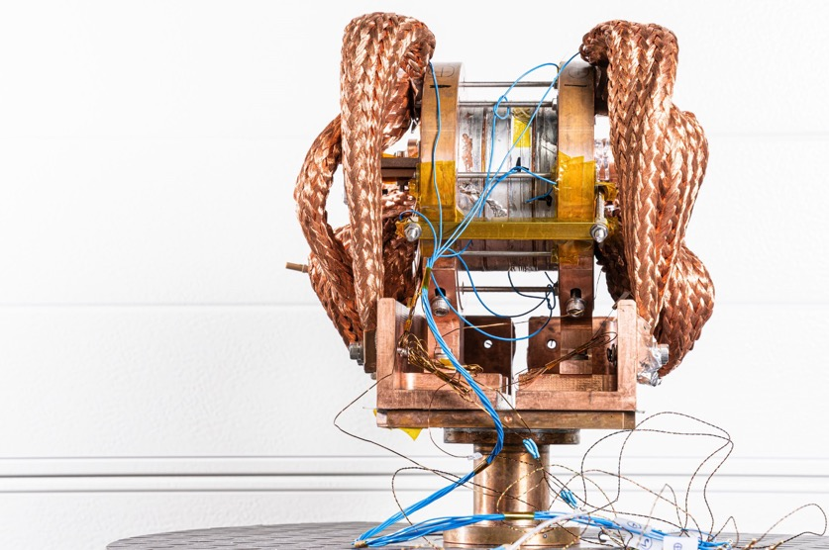


HTS Program at PSI
B. Auchmann, A. Brem, M. Daly, M. Duda, M. Koratzinos, J. Kosse, T. Michlmayr, H. G. Rodrigues, D. Sotnikov
10.03.2023 – HiTAT (https://indico.cern.ch/event/1220254)
This work was performed under the auspices of and with support from the Swiss Accelerator Research and Technology (CHART) program (www.chart.ch).

Slide 2
Overview
Solder-impregnated NI solenoid
P3 adiabatic matching device for operation in SwissFEL
FCCee HTS4 demonstrator study
HTS HFM study
Outlook

Slide 3
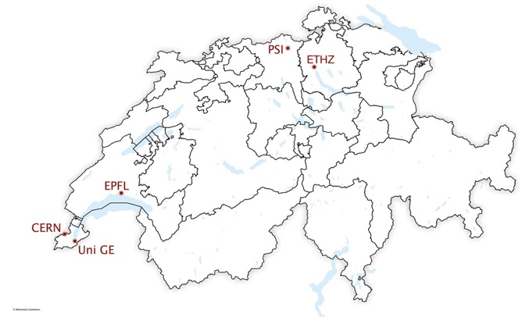




CHART – What, Who, How?
“CHART, the Swiss Center for Accelerator Research and Technology, was founded to support the future oriented accelerator project Future Circular Collider (FCC) at CERN and the development of advanced accelerator concepts in Switzerland beyond the existing technology. […] The high field magnet R&D has strong synergies with PSI projects […]”
[Application for support of the Swiss Accelerator Research and Technology Initiative, 2018]
http://chart.ch

Slide 4
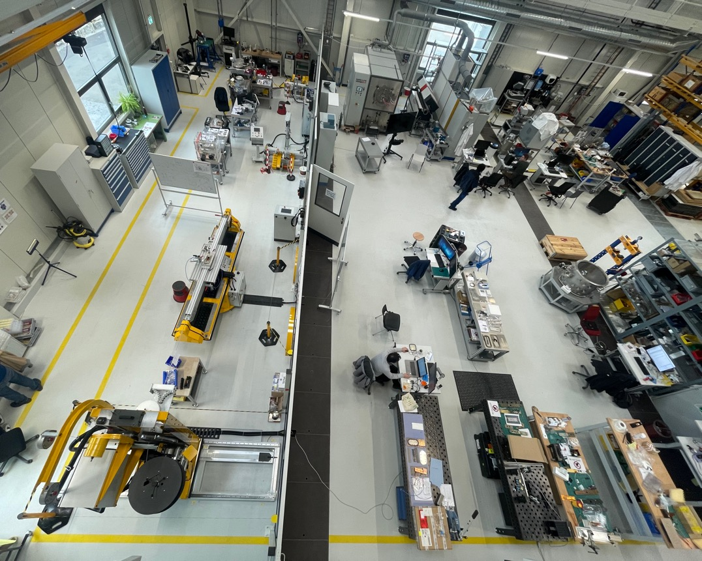
MagDev Laboratory Layout
3D Scanning
Heat treatment
HTS winding
Re-reeler
Impregnation
Storage
Instrumentation
LTS winding
Loading / Assembly

Slide 5
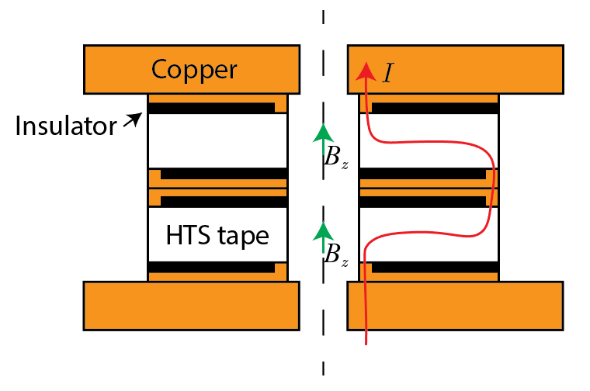

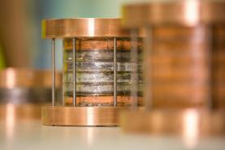
NI Solder-Impregnated Technology Solenoid
Goal: Rapidly develop infrastructure for HTS coil manufacturing and testing
via NI coil technology license agreement with Tokamak Energy.
Axial joints
Greg Brittles

Slide 6
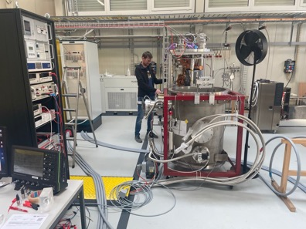
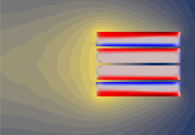
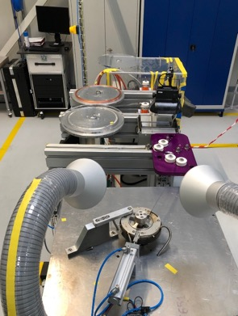
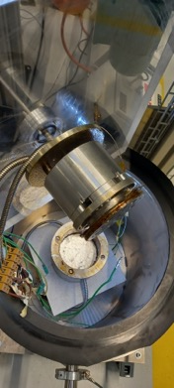
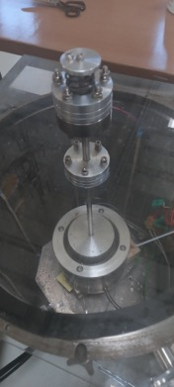




HTS Infrastructure and Team @ MagDev Lab
Vacuum Solder
Impregnation
Winding
Testing
Modeling
Tensioning system developed by Francois-Olivier Pincot,
Jacky Mazet, CERN
Pre-tinning support by Davide Uglietti, EPFL-SPC
Cryogen-free test station (2 kA)
Mike Koratzinos
Project lead HTS4
Henrique Rodrigues
Engineer P3 ReBCO
Dmitry Sotnikovs
Engineer HFM ReBCO
Jaap Kosse
Engineer HTS4 ReBCO

Slide 7
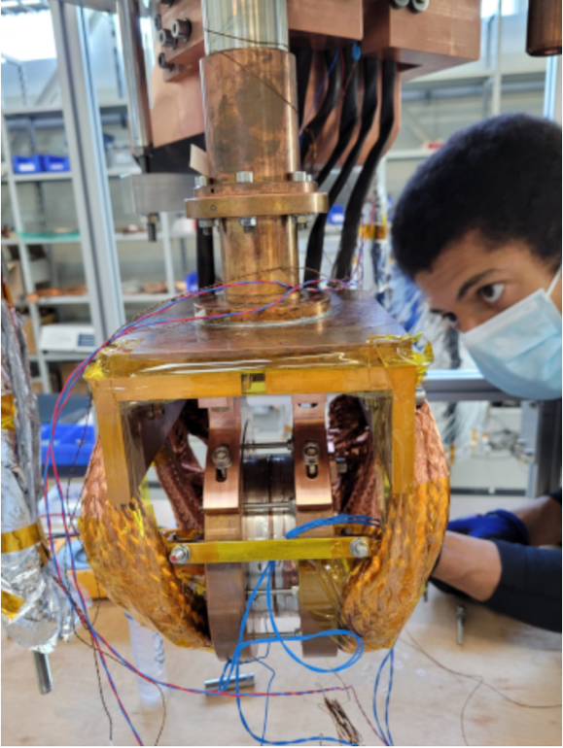
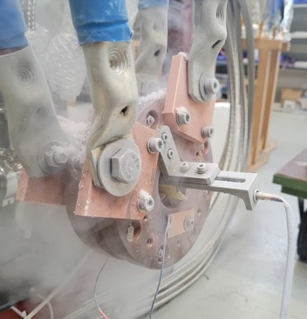
Modular Technology

Slide 8
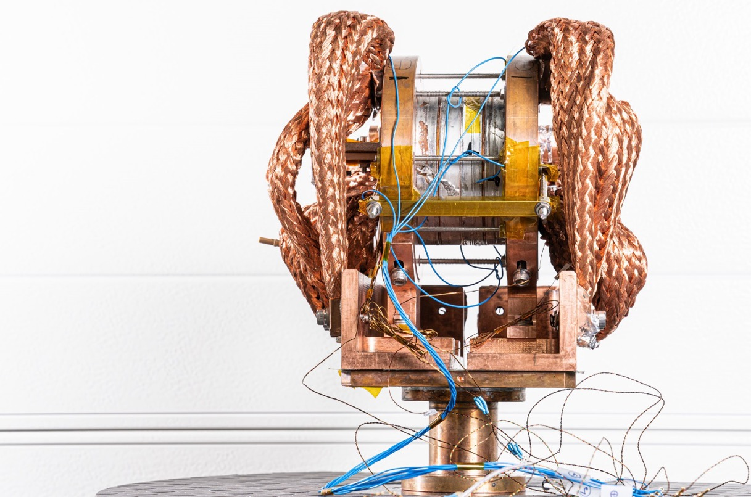
4-Stack Technology Solenoid Cold Test

Slide 9
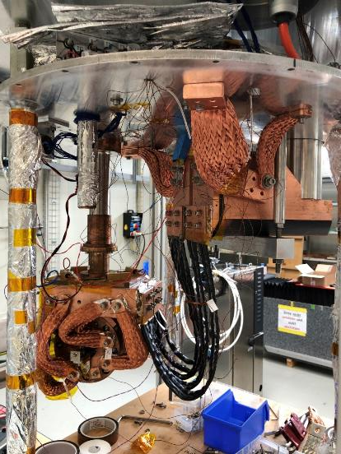
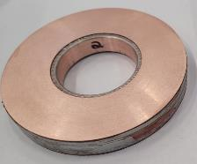
4-Stack Technology Solenoid Cold Test
Successful test in cryogen-free test station of 4-pancake HTS NI solenoid, built in-house at PSI and using licensed Tokamak Energy Ltd technology.
Coil reached 18.2 T in the center,
20.3 T on the conductor at the
maximum current of the power
converter of 2 kA and
12 K coil temp.
Hall probes were qualified
at UniGE up to 19 T.
radiation shield
top plate
thermal
connectors
2nd cryocooler
20K coldhead
1st cryocooler
4K coldhead
Diameter: 100 mm
Aperture: 50 mm
SC type: ReBCO
# tapes: 2
# turns: 2 x 170
SC length: 2 x 49 m
Cu leads
HTS leads
Stack of 4 NI HTS
coils with thermal/
electrical connectors
Courtesy of M. Duda, J. Kosse, H. Rodrigues

Slide 10
4-Stack Technology Solenoid Cold Test
A B C D
0-A:
fast ramp up with 1 A/s
voltage over coils increasing because of current radial path
A-B:
slower ramp up with 0.2 A/s to stabilize coils voltage increase
B-C:
2 kA 3h plateau
coils voltage decreasing because of current redistribution
field is increasing – not reaching plateau
C-D:
slow ramp down with 0.5 A/s to avoid quench back
slow ramp
down with
0.5 A/s only
current
2 kA 3h
coils voltage
1.6 mV
over 4 coils
~800 nohm
18.2 T
field
Courtesy of M. Duda

Slide 11
4-Stack Technology Solenoid Cold Test
A B C D
current
0-A:
fast ramp up with 1 A/s
coils temp regulated by external heaters
A-B:
slower ramp up with 0.2 A/s to stabilize coils temperature
B-C:
2 kA 3h plateau
temperature of Cu-HTS leads joint increasing because of joule heating
coils temperature stable at 12 K
C-D:
slow ramp down with 0.5 A/s
2 kA 3h
78 K
HTS leads temp
12 K
coils temp
external
heater OFF
heating while
current
discharge
Courtesy of M. Duda

Slide 12
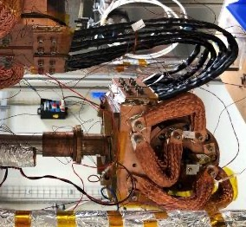
Quench in 4-Stack Technology Solenoid
Thermal runaway as consequence of bad electro-thermal contact (indium contact sheet was re-used).
V taps arrangement
V_in
V_c4
V_c3
V_c2
V_c1
V_out
HTS lead
HTS lead
Cu
C4
C3
C2
C1
Cu
Courtesy M. Duda

Slide 13
Quench in 4-Stack Technology Solenoid
1.99kA
0.2A/s
0.1A/s
0.5A/s
2A/s
0.5A/s
5A/s
1A/s
35K
28K
25K
10A/s
temp sensor
detachment
coils 2&3?
external heater OFF
2min
5min
Courtesy M. Duda

Slide 14
Quench in 4-Stack Technology Solenoid
bad contact heating too much
c4 voltage rise
Courtesy M. Duda

Slide 15
Quench in 4-Stack Technology Solenoid
14.6T
14.4T
14.1T
Courtesy M. Duda

Slide 16
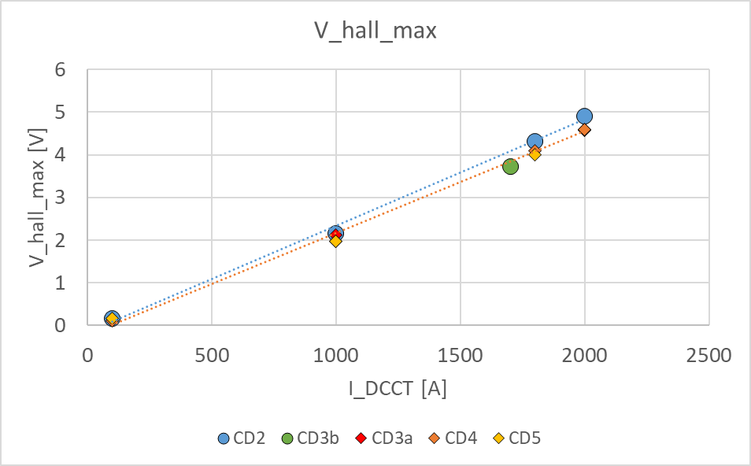
Performance Reduction in 4-Stack after Quench
Courtesy M. Duda
Maximum field decreased to 17.3 T
No sign of SC degradation.
No current-sharing.
    Are there fewer turns with
    azimuthal current?
  Individual pancake tests in LN2
  confirmed performance decrease in
  hottest coil.
  Axial connection plates were replaced.
  A 5th coil is under preparation and we
  may soon assemble a 5-stack.
    Inner copper ring was eliminated,
    Solder impregnation was improved,
    QA procedure is in place to validate all
    connections prior to high-current powering.

Slide 17
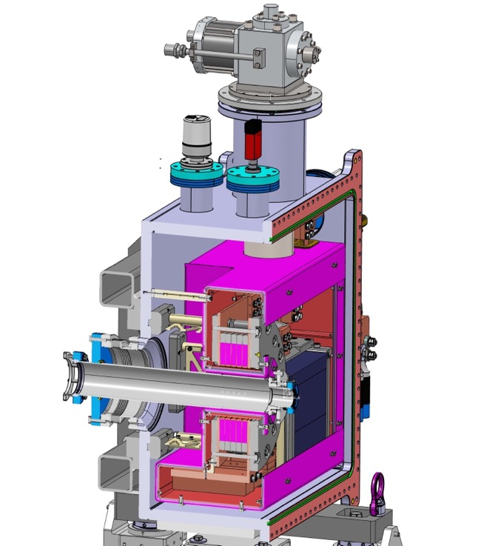
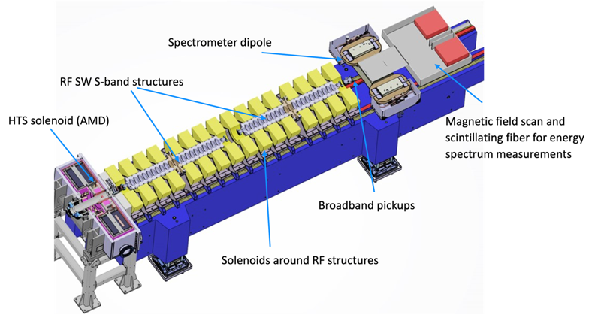
FCCee Injector Study:P³ (PSI
Positron Production)
15 K conduction-cooling
HTS NI target solenoid, to demonstrate
high-yield positron source concept
  stable DC operation,
  high thermal conduction due to solder
  impregnation to extract heat
  deposited in coils,
  radiation robustness due to
  absence of insulators.
Manufacturing Q3’23-Q2’24
Experiment at PSI’s SwissFEL 2025/26
5 coils from 12 mm ReBCO
target
Solid-state (Pb)
thermal buffer
15 T in 72 mm warm bore
21 T on conductor
Courtesy J. Kosse, T. Michlmayr, H. Rodrigues

Slide 18
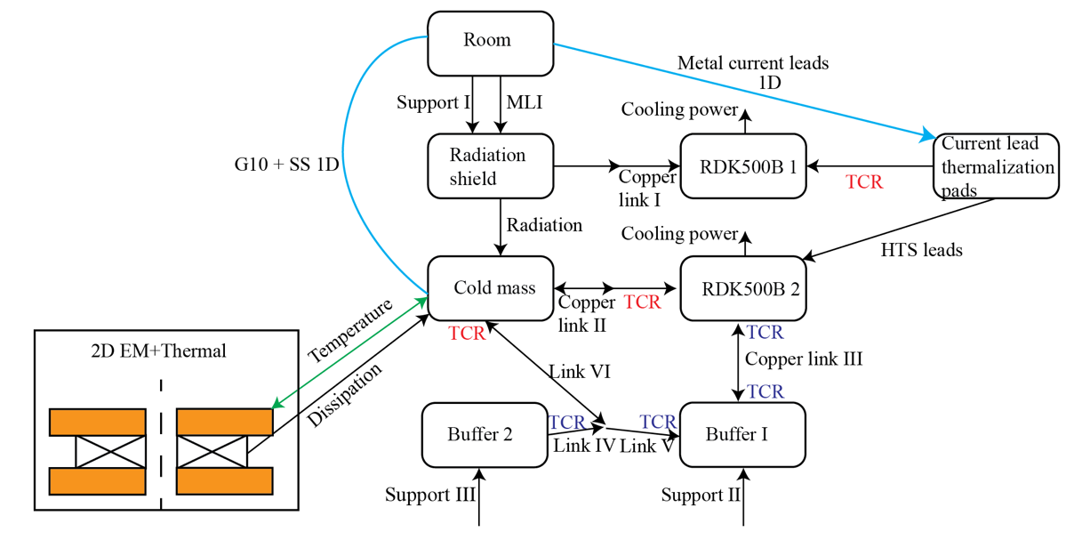
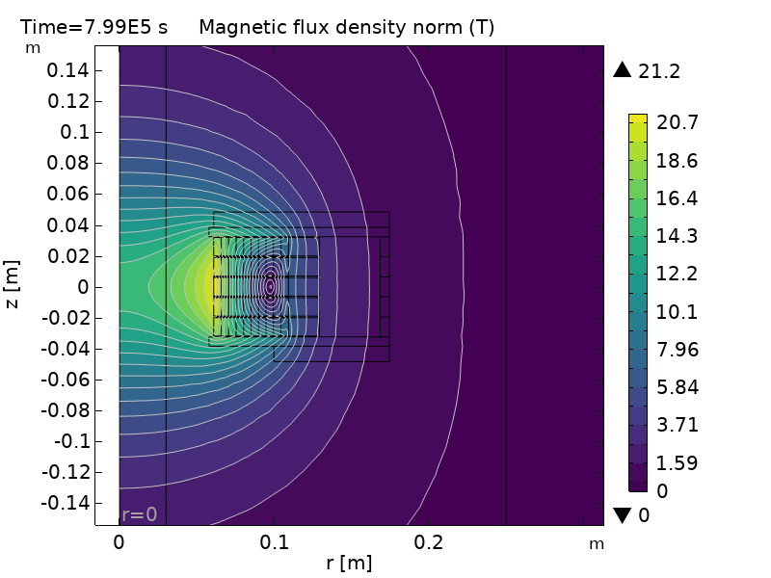
PSI Positron Production
HTS NI target solenoid
Simulations based on time-dependent 2D EM model from [1], coupled with 2D thermal and lumped thermal network.
2D EM + Thermal
Courtesy J. Kosse
[1] Mataira, R.C., Finite-element modelling of no-insulation HTS coils using rotated anisotropic resistivity.
Superconductor Science and Technology, 2020. 33(8)

Slide 19
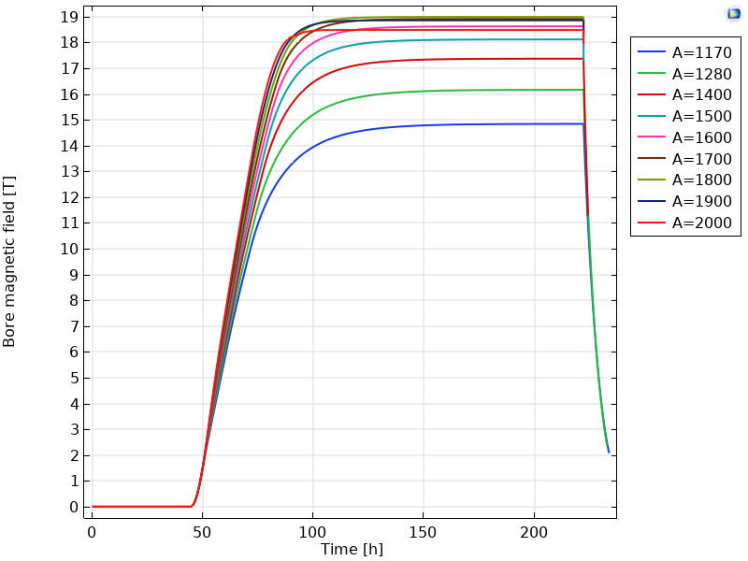
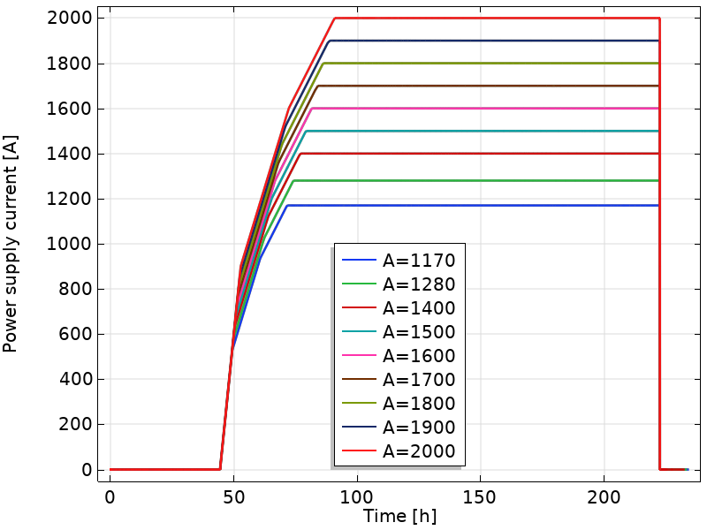
PSI Positron Production
HTS NI target solenoid
Model parameters (contacts, turn-turn-resistivity) based on 18 T test solenoid data
Saturated regime
Power supply failure
Charging
Power supply current [A]
Bore field [T]
Reminder: magnet will operate at 1170 A
Courtesy J. Kosse

Slide 20
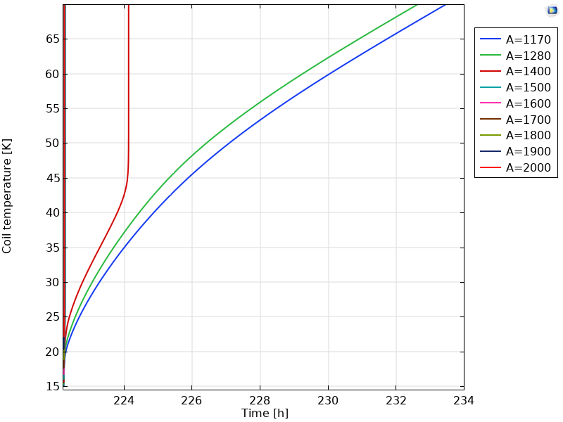
PSI Positron Production
HTS NI target solenoid
Thermal buffer sized to allow safe internal dissipation of stored energy
at currents below 1300 A.
Quench
Slow ramp-down
Max coil temperature [K]
Power supply failure
Courtesy J. Kosse

Slide 21
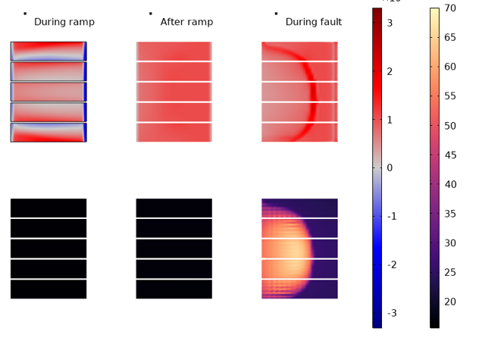
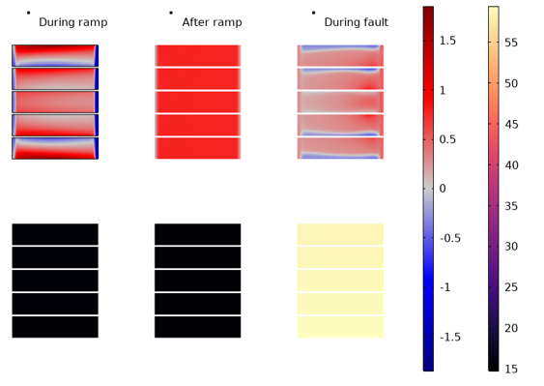




PSI Positron Production.
HTS NI target solenoid
System CAN¹ ramp to 2000 A, but the magnetic energy can’t safely be extracted in fault scenario (cooler failure, power cut, failing lead).
➡ Aim for prevention instead of protection.
Very high current density
around quench front
1170 A
2000 A
During ramp after ramp during fault
During ramp after ramp during fault
$$J_{θ}$$
$$J_{θ}$$
$$T$$
$$T$$
[kA/mm2] [K]
[kA/mm2] [K]
Courtesy J. Kosse
1 … From EM-thermal point of view, mechanical restrictions apply.

Slide 22

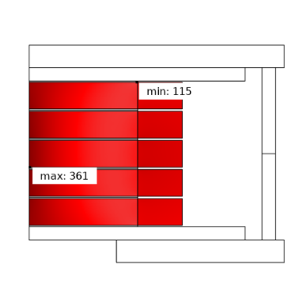
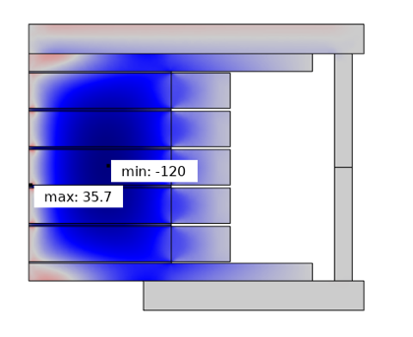
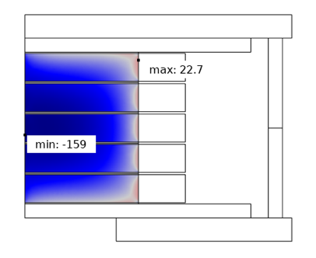
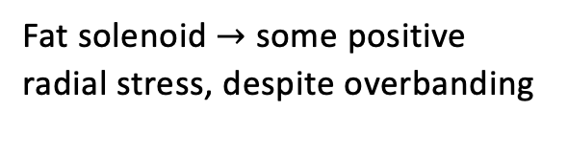
PSI Positron Production.
HTS NI target solenoid
Stresses at 1170 A
Hoop stress [MPa]
Radial stress [MPa]
Fat solenoid $→$ some positive
radial stress, despite overbanding
Axial stress[MPa]
Limit >200 MPa for non-soldered NI pancake [1]
Courtesy J. Kosse
[1] Joshi, S.,. IEEE Transactions on Applied Superconductivity, 2020. 30(4): p. 1-5

Slide 23
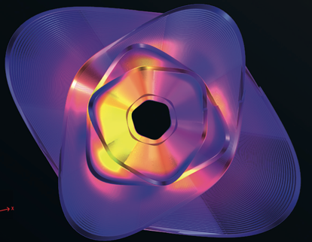
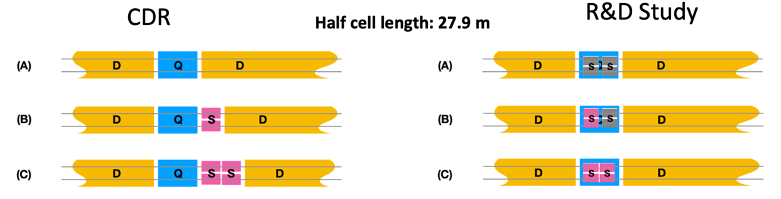
HTS4: HTS short straight sections for FCC-ee
By using HTS sextupoles and quadrupoles instead of the RT baseline, HTS4 aims to:
Reduce energy consumption from up to 80 MW (43 MW in CDR) to <10 MW
Increase dipole filling factor – decrease SR
Enhance optics flexibility
Challenges:
Accelerator-grade field quality with HTS
Balance cooling power with conductor volume
High-reliability cryocooler-based operation
Low heat-load powering
Mitigation of radiation issues on electronics
Sub-scale coils and 1-m prototype module to be constructed and tested at PSI
CCT variant courtesy M. Koratzinos

Slide 24
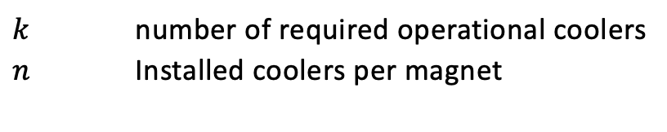
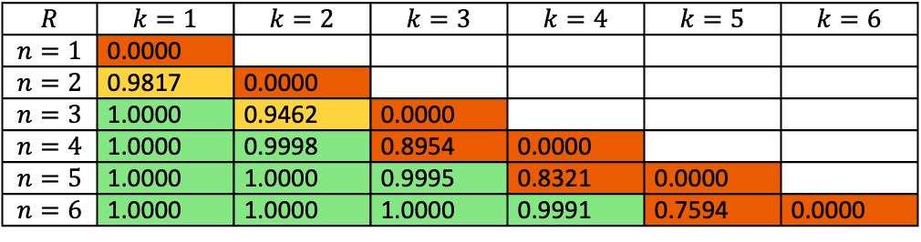
HTS4: HTS short straight sections for FCC-ee
Are magnets operated by cryocoolers reliable enough to enable high availability?
First estimates say YES, IF redundancy is implemented
Total system coldhead reliability >0.999 over 3 year period possible
$k$ number of required operational coolers
$n$ Installed coolers per magnet
$$R$$ | $$k=1$$ | $$k=2$$ | $$k=3$$ | $$k=4$$ | $$k=5$$ | $$k=6$$
$$n=1$$ | 0.0000
$$n=2$$ | 0.9817 | 0.0000
$$n=3$$ | 1.0000 | 0.9462 | 0.0000
$$n=4$$ | 1.0000 | 0.9998 | 0.8954 | 0.0000
$$n=5$$ | 1.0000 | 1.0000 | 0.9995 | 0.8321 | 0.0000
$$n=6$$ | 1.0000 | 1.0000 | 1.0000 | 0.9991 | 0.7594 | 0.0000

Slide 25
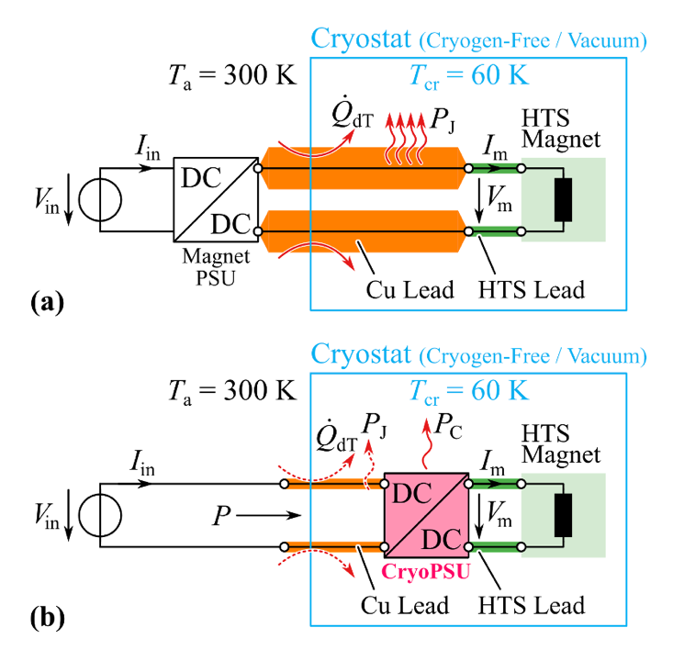
D-ITET PES: FCCee CPES
In support of FCCee HTS4,
CPES develops a cryogenic
power supply which, in its
first iteration, may reduce
heat load to the cryo-cooler
by 50%.
CPES development follows
specifications provided by
CERN power-supply specialists.
The CPES unit may incorporate
magnet protection functionality.
Cold-testing and integration
studies at PSI cryogen-free
test station.
Courtesy J. Huber

Slide 26
HTS for HFM
How to make cable for HTS accelerator magnets (e.g (15 m long, 16+ T, 4.2-20 K)?
  How to deal with ramp losses? Cryogenic concepts?
  How to guarantee sufficient integral field quality?
  How to protect the magnets?
Material development for
insulated tape stack.
Numerical studies for transient
effects in cross-section.
Insulated tape-stack cable manufacturing.
Technology racetracks.
Hybrid configuration of SM-CC beyond 2025.
Ultimately HTS-only SM-CC.
Close technical exchange with MSC has started.
Materials and Numerical Design Studies
Powered Cable Samples
Technology Racetrack Coils
Q4’24
Short Hybrid HTS/LTS
Magnets (15…17 T)
Short All-HTS Magnets
(16…20 T)
(4.2…20 K)

Slide 27
Conclusion
CHART MagDev is gradually building up experience in HTS technologies.
A solder-impregnated NI solenoid, built in collaboration with Tokamak Energy Ltd, reached 18.2 T and survived a quench with an as-yet unexplained reduction in performance.
NI coil technology is being refined and applied to the P3 adiabatic matching device which will operate in a beamline by 2025.
Muon collider cooling solenoids have many similarities, and a PhD under the HorizonEurope MuCol project will soon start at PSI.
Other synergetic activities are under discussion in Swiss academia.
HTS4 aims at energy efficient accelerator magnets with related challenges.
HFM R&D is starting, and it is intriguing to re-think what “accelerator-quality” means in an all-HTS accelerator.
We need to improve on instrumentation, modeling.
We are still at the very beginning of this journey …

Slide 28
Extra Slides

Slide 29
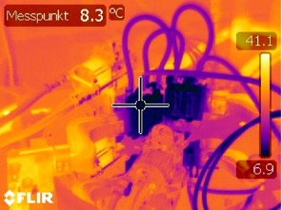
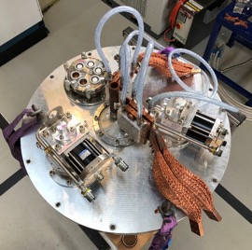
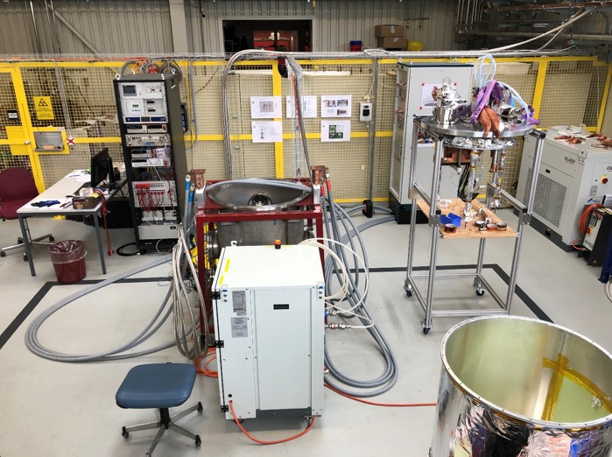
Cryogen-Free Test Stand – Warm-Lead Cooling
Top copper lead temperature
reduced from 56ºC to 8ºC.
2kA ±10V power converter
Cryostat insert with two cryocoolers
Electronic rack
vacuum control/monitoring
temperature control/monitoring
voltage signals recording
quench detection system
Cooling with 2 cryocoolers
  RDK-415D – samples/coils (1.5W@4.2 K and 35W @ 50K)
  RDK-500B – current leads (160W@70K)
DAQ
  2 nanovolt channels
  16 high precision channels
  32 fast sampling channels
FPGA based quench detection system with interlock and safety matrix
10 cernox temp sensors
5 hall probes (calibrated at various temperatures up to 20T)
Vacuum vessel with pumps
Powering cables (500A single cable)
Water chiller
Radiation shield with MLI
Courtesy of H. Rodrigues

Slide 30
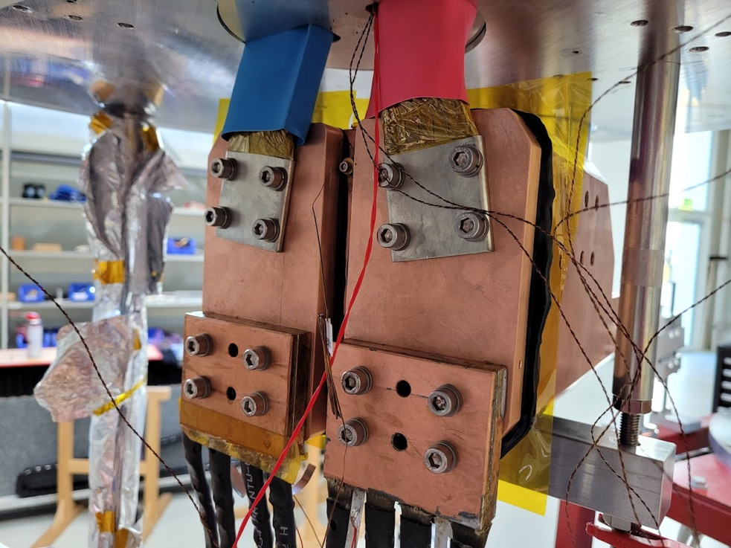
Optimized Thermal/Electrical Contacts
Numerous optimizations of contacts enabled the 12 K operating
temperature at 2 kA operation.
Courtesy of H. Rodrigues

Slide 31
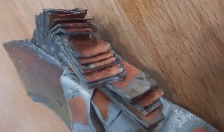
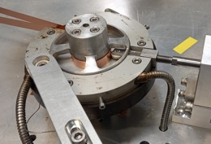
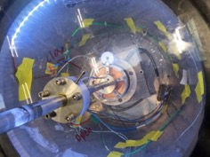
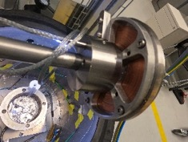
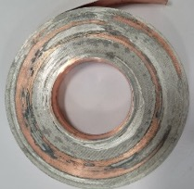
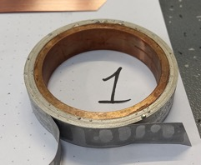
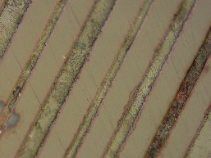

Solder Impregnation Technology
Baseline:
Fluxed Winding
Soldering from top
Fluxed-Hot-winding
Pre-tinned tape
Fluxed winding
Pre-tinned tape
Bath soldering in
vacuum
Removable mandrel
Fluxed winding
Pre-tinned tape
Bath soldering in vacuum
Removable mandrel
Tightening during soldering
Rosin Flux
200 Celsius
+ 30 min cycle
Rosin Flux
200 Celsius
~ 25 min cycle
GSP-2533 Flux
210 Celsius
~ 3 min cycle / ~ 5 mbar
GSP-2533 Flux
220 Celsius
~ 3 min cycle / ~ 5 mbar
Problems:
Dry patches inside
Time
Problems:
Small empty voids
Time
Problems:
Unequally spaced turns
Problems:
Tbs
Courtesy of H. Rodrigues

Slide 32


Implementing Lessons Learned on Test Station
Courtesy H. Rodrigues

