Slide 1
ReBCO I.FAST CCT
& IRIS 10 T HTS dipole at INFN
1st High Temperature superconductor Accelerator Technology (HiTAT) workshop
Stefano Sorti, Ernesto De Matteis, Lucio Rossi
on behalf of LASA team

Slide 2
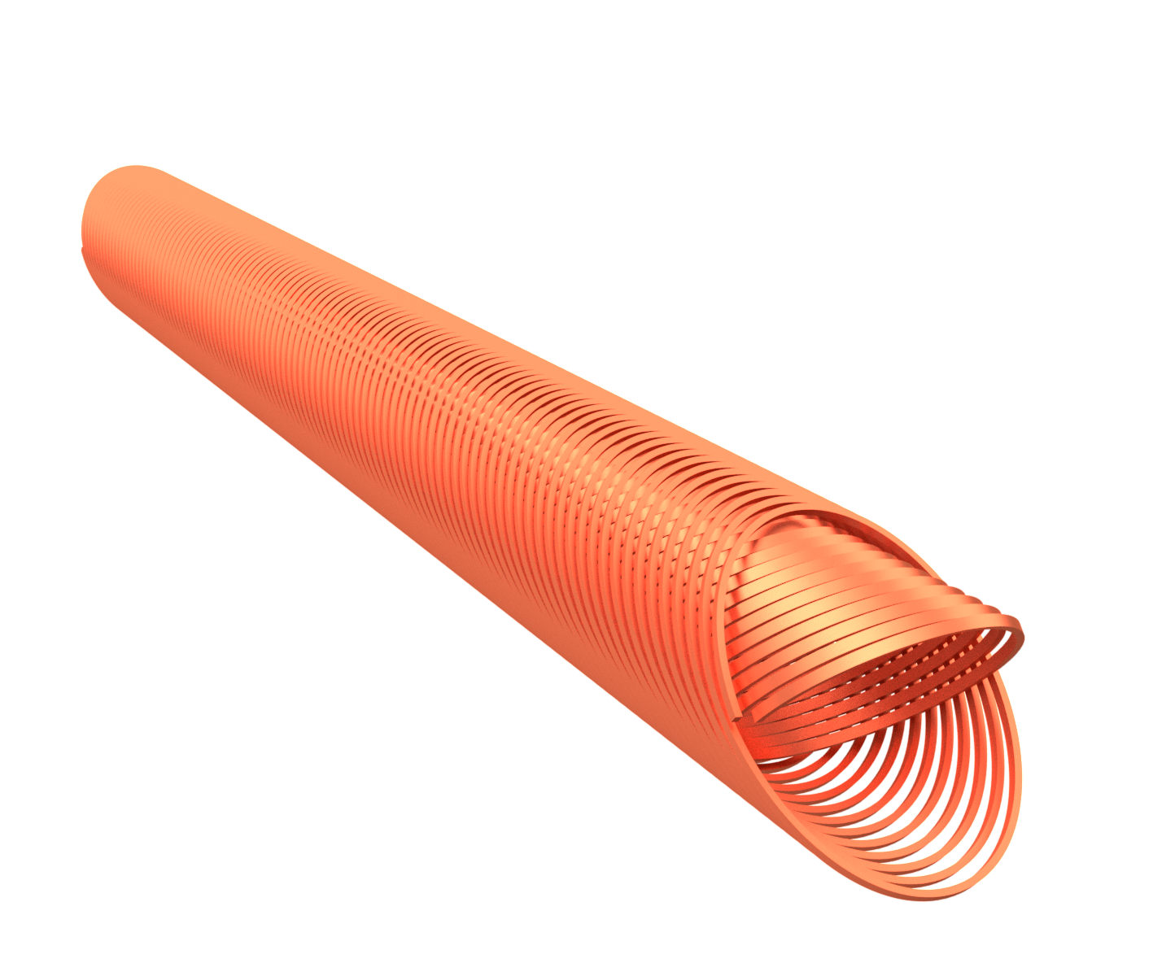
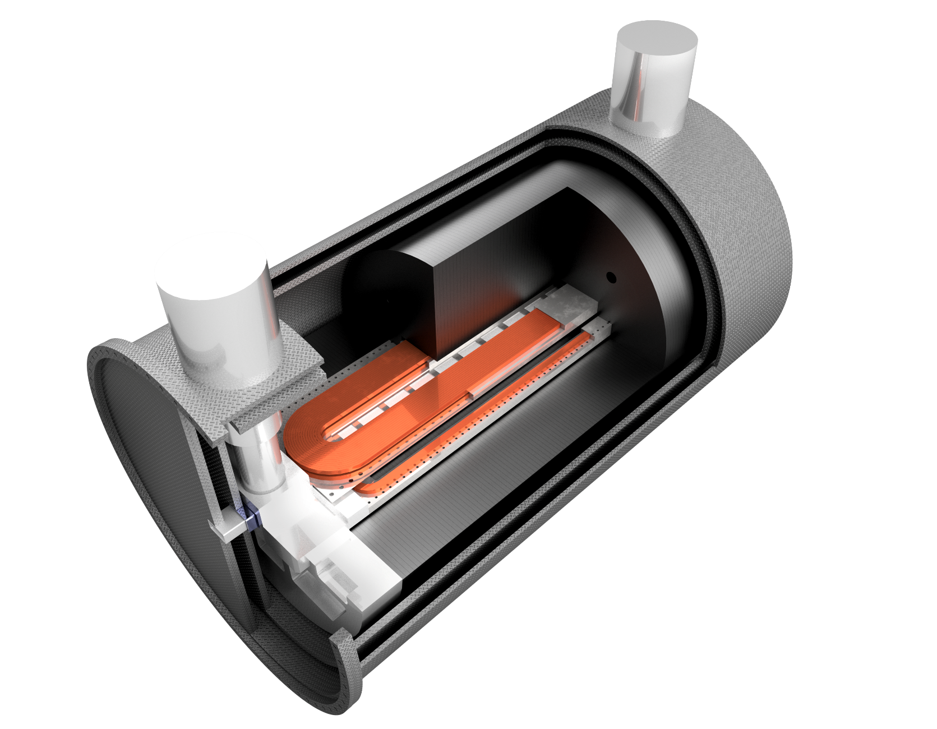
Contents
I.FAST WP8, Innovative superconducting magnets
(explicitly, CCT in HTS)
IRIS project, an Innovative Research Infrastructure on applied Superconductivity

Slide 3
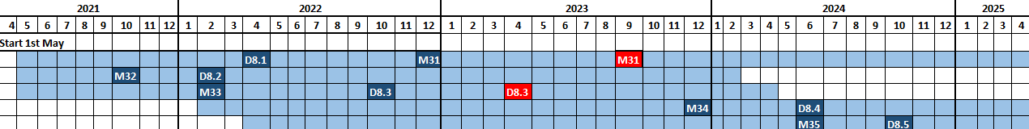
IFAST WP8: main overview
SCOPES:
Exploring Canted Cosine Theta (CCT) with HTS superconductor (main goal), proceeded by a combined function CCT based on LTS, involving the industries that want to learn about the CCT magnets
Form a permanent European Strategy Group, open to worldwide partners, to discuss the European strategy for HTS magnets for accelerators, and to improve Industry involvement in this technology
TASKS:
8.1 - Coordination and HTS Strategy Group
8.2 – Preliminary Engineering design of comb. CCT magnet
8.3 – Preliminary Engineering design of HTS CCT
8.4 - Construction of combined CCT magnet demonstrator
8.5 – Construction of HTS CCT magnet demonstrator
8.6 – Development of ReBCO HTS nuclotron cable
8.1
8.2
8.3
8.4
8.5

Slide 4
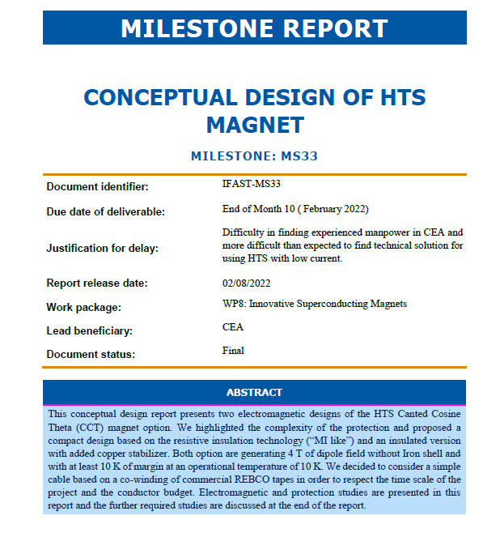
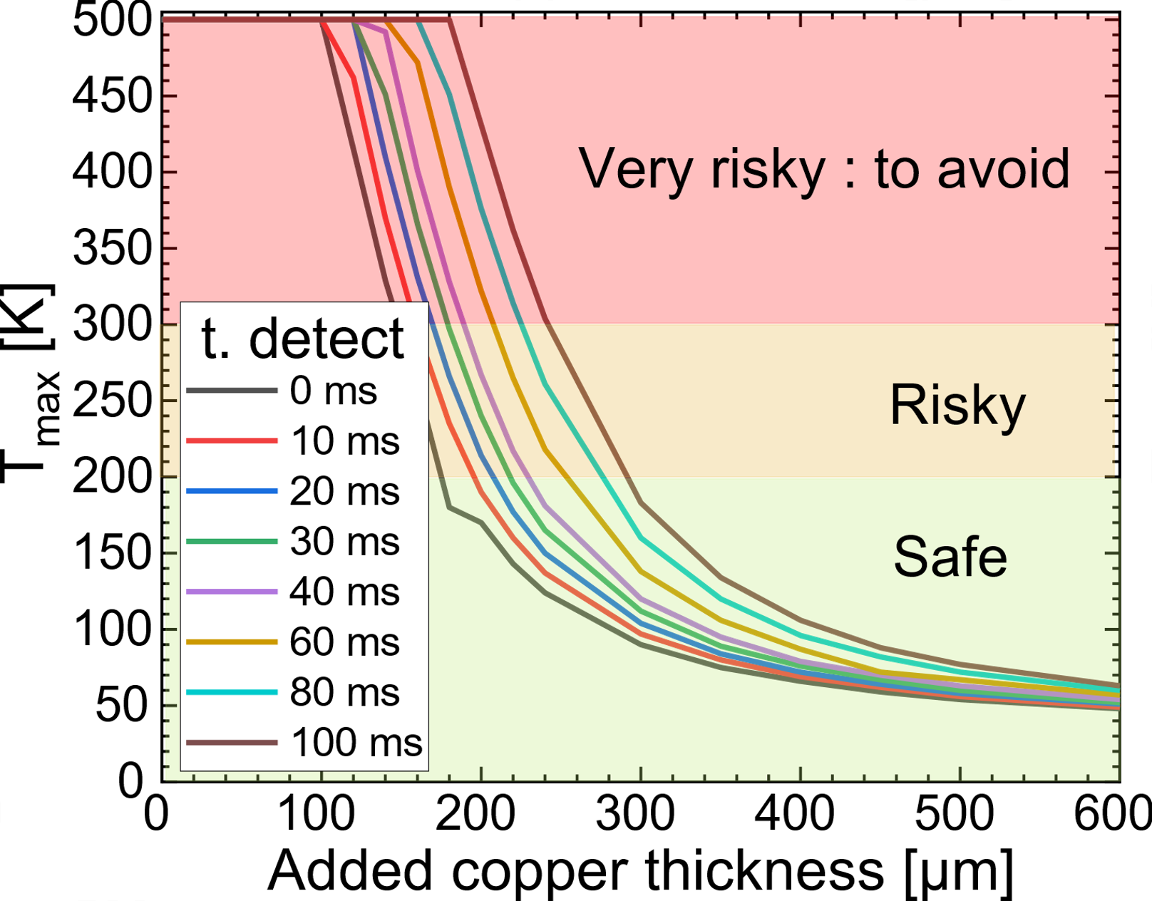

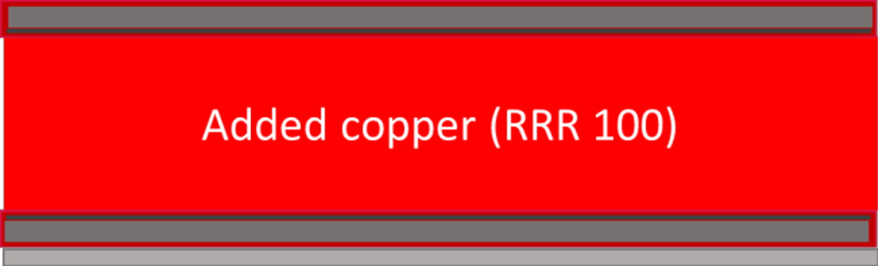
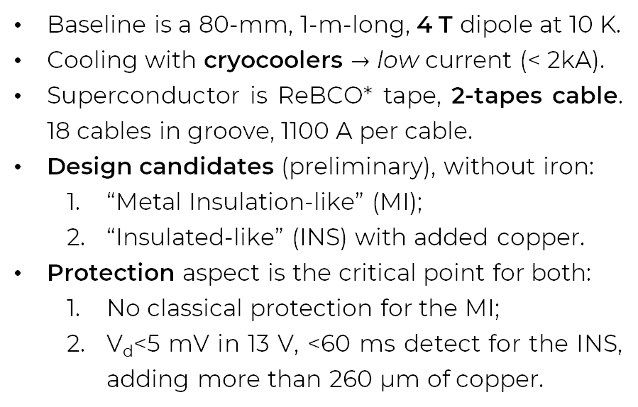
IFAST WP8: M33
Conceptual Design of HTS Magnet
Baseline is a 80-mm, 1-m-long, 4 T dipole at 10 K.
Cooling with cryocoolers $→$ low current (< 2kA).
Superconductor is ReBCO* tape, 2-tapes cable.
18 cables in groove, 1100 A per cable.
Design candidates (preliminary), without iron:
  “Metal Insulation-like” (MI);
  “Insulated-like” (INS) with added copper.
Protection aspect is the critical point for both:
  No classical protection for the MI;
  V_{d}<5 mV in 13 V, <60 ms detect for the INS, adding more than 260 µm of copper.
See HTS Cable for IFAST CCT
(Thibault LECREVISSE, 09/03)
4-mm tape
MI cable
INS cable
*different vendors are compared in M33

Slide 5
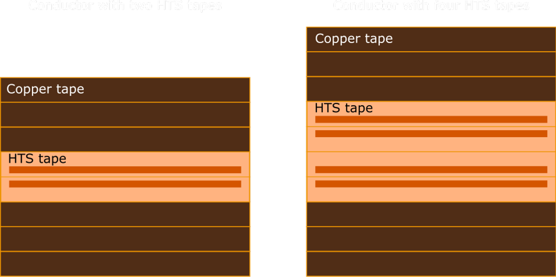
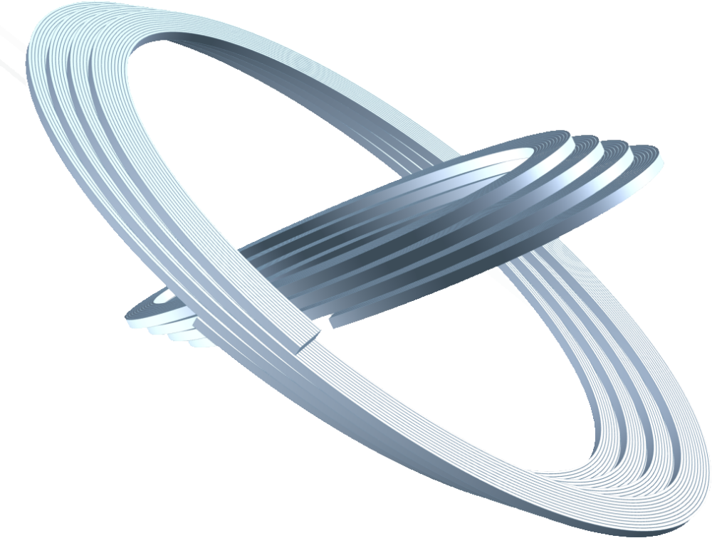
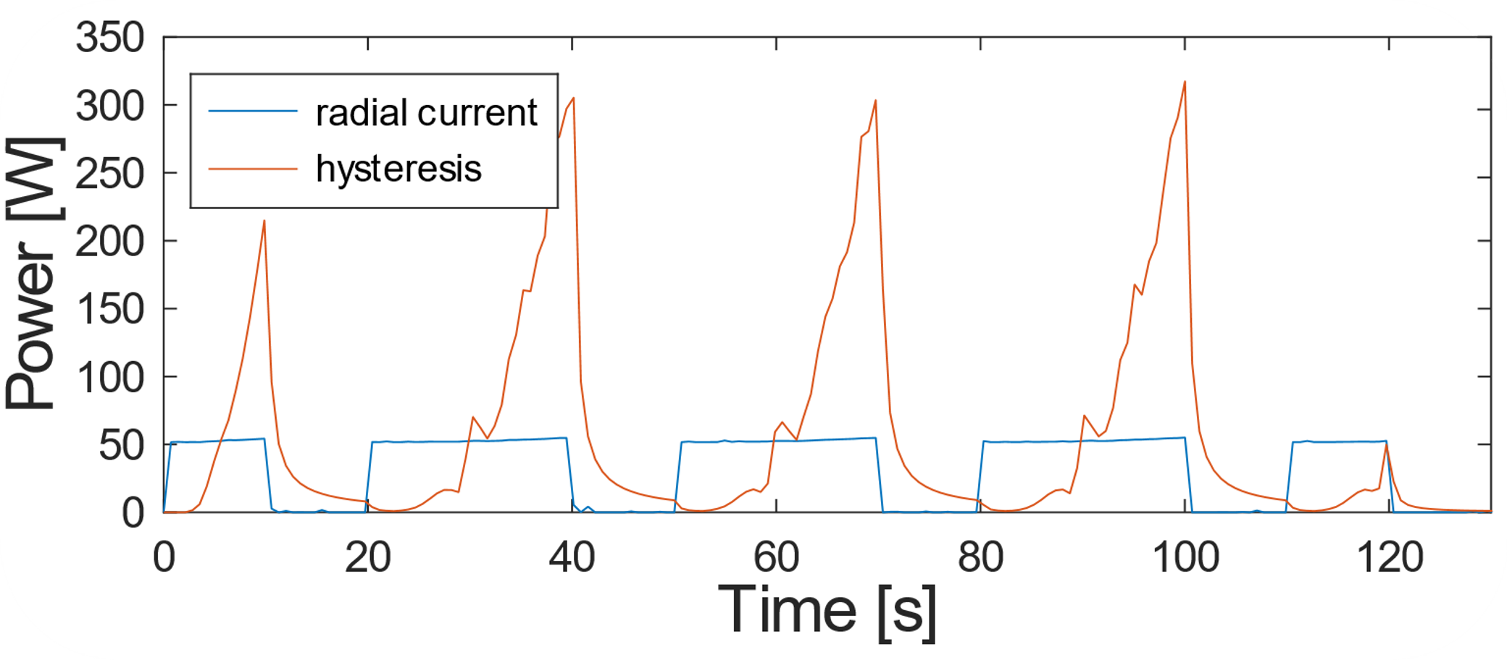

IFAST WP8:
Further Design of
HTS Magnet, pt. I
INS option with Cu stabilizer is pursued. New T_{op} is 20 K, Two further design options:
  2-tapes cable (980 A)
  4-tapes cable (1990 A)
Soldering all tapes inside the
cable under consideration;
Accelerator-level field-quality
(integral below-unit), no iron
yoke (shielding open problem);
Ongoing mechanical studies,
both manufacturing and strength.
Minimum rib thickness is 1 mm (against 0.4 mm LTS),
but Frenet-Serret employed (no radial grooves).
Collaboration with Jeroen van Nugteren (Little Beast Engineering)
M33 design suffers from high AC losses ($\sim$100 W, 25 Ω cm²):
5/12

Slide 6
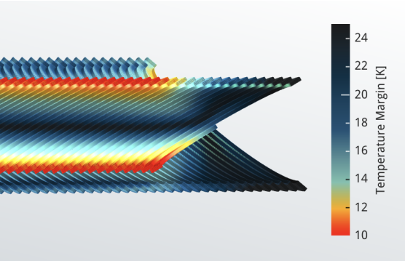
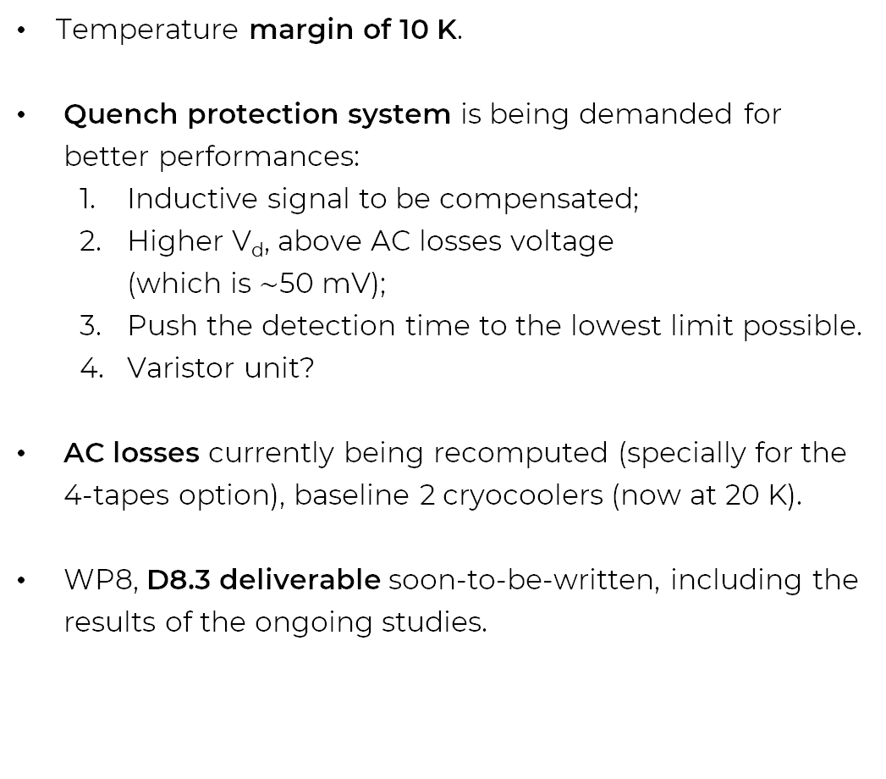
IFAST WP8:
Further Design of
HTS Magnet, pt. II
Temperature margin of 10 K.
Quench protection system is being demanded for better performances:
  Inductive signal to be compensated;
  Higher V_{d}, above AC losses voltage
  (which is $\sim$50 mV);
  Push the detection time to the lowest limit possible.
  Varistor unit?
AC losses currently being recomputed (specially for the 4-tapes option), baseline 2 cryocoolers (now at 20 K).
WP8, D8.3 deliverable soon-to-be-written, including the results of the ongoing studies.
6/12

Slide 7





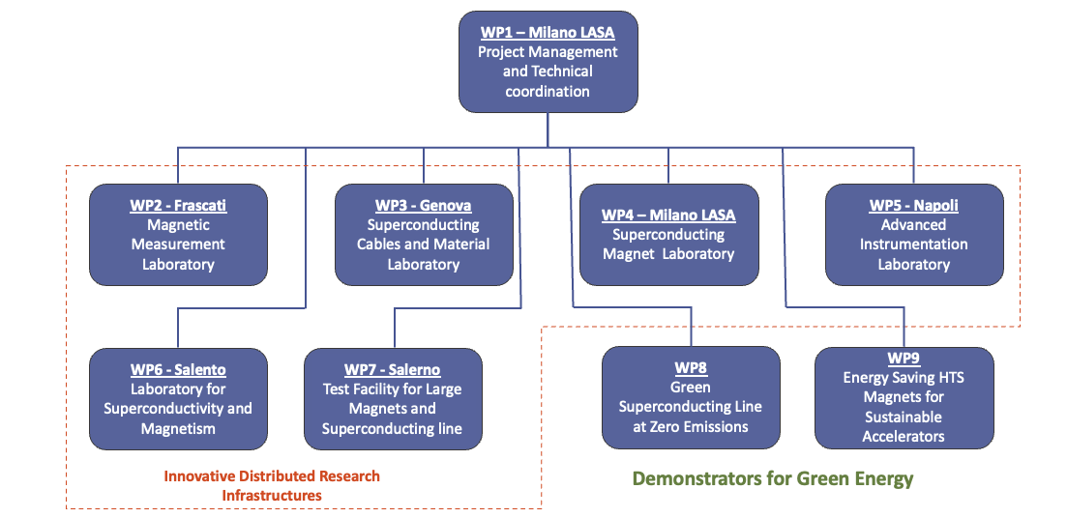
IRIS project
A distributed research infrastructure
A wide range of
objectives
Fundamental Physics instrumentation
Societal Applications
  Green: energy transport at zero emission and energy saving magnets;
  Medical: Superconductivity could play a key role in heavy ion therapy by enabling a rotatable gantry;
Two full-scale demonstrators.
Final deadline is 30 October 2025.

Slide 8
Demonstrators proposal
Green Superconducting Line
Energy Saving HTS magnet
Energy transport at 0³ emission:
  Zero (almost) emission of C02 :
  consumption will be 1% over 1000 km
  Zero emission of e.m. radiation (DC)
  Zero (almost) land consumption: a 50 cm underground pipe can carry the 5 GW power of 30 m X 50 m overhead line.
25 kV - 40kA, at 20 K (50+ kV testing)
Round MgB₂ strands, cooled with He gas;
after IRIS, investigation on LH cooling.
Main goal: 10 T – 20 K, 10 K margin,
conduction cooled.
Aperture 150 mm X 50 mm, with 700 mm straight section, for cable test (at INFN-Genova).
Additionally, technology driver for 15 T – 20 K magnets for FCC or Muon-C.
Around 10 km of 12 mm wide ReBCO tape. Stack cable with controlled-insulation.
Charging time in the range of (a few) hours.

Slide 9
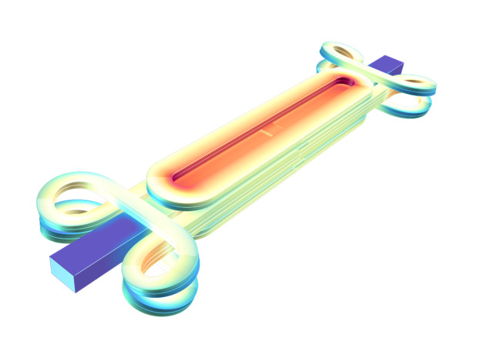
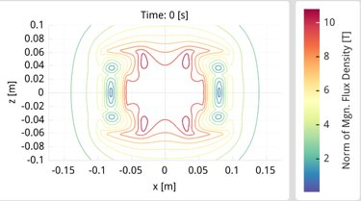
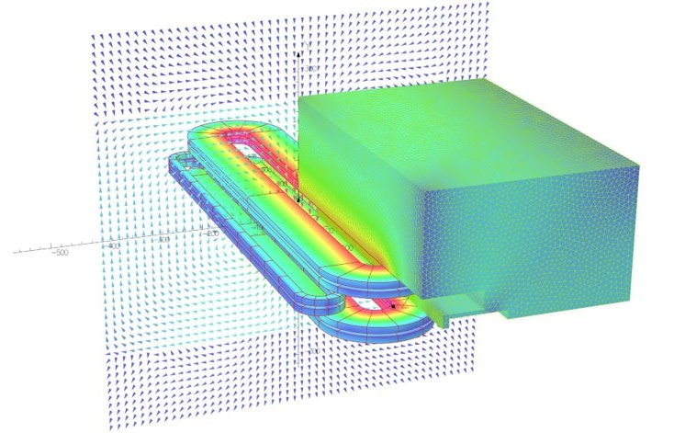
HTS magnet (and green line) kick-off adaptation
Revising concept (a) to a simpler design,
focus is to test technologies (cryocoolers, C.I.),
racetrack coils as baseline for design (b)
Project approval under budget review,
HTS magnet adjusted:
reducing magnetic field and aperture,
from 10 T – 150 mm to 8 T – 80 mm. Same technological goals.
Still, open to higher fields, if achievable.
*
(a)
*
(b)
*Courtesy of J. van Nugteren First small demo at CERN by J.van Nugteren, G. Kirby and T. Nes *Courtesy of Magnus Dam

Slide 10
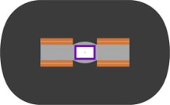

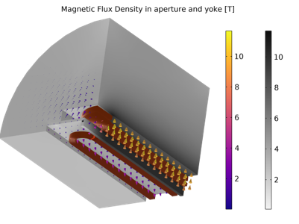
HTS design magnet status, pt. I
Ongoing conceptual design. Two coil layouts are under investigation:
  Helmholtz-like double pancake racetracks
  Mid-plane extra coils (-50% yoke, +15% tape, on the right)
First goal is to minimize tape consumption and critical current limit.
Field quality not optimized yet. Target is <1%
Now is around 2-4% level in aperture,
with a nonlinear, non-optimized, iron yoke.
A charging model is being developed, based on the one for AMaSED-2 (courtesy of Magnus Dam). Investigate different insulation solutions
(Dummy layout, zero-order thermal studies)

Slide 11
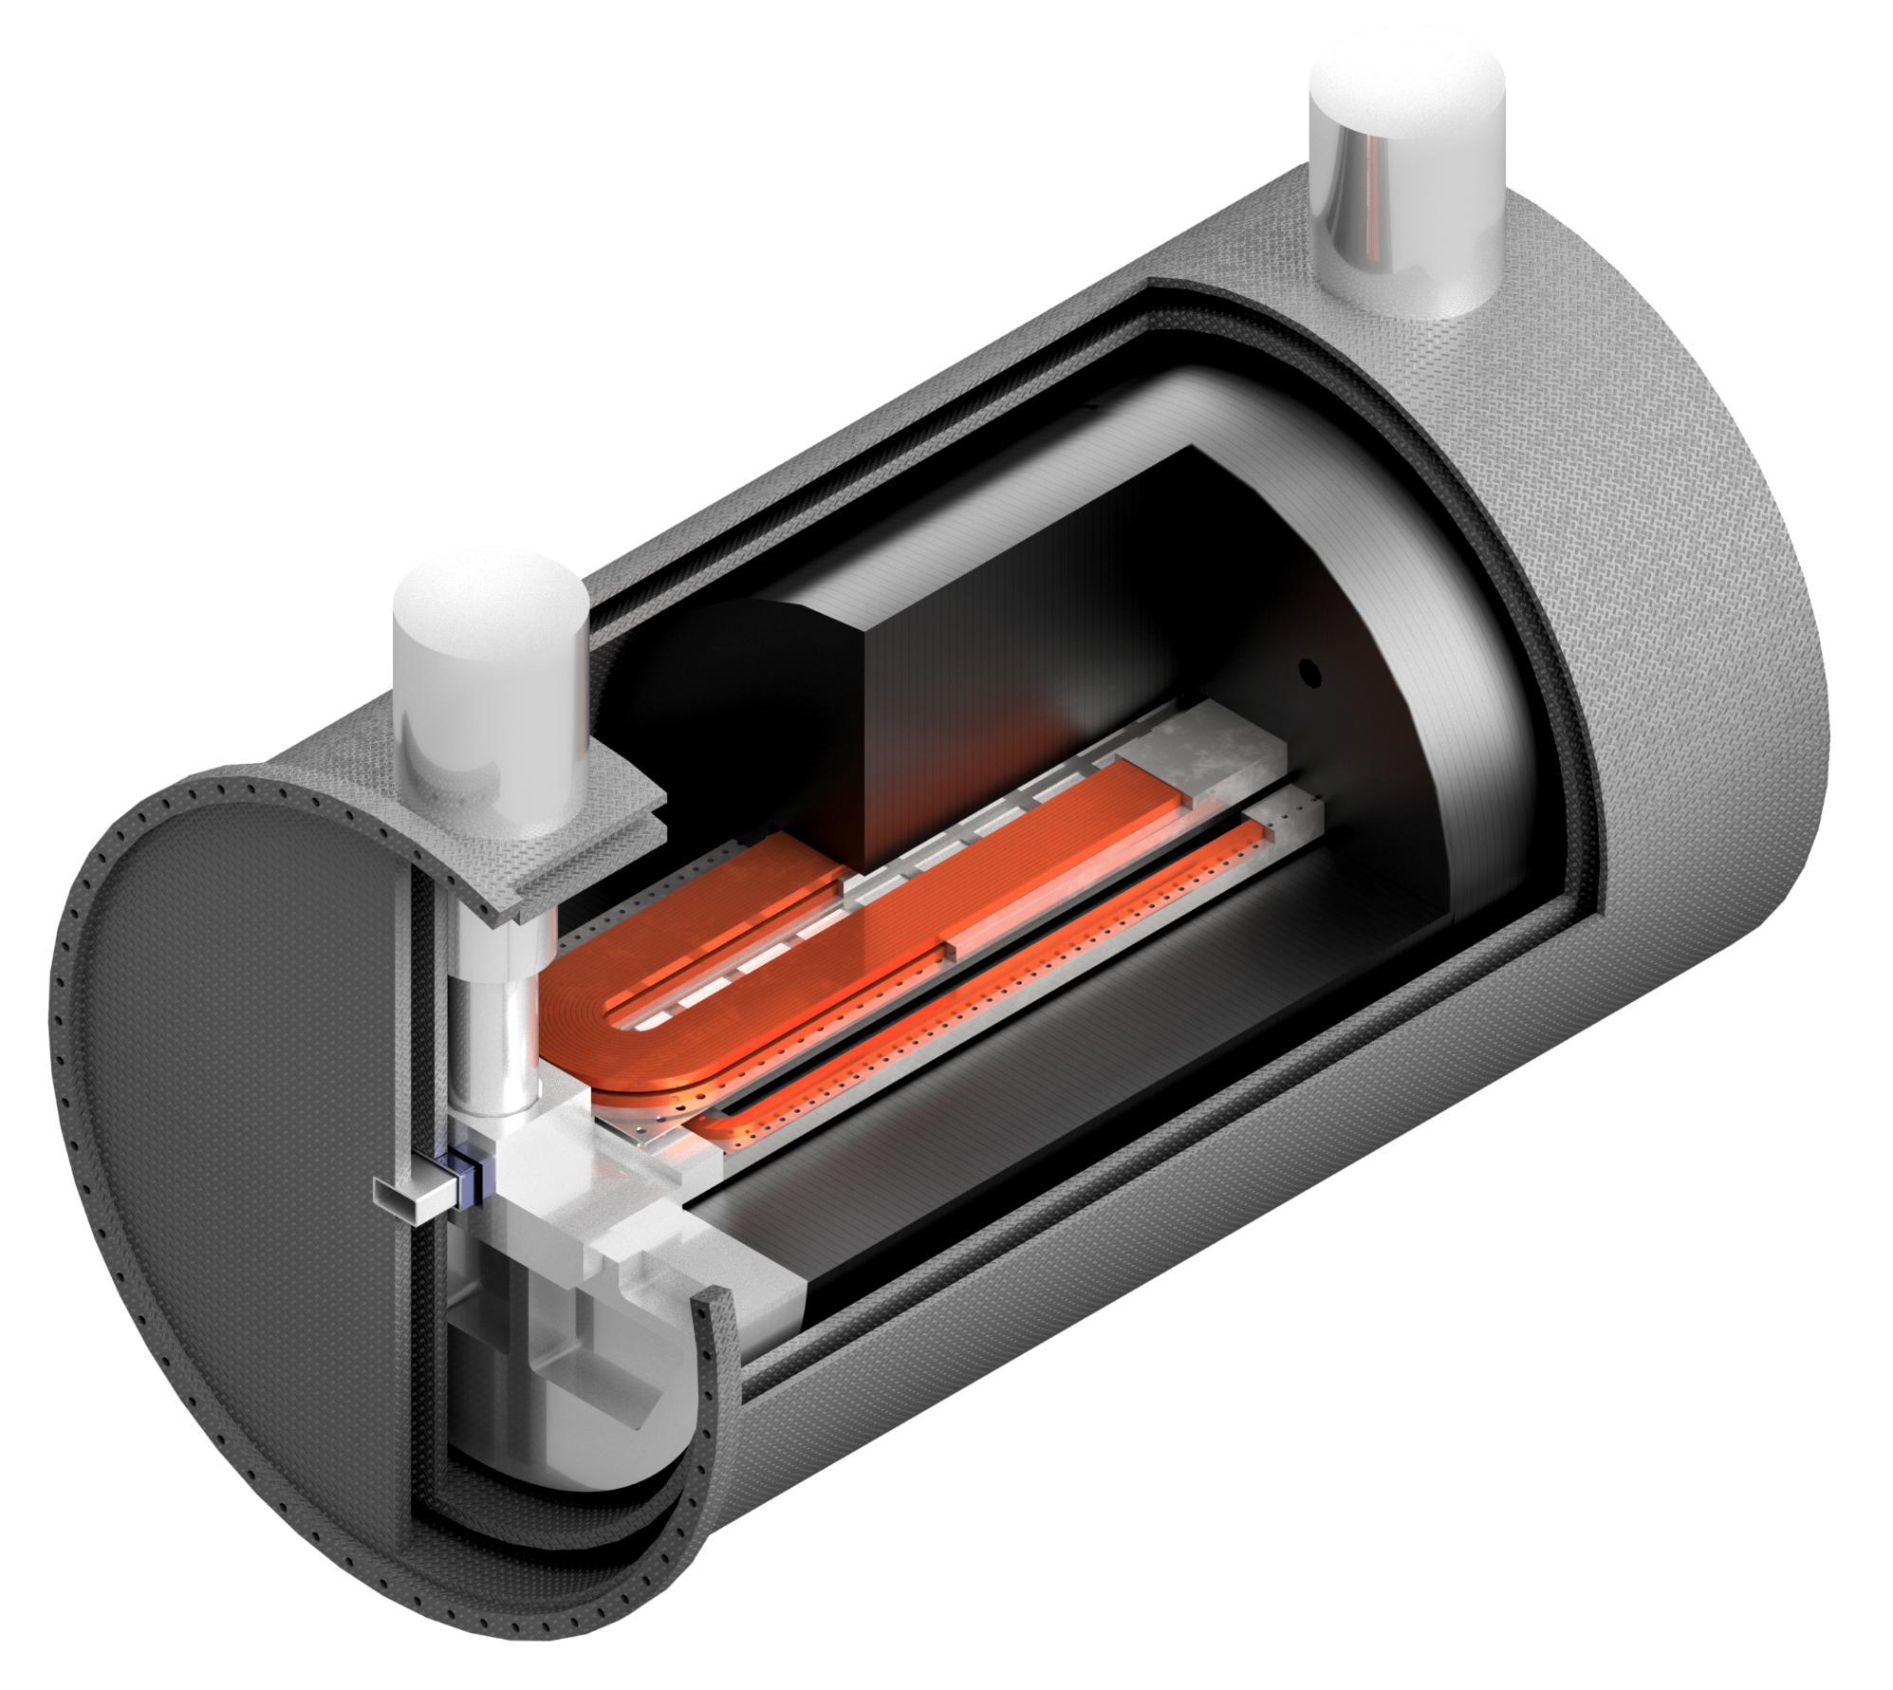
HTS design magnet status, pt. II
Iron Yoke
Coils
Zero-order estimation of DC power consumption (no HTS losses, 50 nΩ joint every 200 m)
Cryocooler
(market inspired)
Q [W] | Thermal Shield | Coil
Supports | 12 | 1
Radiation | 9 | 0.1
Current-Leads | 80 | 0.5
Joints in HTS | 0 | 0.5
TOT | 101 | 2.1
Vessel
& Shield
Coil OB +support
(Stainless steel)
Al end-frame
(thermal short-circuit between
cryocoolers and magnet parts)
Anti-Cryostat
(Vessel and shield)

Slide 12


Conclusions
I.FAST WP8 aims at assessing the feasibility of a fast-ramped, cryocooled, CCT with ReBCO tapes. Possible applications range from accelerators to hadrontherapy gantries.
I.FAST WP8 is currently finalizing the demonstrator design (D8.3).
IRIS project aims at building a dipole magnet for users, testing some essential technologies for higher-field magnets.
IRIS project is currently exploring the design space to finalize a preliminary design.

Slide 13
THANKS FOR THE ATTENTION!

Slide 14

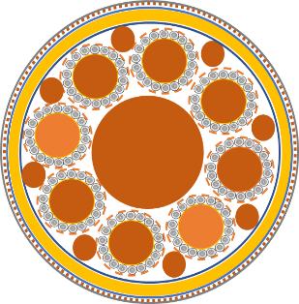
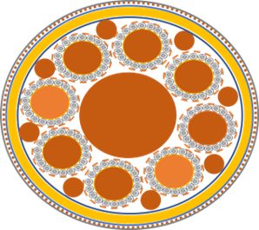
Appendix: Green Superconducting Line
Gas He
Characteristics​ | ​
Length (m)​ | 75 m​
Inner envelope diameter (mm)​ | 127/143​
Outer envelope diameter (mm)​ | 198/220​
Bending radius (m)​ | 2,2 m​
Expected losses ​ | 2,5 W/m at 20K (187,5 W)​
P in ​ | 20 bar​
T In/T out ​ | 18K/20K​
Iris project design: 4x40 kA -25kV 20 K
Outer Cryogenic wall ID 198/OD 220
Inner Cryogenic wall ID 127/OD 143
Expected cooling power at 18 K≈330-370 W
including the 2 terminations, cryo ends…
Mass flow: ≈15 g/s
Pressure drop ≈ 0,4 mbar.
LN₂ required for the current leads of the terminations.
Drum for envelope maximum diameter of 4,5 m
Vacuum chamber
Low thermal conduction spacer

Slide 15
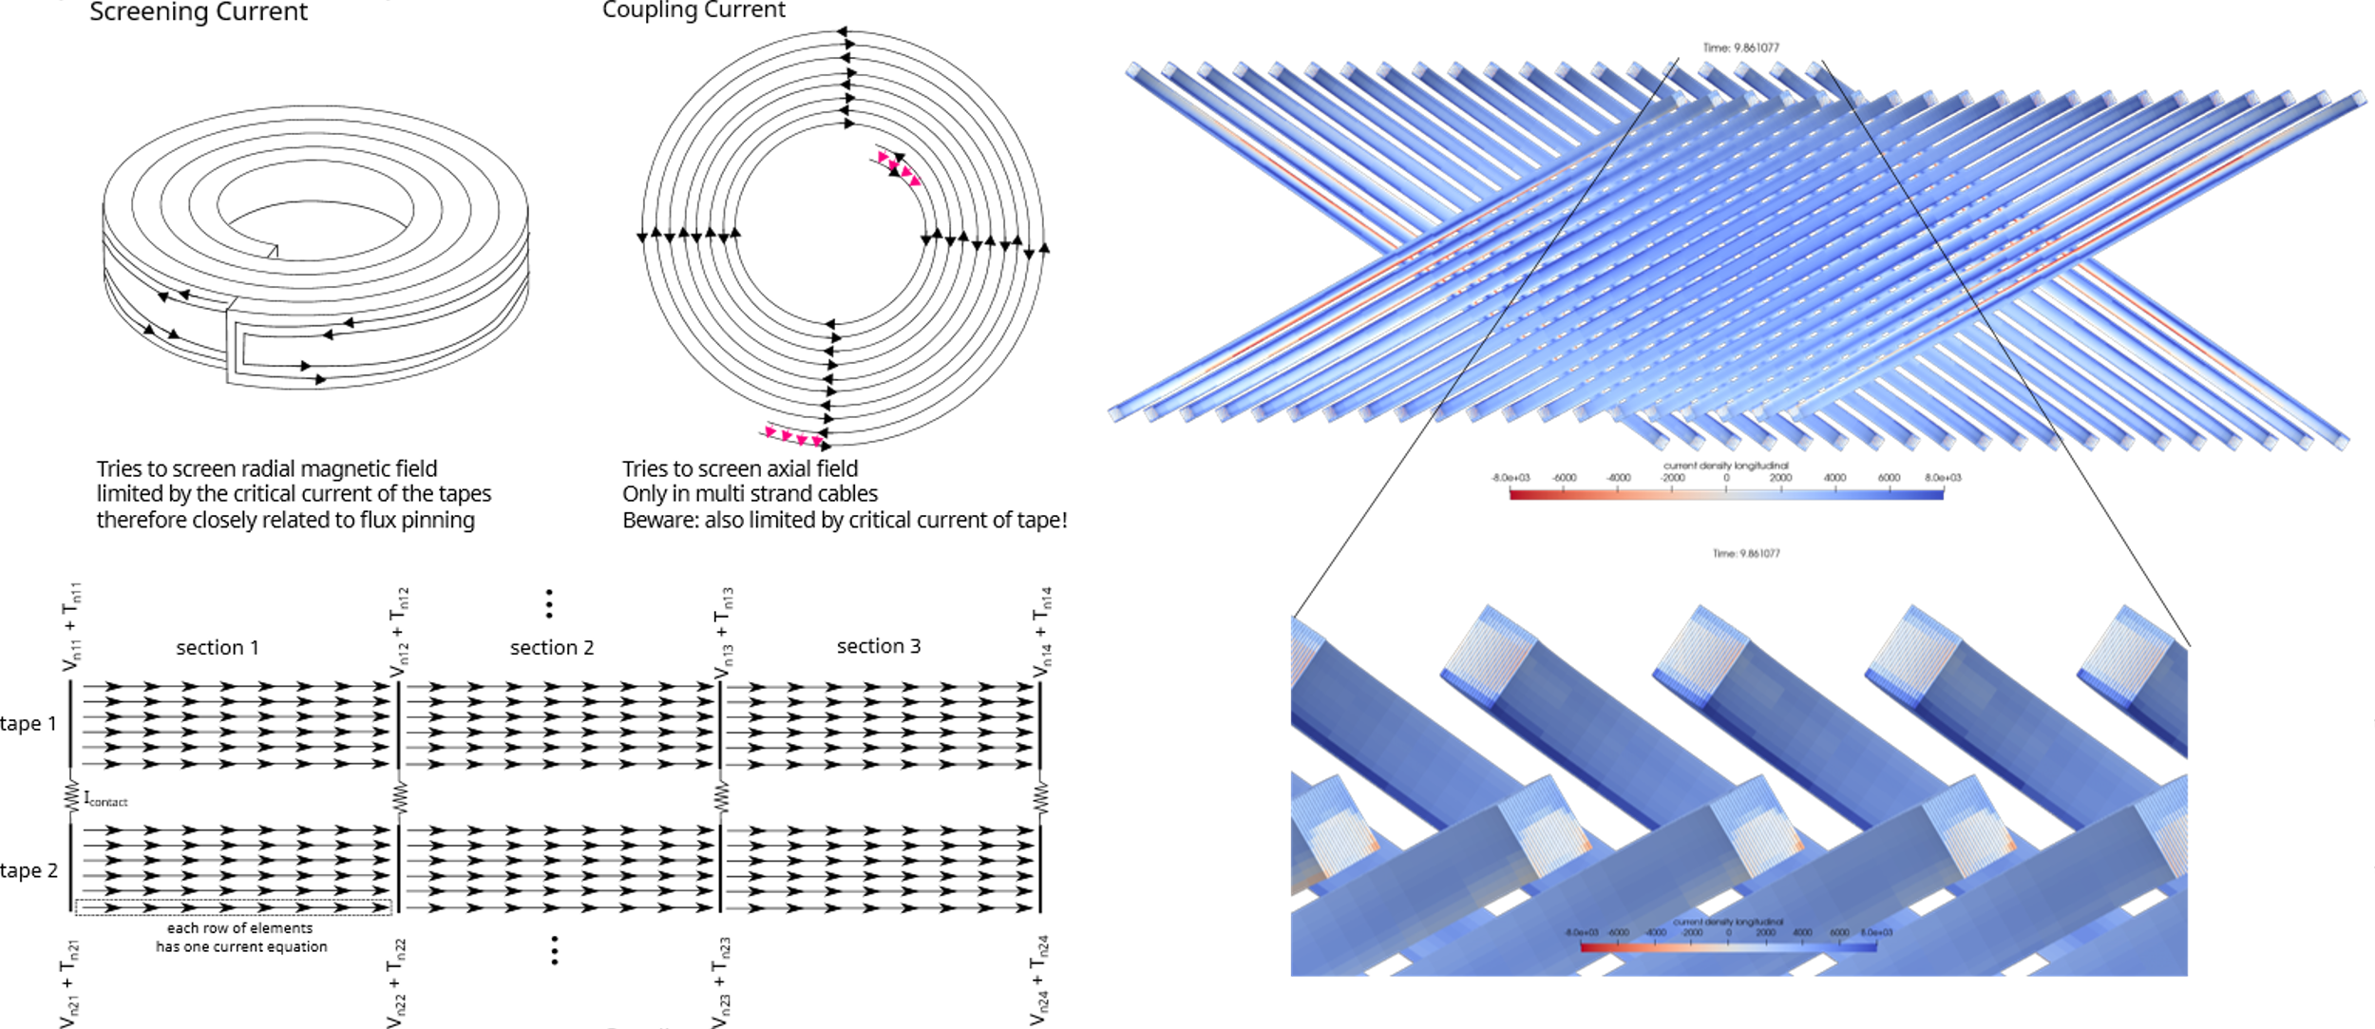
Appendix: AC losses calculation for HTS Magnet (L.B. Engineering)
Main features of the model
current distribution in subscale model at end of first ramp

Slide 16
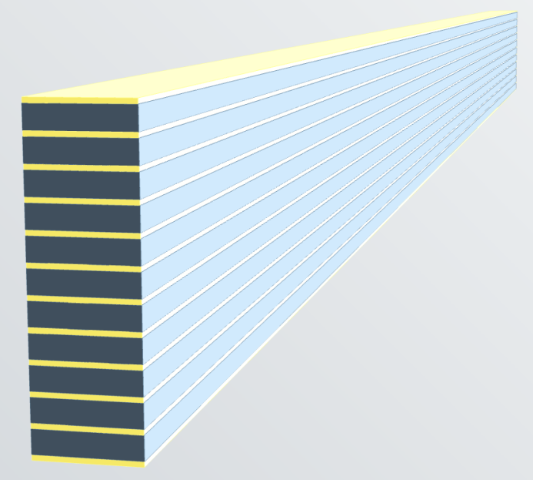
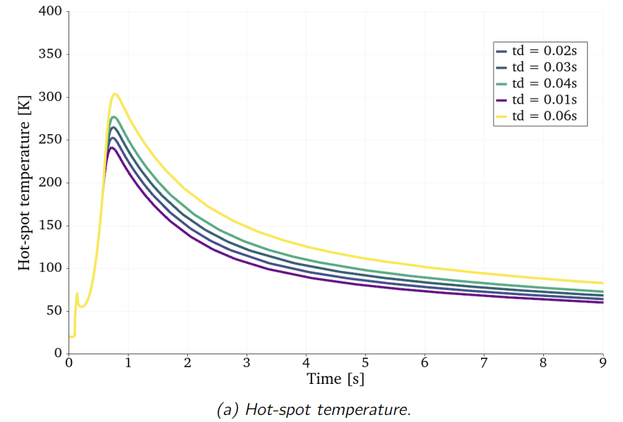
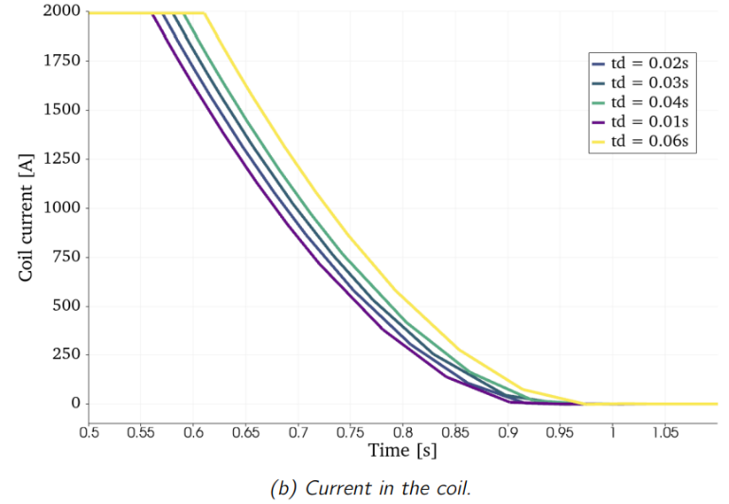
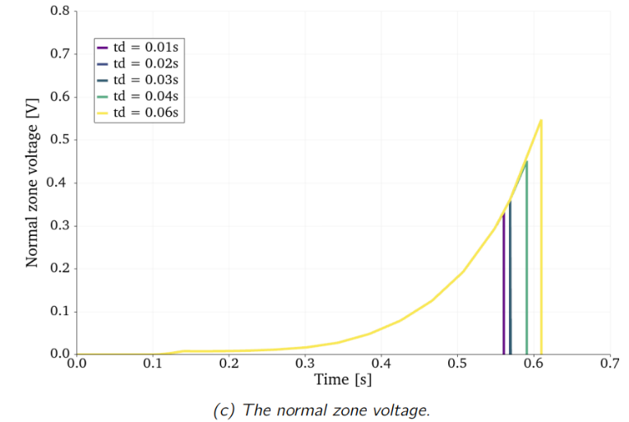
Appendix: Quench calculations work-in-progress
Model (with magnet L in series)
current distribution in subscale model at end of first ramp
Quench simulation of a 200 mm long CCT layer with 11 sub-layers, four HTS tapes per sub-layer and 700 µm copper stabilizer, for different quench protection delays. During each simulation the quench detection voltage was set to be 0.3 V. 500 V threshold with metrosil varistor unit.
A transverse background field of 4 T is applied. The magneto resistance of the copper is also taken into account during.

