Slide 1


Overview of EuCARD2 HTS magnet tests and lessons learned
F. Mangiarotti – 2023.03.10, HiTAT-1 workshop
With data, analysis and input from: H. Bajas, C. Bockstiegel, M. Bonora, V. Desbiolles, M. Duda, M.Durante, S. Ferradas, J. Feuvrier, J.-L. Guyon, G. Kirby, F. Kosowski, T. Lécrevisse, D. Martins Araujo, C. Petrone, G. Pichon, X. Sarasola, J. van Nugteren, G. Willering

Slide 2
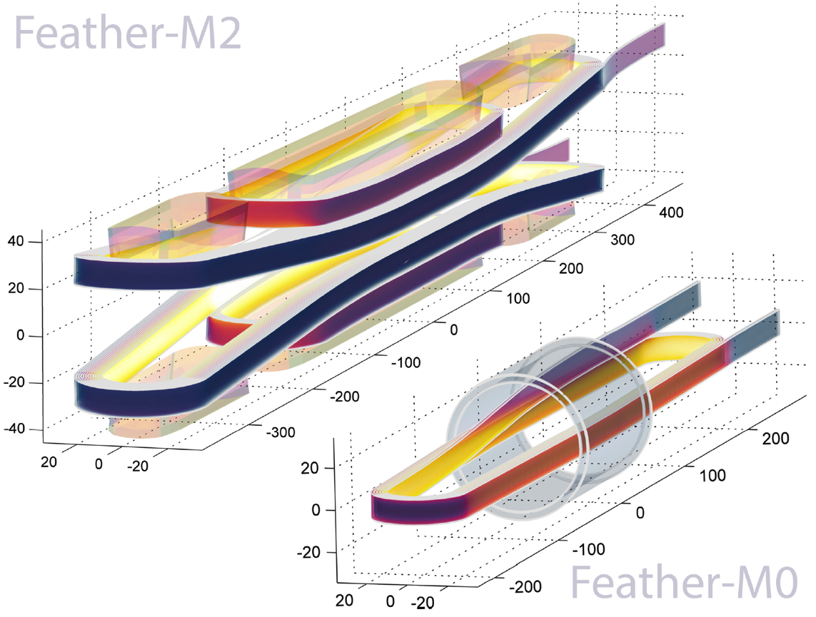
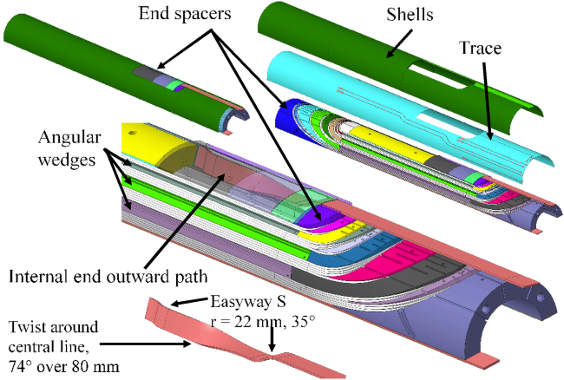

EuCARD2 HTS magnets
Cos-theta

Slide 3
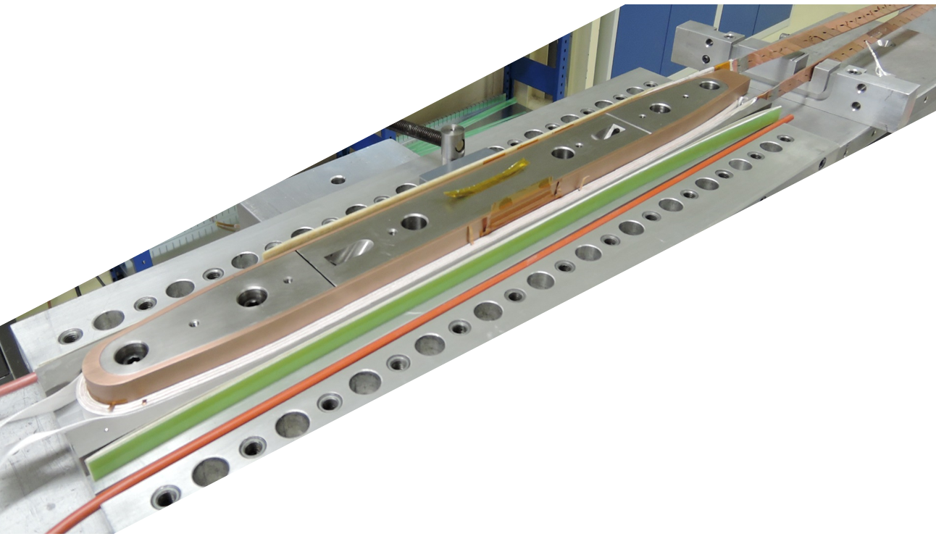
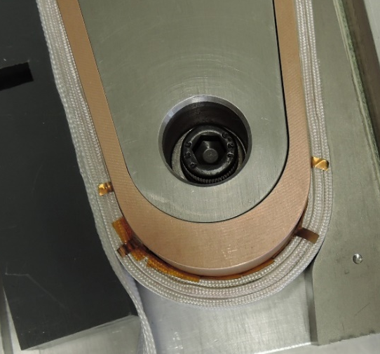
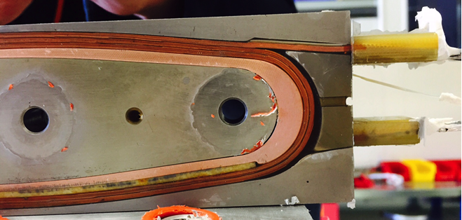
CERN’s Feather-M0
Return end
Lead end
Subscale coils to test manufacturing and quench detection.
Cold tested: Feather-M0.4 with Bruker tape, M0.5 with Sunam tape

Slide 4
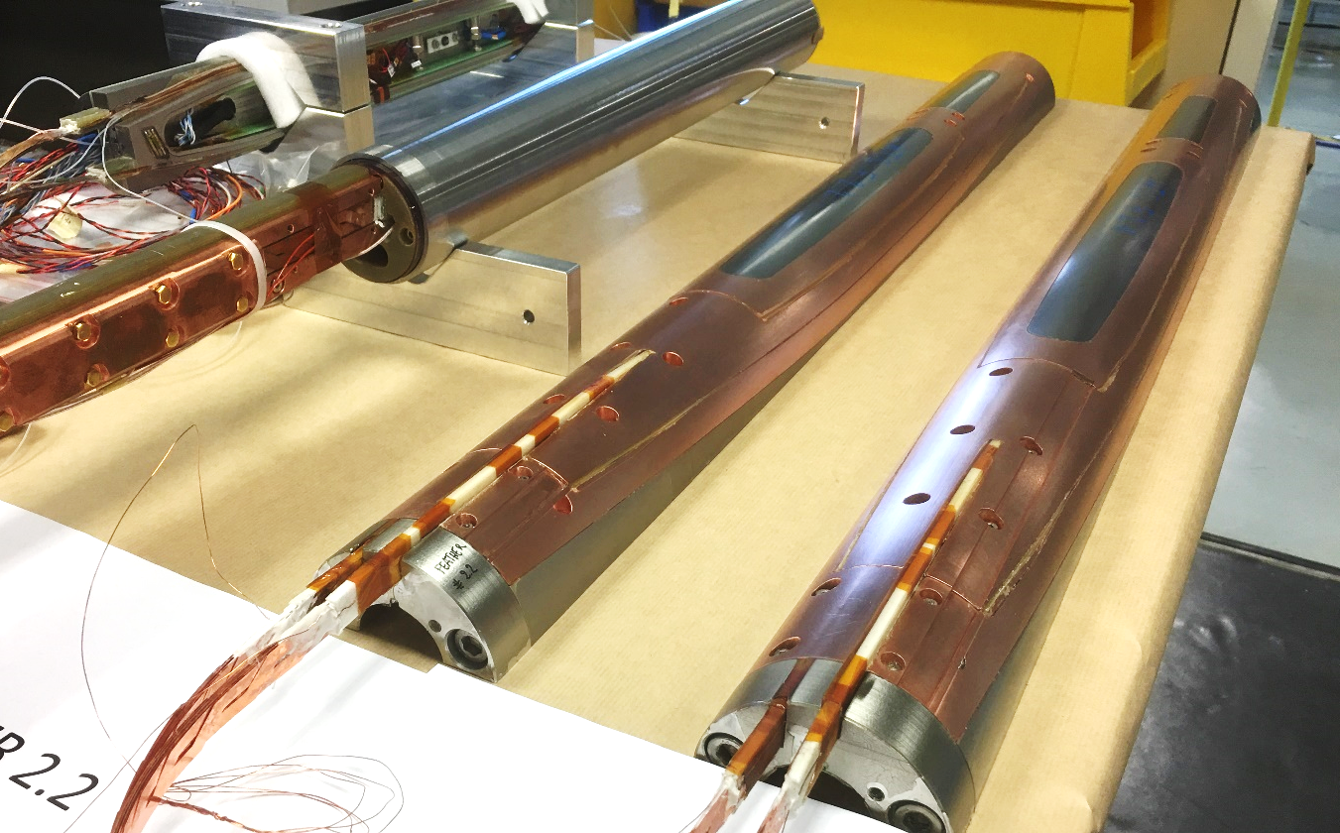
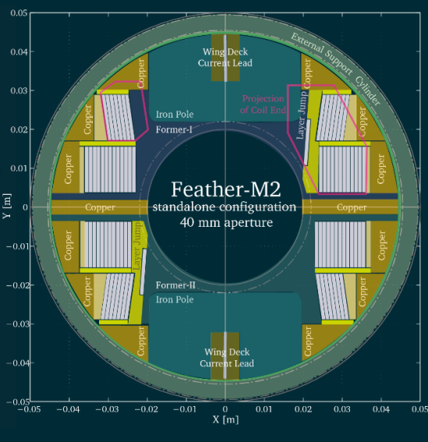
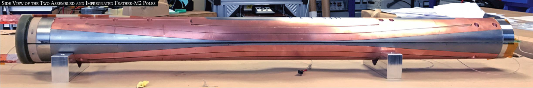
CERN’s Feather-M2
EuCARD2 deliverable. Two assemblies:
Feather-M2.1-2 with Sunam tape
Feather-M2.3-4 with Bruker tape

Slide 5
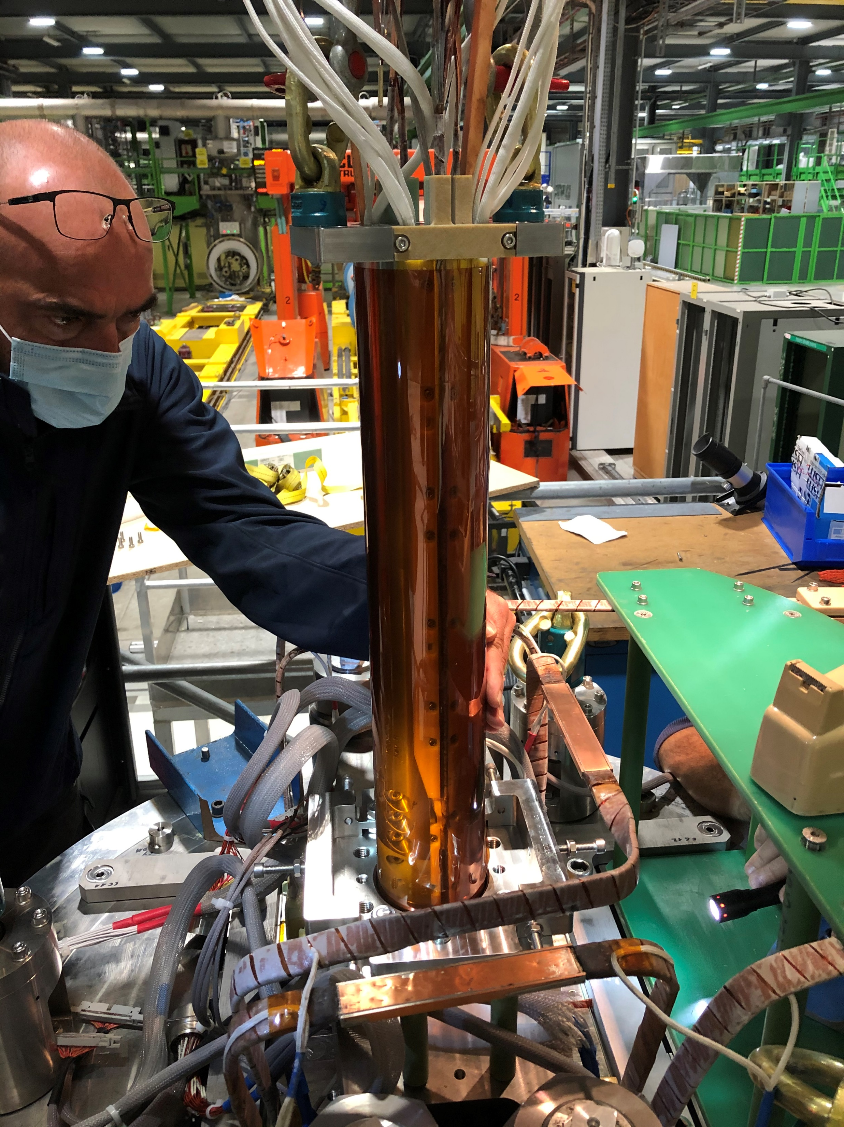
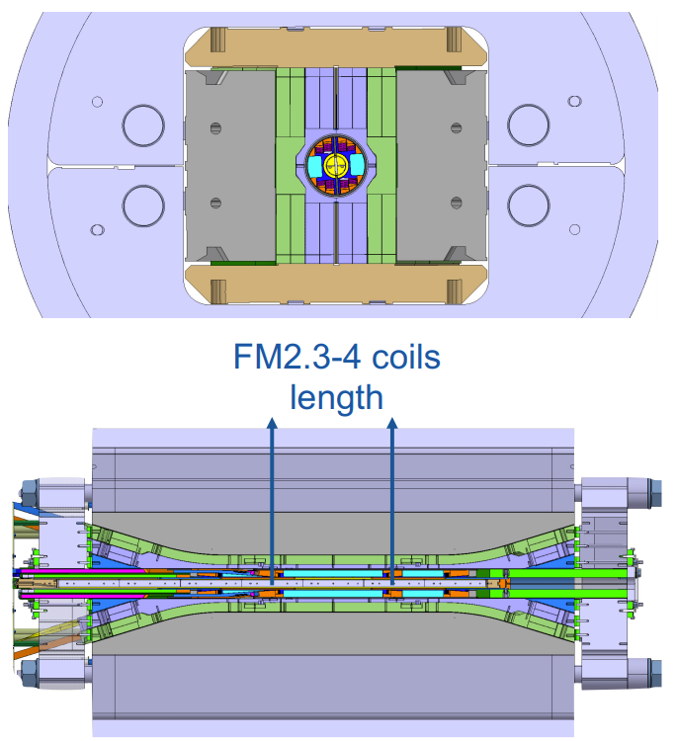
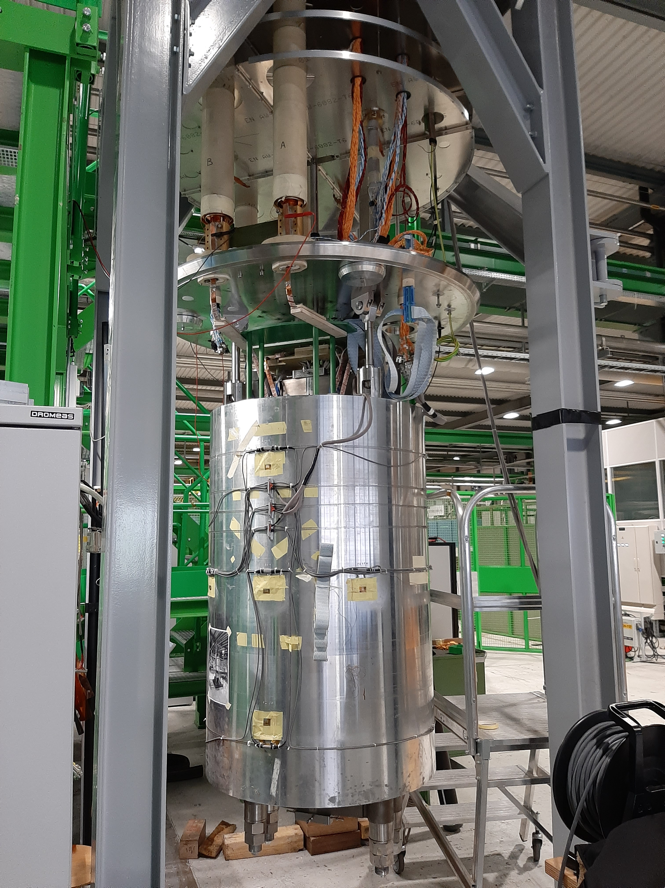
CERN’s Feather-M2 in Fresca2
Feather-M2.3-4 test inside Fresca2 Nb3Sn magnet (~13 T)

Slide 6
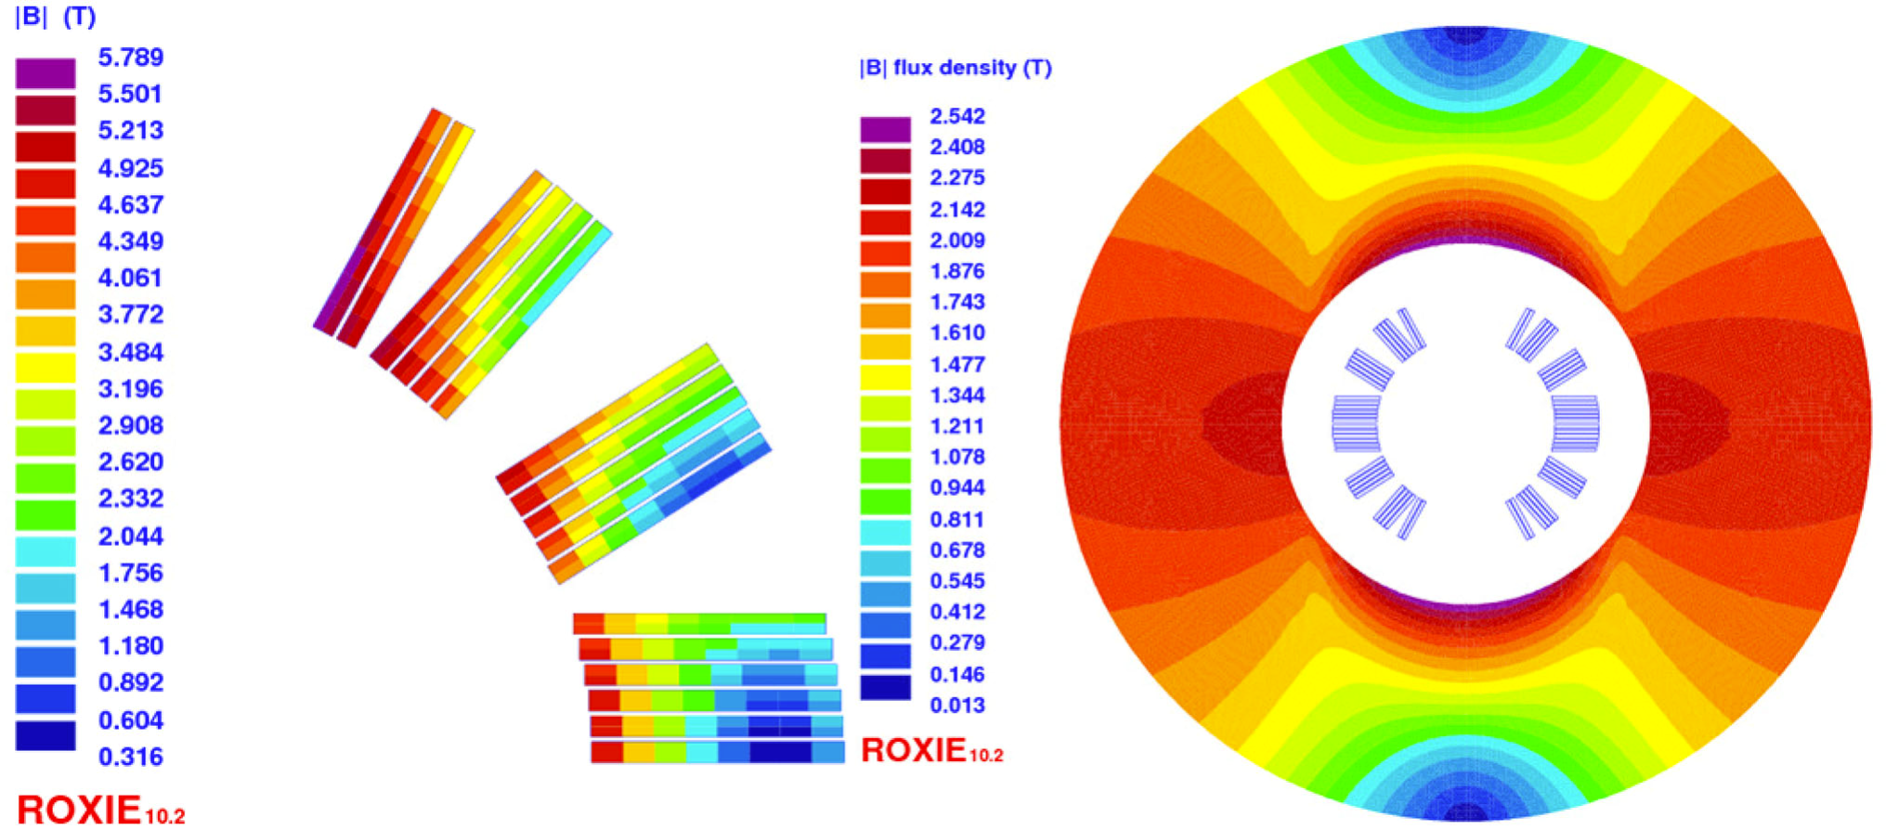
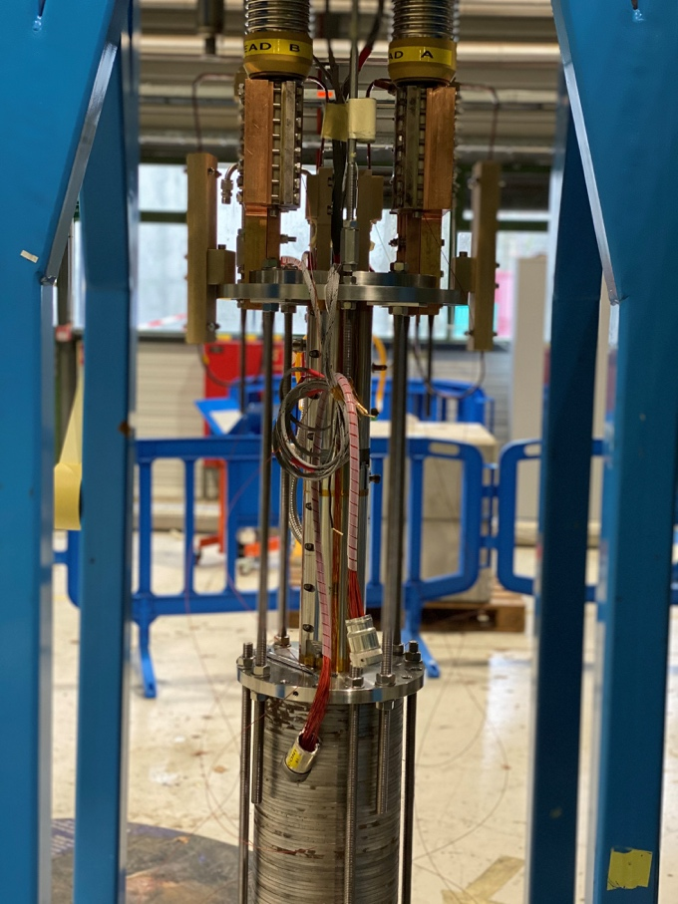
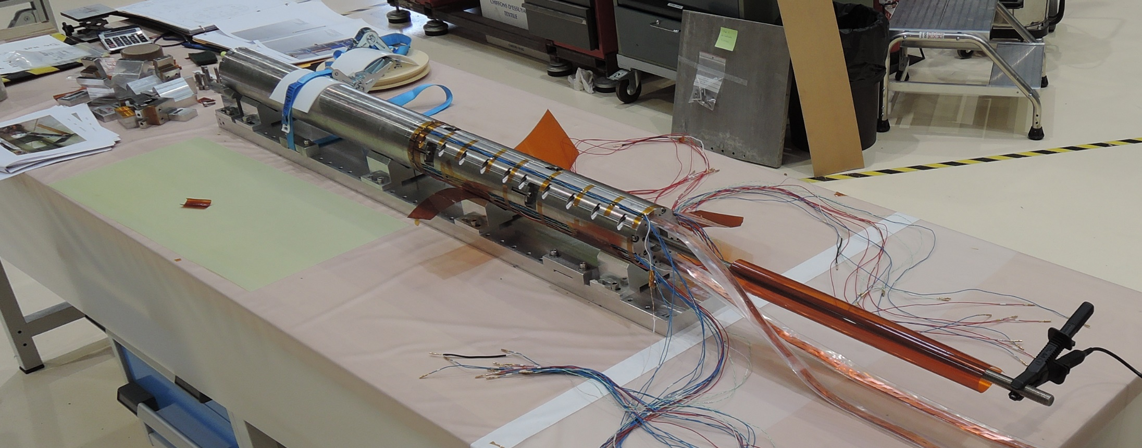
CEA’s cos-theta dipole
EuCARD2 deliverable. Three coils built, two tested (one OK, one overheated). All coils with SuperOx tape.

Slide 7
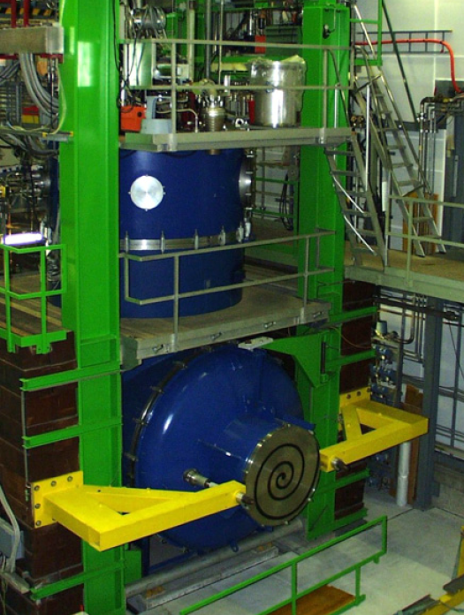
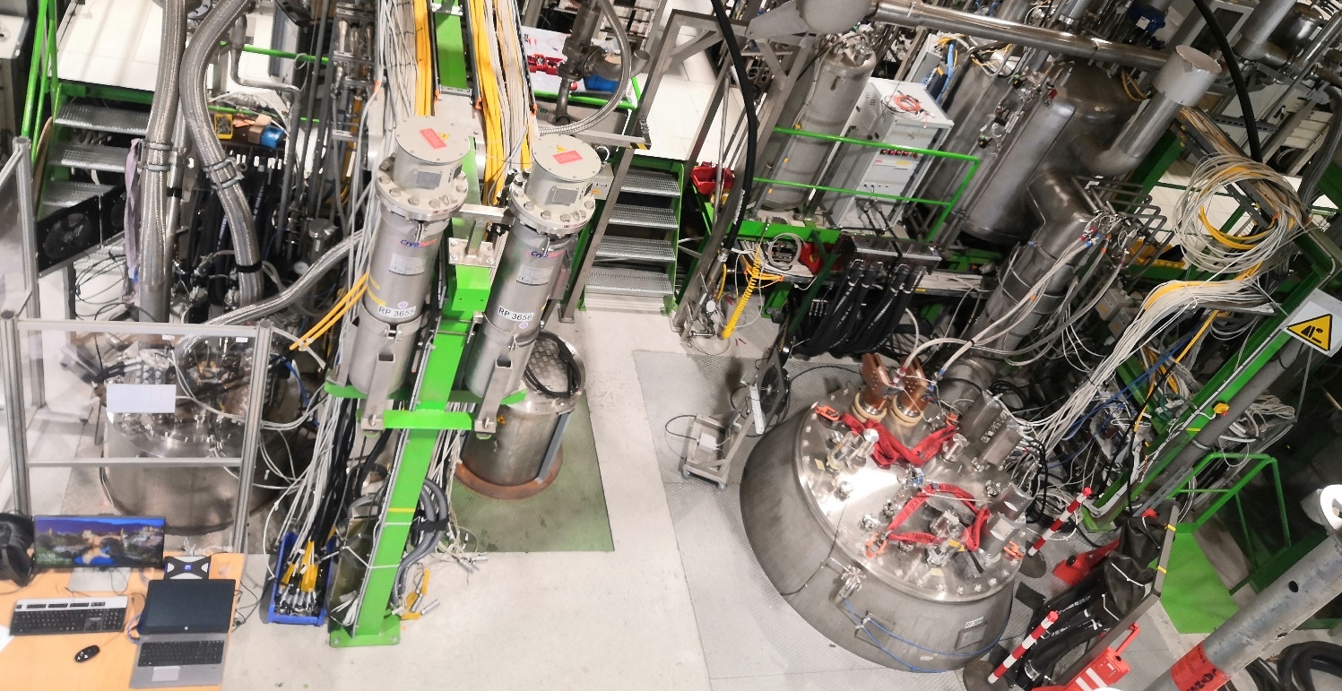
Test timeline
 | 2016 | 2017 | 2018 | 2019 | 2020 | 2021 | 2022
Feather-M0.4 | 4 | 1
Feather-M0.5 |  |  |  | 1
Feather-M2.1-2 |  | 1 | 2
Feather-M2.3-4 |  |  |  | 3
Feather-M2.3-4 in Fresca2 |  |  |  |  | 1
Cos-theta |  |  |  |  |  |  | 1
Number of tests
Tests in SM18
Tests in Sultan

Slide 8
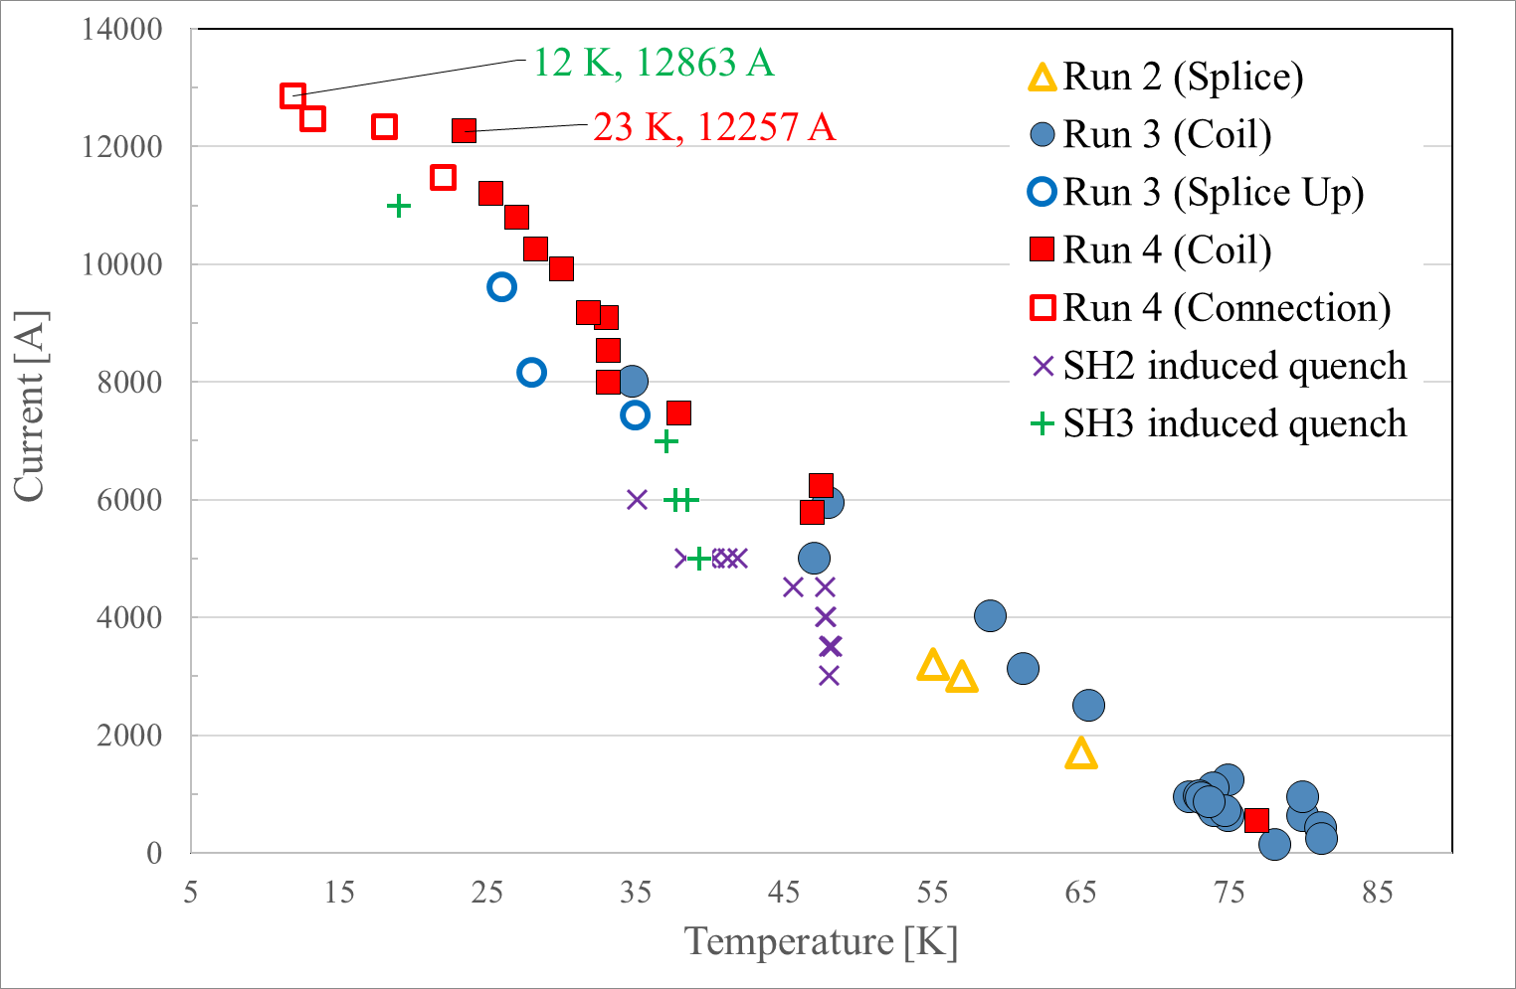
Feather-M0.4 test results at SM18
Run 1: system check
Run 2: current lead connections too hot
  He inlet re-routed
Run 3 and 4: successful tests up to ~13 kA
  No degradation after thermal cycle

Slide 9
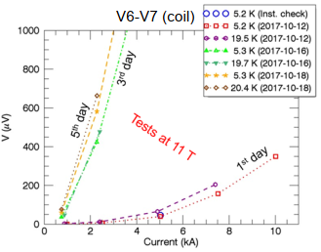
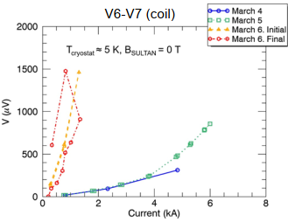
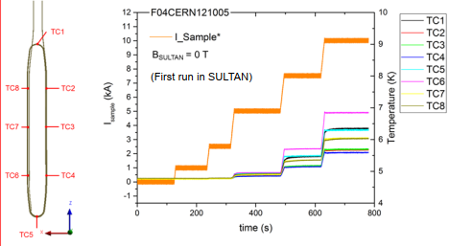

Feather-M0.4 and .5 test at Sultan
Feather-M0.4
M0.4 reached 10 kA in 11 T background field
Both magnets degraded
  “Both tests were limited by the apparent resistance across the coil, which increased dramatically after the tests at high field.”
Heat generation observed in the coils
Feather-M0.5
Courtesy X. Sarasola (EPFL/SPS)

Slide 10
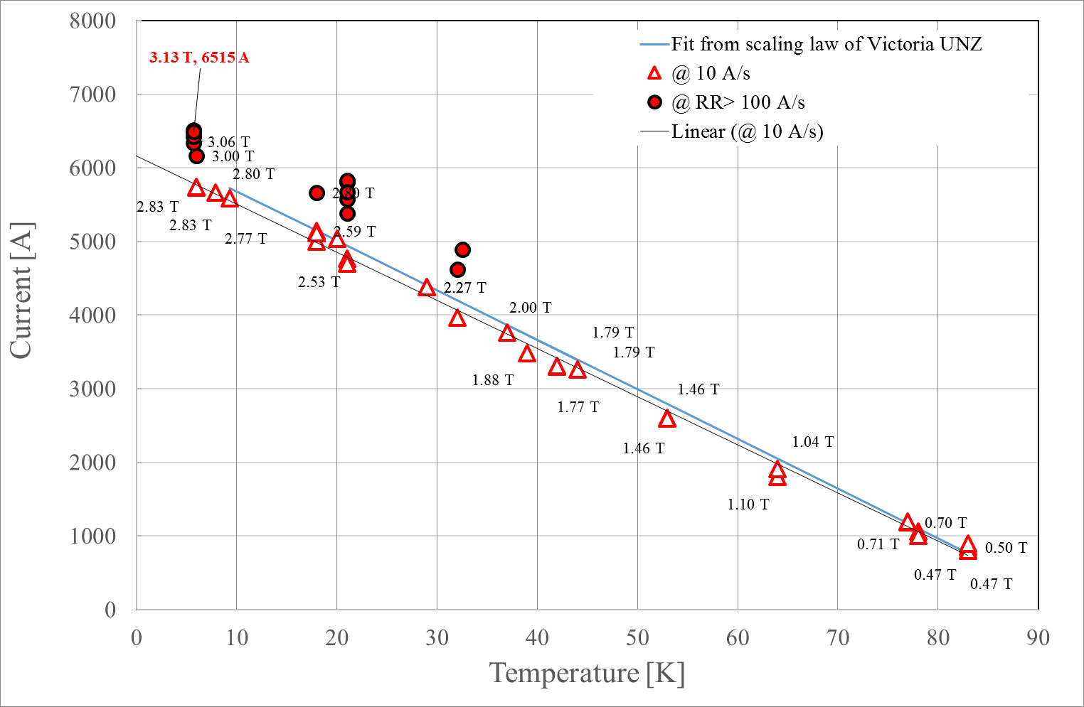
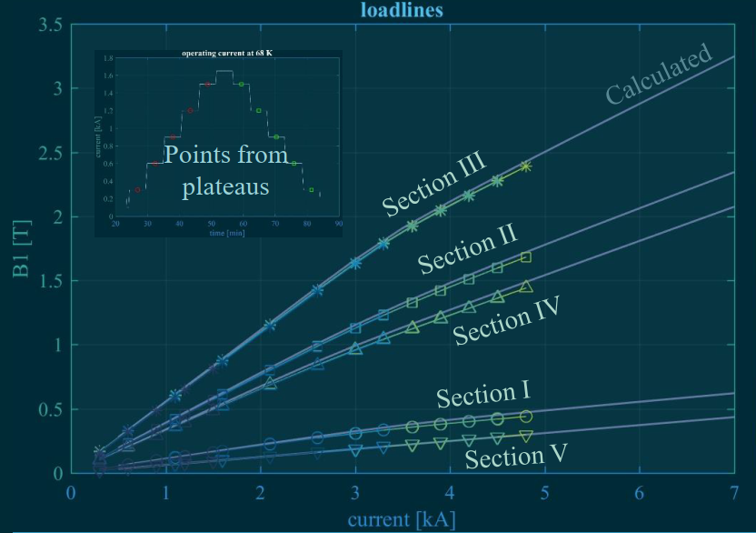
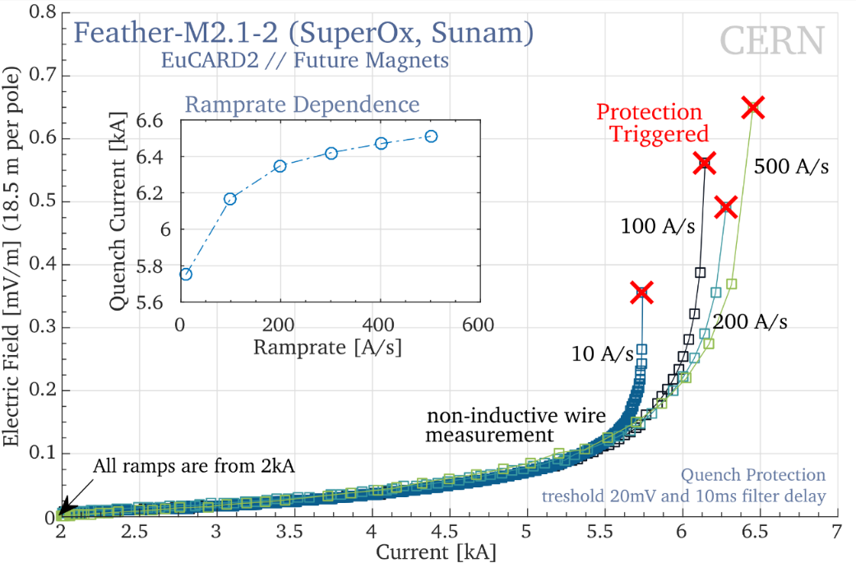
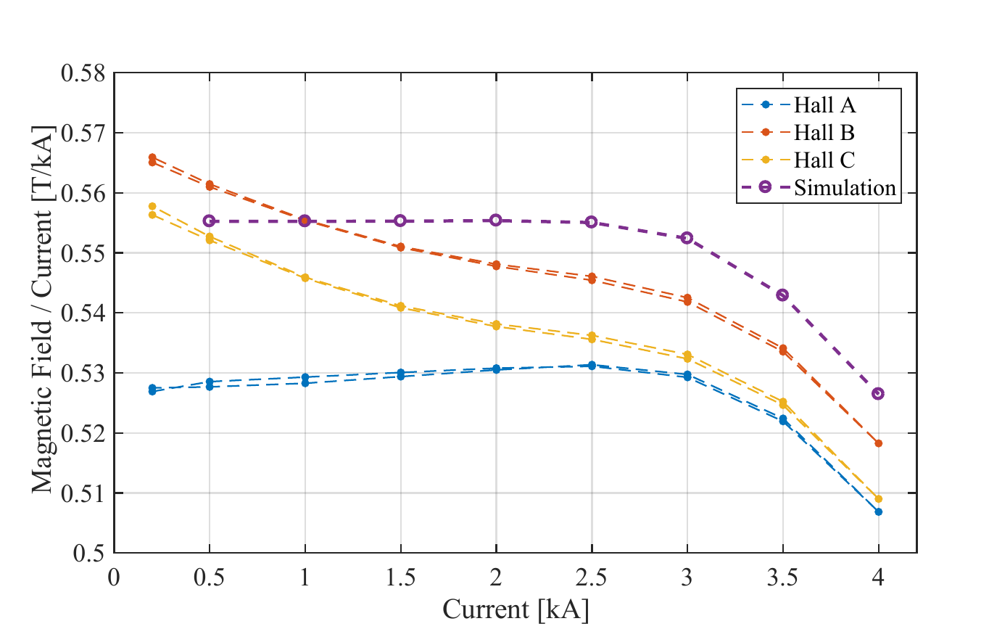
Feather-M2.1-2 test results (1/2)
Reached 6.5 kA (3.1 T) during the first run
Quenches “well inside” current sharing regime
Field measurements slightly lower than simulated

Slide 11
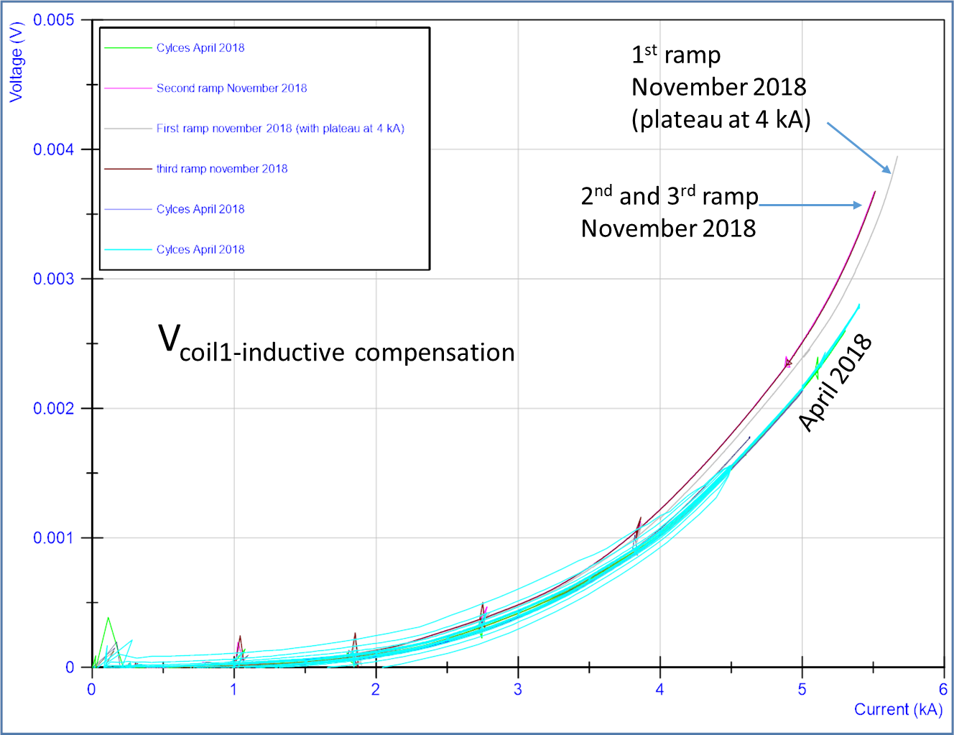
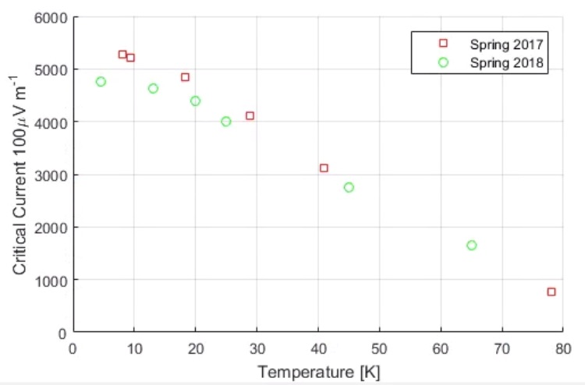
Feather-M2.1-2 test results (2/2)
Degradation observed in both coils after thermal cycle (run 1 → 2 and
2 → 3)

Slide 12
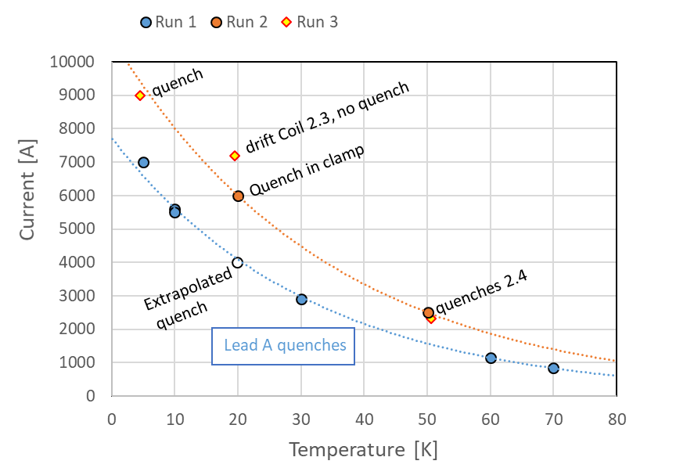
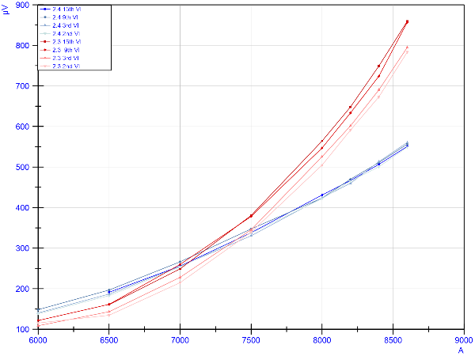
Feather-M2.3-4 test results
Run 1 and 2: current lead and clamps problems
Run 3: reached 9 kA (4.5 T). Field measured as expected from simulations
Degradation observed in one coil after current ramps
Coil 3, successive ramps
Coil 4

Slide 13
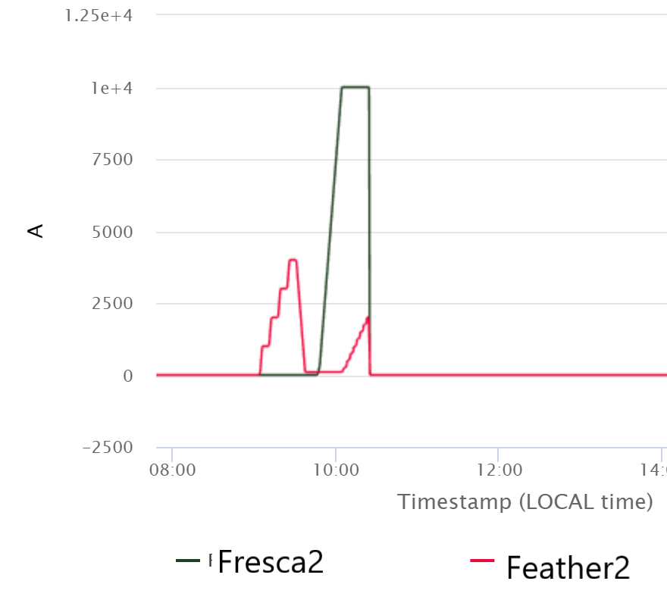
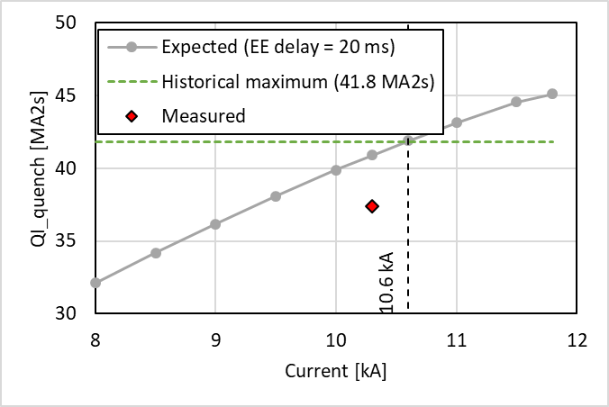
Feather-M2.3-4 in Fresca2 test results (1/2)
Feather-M2.3-4 reached 2 kA in a background field of 12.3 T
Protection strategy validated, historical maximum quench load in Fresca2 not exceeded
10 kA (12.3 T) in Fresca2
2 kA in Feather2

Slide 14
Feather-M2.3-4 in Fresca2 test results (2/2)
Both Feather-M2 coils degraded during the tests:
  after the new assembly,
  after fast discharges in Fresca2,
  after combined current cycles
B
B
C
B
Run 3 standalone
Fresca2
A
Feather2

Slide 15
Cos-theta test results
Reached 3 kA at 4.5-6 K
Bottom coil shows high and mostly distributed performance reduction
  Coil was overheated during production
  Performance of both coils seems stable
Magnetic field measured slightly higher than predicted by simulations
69 K
48-53 K
20 K
6 K

Slide 16
Summary
EuCARD2 test results are promising: Feather-M2 reached 9 kA (target 10 kA), Cos-Theta was limited as expected in the overheated coil.
It is expected to encounter issues during the HTS magnets tests at earlier stages of development. No common “theme” has been found between them:
Magnet | Max. current & central field | Reduced performance? | Issue?
Feather M0 | 12.9 kA (12 K) | Degradation: only in background field | Not designed for background field operation
Feather M2 | 9 kA – 4.5 T (4.5 K) | Degradation: after thermal cycle and during powering with Fresca2 | Probably stress in the Roebel cable, or caused by the induction copper rings
Cos-theta | 3 kA – ~1.5 T (4.5-6 K) | Yes, but stable and distributed | Known: overheating during manufacturing
GaToroid | N/A | Yes, but stable and distributed | Probably during manufacturing. Potentially related to impregnation?
HDMS | 2.8 kA – 2.9 T (10 K) | No | No-insulation coils have different behavior – test procedure needs to be adapted

Slide 17
Some references
 | Date | 1st Author | Title (with link)
Feather | 10-11-16 | Jeroen van Nugteren | High Temperature Superconductor Accelerator Magnets
Feather M0 | 07-02-17 | Hugo Bajas | Feather_0.4 test report
 | 15-02-17 | Hugo Bajas | Results of Feather_M0.4 test
 | 23-03-17 | Hugo Bajas | Cryogenics Test of High Temperature Superconducting Coils at SM18
 | 28-03-17 | Hugo Bajas | Test results of the Feather-M0 HTS coil
Feather M0 in Sultan | 19-10-17 | Xavier Sarasola | Test of FeaTHeR M0.4 in SULTAN Preliminary results
 | 20-03-19 | Xavier Sarasola | FeaTHeR M0.5 Test Report
 | 25-03-19 | Xavier Sarasola | FeaTHeR M0.5 in SULTAN Test Report
 | 25-06-19 | Xavier Sarasola | Test of HTS Demonstrator Coils at High Field and Variable Temperature in the SULTAN Facility
Feather M2.1-2 | 12-05-17 | Hugo Bajas | Feather-M2 test result (preliminary)
 | 21-09-17 | Jeroen van Nugteren | ReBCO 20T+ Dipoles for Particle Accelerators
 | 20-09-17 | Jeroen van Nugteren | Powering of an HTS Dipole Insert-Magnet Operated Standalone in Helium Gas between 5 and 85K
 | 02-02-18 | Carlo Petrone | Measurement and Analysis of the Dynamic Effects in an HTS Dipole Magnet
 | 25-04-18 | Jeroen van Nugteren | Powering of an HTS Dipole Insert-Magnet Operated Standalone in Helium Gas between 5 and 85K
 | 15-05-18 | Jeroen van Nugteren | FM2.1-2 Rotating Field Probe Measurements
 | 22-11-18 | Gerard Willering | Comparison April-November Feather M2 12
 | 29-10-20 | Lorenzo Bortot | Numerical analysis of the screening current-induced magnetic field in the HTS insert dipole magnet Feather-M2.1-2
Feather M2.3-4 | 05-11-19 | Hugo Bajas | Feather M2 3-4: Test results
 | 02-12-19 | Gerard Willering | Feather M2.3-4 Test results 3rd cooldown November 2019
Feather-M2.3-4 in Fresca2 | 09-03-20 | Douglas Martins A. | Preliminary Integration for Testing HTS Feather-M2 in the FRESCA2 Dipole Magnet
 | 11-03-21 | [Several] | Final report on Feather2-in-Fresca2 test
 | 23-05-22 | Franco Mangiarotti | Feather M2.3-4 in Fresca2c test results
Cos-Theta | 05-03-20 | Maria Durante | Manufacturing of the EuCARD2 Roebel-Based Cos-Theta Coils at CEA Saclay
 | 06-03-23 | Filip Kosowski | Test report- EuCARD2 test at SM18
 | 07-03-23 | Melvin Liebsch | Magnetic measurements on the EuCard2 cosθ stand-alone HTS magnet

