Slide 1
HTS Magnet Activity at Fermilab
Vadim Kashikhin
1st High Temperature superconductor Accelerator Technology (HiTAT) workshop
March 10, 2023

Slide 2
Outline
High-field (US-MDP) magnet development
  Present target – 5 T dipole self field from REBCO magnet
  Compatible with operation in ~16 T background field as part of a hybrid system
Low-field, fast-cycling magnet R&D
  Iron-dominated design
  High ramp-rates, low conductor losses
Low-field, persistent current magnet R&D
  Flux is pumped using a primary coil or a mechanical magnetizer
  Fully superconducting secondary coil without joints

Slide 3
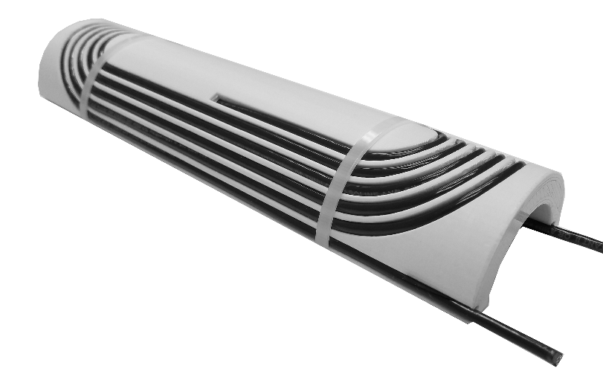
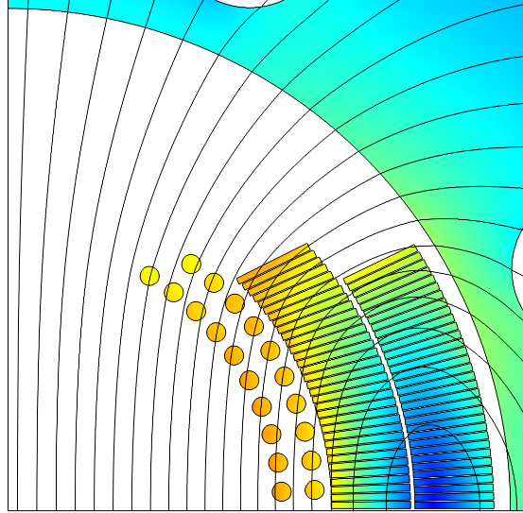

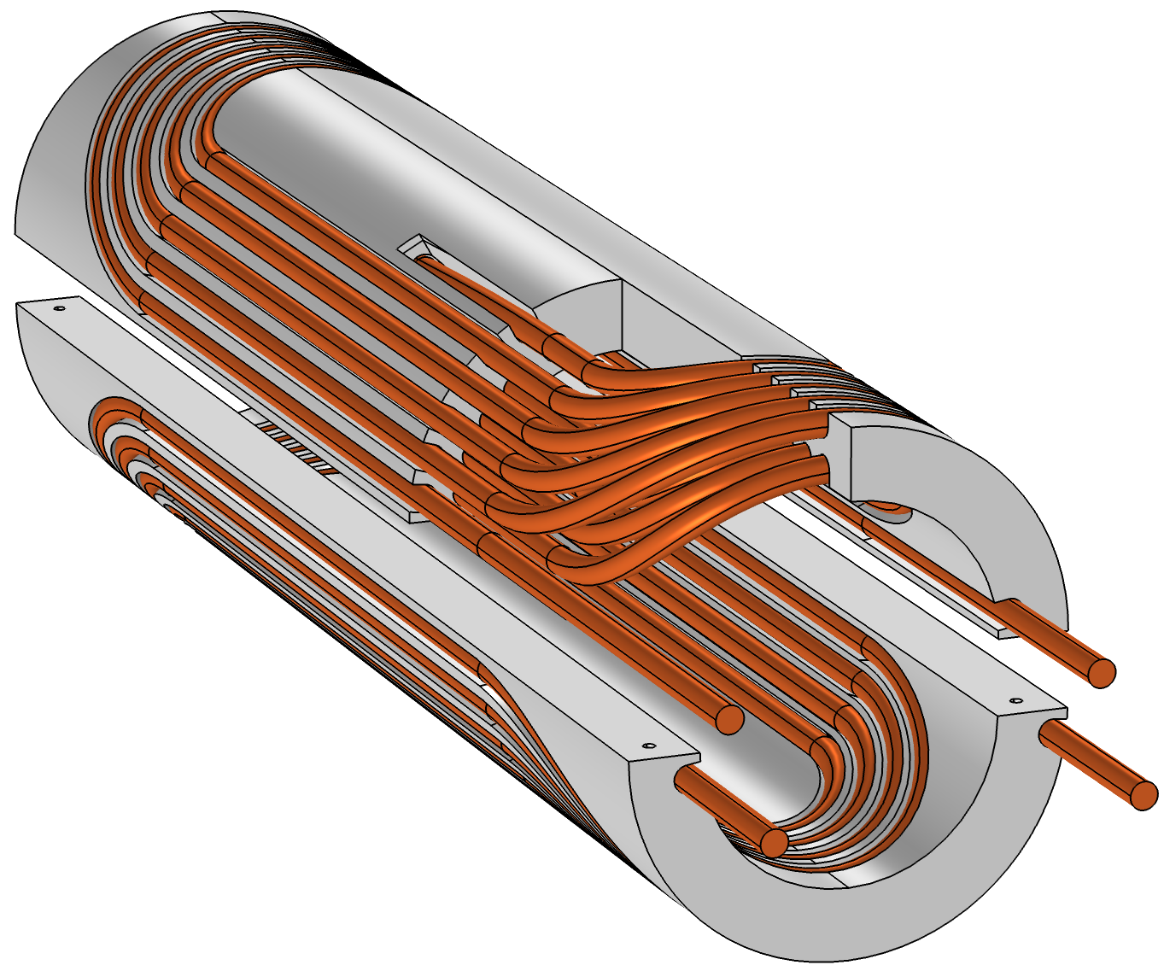
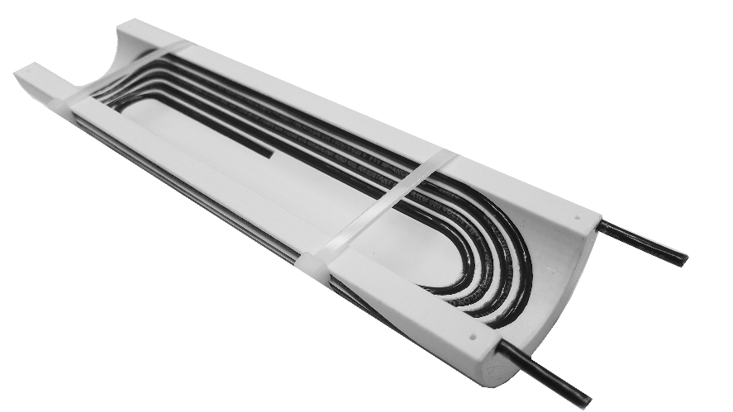
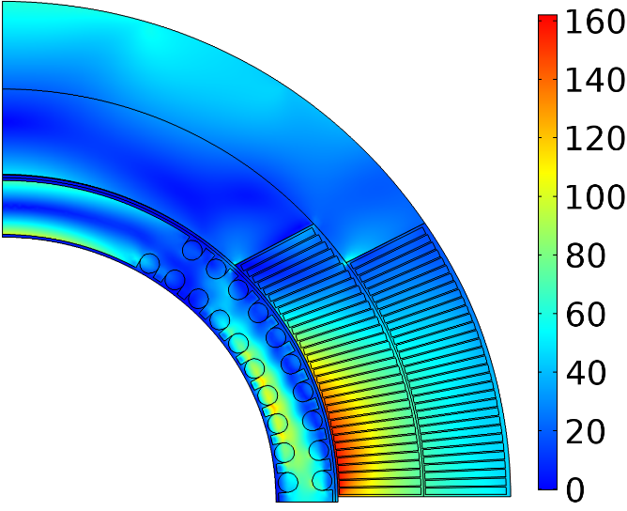
Conductor On Molded Barrel (COMB) Magnet Technology
Magnetic field (T)
Nb₃Sn coil
HTS coil
Hybrid HTS/LTS
magnet
Equivalent stress (MPa)
110 MPa
Mock-up coil built to demonstrate manufacturability
Support structure
160 MPa
Within safe limits

Slide 4
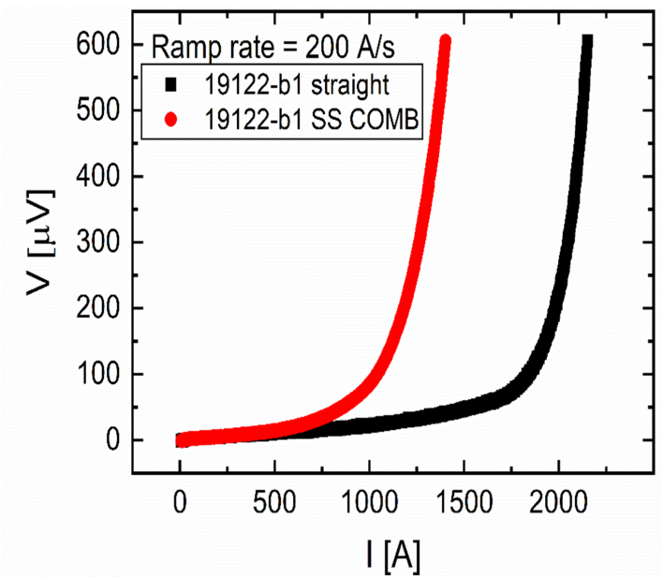
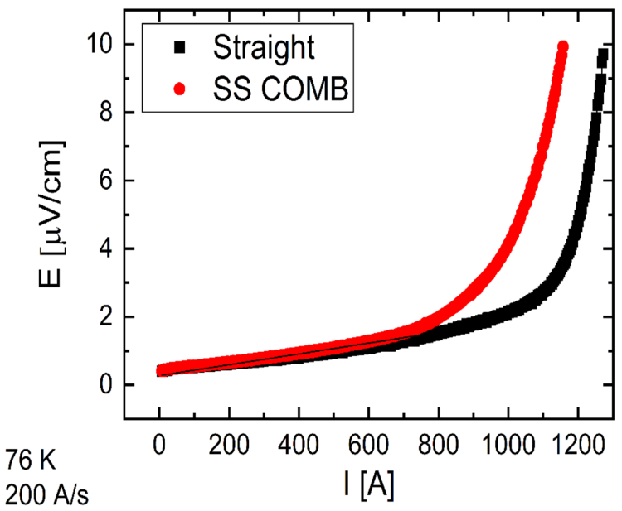
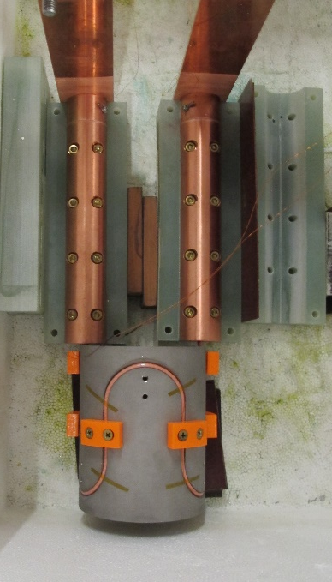
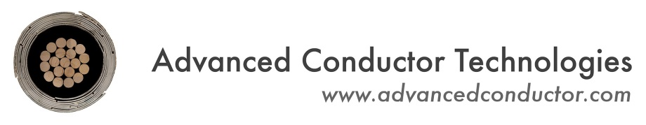
COMB magnet development with CORC cables
Early CORC cables
Later CORC cables
56 mm
Critical current of CORC cables before and after winding into the COMB structure with 100 mm ID:
  ~56% I_{c} retention in the early CORC designs
  improved to ~80% I_{c} retention in the next generation cables
CORC-related activities are currently on hold pending procurement of the conductor with improved flexibility:
  Plans to build a 100-mm bore insert and test it as a part of a hybrid HTS/LTS magnet system in 2024-25
316L sample holder with serpentine channel and 3 bends
Data courtesy of

Slide 5
STAR in COMB SBIR with AMPeers
Phase-I (ongoing):
  STAR wire fabrication by AMPeers LLC – 2x5-m long pieces with 12 tapes and expected self-field I_{c} of ~1 kA at 77K
  COMB demonstration magnet with 60 mm clear bore - design and fabrication at Fermilab
  Testing in LN₂ at Fermilab
  Target is >90% I_{c} retention after winding, but >70% is considered acceptable (with the expectation of future improvements)
Phase-II (if approved):
  manufacturing of ~100 m of STAR wire
  fabrication of a multi-layer COMB dipole magnet
  testing the magnet in liquid helium to demonstrate >5 T field in ~60 mm aperture generated by the HTS coil (performance demonstration)

Slide 6
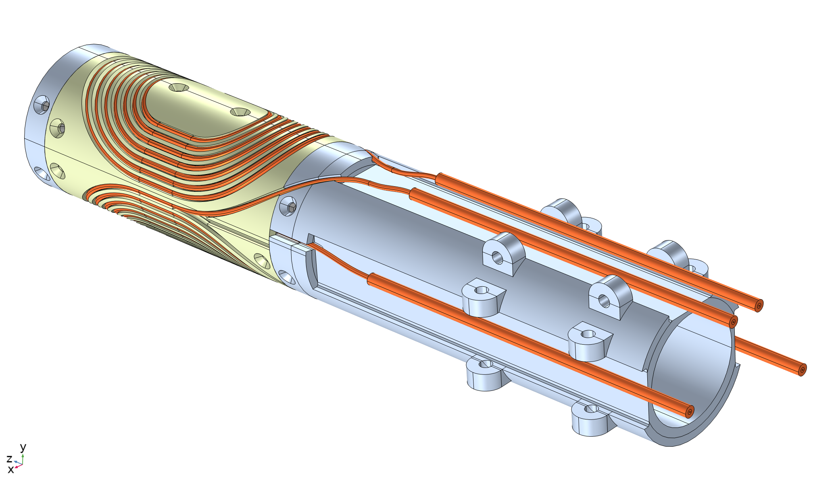
Coil/structure design
60 mm clear bore
Two half-coils, with two layers of cable each
5 m of STAR wire per half-coil, including the leads
The STAR wire is not insulated – COMB structures should not be electrically conductive
The channel is oversized to account for the thermal contraction of high-strength thermo-plastics (ULTEM)

Slide 7
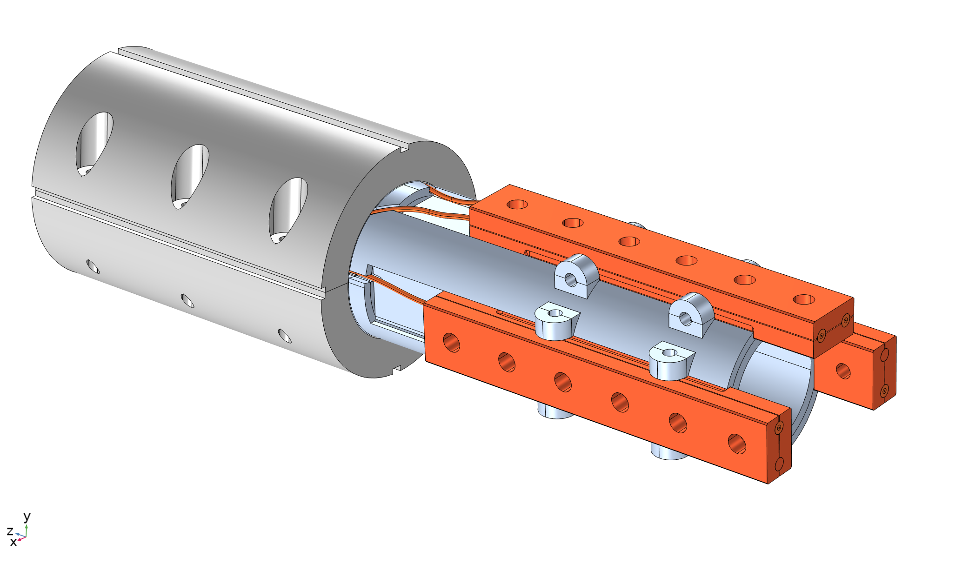
Iron yoke and terminals
Iron yoke is sized for LN₂ test with the expected bore field of 0.2-0.3 T
Designed to fit into ~400 mm OD yokes from Nb₃Sn magnet projects, which will be needed if LHe test is performed (in Phase-II) due to 4-5 T bore field
There are 3 copper adapters with the middle point between the top and bottom coils
It allows to test each half-coil separately and together

Slide 8
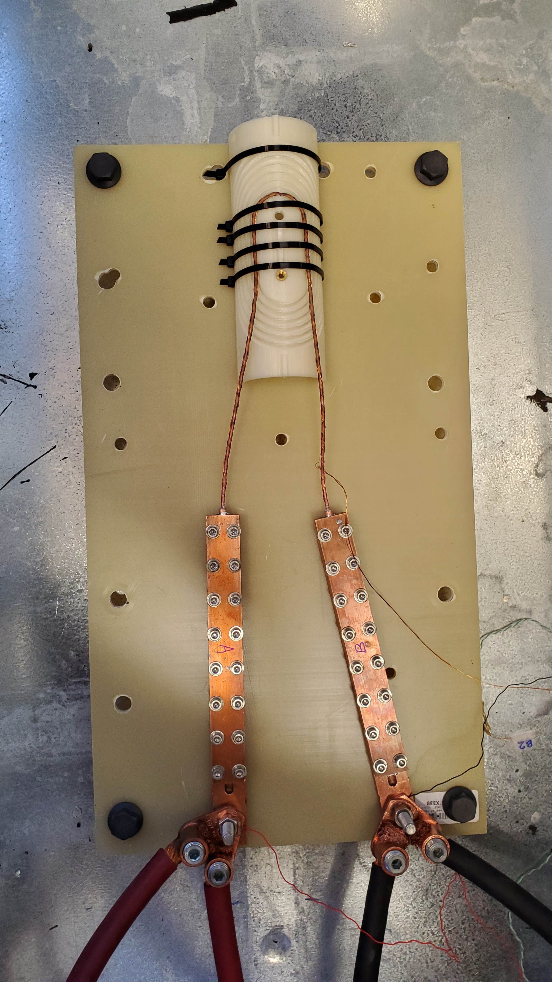
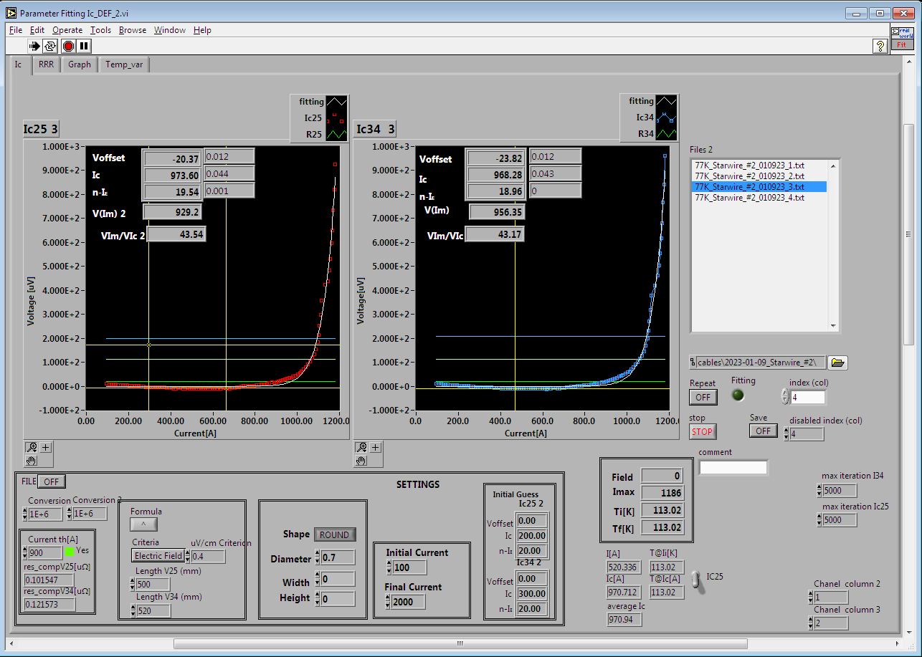
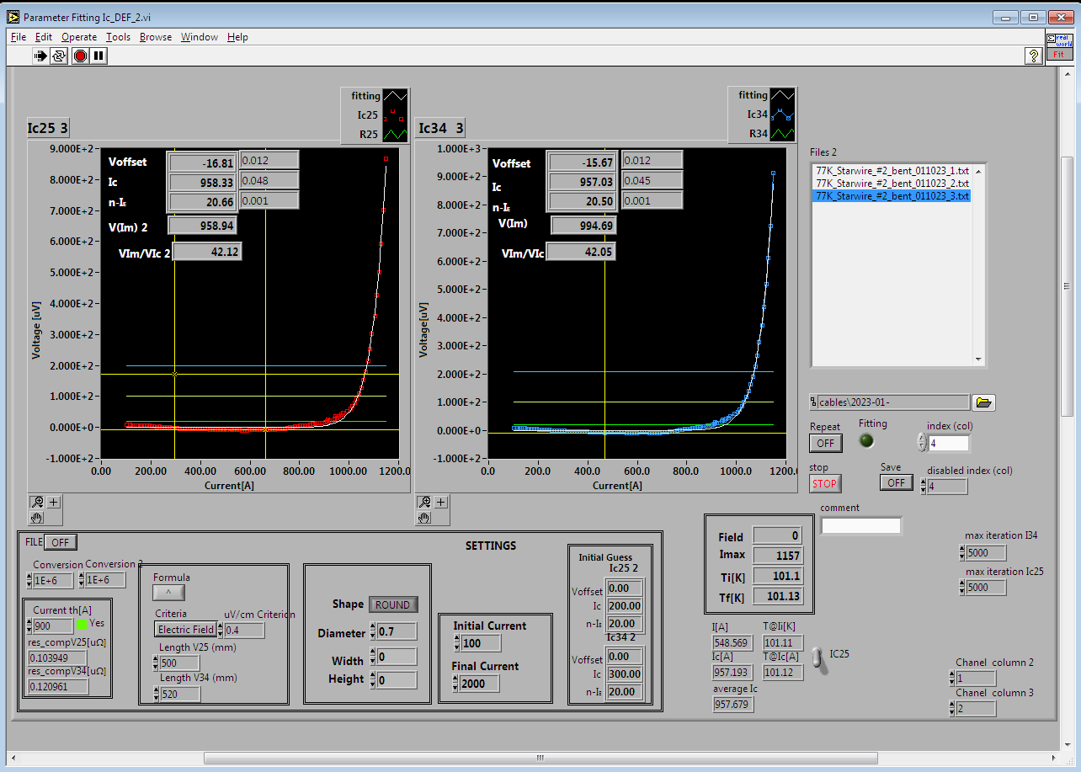
Short STAR wire testing
33 mm
A short piece or STAR wire was tested in LN₂ before and after bending around the 33-mm wide pole in the COMB structure (the tightest bend in the coil)
~98% critical current retention was observed (not corrected for the self field), which essentially means no degradation due to bending

Slide 9
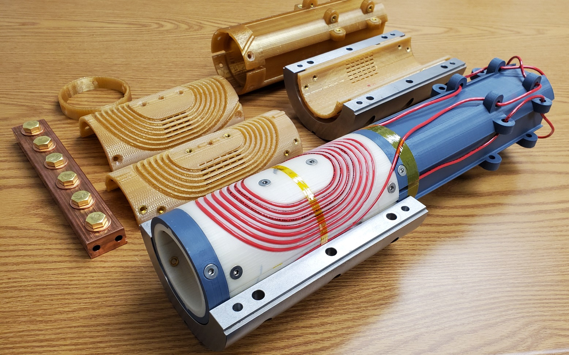
Pre-fabrication activities
Practice to go through all the steps prior to working with the real STAR wires
  Wound four mockup half-coils into the dummy and real (ULTEM) structures
  Installed ground insulation and assembled the iron yoke
The COMB-STAR magnet will be fabricated and tested in March-April 2023

Slide 10
Low-field, fast-cycling magnet R&D
Courtesy of Henryk Piekarz

Slide 11
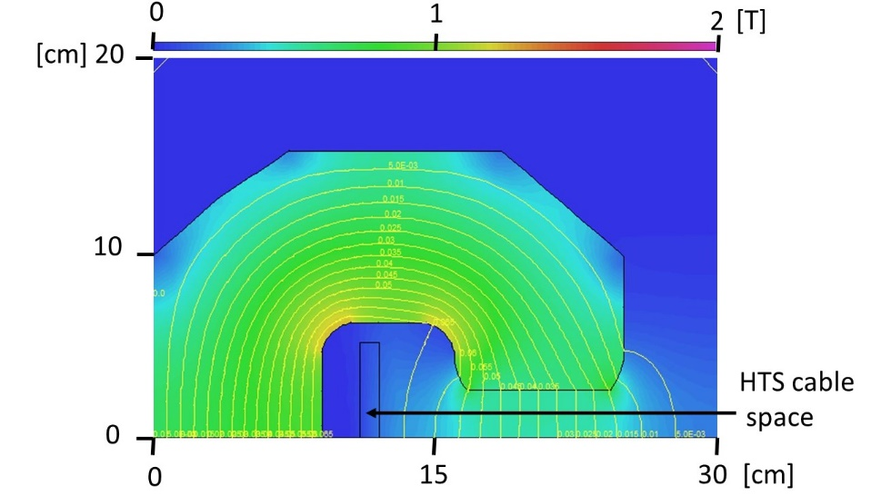
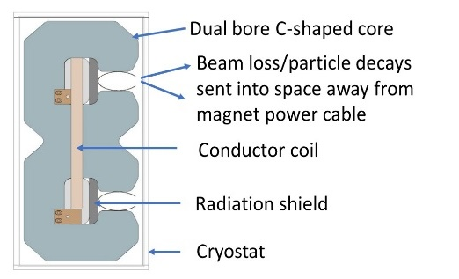
HTS-Based Rapid-Cycling Accelerator Magnet*
Principles of Rapid Cycling HTS-Based Accelerator Magnet Design
Conductor Exposed to Minimal
B-Field Descending from the Core.
Vertically Wound Conductor Coil
Energizes Dual-Bore Magnet.
Projected B-field for the Fe3.5%Si laminated core with narrow conductor extended in vertical plane of core cable space. For 40 mm (V) x 100 mm (H) beam gap this conductor is exposed to < 5% of 1 T field in the beam gap. Superconductors facilitate formation of a power cable within a small space.
A single HTS-based conductor power coil energizes two beam gaps allowing for simultaneous acceleration of two beams, as required for a particle collider.
Beam particle polarities can be selected for the same or the opposite circulation directions with beam losses and particle decays emitted away from the conductor.
*) H. Piekarz, B. Claypool, S. Hays, M. Kufer, V. Shiltsev,
Record High Ramping Rates in HTS-Based Superconducting Accelerator Magnet,
MT-26, IEEE Trans. on Applied Superconductivity, Vol.: 32, Issue: 6, Sept. 2022

Slide 12
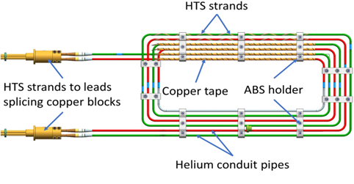
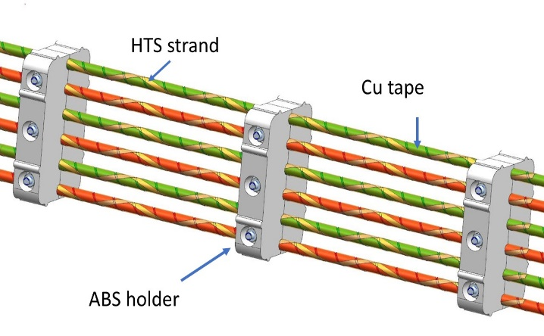
Narrowly Structured HTS-Based Power Cable
Three-turn conductor coil
Close-up view of current coil straight section
Two YBCO strands (Super-Power*2G HTS, 2.5 mm x 0.1 mm) are wrapped at 10 cm pitch over a liquid helium conduit SS pipes (9 mm OD, 0.5 mm wall). A single layer of 0.1 mm x 12.5 mm copper tape is wrapped over strands securing their firm attachment to the cold pipe. Two parallel conductor pipes split magnet energizing current and make 3 turns within the core cable space. The cable critical current is 6 kA @ 6.5 K and 2 kA @ 30 K. Cable structure is held together with ABS holders which also secure cable placement within magnet core cable space. Conductor coil is wrapped with 40 layers of MLI in spaces between the ABS holders.
*) http://www.superpower-inc.com/system/files/SP_2G+Wire+Spec+Sheet_2014_web_v1.pdf

Slide 13
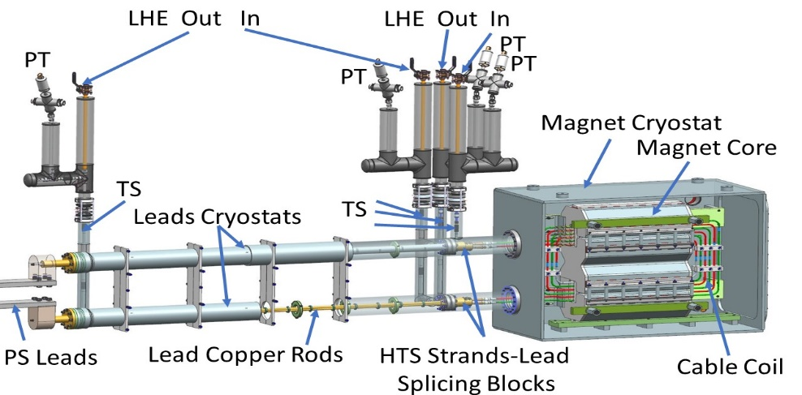
HTS-Based Magnet Cryogenic Support
1.6-m resistive current leads connect power supply to magnet conductor coil.
Magnet coil and leads are independently cooled with liquid helium flows.
Temperature sensors and pressure transducers at inlet and outlet of both circuits.
Supercritical helium of ~ 5.5 K, 2.8 bar and 2.4 g/s flow was used to cool the coil.

Slide 14
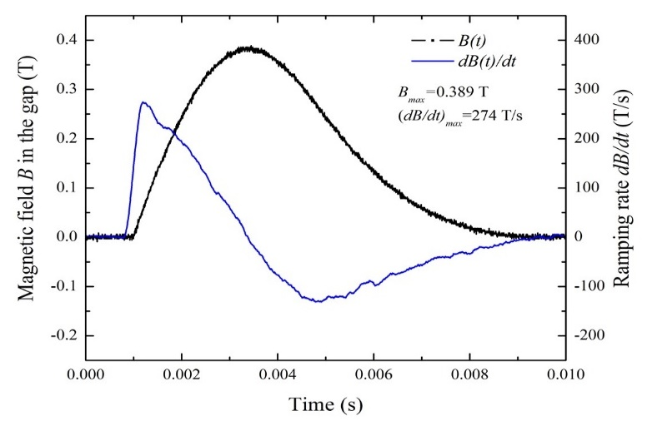
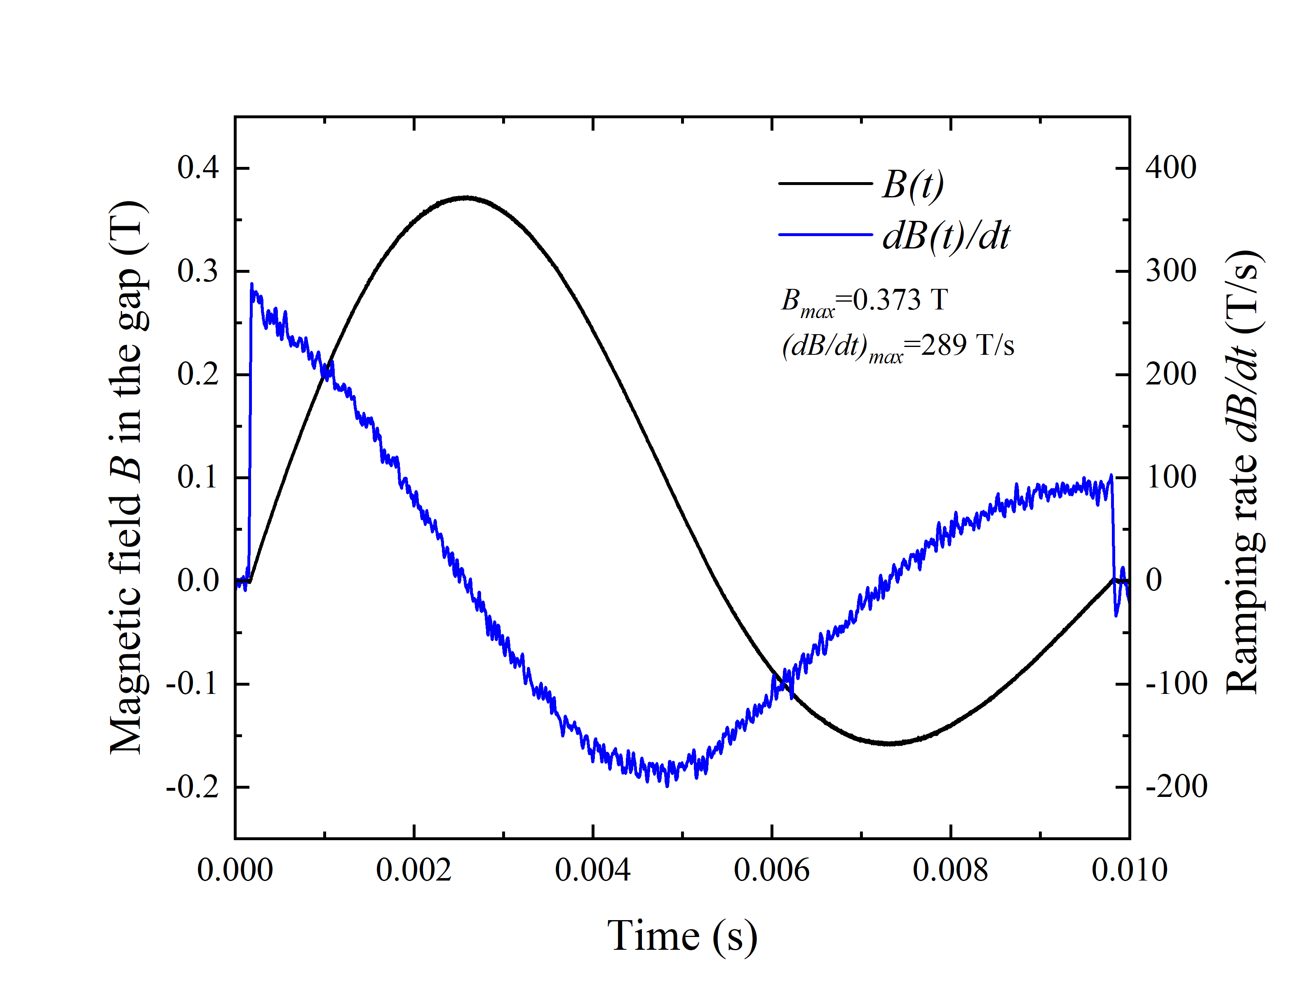
HTS-Based Magnet Power Tests – B-Field Ramping Rates
Magnet conductor current source:
Capacitor Bank: 20 x 960 µF, Discharge voltage: 80 V
Energizing current: 1 kA @ 3-turns, Rep rate = (1 – 14) Hz
Unipolar current excitation:
- Maximum B-field: 0.389 T
- Maximum dB/dt: 278 T/s
- Averaged dB/dt: 160 T/s
Bipolar current excitation:
- Maximum B field: 0.373 T
- Maximum dB/dt: 289 T/s

Slide 15
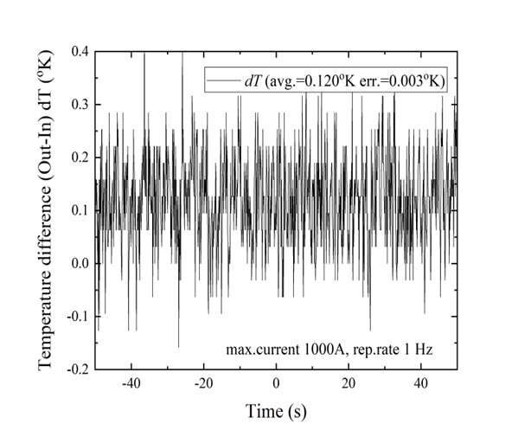
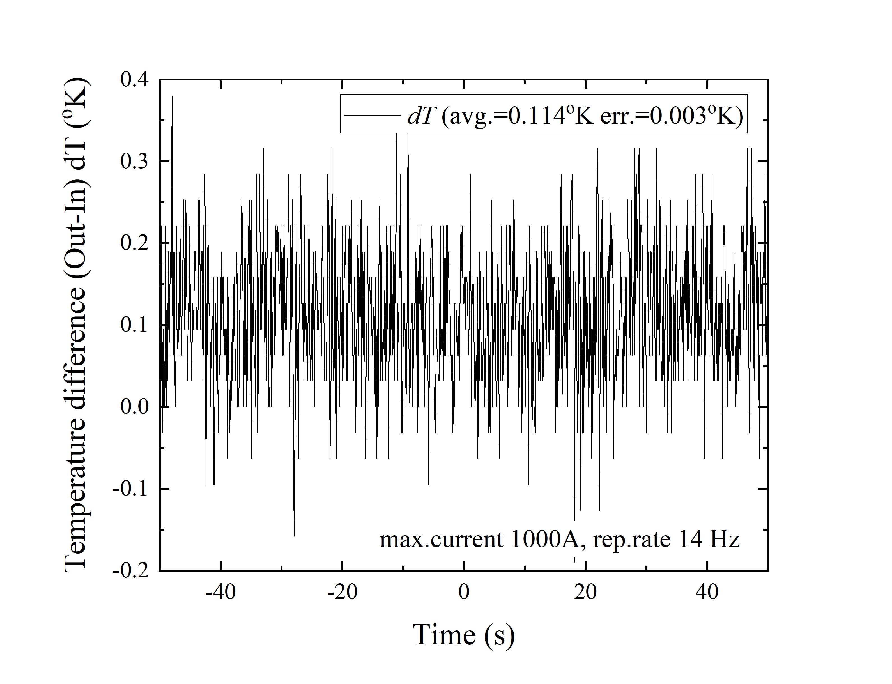
Magnet Power Tests – Cryogenic Power Loss
HTS coil temperature rise versus current pulse repetition rate
Δ T _{(Out – In)} @ 1 Hz = (0.120 +/- 0.003) K
Δ T _{(Out-In)} @ 14 Hz = (0.114 +/- 0.003) K
With dB/dt ~ 300 T/s @ 0.4 T peak field in the magnet gap, the temperature of liquid helium cooling conductor coil did not change with magnet excitation repetition rate within an error of +/- 0.003 K.
This test indicates that the HTS-based magnet technology can be extended to much higher B-fields and dB/dt ramping rates.

Slide 16
Low-field, persistent current magnet R&D
Courtesy of Vladimir Kashikhin

Slide 17
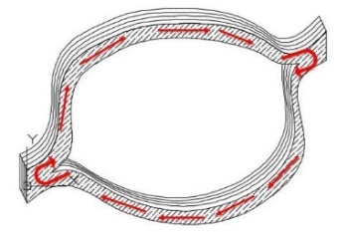
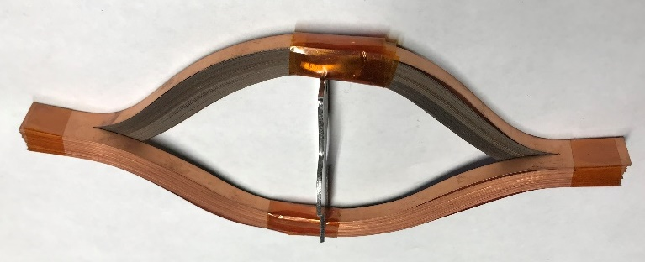

HTS coil design without splices
A novel approach for the HTS coils fabrication assembled from the parallel REBCO tape loops without splices. Different magnet configurations investigated in 2019-22.
Magnetic flux change
Induced current flow
Coil from 100 parallel REBCO tape loops
The persistent current in the coil is generated by a magnetic flux change from the primary source.
The iron dominated superconducting quadrupoles and dipoles were used as test benches for the HTS coils.

Slide 18
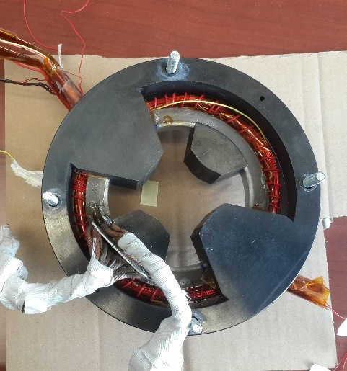
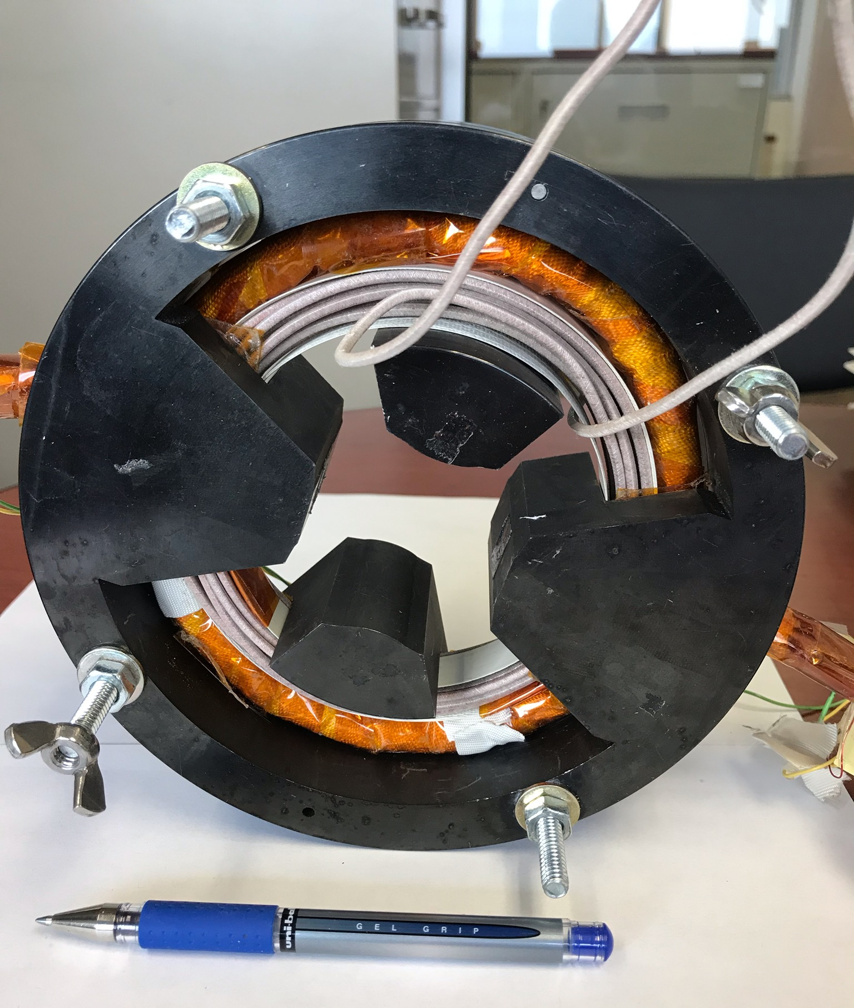
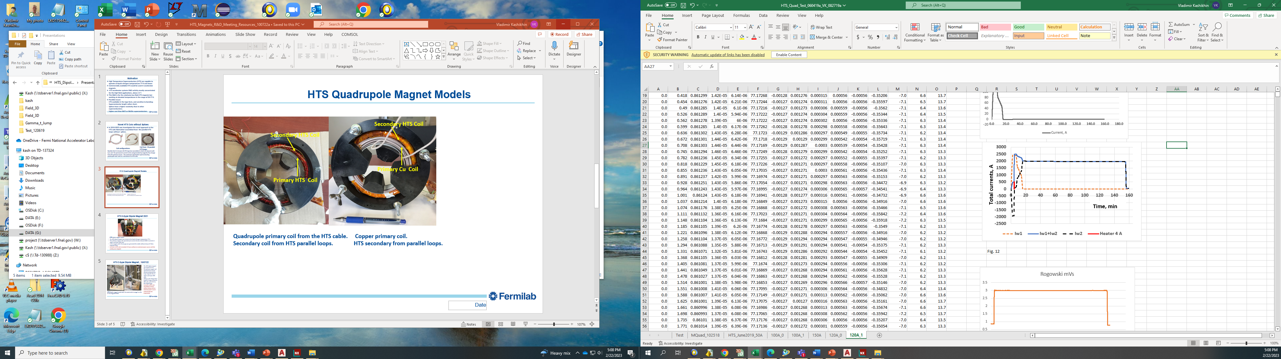
HTS Quadrupole Magnet Models (2019-2020)
Secondary HTS Coil
Secondary HTS Coil
Primary HTS Coil
Primary Cu Coil
Primary HTS coil.
Secondary HTS coil from parallel loops.
Primary copper coil.
Secondary HTS coil from parallel loops.
Energizing cycle for the HTS coil.
2 kA current circulated in HTS coil until LN₂ was evaporated.

Slide 19
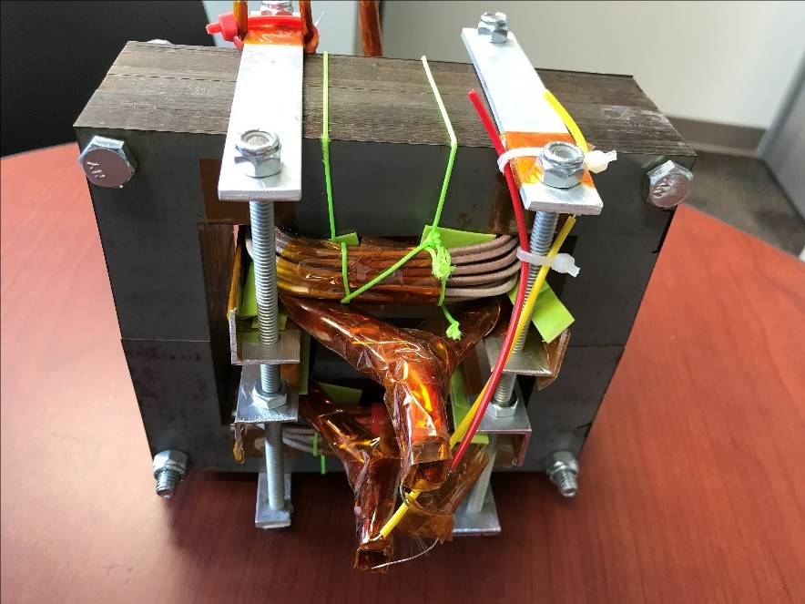
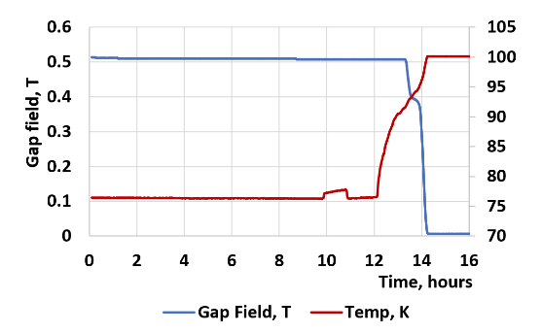
HTS H-type Dipole Magnet (2021)
Primary Cu Coil
Secondary HTS Coil
The H-type HTS dipole magnet was tested in LN₂.
The primary copper coil was energized when the secondary HTS coil were resistive.
Then the HTS coils were cooled down and the primary current was ramped down to zero, which induced 4000 A currents in upper and lower HTS coils.
A stable dipole field of 0.5 T was generated in 20 mm magnet gap.
Persistent currents in the HTS coils circulated for 12 hours without decay until all LN₂ evaporated.

Slide 20
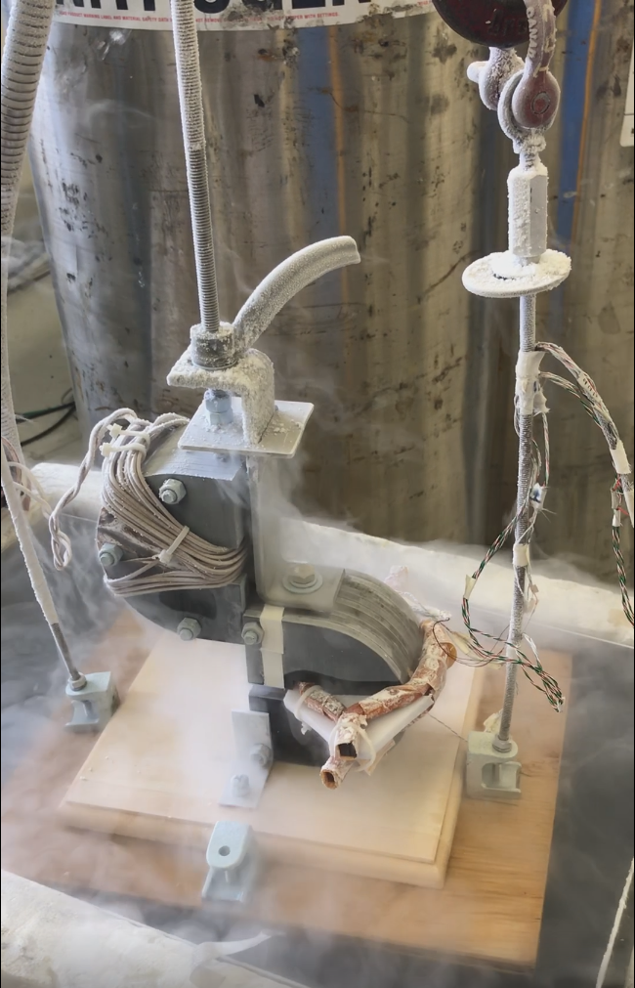
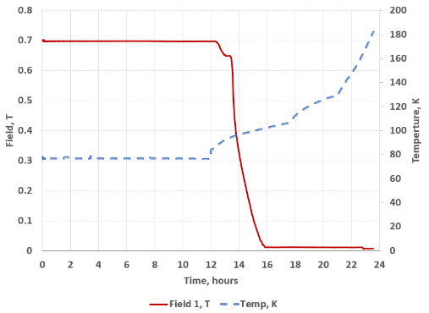
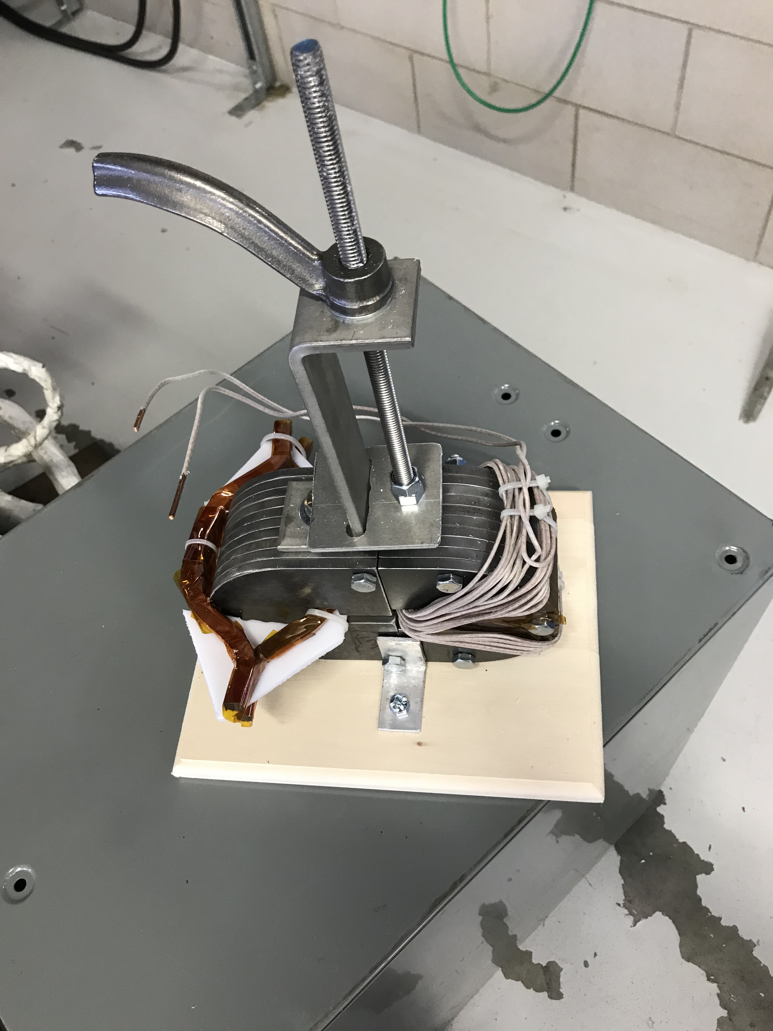
HTS Dipole with Mechanical to Magnetic Energy Transfer (2022)
Magnetizer lifted up
C-Dipole with HTS Coil
Magnetizer with Cu Coil
The C-type HTS dipole magnet was tested in LN₂.
The primary copper coil created a magnetic flux linked with the HTS coils when they were resistive.
Lifting the magnetizer yoke disrupted the magnetic circuit and induced a large current in the HTS coils and 0.7 T in the magnet gap.
Persistent currents in the HTS coils circulated for 12 hours without decay until all LN₂ evaporated.

